Slide 1
A First “Large Box”: Science Use and Internal Structure
(Virtual Space Physics Observatory)
Aaron Roberts, NASA/GSFC
Vasili Rezapkin, Aquilent
Joe King, QSS
27 October 2004

Slide 2
Overview
VSPO is designed to provide access to a wide variety of data, image, model, and other products or URLs to sites that deliver these products. (“Three clicks from data.”)
A dynamic web page front end allows “Google-like” and element-based searches for products.
“SOAP” interfaces pass internal messages, and are used for direct repository access. Other protocols for the latter (e.g., ftp) will be implemented.
Additional service links (for orbits, references, and current space weather) are provided for convenience.

Slide 3
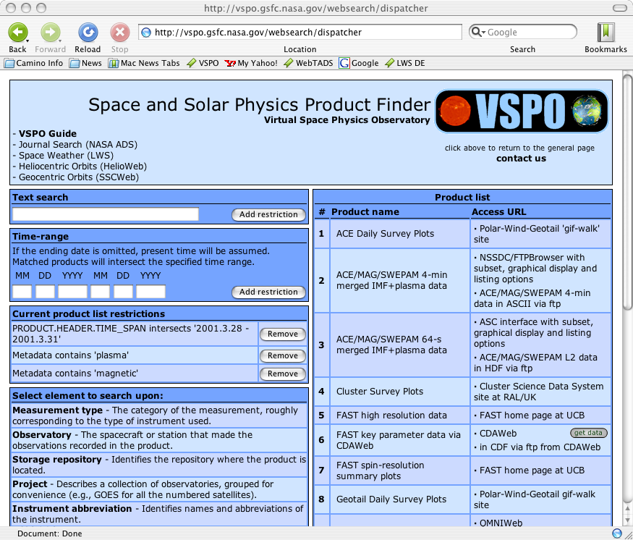

Slide 4
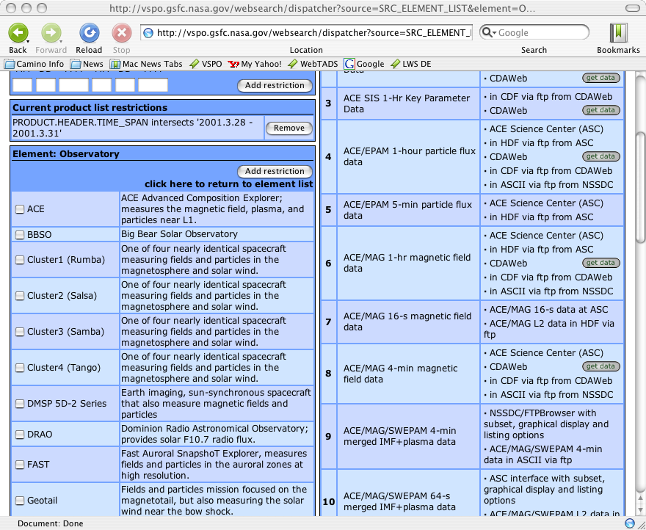

Slide 5
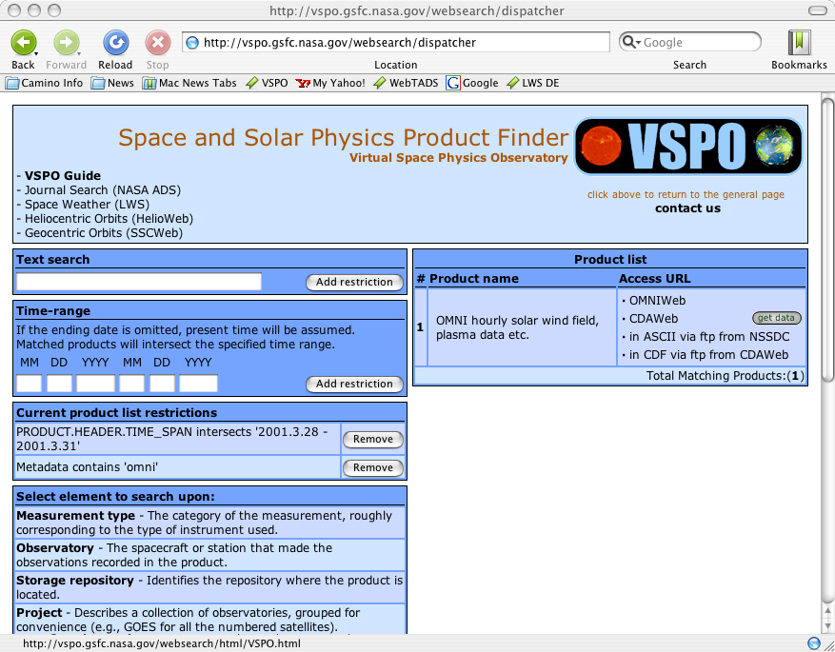

Slide 6
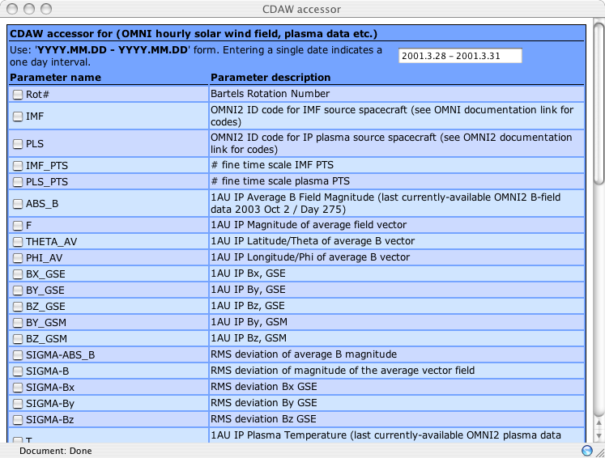

Slide 7
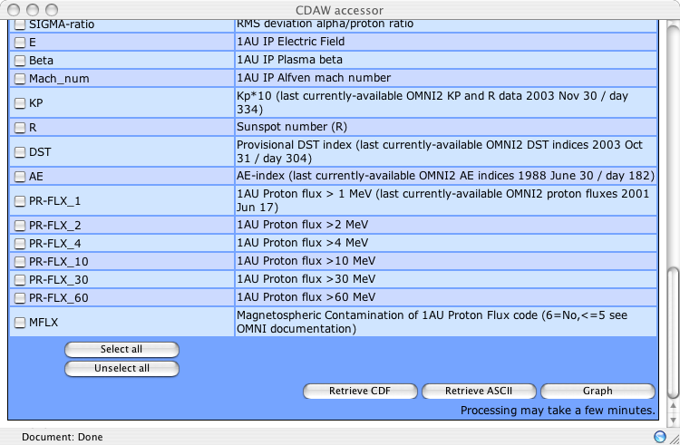

Slide 8
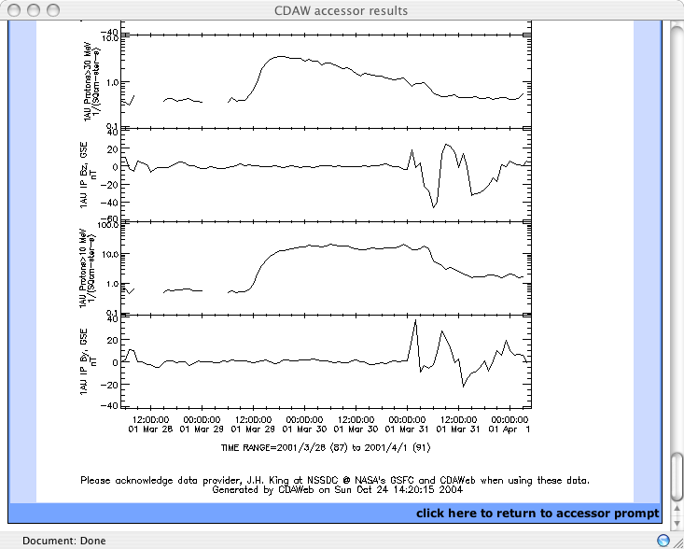

Slide 9
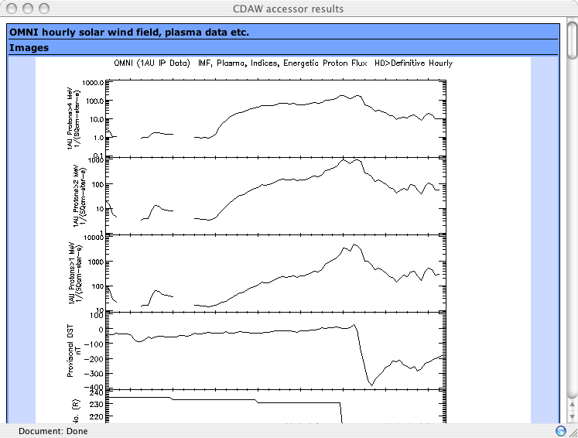

Slide 10
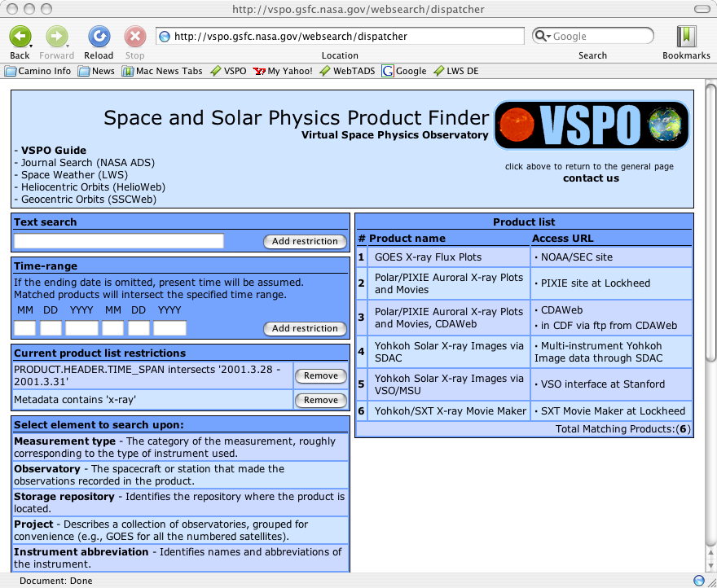

Slide 11
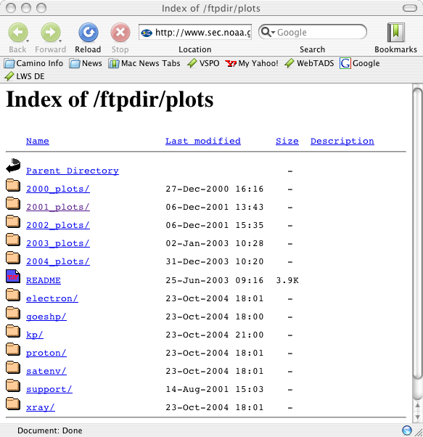

Slide 12
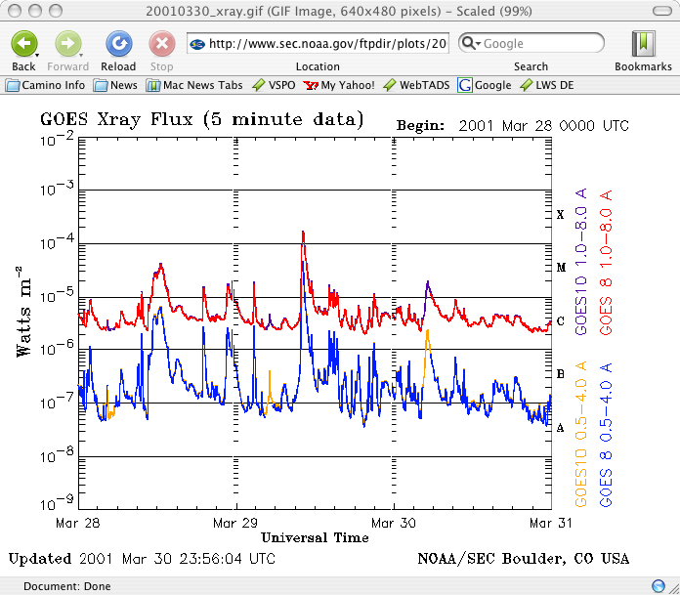

Slide 13
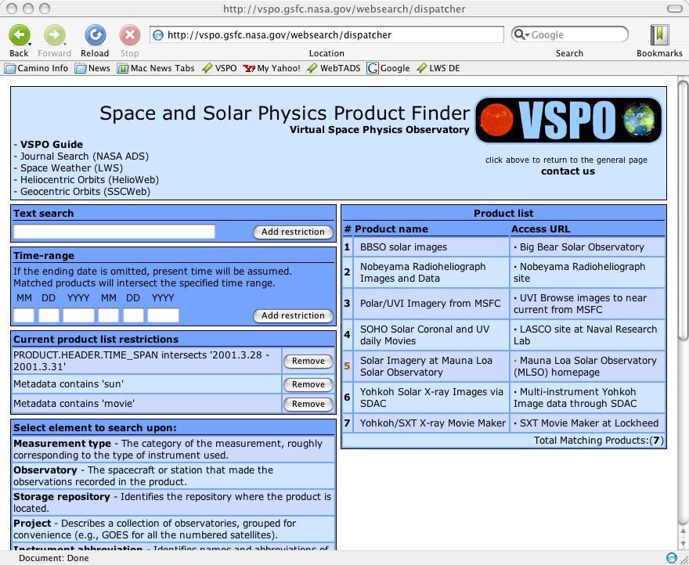

Slide 14
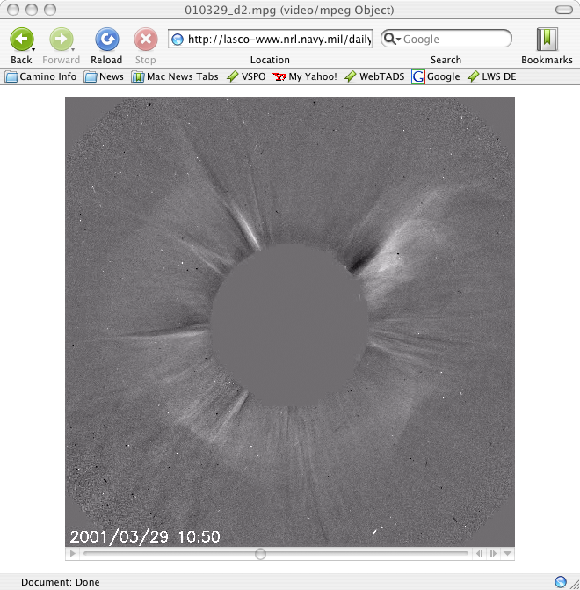

Slide 15
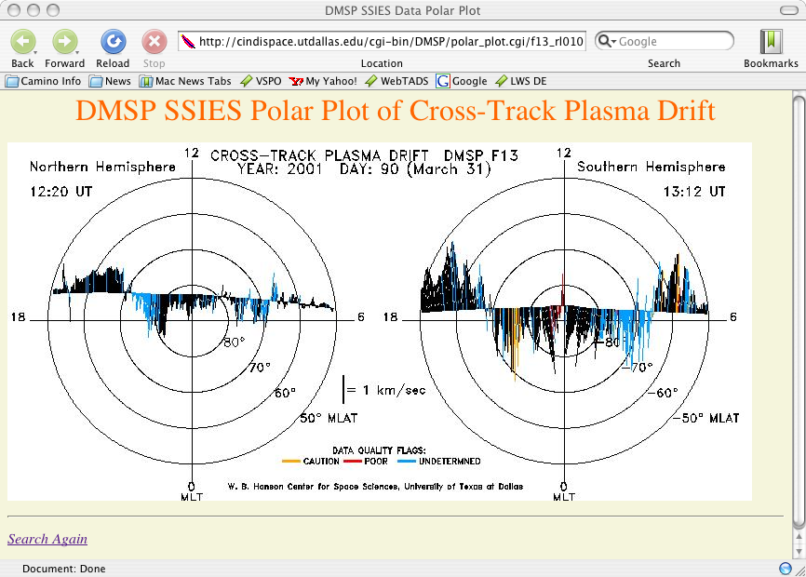

Slide 16
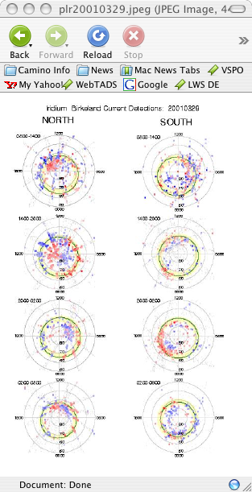
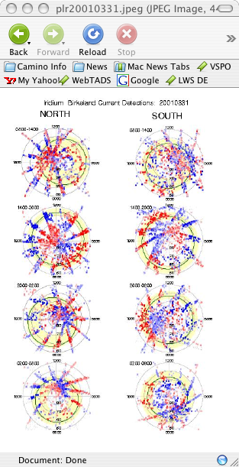

Slide 17
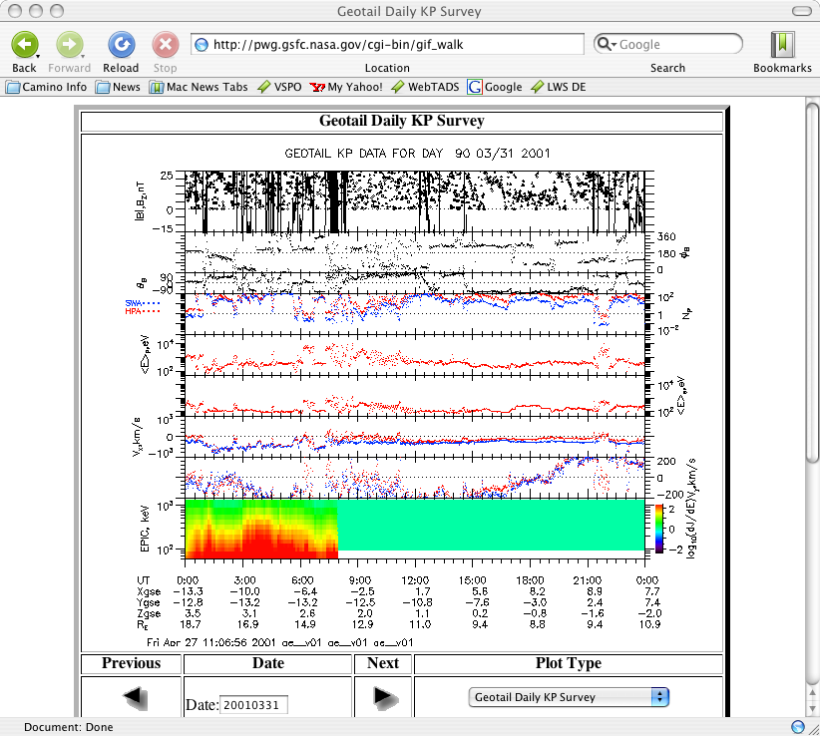

Slide 18
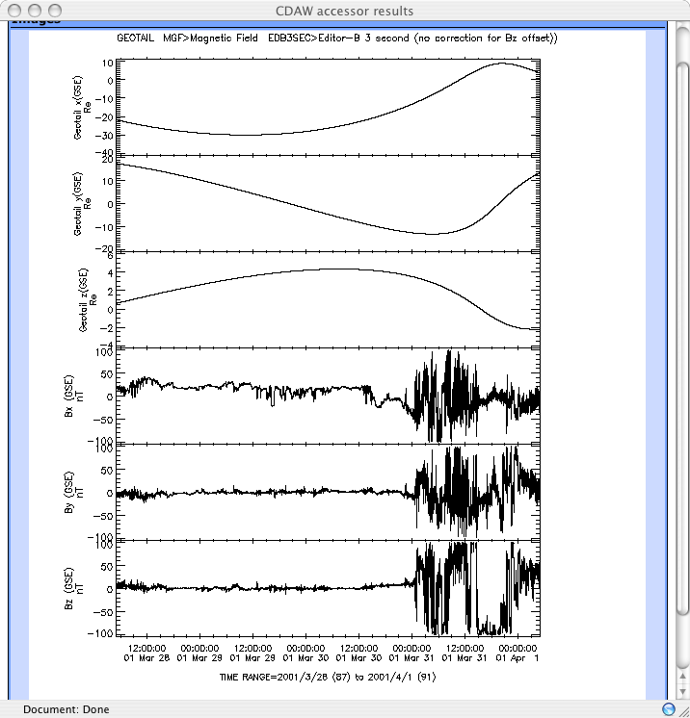

Slide 19
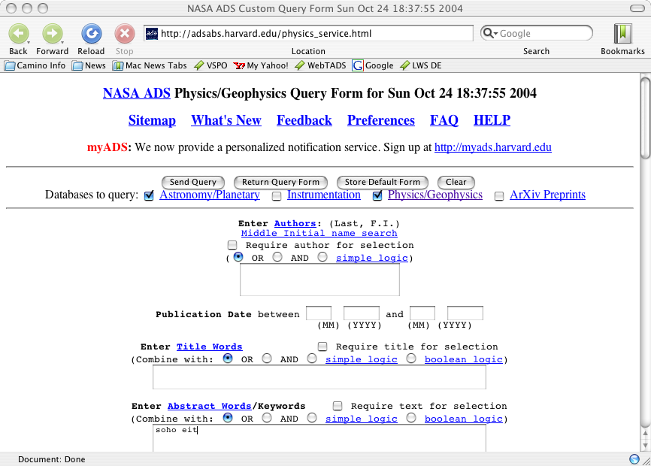

Slide 20
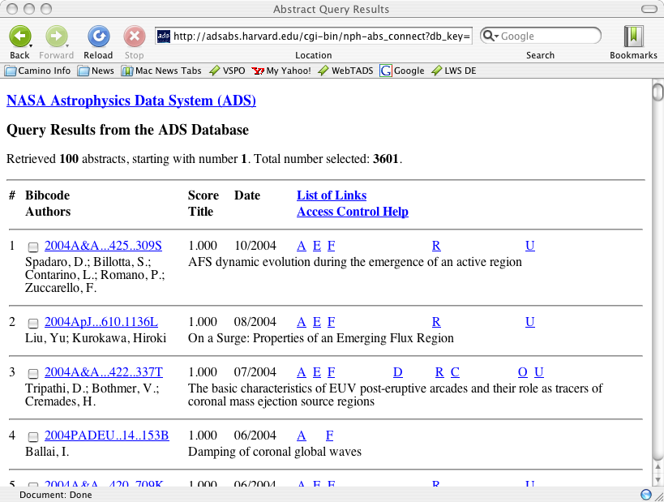

Slide 21
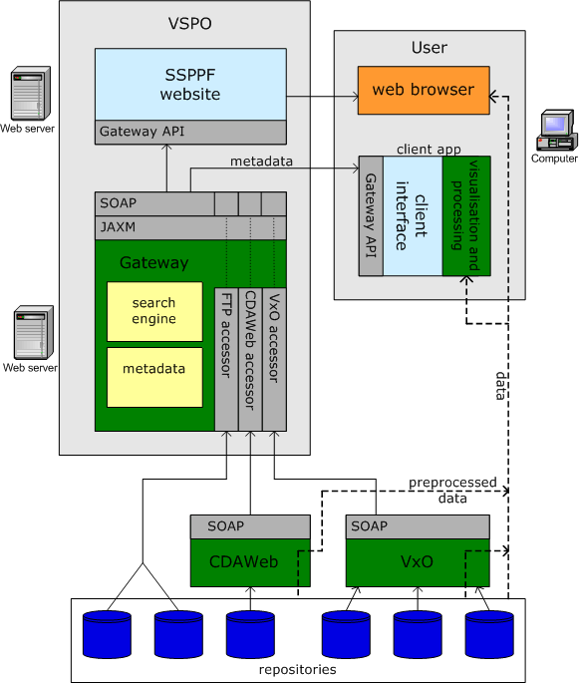

Slide 22
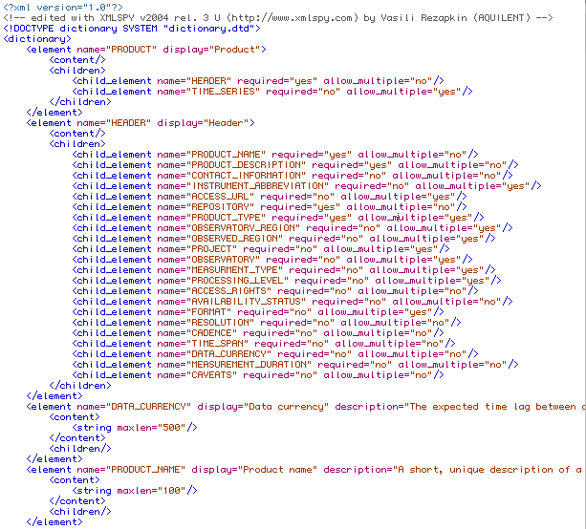

Slide 23
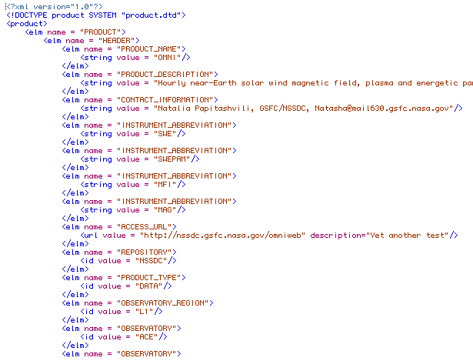

Slide 24
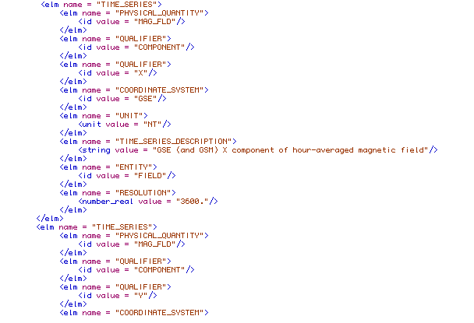

Slide 25
Future Directions
Add accessor for “ordered” ftp sites.
Add accessors for VSO and other products when the APIs are available.
Continue to add products.
Develop metadata management software.
Provide an API for access from applications.
Produce a companion higher-order query service based on event lists and modest resolution data sets held and manipulated in RAM.

