Slide 1

The Virtual Solar-Terrestrial Observatory*
Peter Fox (pfox@ucar.edu)
HAO/ESSL/NCAR
(with Don Middleton, Stan Solomon, Deborah McGuinness, Jose Garcia, Patrick West, Luca Cinquini, James Benedict, Tony Darnell)
*Work partially funded by NSF/CISE/SCI

Slide 2
Outline
VSTO aims/scope and what’s different
Current developments
  Phased implementation
  Existing data sources
  Use-cases 1, 2 - examples
  Software architecture
  Ontology development
Status/ plans

Slide 3
Aims/Scope
The Virtual Solar-Terrestrial Observatory (VSTO) is a:
distributed, scalable education and research environment for searching, integrating, and analyzing observational, experimental and model databases in the fields of solar, solar-terrestrial and space physics
VSTO comprises:
a system-level framework built on semantics providing virtual access to specific data, model, tool and material archives containing items from a variety of space- and ground-based instruments and experiments, as well as individual and community modeling and software efforts bridging research and educational use
Notes:
To contrast the approach of proxy models with physics based models – no “free parameters” and absolute units

Slide 4
What’s different about VSTO?
Ability to find datasets alone: is not sufficient to build a virtual observatory: VSTO integrates tools, models, and data and arranges for delivery of these to the end-user
Thus, VSTO addresses the interface problem, effectively and scalably
Also, VSTO addresses the interdisciplinary metadata and ontology problem - bridging terminology and use of data within and across disciplines
VSTO leverages the development of schema describing
  syntax (name of a variable, its type, dimensions, etc. or the procedure name and argument list, etc.),
  semantics (what the variable physically is, its units, etc.) and
  pragmatics (or what the procedure does and returns, etc.) of the datasets and tools.
VSTO provides a basis for a framework for integrating data within and across disciplines, and building and distributing advanced data assimilation tools
Notes:
To contrast the approach of proxy models with physics based models – no “free parameters” and absolute units

Slide 5
Phased implementation
CEDAR, CISM, ACOS
Realms (ontologies):
  Covers middle atmosphere to the Sun + SPDML
  Mesh with Earth Realm (SWEET)
  Mesh with GEON
Use-cases and user requirements
VSTO
SWEET
+SPDML
ACOS
CISM
CEDAR

Slide 6
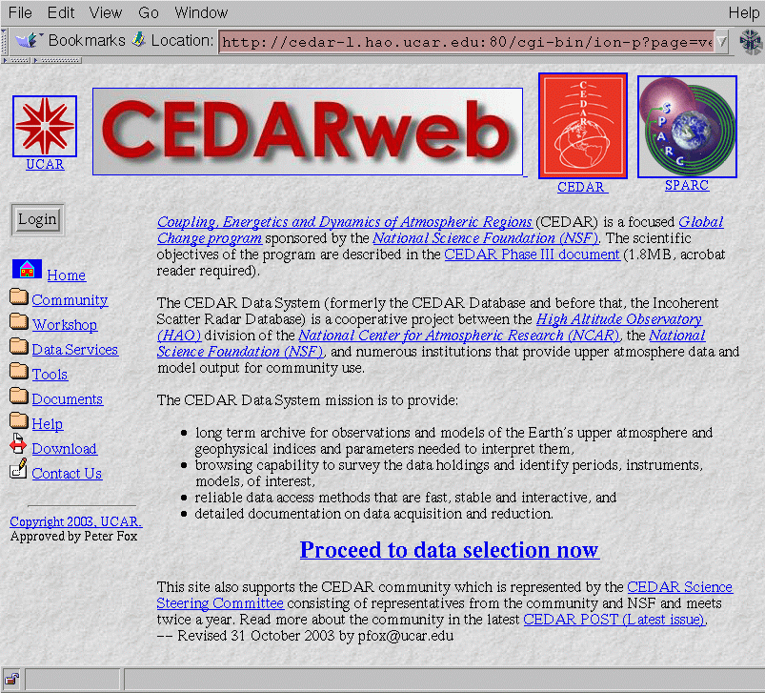
CEDARWEB
Community data archive, documents, and support.

Slide 7
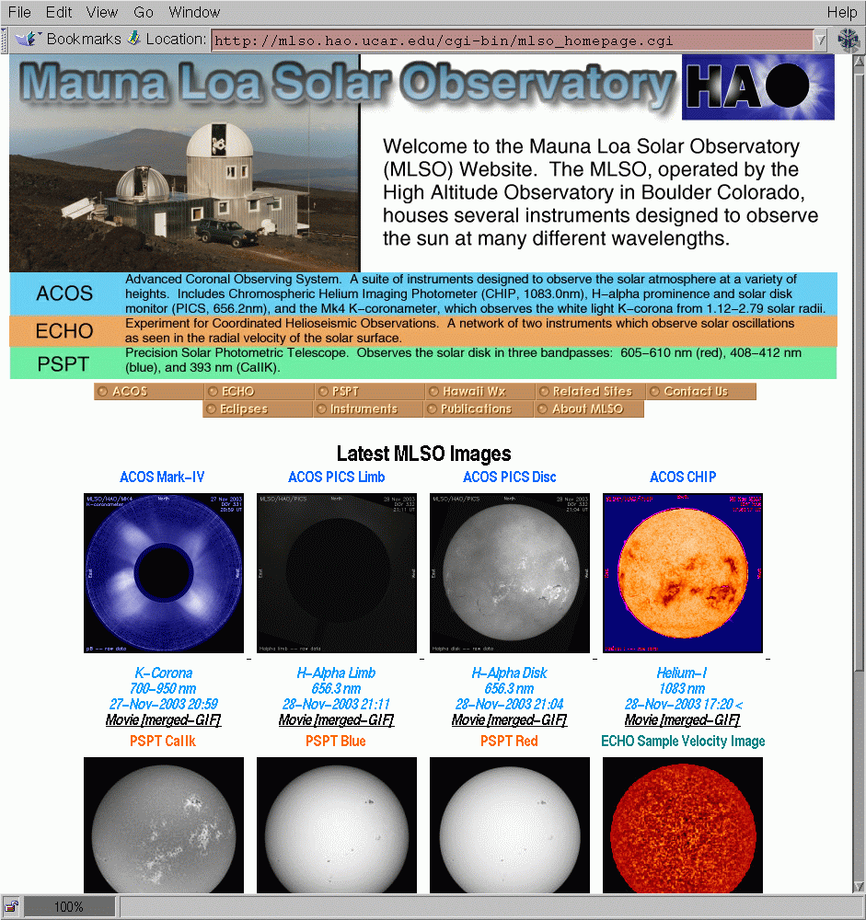
ACOS at the MLSO
Near real-time data from Hawaii from a variety of solar instruments, as a valuable source for space weather, solar variability and basic solar physics

Slide 8
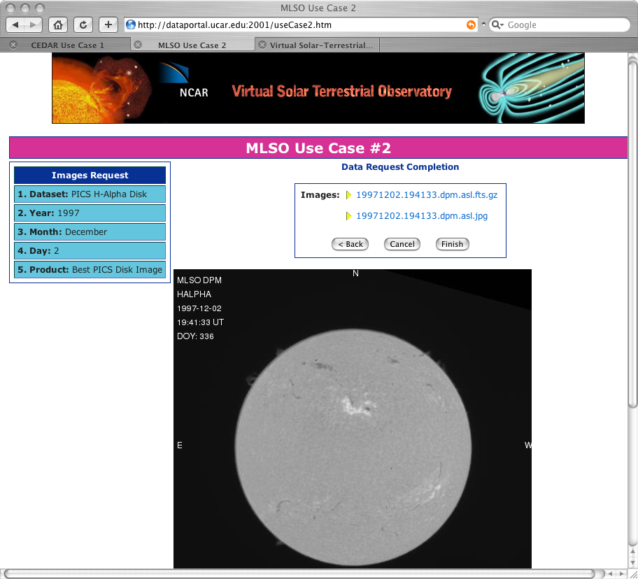

Slide 9
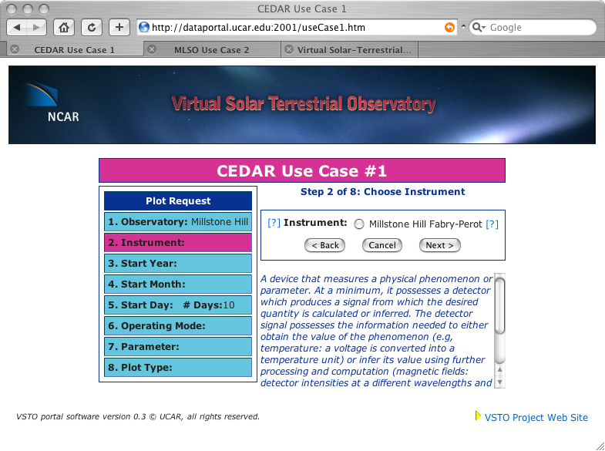

Slide 10
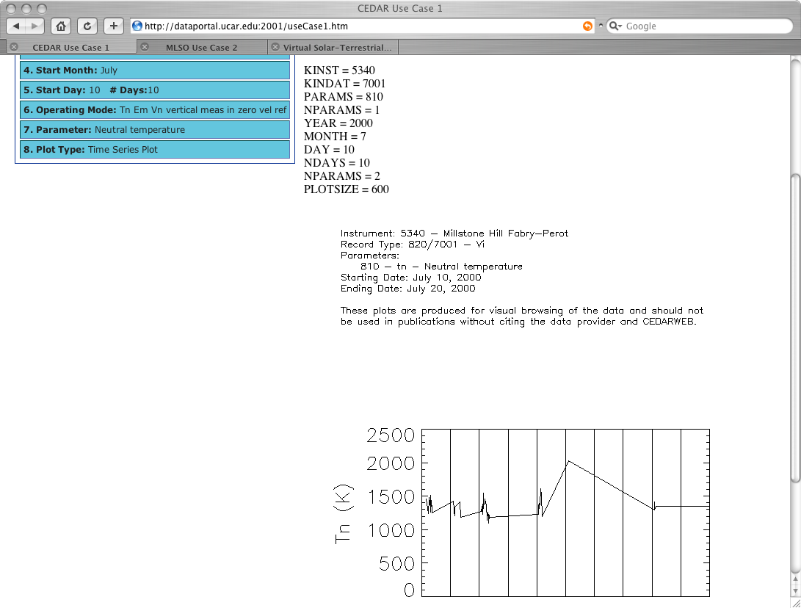

Slide 11
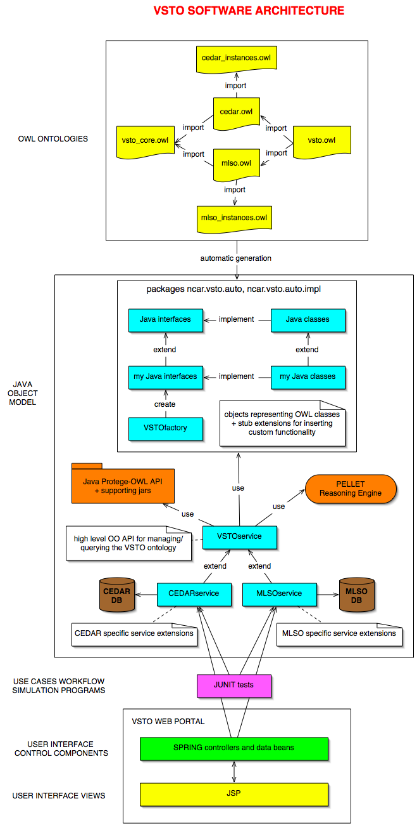

Slide 12
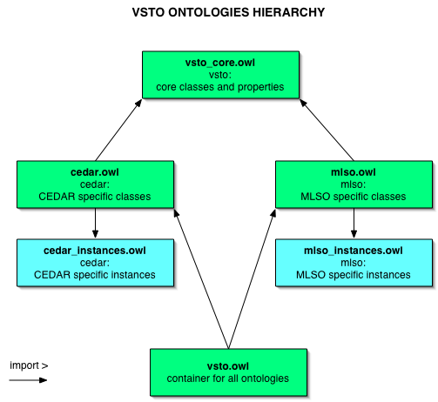

Slide 14
Status
VSTO prototype, and ontology version 0.3, (vsto.owl)
Initial contributions to SWEET
Detailed implementation for Use-case 1 (CEDAR) and Use-case 2 (ACOS) - both going into production in August with new portal
API/Web services encapsulation of interfaces being documented
  Collaboration with APL and Madrigal
Use-case 3 (radar) is being developed, also 4, 5
Feedback - lots of users, all prepared to tell us the G/B/U but use-cases build a lot of feedback in right from the start
Adding models, tools, educational material in 2007
Semantics as a basis for “configuring” VxOs in 2007
http://vsto.hao.ucar.edu/ - project web site
Collaborations: SESDI, SKIF, ESG, CISM, GEON, NMI, SWEET, SciFlo, CDP, ECHO, NSDL/DLESE/OAI, VITMO, SPDML, OPeNDAP …
Contact (pfox@ucar.edu)

Slide 15
Pushing the use-case envelope
Find data which represents the state of the neutral atmosphere anywhere above 100km and toward the arctic circle (above 45N) at any time of high geomagnetic activity.
WHAT is needed to query the CEDAR database?
What information do we have to extract from the use-case?
What we can infer?
How does that lead to a complete query?

Slide 16
Advertising

Slide 17
Ontologies workshop
May 26, 2006 at JHU/APL, 8 am - 5 pm
Workshop participants will have the opportunity to learn:
  What ontologies are (in simple terms):
  Why to develop one, how to use one, how to build one and how example applications use them
  An indication of how knowledge representation technologies can change the way our communities develop interdisciplinary and diverse science applications
  Ways in which these changes can enable new science
  An opportunity to clarify how knowledge representation can help educators
http://sras.jhuapl.edu/workshop.html
Talk to Michele Weiss or Peter Fox this afternoon

Slide 18


Introduction to the Electronic Geophysical Year, 2007-2008 (eGY)
www.egy.org
Booth #7 at AGU/JA
Notes:
This presentation provides an introduction to the Electronic Geophysical Year, 2007-2008 (eGY).
Notes accompany each slide, so we recommend that the presentation be viewed under “View: Normal”, or perhaps “View: Notes”.
eGY Development Team
06 January 2006

Slide 19
What is eGY?
eGY is a cooperative international effort to address the challenges of modern data stewardship, interoperability (e-Science), and integrative science:
  Ready and open access to distributed data, information and services
  Access to large, complex, and cross-disciplinary data sets
  Real-time access and assimilation of data into models
  Data integration and knowledge discovery
  Data discovery (who holds what, where, how? Metadata issues)
  Data release (secure access permission)
  Data preservation (preserve existing and future data)
  Data rescue (identify and rescue critical data sets at risk)
  Education and public outreach; informing decision makers
  Advancement of science in developing countries (reducing the digital divide)
Notes:
eGY is mainly about promoting e-Science for Geoscience - producing a Geoscience Information Commons. The steps that lead to this utopia are embodied in the seven themes of eGY: Data Access, Data Discovery, Data Release, Data Preservation, Data Rescue, Education and Public Outreach, and Capacity Building. The latter is restricted largely to reducing the digital divide between the science haves and have nots.
In a 21st century interoperable world, all these theme areas need to be revisited and new policies developed. What we can do now and how we do it are fundamentally different from what was possible at the time of IGY.

Slide 20
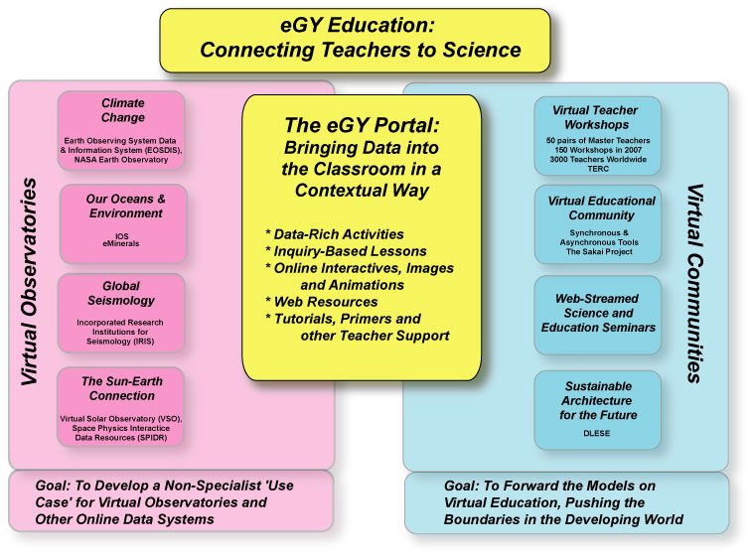
WG: Education and Public Outreach+VO
Notes:
eGY has embarked on an Education and Public Outreach Program under the leadership of Emily CoBabe-Ammann (LASP).
The goal of the eGY Education and Outreach is to create an education portal that connects teachers, in a well-defined way, to the virtual observatories. The programming developed will allow teachers to use the virtual observatories and its data in an educational context, with supporting materials and activities. In addition, and perhaps as important, the portal will support virtual educational communities, both synchronously and asynchronously. There will be virtual seminars, not only on science content, but on the educational technology and assessment. Teachers will be provided with multimedia assets, including scientific talks, computer-based animations and interactives.
The anticipated budget is about USD 2.5 million, to be provided through University Foundations. The program is expanding and may grow to encompass some of the needs of the other I*Y programs (IPY, IHY, Planet Earth).

Slide 21
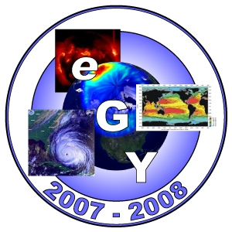
Interested in Getting Involved?
www.egy.org
eGY News
VO working group
Email lists
Sign the “Declaration for a Geoscience Information Commons”
Contact: Bill.Peterson@lasp.colorado.edu
Notes:
Welcome to eGY
Take advantage of eGY and the 50-year anniversary of IGY
Visit the eGY website
Subscribe to eGY News and use it to inform and be informed
Subscribe to the three-tiered email list server (choose the level of detail of communications that suits you)
Become a signatory to the eGY Declaration
Contact Bill to discuss your interests
We provide a list of suggested actions for eGY participants.
THANK YOU

Slide 22
Extra slides

Slide 23
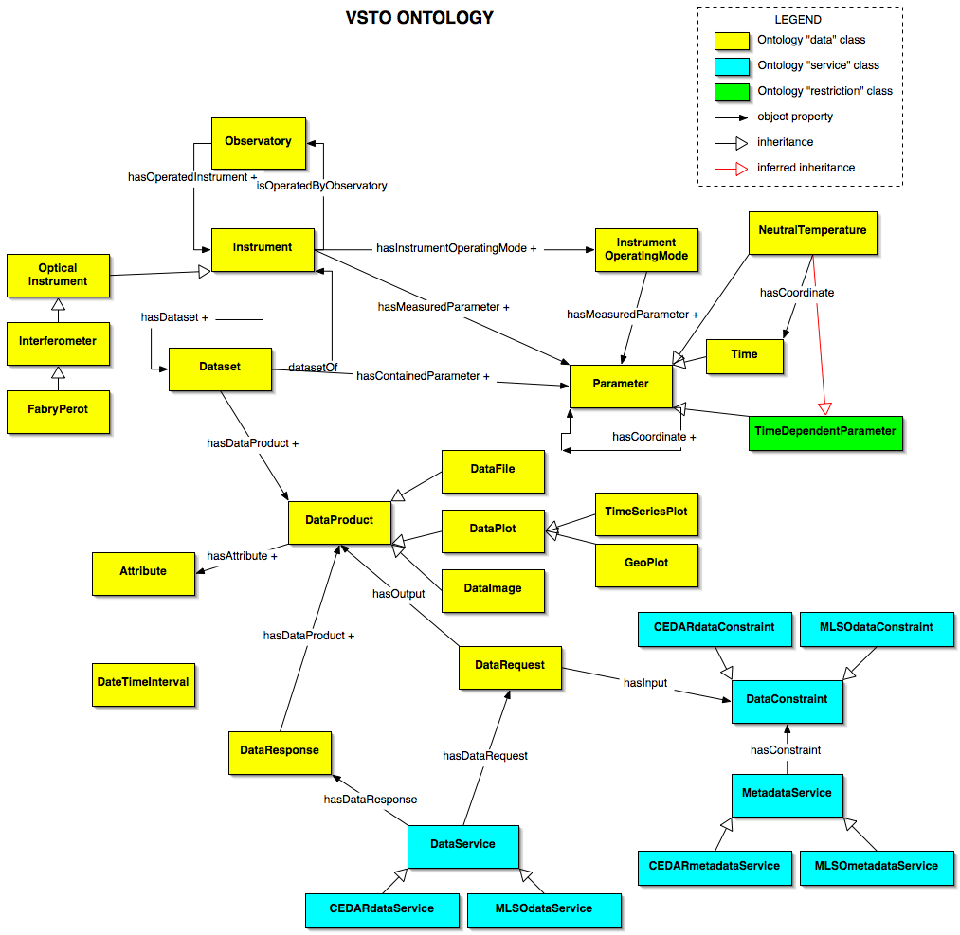

Slide 24
Instrument ontology
Instrument
OpticalInstrument
Interferometer
Fabry-PerotInterferometer
MichelsonInterferometer
IRMichelsonInterferometer (hasBand IR)
DopplerMichelsonInterferometer
AirglowImager
AllSkyCamera
Lidar
Spectrometer
Polarimeter
Heliograph
Photometer
SingleChannel
MultiChannel

Slide 25
CEDAR ontology - parameters
PhysicalQuantity
refersToRealm
Density
ElectronDensity
NeutralDensity
measuredBy: mass, number
Pressure
NeutralPressure
Temperature
IonTemperature
ElectronTemperature
NeutralTemperature
Field
hasMagnitude: xsd::number FieldComponent hasDirection hasCoordinateSystem
MagneticFieldComponent
ElectricFieldComponent
VelocityFieldComponent
Wavelength: hasInterval
Wavenumber: hasInterval
Index
hasSamplingRepresentation
Geophysical
Solar
StatisticalMeasure
Covariance
ChiSquare
ReducedChiSquare
CrossCorrelation
Coherence
Curtosis
…
StatisticalOperation (SWEET)
numerics.owl

Slide 26
What is an Ontology?
Thesauri
“narrower
term”
relation
Formal
is-a
Frames
(properties)
General
Logical
constraints
Catalog/
ID
Informal
is-a
Formal
instance
Disjointness, Inverse, part-of…
Terms/
glossary
Value Restrs.
*based on AAAI ’99 Ontologies panel – McGuinness, Welty, Ushold, Gruninger, Lehmann

Slide 27
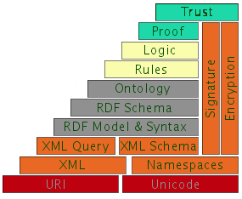
Semantic Web Layers
Ontology Level
  Language (OWL (RDF/XML compatible))
  Environments (inspired by FindUR, Chimaera, Ontolingua, OntoBuilder/Server, Sandpiper Tools, Cerebra, …)
  Standards body leverage (W3C’s WebOnt, W3C’s Semantic Web Best Practices, EU/US Joint Committee, OMG ODM, Scientific Markup Standards, …)
Rules
  SWRL
Logic
  Description Logics
Proof
  PML, Inference Web Services and Infrastructure
Trust
  IWTrust
http://www.w3.org/2004/Talks/0412-RDF-functions/slide4-0.html

Slide 28
Virtual Observatories
Conceptual examples:
In-situ: Virtual measurements
  Related measurements
Remote sensing: Virtual, integrative measurements
  Data integration

Slide 29
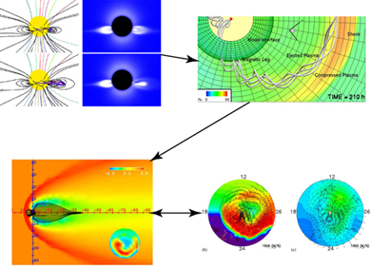
CISM
Goal: To create a physics-based numerical simulation model that describes the space environment from the Sun to the Earth.
THE USES OF SPACE WEATHER MODELING
A scientific tool for increased understanding of the complex space environment.
A specification and forecast tool for space weather prediction.
An educational tool for teaching about the space environment.

