Slide 1
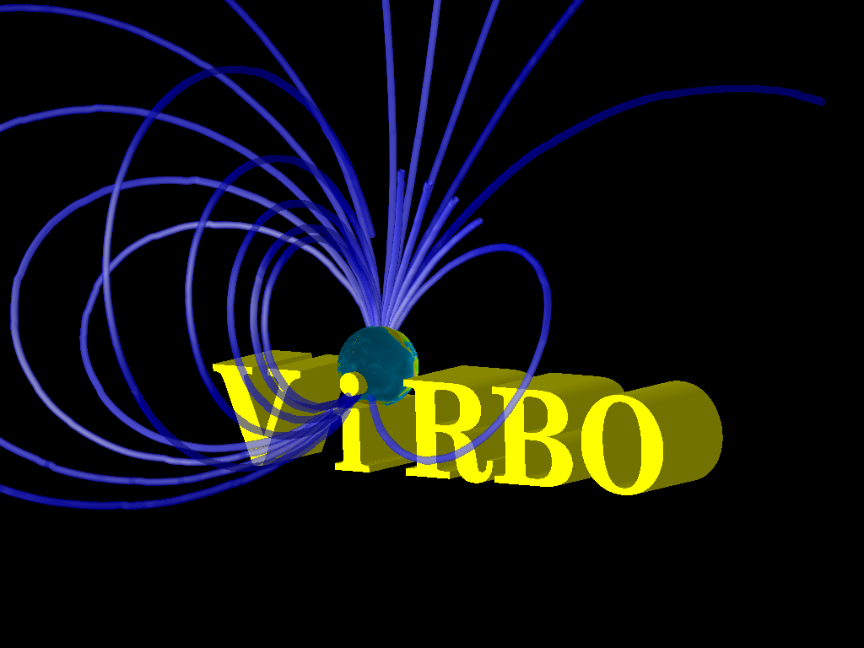
[The Virtual Radiation Belt Observatory]
Bob Weigel (George Mason University)
Software:
Eric Kihn (NOAA/NGDC, ViRBO Web and API)
Mikhail Zhizhin (RFO, ViRBO Web and API)
Jeremy Fadden (Cottage Systems, ViRBO Software)
Data:
Dan Baker (CU/LASP, Data and metadata)
Sebastian Bourdarie (Onera, Data calibration)
Janet Green (NOAA/SEC, Data and metadata)
Shri Kanekal (CU/LASP, Data and metadata)
Reiner Friedel (LANL, Data and calibration)
Paul O’Brien (Aerospace, Data and metadata)

Slide 2
ViRBO Objectives
  Objective 1: To enable scientific achievement and support hazard mitigation by providing a gateway for scientists, operators, and engineers to obtain high quality, calibrated radiation belt data and model output in a unified form along with necessary analysis tools.
  Objective 2: To develop a generic, extensible, open software system that will quickly allow new VxOs to be implemented for other communities faced with similar challenges.

Slide 3
My Background
CISM Knowledge Transfer
CISM_DX
TSDS

Slide 4
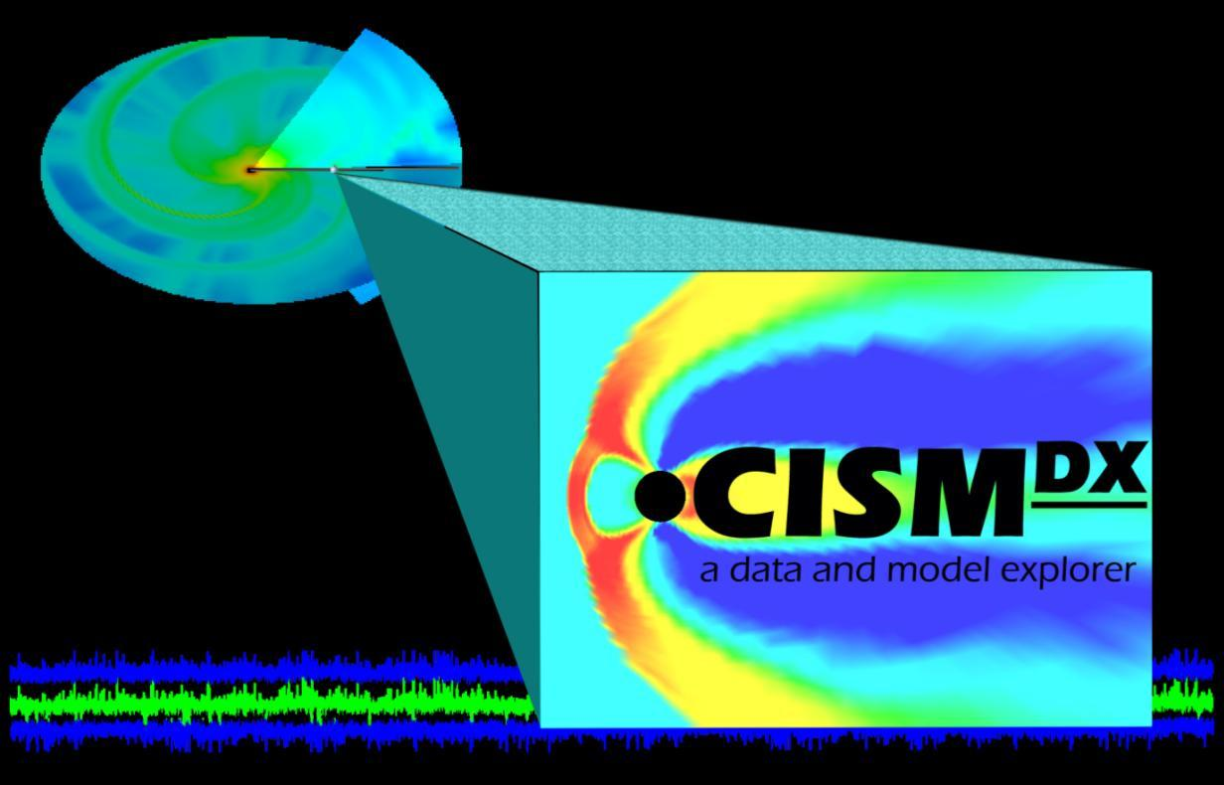
CISM_DX
A package of loosely coupled programs with the purpose of more tightly coupling a loose set of research scientists
OpenDX (3-D Viz)
Octave (Forecast models, time series analysis)
TSDS
Simulation Data
HDF, CDF, FITS, etc.
Summer School Labs

Slide 5
My Background
CISM Knowledge Transfer
CISM_DX
TSDS

Slide 6
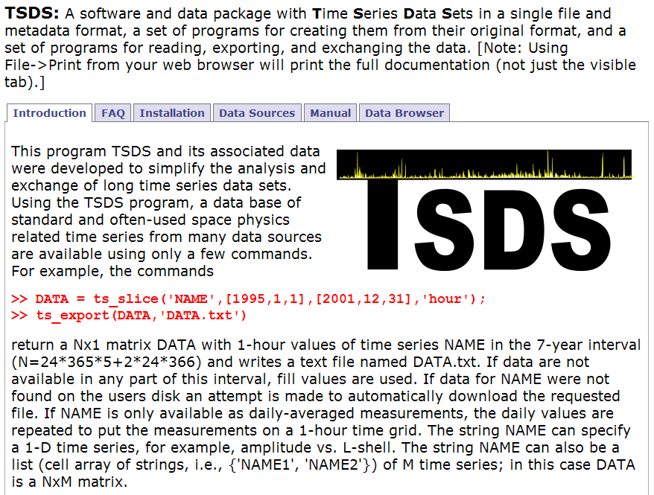
Example of a ‘Bottoms-up’ approach. See also PaPCo

Slide 7
Science Constituency
Radiation Belt Community
  Not all data that could be is public
  Reduction and calibration
  Opportunities for industrial/military interaction
  Many individuals use “ground-up” approach for data managements
VxO
  NASA’s VxO concept addresses “last mile” problem
  First task that must be accomplished before generalization is to find “tipping point” for getting scientists to use Software Engineering 101

Slide 8
Communication and Community
the problem
“Special” Scientist
Scientist spends time formatting and distributing
Difficult for scientist to benefit from others
Transient
Hidden knowledge

Slide 9
Communication and Community
a solution
“Special” Scientist
ViRBO
Key: Get “Special” Scientist to use the new development environment

Slide 10
Key issues for Communication and Community
Getting scientists to use a common repository
  lessons learned from CISM
Connections to Literature
  data is content
Connections to Industry
  APIs, versioning, and validation

Slide 11
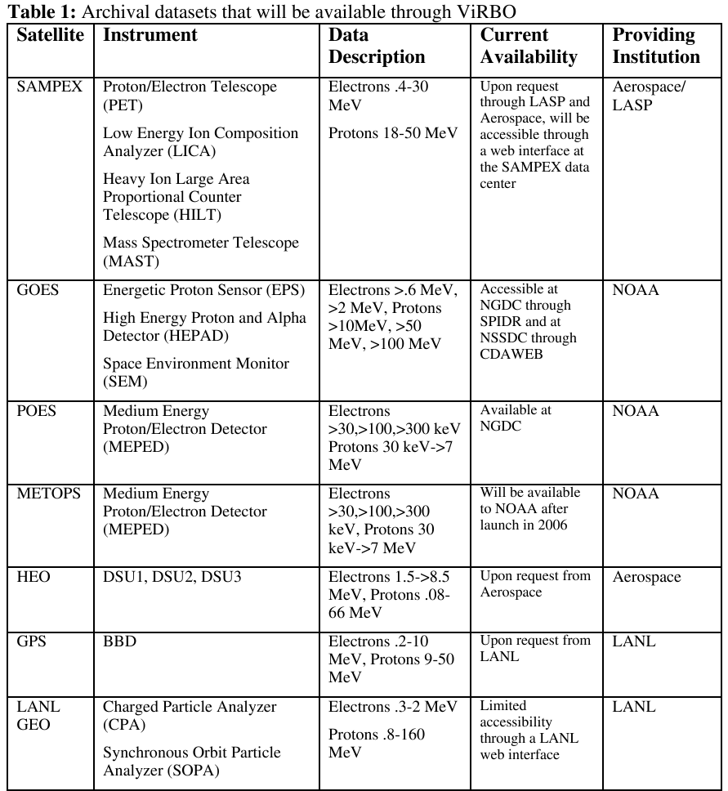
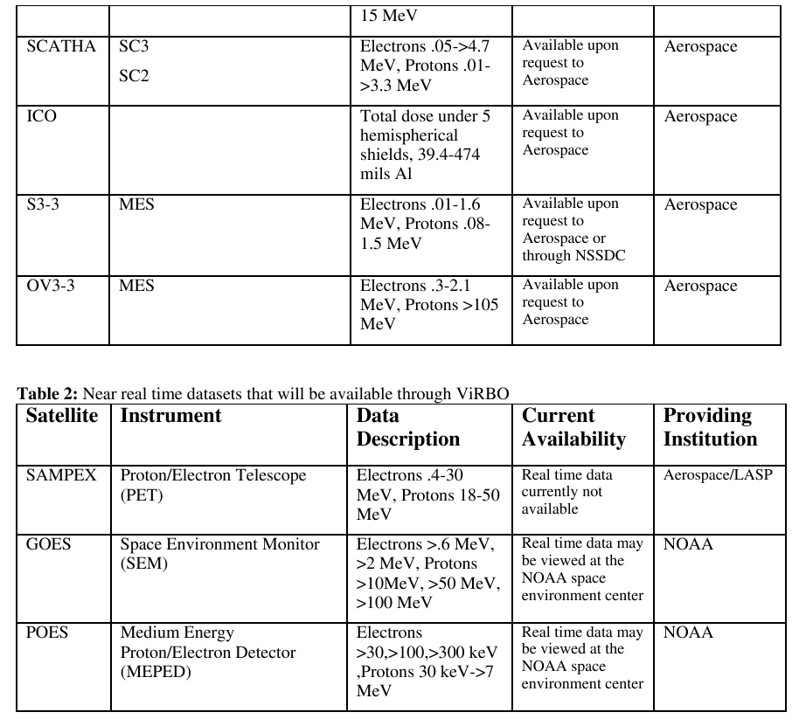
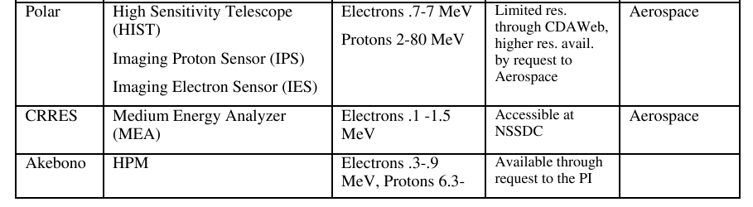
Base Data Sets

Slide 12
Services
ViRBO Web
ViRBO Software
  Matlab/IDL analysis collection
VxO Software
  Matlab/IDL database interaction clients
  Command line Java clients
  Many, many demos

Slide 13
Sample ViRBO interaction/usage
“Provider”
  data_put(‘DirectoryName’,’MetadataFile’)
  “Users” get email
“User”
  data_update
  [re]run model
  feedback to “Provider”
“Provider”
  Try new filter/field model, etc.
  data_put(‘DirectoryName2’,’MetadataFile2’)
  “Users” get email
Notes:
When you ssh or ftp, do you know how the bits are being transferred? Do you need to know?

Slide 14
Infrastructure
Space Physics Interactive Data Resource (SPIDR)
  A distributed cluster of space weather databases and web services
  Satellite Archive Browse and Retrieval (SABR)
  Provides unified web access to satellite data sources and products at the NGDC
Investigation of Distributed Environmental Archives System (IDEAS)
  A distributed cluster of environmental databases interconnected by web-services at the application level
  Allows parallel web-based search and visualization of environmental events in all of the interconnected databases using fuzzy logic mapping from natural language event specifications.

Slide 15
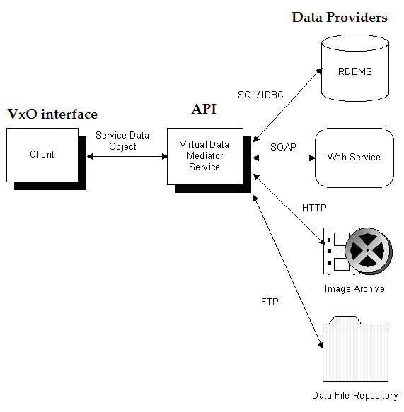
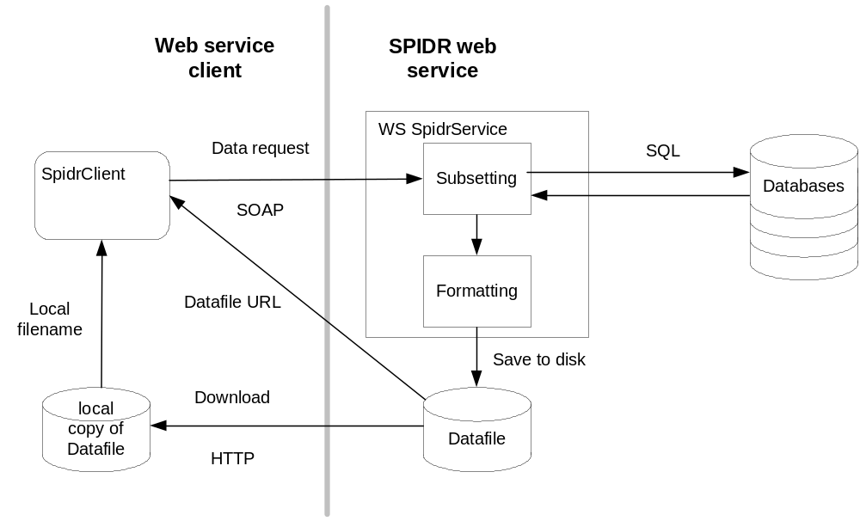
Infrastructure
Space Physics Interactive Data Resource (SPIDR)
Satellite Archive Browse and Retrieval (SABR)
Investigation of Distributed Environmental Archives System (IDEAS)

Slide 16
User Feedback
Email list – devel and user
Track logs
ViRBO Labs

Slide 17
Timeline
2006 Milestones
  Fall Key ViRBO members are uploading and exchanging data from ViRBO repository
2007 Milestones
  ViRBO is populated with data
  Beta testing in Summer
  First public release at Fall AGU
2008/2009 Milestones
  ViRBO Labs
  Generalization and packaging
  Finalize UI and documentation

