Slide 1

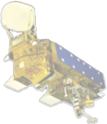
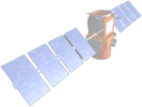

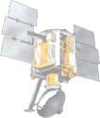
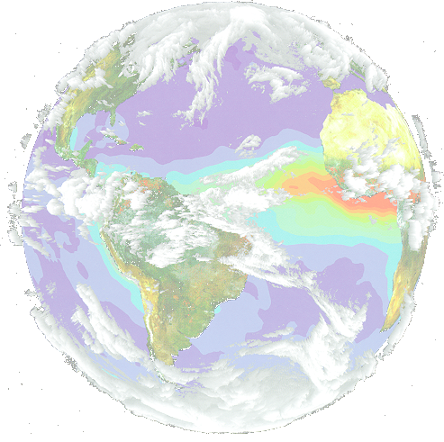
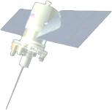




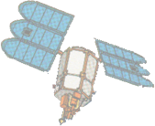
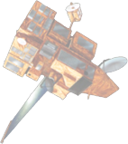
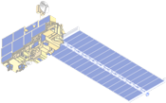
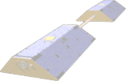
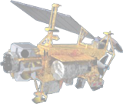
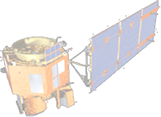
Geospatial Interoperability
Jeff de La Beaujardière, PhD
NASA Geospatial Interoperability Office

Slide 2
Overview
Definition of geospatial interoperability
NASA's Geospatial Interoperability Office (GIO)
Geospatial Web Services
Earth Science Gateway

Slide 3
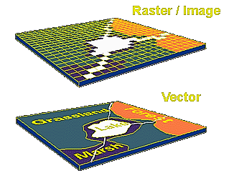
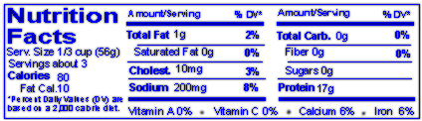
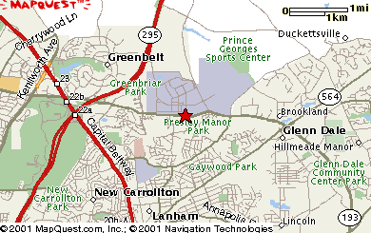
Geospatial Information Content
Features | Coverages
Metadata | Maps
From Geospatial Interoperability Reference Model (GIRM)

Slide 4
Transfer of Geospatial Information
Recommended method:
  Open-standard, vendor-neutral web services
    Interoperability among data/model/DSS components
    Each application can combine info from multiple sources
    Each source can serve multiple applications
  More specifically:
    Standardized URL patterns for requesting information
    Metadata describing available content
GIO can help you implement this method
  Expertise with each standard
  Influence with standards bodies

Slide 5
NASA Geospatial Interoperability Office
GIO is a Level II (NASA-wide) function
Manages NASA participation in geospatial standards-developing organizations
  FGDC (Federal Geographic Data Committee)
  OGC (Open GIS Consortium)
  ISO TC211 (Technical Committee for Geographic Information/Geomatics)
  Assesses & represents Agency consensus on standards
  Ensures standards meet NASA needs
Advocates & assists Agency adoption of geospatial standards
Standards Development Expertise
Expertise in Standards Implementation
Business perspective for alignments & industry partnerships

Slide 6



Geospatial Standards Bodies
Open GIS Consortium
  www.opengis.org
  Not-for-profit consortium
  Vendor-neutral specifications
ISO TC211- Geographic Information/Geomatics
  www.isotc211.org
  Technical Committee of ISO
  International Standards
Federal Geographic Data Committee
  www.fgdc.gov
  US Federal government directive
  Federal standards

Slide 7
Geospatial Web Services (1)
Web Map Service (WMS) (aka ISO DIS 19128)
  For pictures of data (GIF, PNG, JPEG, …)
  Example: solar or planetary image
Web Coverage Service (WCS)
  For gridded data (GeoTIFF, HDF, …)
  Example: solar photospheric magnetic field
Web Feature Service (WFS)
  For point/line/polygon data (XML/GML)
  Example: in-situ data; planetary surface features

Slide 8
Geospatial Web Services (1 1/2)
Feature Portrayal Service ("SLD WMS")
  Reads feature data from WFS
  Returns map like WMS
Coverage Portrayal Service (CPS)
  Reads coverage data from WCS
  Returns map like WMS
Styled Layer Descriptors (SLD)
  XML description of how data should be rendered into picture

Slide 9
Geospatial Web Services (2)
WMS Context (XML file format)
  Save/restore composite map from multiple WMS
  Remembers bounding box & other view params
Web Terrain Service
  Perspective views of data draped over elevation
  3D in 2D, but image pairs could be stereo

Slide 10
Geospatial Web Services (3)
Sensor Planning Service
  Manage network of deployed in-situ sensors
Catalog Services for Web (CS/W)
  Web-queryable catalog of data & services
  Example: search for multiple datasets needed for research and automatically integrate into view
FGDC Clearinghouse
  Network of ~200 catalogs (incl. NASA GCMD)
  Example: find archival data not available from web service and manually retrieve & integrate

Slide 11
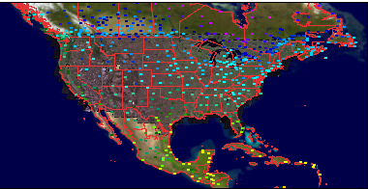
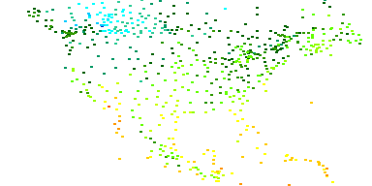
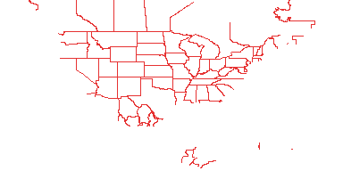
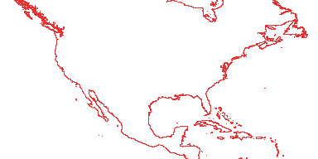
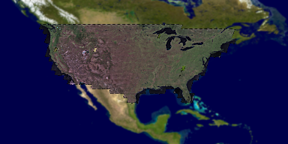
WMS & Context Example
  using NASA WMS Viewer - viewer.digitalearth.gov
GLOBE
FGDC
JPL

Slide 12
Earth Science Gateway
National
Application
DSS
Web Browser
Web Browser
Space Time Toolkit
Digital Earth PC (?)
Existing NASA WMS Viewer
Existing (OGC) Viewer Client
New WCS Request
W*S
Clients
New Catalog Client
Catalog Client
W*S
Clients
Terrain Cache
W*S
WMS
WMS
http, WMS,
Catalog
http, WMS,
Catalog
W*S
http, WMS
http, WMS
W*S
GNIS - Gazetteer
Existing (OGC)
Viewer Client Generator
GOS Portal
Earth Science Gateway
Other NASA middleware
New Coverage
Portrayal Service
Catalog
DLESE, GCMD,
ECHO
OGC Web Services
OGC-Z39.50
Other
Organizations
JPL WMS
* WMS
National
Application
Data Centers
Other ESE
Synergy
Data Pools
WMS Global Mosaic
WMS Global Mosaic
Access to Grid
Access to Models
WCS, WFS
WMS, Catalog
WCS, WMS
(Data TBD)
Existing
WCS, WFS
WMS, Catalog
Infomarts
Earth Observatory

