Slide 1
The Evolving Heliophysics Data Environment:
“VxO Kickoff”
Chuck Holmes
Joe Bredekamp
May 22, 2006

Slide 2
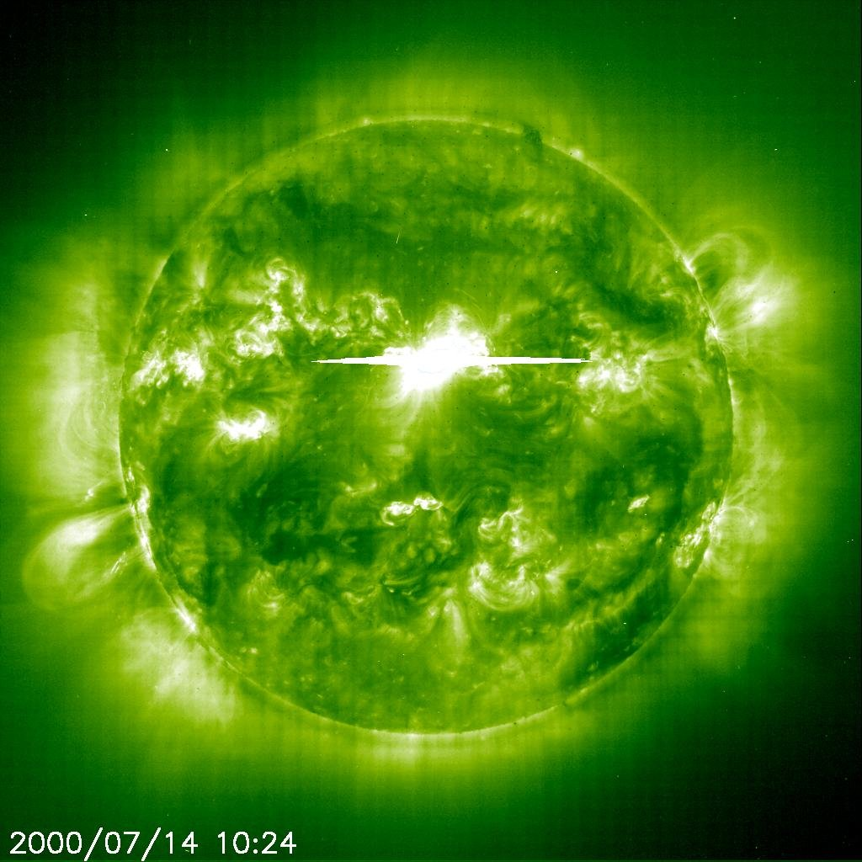
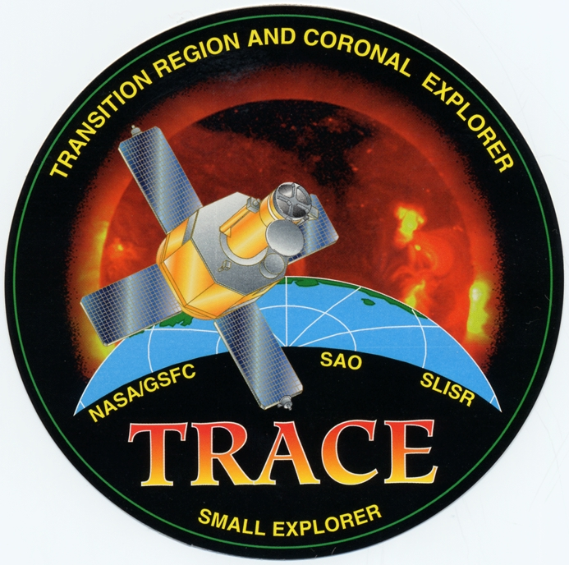
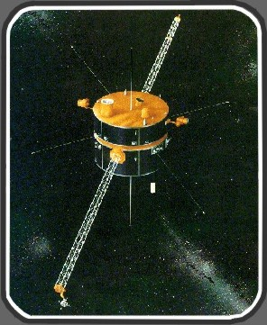
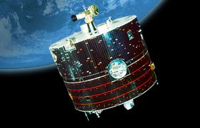
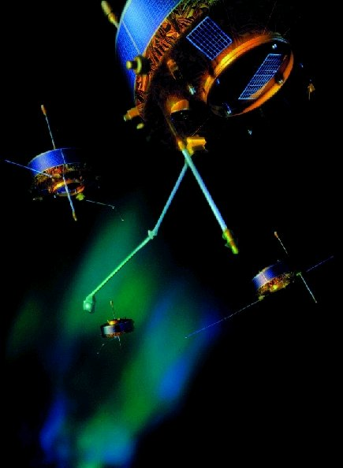
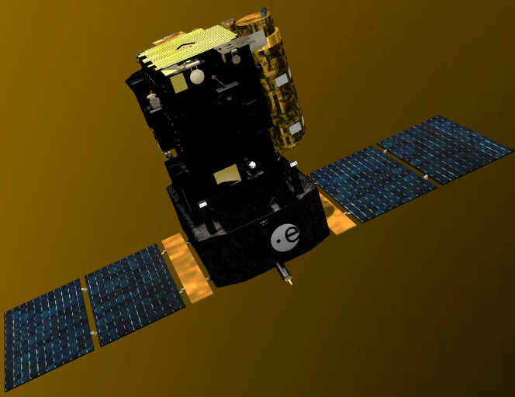
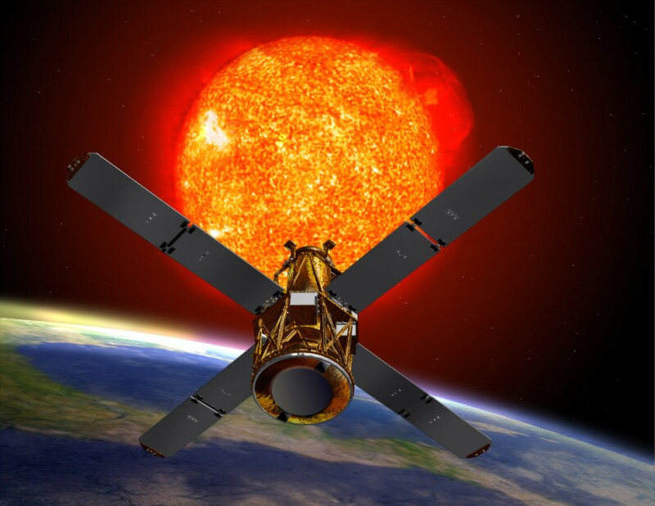
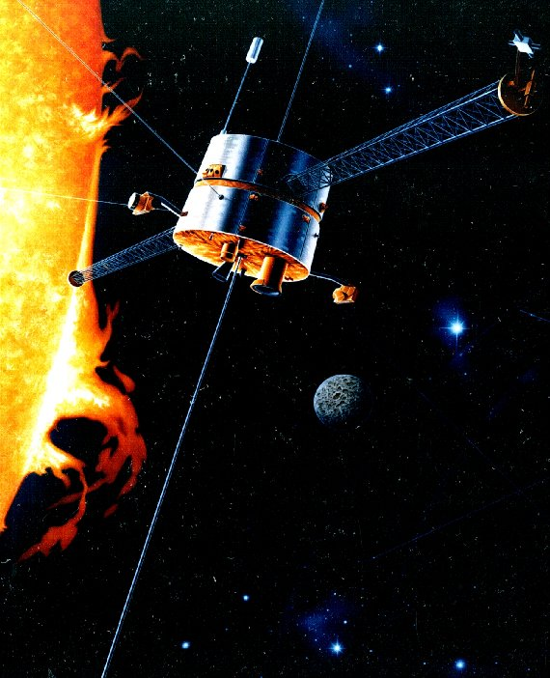
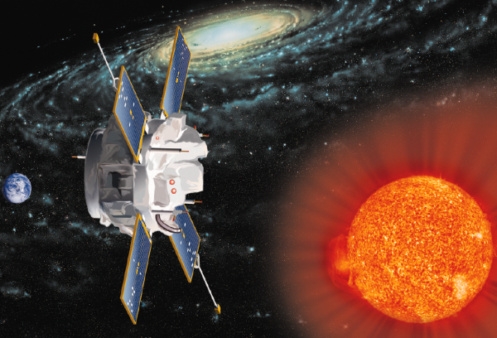
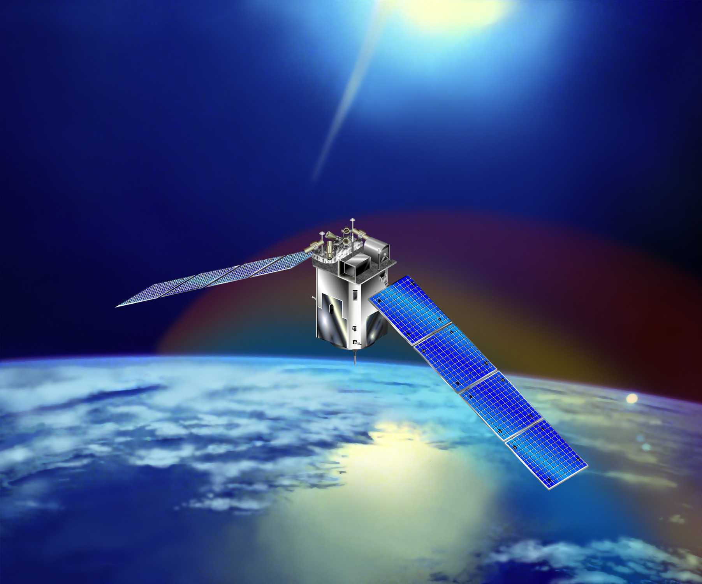
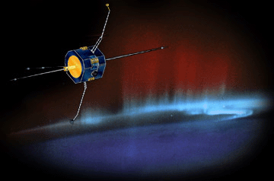
The Heliophysics Great Observatory
Geotail
Wind
IMAGE
SOHO
RHESSI
ACE
Cluster
Solar
Source
Solar Wind
Drivers
Polar
Seed
Population
FAST
TIMED
Precipitation
And Loss
Atmospheric &
Ionospheric
Coupling
Heliospheric
Structure

Slide 3
S³C Missions Under Development

Slide 4
The HP Data Environment
Data from the Great Observatory reside in a distributed environment and are served from multiple sources.
Multimission Data Centers
  Solar Data Analysis Center
  Space Physics Data Facility [CDAWeb, OMNIWeb, etc.]
  The Community Coordinated Modeling Center
Mission-level active archives: e.g. ACE, TIMED, TRACE, Cluster, etc.
Much of our data are served from the individual instrument sites.
We are moving into a new data environment of
  Virtual Observatories for convenient search and access of the distributed data, and
  Resident Archives to retain the distributed data sources even after mission termination.
We have a Data and Computing Working Group to help us move ahead.

Slide 5
Vision for the Heliophysics Data Environment
“Report and Recommendations of the LWS Data System Planning Team”, Winter, 2002.
The Heliophysics (nee SEC, Sun-Solar System Connection) Data Environment:
  Will be based on existing services and evolve in response to user needs -> no new data system
  Will allow for the selective inclusion of essential data sets and modeling from other sources.
  Requires science participation in data management -> no new data system management group
  The environment will be distributed and virtual.
  Will have peer-reviewed process for elements of the environment.

Slide 6
Corollaries to the Vision
Heliophysics data environment needs to support all heliophysics research activities and programs.
The “Right Amount of Glue” sets the philosophy.
  J.B. Gurman (Fall 2002 AGU, SH52C-03)
  Technology is or will be ready
  XML plus software tools become the new standard (the ‘glue’)
  A standard of behavior - share one’s data with everyone
The Virtual Solar Observatory is a path-finder.
Activate/Energize discipline-based approaches to the evolution of the data environment.
The SPASE dictionary will be the ‘Rosetta Stone’ for HP data models.
Distributed funding and implementation activities.
Blend ‘bottoms-up’ implementation approaches with ‘top-down’ vision for the whole scope of an integrated data environment.

Slide 7
Agenda
Welcome (McGuire & Roberts)
Introduction (Holmes & Bredekamp)
The Invocation (Gurman)
Status and plans reports from funded VxO Activities (~10-15 min)
  VSO, VSPO, GAIA, VSTO
  VHO, VITMO, VIRBO, VMO/G, VMO/U
    Science constituency served
    Who’s Doing What (People and Institutions)
    Datasets to be made available
    Services
    Overall architecture including Technology, Data Model, etc.
    Milestones/Timeline
    Methodology for user feedback
Notes:
This is an interdisciplinary program: the science, the data, and the new software technologies needed for the emerging virtual observatories. We have assembled an interdisciplinary panel to cover the breadth of the proposals, and it is only through triangulation of these perspectives that we can build a true consensus evaluation This also means that we need to count on each of you to participate beyond your assignments, contributing fully towards building the consensus evaluations.

Slide 8
Agenda (cont’d)
A conversation about SPASE and the VxOs and other Data Centers (Roberts, Thieman, T. King)
  What is SPASE and its Data Model?
  Status of the Data Model and tools for its use
  Proposed plan for populating registries and for model feedback
  Open discussion of suggestions and plans
Value-added services for VxOs (10-15 min each)
  SPDF, COSEC, tbd
Future directions
  Ideas for coordination and collaborations
  Approaches for evolving to THE VHPO
  Ideas/models for transitioning capabilities developed to operating infrastructure
  Next steps in gathering user requirements, priorities, concerns for data and services
  Building community buy-in and enthusiasm to data environment efforts
Community Workshop Planning
  Next VxO technical workshop
  Ideas and volunteers for organization, timing, topics etc
Notes:
This is an interdisciplinary program: the science, the data, and the new software technologies needed for the emerging virtual observatories. We have assembled an interdisciplinary panel to cover the breadth of the proposals, and it is only through triangulation of these perspectives that we can build a true consensus evaluation This also means that we need to count on each of you to participate beyond your assignments, contributing fully towards building the consensus evaluations.

Slide 9
Charge to the Workshop
What we are trying to accomplish:
  Promote the VxOs to collaborate [sharing info and how to],
  Start the dialog for integrating upwards in order to break down the barriers between the sub-disciplines, and
  As we proliferate the VxOs: assist the data services - don’t confuse them.
Our researchers don't know the barriers; why should we impose artificial ones?

Slide 11
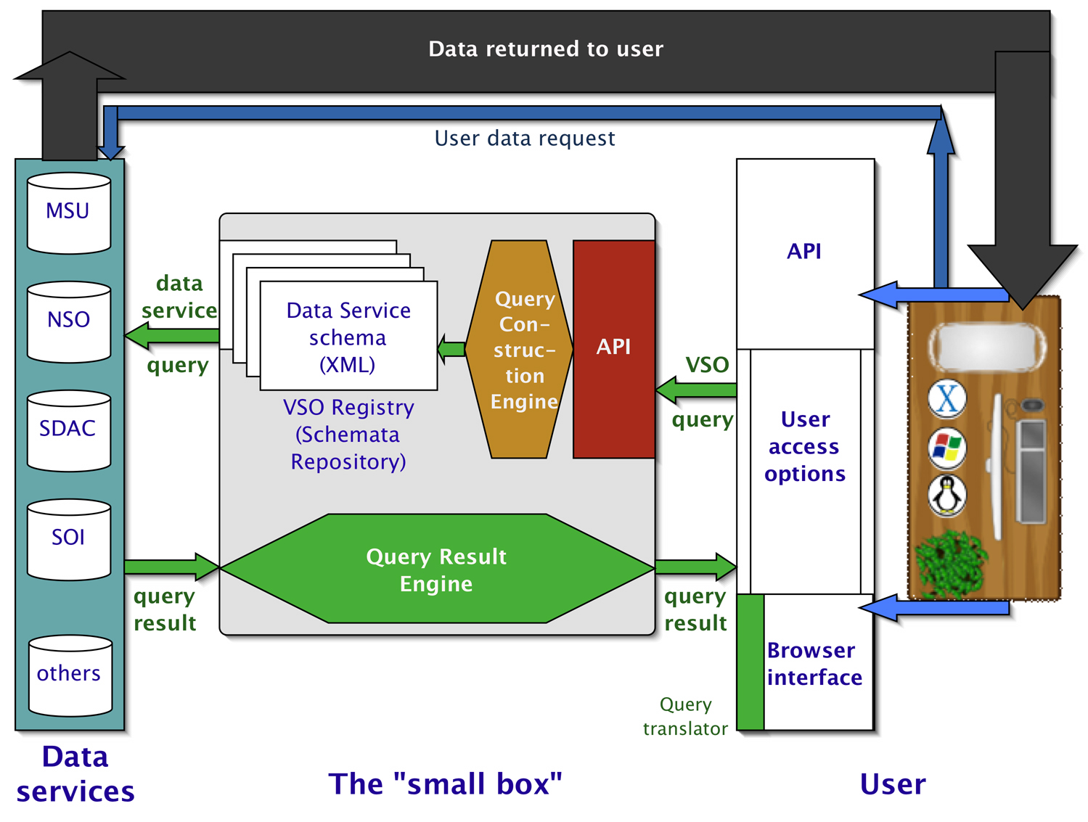
The Virtual Solar Observatory
Completed prototype development
Organized by the solar data services
  SDAC
  NSO
  Stanford
  Montana State Univ
Small box approach but ‘extensible’
See the Design Proposal and other info at http://virtualsolar.org

Slide 12
2002 Concept for the Heliophysics Data Environment via ‘small boxes’
Virtual Solar Observatory
Virtual Heliospheric Observatory
Virtual Magnetospheric Observatories
Virtual ITM Observatories
Services <-> VxOs <-> Analysts’ tools

Slide 13
Think ‘small box’
Limit the initial set of data services
  Place additional or future data services on the ‘to do’ list
Limit functionality and capability
  Focus on the core functions of data query and retrieval
Share (publish) the schemata
  Schemata are referenced via registered URLs
VxOs work w/ data services to create and maintain schemata
Analysts work w/ the VxOs to create, debug and update the query engines and APIs
Each VxO needs an associated software library of data manipulation and analysis tools
  E.g. SolarSoft library serves the solar research community

