Slide 1
An Automatic System for CME Detection and Source Region Identification
Solar and Space Physics Virtual Observatories Conferences
Oct. 27 – 29, 2004 Greenbelt, MD
Jie Zhang (jiez@scs.gmu.edu)
Art Poland,
Harry Wechsler
Kirk Borne
George Mason University

Slide 2
Introduction
CME is the major driven force of severe space weather that have technology and societal impacts
An automatic event detection system is needed, because
  Timely detection of events, which is crucial for space weather forecasting
  Reducing human cost, overcoming the limitation of human performance; growing amount of data, e.g., SOHO, STEREO and SDO
  Objective event characterization, by imposing a uniform event processing standard, providing consistent data for users
  Flexibility and scalability, allowing further in-depth applications added on later.

Slide 3
Three computational components
Image Processing
  Event/pattern recognition
Machine Learning
  Developing robust and efficient image analysis and pattern recognition algorithms
  Statistical Learning Theory (SLT), e.g., Support Vector Machine (SVM)
  Transductive Inference, locality aspect of objects
Data Mining
  Case Based Learning (CBL)
  Memory-based Reasoning (MBR)

Slide 4
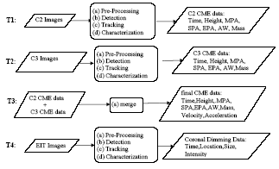
Six major tasks in the system
T5: Associate CME events with dimming events
T6: Performance Evaluation and Enhancement, iterative task 1 to task 5

Slide 5
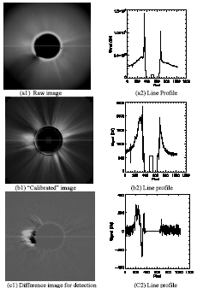
CME Detection/Tracking and Characterization
Find a faint moving object against a cluttered background
CME, like other astrophysical objects, is optically thin; no hard surface
CME, no fixed shape, an expansion flow

Slide 6
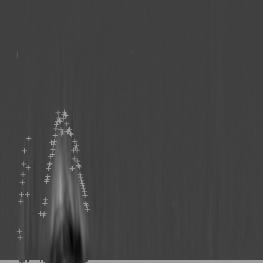
CME Detection/Tracking and Characterization
Preprocessing
  Calibration
  Filtering and relaxation
  polar transformation
Detection
  Morphology analysis
  Boundary detection
  Region Growing
Tracking
  CONDENSATION (CONditaional DENSity propagATION)
  Use temporal relations between frames

Slide 7
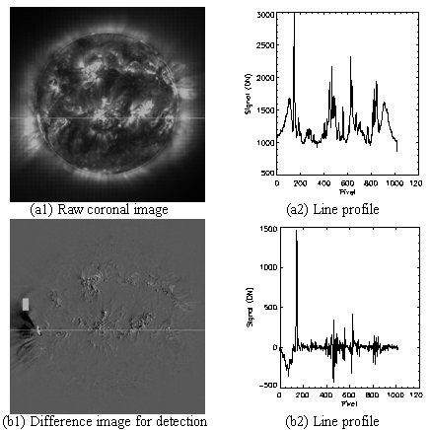
EIT dimming Detection and Characterization
EIT or coronal dimming, the most reliable observations to locate CME disk source region
Characterization
  Heliocentric coordinate
  Timing
  Size
  Intensity

Slide 8
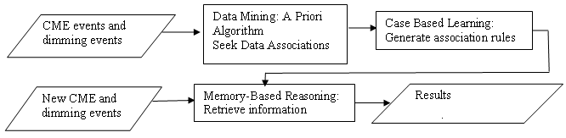
Data Mining, CME Source Regions
Find out Spatial and Temporal association rule
CME
  Timing
  Position angle and size
  Velocity
Coronal dimming
  Timing
  Heliocentric coordinate
  Size and dimming intensity

Slide 9
Performance Evaluation
Understanding the applicability of the proposed methods
Achieving the best performance for different needs
  Building catalogs
  Neal real time detection for forecasting
  In depth research
Find true error rate from apparent error rate
  ROC (Receiver Operator Characteristics) curve, tradeoff between false alarm and detection rate
  Cross-validation
  Bootstrapping

