Slide 1
What NASA needs from us?
Presented to the Workshop:
VOs in Space and Solar Physics
27-29 October 2004
Chuck Holmes & Joe Bredekamp
Science Mission Directorate
March 26, 2003

Slide 2
Vision for the LWS Data Environment
“Report and Recommendations of the LWS Data System Planning Team”, Winter, 2002.
The LWS data environment:
  Will be based on existing services and evolve in response to user needs.
  Will allow for the selective inclusion of essential data sets and modeling from other sources.
  Requires science participation in data management…the environment will be distributed and virtual.
  Will have peer-reviewed process for elements of the environment.
  Begin now … integral to the Target Research & Technology program.

Slide 3
Authors’ Extensions to the Vision
LWS data environment needs to support all SEC research activities and programs.
The “Right Amount of Glue” sets the philosophy.
  J.B. Gurman (Fall 2002 AGU, SH52C-03)
  Technology is or will be ready
  XML plus software tools become the new standard (the ‘glue’)
  A standard of behavior - share one’s data with everyone
The Virtual Solar Observatory is a path-finder.
Activate/Energize discipline-based approaches to the evolution of the data environment.
Distributed funding and implementation activities.
Blend ‘bottoms-up’ implementation approaches with ‘top-down’ vision for the whole scope of an integrated data environment.

Slide 4
A Concept for the
SEC/LWS Data Environment via ‘small boxes’
Virtual Solar Observatory
Virtual Heliospheric Observatory
Virtual Magnetospheric Observatories
Virtual ITM Observatories
Services <-> VxOs <-> Analysts’ tools

Slide 5
A generalized data environment concept
Data services:
  Data online
  Searchable capability
  Dynamic -> updates to existing services plus new services can be included
The VxO broker mediates between the data services and data user:
  Metadata library employing XML Schema as the standard
  Discipline-specific query engine
  Returns set of instructions to retrieve queried data
  APIs to analysis tools
  Logged searches would be cited and acknowledged in published articles
The analysts’ work bench:
  Accesses the VxO
  Software library of analysis tools, data manipulation and translation
  Some results can in turn become new or updates to the data services

Slide 6
Progress
Data Services
  Sustaining a community attitude of making high resolution data ‘on line’.
  Taking steps in organizing data directories and metadata for remote query and retrieval.
  We have sponsored ‘small’ grants programs for upgrading online data services
  The LWS program is initiating a metadata services approach.
  We are developing the concept for “Resident Archives” for managing data services after termination of a science mission.
VxOs
  VSO is a mature prototype; close coordination with the EGSO activities
  VHO is starting up - using SPASE as the reference data model
  VSPO is taking inclusive evolutionary approach; adopted SPASE
  Several groups are studying concepts for VxOs in magnetospheric and ITM areas
  Developing NRA opportunity for new VxO developments: Released in Feb 2005
Analysts’ work bench
  COSEC is under development
  Evolving NSSDC/SPDF data analysis services
  Opportunities for new developments are advertised in AISRP, LWS/TRT, and elsewhere

Slide 7
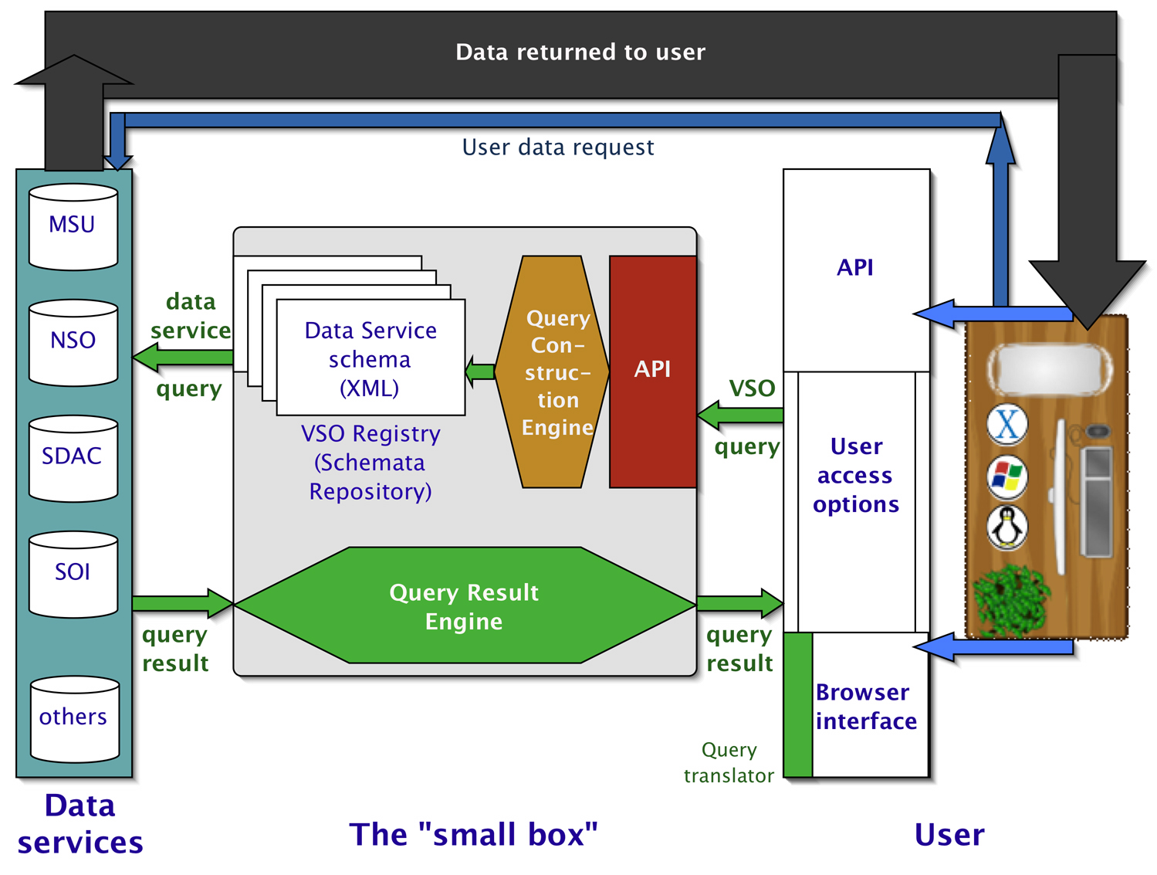
Towards the future: what does NASA need from us?
Keep up the good work!
Continue to promote & facilitate the universal data standard: “share your data”
Need to consider integrating of cross-disciplinary items
Follow the paths and and lessons learned.
Participate in our future research announcements.
  To foster and promote the elements of the SEC/LWS data environment.
  Promote research and technology for integrating the environment
    E.g., cross VxO interactions, data mining, grid-like features, etc.
Adhere to the ‘market principle’ => are the fruits of our labors being used?
  Yes: we will continue to support future operations and evolution
  No: we will not!
  Use ‘peer’ process as a means of gauging the market
Get me some new graphics =>

Slide 8
Backup

Slide 9
The Virtual Solar Observatory
Beginning prototype development
Organized by the solar data services
  SDAC
  NSO
  Stanford
  Montana State Univ
Small box approach but ‘extensible’
See the Design Proposal and other info at http://virtualsolar.org

Slide 10
Think ‘small box’
Limit the initial set of data services
  Place additional or future data services on the ‘to do’ list
Limit functionality and capability
  Focus on the core functions of data query and retrieval
Share (publish) the schemata
  Schemata are referenced via registered URLs
VxOs work w/ data services to create and maintain schemata
Analysts work w/ the VxOs to create, debug and update the query engines and APIs
Each VxO needs an associated software library of data manipulation and analysis tools
  E.g. SolarSoft library serves the solar research community

