Slide 1

Evolving SPDF/SECAA Active-Archive Multi-Mission Services in the Era of Virtual Observatories and LWS
R E McGuire¹, R M Candey¹, R A Chimiak², D Han², B T Harris²,
R C Johnson³, C Klipsch³,T J Kovalick³, H A Leckner³, M. Liu⁴
¹Code 630, ²Code 580, ³QSS/Code 630, ⁴Raytheon/Code 630
NASA's Goddard Space Flight Center, Greenbelt, MD 20771

Slide 2
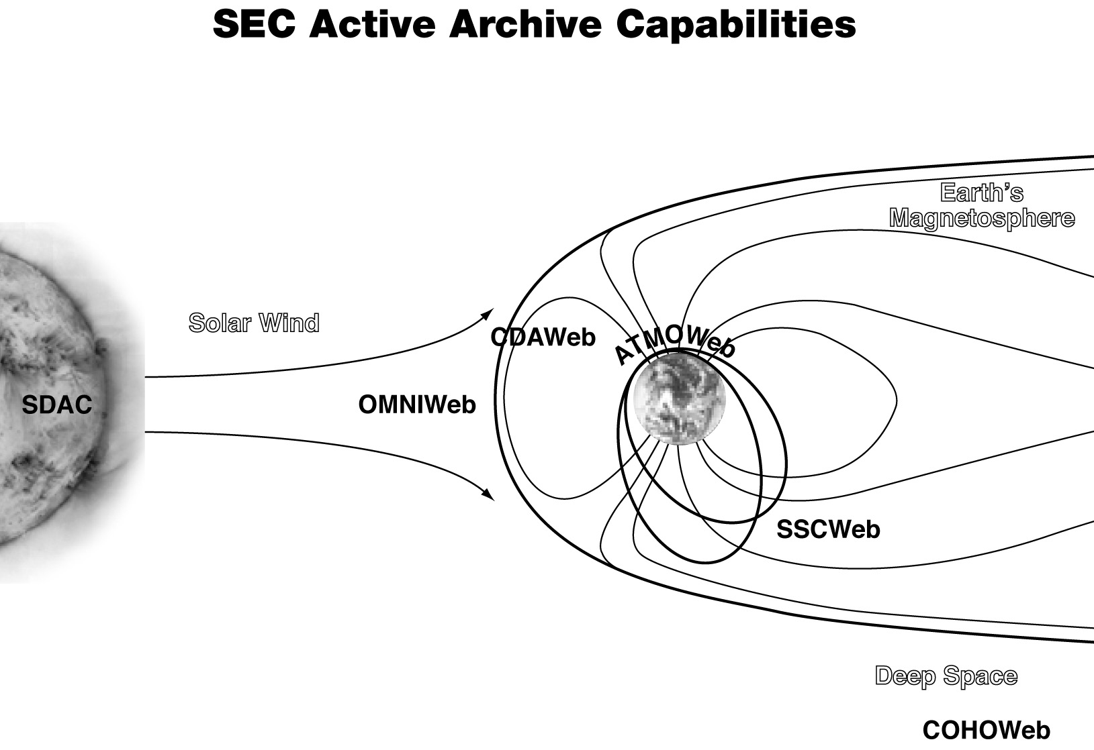
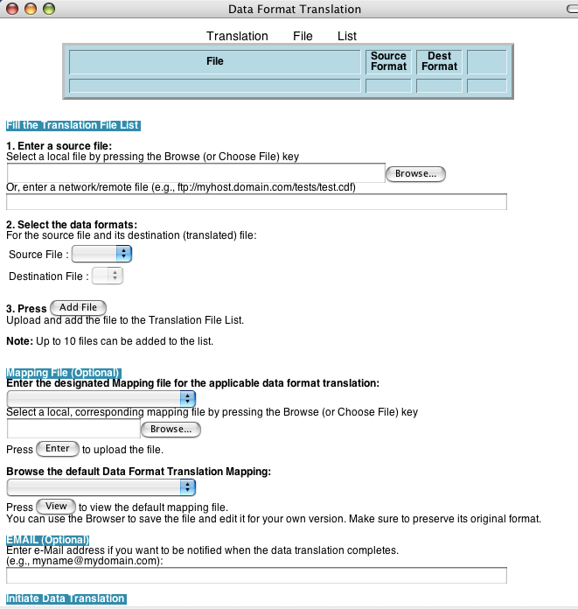
Multi-Mission Services Today
(cf. http://spdf.gsfc.nasa.gov)
ModelWeb
An Overview of SECAA Services and Roles
(Trajectories)
CDAWLib & CDFX
NSSDCFTP Data, FTPBrowser I/F
HelioWeb and COHOWeb
Acquisition & Ingest
Science User Support
CDF with Tools-S/W
SSC Facility
CDAWeb: Easy data browse and display, user-specified time and parameter subsets with graphics, listings, file downloads
  Data from most currently-important SEC missions
SSCWeb: Multi-mission orbits, with graphics and conjunction logic for coordinated science planning
OMNI2: Field, plasma, particle hourly avgs at 1 AU
CDF standard data format and associated software
Data format translations
ModelWeb: Information, codes, execution I/F

Slide 3
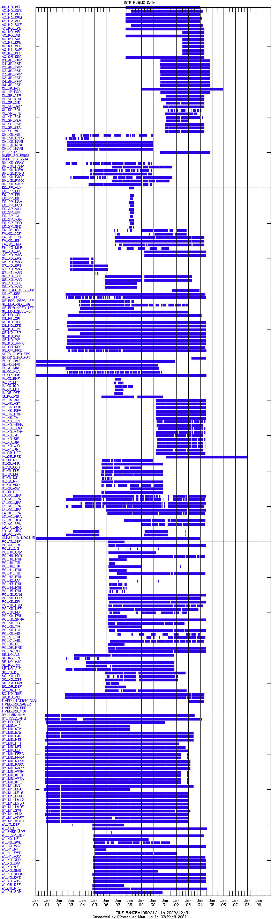
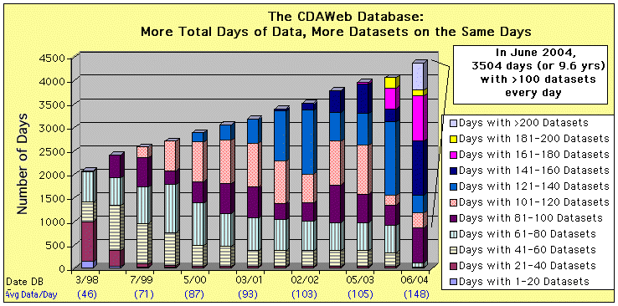
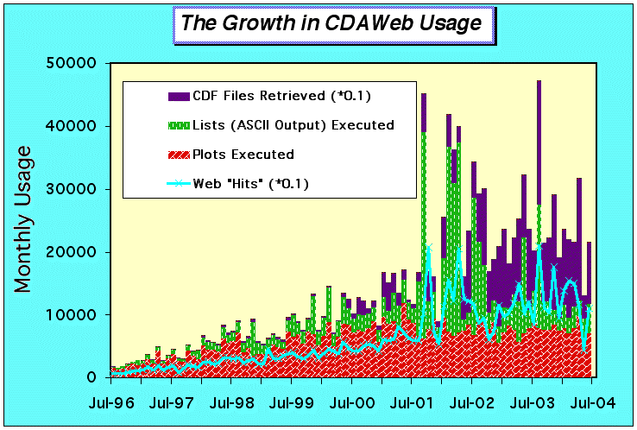
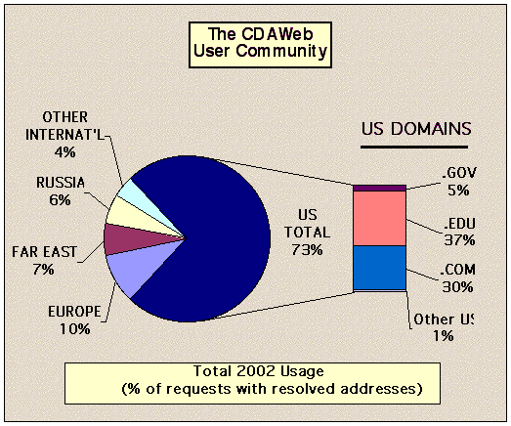
Unique Community Resources
  Scope of CDAWeb data holdings and multi-mission service
  Nature of SSCWeb database and unique functions supported
  OMNI2 database as near-Earth 40- year interplanetary baseline
  CDF supports multiple programs (including planned STEREO and THEMIS)
Citations to services & data (with NSSDC, >107 in 2003)
  Resources are heavily used (plots, lists, files, queries)
  Many regular distinct science users: e.g. ~900 CDAWeb
International sharing of data (including CDAWeb mirror sites)
Variety of technologies
  FTP access plus S/W (e.g. CDAWLib and CDFX)
  Html-based user I/F
  Web-services application I/F
  New Java-based clients (with Webstart installations)
Missions include
ACE
Cluster
FAST
Geotail
GOES
IMAGE
Interball
LANL
Polar
TIMED
Ulysses
Wind
CDAWeb Data Sets
(~240 total datasets in this overview, one row per dataset)
Years 1990-2010

Slide 4
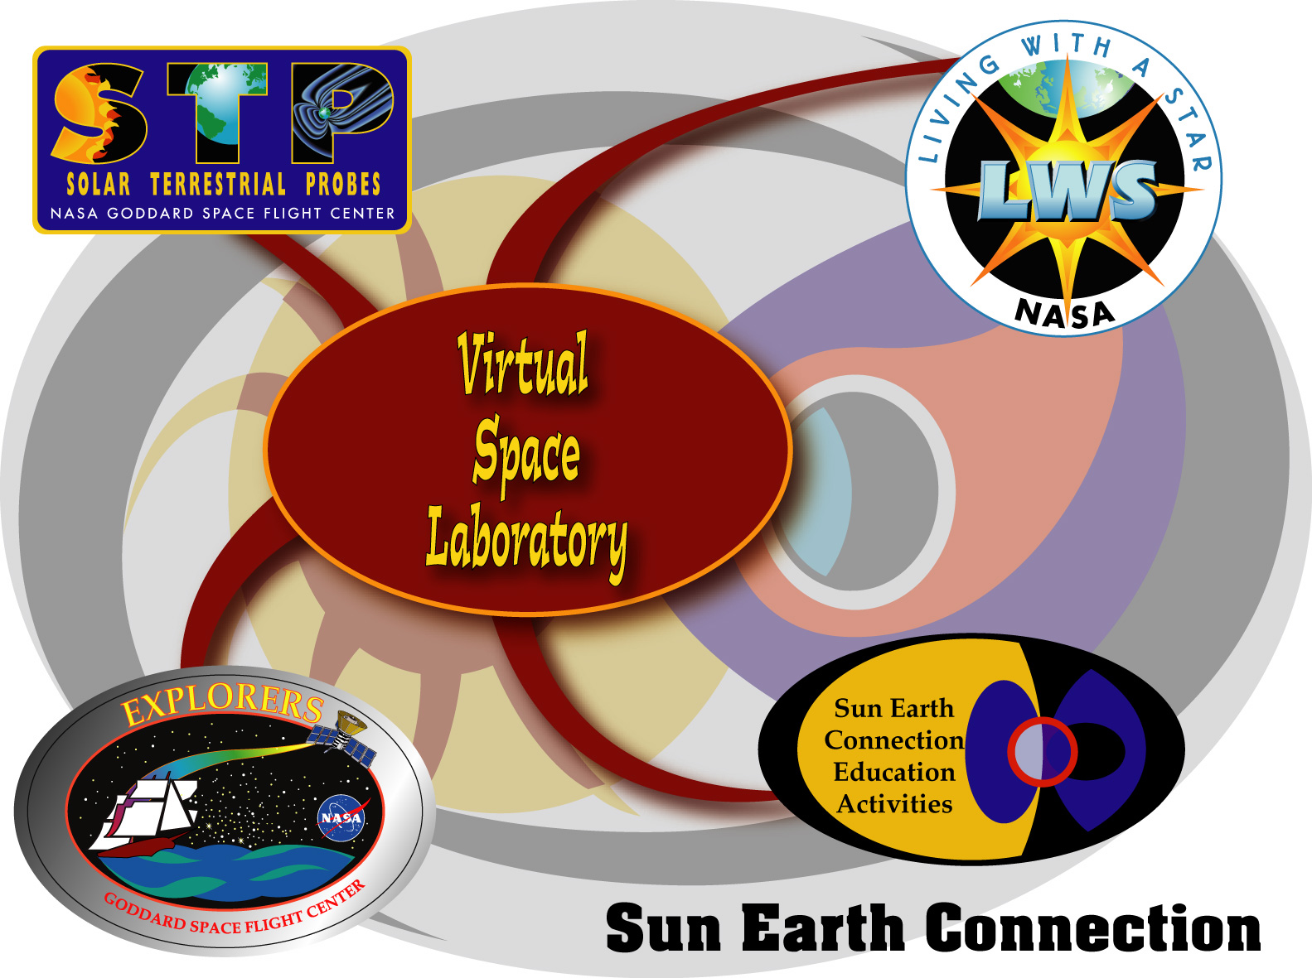
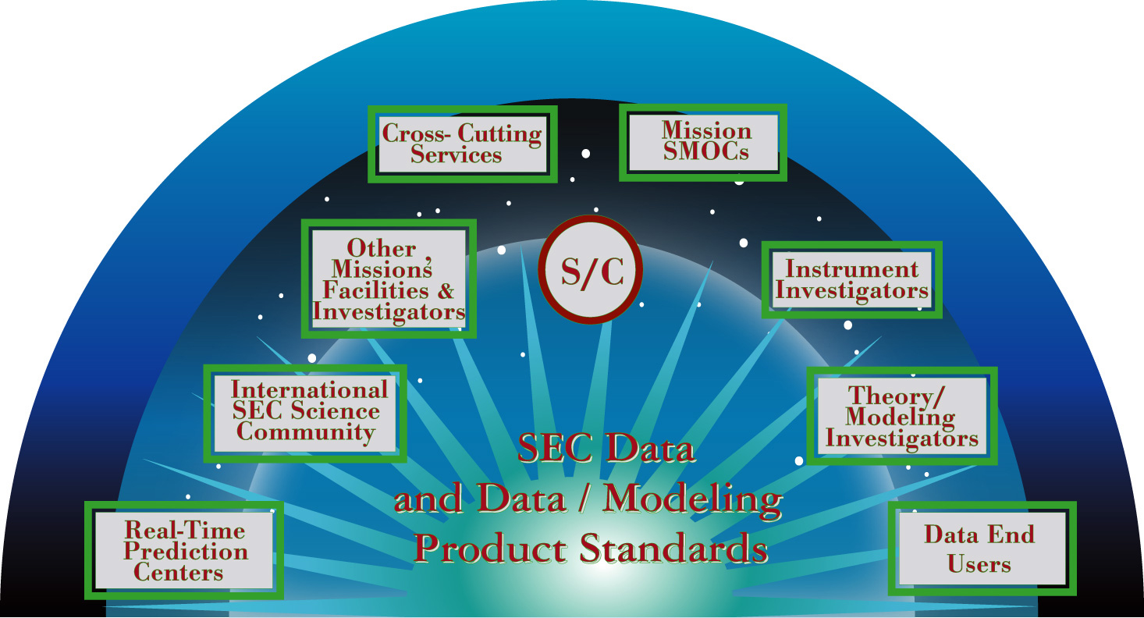
SECAA Services in the Context of VxOs
Virtual Observatory (VO) paradigm for Sun-Space-Geospace research community might be defined as a vision of a future Solar-Terrestrial data environment
  Where data, models and services can be highly distributed
  While end users see an integrated view, and where
  All potentially-useful data are readily findable, accessible, useable
  With appropriate services and across mission-instrument boundaries
VO is similar to the Virtual Space Laboratory concept proposed several years ago as a Roadmap effort
VxO strategy to build the new data environment by leveraging existing capabilities, while those capabilities evolve in turn to talk to the new data environment
  Want a flexible long-term architecture delivering over time the best services at the lowest effective cost
  Technology => hybrid solution with both distributed and centralized service elements whose mix will change

Slide 5
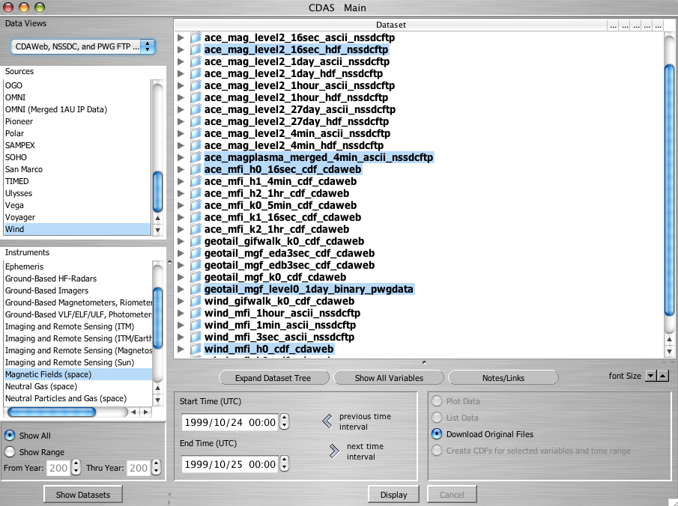
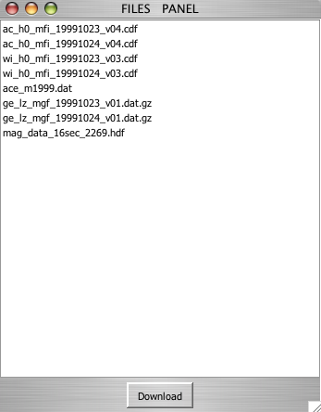
Short-Term Plans
Retain (+build) excellence & utility of what works now
  Must maintain performance and reliability
  Access to more (& higher quality/content) (& distributed) data
  New services (e.g. FTP Data Finder), functions and I/F flexibility
Data, models, and services through multiple paths
  FTP (files+s/w), service user-I/Fs (html, Java), Web Service APIs
Data and capabilities available to early SEC VxOs
  Via Web Services with XML/WSDL-SOAP for communications, URL pointers to result files (data files or service products)
  Exploit these extensions directly (Java-based clients, using WebStart for easy installation e.g. SSCWeb 3D interactive plots)
  Support mapping to evolving SEC data dictionary (SPASE effort)
Enable and partner in the various VxO efforts
  Data format translation and other enabling services
  Data/service "provider" (and “consumer”) to larger VxO environment
  Expect framework and participation will evolve to a range of cooperative and innovative partnerships (e.g. VITMO conversation)
VO concept should be empowering
  Wider range of data with much deeper analysis capabilities
  Wide range of service approaches
    E.g Many interfaces and services evolving over time that are "easy to prove" by attaching to full data environment
  Multi-source data coupled to display, models and analysis,
    Including accessible computing power

Slide 6
Virtual Observatory Technical Questions, Concerns and Personal Observations
Technology is only one part of making the right data fully accessible to the required user community
  Resource and cultural issues must have ongoing attention
  Full data requirements to accomplish a science program (e.g. LWS) needed center-stage early & within effective data policy framework
  Software is only one part (if perhaps the most fun) of the problem
Primary consideration in implementing Virtual Observatories must be effective and adequate service to the end users of the data
  Users need ability to perform a full range of functions
  Users need to be able to accomplish functions quickly
  Users need to be able to perform functions predictably
    What worked yesterday should work today
Software libraries and simple file finding/retrieval can offer high functional (analysis) capabilities
  But software … takes time to install and learn to operate
  May not readily integrate data from different sources
  May have issues with platforms and reliance on commercial s/w
Many users want/need more than simple file finding and retrieval (even with supporting s/w)
  And need functions across mission / dataset boundaries
Higher-functions hard with too much heterogeneity
  Metadata standards vital; data format standards still important

Slide 7
Contact information: mailto:robert.e.mcguire@nasa.gov
Not everything may make sense to distribute
  User “wall-clock”time is the most valuable commodity
    Plus development and maintenance resources of couse
  WAN transfer times are still a design issue
    Often better to store multi-source data at the service host
  Data service architecture with almost all work done at the server end and talking to thin (very basic browser) clients is fairly robust
    Can be made to work almost every time for almost everybody
  ”Duplicated" disk storage is one more tool (and OK if it works)
    Can allow less complex s/w development and maintenance
    Allows work offline preparing diverse data for common service
NASA science research community uses (and will use) many distinct operating systems (and versions), hardware and software platforms
  Complex functionality built on distributed data and smart desktop clients will present cross-platform and maintenance challenges
    E.g. Web services to talk to both Java and .NET clients
    E.g. Testing for client development and support for easy installation across multiple platforms
  E.g. Deployed web services infrastructure may become hard to change or evolve (as technology evolves, as new requirements are identified) as more clients are developed
    We‘re changing our web service I/F but are you able/willing to change your client as we change and evolve over time?
KISS will always be important for effective services, software installation/operation and interfaces
  Critical future science from a diverse research community
  Options for a few “power” users will confuse many “novice” users
    We are ALL novices more times than we might care to admit
  Can there be too much data and too much capability to use?

