Slide 1

Notes:
SPAR Sri Lanka cover slide. Welcome our supplier partners before starting.

Slide 2


Fruit & Vegetable Procurement System: Supplier Training
SPAR SRI LANKA · FRESH PROCUREMENT
Partnering for Fresher Supply
[Your name], SPAR Fresh Procurement · [Training date]
Notes:
About 30 minutes, including a live walk-through and Q&A. Ask every supplier to bring their username (e.g. sup01).

Slide 3
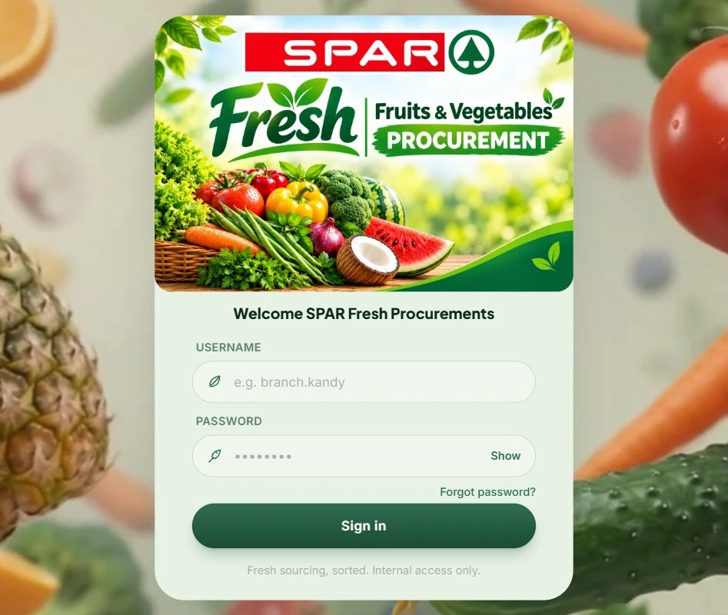



What is this system?
Quote your prices online
Send SPAR your fruit and vegetable prices on price days, from any browser.
See exactly what to deliver
Orders arrive broken down by branch: which item, how much, where.
Agreed prices on record
Price changes, approvals and purchase orders are all saved and signed.
SPAR Sri Lanka · Fresh Procurement · Supplier Training
Notes:
This is the same website SPAR branches use to order. As a supplier you see only your own prices, orders and purchase orders.

Slide 4



Why are we moving to it?
Fixed price days
Prices are sent on Monday, Wednesday and Friday, before one daily cutoff.
Clear orders by branch
No more guessing from calls and messages: every branch's quantity is listed.
Signed, agreed prices
When SPAR adjusts a price, you approve and sign it, so both sides agree.
Everything in one place
Purchase orders, messages and your account details, always up to date.
SPAR Sri Lanka · Fresh Procurement · Supplier Training
Notes:
Focus on what changes for suppliers: predictable price days, clear branch orders and a written record of every agreed price.

Slide 5


Your role as a supplier
Your job: quote your prices on time, confirm any price SPAR adjusts, then deliver each branch's order.
You CAN
You CANNOT
Submit prices on Monday, Wednesday and Friday
Update a price again before the cutoff
See the prices you submitted
Approve or reject prices SPAR adjusts
See your orders by branch and download them
View and print your purchase orders
Message SPAR and update your details
Submit after the cutoff (12:00 PM by default)
Submit on other days of the week
See other suppliers' prices
Change an order or purchase order
Change products, units or the cutoff time
Open Admin or branch screens
One login per supplier (e.g. sup01 for Bloomax). You only ever see your own prices and orders.
SPAR Sri Lanka · Fresh Procurement · Supplier Training
Notes:
If something on an order looks wrong, message SPAR or call the support number. Suppliers cannot edit orders themselves.

Slide 6







Your dashboard at a glance
After you sign in, a short welcome screen opens your Supplier Dashboard. The menu on the left has eight tabs:
Submit Prices
Quote prices for the next cycle
My Submitted Prices
Check what you quoted
Price Approvals
Sign prices SPAR adjusted
Orders by Branch
What each branch needs
Purchase Orders
View and print your POs
Messages
Chat with SPAR
Insert screenshot
Supplier Dashboard with the eight tabs
Supplier Guidelines
The rules, Sinhala and English
Account
Your company details
Benefit: Prices, approvals, orders and purchase orders, all in one place.
SPAR Sri Lanka · Fresh Procurement · Supplier Training
Notes:
Show the live dashboard if you can. Point out the badge on Price Approvals and the bell icon for messages.

Slide 7

Submitting your prices
1
2
3
4
Open Submit Prices
The top line shows the delivery date and today's closing time.
Enter your prices
Type a Rs. price for each item you can supply. Your last price is filled in to start.
Submit Prices
Sends them to SPAR. You'll see "Prices submitted successfully".
Need a change?
Submit again before the cutoff. It updates the price, no duplicates.
Key rule
Monday, Wednesday and Friday only, before 12:00 PM (default). Prices apply to delivery two days later.
Insert screenshot
Submit Prices form with prices entered
Benefit: Quick to fill in, pre-filled with your last prices, and easy to correct before the cutoff.
SPAR Sri Lanka · Fresh Procurement · Supplier Training
Notes:
Demo: enter three prices and submit. Outside price days or after the cutoff, the form shows "Price submission is closed right now". "Clear" only clears the form, not prices already submitted.

Slide 8


When SPAR adjusts your prices
If SPAR negotiates a different price, it sends you a price sheet to approve:
You're notified
Review the sheet
Approve & sign
A banner and a badge on Price Approvals show a sheet waiting for you.
It lists each adjusted item, your price and SPAR's price.
Tick the agreement, type your name, draw your signature, re-enter your password.
Don't agree? Click Reject and give a reason. SPAR will review it and may send a new sheet.
No reply? Respond before the delivery date. If you don't, your own submitted prices apply.
Benefit: Every agreed price is signed and saved, so there are no disputes later.
SPAR Sri Lanka · Fresh Procurement · Supplier Training
Notes:
Your signature, name and the exact prices are saved together as a record of the agreement. 5 wrong passwords lock signing for 15 minutes, the same as login.

Slide 9
Orders by Branch
Once SPAR places an order with you, it appears here: one row per item, one column per branch, with the quantity each branch needs.
Insert screenshot
Orders by Branch table for one delivery date
Pick
a delivery date
Check
each branch's quantity
Download
as Excel
Benefit: Pack and load for each branch straight from the list, with no phone calls to check.
SPAR Sri Lanka · Fresh Procurement · Supplier Training
Notes:
The Excel download matches the screen: items down the side, branches across the top. Many suppliers print it for packing.

Slide 10


Purchase Orders
When SPAR issues you a purchase order, it appears here with the delivery date, the branches, the items and the agreed prices.
Insert screenshot
An opened purchase order, approved by SPAR
Search
the list
Open
a PO
Print
or save as PDF
Benefit: An official, e-signed order for every delivery, ready to print and send with your goods.
SPAR Sri Lanka · Fresh Procurement · Supplier Training
Notes:
Each PO carries SPAR's e-signature stamp. Branches see their own copy and check your delivery against it.

Slide 11
Your account and messages
Account
Keep your supplier name, company number, WhatsApp number and email up to date, then Save.
Messages
Chat with SPAR inside the system. A red badge on the bell shows unread replies.
Insert screenshot
Account details and Messages screens
Supplier Guidelines
SPAR's quality standards and price-day rules, in Sinhala and English.
Benefit: SPAR can always reach you, and every question gets a written answer.
SPAR Sri Lanka · Fresh Procurement · Supplier Training
Notes:
Ask suppliers to check their account details today, especially the WhatsApp number and email.

Slide 12
A price cycle, start to finish
PRICE DAY (MON · WED · FRI)
Submit prices
Before 12:00 PM
SPAR reviews
Compares and may adjust
Orders and POs issued
Orders by Branch, Purchase Orders
Price adjusted?
Approve & sign the sheet
DELIVERY DAY
Pack by branch
Check it against the PO
Deliver to each branch
Two days after the price day
The one time to remember is 12:00 PM on price days.
SPAR Sri Lanka · Fresh Procurement · Supplier Training
Notes:
Walk through one real cycle: Monday's prices, the order and PO, then Wednesday's delivery to each branch.

Slide 13








What's in it for you
Predictable price days
Plan your week around Mon, Wed, Fri
Last prices pre-filled
Only change what moved
Fix a price before cutoff
Resubmit, no duplicates
Signed agreements
No disputes over agreed prices
Orders by branch
Know exactly what goes where
Excel download
Ready for packing lists
Printable POs
Official, e-signed orders
Messages tab
Questions answered in writing
SPAR Sri Lanka · Fresh Procurement · Supplier Training
Notes:
Recap: predictable price days, less admin, signed agreements and clear branch orders.

Slide 14

Getting started: how to log in
1
Open the system in your browser
[insert live URL]
2
Enter your supplier username
e.g. sup01, plus the starting password from SPAR
5
15
3
Choose your own password
Required at first sign-in before you can continue
wrong passwords
minutes locked
Wait it out, or call support.
4
Keep it safe
You also use it to sign price approvals
Benefit: Your own password protects your prices and your signature.
SPAR Sri Lanka · Fresh Procurement · Supplier Training
Notes:
Hand out the starting passwords privately, then have each supplier change it on the spot.

Slide 15


Where to get help
Messages tab
Supplier Guidelines
Support phone
Training materials
Chat with SPAR inside the system. A red badge on the bell shows unread replies.
Quality standards and price-day rules, in Sinhala and English, any time.
076 562 2317
Shown in Supplier Guidelines; SPAR can update it.
This deck and a quick-reference card: [insert link]
SPAR Sri Lanka · Fresh Procurement · Supplier Training
Notes:
Encourage suppliers to use the Messages tab first so questions are in writing; call for anything urgent on a price day.

Slide 16
Questions?
Use the Messages tab any time
Support: 076 562 2317
Notes:
Questions to prepare for:
• "Can I send prices on a Tuesday?" No. Price days are Monday, Wednesday and Friday, before the cutoff.
• "I made a mistake in a price." Submit it again before the cutoff; it replaces the old price.
• "What if I don't sign an adjusted price sheet?" If you don't respond before the delivery date, your own submitted prices apply.
• "Why can't I see an order?" Orders appear once SPAR places them with you.

Slide 17

Notes:
Thank our supplier partners for attending.

