Slide 1
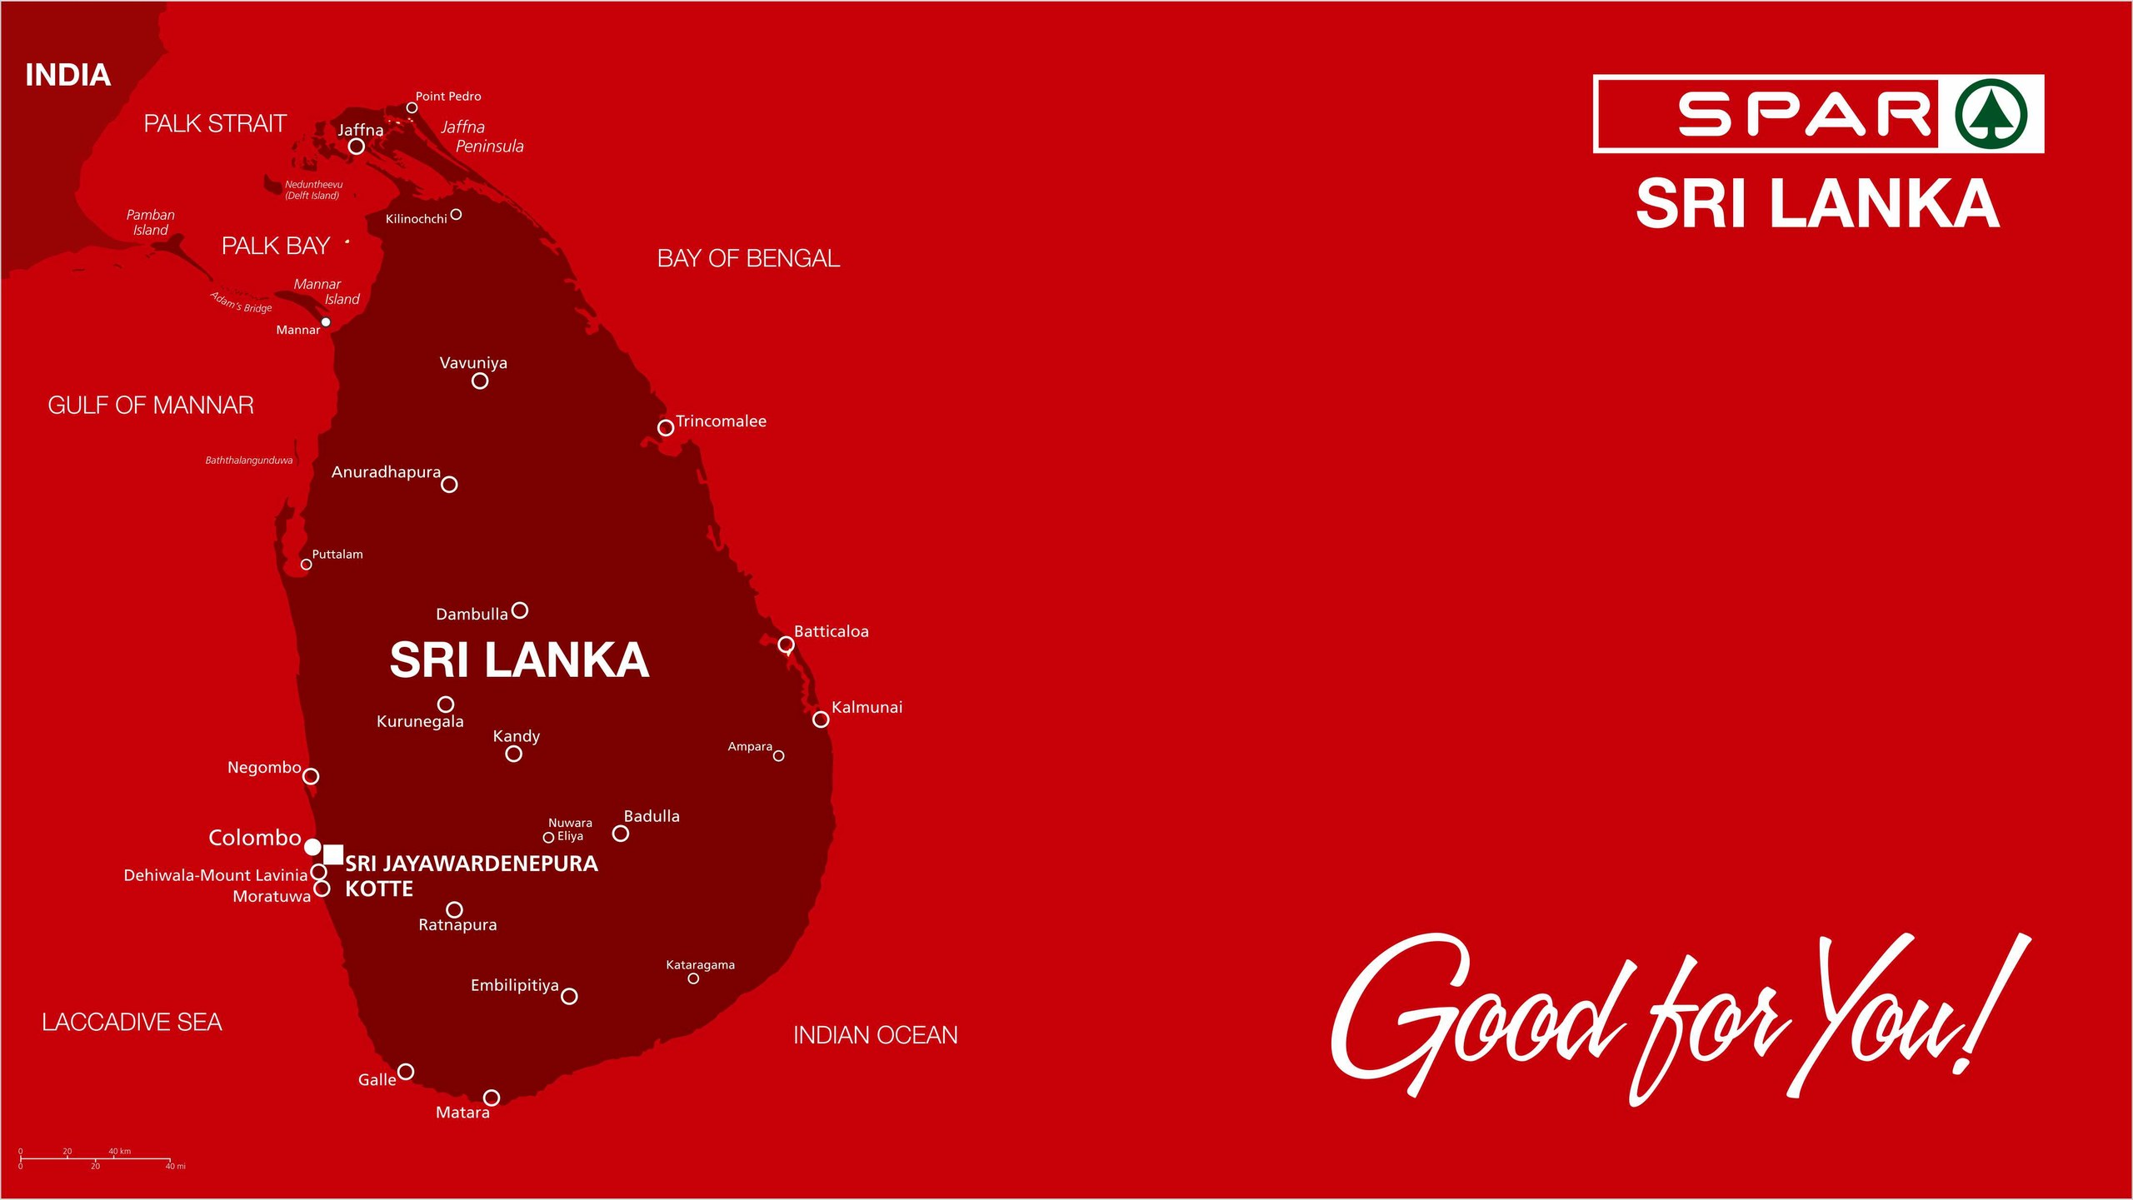
Notes:
SPAR Sri Lanka cover slide. Welcome everyone before starting.

Slide 2


Fruit & Vegetable Procurement System: Branch User Training
SPAR SRI LANKA · FRESH PROCUREMENT
Streamlining Your Procurement Process
[Your name], SPAR Fresh Procurement · [Training date]
Notes:
About 30 minutes, including a live walk-through and Q&A. Ask everyone to bring their branch username.

Slide 3
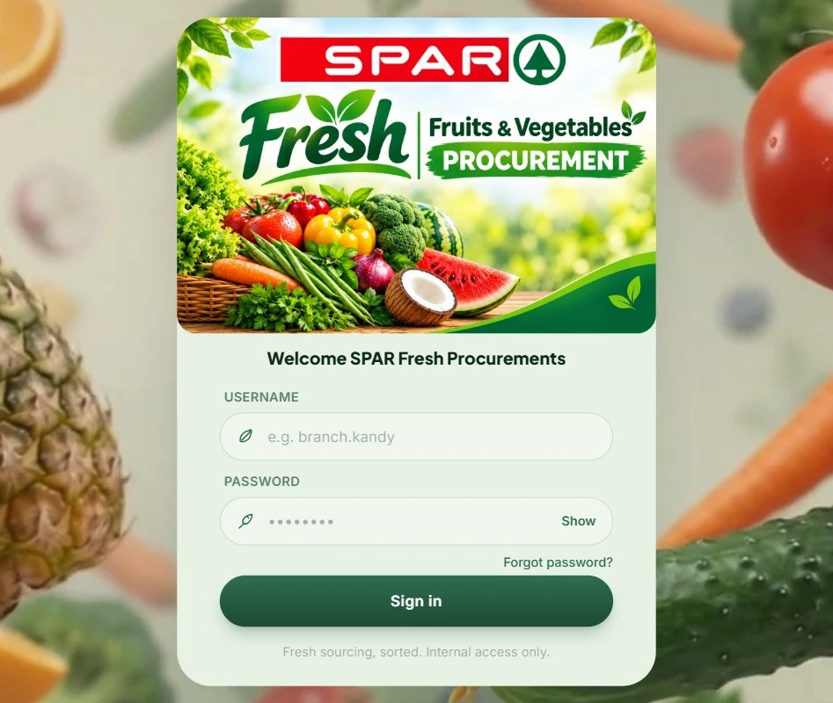



What is this system?
Order online, every day
Your branch orders fresh fruit and vegetables from SPAR Fresh Procurement here.
One shared order list
Replaces phone calls, WhatsApp messages and paper order sheets.
Works in any web browser
On a computer, tablet or phone. Nothing to install.
SPAR Sri Lanka · Fresh Procurement · Branch User Training
Notes:
This is the website your branch uses to order fresh produce from SPAR Fresh Procurement each day. It replaces calls, WhatsApp and paper sheets with one shared order list, and runs in any browser.

Slide 4




Why are we moving to it?
One clear deadline
Every branch orders the same way, before the same daily cutoff.
No lost orders
Every order is saved, dated and visible to you and to head office.
Never miss a delivery
Forget to order? The system places one for you, based on an earlier week.
Proof of what arrived
You record what was actually delivered, so shortages are on record.
SPAR Sri Lanka · Fresh Procurement · Branch User Training
Notes:
Focus on what changes for the branch: one deadline, nothing lost, an automatic safety net, and a record of every delivery.

Slide 5


Your role as a branch user
Your job: tell head office what your branch needs for tomorrow, then confirm what actually arrived.
You CAN
You CANNOT
Place one order per day for next-day delivery
Save an order as a draft and finish it later
See your past orders and their status
Confirm what was delivered, with notes
View purchase orders issued for your branch
Set your branch's safety stock levels
Message head office
Order after the daily cutoff (2:00 PM by default)
Change an order once it is submitted
Choose or contact suppliers
See supplier prices or other branches' orders
Open Admin screens, even by typing the address
Change products, prices or the cutoff time
One login per branch, shared by the branch team (e.g. br01 for Kurunegala). You only ever see your own branch.
SPAR Sri Lanka · Fresh Procurement · Branch User Training
Notes:
Need a change after submitting? Message head office or call the support number. They can add items to your order. Added items show as "Ordered by SPAR Fresh Procurement".

Slide 6
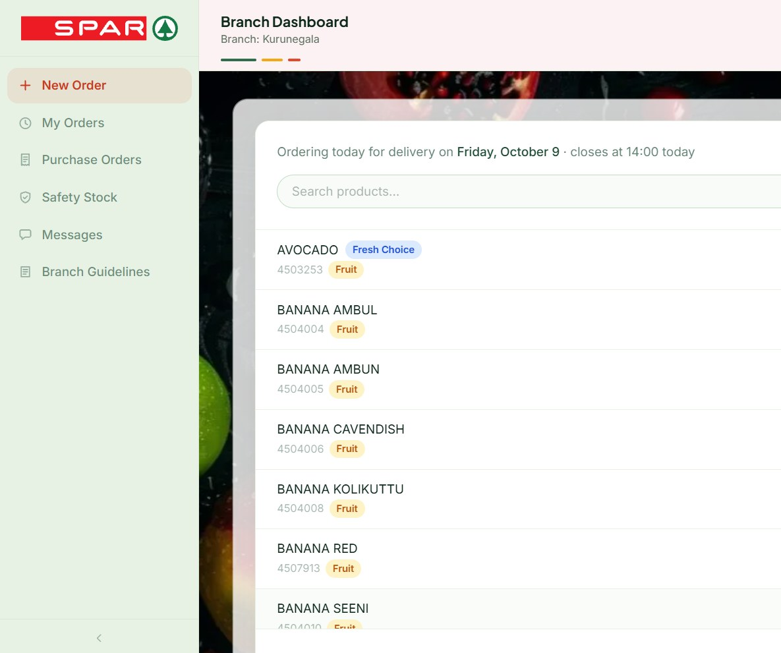







Your dashboard at a glance
After you sign in, a short welcome screen opens your Branch Dashboard. The menu on the left has six tabs:
New Order
Place tomorrow's order
My Orders
Track orders, confirm deliveries
Purchase Orders
What was ordered for your branch
Safety Stock
Set your minimum stock levels
Messages
Chat with head office
Branch Guidelines
The rules, in Sinhala and English
Benefit: Everything for your branch is in one place, with no paperwork.
SPAR Sri Lanka · Fresh Procurement · Branch User Training
Notes:
Show the live dashboard if you can. Point out the bell icon: it shows unread messages from head office.

Slide 7
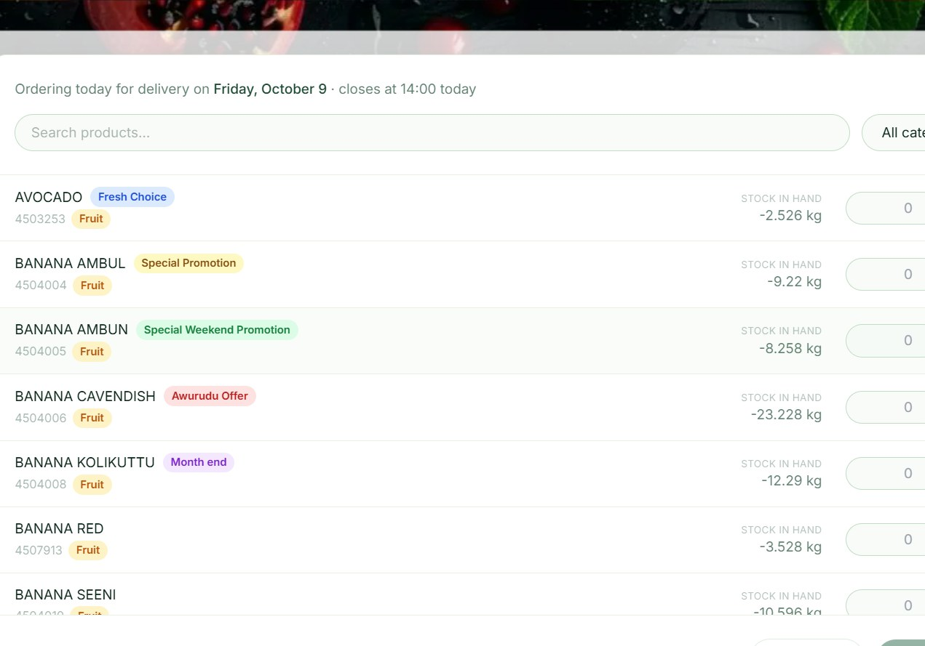




Viewing products and stock in hand
Every item you can order
with its code, category and unit (kg, pcs)
Search and filter
by name, or by category
Stock in Hand
your current stock, from your till (POS) system; "—" if unavailable
Promotion badges
mark items on promotion; hover a name to see its photo
Benefit: See what you already have before you order: less over-ordering, less waste.
SPAR Sri Lanka · Fresh Procurement · Branch User Training
Notes:
The New Order tab lists every fruit and vegetable you can order. Stock in Hand comes from your till system and is for reference only.

Slide 8
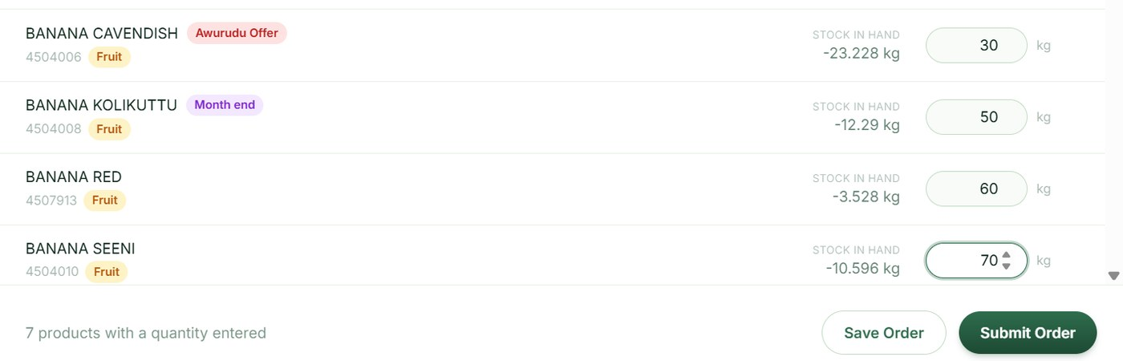

Placing a new order
1
2
3
4
Open New Order
The top line shows the delivery date (always tomorrow) and today's closing time.
Enter quantities
Type a quantity next to each item you need. Leave the rest empty.
Save Order
Keeps a draft you can come back to and still change.
Submit Order
Sends it when final. The order then locks and cannot be changed.
Key rule
One order per branch per day, submitted before the cutoff (2:00 PM by default). After it, the form shows "Ordering is closed for today".
Benefit: Quick to fill in, save and finish later, and clear confirmation when it's sent.
SPAR Sri Lanka · Fresh Procurement · Branch User Training
Notes:
Demo: enter two quantities, Save Order, then Submit Order. Point out that the order is read-only afterwards.

Slide 9



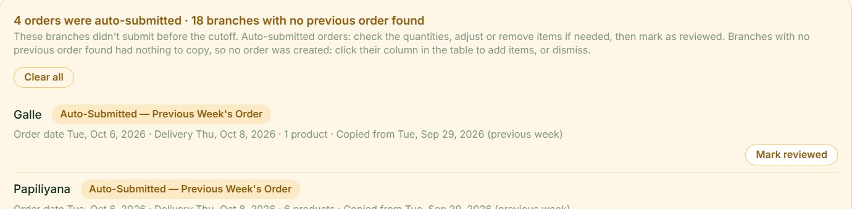
Missed the cutoff? Automatic orders
If nothing is submitted by the cutoff, the system places an order for you:
Saved a draft?
No draft?
Nothing found?
Your draft is submitted.
Copies your order from the same weekday last week. None? It tries 2, 3 … up to 8 weeks back.
No order is placed, and head office is alerted.
How to spot one: auto-placed orders are labelled "Submitted automatically" and say where they came from.
Benefit: Shelves are never left empty on a busy day. Still, order on time: a copy may not fit this week.
SPAR Sri Lanka · Fresh Procurement · Branch User Training
Notes:
Stress that this is a safety net, not the plan. A copied order may not match this week's needs.

Slide 10
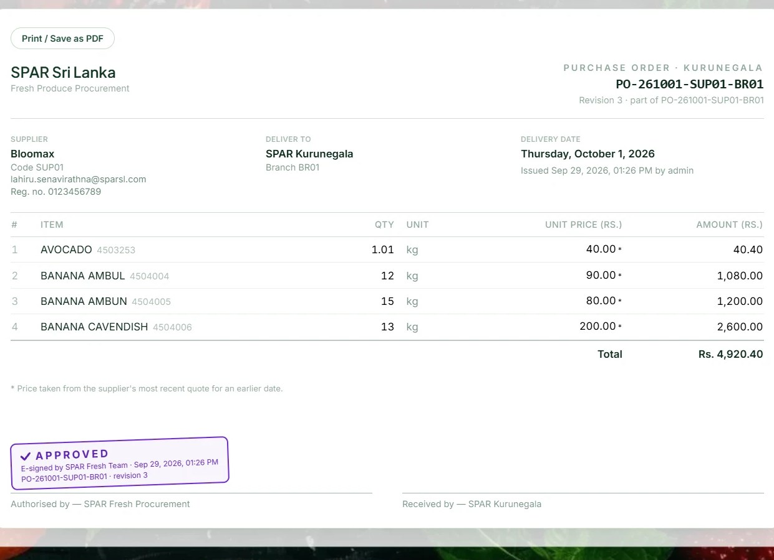


Purchase Orders
When head office issues a purchase order to a supplier for your branch, it appears here, with the supplier, the delivery date and the items.
Search
the list
Open
a PO
Print
or save as PDF
Benefit: You know exactly which supplier is bringing what, so you can check the delivery at the door.
SPAR Sri Lanka · Fresh Procurement · Branch User Training
Notes:
Suggest printing the day's PO and keeping it at the receiving door.

Slide 11
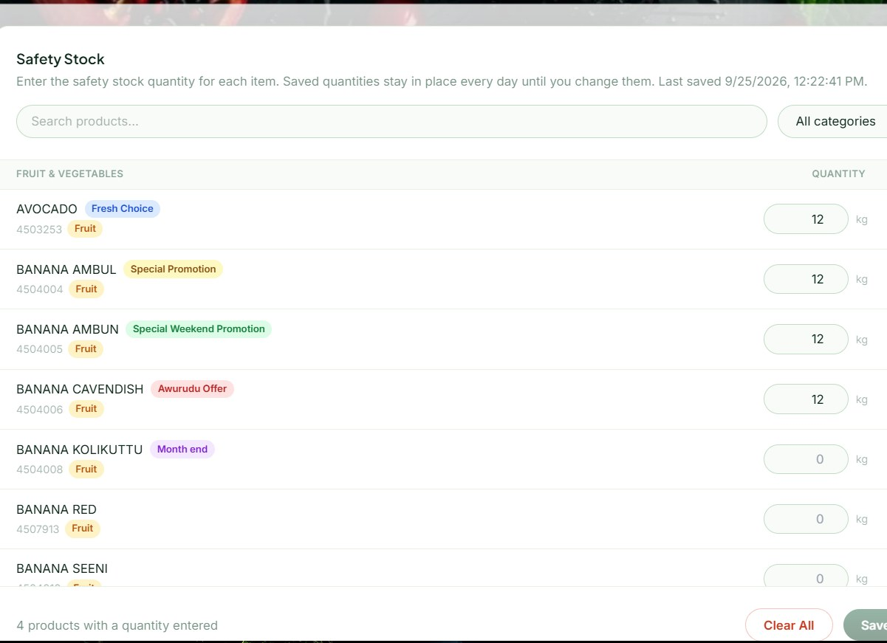


Safety Stock
Set once. Stays until you change it.
Enter the minimum quantity of each item your branch should always have.
Enter a minimum per item
Save levels stay day after day
Clear all removes every level
Benefit: Head office can see your minimum needs and plan supply around them.
SPAR Sri Lanka · Fresh Procurement · Branch User Training
Notes:
Unlike an order, safety stock is not per day. It stays saved until the branch edits or clears it.

Slide 12
A day in the life of a branch order
TODAY (ORDER DAY)
Check stock, save draft
New Order tab
Submit by 2:00 PM
Order locks: SUBMITTED
Head office assigns
Status becomes ASSIGNED
Missed 2:00 PM?
Auto-order: draft or past week
supplier delivers next day
TOMORROW (DELIVERY DAY)
Delivery arrives
Check it against the PO
Confirm Delivery
Status becomes CONFIRMED
The one time to remember is 2:00 PM. The dashed box is the safety net, not the plan.
SPAR Sri Lanka · Fresh Procurement · Branch User Training
Notes:
Walk through one real order from yesterday, from draft to confirmed.

Slide 13







What's in it for your branch
Order online in minutes
No calls, messages or paper to chase
Stock in hand while ordering
Order what you need, waste less
Save a draft, submit later
Order around your busy hours
Automatic order if you miss it
Shelves are never left empty
Live order status
Know where it is without phoning
Record what arrived
Shortages are on record and followed up
Printable purchase orders
Check deliveries at the door
Messages tab
Questions go to head office, in writing
SPAR Sri Lanka · Fresh Procurement · Branch User Training
Notes:
Recap: the system saves time, reduces waste, protects against missed orders and puts every delivery on record.

Slide 14

Getting started: how to log in
1
Open the system in your browser
[insert live URL]
2
Enter your branch username
e.g. br01, plus the starting password from head office
5
15
3
Choose your own password
Required at first sign-in before you can continue
wrong passwords
minutes locked
Wait it out, or call support.
4
Keep it within your team
Share it only with your branch team
Benefit: Your own password keeps your branch's orders safe.
SPAR Sri Lanka · Fresh Procurement · Branch User Training
Notes:
Hand out the starting passwords on paper at the session, then have each branch change it on the spot.

Slide 15


Where to get help
Messages tab
Branch Guidelines
Support phone
Training materials
Chat with head office inside the system. A red badge on the bell shows unread replies.
The ordering rules, in Sinhala and English, available any time.
076 562 2317
Shown in Branch Guidelines; head office can update it.
This deck and a quick-reference card: [insert link]
SPAR Sri Lanka · Fresh Procurement · Branch User Training
Notes:
Encourage branches to use the Messages tab first so questions are in writing; call for anything urgent.

Slide 16
Questions?
Use the Messages tab any time
Support: 076 562 2317
Notes:
Questions to prepare for:
• "I submitted the wrong quantity. Can I fix it?" No, a submitted order is locked. Message or call head office straight away.
• "What if the delivery is short?" Enter the real quantity in Confirm Delivery and add a note.
• "Can I order for the day after tomorrow?" No. Orders are always for next-day delivery.

Slide 17

Notes:
Thank everyone for attending.

