Slide 1
NON-FUNGABLE DOCUMENT TOKEN
DOCUMENT PRODUCTION AND CONFIRMATION
WAHAP3

Slide 2
AIMS
To reduce confirmation process and production cost.
To prevent forgery and fraud.
To reduce to liability to a third person during confirmation process .
To make the documents unchangeable and add them immediately to the blockchain.
To view all documents from an only source.
To provide for the target audience.
WAHAP3

Slide 3
01
02
03
PROBLEM
PROCESS
HOW IT WORKS
Nowadays, false document editing is a major problem.
A 3 step verification process is developed to control the safety of the edited files.
The publishers are storing the files they signed by their public key in the inalterable blokchain web.

Slide 4
HOW IT WORKS
Zincirde Depolanacak Olan Veriler
Step 1: Confirmation of the existence of the document.
4 Data’s Unique Hash
Validation Data
Content Data’s Hash
When the document is published, the unique document number is determined by hashing 4 different data and this number is stored in the blockchain. Then, in the confirmation process, the stored in blockchain document number and the number that is requested number from the user are compared if there is a match..
The 4 Data:
SSN
The Public Key of the creator of document
The date the document is sent
Document name
WAHAP3

Slide 5
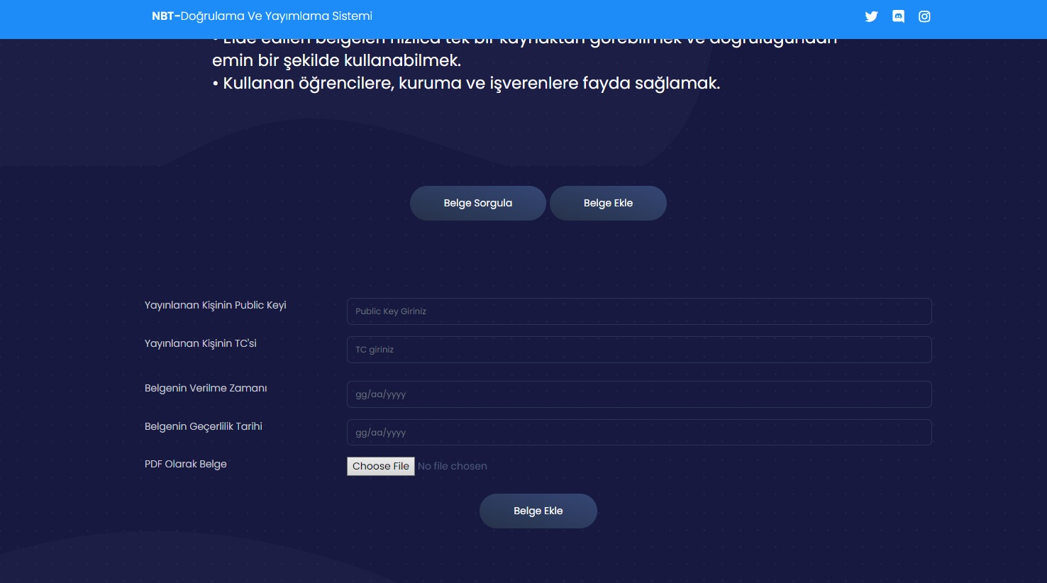
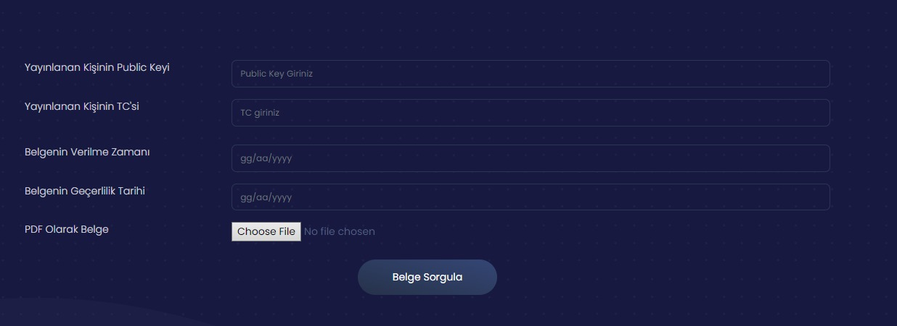
WAHAP3

Slide 6
HOW IT WORKS
Step 2: Verify the Validity of the Documents
The validation date and cancellation status of a document is verified by the document number obtained in the first stage. With this data that is stored in the blockchain web, it is checked if the document is still valid.
WAHAP3

Slide 7
HOW IT WORKS
Step 3: Verify The Content of The Document
Whilst the files that are formatted PDF,JPG etc. are saved, the content will be hashed and encrypted by the public key of the document’s owner.
WAHAP3

Slide 8
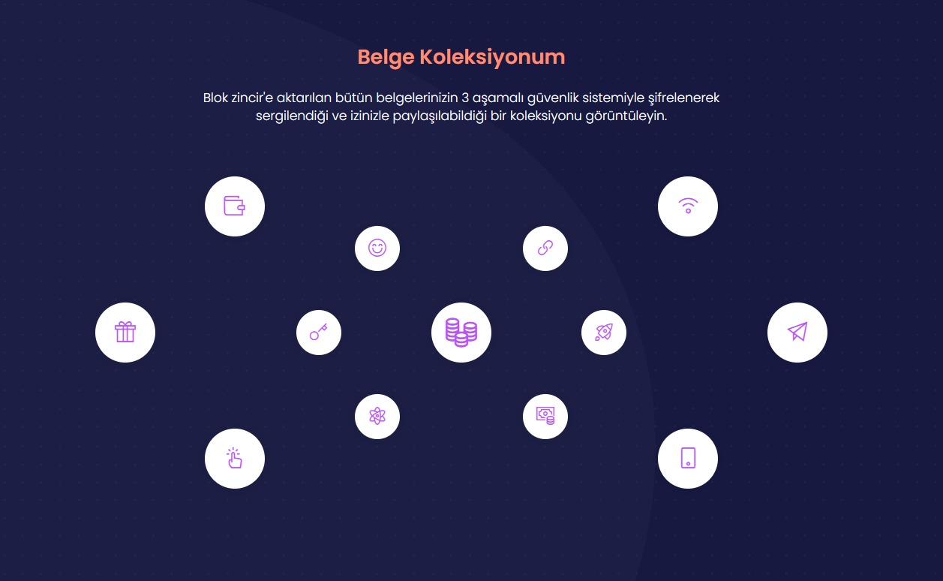

Slide 9
Genel Değerlendirme
A
D
O
C
Advantages
Disadvantages
Opportunties
Challanges
The data published on Blockchain cannot be altered and can be confirmed fast.
Public addresses must be verified and the corporations and the wallet id must be matched.
The Blockchain technology is not yet fully accepted by the majority,thus, it does not meet all the standards.
It is a relaible and an adaptive system for production and verification of all types of documents.
WAHAP3

Slide 10
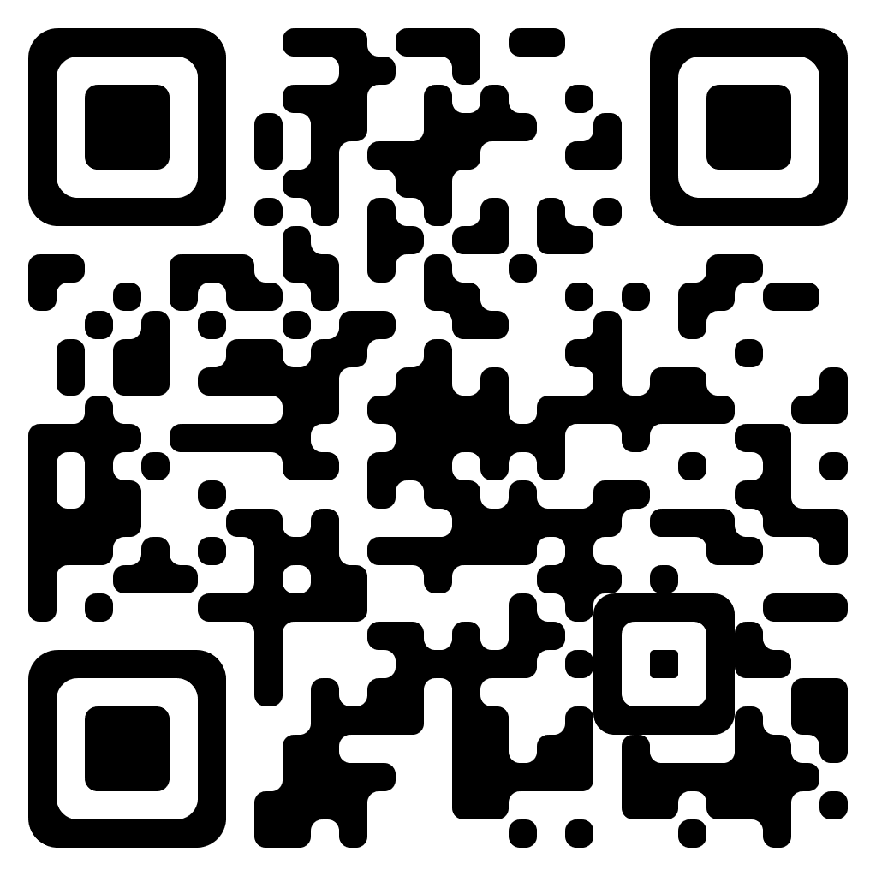
Thank you
linktr.ee/tobbetublockchain
WAHAP3

