Slide 1
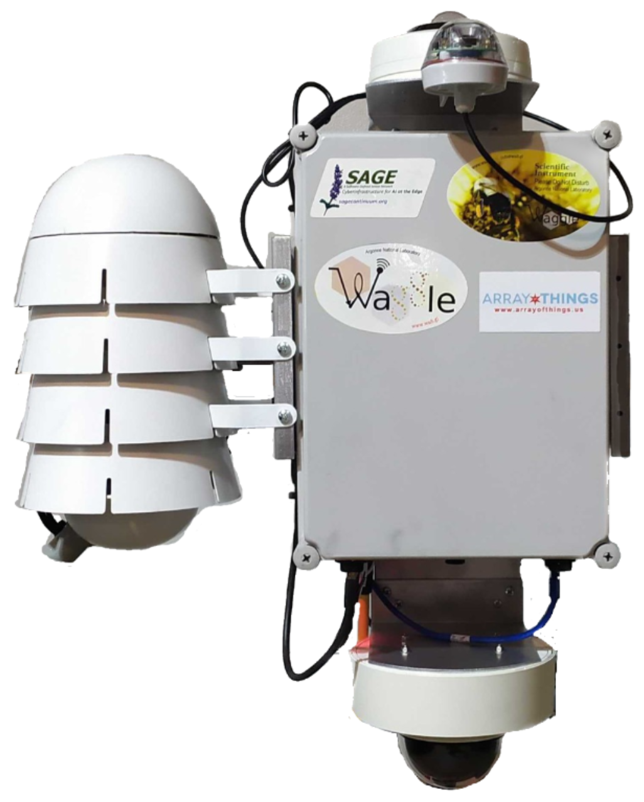
Optical Rain Sensor (HYDREON RG-15)
POE Camera (HANWHA XNV-8080R)
POE Sensor Stevenson Shield
Additional Sensors Mounting Location
Relative humidity, barometric pressure, ambient temperature sensor (BOSCH BME680)
NVIDIA Xavier NX GPU, power, wireless communication (4G/5G/WiFi) and management.
Microphone (ETS ML1-WS)
POE and USB ports for Sensors (additional expansion ports)
110/230V AC Power and Ethernet
POE Camera (HANWHA TEC XNV-8081Z)

