Slide 1

SYD_DAT_6 Presentation
Harry Peppitt

Slide 2
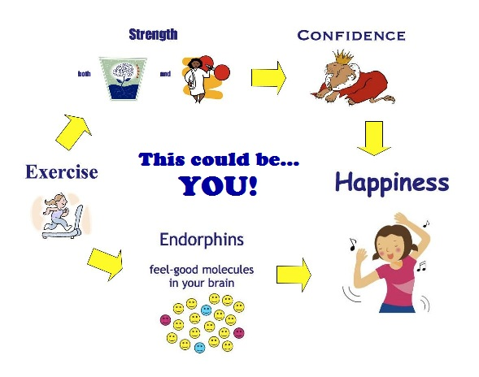
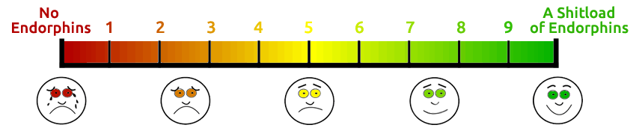
I like to exercise, it makes me feel good…

Slide 3
IDEA #1
I wanted to do an analysis of the effect of exercise on happiness.
Two problems:
Lack of extensive publicly available ‘exercise data’ & results (health improvements)
How to measure happiness in the same dataset
Essentially, big companies like FitBit and Apple would have this data, I don’t, then measuring the ‘happiness’ of that particular dataset would also be complicated – scratch that idea.

Slide 4
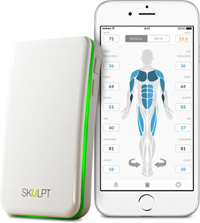
IDEA #2
I could create my own data!
Two more problems:
I needed to be consistent with readings and measurements
I had to be consistent with my exercise (which I’m not…)
The potential dataset would then be:
1 reading per day x 10 weeks –
~3 weeks for disorganisation =
49 – 70 values for each muscle group

Slide 5


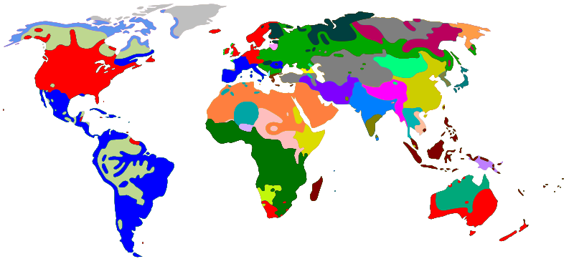
IDEA #3
What if I could look at the relationship between health and happiness on a global scale?

Slide 6
ASSUMPTIONS
#Not at all correct in code or colour
def Country(happiness) :
if Country = Healthy:
print “Happy”
else:
if Country != Healthy:
print “Not Happy”

Slide 7

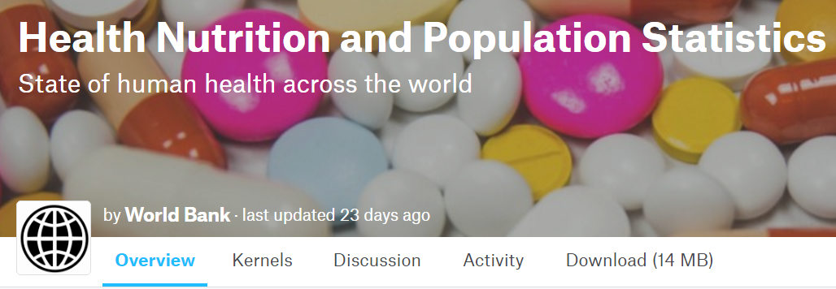
THE DATA
The World Happiness Report
http://worldhappiness.report/
World Bank Open Data
http://data.worldbank.org/
Kaggle – World Bank Data
https://www.kaggle.com/theworldbank/health-nutrition-and-population-statistics

Slide 8
THE GOAL
An interactive data map visualisation

Slide 9
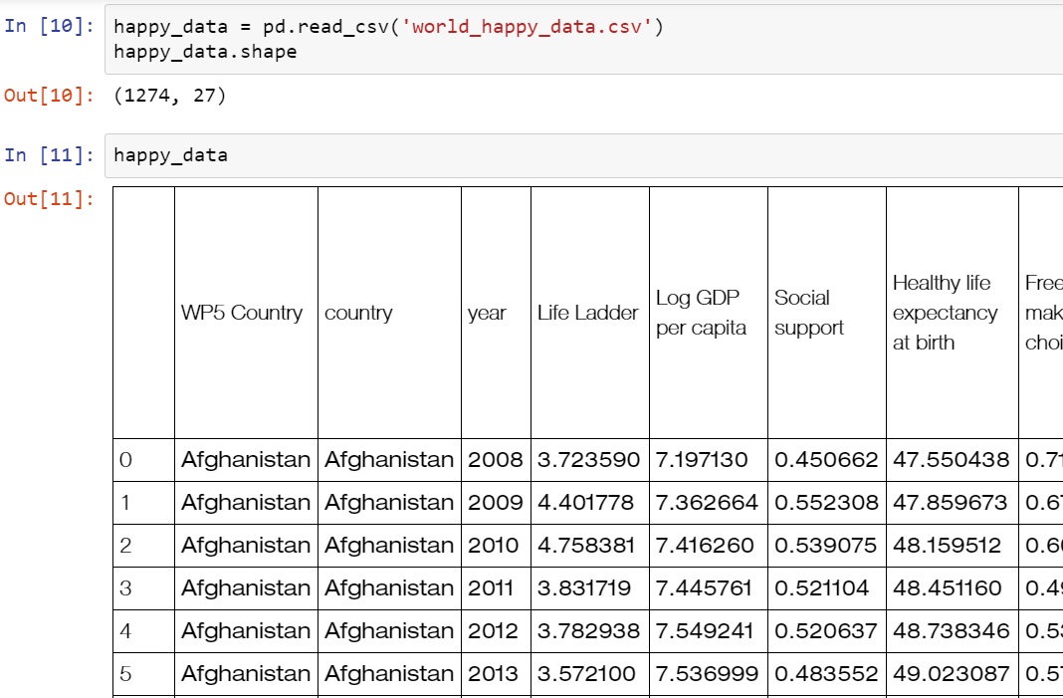
Basic Science
Raw Data:
157 countries
2008 – 2014
24 different data points (columns)
1274 different values for each (rows)

Slide 10
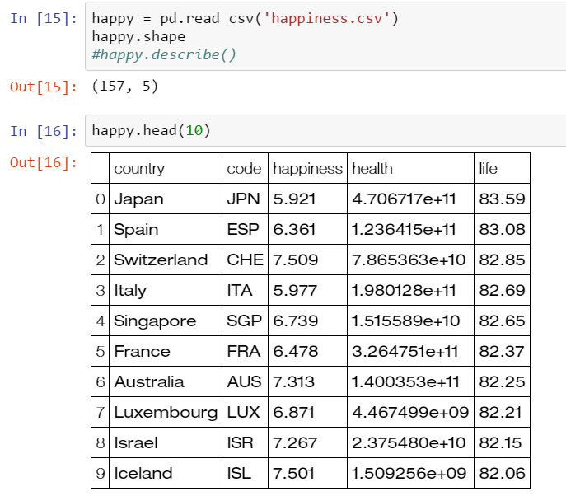
Basic Science
Cleaned Data:
157 countries
2014 data
3 different data points (columns)
Happiness Index (From Report)
Healthcare Expenditure
Life Expectancy
157 different values for each (rows)

Slide 11
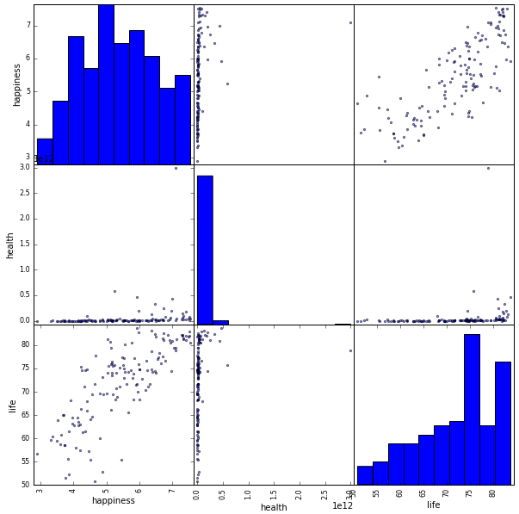
INITIAL OBSERVATIONS
Positive correlation between life expectancy of a country and the happiness index
Health expenditure data isn’t too useful in this context
Could possibly fit a linear regression model to predict happiness of a country based on life expectancy.

Slide 12
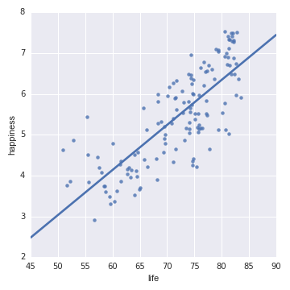
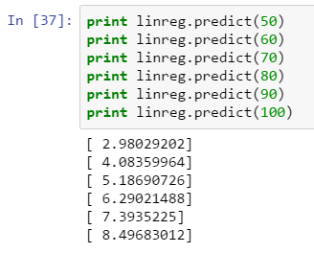
REGRESSION
Fit a linear regression model
Not particularly useful, more just for relationship demonstration.

Slide 13
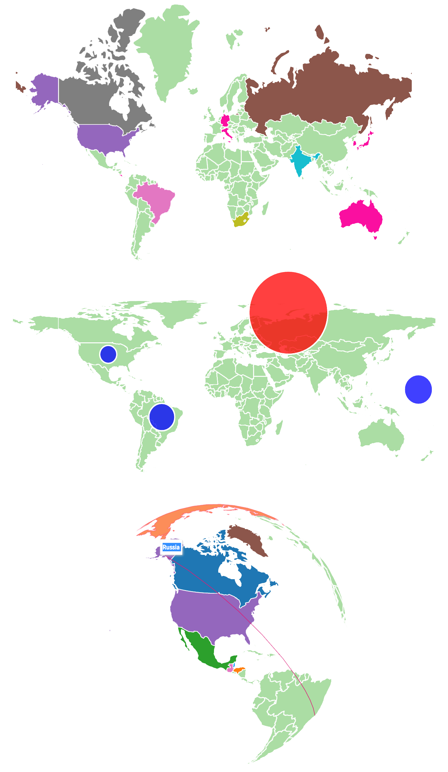
VISUALISATION
Datamaps:
Customizable SVG map visualizations for the web in a single Javascript file using D3.js
https://datamaps.github.io/
Has some cool map choices
Fully customizable
Hover over values
Easy code
Looks nice
Open source

Slide 14
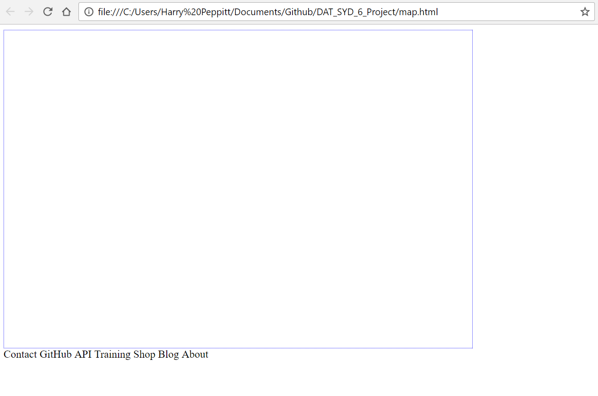
UNFORTUNATELY…
I couldn’t work it out. This is my map:

Slide 15
A SHOCKING REALISATION
My housemate has been raving about Power BI, Microsoft’s data visualisation tool, so I downloaded the desktop version, dumped all the data in with no cleaning, and in 10 minutes…

Slide 16
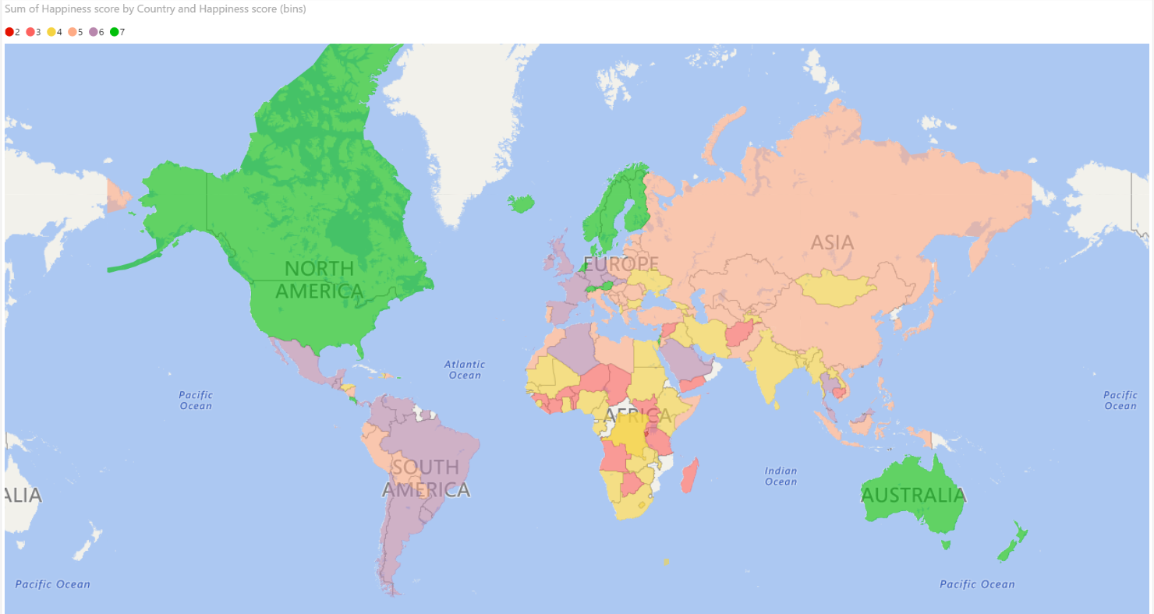
A BEAUTIFUL MAP VISUALISATION

Slide 17
LEARNINGS AND NEXT STEPS
LEARNINGS
Map visualisations are fun, but lots of work
My D3 Javascript knowledge could use some work…
There are more and more tools like Tableau and Power BI which saves all the manual work for visualisation and even some scripting – they’re worth exploring.
NEXT STEPS
Look into D3.js some more and get the map working and online.
Factor in some more variables from the raw data sets, and explore relationships
A more detailed analysis could be done, but for the purposes of this project, I wanted to focus on geo-visualisation.

Slide 18

THANKS
Thanks for all your hard work and support Alasdair and Louis!

