Slide 1
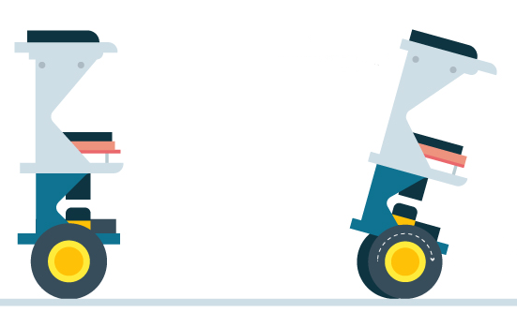
Self Balancing Robot COEN 6711
Project proposal submitted by
Horia Petre (26035035)
Md Shafayet Sajid (40075368)
Diego Mayorga (40075927)
September 21, 2018

Slide 2
Overview
Goal Statement
Functional Specification
Preliminary Component List
Schedule & Tasks

Slide 3
Goal Statement
Project objective is to design and build a machine that can balance itself on two wheels
Machine will counteract any reasonable forces that try to disturb it from its vertical balance
Robot will move until it encounters an obstacle
Use ARM Cortex M0+ microcontroller

Slide 4
Functional Specification
ARM Cortex M0+
Balance module
Obstacle dection module
Motor Drive module
Obstacle
Sensors
Internal to ARM
External to ARM
Wheel Motors
Body Physics
Battery

Slide 5
System modules
Balance module
Monitors and corrects the vertical balance of the robot.
Sends commands to the Motor Drive module.
Runs on the FRDM KL25Z.
Obstacle detection module
Checks for obstacles in the robot’s path.
Sends commands to the Motor Drive module to stop moving the robot.
Runs on the FRDM KL25Z.

Slide 6
System modules
Motor Drive module
receives commands from all other modules
maintains a specific speed
sends commands to the wheel motors
Runs on the FRDM KL25Z.

Slide 7
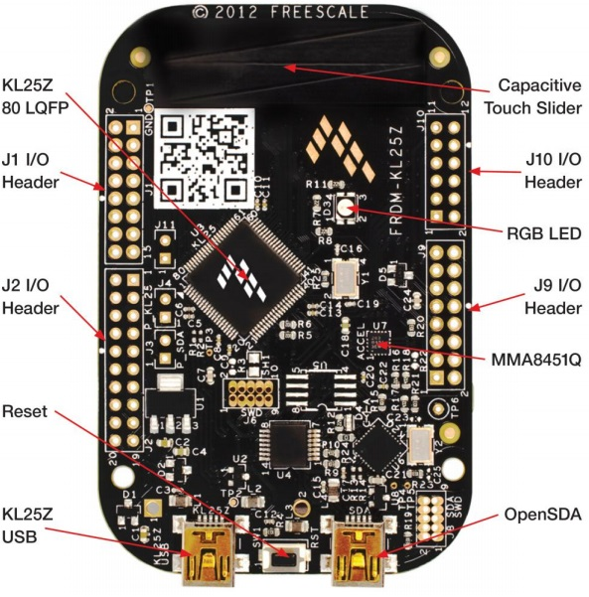
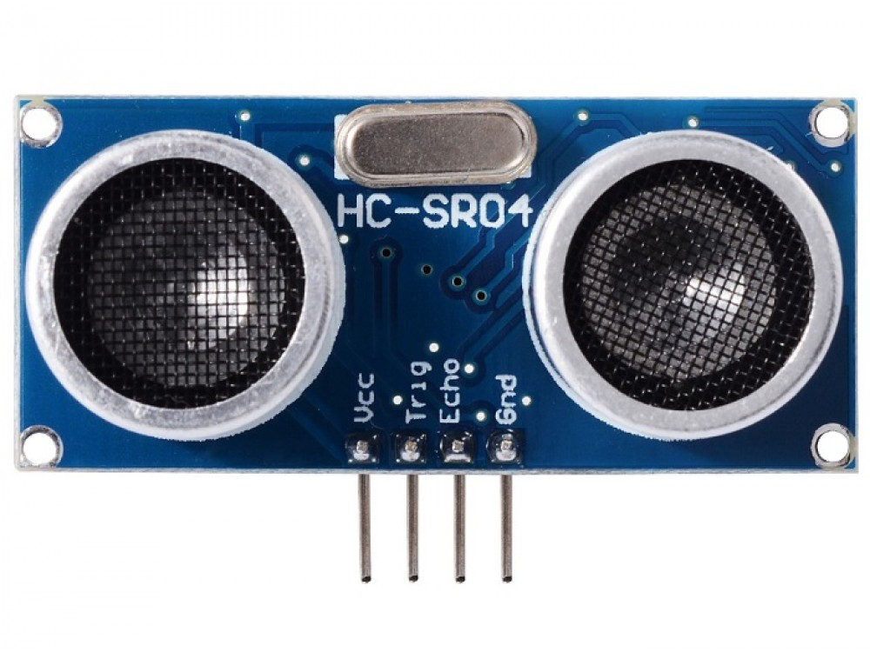
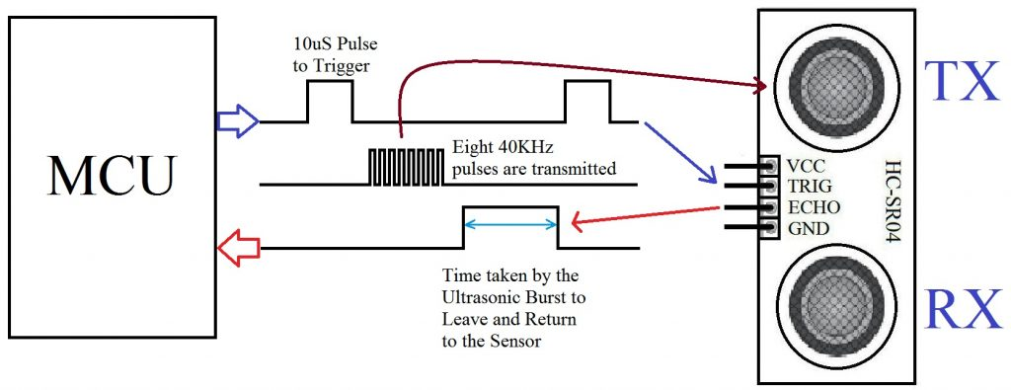
Key Components:
Picture: Ultrasonic Sensor (HC-SR04)
Picture: MCU (FRDM-KL25Z - ARM CORTEX M0+)

Slide 8
Preliminary component list & price
Component | Quantity | Price (CAD)
FRDM-KL25Z board | 1 | 24
Ultrasonic sensor hc-sr04 | 1 | 4
Motor driver | 1 | 4
Self Balancing robot kit | 1 | 40
Battery | 1 | 30
TOTAL: 102

Slide 9
Schedule & Tasks

