Slide 1
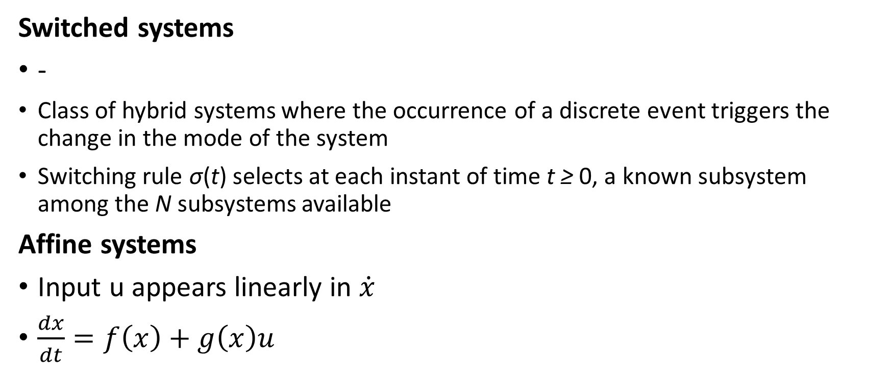
Local Stabilization of Switched Affine Systems Preliminaries
Switched systems
-
Class of hybrid systems where the occurrence of a discrete event triggers the change in the mode of the system
Switching rule σ(t) selects at each instant of time t ≥ 0, a known subsystem among the N subsystems available
Affine systems
Input u appears linearly in $\dot{x}$
$\frac{dx}{dt}=f\left(x\right)+g\left(x\right)u$

Slide 2

Local Stabilization of Switched Affine Systems Preliminaries
Set-Valued Maps
Mapping that associates sets to points
Caratheodory Solutions
Involve analysis of vector fields at specific points in space
Filippov Solutions
Involve analysis of the vector field around each point in space

Slide 3
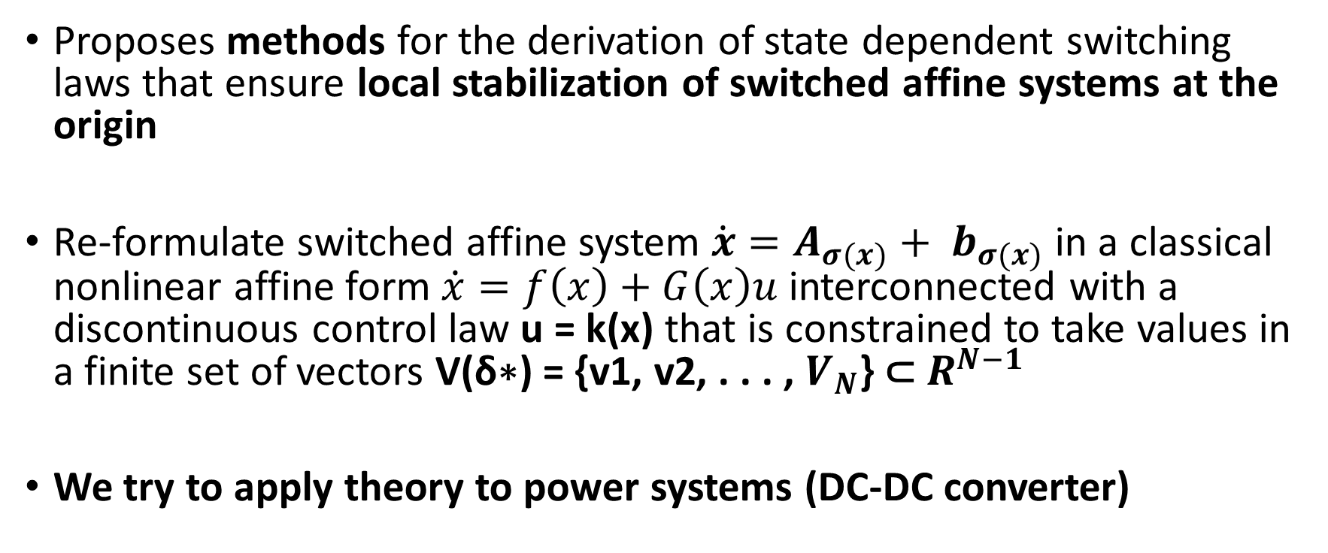
Local Stabilization of Switched Affine Systems Laurentiu Hetel and Emmanuel Bernuau - Introduction
Proposes methods for the derivation of state dependent switching laws that ensure local stabilization of switched affine systems at the origin
Re-formulate switched affine system $\dot{x}=A_{σ(x)}+ b_{σ(x)}$in a classical nonlinear affine form $\dot{x}=f\left(x\right)+G\left(x\right)u$ interconnected with a discontinuous control law u = k(x) that is constrained to take values in a finite set of vectors V(δ∗) = {v1, v2, . . . , $V_{N}$} ⊂ $R^{N−1}$
We try to apply theory to power systems (DC-DC converter)

Slide 4
Local Stabilization of Switched Affine Systems Literature review
Stabilization of switched affine systems: An application to the buck-boost converter (Corona, Buisson, Schutter and Giua)
Switched Affine Systems Control Design with Application to DC DC Converters (Deaecto, Geromel, Garcia and Pomilio)
On Control Design of Switched Affine Systems with Application to DC-DC Converters (Mainardi Junior, Teixeira, Cardim, Moreira, Assunacao and Yoshimura)
Global Stabilization of power systems by designing switching law

