Slide 1
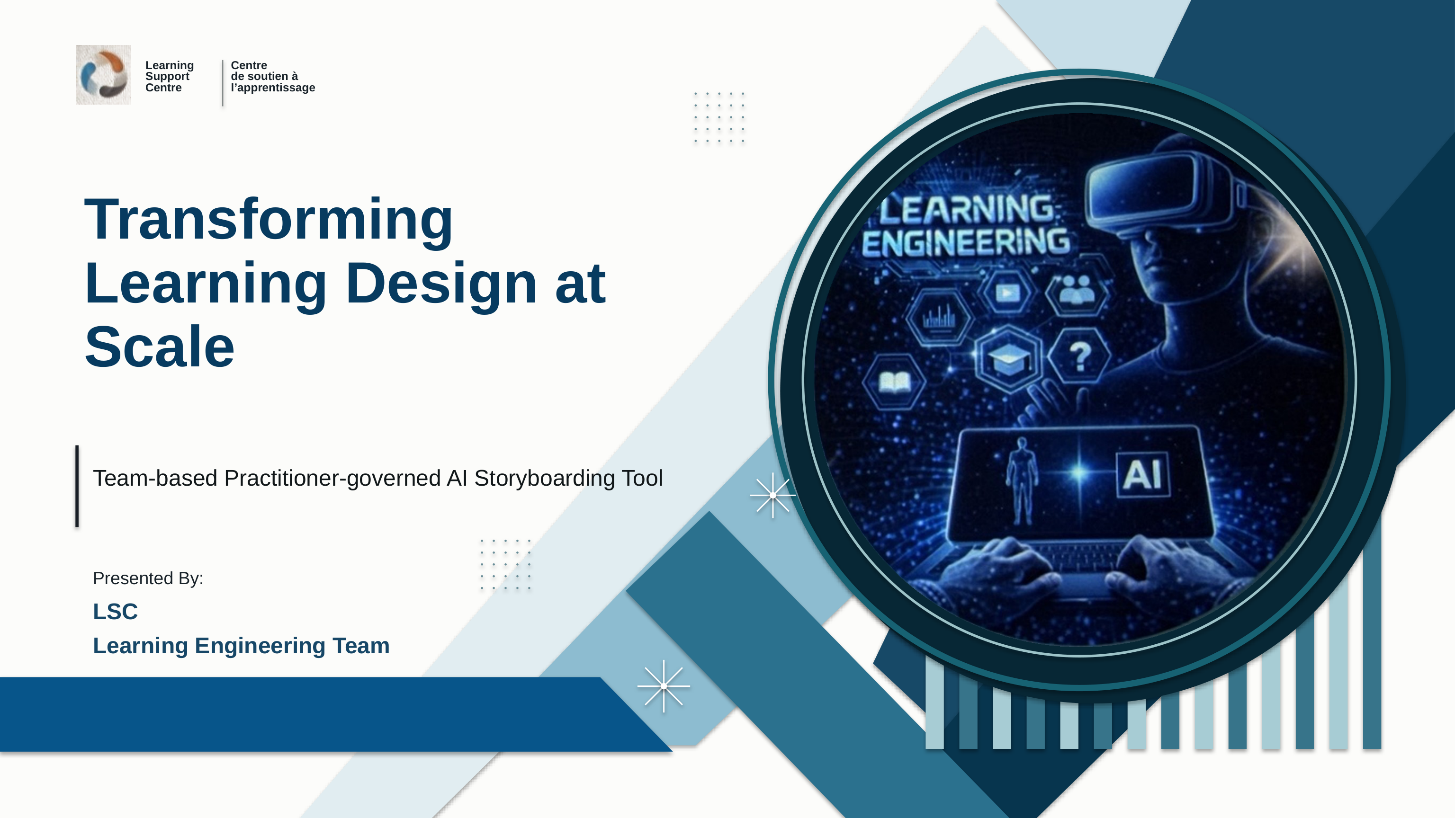
Notes:
Good morning, and thank you for visiting the Learning Support Centre. In the next ten minutes I will show you one project from the Learning Engineering Team: a team-based, practitioner-governed AI storyboarding tool. The word order matters: the team and the practitioners come first, and the AI is the tool. I will cover how it was built, what it does for the team, where it still falls short, and where we would value your expertise.

Slide 2
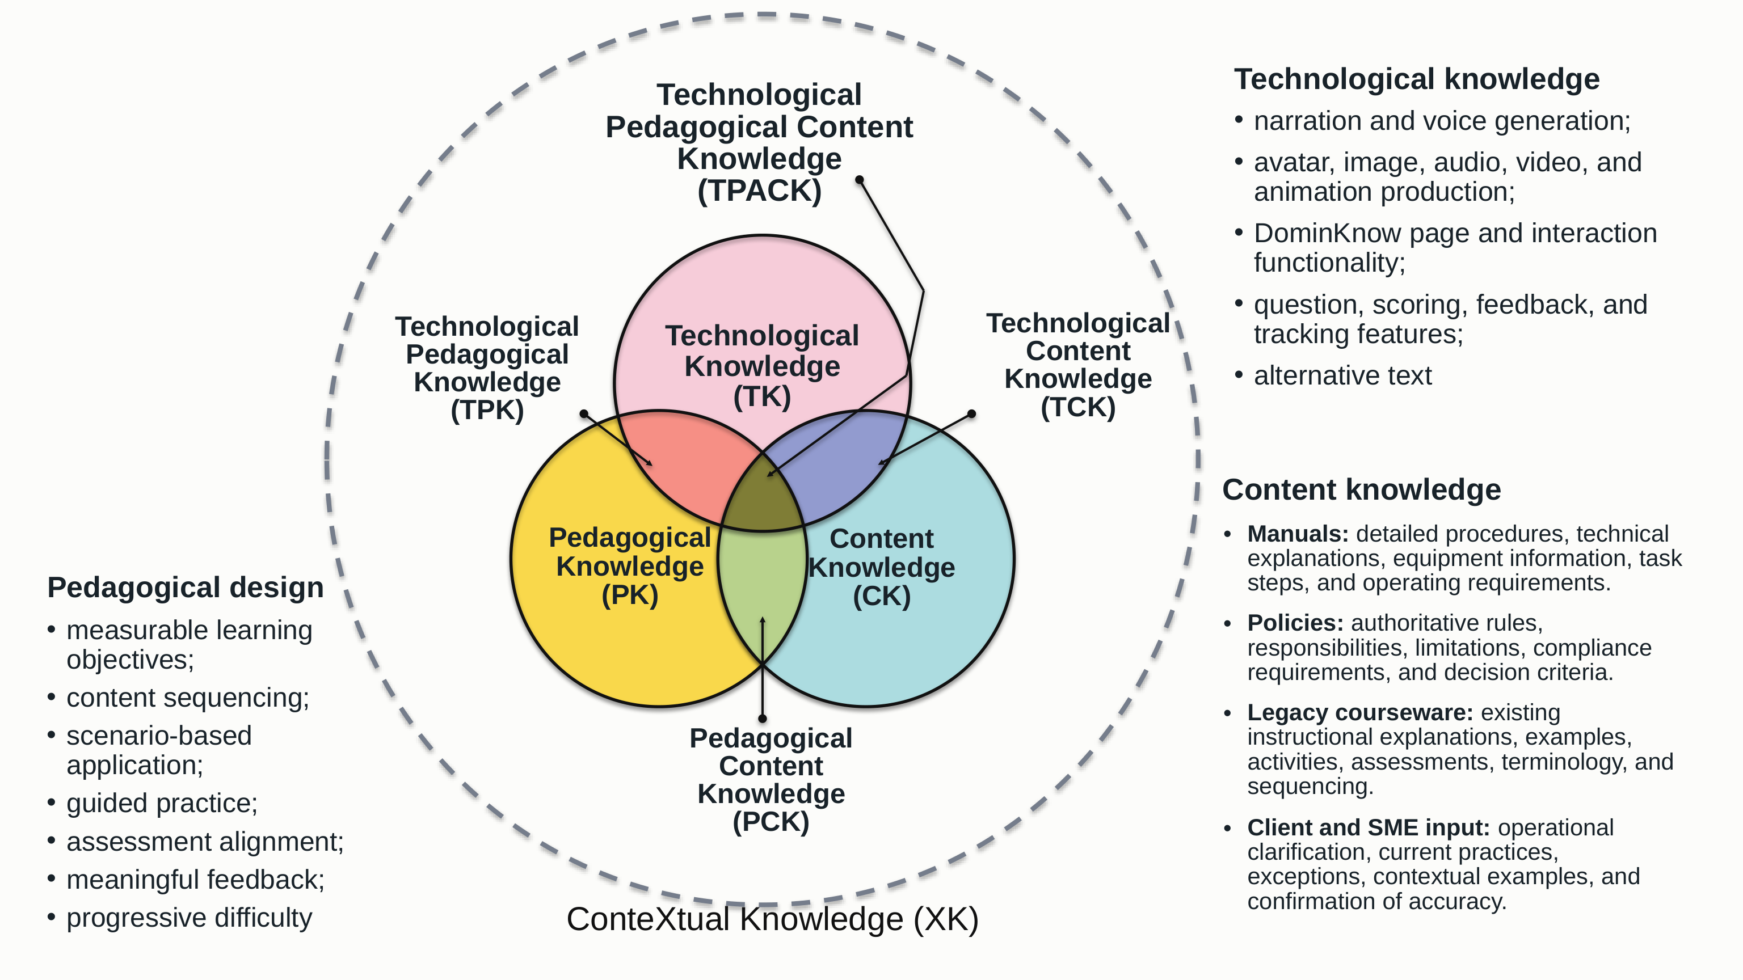
Notes:
We interpret the work through TPACK: Technological Pedagogical Content Knowledge. An eLearning course needs three kinds of knowledge at once. Content knowledge comes from the client: manuals, policies, legacy courseware and subject-matter experts. Pedagogical knowledge is what our designers add: measurable objectives, sequencing, guided practice, aligned assessment and meaningful feedback. Technological knowledge is what the platform allows: DominKnow pages and interactions, narration, media, scoring and accessibility. Good design lives in the overlap, inside the context of a specific project. Our question was: can that overlap be written down so that a tool reproduces it every time?

Slide 3
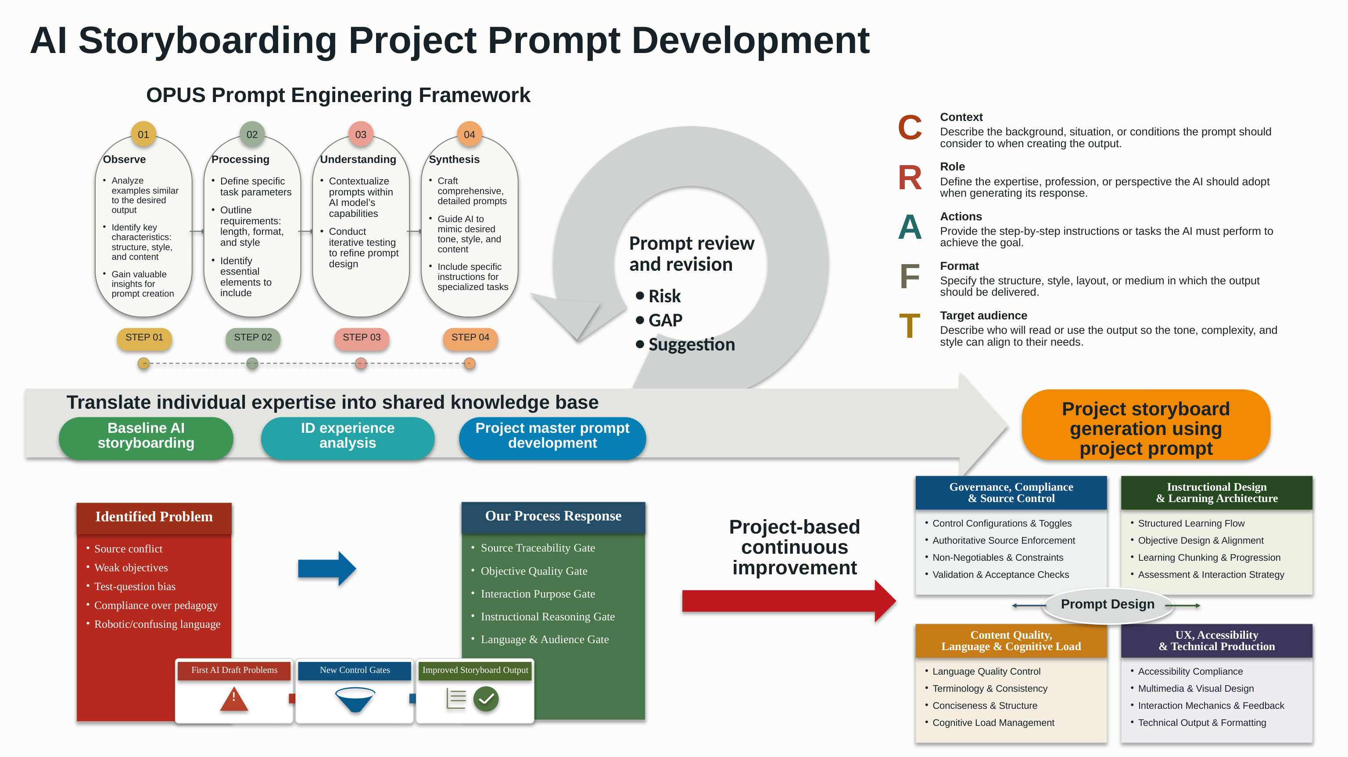
Notes:
This is how the prompt was developed. We followed a prompt-engineering framework: observe good storyboards, define the task, understand what the model can and cannot do, and synthesize a comprehensive prompt, reviewed each time for risk, gaps and suggestions. Its structure follows CRAFT: Context, Role, Actions, Format and Target audience. The arc along the bottom is the project history: a baseline of AI storyboarding, an analysis of our own design experience, a master prompt, and then project storyboards generated from it. The first drafts had real problems: source conflicts, weak objectives, robotic language. Each problem became a control gate.

Slide 4
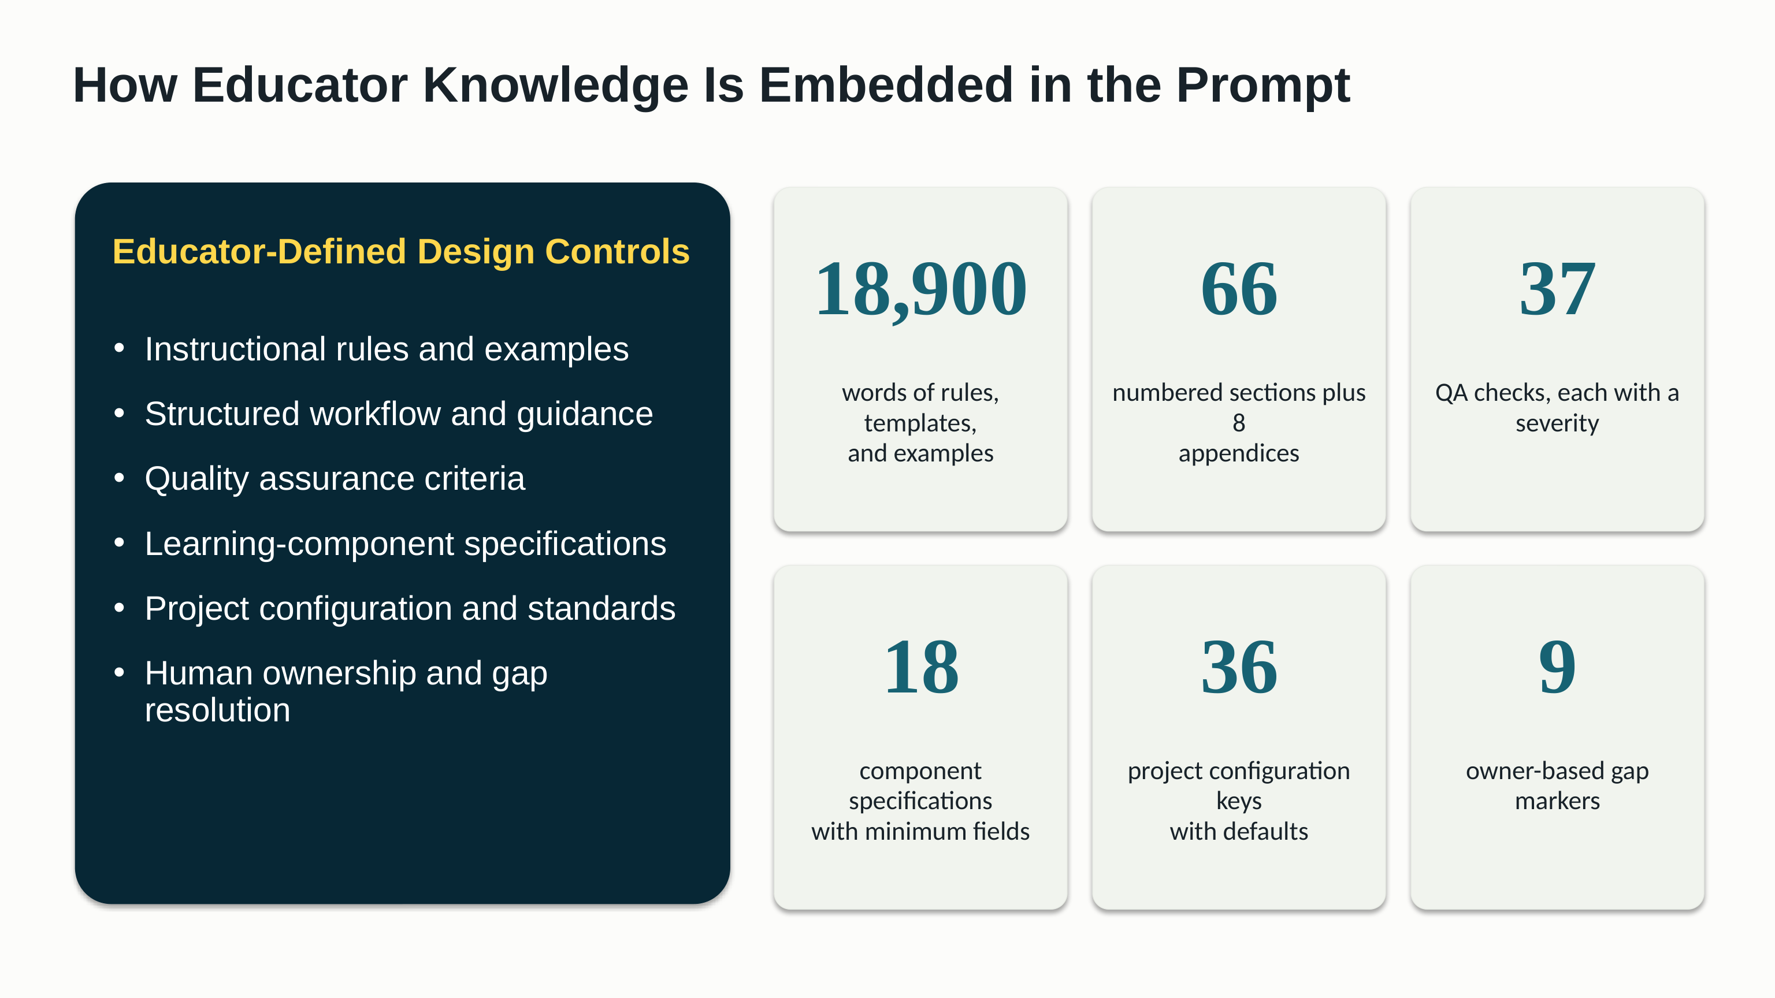
Notes:
The result is not a clever sentence; it is educator knowledge, written down: instructional rules and examples, a structured workflow, quality criteria, component specifications, project configuration, and human ownership of every gap. The numbers give the scale: close to nineteen thousand words; thirty-seven quality checks, each with a severity; eighteen component specifications; thirty-six configuration keys; and nine markers that assign every unresolved item to a person. That is the raw material. The rest of this presentation is about what it does for the team.

Slide 5






From TPACK to a working tool
The prompt is where the three kinds of knowledge are joined, and the storyboard is how they reach the developer.
Content: client sources
The master prompt
Storyboard
Manuals, policies, legacy courseware, SME input
Ranked by a nine-level authority stack; nothing is invented
TPACK, written down as rules the AI must follow
Five columns, real Word tables, every gap owned. Developer Ready when every row is.
CK
C
Context: readers, authority, gaps
Pedagogy: the practitioners
R
Role: the generator drafts, people decide
Built in DominKnow
Objectives as job tasks; teach, show, practise, assess
Feedback wording, cognitive-load limits, plain language
The developer builds from Multimedia and Interaction alone; nothing the standard already gives is repeated.
PK
A
Action: seven steps, in order
F
Format: locked document, five columns
Technology: platform, AI
eLearning course
DominKnow components, five interaction modes, WCAG 2.2 AA
Prompt engineering: CRAFT structure, gates and checks
T
Tone: one voice for three readers
The learner can learn from Text Content alone; the client reviewer can read every row once.
TK
ConteXtual knowledge: the project intake sets the context once, and every rule applies inside it.
LSC Learning Engineering Team · AI Storyboarding
5
Notes:
Here is TPACK as we actually use it. On the left are the three inputs. Content knowledge is the client's sources, ranked by authority, so the prompt never guesses which document wins. Pedagogical knowledge is our practitioners' interpretation: objectives written as job tasks, a teach-show-practise-assess sequence, fixed feedback wording, limits on cognitive load. Technological knowledge is what DominKnow can build and what the AI can reliably do. The master prompt in the centre joins them; it is TPACK written as rules the AI must follow. On the right is what comes out: a storyboard in a locked format with every gap owned, which a developer builds in DominKnow without needing to meet the designer, and a course the learner can learn from.

Slide 6



The CRAFT prompt in one view
Every rule has one home and one check. Change a value once, and it applies everywhere.
C
R
A
F
T
Context
Role
Action
Format
Tone
Who reads it, what counts as authority, what to do with gaps
The generator drafts, people decide
Seven steps, always in this order
What the deliverable looks like
One voice for three readers
Three readers: learner, client reviewer, developer
Nine-level source authority stack
Gaps classified Critical, Blocking or Non-blocking, each with an owner
Generates, structures, maps and checks
Never decides purpose, accuracy or feasibility on its own
Learning Design, SMEs, Multimedia, Accessibility and Development own the decisions
Objectives as job tasks, with quoted evidence
A verification gate before any design starts
Every slide: content first, component minimums, feedback, accessibility
Locked block order and real Word tables
Five columns, one owner per column
Five interaction modes; a mock-up for any complex layout
Complete sentences, one term per thing
Acronyms defined; cognitive-load limits per slide
Narration teaches; it never repeats the screen
Set once: 36 configuration keys with defaults
Checked on every run: 37 quality checks in three severities
Owned, never invented: 9 gap markers, each naming a human owner
LSC Learning Engineering Team · AI Storyboarding
6
Notes:
This is the whole prompt on one page. Context tells the AI who will read the storyboard, which sources win when they disagree, and what to do when something is missing: classify it and assign it to a person, never fill it in. Role says the generator drafts and people decide. Action fixes the order of work, starting with objectives as job tasks and a verification gate before any slide is designed. Format locks the document so every storyboard has the same shape. Tone is one writing standard that a learner, a client reviewer and a developer can all read. The band at the bottom makes it a standard rather than a suggestion: values set once, thirty-seven checks on every run, nine gap markers so nothing is invented.

Slide 7









One standard, six kinds of expertise
A socio-technical system: people decide, the process gates, the technology drafts.
Instructional designer
What this changes for the team
Same shape, whoever runs it
A storyboard from any team member arrives in the same format with the same checks.
Storyboard-production architect
Learning-engineering analyst
The master prompt
one shared standard
Day-one onboarding
A new member produces a standard-compliant storyboard on their first project.
Knowledge outlives turnover
Expertise lives in the prompt and its change log, not only in one person's head.
Source-fidelity reviewer
Assessment designer
Practitioners govern it
Reviewer comments become rules; the team, not the tool, decides what changes.
Accessibility and UX reviewer
Rules and examples flow in; the same standard flows back to everyone.
LSC Learning Engineering Team · AI Storyboarding
7
Notes:
This is the slide I most want you to remember. The prompt asks the AI to act as six specialists at once: instructional designer, learning-engineering analyst, assessment designer, accessibility and UX reviewer, source-fidelity reviewer, and storyboard-production architect. Those are the kinds of expertise on our team. Before this, each practitioner had their own storyboard, their own habits, their own idea of complete. Getting six experts to produce the same thing is genuinely hard. The standard did that without flattening anyone: the interpretation still belongs to the designer; the shape, the checks and the language belong to the team. The effects are on the right. A storyboard looks the same whoever ran it. A new colleague is inside the standard on their first project. When someone moves on, their rules stay in the prompt and its change log. And the practitioners govern it: reviewer comments become rules, so the tool follows the team, not the other way round.

Slide 8



Three ways the team uses it
The same prompt generates, standardizes, and converts.
01
02
03
Generate
Standardize
Convert
Attach the intake, the sources and any reviewer comments, and say “Generate the storyboard.” The result is a Developer Ready storyboard in the locked format, with every unresolved item assigned to an owner.
The template and the writing standard are built into every run. Nobody has to remember to follow the format; it is already there. Individual judgement stays where it belongs: in the design decisions, not in the shape of the document.
A storyboard or standard from another unit, in any format, is rebuilt in the LSC format that the developers accept. The same rules apply, so a converted storyboard is checked like one of ours.
Before
Intake, sources, review comments
After
A Developer Ready storyboard in the locked format
Before
Six personal templates, uneven compliance
After
One template on every storyboard, by default
Before
A partner unit's storyboard in its own format
After
The LSC storyboard the developers can build from
LSC Learning Engineering Team · AI Storyboarding
8
Notes:
In daily work it does three jobs. Generate: a designer attaches the intake, the sources and any reviewer comments, and what comes back is Developer Ready, or says exactly why it is not. Standardize: we used to ask people to follow the template, and compliance was uneven, because everyone has a better idea. Now the template is inside the tool; nobody has to remember it, and you would have to work hard to produce something that does not comply. The designer's judgement is still there, in the objectives, the scenarios and the sequencing; only the shape is fixed. Convert: when another unit sends a storyboard or a standard in its own format, we run it through the same prompt and hand the developers the format they can build from, checked by the same rules. Without that, the developers could not accept it.

Slide 9

Quality is governed by the people who review
A polished sentence is not evidence of sound design. Failures must be observable, classified, and correctable.
Reviewer said
The prompt now requires
1 Reviewer comment
“Should use full sentences, otherwise it is difficult to connect meaning.”
Complete sentences for any line that states a fact, rule, condition or action.
“You call them stages and processes. Which is it?”
One term per thing across the title, every column and the narration.
5 Next storyboard, checked
2 Defect classified
“What is the actual question stem?”
A stem before every practice or assessment activity.
continuous
improvement
“Devs don't program this. Delete.”
Platform behaviour stays out of the rows; Development owns it.
“The distractors are not plausible.”
Item-quality rules: plausible distractors, one defensible answer.
4 Acceptance check added
3 Rule written into the prompt
14 reviewer comments on one storyboard became rules. Every rule has one home in the prompt and one line in the acceptance checks.
LSC Learning Engineering Team · AI Storyboarding
9
Notes:
How does it get better? Every improvement so far has come from a real reviewer comment on a real storyboard. The loop on the left is the governance model. A reviewer writes a comment. We classify the defect. We write the rule into the one place in the prompt where that topic lives, and add one line to the acceptance checks so the generator tests for it on every run. The next storyboard is checked before anyone sees it. The table shows five real examples. Fragments made it hard to connect meaning; now complete sentences are required. Stages or processes? Now it is one term per thing. What is the actual question stem? Now there is a stem before every activity. A developer wrote, in effect, we don't program this, delete it; now platform behaviour stays out of the rows. Fourteen comments on one storyboard became rules. The point is who decides: the reviewers and the practitioners, not the tool.

Slide 10



Where it still falls short
Three limits we can see from the inside. Each is on the change log; none has a complete answer yet.
Presentation of information
Human review is not optional
No outside benchmark
The content is right more often than it is well presented. Layouts, visual treatment and the balance between text and media are still uneven from slide to slide.
The generator drafts; people decide. A storyboard still needs a subject-matter expert to confirm accuracy and a learning designer to read it as a learner would.
Every improvement came from our own reviewers. We do not know how the approach compares with how other organizations govern AI in learning design, or what we have not thought of.
Where we are Mock-ups are now required for complex layouts, but a designer's eye is still needed before hand-off.
Where we are The gap markers make that work visible and assignable, but they do not make it smaller.
Where we are This is the limit we can only remove with help from outside the team.
We treat these as design problems, not as reasons to stop: each one is observable, classified, and assigned to someone.
LSC Learning Engineering Team · AI Storyboarding
10
Notes:
I want to be straightforward about the limits, because they are why we are talking to you. First, presentation: the content is right far more often than it is well presented. Mock-ups are now required for complex layouts, but the visual side still needs a designer's eye. Second, human review is not optional and it is not getting smaller. The gap markers make that work visible and assignable; they do not remove it, and we would distrust any tool that claimed to. Third, and this is the one we cannot fix from inside: we have no outside benchmark. Everything you have seen was improved by our own reviewers. We do not know how this compares with the wider field, or what we have simply not thought of. We treat all three as design problems on the change log, not as reasons to stop.

Slide 11


The platform, not the prompt, is now the limit
The standard is ready to scale beyond the team. The way it runs today is not.
Today: a document and a link
What scale needs: a governed team tool
The prompt runs in a general-purpose AI chat; each run starts with a manual paste of the standard.
Upload and context limits cap how much of a source set one run can read.
No shared workspace: versions, usage and results are not tracked, and only one person runs it at a time.
the gap
The prompt, the standards and the reference libraries stored once, versioned, and updated in one place.
Shared by the whole team and by partner units, with usage and results tracked.
Enough capacity to read a full source set and return a full storyboard in one run.
What we have tried
Azure AI Foundry
Capacity and compute limits in our environment; too small for a full source set.
Copilot agent, current tier
Feature and upload limits; the standard cannot be stored and shared as an agent.
The question we cannot answer alone: which platform, and which hosting approach, lets a practitioner-governed prompt run as a shared, governed tool inside a Government of Canada environment?
LSC Learning Engineering Team · AI Storyboarding
11
Notes:
The second thing we cannot solve alone is scale. Today the tool is, honestly, a document and a link. The prompt runs in a general-purpose AI chat; each run starts by pasting the standard in. Upload and context limits cap how much of a source set one run can read, which matters when a course draws on several manuals. And there is no shared workspace: versions, usage and results are not tracked. What scale needs is on the right: the prompt, the standards and the reference libraries stored once and versioned, shared across the team and with partner units, with enough capacity for a full source set in one run. We have tried two routes. Azure AI Foundry, where the capacity available to us was too small. And the Copilot agent on our current tier, where the limits mean the standard cannot be stored and shared as an agent. So the question is which platform and which hosting approach let a practitioner-governed prompt run as a shared, governed tool in a Government of Canada environment.

Slide 12



Where we would welcome your expertise
We can describe the problem precisely. We do not have the capacity to solve it alone.
A benchmark
A path to scale
An exchange
Tell us how this compares with your own practice: what is strong, what you would change, and what we have not seen yet.
A platform, a person, or an approach that lets the prompt run as a governed, shared tool: any of the three would move us forward.
We will share the standard, the change log and the review method. We would like to learn how others govern AI in learning design.
Thank you.
LSC Learning Engineering Team · Learning Support Centre / Centre de soutien à l’apprentissage
LSC Learning Engineering Team · AI Storyboarding
12
Notes:
So here is the ask, and it is a modest one. We are not looking for someone to take the project over; the standard works and the team governs it. We are looking for three things. A benchmark: how this compares with your practice, what is strong, what you would change, what we have not seen. A path to scale: a platform, a person or an approach; any one of the three would move us forward. And an exchange: we will share the standard, the change log and the review method, and we would like to learn how others govern AI in learning design. Thank you. I am happy to take questions or to show a storyboard being generated.

