Slide 1

Introduction to Computer Programming
Week 11 – Looking ahead

Slide 2
Overview
Further Python functionality to help with your studies
Other programming languages
Further Computer Programming EMAT10006
Further programming opportunities
Real-world applications of programming

Slide 3


SciPy
Contains a broad range of algorithms for solving engineering problems
Used to tackle problems that cannot be solved exactly
Functions for optimisation, linear algebra, differential equations, interpolation, image and signal processing, statistics
scipy-lectures.org
Original
Blurred
Deblurred
Notes:
The image here shows how SciPy functions can be used to deblur an image. Left is the original, middle is a blurred copy, and the right is the deblurred image.

Slide 4

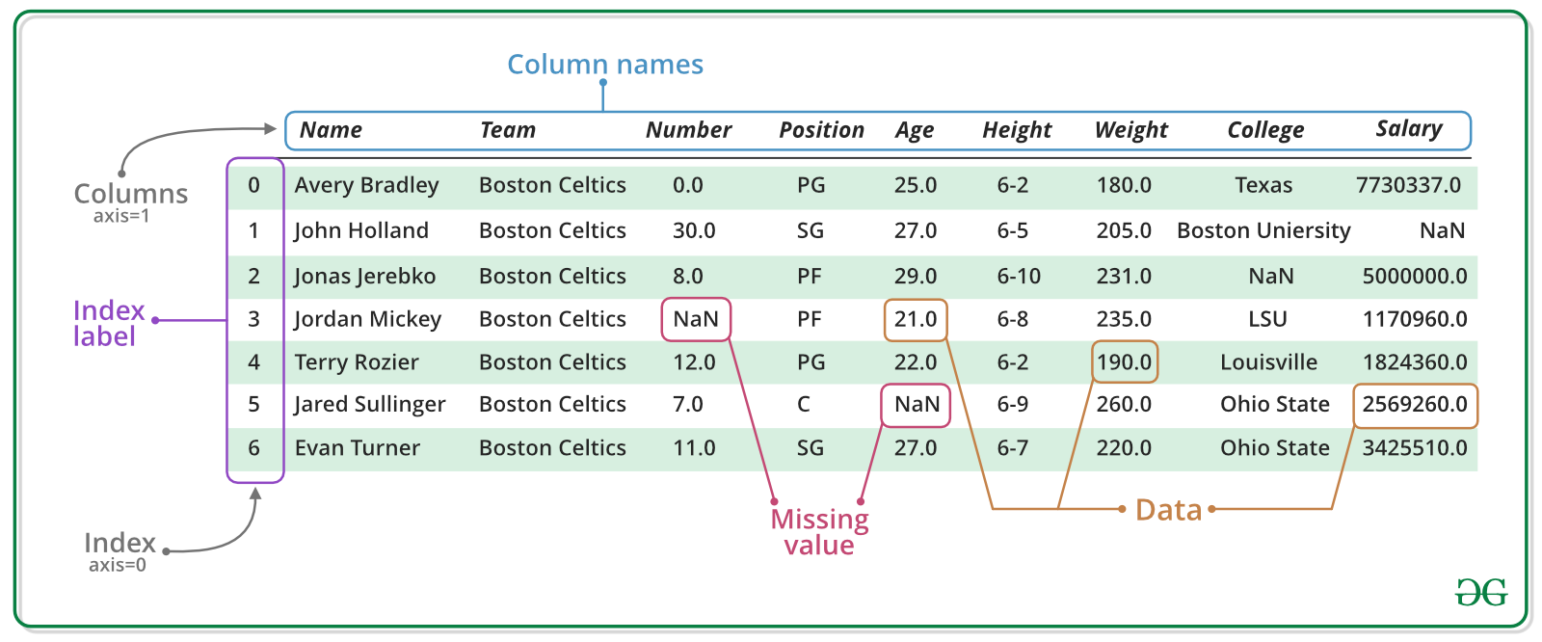
Pandas
A Python library for data storage, manipulation, and analysis
Many convenient functions for working with tables of complex data
File import/export is straightforward
www.geeksforgeeks.org

Slide 5

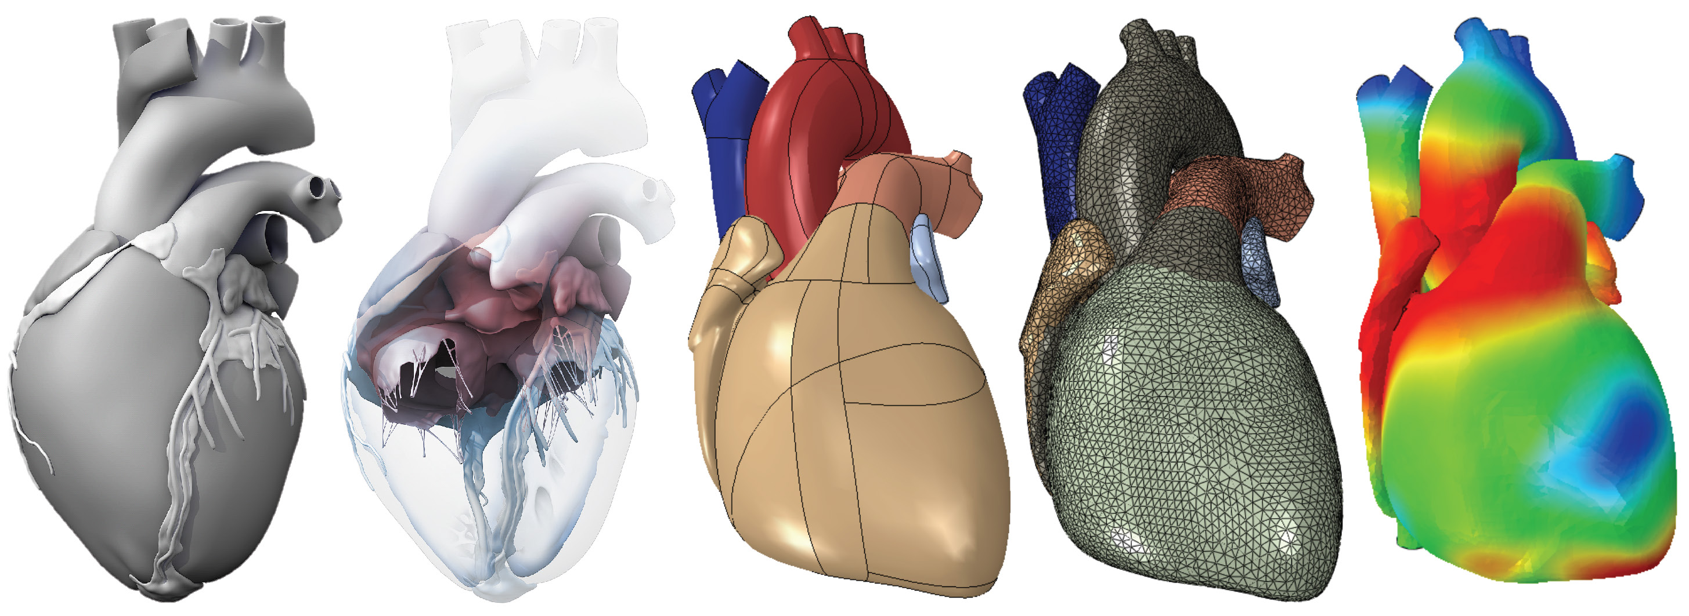
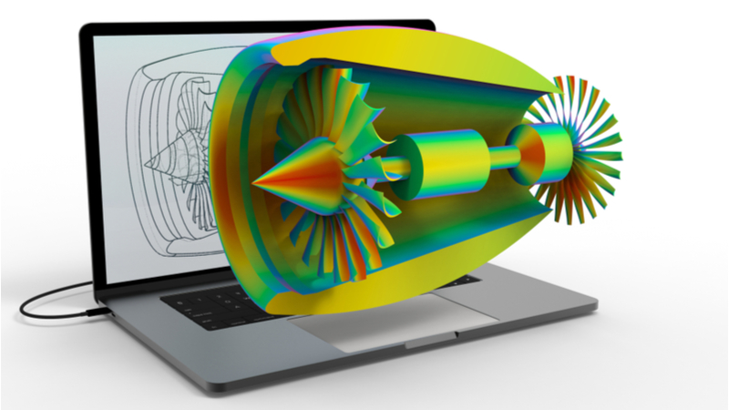
FEniCS
A Python library for simulating models of heat transfer, fluid flow, solid deformation, and more
Code is parallelized and can run on supercomputers
Useful for final-year projects or MSc dissertations involving modelling of physical and/or biological processes
biomechanics.stanford.edu
www.imeche.org
Notes:
Top image: electro-mechanical modelling of the human heart (aside: this simulation is from Ellen Kuhl’s lab at Stanford. Ellen is a world-leading researcher in biomechanics)
Bottom image: the stresses in an airplane engine

Slide 6

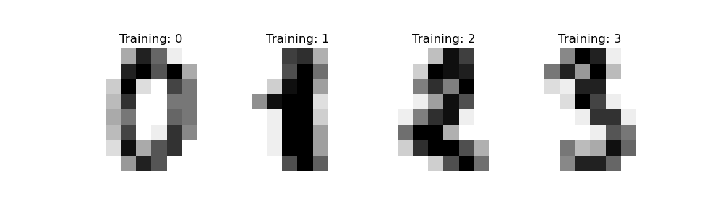

scikit-learn
An open-source Python library for machine learning
Tools for predictive data analysis
Data classification, regression, clustering, dimension reduction
Built on SciPy, NumPy, and matplotlib
scikit-learn.org
Notes:
Example of handwriting recognition

Slide 7
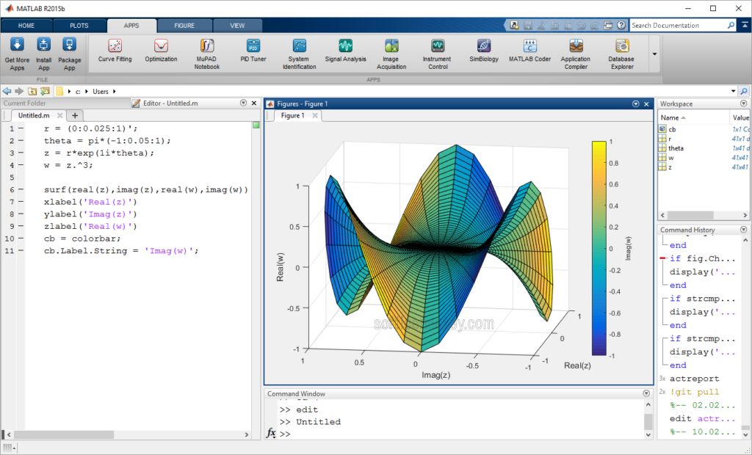
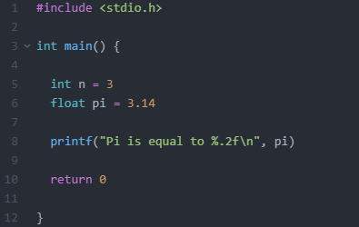
Other programming languages
There are thousands of programming languages!
MATLAB (Numerical Methods in Matlab, EMAT20920)
R (for statistics)
C/C++ (C for Embedded Systems, EENG20004)
LaTeX (used for writing technical reports)
Notes:
Quick comparison of C with Python (need to explicitly define a main function, declare types of variables and function outputs, compile the code before running it; generally more difficult to code but very fast)

Slide 8
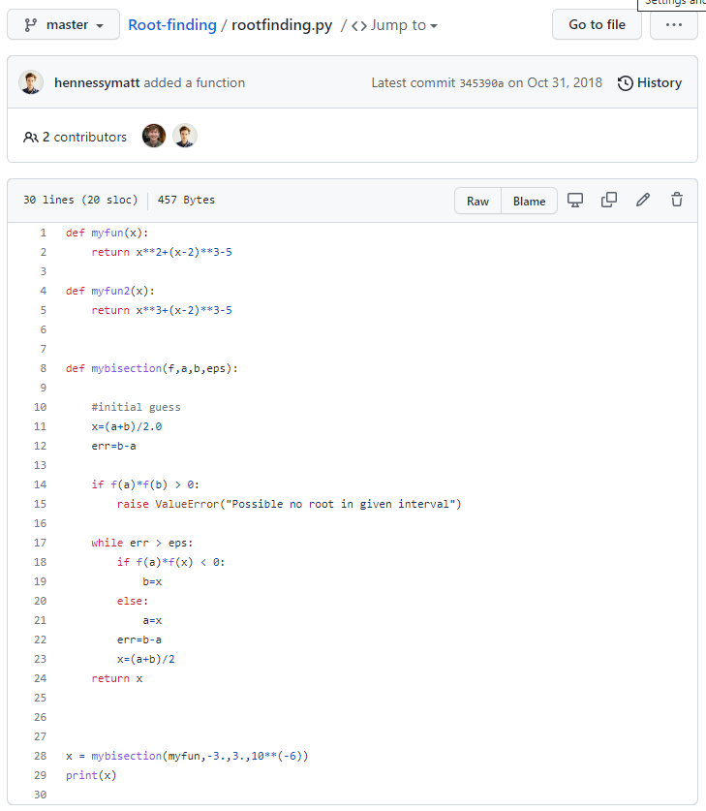
Further Computer Programming EMAT10006
Create and navigate larger codebases
Use version control with git and GitHub
Work collaboratively in groups in a single codebase
Use Python for simulations and plotting and for engineering or scientific work
Use additional intermediate-level features of Python as a programming language

Slide 9
Further Programming Opportunities at Bristol
Computer Science Society (https://cssbristol.co.uk/)
Hackathons, workshops, programming activities, and social events
Bristol Data Science Society (https://www.facebook.com/BristolDSS/)
Programming workshops, seminars, data-science competitions
ChallEng (look them up at https://www.bristolsu.org.uk/)
Work with fellow students to solve real problems faced by small businesses and start-ups
180 Degrees Consulting (https://180dc.org/branch/bristol/)
Student-led organisation – opportunities to work with charities and NGOs on a voluntary basis providing Data Science (statistics, visualisation, NLP) and other consulting services.
Notes:
180DC Bristol is part of the 180 Degree Consulting student group, which provides consulting services to charities and NGOs. The Bristol branch also introduced Data Science as one of our services. This means that we process data (for example by merging databases, clean the data etc.), analyse the data (ranging from simple statistical analysis and linear regression to NLP), and visualize it through dashboards (with Google Data Studio or similar software). Previous clients include TreeAid and the United Nations Development Program. Usually, we run three project cycles a year (fall term, spring term, summer), with recruitment taking place typically in the month before. Any updates on this will be posted via Facebook/Instagram/LinkedIn, including the application link. The number of available spaces depends on the projects that are scheduled for the respective period.

Slide 10
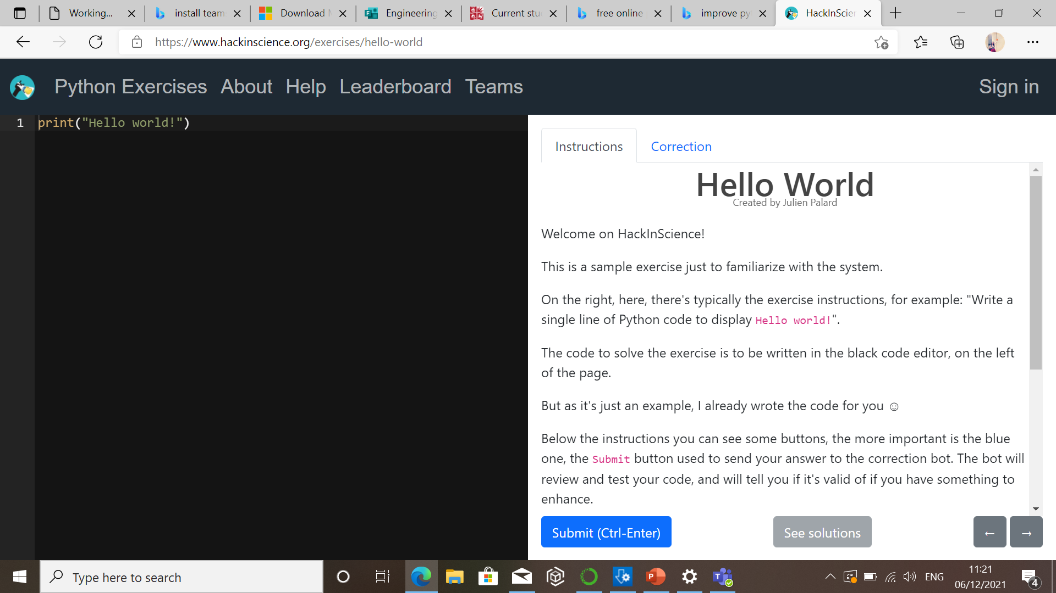
Further Programming Opportunities
Hackathons – These are one off events which normally target a specific problem. There are sometimes prizes and these are great ways to learn more programming away from your studies.
Online practice – There are lots of free online courses on specific parts of programming especially python.
Code academy – Wide range of courses in lots of programming languages
HackInScience — Python Exercises – HackInScience has lots of small problems for you to work on. You can compare your code to others and see how it meets industry standards.
Coding may seem like an individual task but it’s all about building something that works, and others can understand. Paired programming and rubber ducking and standardized formats are common tools for improving the understanding of code.

Slide 11
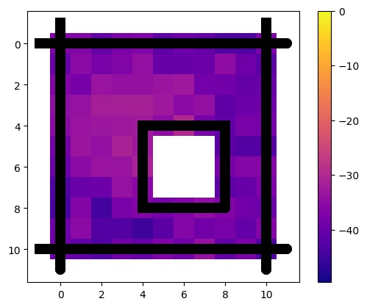
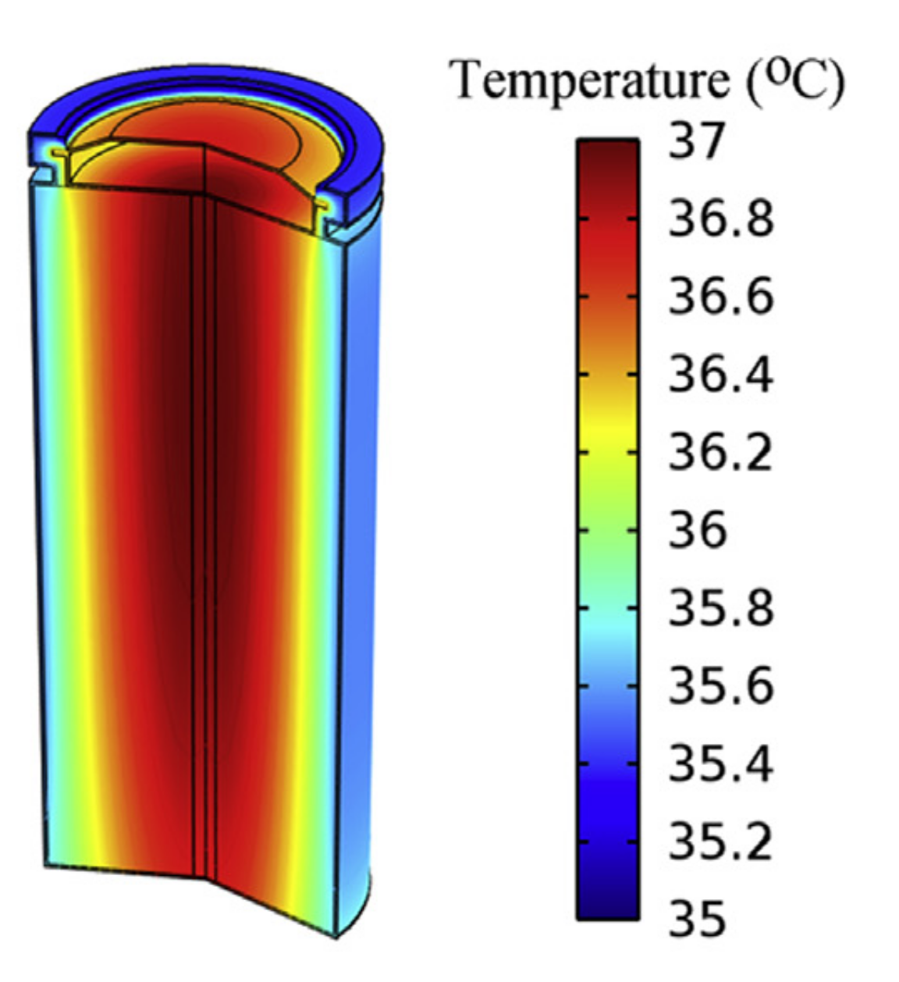

Real-world applications
How we use programming
Building robots and autonomous systems
Thermal management of lithium-ion batteries; real-time detection of short circuits
Modelling WiFi signals and 4G/5G.
Predicting the spread of Covid-19 and deciding on lockdown strategies
Li et al., J Power Sources, 2014
Software and packages we use
PyBaMM (Python Battery Mathematical Modelling): open-source code for solving battery models
OpenABM-Covid19: Agent-based modelling of the Covid-19 pandemic, used to inform policy makers. The code consists of a mixture of Python (52%), C (30%), and R (10%).
PyBullet : Physics engine
Notes:
Simulation of heat generation in a cylindrical lithium-ion battery

Slide 12
Real-world applications
Industry-led projects in EMAT30005 (Mathematical and Data Modelling 3)
Projects come from a wide range of companies including Sky, Ocado, GCHQ, Toshiba, and many more
Example problems:
Calculating flight paths of rockets and risk assessments
Predicting when oil and gas pipelines will fail from ultrasound images
Automated detection of abnormal sperm from microscope images

Slide 13
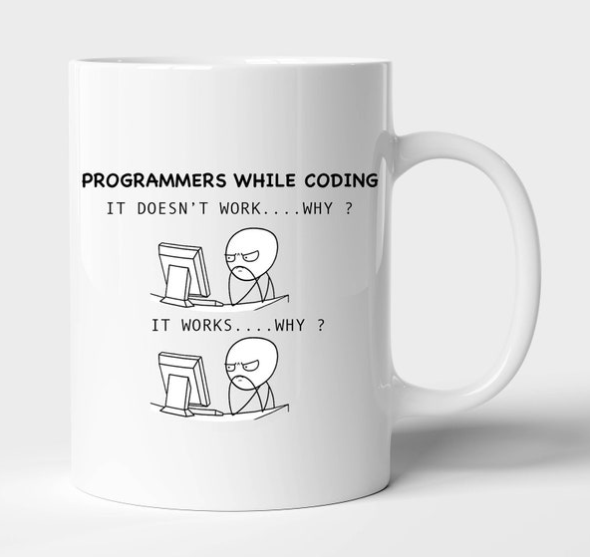
Closing remarks
Programming has transformed the way in which engineering (and other) problems are solved
You will likely cross paths with programming again in your studies and possibly in your career
All programming languages are built on the basic ideas covered in this course (variables, if/else statements, loops, etc).
Good luck!

