Slide 1

Survey: Related work on Real-time implementation of vision-based land detection on embedded platform
December 5, 2022

Slide 2
[1] Review on Lane Detection and Tracking Algorithms of Advanced Driver Assistance System
This study investigate and summary 50 recent works on Lane Detection and Tracking Algorithms of ADAS, it gives vast information including
Pros & cons of vision-based method
Give us the streamline for our algorithms
Low cost
Hardware-availability in automotive sector
Low-power
High precision
-> Reason they are used in ADAS Dependent on light
Vulnerable to whether & road condition
-> Can be mitigate by robust algorithms
Capturing and Processing Video
Road Segmentation
Lane Marking
Bird’s Eye View
Image Framing, ROI

Slide 3
[2] Lane Detection Algorithm for Intelligent Vehicles in Complex Road Conditions and Dynamic Environments
Detailed Validation of the Algorithms
Image Processing
Camera calibration -> undistorted image
Edge Detection (HSL transformation)
ROI -> narrow the frame -> speed up
Inverse Perspective Transform
Lane Detection
Mask Operation
RANSAC
Curve-fitting -> determine curvature
Test evaluation with good condition video, GP CPU environment:
22.2 ms/frame
98% accuracy
Yet neither implement on embedded system nor tested on real road
Because of the differences in developing environment, one still cannot conclude whether the performance is good enough

Slide 4
[3] A Comprehensive Real-Time Road-Lanes Tracking Technique for Autonomous Driving
Another (but very similar) approach of Computer Vision algorithms for Lane Detection
When viewed together with [2], gives the target speed for the application: 15 FPS.
Which is one of the criteria regard to Real-time application
Consolidate our feasibility of this project in terms of the algorithms
Still, this study was not implemented on embedded environment

Slide 5
[4] Robust Lane Detection and Tracking for Real-Time Applications
Set out the basis for embedded implementation
Video input:
~ 48000 frames
1920x1080
Proposed system:
Programming Language: C++
Algorithms in OpenCV library
OS: Ubuntu 14
Target: Dual ARM Cortex-A9 processors 800MHz
Results:
> 93% accuracy (all weather)
28 FPS

Slide 6

Visualize the project product

Slide 7
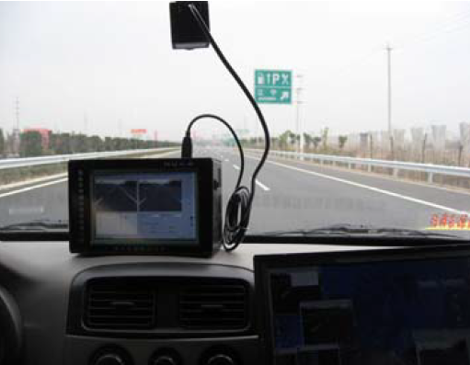
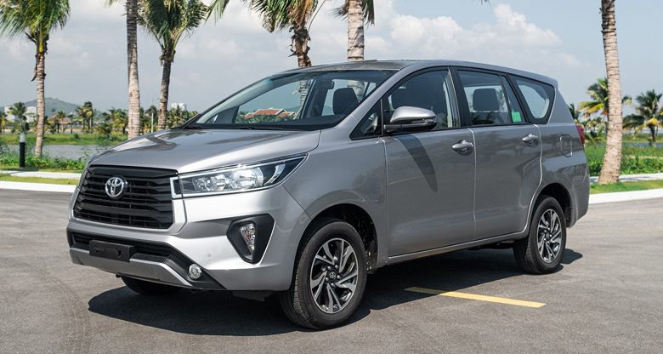
The final product consists of:
Camera
Name: Webcam 1080P Rapoo C260
1920x1080
30 FPS
Embedded Computer: Nvidia Jetson Nano
CPU: Quad-core ARM Cortex-A57 MPCore processor
Memory: 4 GB 64-bit LPDDR4, 1600MHz 25.6 GB/s
Video Encoder: 250MP/sec: 4x 1080p @ 30 (HEVC)
A generic indicating screen
Vehicle frame: Toyota Innova 2020
Installation
Platform

Slide 8
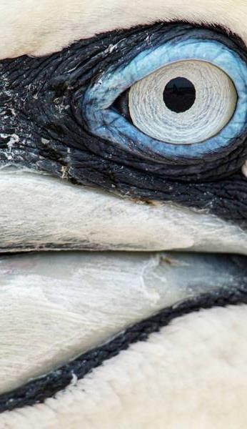
Thank you

