Slide 1

Implementation Of computer vision on real-time lane-detection using RENESAS R-CAR V3H
Truong Thanh Nguyen
Ha Phan Ngoc Quan
Graduation Thesis
Instructor: Mr. Nguyen Trung Hieu, MSc.

Slide 2

Agenda
introduction
Requirement analysis
System design
Development plan
Testing
Deployment
Timeline

Slide 3
introduction
Unintended Lane-Departure causes accidents
Demand of Real-Time Lane-Detection system
In-time Lane-Departure Warning
Reason for the project
Why image processing?
Project Prosperity
Autonomous Driving
Advanced Driver-Assistance Systems (ADAS)
Over 50 studies since 2017
Rich document resources in Computer Vision
Availability of hardware

Slide 4

Requirement analysis
While others are based on video simulation. The improvement of this project is
REAL-TIME CONSTRAINT
Capturing
Transmitting
Processing
Deciding
Target frequency: … Hz
[KPI for the whole process]
To accomplish that, the speed challenge needs to be overcome

Slide 5
System design
To reach such speed, the system needs
Hardware
software
Capturing and Processing Video
Road Segmentation
Lane Marking
Bird’s Eye View
Image Framing, ROI

Slide 6
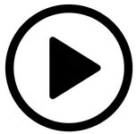




Development plan
Code on PC
Test with video
Port into embedded computer
Deployment
Casing
Attaching and test on real road

Slide 7
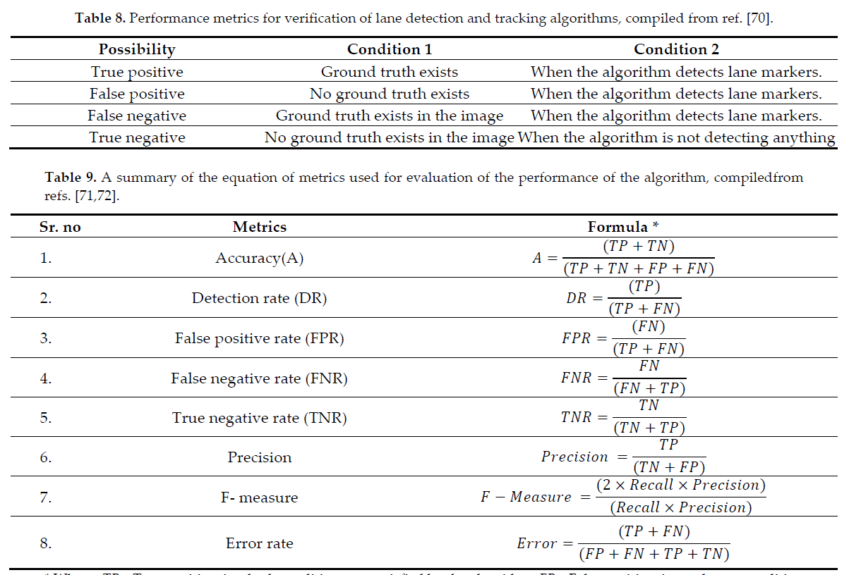
Testing
[these are conventional (fixed)]
[set KPI for these, and use it as a test]

Slide 8
Testing
 | Operation | Reference/Algorithm | Objectives | Target KPI
Stage 1 | Capturing and Processing Video | OpenCV, Pyplot,... | Capture Real-time Video Data
Stage 2 | Region of Interests | OpenCV, Pyplot… | Ignore Background
Stage 3 | Bird’s Eye View | Inverse Perspective Mapping | Curve Road Detection Curvature Calculation
Stage 4 | Road Segmentation | Image Thresholding | Differentiate Lane lines and other segment
Stage 5 | Lane Marking | Histogram Graph | Lane lines Detection
 |  | Sliding Windows | Lane lines Marking
Note: Test procedures are conducted in sufficiently illuminated environment

Slide 9
Deployment
SPEED
After passing the test
Record the processing time
Take the difference
Hardware accelerator
Desire outcome
ROBUSTNESS
[ADD methods to increase robustness]
[this slide need more graphic care]

Slide 10
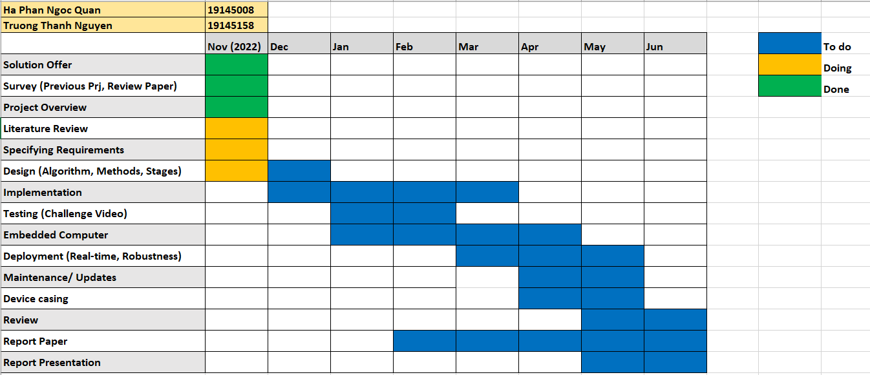
Time Line

Slide 11


Thank you

