Slide 1

Implementation Of computer vision on real-time lane-detection using RENESAS R-CAR V3H
Truong Thanh Nguyen
Ha Phan Ngoc Quan
Graduation Thesis
Instructor: Mr. Nguyen Trung Hieu, MSc.

Slide 2

Agenda
introduction
Requirement analysis
System design
Development plan
Testing
Deployment
Timeline

Slide 3
introduction
Unintended Lane-Departure causes accidents
Demand of Real-Time Lane-Detection system
In-time Lane-Departure Warning
Reason for the project
Why image processing?
Project Prosperity
Autonomous Driving
Advanced Driver-Assistance Systems (ADAS)
Over 50 studies since 2017
Rich document resources in Computer Vision
Availability of hardware

Slide 4

Requirement analysis
While others are based on video simulation. The improvement of this project is
REAL-TIME CONSTRAINT
Capturing
Processing
Deciding
Target frequency: … Hz
[KPI for the whole process]
To accomplish that, the speed challenge needs to be overcome

Slide 5
System design
To reach such outcome, the system chiefly needs
Hardware
software
Capturing and Processing Video
Road Segmentation
Lane Marking
Bird’s Eye View
Image Framing, ROI
Capturing
Camera
Processing
[CPU speed]
[Other requirement]
An automobile to mount camera on

Slide 6





Development plan
Code on PC
Test with video
Port into embedded computer
Deployment
Casing
Attaching and test on real road

Slide 7
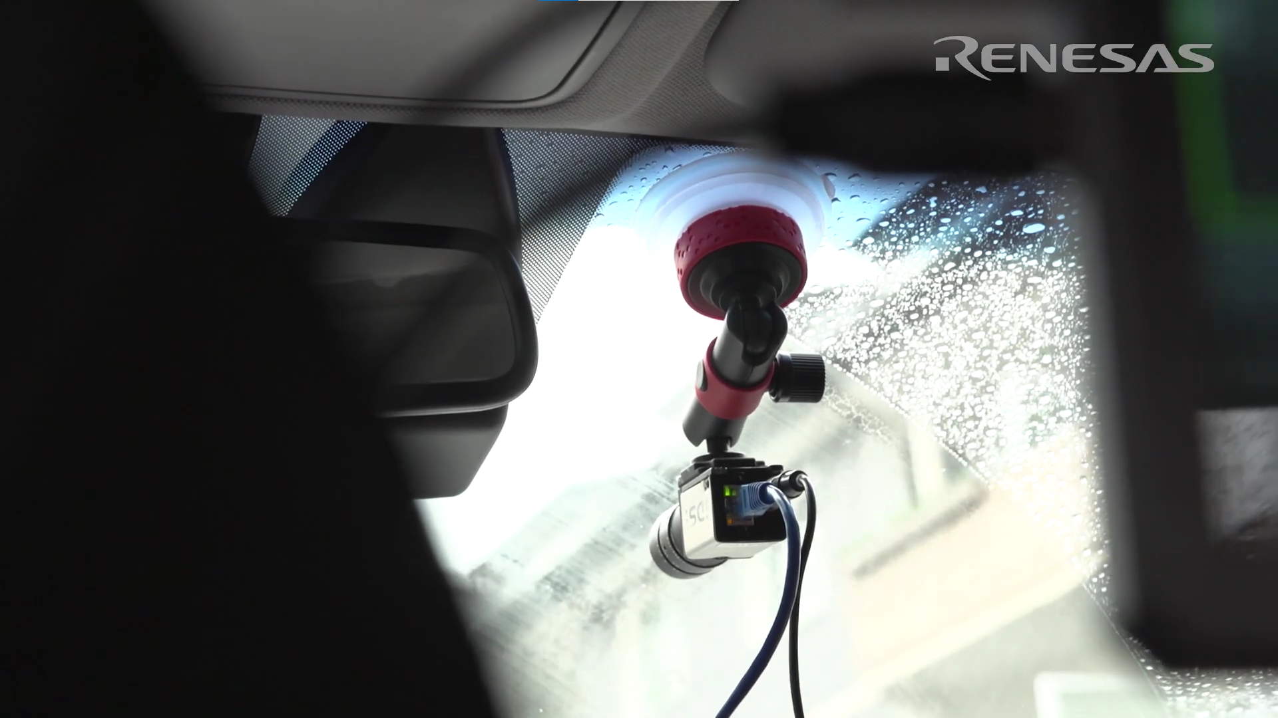
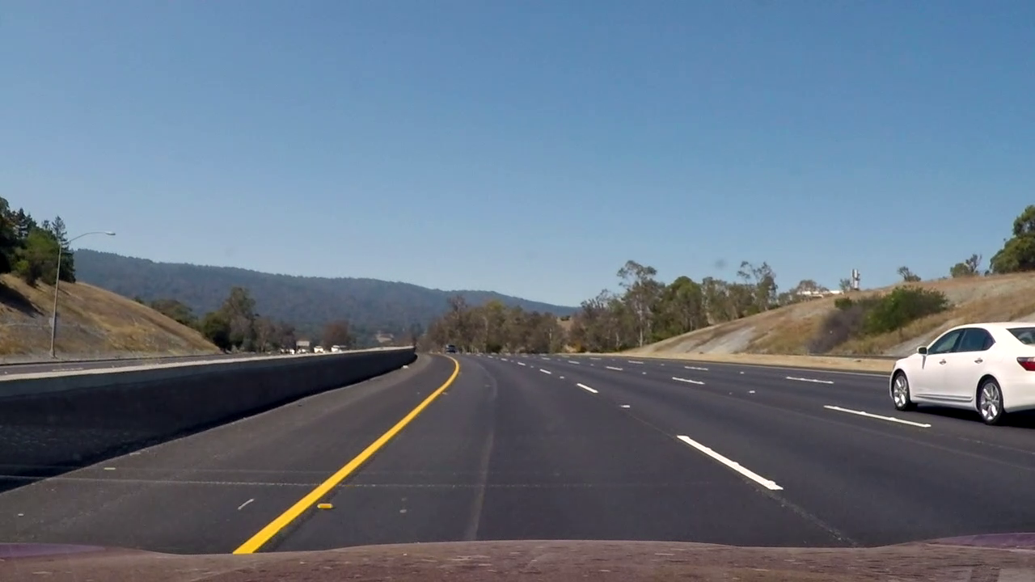
Testing environment
Camera is mounted on car’s windshield (inside)
Approximate height of perspective: 1.5 m
Vehicle speed less than 72km/h
Road conditions:
Enough lightness
Vivid lane-markings
No miscellaneous objects (human, shading)

Slide 8
Performance verification
PERFORMANCE METRICS
Possibility | Ground truth? | Detection?
True Positive | Yes | Yes
False Positive | No | Yes
True Negative | No | No
False Negative | Yes | No

Slide 9
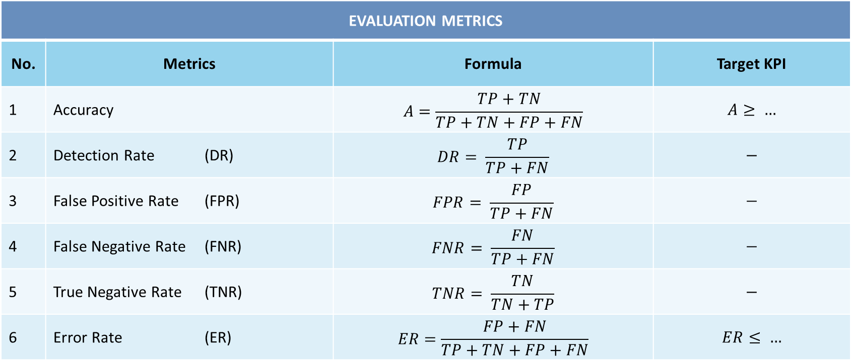
Testing evaluation
EVALUATION METRICS
No. | Metrics | Formula | Target KPI
1 | Accuracy | $$A=\frac{TP+TN}{TP+TN+FP+FN}$$ | $$A≥ …$$
2 | Detection Rate (DR) | $$DR= \frac{TP}{TP+FN}$$ | $$−$$
3 | False Positive Rate (FPR) | $$FPR= \frac{FP}{TP+FN}$$ | $$−$$
4 | False Negative Rate (FNR) | $$FNR= \frac{FN}{TP+FN}$$ | $$−$$
5 | True Negative Rate (TNR) | $$TNR= \frac{TN}{TN+TP}$$ | $$−$$
6 | Error Rate (ER) | $$ER=\frac{FP+FN}{TP+TN+FP+FN}$$ | $$ER≤ …$$

Slide 10
Processing Speed verification
 | Operation | Reference/Algorithm | Objectives | Target KPI
Stage 1 | Capturing and Processing Video | OpenCV, Pyplot,... | Capture Real-time Video Data
Stage 2 | Region of Interests | OpenCV, Pyplot… | Ignore Background
Stage 3 | Bird’s Eye View | Inverse Perspective Mapping | Curve Road Detection Curvature Calculation
Stage 4 | Road Segmentation | Image Thresholding | Differentiate Lane lines and other segment
Stage 5 | Lane Marking | Histogram Graph | Lane lines Detection
 |  | Sliding Windows | Lane lines Marking

Slide 11



Deployment
SPEED
Performance Verification
Hardware acceleration
Desire outcome
ROBUSTNESS
[ADD methods to increase robustness]
[this slide need more graphic care]

Slide 12
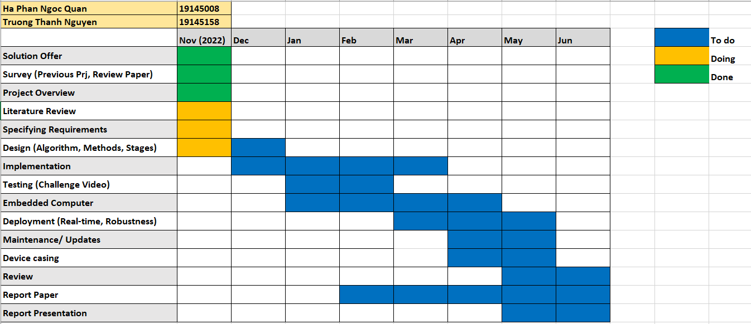
Time Line

Slide 13

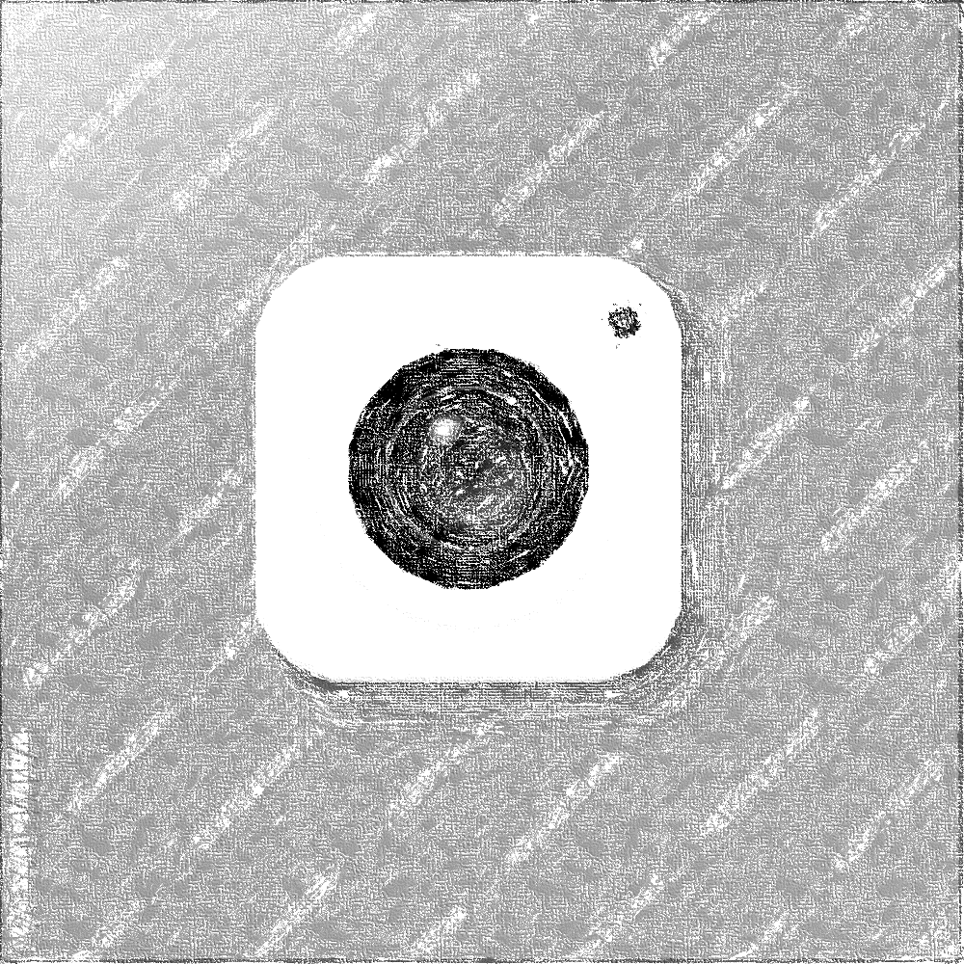
Thank you

