Slide 1

Implementation Of computer vision on real-time lane-detection using RENESAS R-CAR V3H
Truong Thanh Nguyen
Ha Phan Ngoc Quan
Graduation Thesis
Instructor: Mr. Nguyen Trung Hieu, MSc.

Slide 2

Agenda
introduction
Requirement analysis
System design
Development plan
Testing
Deployment
Timeline

Slide 3
introduction
Unintended Lane-Departure causes accidents
Demand of Real-Time Lane-Detection system
In-time Lane-Departure Warning
Reason for the project
Why image processing?
Project Prosperity
Autonomous Driving
Advanced Driver-Assistance Systems (ADAS)
Over 50 studies since 2017
Rich document resources in Computer Vision
Availability of hardware

Slide 4

Requirement analysis
While others are based on video simulation. The improvement of this project is
REAL-TIME CONSTRAINT
Capturing
Transmitting
Processing
Deciding
Target frequency: … Hz
[KPI for the whole process]
To accomplish that, the speed challenge needs to be overcome

Slide 5
System design
To reach such outcome, the system chiefly needs
Hardware
software
Capturing and Processing Video
Road Segmentation
Lane Marking
Bird’s Eye View
Image Framing, ROI
Capturing
Camera with ISP
An automobile to mount camera on
Processing
[CPU speed]
[Other requirement]

Slide 6





Development plan
Code on PC
Test with video
Port into embedded computer
Deployment
Casing
Attaching and test on real road

Slide 7
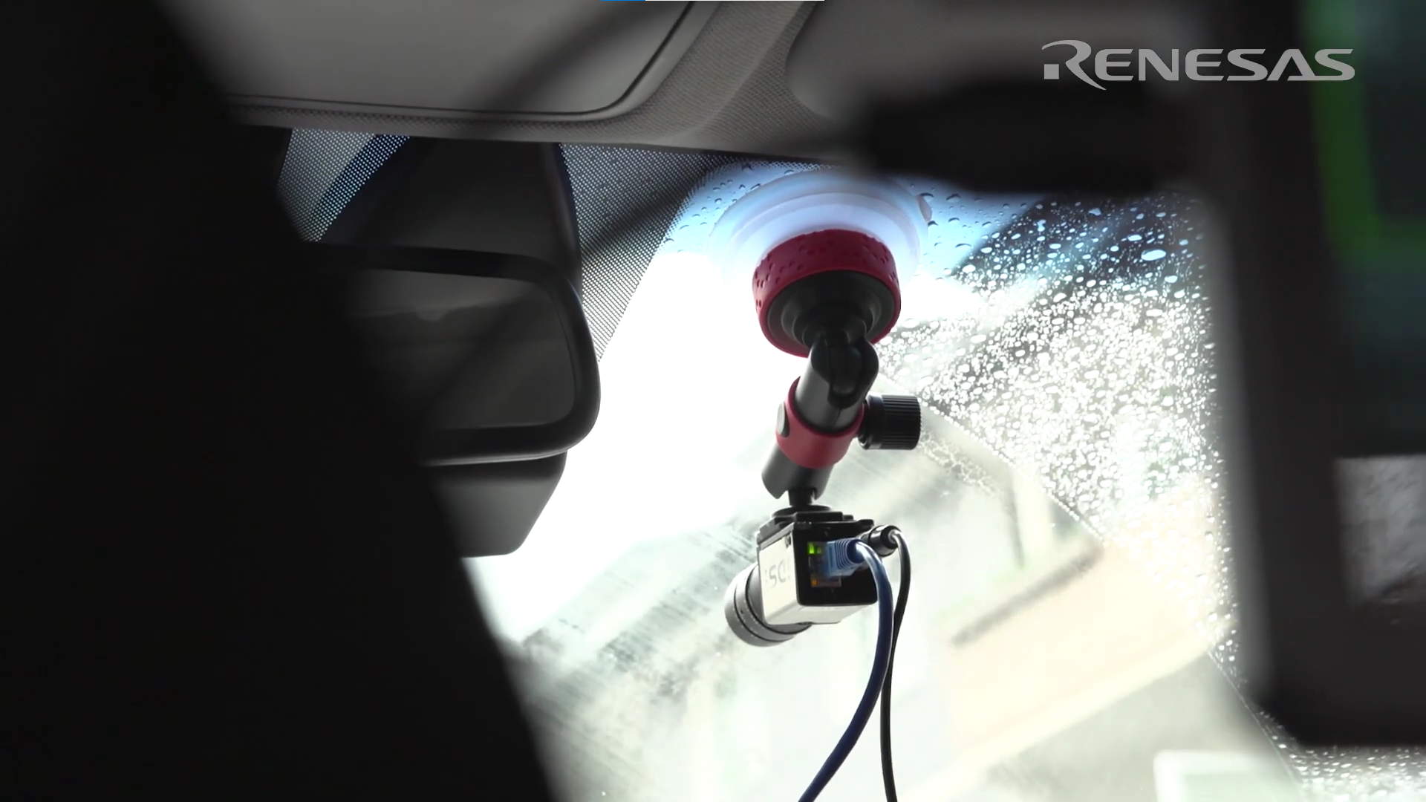
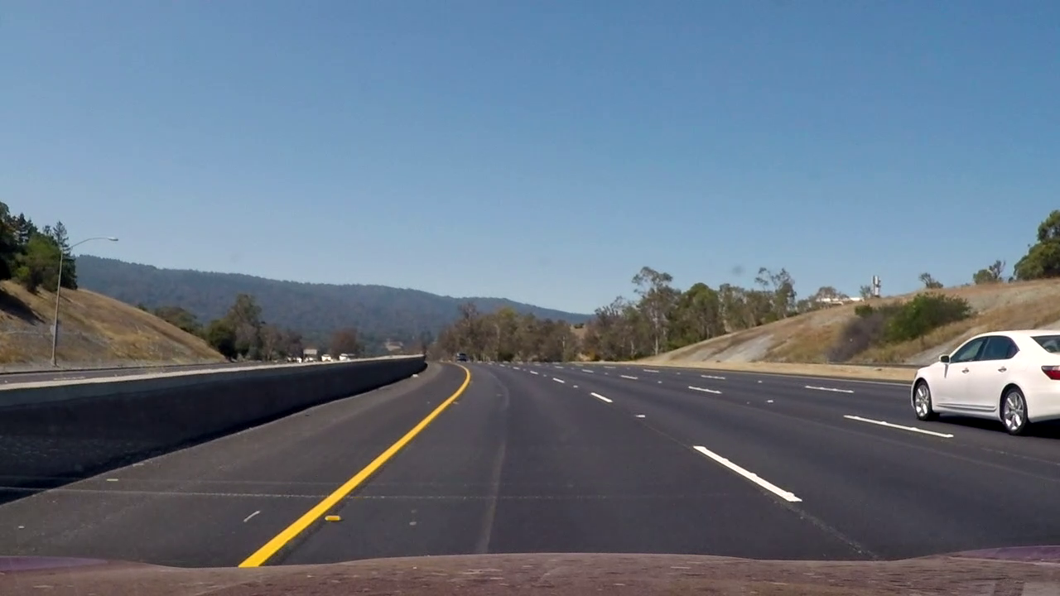
Testing environment
Camera is mounted on car’s windshield (inside)
Approximate height of perspective: 1.5 m
Vehicle speed less than 72km/h
Road conditions:
Enough lightness
Vivid lane-markings
No miscellaneous objects (human, shading)

Slide 8
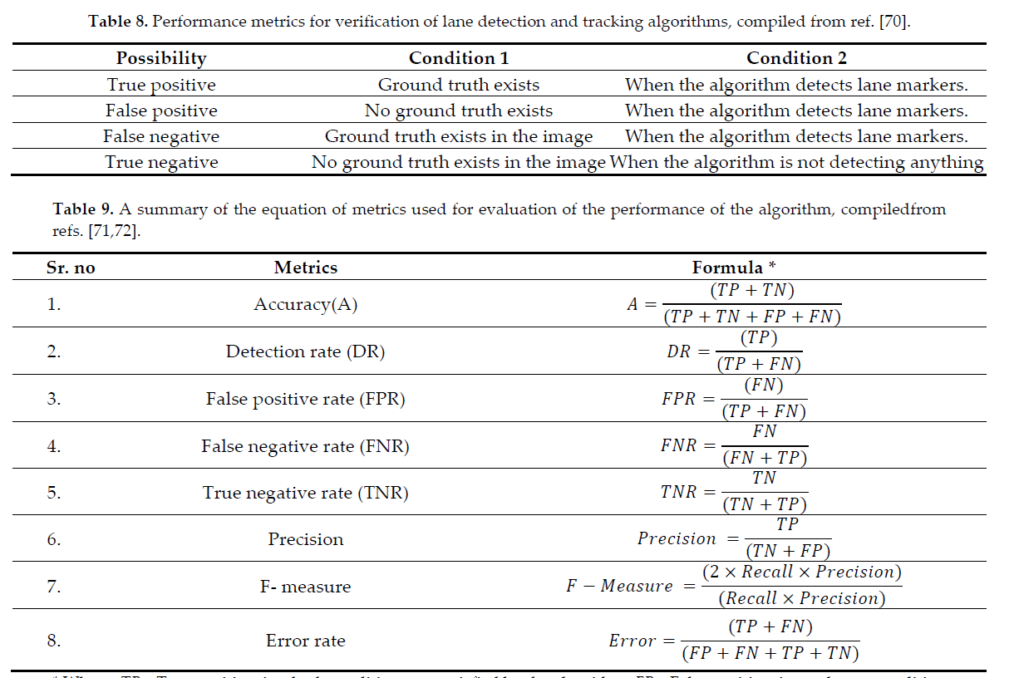
Testing evaluation
[these are conventional (fixed)]
[set KPI for these, and use it as a test]

Slide 9
Testing
 | Operation | Reference/Algorithm | Objectives | Target KPI
Stage 1 | Capturing and Processing Video | OpenCV, Pyplot,... | Capture Real-time Video Data
Stage 2 | Region of Interests | OpenCV, Pyplot… | Ignore Background
Stage 3 | Bird’s Eye View | Inverse Perspective Mapping | Curve Road Detection Curvature Calculation
Stage 4 | Road Segmentation | Image Thresholding | Differentiate Lane lines and other segment
Stage 5 | Lane Marking | Histogram Graph | Lane lines Detection
 |  | Sliding Windows | Lane lines Marking
Note: Test procedures are conducted in sufficiently illuminated environment

Slide 10
Deployment
SPEED
After passing the test
Record the processing time
Take the difference
Hardware accelerator
Desire outcome
ROBUSTNESS
[ADD methods to increase robustness]
[this slide need more graphic care]

Slide 11
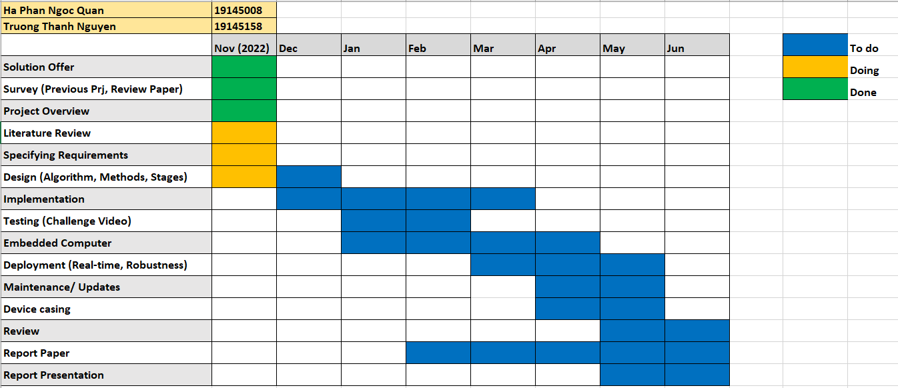
Time Line

Slide 12


Thank you

