Slide 1
Implementation of Real-time Lane-Detection on (machineName)
Periodic Report
dd/mm/2022

Slide 2
Reasons for the topic
Unintended Lane-Departure causes accidents
Demand of Real-Time Lane-Detection system
In-time Lane-Departure Warning
Problem & Solution
Potential Development
Project Prosperity
Autonomous Driving
Advanced Driver-Assistance Systems (ADAS)
Over 50 studies since 2017
Rich document resources in Computer Vision
Availability of hardware

Slide 3
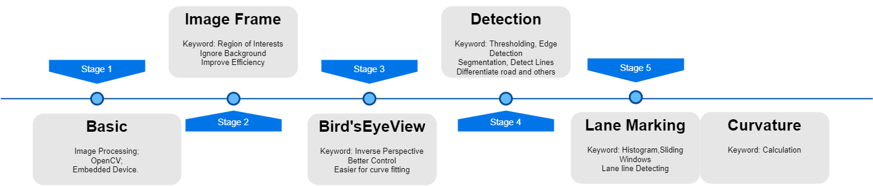
Overview
While other previous studies are based on video simulation. The improvement and also challenge of this project is Real-Time constraint

Slide 4
Survey Reference
[1] Waykole, S.; Shiwakoti, N.; Stasinopoulos, P. Review on Lane Detection and Tracking Algorithms of Advanced Driver Assistance System. Sustainability 2021, 13, 11417
[2] Ammu M Kumar and Philomina Simon, Review Of Lane Detection And Tracking Algorithms In Advanced Driver Assistance System, International Journal of Computer Science & Information Technology (IJCSIT) Vol 7, No 4, August 2015

Slide 5
Algorithms
 | Operation | Reference/Algorithm | Objectives
Stage 1 | Capturing and Processing Video | OpenCV, Pyplot,... | Capture Real-time Video Data
Stage 2 | Region of Interests | OpenCV, Pyplot… | Ignore Background
Stage 4 | Bird’s Eye View | Inverse Perspective Mapping | Curve Road Detection Curvature Calculation
Stage 3 | Road Segmentation | Image Thresholding | Differentiate Lane lines and other segment
Stage 5 | Lane Marking | Histogram Graph | Lane lines Detection
 |  | Sliding Windows | Lane lines Marking

Slide 6
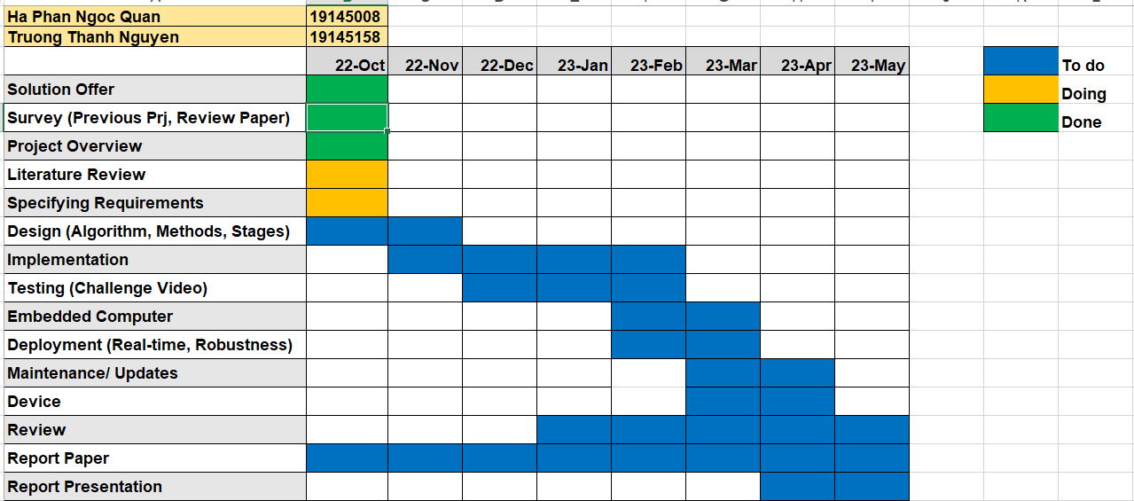
Project Timeline

