Slide 1

Survey: Related work on Real-time implementation of vision-based land detection on embedded platform
December 5, 2022

Slide 2
[1] Review on Lane Detection and Tracking Algorithms of Advanced Driver Assistance System
This study investigate and summary 50 recent works on Lane Detection and Tracking Algorithms of ADAS, it gives vast information including
Pros & cons of vision-based method
Give us the streamline for our algorithms
Low cost
Hardware-availability in automotive sector
Low-power
High precision
-> Why they are used in ADAS systems
Dependent on light
Vulnerable to whether condition
-> Can be mitigate by robust algorithms
Capturing and Processing Video
Road Segmentation
Lane Marking
Bird’s Eye View
Image Framing, ROI

Slide 3
[2] Lane Detection Algorithm for Intelligent Vehicles in Complex Road Conditions and Dynamic Environments
Detailed Validation of the Algorithms
Image Processing
Camera calibration -> undistorted image
Edge Detection (HSL transformation)
ROI -> narrow the frame -> speed up
Inverse Perspective Transform
Lane Detection
Mask Operation
RANSAC
Curve-fitting -> determine curvature
Test evaluation with good condition video, GP CPU environment:
22.2 FPS
98% accuracy
Yet neither implement on embedded system nor tested on real road
Because of the differences in developing environment, one still cannot conclude whether the performance is good enough

Slide 4
[3] A Comprehensive Real-Time Road-Lanes Tracking Technique for Autonomous Driving
Another (but very similar) approach of Computer Vision algorithms for Lane Detection
When viewed together with [2], gives the target speed for the application: 15 FPS.
Which is one of the criteria regard to Real-time application
Consolidate our feasibility of this project in terms of the algorithms
Still, this study was not implemented on embedded environment

Slide 5
[4] Lane detection using Raspberry Pi
When viewed together with [2], gives the target speed for the application: 15 FPS.
Which is one of the criteria regard to Real-time application
Still, this study was not implemented on embedded environment

Slide 7

Primary Goals
Annual revenue growth

Slide 8
Quality Performance

Slide 9
Areas of growth

Slide 10

Business opportunities are like buses. There's always another one coming.
Richard Branson

Slide 11

Summary
At Contoso, we believe in giving 110%. By using our next-generation data architecture, we help organizations virtually manage agile workflows. We thrive because of our market knowledge and great team behind our product. As our CEO says, "Efficiencies will come from proactively transforming how we do business."​

Slide 12

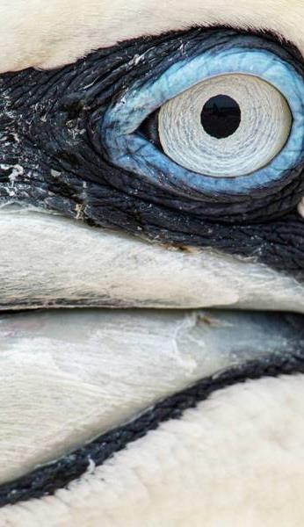
Thank you
Mirjam Nilsson​​
mirjam@contoso.com​
www.contoso.com​

