Slide 1
T22 PA8536 ESD
Verify Result & Analysis
July, 2019

Slide 2
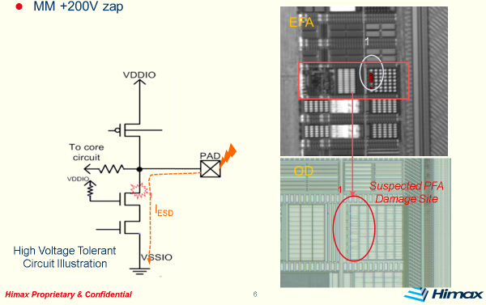
T22 IO/ESD Testing
HBM/MM Test Result list in Table 1
VH_1: 1.8V
VH_2 (A): 0.9V
PLLS_AVDD09/PLLS_DVDD09
VH_2 (A): 0.9V
TX_VDD09
IO : GPIO (5VT cell)
Root Cause Summary
VH_2 (B): Described later in next page
5VT summary as following
Table 1 ESD Test Result Summary
PASS | HBM | MM
VH_1-VG | 3KV | 250V
VH_2-VG (A) | 3KV | 300V
VH_2-VG (B) | 2KV | 150V
IO-VG | 3KV | 150V
Fig. RST_N hot spot and PFA locage NMOS drain side damage at MM200V

Slide 3
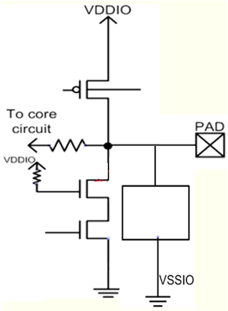
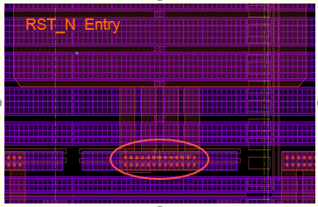
MM Solution by Himax
High voltage-tolerant Solution
Modify the entry site of RST_N cell → VIA5
(avoid the current limit at entry site)
Auxiliary pad
Create auxiliary pad to enhance ESD level (not recommended)
Need to check functionality for integrated pad
High Voltage Tolerant
Circuit Illustration

Slide 4
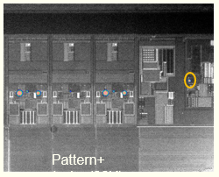
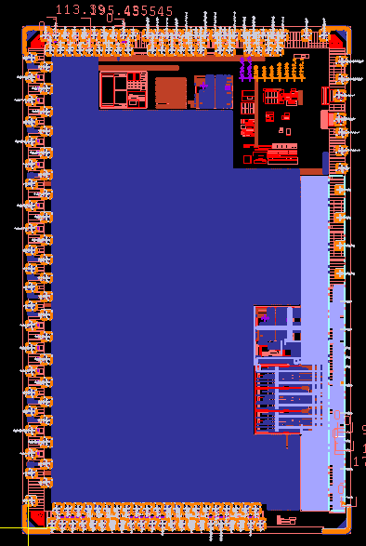
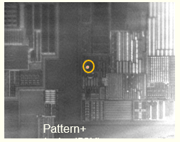
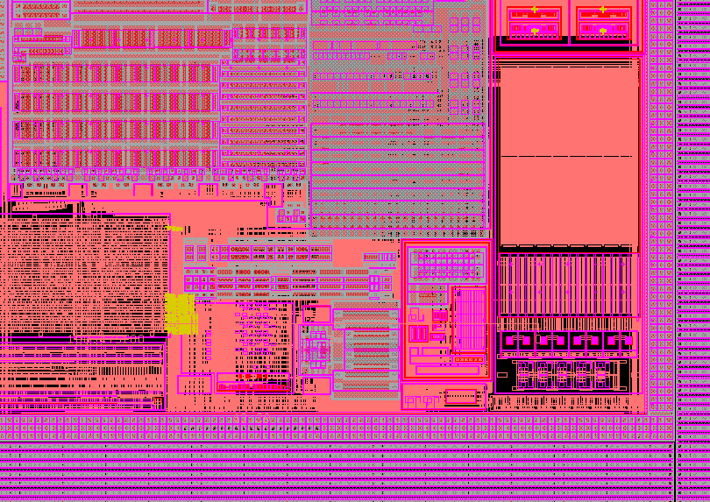
MM Failure Analysis TX_VDD09 (pin 27) Result
MM +200V failure location
Measurement condition
Layout check on going
PFA on going
Pattern+ emission(20X)

Slide 5
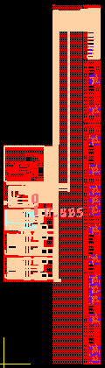
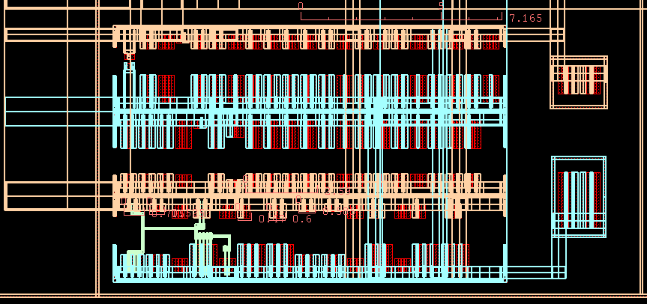
IP0956 TX_VDD09 MM=200V Damage Location
Dummy region
VSSA18
MM fail: TX_VDD09 – GND group
內部點, 無出PAD
VSSA18

Slide 6
Damage Circuit Evaluation → Perc condition reference
ESD
TX_VDD09
MPG
Turn-on
W/L=
1000u/0.15u,
通常這點為內部電路, P & NMOS 2 junction 不會ESD fail.
發生條件為: MPG size夠大, gate node floating.
當ESD來時, MPG 有機會turn on, 以至core is weak because of ESD rule 而被damage.
Damage
GND

Slide 7
IP0956 TX_VDD09 MM=200V Damage Location
VSSA18
VSSA18
Dummy region (藍色虛線框)
TXVDD09 → VSSA18 direct clamp
Ideal path
Damage path into core
2. Cap inserted in between core to VSSA
Direct
Clamp
TX_VDD09

