Slide 1
Project #2
Robert Richter
Robert Richter

Slide 2
Part 1: Training a Decision Tree Classifier
Prepare Data
Train Model
Merge Explanations
Robert Richter

Slide 3
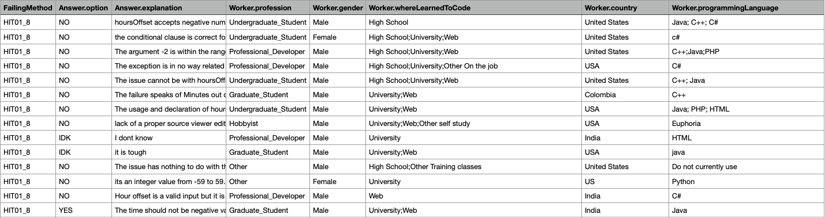
Preparing Data – Enums
DTCs require numbers only: How to transform Strings to Numbers?
Step 1: All fields with enums can be replaced by numbers
Enum
Enum
Enum
Enum
Enum
Robert Richter

Slide 4
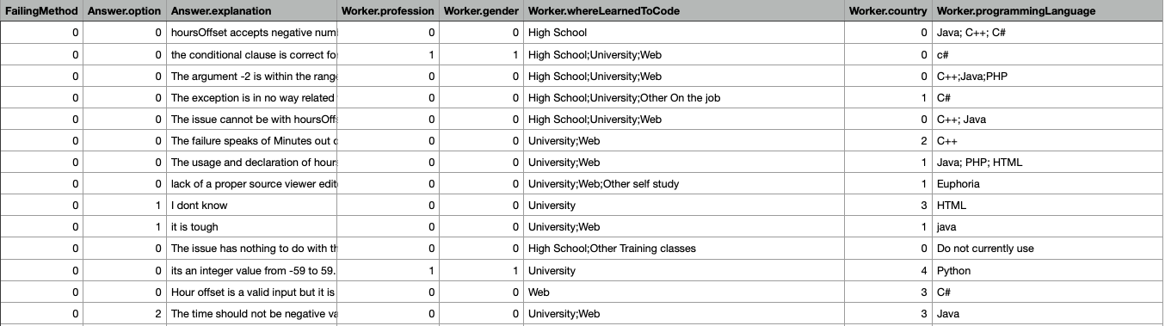
Preparing Data – Partial Enums and Explanation Complexity
Step 2, Partial Enums (i.e., unstructured enums): Scoring (e.g., 1 point per programming language)
Step 3, Explanation Complexity: various metrics to test (here: word count)
Robert Richter

Slide 5
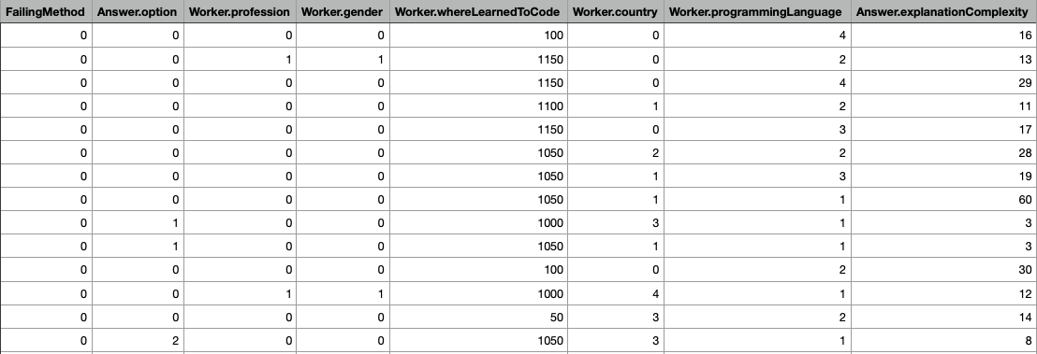
Preparing Data – Partial Enums and Explanation Complexity
Enum
Enum
Enum
Enum
Score
Enum
Score
Word Count
Robert Richter

Slide 6
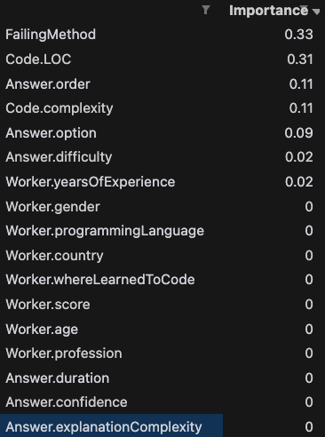
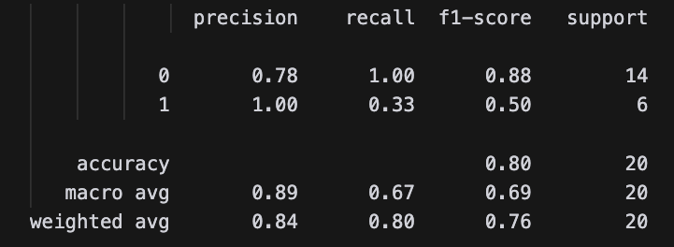
Performance of this?
Parameters:
ccp_alpha: 0.04
criterion: entropy
Test size: 20 Samples
Explanation Complexity: Word Count
Robert Richter

Slide 7
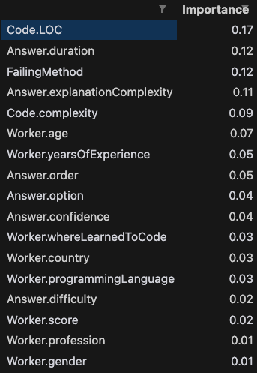
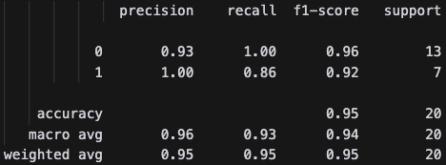
Untuned Model even better?
Parameters:
ccp_alpha: 0
criterion: gini
Test size: 20 Samples
Explanation Complexity: Word Count
This often holds recall & precision of 1 ...
Robert Richter

Slide 8
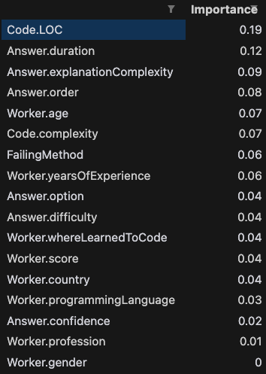
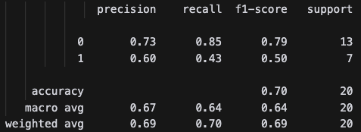
What about the Halstead Metric?
Parameters:
ccp_alpha: 0.04
criterion: gini
Test size: 20 Samples
Explanation Complexity: Word Count
Halstead makes it worse
Should we not look at the code?
Robert Richter

Slide 9
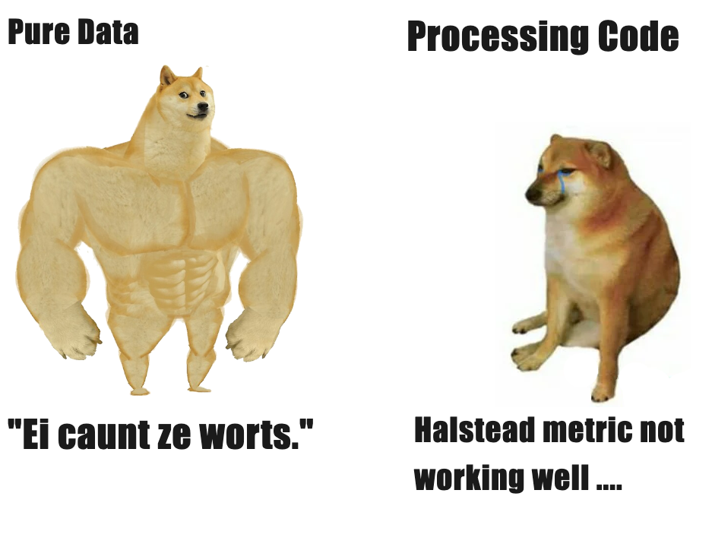
Part 1: Conclusion
Running the model purely on the prepared data without tuning the DTC gave the best results.
What I did not mention: Adding QuestionIDs and AnswerIDs yielded perfect results (ask for it!)
Robert Richter

Slide 10
Part 2: Merge Explanations
Model: GPT4o (via OpenAI API)
Approach #1: Only use Test Set (answers predicted to be corrected)
Answers like “I cannot give a conclusive answer without looking at the code” (but that would be too easy, wouldn’t it?)
Also, we don’t know whether we predicted correctly
Improvements: Adding more context, target groups, handing over code files
Robert Richter

Slide 11
Part 2: Merge Explanations
Approach #2: Use the whole dataset with the ground truth
GPT-4o: 0.05 $, 56.51s
GPT-4o-mini: 0.003 $, 88.43s
But results were really nice!
The issue arises from a check on line 279 of the code which incorrectly restricts the `minutesOffset` parameter to values between 0 and 59. This restriction is inconsistent with the comments and documentation that indicate `minutesOffset` can be negative, up to -59, starting from version 2.3. The problem occurs because the check (`if (minutesOffset < 0 || minutesOffset > 59)`) throws an `IllegalArgumentException` for negative values such as -15, as set by `DateTimeZone.forOffsetHoursMinutes(-2, -15)`. To fix the issue, the check on line 279 should be updated to allow negative values by changing the condition to `if (minutesOffset < -59 || minutesOffset > 59)`. This aligns with the documented behavior and allows the code to progress correctly without throwing an exception for valid negative minute offsets.',
Robert Richter

Slide 12
Appendix
Robert Richter

Slide 13
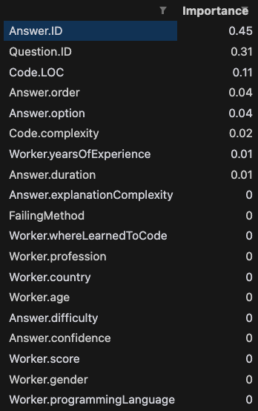
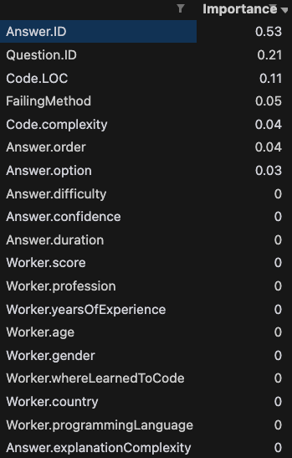
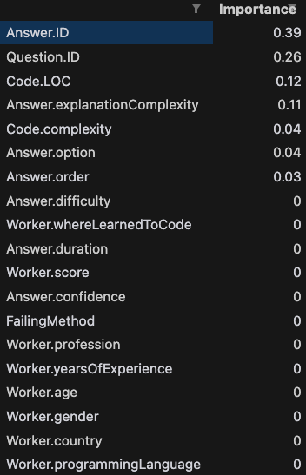
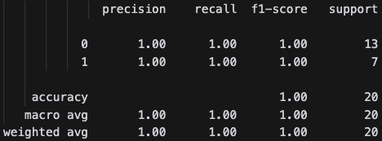
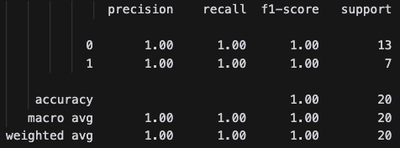
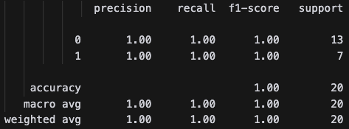
Appendix 1: Adding QuestionID and AnswerID
Number of Words
(untuned model)
Number of Words
(tuned model)
Halstead Metric
(tuned model)
Robert Richter

