Slide 1

Belana Zwadsich, Ole Schmitt
Mini Project 2:
Consolidate Bug Report Explanations
Advanced Software Engineering
WiSe 24-25

Slide 2
Training the Model: Prepare Data
adding text complexity column
chose TTR (type-token-ratio) as metric for diversity of vocabulary
low value = tendency to use same words
easy to comprehend & implement
text length influences score
def calculate_ttr(text): # split on non-alpha. chars, lower case tokens = tokenize(text) # unique tokens types = set(tokens) return len(types) / len(tokens) if len(tokens) > 0 else 0

Slide 3
Training the Model: Precision & Recall
Bug Report | Precision | Recall
Overall | 0.2286 | 0.0381
HIT03_6 | 0.44 | 0.09
HIT04_7 | 0.08 | 0.02
HIT05_35 | 0.25 | 0.03
HIT06_51 | 0.11 | 0.02
HIT07_33 | 0.60 | 0.05
HIT08_54 | 0.14 | 0.02
used Random Forest Classifier
not so great results
small amount of data
ground truth heavily skewed (training set - 0: 1840, 1: 420)
Dataset | Precision | Recall
Holdout | 0.3333 | 0.025
HIT01_8 | 0.25 | 0.03
HIT02_24 | 0.50 | 0.03
Cross-Validation Metrics
Holdout Metrics

Slide 4
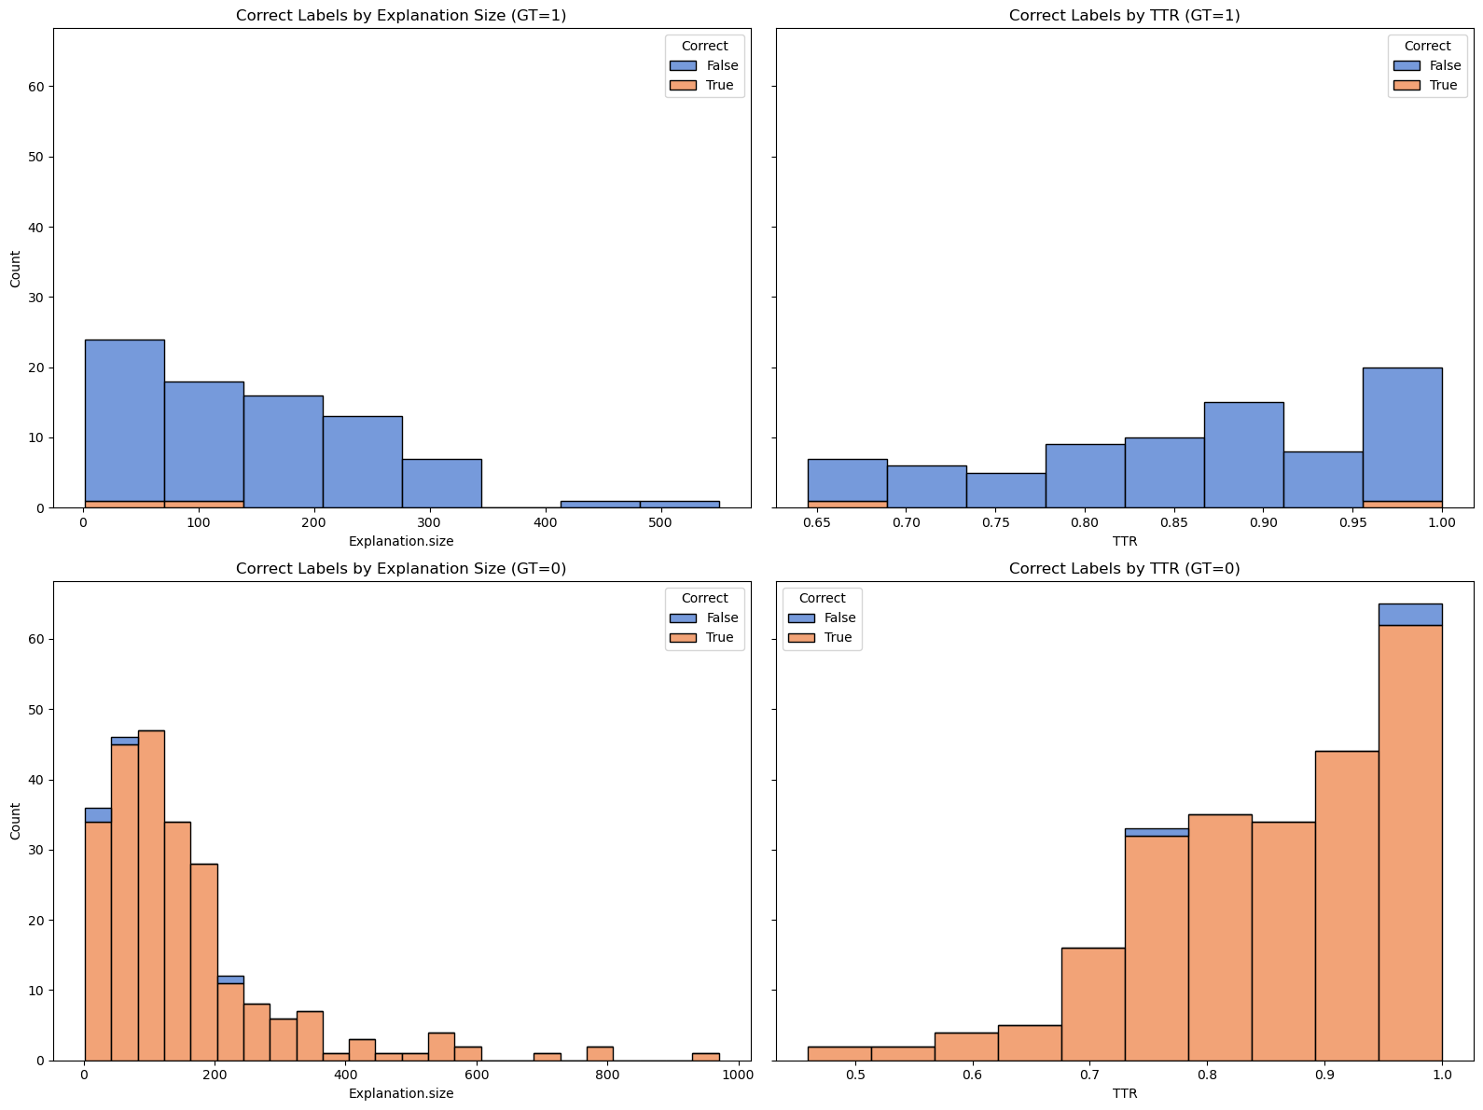
Training the Model: Categorizing Answers
Correct Labels by Explanation Size (GT=1)
Correct Labels by TTR (GT=1)
detection performance on holdout set
classifier biased towards predicting 0
label 1 predicted in only 6 of 320 cases
→ balance / augment dataset
most explanations short
TTR high
Count
Explanation.size
TTR
Correct Labels by Explanation Size (GT=0)
Correct Labels by TTR (GT=0)
Count
Explanation.size
TTR

Slide 5
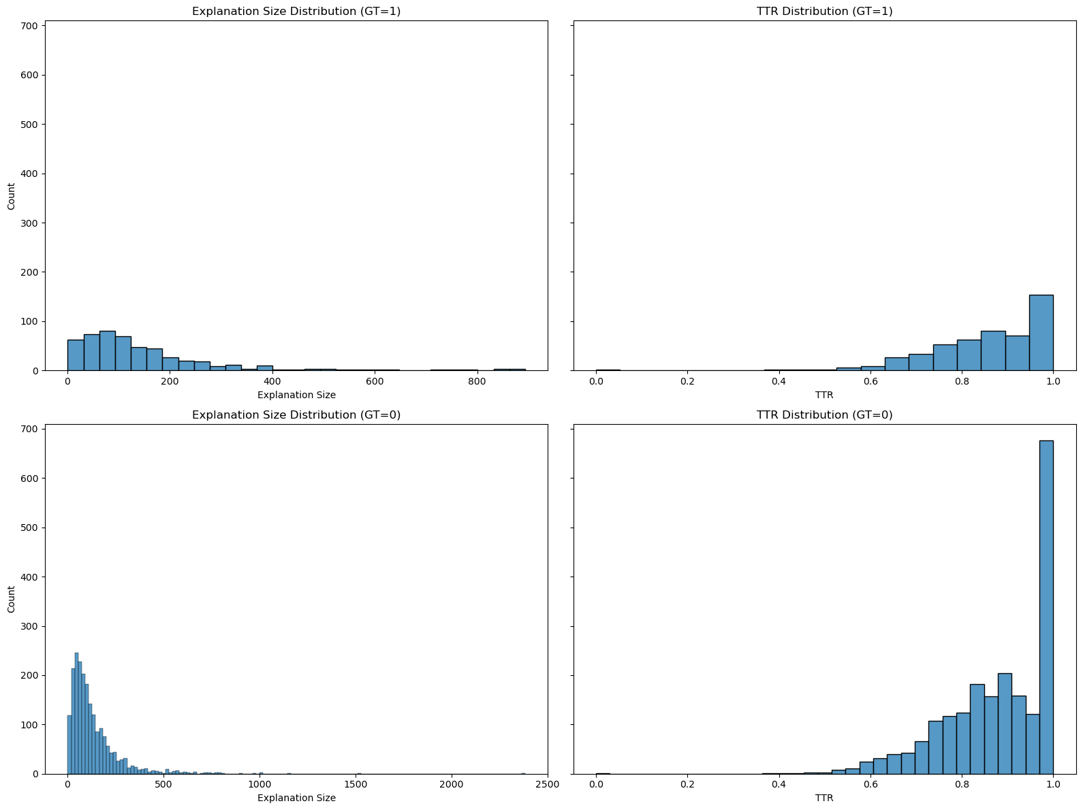
Training the Model: Categorizing Answers
Explanation Size Distribution (GT=1)
TTR Distribution (GT=1)
detection performance on holdout set
classifier biased towards predicting 0
label 1 predicted in only 6 of 320 cases
→ balance / augment dataset
most explanations short
TTR high
Count
Explanation.size
TTR
Explanation Size Distribution (GT=0)
TTR Distribution (GT=0)
Count
Explanation.size
TTR

Slide 6
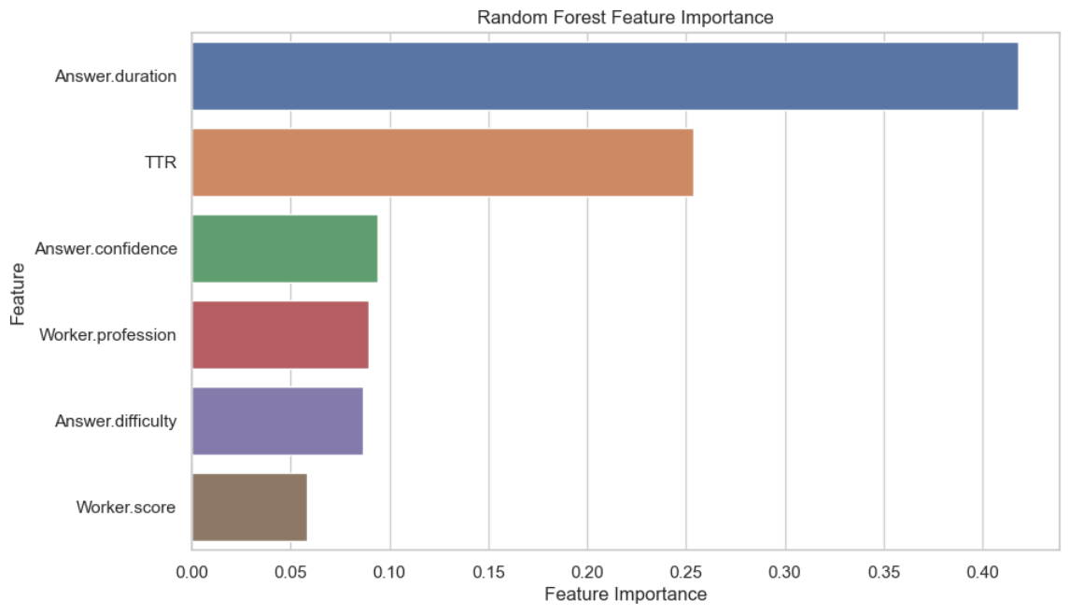
Training the Model: Categorizing Answers
Random Forest Feature Importance
detection performance on holdout set
classifier biased towards predicting 0
label 1 predicted in only 6 of 320 cases
→ balance / augment dataset
most explanations short
TTR high
model relied on TTR as 2nd most important feature
→ more data for positive examples
Duration
TTR
Confidence
Worker Profession
Difficulty
Worker Score
Feature Importance

Slide 7
Consolidating Explanations
Compared 5 Prompts for consolidating explanations for HIT02_24 using ChatGPT4o
 | Chain of Density [Adams23] | Our prompt | Summarize | Professional Summarizer [Reddit] | Task copied
Word Count | 63 | 348 | 299 | 121 | 511
TTR | 0.838 | 0.277 | 0.377 | 0.717 | 0.227
Readability | - | o | o | ++ | +
Speed* | - | o | o | ++ | o
Suggestion | No | Yes | Yes | No | Yes
Adams, Griffin & Fabbri, Alexander & Ladhak, Faisal & Lehman, Eric & Elhadad, Noémie. (2023). From Sparse to Dense: GPT-4 Summarization with Chain of Density Prompting. 10.48550/arXiv.2309.04269.

Slide 8
Comparing Explanations: BLEU
Issue | BLEU Score
HIT01_8 | 0.15
HIT02_24 | 0.00
HIT03_6 | 0.00
HIT04_7 | 0.11
HIT05_35 | 0.00
HIT06_51 | 0.00
HIT07_33 | 0.00
HIT08_54 | 0.00
used Chain of Density (CoD) method for summary
BLEU scores low
→ designed for precise matching & lexical overlap
→ explanation length, structure, word choice varies
→ penalizes shorter summaries (fewer n-gram matches)
→ too much density using CoD?
→ doesn’t account for semantic similarity
BLEU Scores per Issue
Notes:
BLEU: n-gram overlap

Slide 9
Comparing Explanations: ROUGE
Issue | ROUGE Score
HIT01_8 | 0.13
HIT02_24 | 0.11
HIT03_6 | 0.09
HIT04_7 | 0.07
HIT05_35 | 0.08
HIT06_51 | 0.06
HIT07_33 | 0.11
HIT08_54 | 0.09
used Chain of Density (CoD) method for summary
ROUGE scores similarly low (for full report see Jupyter Notebook)
→ likely similar reasons
low scores do not necessarily mean poor summary
ROUGE Scores per Issue
Notes:
BLEU: n-gram overlap

Slide 10
Reflection
Data quality: crowd-sourced, diverse, uncleaned
Classifier update: results may worsen over time (concept drift), updating / re-training strategy necessary; concept shift detection difficult
Output testing of classifier & LLM: error propagation risk, manual review, monitor metrics, curate golden data set
Estimate consolidation quality: BLEU / ROUGE seem limited, manual review, field study of devs uing summaries in the wild
Classifier-LLM integration: manual copy paste, (tested) data exchange pipeline necessary

Slide 11
Anhang

Slide 12
Consolidating Explanations: Chain of Density
You will generate increasingly concise, entity-dense summaries of the above answer explanations.
Repeat the following 2 steps 5 times.
Step 1. Identify 1-3 informative entities (";" delimited) from the article that are missing from the previously generated summary.
Step 2. Write a new, denser summary of identical length which covers every entity and detail from the previous summary plus the missing entities.
A missing entity is:
- Relevant to the main answer explanations,
- Specific yet concise (5 words or fewer),
- Novel (not in the previous summary),
- Faithful (present in the answer explanations),
- Anywhere (can be located anywhere in the answer explanations).
Guidelines:
- The first summary should be long (4-5 sentences, ~80 words) yet highly non-specific, containing little information beyond the entities marked as missing. Use overly verbose language and fillers (e.g., "these answer explanations discuss") to reach ~80 words.
- Make every word count: rewrite the previous summary to improve flow and make space for additional entities.
- Make space with fusion, compression, and removal of uninformative phrases like "the article discusses".
- The summaries should become highly dense and concise yet self-contained, i.e., easily understood without the answer explanations.
- Missing entities can appear anywhere in the new summary.
- Never drop entities from the previous summary. If space cannot be made, add fewer new entities.
Remember, use the exact same number of words for each summary.
Adapted from: Adams, Griffin & Fabbri, Alexander & Ladhak, Faisal & Lehman, Eric & Elhadad, Noémie. (2023). From Sparse to Dense: GPT-4 Summarization with Chain of Density Prompting. 10.48550/arXiv.2309.04269.

Slide 13
Consolidating Explanations: Chain of Density Result
The "g" variable, scaled within a 255 range and cast to int, impacts the Color class, triggering IllegalArgumentException if bounds fail. this.lowerBound and this.upperBound inadequacies prevent sanitization, allowing negatives. Misusing "value" over "v" (line 117) worsens errors. Reliance on Math.max() and Math.min(), double types, and input consistency is emphasized. The Color(float, float, float) constructor and RuntimeException encapsulate broader dependency issues in parameter handling.
Adapted from: Adams, Griffin & Fabbri, Alexander & Ladhak, Faisal & Lehman, Eric & Elhadad, Noémie. (2023). From Sparse to Dense: GPT-4 Summarization with Chain of Density Prompting. 10.48550/arXiv.2309.04269.

Slide 14
Consolidating Explanations: Our Prompt
Consolidating Explanations: Summarize
I have a list of explanations of where there is a bug in a given code statement. Please merge the explanations in a way that minimizes redundant information, while keeping the information that would be necessary for someone else to fix the bug.Types of information that, if present in the explanation, should be preserved - how the program works,how the failure is happening, what is problem in the code, etc.
Be short, concise, do not use verbose laguage.
Summarize

Slide 15
Consolidating Explanations: Professional Summarizer
As a professional summarizer, create a concise and comprehensive summary of the provided text, be it an article, post, conversation, or passage, while adhering to these guidelines:
1. Craft a summary that is detailed, thorough, in-depth, and complex, while maintaining clarity and conciseness.
2. Incorporate main ideas and essential information, eliminating extraneous language and focusing on critical aspects.
3. Rely strictly on the provided text, without including external information.
4. Format the summary in paragraph form for easy understanding.
Adapted from: [Reddit]

Slide 16
Consolidating Explanations: Professional Summarizer Result
The provided text discusses a technical issue involving the use of the "g" variable in a coding context, where it is scaled within a range of 255 and cast to an integer, potentially causing problems in the Color class. Specifically, an IllegalArgumentException is triggered when values exceed defined bounds. The failure to properly sanitize the this.lowerBound and this.upperBound variables allows negative values, compounding the issue. Additionally, incorrect usage of "value" instead of "v" on line 117 introduces further complications. The text underscores the importance of using methods like Math.max() and Math.min() with consistent double-type inputs to ensure reliability. Broader challenges are identified with parameter handling in the Color(float, float, float) constructor, with dependencies further obscured by encapsulating issues in a RuntimeException.
Adapted from: [Reddit]

Slide 17
Consolidating Explanations: Copied Task
generate a single explanation by merging the participants’ explanations in a way that minimizes
redundant information, while keeping the information that would be necessary for someone else to fix the
bug.
Types of information that, if present in the explanation, should be preserved - how the program works, how the failure is happening, what is problem in the code, etc.

