Slide 1
Project #2
Robert Richter

Slide 2
Part 1: Training a Decision Tree Classifier
Prepare Data
Train Model
Merge Explanations

Slide 3
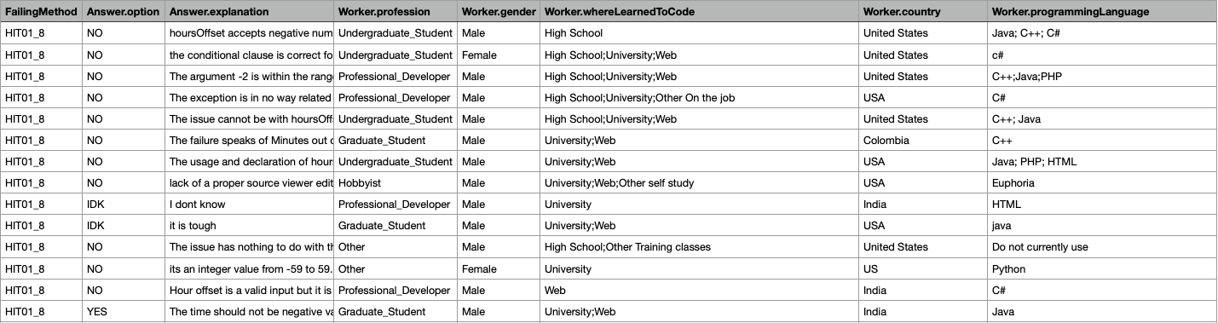
Preparing Data – Enums
DTCs require numbers only: How to transform Strings to Numbers?
Step 1: All fields with enums can be replaced by numbers
Enum
Enum
Enum
Enum
Enum

Slide 4
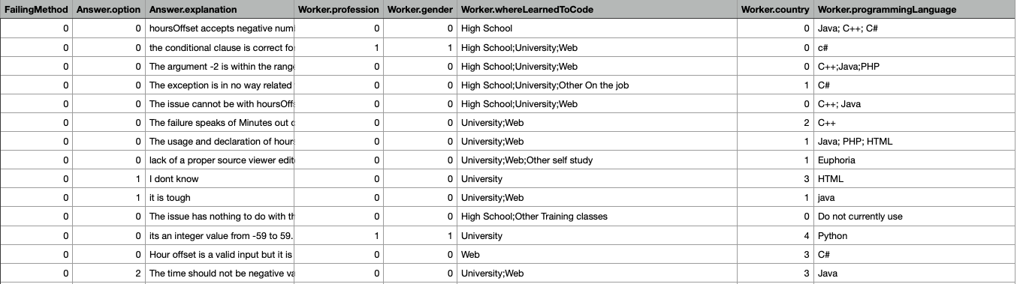
Preparing Data – Partial Enums and Explanation Complexity
Step 2, Partial Enums (i.e., unstructured enums): Scoring (e.g., 1 point per programming language)
Step 3, Explanation Complexity: various metrics to test (here: word count)

Slide 5
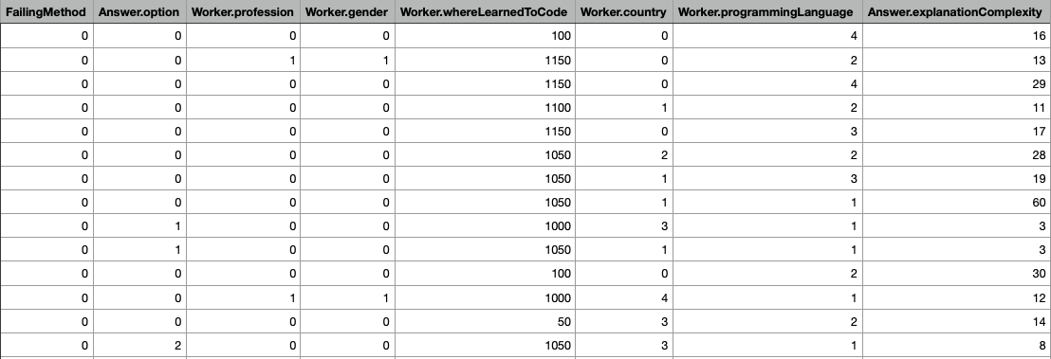
Preparing Data – Partial Enums and Explanation Complexity
Enum
Enum
Enum
Enum
Score
Enum
Score
Word Count

Slide 6
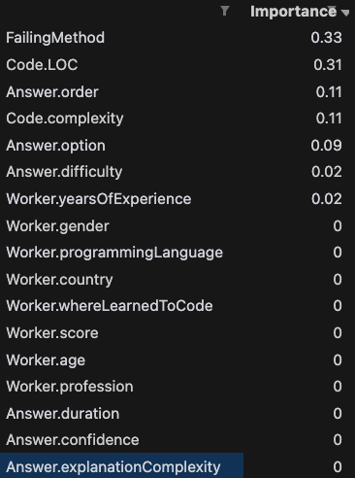
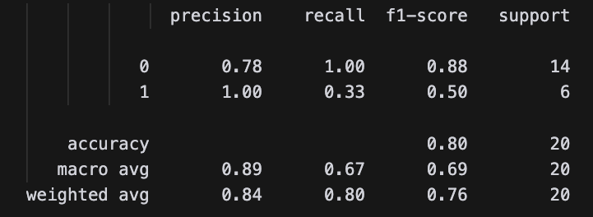
Performance of this?
Parameters:
ccp_alpha: 0.04
criterion: entropy
Test size: 20 Samples
Explanation Complexity: Word Count

Slide 7
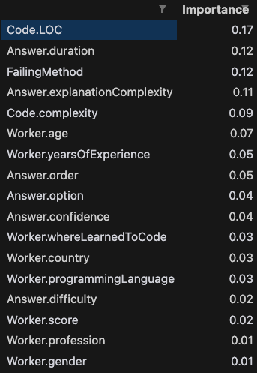
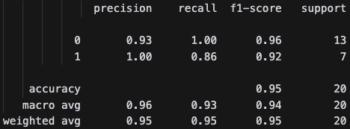
Untuned Model even better?
Parameters:
ccp_alpha: 0.04
criterion: gini
Test size: 20 Samples
Explanation Complexity: Word Count
This often holds recall & precision of 1 ...

Slide 8
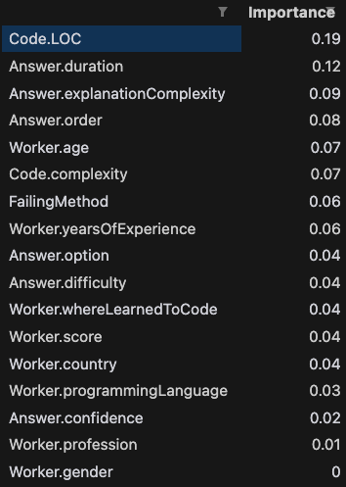
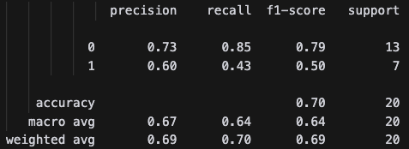
What about the Halstead Metric?
Parameters:
ccp_alpha: 0.04
criterion: gini
Test size: 20 Samples
Explanation Complexity: Word Count
Halstead makes it worse
Should we not look at the code?

Slide 9
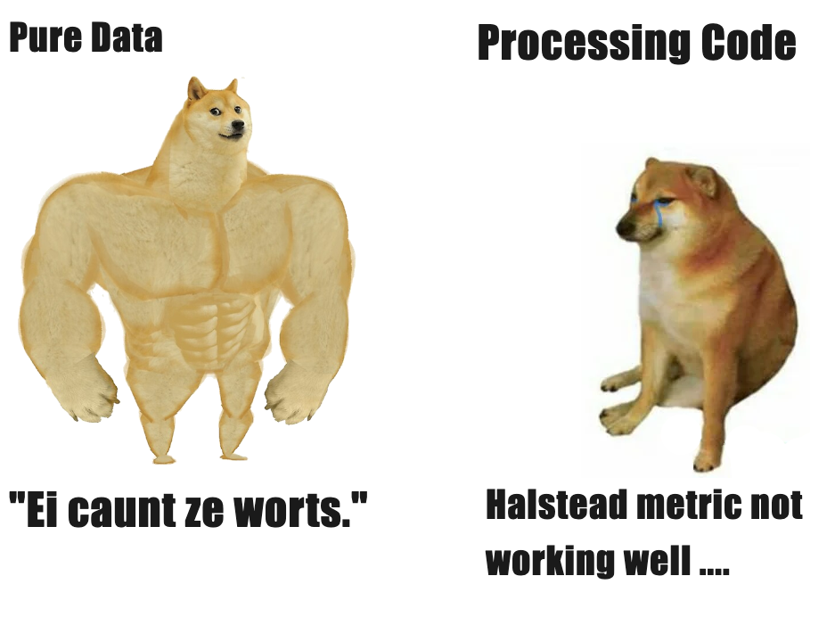
Part 1: Conclusion
Running the model purely on the prepared data without tuning the DTC gave the best results.
What I did not mention: Adding QuestionIDs and AnswerIDs yielded perfect results (ask for it!)

Slide 10
Part 2: Merge Explanations
Model: GPT4o
Approach #1: Only use Test Set (answers predicted to be corrected)
Answers like “I cannot give a conclusive answer without looking at the code” (but that would be too easy, wouldn’t it?)
Also, we don’t know whether we predicted correctly
Improvements: Adding more context, target groups, handing over code files

Slide 11
Part 2: Merge Explanations
Approach #2: Use the whole dataset with the ground truth
Quite costly (~ 0.40$)
But results were really nice!
The issue arises from a check on line 279 of the code which incorrectly restricts the `minutesOffset` parameter to values between 0 and 59. This restriction is inconsistent with the comments and documentation that indicate `minutesOffset` can be negative, up to -59, starting from version 2.3. The problem occurs because the check (`if (minutesOffset < 0 || minutesOffset > 59)`) throws an `IllegalArgumentException` for negative values such as -15, as set by `DateTimeZone.forOffsetHoursMinutes(-2, -15)`. To fix the issue, the check on line 279 should be updated to allow negative values by changing the condition to `if (minutesOffset < -59 || minutesOffset > 59)`. This aligns with the documented behavior and allows the code to progress correctly without throwing an exception for valid negative minute offsets.',

Slide 12
Appendix

Slide 13
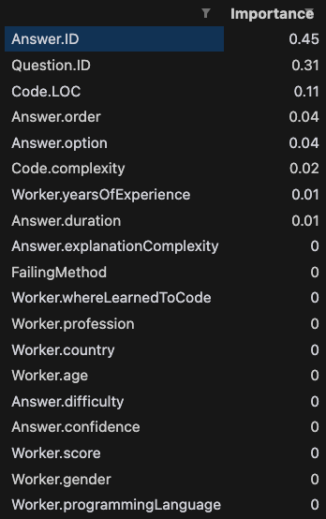
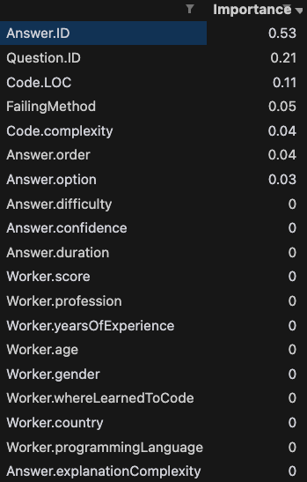
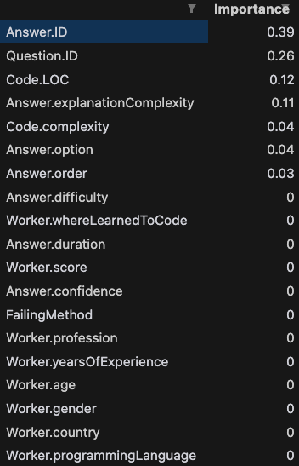
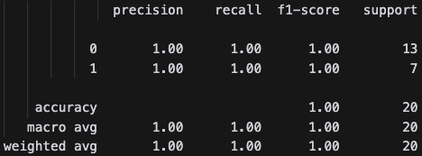
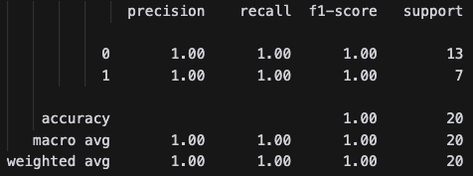
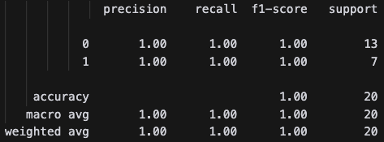
Appendix 1: Adding QuestionID and AnswerID
Number of Words
(untuned model)
Number of Words
(tuned model)
Halstead Metric
(tuned model)

