Slide 1
PM Project BIC
Benito, Ivan, Christoph

Slide 2
P1 (Benito)

Slide 3
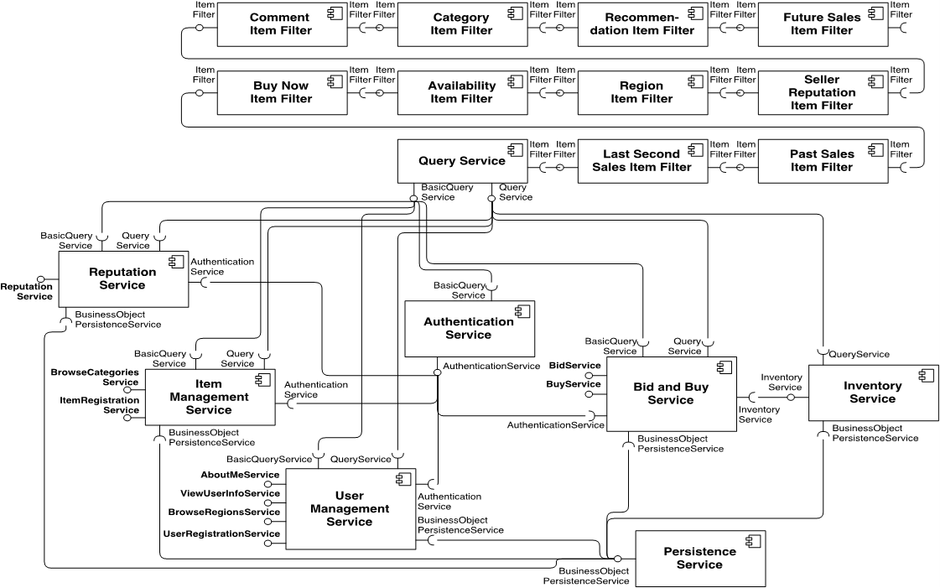
P1: mRubis
18 components and 3 states of operation = 54 total states
Two completion strategies
adding self-loops
supervisory component
Notes:
construction of DTMC
self-loops
completion strategies (stuck self-loops, supervisory component)
add_stuck_self_loops, add_supervisory_component
operation states (Kronecker product)
generate_transitions

Slide 4
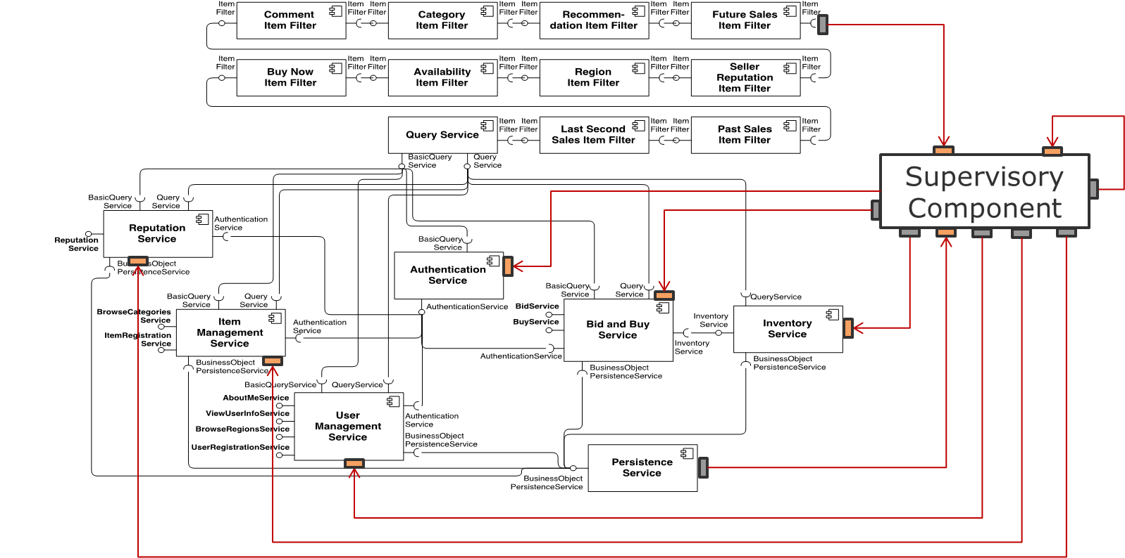
P1: mRubis
18 components and 3 states of operation = 54 total states
Two completion strategies
adding self-loops
supervisory component
Notes:
construction of DTMC
self-loops
completion strategies (stuck self-loops, supervisory component)
add_stuck_self_loops, add_supervisory_component
operation states (Kronecker product)
generate_transitions

Slide 5
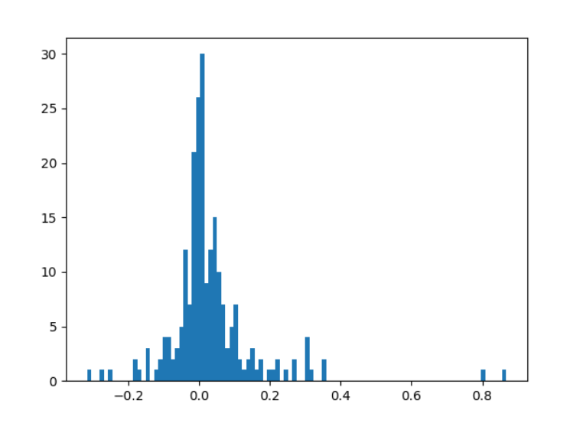
P1: mRubis
18 components and 3 states of operation = 54 total states
Two completion strategies
adding self-loops
supervisory component
Learning a DTMC
Generate random walks → transition log
Statistical inference
→ To Demo in Code
Notes:
construction of DTMC
self-loops
completion strategies (stuck self-loops, supervisory component)
add_stuck_self_loops, add_supervisory_component
operation states (Kronecker product)
generate_transitions
re-learning of DTMC
random walks
random_walks
statistical inference
estimate_transition_matrix
estimation error (see numbers from output)

Slide 6
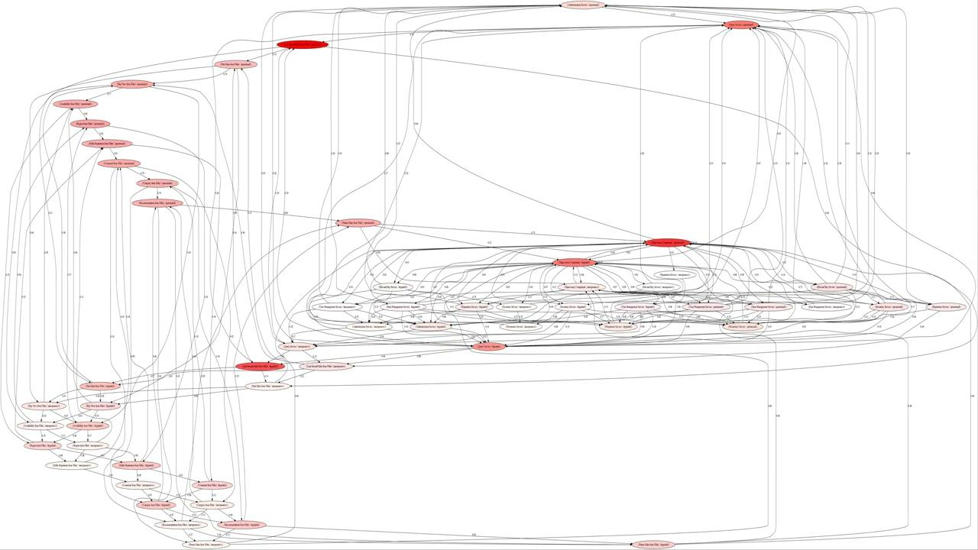
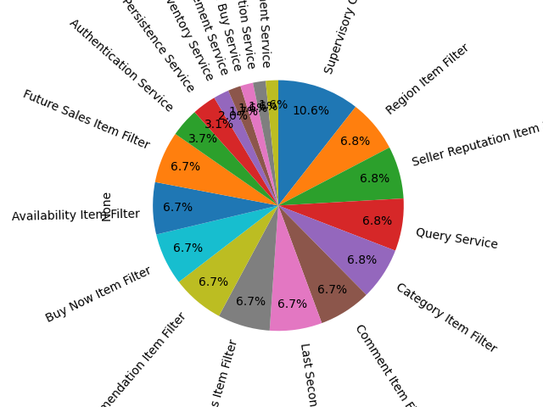
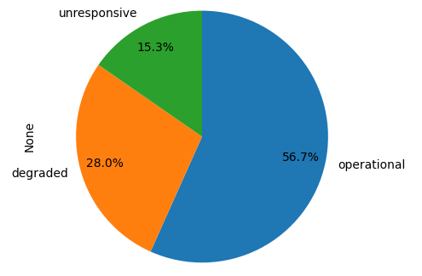
P1: Steady-State
Notes:
analysis of steady-state
approximation of numeric solution (avoid identifying BSCCs)
visualization:
pie charts
animated heatmap
graphviz + ffmpeg

Slide 7
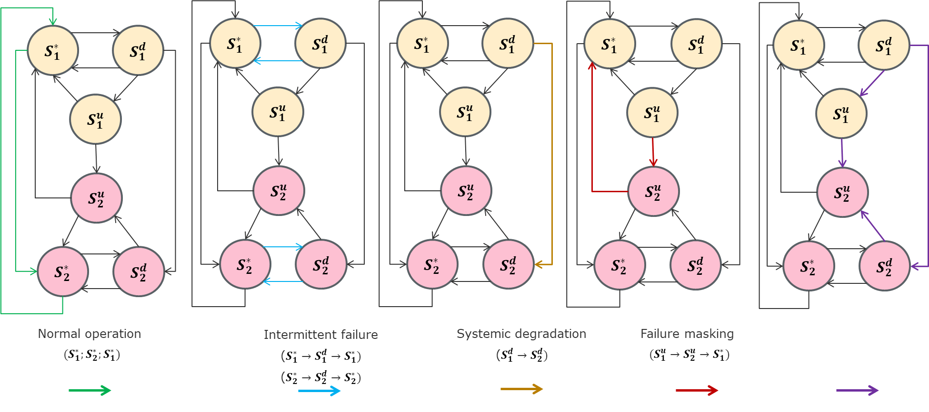
P1: Failure Patterns & Questions

Slide 8
P2 (Ivan)

Slide 9
P2: HMM Construction
Constructing HMM from our DTMC
using walkthroughs
to generate emission matrix we used the identity matrix and added some noise
Using hmmlearn to learn CategoricalHMM
using many random initializations and choosing best performing model
Issues with model quality
tests with minimum example also lead to unexpected results (more in Code Demo)

Slide 10
P2: Failure Patterns
Similar to P1
Get most probable sequence of states
Collect states
Find argmax
Use model.predict
→ Code Demo

Slide 11
P3 (Christoph)

Slide 12
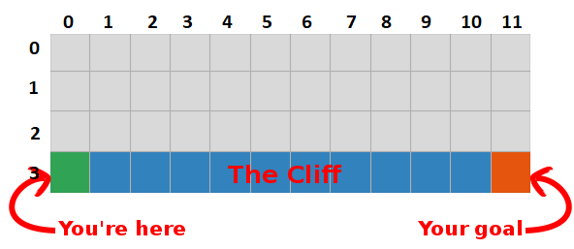
P3 (Cliff Maze): Game Design
FORMALIZATION
states: coordinates
actions: edges between free fields + back over cliff to start
REWARD STRUCTURE
-1 per edge
-100 per cliff
https://medium.com/@lgvaz/understanding-q-learning-the-cliff-walking-problem-80198921abbc
Cliff.step()

Slide 13
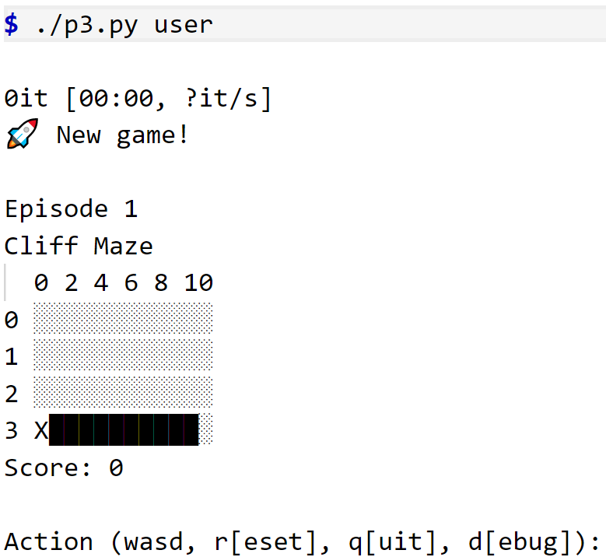
P3 (Cliff Maze): Demo

Slide 14
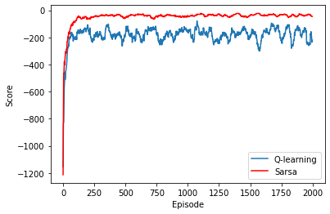
P3 (Cliff Maze): Learning
Agents for Q-Learning & Sarsa
train()
Demo
Q-Learning:
considers all possible actions for current state → more systematic, learns better risk assessment, takes optimal path
Sarsa:
only consider last taken action → less optimistic, always takes safe path
fewer punishments/crashes during learning

Slide 15
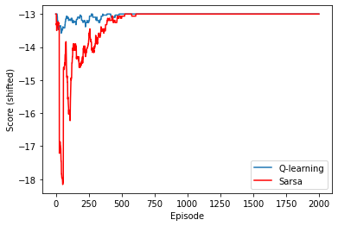
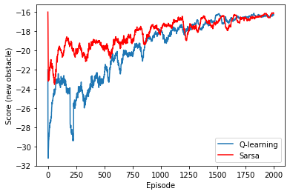
P3 (Cliff Maze): Learning Properties
Dealing with concept shifts?
Transfer Learning?
Idea: “Protocell” with shared Q-values for all uninitialized/non-mature cells?

Slide 16
P4

Slide 17
P4 (Cliff Maze): Construction of CTMC
time measurements in P3 (q-learning)
profile.csv
fit lambda per transition (main.py, fit)

Slide 18
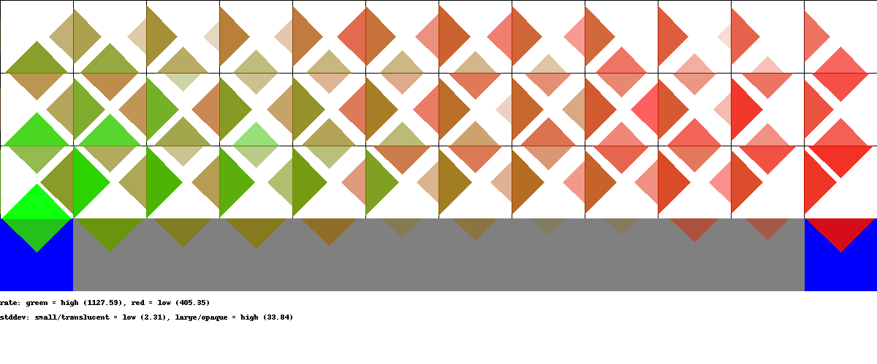
P4 (Cliff Maze): CTMC

Slide 19
P4 (Cliff Maze): Limiting Distribution
construct generator matrix
outlook: reduction of induced DTMC + analytical solution using sympy

