Slide 1
Introduction to Multi-Armed Bandits
"When solving a problem of interest, do not solve a more general problem as an intermediate step"
Vladimir Vapnik [1]
Christian Adriano
christian.adriano@hpi.de
Notes:
https://en.wikipedia.org/wiki/Transduction_(machine_learning)

Slide 2
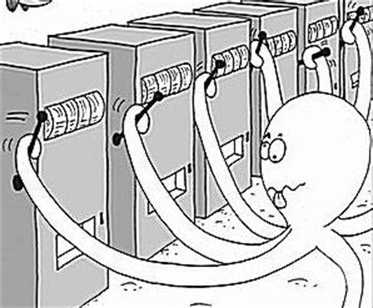
Why Multi-Armed Bandits (MAB)?
MAB allows to learn while making sequential decisions
Algorithms are simple, elegant and with rigorous theoretical guarantees of performance
Many applications in practice!
Clinical trials [1,2,3,4]
Pricing [5], Innovation [6], Auctions [7]
Assortment/Recommendations [8]
Adversting planning [9,10]
A/B testing [11], Load balancing [12], Routing [13]
Notes:
[1] W. R. Thompson. On the likelihood that one unknown probability exceeds another in view of the evidence of two samples. Biometrika, 25:285–294, 1933.
[2] H. Robbins. Some aspects of the sequential design of experiments. Bulletin of the American Mathematical Society, 55:527–535, 1952.
[3] M. Zelen. Play the winner rule and the controlled clinical trials. Journal of the American Statistical Association, 64:131–146, 1969.
[4] Aziz et al., 2019, "On Multi-Armed Bandit Designs for Phase I Clinical Trials", https://www.groundai.com/project/on-multi-armed-bandit-designs-for-phase-i-clinical-trials/1
[5] D. Bergemann and J. Valimaki. Learning and strategic pricing. Econometrica, 64:1125–1149, 1996.
[6] D. Bergemann and U. Hege. The financing of innovation: Learning and stopping. RAND Journal of Economics, 36 (4):719–752, 2005.
[7] R. D. Kleinberg and T. Leighton. The value of knowing a demand curve: Bounds on regret for online posted-price auctions. In Proceedings of the 44th Annual IEEE Symposium on Foundations of Computer Science (FOCS), pages 594–605, 2003.
[8] F. Caro and G. Gallien. Dynamic assortment with demand learning for seasonal consumer goods. Management Science, 53:276–292, 2007.
[9] S. Pandey, D. Agarwal, D. Charkrabarti, and V. Josifovski. Bandits for taxonomies: A model-based approach. In SIAM International Conference on Data Mining, 2007.
[10] Lu, T., Pál, D., & Pál, M. (2009). Showing relevant ads via context multi-armed bandits. In Proceedings of AISTATS.
[11] Microsoft Research, 2017, "Contextual bandit breakthrough enables deeper personalization", https://www.microsoft.com/en-us/research/blog/contextual-bandit-breakthrough-enables-deeper-personalization/
[12] B. Awerbuch and R. D. Kleinberg. Adaptive routing with end-to-end feedback: distributed learning and geometric approaches. In Proceedings of the 36th ACM Symposium on Theory of Computing (STOC), pages 45–53, 2004.
[13] Carrascosa, M., & Bellalta, B. (2019). Decentralized AP selection using Multi-Armed Bandits: Opportunistic {\epsilon}-Greedy with Stickiness. arXiv preprint arXiv:1903.00281.

Slide 3
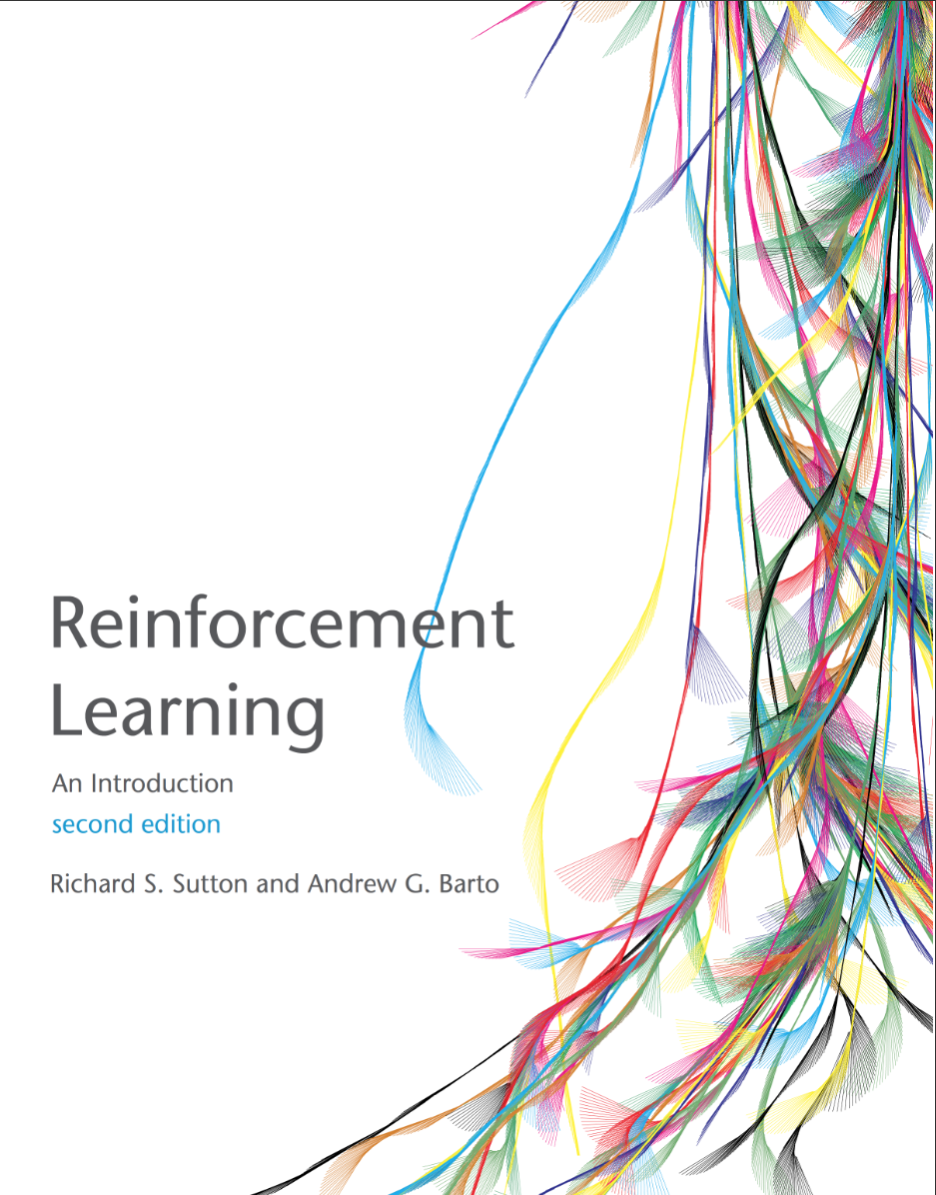
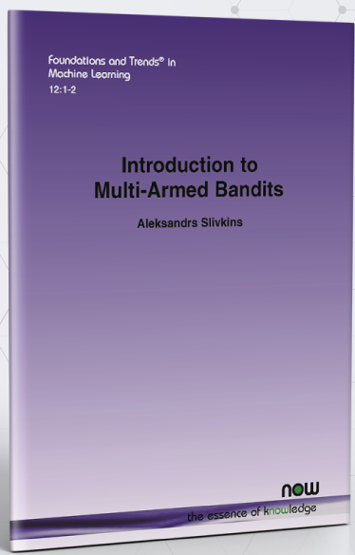

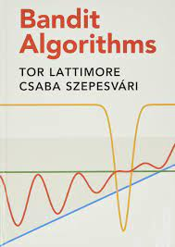
Textbooks (free access)
Sutton, R. S., & Barto, A. G. (2015). Reinforcement learning: An introduction. MIT press. http://richsutton.com
Aleksandrs Slivkins (2019). Introduction to Multi-Armed Bandits, Foundations and Trends® in Machine Learning: Vol. 12: No. 1-2, pp 1-286. https://arxiv.org/abs/1904.07272
Daniel J. Russo, Benjamin Van Roy, Abbas Kazerouni, Ian Osband and Zheng Wen (2017). A Tutorial on Thompson Sampling https://web.stanford.edu/~bvr/pubs/TS_Tutorial.pdf
Tor Lattimore and Csaba Szepesvári, (2020). Bandit Algorithms, https://tor-lattimore.com/downloads/book/book.pdf
Notes:
https://www.microsoft.com/en-us/research/blog/exploring-the-fundamentals-of-multi-armed-bandits/

Slide 4
Definition
The multi-armed bandit (MAB) problem consists of an agent (gambler) choice at each round
of play one of K arms. Each arm has an unknown reward distribution.
Rewards are only obtained (observed) when the arm is chosen. The goal of the agent is to maximize the cumulative expected rewards over a time horizon (T).
The agent strategies consists of balancing the cost of acquiring knowledge about the arms (exploration) and maximizing the immediate rewards (exploitation).
The trade-off between exploration and exploitation implies a cost is called regret (L), which the agent wants to minimize over the time horizon T.

Slide 5
Topics
Exploration vs Exploitation
Regret
Strategies
ε-Greedy
Upper-confidence bounds (UCB)
Bayesian Thompson sampling
Contextual Bandits

Slide 6
Model
State = only one
Actions = number of arms
Reward = often normalized to be in [0,1]
Implications?
No transitions function to be learned
Only thing left to learn is the stochastic reward function

Slide 7
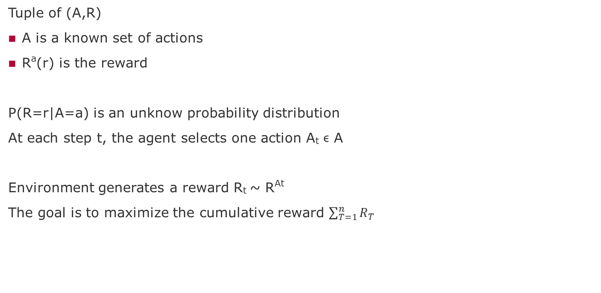
Problem Formalization
Tuple of (A,R)
A is a known set of actions
Rª(r) is the reward
P(R=r|A=a) is an unknow probability distribution
At each step t, the agent selects one action A_{t} ϵ A
Environment generates a reward R_{t} ~ R^{At}
The goal is to maximize the cumulative reward $\sum_{T=1}^{n}{R_{T}}$

Slide 8

Agent and Environment Interaction
Action
Agent
Environment
State
Reward
Agent’s Goal: Maximize its reward
Our Goal: Discover a strategy that allows the agent to achieve its goal under various circumstances
Search, Estimate, Learn
Policy = $π(S,A)$
knowlege about the environment

Slide 9
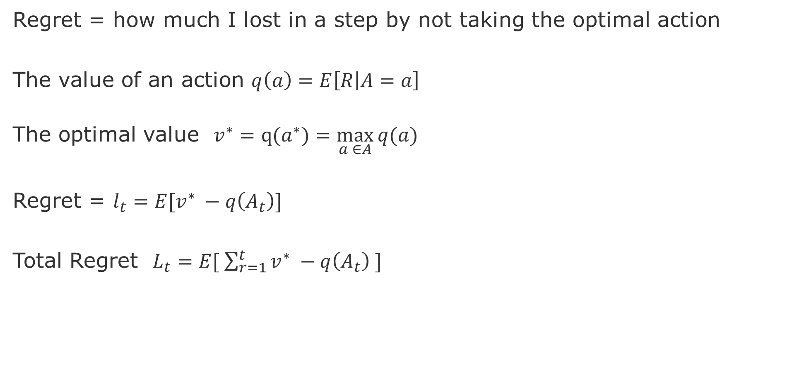
Solution Formalization - Regret
Regret = how much I lost in a step by not taking the optimal action
The value of an action $q\left(a\right)=E\left[R | A=a\right]$
The optimal value $v^{∗}=q(a^{∗})=\max_{a ∈A}{q(a)}$
Regret = $l_{t}=E[v^{∗} −q\left(A_{t}\right)]$
Total Regret $L_{t}=E[ \sum_{r=1}^{t}{v^{∗} −q\left(A_{t}\right) ]}$
Goal: Minimize this

Slide 10
Approaches to Trade-off Explore vs Exploit
Random
Greedy (no exploration)
ϵ-Greedy (epsilon Greedy)
Systematically
Upper Confidence Bounds
Thompson Sampling
Contextual Bandits
State Space
Bayes Adaptive Bandits
Gittin indices Bandits

Slide 11
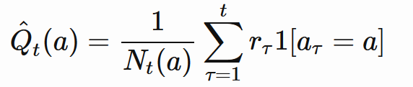
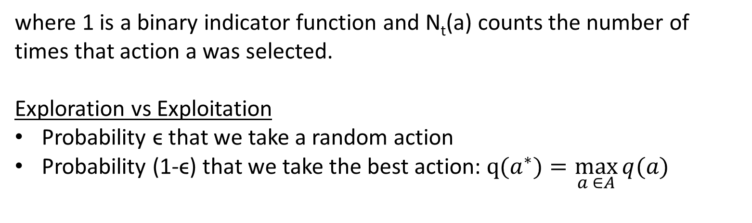
ϵ-Greedy
Total reward of an action is Monte Carlo estimate of rewards obtain for that action
where 1 is a binary indicator function and N_{t}(a) counts the number of times that action a was selected.
Exploration vs Exploitation
Probability ϵ that we take a random action
Probability (1-ϵ) that we take the best action: $q(a^{∗})=\max_{a ∈A}{q(a)}$

Slide 12
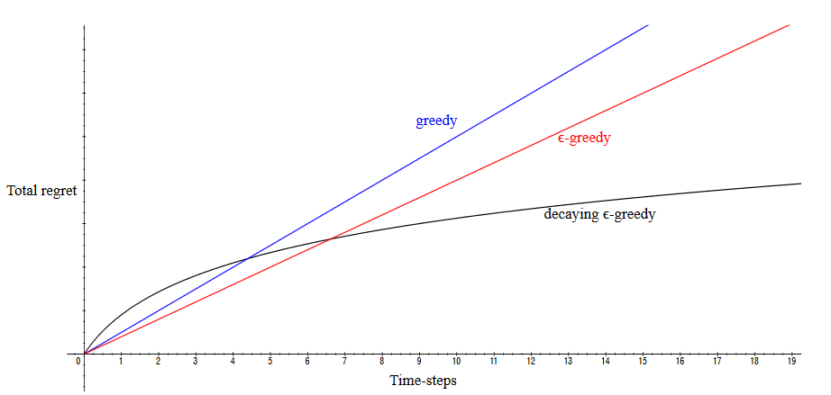
Decaying ϵ-Greedy
Follows a decay series ϵ_{1,}ϵ_{2,}ϵ_{3 ...} ϵ_{n}
Source: [Silver 2015]
Notes:
[Silver 2015] https://www.davidsilver.uk/wp-content/uploads/2020/03/XX.pdf

Slide 13
Systematic Exploration

Slide 14

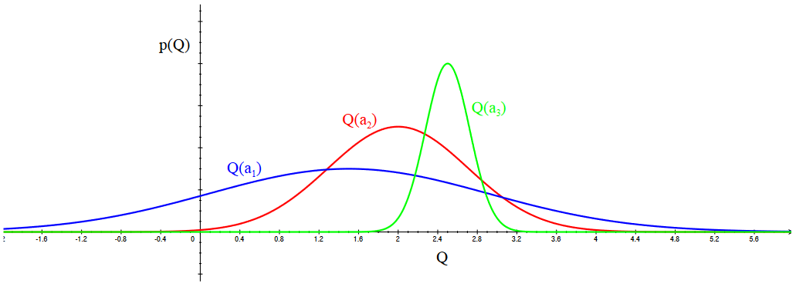
Optimism in face of uncertainty
No catastrophic consequence of our decisions.
We either learn something new or obtain a maximum reward
(what doesn’t kill you makes you stronger...)
Source: Silver, https://www.davidsilver.uk/wp-content/uploads/2020/03/XX.pdf
Notes:
[Silver 2015] https://www.davidsilver.uk/wp-content/uploads/2020/03/XX.pdf

Slide 15
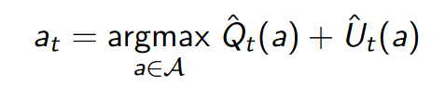


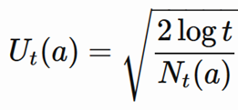
Upper Confidence Bounds
Select action that maximizes the action value with a given upper confidence bound
Hoeffdings Inequality

Slide 16
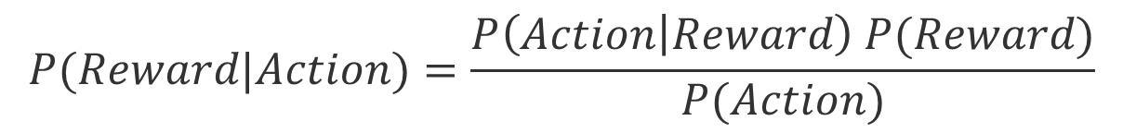
Bayesian Bandits
Bayesian bandits exploit prior knowledge of rewards P(R).
Uses Bayesian Rule to update the probabilities of reward of each action.
___
$$P(Reward|Action)=\frac{P\left(Action | Reward\right) P(Reward)}{P(Action)}$$
Bayesian Bandits depend on good knowledge about the prior distribution of rewards. When this is true, the search process for the best arm is more efficient, i.e., less useless exploration.

Slide 17
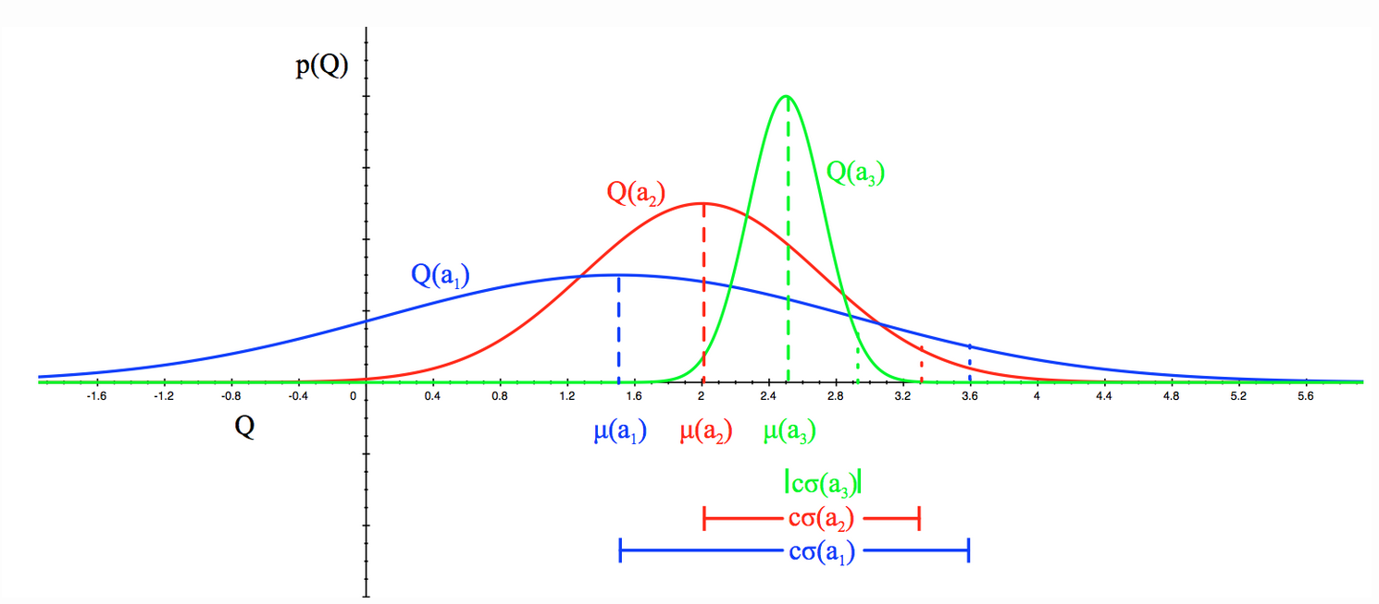
Bayesian Bandits Algorithm
The posterior probability can be used by the following algorithms:
Upper confidence bounds (Bayesian UCB)
Probability matching (Thompson sampling)
Source: Silver, https://www.davidsilver.uk/wp-content/uploads/2020/03/XX.pdf

Slide 18
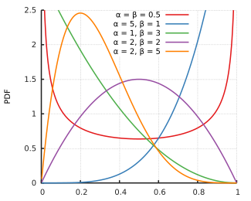
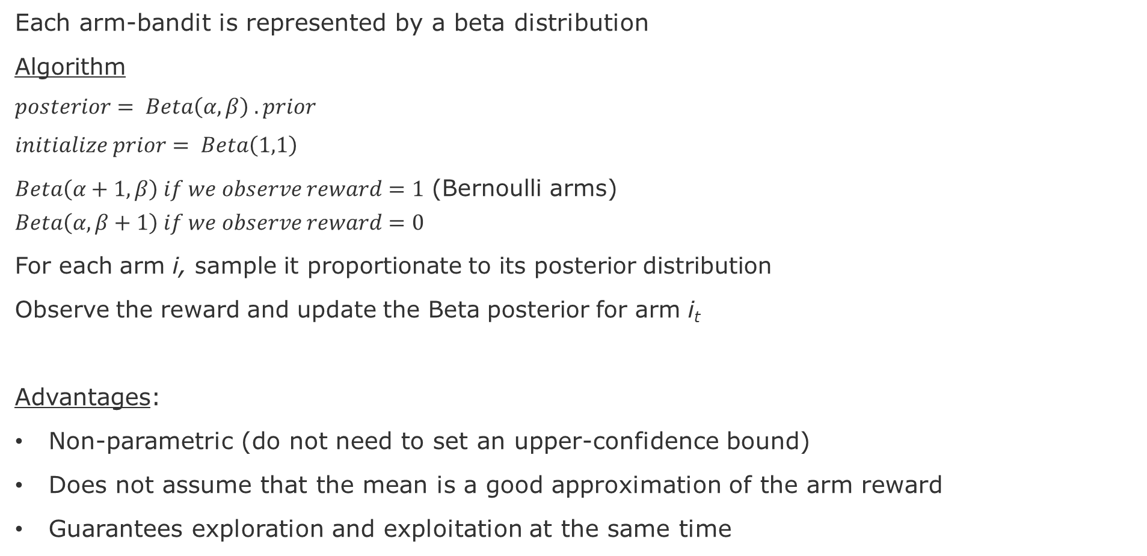
Bayesian Bandits – Thompson Sampling
Each arm-bandit is represented by a beta distribution
Algorithm
$$posterior= Beta\left(α,β\right) . prior$$
$$initialize prior= Beta\left(1,1\right)$$
$Beta\left(α+1,β\right) if we observe reward=1$ (Bernoulli arms) $$Beta\left(α,β+1\right) if we observe reward=0$$
For each arm i, sample it proportionate to its posterior distribution
Observe the reward and update the Beta posterior for arm i_{t}
Advantages:
Non-parametric (do not need to set an upper-confidence bound)
Does not assume that the mean is a good approximation of the arm reward
Guarantees exploration and exploitation at the same time
source: Wikipedia

Slide 19
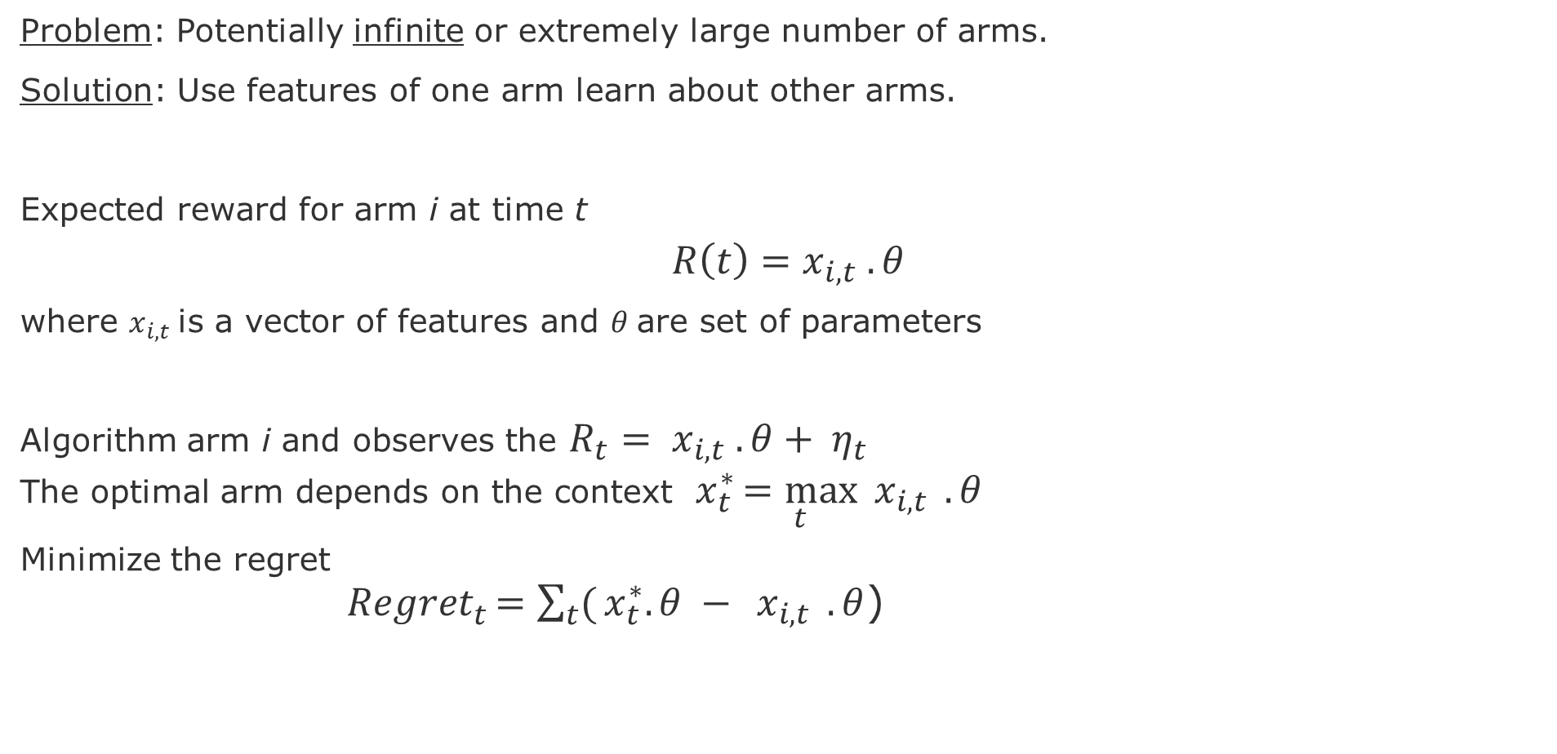
Contextual Bandits
Problem: Potentially infinite or extremely large number of arms.
Solution: Use features of one arm learn about other arms.
Expected reward for arm i at time t
$$R\left(t\right)=x_{i,t} .θ$$
where $x_{i,t}$is a vector of features and $θ$are set of parameters
Algorithm arm i and observes the $R_{t}{= x}_{i,t} .θ+ η_{t}$
The optimal arm depends on the context $x_{t}^{∗}\underset{t}{=max}{{ x}_{i,t}} .θ$
Minimize the regret
${Regret}_{t}^{ }\underset{ }{=\sum_{t}{(}x_{t}^{∗}.θ −}{{ x}_{i,t}} .θ$)

Slide 20
Other Bandit Models
Adversarial Bandits: do not assume that rewards have a distribution (see [1-2])
Combinatorial bandits: special case of Linear Bandits where the actions are multi-dimensional (see [3-4]). See ideas for ranking with bandits in [5].
Markovian bandits: reward processes are neither i.i.d. nor adversarial. Arms are Markov processes with their own state space (see [6-7])
Infinitely many-armed bandits: continuum-armed bandits (arms are in a Euclidean space), which means that the set of possible actions are very large (see [8-9])
Notes:
[1] Chapter 27 in Lattimore, T., & Szepesvári, C. (2020). Bandit algorithms. Cambridge Press, 2020
[2] https://banditalgs.com/2016/10/01/adversarial-bandits/
[3] Chapter 30 in Lattimore, T., & Szepesvári, C. (2020). Bandit algorithms. Cambridge Press, 2020
[4] Kleinberg, R. D. (2005). Nearly tight bounds for the continuum-armed bandit problem. In Advances in Neural Information Processing Systems (pp. 697-704).
[5] Chapter 32 in Lattimore, T., & Szepesvári, C. (2020). Bandit algorithms. Cambridge Press, 2020
[6] John C Gittins. Bandit processes and dynamic allocation indices. Journal of the Royal
Statistical Society. Series B (Methodological), pages 148{177, 1979.
[7] John Gittins, Kevin Glazebrook, and Richard Weber. Multi-armed bandit allocation indices.
John Wiley & Sons, 2011.
[8] Emilie Kaufmann, Olivier Cappe, and Aurelien Garivier. On bayesian upper condence bounds for bandit problems. In Articial Intelligence and Statistics, pages 592-600, 2012.
[9] Chapter-7 in Lattimore, T., & Szepesvári, C. (2020). Bandit algorithms. Cambridge Press, 2020

Slide 21
References
[1] Chapter 27 in Lattimore, T., & Szepesvári, C. (2020). Bandit algorithms. Cambridge Press, 2020
[2] https://banditalgs.com/2016/10/01/adversarial-bandits/
[3] Chapter 30 in Lattimore, T., & Szepesvári, C. (2020). Bandit algorithms. Cambridge Press, 2020
[4] Kleinberg, R. D. (2005). Nearly tight bounds for the continuum-armed bandit problem. In Advances in Neural Information Processing Systems (pp. 697-704).
[5] Chapter 32 in Lattimore, T., & Szepesvári, C. (2020). Bandit algorithms. Cambridge Press, 2020
[6] John C Gittins. Bandit processes and dynamic allocation indices. Journal of the Royal
Statistical Society. Series B (Methodological), pages 148{177, 1979.
[7] John Gittins, Kevin Glazebrook, and Richard Weber. Multi-armed bandit allocation indices.
John Wiley & Sons, 2011.
[8] Emilie Kaufmann, Olivier Cappe, and Aurelien Garivier. On bayesian upper condence bounds for bandit problems. In Articial Intelligence and Statistics, pages 592-600, 2012.
[9] Chapter-7 in Lattimore, T., & Szepesvári, C. (2020). Bandit algorithms. Cambridge Press, 2020

Slide 22
Interesting video lectures
Shipra Agrawal, 2019, Advances in Multiarmed Bandits for Sequential Decision Making https://www.youtube.com/watch?v=7F0jPUyb7m4&pbjreload=10 | Good intuition about Bandit algorithms and explanation of the
David Silver, 2015, Lecture 9: Exploration and Exploitation https://www.youtube.com/watch?v=sGuiWX07sKw&pbjreload=10 | Great visual explanations, clear formulations of algorithms, and the connection between bandits and MDPs
Tor Lattimore, 2018, Two lectures at Winter Schools for Quant. Sys. Biology Part-1 (https://www.youtube.com/watch?v=xN11-epRuSU&pbjreload=10 Part-2 (https://www.youtube.com/watch?v=NyyLr6F4bkI&pbjreload=10 | Good intuitions about the derivations and the proofs
Pascal Poupart, 2018, Lectures at Uni Waterloo, Canada Lecture-1 (https://www.youtube.com/watch?v=Qy-vum3GH-s&pbjreload=10) Lecture-2 (https://www.youtube.com/watch?v=jlcbEZTgisQ&pbjreload=10) | Higher level exposition and insightful Q&A with the students
Charles Isbell & Michael Littman, 2015, Set of Coursera videos https://www.youtube.com/watch?v=rETmf4NnlPM&list=PL__ycckD1ec_yNMjDl-Lq4-1ZqHcXqgm7&index=128&pbjreload=10 | Step-by-step explanations with fun discussions about various bandit topics (algorithms, optimality, metrics, connection with MDPs)
Nando Freitas, 2013, Lecture at Uni British Columbia, Canada https://www.youtube.com/watch?v=vz3D36VXefI&list=PLE6Wd9FR--EdyJ5lbFl8UuGjecvVw66F6&index=10 | Great graphics and explanations about the relation between Bandits and Bayesian Optimization

Slide 23
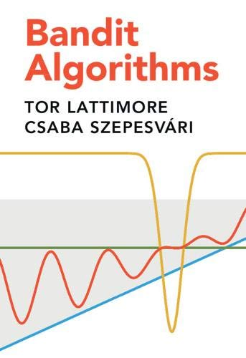
Textbooks (free access)
Sutton, R. S., & Barto, A. G. (2015). Reinforcement learning: An introduction. MIT press.
free access at the author’s page: http://richsutton.com
Aleksandrs Slivkins (2019). Introduction to Multi-Armed Bandits, Foundations and Trends® in Machine Learning: Vol. 12: No. 1-2, pp 1-286
free access by the authors’
https://arxiv.org/abs/1904.07272
Tor Lattimore & Csaba Szepesvári (2020). Bandit Algorithms, Cambridge University Press
free access by the authors’
https://tor-lattimore.com/downloads/book/book.pdf
Notes:
https://www.microsoft.com/en-us/research/blog/exploring-the-fundamentals-of-multi-armed-bandits/

Slide 24
end

