Slide 1
Controlling mRUBiS from Python
Paul Wullenweber
August 3rd, 2021
Machine Learning-based Control of Dynamical Systems

Slide 2
Agenda
Idea
Challenges
Communication protocol
Control Strategies
Conclusion & Outlook

Slide 3
Idea
Jakob‘s Linear Model + TBD
mRUBiS
Machine Learning-based Control of Dynamical Systems
Python Controller

Slide 4
Challenges
Launching mRUBiS
Communicating
Observing mRUBiS states
Assigning order of fix execution
(all with minimal Java / sockets experience)

Slide 5
Communication – observing states
mRUBiS
Issues handled invidually
Encapsulation
Complex Architecture
quick solutions:
persist required data to disk (json)
copy individual issue flow

Slide 6
Communication – initial connection
Controller
mRUBiS
launch (subprocess) | optional
open socket
connect to socket

Slide 7
Communication – initial states
Controller
mRUBiS
QUERY(total # of shops)
RESPONSE(total # of shops)
QUERY(initial state per shop)
RESPONSE(initial state per shop)

Slide 8
Communication – within run
Controller
mRUBiS
# of issues in current run
current issue, available actions
pick action for issue (lowest cost)
specify order of execution (utility)
update fixed components

Slide 9
Control Strategies
Which action to take?
Compare available actions per issue
Which issue to address first?
Compare components within and between shops

Slide 10
Control Strategies
Contrast three strategies:
Random issue ordering
Cost-based issue ordering
Predicted-utility-based issue ordering

Slide 11
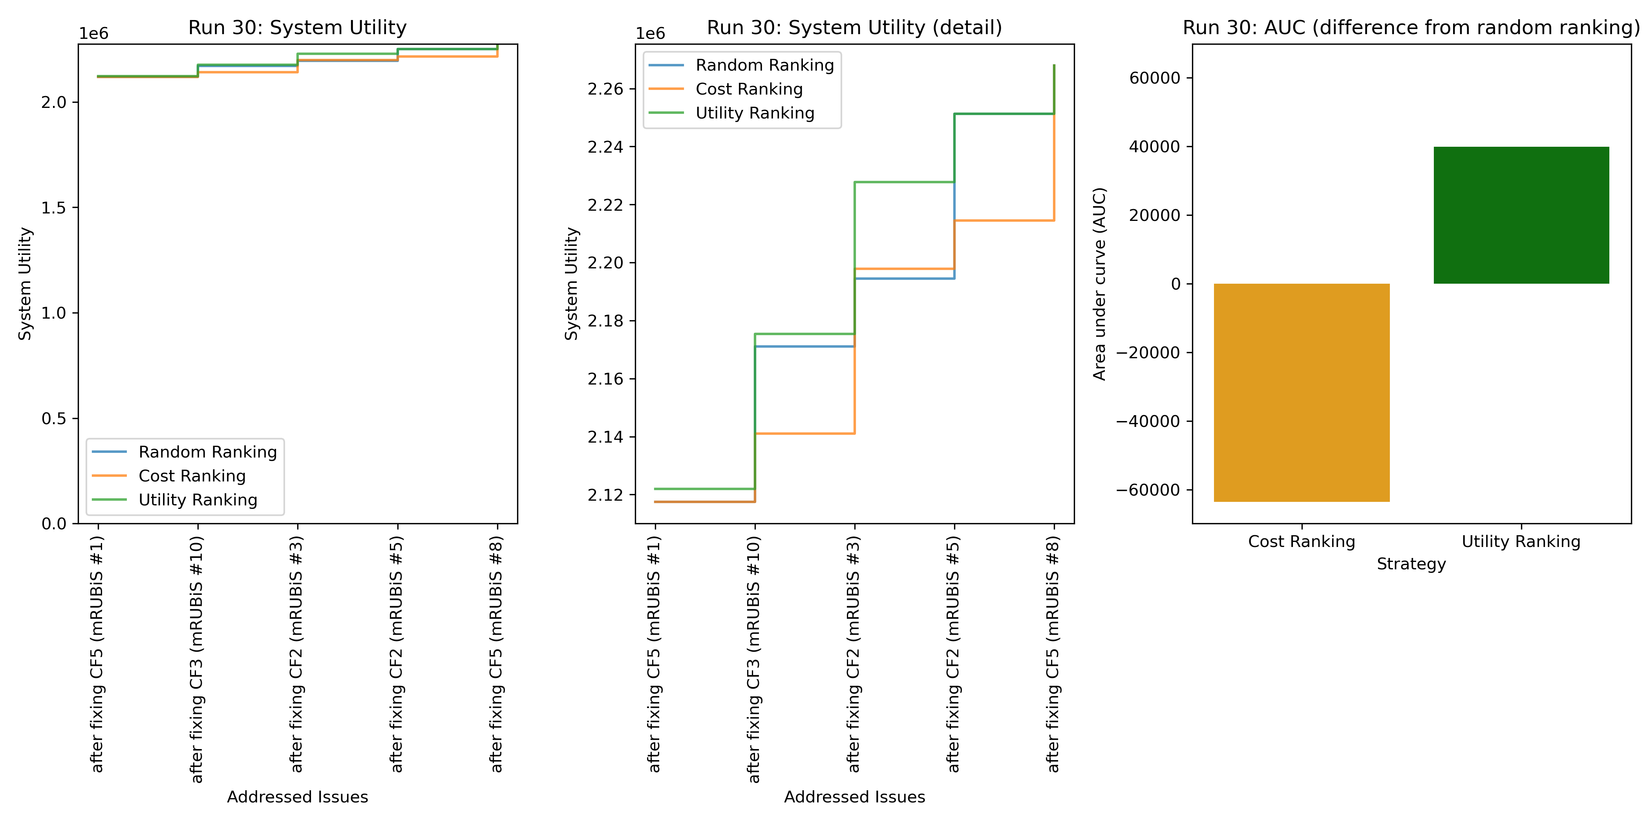
Issue ranking – example run

Slide 12
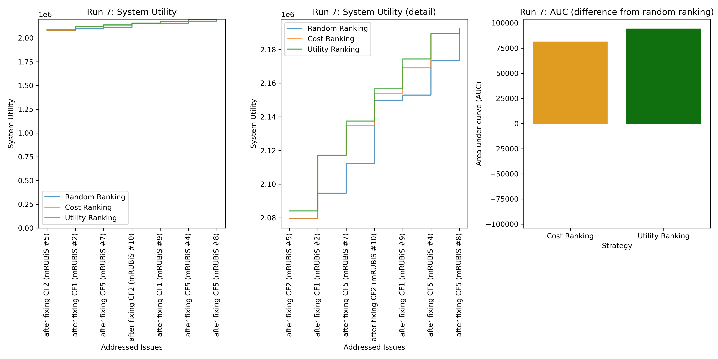
Issue ranking – example run

Slide 13
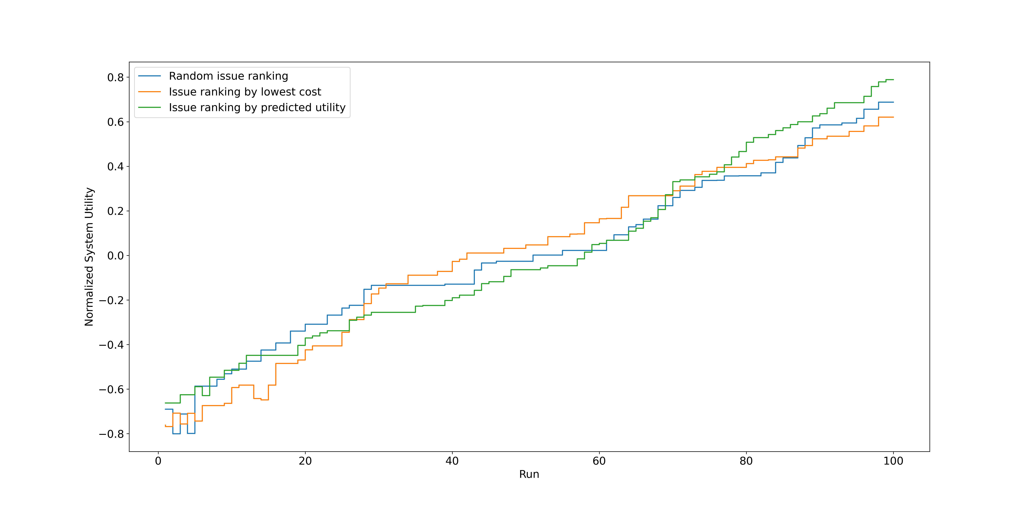
Issue ranking – multiple runs

Slide 14
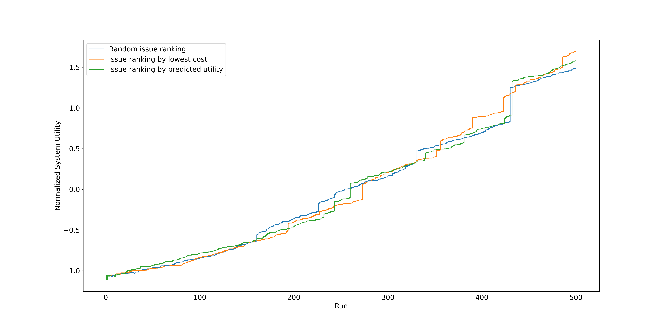
Issue ranking – multiple runs

Slide 15
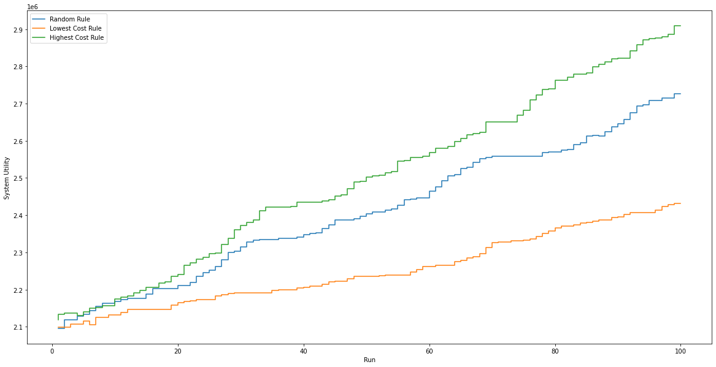
Action picking – multiple runs

Slide 16
Conclusion
Jakob‘s model performs quite well
Ordering by predicted utility seems to maximize AUC
Python – Java integration more difficult than expected
mRUBiS logic is sometimes difficult to understand
Impossible without support from Sona and Chris, thanks! ☺

Slide 17
Outlook
Controller code still in prototype shape
Out-of-sync issue when launching mRUBiS inside subprocess
Plug HMM into controller
Analyze strategy/AUC distribution across runs
Plot utility-cost for the three issue ranking strategies
Test robustness w.r.t. even more shops, issues per shop

Slide 18
Thank you for your attention!
Paul Wullenweber
August 3rd, 2021
Machine Learning-based Control of Dynamical Systems

