Slide 1
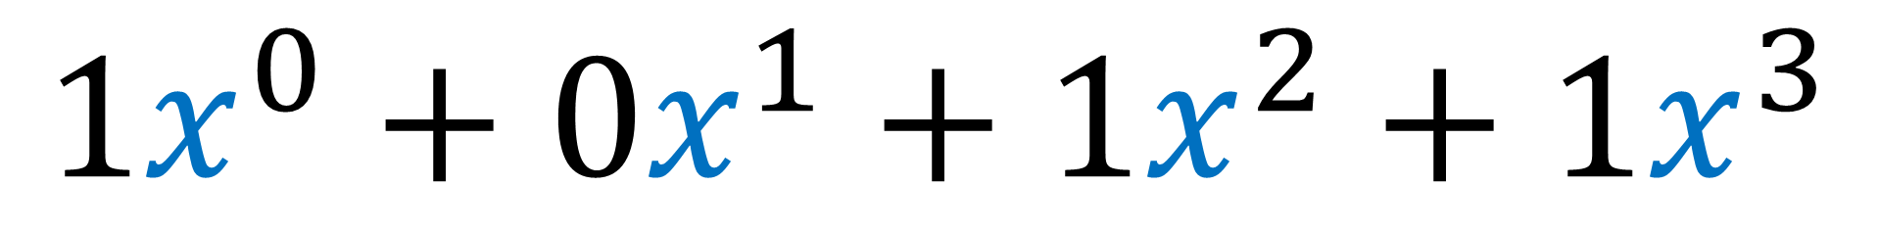
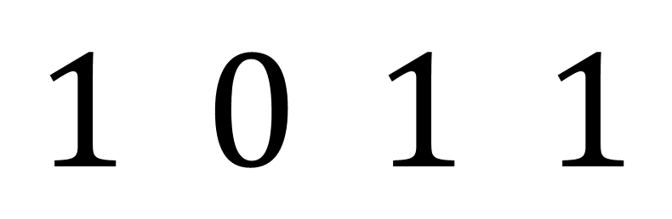
$$1 0 1 1$$
$$1x^{0}+0x^{1}+1x^{2}+1x^{3}$$
Cyclic Codes
Polynomial Properties

Slide 2

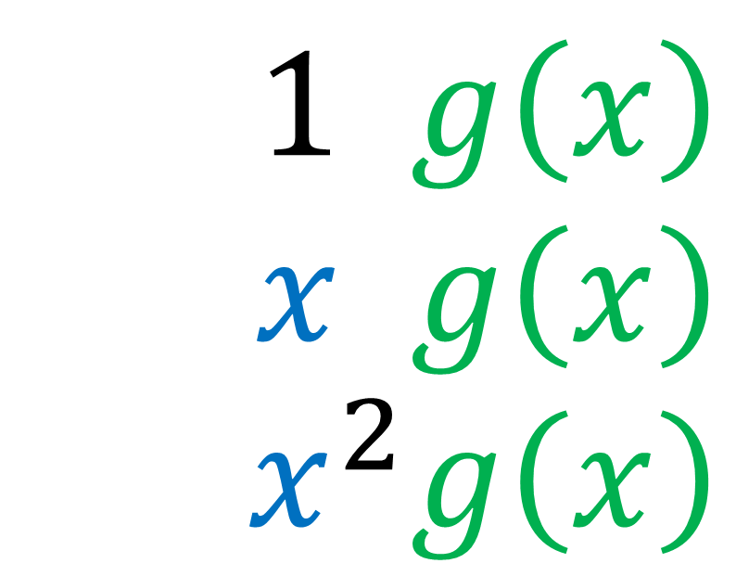
$$1 g\left(x\right)$$
$$x g\left(x\right)$$
$$x^{2}g\left(x\right)$$
$$→$$
$$→$$
$$→$$
100100
010010
001001
Cyclic Codes
Generator Polynomial

Slide 3
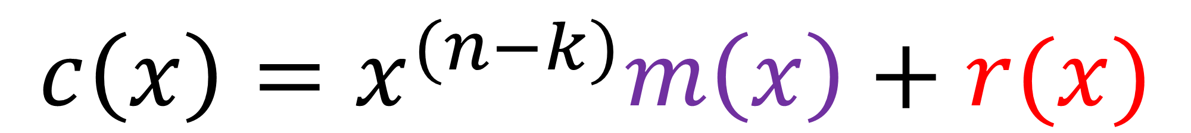
$$x^{(n−k)}m\left(x\right)=q\left(x\right)g\left(x\right)+r(x)$$
$$c\left(x\right)=x^{(n−k)}m\left(x\right)+r(x)$$
Cyclic Codes
Systematic Encoding

Slide 4
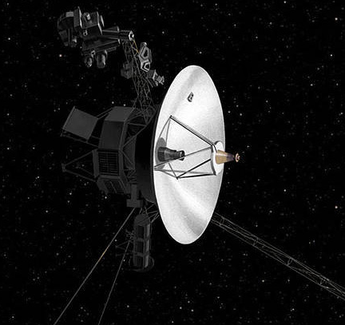

Cyclic Polynomial Codes
(Cyclic) Reed-Solomon Codes
Notes:
In this video I’m going to go over the mathematics required to understand RSA cryptography.
If you’re unaware, RSA is a cryptographic system used when two parties who have never met before, want to communicate with each other securely, without other people listening in or changing the information being passed back and forth. Anytime you browse the web using HTTPS, your web browser uses RSA to talk to the web server securely.
So I’m not going to talk about RSA a whole lot in this video—I’m going to leave that for another video.
What I’m going to do in this video is give you the mathematical background needed to understand the technical details of RSA.
When you’re reading about the details RSA, there are often a lot of references to mathematical theorems that you may have never heard of, and you can feel a bit lost at sea if you don’t understand where the theorems come from.
So I’m going to go over the important mathematical results that underpin RSA.

Slide 5
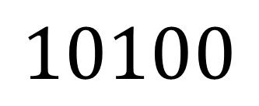
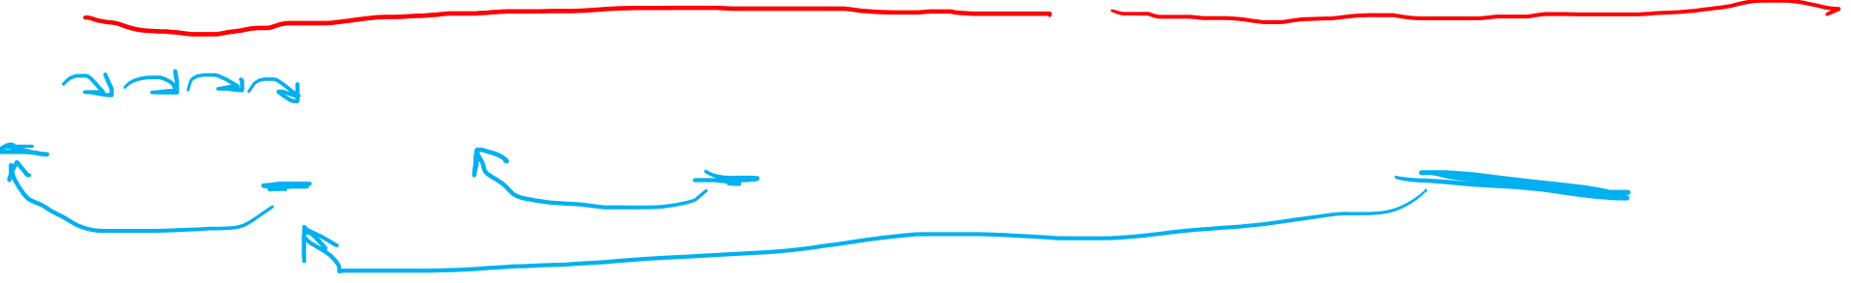
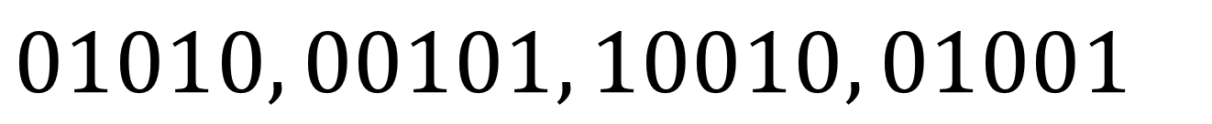
Cyclic Codes
Any circular shift of a valid codeword is another valid codeword
$$10100$$
$$01010, 00101, 10010, 01001$$

Slide 6
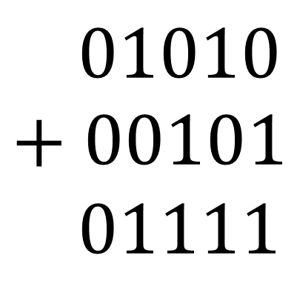
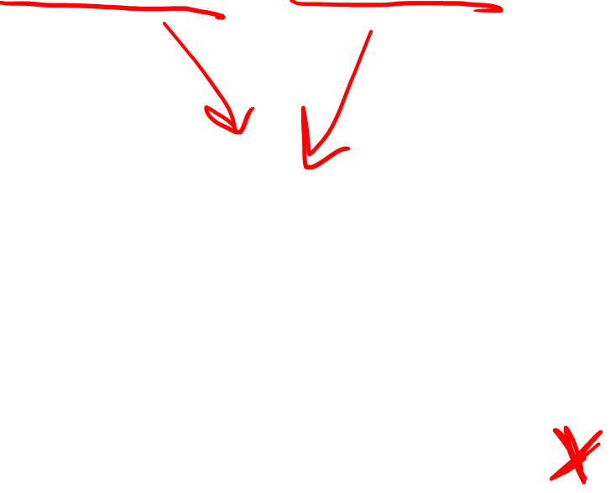
Cyclic Codes
Any circular shift of a valid codeword is another valid codeword
Not necessarily linear
$$10100$$
$$01010, 00101, 10010, 01001$$
$$01010$$
$$+ 00101$$
$$01111$$

Slide 7
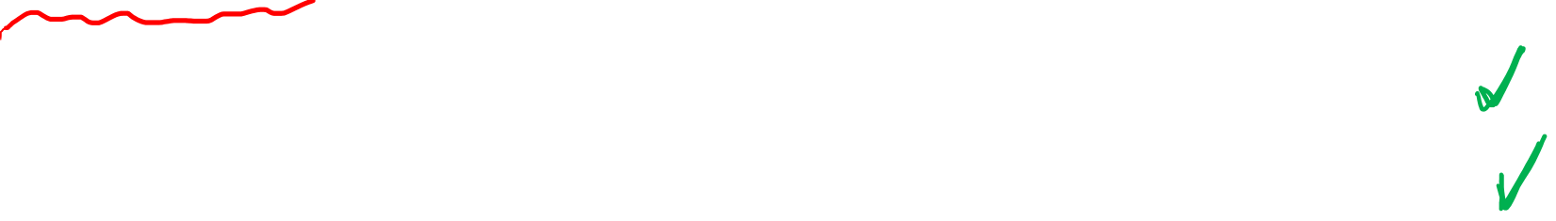
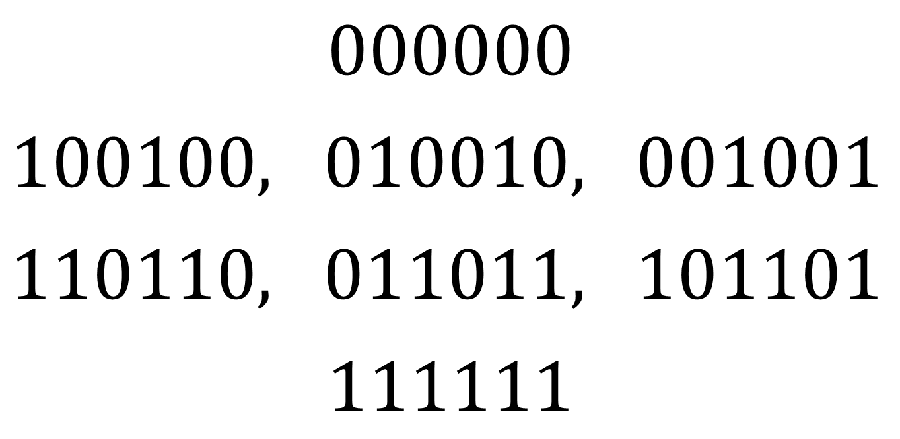
Cyclic (Linear) Codes
Any circular shift of a valid codeword is another valid codeword
We normally only care about cyclic codes that are also linear
$$000000$$
$100100,$ $010010,$ $001001$
$110110,$ $011011,$ $101101$
$$111111$$

Slide 8
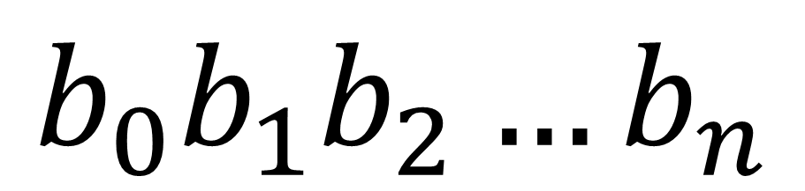
$$b_{0}b_{1}b_{2}…b_{n}$$
$$b_{0}x^{0}+b_{1}x^{1}+b_{2}x^{2}+…+b_{n}x^{n}$$

Slide 9
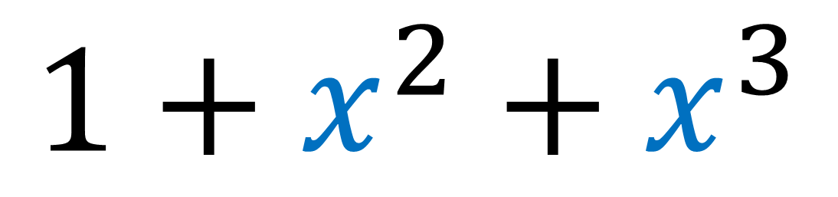
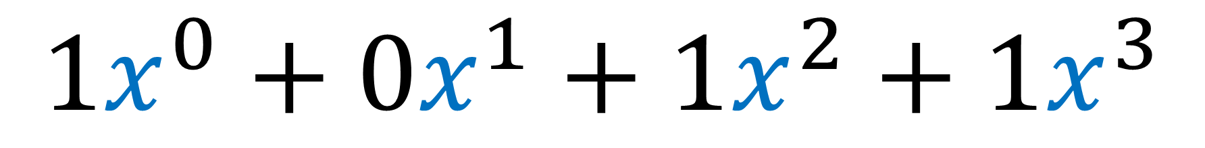
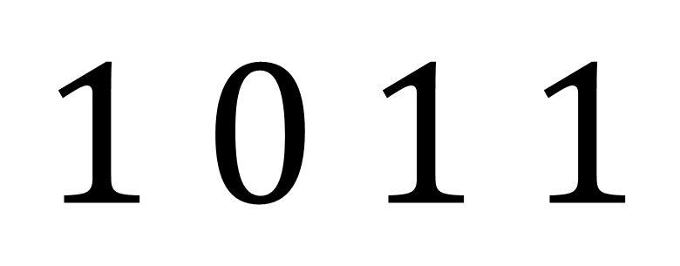
$$1 0 1 1$$
$$1x^{0}+0x^{1}+1x^{2}+1x^{3}$$
$$1+x^{2}+x^{3}$$

Slide 10
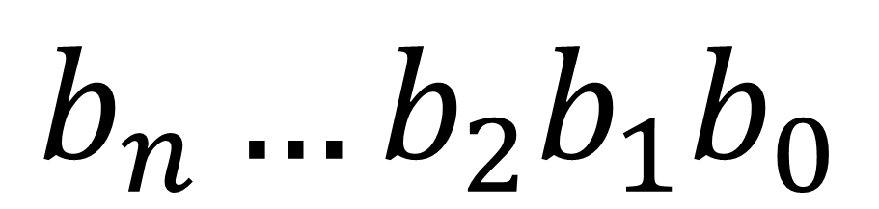
$$b_{n}…b_{2}b_{1}b_{0}$$
$$b_{n}x^{n}+…+b_{2}x^{2}+b_{1}x^{1}+b_{0}x^{0}$$

Slide 11
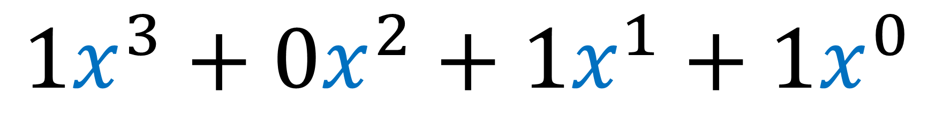
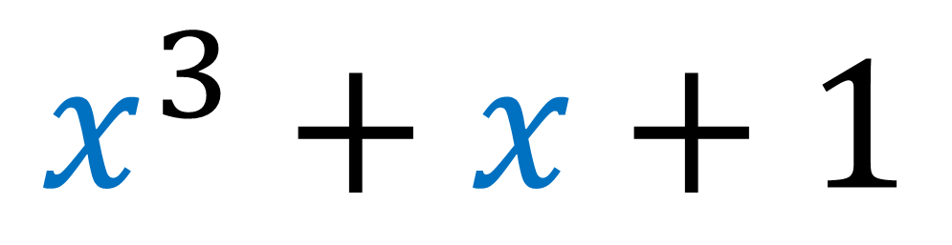
$$1 0 1 1$$
$$1x^{3}+0x^{2}+1x^{1}+1x^{0}$$
$$x^{3}+x+1$$

Slide 12
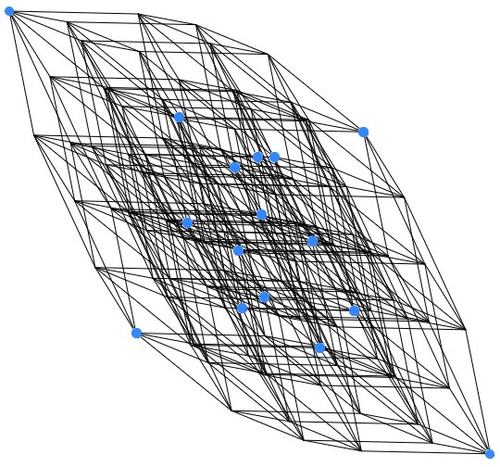











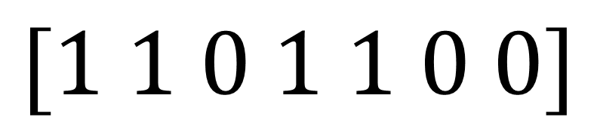


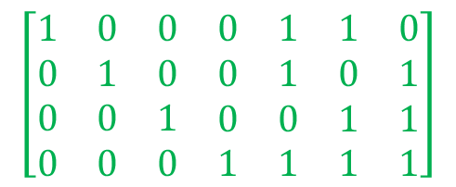




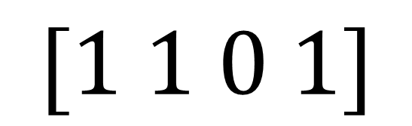
$$0110$$
$$1110$$
Generator
Matrix
$$0100$$
$$1100$$
$$0010$$
$$1010$$
$$0111$$
$$1111$$
$$0000$$
$$1000$$
$$0101$$
$$1101$$
$$0011$$
$$1011$$
$$\left[\begin{matrix}\begin{matrix}\begin{aligned}1 \\ 0 \\ 0 \\ 0\end{aligned} & \begin{aligned}0 \\ 1 \\ 0 \\ 0\end{aligned}\end{matrix} & \begin{matrix}\begin{aligned}0 \\ 0 \\ 1 \\ 0\end{aligned} & \begin{aligned}0 \\ 0 \\ 0 \\ 1\end{aligned} & \begin{aligned}1 \\ 1 \\ 0 \\ 1\end{aligned}\end{matrix} & \begin{matrix}\begin{aligned}1 \\ 0 \\ 1 \\ 1\end{aligned} & \begin{aligned}0 \\ 1 \\ 1 \\ 1\end{aligned}\end{matrix}\end{matrix}\right]$$
$$0001$$
$$1001$$
Message Space
Codeword Space
$$[1 1 0 1]$$
$$[1 1 0 1 1 0 0]$$

Slide 13
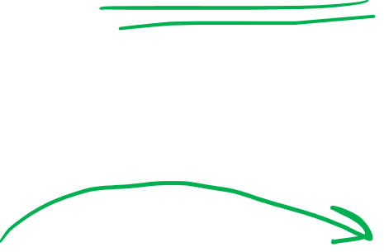
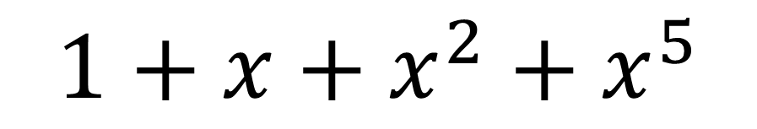
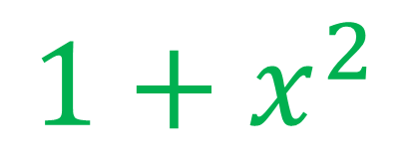
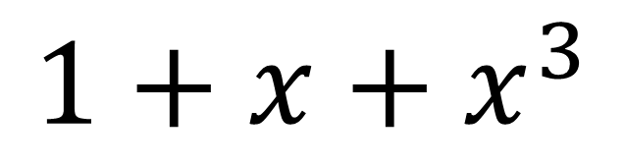
$$0110$$
$$1110$$
Generator
Polynomial
$$0100$$
$$1100$$
$$0010$$
$$1010$$
$$0111$$
$$1111$$
$$0000$$
$$1000$$
$$0101$$
$$1101$$
$$0011$$
$$1011$$
$$1+x^{2}$$
$$0001$$
$$1001$$
Message Space
Codeword Space
$$1+x+x^{3}$$
$$1+x+x^{2}+x^{5}$$

Slide 14

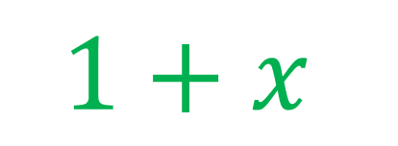


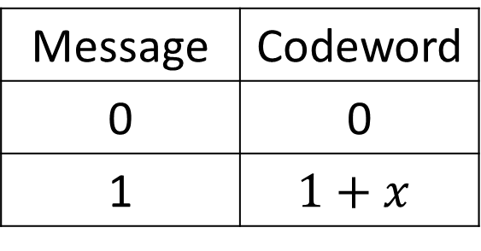



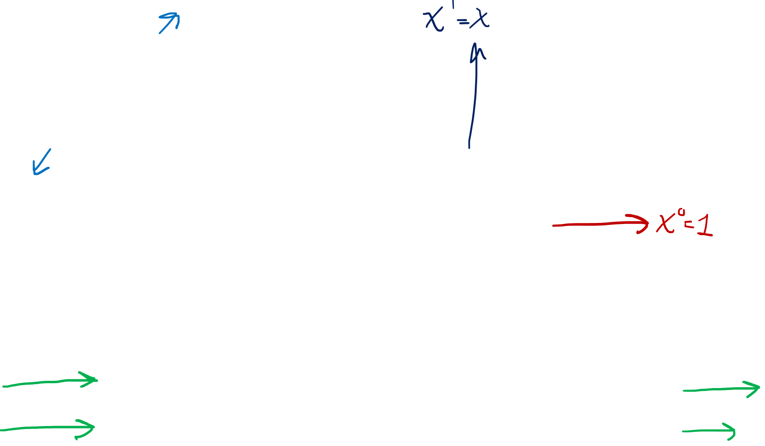





$$10$$
$$11$$
$$x$$
$$1+x$$
$$x$$
$$00$$
$$01$$
$$0$$
$$1$$
$$1$$
$$\left[\begin{matrix}1 & 1\end{matrix}\right]$$
$$1+x$$
Message | Codeword
0 | 00
1 | 11
Message | Codeword
0 | 0
1 | $$1+x$$

Slide 15







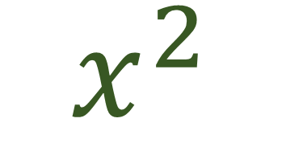

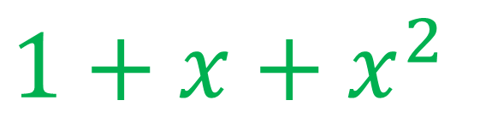





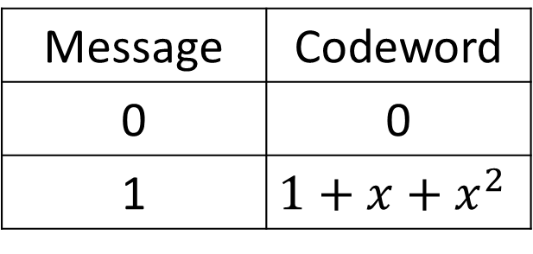






$$110$$
$$111$$
$$x+x^{2}$$
$$1+x+x^{2}$$
$$010$$
$$011$$
$$x$$
$$1+x$$
$$100$$
$$101$$
$$x^{2}$$
$$1+x^{2}$$
$$x$$
$$000$$
$$001$$
$$0$$
$$1$$
$x^{2}$
$$\left[\begin{matrix}1 & 1 & 1\end{matrix}\right]$$
$$1+x+x^{2}$$
Message | Codeword
0 | 000
1 | 111
Message | Codeword
0 | 0
1 | $$1+x+x^{2}$$
$$1$$

Slide 16
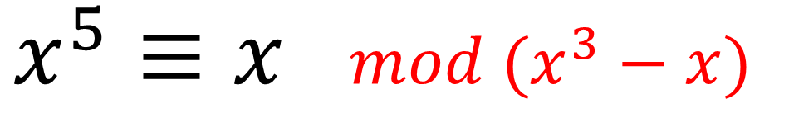
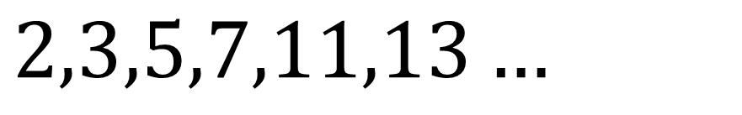
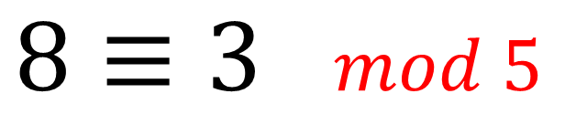
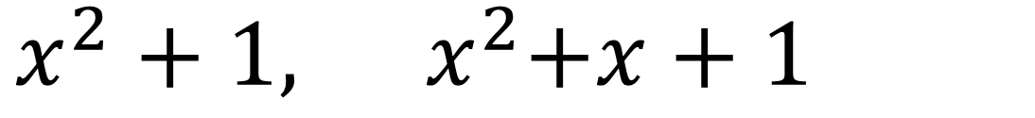
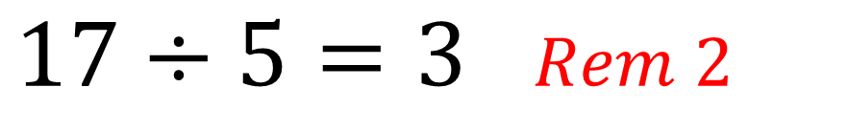

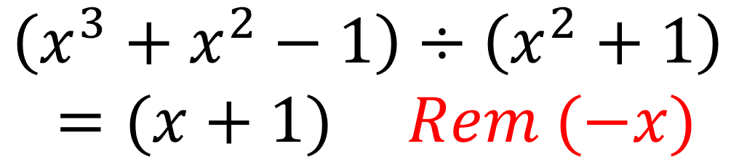
Polynomials are like Integers
Integer Division | Polynomial Division
Integer Modular Arithmetic | Polynomial Modular Arithmetic
Prime Numbers | Irreducible Polynomials
$$\left(x^{3}+x^{2}−1\right)÷\left(x^{2}+1\right)$$
$=(x+1)$ $Rem (−x)$
$17÷5=3$ $Rem 2$
$8≡3$ $mod 5$
$x^{5}≡x$ $mod (x^{3}−x)$
$$2,3,5,7,11,13…$$
$x^{2}+1,$ ${ x}^{2}+x+1$

Slide 17
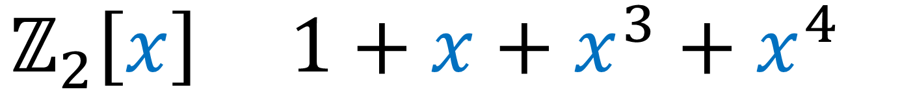

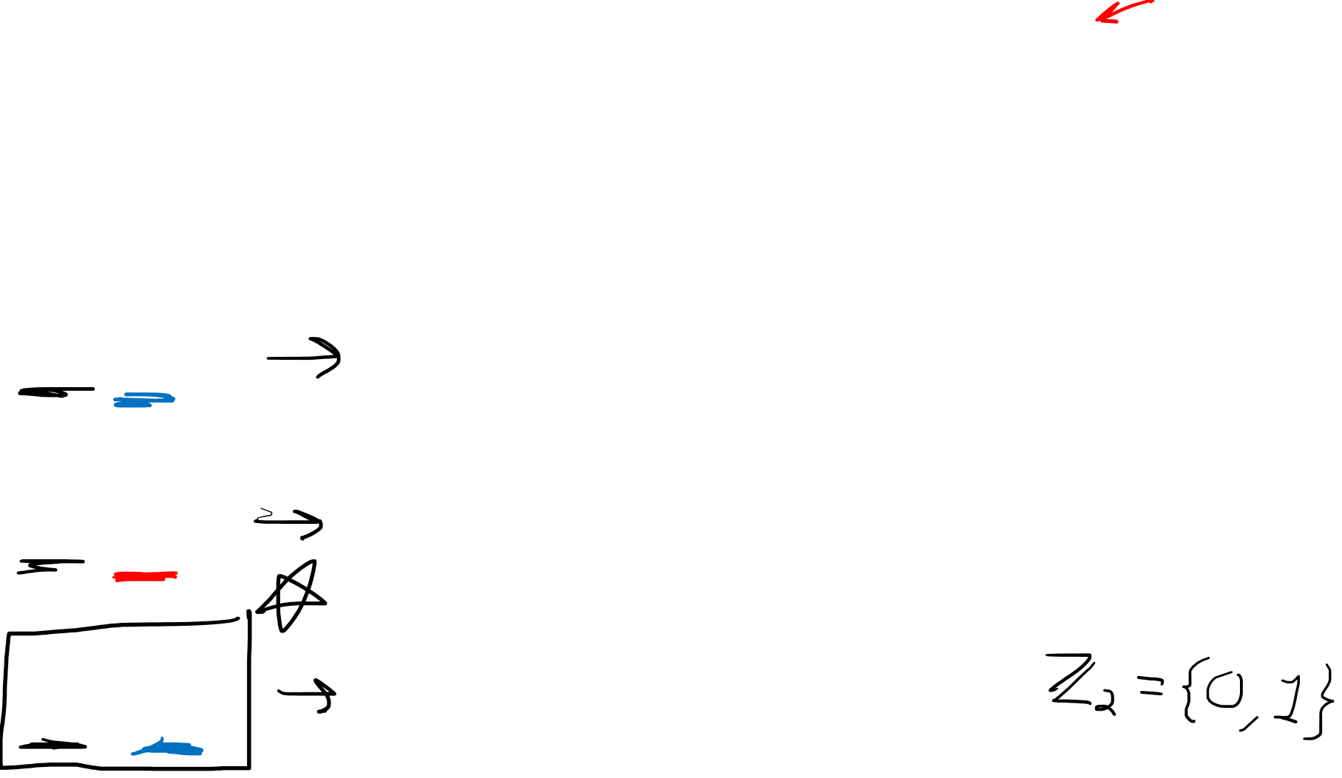
Polynomial Set Notation $ℝ[x]$
Coefficient Set
Variable
$ℝ\left[x\right]$ $1.1+7.5x−0.2x^{2}+6.2x^{5}$
$ℤ\left[y\right]$ $7−3y^{2}+2y^{3}−9y^{4}$
$$ℤ_{2}\left[x\right] 1+x+x^{3}+x^{4}$$

Slide 18



Integers mod 2 ${(ℤ}_{2})$
$$0≡2$$
Even numbers: $2n ≡0n =0$
Odd numbers: $2n+1≡0n+1=1$
$−1=\left(1−2\right)≡\left(1−0\right)=1$

Slide 19




Polynomials are like Integers: Division
$$17÷5$$
$$17=5⋅3+2$$
$$a=b⋅q+r$$
$$(x^{3}+x^{2}+1)÷(x^{2}+1)$$
$$\left(x^{3}+x^{2}+1\right)=\left(x^{2}+1\right)⋅(x+1)+(−x)$$

Slide 20


Polynomials are like Integers: Division
$$17÷5$$
$$17=5⋅3+2$$
$$a=b⋅q+r$$
$$(x^{3}+x^{2}+1)÷(x^{2}+1)$$
$$\left(x^{3}+x^{2}+1\right)=\left(x^{2}+1\right)⋅(x+1)+(−x)$$

Slide 21




$$5625$$
$$11$$
$$5625=11⋅511+4$$

Slide 22




https://en.wikipedia.org/wiki/Polynomial_code
$$x^{2}+1$$
$$x^{5}+x^{4} +x^{2} +1$$
$$x^{5}+x^{4}+x^{2}+1$$
$$=\left(x^{2}+1\right)⋅\left(x^{3}+x^{2}−x\right)+(x+1)$$

Slide 23




Polynomials are like Integers: Modular Arithmetic
$$ℤ/12ℤ$$
$$ℤ_{12}$$
$$12ℤ=\{…,−24,−12, 0,+12,+24,…\}$$

Slide 24










Polynomials are like Integers: Modular Arithmetic
$$ℤ\left[x\right]/(x^{3}−x)$$
$$ℤ/5ℤ$$
$$8=5+3≡3$$
$$x^{3}−x+2x^{2}+5$$
$$≡2x^{2}+5$$
$$17=5+5+5+2≡2$$
$$ℤ/2ℤ$$
$$x^{5}=x^{3}⋅x^{2}$$
$$≡(x)⋅x^{2}$$
$$= (x^{3})$$
$$≡ x$$
$$6=2+2+2≡0$$
$$−1=−(2)+1≡1$$

Slide 25




Polynomials are like Integers: Irreducibles
Composites:
Reducibles $ℝ[x]$:
$$x^{2}−4=\left(x+2\right)⋅\left(x−2\right)$$
$$x^{2}+2x+1=\left(x+1\right)⋅(x+1)$$
$$6=2⋅3$$
$$35=5⋅7$$
Primes:
2,3,5,7,11,13,…
Irreducibles $ℝ[x]$:
$x^{2}+1,$ ${ x}^{2}+x+1$

Slide 26

$$b_{0}b_{1}b_{2}…b_{n−1}$$
$b_{0}x^{0}+b_{1}x^{1}+b_{2}x^{2}$ $+…+$ $b_{n−1}x^{n−1}$

Slide 27





$$b_{0}b_{1}b_{2}b_{3}b_{4}$$
$$ℤ_{2}\left[x\right]/(x^{5}−1)$$
$$c\left(x\right)= b_{0}+b_{1}x+b_{2}x^{2}+b_{3}x^{3}+b_{4}x^{4}$$
$$xc\left(x\right)=x\left(b_{0}+b_{1}x+b_{2}x^{2}+b_{3}x^{3}+b_{4}x^{4}\right)$$
$$xc\left(x\right)=b_{0}x+b_{1}x^{2}+b_{2}x^{3}+b_{3}x^{4}+b_{4}x^{5}$$
$$xc\left(x\right)=b_{4}+b_{0}x+b_{1}x^{2}+b_{2}x^{3}+b_{3}x^{4}$$
$$b_{4}b_{0}b_{1}b_{2}b_{3}$$

Slide 28





$$b_{0}b_{1}b_{2}…b_{n−1}$$
$$ℤ_{2}\left[x\right]/(x^{n}−1)$$
$$c\left(x\right)= b_{0}+b_{1}x+b_{2}x^{2}+…+b_{n−1}x^{n−1}$$
$$xc\left(x\right)=x\left(b_{0}+b_{1}x+b_{2}x^{2}+…+b_{n−1}x^{n−1}\right)$$
$$xc\left(x\right)=b_{0}x+b_{1}x^{2}+b_{2}x^{3}+…+b_{n−1}x^{n}$$
$$xc\left(x\right)={b_{n−1}+b}_{0}x+b_{1}x^{2}+…+b_{n−2}x^{n−1}$$
$b_{n−1}b_{0}b_{1}…$ $b_{n−2}$

Slide 29


$$ℤ_{2}\left[x\right]/(x^{n}−1)$$
Cyclic Codes
Linear Codes
$$c\left(x\right)⇒xc\left(x\right)⇒x^{2}c\left(x\right)⇒x^{3}c\left(x\right)⇒…$$
$$c\left(x\right)+xc\left(x\right)+x^{2}c\left(x\right)+x^{3}c\left(x\right)+…$$
$$=(1+x+x^{2}+x^{3}+…)c\left(x\right)$$
$$=u\left(x\right)c\left(x\right)$$

Slide 30




$$ℤ_{2}\left[x\right]/(x^{6}−1)$$
$$001001$$
$$001001$$
$$010010$$
$⊕$ $001001$
$$010010$$
$$=\left(1+x^{2}+x^{3}\right)\left(x^{2}+x^{5}\right)$$
$$=x^{2}+x^{4}+x^{5}+x^{5}+x^{7}+x^{8}$$
$$=x^{2}+x^{4}+x^{5}+x^{5}+x^{6}x+x^{6}x^{2}$$
$$=x^{2}+x^{4}+x^{5}+x^{5}+x+x^{2}$$
$$=x+x^{4}$$

Slide 31

$$000000$$
$100100,$ $010010,$ $001001$
$110110,$ $011011,$ $101101$
$$111111$$

Slide 32

$$000000$$
$100100,$ $010010,$ $001001$
$110110,$ $011011,$ $101101$
$$111111$$

Slide 33




$$ℤ_{2}\left[x\right]/(x^{6}−1)$$
$$000000$$
$$100100$$
$$010010$$
$$001001$$
$$110110$$
$$011011$$
$$101101$$
$$111111$$
$$0$$
$$1+x^{3}$$
$$x+x^{4}$$
$$x^{2}+x^{5}$$
$$1+x+x^{3}+x^{4}$$
$$x+x^{2}+x^{4}+x^{5}$$
$$1+x^{2}+x^{3}+x^{5}$$
$$1+x+x^{2}+x^{3}+x^{4}+x^{5}$$
 |  | $$0 g(x)$$
 |  | $$g(x)$$
 |  | $$xg(x)$$
 |  | $$x^{2}g(x)$$
 |  | $$g\left(x\right)+xg\left(x\right)$$
 |  | $$xg\left(x\right)+x^{2}g\left(x\right)$$
 |  | $$g\left(x\right)+x^{2}g\left(x\right)$$
 |  | $$(1+x+x^{2})g(x)$$

Slide 34




$$ℤ_{2}\left[x\right]/(x^{6}−1)$$
$$000000$$
$$100100$$
$$010010$$
$$001001$$
$$110110$$
$$011011$$
$$101101$$
$$111111$$
$$0$$
$$1+x^{3}$$
$$x+x^{4}$$
$$x^{2}+x^{5}$$
$$1+x+x^{3}+x^{4}$$
$$x+x^{2}+x^{4}+x^{5}$$
$$1+x^{2}+x^{3}+x^{5}$$
$$1+x+x^{2}+x^{3}+x^{4}+x^{5}$$
 |  | $$0 g(x)$$
 |  | $$g(x)$$
 |  | $$xg(x)$$
 |  | $$x^{2}g(x)$$
 |  | $$g\left(x\right)+xg\left(x\right)$$
 |  | $$xg\left(x\right)+x^{2}g\left(x\right)$$
 |  | $$g\left(x\right)+x^{2}g\left(x\right)$$
 |  | $$(1+x+x^{2})g(x)$$

Slide 35

$$ℤ_{2}\left[x\right]/(x^{6}−1)$$
$$000000$$
$$100100$$
$$010010$$
$$001001$$
$$110110$$
$$011011$$
$$101101$$
$$111111$$
$$0$$
$$1+x^{3}$$
$$x+x^{4}$$
$$x^{2}+x^{5}$$
$$1+x+x^{3}+x^{4}$$
$$x+x^{2}+x^{4}+x^{5}$$
$$1+x^{2}+x^{3}+x^{5}$$
$$1+x+x^{2}+x^{3}+x^{4}+x^{5}$$
 |  | $$0 g(x)$$
 |  | $$g(x)$$
 |  | $$xg(x)$$
 |  | $$x^{2}g(x)$$
 |  | $$g\left(x\right)+xg\left(x\right)$$
 |  | $$xg\left(x\right)+x^{2}g\left(x\right)$$
 |  | $$g\left(x\right)+x^{2}g\left(x\right)$$
 |  | $$(1+x+x^{2})g(x)$$

Slide 36



$$ℤ_{2}\left[x\right]/(x^{6}−1)$$
$$000000$$
$$100100$$
$$010010$$
$$001001$$
$$110110$$
$$011011$$
$$101101$$
$$111111$$
$$0$$
$$1+x^{3}$$
$$x+x^{4}$$
$$x^{2}+x^{5}$$
$$1+x+x^{3}+x^{4}$$
$$x+x^{2}+x^{4}+x^{5}$$
$$1+x^{2}+x^{3}+x^{5}$$
$$1+x+x^{2}+x^{3}+x^{4}+x^{5}$$
 |  | $$0 g(x)$$
 |  | $$1g(x)$$
 |  | $$xg(x)$$
 |  | $$x^{2}g(x)$$
 |  | $$(1+x)g(x)$$
 |  | $$(x+x^{2})g(x)$$
 |  | $$(1+x^{2})g(x)$$
 |  | $$(1+x+x^{2})g(x)$$

Slide 37


$$ℤ_{2}\left[x\right]/(x^{6}−1)$$
$$000000$$
$$100100$$
$$010010$$
$$001001$$
$$110110$$
$$011011$$
$$101101$$
$$111111$$
$$0$$
$$1+x^{3}$$
$$x+x^{4}$$
$$x^{2}+x^{5}$$
$$1+x+x^{3}+x^{4}$$
$$x+x^{2}+x^{4}+x^{5}$$
$$1+x^{2}+x^{3}+x^{5}$$
$$1+x+x^{2}+x^{3}+x^{4}+x^{5}$$
 |  | $$0 g(x)$$
 |  | $$1g(x)$$
 |  | $$xg(x)$$
 |  | $$x^{2}g(x)$$
 |  | $$\left(1+x\right)g\left(x\right)$$
 |  | $$(x+x^{2})g\left(x\right)$$
 |  | $$(1+x^{2})g\left(x\right)$$
 |  | $$(1+x+x^{2})g(x)$$

Slide 38







Messages $m(x)$ (k=3)
$$0$$
$$1$$
$$x$$
$$x^{2}$$
$$1+x$$
$$x+x^{2}$$
$$1+x^{2}$$
$$1+x+x^{2}$$
$$x^{2}+x$$
$$x^{2}+x+1$$
$$x$$
$$x+1$$
$$x^{2}$$
$$x^{2}+1$$
$$0$$
$$1$$

Slide 39





Messages $m(x)$ (k=3)
Codewords $c\left(x\right)$ (n=6)
$$0$$
$$1$$
$$x$$
$$x^{2}$$
$$1+x$$
$$x+x^{2}$$
$$1+x^{2}$$
$$1+x+x^{2}$$
$$c\left(x\right)=m(x)g\left(x\right)$$
$$0$$
$$1+x^{3}$$
$$x+x^{4}$$
$$x^{2}+x^{5}$$
$$1+x+x^{3}+x^{4}$$
$$x+x^{2}+x^{4}+x^{5}$$
$$1+x^{2}+x^{3}+x^{5}$$
$$1+x+x^{2}+x^{3}+x^{4}+x^{5}$$
$$g\left(x\right)=$$
$$1+x^{3}$$

Slide 40







$$\vec{c}=111110$$
$$c\left(x\right)=m(x)g\left(x\right)$$
$$c\left(x\right)=1+x+x^{2}+x^{3}+x^{4}$$
$$g\left(x\right)=1+x^{3}$$
$$x^{3}+1$$
$$x^{4}+x^{3}+x^{2}+x+1$$

Slide 41





$$\vec{c}=111110$$
$$c\left(x\right)=m(x)g\left(x\right)$$
$$c\left(x\right)=1+x+x^{2}+x^{3}+x^{4}$$
$$g\left(x\right)=1+x^{3}$$
$$1+x+x^{2}+x^{3}+x^{4}=\left(1+x\right)\left(1+x^{3}\right)+x^{2}$$
$$\vec{c}=111110$$
$$\vec{e}=001000$$
$$+ \vec{e}=001000$$
$$110110$$

Slide 42



Cyclic (Linear) Polynomial Codes
All valid codewords must be divisible by the generator polynomial $g(x)$.
Any “failure to divide” (i.e. remainder $e(x)$) indicates an error.
The original message is mostly likely the quotient $m\left(x\right)$.
$$c\left(x\right)=m\left(x\right)g\left(x\right)+e(x)$$

Slide 43




Matrix View
Polynomial View
$$\vec{c}=\vec{m}G$$
$$c\left(x\right)=m\left(x\right)g\left(x\right)$$
Generator
$$H{\vec{c}}^{T}=\vec{0}$$
$$h\left(x\right)c\left(x\right)=0$$
Parity-Check

Slide 44




Parity-Check Polynomial
$$ℤ_{2}\left[x\right]/(x^{n}−1)$$
$$g\left(x\right)h\left(x\right)=\left(x^{n}−1\right)≡0$$
Definition:
$$c\left(x\right)h\left(x\right)=m\left(x\right)g\left(x\right)h\left(x\right)+e(x)$$
$$c\left(x\right)h\left(x\right)=m\left(x\right)g\left(x\right)h\left(x\right)+e(x)h\left(x\right)$$
$$c\left(x\right)h\left(x\right)=e(x)h\left(x\right)$$

Slide 45





$$ℤ_{2}\left[x\right]/(x^{6}−1)$$
$$g\left(x\right)=1+x^{3}$$
$$000000$$
$$100100$$
$$010010$$
$$001001$$
$$110110$$
$$011011$$
$$101101$$
$$111111$$
$$g\left(x\right)h\left(x\right)=\left(x^{6}−1\right)≡0$$
$$x^{3}+1$$
$$x^{6}−1$$

Slide 46




$$ℤ_{2}\left[x\right]/(x^{6}−1)$$
$$g\left(x\right)=1+x^{3}$$
$$000000$$
$$100100$$
$$010010$$
$$001001$$
$$110110$$
$$011011$$
$$101101$$
$$111111$$
$$g\left(x\right)h\left(x\right)=\left(x^{6}+1\right)≡0$$
$$x^{3}+1$$
$$x^{3}+1$$
$$x^{6}+1$$
$$h\left(x\right)=1+x^{3}$$

Slide 47



$$\vec{m}G=\vec{c}$$
$\left[1 1 0 1\right]$ $\left[\begin{matrix}\begin{matrix}\begin{aligned}1 \\ 0 \\ 0 \\ 0\end{aligned} & \begin{aligned}0 \\ 1 \\ 0 \\ 0\end{aligned}\end{matrix} & \begin{matrix}\begin{aligned}0 \\ 0 \\ 1 \\ 0\end{aligned} & \begin{aligned}0 \\ 0 \\ 0 \\ 1\end{aligned} & \begin{aligned}1 \\ 1 \\ 0 \\ 1\end{aligned}\end{matrix} & \begin{matrix}\begin{aligned}1 \\ 0 \\ 1 \\ 1\end{aligned} & \begin{aligned}0 \\ 1 \\ 1 \\ 1\end{aligned}\end{matrix}\end{matrix}\right]$ $=[1 1 0 1 1 0 0]$

Slide 48







$$\vec{m}=101001$$
$$\vec{g}=1101$$
$$m\left(x\right)=1+x^{2}+x^{5}$$
$$g(x)=1+x+x^{3}$$
$$c\left(x\right)=m\left(x\right)g\left(x\right)$$
$$c\left(x\right)=\left(1+x^{2}+x^{5}\right)\left(1+x+x^{3}\right)$$
$$c\left(x\right)=1+x+x^{2}+x^{6}+x^{8}$$
$$c=111000101$$

Slide 49





Word | $$\vec{m}=101001$$ | $$\vec{g}=1101$$ | $$\vec{c}=111000101$$
Length | $$k=6$$ | $$4$$ | $$n=9$$
$$x^{3}m\left(x\right)=1+x^{2}+x^{5}$$
$$x^{3}m\left(x\right)=x^{3}+x^{5}+x^{8}$$
$$101001$$
$$000101001$$
$$x^{3}m\left(x\right)=q\left(x\right)g\left(x\right)+r(x)$$
$$x^{3}m\left(x\right)=\left(x+x^{3}+x^{5}\right)\left(1+x+x^{3}\right)+(x+x^{2})$$

Slide 50


Word | $$\vec{m}=101001$$ | $$\vec{g}=1101$$ | $$\vec{c}=111000101$$
Length | $$k=6$$ | $$4$$ | $$n=9$$
$$x^{3}m\left(x\right)=1+x^{2}+x^{5}$$
$$x^{3}m\left(x\right)=x^{3}+x^{5}+x^{8}$$
$$101001$$
$$000101001$$
$$x^{3}m\left(x\right)−r(x)=q\left(x\right)g\left(x\right)$$
$$x^{3}m\left(x\right)−\left(x+x^{2}\right) =\left(x+x^{3}+x^{5}\right)\left(1+x+x^{3}\right)$$

Slide 51




Word | $$\vec{m}=101001$$ | $$\vec{g}=1101$$ | $$\vec{c}=111000101$$
Length | $$k=6$$ | $$4$$ | $$n=9$$
$$x^{3}m\left(x\right)=1+x^{2}+x^{5}$$
$$x^{3}m\left(x\right)=x^{3}+x^{5}+x^{8}$$
$$x^{3}m\left(x\right)+r(x)$$
$$101001$$
$$000101001$$
$$011101001$$
$$x^{3}m\left(x\right)+r(x)=q\left(x\right)g\left(x\right)$$
$$x^{3}m\left(x\right)+\left(x+x^{2}\right) =\left(x+x^{3}+x^{5}\right)\left(1+x+x^{3}\right)$$

Slide 52



Simple Encoding:
$$c\left(x\right)=m\left(x\right)g\left(x\right)$$
Systematic Encoding
$$x^{deg⁡(g)}m\left(x\right)=q\left(x\right)g\left(x\right)+r(x)$$
$$c\left(x\right)=x^{deg⁡(g)}m\left(x\right)+r(x)$$

Slide 53


Simple Encoding:
$$c\left(x\right)=m\left(x\right)g\left(x\right)$$
Systematic Encoding (common with CRCs)
$$x^{(n−k)}m\left(x\right)=q\left(x\right)g\left(x\right)+r(x)$$
$$c\left(x\right)=x^{(n−k)}m\left(x\right)+r(x)$$

Slide 54
Polynomials are like Integers
Integer Division | Polynomial Division
Integer Modular Arithmetic | Polynomial Modular Arithmetic
Prime Numbers | Irreducible Polynomials
$$\left(x^{3}+x^{2}−1\right)÷\left(x^{2}+1\right)$$
$=(x+1)$ $Rem (−x)$
$17÷5=3$ $Rem 2$
$8≡3$ $mod 5$
$x^{5}≡x$ $mod (x^{3}−x)$
$$2,3,5,7,11,13…$$
$x^{2}+1,$ ${ x}^{2}+x+1$

Slide 55


Codewords of length $n$ $∈ℤ_{2}\left[x\right]/(x^{n}−1)$
$$b_{0}b_{1}b_{2}…b_{n−1}$$
$b_{0}x^{0}+b_{1}x^{1}+b_{2}x^{2}+…+$ $b_{n−1}x^{n−1}$

Slide 56

Cyclic (Linear) Codes
Any circular shift of a valid codeword is another valid codeword
We normally only care about cyclic codes that are also linear
Multiplication by $x$ = Circular Shift
$$c\left(x\right)⇒xc\left(x\right)⇒x^{2}c\left(x\right)⇒x^{3}c\left(x\right)⇒…$$
$(1+x+x^{2}+…)c\left(x\right)⇒$ another valid codeword

Slide 57



Generator Polynomial $g(x)$
Can generate the entire code through circular shifts & addition
$$g\left(x\right)=1+x^{3}$$
100100
$$\left(1+x+x^{2}\right)g\left(x\right)$$

Slide 58


Generator Polynomial $g(x)$
Can generate the entire code through circular shifts & addition
$$g\left(x\right)=1+x^{3}$$
100100
$$1g\left(x\right)$$
$$+ xg\left(x\right)$$
$$+ x^{2}g\left(x\right)$$
100100
010010
+ 001001
$$1+x+ x^{2}+x^{3}+ x^{4}+x^{5}$$
111111

Slide 59
Simple Encoding:
$$c\left(x\right)=m\left(x\right)g\left(x\right)$$
Systematic Encoding (common with CRCs)
$$x^{(n−k)}m\left(x\right)=q\left(x\right)g\left(x\right)+r(x)$$
$$c\left(x\right)=x^{(n−k)}m\left(x\right)+r(x)$$

Slide 60


Parity Check Polynomial $h(x)$
$$g\left(x\right)h\left(x\right)=\left(x^{n}−1\right)≡0$$
$$c\left(x\right)h\left(x\right)=m\left(x\right)g\left(x\right)h\left(x\right)+e(x)$$
$$c\left(x\right)h\left(x\right)=m\left(x\right)g\left(x\right)h\left(x\right)+e(x)h\left(x\right)$$
$$c\left(x\right)h\left(x\right)=e(x)h\left(x\right)$$

Slide 61


Next: (Cyclic) Reed-Solomon Codes
Pick $g(x)$ with any $d$
Notes:
In this video I’m going to go over the mathematics required to understand RSA cryptography.
If you’re unaware, RSA is a cryptographic system used when two parties who have never met before, want to communicate with each other securely, without other people listening in or changing the information being passed back and forth. Anytime you browse the web using HTTPS, your web browser uses RSA to talk to the web server securely.
So I’m not going to talk about RSA a whole lot in this video—I’m going to leave that for another video.
What I’m going to do in this video is give you the mathematical background needed to understand the technical details of RSA.
When you’re reading about the details RSA, there are often a lot of references to mathematical theorems that you may have never heard of, and you can feel a bit lost at sea if you don’t understand where the theorems come from.
So I’m going to go over the important mathematical results that underpin RSA.

