Slide 1
General Relativity 101: Introduction From Galileo to Einstein
(Check Description for Errors)
Notes:
Welcome to this video series on General Relativity.

Slide 2
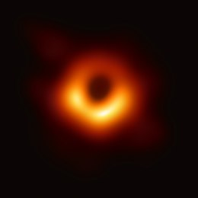
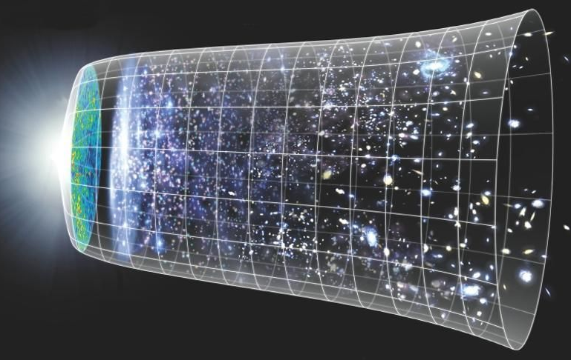
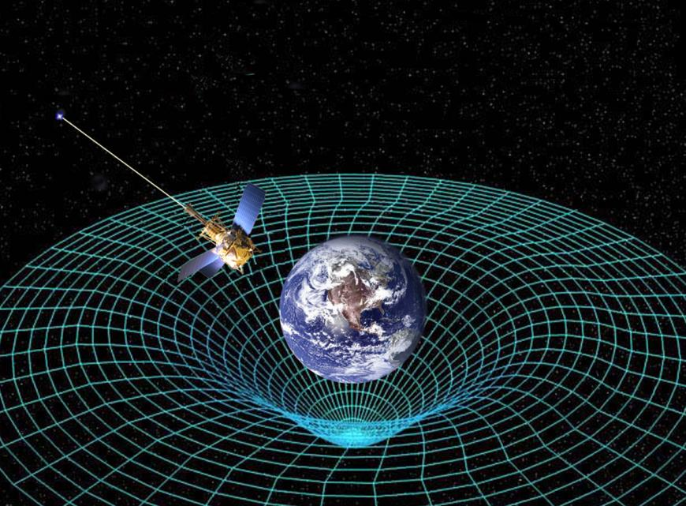
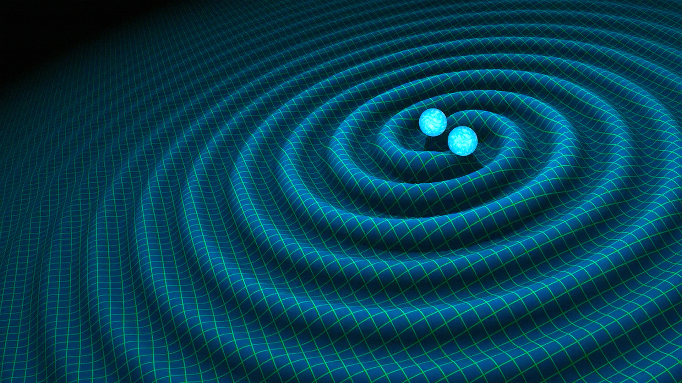


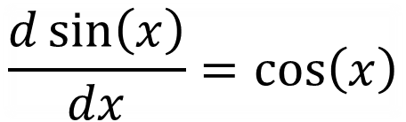
$$\frac{d\sin\left(x\right)}{dx}{=\cos\left(x\right)}$$
Basic Calculus
Black Holes
Expansion of
the universe
$$\left[\begin{matrix}1 & 3 \\ 5 & −2\end{matrix}\right]\left[\begin{aligned}1 \\ 2\end{aligned}\right]$$
Basic Linear Algebra
$$\vec{F}=m\vec{a}$$
Gravitational
Time Dilation
Gravitational
Waves
Basic Physics
Notes:
In this video series I’m going to try and help someone who is familiar with basic calculus, basic linear algebra, and basic physics, and guide them toward a mathematical understanding of general relativity, including topics like black holes, the expansion of the universe, gravitational time dilation, and gravitational waves.

Slide 3
several hours long…
Relativity
101
Relativity 102
Relativity 103
Relativity 104
Relativity 105
self-contained
introduction!
(Without too much math!)
Notes:
Now, this video series is going to be several hours long, but this video that you’re watching now is going to be a self-contained introduction that doesn’t have too much math and can be watched on its own.

Slide 4
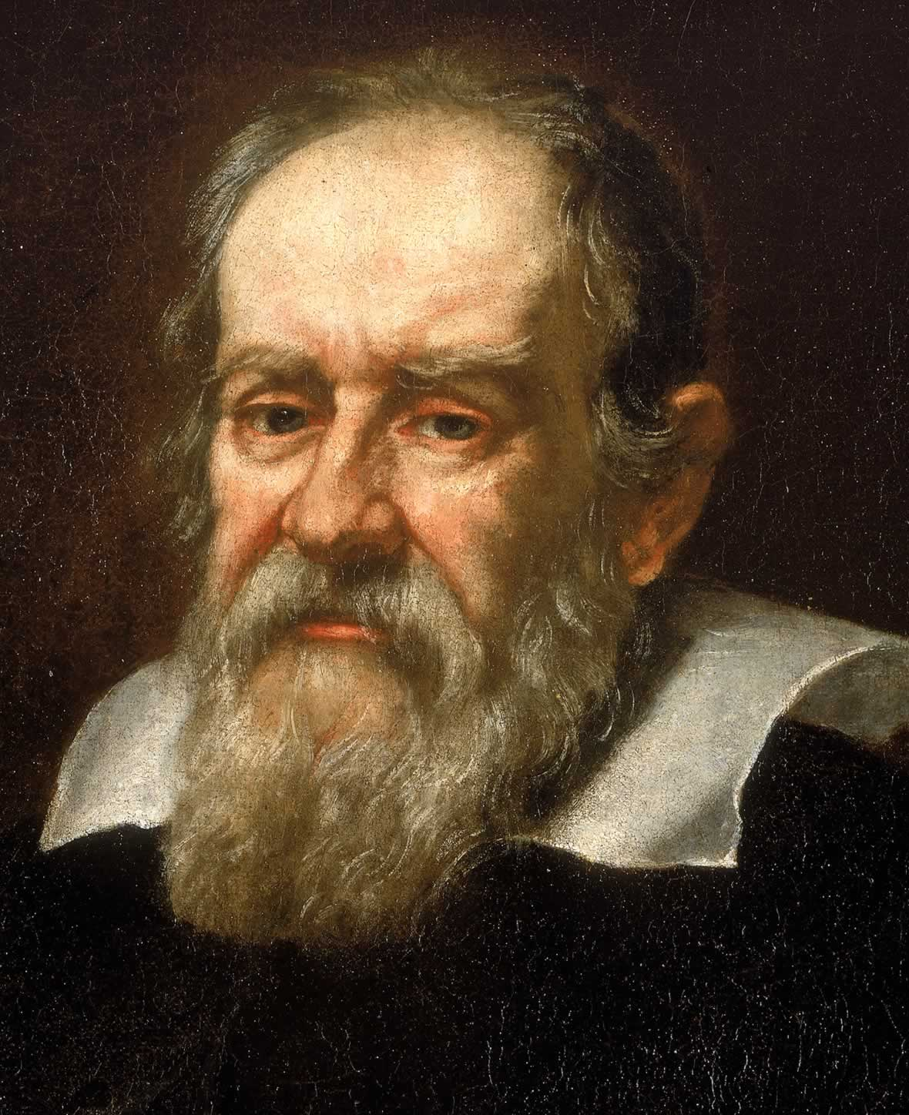
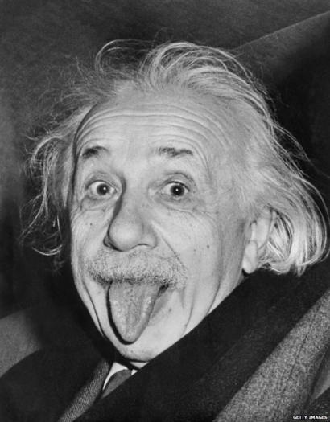
How did Relativity come about?
Relativity
101
Galileo Galilei
Albert Einstein
Notes:
In this video, I’m going to explain how the ideas of relativity came about, starting with Galileo in the 17th Century, and going up to Einstein in the 20th century.

Slide 5
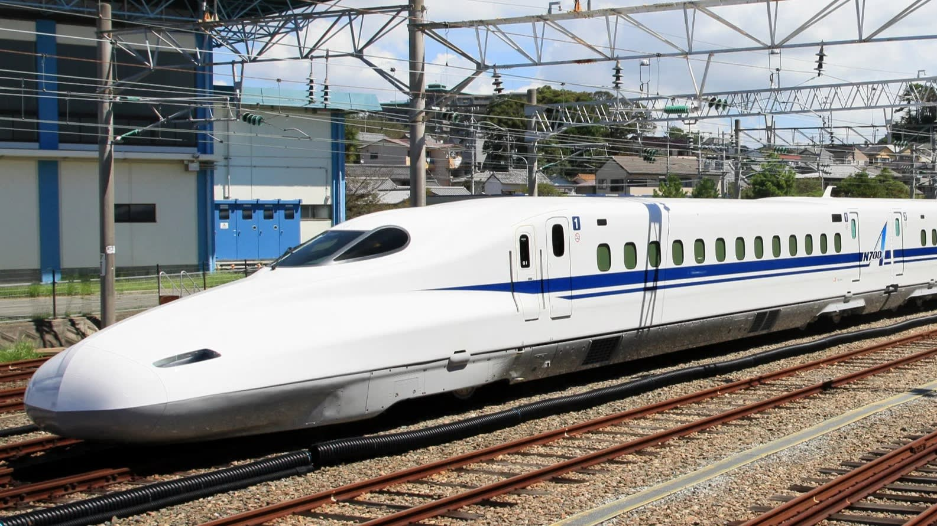
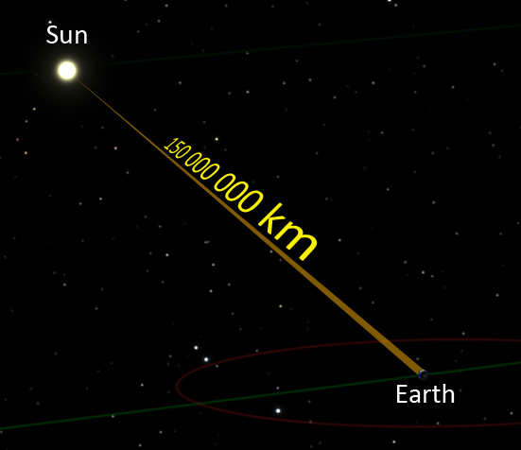
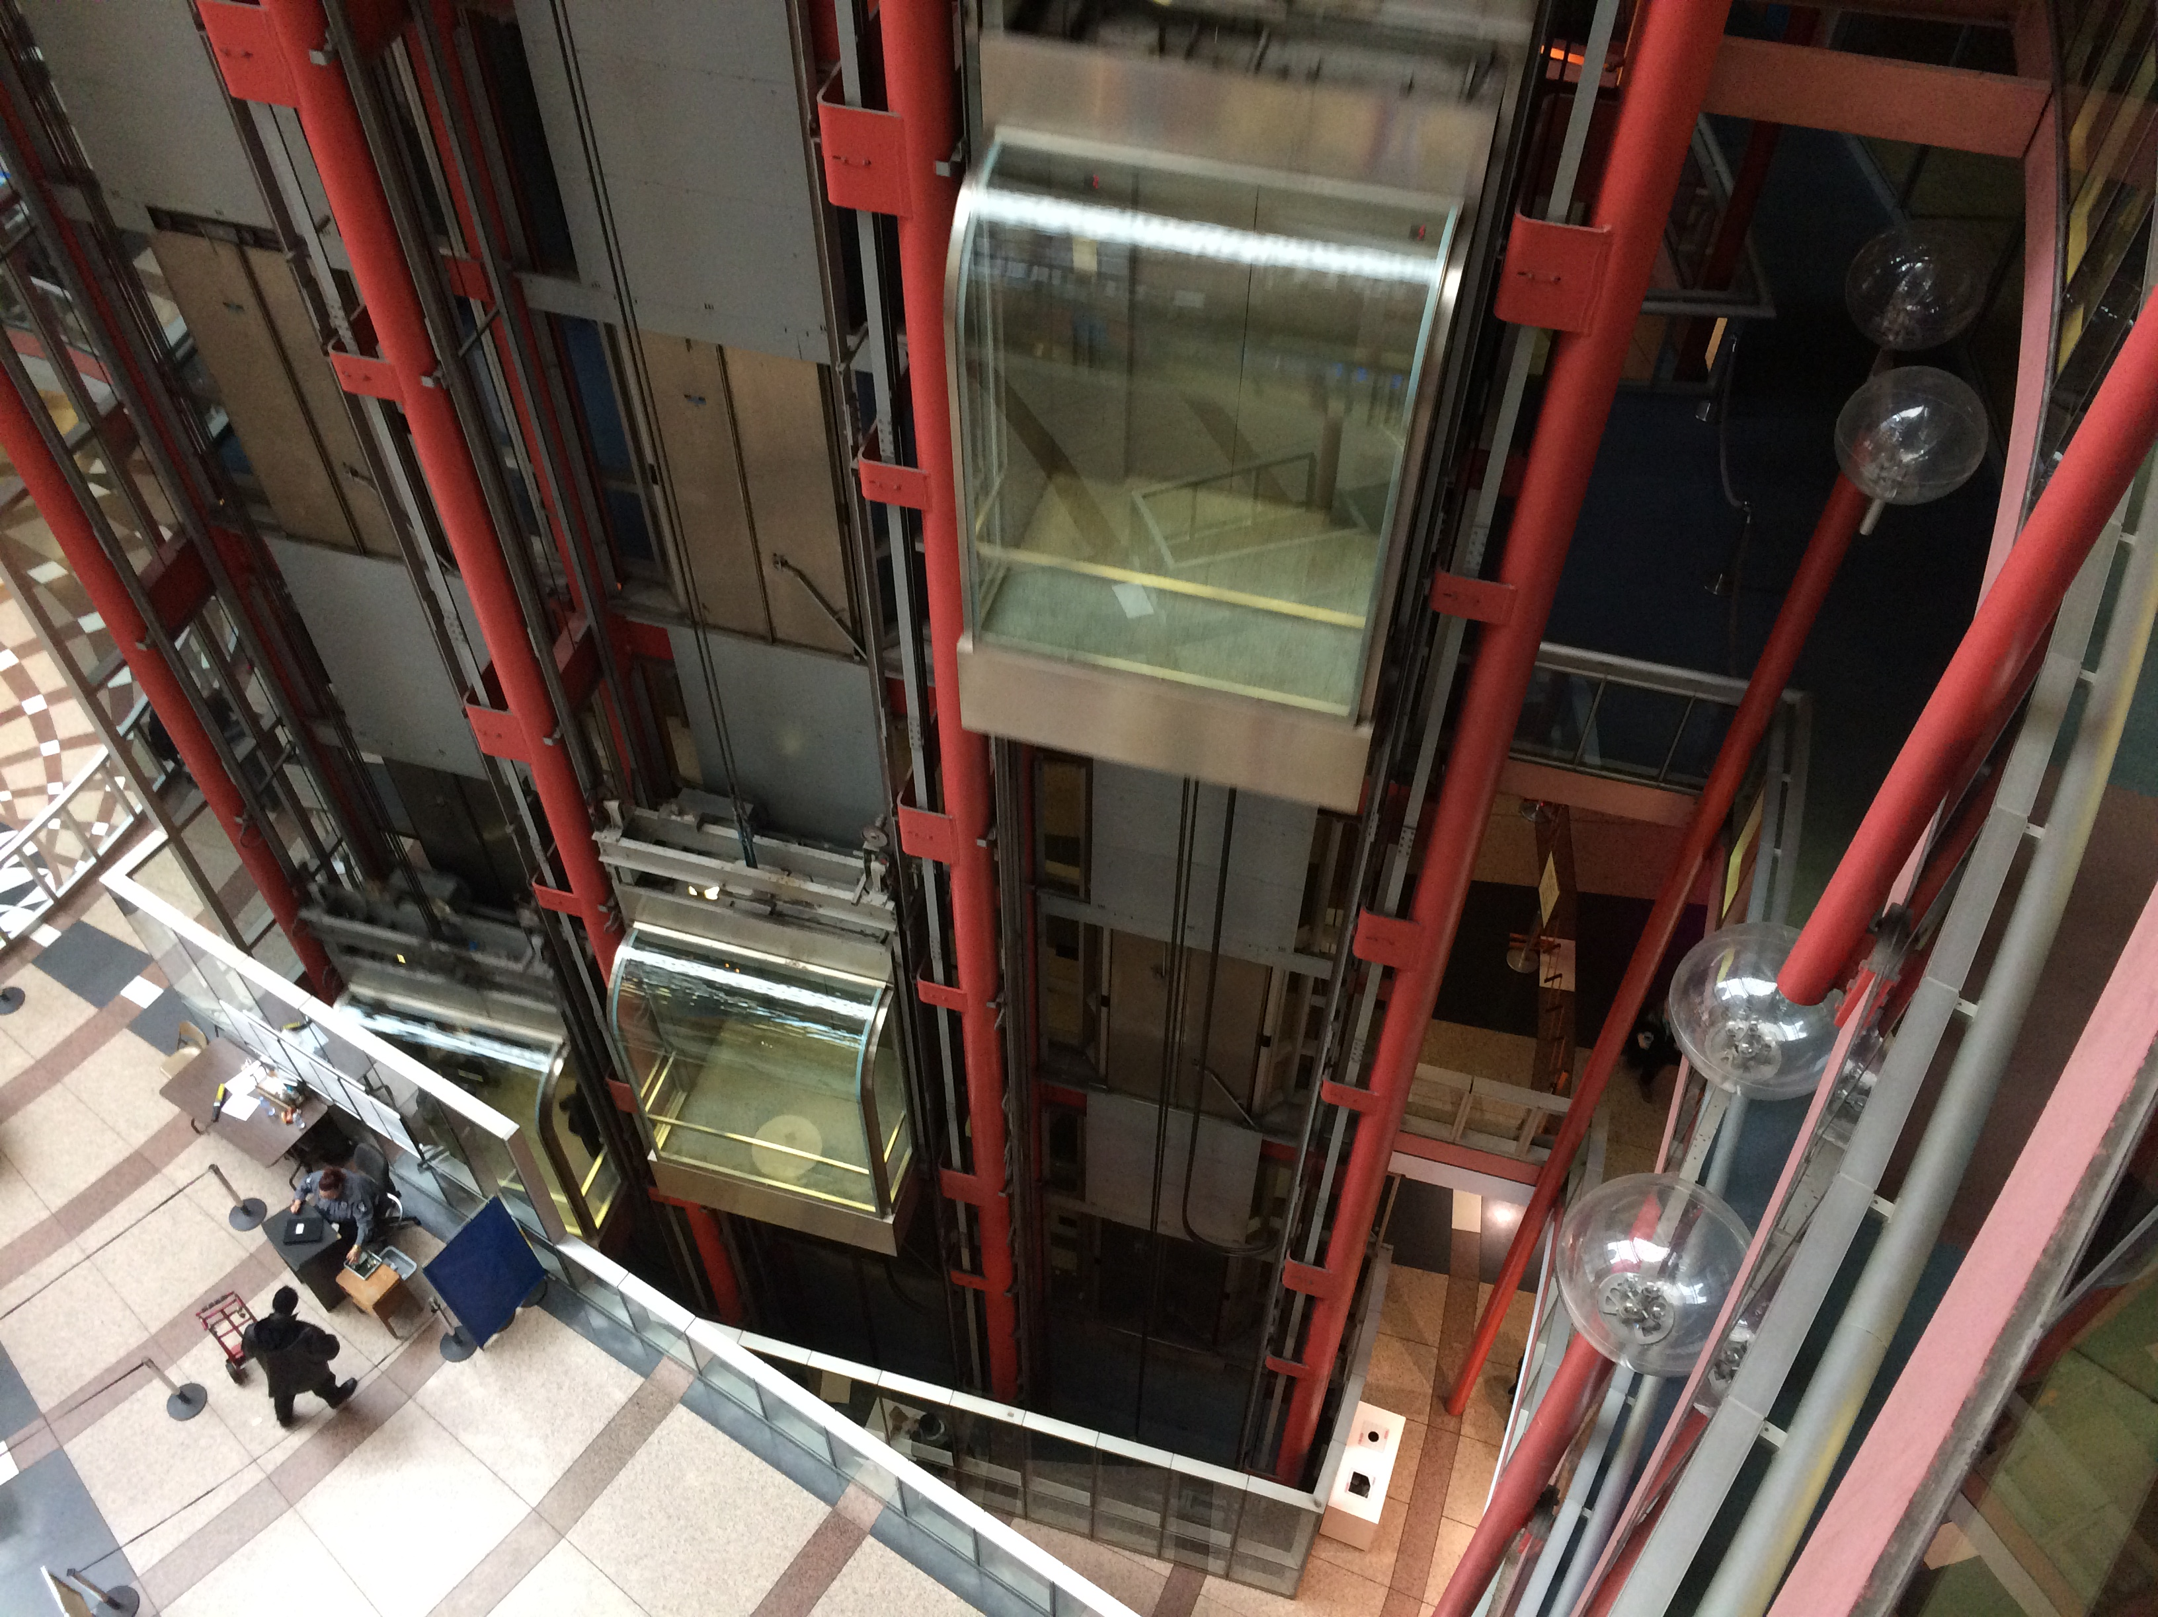
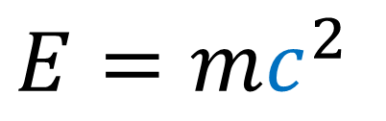
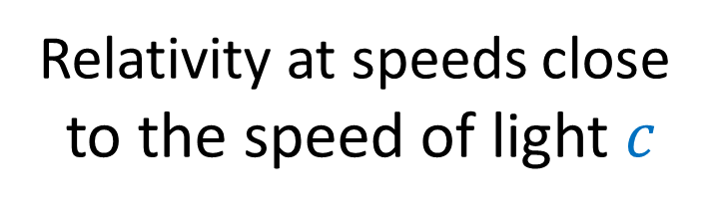
https://www.fourmilab.ch/etexts/einstein/specrel/www/
Galilean Relativity
(1632)
Special Relativity
(1905)
General Relativity
(1915)
Relativity at speeds close
to the speed of light $c$
A new theory of gravity.
(Gravity = spacetime curvature)
Relativity at
everyday speeds
$$E=mc^{2}$$
Notes:
So there are really 3 scientific theories of relativity. There’s Galilean Relativity, which is the relativity we experience at everyday speeds, like inside trains or elevators. And this is the type of relativity that was understood by Galileo, Newton, and other physics before the 20th Century.
Then, in 1905 Albert Einstein built on the work of other physicists and came up with Special Relativity, which is the relativity we see when we travel close to the speed of light. The famous equation, E = m c^2, is a result from considering physics in special relativity. Finally in 1915, Einstein published a generalized version of special relativity, called general relativity. General relativity is a new theory of gravity which replaces newton’s older theory of gravity. General Relativity treats gravity geometrically and says it’s the result of spacetime curvature.

Slide 6



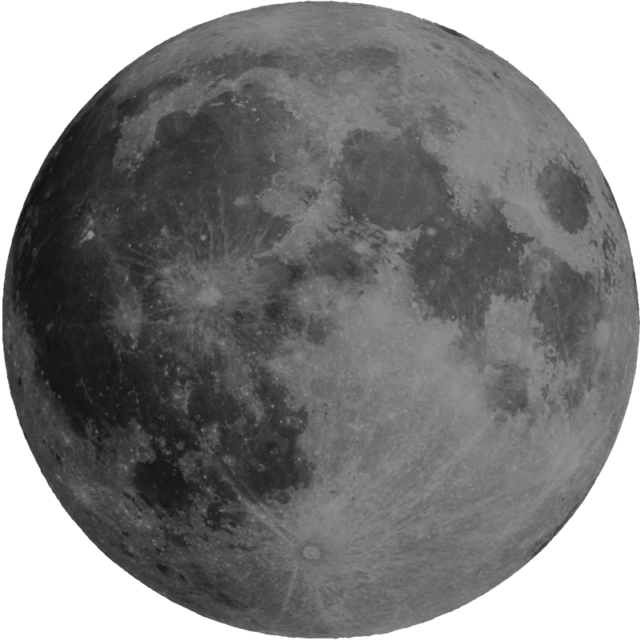
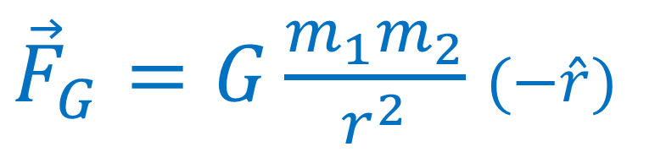
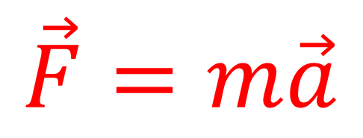
What is Relativity?
How the laws of motion work in different reference frames
$$\vec{F}=m\vec{a}$$
${\vec{F}}_{G}=G\frac{m_{1}m_{2}}{r^{2}}$ $(−\hat{r})$
Notes:
Before we start, we should ask, what is relativity? Relativity is the study of how the laws of motion work in different reference frames. When we’re talking about the laws of motions, we’re talking about laws like Newton’s Laws, which determine how forces cause objects to move and accelerate, and also Newton’s Law of Gravity.

Slide 7
What is Relativity?
How the laws of motion work in different reference frames
Galilean Principle of Relativity:
The laws of motion are the same in all inertial reference frames
“not accelerating”
Notes:
Galilean Relativity was the first theory that considered how the motion of objects would work in different reference frames. The Galilean Principal of Relativity tells us that the laws of motion are the same in all inertial reference frames. The word inertial here refers to frames of reference that are not accelerating.

Slide 8
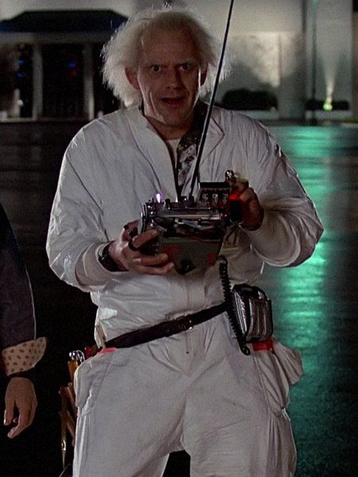

What is Relativity?
How the laws of motion work in different reference frames
Notes:
To understand what the Principal of Galilean Relativity means, let’s take a look at an example of a scientist standing on the ground dropping a ball. To the scientist, this ball appears to be falling straight down to the ground.

Slide 9

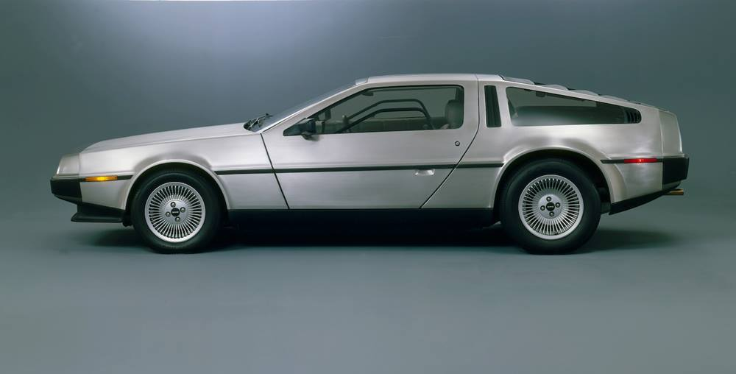
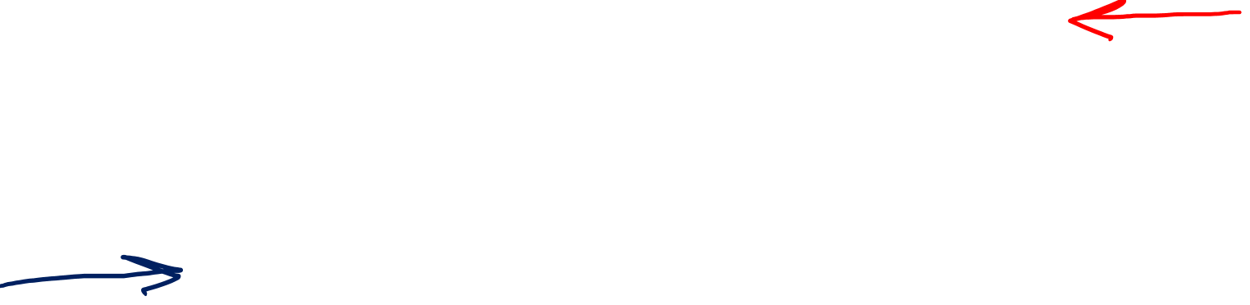
What is Relativity?
How the laws of motion work in different reference frames
Notes:
But other observers, such as a person driving a car at constant speed to the right, or a passenger in an airplane travelling at constant speed to the left, will see things differently. This is because the car and the plane have different frames of reference than the scientist standing on the ground.

Slide 10
Frame of the scientist (on the ground)
Notes:
Let’s consider the frame of reference of the scientist who is standing on the ground.

Slide 11

Frame of the scientist (on the ground)
Notes:
The scientist drops the ball, which travels straight downward due to gravity. The scientist also sees the car drive by him to the right at constant velocity.

Slide 12
Frame of the car
Notes:
But things will look different in the frame of reference of the car and its driver.

Slide 13
Frame of the car
Notes:
The driver could viewer their car as simply standing still, with the ground and the surrounding neighbor passing by with a constant speed toward the left.

Slide 14
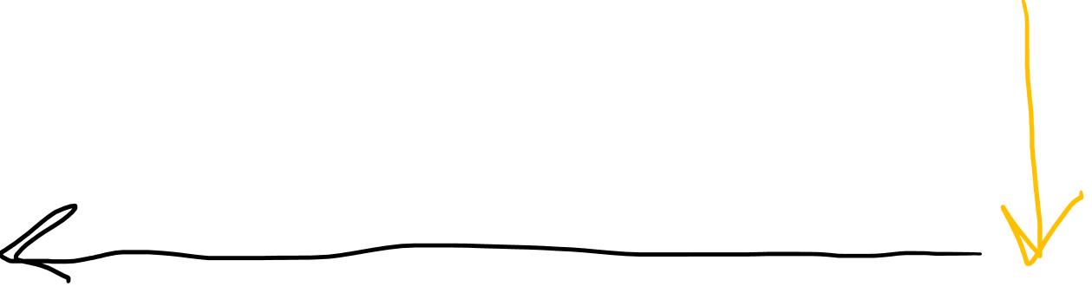
Frame of the car
Notes:
When the scientist on ground drops the ball, the car driver will see the ball fall in an arc shape, which is a combination of the ball’s downward motion toward the ground, and also the horizontal motion that the ground, scientist and neighbourhood are moving with towards the left.

Slide 15
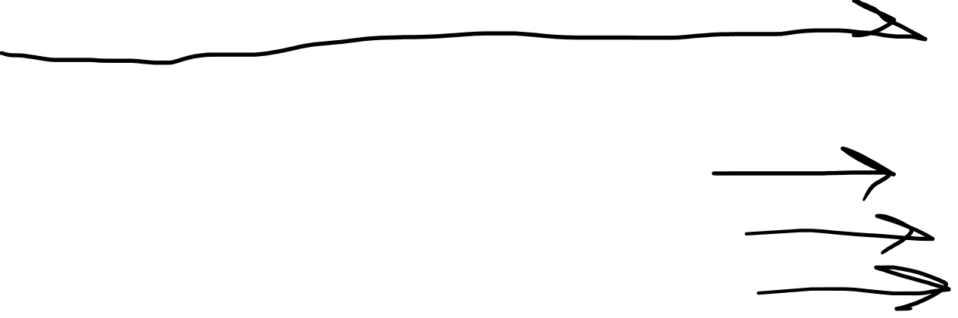
Frame of the plane
Notes:
When the scientist drops the ball, it travels in a long arc, because the world is travelling horizontally beneath the plane very quickly. The car, which is driving on top of the ground in the opposite direction, appears to travel by even faster.

Slide 16
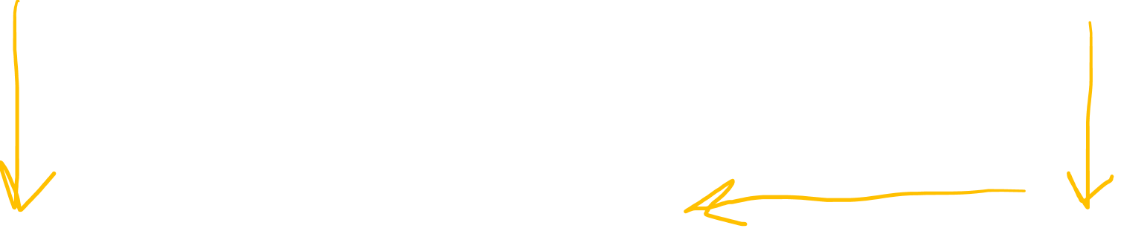
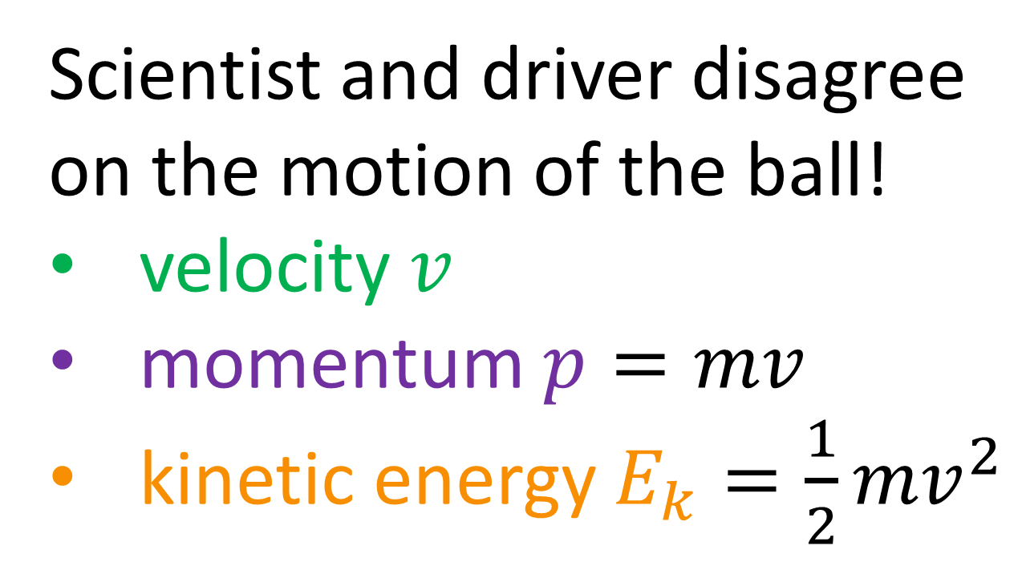
Scientist and driver disagree on the motion of the ball!
velocity $v$
momentum $p=mv$
kinetic energy $E_{k}=\frac{1}{2}{mv}^{2}$
Do they agree on anything?
Notes:
So we’ve seen that different observers in different frames of reference will observe the motion of objects differently. In our example, the scientist and the driver will disagree on how the ball is moving. The scientist sees the ball having vertical motion only, while the car driver sees the ball has vertical motion as well as horizontal motion. This means that the scientist and driver will disagree on the ball’s speed, or velocity. Because of this, they will also disagree on the ball’s momentum, which is mass times velocity. They will also disagree on the ball’s kinetic energy, ½ * m * v^2. So the scientist and driver disagree on a lot of things. You might be wondering if they agree on anything at all.

Slide 17
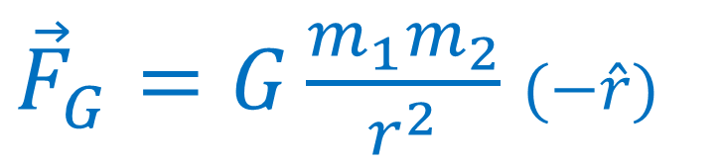

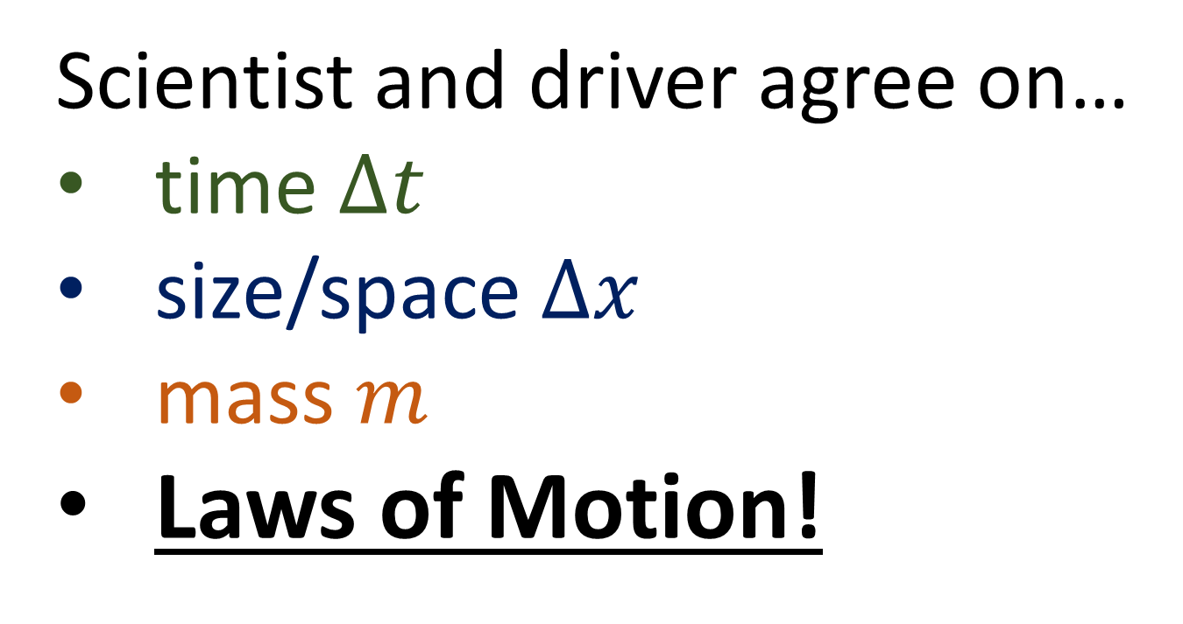
Scientist and driver agree on…
time $Δt$
size/space $Δx$
mass $m$
Laws of Motion!
$$\vec{F}=m\vec{a}$$
${\vec{F}}_{G}=G\frac{m_{1}m_{2}}{r^{2}}$ $(−\hat{r})$
Notes:
It turns out that the scientist and driver do agree on some things. If we watch the ball drop from both of their perspectives, or frames of reference, we see the ball takes the same amount of time to reach the ground in both cases. So the scientist and driver will both agree on the passage of time. They will also agree on the size or spatial dimensions of the ball. They will also agree on the ball’s mass. Most importantly, the scientist and driver will agree on the laws of motion, like Newton’s 3 Laws of motion and Newton’s Law of gravity.

Slide 18
Frame of the scientist (on the ground)
Notes:
We already know that in the scientist’s frame of reference, when the scientist drops the ball, it travels straight down towards the ground.

Slide 19
Frame of the car
Notes:
But now let’s consider what happens if the driver has the ball, and drops it in their car as they drive along. The ball also travels straight down toward the ground. This is exactly what the scientist saw in his own frame of reference when he dropped the ball.

Slide 20

Frame of the plane
Notes:
Finally, if a passenger on the plane dropped a ball, it would also travel straight down to the floor of the plane, exactly what the scientist and driver would have seen dropping the ball in their own reference frames.

Slide 21
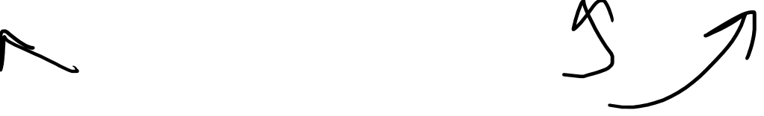
Inertial Frames
Galilean Principle of Relativity:
The laws of motion are the same in all inertial reference frames
There is no experiment you can do to determine if your reference frame is stationary, or moving at constant speed
There is no “special” reference frame truly stationary
Notes:
So the scientist, driver, and plane passenger, all see a ball fall with the same motion in their own references frames. That’s because these are all examples of inertial reference frames, which are frames that travel at a constant speed. This is because of the Galilean Principal of Relativity, which says the laws of motion and gravity are the same in all inertial reference frames, which are reference frames travelling at constant speed. Because of this, there is no physical experiment you can do to determine if your own frame of reference is stationary or moving at a constant speed. The scientist may think he is standing still on the ground, watching the car and plane travel past time, but it’s equally correct to say that the car is stationary, with the scientist and plane moving around it. In Galilean Relativity, there’s no special frame of reference that’s truly stationary. All motion is always relevant to something else. But when reference frames are travelling at constant speed relativity to each other, like the scientist, car or plane, they will all experience the same laws of motion.

Slide 22
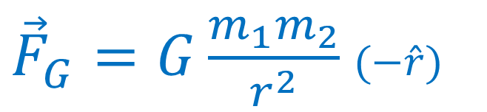

Galilean Principle of Relativity
Laws of motion are the same in all inertial reference frames
Things we disagree on:
Things we agree on:
An object’s motion
Laws of motion
$$\vec{F}=m\vec{a}$$
${\vec{F}}_{G}=G\frac{m_{1}m_{2}}{r^{2}}$ $(−\hat{r})$
Notes:
Let’s sum up what we’ve learned about Galilean relativity. In Galilean relativity, there are some things we disagree on depending on which reference frame we’re observing from. We’ll disagree on the motion of objects.

Slide 23
Galilean Principle of Relativity
Laws of motion are the same in all inertial reference frames
Things we disagree on:
Things we agree on:
An object’s motion
Laws of motion
$$\vec{F}=m\vec{a}$$
${\vec{F}}_{G}=G\frac{m_{1}m_{2}}{r^{2}}$ $(−\hat{r})$
Notes:
Let’s sum up what we’ve learned about Galilean relativity. In Galilean relativity, there are some things we disagree on depending on which reference frame we’re observing from. We’ll disagree on the motion of objects. This means we’ll disagree on an object’s velocity, momentum, and kinetic energy. But there are other things we will agree on in all reference frames. The most important thing we agree on is the last of motion. But we will also agree on passage of time, size and space, and the mass of objects.

Slide 24

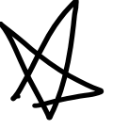


Galilean Principle of Relativity
Laws of motion are the same in all inertial reference frames
Things we disagree on:
Things we agree on:
velocity $\vec{v}$
Laws of motion
momentum $\vec{p}$
$$\vec{F}=m\vec{a}$$
kinetic energy $E_{k}$
${\vec{F}}_{G}=G\frac{m_{1}m_{2}}{r^{2}}$ $(−\hat{r})$
Notes:
This means we’ll disagree on an object’s velocity, momentum, and kinetic energy. But there are other things we will agree on in all reference frames. The most important thing we agree on is the last of motion.

Slide 25
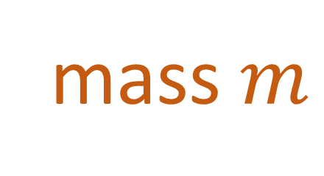
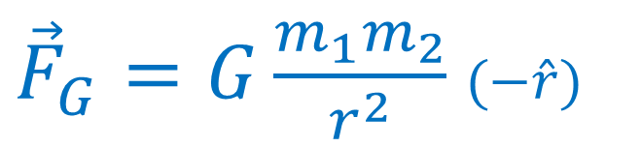

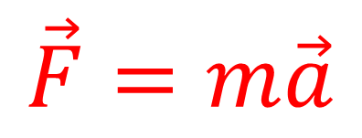
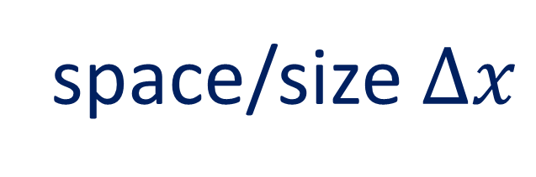
Galilean Principle of Relativity
Laws of motion are the same in all inertial reference frames
Things we disagree on:
Things we agree on:
time $Δt$
space/size $Δx$
velocity $\vec{v}$
mass $m$
momentum $\vec{p}$
Laws of motion
kinetic energy $E_{k}$
$$\vec{F}=m\vec{a}$$
${\vec{F}}_{G}=G\frac{m_{1}m_{2}}{r^{2}}$ $(−\hat{r})$
Notes:
But we will also agree on passage of time, size and space, and the mass of objects.

Slide 26
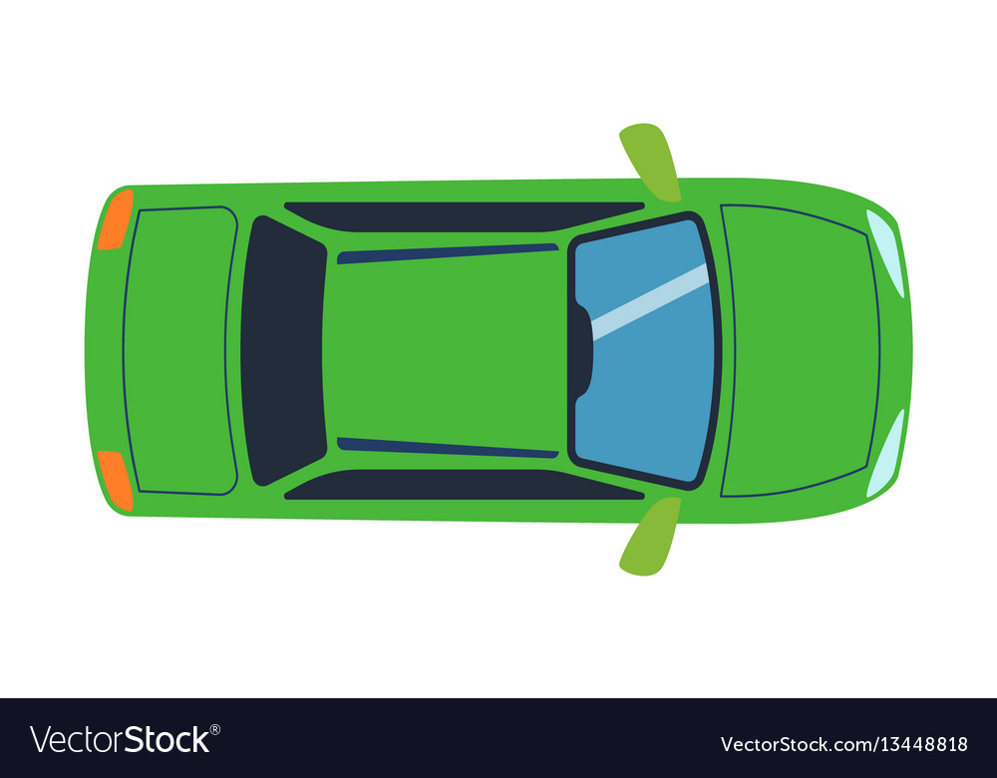

Gallilean Relativity
Examples of accelerating frames (non-inertial frame):
Elevator accelerates
upward…
Car accelerates forward…
… passenger feels pulled backward
Car turns a corner… (accelerates inward)
… passenger feels
pulled downward.
… passenger feels
pulled outward
In a car, hitting the gas pedal (or hitting the brakes) (Beginning/end of ride in elevator)
In a car, turning corner at constant speed
Notes:
You might ask what will happen if we’re in an accelerating reference frame, which would be a non-inertial reference frame. We an understand what would happen using our experience in everyday life. If you’ve ever been in an elevator that’s accelerating upward, you might have noticed that you feel heavier, like you’re being pulled downward. If you’ve ever been in an accelerating car, you might have felt like you were fetting pulled into the back of your seat. And if you’ve been in a car that took a sharp turn, the was actually had centripetal accelerating inward , which makes the passenger feel thrown outward toward the side door.

Slide 27


Gallilean Relativity
A passenger in an accelerating box…
…will feel a fictitious force pulling on them.
A passenger in an accelerating reference frame…
…will have different laws of motion!
$$\vec{F}=m\vec{a}+{\vec{F}}_{ficticious}$$
Newton’s 2nd Law for
accelerating reference frame.
Notes:
So we can see that when a passenger is an in accelerating box, or accelerarting reference frame, they will feel a mysterious fictitious force pulling on them in the opposite direction of the box’s acceleration.
This means that a passenger in an accelerating reference frame will have different set of laws of motion. Every time they use Newton’s 2nd law, they will need to add a term for the fictitious force in order to predict the motion of objects correctly.

Slide 28

stationary
acceleration

Slide 29
stationary
acceleration

Slide 30
stationary
acceleration
Non-inertial Frames (Galilean relativity does not apply)
stationary/constant speed
acceleration

Slide 31
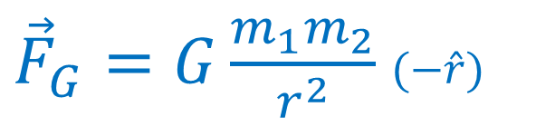
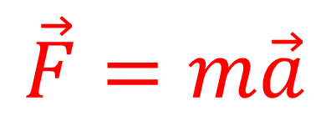

Galilean Principle of Relativity
Laws of motion are the same in all inertial reference frames
Things we disagree on:
Things we agree on:
time $Δt$
space/size $Δx$
velocity $\vec{v}$
mass $m$
momentum $\vec{p}$
Laws of motion
kinetic energy $E_{k}$
$$\vec{F}=m\vec{a}$$
${\vec{F}}_{G}=G\frac{m_{1}m_{2}}{r^{2}}$ $(−\hat{r})$
Notes:
Remember that the Galilean Principle of Relativiy means that the laws of motion are the same, only for inertial reference frames.

Slide 32
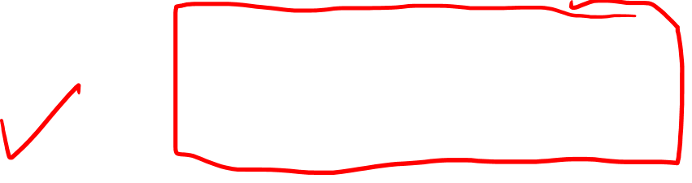

https://www.fourmilab.ch/etexts/einstein/specrel/www/
Galilean Relativity
(1632)
Special Relativity
(1905)
General Relativity
(1915)
Physics at speeds close
to the speed of light $c$
A new theory of gravity.
(Gravity = spacetime curvature)
Physics at
everyday speeds
$$E=mc^{2}$$
Notes:
So we finished leaerning about Galilean relativity, which is the relativity of everyday life. Now let’s talk about Special Relativity, which is the relativity that we observe when close to the speed of light

