Slide 1

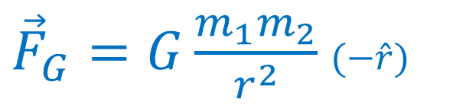

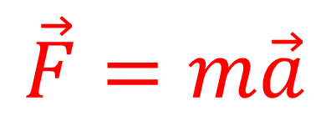
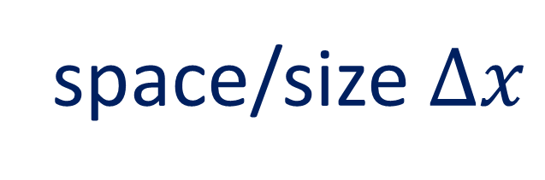


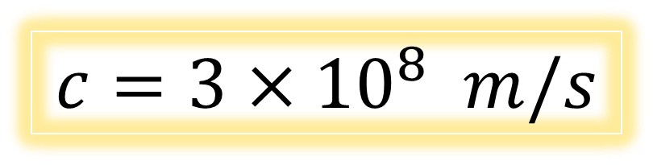
Special Relativity (attempt…)
Laws of physics are the same in all inertial reference frames
Things we disagree on:
Things we agree on:
time $Δt$
space/size $Δx$
velocity $\vec{v}$
momentum $\vec{p}$
Laws of physics
$$c=3×{10}^{8} m/s$$
kinetic energy $E$
$$\vec{F}=m\vec{a}$$
${\vec{F}}_{G}=G\frac{m_{1}m_{2}}{r^{2}}$ $(−\hat{r})$
Notes:
So in attempt to built a new theory of relativity… Einstein began by agreeing with Galileo and said that the laws of motion should be the same in all inertial frames of reference. But he expanded this principle to include not just Newton’s Laws of motion, but all laws of physics, including Maxwell’s equations, and made the speed of light C a law of physics that is agreed upon in all inertial frames.

Slide 2
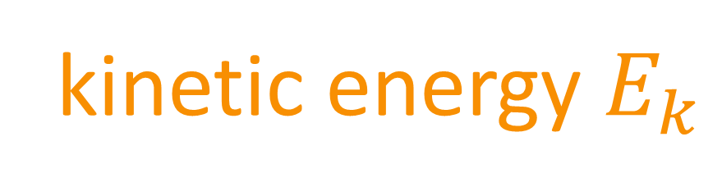
Special Relativity (attempt…)
Laws of physics are the same in all inertial reference frames
Things we disagree on:
Things we agree on:
time $Δt$
space/size $Δx$
velocity $\vec{v}$
momentum $\vec{p}$
Laws of physics
$$c=3×{10}^{8} m/s$$
kinetic energy $E_{k}$
$$\vec{F}=m\vec{a}$$
${\vec{F}}_{G}=G\frac{m_{1}m_{2}}{r^{2}}$ $(−\hat{r})$
Notes:
So unfortunately, the information on the screen in front of you contracts itself and is not consistent. But there is a way we can create a theory of relativity where the speed of light in a vacuum is a law of physics. And that’s my taking time, space and mass, and changing them from things everyone agrees on….

Slide 3
Special Relativity (attempt…)
Laws of physics are the same in all inertial reference frames
Things we disagree on:
Things we agree on:
time $Δt$
space/size $Δx$
velocity $\vec{v}$
momentum $\vec{p}$
Laws of physics
$$c=3×{10}^{8} m/s$$
kinetic energy $E_{k}$
$$\vec{F}=m\vec{a}$$
${\vec{F}}_{G}=G\frac{m_{1}m_{2}}{r^{2}}$ $(−\hat{r})$

Slide 4



Special Relativity (attempt…)
Laws of physics are the same in all inertial reference frames
Things we disagree on:
Things we agree on:
time $Δt$
space/size $Δx$
Laws of physics
velocity $\vec{v}$
momentum $\vec{p}$
$$c=3×{10}^{8} m/s$$
kinetic energy $E_{k}$
$$\vec{F}=m\vec{a}$$
${\vec{F}}_{G}=G\frac{m_{1}m_{2}}{r^{2}}$ $(−\hat{r})$
Notes:
To things that everyone can disagree on. In the theory of special relativity, time, space and mass become relative and depend on the observer’s reference frame, just like velocity, momentum and kinetic energy

Slide 5


Special Relativity (attempt…)
Laws of physics are the same in all inertial reference frames
Things we disagree on:
Things we agree on:
time $Δt$
space/size $Δx$
Laws of physics
velocity $\vec{v}$
momentum $\vec{p}$
$$c=3×{10}^{8} m/s$$
kinetic energy $E_{k}$
$$\vec{F}=m\vec{a}$$
${\vec{F}}_{G}=G\frac{m_{1}m_{2}}{r^{2}}$ $(−\hat{r})$
Notes:
To things that everyone can disagree on. In the theory of special relativity, time, space and mass become relative and depend on the observer’s reference frame, just like velocity, momentum and kinetic energy

Slide 6
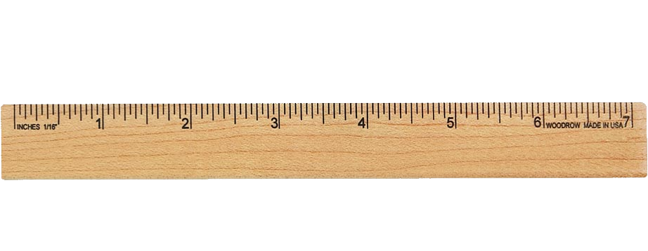
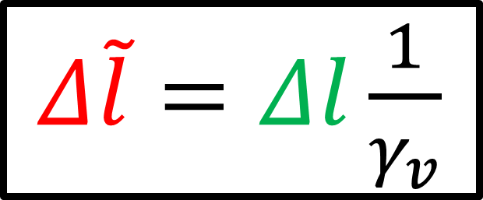
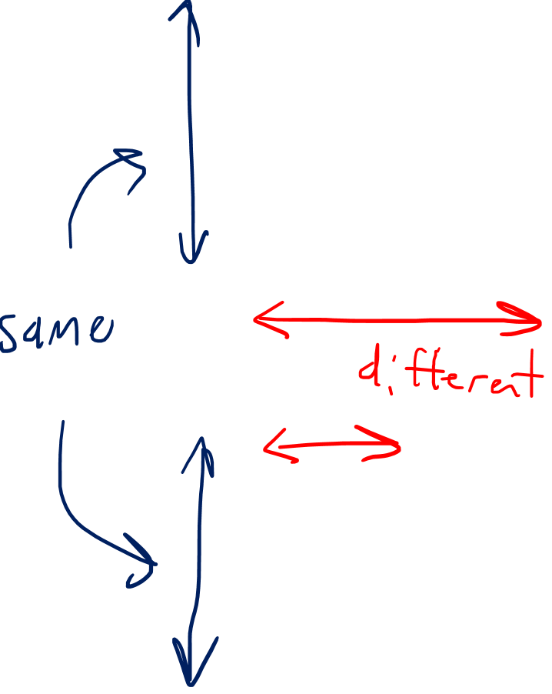
Length Contraction:
Moving rods appear short
$Δ\tilde{l}=Δl\frac{1}{γ_{v}}$
Notes:
There is a similar effect on space called length contraction where rods that are moving appear to have a shorter length than the same rods when they are standing still. However, the length contraction only happens in the direction of motion, in the direction perpendicular to the motion, no length contraction happens, and identical rods will be measured to have the same length.

Slide 7

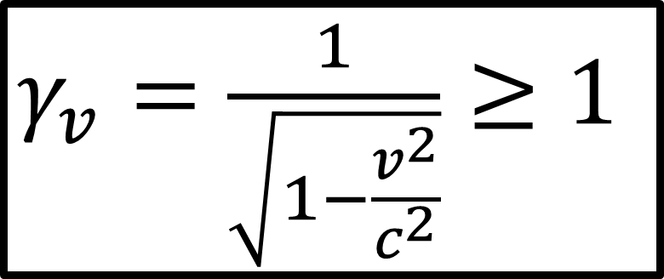
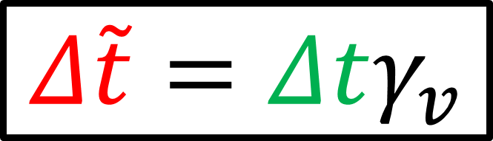


$γ_{v}=\frac{1}{\sqrt{1−\frac{v^{2}}{c^{2}}}}≥1$
Lorentz Factor:
everyday speeds << $c$
Time Dilation:
Moving clocks run slow
Length Contraction:
Moving rods appear short
$Δ\tilde{l}=Δl\frac{1}{γ_{v}}$
$$Δ\tilde{t}=Δtγ_{v}$$
Only noticeable when $v$ is close to $c$.
Notes:
So, w e now see that time, space, and mass are relative quantities that depend on the reference frame we’re in. But this definitely doesn’t match up with our everyday experiences, so how can it be true? Well, the everyday speeds of cars, trains, and planes are much smaller than the speed of light C, and we see in the Lorentz factor Formula that if V is much smaller than C, v2 / c/2 is basically zero, meaning the Lorentz factor is basically equal to 1, meaning all reference frames agree on time, space and mass. So the effects of special relativity are not apparent at everyday speed. But at high speeds, like the speeds of faraway galaxies or the speeds of subatomic particles, special relativity needs to be taken into account to understand physics properly.

Slide 8
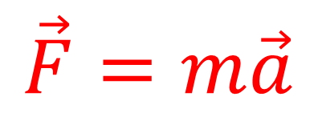
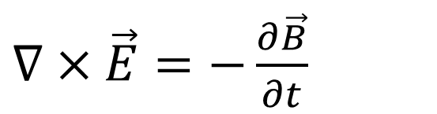

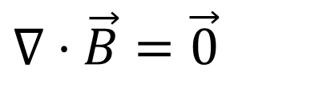
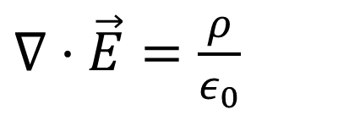
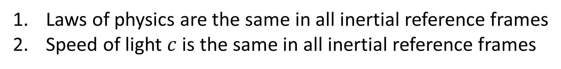


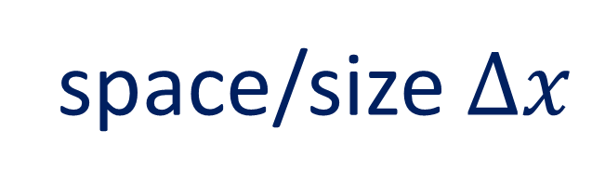
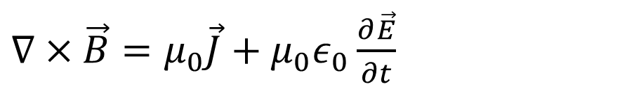

Special Relativity
Laws of physics are the same in all inertial reference frames
Speed of light $c$ is the same in all inertial reference frames
Things we disagree on:
Things we agree on:
time $Δt$
space/size $Δx$
Laws of physics
$$c=3×{10}^{8} m/s$$
velocity $\vec{v}$
$$\vec{F}=m\vec{a}$$
${\vec{F}}_{G}=G\frac{m_{1}m_{2}}{r^{2}}$ $(−\hat{r})$
momentum $\vec{p}$
$∇⋅\vec{E}=\frac{ρ}{ε_{0}}$
$∇×\vec{E}=−\frac{∂\vec{B}}{∂t}$
kinetic energy $E_{k}$
$∇⋅\vec{B}=\vec{0}$
$∇×\vec{B}=μ_{0}\vec{J}+μ_{0}ε_{0}\frac{∂\vec{E}}{∂t}$
Notes:
So to sum up special relativity, the two postulates are that all laws of physics are the same in all inertial reference frames, and we also have to remember that the speed of light in a vacuum C is also a law of physics that is the same in all inertial reference frames. This means all inertial frame will agree on Newton’s laws, Maxwell’s equations, and the speed of light, but differential inertial frames will disagree on time, space and mass, as well as velocity, momentum and kinetic energy.

Slide 9
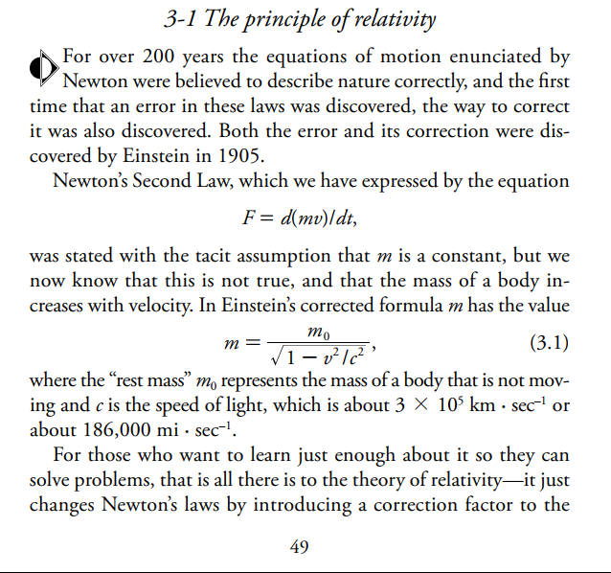
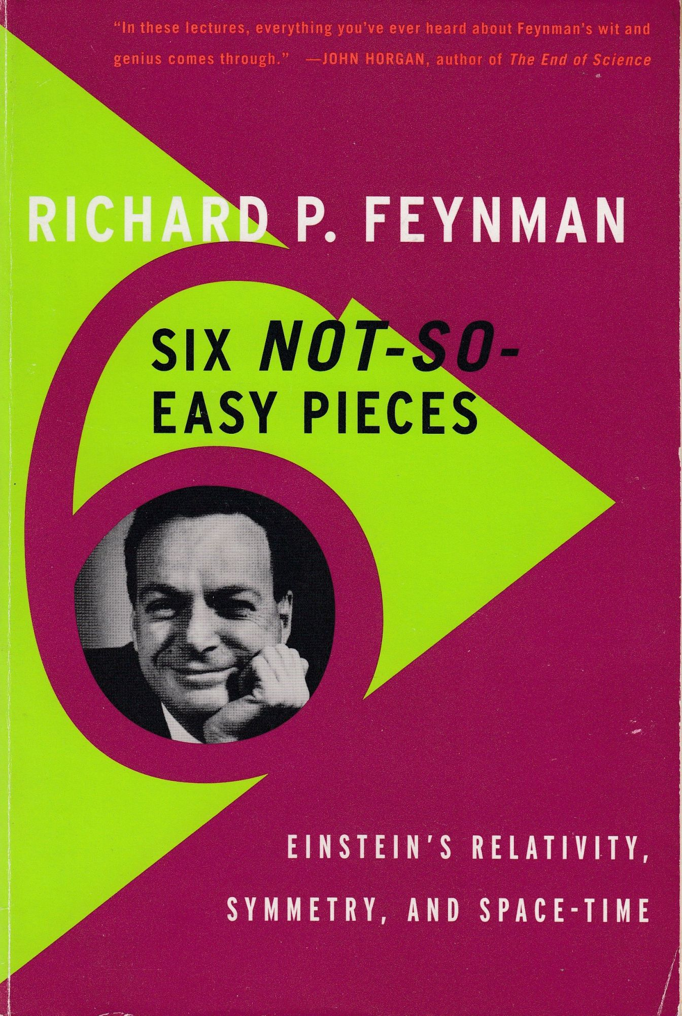
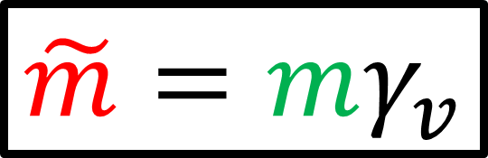

What about mass $m$?
Relativistic Mass:
Moving objects more massive
$$\tilde{m}=mγ_{v}$$
This definition can lead to a lot of confusion!
Modern approach is to treat mass as non-relativistic!
Notes:
One last thing… Some viewers might have noticed that I haven’t spoken about mass in this video. There is a concept called relativistic mass, where fast-moving objects increase in mass due to the Lorentz Factor, similar to how time dilation works. I was taught this concept in university, and it’s also described in physics lectures note by Richard Feymann.
However, many physicists, including Einstein, began to question the concept of relativistic mass after it was introduced. They found that the concept of relativistic mass can sometimes be useful in some specific circumstances, but in general it is a messy concept that leads to a lot of confusion. Modern approaches to relativity treat mass as a non-relativistic quantity, and I plan to do this as well. I will wait until a later video to explain the details. You can check the description for links on the topic of relativistic mass if you want to learn more.

Slide 10
What about mass $m$?
Relativistic Mass:
Moving objects more massive
See description for links on “relativistic mass”!
$$\tilde{m}=mγ_{v}$$
This definition can lead to a lot of confusion!
Modern approach is to treat mass as non-relativistic!
Notes:
One last thing… Some viewers might have noticed that I haven’t spoken about mass in this video. There is a concept called relativistic mass, where fast-moving objects increase in mass due to the Lorentz Factor, similar to how time dilation works. I was taught this concept in university, and it’s also described in physics lectures note by Richard Feymann.
However, many physicists, including Einstein, began to question the concept of relativistic mass after it was introduced. They found that the concept of relativistic mass can sometimes be useful in some specific circumstances, but in general it is a messy concept that leads to a lot of confusion. Modern approaches to relativity treat mass as a non-relativistic quantity, and I plan to do this as well. I will wait until a later video to explain the details. You can check the description for links on the topic of relativistic mass if you want to learn more.

