Slide 1
Relativity 102:
The Key to the Mathematics of Relativity
(Check Description for Errors)
Notes:
Welcome to Relativity 102: The Key to the mathematics of relativity.

Slide 2
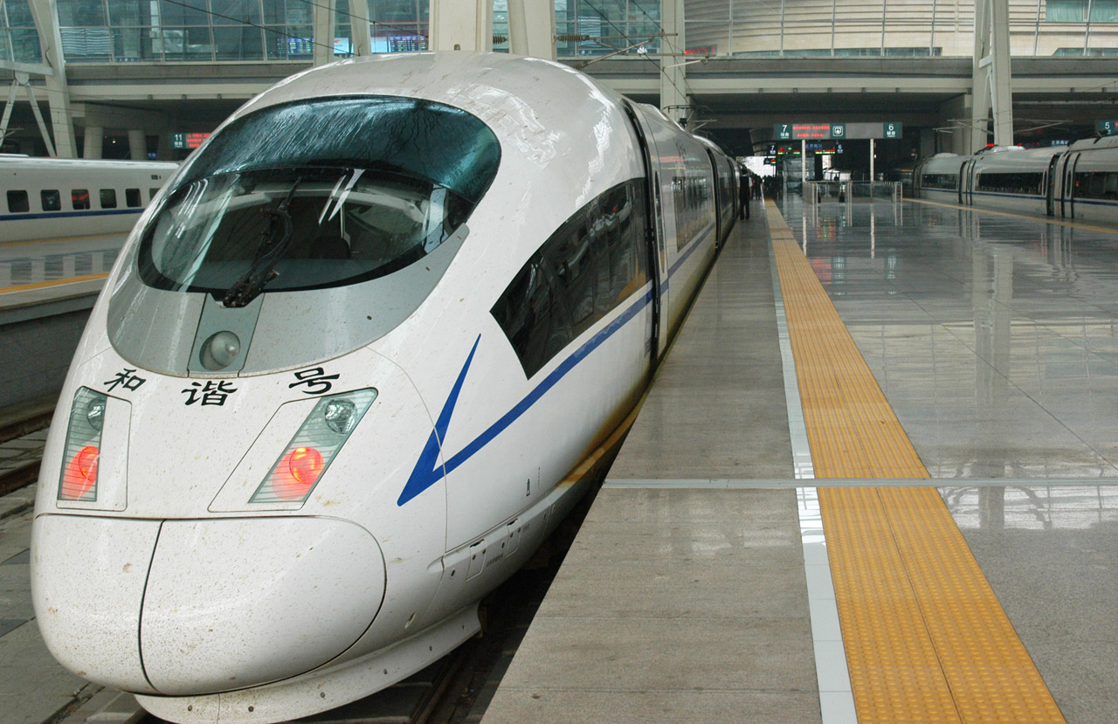

Relativity 102: The Keys to Relativity
Invariance
Covariance & Contravariance
Notes:
In Relativity 102 I’ll be explaining what I think are the two most important mathematical ideas for understanding the math behind relativity. And those key ideas are #1, invariance, and #2, the twin concepts of covariance and contravariance. Now, some viewers might already be scared by these scary, abstract-sounding words. First, I’ll say that these ideas aren’t as hard as they sound. And second, I’m going to spend a couple minutes explaining why I’m introducing these concepts right away, instead of explaining relativity about familiar things in the real world, like trains and planes.

Slide 3
more mathematically in-depth…
Relativity
101
Relativity 102
Relativity 103
Relativity 104
Relativity 105
self-contained
introduction!
(Without too much math!)
Notes:
My relativity 101 videos give you an introduction to the concepts in relativity without using too much math. But I’m assuming viewers who are watching these later videos are willing to put in more effort to understand relativity and that many of you will be here for the long-term.

Slide 4
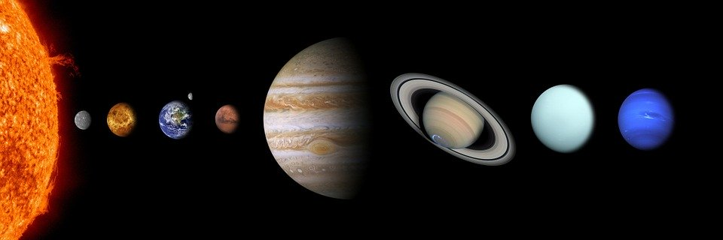
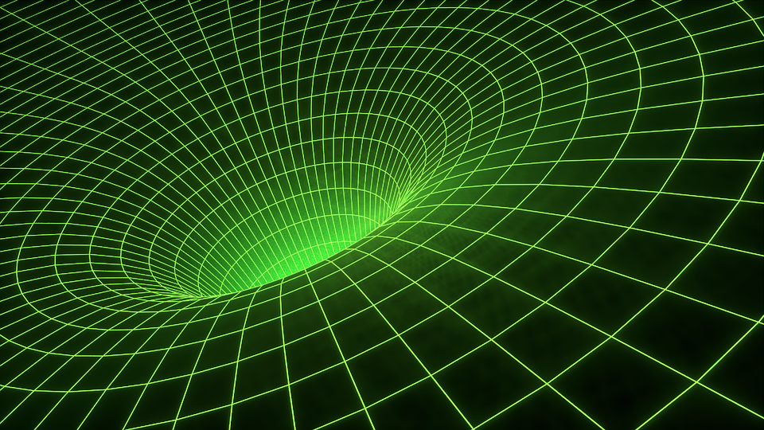

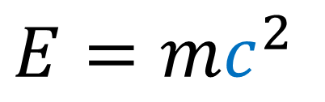
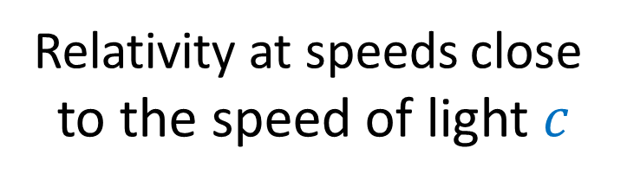
Galilean Relativity
(1632)
Special Relativity
(1905)
General Relativity
(1915)
300,000,000 m/s
Relativity at speeds close
to the speed of light $c$
A new theory of gravity.
(Gravity = spacetime curvature)
Relativity at
everyday speeds
$$E=mc^{2}$$
Notes:
When I said “long-term” I mean I expect you’re going to use this series to understand Galilean Relativity, which is the relativity of everyday life. Special Relativity which is relativity we see when going close to the speed of light, and General Relativity which is the modern theory of gravity.

Slide 5
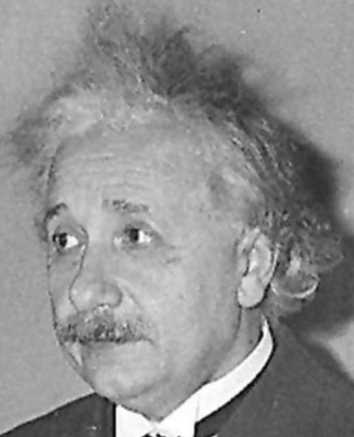
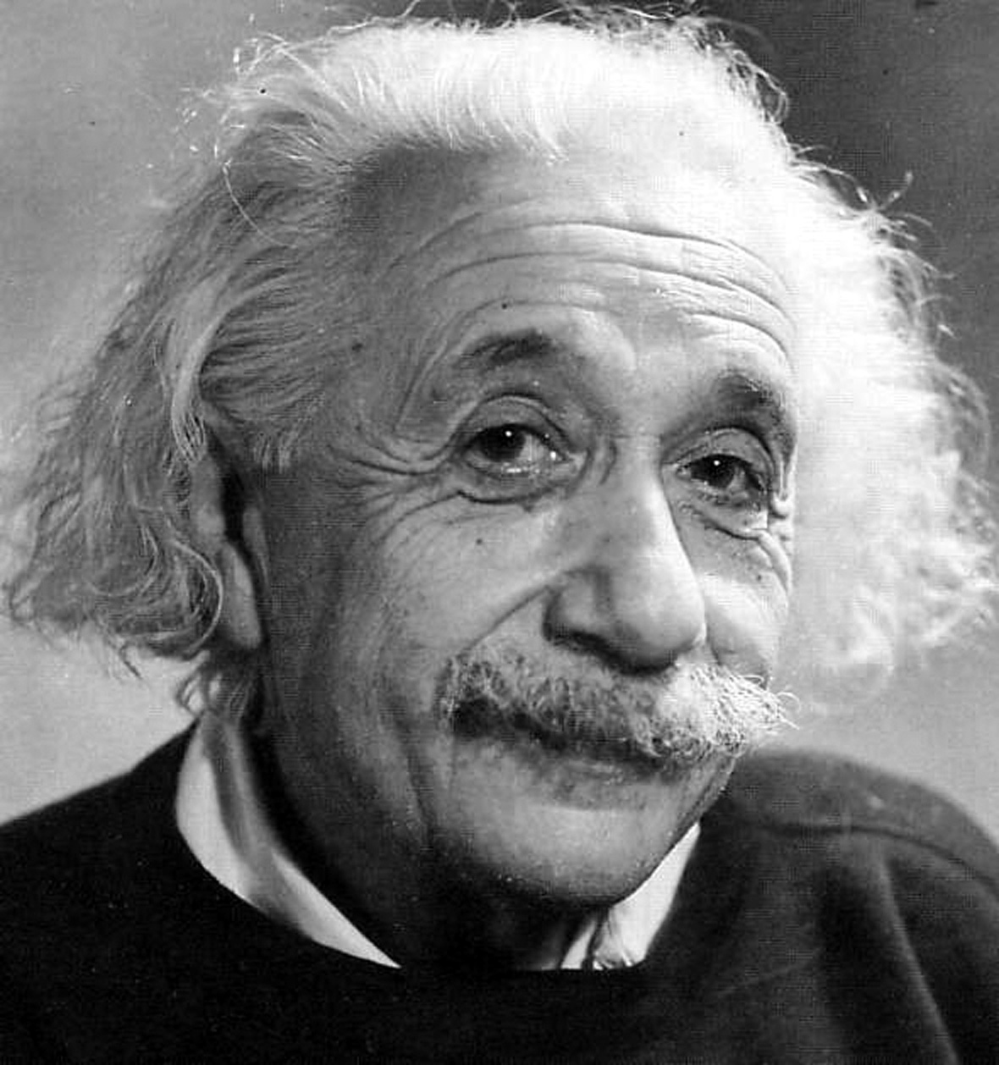
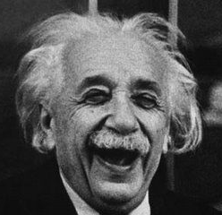
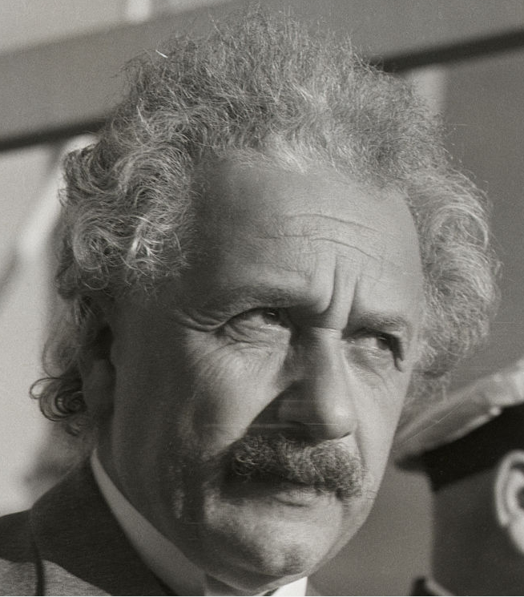
Galilean Relativity
(1632)
Special Relativity
(1905)
General Relativity
(1915)
Difficulty:
Difficulty:
Difficulty:
Notes:
So I’m hoping that, by introducing invariance, covariance, and contravariance at the very beginning, before Galilean Relativity… by the time General Relativity comes around, you’ll be used to used to the ideas, and general relativity won’t be so difficult.

Slide 6
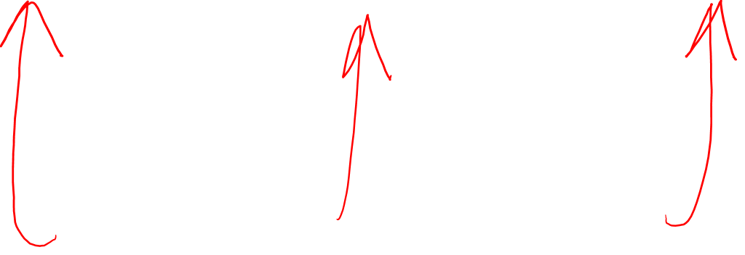
Galilean Relativity
(1632)
Special Relativity
(1905)
General Relativity
(1915)
Difficulty:
Difficulty:
Difficulty:
Invariance
Covariance & Contravariance
Notes:
Now I suspect expecting most people watching will find Galilean Relativity very easy. Special Relativity will be a little confusing, but most people will probably understand it after thinking about it for a while. Meanwhile, General Relativity has a reputation for being very difficult, and I’m little afraid some people watching might give up before ever finishing it. This is why I’m introducing the ideas of invariance, and covariance and contravariance as early as possible, even if the ideas are a little abstract. These ideas are found in all 3 theories of relativity, and the sooner you understand them, the easier things will be in the future.

Slide 7
Relativity 102: The Keys to Relativity
Invariance
The same object can be described in different ways from different points of view
Covariance & Contravariance
When one thing grows, another thing shrinks
Opposite changes will balance out
Notes:
So, what do these fancy words actually mean? Roughly, Invariance is the idea that the same object can be described in different ways from different points of view.
Also, covariance and contravariance roughly refer to the idea that when on thing grows, another thing shrinks… and that opposite changes will balance out. Now this all sounds very abstract.

Slide 8
Key to Relativity:
Vectors!
Notes:
To make things more concrete, we need to talk about vectors, which are basically like arrows. Vectors have both a length, and a direction. Vectors can represent all sorts of things in physics, like position, momentum, and velocity. And for that reason we’ll be using them all the time in relativity.

Slide 9
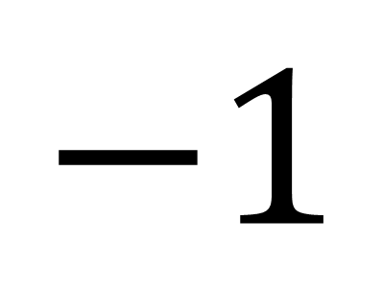



Scaling Vectors
$$2$$
$$=$$
$$−1$$
$$=$$
Notes:
I’m hoping you already know that we can scale vectors. For example, if I multiply a vector by 2, that vector becomes twice as long, pointing in the same direction. And if I multiply a vector by -1, it keeps the same length, but reverse its direction.

Slide 10
Adding Vectors
Notes:
I’m also hoping you know how to add vectors. If we add a bunch of vectors together, we get the result by placing them one after another, tip to tail, and drawing a new vector starting at the tail of the first vector and ending at the tip of the last vector.

Slide 11





Adding Vectors
$$+$$
$$+$$
$$+$$
$$=$$

Slide 12
Adding Vectors
$$+$$
$$+$$
$$+$$
$$=$$

Slide 13
Relativity 102: The Keys to Relativity
Invariance
The same object can be described in different ways from different points of view
Covariance & Contravariance
When one thing grows, another thing shrinks
Opposite changes will balance out
Notes:
So let’ start off by talking about the invariance of vectors, or how the same vector can be described in different ways from different points of view.

Slide 14
invariance
The same object can be described in different ways from different points of view
Notes:
So let’s talk about how vectors are related to the idea of invariance

Slide 15

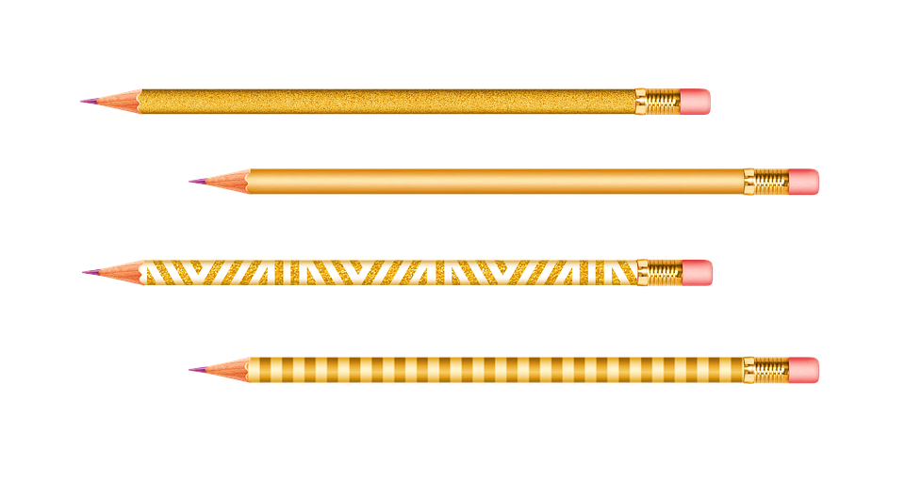
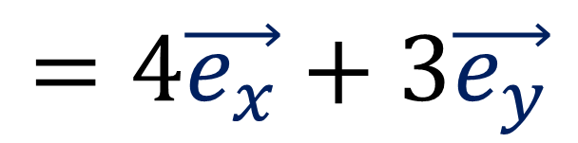
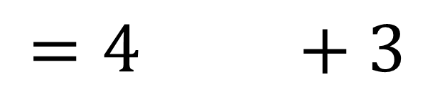
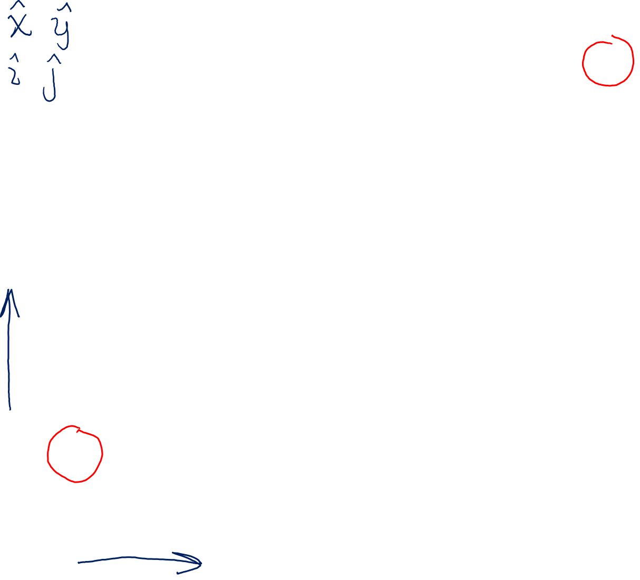
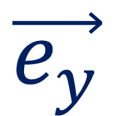

$$=4 +3$$
$$=4\vec{e_{x}}+3\vec{e_{y}}$$
$$\vec{e_{y}}$$
$$\vec{e_{x}}$$
Notes:
Let’s take a look at using vectors is to describe the separation between two points in a plane. For example, if we have a table with a pencil sitting on it, we can describe the separation between the pencil’s eraser and the pencil’s tip using some basis vectors, Ex and Ey. You might have heard these vectors called other names, like xHat and yHat, or maybe iHat and jHat, but their names aren’t important. Ex gives us one unit in the horizontal direction and Ey gives us one unit in the vertical direction. eX and eY basically give us a coordinate system for the 2D plane.
And we can add together Ex and Ey in different amounts to get from the pencil’s eraser to the pencil’s tip. In this case, the separation between the pencil’s eraser and tip is given by 4 horizontal vectors, and 3 vertical vectors. Writing this in math notation, we get 4 Ex + 3 Ey.

Slide 16
$$=4 +3$$
$$=4\vec{e_{x}}+3\vec{e_{y}}$$
$$\vec{e_{y}}$$
$$\vec{e_{x}}$$
Notes:
But we can also measure this pencil using different basis vectors. For example, a pair of basis vectors that are rotated by some angle.

Slide 17
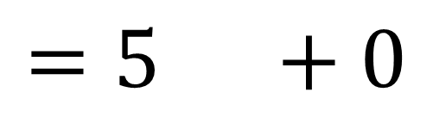


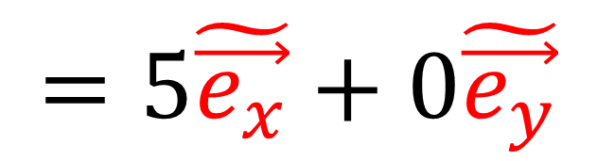
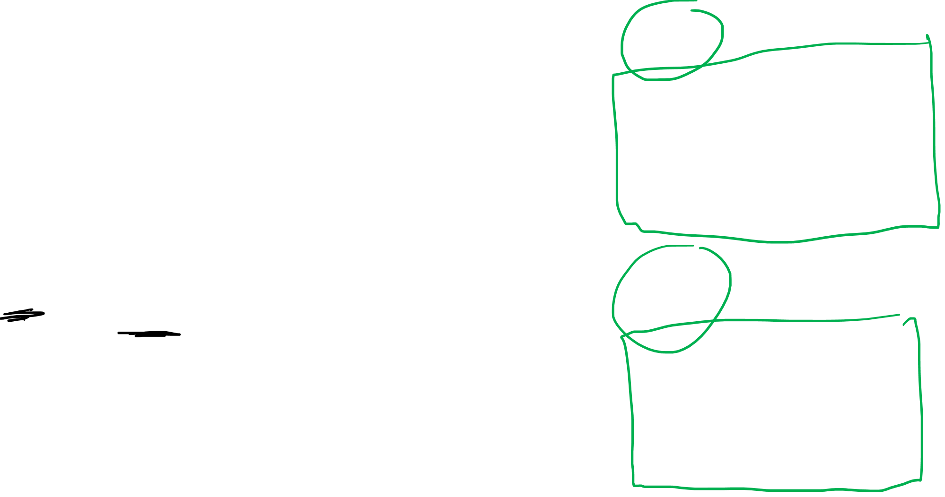
$$=4 +3$$
$$=4\vec{e_{x}}+3\vec{e_{y}}$$
$$\vec{e_{y}}$$
$$\tilde{\vec{e_{y}}}$$
$$\tilde{\vec{e_{x}}}$$
$$=5 +0$$
$$\vec{e_{x}}$$
$$=5\tilde{\vec{e_{x}}}+0\tilde{\vec{e_{y}}}$$
Notes:
We’ll call these rotated vectors eX-tilde and eY-tilde. And using these basis vectors to describe the pencil, we find the pencil is equal to 5 eX-tilde basis vectors and 0 eY-tilde basis vectors. Now there’s a really really important idea going on here. We see that the pencil separation can be described in two different ways, using different numbers, depending on which basis vectors we’re using.

Slide 18
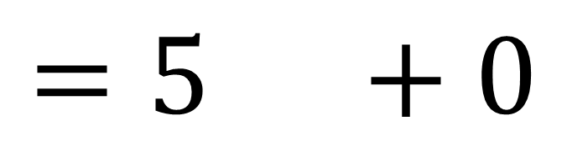
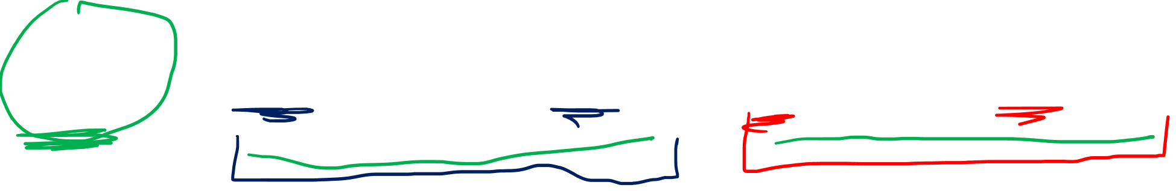
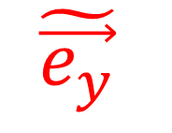
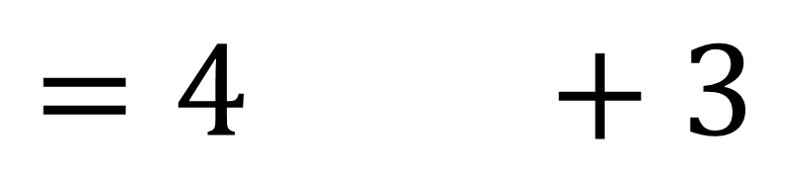
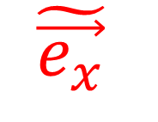
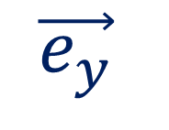
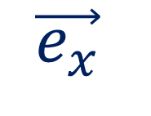
$$\vec{e_{y}}$$
$$\tilde{\vec{e_{x}}}$$
$$\tilde{\vec{e_{y}}}$$
$$\vec{e_{x}}$$
$$=4 +3$$
$$=5 +0$$
The pencil has different components
in different coordinate systems.
The pencil is invariant
but the components can change.
Notes:
We can express the pencil in term of the Ex and Ey basis vectors, and get the components 4,3 …. OR we can express the pencil in terms of the Ex-tilde and eY-tilde basis vectors and get the components 5,0… Now the pencil is a physical object, and it’s not changing. But the pencil can have different components if we measure it in a different coordinate system.
And this is the main idea behind invariance. The pencil is invariant, or in other words, it’s not changing, but the pencil’s components can change depending on how we measure it.

Slide 19


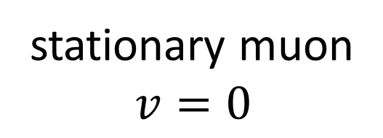


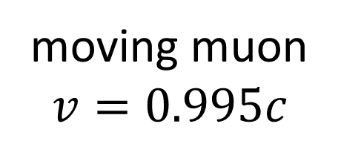


stationary muon
$$v=0$$
decay
$$μ^{−}$$
$$μ^{−}$$
$$2 μs$$
moving muon
$$v=0.995c$$
decay
$$μ^{−}$$
$$μ^{−}$$
$$20 μs$$
Notes:
In Relativity 101, I gave the example of a how a muon particle that’s stationary will live for about 2 microseconds on average before it decays.
But that same muon, if it’s moving at close to the speed of light relative to the earth, scientists on the earth will observe the muon living for about 20 microseconds, 10 times longer, because of time dilation, before it decays. And this sounds pretty crazy, but it’s not that hard to explain if we use vectors and the idea of invariance.

Slide 20
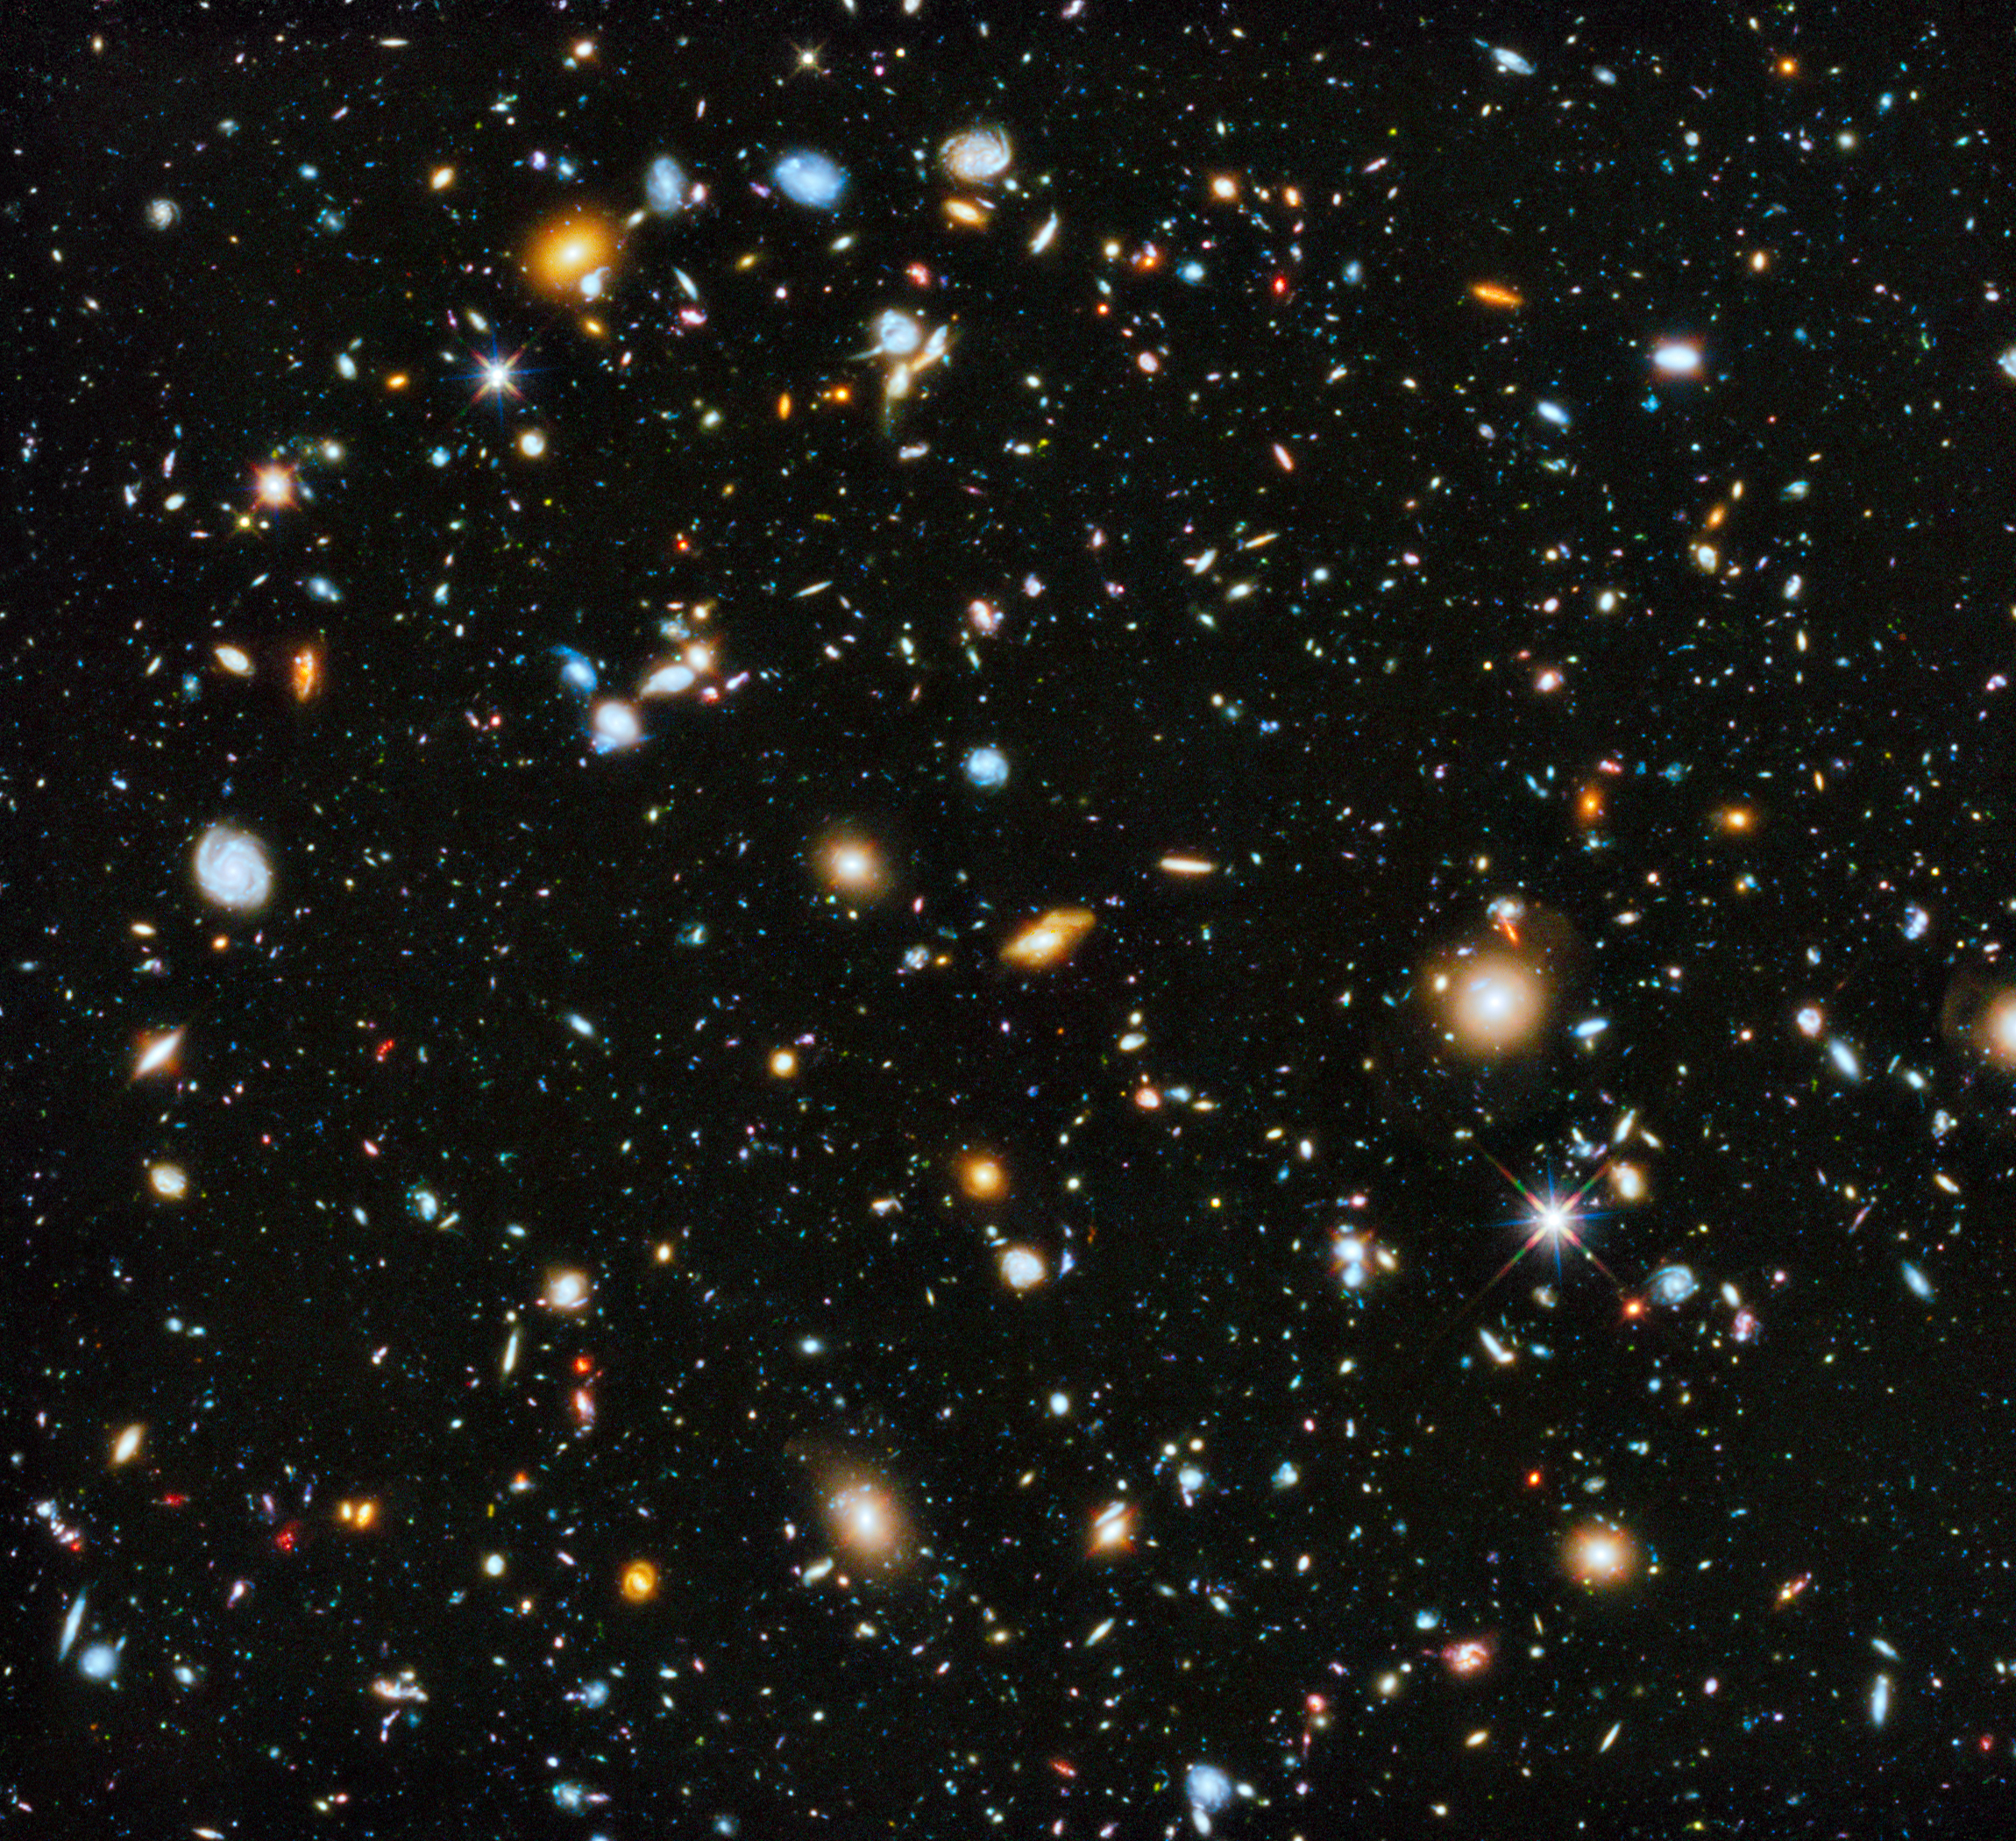








Muon decay in spacetime.
$$μ^{−}$$
decay
$$2μs$$
$$20μs$$
$$\tilde{\vec{e_{t}}}$$
Time dilation
= change of coordinates
$$\tilde{\vec{e_{x}}}$$
$$\vec{e_{t}}$$
$$μ^{−}$$
$$\vec{e_{x}}$$
Notes:
If we observe the muon creation and its later decay in spacetime, the separation between these two spacetime points can be measured using vectors. with this coordinate system the decay time is measured to be 2 microseconds, but in another coordinate system the decay time can be measured to be 20 microseconds. Time dilation effect seen in different reference frames just the result of measuring time and space using a different coordinate system.

Slide 21
$$=4 +3$$
$$=4\vec{e_{x}}+3\vec{e_{y}}$$
$$\vec{e_{y}}$$
$$\tilde{\vec{e_{y}}}$$
$$\tilde{\vec{e_{x}}}$$
$$=5 +0$$
$$\vec{e_{x}}$$
$$=5\tilde{\vec{e_{x}}}+0\tilde{\vec{e_{y}}}$$
Notes:
This is almost the exact same thing as measuring the pencil using different coordinate systems and getting different components as a result.

Slide 22
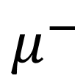
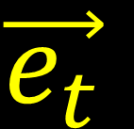
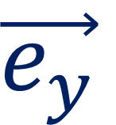
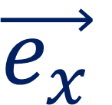

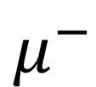
2D Space
Spacetime
$$μ^{−}$$
decay
$$\vec{e_{y}}$$
$$\vec{e_{t}}$$
$$\vec{e_{x}}$$
$$μ^{−}$$
$$\vec{e_{x}}$$
Notes:
The only difference is the at for the pencil on the table, our vector is in 2D space, measured with X and Y. But the decaying muon is measured in spacetime, using X and T. I’m not expecting you to fully understand this right now. Again I will be explaining this in greater detail in later videos. I’m just trying to prepare you for this idea of measuring a vector using a different basis and getting different results.

Slide 23
a) invariance
The same object can be described in different ways from different points of view
The same vector (invariant) can have different components when measured in a different basis
Notes:
So this is the main idea behind invariance. The same object can be described in different ways from different points of view. More specifically, the same vector, which is invariant and unchanging, can have different components when measured in a different basis.

Slide 24
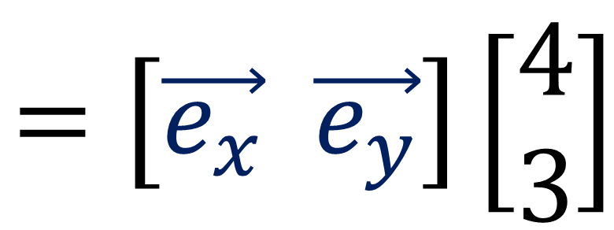
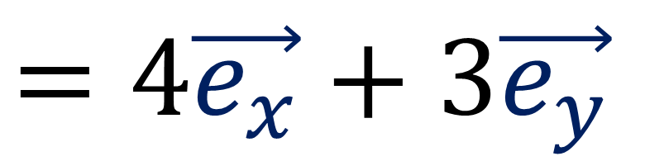
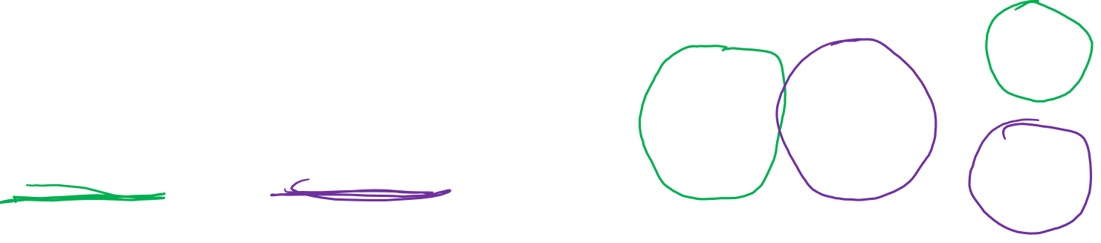
$$\vec{e_{y}}$$
$$\tilde{\vec{e_{x}}}$$
$$\tilde{\vec{e_{y}}}$$
$$\vec{e_{x}}$$
$$=5 +0$$
$$=4 +3$$
Tensor = an invariant
(something we agree on in all coordinate systems… even if the components are different in each one)
$$=\left[\vec{e_{x}} \vec{e_{y}}\right]\left[\begin{aligned}4 \\ 3\end{aligned}\right]$$
$$=4\vec{e_{x}}+3\vec{e_{y}}$$
Notes:
Later in this series, we will talk about tensors. A tensor is just another word for an invariant object, something unchanging that we agree on in all coordinate systems, even if the components are different in each one. And we’ll see that we can write tensors as arrays. For example we can write 4eX + 3eY using array multiplication, with the basis vectors in a row, and the vector components in a column. We use the rule of 1st times 1st to get 4eX and 2nd times 2nd to get 3eY.

