Slide 1
Relativity 103:
Galilean Relativity In-Depth
(Check Description for Errors)
Notes:
Welcome to Relativity 103: Galilean Relativity In Depth:

Slide 2
Relativity 103: Galilean Relativity
Spacetime Diagrams
Spacetime Separation Vector
Galilean Transform
Metric Tensor (Euclidean)
black holes
expansion of universe
gravitational waves
…more!
(Check Description for Errors)
Notes:
In relativity 103 we’ll cover spacetime diagrams, the spacetime separation vector, the Galilean transform, and the Euclidean metric tensor. Much later in the series, the metric tensor will help us understand black holes, the expansion of the universe, gravitational waves, and much more. But for now we’re just going to study the simple metric tensor in Euclidean geometry

Slide 3
Galilean Principle of Relativity
Laws of motion are the same in all inertial reference frames
Notes:
Remember in Relativity 101, we stated the principal of Galilean relativity: which means that that the Laws of motion are the same in all inertial reference frames.

Slide 4
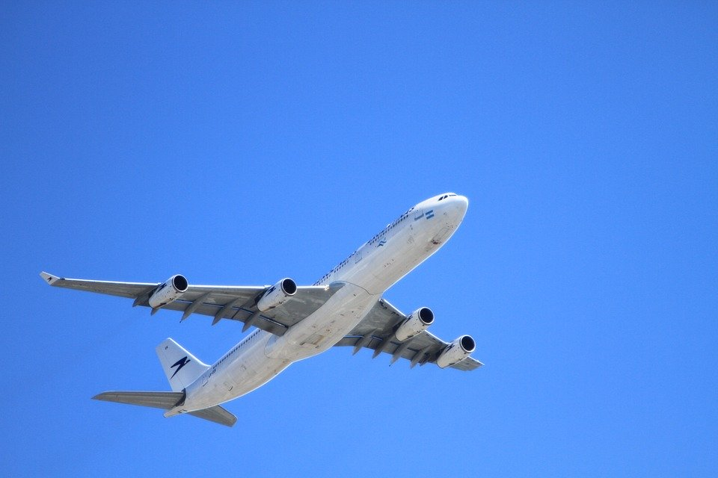
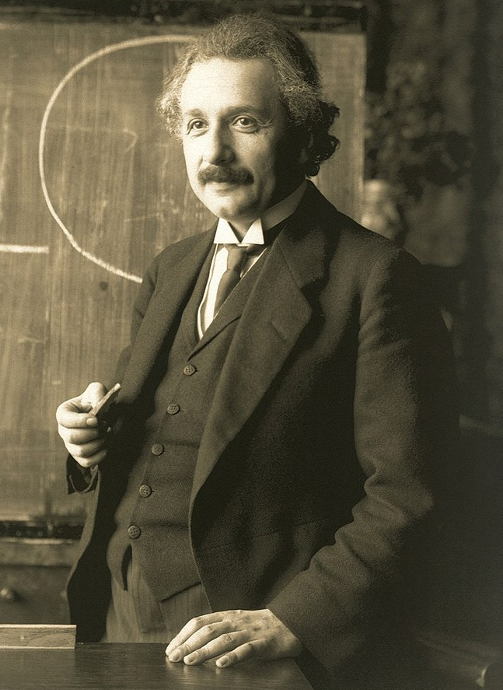
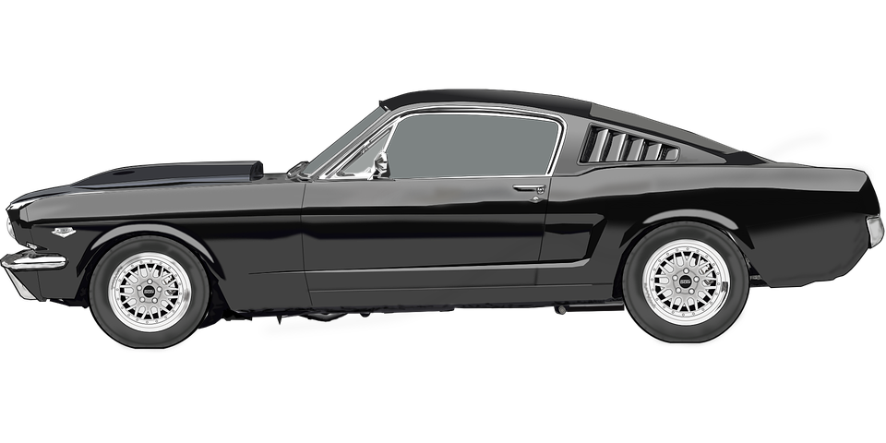
Galilean Principle of Relativity
Laws of motion are the same in all inertial reference frames
Notes:
An inertial reference frame is just a non-accelerating reference frame, such as a Scientist standing still on the ground, or a car or a plane travelling by at constant speed.

Slide 5

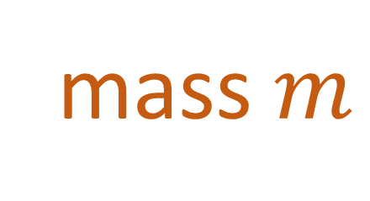
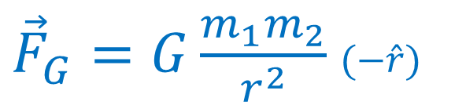

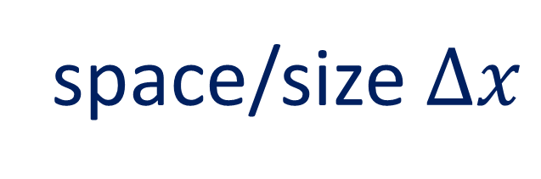
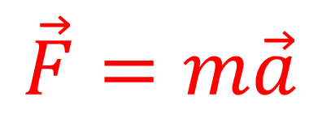


Galilean Principle of Relativity
Laws of motion are the same in all inertial reference frames
Things we disagree on:
Things we agree on:
time $Δt$
space/size $Δx$
velocity $\vec{v}$
mass $m$
momentum $\vec{p}$
Laws of motion
kinetic energy $E_{k}$
$$\vec{F}=m\vec{a}$$
${\vec{F}}_{G}=G\frac{m_{1}m_{2}}{r^{2}}$ $(−\hat{r})$
Notes:
In Galilean relativity, different inertial frames will disagree on an object’s velocity, momentum, and kinetic energy, but they will agree on time, space/size and mass, as well as Newton’s Laws of Motion and gravity. Now I should mention that, even though different observers will agree on the size of objects and the space between objects, denoted by delta-X, different observers will disagree on the position of objects, which is denoted by X all on its own.

Slide 6

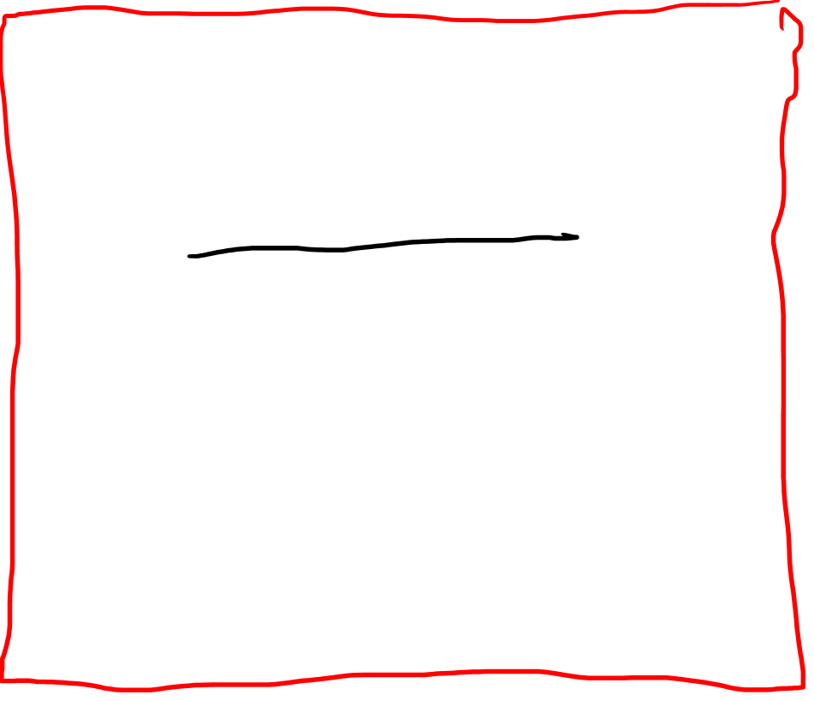



Galilean Principle of Relativity
Laws of motion are the same in all inertial reference frames
Things we disagree on:
Things we agree on:
time $Δt$
space/size $Δx$
position $x$
mass $m$
velocity $\vec{v}$
momentum $\vec{p}$
Laws of motion
kinetic energy $E_{k}$
$$\vec{F}=m\vec{a}$$
${\vec{F}}_{G}=G\frac{m_{1}m_{2}}{r^{2}}$ $(−\hat{r})$
Notes:
The main goal of Galilean relativity is to calculate all the different quantities that people disagree on in different reference frames.

Slide 7

Galilean Principle of Relativity
Laws of motion are the same in all inertial reference frames
Notes:
That way, even if a scientist is doing a physics calculation while standing still on the ground, other observers in different frames of reference will still be able to agree on how the laws of motion cause objects to move

Slide 8
Galilean Principle of Relativity
Laws of motion are the same in all inertial reference frames

Slide 9
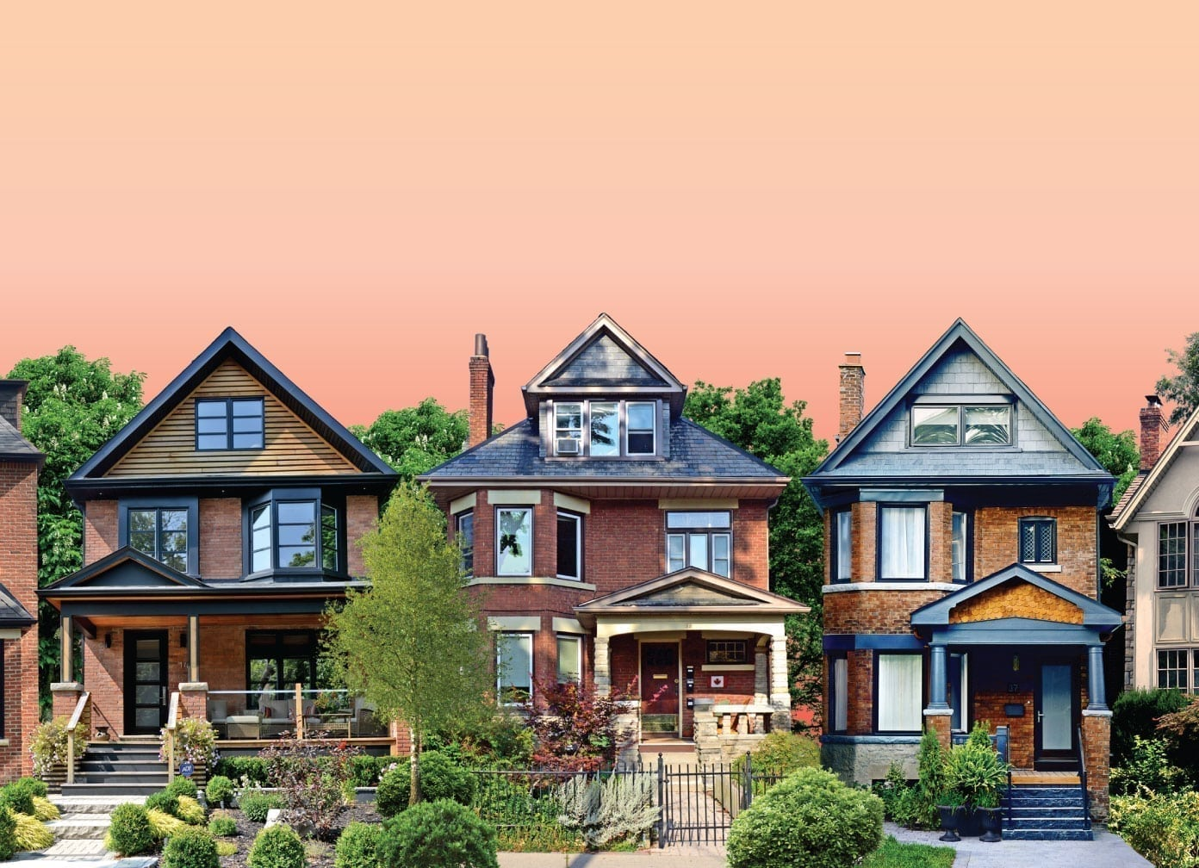
Galilean Principle of Relativity
Laws of motion are the same in all inertial reference frames
Notes:
Even if they are doing calculations from different perspectives and end up with different numbers.

Slide 10


Galilean Principle of Relativity
Laws of motion are the same in all inertial reference frames
Things we disagree on:
Things we agree on:
time $Δt$
space/size $Δx$
position $x$
mass $m$
velocity $\vec{v}$
momentum $\vec{p}$
Laws of motion
kinetic energy $E_{k}$
$$\vec{F}=m\vec{a}$$
${\vec{F}}_{G}=G\frac{m_{1}m_{2}}{r^{2}}$ $(−\hat{r})$
Notes:
Now, of all these quantities that people in different reference frames disagree on, the most important is the position of objects, X.

Slide 11
Relativity 102: Galilean Relativity
Spacetime Diagrams
Spacetime Separation Vector
Galilean Transform
Metric Tensor (Euclidean)
Notes:
And to understand how observers disagree on position in Galilean relativity, we’ll begin by studying spacetime diagrams.

Slide 12
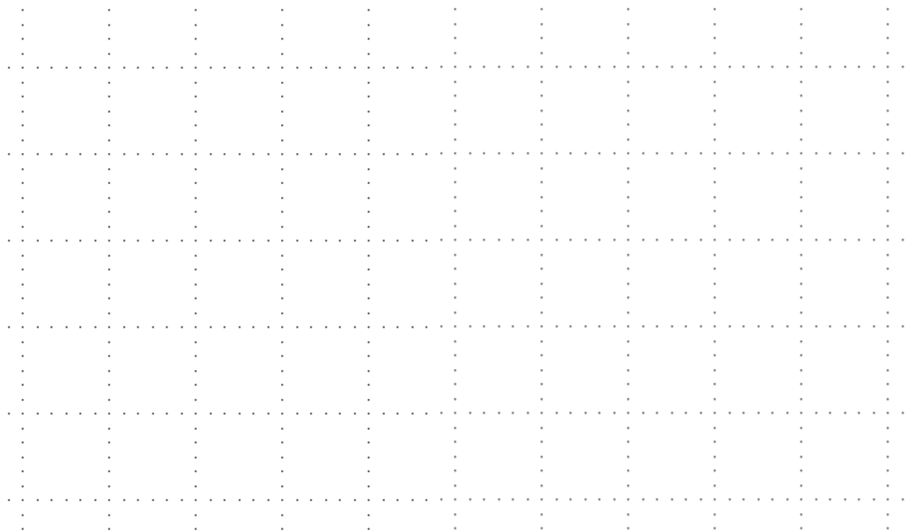


(Galilean) Spacetime Diagram
time $t$
A tool for visualizing the motion of objects when studying Relativity.
position $x$
Notes:
A spacetime diagram is a tool for visualizing the motion of objects in different frames for reference. In this video we’re going to be using spacetime diagrams to study Galilean Relativity. A spacetime diagram has time along the vertical axis, increasing upward, and position on the horizontal axis, increasing to the right. You might think this is pretty strange, since most physics classes put time on the horizontal axis

Slide 13
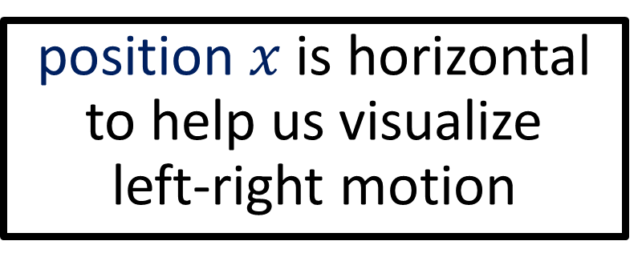
(Galilean) Spacetime Diagram
time $t$
A tool for visualizing the motion of objects when studying Relativity.
position $x$ is horizontal to help us visualize left-right motion
position $x$
Notes:
But in relativity we are often interested in tracking the motion of objects to the left and right. So it makes sense to have position on the horizontal axis so that we can track left and right motion. Also, whether you like it or not, putting time on the vertical axis has become a standard convention in just about every relativity textbook at this point, so I’ll be following this convention and put time on the vertical axis.

Slide 14


Galilean Spacetime Diagram
time $t$
Observer 1: Scientist standing still
5s
4s
3s
2s
1s
position $x$
-100m
0m
100m
200m
-100m
-50m
50m
150m
-50m
Notes:
Let’s look at our first example of motion in a spacetime diagram: Observer number 1 is a scientist who is standing still.

Slide 15
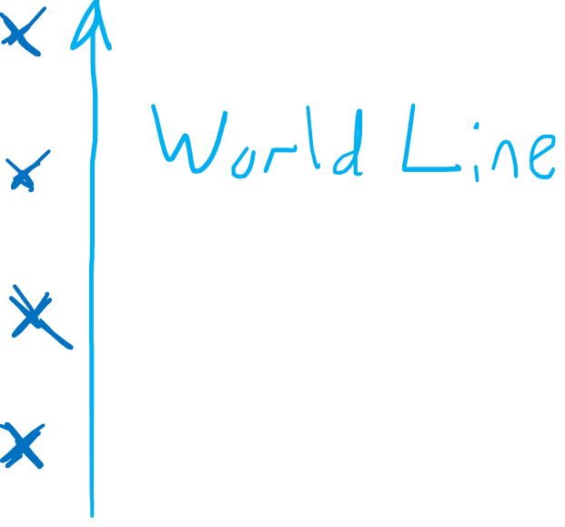
Galilean Spacetime Diagram
time $t$
Observer 1: Scientist standing still
5s
4s
3s
2s
1s
position $x$
-100m
0m
100m
200m
-100m
-50m
50m
150m
-50m
Notes:
Let’s say that the scientist starts at the origin at a position of zero meters. If he stands still, then 1 second later in time he’ll still be at a position of zero meters. He’ll continue to stay at the same position at 2 seconds, 3 seconds, 4 seconds, and so on. So in this spacetime diagram, an observer who is standing still will simply travel in a vertical line. They are travelling through time, but they are not travelling through space. And this path that the scientist follows in the spacetime diagram his called his worldline.

Slide 16
Galilean Spacetime Diagram
time $t$
Observer 2: Car moving 25 m/s right
5s
4s
3s
2s
1s
position $x$
-100m
0m
100m
200m
-100m
-50m
50m
150m
-50m
Notes:
Here’s another example: Observer number 2 is a car moving at a speed of 25 m/s to the right. If the car starts at the origin at a position of zero meters, after 1 second, the car will have travelled 25m to the right. After 2 seconds, its position will be 50m to the right. After 3 seconds, 75 m to the right, and so on and so forth. So we can see that, in a spacetime diagram, an object travelling to the right is represented by a diagonal worldline pointing to the upper right.

Slide 17
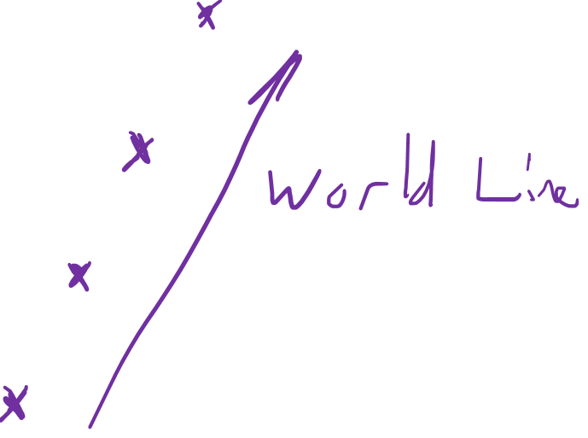
Galilean Spacetime Diagram
time $t$
Observer 2: Car moving 25 m/s right
5s
4s
3s
2s
1s
position $x$
-100m
0m
100m
200m
-100m
-50m
50m
150m
-50m

Slide 18


Galilean Spacetime Diagram
time $t$
Observer 3: Plane moving 200 m/s left
5s
4s
3s
2s
1s
position $x$
-400m
-350m
-300m
-250m
-200m
-150m
-100m
-50m
0m
Notes:
Now our last example, observer number 3, is a plane moving at 200m/s to the left. This time I’ve given myself more room on the left on the spacetime diagram to show the plane’s worldline.
Again let’s say that the plane starts at the origin. After 1 second it will have moved 200m to the left. Or in other words, it has a position of -200m. After 2 seconds, it has a position of -400m.
So we can see that the plane is travelling very fast to the left, and the worldline follows a diagonal path moving up and to the left. And because the plane is travelling so fast, the plane is closer to the horizontal than the car’s path.

Slide 19

Galilean Spacetime Diagram
time $t$
Observer 3: Plane moving 200 m/s left
5s
4s
3s
2s
1s
position $x$
-400m
-350m
-300m
-250m
-200m
-150m
-100m
-50m
0m

Slide 20

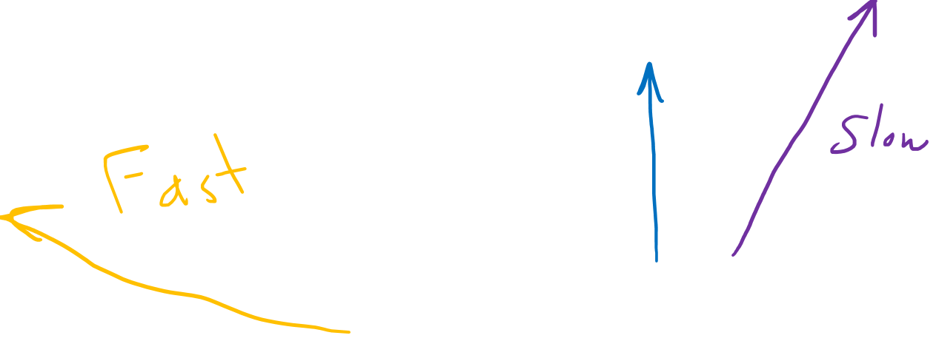
Galilean Spacetime Diagram
time $t$
5s
4s
3s
2s
1s
position $x$
-400m
-350m
-300m
-250m
-200m
-150m
-100m
-50m
0m
50m
100m
150m
200m
Notes:
So to summarize, in spacetime diagram. Objects that are not moving will have a completely vertical worldline. And objects that are moving at a constant speed will have a diagonal worldline. Objects that are moving more slowly will have a worldline that is closer to the vertical, whereas objects that are moving more quickly will have a worldline that is closer to the horizontal

Slide 21


5s
time $t$
4s
3s
2s
1s
position $x$
-50m
0m
50m
100m
150m
Galilean Relativity: All motion is relative to something else
There is no special “stationary” reference frame at rest
Notes:
So hopefully you now understand how spacetime diagrams use worldlines to help visualize the motion of objects through space and time. But there is one last very important point I need to mention.
Earlier I said that when a wordline is vertical, it means the object is stationary and not moving. However, according to Galilean relativity, all motion is relative to something else, and there is no special “stationary” reference frame that’s at rest.

Slide 22
Frame of the scientist (on the ground)
Notes:
From the point of view of the scientist, the scientist is stationary, and the car is driving by to the right.

Slide 23
Frame of the car
Notes:
But from the point of view of the car, the car is stationary, and the scientist is going by to the left, along with the road and the entire neighbourhood.

Slide 24
5s
time $t$
4s
3s
2s
1s
position $x$
-50m
0m
50m
100m
150m
Frame of the scientist
Notes:
So this spacetime diagram, with the scientist having the vertical worldline and the car moving right is a diagram drawn from the scientist’s frame of reference.

Slide 25


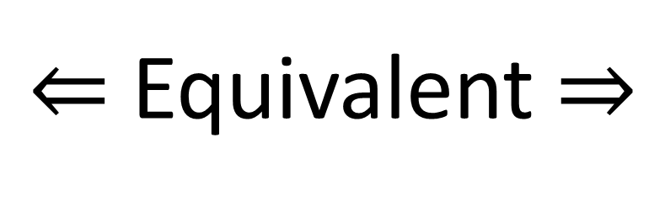
5s
time $t$
5s
time $t$
4s
4s
3s
$⇐$ Equivalent $⇒$
3s
2s
2s
1s
1s
position $x$
position $x$
-50m
0m
50m
100m
150m
-150m
-100m
-50m
0m
50m
100m
Frame of the scientist
Frame of the car
Notes:
It would be equally correct to draw a spacetime diagram from the car’s frame of reference, where the car is stationary with a vertical worldline, and the scientist is moving to the left.

Slide 26



time $t$
Frame of the scientist
position $x$
Notes:
Here’s one way to think about different reference frames in space time diagrams. Let’s say that as time moves forward, at each second we take a photograph of all the objects in space. We end up with a series of photographs, or time slices that can help us trace out the worldlines of all the different objects. We can see here that the scientist has a vertical worldline, so this spacetime diagram represents the frame of reference of the scientist, since he is standing still.

Slide 27
time $t$
position $x$
Notes:
Here’s one way to think about different reference frames in space time diagrams. Let’s say that as time moves forward, at each second we take a photograph of all the objects in space. We end up with a series of photographs, or time slices that can help us trace out the worldlines of all the different objects. We can see here that the scientist has a vertical worldline, so this spacetime diagram represents the frame of reference of the scientist, since he is standing still.

Slide 28
time $t$
Frame of the car
position $x$
Notes:
Now watch what happens if we slide all these photographs over to the left. We have arranged the photographs so that the car’s worldline is now vertical. The spacetime diagram is now drawn from the car’s frame of reference. Car is stationary, the scientist is moving to the left, and the plane is travelling very fast off to the left.

Slide 29
time $t$
position $x$

Slide 30
time $t$
Frame of the plane
position $x$
Notes:
We can also arrange the photographs so that the plane’s worldline is vertical. This shows the plane’s frame of reference where the plane is stationary. The scientist is travelling fast to the right, and the car is going right even faster.

Slide 31
time $t$
position $x$
Notes:
We can also arrange the photographs so that the plane’s worldline is vertical. This shows the plane’s frame of reference where the plane is stationary. The scientist is travelling fast to the right, and the car is going right even faster.

Slide 32
time $t$
Reminder:
There is no special “stationary” frame of reference
We can always change reference frames by sliding time slices back and forth.
position $x$
Notes:
So we can always re-arrange a spacetime diagram so that any object is stationary by making that object’s worldline vertical. Remember that is Galilean relativity, there is no special stationary frame of reference. We can always change reference frames by sliding time slides in our spacetime diagram back and forth.

Slide 33
time $t$
Reminder:
There is no special “stationary” frame of reference
We can always change reference frames by sliding time slices back and forth.
position $x$
Notes:
So we can always re-arrange a spacetime diagram so that any object is stationary by making that object’s worldline vertical. Remember that is Galilean relativity, there is no special stationary frame of reference. We can always change reference frames by sliding time slides in our spacetime diagram back and forth.

Slide 34
Galilean Spacetime Diagram
Reminder:
There is no special “stationary” frame of reference
We can always change reference frames by sliding time slices back and forth.
time $t$
5s
4s
3s
2s
1s
position $x$
-400m
-350m
-300m
-250m
-200m
-150m
-100m
-50m
0m
50m
100m
150m
200m
Notes:
So in summary, a spacetime diagram helps track the motion of objects through space and time. A vertical worldline means the object is stationary, and a diagonal worldline means the object is moving at a constant velocity. A worldline closer to the vertical means the object is travelling slower, and a worldline closer to the horizontal means the object is travelling faster. Also, remember that there is no such thing as a special stationary frame of reference, and we can always change frame of reference in a Galilean spacetime diagram by moving the time slices back and forth.

