Slide 1
Relativity 103: Galilean Relativity
(also called “spacetime interval vector”)
Spacetime Diagrams
Spacetime Separation Vector
Galilean Transform
Metric Tensor (Euclidean)
Notes:
Welcome back to Relativity 103 on Galilean Relativity. In this video we’ll discuss the spacetime separation vector, also called the “spacetime interval vector”

Slide 2
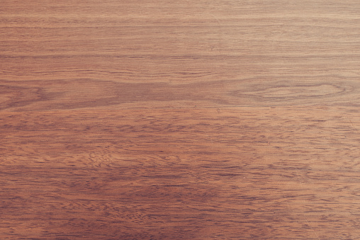

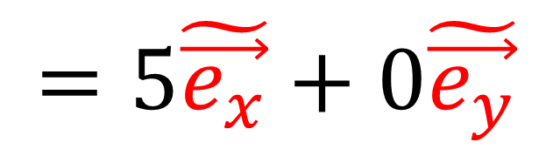
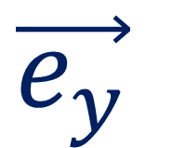
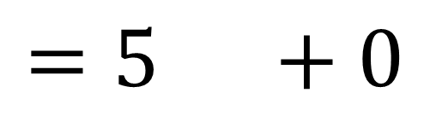
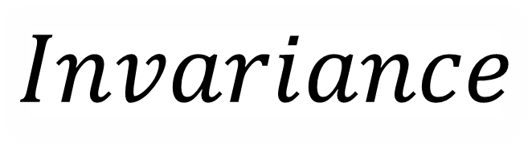

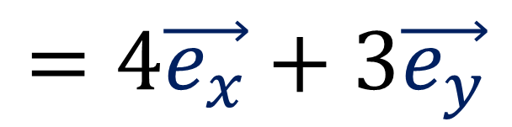

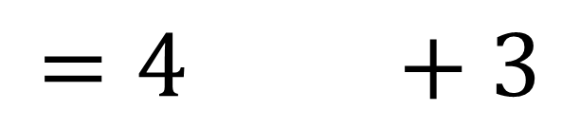

$$Invariance$$
$$=4 +3$$
$$=4\vec{e_{x}}+3\vec{e_{y}}$$
$$\vec{e_{y}}$$
$$\tilde{\vec{e_{y}}}$$
$$\tilde{\vec{e_{x}}}$$
$$=5 +0$$
$$\vec{e_{x}}$$
$$=5\tilde{\vec{e_{x}}}+0\tilde{\vec{e_{y}}}$$

Slide 3
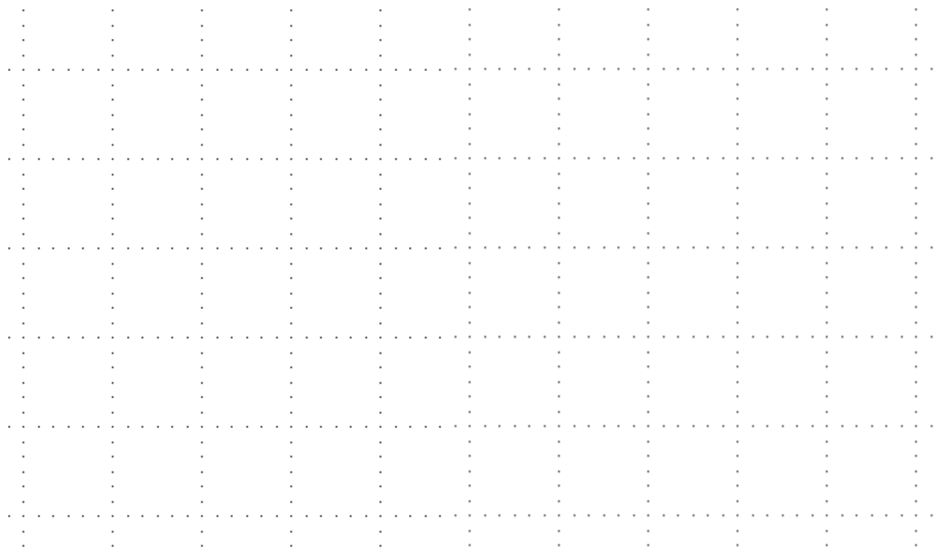
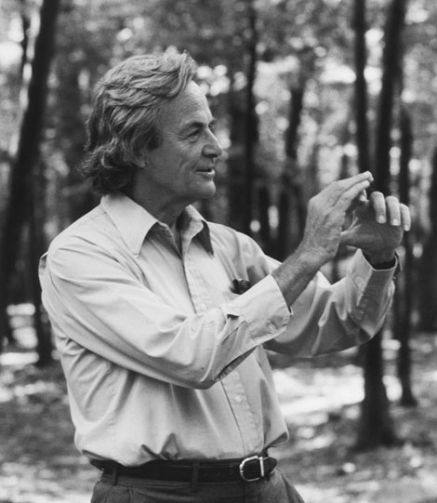

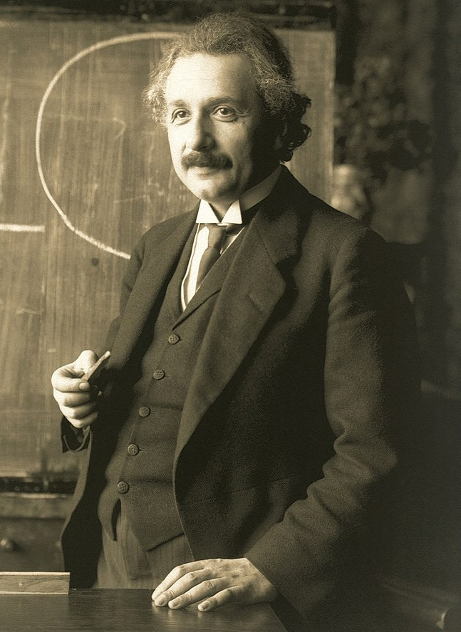




Spacetime Separation Vector
time $t$
An arrow joining two points (two “events”) in a spacetime diagram
5s
4s
3s
gesundheit.
$$\vec{S}$$
2s
1s
position $x$
-1m
0m
1m
2m
3m
4m
5m
Notes:
The spacetime separation vector is an arrow on a spacetime diagram that joints two points on a spacetime diagram. Points in a spacetime diagram are also called “events” because they mark a point in space and time. Let’s say at this red point event, at the time 0s and the position 0m, Albert Einstein sneezes, and over here 3 seconds later, 4 meters to the right, this green event point marks when and where Richard Feynmann snaps his fingers. In this case the spacetime separation vector between Einsten and Feynman would look like this.

Slide 4

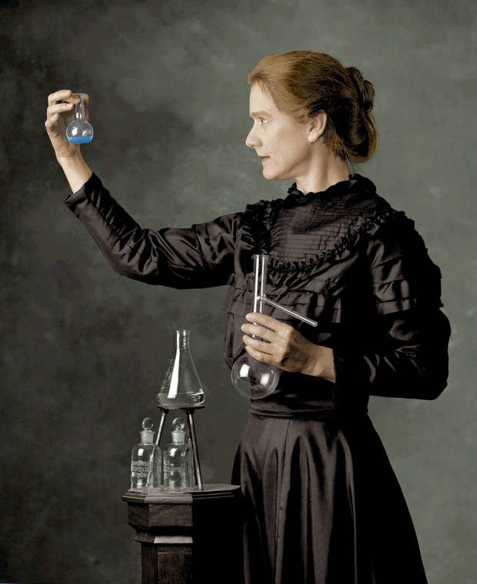

Spacetime Separation Vector
time $t$
5s
this is not sanitary…
4s
$$\vec{S}$$
3s
2s
1s
position $x$
-1m
0m
1m
2m
3m
4m
5m
Notes:
In this next example, this yellow event point marks when and where the scientist Mary Curie claps her hands. It’s at the same position where Einstein sneezed, but 5 seconds later. So the events are at the same position, but different times, and in this case the spacetime separation vector would be vertical.

Slide 5
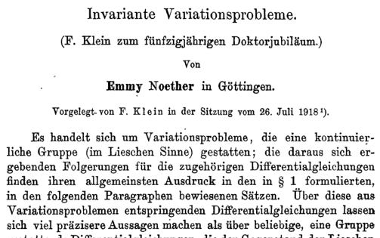

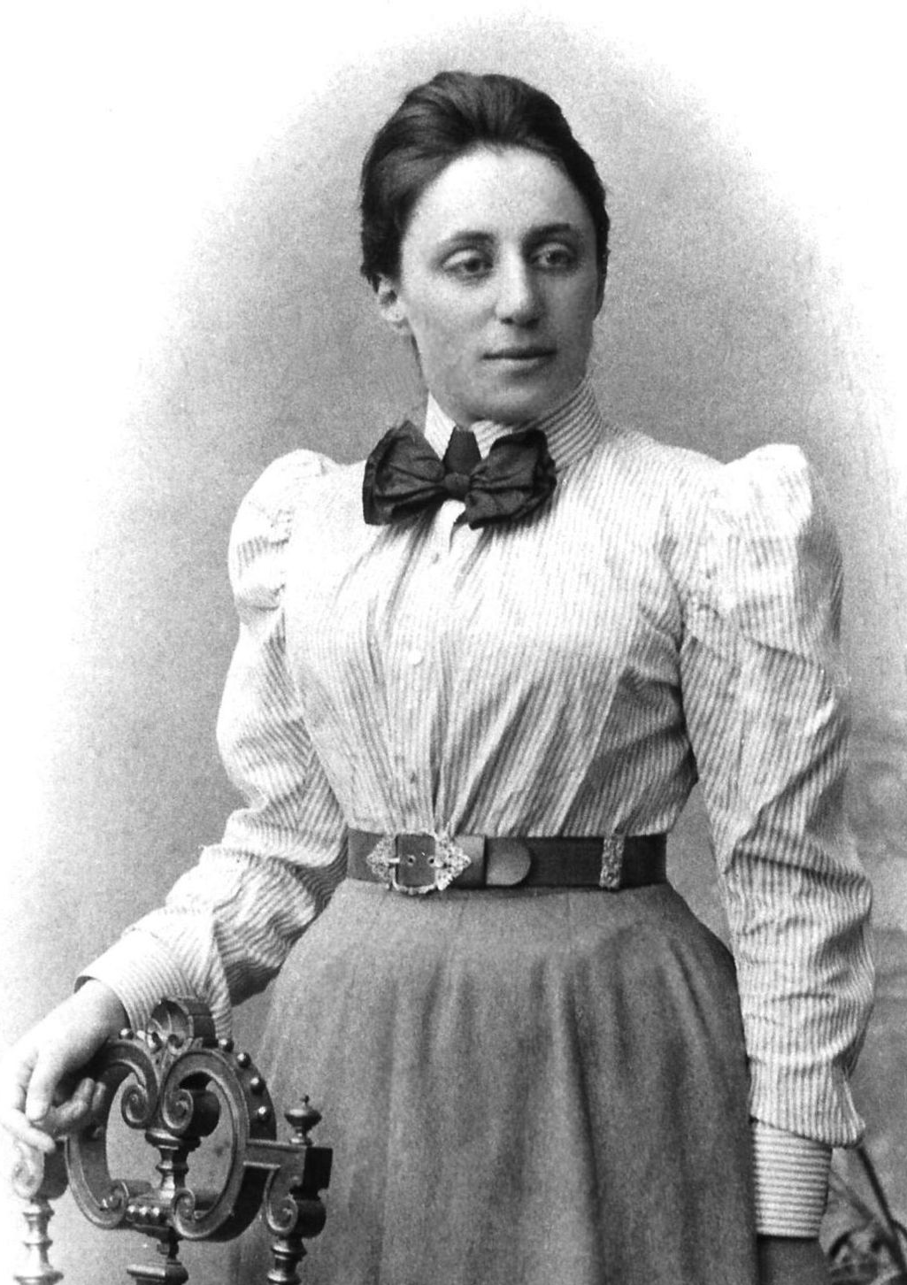

Spacetime Separation Vector
time $t$
5s
4s
3s
2s
$$\vec{S}$$
1s
position $x$
-1m
0m
1m
2m
3m
4m
5m
Notes:
And in this last example, this pink event point marks the time and place where Emily Noether has just proven a theorem about differential symmetries. This happens 3 meters to the right of Einstein when he sneezed, so the spacetime separation vector would look like this. It’s completely horizontal because the two events happen at the same time.

Slide 6




$$\vec{S}$$
Spacetime Coordinates
time $t$
(time 3s, space 4m)
3s
$$\vec{S}$$
2s
1s
0m
1m
2m
3m
4m
happens 3 time units after and
4 space units to the right of
position $x$
Notes:
Now, to measure the spacetime separation vectors, one option is to look at the coordinate lines on spacetime diagram.

Slide 7
$$\vec{S}$$
Spacetime Coordinates
time $t$
(time 3s, space 4m)
3s
$$\vec{S}$$
2s
1s
0m
1m
2m
3m
4m
happens 3 time units after and
4 space units to the right of
position $x$
Notes:
Now, to measure the spacetime separation vectors, one option is to look at the coordinate lines on spacetime diagram.

Slide 8
Key to Relativity:
Vectors!
Notes:
However, in this video series I am going to strongly encourage the use of vectors instead.

Slide 9


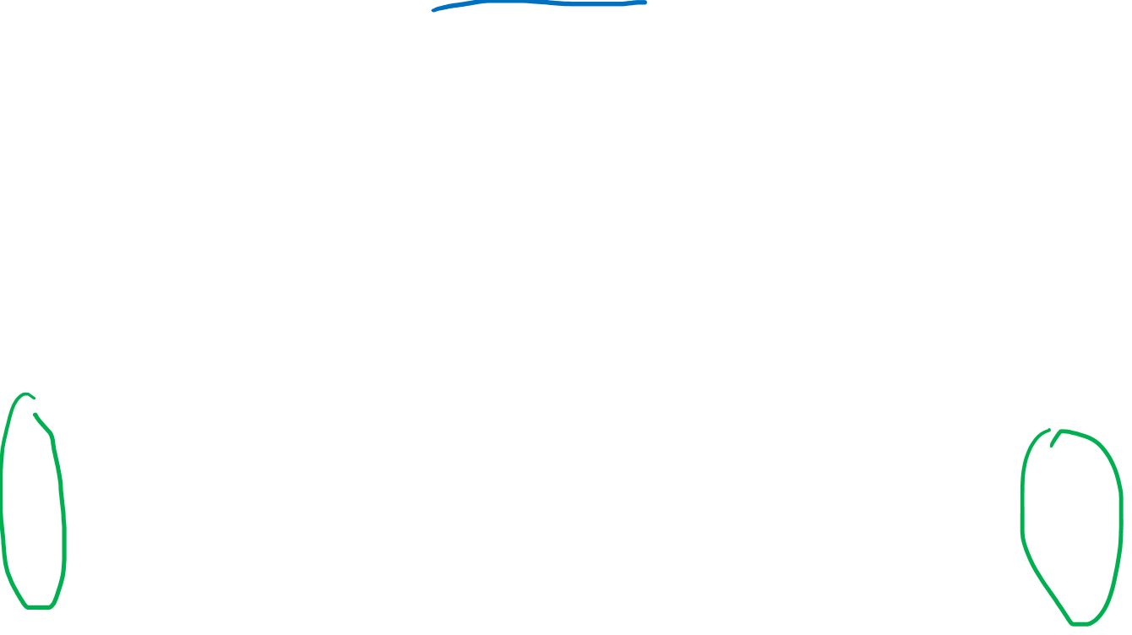

$$\vec{S}$$
Spacetime Basis (aka reference frame)
time $t$
Basis vectors give us the
sizes and directions
of time and space
in a spacetime diagram
3s
2s
1s
$$\vec{e_{t}}$$
$$\vec{e_{x}}$$
0m
1m
2m
3m
4m
one unit of time
one unit of space
position $x$
Notes:
So instead of using coordinate lines, I’m going to introduce a spacetime basis, also called a reference frame, for our spacetime diagrams. Basis vectors give us the sizes and directions of time and space in a spacetime diagram.
The time basis vector, eT, represents 1 unit of time. In this particular case, eT represents 1 second on our spacetime diagram. But in general the eT basis vector can represent any unit of time that we like, such as one minute, one hour, or one year. There is also the eX basis vector, which represents one unit of distance to the right.

Slide 10
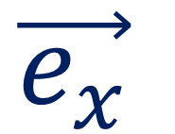
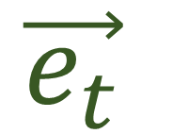
$$\vec{S}$$
Spacetime Basis (aka reference frame)
time $t$
Basis vectors give us the
sizes and directions
of time and space
in a spacetime diagram
3s
2s
1s
$$\vec{e_{t}}$$
$$\vec{e_{x}}$$
-1m
0m
1m
2m
3m
4m
5m
position $x$
Notes:
So I’m going to remove the time and space axes with the time and positions marked on them and instead I’m going to measure time and space using the eT and eX basis vectors.

Slide 11


$$\vec{S}$$
Spacetime Basis (aka reference frame)
Basis vectors give us the
sizes and directions
of time and space
in a spacetime diagram
$$\vec{e_{t}}$$
$$\vec{e_{x}}$$

Slide 12
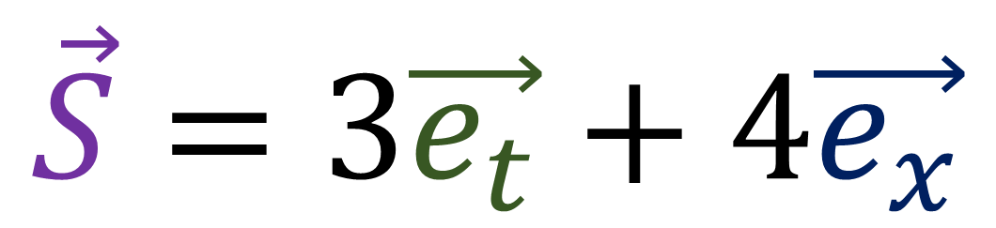

$$\vec{S}$$
Spacetime Basis (aka reference frame)
Basis vectors give us the
sizes and directions
of time and space
in a spacetime diagram
$$\vec{S}$$
$$\vec{S}=3\vec{e_{t}}+4\vec{e_{x}}$$
$$\vec{e_{t}}$$
$$\vec{e_{x}}$$
happens 3 time units after and
4 space units to the right of
Notes:
To get the spacetime separation vector between Einstein’s sneeze and Feynman’s snap, we can use our spacetime basis vectors. We can see that the spacetime separation vector S is made up of 3 eT vectors and 4 eX vectors. In common english., this means that Feynman’s snap happens 3 time units after, and 4 units to the right of Einstein’s sneeze. As we can see, after waiting 3 seconds, Einstein is 4 m away from feynman when he snaps.

Slide 13



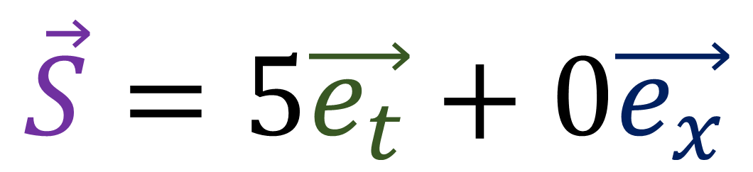
Spacetime Basis (aka reference frame)
happens 5 time units after
(0 space units to the right)
$$\vec{S}$$
$$\vec{e_{t}}$$
$$\vec{S}=5\vec{e_{t}}+0\vec{e_{x}}$$
$$\vec{e_{x}}$$
Notes:
In the example with Mary Curie’s clap, we can construct the spacetime separation vector using only 5 time vectors, and zero space vectors. This means that Mary Curie’s clap happens 5 time units after Einstein’s sneeze. But they happen at the same position, so zero space units are involved. We can see after 5 seconds, Einstein is right beside Emily when she claps.

Slide 14
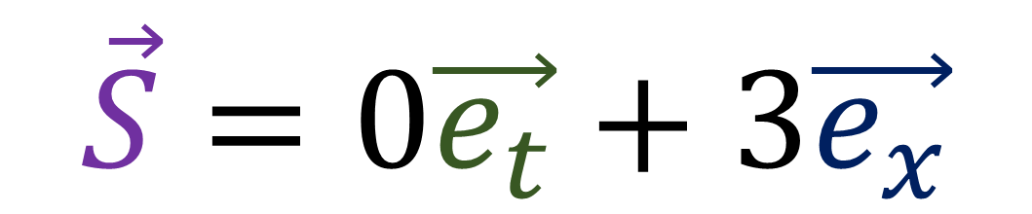



Spacetime Basis (aka reference frame)
happens 3 space units to the right of
(0 time units away)
$$\vec{e_{t}}$$
$$\vec{e_{x}}$$
$$\vec{S}$$
$$\vec{S}=0\vec{e_{t}}+3\vec{e_{x}}$$
Notes:
Finally, the spacetime separation vector between Einstein’s sneeze and Emily Noether’s stroke of genius, is made up of 3 space vectors. It happens 3 space units to the right, but it happens at the same time, so zero time units away.

Slide 15


Spacetime Basis (aka reference frame)
time $t$
Observer 1: Scientist standing still
position $x$
Notes:
So we’ve seen several examples of spacetime separation vectors that measure the time and space between two events. However, we’ve been doing the measurements from the frame of Einstein, who, from the point of view of his own reference frame, is standing still at a position of zero for all time.

Slide 16
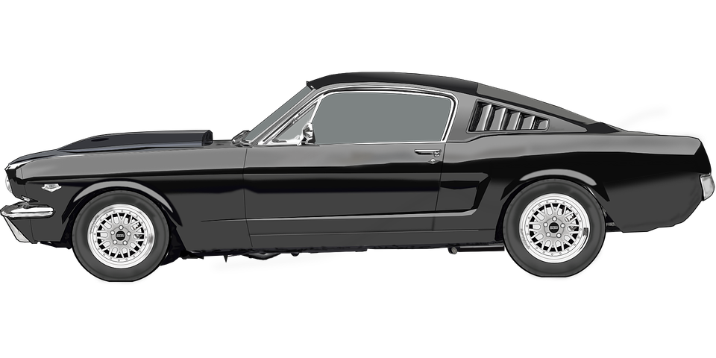
Spacetime Basis (aka reference frame)
time $t$
Observer 2: Car moving right
position $x$
Notes:
Now let’s consider the events from the frame of reference of a car that’s moving to the right of Einstein at a constant speed.

Slide 17
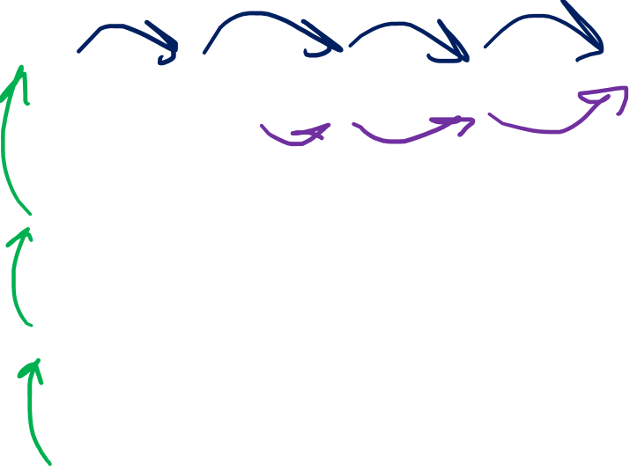
Spacetime Basis (aka reference frame)
time $t$
Observer 2: Car moving right
position $x$
Notes:
Previously we said that the spacetime separation from Einstein’s sneeze and Feynman’s snap was 3 time units into the future, and 4 space units to the right. But looking at the reference frame of the car, the snap is still 3 time units into the future, but it’s only 2 and a half space units to the right. Einstein and the car agree on time, but they disagree on position, because they are in different reference frames.

Slide 18
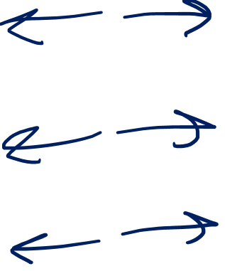
Galilean Spacetime Diagram
time $t$
Observer 1: Scientist standing still
position $x$
Notes:
Let’s think about how position is measure Einstein’s point of view. Einstein believes he is standing still, and so his world line is a straight vertical line, where his position doesn’t change relative to the vertical axis. We can place another vertical line to his left, indicating a position one unit of distance to his left. We can place another vertical line to his right, indicating a position one unit of distance to his right. If we continue this pattern, and include horizontal lines denoting different moments in time, we see that the coordinate lines in spacetime according to Doc Brown form a grid of squares.

Slide 19
Spacetime Basis (aka reference frame)
time $t$
Observer 1: Scientist standing still
5s
4s
-3m
-2m
-1m
0m
1m
2m
3m
3s
2s
1s
position $x$
Notes:
Let’s think about how position is measure Einstein’s point of view. Einstein believes he is standing still, and so his world line is a straight vertical line, where his position doesn’t change relative to the vertical axis. We can place another vertical line to his left, indicating a position one unit of distance to his left. We can place another vertical line to his right, indicating a position one unit of distance to his right. If we include one vertical line for every unit of position, and also include horizontal lines denoting different moments in time, we see that the coordinate lines in spacetime according to Einstein form a grid of squares.

Slide 20
Spacetime Basis (aka reference frame)
time $t$
Observer 1: Scientist standing still
5s
4s
-3m
-2m
-1m
0m
1m
2m
3m
3s
2s
1s
position $x$
Notes:
Let’s think about how position is measure Einstein’s point of view. Einstein believes he is standing still, and so his world line is a straight vertical line, where his position doesn’t change relative to the vertical axis. We can place another vertical line to his left, indicating a position one unit of distance to his left. We can place another vertical line to his right, indicating a position one unit of distance to his right. If we include one vertical line for every unit of position, and also include horizontal lines denoting different moments in time, we see that the coordinate lines in spacetime according to Einstein form a grid of squares.

Slide 21
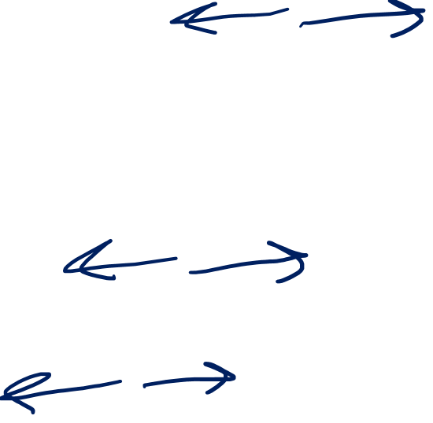
Spacetime Basis (aka reference frame)
time $t$
Observer 2: Car moving right
5s
4s
3s
-4m
-3m
-2m
-1m
0m
1m
2m
2s
1s
position $x$
Notes:
Now let’s consider doing this again, but from the car’s point of view. The car is travelling right relative to Einstein and can be seen to have a diagonal worldline, but the car driver will measure all positions relative to the car itself. In other words the car driver will always measure distance relative to their worldline. So we can place a diagonal line to the car’s left, indicating a position one unit of distance to the left of the car. We can place another diagonal line to its right, indicating a position one unit of distance to the car’s right. If we include all the other position lines as well as the time lines, we see that the coordinate lines in spacetime according to the car form a grid of parallelograms

Slide 22
Spacetime Basis (aka reference frame)
time $t$
Observer 2: Car moving right
5s
4s
3s
-4m
-3m
-2m
-1m
0m
1m
2m
2s
1s
position $x$
Notes:
Now let’s consider doing this again, but from the car’s point of view. The car is travelling right relative to Einstein and can be seen to have a diagonal worldline, but the car driver will measure all positions relative to the car itself. In other words the car driver will always measure distance relative to their worldline. So we can place a diagonal line to the car’s left, indicating a position one unit of distance to the left of the car. We can place another diagonal line to its right, indicating a position one unit of distance to the car’s right. If we include all the other position lines as well as the time lines, we see that the coordinate lines in spacetime according to the car form a grid of parallelograms

Slide 23


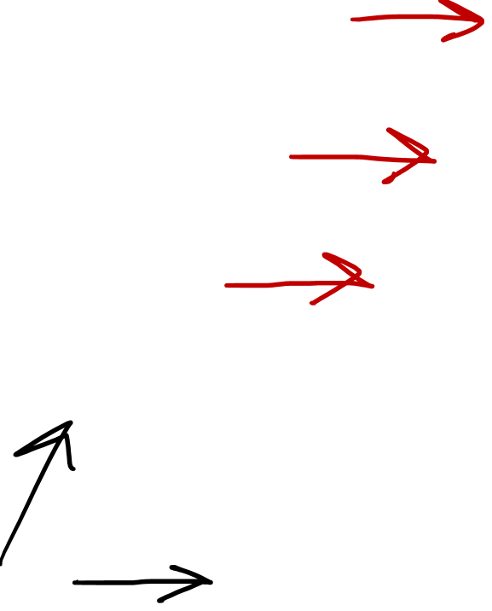

Spacetime Basis (aka reference frame)
time $t$
Observer 2: Car moving right
5s
4s
3s
-4m
-3m
-2m
-1m
0m
1m
2m
2s
$$\tilde{\vec{e_{t}}}$$
1s
$$\tilde{\vec{e_{x}}}$$
position $x$
Notes:
For this reason, the spacetime basis for the car, which I’m calling eT-tilde and eX-tilde, will be slightly different than Einstein’s spacetime basis. The space vector still points in the same direction, however the time vector is now slanted so that it aligns with the car’s worldline. This way we will always be measuring position frame the car’s position on its own worldline, because the time axis is now diagonal.

Slide 24

Spacetime Basis (aka reference frame)
time $t$
Observer 2: Car moving right
position $x$
Notes:
Now let’s once again measure the spacetime separation vectors for these events… but this time using our diagonal time axis that lines up with the car’s worldline

Slide 25
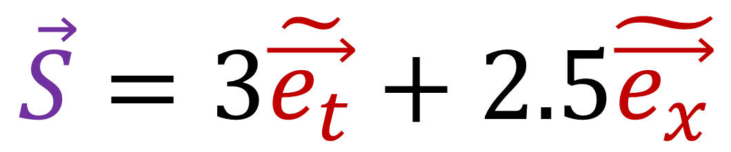



Spacetime Basis (aka reference frame)
$$\vec{S}=3\tilde{\vec{e_{t}}}+2.5\tilde{\vec{e_{x}}}$$
$$\vec{S}$$
$$\tilde{\vec{e_{t}}}$$
happens 3 time units after and
2.5 space units to the right of
$$\tilde{\vec{e_{x}}}$$
Notes:
For the car, We see the separation between Einstein’s sneeze at the origin and Feynman’s snap is 3 units of time, plus 2.5 units of distance. In common English this means the snap happens 3 time units after and 2.5 space units to the right of the sneeze, according to the car’s perspective.

Slide 26
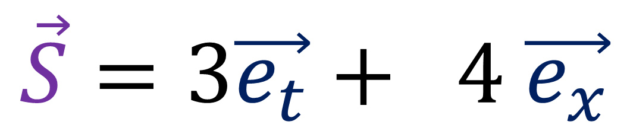




Spacetime Basis (aka reference frame)
$$\vec{S}=3\vec{e_{t}}+ 4 \vec{e_{x}}$$
$$\vec{S}=3\tilde{\vec{e_{t}}}+2.5\tilde{\vec{e_{x}}}$$
$$Invariance$$
$$\vec{S}$$
$$\tilde{\vec{e_{t}}}$$
$$\vec{e_{t}}$$
happens 3 time units after and
2.5 space units to the right of
$$\tilde{\vec{e_{x}}}$$
$$\vec{e_{x}}$$
Notes:
For the car, We see the separation between Einstein’s sneeze at the origin and Feynman’s snap is 3 units of time, plus 2.5 units of distance. In common English this means the snap happens 3 time units after and 2.5 space units to the right of the sneeze, according to the car’s perspective.

Slide 27

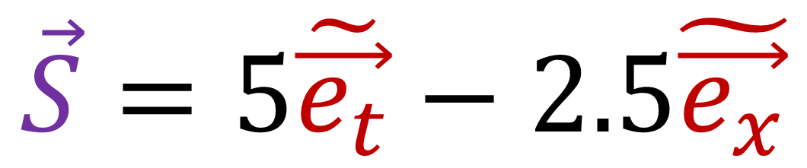
Spacetime Basis (aka reference frame)
$$\vec{S}=5\tilde{\vec{e_{t}}}−2.5\tilde{\vec{e_{x}}}$$
$$\vec{S}$$
$$\tilde{\vec{e_{t}}}$$
happens 5 time units after and
2.5 space units to the left of
$$\tilde{\vec{e_{x}}}$$

Slide 28




Spacetime Basis (aka reference frame)
$$\vec{S}=5\vec{e_{t}}+ 0 \vec{e_{x}}$$
$$\vec{S}=5\tilde{\vec{e_{t}}}−2.5\tilde{\vec{e_{x}}}$$
$$\vec{S}$$
$$Invariance$$
$$\tilde{\vec{e_{t}}}$$
$$\vec{e_{t}}$$
happens 5 time units after and
2.5 space units to the left of
$$\tilde{\vec{e_{x}}}$$
$$\vec{e_{x}}$$

Slide 29

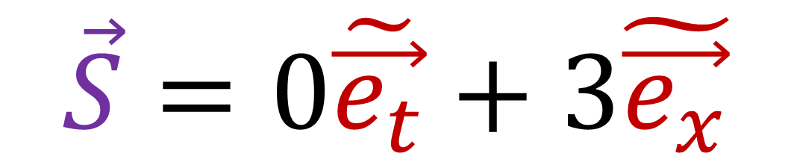

Spacetime Basis (aka reference frame)
$$\vec{S}=0\tilde{\vec{e_{t}}}+3\tilde{\vec{e_{x}}}$$
happens 3 space units to the right of
(0 time units away)
$$\tilde{\vec{e_{t}}}$$
$$\vec{S}$$
$$\tilde{\vec{e_{x}}}$$

Slide 30
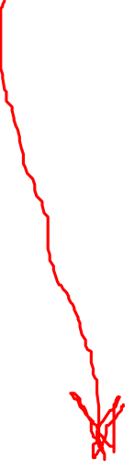
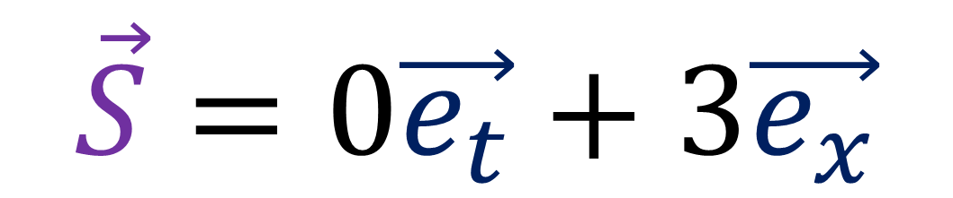
Spacetime Basis (aka reference frame)
$$\vec{S}=0\vec{e_{t}}+3\vec{e_{x}}$$
$$\vec{S}=0\tilde{\vec{e_{t}}}+3\tilde{\vec{e_{x}}}$$
happens 3 space units to the right of
(0 time units away)
$$\tilde{\vec{e_{t}}}$$
$$\vec{S}$$
$$\vec{e_{t}}$$
$$\tilde{\vec{e_{x}}}$$
$$\vec{e_{x}}$$

Slide 31
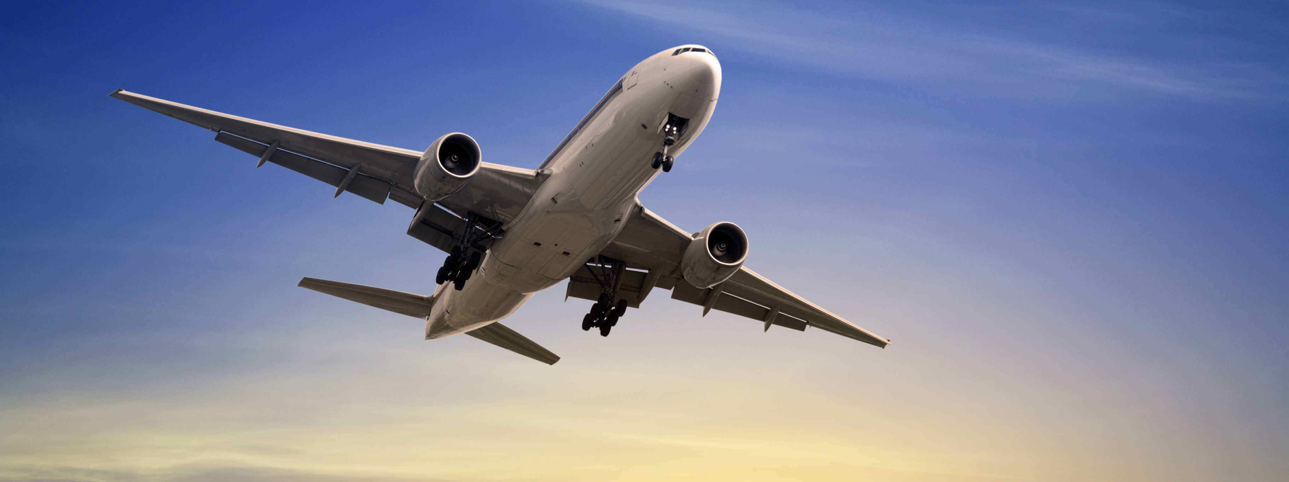


Spacetime Basis (aka reference frame)
$$\breve{\vec{e_{t}}}$$
$$\breve{\vec{e_{x}}}$$
Notes:
And I’m not going to bother showing this but you could also measure the various spacetime separations from the plane’s point of view using a different spacetime basis where the time vector is aligned with the plane’s worldline.

Slide 32
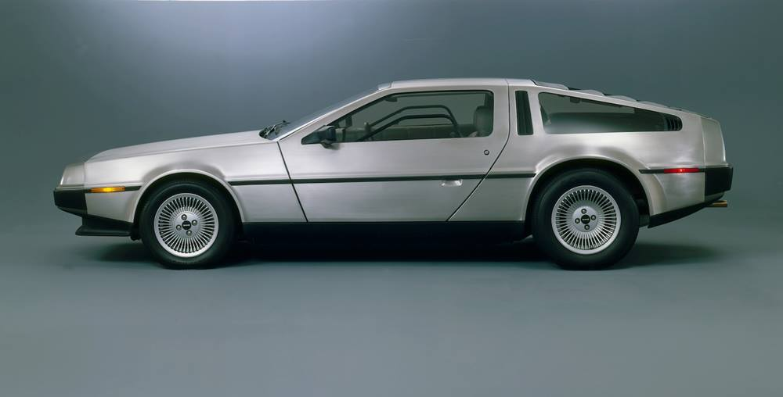
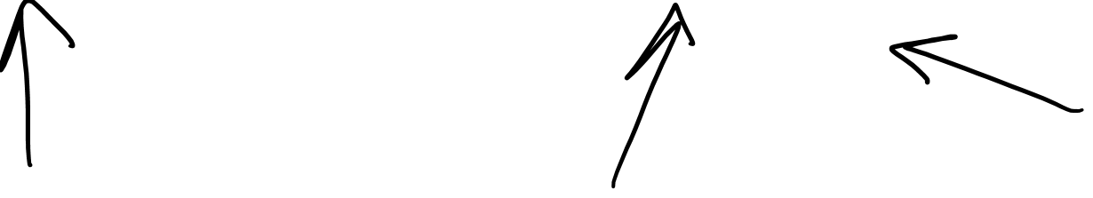
Different inertial frame = Different basis
Notes:
So we can see that in Galilean Relativity, the different inertial frames of the scientist, the car, and the plane, are all represented by different spacetime basis vectors, where the space vector is the same in each case, but the time vector is tilted at different angles so that it aligns with their worldline of the object in the spacetime diagram.

Slide 33





5s
time $t$
5s
time $t$
4s
4s
3s
$⇐$ Equivalent $⇒$
3s
2s
2s
1s
1s
position $x$
position $x$
-50m
0m
50m
100m
150m
-150m
-100m
-50m
0m
50m
100m
Galilean Relativity: All motion is relative to something else
There is no special “stationary” reference frame at rest
Notes:
Now remember that in Galilean relativity there is no such thing as a special stationary reference frame. We can always re-draw a spacetime diagram so that a different object is stationary with a vertical worldline.

Slide 34
5s
time $t$
5s
time $t$
4s
4s
3s
$⇐$ Equivalent $⇒$
3s
2s
2s
1s
1s
position $x$
position $x$
-50m
0m
50m
100m
150m
-150m
-100m
-50m
0m
50m
100m
Frame of the scientist
Frame of the car
Notes:
Now remember that in Galilean relativity there is no such thing as a special stationary reference frame. We can always re-draw a spacetime diagram so that a different object is stationary with a vertical worldline.

Slide 35




time $t$
position $x$
Notes:
I showed how we could do this by slicing up the spacetime diagram into different instants in time, almost as if we had taken a series of photographs, and then sliding the slices over to make the car’s worldline vertical.

Slide 36
time $t$
Frame of the car
position $x$

Slide 37



time $t$
$$\vec{S}=3\vec{e_{t}}+ 4 \vec{e_{x}}$$
$$\vec{S}$$
$$\vec{S}=3\tilde{\vec{e_{t}}}+2.5\tilde{\vec{e_{x}}}$$
position $x$
Notes:
We can draw the spacetime separation vector S on our spacetime diagram and building it using Einstein’s basis vectors and the car’s basis vectors. If we shift the time slices over so that we’re in the reference frame of the car, all the vector addition still make sense, it’s just that the vectors are drawn a little differently because we changed reference frames.

Slide 38
time $t$
$$\vec{S}=3\vec{e_{t}}+ 4 \vec{e_{x}}$$
$$\vec{S}$$
$$\vec{S}=3\tilde{\vec{e_{t}}}+2.5\tilde{\vec{e_{x}}}$$
position $x$
Notes:
Here’s one way to think about different reference frames in space time diagrams. Let’s say that as time moves forward, at each second we take a photograph of all the objects in space. We end up with a series of photographs, or time slices that can help us trace out the worldlines of all the different objects. We can see here that the scientist has a vertical worldline, so this spacetime diagram represents the frame of reference of the scientist, since he is standing still.

Slide 39




Spacetime Basis (aka reference frame)
An arrow joining two points (two “events”) in a spacetime diagram
same
different
$$\vec{S}=3\vec{e_{t}}+ 4 \vec{e_{x}}$$
$$\tilde{\vec{e_{t}}}$$
$$\vec{S}$$
$$\vec{S}=3\tilde{\vec{e_{t}}}+2.5\tilde{\vec{e_{x}}}$$
$$\vec{e_{t}}$$
$$\tilde{\vec{e_{x}}}$$
$$Invariance$$
$$\vec{e_{x}}$$
Notes:
For the car, We see the separation between Einstein’s sneeze at the origin and Feynman’s snap is 3 units of time, plus 2.5 units of distance. In common English this means the snap happens 3 time units after and 2.5 space units to the right of the sneeze, according to the car’s perspective.

Slide 40


Different inertial frame = Different basis
Notes:
So we can see that in Galilean Relativity, the different inertial frames of the scientist, the car, and the plane, are all represented by different spacetime basis vectors, where the space vector is the same in each case, but the time vector is tilted at different angles so that it aligns with their worldline of the object in the spacetime diagram.

Slide 41
Relativity 103: Galilean Relativity?
Spacetime Diagrams
Spacetime Separation Vector
Galilean Transform (change of basis)
Metric Tensor (Euclidean)
Notes:
Welcome back to Relativity 102, Galilean Relativity. Last time we learned all about the spacetime separation vector and spacetime diagrams. Now we’re going to move onto the Galilean Transform, which is how we change our basis in Spacetime Diagrams for Galilean relativity.

