Slide 1
Relativity 103: Galilean Relativity
Spacetime Diagrams
Spacetime Separation Vector
Galilean Transform (change of basis)
Metric Tensor (Euclidean)
Notes:
Welcome back to Relativity 103, Galilean Relativity. going to move onto the Galilean Transform, which is how we change our basis in Spacetime Diagrams for Galilean relativity.

Slide 2

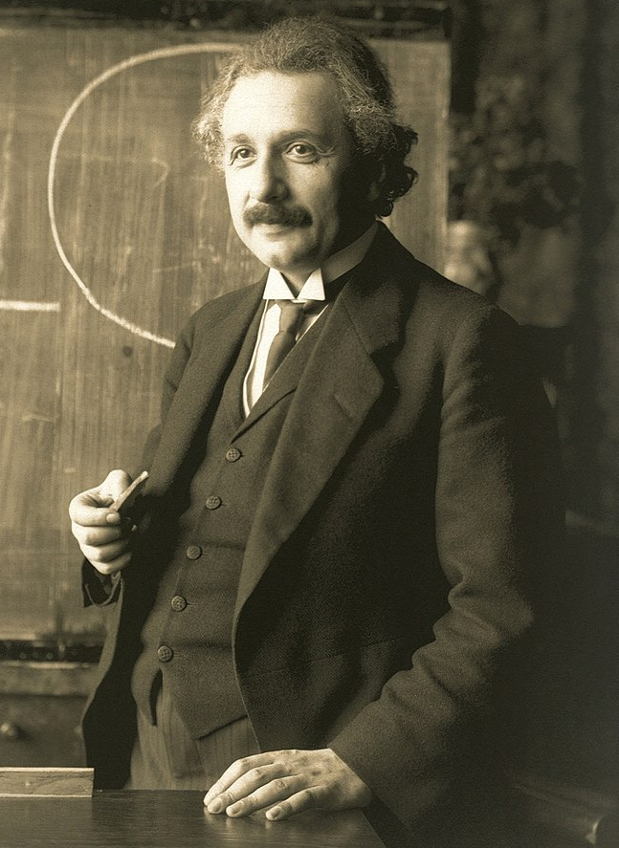
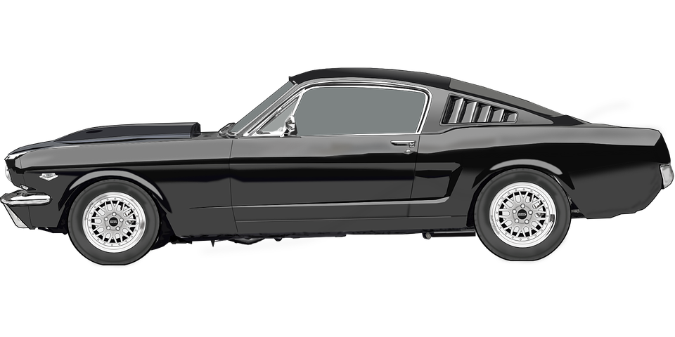
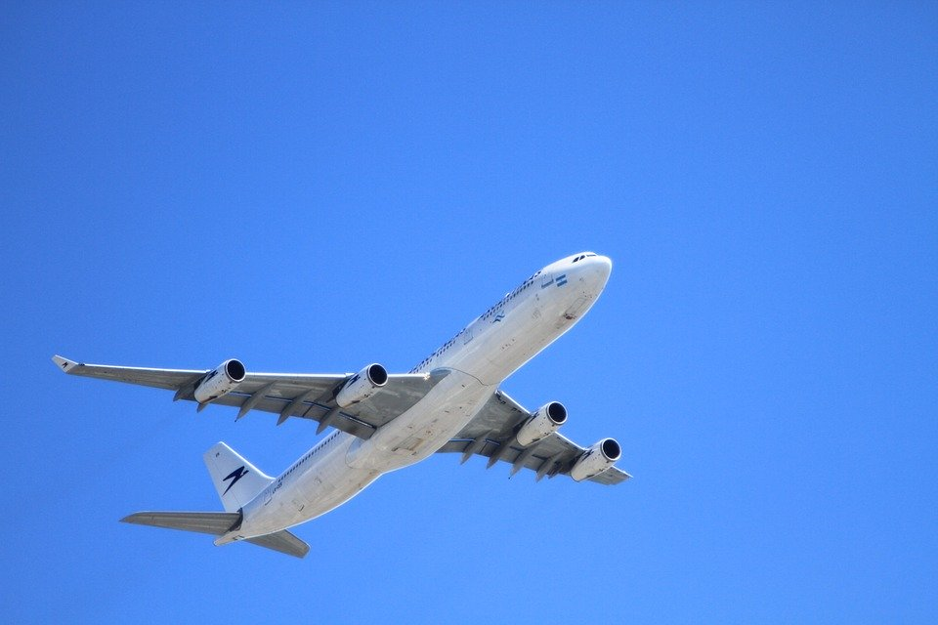


Changing coordinates (Galilean Relativity)
time $t$
position $x$
Notes:
We’ve seen that in Galilean relativity, observers in different reference frames will agree on time, but they will disagree on position.

Slide 3

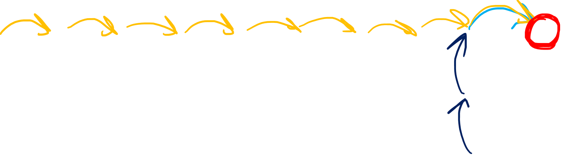


Changing coordinates (Galilean Relativity)
time $t$
$$t=2$$
$$x=1$$
Equation to convert between time and space coordinates?
$$\breve{t}=2$$
$$\breve{x}=9$$
$$\tilde{t}=2$$
$$\tilde{x}=0$$
position $x$
Notes:
For example, if we look at this green event point on the space time diagram, according Einstein’s reference frame, this will happen 2 time units into the future, and 1 space unit to the right. From the plane’s point of view the green event point is 2 time units into the future, and 9 space units to the right. From the car’s point of view, it happens 2 seconds into the future and zero space units away. This is because the event happens right on top of the car’s worldline, so the position of the event is equal to the car’s position when it happens. So we can measure the time and space coordinates manually by looking at the spacetime diagram picture, but it would be nice if there was an equation that could do the coordinate conversion for us.

Slide 4
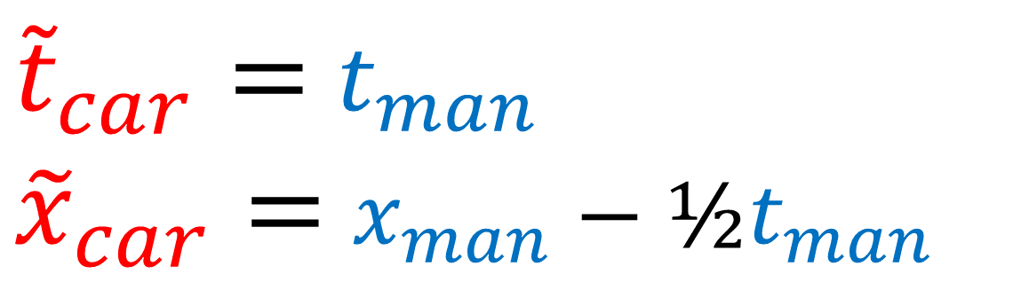

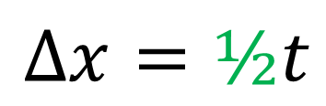


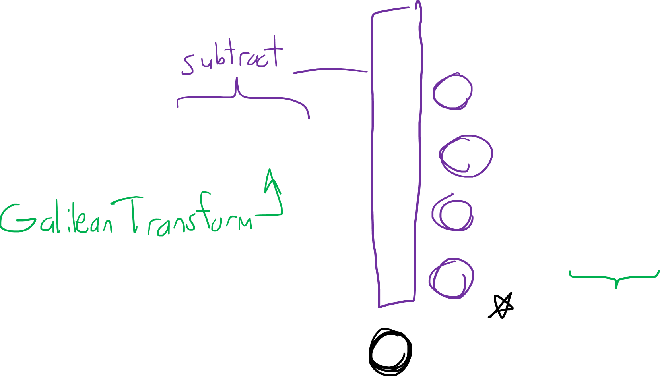




Changing coordinates (Galilean Relativity)
time $t$
$$Δx=2\text{½}$$
${\tilde{t}}_{car}=$ $t_{man}$
${\tilde{x}}_{car}=$ $x_{man}−\text{½}t_{man}$
$$Δx=2$$
$${\tilde{x}}_{car}=0$$
$$Δx=1\text{½}$$
$$Δx=1$$
$$v=\text{½}$$
$$Δx=\text{½}$$
$$Δx=\text{½}t$$
position $x$
Notes:
We know that in Galilean Relativity, time is universe, and so time for the car is equal to time for the scientist Einstein. But what about converting the position coordinates.
We can start by noting the speed of the car in Einstein’s reference frame is ½ space units to the right for every time unit.
At the origin, Einstein and the car are at the same position. After 1 time unit, their spatial separation is ½. After 2 times units, separation is 1. After 3 times units separation is 1 ½. And so on and so forth. The separation delta X between Einstein and the var is ½ multiplied by time where ½ is the speed of the car. So that car’s position coordinate is equal to the scientist’s position coordinate – ½ t. If you’re wondering why I used a minus sign instead of a plus sign, just remember that the car’s position according Einstein is ½, 1, 1 ½ , 2…. but the car’s position according to itself is always zero. So we need to subtract off this separation in order to measure position from the car’s perspective. Now if I just wanted to teach you Galilean relativity, I could just tell you that this is the Galilean transform and say that’s the end of it.

Slide 5

Galilean Relativity
(1632)
Special Relativity
(1905)
General Relativity
(1915)
Difficulty:
Difficulty:
Difficulty:
We need to go deeper!
Notes:
However, I’m assuming you want to learn General Relativity in the long term, so we’re going to need to study the Galilean Transform more deeply.

Slide 6





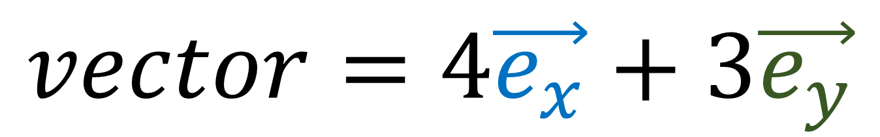
$$vector=4\vec{e_{x}}+3\vec{e_{y}}$$
$$\vec{e_{y}}$$
$$x=4$$
$$\vec{e_{x}}$$
$$y=3$$
Vector Basis (Measuring Sticks)
Vector Components
(Coordinates/Numbers)
Notes:
I want you to remember that basis vectors and vector components are two sides of the same coin. Any time we’re dealing with vectors, we need to think about both the basis vectors and the components. It doesn’t make sense to talk about one without talking about the other.

Slide 7
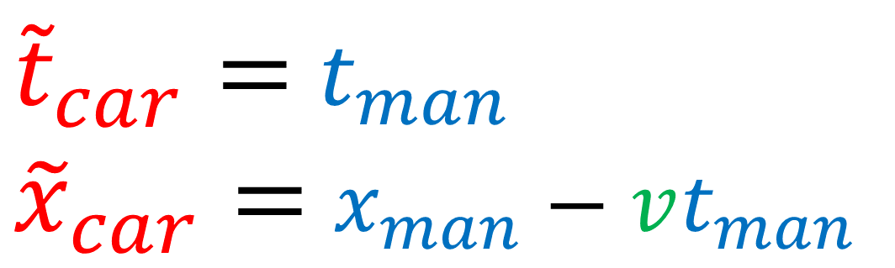
Galilean
Transform??
${\tilde{t}}_{car}=$ $t_{man}$
${\tilde{x}}_{car}=$ $x_{man}−vt_{man}$
only half of the story
Notes:
The Galilean transform isn’t just about changing coordinates. That’s only half of the story…

Slide 8
Galilean Transform changes both the basis and the components!
…and they change in opposite ways!
$$\vec{e_{y}}$$
$$x=4$$
$$\vec{e_{x}}$$
$$y=3$$
Vector Basis (Measuring Sticks)
Vector Components
(Coordinates/Numbers)
Notes:
The Galilean transform changes both the basis vectors and the vector components… and they change in opposite ways…

Slide 9

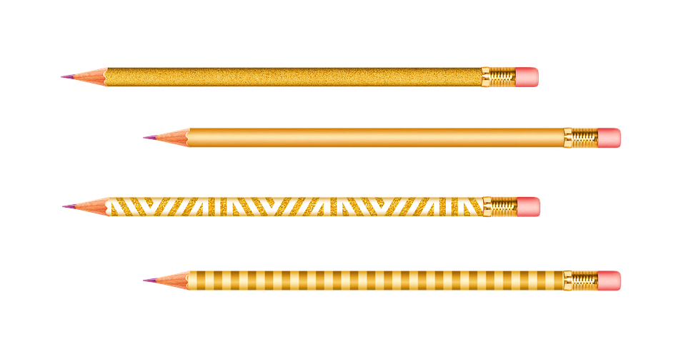
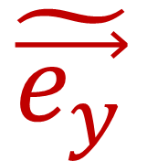
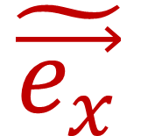
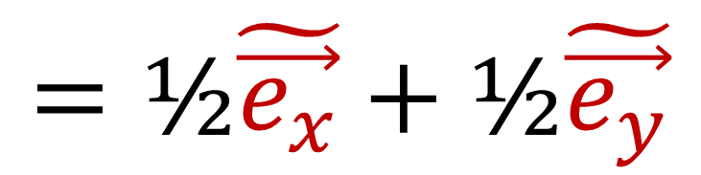
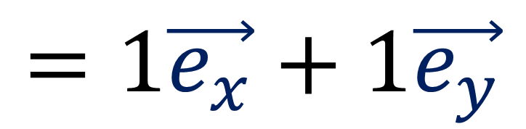
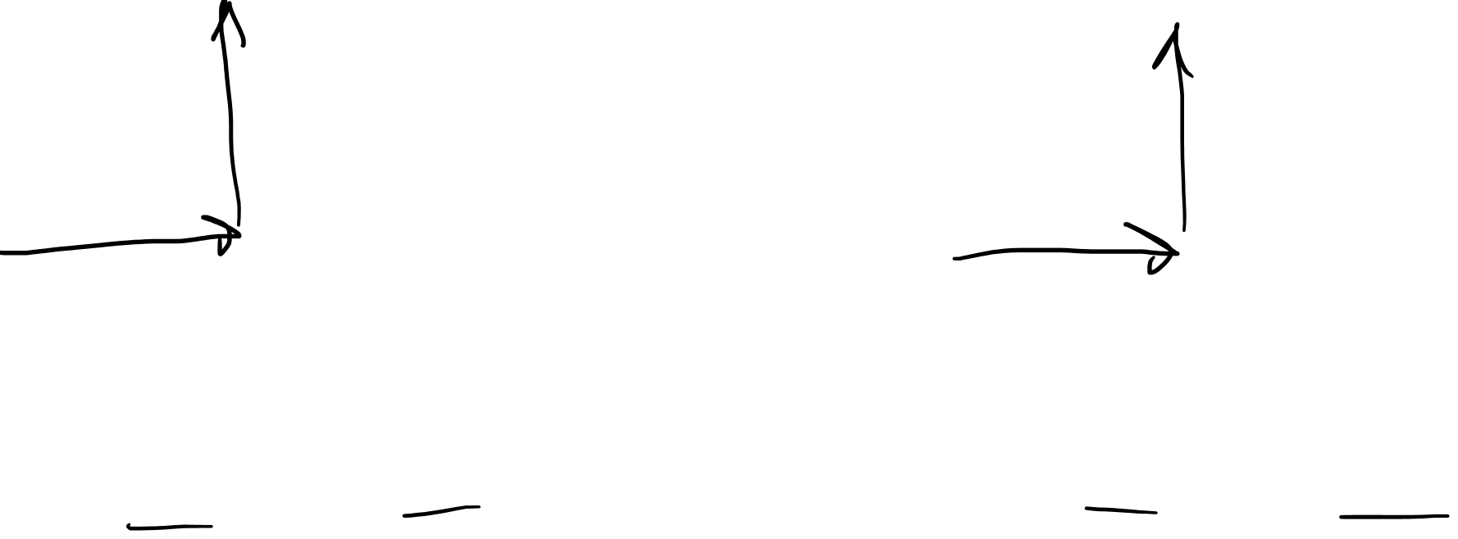
Basis Change changes both the basis and the components!
…and they change in opposite ways!
$$\tilde{\vec{e_{x}}}=2\vec{e_{x}}$$
$$\tilde{\vec{e_{y}}}=2\vec{e_{y}}$$
$$\tilde{\vec{e_{y}}}$$
$$\vec{e_{y}}$$
$$\tilde{\vec{e_{x}}}$$
$$\vec{e_{x}}$$
$$=1\vec{e_{x}}+1\vec{e_{y}}$$
$$=\text{½}\tilde{\vec{e_{x}}}+\text{½}\tilde{\vec{e_{y}}}$$
Notes:
In Relativity 102, I showed that if we took this basis eX and eY and measured this pencil to have components 1,1… If we doubled the length of the basis vectors, the components would become ½, ½.

Slide 10

Covariant
Contravariant
$$\vec{e_{y}}$$
$$x=4$$
$$\vec{e_{x}}$$
$$y=3$$
Vector Basis (Measuring Sticks)
Vector Components
(Coordinates/Numbers)

Slide 11


Covariant
Contravariant
$$\vec{e_{y}}$$
$$x=4$$
Galilean Transform Affects Both
$$\vec{e_{x}}$$
$$y=3$$
Vector Basis (Measuring Sticks)
Vector Components
(Coordinates/Numbers)

Slide 12

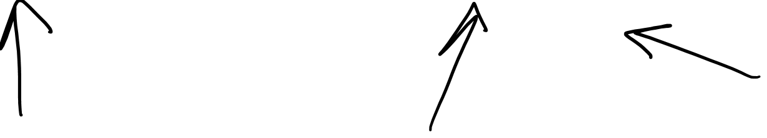
Different inertial frame = Different basis
Notes:
We learned in the last video that every inertial frame has items own spacetime basis, where the time vector is angled to align with the frame’s worldine.

Slide 13

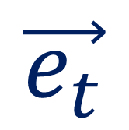
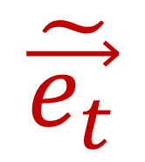
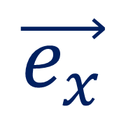
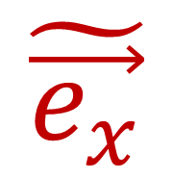

Galilean Transform (change of basis)
$$\vec{e_{t}}$$
$$\vec{e_{x}}$$
$${\tilde{t}}_{car}=t_{man}$$
$${\tilde{x}}_{car}=x_{man}−vt_{man}$$
$$\tilde{\vec{e_{t}}}$$
$$\tilde{\vec{e_{x}}}$$
Notes:
We’re going to find that knowing how to change from the scientists spacetime basis to the car’s spacetime basis will result in the coordinate-change formulas we need.

Slide 14
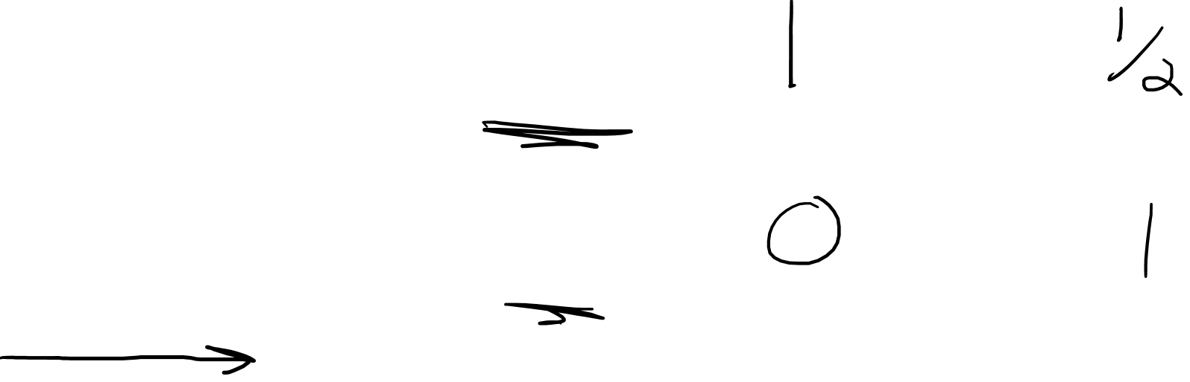
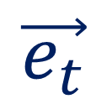
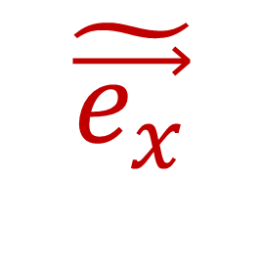
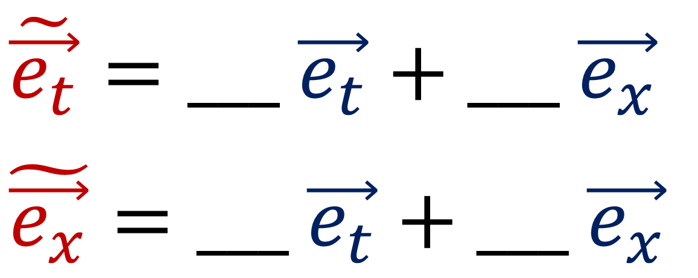
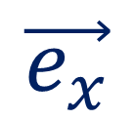

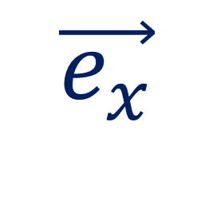
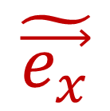
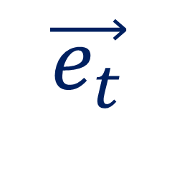
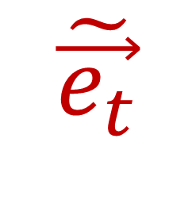
Galilean Transform (change of basis)
$$\vec{e_{t}}$$
$$\tilde{\vec{e_{t}}}$$
$$\vec{e_{x}}$$
$$\tilde{\vec{e_{x}}}$$
$$\vec{e_{t}}$$
$$\tilde{\vec{e_{t}}}$$
$$\tilde{\vec{e_{t}}}=___ \vec{e_{t}}+___ \vec{e_{x}}$$
$$\tilde{\vec{e_{x}}}=___ \vec{e_{t}}+___ \vec{e_{x}}$$
$$\vec{e_{x}}$$
$$\tilde{\vec{e_{x}}}$$
Notes:
So we have the scientist’s spacetime basis and the car’s spacetime basis. Let’s try to build the car’s basis vectors out of the scientist’s basis vectors. So what would the car’s time vector, eT-tilde, be equal to if we needed to build it out of eT and eX? Well, it looks like we need ONE eT vector, and ½ of an eX vector. So I’ll write in the components 1 and ½. What about the eX-tilde vector? Well, it looks like eX-tilde is exactly equal to eX. So we need zero eT and 1 eX to build eX tilde.

Slide 15
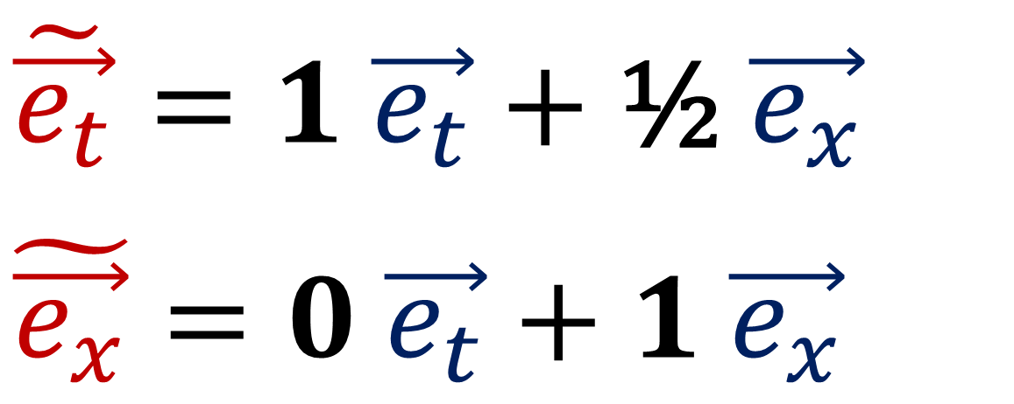
Galilean Transform (change of basis)
$$\vec{e_{t}}$$
$$\tilde{\vec{e_{t}}}$$
$$\vec{e_{x}}$$
$$\tilde{\vec{e_{x}}}$$
$$\vec{e_{t}}$$
$$\tilde{\vec{e_{t}}}$$
$$\tilde{\vec{e_{t}}}=1 \vec{e_{t}}+\text{½} \vec{e_{x}}$$
$$\tilde{\vec{e_{x}}}=0 \vec{e_{t}}+1 \vec{e_{x}}$$
$$\vec{e_{x}}$$
$$\tilde{\vec{e_{x}}}$$
Notes:
To make things simpler, I’m going to leave out the 1s in this formula, and get rid of the term with the zero in it.

Slide 16
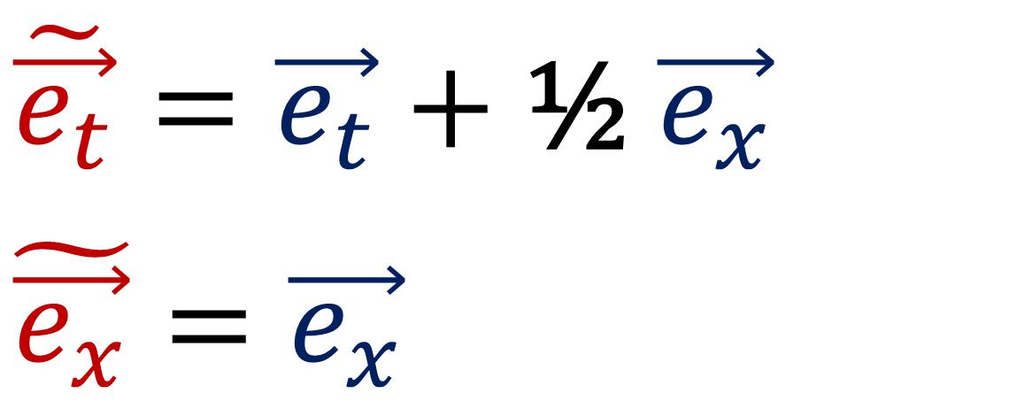

Galilean Transform (change of basis)
$$\vec{e_{t}}$$
$$\tilde{\vec{e_{t}}}$$
$$\vec{e_{x}}$$
$$\tilde{\vec{e_{x}}}$$
$$\vec{e_{t}}$$
$$\tilde{\vec{e_{t}}}$$
$$\tilde{\vec{e_{t}}}=\vec{e_{t}}+\text{½} \vec{e_{x}}$$
$$\tilde{\vec{e_{x}}}=\vec{e_{x}}$$
$$\vec{e_{x}}$$
$$\tilde{\vec{e_{x}}}$$

Slide 17
Galilean Transform (change of basis)
$$\vec{e_{t}}$$
$$\tilde{\vec{e_{t}}}$$
$$\vec{e_{x}}$$
$$\tilde{\vec{e_{x}}}$$
$$\vec{e_{t}}$$
$$\tilde{\vec{e_{t}}}$$
$$\vec{e_{x}}$$
$$\tilde{\vec{e_{x}}}$$

Slide 18
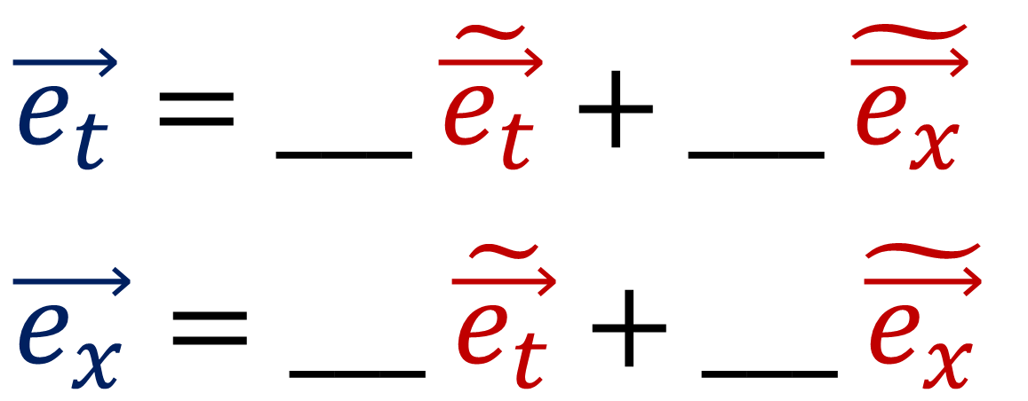
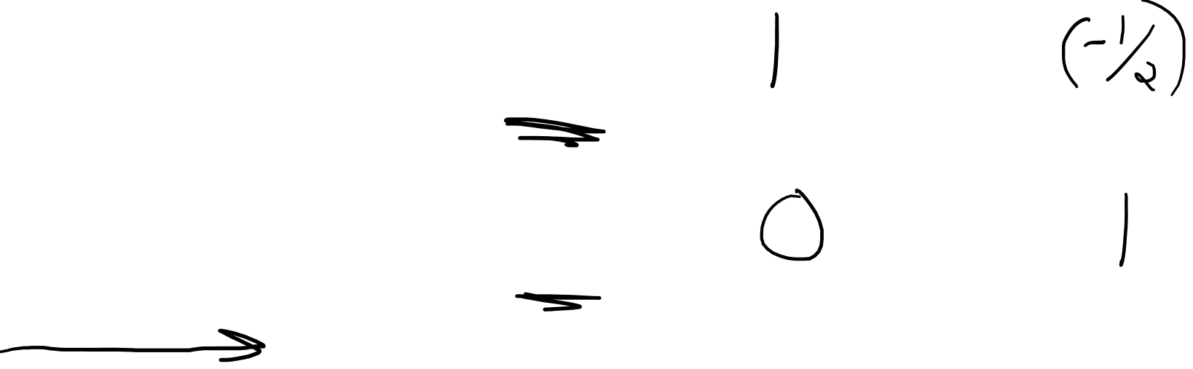
Galilean Transform (change of basis)
$$\vec{e_{t}}$$
$$\tilde{\vec{e_{t}}}$$
$$\vec{e_{x}}$$
$$\tilde{\vec{e_{x}}}$$
$$\vec{e_{t}}$$
$$\tilde{\vec{e_{t}}}$$
$$\vec{e_{t}}=___ \tilde{\vec{e_{t}}}+___ \tilde{\vec{e_{x}}}$$
$$\vec{e_{x}}=___ \tilde{\vec{e_{t}}}+___ \tilde{\vec{e_{x}}}$$
$$\vec{e_{x}}$$
$$\tilde{\vec{e_{x}}}$$

Slide 19
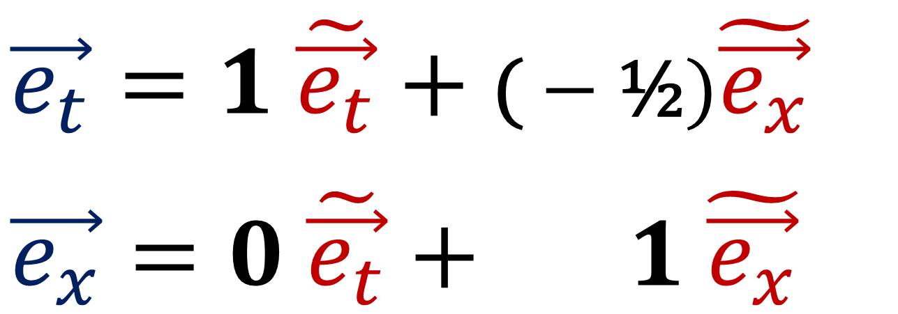
Galilean Transform (change of basis)
$$\vec{e_{t}}$$
$$\tilde{\vec{e_{t}}}$$
$$\vec{e_{x}}$$
$$\tilde{\vec{e_{x}}}$$
$$\vec{e_{t}}$$
$$\tilde{\vec{e_{t}}}$$
$$\vec{e_{t}}=1 \tilde{\vec{e_{t}}}+\text{(}−\text{½})\tilde{\vec{e_{x}}}$$
$$\vec{e_{x}}=0 \tilde{\vec{e_{t}}}+ 1 \tilde{\vec{e_{x}}}$$
$$\vec{e_{x}}$$
$$\tilde{\vec{e_{x}}}$$

Slide 20
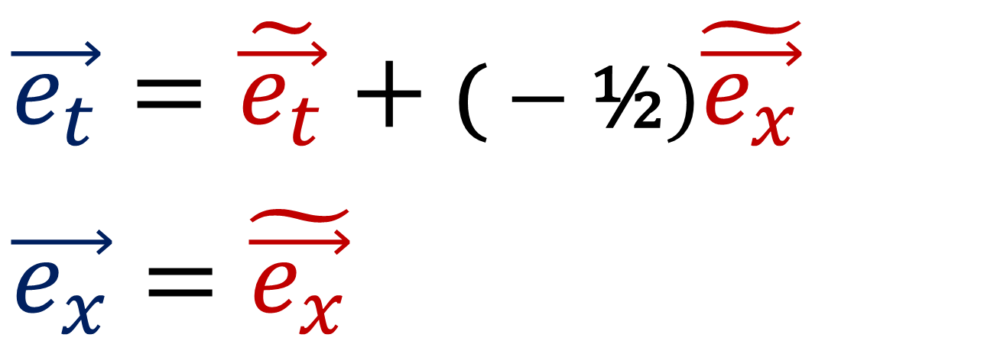
Galilean Transform (change of basis)
$$\vec{e_{t}}$$
$$\tilde{\vec{e_{t}}}$$
$$\vec{e_{x}}$$
$$\tilde{\vec{e_{x}}}$$
$$\vec{e_{t}}$$
$$\tilde{\vec{e_{t}}}$$
$$\vec{e_{t}}=\tilde{\vec{e_{t}}}+\text{(}−\text{½})\tilde{\vec{e_{x}}}$$
$$\vec{e_{x}}=\tilde{\vec{e_{x}}}$$
$$\vec{e_{x}}$$
$$\tilde{\vec{e_{x}}}$$

Slide 21
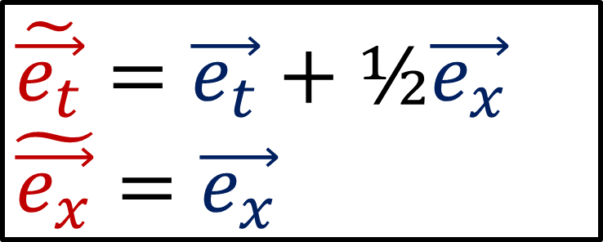

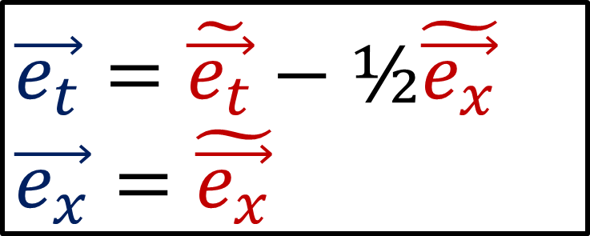

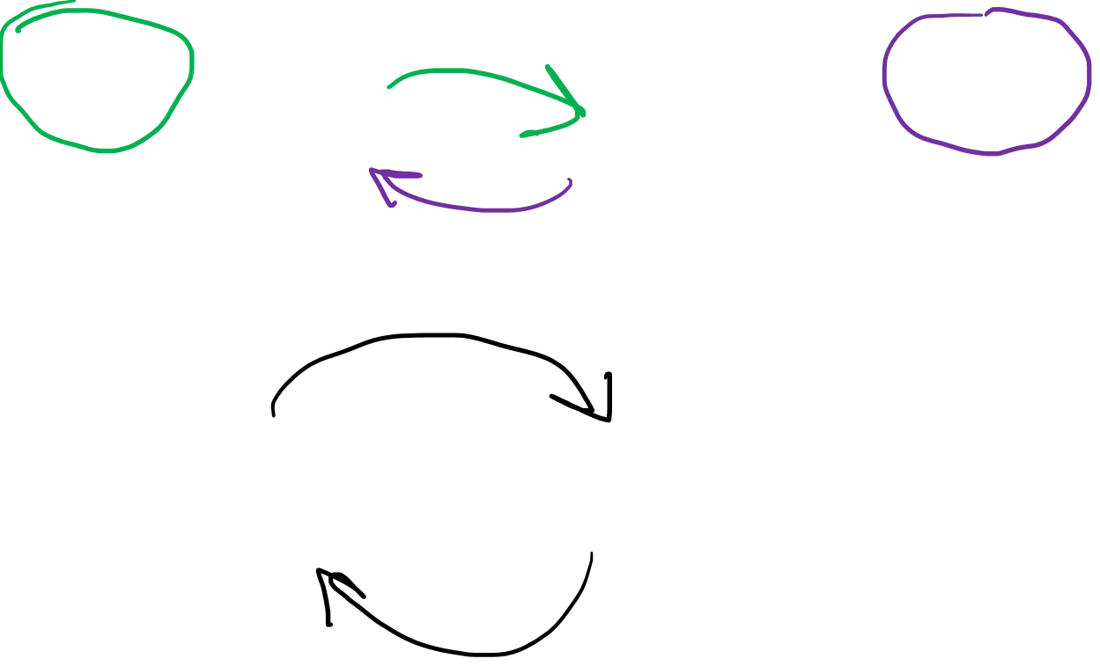
Basis: Man $→$ Car
Basis: Car $→$ Man
$$\tilde{\vec{e_{t}}}=\vec{e_{t}}+\text{½}\vec{e_{x}}$$
$$\tilde{\vec{e_{x}}}=\vec{e_{x}}$$
$$\vec{e_{t}}=\tilde{\vec{e_{t}}}−\text{½}\tilde{\vec{e_{x}}}$$
$$\vec{e_{x}}=\tilde{\vec{e_{x}}}$$
$$\vec{e_{t}}$$
$$\tilde{\vec{e_{t}}}$$
$$\vec{e_{x}}$$
$$\tilde{\vec{e_{x}}}$$
The formulas reverse each other!
Notes:
So we now how the equations to switch back and forth between Einstein’s basis and the car’s basis.
You’ll notice that this first set of formulas has a positive ½ and the other set has negative ½
This is because the equations are opposites of each other. If we start with Einstein’s basis, and then change to the car’s basis, and then change back again, we should end up with what we started with. I’ll show you want I mean.

Slide 22
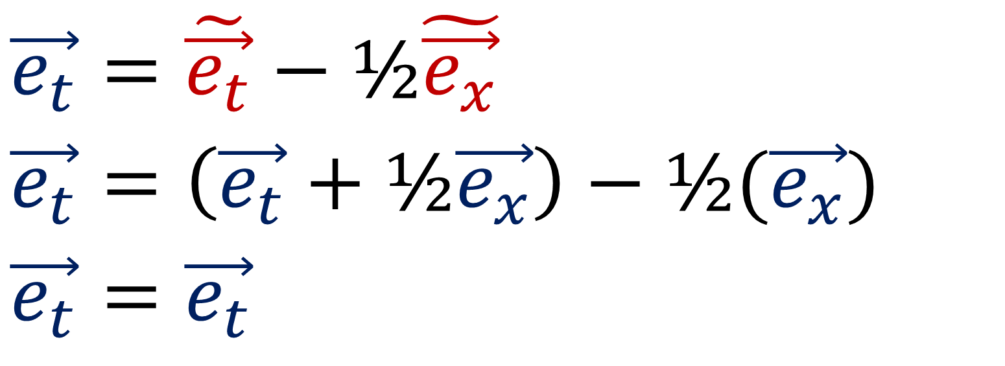
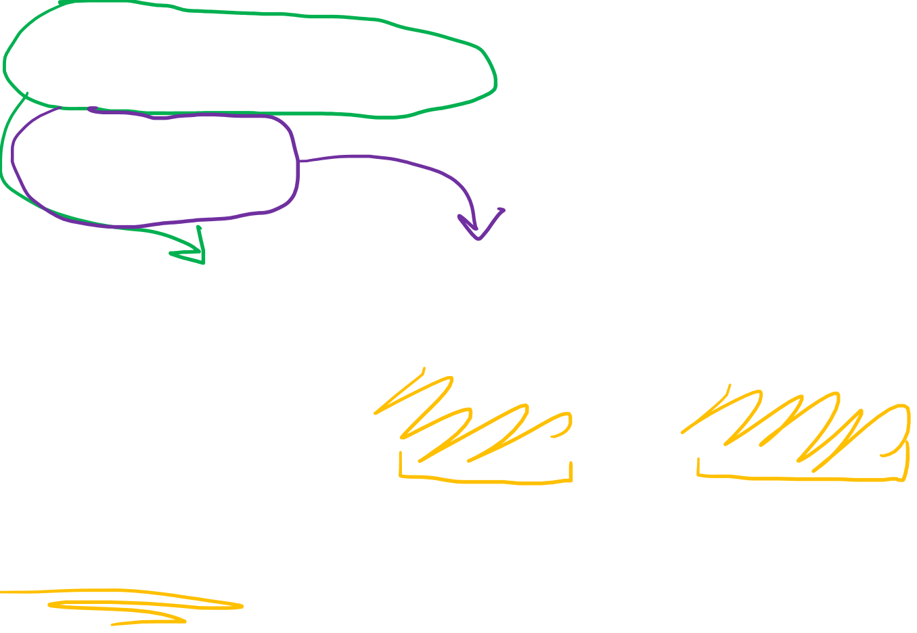
Basis: Man $→$ Car
Basis: Car $→$ Man
$$\tilde{\vec{e_{t}}}=\vec{e_{t}}+\text{½}\vec{e_{x}}$$
$$\tilde{\vec{e_{x}}}=\vec{e_{x}}$$
$$\vec{e_{t}}=\tilde{\vec{e_{t}}}−\text{½}\tilde{\vec{e_{x}}}$$
$$\vec{e_{x}}=\tilde{\vec{e_{x}}}$$
$$\vec{e_{t}}=\tilde{\vec{e_{t}}}−\text{½}\tilde{\vec{e_{x}}}$$
$$\vec{e_{t}}=\left(\vec{e_{t}}+\text{½}\vec{e_{x}}\right)−\text{½}\text{(}\vec{e_{x}}\text{)}$$
$$\vec{e_{t}}=\vec{e_{t}}$$
Notes:
We’ll start with the equation for eT in terms of the car’s spacetime basis. Then let’s replace eT-tilde and eX-tilde with the formulas from this box.
Notice that the positive ½ eX and negative ½ eX cancel out and we’re left with eT=eT.
So applying the Car-to-Man equations and then applying the Man-to-Car equations brings us back to where we started, since the equations are opposites.

Slide 23
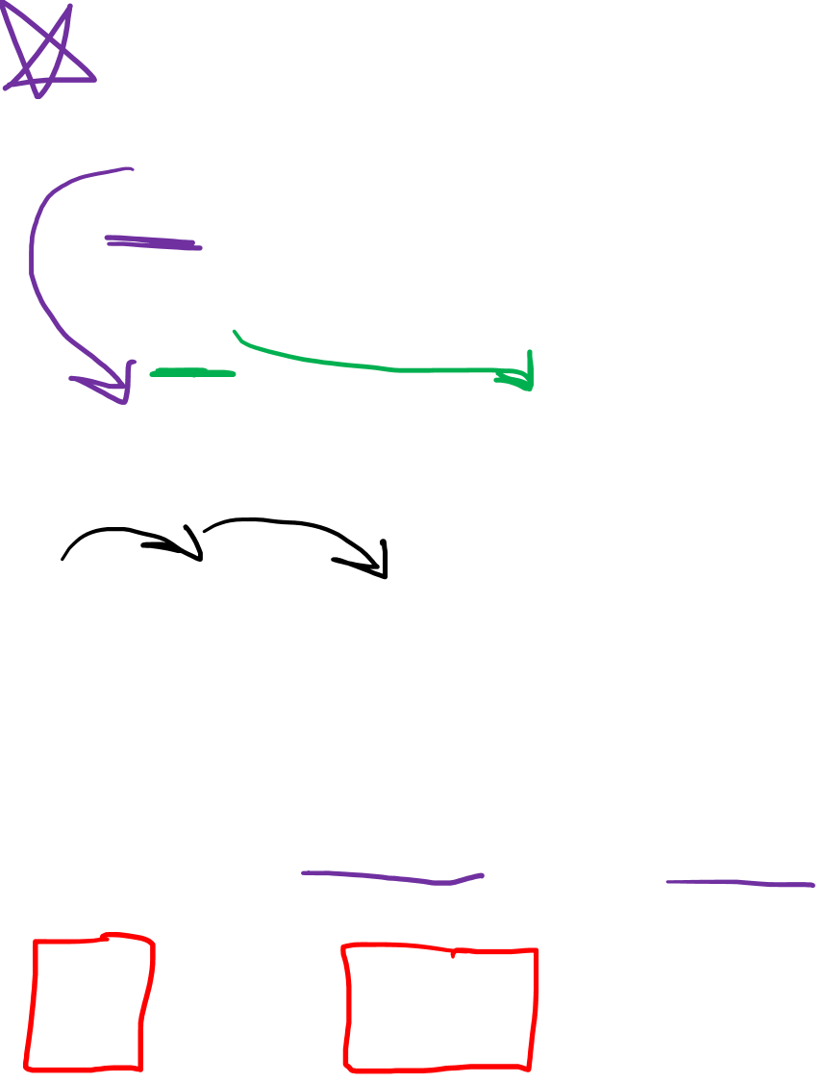
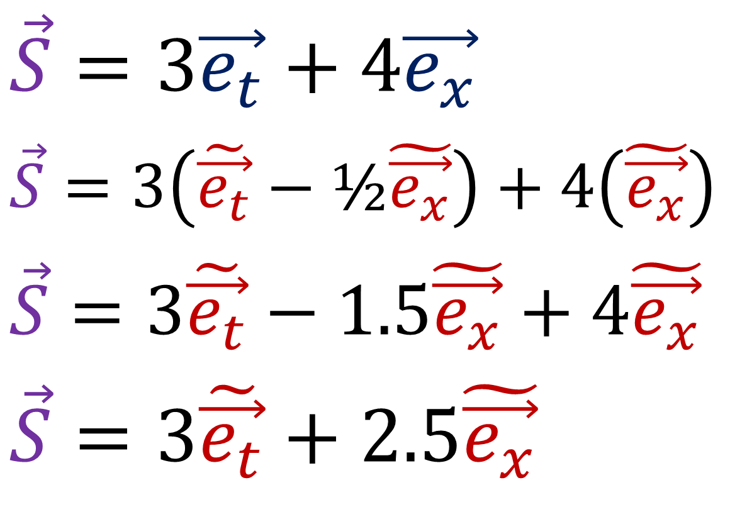



Basis: Man $→$ Car
Basis: Car $→$ Man
$$\tilde{\vec{e_{t}}}=\vec{e_{t}}+\text{½}\vec{e_{x}}$$
$$\tilde{\vec{e_{x}}}=\vec{e_{x}}$$
$$\vec{e_{t}}=\tilde{\vec{e_{t}}}−\text{½}\tilde{\vec{e_{x}}}$$
$$\vec{e_{x}}=\tilde{\vec{e_{x}}}$$
$$\vec{S}=3\vec{e_{t}}+4\vec{e_{x}}$$
$$\vec{S}=3\left(\tilde{\vec{e_{t}}}−\text{½}\tilde{\vec{e_{x}}}\right)+4\left(\tilde{\vec{e_{x}}}\right)$$
$$\vec{S}=3\tilde{\vec{e_{t}}}−1.5\tilde{\vec{e_{x}}}+4\tilde{\vec{e_{x}}}$$
$$\vec{S}=3\tilde{\vec{e_{t}}}+2.5\tilde{\vec{e_{x}}}$$
$$\vec{e_{t}}$$
$$\vec{S}$$
$$\vec{e_{x}}$$
Notes:
So we know this S vector is made up of 3 time vectors and 4 space vectors in Einstein’s frame. Now let’s use the change-of-basis equations to get the components from the Car’s frame. We can using substitution to replace eT and eX using these equations, containing eT-tilde and eX-tilde..
We can distribute the 3 here to get 3eT and -1.5 eX. And if we add -1.5 to 4, we get 2.5

Slide 24



Basis: Man $→$ Car
Basis: Car $→$ Man
$$\tilde{\vec{e_{t}}}=\vec{e_{t}}+\text{½}\vec{e_{x}}$$
$$\tilde{\vec{e_{x}}}=\vec{e_{x}}$$
$$\vec{e_{t}}=\tilde{\vec{e_{t}}}−\text{½}\tilde{\vec{e_{x}}}$$
$$\vec{e_{x}}=\tilde{\vec{e_{x}}}$$
$$\vec{S}=3\vec{e_{t}}+4\vec{e_{x}}$$
$$\vec{S}=3\left(\tilde{\vec{e_{t}}}−\text{½}\tilde{\vec{e_{x}}}\right)+4\left(\tilde{\vec{e_{x}}}\right)$$
$$\vec{S}=3\tilde{\vec{e_{t}}}−1.5\tilde{\vec{e_{x}}}+4\tilde{\vec{e_{x}}}$$
$$\vec{S}=3\tilde{\vec{e_{t}}}+2.5\tilde{\vec{e_{x}}}$$
$$\tilde{\vec{e_{t}}}$$
$$\vec{S}$$
$$\tilde{\vec{e_{x}}}$$
Notes:
So we can see the new components in the frame of the car are 3 time units and 2.5 space units, which matches up with our spacetime diagram. Now, we successfully changed coordinates in one specific case here… but we should try to get formulas that work in all cases for any vector.

Slide 25

Basis: Man $→$ Car
Basis: Car $→$ Man
$$\tilde{\vec{e_{t}}}=\vec{e_{t}}+\text{½}\vec{e_{x}}$$
$$\tilde{\vec{e_{x}}}=\vec{e_{x}}$$
$$\vec{e_{t}}=\tilde{\vec{e_{t}}}−\text{½}\tilde{\vec{e_{x}}}$$
$$\vec{e_{x}}=\tilde{\vec{e_{x}}}$$
Notes:
Let’s start with a generic vector S = t eT + x eX in Einstein’s reference frame. Then we’ll replace eX and eT using these change of basis equations. Then we distributed t here to get t eT-tilde – vt eT-tilde Then, since both of these are terms with the eX-tilde basis vector, we can re-write it as a single component, negative vt + x.

Slide 26




Basis: Man $→$ Car
Basis: Car $→$ Man
$$\tilde{\vec{e_{t}}}=\vec{e_{t}}+v\vec{e_{x}}$$
$$\tilde{\vec{e_{x}}}=\vec{e_{x}}$$
$$\vec{e_{t}}=\tilde{\vec{e_{t}}}−v\tilde{\vec{e_{x}}}$$
$$\vec{e_{x}}=\tilde{\vec{e_{x}}}$$
$$\vec{S}=t\vec{e_{t}}+x\vec{e_{x}}$$
$$\vec{S}=t\left(\tilde{\vec{e_{t}}}−v\tilde{\vec{e_{x}}}\right)+x\left(\tilde{\vec{e_{x}}}\right)$$
$$\vec{S}=t\tilde{\vec{e_{t}}}−vt\tilde{\vec{e_{x}}}+x\tilde{\vec{e_{x}}}$$
$$\vec{S}=t\tilde{\vec{e_{t}}}+\left(−vt+x\right)\tilde{\vec{e_{x}}}$$
Notes:
Let’s start with a generic vector S = t eT + x eX in Einstein’s reference frame. Then we’ll replace eX and eT using these change of basis equations. Then we distributed t here to get t eT-tilde – vt eT-tilde Then, since both of these are terms with the eX-tilde basis vector, we can re-write it as a single component, negative vt + x.

Slide 27




Basis: Man $→$ Car
Basis: Car $→$ Man
$$\tilde{\vec{e_{t}}}=\vec{e_{t}}+v\vec{e_{x}}$$
$$\tilde{\vec{e_{x}}}=\vec{e_{x}}$$
$$\vec{e_{t}}=\tilde{\vec{e_{t}}}−v\tilde{\vec{e_{x}}}$$
$$\vec{e_{x}}=\tilde{\vec{e_{x}}}$$
$$\vec{S}=t\vec{e_{t}}+x\vec{e_{x}}$$
$$\vec{S}=t\tilde{\vec{e_{t}}}+\left(−vt+x\right)\tilde{\vec{e_{x}}}$$
$$\vec{S}=\tilde{t}\tilde{\vec{e_{t}}}+ \tilde{x} \tilde{\vec{e_{x}}}$$
Components: Man $→$ Car
$$\tilde{t}=t$$
$$\tilde{x}=−vt+x$$
Notes:
Now notice this formula is written in terms of the car’s spacetime basis eT-tilde and eX-tilde
This means that these components are just equal to t-tilde, the time according to the car, and x-tilde, the position according to the car.

Slide 28


Basis: Man $→$ Car
Basis: Car $→$ Man
$$\tilde{\vec{e_{t}}}=\vec{e_{t}}+v\vec{e_{x}}$$
$$\tilde{\vec{e_{x}}}=\vec{e_{x}}$$
$$\vec{e_{t}}=\tilde{\vec{e_{t}}}−v\tilde{\vec{e_{x}}}$$
$$\vec{e_{x}}=\tilde{\vec{e_{x}}}$$
$$\vec{S}=\tilde{t}\tilde{\vec{e_{t}}}+\tilde{x}\tilde{\vec{e_{x}}}$$
$$\vec{S}=\tilde{t}\left(\vec{e_{t}}+v\vec{e_{x}}\right)+\tilde{x}\left(\vec{e_{x}}\right)$$
$$\vec{S}=\tilde{t}\vec{e_{t}}+v\tilde{t}\vec{e_{x}}+\tilde{x}\vec{e_{x}}$$
$$\vec{S}=\tilde{t}\vec{e_{t}}+\left(v\tilde{t}+\tilde{x}\right)\vec{e_{x}}$$
Components: Man $→$ Car
$$\tilde{t}=t$$
$$\tilde{x}=−vt+x$$
Notes:
We can also do the reverse and start with a vector in the car’s basis with components t-Tilde and x-Tilde, and then use these equations to replace the basis vectors eT-tilde and eX-tilde. We distribute the t-Tilde, and then since these terms both contain eX, we can combine them and write the component vt-tilde + x-tilde

Slide 29




Basis: Man $→$ Car
Basis: Car $→$ Man
$$\tilde{\vec{e_{t}}}=\vec{e_{t}}+v\vec{e_{x}}$$
$$\tilde{\vec{e_{x}}}=\vec{e_{x}}$$
$$\vec{e_{t}}=\tilde{\vec{e_{t}}}−v\tilde{\vec{e_{x}}}$$
$$\vec{e_{x}}=\tilde{\vec{e_{x}}}$$
$$\vec{S}=\tilde{t}\tilde{\vec{e_{t}}}+\tilde{x}\tilde{\vec{e_{x}}}$$
$$\vec{S}=\tilde{t}\vec{e_{t}}+\left(v\tilde{t}+\tilde{x}\right)\vec{e_{x}}$$
$$\vec{S}=t\vec{e_{t}}+ x \vec{e_{x}}$$
Components: Man $→$ Car
$$\tilde{t}=t$$
$$\tilde{x}=−vt+x$$
Components: Car $→$ Man
$$t=\tilde{t}$$
$$x=v\tilde{t}+\tilde{x}$$
Notes:
But since this is written in terms of Einstein’s spacetime basis, these components are really just t and X.
So we can write the equations t=t-tilde and x = vt-tilde + x-tilde

Slide 30




Basis: Man $→$ Car
Basis: Car $→$ Man
$$\tilde{\vec{e_{t}}}=\vec{e_{t}}+v\vec{e_{x}}$$
$$\tilde{\vec{e_{x}}}=\vec{e_{x}}$$
$$\vec{e_{t}}=\tilde{\vec{e_{t}}}−v\tilde{\vec{e_{x}}}$$
$$\vec{e_{x}}=\tilde{\vec{e_{x}}}$$
Components: Man $→$ Car
Components: Car $→$ Man
$$\tilde{t}=t$$
$$\tilde{x}=−vt+x$$
$$t=\tilde{t}$$
$$x=v\tilde{t}+\tilde{x}$$
$↑$ Galilean Transform $↑$
Notes:
So we’ve discovered these 4 sets of formulas, for changing between the basis vectors and vector components for the man an the car. And the Galilean transform is really all of these formula put together.
So I mentioned that the two formula for the basis vectors are opposites, because there’s a +v here and a –v here. This means that if we use one set of formulas, and then the other, we end up back where we started. The formulas for changing components are also opposites. There’s a –v here and a +v here, and you can check for yourself that if we use one set of formulas, and then the other, we end up back where we started with the original variables being equal to themselves. Now what might not be obvious is what the we have a +v here for changing the basis from the man to the car, and here we have a –ve for changing the components from the man to the car. And the reason for this is covariance and contravariance.

Slide 31
Covariant
Contravariant
$$\vec{e_{y}}$$
$$x=4$$
$$\vec{e_{x}}$$
$$y=3$$
Vector Basis (Measuring Sticks)
Vector Components
(Coordinates/Numbers)
Notes:
Remember that basis vectors are covariant. And vector components are contravariant, which means they do the opposite thing that basis vectors do.

Slide 32












Basis: Man $→$ Car
$$\tilde{\vec{e_{t}}}=\vec{e_{t}}+v\vec{e_{x}}$$
$$\tilde{\vec{e_{x}}}=\vec{e_{x}}$$
$$t=2$$
$$x=2$$
Components: Man $→$ Car
$$\tilde{t}=2$$
$$\tilde{x}=1$$
$$\tilde{t}=t$$
$$\tilde{x}=−vt+x$$
$$\vec{S}$$
$$\vec{e_{t}}$$
$$\tilde{\vec{e_{t}}}$$
$$\vec{e_{x}}$$
$$\tilde{\vec{e_{x}}}$$
Notes:
What’s happening is that this +v term here is pushing the eT-tilde basis vector to lean more in the positive horizontal direction, and that’s why it’s slanted. Meanwhile this –v is pushing the x-tilde components more in the negative direction. In Einstein’s frame the position component is 2, but in the car’s frame the position component has been pull towards the negative direction and is just 1… because this event is closer to the car’s worldine than Einstein’s worldine, the position component for the car is smaller.
So that’s why these sets of formulas are opposites. +V pushes the eT-tilde basis vector one way, and this –v pushes the x-tilde component in the opposite way.

Slide 33
Basis: Man $→$ Car
Basis: Car $→$ Man
$$\tilde{\vec{e_{t}}}=\vec{e_{t}}+v\vec{e_{x}}$$
$$\tilde{\vec{e_{x}}}=\vec{e_{x}}$$
$$\vec{e_{t}}=\tilde{\vec{e_{t}}}−v\tilde{\vec{e_{x}}}$$
$$\vec{e_{x}}=\tilde{\vec{e_{x}}}$$
Components: Man $→$ Car
Components: Car $→$ Man
$$\tilde{t}=t$$
$$\tilde{x}=−vt+x$$
$$t=\tilde{t}$$
$$x=v\tilde{t}+\tilde{x}$$
Matrix/Array notation makes this much easier to understand!
Notes:
So this stuff I’ve explained in this video about opposite formulas and covariance and contravariance might seam hard to understand right now. But it will all become much easier to understand if we write these equations in matrix array notation.

Slide 34



Basis: Man $→$ Car
$$\tilde{\vec{e_{t}}}=1\vec{e_{t}}+v\vec{e_{x}}$$
$$\tilde{\vec{e_{x}}}=0\vec{e_{t}}+1\vec{e_{x}}$$
$$\left[\tilde{\vec{e_{t}}} \tilde{\vec{e_{x}}}\right]=\left[\vec{e_{t}} \vec{e_{x}}\right]\left[\begin{matrix}1 & 0 \\ v & 1\end{matrix}\right]$$
Galilean Matrix

Slide 35





Basis: Man $→$ Car
$$\tilde{\vec{e_{t}}}=1\vec{e_{t}}+v\vec{e_{x}}$$
$$\tilde{\vec{e_{x}}}=0\vec{e_{t}}+1\vec{e_{x}}$$
$$\left[\tilde{\vec{e_{t}}} \tilde{\vec{e_{x}}}\right]=\left[\vec{e_{t}} \vec{e_{x}}\right]\left[\begin{matrix}1 & 0 \\ v & 1\end{matrix}\right]$$
Galilean Matrix
Components: Man $→$ Car
$$\tilde{t}= 1t+0x$$
$$\tilde{x}=−vt+1x$$
$$\left[\begin{aligned}\tilde{t} \\ \tilde{x}\end{aligned}\right]=\left[\begin{matrix}1 & 0 \\ −v & 1\end{matrix}\right]\left[\begin{aligned}t \\ x\end{aligned}\right]$$
Galilean Matrix
$\left[\begin{matrix}1 & 0 \\ v & 1\end{matrix}\right]$ and $\left[\begin{matrix}1 & 0 \\ −v & 1\end{matrix}\right]$ are inverses!
$$\left[\begin{matrix}1 & 0 \\ v & 1\end{matrix}\right]\left[\begin{matrix}1 & 0 \\ −v & 1\end{matrix}\right]=\left[\begin{matrix}1 & 0 \\ 0 & 1\end{matrix}\right]$$

Slide 36





$\left[\begin{matrix}1 & 0 \\ v & 1\end{matrix}\right]$ and $\left[\begin{matrix}1 & 0 \\ −v & 1\end{matrix}\right]$ are inverses!
$$\left[\begin{matrix} 1 & 0 \\ −v & 1\end{matrix}\right]$$
$$\left[\begin{matrix} 1 & 0 \\ v & 1\end{matrix}\right]$$
$$\left[\begin{matrix} 1 & 0 \\ −v & 1\end{matrix}\right]$$

Slide 37




$$\left[\tilde{\vec{e_{t}}} \tilde{\vec{e_{x}}}\right]=\left[\vec{e_{t}} \vec{e_{x}}\right]\left[\begin{matrix}1 & 0 \\ v & 1\end{matrix}\right]$$
$$\left[\begin{aligned}\tilde{t} \\ \tilde{x}\end{aligned}\right]=\left[\begin{matrix}1 & 0 \\ −v & 1\end{matrix}\right]\left[\begin{aligned}t \\ x\end{aligned}\right]$$
$$\vec{S} =t\vec{e_{t}} +x\vec{e_{x}}= \left[\vec{e_{t}} \vec{e_{x}}\right]\left[\begin{aligned}t \\ x\end{aligned}\right]$$
$=\left[\vec{e_{t}} \vec{e_{x}}\right]\left[\begin{matrix}1 & 0 \\ 0 & 1\end{matrix}\right]\left[\begin{aligned}t \\ x\end{aligned}\right]$
$=\left[\vec{e_{t}} \vec{e_{x}}\right]\left[\begin{matrix}1 & 0 \\ v & 1\end{matrix}\right]\left[\begin{matrix}1 & 0 \\ −v & 1\end{matrix}\right]\left[\begin{aligned}t \\ x\end{aligned}\right]$
$$=\tilde{t}\tilde{\vec{e_{t}}}+\tilde{x}\tilde{\vec{e_{x}}}= \left[\tilde{\vec{e_{t}}} \tilde{\vec{e_{x}}}\right] \left[\begin{aligned}\tilde{t} \\ \tilde{x}\end{aligned}\right]$$

Slide 38




Basis: Man $→$ Car
Basis: Car $→$ Man
$$\tilde{\vec{e_{t}}}=1\vec{e_{t}}+v\vec{e_{x}}$$
$$\tilde{\vec{e_{x}}}=0\vec{e_{t}}+1\vec{e_{x}}$$
$$\vec{e_{t}}=1\tilde{\vec{e_{t}}}−v\tilde{\vec{e_{x}}}$$
$$\vec{e_{x}}=0\tilde{\vec{e_{t}}}+1\tilde{\vec{e_{x}}}$$
Components: Man $→$ Car
Components: Car $→$ Man
$$\tilde{t}= 1t+0x$$
$$\tilde{x}=−vt+1x$$
$$t= 1\tilde{t}+0\tilde{x}$$
$$x=v\tilde{t}+1\tilde{x}$$

Slide 39




Basis: Man $→$ Car
Basis: Car $→$ Man
$$\left[\tilde{\vec{e_{t}}} \tilde{\vec{e_{x}}}\right]=\left[\vec{e_{t}} \vec{e_{x}}\right]\left[\begin{matrix}1 & 0 \\ v & 1\end{matrix}\right]$$
$$\vec{e_{t}}=1\tilde{\vec{e_{t}}}−v\tilde{\vec{e_{x}}}$$
$$\vec{e_{x}}=0\tilde{\vec{e_{t}}}+1\tilde{\vec{e_{x}}}$$
Components: Man $→$ Car
Components: Car $→$ Man
$$\left[\begin{aligned}\tilde{t} \\ \tilde{x}\end{aligned}\right]=\left[\begin{matrix}1 & 0 \\ −v & 1\end{matrix}\right]\left[\begin{aligned}t \\ x\end{aligned}\right]$$
$$t= 1\tilde{t}+0\tilde{x}$$
$$x=v\tilde{t}+1\tilde{x}$$

Slide 40



Basis: Car $→$ Man
$$\vec{e_{t}}=1\tilde{\vec{e_{t}}}−v\tilde{\vec{e_{x}}}$$
$$\vec{e_{x}}=0\tilde{\vec{e_{t}}}+1\tilde{\vec{e_{x}}}$$
$$\left[\vec{e_{t}} \vec{e_{x}}\right]=\left[\tilde{\vec{e_{t}}} \tilde{\vec{e_{x}}}\right]\left[\begin{matrix}1 & 0 \\ −v & 1\end{matrix}\right]$$
Galilean Matrix
Components: Car $→$ Man
$$\left[\begin{aligned}t \\ x\end{aligned}\right]=\left[\begin{matrix}1 & 0 \\ v & 1\end{matrix}\right]\left[\begin{aligned}\tilde{t} \\ \tilde{x}\end{aligned}\right]$$
$$t= 1\tilde{t}+0\tilde{x}$$
$$x=v\tilde{t}+1\tilde{x}$$
Galilean Matrix

Slide 41
Basis: Man $→$ Car
Basis: Car $→$ Man
$$\left[\tilde{\vec{e_{t}}} \tilde{\vec{e_{x}}}\right]=\left[\vec{e_{t}} \vec{e_{x}}\right]\left[\begin{matrix}1 & 0 \\ v & 1\end{matrix}\right]$$
$$\vec{e_{t}}=1\tilde{\vec{e_{t}}}−v\tilde{\vec{e_{x}}}$$
$$\vec{e_{x}}=0\tilde{\vec{e_{t}}}+1\tilde{\vec{e_{x}}}$$
Components: Man $→$ Car
Components: Car $→$ Man
$$\left[\begin{aligned}\tilde{t} \\ \tilde{x}\end{aligned}\right]=\left[\begin{matrix}1 & 0 \\ −v & 1\end{matrix}\right]\left[\begin{aligned}t \\ x\end{aligned}\right]$$
$$t= 1\tilde{t}+0\tilde{x}$$
$$x=v\tilde{t}+1\tilde{x}$$

Slide 42




Basis: Man $→$ Car
Basis: Car $→$ Man
$$\left[\tilde{\vec{e_{t}}} \tilde{\vec{e_{x}}}\right]=\left[\vec{e_{t}} \vec{e_{x}}\right]\left[\begin{matrix}1 & 0 \\ v & 1\end{matrix}\right]$$
$$\left[\vec{e_{t}} \vec{e_{x}}\right]=\left[\tilde{\vec{e_{t}}} \tilde{\vec{e_{x}}}\right]\left[\begin{matrix}1 & 0 \\ −v & 1\end{matrix}\right]$$
Components: Man $→$ Car
Components: Car $→$ Man
$$\left[\begin{aligned}\tilde{t} \\ \tilde{x}\end{aligned}\right]=\left[\begin{matrix}1 & 0 \\ −v & 1\end{matrix}\right]\left[\begin{aligned}t \\ x\end{aligned}\right]$$
$$\left[\begin{aligned}t \\ x\end{aligned}\right]=\left[\begin{matrix}1 & 0 \\ v & 1\end{matrix}\right]\left[\begin{aligned}\tilde{t} \\ \tilde{x}\end{aligned}\right]$$

Slide 43




Galilean Transform (summary)
Change-of-Basis equation and Change-of-Component equation use inverse Galilean matrices because of covariance and contravariance
When basis vectors do one thing, the vector components do the opposite thing
Basis Change
Basis Change (reverse)
$$\left[\tilde{\vec{e_{t}}} \tilde{\vec{e_{x}}}\right]=\left[\vec{e_{t}} \vec{e_{x}}\right]\left[\begin{matrix}1 & 0 \\ v & 1\end{matrix}\right]$$
$$\left[\vec{e_{t}} \vec{e_{x}}\right]=\left[\tilde{\vec{e_{t}}} \tilde{\vec{e_{x}}}\right]\left[\begin{matrix}1 & 0 \\ −v & 1\end{matrix}\right]$$
inverse matrix
inverse matrix
Components Change
Components Change (reverse)
$$\left[\begin{aligned}\tilde{t} \\ \tilde{x}\end{aligned}\right]=\left[\begin{matrix}1 & 0 \\ −v & 1\end{matrix}\right]\left[\begin{aligned}t \\ x\end{aligned}\right]$$
$$\left[\begin{aligned}t \\ x\end{aligned}\right]=\left[\begin{matrix}1 & 0 \\ v & 1\end{matrix}\right]\left[\begin{aligned}\tilde{t} \\ \tilde{x}\end{aligned}\right]$$

Slide 44


Galilean Transform (summary)
$$\vec{S} =t\vec{e_{t}} +x\vec{e_{x}}= \left[\vec{e_{t}} \vec{e_{x}}\right]\left[\begin{aligned}t \\ x\end{aligned}\right]$$
$=\left[\vec{e_{t}} \vec{e_{x}}\right]\left[\begin{matrix}1 & 0 \\ 0 & 1\end{matrix}\right]\left[\begin{aligned}t \\ x\end{aligned}\right]$
$=\left[\vec{e_{t}} \vec{e_{x}}\right]\left[\begin{matrix}1 & 0 \\ v & 1\end{matrix}\right]\left[\begin{matrix}1 & 0 \\ −v & 1\end{matrix}\right]\left[\begin{aligned}t \\ x\end{aligned}\right]$
$$=\tilde{t}\tilde{\vec{e_{t}}}+\tilde{x}\tilde{\vec{e_{x}}}= \left[\tilde{\vec{e_{t}}} \tilde{\vec{e_{x}}}\right] \left[\begin{aligned}\tilde{t} \\ \tilde{x}\end{aligned}\right]$$
Opposite changes (Galilean Matrices) will balance out

Slide 45





Change-of-Basis equations use inverse Galilean matrices
If we use one, then the other, we end up back where we started
Basis vectors are covariant, so write them as rows and place on the left
inverse matrix
Basis Change
Basis Change (reverse)
$$\left[\tilde{\vec{e_{t}}} \tilde{\vec{e_{x}}}\right]=\left[\vec{e_{t}} \vec{e_{x}}\right]\left[\begin{matrix}1 & 0 \\ v & 1\end{matrix}\right]$$
$$\left[\vec{e_{t}} \vec{e_{x}}\right]=\left[\tilde{\vec{e_{t}}} \tilde{\vec{e_{x}}}\right]\left[\begin{matrix}1 & 0 \\ −v & 1\end{matrix}\right]$$
Change-of-Component equations use inverse Galilean matrices
If we use one, then the other, we end up back where we started
Vector components are contravariant, write as columns and place on the right
inverse matrix
Components Change
Components Change (reverse)
$$\left[\begin{aligned}\tilde{t} \\ \tilde{x}\end{aligned}\right]=\left[\begin{matrix}1 & 0 \\ −v & 1\end{matrix}\right]\left[\begin{aligned}t \\ x\end{aligned}\right]$$
$$\left[\begin{aligned}t \\ x\end{aligned}\right]=\left[\begin{matrix}1 & 0 \\ v & 1\end{matrix}\right]\left[\begin{aligned}\tilde{t} \\ \tilde{x}\end{aligned}\right]$$

Slide 46


$$\left[\begin{matrix}1 & 0 \\ v & 1\end{matrix}\right]$$
$→$ $\left[\vec{e_{t}} \vec{e_{x}}\right]\left[\begin{matrix}1 & 0 \\ v & 1\end{matrix}\right]\left[\begin{matrix}1 & 0 \\ −v & 1\end{matrix}\right]\left[\begin{aligned}t \\ x\end{aligned}\right]$
Galilean Matrix
inverse matrix
Basis Change
Basis Change (reverse)
$$\left[\tilde{\vec{e_{t}}} \tilde{\vec{e_{x}}}\right]=\left[\vec{e_{t}} \vec{e_{x}}\right]\left[\begin{matrix}1 & 0 \\ v & 1\end{matrix}\right]$$
$$\left[\vec{e_{t}} \vec{e_{x}}\right]=\left[\tilde{\vec{e_{t}}} \tilde{\vec{e_{x}}}\right]\left[\begin{matrix}1 & 0 \\ −v & 1\end{matrix}\right]$$
inverse matrix
inverse matrix
inverse matrix
Components Change
Components Change (reverse)
$$\left[\begin{aligned}\tilde{t} \\ \tilde{x}\end{aligned}\right]=\left[\begin{matrix}1 & 0 \\ −v & 1\end{matrix}\right]\left[\begin{aligned}t \\ x\end{aligned}\right]$$
$$\left[\begin{aligned}t \\ x\end{aligned}\right]=\left[\begin{matrix}1 & 0 \\ v & 1\end{matrix}\right]\left[\begin{aligned}\tilde{t} \\ \tilde{x}\end{aligned}\right]$$

Slide 47
Relativity 103: Galilean Relativity
Spacetime Diagrams
Spacetime Separation Vector
Galilean Transform (change of basis)
Metric Tensor (Euclidean)
Notes:
Welcome back to Relativity 103, Galilean Relativity. going to move onto the Galilean Transform, which is how we change our basis in Spacetime Diagrams for Galilean relativity.

