Slide 1
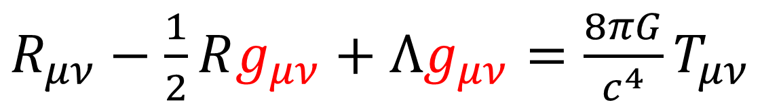
Relativity 103: Galilean Relativity
Spacetime Diagrams
Spacetime Separation Vector
Galilean Transform
Metric Tensor (Euclidean)
black holes
expansion of universe
gravitational waves
…more!
$R_{μν}−\frac{1}{2}Rg_{μν}+Λg_{μν}=\frac{8πG}{c^{4}}T_{μν}$
(Einstein Field Equations)
Notes:
Welcome to the final topic in Relativity 103: Galilean Relativity. We’re going to discuss the Euclidean metric tensor, which is a mathematical tool used for measuring distances. Much later in this video series, we’ll discover that the metric tensor is responsible for black holes, the expansion of the universe, gravitational waves, and more. You can see the metric tensor in here in the Einstein field equations, denoted by a lower-case g. We’re still far away from understanding these equations, but this video will give you your first step to understanding the metric tensor.

Slide 2


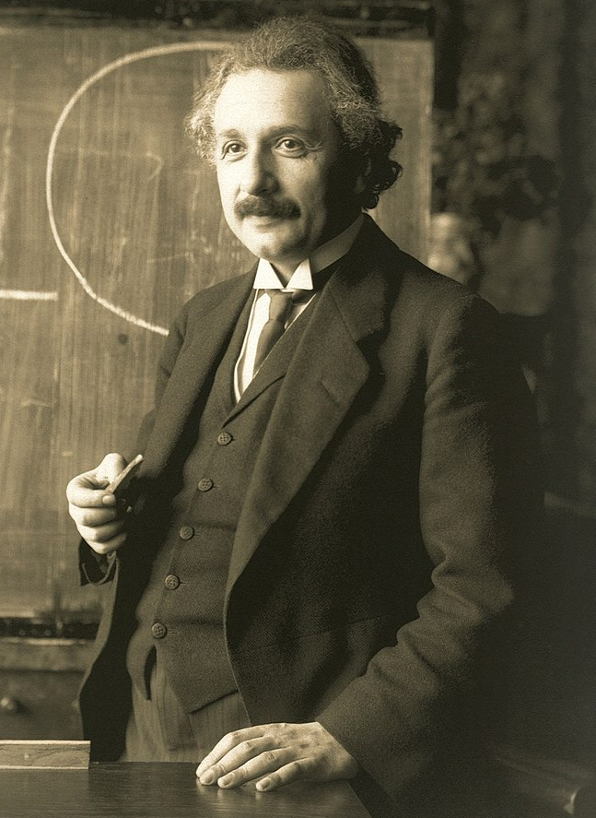

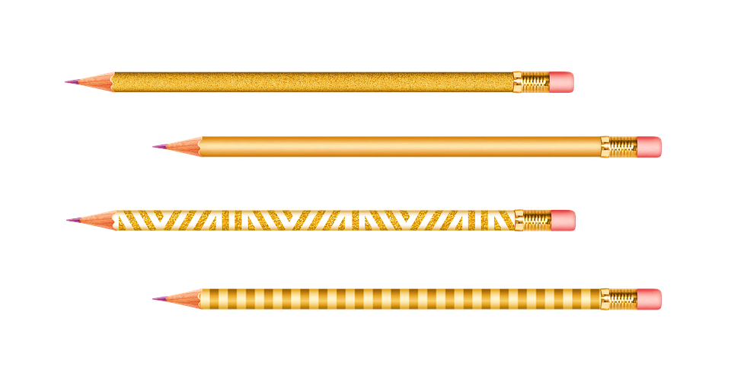


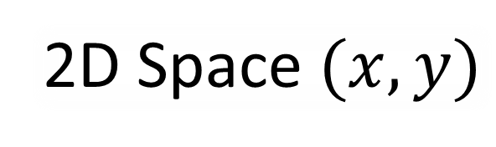
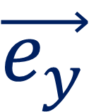
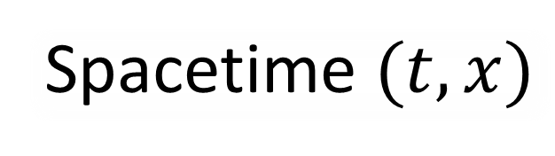
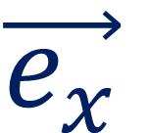
Metric = measure distance
time $t$
$$\vec{e_{y}}$$
position $x$
2D Space $(x,y)$
Spacetime $(t,x)$
$$\vec{e_{x}}$$
Galilean Relativity doesn’t have a “spacetime distance”.
Deal with 2D space for now.
Notes:
As I said, a metric is a mathematical tool for measuring distances. So far in relativity 103, we’ve been talking a lot about spacetime diagrams, where we measure both space and time. In Galilean relativity, there isn’t a sensible way to define a spacetime distance… so in this video we’re going to focus on measuring distances in 2D space, measured with the X and Y variables.

Slide 3


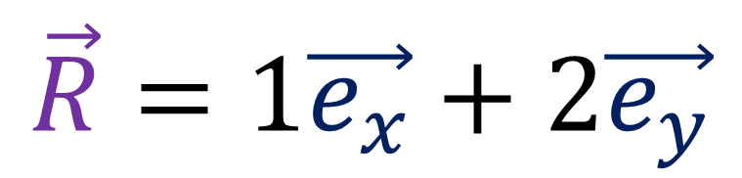

$$\vec{R}$$
$$\vec{e_{y}}$$
$$\vec{e_{x}}$$
$$\vec{R}=1\vec{e_{x}}+2\vec{e_{y}}$$
Notes:
Let’s say we have this pencil sitting in the 2D plane and we want to find out how long it is. We can think of this pencil as a vector R which is equal to 1eX + 2eY. You’ll notice that this pencil forms the longest side of a right-angle triangle, where the other two sides are parallel to the eX and eY vectors.

Slide 4
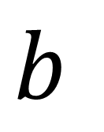
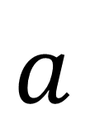

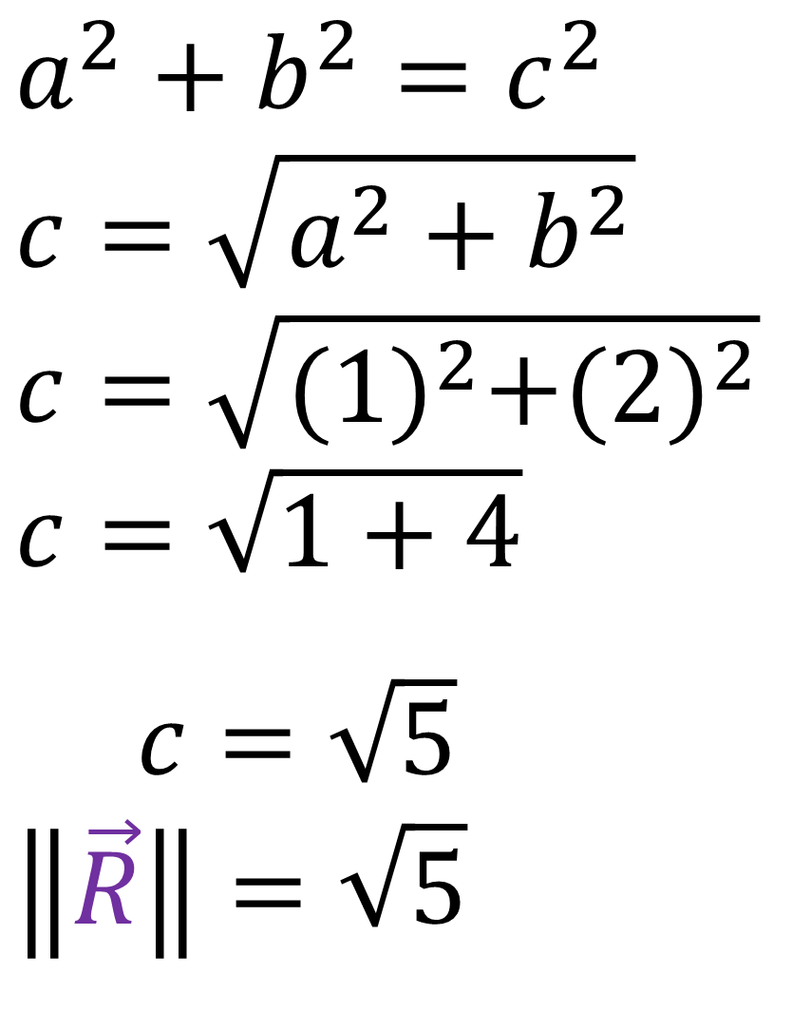
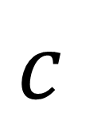
$$\vec{R}$$
$$a^{2}+b^{2}=c^{2}$$
$$c=\sqrt{a^{2}+b^{2}}$$
$$c=\sqrt{{(1)}^{2}+{(2)}^{2}}$$
$$c=\sqrt{1+4}$$
$c=\sqrt{5}$
$$\left\|\vec{R}\right\|=\sqrt{5}$$
$$\vec{e_{y}}$$
$$c$$
$$b$$
$$\vec{e_{x}}$$
$$a$$
$$\vec{R}=1\vec{e_{x}}+2\vec{e_{y}}$$
Notes:
If we label the lengths shorter sides of the triangle as “a” and “b”, and label the longest side length ass “c”, since this is a right angle triangle, we can use Pythagoras’s theorem and write down the equation a^2 + b^2 = c^2.
This means that the length of the pencil c = the square root of a^2 + b^2.
“a” is just the horizontal component of the Vector, 1
And “b” is just the vertical component of the vector, 2
1-squared is 1 and 2-squared is 4, so this means c = the square root of 5. Which is also the length of the vector R.

Slide 5

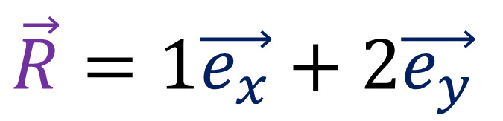
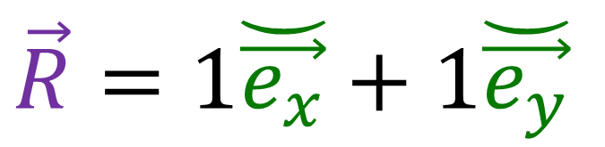
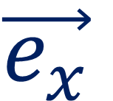

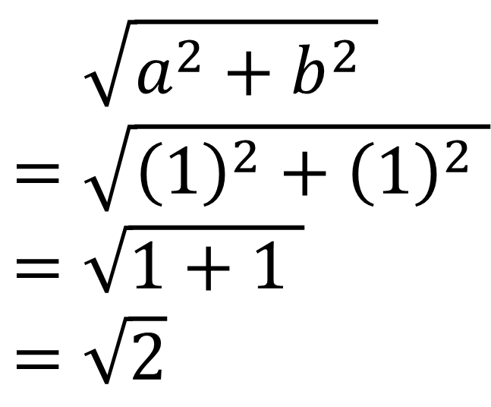
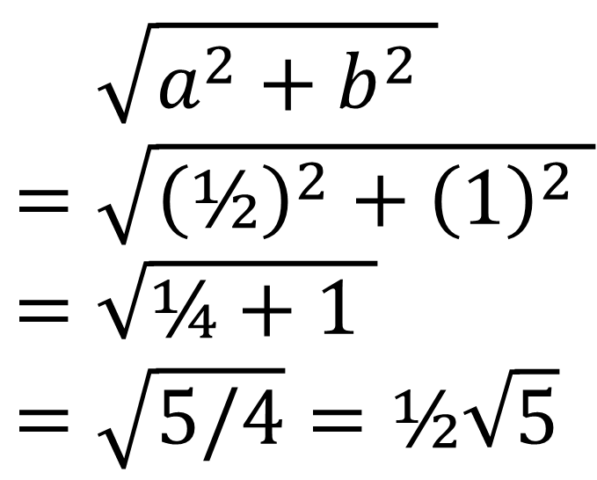
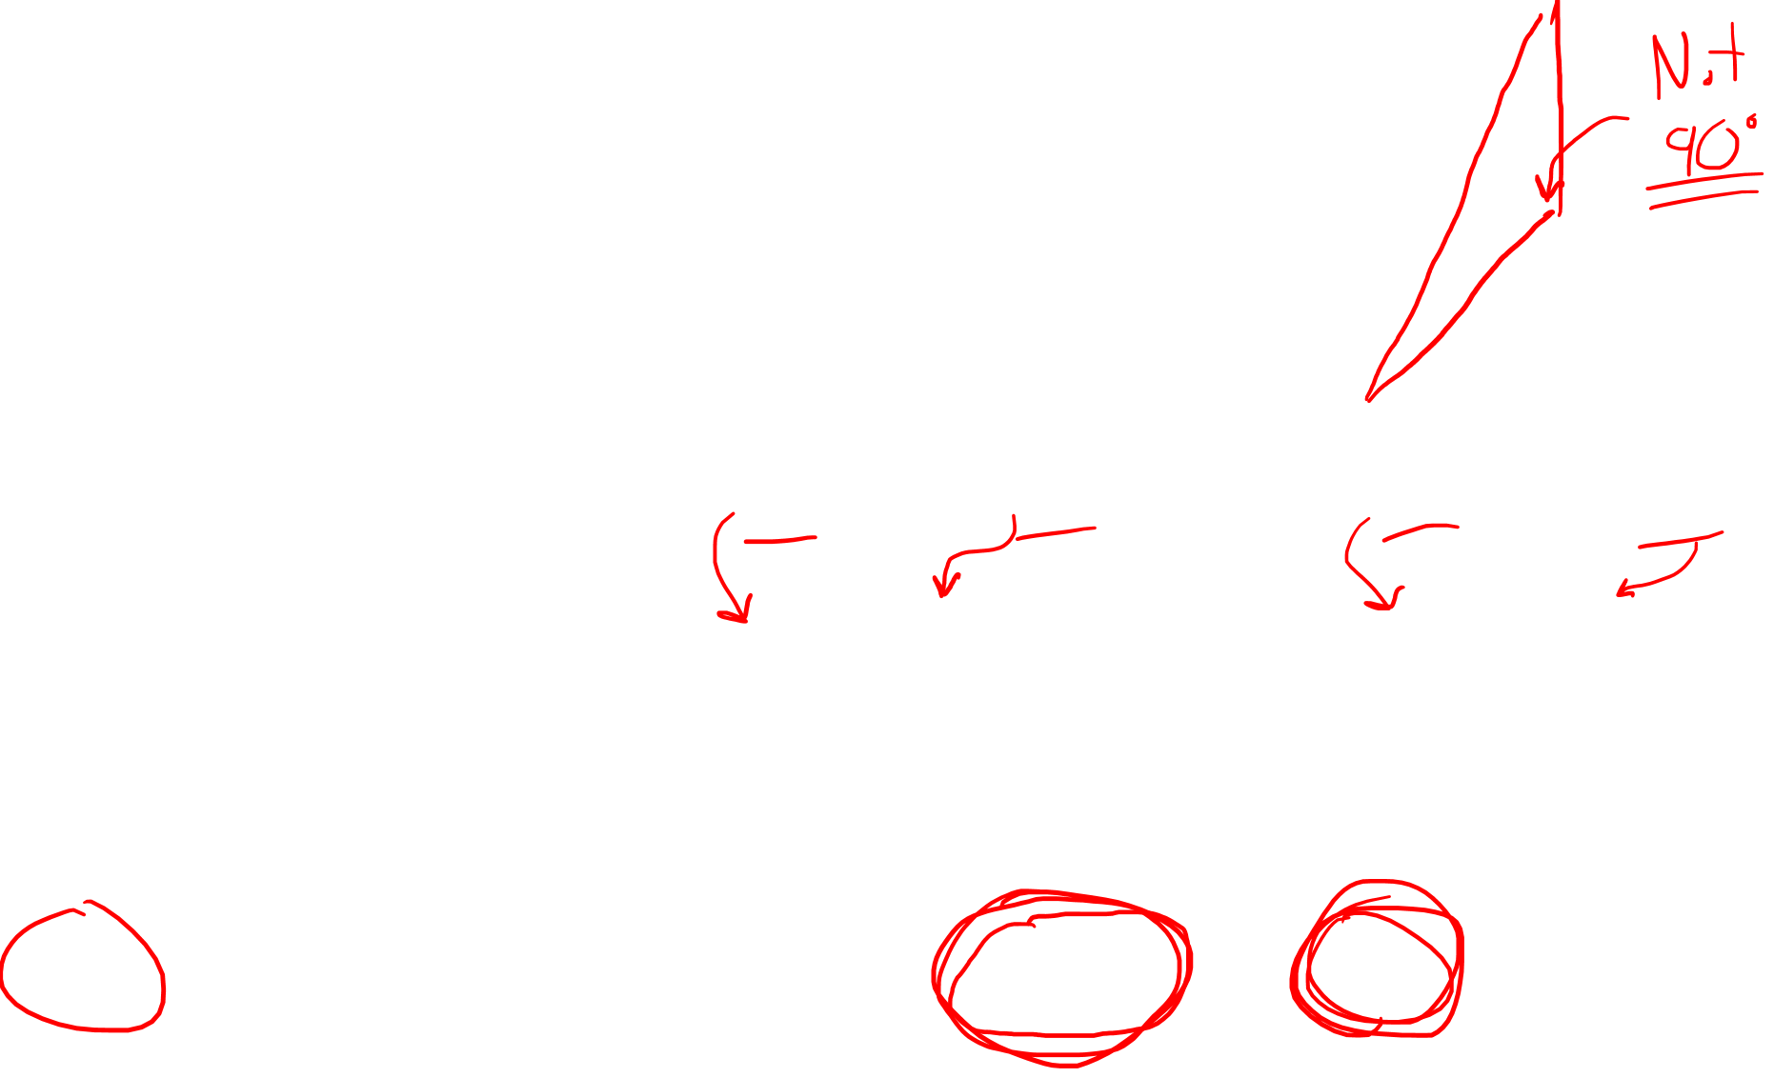

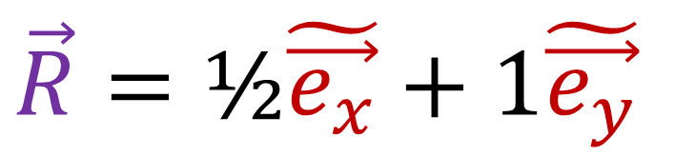



$$\breve{\vec{e_{y}}}$$
$$\vec{e_{y}}$$
$$\tilde{\vec{e_{y}}}$$
$$\tilde{\vec{e_{x}}}$$
$$\breve{\vec{e_{x}}}$$
$$\vec{e_{x}}$$
$$\vec{R}=1\vec{e_{x}}+2\vec{e_{y}}$$
$$\vec{R}=\text{½}\tilde{\vec{e_{x}}}+1\tilde{\vec{e_{y}}}$$
$$\vec{R}=\text{1}\breve{\vec{e_{x}}}+1\breve{\vec{e_{y}}}$$
$$=\sqrt{a^{2}+b^{2} }$$
$$=\sqrt{{\left(1\right)}^{2}+{\left(2\right)}^{2} }$$
$$=\sqrt{1+4 }$$
$$=\sqrt{5}$$
$$=\sqrt{a^{2}+b^{2} }$$
$$=\sqrt{{\left(\text{½}\right)}^{2}+{\left(1\right)}^{2} }$$
$$=\sqrt{\text{¼}+1 }$$
$$=\sqrt{5/4}=\text{½}\sqrt{5}$$
$$=\sqrt{a^{2}+b^{2} }$$
$$=\sqrt{{\left(\text{1}\right)}^{2}+{\left(1\right)}^{2} }$$
$$=\sqrt{1+1 }$$
$$=\sqrt{2}$$
Notes:
So we calculated the length of the pencil to be the square root of 5. But let’s try calculating the length of the pencil in another basis, like eX-tilde and eY-tilde where the basis vectors are twice as long. The components of the vector are ½ and 1, and if we plug these values into “a” and “b” in the Pythagoras’s Theorem formula, we get ½-square + 1-square, which is the square root of ¼ + 1, or the square root of 5/4, or one half the square root of 5. So we can see this answer doesn’t match the first answer we got.
If we use this other basis, where the components are 1 and 1, subbing into “a” and “b”, we get the square root of 2. This formula from Pythagoras’s theorem gives us different answers when we use different basis vectors. In this case the answer is half as big as it should be. And in this case, the triangle formed by the pencil and the basis vectors isn’t even a right-angle triangle.. so the Pythagoras formula gives us a very weird answer.

Slide 6


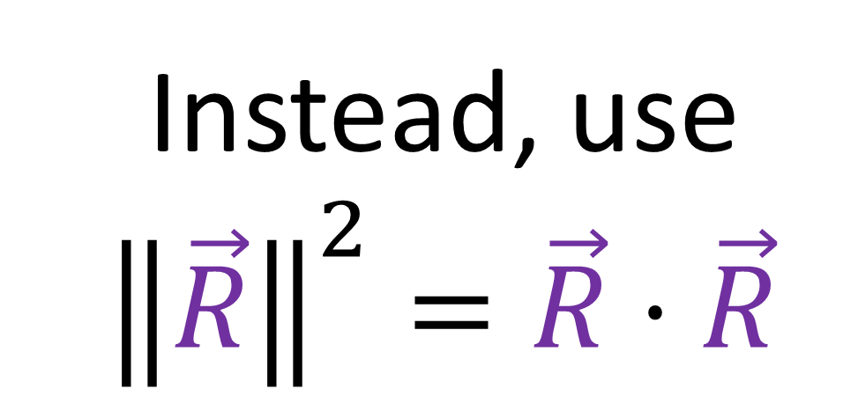
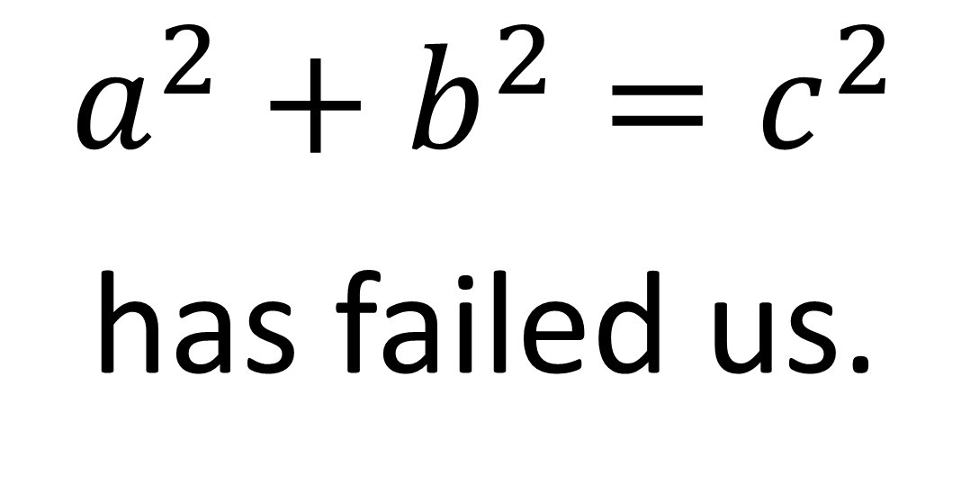
$$a^{2}+b^{2}=c^{2}$$
has failed us.
Instead, use $${\left\|\vec{R}\right\|}^{2}=\vec{R}⋅\vec{R}$$
Notes:
So the formula a^2 + b^2 = c^2 has failed us. We need a better way to measure lengths. And the solution is to calculate the squared magnitude of a vector R using the dot product of R with itself.
So let’s start with our first basis and try and use this formula.

Slide 7
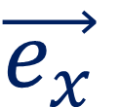
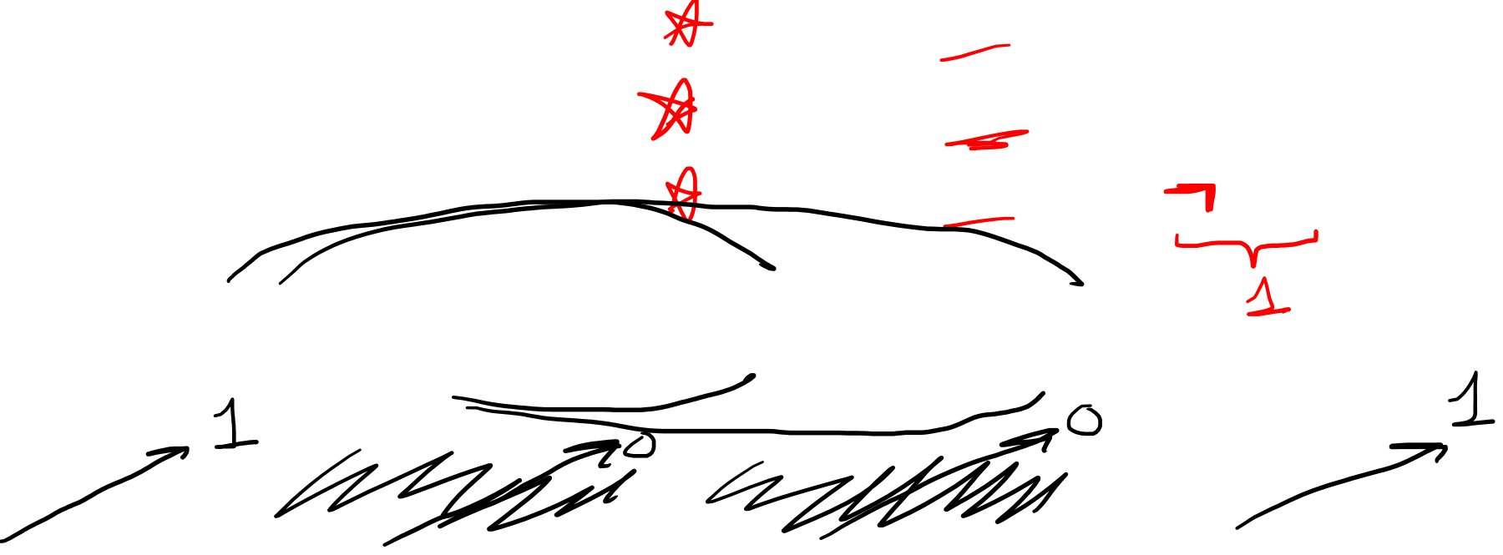
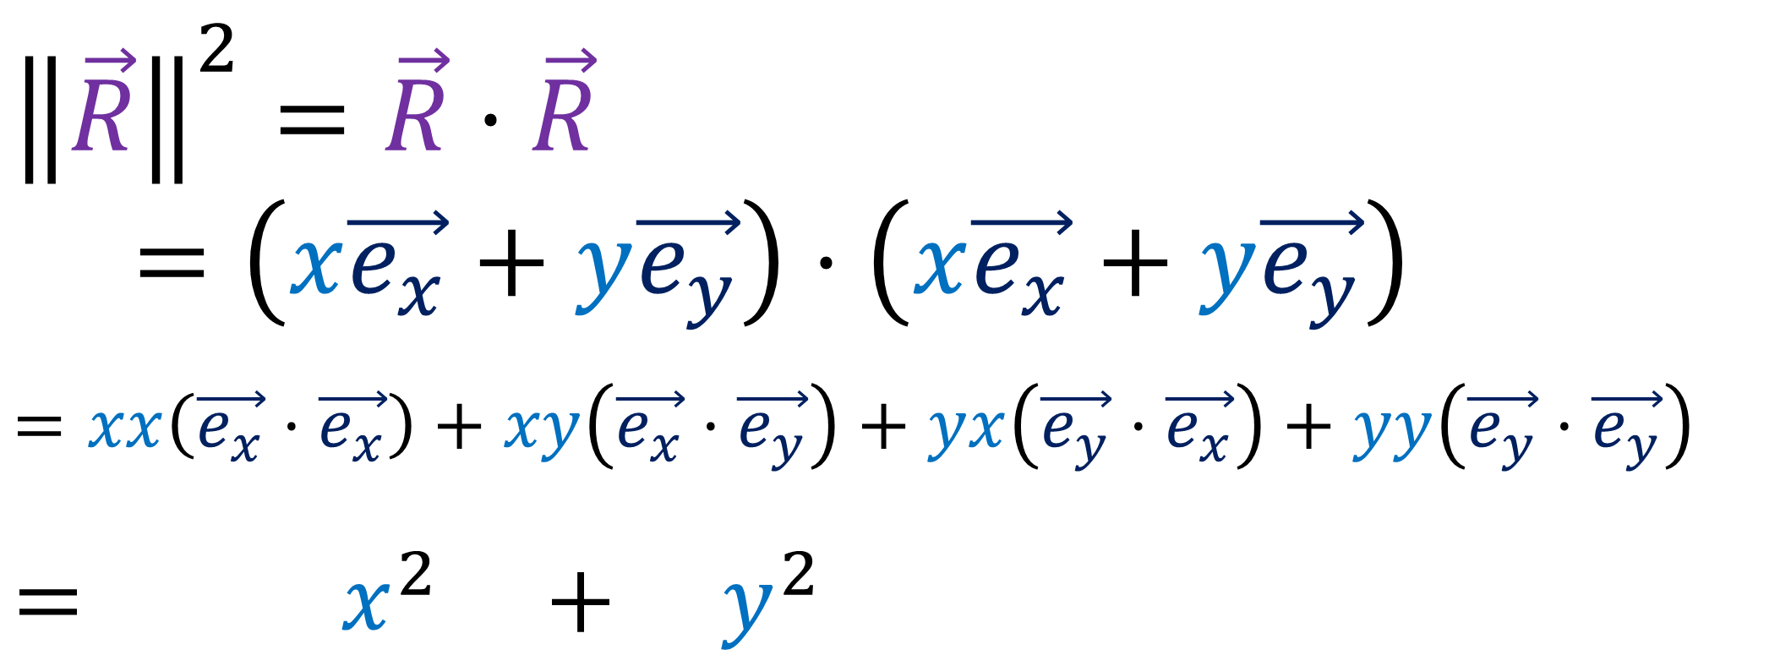
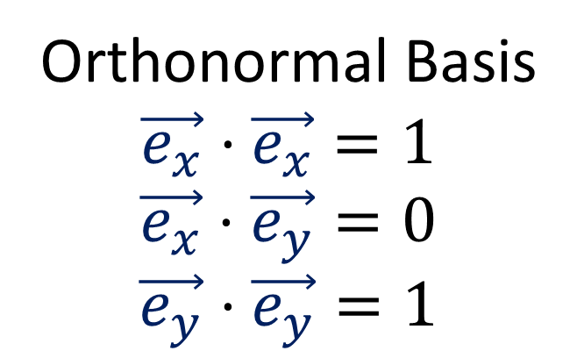
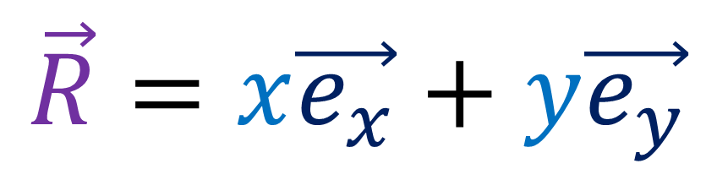

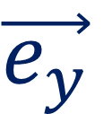
$$\vec{R}=x\vec{e_{x}}+y\vec{e_{y}}$$
Orthonormal Basis
$$\vec{e_{x}}⋅\vec{e_{x}}=1$$
$$\vec{e_{x}}⋅\vec{e_{y}}=0$$
$$\vec{e_{y}}⋅\vec{e_{y}}=1$$
$$\vec{e_{y}}$$
$${\left\|\vec{R}\right\|}^{2}=\vec{R}⋅\vec{R}$$
$=\left(x\vec{e_{x}}+y\vec{e_{y}}\right)⋅\left(x\vec{e_{x}}+y\vec{e_{y}}\right)$
$$=xx\left(\vec{e_{x}}⋅\vec{e_{x}}\right)+xy\left(\vec{e_{x}}⋅\vec{e_{y}}\right)+yx\left(\vec{e_{y}}⋅\vec{e_{x}}\right)+yy\left(\vec{e_{y}}⋅\vec{e_{y}}\right)$$
$$= x^{2} + y^{2}$$
$$\vec{e_{x}}$$
Pythagorean Theorem
$${\left\|\vec{R}\right\|}^{2}=x^{2}+y^{2}$$
$$c^{2}=a^{2}+b^{2}$$
Notes:
eX and eY form an orthonormal basis, meaning the vectors are perpendicular to each other and have length 1.
This means that eX dot eX and eY dot eY are both 1 since they have length 1, and eX dot eY is zero since they are orthogonal.
So given some generic vector R = x eX + y Ey, let’s compute the squared magnitude of R using R-dot-R.
This is just x Ex + y Ey dotted with itself. We can use the rule for distributing, first, outer, inner, last, to get these for terms with basis vector dot product. The eX-dot-eY term goes to zero, and so does the eY-dot-eX term, since the order of the dot product doesn’t matter. Also, eX-dot-eX is 1, and so is eY-dot-eY.
So we end up with the formula x^2 + y^2, which is very similar to the familiar equation from the Pythagorean Theorem, c^2 = a^2 + b^2.

Slide 8
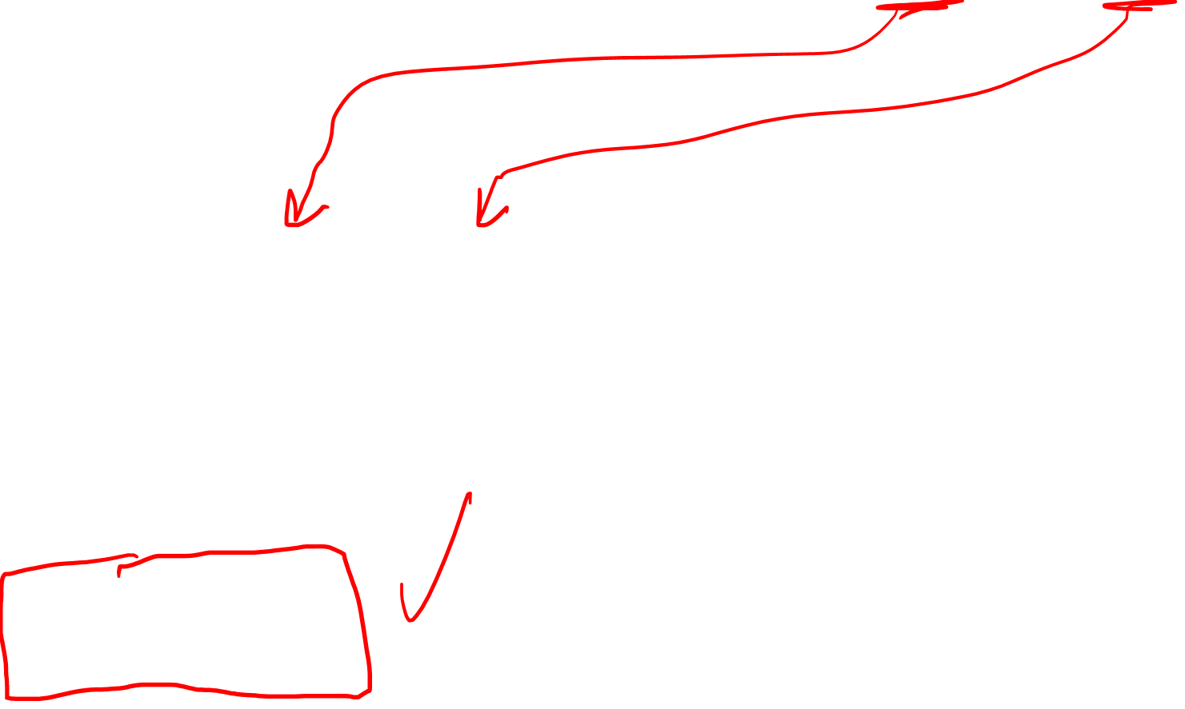
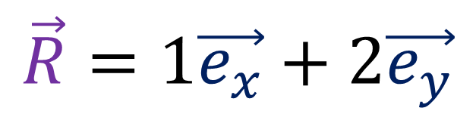
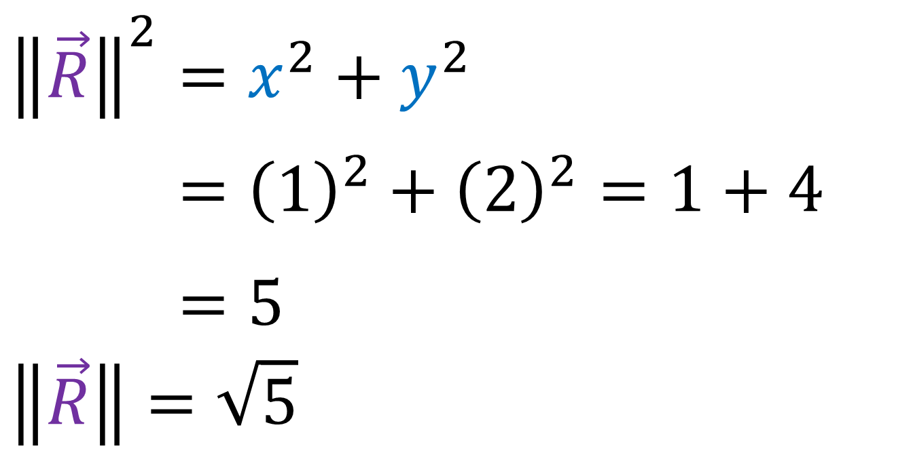
$$\vec{R}=x\vec{e_{x}}+y\vec{e_{y}}$$
$$\vec{e_{y}}$$
$$\vec{R}=1\vec{e_{x}}+2\vec{e_{y}}$$
$$\vec{e_{x}}$$
$${\left\|\vec{R}\right\|}^{2}=x^{2}+y^{2}$$
$${\left\|\vec{R}\right\|}^{2}={\left(1\right)}^{2}+{\left(2\right)}^{2}=1+4$$
$${\left\|\vec{R}\right\|}^{2}=5$$
$$\left\|\vec{R}\right\|=\sqrt{5}$$
Notes:
So let’s take the formula x^2 + y^2 and sub in the x-component of R, which is 1, and the y-component of R, which is 4. We get 1^2 + 2^2, which is 1+4, which is 5. So the length of R is the square root of 5, as we got last time.

Slide 9
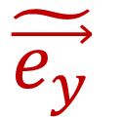
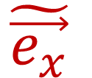
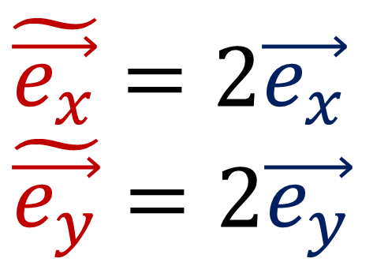
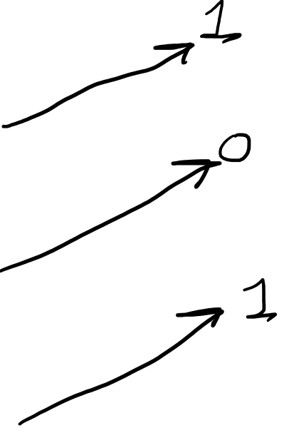
$$\tilde{\vec{e_{x}}}=2\vec{e_{x}}$$
$$\tilde{\vec{e_{y}}}=2\vec{e_{y}}$$
$$\tilde{\vec{e_{y}}}$$
$$\tilde{\vec{e_{x}}}$$
$$\tilde{\vec{e_{x}}}⋅\tilde{\vec{e_{x}}}=\left(2\vec{e_{x}}\right)⋅\left(2\vec{e_{x}}\right)=4\left(\vec{e_{x}}⋅\vec{e_{x}}\right)=4$$
$$\tilde{\vec{e_{x}}}⋅\tilde{\vec{e_{y}}}=\left(2\vec{e_{x}}\right)⋅\left(2\vec{e_{y}}\right)=4\left(\vec{e_{x}}⋅\vec{e_{y}}\right)=0$$
$$\tilde{\vec{e_{y}}}⋅\tilde{\vec{e_{y}}}=\left(2\vec{e_{y}}\right)⋅\left(2\vec{e_{y}}\right)=4\left(\vec{e_{y}}⋅\vec{e_{y}}\right)=4$$
Notes:
Now let’s look at the basis where the basis vectors are twice as long, eX-tilde = 2eX and eY-tilde = 2eY. To compute eX-tilde dot eX-tilde, we can replace it with 2 eX dot 2 eX, which is 4 times eX-dot-eX. And since eX-dot-eX is one, because the vector is normalized, we get 4 as the result. We can use the same substitution trick for eX-tilde dot eY-tilde, and since eX and eY are orthogonal, this goes to zero.
And for eY-tilde dot eY-tilde… eY-dot-eY is again 1, so the result is 4.

Slide 10
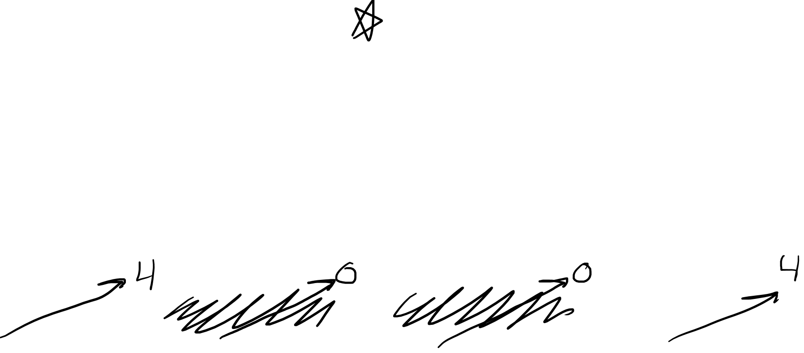
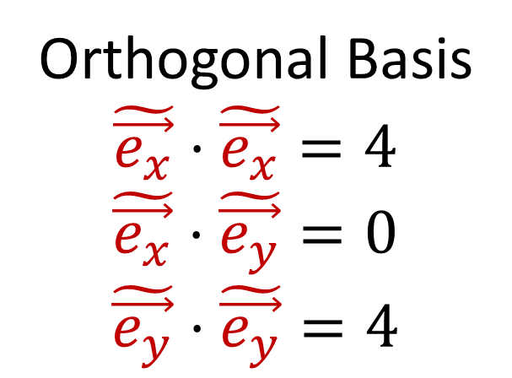
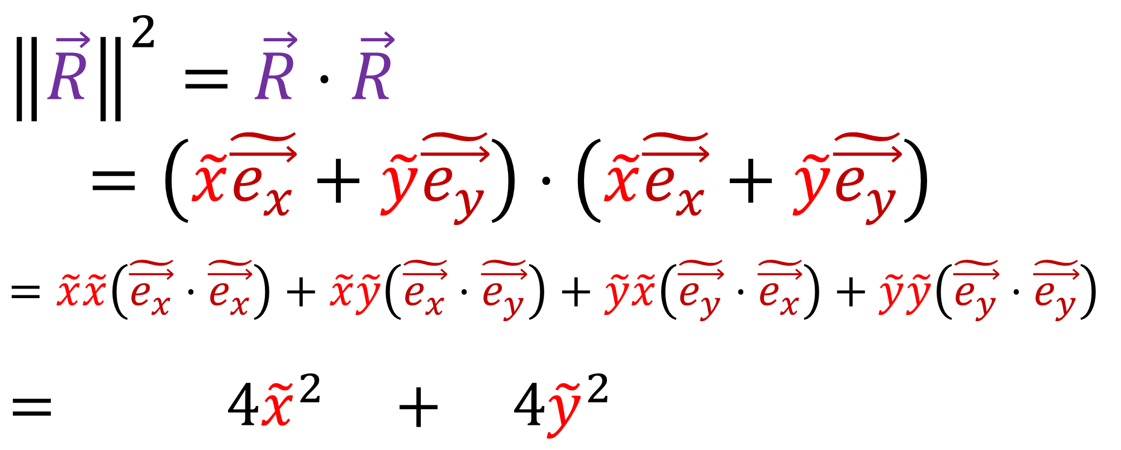
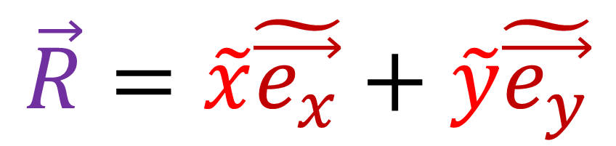
$$\vec{R}=\tilde{x}\tilde{\vec{e_{x}}}+\tilde{y}\tilde{\vec{e_{y}}}$$
Orthogonal Basis
$$\tilde{\vec{e_{x}}}⋅\tilde{\vec{e_{x}}}=4$$
$$\tilde{\vec{e_{x}}}⋅\tilde{\vec{e_{y}}}=0$$
$$\tilde{\vec{e_{y}}}⋅\tilde{\vec{e_{y}}}=4$$
$$\tilde{\vec{e_{y}}}$$
$$\tilde{\vec{e_{x}}}$$
$${\left\|\vec{R}\right\|}^{2}=\vec{R}⋅\vec{R}$$
$=\left(\tilde{x}\tilde{\vec{e_{x}}}+\tilde{y}\tilde{\vec{e_{y}}}\right)⋅\left(\tilde{x}\tilde{\vec{e_{x}}}+\tilde{y}\tilde{\vec{e_{y}}}\right)$
$$=\tilde{x}\tilde{x}\left(\tilde{\vec{e_{x}}}⋅\tilde{\vec{e_{x}}}\right)+\tilde{x}\tilde{y}\left(\tilde{\vec{e_{x}}}⋅\tilde{\vec{e_{y}}}\right)+\tilde{y}\tilde{x}\left(\tilde{\vec{e_{y}}}⋅\tilde{\vec{e_{x}}}\right)+\tilde{y}\tilde{y}\left(\tilde{\vec{e_{y}}}⋅\tilde{\vec{e_{y}}}\right)$$
$$= 4{\tilde{x}}^{2} + 4{\tilde{y}}^{2}$$
Notes:
So we have all the necessary dot products listed here. Let’s now computer R-dot-R, which is equal to x-tilde eX-tilde + y-tilde eY-tilde, dotted with itself. Again, using the first, outer, inner, last rule ,we get 4 terms. eX-tilde dot eY-tilde and the reversed version go to zero. And the other dot products are equal to 4. So we get 4 X-tilde squared, plus 4 Y-tilde squared

Slide 11
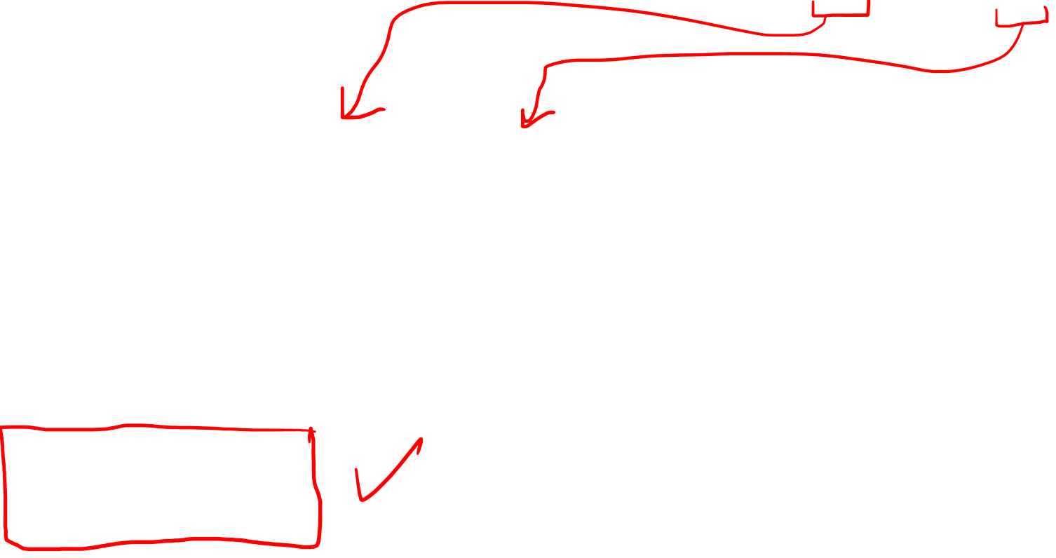
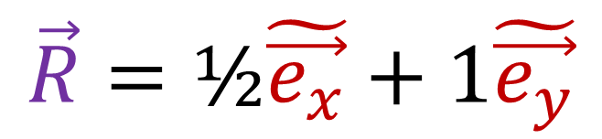
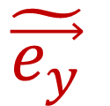
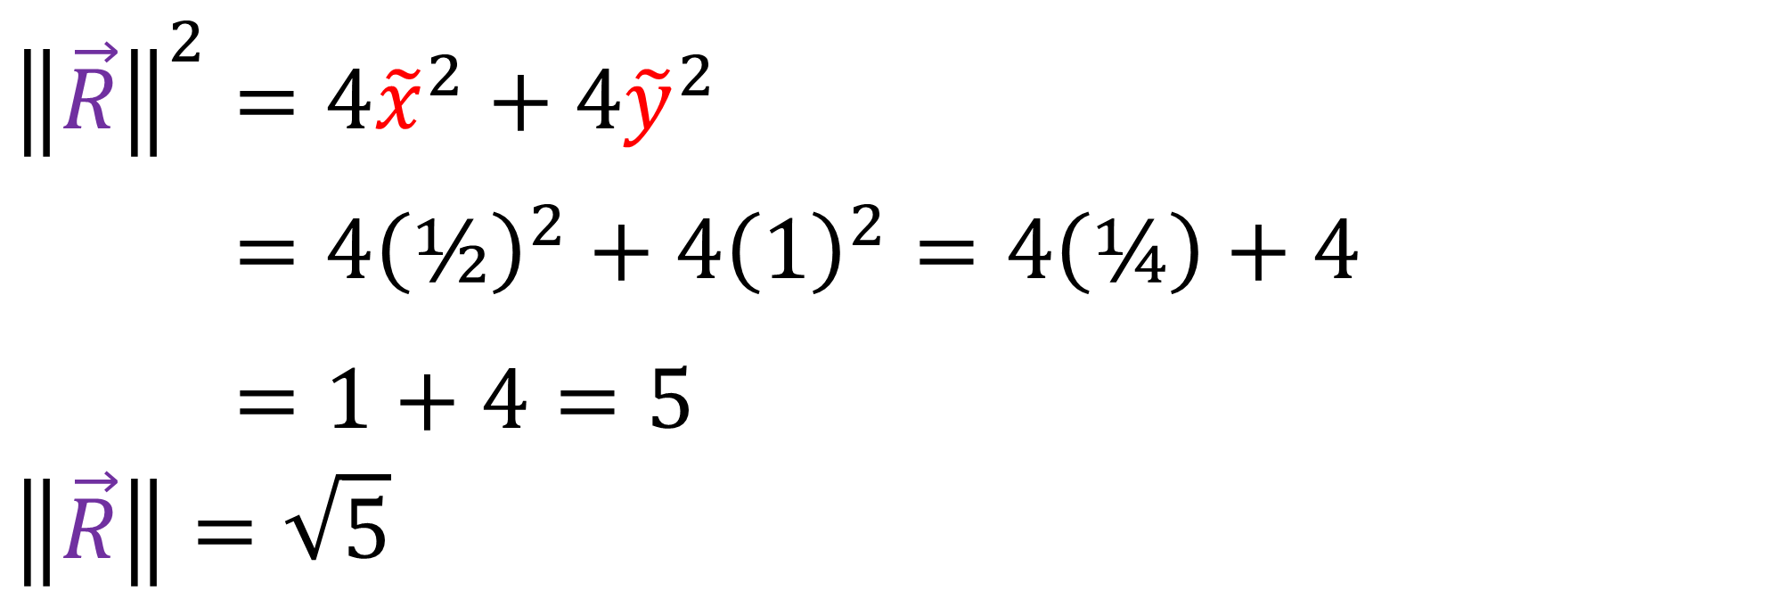
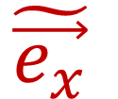

$$\vec{R}=\tilde{x}\tilde{\vec{e_{x}}}+\tilde{y}\tilde{\vec{e_{y}}}$$
$$\tilde{\vec{e_{y}}}$$
$$\vec{R}=\text{½}\tilde{\vec{e_{x}}}+1\tilde{\vec{e_{y}}}$$
$$\tilde{\vec{e_{x}}}$$
$${\left\|\vec{R}\right\|}^{2}=4{\tilde{x}}^{2}+4{\tilde{y}}^{2}$$
$${\left\|\vec{R}\right\|}^{2}=4{\left(\text{½}\right)}^{2}+{4\left(1\right)}^{2}=4\left(\text{¼}\right)+4$$
$${\left\|\vec{R}\right\|}^{2}=1+4=5$$
$$\left\|\vec{R}\right\|=\sqrt{5}$$
Notes:
Now let’s sub in the components of R in this basis into the formula for the squared length of R. We use ½ for x-tilde and 1 for y-tilde. ½ squared is ¼ and 1 squared is 1. So we get 1+4, which is 5.
This means the length of the R vector is the square root of 5, which agree with what we got in the previous basis.

Slide 12







$$\breve{\vec{e_{x}}}=1\vec{e_{x}}+1\vec{e_{y}}$$
$$\breve{\vec{e_{y}}}=\vec{e_{y}}$$
$$\breve{\vec{e_{y}}}$$
$$\breve{\vec{e_{x}}}$$
$$\breve{\vec{e_{x}}}⋅\breve{\vec{e_{x}}}=\left(1\vec{e_{x}}+1\vec{e_{y}}\right)⋅\left(1\vec{e_{x}}+1\vec{e_{y}}\right)$$
$$=\left(1\right)\left(1\right)\left(\vec{e_{x}}⋅\vec{e_{x}}\right)+0+0+\left(1\right)\left(1\right)\left(\vec{e_{y}}⋅\vec{e_{y}}\right)=2$$
$$\breve{\vec{e_{x}}}⋅\breve{\vec{e_{y}}}=\left(1\vec{e_{x}}+1\vec{e_{y}}\right)⋅1\vec{e_{y}}$$
$$=\left(1\right)\left(1\right)\left(\vec{e_{x}}⋅\vec{e_{y}}\right)+\left(1\right)\left(1\right)\left(\vec{e_{y}}⋅\vec{e_{y}}\right)=1$$
$$\breve{\vec{e_{y}}}⋅\breve{\vec{e_{y}}}=\vec{e_{y}}⋅\vec{e_{y}}=1$$
Notes:
Now let’s try this final basis, where eX with the three dots equals 1 eX plus 1 eY, and eY with the dots just equals eY.
The dot product of eX triple-dot with itself is 1 eX + 1 eY dotted with itself. If we distribute this out we get 4 terms… the middle 2 terms go away because they have dot products that go to zero. Meanwhile the other dot products go to 1, and addin the results up, we get 2. Now let’s dot the eX-triple-dot with eY-triple-dot. This expand to 2 terms. This goes to zero and this goes to one, so the final results is 1. And the last dot product is just eY dot eY, which is 1.

Slide 13




$$\vec{R}=\breve{x}\breve{\vec{e_{x}}}+\breve{y}\breve{\vec{e_{y}}}$$
General Basis
$$\breve{\vec{e_{x}}}⋅\breve{\vec{e_{x}}}=2$$
$$\breve{\vec{e_{x}}}⋅\breve{\vec{e_{y}}}=1$$
$$\breve{\vec{e_{y}}}⋅\breve{\vec{e_{y}}}=1$$
$$\breve{\vec{e_{y}}}$$
$$\breve{\vec{e_{x}}}$$
$${\left\|\vec{R}\right\|}^{2}=\vec{R}⋅\vec{R}$$
$=\left(\breve{x}\breve{\vec{e_{x}}}+\breve{y}\breve{\vec{e_{y}}}\right)⋅\left(\breve{x}\breve{\vec{e_{x}}}+\breve{y}\breve{\vec{e_{y}}}\right)$
$$=\breve{x}\breve{x}\left(\breve{\vec{e_{x}}}⋅\breve{\vec{e_{x}}}\right)+\breve{x}\breve{y}\left(\breve{\vec{e_{x}}}⋅\breve{\vec{e_{y}}}\right)+\breve{y}\breve{x}\left(\breve{\vec{e_{y}}}⋅\breve{\vec{e_{x}}}\right)+\breve{y}\breve{y}\left(\breve{\vec{e_{y}}}⋅\breve{\vec{e_{y}}}\right)$$
$$= 2{\breve{x}}^{2} + 2\breve{x}\breve{y} + {\breve{y}}^{2}$$
Notes:
So we have all the dot products in this basis. Now let’s compute the formula for the squared length of R, which is R dot R. Again we distribute this out to get 4 terms, and these got products become 2, 1, 1, and ,1. This gives us the formula 2 x-triple-dot square, puts 2x-tripledot-y-tripledot + y-tripledot squared Note that I’m add these two terms together since they are both just a product of x and y, so that’s why there’s a 2 here.

Slide 14



$$\vec{R}=\breve{x}\breve{\vec{e_{x}}}+\breve{y}\breve{\vec{e_{y}}}$$
$$\breve{\vec{e_{y}}}$$
$$\vec{R}=\text{1}\breve{\vec{e_{x}}}+1\breve{\vec{e_{y}}}$$
$$\breve{\vec{e_{x}}}$$
$${\left\|\vec{R}\right\|}^{2}=2{\breve{x}}^{2}+2\breve{x}\breve{y}+{\breve{y}}^{2}$$
$${\left\|\vec{R}\right\|}^{2}=2{\left(1\right)}^{2}+2(1)(1)+{\left(1\right)}^{2}$$
$${\left\|\vec{R}\right\|}^{2}=2+2+1=5$$
$$\left\|\vec{R}\right\|=\sqrt{5}$$
Notes:
So let’s take the formula for the squared length of 2 and sub in 1 for the x component and 1 for the y components. And carrying out the multiplications, we get 2+2+1, which is 5. And so the length of R is the square root of 5, which is consistent, which our

Slide 15



$$\vec{R}=x\vec{e_{x}}+y\vec{e_{y}}$$
$${\left\|\vec{R}\right\|}^{2}=x^{2}+y^{2}$$
$${\left\|\vec{R}\right\|}^{2}=\vec{R}⋅\vec{R}$$
$=\left(x\vec{e_{x}}+y\vec{e_{y}}\right)⋅\left(x\vec{e_{x}}+y\vec{e_{y}}\right)$
$$=xx\left(\vec{e_{x}}⋅\vec{e_{x}}\right)+xy\left(\vec{e_{x}}⋅\vec{e_{y}}\right)+yx\left(\vec{e_{y}}⋅\vec{e_{x}}\right)+yy\left(\vec{e_{y}}⋅\vec{e_{y}}\right)$$
$$=\left[\begin{matrix}x & y\end{matrix}\right]\left[\begin{matrix}\vec{e_{x}}⋅\vec{e_{x}} & \vec{e_{x}}⋅\vec{e_{y}} \\ \vec{e_{y}}⋅\vec{e_{x}} & \vec{e_{y}}⋅\vec{e_{y}}\end{matrix}\right]\left[\begin{aligned}x \\ y\end{aligned}\right]$$
Metric Tensor
Matrix
(Components are basis vector dot products)
Notes:
So when measuring lengths, we cant just blindly use the familiar formula a^2 + b^2 = c^2 from elementary school. The real way to get the square length of a vector R is to take the dot product of R with itself, expand R in a basis, and distribute over the dot product. The key to getting the correct formula is to remember to calculate all these dot products properly. We can’t just assume they’re 1 or 0. This formula for the squared length can also be written in matrix notation like this, with the vector components in this row and this columns… and this matrix of dot products in the middle. This matrix of basis vector dot products is called the metric tensor.

Slide 16


$$\vec{R}=x\vec{e_{x}}+y\vec{e_{y}}$$
$${\left\|\vec{R}\right\|}^{2}=x^{2}+y^{2}$$
$${\left\|\vec{R}\right\|}^{2}=\vec{R}⋅\vec{R}$$
$=\left(x\vec{e_{x}}+y\vec{e_{y}}\right)⋅\left(x\vec{e_{x}}+y\vec{e_{y}}\right)$
$$=xx\left(\vec{e_{x}}⋅\vec{e_{x}}\right)+xy\left(\vec{e_{x}}⋅\vec{e_{y}}\right)+yx\left(\vec{e_{y}}⋅\vec{e_{x}}\right)+yy\left(\vec{e_{y}}⋅\vec{e_{y}}\right)$$
$=\left[\begin{matrix}x & y\end{matrix}\right]\left[\begin{matrix}\vec{e_{x}}⋅\vec{e_{x}} & \vec{e_{x}}⋅\vec{e_{y}} \\ \vec{e_{y}}⋅\vec{e_{x}} & \vec{e_{y}}⋅\vec{e_{y}}\end{matrix}\right]\left[\begin{aligned}x \\ y\end{aligned}\right]=\left[\begin{matrix}x & y\end{matrix}\right]\left[\begin{matrix}g_{xx} & g_{xy} \\ g_{yx} & g_{yy}\end{matrix}\right]\left[\begin{aligned}x \\ y\end{aligned}\right]$
Notes:
The metric tensor matrix components are also written with the lower case letter g. For example g_xx is equal to the dot product of eX and eX.

Slide 17







$$Invariance$$
Metric Tensor
Matrix
$${\left\|\vec{R}\right\|}^{2}=x^{2}+y^{2}$$
$$=\left[\begin{matrix}x & y\end{matrix}\right]\left[\begin{matrix}1 & 0 \\ 0 & 1\end{matrix}\right]\left[\begin{aligned}x \\ y\end{aligned}\right]$$
$${\left\|\vec{R}\right\|}^{2}=4{\tilde{x}}^{2}+4{\tilde{y}}^{2}$$
$$=\left[\begin{matrix}\tilde{x} & \tilde{y}\end{matrix}\right]\left[\begin{matrix}4 & 0 \\ 0 & 4\end{matrix}\right]\left[\begin{aligned}\tilde{x} \\ \tilde{y}\end{aligned}\right]$$
$${\left\|\vec{R}\right\|}^{2}=2{\breve{x}}^{2}+2\breve{x}\breve{y}+{\breve{y}}^{2}$$
$$=\left[\begin{matrix}\breve{x} & \breve{y}\end{matrix}\right]\left[\begin{matrix}2 & 1 \\ 1 & 1\end{matrix}\right]\left[\begin{aligned}\breve{x} \\ \breve{y}\end{aligned}\right]$$
Notes:
And I’d like to tie this back to the idea of Invariance. The squared length of the vector R has different formulas when we use different basis vectors, but the results are always equal. And writing things in array notation, the metric tensor matrix has different components when we use different reference frames, but the resulting vector lengths were the same in all cases.

Slide 18













$$Invariance$$
Vector Components
Metric Tensor
Matrix
$$\vec{e_{y}}$$
$$\left[\begin{aligned}1 \\ 2\end{aligned}\right]$$
$$=\left[\begin{matrix}x & y\end{matrix}\right]\left[\begin{matrix}1 & 0 \\ 0 & 1\end{matrix}\right]\left[\begin{aligned}x \\ y\end{aligned}\right]$$
$$\vec{e_{x}}$$
$$\tilde{\vec{e_{y}}}$$
$$\left[\begin{aligned}\text{½} \\ 1\end{aligned}\right]$$
$$=\left[\begin{matrix}\tilde{x} & \tilde{y}\end{matrix}\right]\left[\begin{matrix}4 & 0 \\ 0 & 4\end{matrix}\right]\left[\begin{aligned}\tilde{x} \\ \tilde{y}\end{aligned}\right]$$
$$\tilde{\vec{e_{x}}}$$
$$\left[\begin{aligned}1 \\ 1\end{aligned}\right]$$
$$=\left[\begin{matrix}\overset{⃛}{x} & \overset{⃛}{y}\end{matrix}\right]\left[\begin{matrix}2 & 1 \\ 1 & 1\end{matrix}\right]\left[\begin{aligned}\overset{⃛}{x} \\ \overset{⃛}{y}\end{aligned}\right]$$
$$\overset{⃛}{\vec{e_{y}}}$$
$$\overset{⃛}{\vec{e_{x}}}$$
Notes:
This is a little bit like how the vector components of the pencil are different when we use different basis vectors, even if the vector itself is the same and invariant. Similarly, the components inside the metric tensor matrix are different when we use different basis vectors, but the metric tensor itself is invariant and unchanging.

Slide 19





Metric Tensor $g$
Doesn’t depend on coordinate system
$$g\left(\vec{R},\vec{T}\right)=\vec{R}⋅\vec{T}$$
$$Invariance$$
$$g\left(\vec{R},\vec{T}\right)= \left[R_{x} R_{y}\right]\left[\begin{matrix}g_{xx} & g_{xy} \\ g_{yx} & g_{yy}\end{matrix}\right]\left[\begin{aligned}T_{x} \\ T_{y}\end{aligned}\right]$$
$$g\left(\vec{R},\vec{T}\right)= \left[\tilde{R_{x}} \tilde{R_{y}}\right]\left[\begin{matrix}\tilde{g_{xx}} & \tilde{g_{xy}} \\ \tilde{g_{yx}} & \tilde{g_{yy}}\end{matrix}\right]\left[\begin{aligned}\tilde{T_{x}} \\ \tilde{T_{y}}\end{aligned}\right]$$
Notes:
The metric tensor itself is actually a function that takes two vectors as inputs and returns their dot product. The dot product of two vectors R and T does not depend on the coordinate system. This means that the metric tensor function is invariant and does not depend on the coordinate system. The metric tensor matrix will have different numbers in different coordinate system, but so will the vector components of R and T, so the result R dot T, which is the same as g of R and T, is the same in all coordinates.

Slide 20






$$\tilde{\vec{e_{x}}}=2\vec{e_{x}}$$
$$\tilde{\vec{e_{y}}}=2\vec{e_{y}}$$
$$\tilde{\vec{e_{y}}}$$
$$\vec{e_{y}}$$
Contravariant
$$\tilde{\vec{e_{x}}}$$
$$\vec{e_{x}}$$
$$=1\vec{e_{x}}+1\vec{e_{y}}$$
$$=\text{½}\tilde{\vec{e_{x}}}+\text{½}\tilde{\vec{e_{y}}}$$
Notes:
Now I’ve mentioned several times before that vector components are contravariant. If we measure the components of this pencil to be 1,1 in this basis, then double the length of the basis vectors, the components shrink to ½, ½. When the basis vectors get bigger, the vector components get smaller. And that’s why vector components are contravariant, because they do the opposite thing that basis-vectors do.

Slide 21



$$\tilde{\vec{e_{x}}}=2\vec{e_{x}}$$
$$\tilde{\vec{e_{y}}}=2\vec{e_{y}}$$
$$\tilde{\vec{e_{y}}}$$
$$\vec{e_{y}}$$
$$\left[\begin{matrix}\tilde{\vec{e_{x}}}⋅\tilde{\vec{e_{x}}} & \tilde{\vec{e_{x}}}⋅\tilde{\vec{e_{y}}} \\ \tilde{\vec{e_{y}}}⋅\tilde{\vec{e_{x}}} & \tilde{\vec{e_{y}}}⋅\tilde{\vec{e_{y}}}\end{matrix}\right]$$
$$\left[\begin{matrix}\vec{e_{x}}⋅\vec{e_{x}} & \vec{e_{x}}⋅\vec{e_{y}} \\ \vec{e_{y}}⋅\vec{e_{x}} & \vec{e_{y}}⋅\vec{e_{y}}\end{matrix}\right]$$
$$\tilde{\vec{e_{x}}}$$
$$\vec{e_{x}}$$
$$\left[\begin{matrix}1 & 0 \\ 0 & 1\end{matrix}\right]$$
Covariant? Contravariant?
Notes:
It’s worth asking the same question with the metric tensor. If the metric tensor matrix in this first basis is the identity matrix, what happens to the metric tensor matrix when we double the length of the basis vectors. Is it covariant or contravariant.

Slide 22



$$=\left[\begin{matrix}\tilde{\vec{e_{x}}}⋅\tilde{\vec{e_{x}}} & \tilde{\vec{e_{x}}}⋅\tilde{\vec{e_{y}}} \\ \tilde{\vec{e_{y}}}⋅\tilde{\vec{e_{x}}} & \tilde{\vec{e_{y}}}⋅\tilde{\vec{e_{y}}}\end{matrix}\right]$$
$$=\left[\begin{matrix}2\vec{e_{x}}⋅2\vec{e_{x}} & 2\vec{e_{x}}⋅2\vec{e_{y}} \\ 2\vec{e_{y}}⋅2\vec{e_{x}} & 2\vec{e_{y}}⋅2\vec{e_{y}}\end{matrix}\right]$$
$$=\left[\begin{matrix}4\left(\vec{e_{x}}⋅\vec{e_{x}}\right) & 4\left(\vec{e_{x}}⋅\vec{e_{y}}\right) \\ 4\left(\vec{e_{y}}⋅\vec{e_{x}}\right) & 4\left(\vec{e_{y}}⋅\vec{e_{y}}\right)\end{matrix}\right]$$
$$= \left[\begin{matrix}4 & 0 \\ 0 & 4\end{matrix}\right]$$
$$\tilde{\vec{e_{x}}}=2\vec{e_{x}}$$
$$\tilde{\vec{e_{y}}}=2\vec{e_{y}}$$
Notes:
We can find out by writing the metric tensor matrix in the eX-tilde and eY-tilde basis. Then we’ll re-write the basis vectors in terms of eX and eY using these equations that relate the two bases. So you can see we have pairs of 2s everywhere, and we can bring them all out in front to get 2x2, or 4. And we already know the original basis is orthonormal, so the dot products are 1, 0, 0, 1. And so we see that the metric tensor matric in this eX-tilde eY-tilde basis is 4, 0, 0 , 4.

Slide 23


$$\tilde{\vec{e_{x}}}=2\vec{e_{x}}$$
$$\tilde{\vec{e_{y}}}=2\vec{e_{y}}$$
$$\tilde{\vec{e_{y}}}$$
$$\vec{e_{y}}$$
$$\left[\begin{matrix}\tilde{\vec{e_{x}}}⋅\tilde{\vec{e_{x}}} & \tilde{\vec{e_{x}}}⋅\tilde{\vec{e_{y}}} \\ \tilde{\vec{e_{y}}}⋅\tilde{\vec{e_{x}}} & \tilde{\vec{e_{y}}}⋅\tilde{\vec{e_{y}}}\end{matrix}\right]$$
$$\left[\begin{matrix}\vec{e_{x}}⋅\vec{e_{x}} & \vec{e_{x}}⋅\vec{e_{y}} \\ \vec{e_{y}}⋅\vec{e_{x}} & \vec{e_{y}}⋅\vec{e_{y}}\end{matrix}\right]$$
$$\tilde{\vec{e_{x}}}$$
2-Covariant
$$\vec{e_{x}}$$
$$\left[\begin{matrix}1 & 0 \\ 0 & 1\end{matrix}\right]$$
$$\left[\begin{matrix}4 & 0 \\ 0 & 4\end{matrix}\right]$$
Notes:
So when we double the lengths of the basis vectors, the metric tensor matrix components multiply by 4. In other words, they doubled, and then doubled again. So the metric tensor is what we call “twice-covariant” because when the basis vectors change, the metric tensor matrix changes in the same way twice.
And this makes sense because every entry in the metric tensor matrix has two basis vectors in it, so it makes sense that when the basis vectors change, these matrix components will do that change twice.

Slide 24







$$\left[\tilde{\vec{e_{x}}} \tilde{\vec{e_{y}}}\right]=\left[\vec{e_{x}} \vec{e_{y}}\right]\left[\begin{matrix}a & b \\ c & d\end{matrix}\right]$$
$$\left[\begin{aligned}\tilde{x} \\ \tilde{y}\end{aligned}\right]={\left[\begin{matrix}a & b \\ c & d\end{matrix}\right]}^{−1}\left[\begin{aligned}x \\ y\end{aligned}\right]$$
$$\left[\vec{e_{x}} \vec{e_{y}}\right]=\left[\tilde{\vec{e_{x}}} \tilde{\vec{e_{y}}}\right]{\left[\begin{matrix}a & b \\ c & d\end{matrix}\right]}^{−1}$$
$$\left[\begin{aligned}x \\ y\end{aligned}\right]=\left[\begin{matrix}a & b \\ c & d\end{matrix}\right]\left[\begin{aligned}\tilde{x} \\ \tilde{y}\end{aligned}\right]$$
$${\left\|\vec{R}\right\|}^{2}=\left[x y\right]\left[\begin{matrix}g_{xx} & g_{xy} \\ g_{yx} & g_{yy}\end{matrix}\right]\left[\begin{aligned}x \\ y\end{aligned}\right]$$
Note: $\left[\begin{matrix}a & b \\ c & d\end{matrix}\right]{\left[\begin{matrix}a & b \\ c & d\end{matrix}\right]}^{−1}=\left[\begin{matrix}1 & 0 \\ 0 & 1\end{matrix}\right]$
Notes:
So that gives us intuition why the metric tensor matrix is twice-covariant, but let’s see if we can prove it. You’ve seen in previous videos that if the basis vectors change with this matrix abcd, then the basis vector components change with the opposite matrix, abcd inverse, with the inverse denoted by this -1 up here. Also if we change basis in the reverse direction, we also use the inverse matrix, and if we reverse the component change, we use the inverse of that… and the inverse of the inverse is just the original matrix, so these two matrices are the same.
Now let’s take our array formula for the squared length of a vector. And I’m going to write this row of vector components as the transpose of a column. The transpose is denoted with this T symbol, and it just tells us to flip the column into a row. Now notice that we have an equation up here for this XY column. So I’m going to substitute this array multiplication involving the abcd matrix and the x-tilde and y-tilde components into here and here.

Slide 25


$$\left[\tilde{\vec{e_{x}}} \tilde{\vec{e_{y}}}\right]=\left[\vec{e_{x}} \vec{e_{y}}\right]\left[\begin{matrix}a & b \\ c & d\end{matrix}\right]$$
$$\left[\begin{aligned}\tilde{x} \\ \tilde{y}\end{aligned}\right]={\left[\begin{matrix}a & b \\ c & d\end{matrix}\right]}^{−1}\left[\begin{aligned}x \\ y\end{aligned}\right]$$
$$\left[\vec{e_{x}} \vec{e_{y}}\right]=\left[\tilde{\vec{e_{x}}} \tilde{\vec{e_{y}}}\right]{\left[\begin{matrix}a & b \\ c & d\end{matrix}\right]}^{−1}$$
$$\left[\begin{aligned}x \\ y\end{aligned}\right]=\left[\begin{matrix}a & b \\ c & d\end{matrix}\right]\left[\begin{aligned}\tilde{x} \\ \tilde{y}\end{aligned}\right]$$
$${\left\|\vec{R}\right\|}^{2}={\left[\begin{aligned}x \\ y\end{aligned}\right]}^{T}\left[\begin{matrix}g_{xx} & g_{xy} \\ g_{yx} & g_{yy}\end{matrix}\right]\left[\begin{aligned}x \\ y\end{aligned}\right]$$
$${\left\|\vec{R}\right\|}^{2}={\left(\left[\begin{matrix}a & b \\ c & d\end{matrix}\right]\left[\begin{aligned}\tilde{x} \\ \tilde{y}\end{aligned}\right]\right)}^{T}\left[\begin{matrix}g_{xx} & g_{xy} \\ g_{yx} & g_{yy}\end{matrix}\right]\left(\left[\begin{matrix}a & b \\ c & d\end{matrix}\right]\left[\begin{aligned}\tilde{x} \\ \tilde{y}\end{aligned}\right]\right)$$
Notes:
So that gives us intuition why the metric tensor matrix is twice-covariant, but let’s see if we can prove it. You’ve seen in previous videos that if the basis vectors change with this matrix abcd, then the basis vector components change with the opposite matrix, abcd inverse, with the inverse denoted by this -1 up here. Also if we change basis in the reverse direction, we also use the inverse matrix, and if we reverse the component change, we use the inverse of that… and the inverse of the inverse is just the original matrix, so these two matrices are the same.
Now let’s take our array formula for the squared length of a vector. And I’m going to write this row of vector components as the transpose of a column. The transpose is denoted with this T symbol, and it just tells us to flip the column into a row. Now notice that we have an equation up here for this XY column. So I’m going to substitute this array multiplication involving the abcd matrix and the x-tilde and y-tilde components into here and here.

Slide 26



$${\left\|\vec{R}\right\|}^{2}={\left[\begin{aligned}x \\ y\end{aligned}\right]}^{T}\left[\begin{matrix}g_{xx} & g_{xy} \\ g_{yx} & g_{yy}\end{matrix}\right]\left[\begin{aligned}x \\ y\end{aligned}\right]$$
$${\left\|\vec{R}\right\|}^{2}={\left(\left[\begin{matrix}a & b \\ c & d\end{matrix}\right]\left[\begin{aligned}\tilde{x} \\ \tilde{y}\end{aligned}\right]\right)}^{T}\left[\begin{matrix}g_{xx} & g_{xy} \\ g_{yx} & g_{yy}\end{matrix}\right]\left(\left[\begin{matrix}a & b \\ c & d\end{matrix}\right]\left[\begin{aligned}\tilde{x} \\ \tilde{y}\end{aligned}\right]\right)$$
$${\left\|\vec{R}\right\|}^{2}={\left[\begin{aligned}\tilde{x} \\ \tilde{y}\end{aligned}\right]}^{T}{\left[\begin{matrix}a & b \\ c & d\end{matrix}\right]}^{T}\left[\begin{matrix}g_{xx} & g_{xy} \\ g_{yx} & g_{yy}\end{matrix}\right]\left[\begin{matrix}a & b \\ c & d\end{matrix}\right]\left[\begin{aligned}\tilde{x} \\ \tilde{y}\end{aligned}\right]$$
$${\left\|\vec{R}\right\|}^{2}= {\left[\begin{aligned}\tilde{x} \\ \tilde{y}\end{aligned}\right]}^{T} \left[\begin{matrix}\tilde{g_{xx}} & \tilde{g_{xy}} \\ \tilde{g_{yx}} & \tilde{g_{yy}}\end{matrix}\right] \left[\begin{aligned}\tilde{x} \\ \tilde{y}\end{aligned}\right]$$
$$\left[\begin{matrix}\tilde{g_{xx}} & \tilde{g_{xy}} \\ \tilde{g_{yx}} & \tilde{g_{yy}}\end{matrix}\right]={\left[\begin{matrix}a & b \\ c & d\end{matrix}\right]}^{T}\left[\begin{matrix}g_{xx} & g_{xy} \\ g_{yx} & g_{yy}\end{matrix}\right]\left[\begin{matrix}a & b \\ c & d\end{matrix}\right]$$
Notes:
Now it’s a rule in linear algebra, that when we have a transpose of an array multiplication like we do here, this is equal to the multiplication of the transposes, with the arrays written in the opposite order. So you can see the abcd matrix is now written on the right, next to the metric tensor matrix. Now, notice how these columns have the x-tilde y-tilde components in them, and that means that all of this in the middle is equal to the metric tensor components in the basis for x-tilde and y-tilde. So this gives us an array formula for converting between metric tensor components in different coordinate systems.

Slide 27



$$\left[\tilde{\vec{e_{x}}} \tilde{\vec{e_{y}}}\right]=\left[\vec{e_{x}} \vec{e_{y}}\right]\left[\begin{matrix}a & b \\ c & d\end{matrix}\right]$$
$$\left[\begin{aligned}\tilde{x} \\ \tilde{y}\end{aligned}\right]={\left[\begin{matrix}a & b \\ c & d\end{matrix}\right]}^{−1}\left[\begin{aligned}x \\ y\end{aligned}\right]$$
$$\left[\vec{e_{x}} \vec{e_{y}}\right]=\left[\tilde{\vec{e_{x}}} \tilde{\vec{e_{y}}}\right]{\left[\begin{matrix}a & b \\ c & d\end{matrix}\right]}^{−1}$$
$$\left[\begin{aligned}x \\ y\end{aligned}\right]=\left[\begin{matrix}a & b \\ c & d\end{matrix}\right]\left[\begin{aligned}\tilde{x} \\ \tilde{y}\end{aligned}\right]$$
2-Covariant
$$\left[\begin{matrix}\tilde{g_{xx}} & \tilde{g_{xy}} \\ \tilde{g_{yx}} & \tilde{g_{yy}}\end{matrix}\right]={\left[\begin{matrix}a & b \\ c & d\end{matrix}\right]}^{T}\left[\begin{matrix}g_{xx} & g_{xy} \\ g_{yx} & g_{yy}\end{matrix}\right]\left[\begin{matrix}a & b \\ c & d\end{matrix}\right]$$
$$\left[\begin{matrix}g_{xx} & g_{xy} \\ g_{yx} & g_{yy}\end{matrix}\right]={\left({\left[\begin{matrix}a & b \\ c & d\end{matrix}\right]}^{−1}\right)}^{T}\left[\begin{matrix}\tilde{g_{xx}} & \tilde{g_{xy}} \\ \tilde{g_{yx}} & \tilde{g_{yy}}\end{matrix}\right]{\left[\begin{matrix}a & b \\ c & d\end{matrix}\right]}^{−1}$$
Notes:
Notice that this abcd matrix used to change from the eX eY basis to the eX-tilde eY-tilde basis. Is the same abcd matrix that changes the metric tensor matrix components from the first basis to the tilde basis, and the matrix is used twice… therefore the metric tensor is twice-covariant. Changing the components in the other direction direction, we use the inverse of the abcd matrix on both sides.

Slide 28
$$\vec{R}=x\vec{e_{x}}+y\vec{e_{y}}$$
$${\left\|\vec{R}\right\|}^{2}=x^{2}+y^{2}$$
$${\left\|\vec{R}\right\|}^{2}=\vec{R}⋅\vec{R}$$
$=\left(x\vec{e_{x}}+y\vec{e_{y}}\right)⋅\left(x\vec{e_{x}}+y\vec{e_{y}}\right)$
$$=xx\left(\vec{e_{x}}⋅\vec{e_{x}}\right)+xy\left(\vec{e_{x}}⋅\vec{e_{y}}\right)+yx\left(\vec{e_{y}}⋅\vec{e_{x}}\right)+yy\left(\vec{e_{y}}⋅\vec{e_{y}}\right)$$
$$=\left[\begin{matrix}x & y\end{matrix}\right]\left[\begin{matrix}\vec{e_{x}}⋅\vec{e_{x}} & \vec{e_{x}}⋅\vec{e_{y}} \\ \vec{e_{y}}⋅\vec{e_{x}} & \vec{e_{y}}⋅\vec{e_{y}}\end{matrix}\right]\left[\begin{aligned}x \\ y\end{aligned}\right]$$
Metric Tensor
Matrix
(Components are basis vector dot products)
Notes:
So let’s sum up what we’ve learned about the metric tensor. We learned that when we want to get the length of a vector, we can’t just blindly use the formula a^2 + b^2 = c^2. Instead, we calculate the length of a vector R by computing the dot product R dot R. When we expand R in terms of basis vectors and then distribute over the dot product to get a bunch of terms, which we can then write in array notation like this. This matrix of basis vector dot products is called the metric tensor matrix, and its components are sometimes written using a lower case g.

Slide 29

$${\left\|\vec{R}\right\|}^{2}={\left[\begin{aligned}\tilde{x} \\ \tilde{y}\end{aligned}\right]}^{T} \left[\begin{matrix}\tilde{g_{xx}} & \tilde{g_{xy}} \\ \tilde{g_{yx}} & \tilde{g_{yy}}\end{matrix}\right] \left[\begin{aligned}\tilde{x} \\ \tilde{y}\end{aligned}\right]$$
$$=\left({{\left[\begin{aligned}x \\ y\end{aligned}\right]}^{T}{\left[\begin{matrix}a & b \\ c & d\end{matrix}\right]}^{T}}^{−1}\right)\left({\left[\begin{matrix}a & b \\ c & d\end{matrix}\right]}^{T}\left[\begin{matrix}g_{xx} & g_{xy} \\ g_{yx} & g_{yy}\end{matrix}\right]\left[\begin{matrix}a & b \\ c & d\end{matrix}\right]\right)\left({\left[\begin{matrix}a & b \\ c & d\end{matrix}\right]}^{−1}\left[\begin{aligned}x \\ y\end{aligned}\right]\right)$$
$$= {\left[\begin{aligned}x \\ y\end{aligned}\right]}^{T} \left[\begin{matrix}1 & 0 \\ 0 & 1\end{matrix}\right] \left[\begin{matrix}g_{xx} & g_{xy} \\ g_{yx} & g_{yy}\end{matrix}\right] \left[\begin{matrix}1 & 0 \\ 0 & 1\end{matrix}\right] \left[\begin{aligned}x \\ y\end{aligned}\right]$$
$$= {\left[\begin{aligned}x \\ y\end{aligned}\right]}^{T} \left[\begin{matrix}g_{xx} & g_{xy} \\ g_{yx} & g_{yy}\end{matrix}\right] \left[\begin{aligned}x \\ y\end{aligned}\right]$$
contra
co
co
contra
Notes:
This also helps explain why the length of a vector is invariant. When we change coordinates, the two sets of vector components each change contravariantly, and the metric tensor changes twice covariantly. The two covariant changes cancel out with the two contravariant changes, making sure the result doesn’t change.

Slide 30
$$\vec{R}=x\vec{e_{x}}+y\vec{e_{y}}$$
$${\left\|\vec{R}\right\|}^{2}=x^{2}+y^{2}$$
$${\left\|\vec{R}\right\|}^{2}=\vec{R}⋅\vec{R}$$
$=\left(x\vec{e_{x}}+y\vec{e_{y}}\right)⋅\left(x\vec{e_{x}}+y\vec{e_{y}}\right)$
$$=xx\left(\vec{e_{x}}⋅\vec{e_{x}}\right)+xy\left(\vec{e_{x}}⋅\vec{e_{y}}\right)+yx\left(\vec{e_{y}}⋅\vec{e_{x}}\right)+yy\left(\vec{e_{y}}⋅\vec{e_{y}}\right)$$
$=\left[\begin{matrix}x & y\end{matrix}\right]\left[\begin{matrix}\vec{e_{x}}⋅\vec{e_{x}} & \vec{e_{x}}⋅\vec{e_{y}} \\ \vec{e_{y}}⋅\vec{e_{x}} & \vec{e_{y}}⋅\vec{e_{y}}\end{matrix}\right]\left[\begin{aligned}x \\ y\end{aligned}\right]=\left[\begin{matrix}x & y\end{matrix}\right]\left[\begin{matrix}g_{xx} & g_{xy} \\ g_{yx} & g_{yy}\end{matrix}\right]\left[\begin{aligned}x \\ y\end{aligned}\right]$

Slide 31
Metric Tensor $g$
Doesn’t depend on coordinate system
$$g\left(\vec{R},\vec{T}\right)=\vec{R}⋅\vec{T}$$
$$Invariance$$
$$g\left(\vec{R},\vec{T}\right)= \left[R_{x} R_{y}\right]\left[\begin{matrix}g_{xx} & g_{xy} \\ g_{yx} & g_{yy}\end{matrix}\right]\left[\begin{aligned}T_{x} \\ T_{y}\end{aligned}\right]$$
$$g\left(\vec{R},\vec{T}\right)= \left[\tilde{R_{x}} \tilde{R_{y}}\right]\left[\begin{matrix}\tilde{g_{xx}} & \tilde{g_{xy}} \\ \tilde{g_{yx}} & \tilde{g_{yy}}\end{matrix}\right]\left[\begin{aligned}\tilde{T_{x}} \\ \tilde{T_{y}}\end{aligned}\right]$$
Notes:
Remember The metric tensor is a function that takes two vectors and returns their dot product. This function is invariant and is the same in all coordinate systems. However, the metric tensor matrix components will look different in different coordinate systems, in the same way that vector components look different in different coordinate systems even if the vector is the same.

Slide 32

$$\left[\tilde{\vec{e_{x}}} \tilde{\vec{e_{y}}}\right]=\left[\vec{e_{x}} \vec{e_{y}}\right]\left[\begin{matrix}a & b \\ c & d\end{matrix}\right]$$
$$\left[\begin{aligned}\tilde{x} \\ \tilde{y}\end{aligned}\right]={\left[\begin{matrix}a & b \\ c & d\end{matrix}\right]}^{−1}\left[\begin{aligned}x \\ y\end{aligned}\right]$$
$$\left[\vec{e_{x}} \vec{e_{y}}\right]=\left[\tilde{\vec{e_{x}}} \tilde{\vec{e_{y}}}\right]{\left[\begin{matrix}a & b \\ c & d\end{matrix}\right]}^{−1}$$
$$\left[\begin{aligned}x \\ y\end{aligned}\right]=\left[\begin{matrix}a & b \\ c & d\end{matrix}\right]\left[\begin{aligned}\tilde{x} \\ \tilde{y}\end{aligned}\right]$$
2-Covariant
$$\left[\begin{matrix}\tilde{g_{xx}} & \tilde{g_{xy}} \\ \tilde{g_{yx}} & \tilde{g_{yy}}\end{matrix}\right]={\left[\begin{matrix}a & b \\ c & d\end{matrix}\right]}^{T}\left[\begin{matrix}g_{xx} & g_{xy} \\ g_{yx} & g_{yy}\end{matrix}\right]\left[\begin{matrix}a & b \\ c & d\end{matrix}\right]$$
Notes:
Finally, the metric tensor is twice-covariant. When the basis vectors change one way, the metric tensor components change in that same way twice, as seen by the two matrices here in this coordinate change formula.

Slide 33

Metric Tensor and Relativity
black holes
expansion of universe
gravitational waves
…more!
(Einstein Field Equations)
$R_{μν}−\frac{1}{2}Rg_{μν}+Λg_{μν}=\frac{8πG}{c^{4}}T_{μν}$
Mass/Energy/Momentum
Metric Tensor
Changing rules for measuring distance/time:
Time slowing down near mass
Light bending around black holes
Expansion of the universe
Notes:
I said that the metric tensor can explain black hole, the expansion of the universe, and gravitational waves. This is because mass and energy change the rules for measuring spatial distances and times, which can lead to strange effect. This is all described in the Einstein Field Equations, which will be explained when we reach General Relatvity.

Slide 34
Metric Tensor $g$
Doesn’t depend on coordinate system
$$g\left(\vec{R},\vec{T}\right)=\vec{R}⋅\vec{T}$$
$$Invariance$$
$$g\left(\vec{R},\vec{T}\right)= \left[R_{x} R_{y}\right]\left[\begin{matrix}g_{xx} & g_{xy} \\ g_{yx} & g_{yy}\end{matrix}\right]\left[\begin{aligned}T_{x} \\ T_{y}\end{aligned}\right]$$
$$g\left(\vec{R},\vec{T}\right)= \left[\tilde{R_{x}} \tilde{R_{y}}\right]\left[\begin{matrix}\tilde{g_{xx}} & \tilde{g_{xy}} \\ \tilde{g_{yx}} & \tilde{g_{yy}}\end{matrix}\right]\left[\begin{aligned}\tilde{T_{x}} \\ \tilde{T_{y}}\end{aligned}\right]$$
Notes:
The metric tensor itself is actually a function that takes two vectors as inputs and returns their dot product. The dot product of two vectors R and T does not depend on the coordinate system. This means that the metric tensor function is invariant and does not depend on the coordinate system. The metric tensor matrix will have different numbers in different coordinate system, but so will the vector components of R and T, so the result R dot T, which is the same as g of R and T, is the same in all coordinates.

Slide 35
$${\left\|\vec{R}\right\|}^{2}={\left[\begin{aligned}\tilde{x} \\ \tilde{y}\end{aligned}\right]}^{T} \left[\begin{matrix}\tilde{g_{xx}} & \tilde{g_{xy}} \\ \tilde{g_{yx}} & \tilde{g_{yy}}\end{matrix}\right] \left[\begin{aligned}\tilde{x} \\ \tilde{y}\end{aligned}\right]$$
$$=\left({{\left[\begin{aligned}x \\ y\end{aligned}\right]}^{T}{\left[\begin{matrix}a & b \\ c & d\end{matrix}\right]}^{T}}^{−1}\right)\left({\left[\begin{matrix}a & b \\ c & d\end{matrix}\right]}^{T}\left[\begin{matrix}g_{xx} & g_{xy} \\ g_{yx} & g_{yy}\end{matrix}\right]\left[\begin{matrix}a & b \\ c & d\end{matrix}\right]\right)\left({\left[\begin{matrix}a & b \\ c & d\end{matrix}\right]}^{−1}\left[\begin{aligned}x \\ y\end{aligned}\right]\right)$$
$$= {\left[\begin{aligned}x \\ y\end{aligned}\right]}^{T} \left[\begin{matrix}1 & 0 \\ 0 & 1\end{matrix}\right] \left[\begin{matrix}g_{xx} & g_{xy} \\ g_{yx} & g_{yy}\end{matrix}\right] \left[\begin{matrix}1 & 0 \\ 0 & 1\end{matrix}\right] \left[\begin{aligned}x \\ y\end{aligned}\right]$$
$$= {\left[\begin{aligned}x \\ y\end{aligned}\right]}^{T} \left[\begin{matrix}g_{xx} & g_{xy} \\ g_{yx} & g_{yy}\end{matrix}\right] \left[\begin{aligned}x \\ y\end{aligned}\right]$$
contra
co
co
contra
Notes:
This also helps explain why the length of a vector is invariant. When we change coordinates, the two sets of vector components each change contravariantly, and the metric tensor changes twice covariantly. The two covariant changes cancel out with the two contravariant changes, making sure the result doesn’t change.

