Slide 1
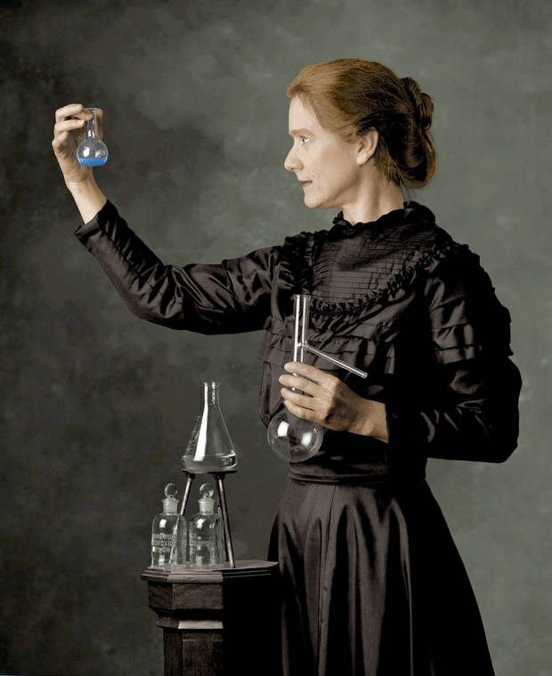
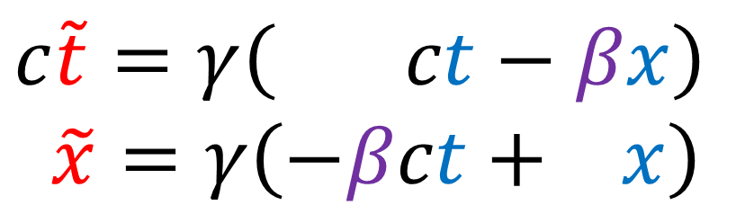
Lorentz
Transform
$$c\tilde{t}=γ\left( ct−βx\right)$$
$$\tilde{x}=γ\left(−βct+ x\right)$$

Slide 2
Lorentz
Transform
$$c\tilde{t}=γ\left( ct−βx\right)$$
$$\tilde{x}=γ\left(−βct+ x\right)$$

Slide 3
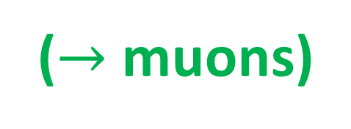
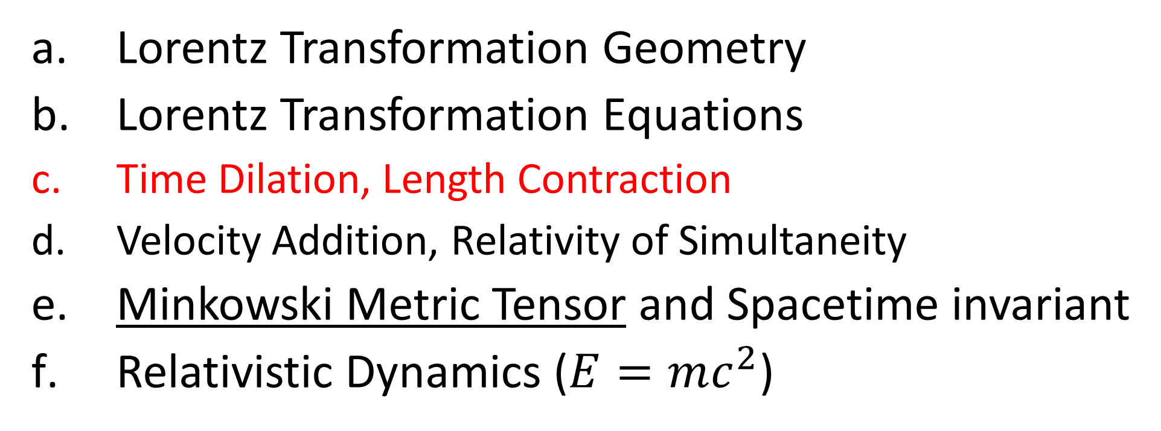
Relativity 104: Special Relativity
Lorentz Transformation Geometry
Lorentz Transformation Equations
Time Dilation, Length Contraction
Velocity Addition, Relativity of Simultaneity
Minkowski Metric Tensor and Spacetime invariant
Relativistic Dynamics ($E=mc^{2}$)
($→$ muons)
Notes:
Now that we’ve dervied the Lorentz Transformation, let’s look at some of its consequences, which are Time Dilation and Length Contraction, and how these concepts affect subatomic particles called muons.

Slide 4
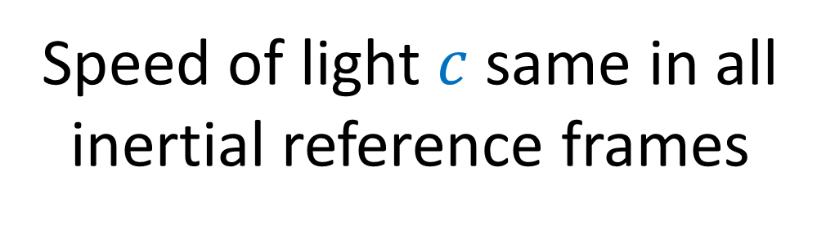
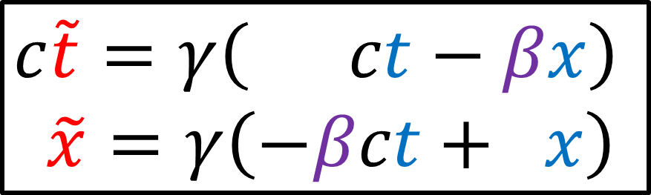
Speed of light $c$ same in all inertial reference frames
Lorentz Transformation
$$c\tilde{t}=γ\left( ct−βx\right)$$
$$\tilde{x}=γ\left(−βct+ x\right)$$
Time Dilation Length Contraction
= “moving clocks run slow”
= “moving rods appear short”
Notes:
If we accept that the speed of light is invariant in all inertial reference frames, we have to accept the Lorentz transformations. And if we accept the Lorentz transformations, we have to accept the idea that different observers will measure time and space differently.
This brings us to time dilation and length contraction.
Roughly speaking, time dilation is the effect that “moving clocks run slow”.
And length contraction is the effect that “moving rods appear short”.

Slide 5


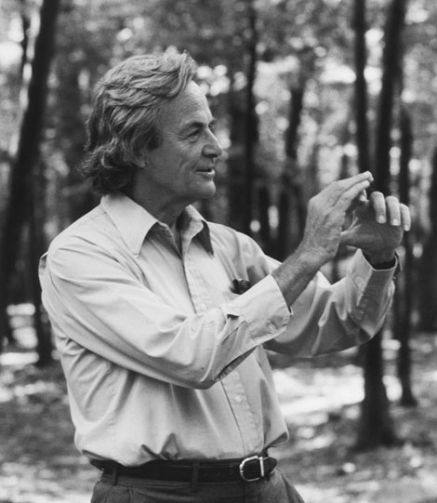
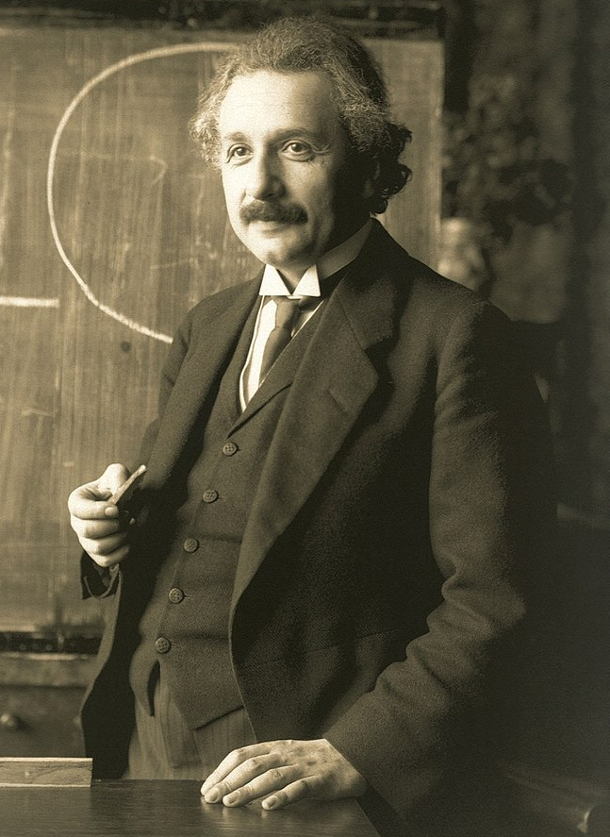

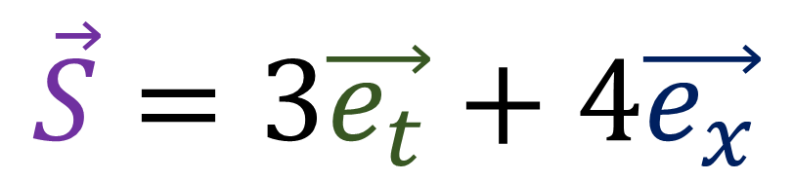



Spacetime Separation Vector (see video 103b)
An arrow joining two points (two “events”) in a spacetime diagram
$$\vec{S}=3\vec{e_{t}}+4\vec{e_{x}}$$
$$\vec{S}$$
happens
3 time units after, and 4 space units to the right of
$$\vec{e_{t}}$$
$$\vec{e_{x}}$$
Notes:
To explain time dilation and length contraction geometrically, we will use spacetime separation vectors that join two points in spacetime.
This vector S connect
=====
This video will make use of spacetime separation vectors that I introduced in Relativity 103b on Galilean Relativity.
Recall that the spacetime separation vector is just an arrow joining two events in spacetime, such as Albert Einstein sneezing and Richard Feynman snapping his fingers.
When we measure the components of this vector using our spacetime basis, it tells us that Richard Feynman’s snap happens 3 seconds into the future, and 4 meters to the right, of Einstein’s sneeze

Slide 6






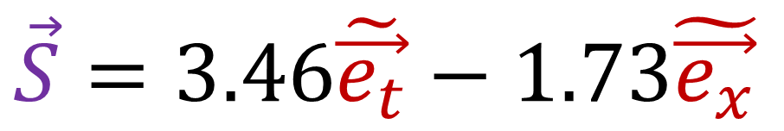
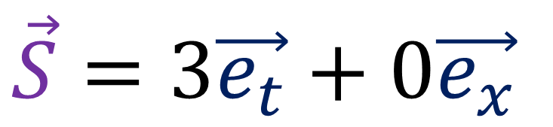
Time Dilation
$$\vec{S}$$
$$\vec{S}$$
$$\tilde{\vec{e_{t}}}$$
$$\vec{e_{t}}$$
$$\tilde{\vec{e_{x}}}$$
$$\vec{e_{x}}$$
$$\vec{S}=3\vec{e_{t}}+0\vec{e_{x}}$$
$$\vec{S}=3.46\tilde{\vec{e_{t}}}−1.73\tilde{\vec{e_{x}}}$$
Travelling with clock: 3 seconds
Watching moving clock: 3.46 seconds
Notes:
Mathematically speaking, time dilation is just measuring the same spacetime separation vector in two different reference frames. In different reference frames, the vector has a different time component, and so different reference frames measure different times.
The first reference frame is travelling with the clock, and it counts 3 clock ticks along the vector S. The second frame is moving with respect to the same clock and counts 3.4 clock ticks along the vector S.
So we can see here that when a clock is moving with respect to the observer, it ticks more slowly and there are fewer clock ticks.

Slide 7






Length Contraction
$$\vec{e_{t}}$$
$$\tilde{\vec{e_{t}}}$$
$$\vec{e_{x}}$$
$$\tilde{\vec{e_{x}}}$$
$$\vec{S}$$
$$\vec{S}$$
Notes:
Now, you might think that, since Time dilation is just the result of measuring the time component of spacetime vector in different reference frames, then length contraction is just the result of measuring the space component of a spacetime vector in different reference frames, but this is actually not correct. Instead, length contraction is the result is the result of measuring two different spacetime separation vectors in two different reference frames. Here we can see that the stationary rod is 3 units long, but the moving rod is 2.6 units long.
I don’t expect any of this to make sense to you right now. But it will hopefully make sense at the end of the video.

Slide 8
Length Contraction
$$\vec{e_{t}}$$
$$\tilde{\vec{e_{t}}}$$
$$\vec{e_{x}}$$
$$\tilde{\vec{e_{x}}}$$
$$\vec{S}$$
$$\vec{S}$$

Slide 9



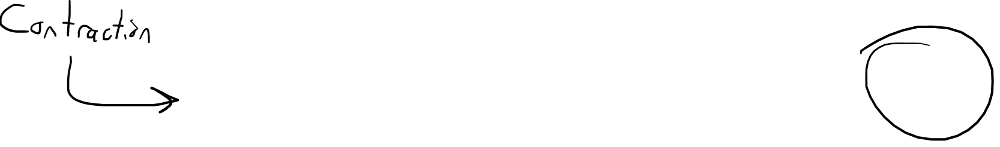

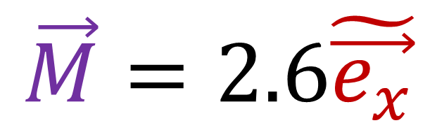
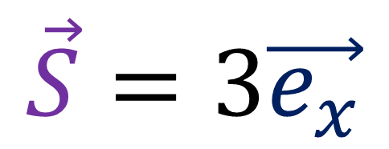
Back End
Front End
Length Contraction
$$\vec{M}$$
$$\tilde{\vec{e_{x}}}$$
$$\vec{S}$$
$$\vec{e_{x}}$$
$$\vec{S}=3\vec{e_{x}}$$
Stationary Rod: 3 units
$$\vec{M}=2.6\tilde{\vec{e_{x}}}$$
Moving Rod: 2.6 units

Slide 10
Strategy:
“Deeper” understanding of how Lorentz geometry affects time + space
Example calculations with time dilation and length contraction
Notes:
So this video is going to be longer than most videos you’ll see on time dilation and length contraction. And that’s because I want you to have a deeper understanding how how Lorentz geometry affects space and time. Before we do any calculations, I’m going to spend a bunch of time drawing pictures on spacetime diagrams with Lorentz transforms to make sure we understand them properly.
After you have a deeper understanding, I’ll do some example calculations of time dilation and length contraction.

Slide 11
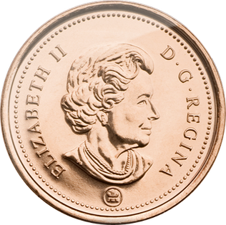




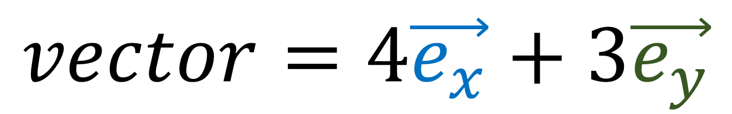
$$vector=4\vec{e_{x}}+3\vec{e_{y}}$$
$$\vec{e_{y}}$$
$$x=4$$
$$\vec{e_{x}}$$
$$y=3$$
Vector Basis (Measuring Sticks)
Vector Components
(Coordinates/Numbers)
Notes:
So I’ve said this several times throughout this series but I’m going to say it again: Basis vectors and vector components are two sides of the same coin.
Any time we’re dealing with vectors, we need to think about both the basis vectors and the components. It doesn’t make sense to talk about one without talking about the other.

Slide 12

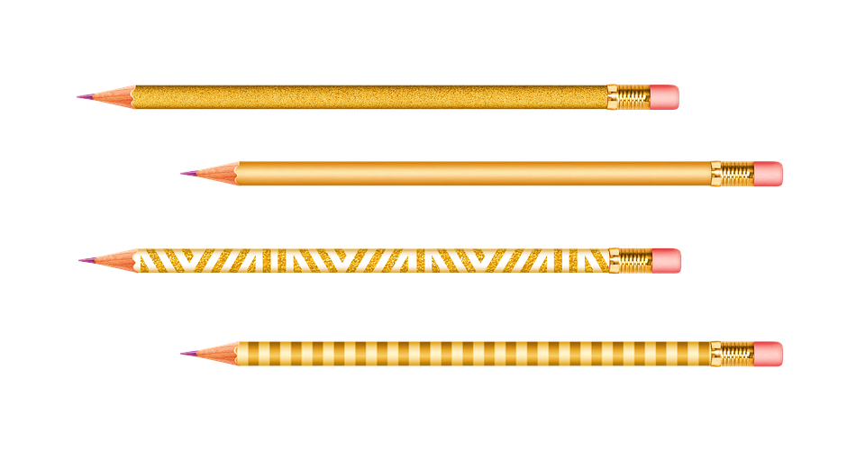
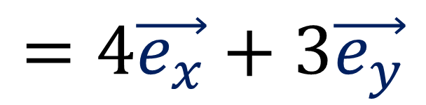

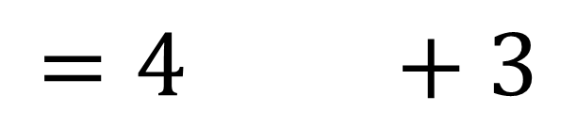
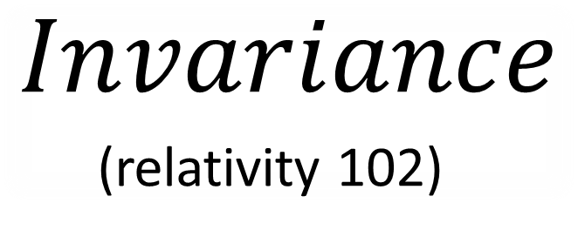

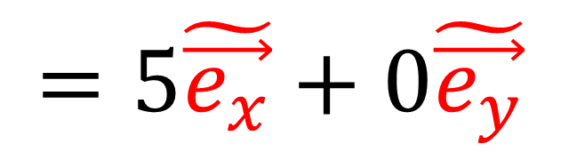

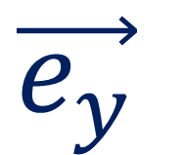
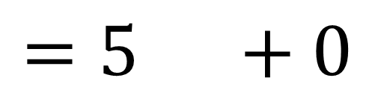
$$Invariance$$
(relativity 102)
$$=4 +3$$
$$=4\vec{e_{x}}+3\vec{e_{y}}$$
$$\vec{e_{y}}$$
$$\tilde{\vec{e_{y}}}$$
$$\tilde{\vec{e_{x}}}$$
$$=5 +0$$
$$\vec{e_{x}}$$
$$=5\tilde{\vec{e_{x}}}+0\tilde{\vec{e_{y}}}$$

Slide 13
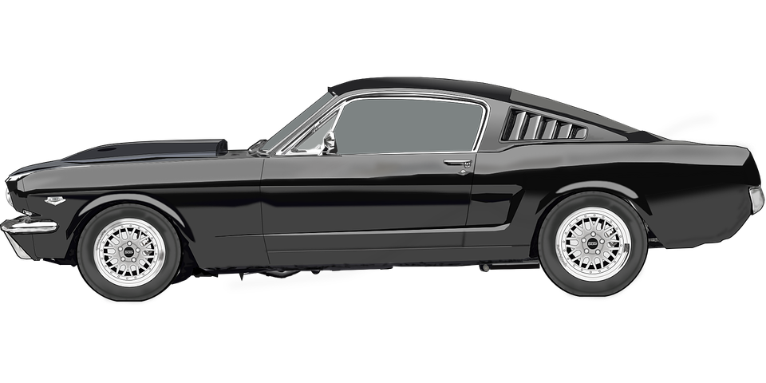
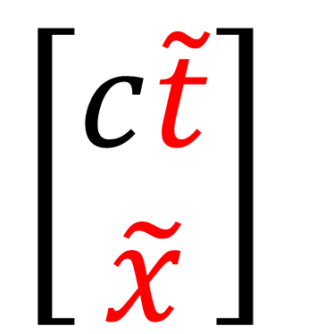
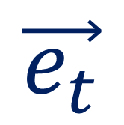
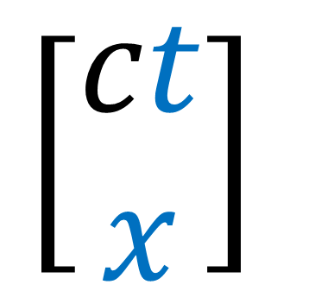
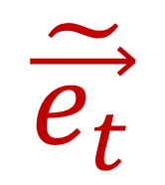
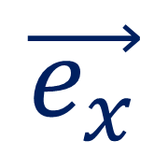
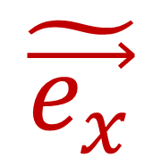
Reference Frame
Basis Vectors
Vector Components
$$\vec{e_{t}}$$
$$\left[\begin{aligned}ct \\ x\end{aligned}\right]$$
$$\vec{e_{x}}$$
$$\tilde{\vec{e_{t}}}$$
$$\left[\begin{aligned}c\tilde{t} \\ \tilde{x}\end{aligned}\right]$$
$$\tilde{\vec{e_{x}}}$$
Notes:
It’s important to remember that each reference frame has basis vectors AND vector componensts.

Slide 14
Lorentz Transformation changes both the basis and the components!
…and they change in opposite ways!
$$\vec{e_{y}}$$
$$x=4$$
$$\vec{e_{x}}$$
$$y=3$$
Vector Basis (Measuring Sticks)
Vector Components
(Coordinates/Numbers)
Notes:
The reason this is important to remember is because coordinate transformations, including the Lorentz transformation, will change both the basis vectors and the vector components.

Slide 15
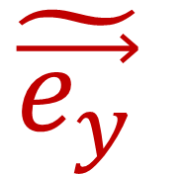
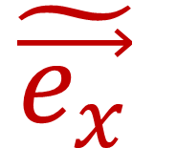
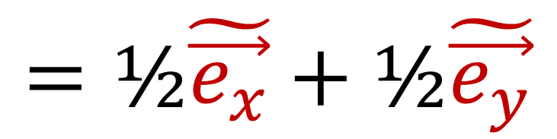
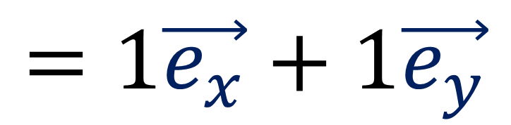
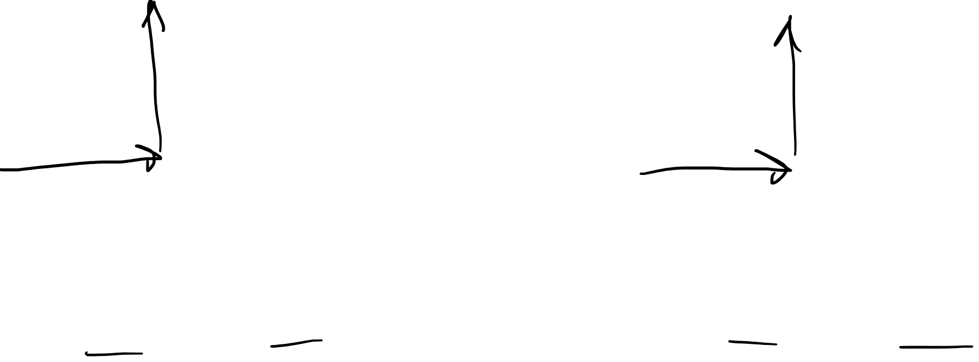
Basis Change changes both the basis and the components!
…and they change in opposite ways!
$$\tilde{\vec{e_{x}}}=2\vec{e_{x}}$$
$$\tilde{\vec{e_{y}}}=2\vec{e_{y}}$$
$$\tilde{\vec{e_{y}}}$$
$$\vec{e_{y}}$$
$$\tilde{\vec{e_{x}}}$$
$$\vec{e_{x}}$$
$$=1\vec{e_{x}}+1\vec{e_{y}}$$
$$=\text{½}\tilde{\vec{e_{x}}}+\text{½}\tilde{\vec{e_{y}}}$$
Notes:
In Relativity 102, I showed that if we took this basis eX and eY and measured this pencil to have components 1,1… If we doubled the length of the basis vectors, the components would become ½, ½.
This is because basis vectors are covariant and vector components are contravariant, which means they change in the opposite way that basis vectors do.

Slide 16
Covariant
Contravariant
$$\vec{e_{y}}$$
$$x=4$$
$$\vec{e_{x}}$$
$$y=3$$
Vector Basis (Measuring Sticks)
Vector Components
(Coordinates/Numbers)

Slide 17




Scaling 2D Space
$$\vec{S} =t\vec{e_{t}} +x\vec{e_{x}}= \left[\vec{e_{x}} \vec{e_{y}}\right]\left[\begin{aligned}x \\ y\end{aligned}\right]$$
$=\left[\vec{e_{x}} \vec{e_{y}}\right]\left[\begin{matrix}1 & 0 \\ 0 & 1\end{matrix}\right]\left[\begin{aligned}x \\ y\end{aligned}\right]$
$=\left[\vec{e_{x}} \vec{e_{y}}\right]\left[\begin{matrix}2 & 0 \\ 0 & 2\end{matrix}\right]\left[\begin{matrix}\text{½} & 0 \\ 0 & \text{½}\end{matrix}\right]\left[\begin{aligned}x \\ y\end{aligned}\right]$
$$=\tilde{t}\tilde{\vec{e_{t}}}+\tilde{x}\tilde{\vec{e_{x}}}= \left[\tilde{\vec{e_{t}}} \tilde{\vec{e_{x}}}\right] \left[\begin{aligned}\tilde{t} \\ \tilde{x}\end{aligned}\right]$$
$$\vec{S} =x\vec{e_{x}}+y\vec{e_{y}}$$
$$=\tilde{x}\tilde{\vec{e_{x}}}+\tilde{y}\tilde{\vec{e_{y}}}=$$
Opposite changes (Scaling Matrices) will balance out
Notes:
We can see covariance and contravariance show up when we take the vector S and write it in array notation, with a row of basis vectors multiplied by a column of vector components. If we insert an identity matrix between the basis and components, we can break it up into a transformation matrix for the basis vectors, and an inverse transformation matrix for the components. Here we can see that the opposite transformations cancel out and the result is we can write the same vector S using a different basis with different components.

Slide 18




Galilean Transformation
(Relativity 103c)
Change Basis
Change Components
$$\tilde{\vec{e_{t}}}=\vec{e_{t}}+v\vec{e_{x}}$$
$$\tilde{\vec{e_{x}}}=\vec{e_{x}}$$
$$\tilde{t}= t$$
$$\tilde{x}=−vt+x$$
Change Basis
Change Components
$$\left[\tilde{\vec{e_{t}}} \tilde{\vec{e_{x}}}\right]=\left[\vec{e_{t}} \vec{e_{x}}\right]\left[\begin{matrix}1 & 0 \\ v & 1\end{matrix}\right]$$
$$\left[\begin{aligned}\tilde{t} \\ \tilde{x}\end{aligned}\right]=\left[\begin{matrix}1 & 0 \\ −v & 1\end{matrix}\right]\left[\begin{aligned}t \\ x\end{aligned}\right]$$

Slide 19





$\left[\begin{matrix}1 & 0 \\ v & 1\end{matrix}\right]$ and $\left[\begin{matrix}1 & 0 \\ −v & 1\end{matrix}\right]$ are inverses!
Galilean Matrices
$$\left[\begin{matrix} 1 & 0 \\ −v & 1\end{matrix}\right]$$
$$\left[\begin{matrix} 1 & 0 \\ v & 1\end{matrix}\right]$$
$$\left[\begin{matrix} 1 & 0 \\ 0 & 1 \end{matrix}\right]$$
Notes:
We can understand the Galilean transformation in a similar way by looking at it in matrix form. Remember that to invert a Galilean matrix, we just change the sign of the velocity.
The Galilean matrices with +v and –v will multiply together to give the identity matrix.

Slide 20


Galilean Transformation
(Relativity 103c)
$$\vec{S} =t\vec{e_{t}} +x\vec{e_{x}}= \left[\vec{e_{t}} \vec{e_{x}}\right]\left[\begin{aligned}t \\ x\end{aligned}\right]$$
$=\left[\vec{e_{t}} \vec{e_{x}}\right]\left[\begin{matrix}1 & 0 \\ 0 & 1\end{matrix}\right]\left[\begin{aligned}t \\ x\end{aligned}\right]$
$=\left[\vec{e_{t}} \vec{e_{x}}\right]\left[\begin{matrix}1 & 0 \\ v & 1\end{matrix}\right]\left[\begin{matrix}1 & 0 \\ −v & 1\end{matrix}\right]\left[\begin{aligned}t \\ x\end{aligned}\right]$
$$=\tilde{t}\tilde{\vec{e_{t}}}+\tilde{x}\tilde{\vec{e_{x}}}= \left[\tilde{\vec{e_{t}}} \tilde{\vec{e_{x}}}\right] \left[\begin{aligned}\tilde{t} \\ \tilde{x}\end{aligned}\right]$$
Opposite changes (Galilean Matrices) will balance out
Notes:
We can change the components of a spacetime vector S toa new reference frame by changing the basis vectors with one Galilean matrix and changing the components with the inverse Galilean Matrix. The opposite changes balance out, and we can write S in terms of a new basis with new components.

Slide 21
Galilean Transformation
(Relativity 103c)
$$\vec{S} =t\vec{e_{t}} +x\vec{e_{x}}= \left[\vec{e_{t}} \vec{e_{x}}\right]\left[\begin{aligned}t \\ x\end{aligned}\right]$$
$=\left[\vec{e_{t}} \vec{e_{x}}\right]\left[\begin{matrix}1 & 0 \\ 0 & 1\end{matrix}\right]\left[\begin{aligned}t \\ x\end{aligned}\right]$
$=\left[\vec{e_{t}} \vec{e_{x}}\right]\left[\begin{matrix}1 & 0 \\ v & 1\end{matrix}\right]\left[\begin{matrix}1 & 0 \\ −v & 1\end{matrix}\right]\left[\begin{aligned}t \\ x\end{aligned}\right]$
$$=\tilde{t}\tilde{\vec{e_{t}}}+\tilde{x}\tilde{\vec{e_{x}}}= \left[\tilde{\vec{e_{t}}} \tilde{\vec{e_{x}}}\right] \left[\begin{aligned}\tilde{t} \\ \tilde{x}\end{aligned}\right]$$
Opposite changes (Galilean Matrices) will balance out

Slide 22



Lorentz Transformation
(Relativity 104b)
Change Components
$$c\tilde{t}=γ\left( ct−βx\right)$$
$$\tilde{x}=γ\left(−βct+ x\right)$$
$β=\frac{v}{c}$
(fraction of the speed of light)
Change Components
$$\left[\begin{matrix}c\tilde{t} \\ \tilde{x}\end{matrix}\right]=γ\left[\begin{matrix}1 & −β \\ −β & 1\end{matrix}\right]\left[\begin{matrix}ct \\ x\end{matrix}\right]$$

Slide 23




$γ=\frac{1}{\sqrt{1−β^{2}}}$
$γ\left[\begin{matrix}1 & β \\ β & 1\end{matrix}\right]$and $γ\left[\begin{matrix}1 & −β \\ −β & 1\end{matrix}\right]$ are inverses!
Lorentz Matrices
(no sign change)
$$β^{2}={\left(−β\right)}^{2}$$
Notes:
The same thing applies to the Lorentz transform. Remember, the beta coefficient is just a fraction of the speed of light, v/c, so it’s a bit like a velocity. To invert a Lorentz matrix, we just change the sign of the beta coefficients. Gamma doesn’t change sign, because –Beta squared is the same thing as + beta squared.
If we ignore the gamma coefficients and just multiply the matrices, we find that we get a matrix with 1-beta^2 on the diagonal.

Slide 24




$γ=\frac{1}{\sqrt{1−β^{2}}}$
$γ\left[\begin{matrix}1 & β \\ β & 1\end{matrix}\right]$and $γ\left[\begin{matrix}1 & −β \\ −β & 1\end{matrix}\right]$ are inverses!
Lorentz Matrices
$$\left[\begin{matrix}1 & −β \\ −β & 1\end{matrix}\right]$$
To start… ignore $γ$…
$$\left[\begin{matrix}1 & β \\ β & 1\end{matrix}\right]$$
$$\left[\begin{matrix}1−β^{2} & 0 \\ 0 & 1−β^{2}\end{matrix}\right]$$

Slide 25
$γ=\frac{1}{\sqrt{1−β^{2}}}$
$γ\left[\begin{matrix}1 & β \\ β & 1\end{matrix}\right]$and $γ\left[\begin{matrix}1 & −β \\ −β & 1\end{matrix}\right]$ are inverses!
Lorentz Matrices
$$\left[\begin{matrix}1 & −β \\ −β & 1\end{matrix}\right]$$
To start… ignore $γ$…
$$\left[\begin{matrix}1 & β \\ β & 1\end{matrix}\right]$$
$$\left[\begin{matrix}1−β^{2} & 0 \\ 0 & 1−β^{2}\end{matrix}\right]$$

Slide 26



$γ=\frac{1}{\sqrt{1−β^{2}}}$
$γ\left[\begin{matrix}1 & β \\ β & 1\end{matrix}\right]$and $γ\left[\begin{matrix}1 & −β \\ −β & 1\end{matrix}\right]$ are inverses!
Lorentz Matrices
$$γ\left[\begin{matrix}1 & β \\ β & 1\end{matrix}\right]γ\left[\begin{matrix}1 & −β \\ −β & 1\end{matrix}\right]$$
$=γ^{2}\left[\begin{matrix}1−β^{2} & 0 \\ 0 & 1−β^{2}\end{matrix}\right]=\frac{1}{1−β^{2}}\left[\begin{matrix}1−β^{2} & 0 \\ 0 & 1−β^{2}\end{matrix}\right]$
Notes:
If we include the gamma coefficients, multiplying Lorentz matrices gives us gamma squared out in front. If we plug this in for Gamma squared, we get 1/(1-beta^2). This cancels out with the 1-beta^2 in the matrix, and we end up with the identity matrix.
So we have shown that we can invert a Lorentz matrix just by changing the sign of Beta.

Slide 27



$γ=\frac{1}{\sqrt{1−β^{2}}}$
$γ\left[\begin{matrix}1 & β \\ β & 1\end{matrix}\right]$and $γ\left[\begin{matrix}1 & −β \\ −β & 1\end{matrix}\right]$ are inverses!
Lorentz Matrices
$$γ\left[\begin{matrix}1 & β \\ β & 1\end{matrix}\right]γ\left[\begin{matrix}1 & −β \\ −β & 1\end{matrix}\right]$$
$$\left[\begin{matrix} 1 & 0 \\ 0 & 1 \end{matrix}\right]$$
$=γ^{2}\left[\begin{matrix}1−β^{2} & 0 \\ 0 & 1−β^{2}\end{matrix}\right]=\frac{1}{1−β^{2}}\left[\begin{matrix}1−β^{2} & 0 \\ 0 & 1−β^{2}\end{matrix}\right]$

Slide 28


Lorentz Transform
$$\vec{S} =ct\vec{e_{t}} +x\vec{e_{x}}= \left[\vec{e_{t}} \vec{e_{x}}\right]\left[\begin{aligned}ct \\ x\end{aligned}\right]$$
$=\left[\vec{e_{t}} \vec{e_{x}}\right]\left[\begin{matrix}1 & 0 \\ 0 & 1\end{matrix}\right]\left[\begin{aligned}ct \\ x\end{aligned}\right]$
$=\left[\vec{e_{t}} \vec{e_{x}}\right]γ\left[\begin{matrix}1 & β \\ β & 1\end{matrix}\right]γ\left[\begin{matrix}1 & −β \\ −β & 1\end{matrix}\right]\left[\begin{aligned}ct \\ x\end{aligned}\right]$
$$=c\tilde{t}\tilde{\vec{e_{t}}}+\tilde{x}\tilde{\vec{e_{x}}}= \left[\tilde{\vec{e_{t}}} \tilde{\vec{e_{x}}}\right] \left[\begin{aligned}c\tilde{t} \\ \tilde{x}\end{aligned}\right]$$
Opposite changes (Lorentz Matrices) will balance out
Notes:
And once again, when we have a spacetime vector S written in array notation, We can change the basis vectors with one Lorentz matrix and change the vector components with the inverse Lorentz matrix. The opposite changes balance out and we can write the spacetime vector in terms of a new basis with new components.

Slide 29





Lorentz Transformation
(Relativity 104b)
Change Basis
Change Components
$$\tilde{\vec{e_{t}}}=γ\left( \vec{e_{t}}+β\vec{e_{x}}\right)$$
$$\tilde{\vec{e_{x}}}=γ\left(β\vec{e_{t}}+ \vec{e_{x}}\right)$$
$$c\tilde{t}=γ\left( ct−βx\right)$$
$$\tilde{x}=γ\left(−βct+ x\right)$$
Change Basis
Change Components
$$\left[\tilde{\vec{e_{t}}} \tilde{\vec{e_{x}}}\right]=\left[\vec{e_{t}} \vec{e_{x}}\right]γ\left[\begin{matrix}1 & β \\ β & 1\end{matrix}\right]$$
$$\left[\begin{matrix}c\tilde{t} \\ \tilde{x}\end{matrix}\right]=γ\left[\begin{matrix}1 & −β \\ −β & 1\end{matrix}\right]\left[\begin{matrix}ct \\ x\end{matrix}\right]$$

Slide 30




$v=\frac{4}{5}c$
$x=1 ct$
$$\vec{S}$$
(light beam)

Slide 31






Fraction of the speed of light $c$
$β=\frac{v}{c}$
$γ=\frac{1}{\sqrt{1−{\left(4/5\right)}^{2}}}$
$γ=\frac{1}{\sqrt{1−\left(16/25\right)}}$
$γ=\frac{1}{\sqrt{9/25}}=\frac{1}{3/5}$
$γ=\frac{5}{3}$
$$v=\left(4/5\right)c$$
$$β=4/5$$
Scaling Factor
$γ=\frac{1}{\sqrt{1−β^{2}}}$
Notes:
We know that the Beta coefficient is just the fraction of the speed of light, v/c. So if the car’s velocity is 4/5 the speed of light C, then the car’s beta coefficient is just 4/5. We also need to figure out the scaling factor Gamma for the Lorentz transformation. If we plug in beta = 4/5, we get Gamma = 1/ sqrt root of (1- 4/5 squared). 4/5 squared is 16/25. And 1 – 16/25 is just 9/25. The square root of 9 is 3, and the square root of 25 is 5, so the square root of 9/25 is just 3/5. And finally, 1 over 3/5 is just the reciprocal, 5/3, so Gamma = 5/3.

Slide 32






Lorentz Transformation (change of basis)
$$\vec{e_{t}}$$
$$\tilde{\vec{e_{t}}}$$
$$\vec{e_{x}}$$
$$\tilde{\vec{e_{x}}}$$
$β=\frac{4}{5}$
$γ=\frac{5}{3}$
Notes:
Now that we have Beta and Gamma, let’s try changing from Einstein’s spacetime basis (e_T and e_X), to the car’s spacetime basis. (e_T-tilde and e_X-tilde).
Remember we Lorentz transformation for vector components normally uses negative Beta. But since the basis vectors change in the opposite way that components do, we change the sign of beta to be positive instead.
Let’s plug in beta = 4/5 and Gamma = 5/3 into the Lorentz transformation equations.

Slide 33


Lorentz Transformation (change of basis)
$$+β$$
$$−β$$
Change Basis
Change Components
$$\left[\tilde{\vec{e_{t}}} \tilde{\vec{e_{x}}}\right]=\left[\vec{e_{t}} \vec{e_{x}}\right]γ\left[\begin{matrix}1 & β \\ β & 1\end{matrix}\right]$$
$$\left[\begin{matrix}c\tilde{t} \\ \tilde{x}\end{matrix}\right]=γ\left[\begin{matrix}1 & −β \\ −β & 1\end{matrix}\right]\left[\begin{matrix}ct \\ x\end{matrix}\right]$$

Slide 34


Lorentz Transformation (change of basis)
$$\vec{e_{t}}$$
$$\tilde{\vec{e_{t}}}$$
$$\vec{e_{x}}$$
$$\tilde{\vec{e_{x}}}$$
$β=\frac{4}{5}$
$$\tilde{\vec{e_{t}}}=γ\left( \vec{e_{t}}+β\vec{e_{x}}\right)$$
$$\tilde{\vec{e_{x}}}=γ\left(β\vec{e_{t}}+ \vec{e_{x}}\right)$$
$γ=\frac{5}{3}$

Slide 35


Lorentz Transformation (change of basis)
$$\vec{e_{t}}$$
$$\tilde{\vec{e_{t}}}$$
$$\vec{e_{x}}$$
$$\tilde{\vec{e_{x}}}$$
$\tilde{\vec{e_{t}}}=\frac{5}{3}\left( \vec{e_{t}}+\frac{4}{5}\vec{e_{x}}\right)$
$\tilde{\vec{e_{x}}}=\frac{5}{3}\left(\frac{4}{5}\vec{e_{t}}+ \vec{e_{x}}\right)$
Notes:
Now lets’ distribute the Gamma value of 5/3 into the brackets.

Slide 36


Lorentz Transformation (change of basis)
$$\vec{e_{t}}$$
$$\tilde{\vec{e_{t}}}$$
$$\vec{e_{x}}$$
$$\tilde{\vec{e_{x}}}$$
$\tilde{\vec{e_{t}}}= \frac{5}{3}\vec{e_{t}}+\frac{5}{3}\frac{4}{5}\vec{e_{x}}$
$\tilde{\vec{e_{x}}}=\frac{5}{3}\frac{4}{5}\vec{e_{t}}+ \frac{5}{3}\vec{e_{x}}$
Notes:
When we do 5/3 times 4/5, the 5 on top and the 5 in the bottom cancel out, and we get 4/3.

Slide 37






Lorentz Transformation (change of basis)
$$\vec{e_{t}}$$
$$\tilde{\vec{e_{t}}}$$
$$\vec{e_{x}}$$
$$\tilde{\vec{e_{x}}}$$
$\tilde{\vec{e_{t}}}=\frac{5}{3}\vec{e_{t}}+\frac{4}{3}\vec{e_{x}}$
$\tilde{\vec{e_{x}}}=\frac{4}{3}\vec{e_{t}}+\frac{5}{3}\vec{e_{x}}$
$$\vec{e_{t}}$$
$$\tilde{\vec{e_{t}}}$$
$$\tilde{\vec{e_{x}}}$$
$$\vec{e_{x}}$$
Notes:
Now that we have the equations to change basis according to the Lorentz transform, let’s draw out a picture to understand it better.
The eT-tilde basis vector equations 5/3 eT + 4/3 eX. So we need 5/3, or 1 and 2/3 of the eT basis vector, and also 4/3, or 1 and 1/3, or the eX basis vector, and that gives us eT-tilde.
Next for eX-tilde we need 5/3 of eX + 4/3 of eT
So as expected, the Lorentz transform causes the time and position axes to scissor together, and the axes are also scaled by the Gamma factor.

Slide 38





Lorentz Transformation (change of basis)
$$\vec{e_{t}}$$
$$\tilde{\vec{e_{t}}}$$
$$\vec{e_{x}}$$
$$\tilde{\vec{e_{x}}}$$
Basis: Man $→$ Car
Basis: Car $→$ Man
$$\tilde{\vec{e_{t}}}= γ\left( \vec{e_{t}}+β\vec{e_{x}}\right)$$
$$\tilde{\vec{e_{x}}}=γ\left(+β\vec{e_{t}}+ \vec{e_{x}}\right)$$
$$\vec{e_{t}}=γ\left( \tilde{\vec{e_{t}}}−β\tilde{\vec{e_{x}}}\right)$$
$$\vec{e_{x}}=γ\left(−β\tilde{\vec{e_{t}}}+ \tilde{\vec{e_{x}}}\right)$$
Notes:
Now let’s try going in the reverse direction, going from the car’s spacetime basis to Einstein’s spacetime basis.
Now remember, to reverse the Lorentz transformation, all we do is change the signs of the Beta coefficients. So here we’re changing the sign of Beta from positive to negative.

Slide 39
Lorentz Transformation (change of basis)
$$\vec{e_{t}}$$
$$\tilde{\vec{e_{t}}}$$
$$\vec{e_{x}}$$
$$\tilde{\vec{e_{x}}}$$
$\tilde{\vec{e_{t}}}=\frac{5}{3}\vec{e_{t}}+\frac{4}{3}\vec{e_{x}}$
$\tilde{\vec{e_{x}}}=\frac{4}{3}\vec{e_{t}}+\frac{5}{3}\vec{e_{x}}$

Slide 40







Lorentz Transformation (change of basis)
$$\vec{e_{t}}$$
$$\tilde{\vec{e_{t}}}$$
$$\vec{e_{x}}$$
$$\tilde{\vec{e_{x}}}$$
$\vec{e_{t}}= \frac{5}{3}\tilde{\vec{e_{t}}}−\frac{4}{3}\tilde{\vec{e_{x}}}$
$\vec{e_{x}}=−\frac{4}{3}\tilde{\vec{e_{t}}}+\frac{5}{3}\tilde{\vec{e_{x}}}$
$$\vec{e_{t}}$$
$$\tilde{\vec{e_{t}}}$$
$$\tilde{\vec{e_{x}}}$$
$$\vec{e_{x}}$$
$$\vec{e_{x}}$$
Notes:
So all we’re going to do to reverse the transformation is put negative signs on these 4/3 coefficients.
So to get eT, we need 5/3, of 1 and 2/3 of eT-tilde, and we subtract 4/3, or 1 and 1/3 of eX-tilde. Remember when we subtract a vector we reverse its direction, so instead of using + eX-tilde, which points to the upper-right, we use –eX-tilde, which points to the lower-left.
And that gives us the eT basis vector, which is what we started with before.
And to get eX, we need 5/3 of eX-tilde, and then subtract 4/3 of eT-tilde. And that also gives us the same eX we had before. So now the spacetime basis vectors have scissored apart, and again they are rescaled because of the Gamma factor.

Slide 41









Basis: Man $→$ Car
Basis: Car $→$ Man
$$\tilde{\vec{e_{t}}}=γ\left( \vec{e_{t}}+β\vec{e_{x}}\right)$$
$$\tilde{\vec{e_{x}}}=γ\left(+β\vec{e_{t}}+ \vec{e_{x}}\right)$$
$$\vec{e_{t}}=γ\left( \tilde{\vec{e_{t}}}−β\tilde{\vec{e_{x}}}\right)$$
$$\vec{e_{x}}=γ\left(−β\tilde{\vec{e_{t}}}+ \tilde{\vec{e_{x}}}\right)$$
$γ=+\frac{5}{3}$
$$\vec{e_{t}}$$
$$\tilde{\vec{e_{t}}}$$
$$\tilde{\vec{e_{x}}}$$
$$\vec{e_{t}}$$
$$\tilde{\vec{e_{t}}}$$
$$\tilde{\vec{e_{x}}}$$
$$\vec{e_{x}}$$
$$\vec{e_{x}}$$
Notes:
So we can see that the Lorentz transformation can bring us from Einstein’s spacetime basis to the car’s spacetime basis, and back again. All we need to do is flip the sign of the beta coefficient if we want to change the direction of the transformation.
One thing that might be surprising is that the Gamma factor of + 5/3 is the same in both cases. You might thing it’s impossible to scale by 5/3 to go from Einstein to the car, and then scale by 5/3 again to go back from the car to Einstein. But as we can see in these pictures, scaling by +5/3 in both the forward and reverse directions works out just fine.
The key difference is that the beta coefficients are positive in one set of equations, which pushes the new basis vectors to the upper right, But in the other direction the beta coefficients are negative and this helps pull the basis vectors back down where they started.

Slide 42





Basis: Man $→$ Car
Basis: Car $→$ Man
$$\left[\tilde{\vec{e_{t}}} \tilde{\vec{e_{x}}}\right]=\left[\vec{e_{t}} \vec{e_{x}}\right]γ\left[\begin{matrix}1 & β \\ β & 1\end{matrix}\right]$$
$$\left[\vec{e_{t}} \vec{e_{x}}\right]=\left[\tilde{\vec{e_{t}}} \tilde{\vec{e_{x}}}\right]γ\left[\begin{matrix}1 & −β \\ −β & 1\end{matrix}\right]$$
$γ=+\frac{5}{3}$
$$\vec{e_{t}}$$
$$\tilde{\vec{e_{t}}}$$
$$\tilde{\vec{e_{x}}}$$
$$\vec{e_{t}}$$
$$\tilde{\vec{e_{t}}}$$
$$\tilde{\vec{e_{x}}}$$
$$\vec{e_{x}}$$
$$\vec{e_{x}}$$
Notes:
And we can also write the basis-change Lorentz equations in matrix form like this. Remember basis vectors are covariant and so we write them as rows and put them on the left side of the Lorentz matrix.

Slide 43






Basis: Man $→$ Car
Basis: Car $→$ Man
$$\left[\tilde{\vec{e_{t}}} \tilde{\vec{e_{x}}}\right]=\left[\vec{e_{t}} \vec{e_{x}}\right]γ\left[\begin{matrix}1 & β \\ β & 1\end{matrix}\right]$$
$$\left[\vec{e_{t}} \vec{e_{x}}\right]=\left[\tilde{\vec{e_{t}}} \tilde{\vec{e_{x}}}\right]γ\left[\begin{matrix}1 & −β \\ −β & 1\end{matrix}\right]$$
Components: Man $→$ Car
Components: Car $→$ Man
$$\left[\begin{matrix}c\tilde{t} \\ \tilde{x}\end{matrix}\right]=γ\left[\begin{matrix}1 & −β \\ −β & 1\end{matrix}\right]\left[\begin{matrix}ct \\ x\end{matrix}\right]$$
$$\left[\begin{matrix}ct \\ x\end{matrix}\right]=γ\left[\begin{matrix}1 & β \\ β & 1\end{matrix}\right]\left[\begin{matrix}c\tilde{t} \\ \tilde{x}\end{matrix}\right]$$
Notes:
And we can also write the basis-change Lorentz equations in matrix form like this. Remember basis vectors are covariant and so we write them as rows and put them on the left side of the Lorentz matrix.

Slide 44
Strategy:
“Deeper” understanding of how Lorentz geometry affects time + space
Example calculations with time dilation and length contraction
Notes:
So at this point I think our understanding of the Lorentz transformation is good enough and we can start doing calculations with time dilation and length contraction.

Slide 45







Time dilation
$$\vec{e_{t}}$$
Measure the time component of a spacetime vector $\vec{S}$ in different bases.
$$\vec{e_{x}}$$
$$\vec{S}$$
$$\tilde{\vec{e_{t}}}$$
$$\tilde{\vec{e_{x}}}$$
Notes:
We’re going to see that Time Dilation is really just about measuring the time component of a spacetime vector S in difference bases. So if we have this spacetime vector S connecting a sneeze event and a clap event, time dilation is just measuring this vector with different basis and we’ll get a different time component in each basis.

Slide 46





$v=\frac{1}{2}c$
$β=\frac{1}{2}$
$x=1 ct$
(light beam)
$γ=\frac{1}{\sqrt{1−β^{2}}}=\frac{1}{\sqrt{1−{\left(1/2\right)}^{2}}}$
$=\frac{1}{\sqrt{1−1/4}}=\frac{1}{\sqrt{3/4}}=\frac{1}{\sqrt{3}/2}$
$=\frac{2}{\sqrt{3}}$
$$\vec{S}$$
Notes:
So once let’s say that Einstein is once again standing still, and from Einstein’s point of view the car is travelling to the right at ½ the speed of light.
So the car’s beta value is one half.
And you can check yourself that for a beta value of ½, the corresponding Gamma value is 2 over the square root 3.

Slide 47







$$β=\text{½}$$
$$\vec{S}=ct\vec{e_{t}}+x\vec{e_{x}}$$
$$\vec{S}= 3\vec{e_{t}}+0\vec{e_{x}}$$
$γ=\frac{2}{\sqrt{3}}$
time $t$
$$\vec{S}$$
happens
$3$ time units after, $0$ space units away
from
$$x=βct$$
Notes:
So let’s say that Einstein and the car start at the same time and place, which is an event where Einstein sneezes. Then, as they start travelling, Einstein claps his hands 3 time units later according to his own reference frame.
The separation vector S between the sneeze and the clap equations 3 eT + 0 eX in Einstein’s reference frame. This means that the clap happens 3 time units after and 0 space units away from the sneeze.

Slide 48









$$β=\text{½}$$
$$\vec{S}=ct\vec{e_{t}}+x\vec{e_{x}}$$
$$\vec{S}= 3\vec{e_{t}}+0\vec{e_{x}}$$
$γ=\frac{2}{\sqrt{3}}$
time $t$
$$\vec{e_{t}}$$
Basis: Man $→$ Car
$$\vec{e_{x}}$$
$$\tilde{\vec{e_{t}}}= γ\left( \vec{e_{t}}+β\vec{e_{x}}\right)$$
$$\tilde{\vec{e_{x}}}=γ\left(+β\vec{e_{t}}+ \vec{e_{x}}\right)$$
$$\tilde{\vec{e_{t}}}$$
$$\vec{S}$$
$$x=βct$$
$$\tilde{\vec{e_{x}}}$$
Components: Man $→$ Car
$$c\tilde{t}=γ\left( ct−βx\right)$$
$$\tilde{x}=γ\left(−βct+ x\right)$$
Notes:
Now if we want to find the time and position components of S for the car, we need to use the Lorentz transformation for the vector components.
(SHOW WE WHY ARE USING –BETA)

Slide 49


$$β=\text{½}$$
$$\vec{S}=ct\vec{e_{t}}+x\vec{e_{x}}$$
$$\vec{S}= 3\vec{e_{t}}+0\vec{e_{x}}$$
$γ=\frac{2}{\sqrt{3}}$
time $t$
$$c\tilde{t}=γ\left(ct−βx\right)$$
$c\tilde{t}=\frac{2}{\sqrt{3}}\left(ct−\frac{1}{2}x\right)$
$c\tilde{t}=\frac{2}{\sqrt{3}}\left((3)−\frac{1}{2}(0)\right)$
$$c\tilde{t}=2\sqrt{3}$$
$$\vec{S}$$
$$x=βct$$
Notes:
First we’ll calculate cT-tilde, the time of the clap according to the car. We’ll start by plugging in Beta=1/2 and gamma = 2/root 3. Then we’ll plug in ct = 3, and x = 0.
So the 2nd term goes to zero, and we’re left with 2/root 3 times 3. Since 3 = root 3 * root 3, we can do some cancelling, and we get that cT-tilde = 2 * root 3.

Slide 50


$$β=\text{½}$$
$$\vec{S}=ct\vec{e_{t}}+x\vec{e_{x}}$$
$$\vec{S}= 3\vec{e_{t}}+0\vec{e_{x}}$$
$γ=\frac{2}{\sqrt{3}}$
time $t$
$$\tilde{x}=γ\left(−βct+x\right)$$
$\tilde{x}=\frac{2}{\sqrt{3}}\left(−\frac{1}{2}ct+x\right)$
$\tilde{x}=\frac{2}{\sqrt{3}}\left(−\frac{1}{2}(3)+(0)\right)$
$$\tilde{x}=−\sqrt{3}$$
$$\vec{S}$$
$$x=βct$$
Notes:
Next we’ll calculate x-tilde, the position of the clap according to the car.
Again we’ll plug in Beta and Gamma.
Then we’ll plug in ct = 3 and x = 0. Again, the 2nd term is zero, and for the first term, the 2 on top cancels with the 2 on the bottom. And again we can cancel a factor of root 3.
So we end up with x-tilde = negative root 3.

Slide 51


$$β=\text{½}$$
$γ=\frac{2}{\sqrt{3}}$
$$\vec{S}= c\tilde{t}\tilde{\vec{e_{t}}}+ \tilde{x} \tilde{\vec{e_{x}}}$$
$$=2\sqrt{3} \tilde{\vec{e_{t}}}−\sqrt{3} \tilde{\vec{e_{x}}}$$
time $t$
$$\vec{S}$$
happens
$2\sqrt{3}$ time units after, $\sqrt{3}$ space units to the left of
$$x=βct$$
Notes:
This means that the clap happens 2*root 3 time units after and root 3 space units to the left of the sneeze.

Slide 52


$$β=\text{½}$$
$γ=\frac{2}{\sqrt{3}}$
$$\vec{S}= c\tilde{t}\tilde{\vec{e_{t}}}+ \tilde{x} \tilde{\vec{e_{x}}}$$
$$=2\sqrt{3} \tilde{\vec{e_{t}}}−\sqrt{3} \tilde{\vec{e_{x}}}$$
time $t$
$$\vec{S}$$
happens
$3.46$ time units after, $1.73$ space units to the left of
$$x=βct$$
Notes:
In decimals, this is 3.46 time units after, and 1.73 space units to the left of the sneeze.
Remember since the position component x-tilde is negative, so this means the sneeze happens to the left. This makes sense since the car is travelling right, and the clap happens behind it off to the left.,

Slide 53











$$β=\text{½}$$
$γ=\frac{2}{\sqrt{3}}$
$$\vec{S}=ct\vec{e_{t}}+x\vec{e_{x}}$$
$$\vec{S}= 3\vec{e_{t}}+0\vec{e_{x}}$$
$$\vec{S}=c\tilde{t}\tilde{\vec{e_{t}}}+\tilde{x}\tilde{\vec{e_{x}}}$$
$$\vec{S}=2\sqrt{3}\tilde{\vec{e_{t}}}−\sqrt{3}\tilde{\vec{e_{x}}}$$
$$\vec{S}≈3.46\tilde{\vec{e_{t}}}−1.73\tilde{\vec{e_{x}}}$$
$$\vec{S}$$
$$\tilde{\vec{e_{t}}}$$
$$\vec{e_{t}}$$
$$\tilde{\vec{e_{x}}}$$
$$c\tilde{t}=γ\left(ct\right)$$
$c\tilde{t}=$ $\frac{2}{\sqrt{3}}\left(3\right)=2\sqrt{3}$
$$\vec{e_{x}}$$
Notes:
And we can see all this matches up with our spacetime diagram.
Einstein requires exactly 3 time vectors and zero position vectors to get the separation vector S, which matches the components 3 and 0. Meanwhile the car needs about 3-and-a-half time vectors and slightly less than 2 reversed position vectors to get S. This matches with the components 3.476 and -1.73
So the man and the car clearly measure the time between the sneeze and the clap to be different. Einstein observes them 3 time units apart and the car observes them 3.46 time units apart.
And the reason that Einstein measures 3 and the car measures 3.46 is because of the gamma factor. If we multiply Einstein’s time measurement by the Gamma factor, we get the car’s time measurement, 2*root 3. So we have confirmed that the times are, in fact different.

Slide 54






$$β=\text{½}$$
$$\vec{T}=c\tilde{t}\tilde{\vec{e_{t}}}+\tilde{x}\tilde{\vec{e_{x}}}$$
$$\vec{S}= 3\tilde{\vec{e_{t}}}+0\tilde{\vec{e_{x}}}$$
$γ=\frac{2}{\sqrt{3}}$
$$\vec{T}$$
$$\tilde{\vec{e_{t}}}$$
$$\tilde{\vec{e_{x}}}$$
Notes:
Now another interesting question to ask is, instead of looking at the time between Einstein sneezing and clapping….
Let’s look at the time between the sneeze and the driver of the car snapping their fingers. We’ll denote the separation between the sneeze and the snap by the separation vector T. T is equal to exactly 3 time units in the car’s reference frame, so e eT-tilde + 0 eX-tilde.
Now we can covert these to Einstein’s components using the Lorentz transformation, but with +ve beta coefficients this time.

Slide 55





$$β=\text{½}$$
$$\vec{T}=c\tilde{t}\tilde{\vec{e_{t}}}+\tilde{x}\tilde{\vec{e_{x}}}$$
$$\vec{S}= 3\tilde{\vec{e_{t}}}+0\tilde{\vec{e_{x}}}$$
$γ=\frac{2}{\sqrt{3}}$
Components: Man $→$ Car
$$c\tilde{t}=γ\left( ct−βx\right)$$
$$\tilde{x}=γ\left(−βct+ x\right)$$
$$\vec{T}$$
Components: Car $→$ Man
$$\tilde{\vec{e_{t}}}$$
$$ct=γ\left( c\tilde{t}+β\tilde{x}\right)$$
$x=γ\left(+βc\tilde{t}+ \tilde{x}\right)$
$$\tilde{\vec{e_{x}}}$$

Slide 56

$$β=\text{½}$$
$$\vec{T}=c\tilde{t}\tilde{\vec{e_{t}}}+\tilde{x}\tilde{\vec{e_{x}}}$$
$$\vec{S}= 3\tilde{\vec{e_{t}}}+0\tilde{\vec{e_{x}}}$$
$γ=\frac{2}{\sqrt{3}}$
$$\vec{T}=ct\vec{e_{t}}+x\vec{e_{x}}$$
$$\vec{S}=2\sqrt{3}\vec{e_{t}}+\sqrt{3}\vec{e_{x}}$$
$$\vec{T}$$
Components: Car $→$ Man
$$\tilde{\vec{e_{t}}}$$
$$ct=γ\left( c\tilde{t}+β\tilde{x}\right)$$
$x=γ\left(+βc\tilde{t}+ \tilde{x}\right)$
$$\tilde{\vec{e_{x}}}$$

Slide 57










$$β=\text{½}$$
$$\vec{T}=c\tilde{t}\tilde{\vec{e_{t}}}+\tilde{x}\tilde{\vec{e_{x}}}$$
$$\vec{S}= 3\tilde{\vec{e_{t}}}+0\tilde{\vec{e_{x}}}$$
$γ=\frac{2}{\sqrt{3}}$
$$\vec{T}=ct\vec{e_{t}}+x\vec{e_{x}}$$
$$\vec{S}=2\sqrt{3}\vec{e_{t}}+\sqrt{3}\vec{e_{x}}$$
$$\vec{S}≈3.46\vec{e_{t}}+1.73\vec{e_{x}}$$
$$\vec{T}$$
$$\tilde{\vec{e_{t}}}$$
$$\vec{e_{t}}$$
$$ct=γ\left(c\tilde{t}\right)$$
$ct=$ $\frac{2}{\sqrt{3}}\left(3\right)=2\sqrt{3}$
$$\tilde{\vec{e_{x}}}$$
$$\vec{e_{x}}$$
Notes:
And if we work all that out we get that T for Einstein = 2*root 3 time vectors + root 3 position vectors.
And in decimals this is about 3.46 time vectors + 1.73 position vectors.
So we can clearly see that Einstein and the car measure different times between the sneezing event at the snapping event.
Once again the relationship between the car’s time and Einstein’s time is giving by multiplication by the gamma factor. If we take the car’s time of 3 and multiply it by the gamma factor, 2 over root 3, we get Einstein’s time, 2 * root 3

Slide 58



$$γ≥1$$
$$c\tilde{t}=γ\left(ct\right)$$
$$ct=γ\left(c\tilde{t}\right)$$
Contradiction???

Slide 59













$$γ≥1$$
Components: Man $→$ Car
Components: Car $→$ Man
$$c\tilde{t}=γ\left( ct−βx\right)$$
$$\tilde{x}=γ\left(−βct+ x\right)$$
$$ct=γ\left( c\tilde{t}+β\tilde{x}\right)$$
$$x=γ\left(+βc\tilde{t}+ \tilde{x}\right)$$
for $x=0$
for $\tilde{x}=0$
$$\vec{S}$$
$$\vec{T}$$
$$c\tilde{t}=γ\left(ct\right)$$
$$ct=γ\left(c\tilde{t}\right)$$
$$\vec{e_{x}}$$
$$\tilde{\vec{e_{x}}}$$
Notes:
The key to untangling the apparent contradiction is to remember that we’re measuring different spacetime vectors in both cases. Along the S vector, Einstein’s position coordinate x is zero, and so the Lorentz transformation for time simplifies to cT-tilde = gamma * cT
And along the T vector, the car’s position coordinate x-tilde is zero, and so the Lorentz transformation for time simplifies to cT = gamma * cT-tilde.

Slide 60














“Time between 2 events is shortest in a reference frame where the events are at the same position.”
$$\vec{S}$$
$$\vec{T}$$
$$\tilde{\vec{e_{t}}}$$
$$\tilde{\vec{e_{t}}}$$
$$\vec{e_{t}}$$
$$\vec{e_{t}}$$
$$\tilde{\vec{e_{x}}}$$
$$\tilde{\vec{e_{x}}}$$
$$\vec{e_{x}}$$
$$\vec{e_{x}}$$
$$c\tilde{t}=γ\left(ct\right)$$
$$γ≥1$$
$$ct=γ\left(c\tilde{t}\right)$$
Notes:
So for the time between the sneeze and the clap, the time dilation effect is given by this equation. And for the time between the sneeze and the snap, the time dilation effect is given by this equation.
Remember, Gamma is always greater than or equal to 1, so it makes the time increase.
At first glace this seems like a contradiction because in the first equation, Einstein’s time is shorter and the car’s time is longer, But we need to remember that we’re measuring two different things here.
In the case of the sneeze and the clap, both events happen in Einstein’s frame. This means that Einstein will measure the time between them to be shorter, and the car measures a longer time
And in the case of the sneeze and the snap, both events happen in the car’s frame. This means the car will measure the time between them to be shorter, and Einstein measures a longer time.

Slide 61












$$c\tilde{t}=γ\left(ct\right)$$
$$γ≥1$$
$$1$$
“Moving clocks run slow.”
$$γ≥1$$
$$1$$
$$γ≥1$$
$$1$$
(Time between clock ticks is fastest in the frame of the clock.)
$$\tilde{\vec{e_{t}}}$$
$$\vec{e_{t}}$$
$$1$$
$$γ≥1$$

Slide 62
Time dilation
$$\vec{e_{t}}$$
Measure the time component of a spacetime vector $\vec{S}$ in different bases.
$$\vec{e_{x}}$$
$$\vec{S}$$
$$\tilde{\vec{e_{t}}}$$
$$\tilde{\vec{e_{x}}}$$
Notes:
So again, time dilation is just the result of measuring the time component of a spacetime vector in different basis.

Slide 63






Length Contraction
$$\tilde{\vec{e_{t}}}$$
$$\vec{e_{t}}$$
$$\tilde{\vec{e_{x}}}$$
Measure the distance component of a spacetime vector $\vec{R}$ in different bases?
$$\vec{e_{x}}$$
$$\vec{R}$$
Wrong!!!
train
Notes:
Now let’s talk about length contraction. Now, as I said at the beginning of this video, Length contraction is NOT about measuring the same vector S with different basis vectors. So length contraction is fundamentally different than time dilation.
And I’ll explain why…

Slide 64
Length Contraction
$$\vec{e_{t}}$$
Measure the distance component of a spacetime vector $\vec{R}$ in different bases?
$$\vec{e_{x}}$$
simultaneity
train back
train front
$$\vec{R}$$
Wrong!!!
train
Notes:
In Einstein’s coordinate system, lines of simultaneity are horizontal. This means events that happens at the same time lie on horizontal lines. In this case it makes sense to measure the vector R to get the length of the train because we are measuring the back and the front of the train at the same time.

Slide 65

Length Contraction
$$\tilde{\vec{e_{t}}}$$
$$\tilde{\vec{e_{x}}}$$
Measure the distance component of a spacetime vector $\vec{R}$ in different bases?
train back
simultaneity
train front
$$\vec{R}$$
Wrong!!!
train
Notes:
However in the car’s reference frame, the lines of simultaneity are diagonal. So if we measure the vector R in the car’s reference frame, the back and the front of the vector S are not on the same line of simultaneity, so it’s line we’re measuring the back of the train at one time and the front of the train at another time, and that doesn’t really make sense for measuring the length of the train.

Slide 66



Length Contraction
$$\tilde{\vec{e_{t}}}$$
$$\vec{e_{t}}$$
$$\tilde{\vec{e_{x}}}$$
Measure the distance component along lines of simultaneity in different bases.
$$\vec{e_{x}}$$
$$\vec{M}$$
train back
simultaneity
train front
$$\vec{R}$$
train
Notes:
The correct thing to do is measure the length of the train along a line of simultaneity in the new basis, so instead for the car we should measure this new vector M which is aligned with a line of simultaneity. I’ll show you how to do this using an example.

Slide 67















$$\vec{M}=m\tilde{\vec{e_{x}}}$$
Basis: Man $→$ Car
train
$$\tilde{\vec{e_{t}}}=γ\left( \vec{e_{t}}+β\vec{e_{x}}\right)$$
$$\tilde{\vec{e_{x}}}=γ\left(β\vec{e_{t}}+ \vec{e_{x}}\right)$$
$$\vec{R}=r\vec{e_{x}}$$
$$\vec{D}=d\vec{e_{t}}$$
$\vec{M} = \vec{D} + \vec{R}$
$m \tilde{\vec{e_{x}}}=d\vec{e_{t}}+r\vec{e_{x}}$
$mγ\left(β\vec{e_{t}}+\vec{e_{x}}\right)=d\vec{e_{t}}+r\vec{e_{x}}$
$$mγβ\vec{e_{t}}+mγ\vec{e_{x}}=d\vec{e_{t}}+r\vec{e_{x}}$$
$m=\left(1/γ\right)r$
$$\vec{M}$$
$$\tilde{\vec{e_{t}}}$$
$$\vec{e_{t}}$$
$$\vec{D}$$
$$\tilde{\vec{e_{x}}}$$
train back
$$\vec{e_{x}}$$
$$\vec{R}$$
train front
Notes:
So let’s say we have a train that’s stationary, so the worldlines of its back and front are vertical on a spacetime diagram.
For Einstein, who is also stationary with a vertical worldline, we measure the length of a train using a horizontal vector R, since lines of simultaneity are horizontal for Einstein.
Now for a moving car, we should measure the length of the train using this diagonal vector M, which is aligned with the car’s lines of simultaneity. I’ll also add this vector D which connects the tip of R to the tip of M.
So, the M vector is parallel with eX-tilde, so M must be some constant lower-case m time eX-tilde. Lower-case m is the length of the train in the moving car frame. Also, R is parallel with eX, so it equals some constant lower-case r times eX. Lower-case r is the length of the train in Einstein’s resting frame.
Finally D is parallel to eT, so it equals some constant lower-case d times eT.
Now, I’m hoping it’s obvious that M = D plus R, since going along R, then D gives us M. And if we sub in all this information into this equation, we get m eX-tilde = d eT + r eX. If we recall our standard Lorentz transformation for the basis vectors, we can sub this formula in for eX-tilde, to get it in terms of eT and eX. Then, distributing Gamma we get this.
Now on both sides of this equation, we have a sum of eT vectors and eX vectors.
So it should make sense that the eX components on both sides of the equation are exactly equal to each other.
In other words, m*Gamma = r, Or, rearranging, m = 1/Gamma * r.

Slide 68





$$\vec{M}=m\tilde{\vec{e_{x}}}$$
$m=\frac{1}{γ}r$
train
$$\vec{R}=r\vec{e_{x}}$$
$γ≥1$
$⇒\frac{1}{γ}≤1$
$$\vec{D}=d\vec{e_{t}}$$
$m<r$
$$\vec{M}$$
$$\tilde{\vec{e_{t}}}$$
$$\vec{e_{t}}$$
Length according to car (moving)
Length according to Einstein (rest)
$$\vec{D}$$
$$\tilde{\vec{e_{x}}}$$
Moving objects appear shorter.
(in direction of motion)
train back
$$\vec{e_{x}}$$
$$\vec{R}$$
train front
Notes:
So what does this equation mean? Remember, lower-case R is the length of the train when observed from Einstein’s rest frame. And lower-case M is the length of the train when observed from the car’s moving frame. And recall that gamma is always equal to or greater than 1. This means that 1/Gamma is equal to or less than one, so lower-case M is always less than R.
What this means is that the length in a moving frame is always less than. In other words, moving objects appear shortened in the direction of motion.

Slide 69







$m=\frac{1}{γ}r$
train
Length according to car (moving)
Length according to Einstein (rest)
$$m=2.6$$
$m=\frac{1}{γ}r$
$m=\frac{1}{2/\sqrt{3}}(3)$
$m=2.6$
$γ=\frac{2}{\sqrt{3}}$
$$\tilde{\vec{e_{x}}}$$
$$\vec{e_{x}}$$
$$r=3$$

Slide 70











Basis: Car $→$ Man
train
$$\vec{e_{t}}=γ\left( \tilde{\vec{e_{t}}}−β\tilde{\vec{e_{x}}}\right)$$
$$\vec{e_{x}}=γ\left(−β\tilde{\vec{e_{t}}}+ \tilde{\vec{e_{x}}}\right)$$
$$\vec{M}=m\vec{e_{x}}$$
$$\vec{R}=r\tilde{\vec{e_{x}}}$$
$\vec{M} = \vec{D} + \vec{R}$
$$m\vec{e_{x}}=−d\tilde{\vec{e_{t}}}+r\tilde{\vec{e_{x}}}$$
$$mγ\left(−β\tilde{\vec{e_{t}}}+\tilde{\vec{e_{x}}}\right)=−d\tilde{\vec{e_{t}}}+r\tilde{\vec{e_{x}}}$$
$$mγβ\tilde{\vec{e_{t}}}+mγ\tilde{\vec{e_{x}}}=−d\tilde{\vec{e_{t}}}+r\tilde{\vec{e_{x}}}$$
$m=\left(1/γ\right)r$
$$\vec{D}=−d\tilde{\vec{e_{t}}}$$
$$\tilde{\vec{e_{t}}}$$
$$\vec{e_{t}}$$
$$\vec{R}$$
$$\vec{D}$$
$$\tilde{\vec{e_{x}}}$$
train back
$$\vec{e_{x}}$$
$$\vec{M}$$
train front
Notes:
We can also repeat this experiment in the situation where the train is stationary with respect to the car, and moving with respect to Einstein.
In this case, we call this vector R since it’s along a line of simultaneity that’s at rest with respect to the car and the train. And this vector M is along a line of simultaneity for Einstein, who is moving with respect to the train.
And again D connects the tips of M and R.
If we see that M is parallel to eX, R is parallel to eX-tilde and D is parallel to eT-tilde, we can write out the vector equation just as before and once again deduce that the moving length m = 1/Gamma times the rest length r.

Slide 71



$m=\frac{1}{γ}r$
$\frac{1}{γ}≤1$
train
$$\vec{M}=m\vec{e_{x}}$$
$$\vec{R}=r\tilde{\vec{e_{x}}}$$
$m<r$
$$\vec{D}=−d\tilde{\vec{e_{t}}}$$
$$\tilde{\vec{e_{t}}}$$
Length according to Einstein (moving)
Length according to car (rest)
$$\vec{e_{t}}$$
$$\vec{R}$$
$$\vec{D}$$
$$\tilde{\vec{e_{x}}}$$
Moving objects appear shorter.
(in direction of motion)
train back
$$\vec{e_{x}}$$
$$\vec{M}$$
train front
Notes:
Once again this shows us that moving objects appear shorter in the direction of motion compared to that object’s length when it’s at rest.

Slide 72








${\tilde{L}}_{car}=\frac{1}{γ}L_{man}$
$\frac{1}{γ}≤1$
$L_{man}=\frac{1}{γ}{\tilde{L}}_{car}$
train
train
$${\tilde{L}}_{car}$$
$${\tilde{L}}_{car}$$
$$\tilde{\vec{e_{x}}}$$
$$\tilde{\vec{e_{x}}}$$
$$\vec{e_{x}}$$
$L_{man}$
$$\vec{e_{x}}$$
$L_{man}$

Slide 73

An object’s length is always longest when measured in its rest frame.
${\tilde{L}}_{car}=\frac{1}{γ}L_{man}$
$\frac{1}{γ}≤1$
$L_{man}=\frac{1}{γ}{\tilde{L}}_{car}$
train
train
$${\tilde{L}}_{car}$$
$${\tilde{L}}_{car}$$
$$\tilde{\vec{e_{x}}}$$
$$\tilde{\vec{e_{x}}}$$
$$\vec{e_{x}}$$
$L_{man}$
$$\vec{e_{x}}$$
$L_{man}$

Slide 74
${\tilde{L}}_{car}=\frac{1}{γ}L_{man}$
$\frac{1}{γ}≤1$
$L_{man}=\frac{1}{γ}{\tilde{L}}_{car}$
train
train
$${\tilde{L}}_{car}$$
$${\tilde{L}}_{car}$$
$$\tilde{\vec{e_{x}}}$$
$$\tilde{\vec{e_{x}}}$$
$$\vec{e_{x}}$$
$L_{man}$
$$\vec{e_{x}}$$
$L_{man}$

Slide 75



Length Contraction
$$\tilde{\vec{e_{t}}}$$
$$\vec{e_{t}}$$
Measure the distance component along lines of simultaneity in different bases.
$$\tilde{\vec{e_{x}}}$$
$$\vec{e_{x}}$$
$$\vec{M}$$
$$\vec{R}$$
train
Notes:
So remember, in geometric terms, Length contraction is about measuring the distance between a pair of worldlines along two different vectors in different reference frames. These two different vectors lie on the lines of simultaneity for each reference frame.

Slide 76











Example: Muon decay
stationary muon
$$v=0$$
decay
$$μ^{−}$$
$$μ^{−}$$
$$μ^{−}$$
$$2 μs$$
$$β=\frac{v}{c}=0.995$$
moving muon
$$v=0.995c$$
decay
$$μ^{−}$$
$$μ^{−}$$
$$20 μs$$
Notes:
The last thing I’ll do in this video is explain how time dilation and length contraction relate to Muon decay. In Relativity 101b, I gave the example of a how a muon particle that’s stationary will live for about 2 microseconds on average before it decays.
But that same muon, if it’s moving at close to the speed of light relative to the earth, scientists on the earth will observe the muon living for about 20 microseconds, 10 times longer, because of time dilation, before it decays. And this sounds pretty crazy, but it’s not that hard to explain if we use vectors and the idea of invariance.

Slide 77







$$β=\frac{v}{c}=0.995$$
Basis: Earth $→$ Muon
$$\tilde{\vec{e_{t}}}=γ\left( \vec{e_{t}}+β\vec{e_{x}}\right)$$
$$\tilde{\vec{e_{x}}}=γ\left(β\vec{e_{t}}+ \vec{e_{x}}\right)$$
$$γ=\frac{1}{\sqrt{1−β^{2}}}$$
$$γ=\frac{1}{\sqrt{1−{\left(0.995\right)}^{2}}}$$
$$γ≈10.0125$$
$$γ≈10$$
$$\tilde{\vec{e_{t}}}=10\left( \vec{e_{t}}+0.995\vec{e_{x}}\right)$$
$$\tilde{\vec{e_{x}}}=10\left(0.995\vec{e_{t}}+ \vec{e_{x}}\right)$$
$$\tilde{\vec{e_{t}}}= 10\vec{e_{t}}+9.95\vec{e_{x}}$$
$$\tilde{\vec{e_{x}}}=9.95\vec{e_{t}}+ 10\vec{e_{x}}$$
Forward (components)
$$c\tilde{t}=γ\left( ct−βx\right)$$
$$\tilde{x}=γ\left(−βct+ x\right)$$
Notes:
If the muon is travelling 0.995 times the speed of light, it’s Beta value is 0.995, and the Gamma value is about 10.
We can plug those into the Lorentz transformation for the basis vectors here. This transforms between the basis vectors in earth’s frame to the basis vectors in the muon’s frame.

Slide 78










$$γ≈10$$
$$β=0.995$$
$$\tilde{\vec{e_{t}}}= 10\vec{e_{t}}+9.95\vec{e_{x}}$$
$$\tilde{\vec{e_{x}}}=9.95\vec{e_{t}}+ 10\vec{e_{x}}$$
$$9.95\vec{e_{x}}$$
Drawing this to-scale is too difficult.
$$\tilde{\vec{e_{t}}}$$
$$10\vec{e_{t}}$$
$$9.95\vec{e_{t}}$$
$$\tilde{\vec{e_{x}}}$$
$$10\vec{e_{x}}$$
Notes:
Now with a speed that’s this large, 0.995 times the speed of light, it ends up being difficult to draw a picture of the spacetime vectors, because the muon’s basis vectors are bent toward each other so much.

Slide 79








Correct scale (but hard to see)
Slightly incorrect scale (but easy to see)
$$\tilde{\vec{e_{t}}}$$
$$\tilde{\vec{e_{t}}}$$
$$\tilde{\vec{e_{x}}}$$
$$\tilde{\vec{e_{x}}}$$
$$\vec{e_{x}}$$
$$\vec{e_{t}}$$
$$\vec{e_{x}}$$
$$\vec{e_{t}}$$
Notes:
So to sum up this video, both time dilation and length contraction have simple geometrical interpretation on a spacetime diagram.
Time dilation is just the result of measuring the time component of a spacetime vector in different coordinate systems. The shortest time between two events will always be for a reference frame whose worldline connects both events.
Length contraction is the result of taking a pair of worldlines and measuring the distance between the along two different vectors. These two vectors are parallel with the lines of simultaneity for two different reference frames. A object will always appear longest in a reference frame that’s at rest with respect to the object.

Slide 80










(Not to scale)
$$μ^{−}$$
$$μ^{−}$$
Atmosphere
Earth’s Surface
$$2 μs$$
Time dilation
$$\tilde{\vec{e_{t}}}$$
$$20 μs$$
$$γ≈10$$
$$\tilde{\vec{e_{x}}}$$
$$\left(20 μs\right)=γ\left(2 μs\right)$$
$$\vec{e_{x}}$$
$$\vec{e_{t}}$$
$$μ^{−}$$
Notes:
So I’m going to try and draw a spacetime diagram for how the muon decays, but it’s not going to be exactly to scale. I’m drawing the muon spacetime basis in a way that’s a bit easier to see, but it’s not totally mathematically correct. In reality they’d be must closer together than this.
But let’s say that a muon is created in the Earth’s atmosphere and moves toward the right at 0.995 times the speed of light until it decays at Earth’s surface.
Let’s first examine how time dilation impacts this situation, by measuring this spacetime vector S. If we measure the vector S using the muon’s spacetime basis, we find it takes about 2 microseconds for the muon to reach the earth’s surface. But if we measure the vector S using the earth’s spacetime basis, we find it takes about 20 microseconds for the muon to reach the earth’s surface.
This explains why scientists on the earth observer muons living longer than the expected amount, because they are moving with respect to the muon, and observe time dilation by a factor of 10.
Now let’s observe how length contraction works in this scenario. According to the reference frame of the earth and people living on it, the distance between the atmosphere and the earth’s surface is given by the length of this vector parallel to the earth’s position axis, which is about 6 and a half kilometers. But if we look in the reference frame of the muon, because the earth is moving, the distance between the earth’s atmosphere and the earth’s surface is length contracted and appears to be 10 times smaller, only 650 meters.
So according to scientists on earth, the reason the muon reaches the earth’s surface before decaying is because time dilation caused it to live 10 times longer than expected. But according to the muon, the reason it reached the earth’s surface is because it lived the normal amount of time, but the earth’s atmosphere and surface underwent length contraction, so the journey to get to earth wasn’t as far.

Slide 81






(Not to scale)
$$μ^{−}$$
$$μ^{−}$$
Atmosphere
Earth’s Surface
Length Contraction
$$γ≈10$$
$$\tilde{\vec{e_{t}}}$$
$$650m$$
$\left(650m\right)=\frac{1}{γ}\left(6500m\right)$
$$\tilde{\vec{e_{x}}}$$
$$\vec{e_{x}}$$
$$μ^{−}$$
$$\vec{e_{t}}$$
$$6500m$$

Slide 82








Muon Journey
$$20 μs$$
$$6500m$$
Length Contraction
Time dilation
$$γ≈10$$
$×\frac{1}{γ}$
$$×γ$$
$$2 μs$$
$$650m$$
$$μ^{−}$$
Muon Journey

Slide 83

Time dilation
$$\vec{e_{t}}$$
Measure the time component of a spacetime vector $\vec{S}$ in different bases.
$$\vec{e_{x}}$$
$$\vec{S}$$
$$\tilde{\vec{e_{t}}}$$
$$\tilde{\vec{e_{x}}}$$
Time is always shortest for the reference frame travelling with the clock.

Slide 84
Length Contraction
$$\tilde{\vec{e_{t}}}$$
Measure the distance component along lines of simultaneity in different bases.
$$\vec{e_{t}}$$
$$\tilde{\vec{e_{x}}}$$
$$\vec{e_{x}}$$
$$\vec{M}$$
Length is always longest for the reference frame travelling with the object.
$$\vec{R}$$
train

Slide 85


train
$$\vec{S}$$
$$\vec{T}$$
train
“Moving rods look short.”
“Moving clocks run slow.”
Notes:
So if we remember that time is always shortest when events are on the same worldline, it’s not hard to figure out which time to multiply gamma by, if we look at the spacetime diagram. We just take the time for the worldline that connects the two events as the shorter time and multiply by Gamma to get the time dilation effect.

Slide 86

Special Relativity Postulates
Laws of physics are the same in all inertial reference frames
Speed of light in a vacuum $c$ is the same in all inertial reference frames
No inertial frame is “more special” than another.
Notes:
So we’ve seen that with the Galilean Transform, the speed of light is different in different reference frames.
But this goes against Einstein’s second postulate of special relativity, that the speed of light in a vacuum is constant in all reference frames. To fix this, we need a new transform that leaves the speed of light unchanged when we go to a different reference frame.
This new transform is called the Lorentz transform. It was Lorentz who first discovered this transform, not Einstein. But Einstein was the first person to derive the transform from the above two postulates.

