Slide 1

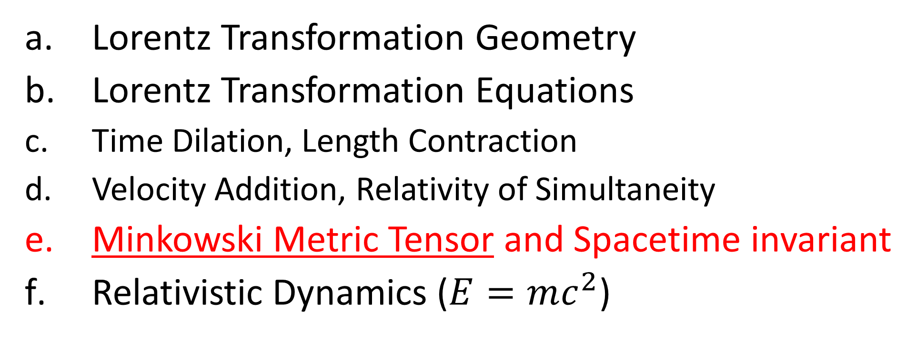
Relativity 104: Special Relativity
Lorentz Transformation Geometry
Lorentz Transformation Equations
Time Dilation, Length Contraction
Velocity Addition, Relativity of Simultaneity
Minkowski Metric Tensor and Spacetime invariant
Relativistic Dynamics ($E=mc^{2}$)
Notes:
In this video we’re going to look at the Minkowski Metric Tensor and the Spacetime invariant, which are used to help us measure distances in spacetime in special relativity.

Slide 2
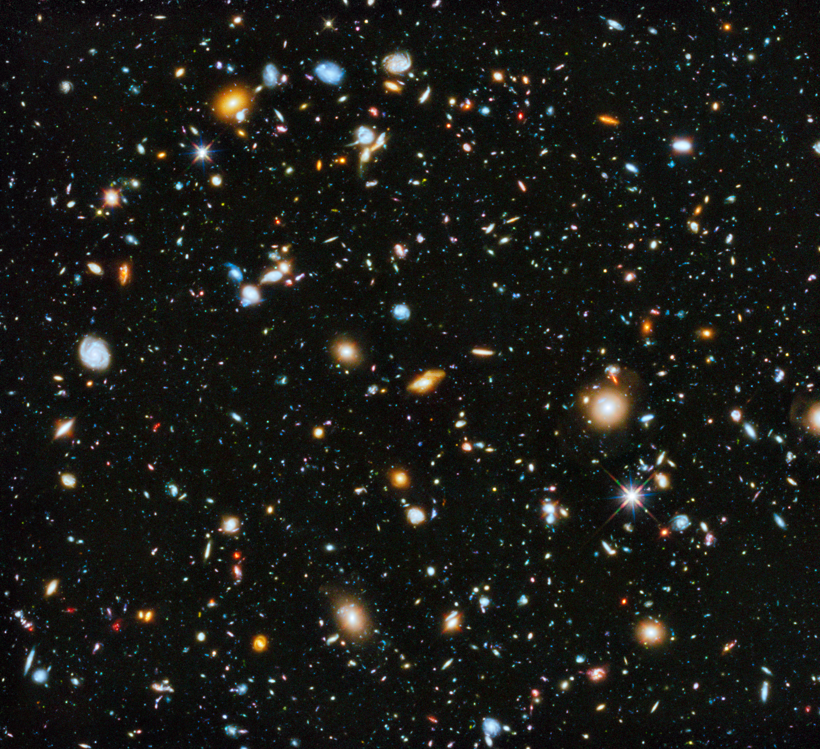


time
spacetime invariant/
spacetime interval
position

Slide 3
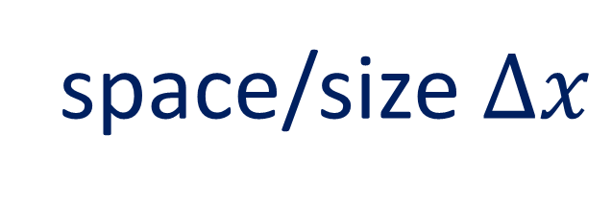


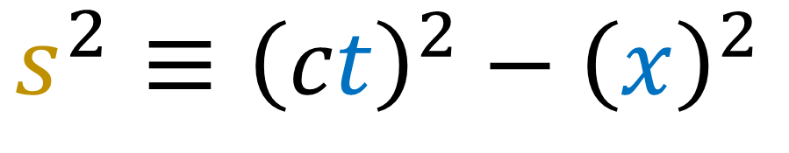

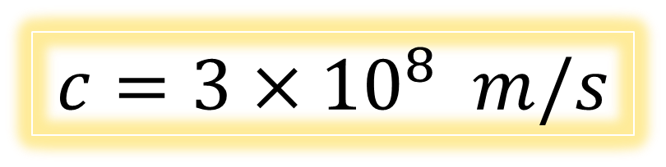
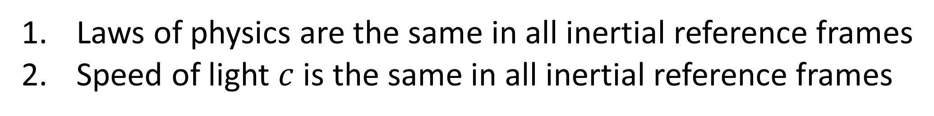

Special Relativity
Laws of physics are the same in all inertial reference frames
Speed of light $c$ is the same in all inertial reference frames
Things we disagree on:
Things we agree on:
time $Δt$
space/size $Δx$
$$c=3×{10}^{8} m/s$$
velocity $\vec{v}$
momentum $\vec{p}$
$$s^{2}≡{\left(ct\right)}^{2}−{\left(x\right)}^{2}$$
kinetic energy $E_{k}$
Notes:
So far in special relativity, we have found that different observers disagree on almost everything: time, space, and velocity, and therefore also momentum, and kinetic energy. The only quantity all inertial frames seem to agree on is the speed of light in a vacuum C, which is 300 million m/s.
In this video we’re going to introduce a new quantity that all inertial frames agree on, which is the spacetime invariant s^2, which equals ct^2 – x^2. The spacetime invariant is how we measure distances in Spacetime, which obeys Minkowski Geometry.

Slide 4
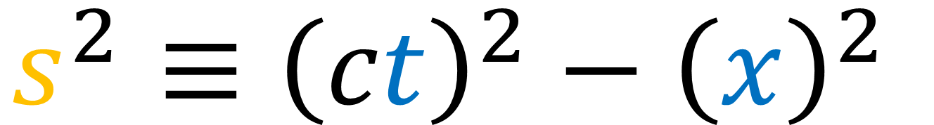
$$s^{2}≡{\left(ct\right)}^{2}−{\left(x\right)}^{2}$$
Spacetime Invariant:
how we measure distances in spacetime.
Notes:
So far in special relativity, we have found that different observers disagree on almost everything: time, space, velocity, momentum, and kinetic energy. The only quantity all inertial frames seem to agree on is the speed of light in a vacuum C, which is 300 million m/s.
In this video we’re going to introduce a new quantity that all inertial frames agree on, which is the spacetime invariant s^2, which equals ct^2 – x^2. The spacetime invariant is how we measure distances in Spacetime, which obeys Minkowski Geometry.

Slide 5
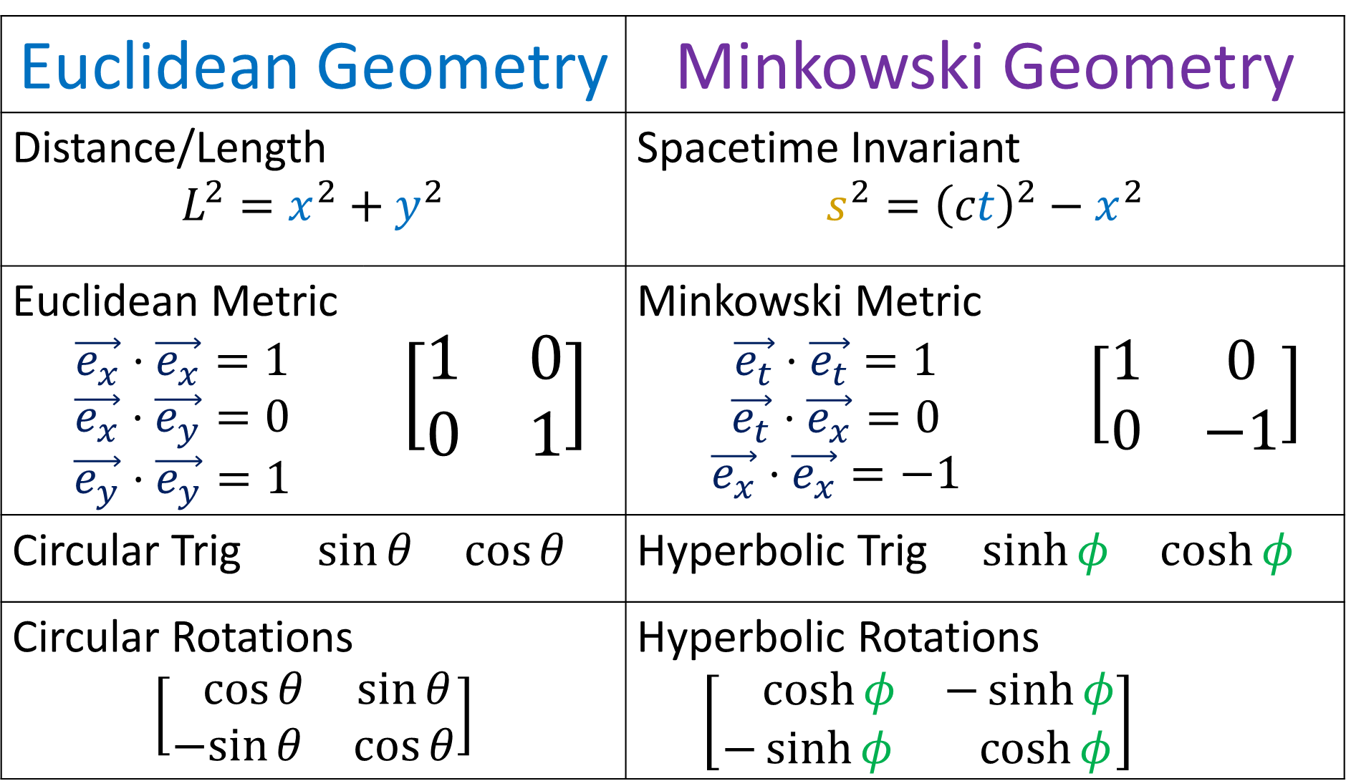
Euclidean Geometry |  | Minkowski Geometry
Distance/Length $$L^{2}=x^{2}+y^{2}$$ |  | Spacetime Invariant $$s^{2}={\left(ct\right)}^{2}−x^{2}$$
Euclidean Metric $$\vec{e_{x}}⋅\vec{e_{x}}=1$$ $$\vec{e_{x}}⋅\vec{e_{y}}=0$$ $$\vec{e_{y}}⋅\vec{e_{y}}=1$$ | $$\left[\begin{matrix}1 & 0 \\ 0 & 1\end{matrix}\right]$$ | Minkowski Metric $$\vec{e_{t}}⋅\vec{e_{t}}=1$$ $$\vec{e_{t}}⋅\vec{e_{x}}=0$$ $$\vec{e_{x}}⋅\vec{e_{x}}=−1$$ | $$\left[\begin{matrix}1 & 0 \\ 0 & −1\end{matrix}\right]$$
Circular Trig $\sin{θ} \cos{θ}$ |  | Hyperbolic Trig $\sinh{φ} \cosh{φ}$
Circular Rotations $$\left[\begin{matrix}\cos{θ} & \sin{θ} \\ −sin{θ} & \cos{θ}\end{matrix}\right]$$ |  | Hyperbolic Rotations $\left[\begin{matrix}\cosh{φ} & −\sinh{φ} \\ −\sinh{φ} & \cosh{φ}\end{matrix}\right]$
Notes:
This video is going all about taking geometry that you’re familiar with in everyday life, which is Euclidean Geometry, and changing it slightly so that we get Minkowski Geometry, which is the geometry of spacetime in special relativity.
Instead of measuring distance or length using the familiar equation x^2 + y^2, we’re going to measure distances in spacetime using the spacetime invariant, ct^2 – x^2.
Instead of using the Euclidean Metric where the dot products of an orthonormal basis are 1,0,1… we’re going to use the Minkowsi metric where the dot products of an orothonormal basis are 1, 0, -1.
Instead of using circular trig functions like sine and cosine, we’re going to use hyperbolic trig functions, like hyperbolic sine and hyperbolic cosine.
And instead of doing circular rotations in space, we’re going to do hyperbolic rotations in spacetime. We’ll see that Lorentz transformations we’ve been studying all along are really just hyperbolic rotations.

Slide 6
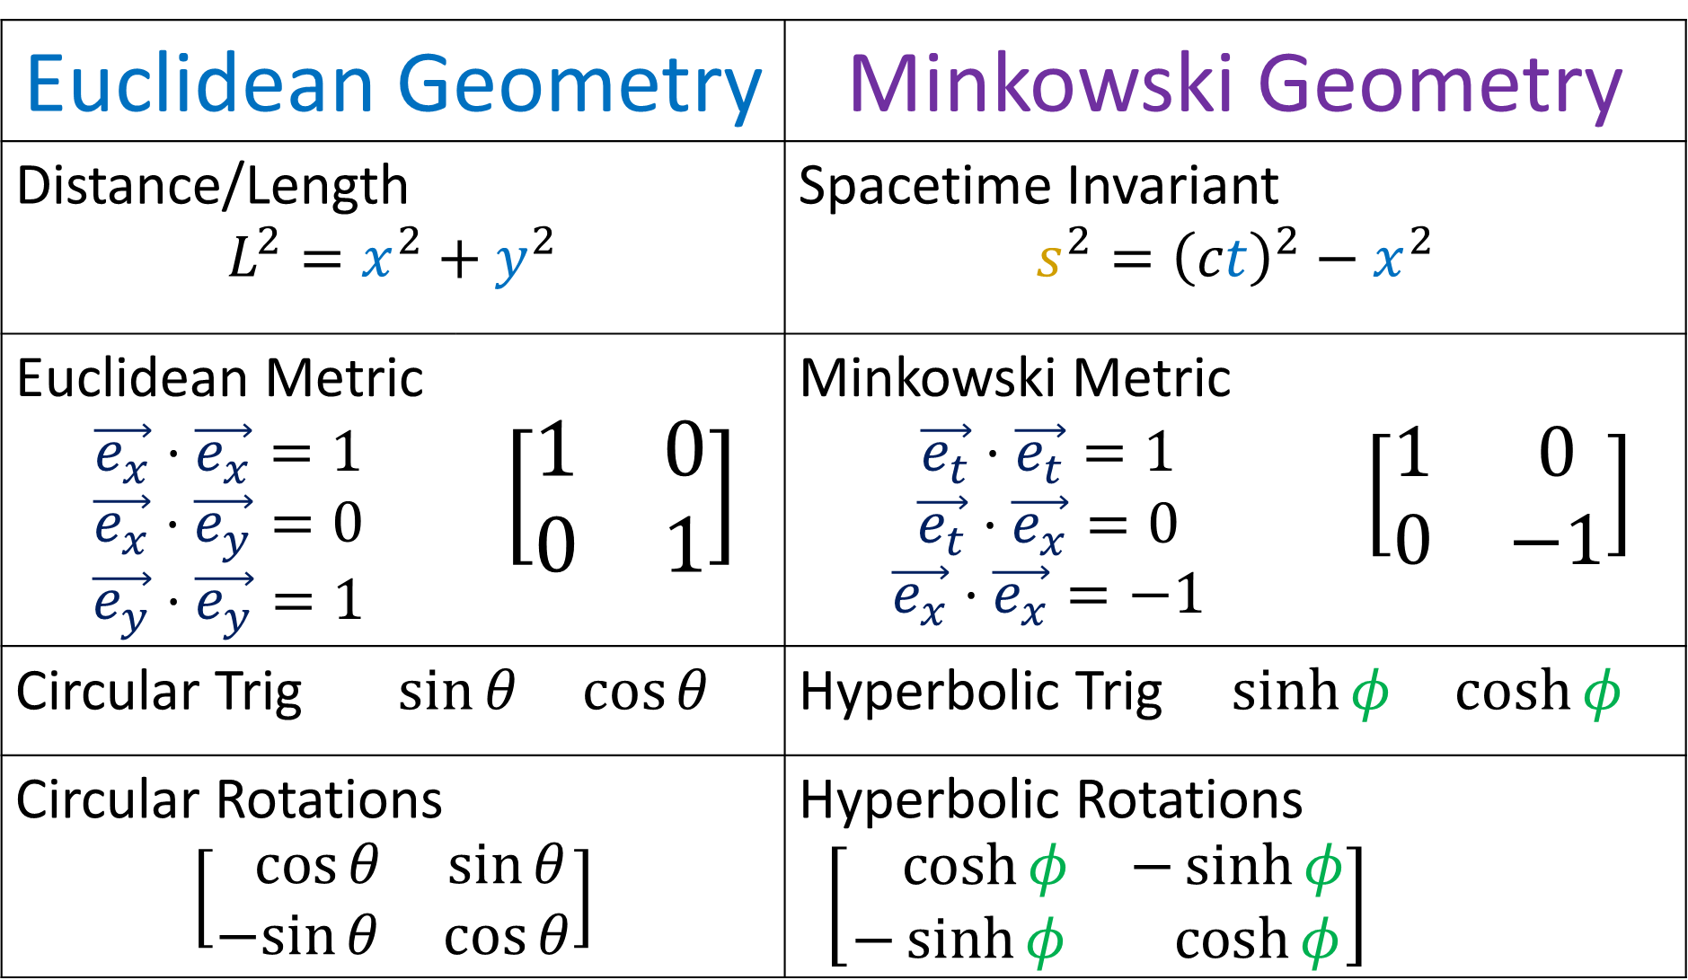
Euclidean Geometry |  | Minkowski Geometry
Distance/Length $$L^{2}=x^{2}+y^{2}$$ |  | Spacetime Invariant $$s^{2}={\left(ct\right)}^{2}−x^{2}$$
Euclidean Metric $$\vec{e_{x}}⋅\vec{e_{x}}=1$$ $$\vec{e_{x}}⋅\vec{e_{y}}=0$$ $$\vec{e_{y}}⋅\vec{e_{y}}=1$$ | $$\left[\begin{matrix}1 & 0 \\ 0 & 1\end{matrix}\right]$$ | Minkowski Metric $$\vec{e_{t}}⋅\vec{e_{t}}=1$$ $$\vec{e_{t}}⋅\vec{e_{x}}=0$$ $$\vec{e_{x}}⋅\vec{e_{x}}=−1$$ | $$\left[\begin{matrix}1 & 0 \\ 0 & −1\end{matrix}\right]$$
Circular Trig $\sin{θ} \cos{θ}$ |  | Hyperbolic Trig $\sinh{φ} \cosh{φ}$
Circular Rotations $$\left[\begin{matrix}\cos{θ} & \sin{θ} \\ −sin{θ} & \cos{θ}\end{matrix}\right]$$ |  | Hyperbolic Rotations $\left[\begin{matrix}\cosh{φ} & −\sinh{φ} \\ −\sinh{φ} & \cosh{φ}\end{matrix}\right]$
Lorentz
Transfor-mation
Notes:
This video is going all about taking geometry that you’re familiar with in everyday life, which is Euclidean Geometry, and changing it slightly so that we get Minkowski Geometry, which is the geometry of spacetime in special relativity.
Instead of measuring distance or length using the familiar equation x^2 + y^2, we’re going to measure distances in spacetime using the spacetime invariant, ct^2 – x^2.
Instead of using the Euclidean Metric where the dot products of an orthonormal basis are 1,0,1… we’re going to use the Minkowsi metric where the dot products of an orothonormal basis are 1, 0, -1.
Instead of using circular trig functions like sine and cosine, we’re going to use hyperbolic trig functions, like hyperbolic sine and hyperbolic cosine.
And instead of doing circular rotations in space, we’re going to do hyperbolic rotations in spacetime. We’ll see that Lorentz transformations we’ve been studying all along are really just hyperbolic rotations.

Slide 7
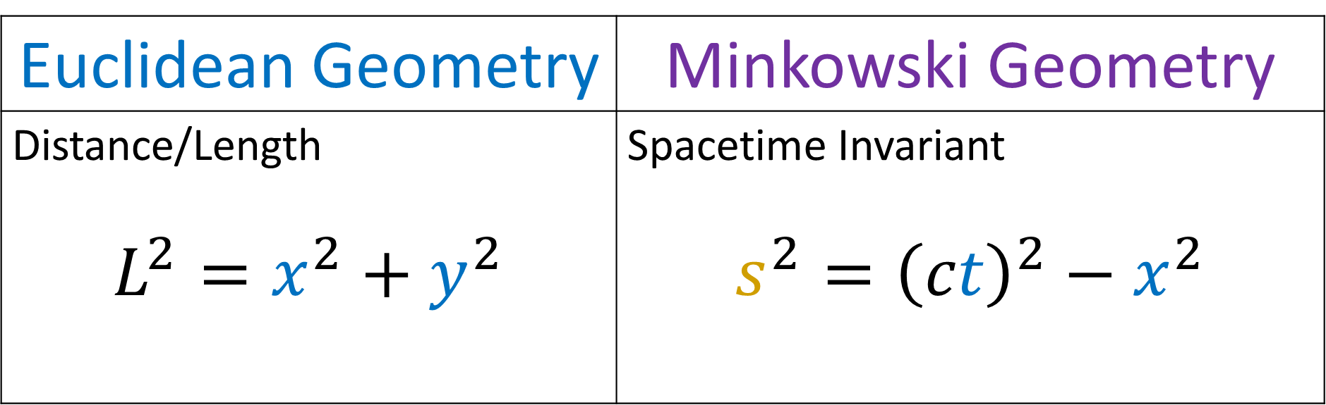
Euclidean Geometry | Minkowski Geometry
Distance/Length $$L^{2}=x^{2}+y^{2}$$ | Spacetime Invariant $$s^{2}={\left(ct\right)}^{2}−x^{2}$$
Notes:
First let’s talk about the concept of length in Euclidean geometry. We’ll see that the spacetime invariant is the equivalent concept in Minkowski geometry for special relativity.

Slide 8
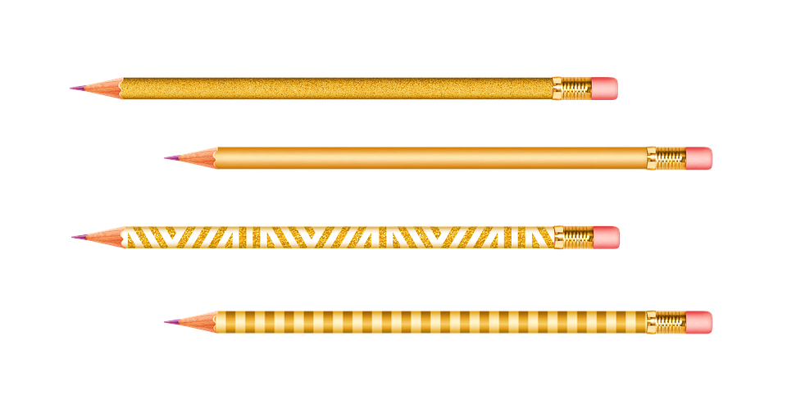
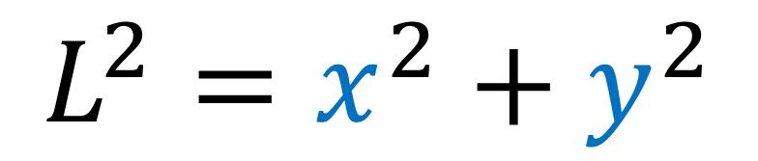
Distance/Length (2D space)
$$L^{2}=x^{2}+y^{2}$$
We can use this formula to get the length $L$ of an object.
Result is the same in any orthonormal basis.
Notes:
We know the familiar formula for the length of an object in 2D space. It’s just Pythagoras’s theorem formula: length^2 = x^2 + y^2.
We can use this formula to get the length of an object. And this formula is nice because it works in ANY orthonormal basis. So as long as our basis vectors have length 1 and are perpendicular to each other, this formula will work and give us the length of an object.

Slide 9


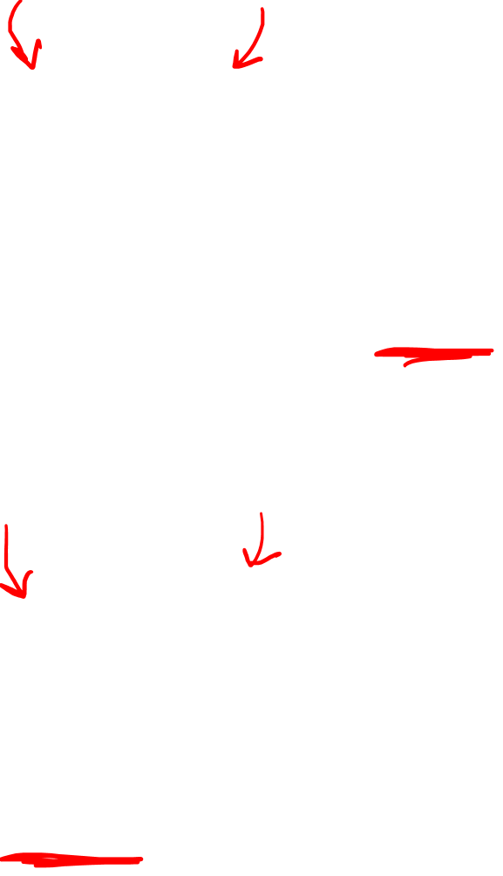
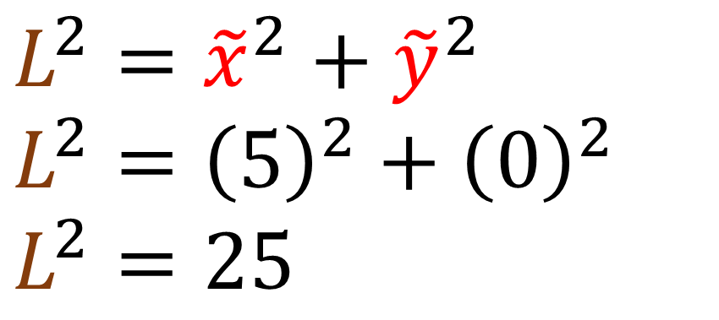


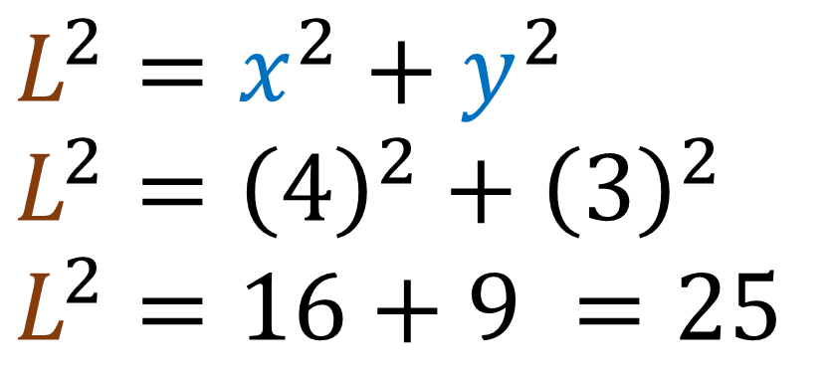
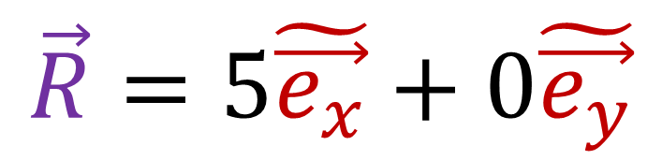
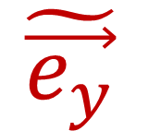
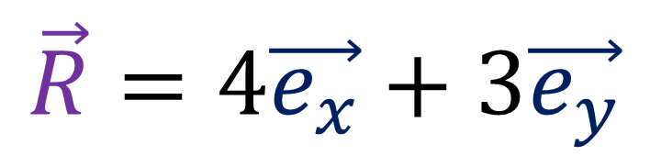

$$\vec{R}=4\vec{e_{x}}+3\vec{e_{y}}$$
$$L^{2}=x^{2}+y^{2}$$
$$L^{2}={\left(4\right)}^{2}+{\left(3\right)}^{2}$$
$$L^{2}=16+9 =25$$
$$\vec{R}$$
$$\vec{e_{y}}$$
$$\tilde{\vec{e_{y}}}$$
$$\vec{R}=5\tilde{\vec{e_{x}}}+0\tilde{\vec{e_{y}}}$$
$$\tilde{\vec{e_{x}}}$$
$$L^{2}={\tilde{x}}^{2}+{\tilde{y}}^{2}$$
$$L^{2}={\left(5\right)}^{2}+{\left(0\right)}^{2}$$
$$L^{2}=25$$
$$\vec{e_{x}}$$
Notes:
Here’s an example. Let’s say this pencil is a vector denoted by capital R. In the eX, eY basis, this vector equals 4 eX vectors + 3 eY vectors. If we take the formula for squared length, and plug in 4 for X and 3 for Y, we get 4^2 + 3^2, which is 16 + 9, or 25.
If we use another orthonormal basis given by eX-tilde and eY-tilde, R = 5 eX vectors exactly. If we plug 5 and 0 into the squared length formula, we get 5^2 + 0^2, which is 25.
So we get the same answer for the squared length of the pencil in any orthonormal basis.

Slide 10
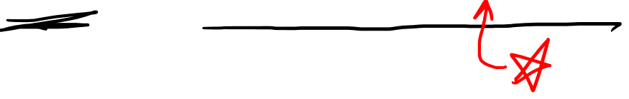
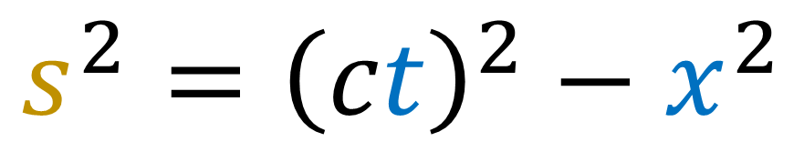
Spacetime Invariant
$$s^{2}={\left(ct\right)}^{2}−x^{2}$$
A “distance” between two events in spacetime...
Result is the same in any orthonormal spacetime basis.
(“Minkowski Orthonormal”)
Notes:
In spacetime in special relativity, we have a similar concept called the spacetime invariant s^2, which equals ct^2 – x^2. Notice that we use a minus sign here instead of a plus sign. This minus sign is extremely important.
The spacetime invariant helps us measure a kind of distance between two events in spacetime. And the result is the same in any orthonormal spacetime basis. Now in spacetime, the definition of orthonormal is a bit different that you expect… and I’ll talk about this more later… but for now you can think of spacetime basis vectors as being orthonormal when they scissor together like this, as we’ve seen with Lorentz transformations.

Slide 11


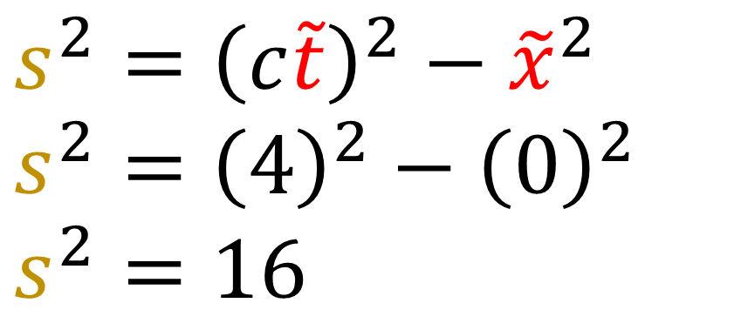
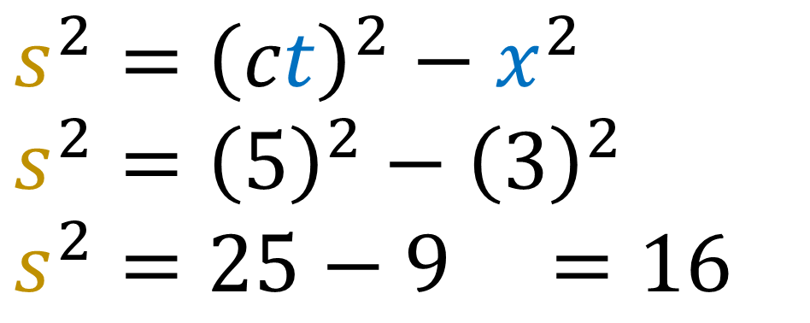

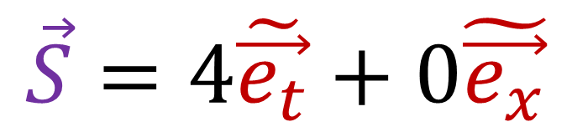

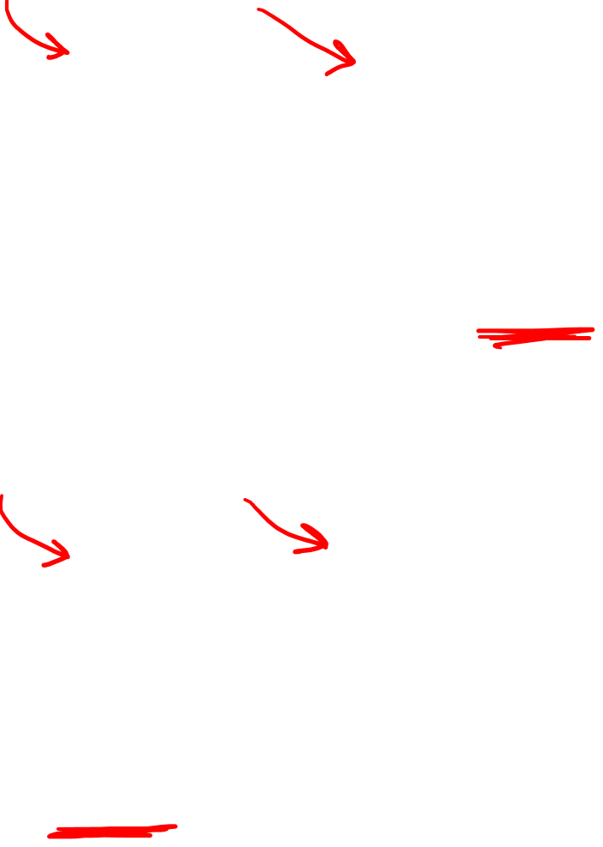

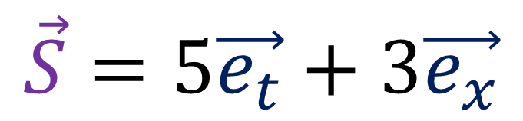
$$\vec{S}=5\vec{e_{t}}+3\vec{e_{x}}$$
$$s^{2}={\left(ct\right)}^{2}−x^{2}$$
$$s^{2}={\left(5\right)}^{2}−{\left(3\right)}^{2}$$
$$s^{2}=25−9 =16$$
$$\vec{S}$$
$$\vec{S}=4\tilde{\vec{e_{t}}}+0\tilde{\vec{e_{x}}}$$
$$\tilde{\vec{e_{t}}}$$
$$s^{2}={\left(c\tilde{t}\right)}^{2}−{\tilde{x}}^{2}$$
$$s^{2}={\left(4\right)}^{2}−{\left(0\right)}^{2}$$
$$s^{2}=16$$
$$\tilde{\vec{e_{x}}}$$
$$\vec{e_{t}}$$
$$\vec{e_{x}}$$
Notes:
If this vector capital S connects two events in spacetime, S = 5 eT time vectors and 3 eX position vectors.
Plugging 5 and 3 into the spacetime invariant formula, we get 5^2 – 3^2, which is 25 – 9, or 16.
If we use this other spacetime basis eT-tilde and eX-tilde, S = 4 eT-tilde vectors exactly. Plugging 4 and 0 into the spacetime invariant formula, we get 4^2 – 0^2, which 16.
So the spacetime invariant s^2 is the same in all orthonormal spacetime coordinate systems if we use the minkowski definition of orthonormal.

Slide 12

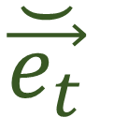

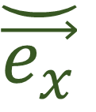

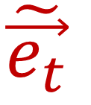
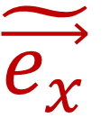
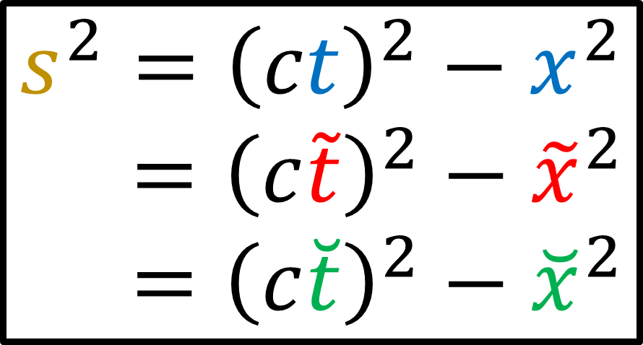
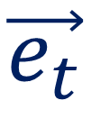
$$\breve{\vec{e_{t}}}$$
$$\vec{e_{t}}$$
$$\tilde{\vec{e_{t}}}$$
$$\breve{\vec{e_{x}}}$$
$$\vec{e_{x}}$$
$$\tilde{\vec{e_{x}}}$$
Minkowski-orthonormal basis $⇒$ inertial reference frame.
$$s^{2}={\left(ct\right)}^{2}−x^{2}$$
$$s^{2}={\left(c\tilde{t}\right)}^{2}−{\tilde{x}}^{2}$$
$$s^{2}={\left(c\breve{t}\right)}^{2}−{\breve{x}}^{2}$$
$$\vec{S}$$
$$⇒$$
Notes:
In special relativity, spacetime basis vectors that are Minkowski orthonormal correspond to inertial reference frames. This means that, for a given spacetime vector, the spacetime invariant s^2 is the same in all inertial reference frames.

Slide 13
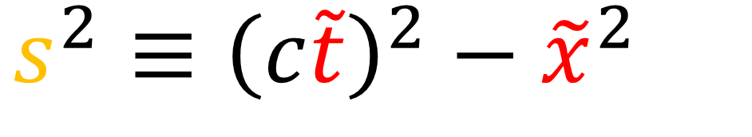
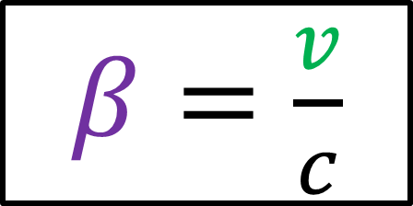
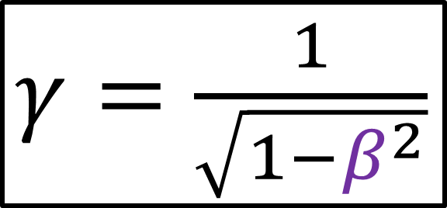
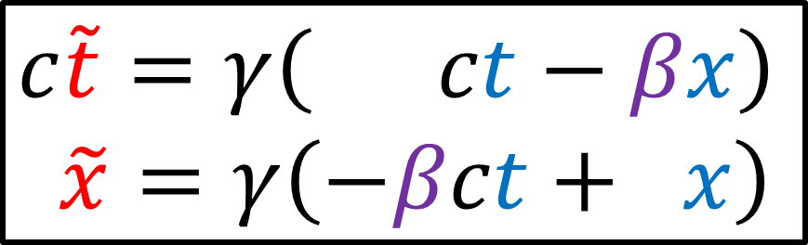

Lorentz Transformation
Spacetime Invariant $s^{2}$
$$c\tilde{t}=γ\left( ct−βx\right)$$
$$\tilde{x}=γ\left(−βct+ x\right)$$
$$s^{2}≡{\left(c\tilde{t}\right)}^{2}−{\tilde{x}}^{2}$$
$β=\frac{v}{c}$
$γ=\frac{1}{\sqrt{1−β^{2}}}$
Notes:
We can go ahead and prove that the spacetime invariant is the same in all inertial reference frames.
Let’s start with the spacetime invariant in the ct-Tilde, x-tilde reference frame… s^2 is equal to ct-tilde square minus x-tilde squared.
Recall our Lorentz transformation to move to another inertial frame with velocity beta looks like this, where beta is just a fraction of the speed of light, v over c, and the gamma coefficient is 1 / the square root of 1-beta^2. If we plug in the formulas for ct-Tilde and x-tilde into the formula for the spacetime invariant, we get this.

Slide 14
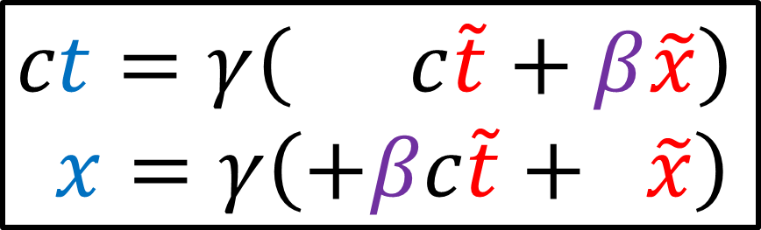
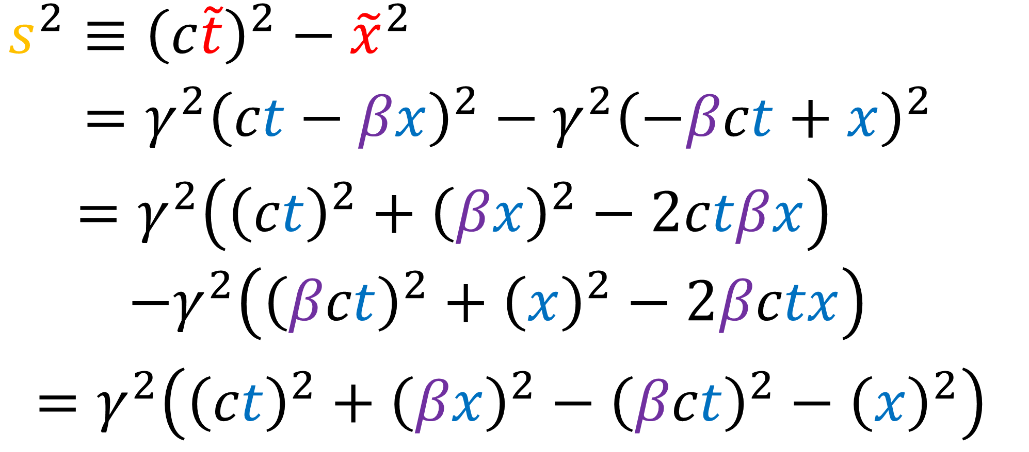
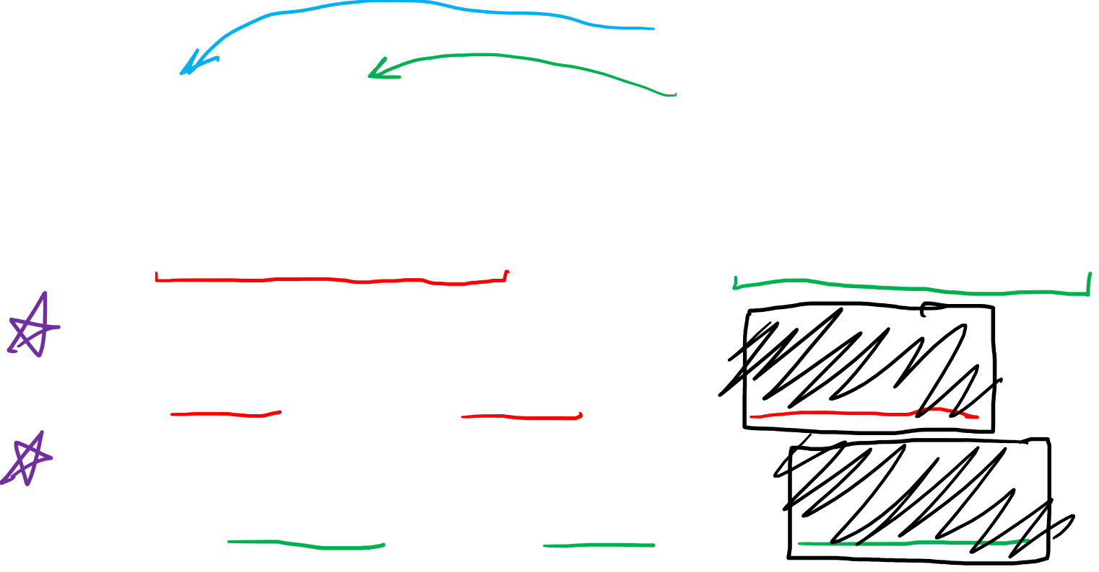
Reverse
$$ct=γ\left( c\tilde{t}+β\tilde{x}\right)$$
$$x=γ\left(+βc\tilde{t}+ \tilde{x}\right)$$
Lorentz Transformation
Spacetime Invariant $s^{2}$
$$c\tilde{t}=γ\left( ct−βx\right)$$
$$\tilde{x}=γ\left(−βct+ x\right)$$
$$s^{2}≡{\left(c\tilde{t}\right)}^{2}−{\tilde{x}}^{2}$$
$$s^{2}={γ^{2}\left(ct−βx\right)}^{2}−{γ^{2}\left(−βct+x\right)}^{2}$$
$=γ^{2}\left({\left(ct\right)}^{2}+{\left(βx\right)}^{2}−2ctβx\right)$
$$−γ^{2}\left({\left(βct\right)}^{2}+{\left(x\right)}^{2}−2βctx\right)$$
$=γ^{2}\left({\left(ct\right)}^{2}+{\left(βx\right)}^{2}−{\left(βct\right)}^{2}−{\left(x\right)}^{2}\right)$
Notes:
Now if we expand ct – beta*x squared, we get 4 terms: ct^2, beta*x^2, and we get minus ct*beta*x twice, so I’ll write that as minus 2 ct*beta*x.
And if we expand –beta*ct + x squared, we get another 2 terms, beta*ct^2 + x^2, and once again we get minus beta*ct*x twice, so we write minus 2*beta*ct*x.
So we have one set of brackets with a POSITIVE gamma^2 in front and another set of brackets with a NEGATIVE gamma^2 in front. But notice that 2*ct*beta*x is the same thing as 2*beta*ct*x. This first one is negative, and the second one is negative but also has this other negative sign out in front of the brackets, so it’s actually positive. So these both cancel with each other.
And if we pull the gamma^2 out of everything and put it in front of , we get this.

Slide 15

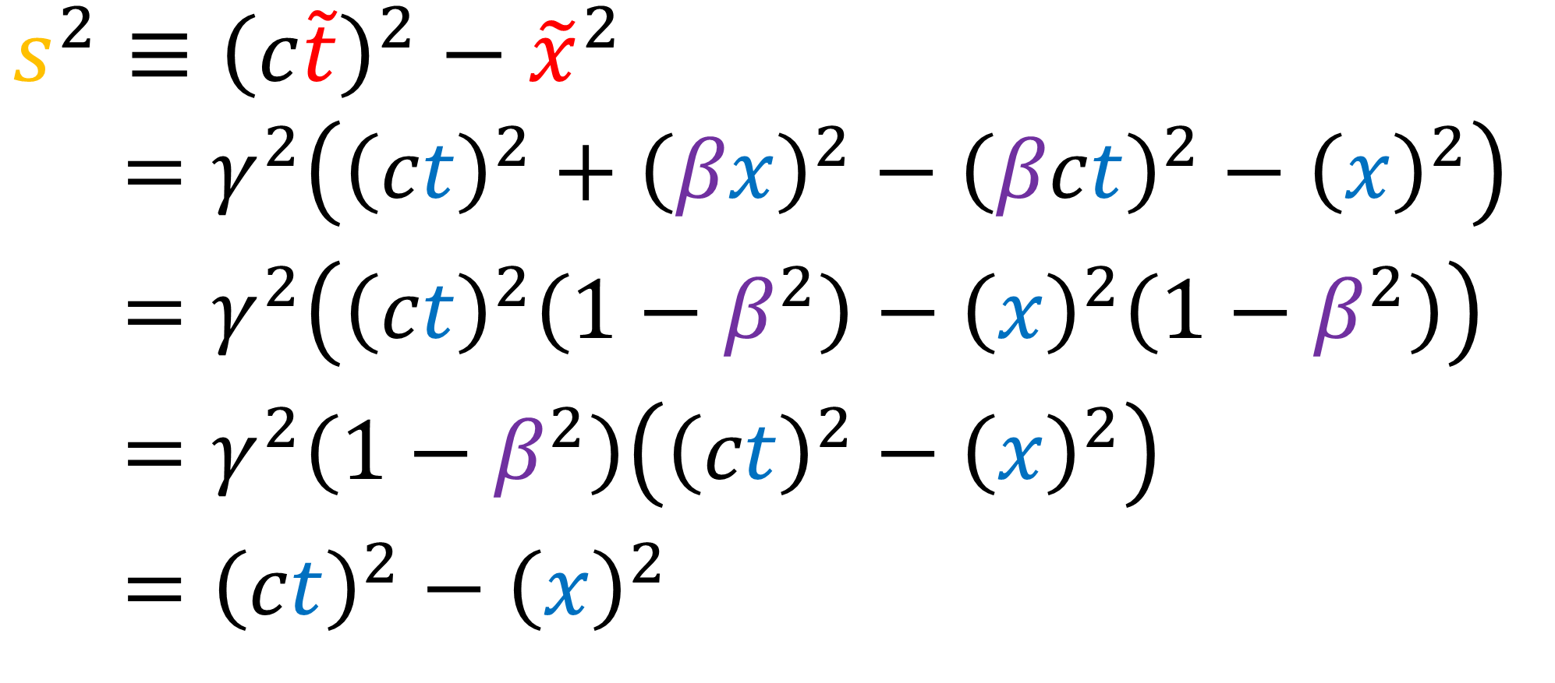
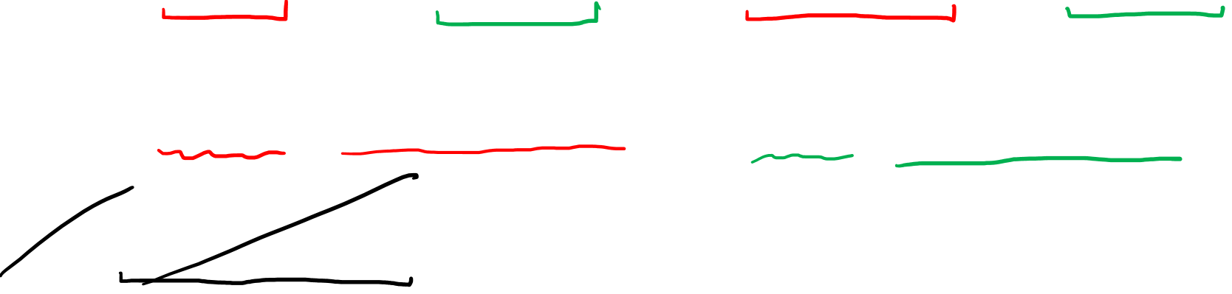
Reverse
$$ct=γ\left( c\tilde{t}+β\tilde{x}\right)$$
$$x=γ\left(+βc\tilde{t}+ \tilde{x}\right)$$
Lorentz Transformation
Spacetime Invariant $s^{2}$
$$c\tilde{t}=γ\left( ct−βx\right)$$
$$\tilde{x}=γ\left(−βct+ x\right)$$
$$s^{2}≡{\left(c\tilde{t}\right)}^{2}−{\tilde{x}}^{2}$$
$$s^{2}=γ^{2}\left({\left(ct\right)}^{2}+{\left(βx\right)}^{2}−{\left(βct\right)}^{2}−{\left(x\right)}^{2}\right)$$
$$s^{2}=γ^{2}\left({\left(ct\right)}^{2}\left(1−β^{2}\right)−{\left(x\right)}^{2}\left(1−β^{2}\right)\right)$$
$$s^{2}=γ^{2}\left(1−β^{2}\right)\left({\left(ct\right)}^{2}−{\left(x\right)}^{2}\right)$$
$$s^{2}={\left(ct\right)}^{2}−{\left(x\right)}^{2}$$
$γ=\frac{1}{\sqrt{1−β^{2}}}$
Notes:
Now notice that inside these brackets we have ct^2 and also a negative beta*ct^2. So we can factor out ct^2 from both of those can get ct^2 * (1-beta^2). And we can also factor out x^2 from beta*x^2 and negative x^2, and get *negative* → x^2 *(1-beta^2), and this negative sign out in front is what lets us change the signs inside here so that 1 is positive and beta^2 is negative.
So notice that we have 1-beta^2 in both of these terms so we can factor it out and put it in front next to the gamma squared. But remember, gamma is just 1/sqrt (1-beta^2), so if we square gamma, we just get the reciprocal of 1-beta^2. So these cancel out and just become 1.
And that means we’re left with ct^2 – x^2. Which is the exact same formula we start with with, except now it’s using the new time and space coordinates. So what we’ve shown is that the spacetime invariant s^2 is the same in any two coordinate systems that are connected by a Lorentz transformation. In otherwords, the spacetime invariant is the same in all inertial coordinate systems.

Slide 16
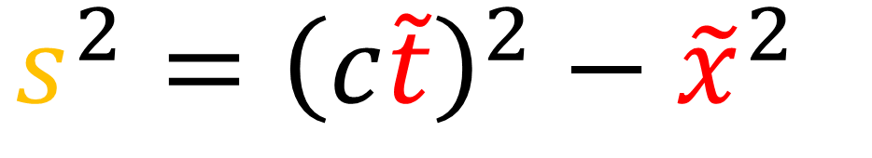
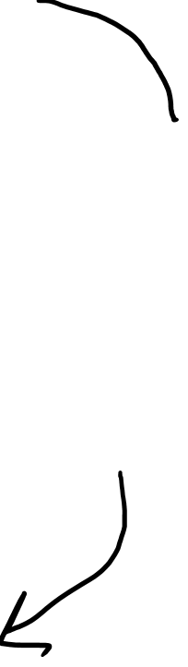


$$s^{2}={\left(c\tilde{t}\right)}^{2}−{\tilde{x}}^{2}$$
Lorentz Transformation
$$c\tilde{t}=γ\left( ct−βx\right)$$
$$\tilde{x}=γ\left(−βct+ x\right)$$
$$s^{2}={\left(ct\right)}^{2}−x^{2}$$

Slide 17

Special Relativity
Laws of physics are the same in all inertial reference frames
Speed of light $c$ is the same in all inertial reference frames
Things we disagree on:
Things we agree on:
time $Δt$
space/size $Δx$
$$c=3×{10}^{8} m/s$$
velocity $\vec{v}$
momentum $\vec{p}$
$$s^{2}≡{\left(ct\right)}^{2}−{\left(x\right)}^{2}$$
$$s^{2}≡{\left(c\tilde{t}\right)}^{2}−{\left(\tilde{x}\right)}^{2}$$
kinetic energy $E_{k}$
Notes:
So far in special relativity, we have found that different observers disagree on almost everything: time, space, and velocity, and therefore also momentum, and kinetic energy. The only quantity all inertial frames seem to agree on is the speed of light in a vacuum C, which is 300 million m/s.
In this video we’re going to introduce a new quantity that all inertial frames agree on, which is the spacetime invariant s^2, which equals ct^2 – x^2. The spacetime invariant is how we measure distances in Spacetime, which obeys Minkowski Geometry.

Slide 18







Length (2D space)
Spacetime Invariant
$$L^{2}=x^{2}+y^{2}$$
$$s^{2}={\left(ct\right)}^{2}−x^{2}$$
Case #1: $s^{2}>0$
$$L^{2}>0$$
Case #2: $s^{2}=0$
($L^{2}=0$ is possible, but less common)
Case #3: $s^{2}<0$
Notes:
So physical length is a quantity we agree on in 2D physical space.
And the spacetime invariant is a quantity we agree on in spacetime.
However when talking about 2D length, we generally only talk about positive lengths. But the spacetime invariant can actually be positive, zero, or negative.

Slide 19










What does $s$ mean?
$$ct$$
Case #1: $s^{2}>0$
light cone
$$s^{2}={\left(ct\right)}^{2}−x^{2}$$
$$⇒{\left(ct\right)}^{2}>x^{2}$$
$$−x=ct$$
$$x=ct$$
$\left|β\right|=\left|\frac{v}{c}\right|=\left|\frac{ x}{ct}\right|<1$
$$x$$
light cone
(inside the light cone)
Notes:
In the case of s^2 being greater than zero, this must mean that the time coordinate ct^2 is greater than the position coordinate x^2.
If we remember the equations of beams of light, x=ct to the right, and –x=ct to the left, A vector with a positive s^2 value has a beta value x/ct than is less than 1, meaning it is slower than light. This means the vector has a slope that is more vertical than a beam of light. This means it must exist in this shaded region here, which is called the light cone.
Also, if we measure this vector in a reference frame where the tip and the tail are at the same position, the position coordinate will be zero. In this case s^2 = ct^2.
Assuming positive time, this gives us s = ct, which we also denote by the special symbol tau.
Tau describes the time between two events in a reference frame where the events that happen at the same position.
This is called the “proper time” between events, and it is the shortest possible time between the two events, because moving frames will see the time increased due to time dilation.

Slide 20




What does $s$ mean?
$$c\tilde{t}$$
Case #1: $s^{2}>0$
light cone
$$s^{2}={\left(ct\right)}^{2}−x^{2}$$
$$⇒{\left(ct\right)}^{2}>x^{2}$$
$$−x=ct$$
$$x=ct$$
$$\tilde{x}$$
$\left|β\right|=\left|\frac{v}{c}\right|=\left|\frac{ x}{ct}\right|<1$
take the case of $\tilde{x}=0$
$$⇒s^{2}={\left(c\tilde{t}\right)}^{2}$$
$$⇒s=c\tilde{t}=cτ$$
light cone
(inside the light cone)
Notes:
In the case of s^2 being greater than zero, this must mean that the time coordinate ct^2 is greater than the position coordinate x^2.
If we remember the equations of beams of light, x=ct to the right, and –x=ct to the left, A vector with a positive s^2 value has a beta value x/ct than is less than 1, meaning it is slower than light. This means the vector has a slope that is more vertical than a beam of light. This means it must exist in this shaded region here, which is called the light cone.
Also, if we measure this vector in a reference frame where the tip and the tail are at the same position, the position coordinate will be zero. In this case s^2 = ct^2.
Assuming positive time, this gives us s = ct, which we also denote by the special symbol tau.
Tau describes the time between two events in a reference frame where the events that happen at the same position.
This is called the “proper time” between events, and it is the shortest possible time between the two events, because moving frames will see the time increased due to time dilation.

Slide 21


What does $s$ mean?
$$c\tilde{t}$$
Case #1: $s^{2}>0$
light cone
$s=cτ$ describes the time between events that happen at the same position
(Proper Time $τ$
Shortest possible time)
$$\tilde{x}$$
light cone
(other frames have the time dilated)

Slide 22




$cτ→$ $c×$ proper time (distance units, e.g. meters)
$cτ→$ proper time (ordinary time units, e.g. seconds)
1 m of time = amount of time it takes light to travel 1m
1 meter of time $≈$ 3.33 ns
1 meter
$3×{10}^{8} m$of time = amount of time it takes light to travel $3×{10}^{8} m$
$3×{10}^{8} m$ of time $≈$ 1 second
$3×{10}^{8} m$

Slide 23



$$\vec{S}=5\vec{e_{t}}+3\vec{e_{x}}$$
$$s^{2}={\left(ct\right)}^{2}−x^{2}$$
$$s^{2}={\left(5\right)}^{2}−{\left(3\right)}^{2}$$
$$s^{2}=25−9 =16$$
$$\vec{S}$$
$$s=cτ=4$$
$$\tilde{\vec{e_{t}}}$$
(Shortest possible time)
$$\tilde{\vec{e_{x}}}$$
$$\vec{e_{t}}$$
$$\vec{S}=4\tilde{\vec{e_{t}}}+0\tilde{\vec{e_{x}}}$$
$$\vec{e_{x}}$$
Notes:
Here’s an example… If we calculate s^2 for this spacetime vector S than connects these 2 events, we get+16, greater than zero.
This means that s, which equals the proper time tau, equals 4.
This means that the shortest possible time between the events at either end of the vector S is 4 time units.
This is the time measured in the reference frame that views the events to be at the same position. It is the shortest possible time, because moving reference frames will see the time dilated to be longer. For example, the original reference frame measures a longer time of 5 time units.

Slide 24

$$\vec{S}=5\vec{e_{t}}+3\vec{e_{x}}$$
$$s^{2}={\left(ct\right)}^{2}−x^{2}$$
$$s^{2}={\left(5\right)}^{2}−{\left(3\right)}^{2}$$
$$s^{2}=25−9 =16$$
$$\vec{S}$$
$$s=cτ=4$$
$τ=\frac{4}{c}$
$$\vec{e_{t}}$$
$$\vec{e_{x}}$$
Notes:
Here’s an example… If we calculate s^2 for this spacetime vector S than connects these 2 events, we get+16, greater than zero.
This means that s, which equals the proper time tau, equals 4.
This means that the shortest possible time between the events at either end of the vector S is 4 time units.
This is the time measured in the reference frame that views the events to be at the same position. It is the shortest possible time, because moving reference frames will see the time dilated to be longer. For example, the original reference frame measures a longer time of 5 time units.

Slide 25





What does $s$ mean?
$$ct$$
Case #2: $s^{2}=0$
light cone
$$s^{2}=0={\left(ct\right)}^{2}−x^{2}$$
$$⇒ x^{2}={\left(ct\right)}^{2}$$
$$⇒± x=ct$$
$$−x=ct$$
$$x=ct$$
$$x$$
$s^{2}=0$ describes the worldline of a beam of light!
light cone
Notes:
Now In the second case where s^2 = 0, this tells us that x^2 = ct^2. In other words, ct = +/- x.
These are exactly the two equations of a beam of light, +x going to the right and –x going to the left. So s^2 = 0 describes a vector that’s pointing along the worldline of a beam of light.

Slide 26



What does $s$ mean?
$$ct$$
Case #3: $s^{2}<0$
light cone
$$s^{2}={\left(ct\right)}^{2}−x^{2}$$
$$⇒{\left(ct\right)}^{2}<x^{2}$$
$$−x=ct$$
$$x=ct$$
$\left|β\right|=\left|\frac{v}{c}\right|=\left|\frac{x}{ct}\right|>1$
$$x$$
light cone
Notes:
Finally, if s^2 is less than zero, this means that ct^2 must be less than x^2.
A vector with a negative s^2 value has a beta value x/ct than is greater than 1, meaning it is faster than light. This means the vector has a slope that is more horizontal than a beam of light. This means it must exist in this outside the light cone.
Also, if we measure this vector in a reference frame where the tip and the tail are at the same time, ct = 0, and s^2 = -x^2 gives us a length. This length is given by taking the square root of negative s^2, and is denoted by L_0.
L_0 describes the length of an object in its own reference frame.
This is called the object’s proper length, and it is the longest possible length the object has, because moving frames will see the object length-contracted.

Slide 27



What does $s$ mean?
$$c\tilde{t}$$
Case #3: $s^{2}<0$
light cone
$$s^{2}={\left(ct\right)}^{2}−x^{2}$$
$$⇒{\left(ct\right)}^{2}<x^{2}$$
$$−x=ct$$
$$x=ct$$
$$\tilde{x}$$
$\left|β\right|=\left|\frac{v}{c}\right|=\left|\frac{x}{ct}\right|>1$
take the case of $c\tilde{t}=0$
$$⇒s^{2}=−{\tilde{x}}^{2}$$
$$⇒\sqrt{−s^{2}}=\tilde{x}=L_{0}$$
light cone
Notes:
Finally, if s^2 is less than zero, this means that ct^2 must be less than x^2.
A vector with a negative s^2 value has a beta value x/ct than is greater than 1, meaning it is faster than light. This means the vector has a slope that is more horizontal than a beam of light. This means it must exist in this outside the light cone.
Also, if we measure this vector in a reference frame where the tip and the tail are at the same time, ct = 0, and s^2 = -x^2 gives us a length. This length is given by taking the square root of negative s^2, and is denoted by L_0.
L_0 describes the length of an object in its own reference frame.
This is called the object’s proper length, and it is the longest possible length the object has, because moving frames will see the object length-contracted.

Slide 28


What does $s$ mean?
$$c\tilde{t}$$
Case #3: $s^{2}<0$
light cone
$\sqrt{−s^{2}}=L_{0}$ describes the length of an object in is own reference frame.
(Proper Length $L_{0}$=
Longest possible length)
$$x=ct$$
$$−x=ct$$
$$\tilde{x}$$
light cone
(other frames have length contracted)
Notes:
If we take negative s^2 and take the square root, we get a length L_0, which is the length of an object in its own reference frame.
This is called the object’s proper length, and it is the longest possible length the object has, because moving frames will see the object length-contracted.

Slide 29










$$\vec{S}=3\vec{e_{t}}+5\vec{e_{x}}$$
$$s^{2}={\left(ct\right)}^{2}−x^{2}$$
$$s^{2}={\left(9\right)}^{2}−{\left(5\right)}^{2}$$
$$s^{2}=9−25=−16$$
$$\vec{S}$$
$$\tilde{\vec{e_{t}}}$$
$$\vec{e_{t}}$$
$$\sqrt{−s^{2}}=L_{0}=4$$
$$\tilde{\vec{e_{x}}}$$
(Longest possible length)
$$\vec{e_{x}}$$
$$\vec{S}=0\tilde{\vec{e_{t}}}+4\tilde{\vec{e_{x}}}$$
Notes:
If we calculate s^2 for this spacetime vector S, we get -16, less than zero.
So if we take the negative of this and take the square root, we get the proper length, which is 4.
This means that in that in this object’s own reference frame, we know that it is exactly 4 distance units long.

Slide 30







Euclidean Geometry | Minkowski Geometry
Length (orthonormal basis) $$L^{2}=x^{2}+y^{2}$$ $$L^{2}={\tilde{x}}^{2}+{\tilde{y}}^{2}$$ | Spacetime Invariant (o.n. basis) $$s^{2}={\left(ct\right)}^{2}−x^{2}$$ $$s^{2}={\left(c\tilde{t}\right)}^{2}−{\tilde{x}}^{2}$$
Case #1: $s^{2}>0$
$s=cτ$ (Proper Time)
Case #2: $s^{2}=0$
(Path of Light Beam)
Case #3: $s^{2}<0$
$\sqrt{−s^{2}}=L_{0}$ (Proper Length)
Notes:
So in the familiar Euclidean geometry of 2D space, the Length L of an object is agreed upon in all orthonormal frames.
But in the Minkowski geometry of spacetime, it is the spacetime invariant s^2, which equals ct^2 – x^2, that is the same in all minkowski-orthonomal frames.
In the case of s^2 being positive, s = the proper time, the shortest possible time between 2 events.
When s^2 = 0, the vector points along the path of a beam of light.
When s^2 is negative, then the square root of –s^2 gives us the proper length, the longest possible length of an object.

Slide 31







Invariant Value
Name
Meaning
$s=cτ$ ($c×$ Proper Time)
$$s^{2}>0$$
“Timelike”
$$\text{“}\text{Lightlike}\text{”}$$
“null”
$$s^{2}=0$$
Path of Light Beam
$\sqrt{−s^{2}}=L_{0}$ (Proper Length)
$$s^{2}<0$$
$$\text{“}\text{Space}\text{like}\text{”}$$
Notes:
In relativity 103D, I gave examples of non-orthonormal bases in 2D space whose metric tensor matrices were not the identity matrix.
Because of this, the formula for Pythagoras’s theorem was different in each case.
Similarly, we have have non-Minkowski-orthonormal bases in spacetime whose metric tensor matrices are not the matrix 1,0,0-1.
And the corresponding formulas for the spacetime invariant are different each case.

Slide 32

Euclidean Geometry |  | Minkowski Geometry
Euclidean Metric $$\vec{e_{x}}⋅\vec{e_{x}}=1$$ $$\vec{e_{x}}⋅\vec{e_{y}}=0$$ $$\vec{e_{y}}⋅\vec{e_{y}}=1$$ | $$\left[\begin{matrix}1 & 0 \\ 0 & 1\end{matrix}\right]$$ | Minkowski Metric $$\vec{e_{t}}⋅\vec{e_{t}}=1$$ $$\vec{e_{t}}⋅\vec{e_{x}}=0$$ $$\vec{e_{x}}⋅\vec{e_{x}}=−1$$ | $$\left[\begin{matrix}1 & 0 \\ 0 & −1\end{matrix}\right]$$
Notes:
Now let’s compare the Euclidean metric in Euclidean geometry, and the Minkowski metric in minkowski geometry.

Slide 33


$$\vec{R}=x\vec{e_{x}}+y\vec{e_{y}}$$
2D Space
$${\left\|\vec{R}\right\|}^{2}=\vec{R}⋅\vec{R}$$
$=\left(x\vec{e_{x}}+y\vec{e_{y}}\right)⋅\left(x\vec{e_{x}}+y\vec{e_{y}}\right)$
$$=xx\left(\vec{e_{x}}⋅\vec{e_{x}}\right)+xy\left(\vec{e_{x}}⋅\vec{e_{y}}\right)+yx\left(\vec{e_{y}}⋅\vec{e_{x}}\right)+yy\left(\vec{e_{y}}⋅\vec{e_{y}}\right)$$
$$=\left[\begin{matrix}x & y\end{matrix}\right]\left[\begin{matrix}\vec{e_{x}}⋅\vec{e_{x}} & \vec{e_{x}}⋅\vec{e_{y}} \\ \vec{e_{y}}⋅\vec{e_{x}} & \vec{e_{y}}⋅\vec{e_{y}}\end{matrix}\right]\left[\begin{aligned}x \\ y\end{aligned}\right]$$
Metric Tensor
Matrix
(Components are basis vector dot products)
Notes:
Let’s say that in 2D space we have a vector capital R given by x eX + y eY.
To get the squared length of the vector, we just take the dot product with itself.
If we expand the vector out in the basis and then distribute over the dot product, we get 4 terms. These 4 terms can be written in matrix form like this. And this matrix of dot products is called the metric tensor matrix. I covered this already in Relativity 103 part D.

Slide 34






$$\vec{R}=x\vec{e_{x}}+y\vec{e_{y}}$$
Orthonormal Basis
$$\vec{e_{x}}⋅\vec{e_{x}}=1$$
$$\vec{e_{x}}⋅\vec{e_{y}}=0$$
$$\vec{e_{y}}⋅\vec{e_{y}}=1$$
$$\vec{e_{y}}$$
$$\vec{R}$$
$${\left\|\vec{R}\right\|}^{2}=\vec{R}⋅\vec{R}$$
$=\left(x\vec{e_{x}}+y\vec{e_{y}}\right)⋅\left(x\vec{e_{x}}+y\vec{e_{y}}\right)$
$$=xx\left(\vec{e_{x}}⋅\vec{e_{x}}\right)+xy\left(\vec{e_{x}}⋅\vec{e_{y}}\right)+yx\left(\vec{e_{y}}⋅\vec{e_{x}}\right)+yy\left(\vec{e_{y}}⋅\vec{e_{y}}\right)$$
$$=\left[\begin{matrix}x & y\end{matrix}\right]\left[\begin{matrix}\vec{e_{x}}⋅\vec{e_{x}} & \vec{e_{x}}⋅\vec{e_{y}} \\ \vec{e_{y}}⋅\vec{e_{x}} & \vec{e_{y}}⋅\vec{e_{y}}\end{matrix}\right]\left[\begin{aligned}x \\ y\end{aligned}\right]$$
$$\vec{e_{x}}$$
Metric Tensor
Matrix
(Components are basis vector dot products)
Notes:
If we assume we’re working in an orthonormal basis, then the basis vectors have length 1 and are perpendicular to each other. This means that a basis vector dotted with itself = 1, and a basis vector dotted with any other basis vector = 0.

Slide 35



$$\vec{R}=x\vec{e_{x}}+y\vec{e_{y}}$$
Orthonormal Basis
$$\vec{e_{x}}⋅\vec{e_{x}}=1$$
$$\vec{e_{x}}⋅\vec{e_{y}}=0$$
$$\vec{e_{y}}⋅\vec{e_{y}}=1$$
$$\vec{e_{y}}$$
$$\vec{R}$$
$${\left\|\vec{R}\right\|}^{2}=\vec{R}⋅\vec{R}$$
$=\left(x\vec{e_{x}}+y\vec{e_{y}}\right)⋅\left(x\vec{e_{x}}+y\vec{e_{y}}\right)$
$$=xx\left(\vec{e_{x}}⋅\vec{e_{x}}\right)+xy\left(\vec{e_{x}}⋅\vec{e_{y}}\right)+yx\left(\vec{e_{y}}⋅\vec{e_{x}}\right)+yy\left(\vec{e_{y}}⋅\vec{e_{y}}\right)$$
$=\left[\begin{matrix}x & y\end{matrix}\right]$ $\left[\begin{matrix}1 & 0 \\ 0 & 1\end{matrix}\right]$ $\left[\begin{aligned}x \\ y\end{aligned}\right]$
$$\vec{e_{x}}$$
$$=x^{2}+y^{2}$$
O.N. Basis
Only!!
Notes:
This means that in an orthonormal basis, the metric tensor matrix is the identity matrix, and the formula for the squared vector length is x^2 + y^2. But this is only in an orthonormal basis.

Slide 36





Orthonormal Basis
(2D Space)
$$\vec{e_{x}}⋅\vec{e_{x}}=1$$
$$\vec{e_{x}}⋅\vec{e_{y}}=0$$
$$\vec{e_{y}}⋅\vec{e_{y}}=1$$
Euclidean Metric Tensor
$$\left[\begin{matrix}\vec{e_{x}}⋅\vec{e_{x}} & \vec{e_{x}}⋅\vec{e_{y}} \\ \vec{e_{y}}⋅\vec{e_{x}} & \vec{e_{y}}⋅\vec{e_{y}}\end{matrix}\right]=\left[\begin{matrix}1 & 0 \\ 0 & 1\end{matrix}\right]$$
Minkowski-Orthonormal Basis
(Spacetime)
$$\vec{e_{t}}⋅\vec{e_{t}}=+1$$
$$\vec{e_{t}}⋅\vec{e_{x}}=0$$
$$\vec{e_{x}}⋅\vec{e_{x}}=−1$$
Minkowski Metric Tensor
$$\left[\begin{matrix}\vec{e_{t}}⋅\vec{e_{t}} & \vec{e_{t}}⋅\vec{e_{x}} \\ \vec{e_{x}}⋅\vec{e_{t}} & \vec{e_{x}}⋅\vec{e_{x}}\end{matrix}\right]=\left[\begin{matrix}1 & 0 \\ 0 & −1\end{matrix}\right]$$
Notes:
So in 2D space, the metric tensor is called the Euclidean metric tensor, and in in an orthonormal basis, the metric tensor matrix is the identity matrix.
But now we’re going to talk about what it means for a basis to be orthonormal in spacetime. A Minkwoski-orthonormal basis is one where the time basis vector dotted with itself gives +1, but a position basis vector dotted with itself gives -1. And any mixed dot products go to zero.

Slide 37


$$\vec{S}=ct\vec{e_{t}}+x\vec{e_{x}}$$
Spacetime
$${\left\|\vec{S}\right\|}^{2}=\vec{S}⋅\vec{S}$$
$=\left(ct\vec{e_{t}}+x\vec{e_{x}}\right)⋅\left(ct\vec{e_{t}}+x\vec{e_{x}}\right)$
$$=ctct\left(\vec{e_{t}}⋅\vec{e_{t}}\right)+ctx\left(\vec{e_{t}}⋅\vec{e_{x}}\right)+xct\left(\vec{e_{x}}⋅\vec{e_{t}}\right)+xx\left(\vec{e_{x}}⋅\vec{e_{x}}\right)$$
$$=\left[\begin{matrix}ct & x\end{matrix}\right]\left[\begin{matrix}\vec{e_{t}}⋅\vec{e_{t}} & \vec{e_{t}}⋅\vec{e_{x}} \\ \vec{e_{x}}⋅\vec{e_{t}} & \vec{e_{x}}⋅\vec{e_{x}}\end{matrix}\right]\left[\begin{aligned}ct \\ x\end{aligned}\right]$$
Minkowski Metric Tensor Matrix
(Components are basis vector dot products)
Notes:
So in spacetime, let’s say we have a spacetime vector capital S, which is ct eT + x eX.
To get this vector’s length, we do the dot product with itself. After expanding S in terms of the basis, distributing over the dot product, and writing in matrix for, we get this, and this matrix is the minkowski metric tensor matrix, which helps us measure distances in spacetime.

Slide 38



$$\vec{S}=ct\vec{e_{t}}+x\vec{e_{x}}$$
Minkowski- Orthonormal Basis
$$\vec{e_{t}}⋅\vec{e_{t}}=+1$$
$$\vec{e_{t}}⋅\vec{e_{x}}=0$$
$$\vec{e_{x}}⋅\vec{e_{x}}=−1$$
$$\vec{e_{t}}$$
$$\vec{S}$$
$${\left\|\vec{S}\right\|}^{2}=\vec{S}⋅\vec{S}$$
$=\left(ct\vec{e_{t}}+x\vec{e_{x}}\right)⋅\left(ct\vec{e_{t}}+x\vec{e_{x}}\right)$
$$=ctct\left(\vec{e_{t}}⋅\vec{e_{t}}\right)+ctx\left(\vec{e_{t}}⋅\vec{e_{x}}\right)+xct\left(\vec{e_{x}}⋅\vec{e_{t}}\right)+xx\left(\vec{e_{x}}⋅\vec{e_{x}}\right)$$
$$=\left[\begin{matrix}ct & x\end{matrix}\right]\left[\begin{matrix}\vec{e_{t}}⋅\vec{e_{t}} & \vec{e_{t}}⋅\vec{e_{x}} \\ \vec{e_{x}}⋅\vec{e_{t}} & \vec{e_{x}}⋅\vec{e_{x}}\end{matrix}\right]\left[\begin{aligned}ct \\ x\end{aligned}\right]$$
$$\vec{e_{x}}$$
Minkowski Metric Tensor Matrix
(Components are basis vector dot products)
Notes:
Remember, in a minkowski orthonormal basis, eT dot eT = +1, eX dot eX = -1, and eT dot eX = 0.
So in a minkwoski orthonormal basis, this matrix has components 1, 0, 0, -1, and the formula for the length of a vector is ct^2 – x^2, which is just the spacetime invariant. So the spacetime invariant is just the squared length of a vector when measuring in a minkowski orthonormal-basis. Or in other words, it’s the length of a vector when measured with the minkowski metric tensor matrix.

Slide 39



$$\vec{S}=ct\vec{e_{t}}+x\vec{e_{x}}$$
Minkowski- Orthonormal Basis
$$\vec{e_{t}}⋅\vec{e_{t}}=+1$$
$$\vec{e_{t}}⋅\vec{e_{x}}=0$$
$$\vec{e_{x}}⋅\vec{e_{x}}=−1$$
$$\vec{e_{t}}$$
$$\vec{S}$$
$${\left\|\vec{S}\right\|}^{2}=\vec{S}⋅\vec{S}$$
$=\left(ct\vec{e_{t}}+x\vec{e_{x}}\right)⋅\left(ct\vec{e_{t}}+x\vec{e_{x}}\right)$
$$=ctct\left(\vec{e_{t}}⋅\vec{e_{t}}\right)+ctx\left(\vec{e_{t}}⋅\vec{e_{x}}\right)+xct\left(\vec{e_{x}}⋅\vec{e_{t}}\right)+xx\left(\vec{e_{x}}⋅\vec{e_{x}}\right)$$
$=\left[\begin{matrix}ct & x\end{matrix}\right]$ $\left[\begin{matrix}1 & 0 \\ 0 & −1\end{matrix}\right]$ $\left[\begin{aligned}ct \\ x\end{aligned}\right]$
$$\vec{e_{x}}$$
$$={\left(ct\right)}^{2}−x^{2}$$
O.N. Basis Only!!

Slide 40



Squared
Vector Length
Minkowski- Orthonormal Basis
$$\vec{e_{t}}⋅\vec{e_{t}}=+1$$
$$\vec{e_{t}}⋅\vec{e_{x}}=0$$
$$\vec{e_{x}}⋅\vec{e_{x}}=−1$$
Spacetime Invariant
$${\left\|\vec{S}\right\|}^{2}=\vec{S}⋅\vec{S}=s^{2}={\left(ct\right)}^{2}−x^{2}$$
Minkowski Metric Tensor Matrix
(Components are basis vector dot products)
$=\left[\begin{matrix}ct & x\end{matrix}\right]$ $\left[\begin{matrix}1 & 0 \\ 0 & −1\end{matrix}\right]$ $\left[\begin{aligned}ct \\ x\end{aligned}\right]$

Slide 41






Lorentz-Transformed Basis
$$\tilde{\vec{e_{t}}}$$
$γ=\frac{1}{\sqrt{1−β^{2}}}$
$$\tilde{\vec{e_{t}}}=γ\left( \vec{e_{t}}+β\vec{e_{x}}\right)$$
$$\tilde{\vec{e_{x}}}=γ\left(β\vec{e_{t}}+ \vec{e_{x}}\right)$$
$$\tilde{\vec{e_{x}}}$$
$$\tilde{\vec{e_{t}}}⋅\tilde{\vec{e_{t}}}=γ\left(\vec{e_{t}}+β\vec{e_{x}}\right)⋅γ\left(\vec{e_{t}}+β\vec{e_{x}}\right)$$
$$=γ^{2}\left(\vec{e_{t}}⋅\vec{e_{t}}\right)+γ^{2}β\left(\vec{e_{t}}⋅\vec{e_{x}}\right)+γ^{2}β\left(\vec{e_{t}}⋅\vec{e_{x}}\right)+γ^{2}β^{2}\left(\vec{e_{x}}⋅\vec{e_{x}}\right)$$
$$=γ^{2}−γ^{2}β^{2}$$
$$=γ^{2}\left(1−β^{2}\right)$$
$$=1$$
Notes:
If we were to change basis using the Lorentz transform equations, we could calculate the basis vector dot products in the new basis. To calculate eT-tilde dot eT-tilde, we just sub in these formulas from the Lorentz Transform, and then distribute over the dot product.
eT dot eT goes to +1. eX dot eX goes to -1 and the mixed dot products go to zero.
This leaves us with gamma^2 – gamma^2 * beta^2. Factoring gamma^2 out, we get gamma^2 * 1 – beta^2. But knowing the definition of Gamma, if we square it, we just get the reciprocal, 1(1-beta^2), so this goes to 1.

Slide 42



Lorentz-Transformed Basis
$$\tilde{\vec{e_{t}}}$$
$γ=\frac{1}{\sqrt{1−β^{2}}}$
$$\tilde{\vec{e_{t}}}=γ\left( \vec{e_{t}}+β\vec{e_{x}}\right)$$
$$\tilde{\vec{e_{x}}}=γ\left(β\vec{e_{t}}+ \vec{e_{x}}\right)$$
$$\tilde{\vec{e_{x}}}$$
$$\tilde{\vec{e_{t}}}⋅\tilde{\vec{e_{x}}}=γ\left(\vec{e_{t}}+β\vec{e_{x}}\right)⋅γ\left(β\vec{e_{t}}+\vec{e_{x}}\right)$$
$$=γ^{2}β\left(\vec{e_{t}}⋅\vec{e_{t}}\right)+γ^{2}β\left(\vec{e_{x}}⋅\vec{e_{x}}\right)=γ^{2}β−γ^{2}β=0$$
$$\tilde{\vec{e_{x}}}⋅\tilde{\vec{e_{x}}}=γ\left(β\vec{e_{t}}+\vec{e_{x}}\right)⋅γ\left(β\vec{e_{t}}+\vec{e_{x}}\right)$$
$$=γ^{2}β^{2}\left(\vec{e_{t}}⋅\vec{e_{t}}\right)+γ^{2}\left(\vec{e_{x}}⋅\vec{e_{x}}\right)=−γ^{2}\left(1−β^{2}\right)=−1$$
Notes:
We can use a similar approach to calculate that eT-tilde dot eX-tilde is zero, and eX-tilde dot eX-tilde is -1.

Slide 43



Minkowski- Orthonormal Basis
$$\vec{e_{t}}⋅\vec{e_{t}}=+1$$
$$\vec{e_{t}}⋅\vec{e_{x}}=0$$
$$\vec{e_{x}}⋅\vec{e_{x}}=−1$$
Lorentz Transformation
$$\tilde{\vec{e_{t}}}=γ\left( \vec{e_{t}}+β\vec{e_{x}}\right)$$
$$\tilde{\vec{e_{x}}}=γ\left(β\vec{e_{t}}+ \vec{e_{x}}\right)$$
Minkowski- Orthonormal Basis
$$\tilde{\vec{e_{t}}}⋅\tilde{\vec{e_{t}}}=+1$$
$$\tilde{\vec{e_{t}}}⋅\tilde{\vec{e_{x}}}=0$$
$$\tilde{\vec{e_{x}}}⋅\tilde{\vec{e_{x}}}=−1$$

Slide 44



$$\vec{S}=ct\vec{e_{t}}+x\vec{e_{x}}$$
Minkowski- Orthonormal Basis
$$\vec{e_{t}}⋅\vec{e_{t}}=1$$
$$\vec{e_{t}}⋅\vec{e_{x}}=0$$
$$\vec{e_{x}}⋅\vec{e_{x}}=−1$$
$$\vec{e_{t}}$$
$$\vec{S}$$
$${\left\|\vec{S}\right\|}^{2}=\vec{S}⋅\vec{S}$$
$=\left(ct\vec{e_{t}}+x\vec{e_{x}}\right)⋅\left(ct\vec{e_{t}}+x\vec{e_{x}}\right)$
$$=ctct\left(\vec{e_{t}}⋅\vec{e_{t}}\right)+ctx\left(\vec{e_{t}}⋅\vec{e_{x}}\right)+xct\left(\vec{e_{x}}⋅\vec{e_{t}}\right)+xx\left(\vec{e_{x}}⋅\vec{e_{x}}\right)$$
$=\left[\begin{matrix}ct & x\end{matrix}\right]\left[\begin{matrix}\vec{e_{t}}⋅\vec{e_{t}} & \vec{e_{t}}⋅\vec{e_{x}} \\ \vec{e_{x}}⋅\vec{e_{t}} & \vec{e_{x}}⋅\vec{e_{x}}\end{matrix}\right]\left[\begin{aligned}ct \\ x\end{aligned}\right]=$ $\left[\begin{matrix}ct & x\end{matrix}\right]\left[\begin{matrix}1 & 0 \\ 0 & −1\end{matrix}\right]\left[\begin{aligned}ct \\ x\end{aligned}\right]$
$$\vec{e_{x}}$$
Notes:
So when measuring lengths, we cant just blindly use the familiar formula a^2 + b^2 = c^2 from elementary school. The real way to get the square length of a vector R is to take the dot product of R with itself, expand R in a basis, and distribute over the dot product. The key to getting the correct formula is to remember to calculate all these dot products properly. We can’t just assume they’re 1 or 0. This formula for the squared length can also be written in matrix notation like this, with the vector components in this row and this columns… and this matrix of dot products in the middle. This matrix of basis vector dot products is called the metric tensor.

Slide 45




$$\vec{S}=c\tilde{t}\tilde{\vec{e_{t}}}+\tilde{x}\tilde{\vec{e_{x}}}$$
Minkowski-Orthonormal
$$\tilde{\vec{e_{t}}}⋅\tilde{\vec{e_{t}}}=1$$
$$\tilde{\vec{e_{t}}}⋅\tilde{\vec{e_{x}}}=0$$
$$\tilde{\vec{e_{x}}}⋅\tilde{\vec{e_{x}}}=−1$$
$$\tilde{\vec{e_{t}}}$$
$$\vec{S}$$
$${\left\|\vec{S}\right\|}^{2}=\vec{S}⋅\vec{S}$$
$=\left(c\tilde{t}\tilde{\vec{e_{t}}}+\tilde{x}\tilde{\vec{e_{x}}}\right)⋅\left(c\tilde{t}\tilde{\vec{e_{t}}}+\tilde{x}\tilde{\vec{e_{x}}}\right)$
$$=c\tilde{t}c\tilde{t}\left(\tilde{\vec{e_{t}}}⋅\tilde{\vec{e_{t}}}\right)+c\tilde{t}\tilde{x}\left(\tilde{\vec{e_{t}}}⋅\tilde{\vec{e_{x}}}\right)+\tilde{x}c\tilde{t}\left(\tilde{\vec{e_{x}}}⋅\tilde{\vec{e_{t}}}\right)+\tilde{x}\tilde{x}\left(\tilde{\vec{e_{x}}}⋅\tilde{\vec{e_{x}}}\right)$$
$=\left[\begin{matrix}c\tilde{t} & \tilde{x}\end{matrix}\right]\left[\begin{matrix}\tilde{\vec{e_{t}}}⋅\tilde{\vec{e_{t}}} & \tilde{\vec{e_{t}}}⋅\tilde{\vec{e_{x}}} \\ \tilde{\vec{e_{x}}}⋅\tilde{\vec{e_{t}}} & \tilde{\vec{e_{x}}}⋅\tilde{\vec{e_{x}}}\end{matrix}\right]\left[\begin{aligned}c\tilde{t} \\ \tilde{x}\end{aligned}\right]=$ $\left[\begin{matrix}c\tilde{t} & \tilde{x}\end{matrix}\right]\left[\begin{matrix}1 & 0 \\ 0 & −1\end{matrix}\right]\left[\begin{aligned}c\tilde{t} \\ \tilde{x}\end{aligned}\right]$
$$\tilde{\vec{e_{x}}}$$
Notes:
So we find that a Minkwoski-orthonormal basis that is transformed by a Lorentz transform stays minkowksi orthonormal. And that means when we calculate the length of the vector, which is the spacetime invariant, we end up using the same minkwoski metric tensor matrix.

Slide 46


Metric Tensors in Orthonormal Basis
Euclidean Metric Tensor Matrix
Minkowski Metric Tensor Matrix
$$\left[\begin{matrix}1 & 0 \\ 0 & 1\end{matrix}\right]$$
$$\left[\begin{matrix}1 & 0 \\ 0 & −1\end{matrix}\right]$$
But we can use non-O.N. Basis as well…
Notes:
So in an orthonormal basis, the Euclidean Metric tensor matrix is the identity matrix, 1,0,0,1. And the Minkowski Metric Tensor Matrix for spacetime is 1,0,0,-1.
Now it is possible to write these metric tensors in a non-orthonormal basis as well.

Slide 47












Basis Vectors
Dot Products
Metric Tensor Matrix
$$\vec{e_{x}}⋅\vec{e_{x}}=1$$
$$\vec{e_{x}}⋅\vec{e_{y}}=0$$
$$\vec{e_{y}}⋅\vec{e_{y}}=1$$
$$\vec{e_{y}}$$
$$\left[\begin{matrix}1 & 0 \\ 0 & 1\end{matrix}\right]$$
$$\vec{e_{x}}$$
$$\tilde{\vec{e_{x}}}⋅\tilde{\vec{e_{x}}}=4$$
$$\tilde{\vec{e_{x}}}⋅\tilde{\vec{e_{y}}}=0$$
$$\tilde{\vec{e_{y}}}⋅\tilde{\vec{e_{y}}}=4$$
$$\tilde{\vec{e_{y}}}$$
$$\left[\begin{matrix}4 & 0 \\ 0 & 4\end{matrix}\right]$$
$$\tilde{\vec{e_{x}}}$$
$$\breve{\vec{e_{x}}}⋅\breve{\vec{e_{x}}}=2$$
$$\breve{\vec{e_{x}}}⋅\breve{\vec{e_{y}}}=1$$
$$\breve{\vec{e_{y}}}⋅\breve{\vec{e_{y}}}=1$$
$$\breve{\vec{e_{y}}}$$
$$\left[\begin{matrix}2 & 1 \\ 1 & 1\end{matrix}\right]$$
$$\breve{\vec{e_{x}}}$$
Notes:
In relativity 103D, I gave examples of non-orthonormal bases in 2D space whose metric tensor matrices were not the identity matrix.
Because of this, the formula for Pythagoras’s theorem was different in each case.
Similarly, we have have non-Minkowski-orthonormal bases in spacetime whose metric tensor matrices are not the matrix 1,0,0-1.
And the corresponding formulas for the spacetime invariant are different each case.

Slide 48






Same Vector
Metric Tensor
Matrix
$${\left\|\vec{R}\right\|}^{2}=x^{2}+y^{2}$$
$$=\left[\begin{matrix}x & y\end{matrix}\right]\left[\begin{matrix}1 & 0 \\ 0 & 1\end{matrix}\right]\left[\begin{aligned}x \\ y\end{aligned}\right]$$
$${\left\|\vec{R}\right\|}^{2}=4{\tilde{x}}^{2}+4{\tilde{y}}^{2}$$
$$=\left[\begin{matrix}\tilde{x} & \tilde{y}\end{matrix}\right]\left[\begin{matrix}4 & 0 \\ 0 & 4\end{matrix}\right]\left[\begin{aligned}\tilde{x} \\ \tilde{y}\end{aligned}\right]$$
$${\left\|\vec{R}\right\|}^{2}=2{\breve{x}}^{2}+2\breve{x}\breve{y}+{\breve{y}}^{2}$$
$$=\left[\begin{matrix}\breve{x} & \breve{y}\end{matrix}\right]\left[\begin{matrix}2 & 1 \\ 1 & 1\end{matrix}\right]\left[\begin{aligned}\breve{x} \\ \breve{y}\end{aligned}\right]$$

Slide 49











Basis Vectors
Dot Products
Metric Tensor Matrix
$$\vec{e_{t}}⋅\vec{e_{t}}=1$$
$$\vec{e_{t}}⋅\vec{e_{x}}=0$$
$$\vec{e_{x}}⋅\vec{e_{x}}=−1$$
$$\vec{e_{t}}$$
$$\left[\begin{matrix}1 & 0 \\ 0 & −1\end{matrix}\right]$$
$$\vec{e_{x}}$$
$$\tilde{\vec{e_{t}}}⋅\tilde{\vec{e_{t}}}=1$$
$$\tilde{\vec{e_{t}}}⋅\tilde{\vec{e_{x}}}=0$$
$$\tilde{\vec{e_{x}}}⋅\tilde{\vec{e_{x}}}=−4$$
$$\tilde{\vec{e_{t}}}$$
$$\left[\begin{matrix}1 & 0 \\ 0 & −4\end{matrix}\right]$$
$$\tilde{\vec{e_{x}}}$$
$$\breve{\vec{e_{t}}}$$
$$\breve{\vec{e_{t}}}⋅\breve{\vec{e_{t}}}=1$$
$$\breve{\vec{e_{t}}}⋅\breve{\vec{e_{x}}}=γβ$$
$$\breve{\vec{e_{x}}}⋅\breve{\vec{e_{x}}}=−1$$
$$\left[\begin{matrix}1 & γβ \\ γβ & −1\end{matrix}\right]$$
$$\breve{\vec{e_{x}}}$$

Slide 50






Same Vector
Metric Tensor
Matrix
$${\left\|\vec{S}\right\|}^{2}={\left(ct\right)}^{2}−x^{2}$$
$$=\left[\begin{matrix}ct & x\end{matrix}\right]\left[\begin{matrix}1 & 0 \\ 0 & −1\end{matrix}\right]\left[\begin{aligned}ct \\ x\end{aligned}\right]$$
$${\left\|\vec{S}\right\|}^{2}={\left(c\tilde{t}\right)}^{2}−4{\tilde{x}}^{2}$$
$$=\left[\begin{matrix}c\tilde{t} & \tilde{x}\end{matrix}\right]\left[\begin{matrix}1 & 0 \\ 0 & −4\end{matrix}\right]\left[\begin{aligned}c\tilde{t} \\ \tilde{x}\end{aligned}\right]$$
$${\left\|\vec{S}\right\|}^{2}={\left(c\breve{t}\right)}^{2}+2γβc\breve{t}\breve{x}−{\breve{x}}^{2}$$
$$=\left[\begin{matrix}c\breve{t} & \breve{x}\end{matrix}\right]\left[\begin{matrix}1 & γβ \\ γβ & −1\end{matrix}\right]\left[\begin{aligned}c\breve{t} \\ \breve{x}\end{aligned}\right]$$

Slide 51


Focus on Minkowski-Orthonormal Basis…
$$\vec{e_{t}}⋅\vec{e_{t}}=1$$
$$\vec{e_{t}}⋅\vec{e_{x}}=0$$
$$\vec{e_{x}}⋅\vec{e_{x}}=−1$$
$$\left[\begin{matrix}\vec{e_{t}}⋅\vec{e_{t}} & \vec{e_{t}}⋅\vec{e_{x}} \\ \vec{e_{x}}⋅\vec{e_{t}} & \vec{e_{x}}⋅\vec{e_{x}}\end{matrix}\right]=\left[\begin{matrix}1 & 0 \\ 0 & −1\end{matrix}\right]$$
(these correspond to inertial reference frames)
Notes:
However for the most part, we’re mainly going to focus on orthonormal basis where the Euclidean metric tensor matrix is the identity, and the minkowski metric tensor matrix is 1,0,0,-1.

Slide 52









Euclidean- Orthonormal Basis
$$\vec{e_{x}}⋅\vec{e_{x}}=1$$
$$\vec{e_{x}}⋅\vec{e_{y}}=0$$
$$\vec{e_{y}}⋅\vec{e_{y}}=1$$
Euclidean- Orthonormal Basis
$$\tilde{\vec{e_{x}}}⋅\tilde{\vec{e_{x}}}=1$$
$$\tilde{\vec{e_{x}}}⋅\tilde{\vec{e_{y}}}=0$$
$$\tilde{\vec{e_{y}}}⋅\tilde{\vec{e_{y}}}=1$$
$$\vec{e_{y}}$$
$$\tilde{\vec{e_{y}}}$$
$$\tilde{\vec{e_{x}}}$$
$$\vec{e_{x}}$$
Euclidean Metric Tensor Matrix
Euclidean Metric Tensor Matrix
$$\left[\begin{matrix}\vec{e_{x}}⋅\vec{e_{x}} & \vec{e_{x}}⋅\vec{e_{y}} \\ \vec{e_{y}}⋅\vec{e_{x}} & \vec{e_{y}}⋅\vec{e_{y}}\end{matrix}\right]=\left[\begin{matrix}1 & 0 \\ 0 & 1\end{matrix}\right]$$
$\left[\begin{matrix}\tilde{\vec{e_{x}}}⋅\tilde{\vec{e_{x}}} & \tilde{\vec{e_{x}}}⋅\tilde{\vec{e_{y}}} \\ \tilde{\vec{e_{y}}}⋅\tilde{\vec{e_{x}}} & \tilde{\vec{e_{y}}}⋅\tilde{\vec{e_{y}}}\end{matrix}\right]=$ $\left[\begin{matrix}1 & 0 \\ 0 & 1\end{matrix}\right]$
Length
Length
$$L^{2}=\left[\begin{matrix}\tilde{x} & \tilde{y}\end{matrix}\right]\left[\begin{matrix}\tilde{\vec{e_{x}}}⋅\tilde{\vec{e_{x}}} & \tilde{\vec{e_{x}}}⋅\tilde{\vec{e_{y}}} \\ \tilde{\vec{e_{y}}}⋅\tilde{\vec{e_{x}}} & \tilde{\vec{e_{y}}}⋅\tilde{\vec{e_{y}}}\end{matrix}\right]\left[\begin{aligned}\tilde{x} \\ \tilde{y}\end{aligned}\right]$$
$$L^{2}=\left[\begin{matrix}x & y\end{matrix}\right]\left[\begin{matrix}\vec{e_{x}}⋅\vec{e_{x}} & \vec{e_{x}}⋅\vec{e_{y}} \\ \vec{e_{y}}⋅\vec{e_{x}} & \vec{e_{y}}⋅\vec{e_{y}}\end{matrix}\right]\left[\begin{aligned}x \\ y\end{aligned}\right]$$
Notes:
So in conclusion, for any orthonormal basis in 2D space, the metric tensor matrix is the identity matrix, and we can calculate the squared length of a vector using this matrix equation here.

Slide 53








Minkowski- Orthonormal Basis
$$\vec{e_{t}}⋅\vec{e_{t}}=1$$
$$\vec{e_{t}}⋅\vec{e_{x}}=0$$
$$\vec{e_{x}}⋅\vec{e_{x}}=−1$$
Minkowski- Orthonormal Basis
$$\tilde{\vec{e_{t}}}⋅\tilde{\vec{e_{t}}}=1$$
$$\tilde{\vec{e_{t}}}⋅\tilde{\vec{e_{x}}}=0$$
$$\tilde{\vec{e_{x}}}⋅\tilde{\vec{e_{x}}}=−1$$
$$\tilde{\vec{e_{t}}}$$
$$\vec{e_{t}}$$
$$\tilde{\vec{e_{x}}}$$
$$\vec{e_{x}}$$
Minkowski Metric Tensor Matrix
Minkowski Metric Tensor Matrix
$\left[\begin{matrix}\vec{e_{t}}⋅\vec{e_{t}} & \vec{e_{t}}⋅\vec{e_{x}} \\ \vec{e_{x}}⋅\vec{e_{t}} & \vec{e_{x}}⋅\vec{e_{x}}\end{matrix}\right]=$ $\left[\begin{matrix}1 & 0 \\ 0 & −1\end{matrix}\right]$
$\left[\begin{matrix}\tilde{\vec{e_{t}}}⋅\tilde{\vec{e_{t}}} & \tilde{\vec{e_{t}}}⋅\tilde{\vec{e_{x}}} \\ \tilde{\vec{e_{x}}}⋅\tilde{\vec{e_{t}}} & \tilde{\vec{e_{x}}}⋅\tilde{\vec{e_{x}}}\end{matrix}\right]=$ $\left[\begin{matrix}1 & 0 \\ 0 & −1\end{matrix}\right]$
Spacetime Invariant
Spacetime Invariant
$$s^{2}=\left[\begin{matrix}ct & x\end{matrix}\right]\left[\begin{matrix}\vec{e_{t}}⋅\vec{e_{t}} & \vec{e_{t}}⋅\vec{e_{x}} \\ \vec{e_{x}}⋅\vec{e_{t}} & \vec{e_{x}}⋅\vec{e_{x}}\end{matrix}\right]\left[\begin{aligned}ct \\ x\end{aligned}\right]$$
$$s^{2}=\left[\begin{matrix}c\tilde{t} & \tilde{x}\end{matrix}\right]\left[\begin{matrix}\tilde{\vec{e_{t}}}⋅\tilde{\vec{e_{t}}} & \tilde{\vec{e_{t}}}⋅\tilde{\vec{e_{x}}} \\ \tilde{\vec{e_{x}}}⋅\tilde{\vec{e_{t}}} & \tilde{\vec{e_{x}}}⋅\tilde{\vec{e_{x}}}\end{matrix}\right]\left[\begin{aligned}c\tilde{t} \\ \tilde{x}\end{aligned}\right]$$
Notes:
An in spacetime, for any minkowski orthonormal basis, the minkowski metric tensor matrix has components 1,0,0,-1. And we can calculate the squared length of a vector, which is the spacetime invariant, using this matrix formula. (should I talk about “length” doesn’t match up with our eyes?)

Slide 54




Contravariant
(column)
Covariant
(row)
$$\left[\begin{aligned}ct \\ x\end{aligned}\right]$$
$$\left[\begin{matrix}\vec{e_{t}} & \vec{e_{x}}\end{matrix}\right]$$
$$s^{2}=\left[\begin{matrix}ct & x\end{matrix}\right]\left[\begin{matrix}\vec{e_{t}}⋅\vec{e_{t}} & \vec{e_{t}}⋅\vec{e_{x}} \\ \vec{e_{x}}⋅\vec{e_{t}} & \vec{e_{x}}⋅\vec{e_{x}}\end{matrix}\right]\left[\begin{aligned}ct \\ x\end{aligned}\right]$$
Vector Components in a row??

Slide 55



$\left[\begin{matrix}\left[\left(\vec{e_{t}}⋅\vec{e_{t}}\right) \left(\vec{e_{t}}⋅\vec{e_{x}}\right)\right] & \left[\left(\vec{e_{x}}⋅\vec{e_{t}}\right) \left(\vec{e_{x}}⋅\vec{e_{x}}\right)\right]\end{matrix}\right]$ $\left[\begin{aligned}ct \\ x\end{aligned}\right]\left[\begin{aligned}ct \\ x\end{aligned}\right]$
$$=$$
$\left(ct\left[\left(\vec{e_{t}}⋅\vec{e_{t}}\right) \left(\vec{e_{t}}⋅\vec{e_{x}}\right)\right]+x\left[\left(\vec{e_{x}}⋅\vec{e_{t}}\right) \left(\vec{e_{x}}⋅\vec{e_{x}}\right)\right]\right)$ $\left[\begin{aligned}ct \\ x\end{aligned}\right]$
$$=$$
$$ctct\left(\vec{e_{t}}⋅\vec{e_{t}}\right)+ctx\left(\vec{e_{t}}⋅\vec{e_{x}}\right)+xct\left(\vec{e_{x}}⋅\vec{e_{t}}\right)+xx\left(\vec{e_{x}}⋅\vec{e_{x}}\right)$$
$$s^{2}=\left[\begin{matrix}ct & x\end{matrix}\right]\left[\begin{matrix}\vec{e_{t}}⋅\vec{e_{t}} & \vec{e_{t}}⋅\vec{e_{x}} \\ \vec{e_{x}}⋅\vec{e_{t}} & \vec{e_{x}}⋅\vec{e_{x}}\end{matrix}\right]\left[\begin{aligned}ct \\ x\end{aligned}\right]$$

Slide 56

Trigonometry
(This is less important… so I will rush through it.)
Euclidean Geometry | Minkowski Geometry
Circular Trig $\sin{θ} \cos{θ}$ | Hyperbolic Trig $\sinh{φ} \cosh{φ}$
Notes:
Next we’ll talk about trigonometry. You’re probably already familiar with the trigonometric functions sine and cosine , which are used in Euclidean geometry. These are the “circular” trig functions.
We’re going to learn about the hyperbolic trig functions used in Minkowski geometry, which are hyperbolic sine, also called “sin-H” or “sinch”, and hyperbolic cosine, also called “cos-H” or “cosh”.

Slide 57








Equation of a circle:
$$x^{2}+y^{2}=r^{2}$$
$$x^{2}+y^{2}=0$$
“radius”
$$x^{2}+y^{2}=1^{2}$$
$$\vec{e_{y}}$$
$$x^{2}+y^{2}=2^{2}$$
$$\vec{e_{x}}$$
$$x^{2}+y^{2}=3^{2}$$
Notes:
Recall the equation of a circle is x^2 + y^2 = r^2, where r is the radius.
Here we can see circles of radius 1, radius 2, and radius 3. A circle of radius 0 would just be a single point at the origin. And a circle of negative radius doesn’t make much physical sense.

Slide 58









Circular angles $θ$ help us find points on a circle.
$$(x=3\cos{θ},y=3\sin{θ})$$
$$(x=2\cos{θ},y=2\sin{θ})$$
$$(x=1\cos{θ},y=1\sin{θ})$$
$$x^{2} + y^{2} = r^{2}$$
$area=\frac{θ}{2}$
$$θ=0$$
$${\left(\cos{θ}\right)}^{2}+{\left(\sin{θ}\right)}^{2}=1$$
Notes:
We can use circular angles, denoted by the Greek letter theta, to help us find the coordinates of points on a circle.
Let’s define a horizontal line moving out to the right from the origin to have an angle theta=0. If we draw another line out from the original this line has angle theta, where the area of this circular wedge is defined as theta/2.
Remember, the area of a full circle is pi*r^2, or equivalently, ½ (2*pi) r*2. Instead of using the angle of 2pi radians, we can use any arbitrary angle theta in radians to get the angle of a circular wedge. And if we set the radius r to 1, the area formula because just theta/2… so that’s where this formula theta = 2*area comes from.
For a circle of radius 1, this line crosses the circle at this red point. By definition, we’ll say this point has coordinates x = cosine theta, and y = sine theta.
For a circle of radius 2, we just multiply the coordinates by 2, x = 2*cos theta and y = 2 * sine theta.
For circle of radius 3, we just multiply the coordinates by 3.
To get the coordinates of a circle, we just multiply cosine and sine by that circle’s radius.
We can also see from the formula of a circle x^2 + y^2 = radius ^2, that for a radius of 1, we get the fundamental trig identity, cosine theta ^2 + sine theta ^2 = 1.

Slide 59





$$radius=1$$
$$radius=1$$
$area=\frac{θ}{2}$
$area=\frac{θ}{2}=\frac{2π}{2}=π$
($area=πr^{2}$)

Slide 60










Equation of hyperbola:
$${\left(ct\right)}^{2}−x^{2}=s^{2}$$
$${(ct)}^{2}−x^{2}=+\left(3^{2}\right)$$
“invariant”
$${(ct)}^{2}−x^{2}=+\left(2^{2}\right)$$
$${(ct)}^{2}−x^{2}=+\left(1^{2}\right)$$
$$\vec{e_{t}}$$
$${(ct)}^{2}−x^{2}=0$$
$${(ct)}^{2}−x^{2}=−\left(1^{2}\right)$$
$$\vec{e_{x}}$$
$${(ct)}^{2}−x^{2}=−\left(2^{2}\right)$$
$${(ct)}^{2}−x^{2}=−\left(3^{2}\right)$$
Notes:
Now if we instead take the equation ct^2 – x^2 = s^2… this is the euation of a curve called a hyperbolic, where s^2 is the hyperbola’s invariant.
A hyperbola with invariant s^2=+1^2 looks like this. Notice that it has an upper portion and a lower portion. This is because a positive value of ct or a negative value of ct can result in the same positive invariant s^2.
This is a hyperbola with invariant s^2 = + 2^2. And this is a hyperbolia with invariant s^2 = + 3^2
We can also have an invariant of s^2=0, which corresponds to these two diagonal lines.
We can also have an invariant of s^2 that’s negative, which are also hyperbolas, but these have a left portion and a right portion.

Slide 61



Equation of hyperbola:
$${\left(ct\right)}^{2}−x^{2}=s^{2}$$
$$ct>0$$
$${(ct)}^{2}−x^{2}=+\left(1^{2}\right)$$
$$\vec{S}⋅\vec{S}=s^{2}=+1$$
$$ct<0$$
Notes:
Now if we instead take the equation ct^2 – x^2 = s^2… this is the euation of a curve called a hyperbolic, where s^2 is the hyperbola’s invariant.
A hyperbola with invariant s^2=+1^2 looks like this. Notice that it has an upper portion and a lower portion. This is because a positive value of ct or a negative value of ct can result in the same positive invariant s^2.
This is a hyperbola with invariant s^2 = + 2^2. And this is a hyperbolia with invariant s^2 = + 3^2
We can also have an invariant of s^2=0, which corresponds to these two diagonal lines.
We can also have an invariant of s^2 that’s negative, which are also hyperbolas, but these have a left portion and a right portion.

Slide 62
Equation of hyperbola:
$${\left(ct\right)}^{2}−x^{2}=s^{2}$$
$${(ct)}^{2}−x^{2}=+\left(3^{2}\right)$$
$${(ct)}^{2}−x^{2}=+\left(2^{2}\right)$$
$$ct>0$$
$${(ct)}^{2}−x^{2}=+\left(1^{2}\right)$$
(asymptotes)
$$ct<0$$
Notes:
Now if we instead take the equation ct^2 – x^2 = s^2… this is the euation of a curve called a hyperbolic, where s^2 is the hyperbola’s invariant.
A hyperbola with invariant s^2=+1^2 looks like this. Notice that it has an upper portion and a lower portion. This is because a positive value of ct or a negative value of ct can result in the same positive invariant s^2.
This is a hyperbola with invariant s^2 = + 2^2. And this is a hyperbolia with invariant s^2 = + 3^2
We can also have an invariant of s^2=0, which corresponds to these two diagonal lines.
We can also have an invariant of s^2 that’s negative, which are also hyperbolas, but these have a left portion and a right portion.

Slide 63


Equation of hyperbola:
$${\left(ct\right)}^{2}−x^{2}=s^{2}$$
$$−x=ct$$
$$x=ct$$
$${(ct)}^{2}−x^{2}=0$$
Notes:
Now if we instead take the equation ct^2 – x^2 = s^2… this is the euation of a curve called a hyperbolic, where s^2 is the hyperbola’s invariant.
A hyperbola with invariant s^2=+1^2 looks like this. Notice that it has an upper portion and a lower portion. This is because a positive value of ct or a negative value of ct can result in the same positive invariant s^2.
This is a hyperbola with invariant s^2 = + 2^2. And this is a hyperbolia with invariant s^2 = + 3^2
We can also have an invariant of s^2=0, which corresponds to these two diagonal lines.
We can also have an invariant of s^2 that’s negative, which are also hyperbolas, but these have a left portion and a right portion.

Slide 64


Equation of hyperbola:
$${\left(ct\right)}^{2}−x^{2}=s^{2}$$
(asymptotes)
$$x<0$$
$$x>0$$
$${(ct)}^{2}−x^{2}=−\left(1^{2}\right)$$
$${(ct)}^{2}−x^{2}=−\left(2^{2}\right)$$
$${(ct)}^{2}−x^{2}=−\left(3^{2}\right)$$
Notes:
Now if we instead take the equation ct^2 – x^2 = s^2… this is the euation of a curve called a hyperbolic, where s^2 is the hyperbola’s invariant.
A hyperbola with invariant s^2=+1^2 looks like this. Notice that it has an upper portion and a lower portion. This is because a positive value of ct or a negative value of ct can result in the same positive invariant s^2.
This is a hyperbola with invariant s^2 = + 2^2. And this is a hyperbolia with invariant s^2 = + 3^2
We can also have an invariant of s^2=0, which corresponds to these two diagonal lines.
We can also have an invariant of s^2 that’s negative, which are also hyperbolas, but these have a left portion and a right portion.

Slide 65








Hyperbolic angles $φ$ help us find points on hyperbola.
$$φ=0$$
$$(ct=3\cosh{φ},x=3\sinh{φ})$$
$$(ct=2\cosh{φ},x=2\sinh{φ})$$
$$(ct=1\cosh{φ},x=1\sinh{φ})$$
$${\left(ct\right)}^{2} − x^{2} = s^{2}$$
$area=\frac{φ}{2}$
$${\left(\cosh{φ}\right)}^{2}−{\left(\sinh{φ}\right)}^{2}=1$$
Notes:
We can use hyperbolic angles, denoted by the Greek letter phi, to help us find the coordinates of points on a hyperbolia.
Let’s define a vertical line moving out to the right from the origin to have an hyperbolic angle phi=0. We can draw another line out from the original this line has angle phi, where the area of this hyperbolic wedge is defined as phi/2.
Note that, unlike circular angles, which loop back onto themselves after a rotation of 2pi radius, hyperbolic angles continue increasing toward positive infinity, because hyperbolas also increase to infinity.
For a hyperbola of s-number 1, this line crosses the hyperbolia at this red point. By definition, we’ll say this point has coordinates ct = cosh phi, and x = sinh phi.
For a hyperbola of s-number 2, we just multiply the coordinates by 2, ct = 2 cosh phi, and x = 2 sinh phi
For hyperbola of s-number 3, we just multiply the coordinates by 3.
To get the coordinates of a hyperbola, we just multiply cosine and sine by that hyperbola’s s number.
We can also see from the formula of a hyperbola ct^2 - x^2 = s ^2, that for an s-value of 1, we get the fundamental trig identity, cosh phi ^2 - sinh phi ^2 = 1.

Slide 66




circular angles
hyperbolic angles
$θ$ loops after $2π$
$$+∞$$
$$φ$$
$φ$ goes to infinity

Slide 67



$\cosh{φ}=\frac{e^{φ}+e^{−φ}}{2}$
$\sinh{φ}=\frac{e^{φ}−e^{−φ}}{2}$
$$= {\left(\cosh{φ}\right)}^{2} − {\left(\sinh{φ}\right)}^{2}$$
$= {\left(\frac{e^{φ}+e^{−φ}}{2}\right)}^{2} − {\left(\frac{e^{φ}−e^{−φ}}{2}\right)}^{2}$
$=\frac{e^{2φ}+e^{−2φ}+2e^{φ}e^{−φ}}{4}−\frac{e^{2φ}+e^{−2φ}−2e^{φ}e^{−φ}}{4}$
$= \frac{2}{4} + \frac{2}{4} =1$
Notes:
It turns out we can define cosh phi and sinh phi using exponentials, where cosh phi = e^phi + e^-phi /2, and sinh phi = e^phi – e^phi /2.
If we plug these into the fundamental trig identity cosh ^2 – sinh^2, and expand the squares, we get that this cancels with this, this cancels with this, and since e^phi * e^-phi is just 1, we end up with 2/4 + 2/4, which is just one. You can pause the video and check this more carefully if you want.

Slide 68



$\cos{θ}=\frac{e^{iθ}+e^{−iθ}}{2}$
$\sin{θ}=\frac{e^{iθ}−e^{−iθ}}{2}$
$$e^{iθ}=\left(\cos{θ}\right)+i\left(\sin{θ}\right)$$
(Euler’s Formula)
Notes:
If you’re familiar with Euler’s Formula, it turns out that cosine and sine have very similar formulas, except they involve complex exponentials instead of real exponentials.

Slide 69






Circular Trig
Hyperbolic Trig
$$x^{2}+y^{2}=r^{2}$$
$${\left(ct\right)}^{2}−x^{2}=s^{2}$$
$$x=r\left(\cos{θ}\right)$$
$$y=r\left(\sin{θ}\right)$$
$$ct=s\left(\cosh{φ}\right)$$
$$x =s\left(\sinh{φ}\right)$$
$${\left(\cos{θ}\right)}^{2}+{\left(\sin{θ}\right)}^{2}=1$$
$${\left(\cosh{φ}\right)}^{2}−{\left(\sinh{φ}\right)}^{2}=1$$
Notes:
So in circular trig, the equation of a circle is x^2 + y^2 = radius^2.
Where x = radius * cos theta and y = radius * sine theta. We also have the identity cosine ^2 + sine ^2 = 1.
In hyperbolic trig, we have the equations of a hyperbola, ct^2 – x^2 = the invariant s^2.
Where ct = s*cosh phi, and x = s *sinh phi.
We also have the identity cosh ^2 – sinh ^2 = 1.

Slide 70












$$\left[\begin{matrix}\tilde{\vec{e_{x}}} & \tilde{\vec{e_{y}}}\end{matrix}\right]=\left[\begin{matrix}\vec{e_{x}} & \vec{e_{y}}\end{matrix}\right]\left[\begin{matrix}\cos{θ} & −\sin{θ} \\ \sin{θ} & \cos{θ}\end{matrix}\right]$$
Circular
Rotations
$$⇒$$
$$\tilde{\vec{e_{y}}}$$
$$\vec{e_{y}}$$
$$\tilde{\vec{e_{x}}}= \left(\cos{θ}\right)\vec{e_{x}}+\left(\sin{θ}\right)\vec{e_{y}}$$
$$\tilde{\vec{e_{y}}}=−\left(\sin{θ}\right)\vec{e_{x}}+\left(\cos{θ}\right)\vec{e_{y}}$$
$$\tilde{\vec{e_{x}}}$$
$$\cos{θ}$$
$$\sin{θ}$$
$$θ$$
$$\vec{e_{x}}$$
$$\sin{θ}$$
$$\cos{θ}$$

Slide 71


Circular Rotation
$$\left[\begin{matrix}\cos{θ} & −\sin{θ} \\ \sin{θ} & \cos{θ}\end{matrix}\right]$$
(keeps $r$ constant)
Notes:
So if we take this box and do a circular rotation on it. The corners of the box will travel along this circle in a counter-clockwise rotation.
The area of the box remains constant, and so the radius of the circle also remains constant. We can see the basis vectors inside this box rotating counter-clockwise as well.

Slide 72
Circular Rotation
$$\left[\begin{matrix}\cos{θ} & −\sin{θ} \\ \sin{θ} & \cos{θ}\end{matrix}\right]$$
(keeps $r$ constant)
Notes:
So if we take this box and do a circular rotation on it. The corners of the box will travel along this circle in a counter-clockwise rotation.
The area of the box remains constant, and so the radius of the circle also remains constant. We can see the basis vectors inside this box rotating counter-clockwise as well.

Slide 73
Circular Rotation
$$\left[\begin{matrix}\cos{θ} & −\sin{θ} \\ \sin{θ} & \cos{θ}\end{matrix}\right]$$
(keeps $r$ constant)
Notes:
So if we take this box and do a circular rotation on it. The corners of the box will travel along this circle in a counter-clockwise rotation.
The area of the box remains constant, and so the radius of the circle also remains constant. We can see the basis vectors inside this box rotating counter-clockwise as well.

Slide 74
Circular Rotation
$$\left[\begin{matrix}\cos{θ} & −\sin{θ} \\ \sin{θ} & \cos{θ}\end{matrix}\right]$$
(keeps $r$ constant)
Notes:
So if we take this box and do a circular rotation on it. The corners of the box will travel along this circle in a counter-clockwise rotation.
The area of the box remains constant, and so the radius of the circle also remains constant. We can see the basis vectors inside this box rotating counter-clockwise as well.

Slide 75





reverse
$$\left[\begin{matrix}\cos\left(−θ\right) & −\sin\left(−θ\right) \\ \sin\left(−θ\right) & \cos\left(−θ\right)\end{matrix}\right]$$
$$\left[\begin{matrix}\cos{θ} & −\sin{θ} \\ \sin{θ} & \cos{θ}\end{matrix}\right]$$
$$\cos{(−θ)}=\cos{θ}$$
$$\sin{(−θ)}=−\sin{θ}$$
$$\left[\begin{matrix}\cos{θ} & \sin{θ} \\ −\sin{θ} & \cos{θ}\end{matrix}\right]$$
Notes:
To reverse a circular rotation, we just use the negative angle theta. Since cos of –theta is just cos theta, and sin of –theta is – sin theta, we can get the inverse of a circular rotation matrix just by changing the signs of the sine entries.
You can prove to yourself that this matrix multiplication gives the identity matrix if you use this fundamental trig identity.
You can also check that the determinant of these matrices are 1, so circular rotations don’t change the area of a box in 2D space.

Slide 76











$$\left[\begin{matrix}\tilde{\vec{e_{t}}} & \tilde{\vec{e_{x}}}\end{matrix}\right]=\left[\begin{matrix}\vec{e_{t}} & \vec{e_{x}}\end{matrix}\right]\left[\begin{matrix}\cosh{φ} & \sinh{φ} \\ \sinh{φ} & \cosh{φ}\end{matrix}\right]$$
Hyperbolic
Rotations
$$⇒$$
$$\sinh{φ}$$
$$\tilde{\vec{e_{t}}}=\cosh{φ}\vec{e_{t}}+\sinh{φ}\vec{e_{x}}$$
$$\tilde{\vec{e_{x}}}=\sinh{φ}\vec{e_{t}}+\cosh{φ}\vec{e_{x}}$$
$$\tilde{\vec{e_{t}}}$$
$$\vec{e_{t}}$$
$$\tilde{\vec{e_{x}}}$$
$$φ$$
$$\cosh{φ}$$
$$\sinh{φ}$$
$$\vec{e_{x}}$$
$$\cosh{φ}$$

Slide 77


Hyperbolic Rotation
$$\left[\begin{matrix}\cosh{φ} & \sinh{φ} \\ \sinh{φ} & \cosh{φ}\end{matrix}\right]$$
(keeps $s^{2}$ constant)
Notes:
So if we take this rectangle and do a hyperbolic rotation on it. The corners of the box will travel along these hyperbolas here.
As you can see, the area of the box remains constant, because when we squash to be shorter in one direction, it grows to be longer in the other direction.
And this is all a hyperbolic rotation is. We just squish the box in one direction and the other direction expands in order to keep the area of the box constant. This is what causes basis vectors to scissor together in hyperbolic rotations.

Slide 78
Hyperbolic Rotation
$$\left[\begin{matrix}\cosh{φ} & \sinh{φ} \\ \sinh{φ} & \cosh{φ}\end{matrix}\right]$$
(keeps $s^{2}$ constant)
Notes:
So if we take this rectangle and do a hyperbolic rotation on it. The corners of the box will travel along these hyperbolas here.
As you can see, the area of the box remains constant, because when we squash to be shorter in one direction, it grows to be longer in the other direction.
And this is all a hyperbolic rotation is. We just squish the box in one direction and the other direction expands in order to keep the area of the box constant. This is what causes basis vectors to scissor together in hyperbolic rotations.

Slide 79
Hyperbolic Rotation
$$\left[\begin{matrix}\cosh{φ} & \sinh{φ} \\ \sinh{φ} & \cosh{φ}\end{matrix}\right]$$
(keeps $s^{2}$ constant)
Notes:
So if we take this rectangle and do a hyperbolic rotation on it. The corners of the box will travel along these hyperbolas here.
As you can see, the area of the box remains constant, because when we squash to be shorter in one direction, it grows to be longer in the other direction.
And this is all a hyperbolic rotation is. We just squish the box in one direction and the other direction expands in order to keep the area of the box constant. This is what causes basis vectors to scissor together in hyperbolic rotations.

Slide 80
Hyperbolic Rotation
$$\left[\begin{matrix}\cosh{φ} & \sinh{φ} \\ \sinh{φ} & \cosh{φ}\end{matrix}\right]$$
(keeps $s^{2}$ constant)
Notes:
So if we take this rectangle and do a hyperbolic rotation on it. The corners of the box will travel along these hyperbolas here.
As you can see, the area of the box remains constant, because when we squash to be shorter in one direction, it grows to be longer in the other direction.
And this is all a hyperbolic rotation is. We just squish the box in one direction and the other direction expands in order to keep the area of the box constant. This is what causes basis vectors to scissor together in hyperbolic rotations.

Slide 81





$$\left[\begin{matrix}\cosh{φ} & \sinh{φ} \\ \sinh{φ} & \cosh{φ}\end{matrix}\right]$$
reverse
$$\left[\begin{matrix}\cosh\left(−φ\right) & \sinh\left(−φ\right) \\ \sinh\left(−φ\right) & \cosh\left(−φ\right)\end{matrix}\right]$$
$$\cosh{(−φ)}=\cosh{φ}$$
$$\sinh{(−φ)}=−\sinh{φ}$$
$$\left[\begin{matrix} \cosh{φ} & −\sinh{φ} \\ −sinh{φ} & \cosh{φ}\end{matrix}\right]$$
Notes:
To reverse a hyperbolic rotation, we just use the negative hyperbolic angle phi. Since cosh of –phi is just cosh of phi, and sinh of –phi is – sinh phi, we can get the inverse of a hyperbolic rotation matrix just by changing the signs of the sinh entries.
You can prove to yourself that this matrix multiplication gives the identity matrix if you use this fundamental hyperbolic trig identity.
You can also check that the determinant of these matrices are 1, so hyperbolic rotations don’t change the area of a box in spacetime.

Slide 82








$$\det\left(\left[\begin{matrix}a & b \\ c & d\end{matrix}\right]\right)=ad−bc$$
$$\det\left(\left[\begin{matrix}\cos{θ} & −\sin{θ} \\ \sin{θ} & \cos{θ}\end{matrix}\right]\right)$$
$$\det\left(\left[\begin{matrix}\cosh{φ} & \sinh{φ} \\ \sinh{φ} & \cosh{φ}\end{matrix}\right]\right)$$
$$=\left(\cos{θ}\right)\left(\cos{θ}\right)$$ $−\left(−\sin{θ}\right)\left(\sin{θ}\right)$
$$=\left(\cosh{φ}\right)\left(\cosh{φ}\right) \\ −\left(\sinh{φ}\right)\left(\sinh{φ}\right)$$
$${\left(\cos{θ}\right)}^{2}+{\left(\sin{θ}\right)}^{2}=1$$
$${\left(\cosh{φ}\right)}^{2}−{\left(\sinh{φ}\right)}^{2}=1$$
Keeps area constant.
Notes:
To reverse a hyperbolic rotation, we just use the negative hyperbolic angle phi. Since cosh of –phi is just cosh of phi, and sinh of –phi is – sinh phi, we can get the inverse of a hyperbolic rotation matrix just by changing the signs of the sinh entries.
You can prove to yourself that this matrix multiplication gives the identity matrix if you use this fundamental hyperbolic trig identity.
You can also check that the determinant of these matrices are 1, so hyperbolic rotations don’t change the area of a box in spacetime.

Slide 83

Hyperbolic Rotation
(area of box is constant)
Notes:
So if we take this rectangle and do a hyperbolic rotation on it. The corners of the box will travel along these hyperbolas here.
As you can see, the area of the box remains constant, because when we squash to be shorter in one direction, it grows to be longer in the other direction.
And this is all a hyperbolic rotation is. We just squish the box in one direction and the other direction expands in order to keep the area of the box constant. This is what causes basis vectors to scissor together in hyperbolic rotations.

Slide 84
Hyperbolic Rotation
(area of box is constant)
Notes:
So if we take this rectangle and do a hyperbolic rotation on it. The corners of the box will travel along these hyperbolas here.
As you can see, the area of the box remains constant, because when we squash to be shorter in one direction, it grows to be longer in the other direction.
And this is all a hyperbolic rotation is. We just squish the box in one direction and the other direction expands in order to keep the area of the box constant. This is what causes basis vectors to scissor together in hyperbolic rotations.

Slide 85
Hyperbolic Rotation
(area of box is constant)
Notes:
So if we take this rectangle and do a hyperbolic rotation on it. The corners of the box will travel along these hyperbolas here.
As you can see, the area of the box remains constant, because when we squash to be shorter in one direction, it grows to be longer in the other direction.
And this is all a hyperbolic rotation is. We just squish the box in one direction and the other direction expands in order to keep the area of the box constant. This is what causes basis vectors to scissor together in hyperbolic rotations.

Slide 86
Hyperbolic Rotation
(area of box is constant)
Notes:
So if we take this rectangle and do a hyperbolic rotation on it. The corners of the box will travel along these hyperbolas here.
As you can see, the area of the box remains constant, because when we squash to be shorter in one direction, it grows to be longer in the other direction.
And this is all a hyperbolic rotation is. We just squish the box in one direction and the other direction expands in order to keep the area of the box constant. This is what causes basis vectors to scissor together in hyperbolic rotations.

Slide 87
Hyperbolic Rotation
(area of box is constant)
Notes:
So if we take this rectangle and do a hyperbolic rotation on it. The corners of the box will travel along these hyperbolas here.
As you can see, the area of the box remains constant, because when we squash to be shorter in one direction, it grows to be longer in the other direction.
And this is all a hyperbolic rotation is. We just squish the box in one direction and the other direction expands in order to keep the area of the box constant. This is what causes basis vectors to scissor together in hyperbolic rotations.

Slide 88
Hyperbolic Rotation
(area of box is constant)
Notes:
So if we take this rectangle and do a hyperbolic rotation on it. The corners of the box will travel along these hyperbolas here.
As you can see, the area of the box remains constant, because when we squash to be shorter in one direction, it grows to be longer in the other direction.
And this is all a hyperbolic rotation is. We just squish the box in one direction and the other direction expands in order to keep the area of the box constant. This is what causes basis vectors to scissor together in hyperbolic rotations.

Slide 89



These are both Lorentz Transformations??
$$γ\left[\begin{matrix} 1 & −β \\ −β & 1\end{matrix}\right]$$
$$\left[\begin{matrix} \cosh{φ} & −\sinh{φ} \\ −sinh{φ} & \cosh{φ}\end{matrix}\right]$$
$γ=\frac{1}{\sqrt{1−β^{2}}}$
Notes:
Now I’ve said that hyperbolic rotations are just a different name for Lorentz transformations. These two matrices are actually just different versions of the same thing. And we can prove it.

Slide 90





$$\cosh{φ}=γ$$
$\cosh{φ}=\frac{1}{\sqrt{1−β^{2}}}$
${\left(\cosh{φ}\right)}^{2}=\frac{1}{1−β^{2}}$
$\left(1−β^{2}\right){\left(\cosh{φ}\right)}^{2}=1$
$${\left(\cosh{φ}\right)}^{2}−β^{2}{\left(\cosh{φ}\right)}^{2}=1$$
$$−β^{2}{\left(\cosh{φ}\right)}^{2}=1−{\left(\cosh{φ}\right)}^{2}$$
$$−β^{2}{\left(\cosh{φ}\right)}^{2}=−{\left(\sinh{φ}\right)}^{2}$$
$β^{2}=\frac{{\left(\sinh{φ}\right)}^{2}}{{\left(\cosh{φ}\right)}^{2}}={\left(\tanh{φ}\right)}^{2}$
$γ=\frac{1}{\sqrt{1−β^{2}}}$
$${\left(\cosh{φ}\right)}^{2}−{\left(\sinh{φ}\right)}^{2}=1$$
$$β=\tanh{φ}$$
Notes:
Let’s take the gamma coefficient from Lorentz transformations and define the hyperbolic angle phi so that cosh phi = gamma, which is just 1/ sqrt (1-beta^2)
If we square both sides, and then multiply both sides by (1-beta^2), we get this.
Using this fundamental hyperbolic trig identity, cosh^2 – sinh^2 = 1, we know that 1 – cosh^2 must equal – sinh^2.
If we divide both sides by cosh ^2, we get beta^2 = sinh^2 / cosh^2. By definition, sinh/cosh is equal to hyperbolic tangent, or tanh, so this means that beta is equal to tanh phi.

Slide 91





$$γ=\cosh{φ}$$
$γβ=\left(\cosh{φ}\right)\left(\frac{\sinh{φ}}{\cosh{φ}}\right)$
$$γβ=\sinh{φ}$$
$$\left[\begin{matrix}γ & −γβ \\ −γβ & γ\end{matrix}\right]$$
$$\left[\begin{matrix} \cosh{φ} & −\sinh{φ} \\ −sinh{φ} & \cosh{φ}\end{matrix}\right]$$
Notes:
So if gamma = cosh phi, and beta = tanh, phi, this must mean that gamma * beta is cosh phi * tanh phi*, which his just sinh phi.
If we take our Lorentz transformation and distribute the gammas inside, we can replace the gamma coefficients with cosh phi, and replace, gamma*beta with sinh phi.
We find that this gives us the familiar hyperbolic rotation transformation.

Slide 92

Area of spacetime boxes stays constant.
Notes:
So if we take this rectangle and do a hyperbolic rotation on it. The corners of the box will travel along these hyperbolas here.
As you can see, the area of the box remains constant, because when we squash to be shorter in one direction, it grows to be longer in the other direction.
And this is all a hyperbolic rotation is. We just squish the box in one direction and the other direction expands in order to keep the area of the box constant. This is what causes basis vectors to scissor together in hyperbolic rotations.

Slide 93
Area of spacetime boxes stays constant.
Notes:
So if we take this rectangle and do a hyperbolic rotation on it. The corners of the box will travel along these hyperbolas here.
As you can see, the area of the box remains constant, because when we squash to be shorter in one direction, it grows to be longer in the other direction.
And this is all a hyperbolic rotation is. We just squish the box in one direction and the other direction expands in order to keep the area of the box constant. This is what causes basis vectors to scissor together in hyperbolic rotations.

Slide 94



Combine Lorentz Transformations…
$$\left[\begin{matrix} \cosh{φ_{u}} & −\sinh{φ_{u}} \\ −sinh{φ_{u}} & \cosh{φ_{u}}\end{matrix}\right]\left[\begin{matrix} \cosh{φ_{v}} & −\sinh{φ_{v}} \\ −sinh{φ_{v}} & \cosh{φ_{v}}\end{matrix}\right]$$
$$=\left[\begin{matrix} \cosh\left(φ_{u}+φ_{v}\right) & −\sinh\left(φ_{u}+φ_{v}\right) \\ −sinh\left(φ_{u}+φ_{v}\right) & \cosh\left(φ_{u}+φ_{v}\right)\end{matrix}\right]$$
(angle sum formulas help prove this…)
$$\cosh\left(φ_{u}±φ_{v}\right)=\left(\cosh{φ_{u}}\right)\left(\cosh{φ_{v}}\right)±\left(\sinh{φ_{u}}\right)\left(\sinh{φ_{v}}\right)$$
$$\sinh\left(φ_{u}±φ_{v}\right)=\left(\sinh{φ_{u}}\right)\left(\cosh{φ_{v}}\right)±\left(\cosh{φ_{u}}\right)\left(\sinh{φ_{v}}\right)$$
Notes:
So if gamma = cosh phi, and beta = tanh, phi, this must mean that gamma * beta is cosh phi * tanh phi*, which his just sinh phi.
If we take our Lorentz transformation and distribute the gammas inside, we can replace the gamma coefficients with cosh phi, and replace, gamma*beta with sinh phi.
We find that this gives us the familiar hyperbolic rotation transformation.

Slide 95







Galilean Transformation
Lorentz Transformation
$β_{u}=\frac{u}{c}=\tanh{φ_{u}}$
$β_{v}=\frac{v}{c}=\tanh{φ_{v}}$
$$u$$
$$v$$
$$φ_{u}$$
$$φ_{v}$$
$$u+v$$
$$φ_{u}+φ_{v}$$
Notes:
So if gamma = cosh phi, and beta = tanh, phi, this must mean that gamma * beta is cosh phi * tanh phi*, which his just sinh phi.
If we take our Lorentz transformation and distribute the gammas inside, we can replace the gamma coefficients with cosh phi, and replace, gamma*beta with sinh phi.
We find that this gives us the familiar hyperbolic rotation transformation.

Slide 96

Euclidean Geometry |  | Minkowski Geometry
Radius (circle) $$r^{2}=x^{2}+y^{2}$$ |  | Spacetime Invariant (Hyperbola) $$s^{2}={\left(ct\right)}^{2}−x^{2}$$
Euclidean Metric $$\vec{e_{x}}⋅\vec{e_{x}}=1$$ $$\vec{e_{x}}⋅\vec{e_{y}}=0$$ $$\vec{e_{y}}⋅\vec{e_{y}}=1$$ | $$\left[\begin{matrix}1 & 0 \\ 0 & 1\end{matrix}\right]$$ | Minkowski Metric $$\vec{e_{t}}⋅\vec{e_{t}}=1$$ $$\vec{e_{t}}⋅\vec{e_{x}}=0$$ $$\vec{e_{x}}⋅\vec{e_{x}}=−1$$ | $$\left[\begin{matrix}1 & 0 \\ 0 & −1\end{matrix}\right]$$
Circular Trig $\sin{θ} \cos{θ}$ |  | Hyperbolic Trig $\sinh{φ} \cosh{φ}$
Circular Rotations $$\left[\begin{matrix} \cos{θ} & \sin{θ} \\ −\sin{θ} & \cos{θ}\end{matrix}\right]$$ |  | Hyperbolic Rotations $\left[\begin{matrix}\cosh{φ} & −\sinh{φ} \\ −\sinh{φ} & \cosh{φ}\end{matrix}\right]$

Slide 97
Euclidean Geometry |  | Minkowski Geometry
Radius (circle) $$r^{2}=x^{2}+y^{2}$$ |  | Spacetime Invariant (Hyperbola) $$s^{2}={\left(ct\right)}^{2}−x^{2}$$
Euclidean Metric $$\vec{e_{x}}⋅\vec{e_{x}}=1$$ $$\vec{e_{x}}⋅\vec{e_{y}}=0$$ $$\vec{e_{y}}⋅\vec{e_{y}}=1$$ | $$\left[\begin{matrix}1 & 0 \\ 0 & 1\end{matrix}\right]$$ | Minkowski Metric $$\vec{e_{t}}⋅\vec{e_{t}}=1$$ $$\vec{e_{t}}⋅\vec{e_{x}}=0$$ $$\vec{e_{x}}⋅\vec{e_{x}}=−1$$ | $$\left[\begin{matrix}1 & 0 \\ 0 & −1\end{matrix}\right]$$
Circular Trig $\sin{θ} \cos{θ}$ |  | Hyperbolic Trig $\sinh{φ} \cosh{φ}$
Circular Rotations $$\left[\begin{matrix} \cos{θ} & \sin{θ} \\ −\sin{θ} & \cos{θ}\end{matrix}\right]$$ |  | Hyperbolic Rotations $\left[\begin{matrix}\cosh{φ} & −\sinh{φ} \\ −\sinh{φ} & \cosh{φ}\end{matrix}\right]$
Lorentz
Transfor-mation
Notes:
So to sum up this video, in the Euclidean Geometry of 2D space, a circle with constant radius r has the formula r^2 = x^2 + y^2. And in spacetime, a hyperbola with constant spacetime invariant s^2 has the formula s^2 = ct^2 – x^2.
In the Euclidean metric, an orthonormal basis has the identity matrix for the metric tensor matrix. But A minkowski-orthonormal basis has eX dot eX = -1, so the minkowski metric tensor matrix has a negative sign for this entry.
We also learned that the circular trig functions sine and cosine have hyperbolic versions, which are sinh and cosh.
We also learned how to make a circular rotation matrix using sine and cosine, which preserves the radius of a circle. And a hyperbolic rotation matrix can be made with cosh and sinh, which preserves the invariant s^2 of a hyperbola. And a hyperbolic rotation is the same thing as a Lorentz transformation.

Slide 98




$$\vec{S}=ct\vec{e_{t}}+x\vec{e_{x}}+y\vec{e_{y}}+z\vec{e_{z}}$$
$$\vec{S}⋅\vec{S}=s^{2}={\left(ct\right)}^{2}−x^{2}−y^{2}−z^{2}$$
$$\left[\begin{matrix}\begin{matrix}\begin{aligned}\vec{e_{t}}⋅\vec{e_{t}} \\ \vec{e_{x}}⋅\vec{e_{t}} \\ \vec{e_{y}}⋅\vec{e_{t}} \\ \vec{e_{z}}⋅\vec{e_{t}}\end{aligned} & \begin{aligned}\vec{e_{t}}⋅\vec{e_{x}} \\ \vec{e_{x}}⋅\vec{e_{x}} \\ \vec{e_{y}}⋅\vec{e_{x}} \\ \vec{e_{z}}⋅\vec{e_{x}}\end{aligned}\end{matrix} & \begin{matrix}\begin{aligned}\vec{e_{t}}⋅\vec{e_{y}} \\ \vec{e_{x}}⋅\vec{e_{y}} \\ \vec{e_{y}}⋅\vec{e_{y}} \\ \vec{e_{z}}⋅\vec{e_{y}}\end{aligned} & \begin{aligned}\vec{e_{t}}⋅\vec{e_{z}} \\ \vec{e_{x}}⋅\vec{e_{z}} \\ \vec{e_{y}}⋅\vec{e_{z}} \\ \vec{e_{z}}⋅\vec{e_{z}}\end{aligned}\end{matrix}\end{matrix}\right]=\left[\begin{matrix}\begin{matrix}\begin{aligned}1 \\ 0 \\ 0 \\ 0\end{aligned} & \begin{aligned}0 \\ −1 \\ 0 \\ 0\end{aligned}\end{matrix} & \begin{matrix}\begin{aligned}0 \\ 0 \\ −1 \\ 0\end{aligned} & \begin{aligned}0 \\ 0 \\ 0 \\ −1\end{aligned}\end{matrix}\end{matrix}\right]$$
Notes:
Now, in this video I was working with spacetime using 1 dimension of time and 1 dimension of space. Obviously there are 3 special dimensions: x,y,z, and so spacetime is really 4-dimensional: 1 time dimension and 3 spatial dimension. The full spacetime invariant formula will look like this, and the full minkowski metric tensor looks like this. Basically in this video I was using the special case where a vectors y and z components were both zero.
However some textbooks will define the space time invariant with opposite signs, where the time coordinate is negative and the space coordinates are positive. The minkowski metric tensor matrix also as opposite signs.
The convention with negative space is called the “mostly minuses” convention, and the convention with negative time is called the “mostly pluses” convention.
Both of these are popular conventions. The physics of special relativity works perfectly fine with either one. It’s just that some formulas and quantities will have a negative sign in one convention but not in the other.
In future videos I’ll be using the “mostly minuses” convention, where the dot product o. So if a formula I show has an extra negative sign in it compared to your textbook, it’s probably because the textbook is using the “mostly pluses” convention instead.

Slide 99





This video… (“mostly minuses”)
Some textbooks… (“mostly pluses”)
$$s^{2}={\left(ct\right)}^{2}−x^{2}−y^{2}−z^{2}$$
$$s^{2}=−{\left(ct\right)}^{2}+x^{2}+y^{2}+z^{2}$$
$$\left[\begin{matrix}\begin{matrix}\begin{aligned}+1 \\ 0 \\ 0 \\ 0\end{aligned} & \begin{aligned}0 \\ −1 \\ 0 \\ 0\end{aligned}\end{matrix} & \begin{matrix}\begin{aligned}0 \\ 0 \\ −1 \\ 0\end{aligned} & \begin{aligned}0 \\ 0 \\ 0 \\ −1\end{aligned}\end{matrix}\end{matrix}\right]$$
$$\left[\begin{matrix}\begin{matrix}\begin{aligned}−1 \\ 0 \\ 0 \\ 0\end{aligned} & \begin{aligned}0 \\ +1 \\ 0 \\ 0\end{aligned}\end{matrix} & \begin{matrix}\begin{aligned}0 \\ 0 \\ +1 \\ 0\end{aligned} & \begin{aligned}0 \\ 0 \\ 0 \\ +1\end{aligned}\end{matrix}\end{matrix}\right]$$
Special Relativity works fine in either convention.
Notes:
Now, in this video I was working with spacetime using 1 dimension of time and 1 dimension of space. Obviously there are 3 special dimensions: x,y,z, and so spacetime is really 4-dimensional: 1 time dimension and 3 spatial dimension. The full spacetime invariant formula will look like this, and the full minkowski metric tensor looks like this. Basically in this video I was using the special case where a vectors y and z components were both zero.
However some textbooks will define the space time invariant with opposite signs, where the time coordinate is negative and the space coordinates are positive. The minkowski metric tensor matrix also as opposite signs.
The convention with negative space is called the “mostly minuses” convention, and the convention with negative time is called the “mostly pluses” convention.
Both of these are popular conventions. The physics of special relativity works perfectly fine with either one. It’s just that some formulas and quantities will have a negative sign in one convention but not in the other.
In future videos I’ll be using the “mostly minuses” convention, where the dot product o. So if a formula I show has an extra negative sign in it compared to your textbook, it’s probably because the textbook is using the “mostly pluses” convention instead.

