Slide 1
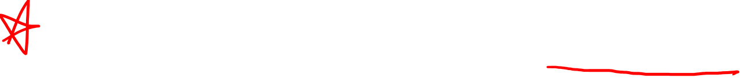
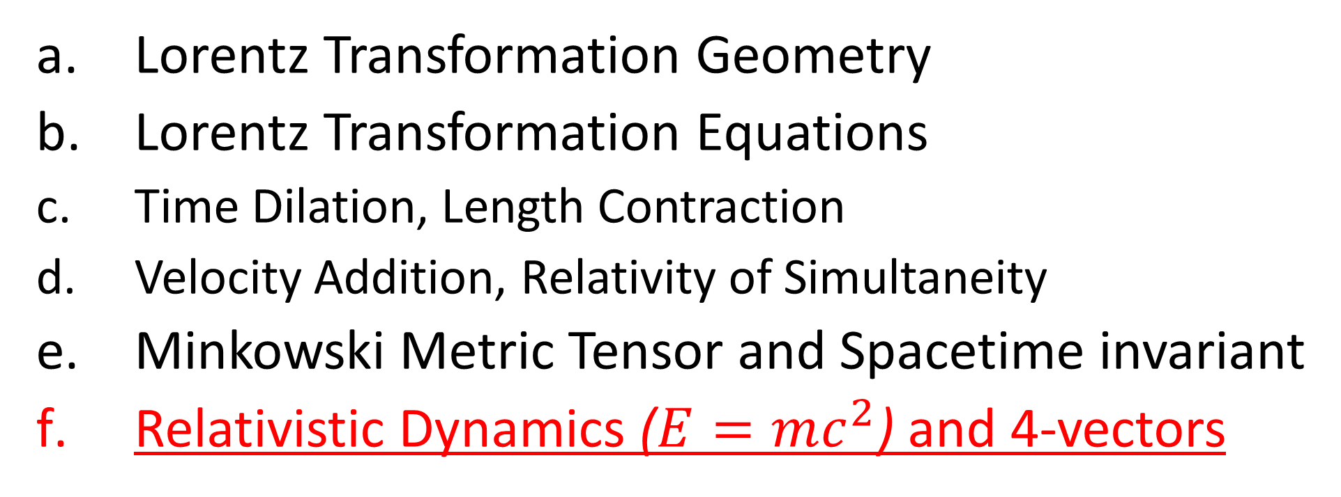
Relativity 104: Special Relativity
Lorentz Transformation Geometry
Lorentz Transformation Equations
Time Dilation, Length Contraction
Velocity Addition, Relativity of Simultaneity
Minkowski Metric Tensor and Spacetime invariant
Relativistic Dynamics ($E=mc^{2}$) and 4-vectors
Notes:
In this video we’re going to talk about relativistic dynamics, which is how things like forces, energy, and momentum behave in special relativity. We’ll also derive the famous equations E = mc^2.

Slide 2
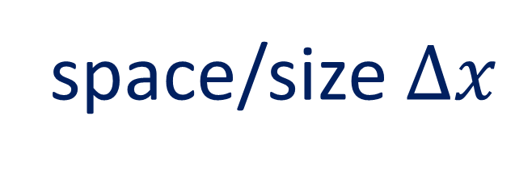




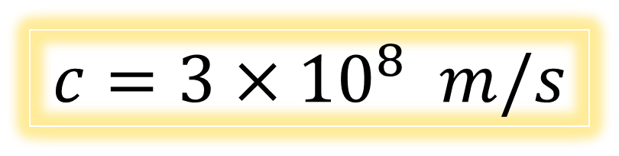
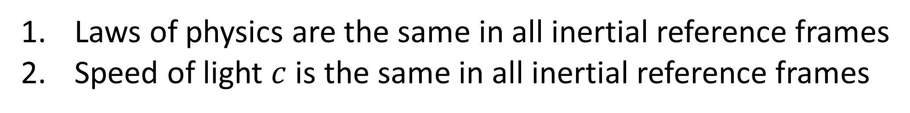

Special Relativity
Laws of physics are the same in all inertial reference frames
Speed of light $c$ is the same in all inertial reference frames
Things we disagree on:
Things we agree on:
time $Δt$
space/size $Δx$
$$c=3×{10}^{8} m/s$$
velocity $\vec{v}$
$s^{2}≡{\left(ct\right)}^{2}−x^{2}−y^{2}$ $−z^{2}$
momentum $\vec{p}$
Minkowski/4-vectors
$$\vec{S} \vec{U} \vec{P} \vec{A} \vec{F}$$
kinetic energy $E_{k}$
Notes:
In special relativity, we’ve found that different observers disagree on many physical quantities like time, space, velocity, momentum, and kinetic energy. We knew from the start that all inertial observers agreed on the speed of light in a vacuum C, and in the last video we discovered the spacetime invariant s^2 for a vector, which all inertial observers also agree on.
In this video we’re going to introduce the idea of minkowski vectors, also called 4-vectors, which are vectors in spacetime that all inertial observers agree on.

Slide 3






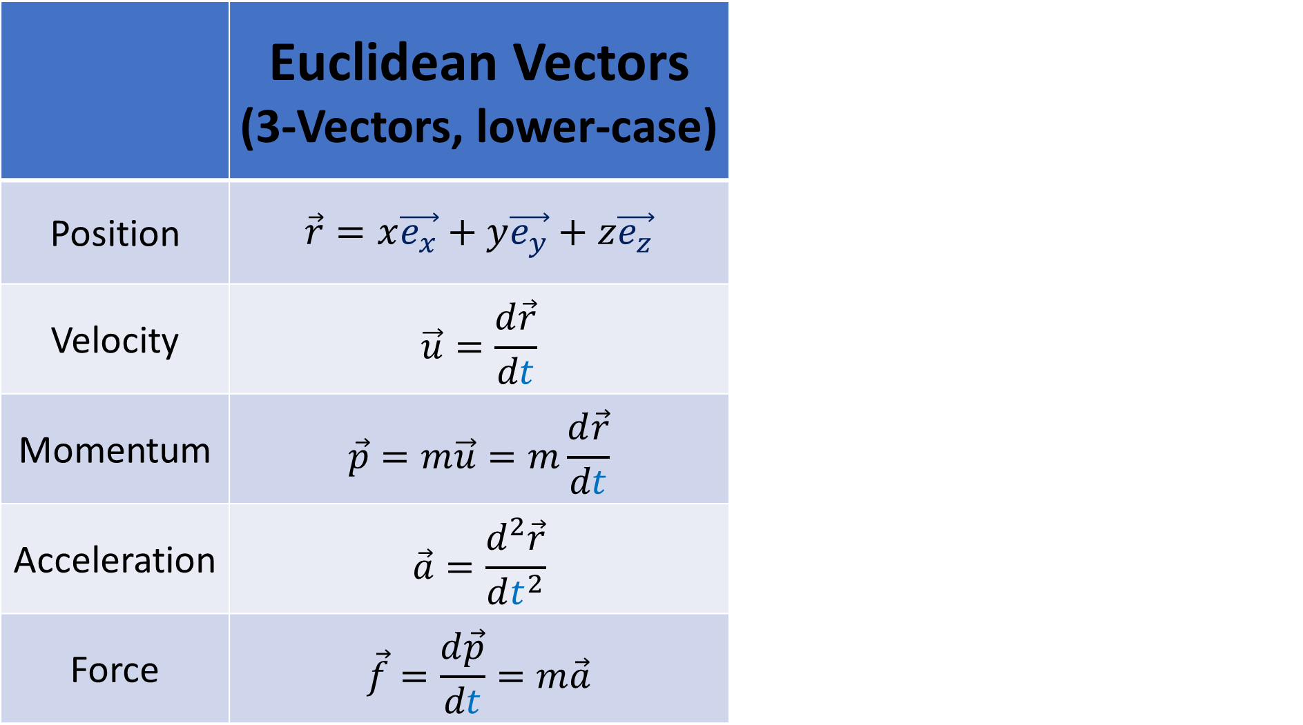

Special Relativity measures time differently in different inertial frames.
 | Euclidean Vectors (3-Vectors, lower-case) | Minkowski Vectors (4-Vectors, upper-case)
Position | $$\vec{r}=x\vec{e_{x}}+y\vec{e_{y}}+z\vec{e_{z}}$$ | $$\vec{R} or \vec{S}=ct\vec{e_{t}}+x\vec{e_{x}}+y\vec{e_{y}}+z\vec{e_{z}}$$
Velocity | $$\vec{u}=\frac{d\vec{r}}{dt}$$ | $$\vec{U}=\frac{d\vec{S}}{dτ}$$
Momentum | $$\vec{p}=m\vec{u}=m\frac{d\vec{r}}{dt}$$ | $$\vec{A}=\frac{d^{2}\vec{S}}{{dτ}^{2}}$$
Acceleration | $$\vec{a}=\frac{d^{2}\vec{r}}{dt^{2}}$$ | $$\vec{P}=m\vec{U}=m\frac{d\vec{S}}{dτ}$$
Force | $$\vec{f}=\frac{d\vec{p}}{dt}=m\vec{a}$$ | $$\vec{F}=\frac{d\vec{P}}{dτ}=m\vec{A}$$
$$t$$
$$\tilde{t}$$
$$\breve{t}$$
This means that every frame will take time derivatives differently…
$\frac{d}{dt}$
$\frac{d}{d\tilde{t}}$
$\frac{d}{d\breve{t}}$
Notes:
In standard newtonian physics, we’re used to 3-dimensional vectors, which I’m doing to denote with small lower-case letters in this video.
We have 3-dimensional position, small r… velocity, small u, which is the derivative of position with respect to time, momentum, small p, which is mass times melocity,
acceleration, small a, which is the 2nd derivative of position with respect to time, and force, small f, which is the derivative of momentum with respect to time, which is also mass times acceleration if mass is constant.
In special relativity, most of these quantities aren’t very useful because the time variable is different in every inertial reference frame due to time dilation.
This means that every frame will take derivatives with respect to a different time variable.

Slide 4


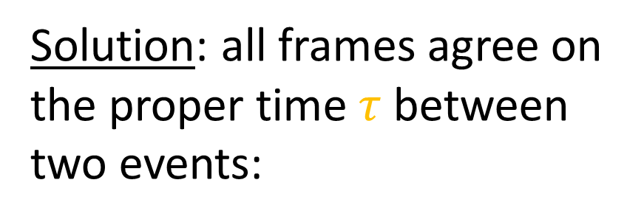
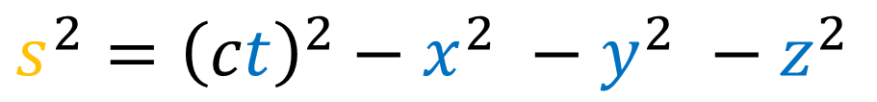
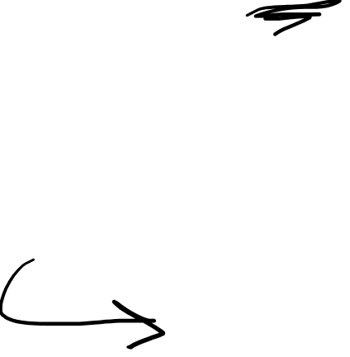
Solution: all frames agree on the proper time $τ$ between two events:
 | Euclidean Vectors (3-Vectors, lower-case) | 4-Vectors, upper-case)
Position | $$\vec{r}=x\vec{e_{x}}+y\vec{e_{y}}+z\vec{e_{z}}$$ | $$\vec{R} or \vec{S}=ct\vec{e_{t}}+x\vec{e_{x}}+y\vec{e_{y}}+z\vec{e_{z}}$$
Velocity | $$\vec{u}=\frac{d\vec{r}}{dt}$$ | $$\vec{U}=\frac{d\vec{S}}{dτ}$$
Momentum | $$\vec{p}=m\vec{u}=m\frac{d\vec{r}}{dt}$$ | $$\vec{P}=m\vec{U}=m\frac{d\vec{S}}{dτ}$$
Acceleration | $$\vec{a}=\frac{d^{2}\vec{r}}{dt^{2}}$$ | $$\vec{A}=\frac{d^{2}\vec{S}}{{dτ}^{2}}$$
Force | $$\vec{f}=\frac{d\vec{p}}{dt}=m\vec{a}$$ | $$\vec{F}=\frac{d\vec{P}}{dτ}=m\vec{A}$$
$$s^{2}={\left(ct\right)}^{2}−x^{2} −y^{2} −z^{2}$$
$$s^{2}>0⇒s=cτ$$
Everyone agrees on derivatives with respect to proper time:
$\frac{d}{dτ}$
Notes:
Recall in the las video we defined the spacetime interval s^2 between 2 events. When s^2 was positive, we said s is equal to the speed of light c times the proper time tau.
Since all frames agree on the proper time tau between two events, they will also agree on derivatives with respect to proper time.

Slide 5
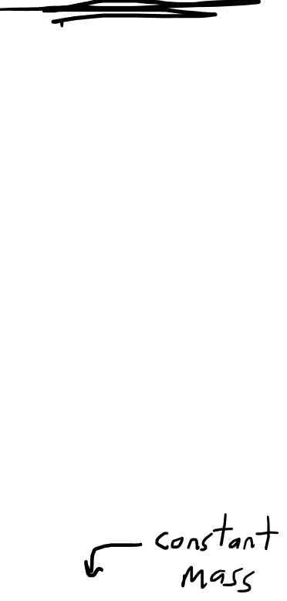
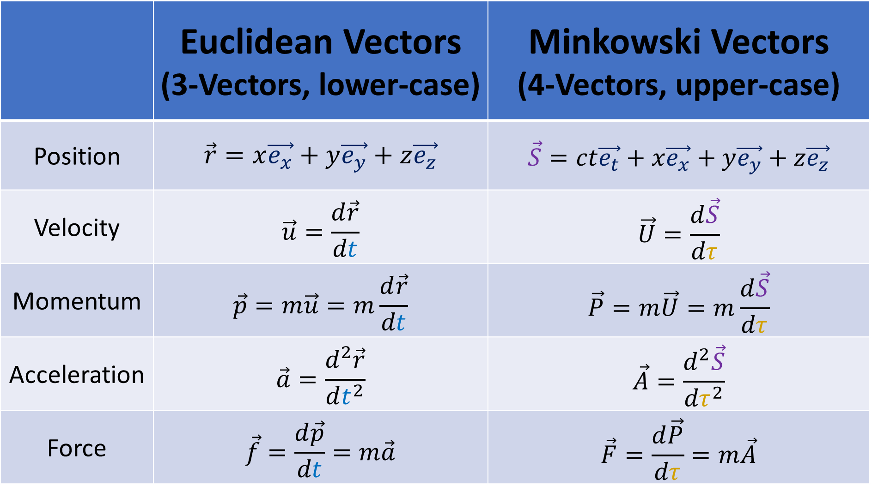
 | Euclidean Vectors (3-Vectors, lower-case) | Minkowski Vectors (4-Vectors, upper-case)
Position | $$\vec{r}=x\vec{e_{x}}+y\vec{e_{y}}+z\vec{e_{z}}$$ | $$\vec{S}=ct\vec{e_{t}}+x\vec{e_{x}}+y\vec{e_{y}}+z\vec{e_{z}}$$
Velocity | $$\vec{u}=\frac{d\vec{r}}{dt}$$ | $$\vec{U}=\frac{d\vec{S}}{dτ}$$
Momentum | $$\vec{p}=m\vec{u}=m\frac{d\vec{r}}{dt}$$ | $$\vec{P}=m\vec{U}=m\frac{d\vec{S}}{dτ}$$
Acceleration | $$\vec{a}=\frac{d^{2}\vec{r}}{dt^{2}}$$ | $$\vec{A}=\frac{d^{2}\vec{S}}{{dτ}^{2}}$$
Force | $$\vec{f}=\frac{d\vec{p}}{dt}=m\vec{a}$$ | $$\vec{F}=\frac{d\vec{P}}{dτ}=m\vec{A}$$
Notes:
We can now define minkowski vectors, or 4-vectors, which are denote with big capital letters, using derivatives with respect to tau.
We start with the 4-position, written either as big R or big S, which is the 4-dimensional position in spacetime.
Then we have 4-velocity, big U, which is the derivative of 4-position with respect to proper time.
4-momentum, big P, is mass times 4-velocity.
4-acceleration, big A is the 2nd derivative of 4-position with respect to proper time.
And 4-force, Big F, is the derivative of 4-momentum with respect to proper time, which is also mass times 4-acceleration if mass is constant.

Slide 6

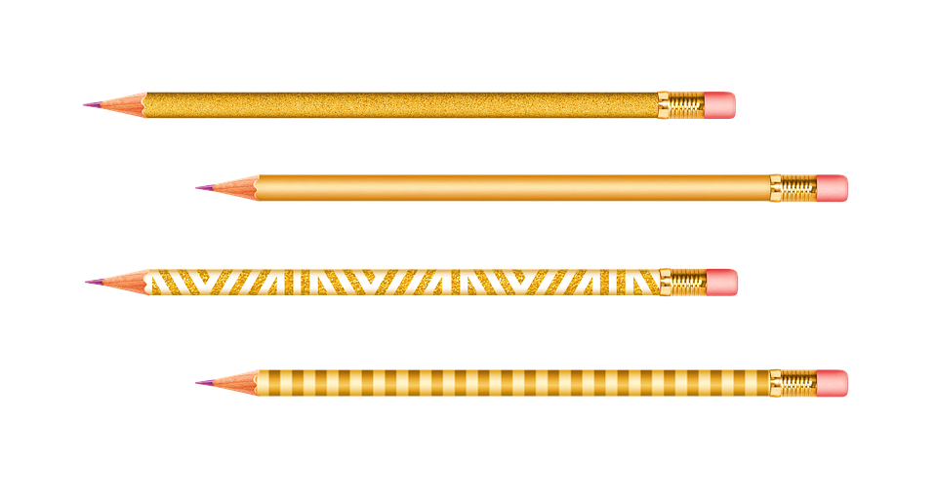
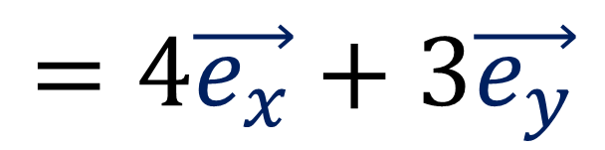

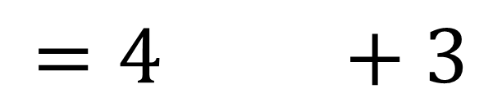
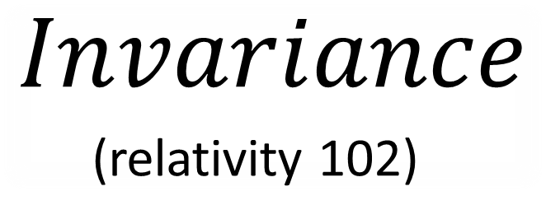

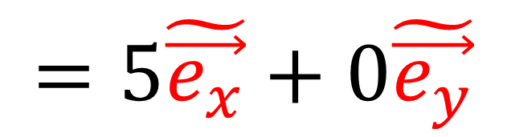

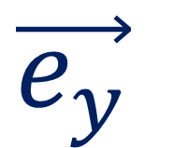
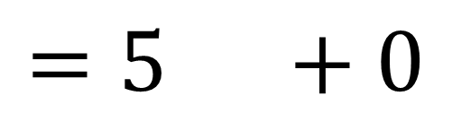
$$Invariance$$
(relativity 102)
$$=4 +3$$
$$=4\vec{e_{x}}+3\vec{e_{y}}$$
$$\vec{e_{y}}$$
$$\tilde{\vec{e_{y}}}$$
$$\tilde{\vec{e_{x}}}$$
$$=5 +0$$
$$\vec{e_{x}}$$
$$=5\tilde{\vec{e_{x}}}+0\tilde{\vec{e_{y}}}$$
Minkowski/4-vectors are invariant.
Notes:
We’re going to find that all reference frames agree on these 4-vectors because they are invariant.
Recall the idea of invariance from relativity 102. If we write the same vector in terms of different basis vectors, we get different components.
We’ve already seen this idea with the spacetime separation vector S, which is also called the 4-position.
And we can change between the components of S in different reference frames using the Lorentz transformation.
In this video we’ll see that this is also true for any 4-vector including 4-velocity, 4-momentum, and others. We can write the same geometrical vector with different components in different reference frames, and change between the components using Lorentzs transformations.

Slide 7
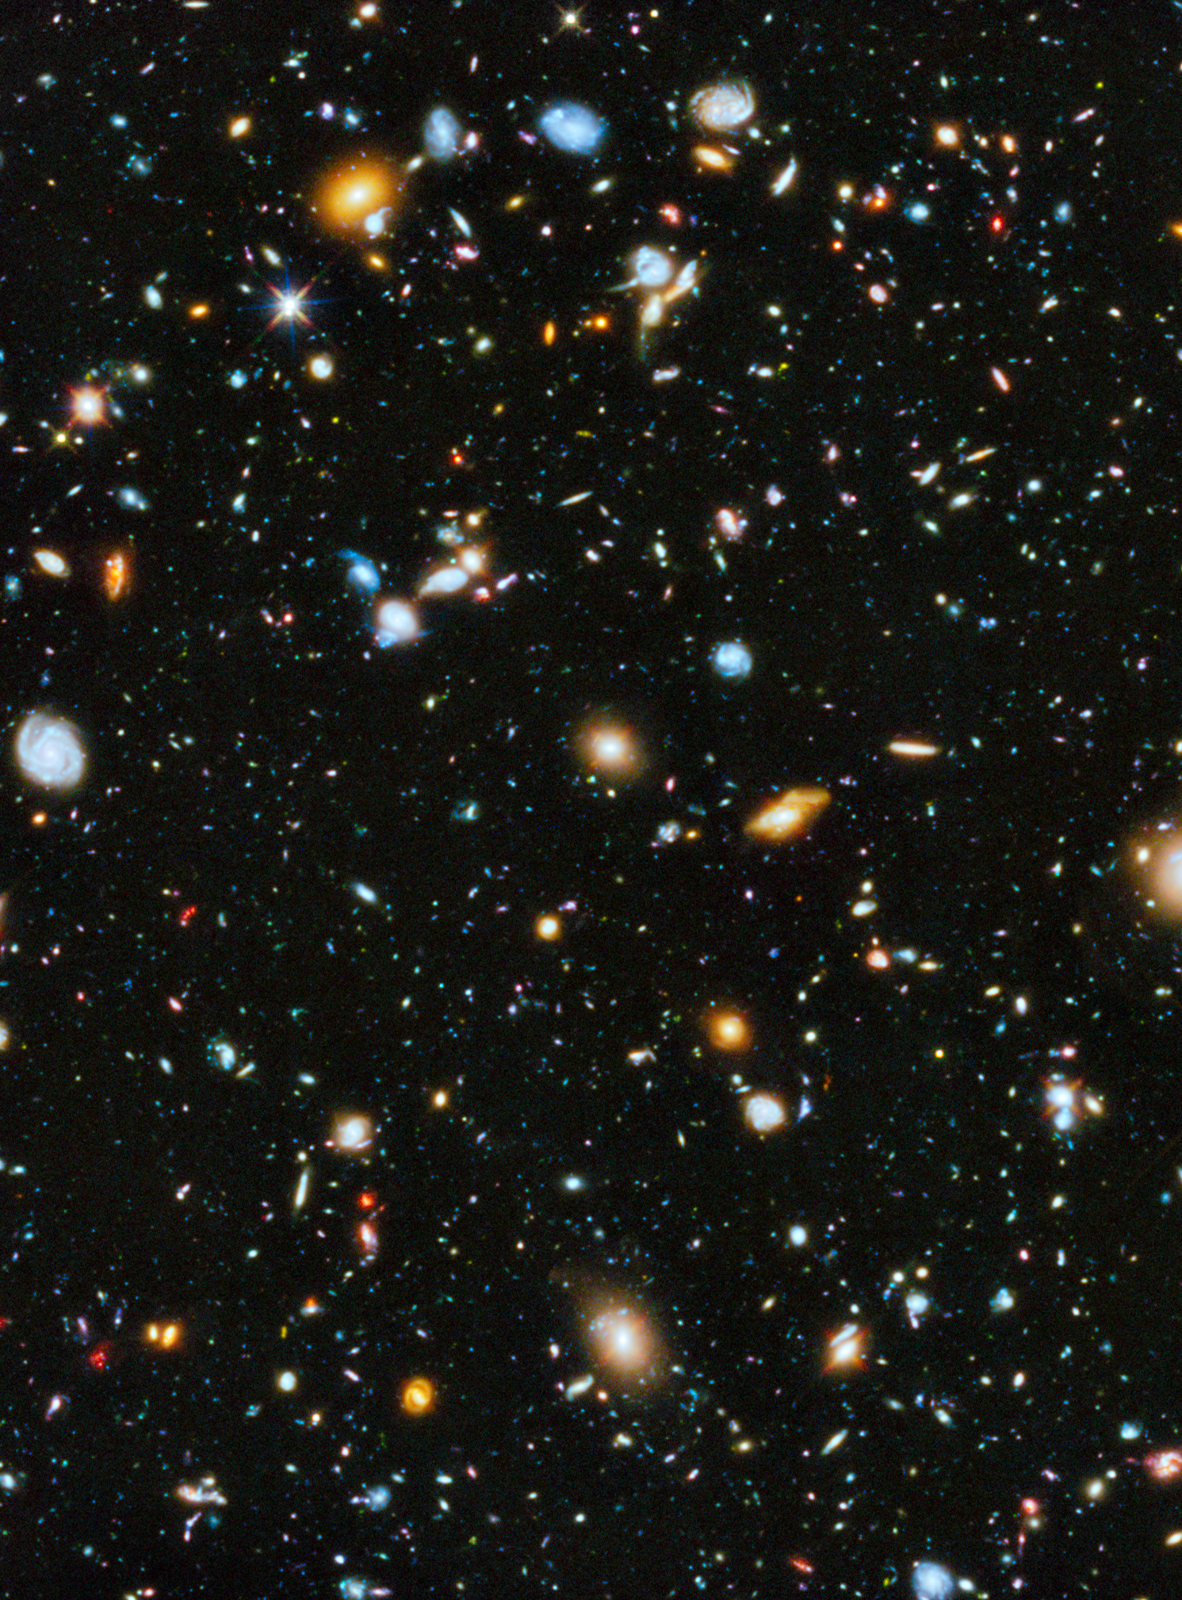




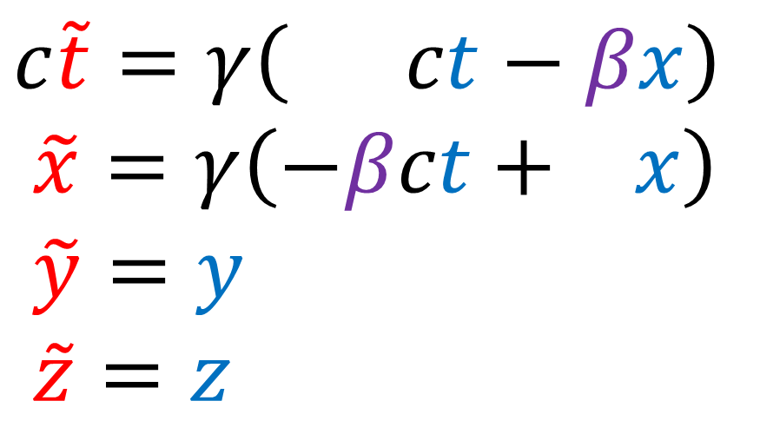

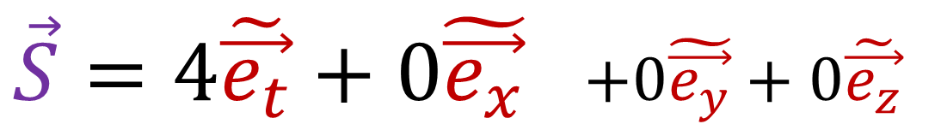


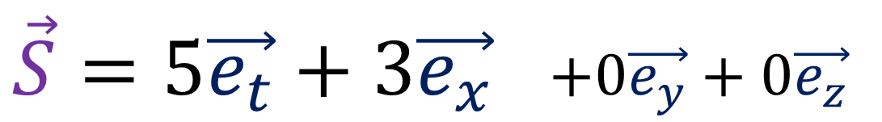
$\vec{S}=5\vec{e_{t}}+3\vec{e_{x}}$ $+0\vec{e_{y}}+0\vec{e_{z}}$
$\vec{S}=4\tilde{\vec{e_{t}}}+0\tilde{\vec{e_{x}}}$ $+0\tilde{\vec{e_{y}}}+0\tilde{\vec{e_{z}}}$
Lorentz Transformation (ct,x)
$$\vec{S}$$
$$c\tilde{t}=γ\left( ct−βx\right)$$
$$\tilde{x}=γ\left(−βct+ x\right)$$
$$\tilde{y}=y$$
$$\tilde{z}=z$$
$$\tilde{\vec{e_{t}}}$$
$$\vec{e_{t}}$$
$$\tilde{\vec{e_{x}}}$$
$$\vec{e_{x}}$$
Notes:
If this vector capital S connects two events in spacetime, S = 5 eT time vectors and 3 eX position vectors.
Plugging 5 and 3 into the spacetime invariant formula, we get 5^2 – 3^2, which is 25 – 9, or 16.
If we use this other spacetime basis eT-tilde and eX-tilde, S = 4 eT-tilde vectors exactly. Plugging 4 and 0 into the spacetime invariant formula, we get 4^2 – 0^2, which 16.
So the spacetime invariant s^2 is the same in all orthonormal spacetime coordinate systems if we use the minkowski definition of orthonormal.

Slide 8
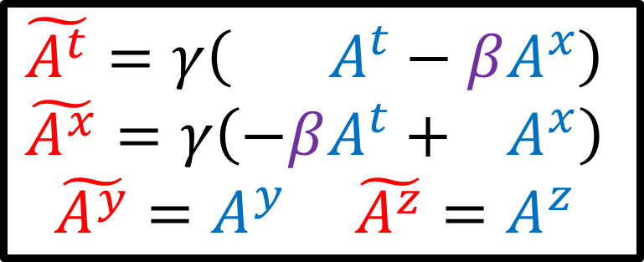
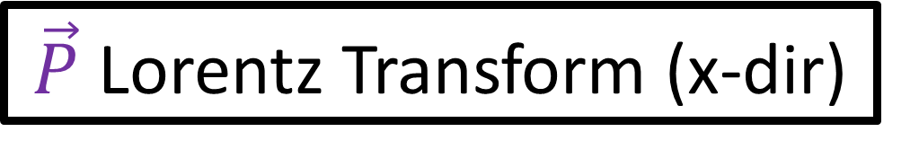
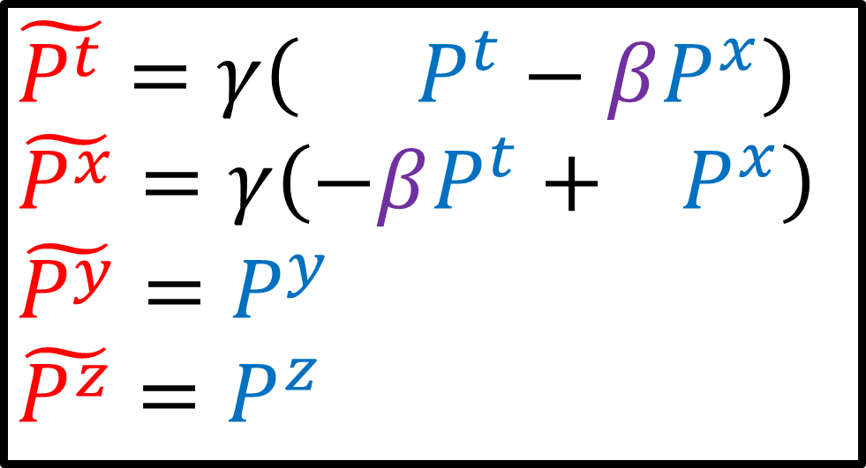
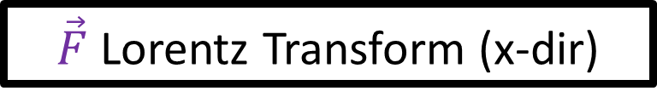

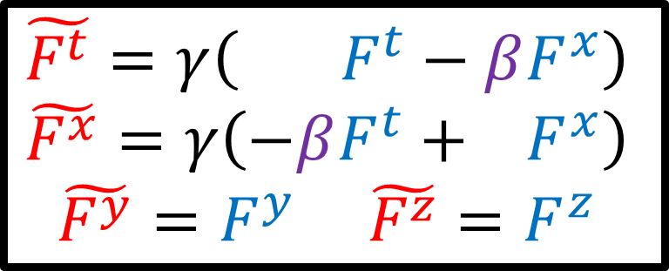
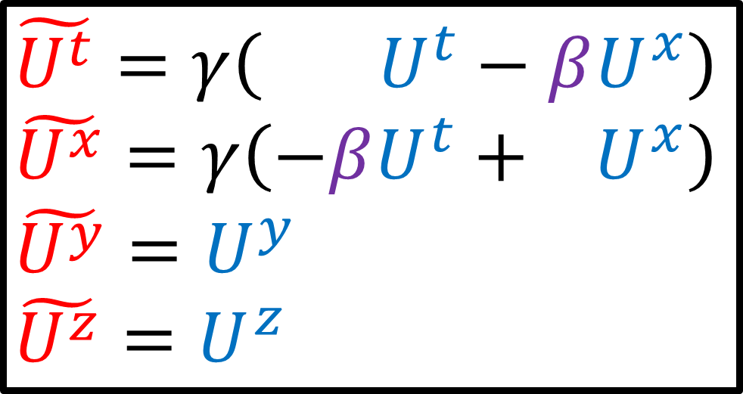
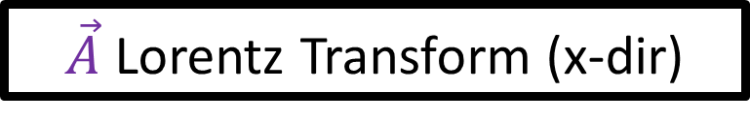
$\vec{U}$ Lorentz Transform (x-dir)
$\vec{P}$ Lorentz Transform (x-dir)
$$\tilde{U^{t}}=γ\left( U^{t}−βU^{x}\right)$$
$$\tilde{U^{x}}=γ\left(−βU^{t}+ U^{x}\right)$$
$$\tilde{U^{y}}=U^{y}$$
$$\tilde{U^{z}}=U^{z}$$
$$\tilde{P^{t}}=γ\left( P^{t}−βP^{x}\right)$$
$$\tilde{P^{x}}=γ\left(−βP^{t}+ P^{x}\right)$$
$$\tilde{P^{y}}=P^{y}$$
$$\tilde{P^{z}}=P^{z}$$
$\vec{A}$ Lorentz Transform (x-dir)
$\vec{F}$ Lorentz Transform (x-dir)
$$\tilde{A^{t}}=γ\left( A^{t}−βA^{x}\right)$$
$$\tilde{A^{x}}=γ\left(−βA^{t}+ A^{x}\right)$$
$$\tilde{A^{y}}=A^{y} \tilde{A^{z}}=A^{z}$$
$$\tilde{F^{t}}=γ\left( F^{t}−βF^{x}\right)$$
$$\tilde{F^{x}}=γ\left(−βF^{t}+ F^{x}\right)$$
$$\tilde{F^{y}}=F^{y} \tilde{F^{z}}=F^{z}$$

Slide 9
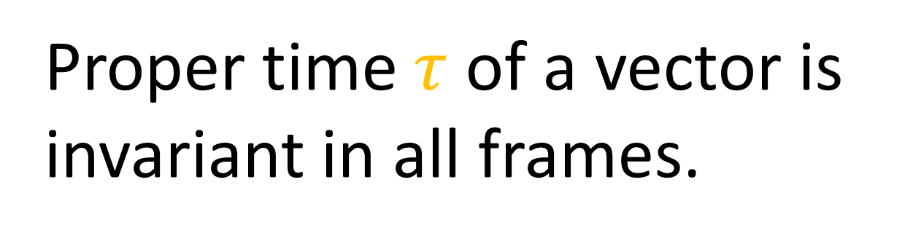
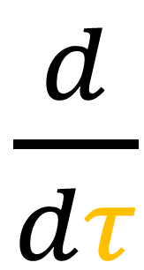
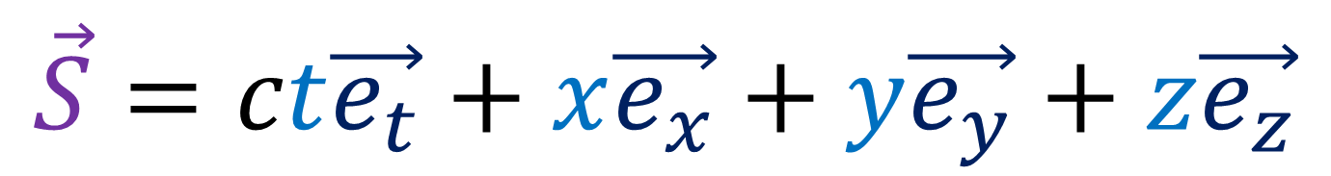
Spacetime Separation Vector
(minkowski-position / 4-position)
$$\vec{S}=ct\vec{e_{t}}+x\vec{e_{x}}+y\vec{e_{y}}+z\vec{e_{z}}$$
How to take time derivatives?
$\frac{d}{dτ}$
Proper time $τ$ of a vector is invariant in all frames.
Notes:
Now our starting point for all of these minkowski-vectors is the 4-position vector big S, which gives the position of an event in spacetime relative to the origin. Big S, has one time component ct, and 3 space components xyz.
Starting with the 4-position, we can get other 4-vectors like the 4-velocity and 4-acceleration. To do this we need to take derivatives with respect to proper time.

Slide 10
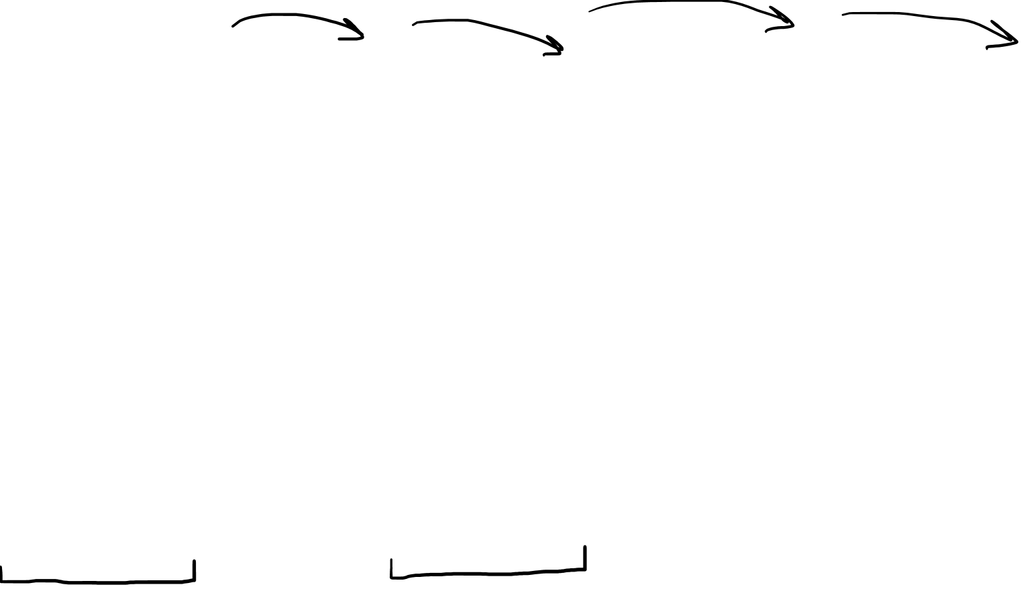
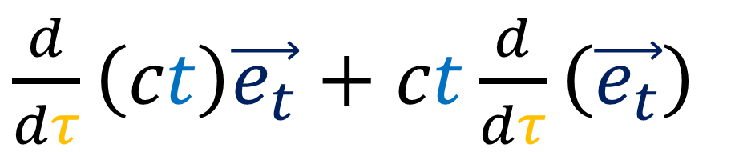
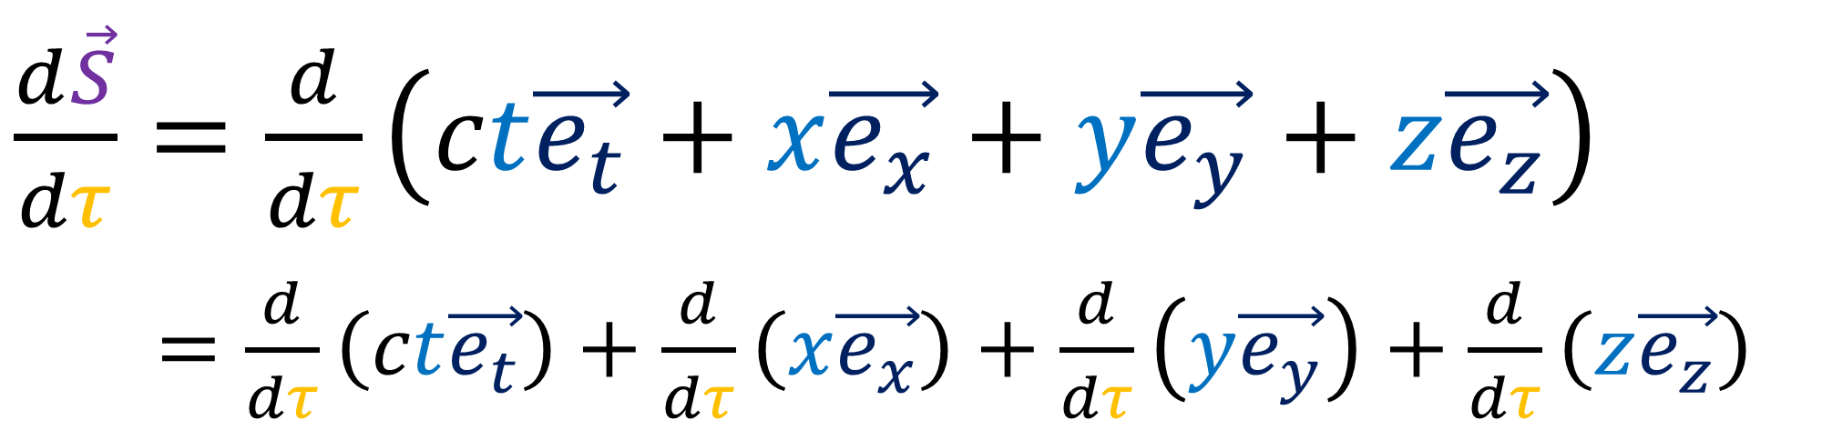
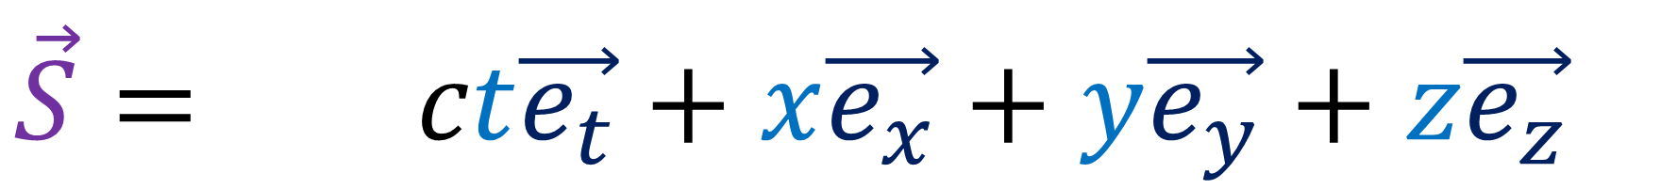
$$\vec{S}= ct\vec{e_{t}}+x\vec{e_{x}}+y\vec{e_{y}}+z\vec{e_{z}}$$
$\frac{d\vec{S}}{dτ}=\frac{d}{dτ}\left(ct\vec{e_{t}}+x\vec{e_{x}}+y\vec{e_{y}}+z\vec{e_{z}}\right)$
$\frac{d\vec{S}}{dτ} =\frac{d}{dτ}\left(ct\vec{e_{t}}\right)+\frac{d}{dτ}\left(x\vec{e_{x}}\right)+\frac{d}{dτ}\left(y\vec{e_{y}}\right)+\frac{d}{dτ}\left(z\vec{e_{z}}\right)$
Product Rule
(Basis vectors are constant
for inertial frames!)
$\frac{d}{dτ}\left(ct\right)\vec{e_{t}}+ct\frac{d}{dτ}\left(\vec{e_{t}}\right)$
Notes:
So when we take the derivative of 4-position big S with respect to proper time tau, we can expand S into its components.
When we have the derivative of a sum of terms, we can just give the derivative operator to each individual term.
Now something to keep in mind is that each of these terms involves the derivative of a product: a vector component times the basis vector. So we need to use product rule, which gives us one term with the derivative of the component times the basis vector, and another term with the components times the derivative of the basis vector.
But, in the case of inertial reference frames, the basis vectors are constant everywhere in spacetime, so since the basis vectors are constant everywhere, their derivative always goes to zero. In future videos when we deal with non-inertial reference frames, we’re going to see this derivative of the basis vector is non-zero. But for this video, we’re dealing with inertial frames, so the derivatives of basis vectors are zero.

Slide 11



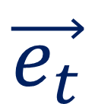









$$\tilde{\vec{e_{t}}}$$
$$\vec{e_{t}}$$
$$\tilde{\vec{e_{x}}}$$
$$\vec{e_{x}}$$
$$\vec{e_{t}}$$
$$\vec{e_{t}}$$
$$\vec{e_{t}}$$
$$\vec{e_{t}} \vec{e_{x}} \vec{e_{y}} \vec{e_{z}}$$
are constant everywhere for inertial frames.
$$\vec{e_{x}}$$
$$\vec{e_{x}}$$
$$\vec{e_{x}}$$
$$\vec{e_{t}}$$
$$\vec{e_{t}}$$
$$\vec{e_{t}}$$
$$\vec{e_{x}}$$
$$\vec{e_{x}}$$
$$\vec{e_{x}}$$
$\frac{d\vec{e_{t}}}{dτ}=\frac{d\vec{e_{x}}}{dτ}=⋯=0$
$$\vec{e_{t}}$$
$$\vec{e_{t}}$$
$$\vec{e_{t}}$$
$$\vec{e_{x}}$$
$$\vec{e_{x}}$$
$$\vec{e_{x}}$$

Slide 12




















$$\tilde{\vec{e_{t}}}$$
$$\vec{e_{t}}$$
$$\tilde{\vec{e_{x}}}$$
$$\vec{e_{x}}$$
$$\tilde{\vec{e_{t}}}$$
$$\tilde{\vec{e_{t}}}$$
$$\tilde{\vec{e_{t}}}$$
$$\tilde{\vec{e_{t}}} \tilde{\vec{e_{x}}} \tilde{\vec{e_{y}}} \tilde{\vec{e_{z}}}$$
are constant everywhere for inertial frames.
$$\tilde{\vec{e_{x}}}$$
$$\tilde{\vec{e_{x}}}$$
$$\tilde{\vec{e_{x}}}$$
$$\tilde{\vec{e_{t}}}$$
$$\tilde{\vec{e_{t}}}$$
$$\tilde{\vec{e_{t}}}$$
$$\tilde{\vec{e_{x}}}$$
$$\tilde{\vec{e_{x}}}$$
$$\tilde{\vec{e_{x}}}$$
$\frac{d\tilde{\vec{e_{t}}}}{dτ}=\frac{d\tilde{\vec{e_{x}}}}{dτ}=⋯=0$
$$\tilde{\vec{e_{t}}}$$
$$\tilde{\vec{e_{t}}}$$
$$\tilde{\vec{e_{t}}}$$
$$\tilde{\vec{e_{x}}}$$
$$\tilde{\vec{e_{x}}}$$
$$\tilde{\vec{e_{x}}}$$

Slide 13
$$\vec{S}= ct\vec{e_{t}}+x\vec{e_{x}}+y\vec{e_{y}}+z\vec{e_{z}}$$
$\frac{d\vec{S}}{dτ}=\frac{d}{dτ}\left(ct\vec{e_{t}}+x\vec{e_{x}}+y\vec{e_{y}}+z\vec{e_{z}}\right)$
$\frac{d\vec{S}}{dτ} =\frac{d}{dτ}\left(ct\vec{e_{t}}\right)+\frac{d}{dτ}\left(x\vec{e_{x}}\right)+\frac{d}{dτ}\left(y\vec{e_{y}}\right)+\frac{d}{dτ}\left(z\vec{e_{z}}\right)$
Product Rule
(Basis vectors are constant
for inertial frames!)
$\frac{d}{dτ}\left(ct\right)\vec{e_{t}}+ct\frac{d}{dτ}\left(\vec{e_{t}}\right)$

Slide 14


$$\vec{S}= ct\vec{e_{t}}+x\vec{e_{x}}+y\vec{e_{y}}+z\vec{e_{z}}$$
$\frac{d\vec{S}}{dτ}=\frac{d}{dτ}\left(ct\vec{e_{t}}+x\vec{e_{x}}+y\vec{e_{y}}+z\vec{e_{z}}\right)$
$\frac{d\vec{S}}{dτ} =\frac{d}{dτ}\left(ct\vec{e_{t}}\right)+\frac{d}{dτ}\left(x\vec{e_{x}}\right)+\frac{d}{dτ}\left(y\vec{e_{y}}\right)+\frac{d}{dτ}\left(z\vec{e_{z}}\right)$
$\frac{d\vec{S}}{dτ}=c\frac{dt}{dτ}\vec{e_{t}}+\frac{dx}{dτ}\vec{e_{x}}+\frac{dy}{dτ}\vec{e_{y}}+\frac{dz}{dτ}\vec{e_{z}}$
Notes:
So the derivative of 4-position S is another 4-dimensional vector containing derivatives of t,x,y,z with respect to proper time tau. We can take the speed of light in a vacuum C, out of the derivative because it’s constant.
Let’s figure out what dt/d-tau is.

Slide 15










What is $\frac{dt}{dτ}$ ?
Lorentz Transformation for Components
$$ct=γ\left( c\tilde{t}+β\tilde{x}\right)$$
$$x=γ\left(βc\tilde{t}+ \tilde{x}\right)$$
$$ct=γ\left(c\tilde{t}+β\tilde{x}\right)$$
$$ct=γ\left(cτ+β0\right)$$
$$ct=γ\left(cτ\right)$$
$t=γτ$
$β=\frac{u}{c}$
Proper time $τ$ between 2 events occurs in worldline connecting events $\left(\tilde{x}=0\right)$.
$$\vec{e_{t}}$$
$$τ$$
$\frac{dt}{dτ}=γ$
$$\vec{e_{x}}$$
Notes:
Recall the Lorentz transformation between from a coordinate system ct-tilde and x-tilde to another coordinate system ct and x. Here, beta is just the fraction of the speed of light, v/c, and gamma = 1/sqrt(1-beta^2).
Also recall that the proper time tau between two events is the time measured between events in a coordinate system where the events are at the same position. Let’s take this frame to be the ct-tilde and x-tilde coordinate system. So x-tilde = 0 between these two events.
So given the Lorentz transformation equation for time, this means that if we set x-tilde = 0, then the time t-tilde is equal to the proper time tau.
So this term goes to zero and we can cancel c from both sides to get t = gamma * tau.
So taking the derivative of t with respect to tau, we just get gamma.

Slide 16






$$\vec{S}=ct\vec{e_{t}}+x\vec{e_{x}}+y\vec{e_{y}}+z\vec{e_{z}}$$
$\frac{dt}{dτ}=γ$
$\frac{d\vec{S}}{dτ}=c\frac{dt}{dτ}\vec{e_{t}}+\frac{dx}{dτ}\vec{e_{x}}+\frac{dy}{dτ}\vec{e_{y}}+\frac{dz}{dτ}\vec{e_{z}}$
Chain Rule:
$$\frac{df}{dτ}=\frac{df}{dt}\frac{dt}{dτ}$$
$$f\left(t\left(τ\right)\right)$$
Notes:
So we’ve determined that dt/d-tau is gamma, and this helps us determine the first term in dS/d-tau… but what about the x,y,z derivatives?
Well, if we recall chain rule from calculus, if we have nested functions, where t is a function of tau and f is a function of t, we can calculate the derivative df/d-tau by multiplying df/dt by dt/d-tau.
As an example we can turn dx/d-tau into dx/dt times dt/tau.
Of course, dx/dt is just the familiar velocity in the x-direction we know from non-relativistic physics, which I’ll denote with u_sub_x. And we already know from before that dt/d-tau is just Gamma.
So the derivative of x with respect to the proper time tau is just the ordinary x-direction velocity times gamma.

Slide 17





$$\vec{S}=ct\vec{e_{t}}+x\vec{e_{x}}+y\vec{e_{y}}+z\vec{e_{z}}$$
$\frac{dt}{dτ}=γ$
$\frac{d\vec{S}}{dτ}=c\frac{dt}{dτ}\vec{e_{t}}+\frac{dx}{dτ}\vec{e_{x}}+\frac{dy}{dτ}\vec{e_{y}}+\frac{dz}{dτ}\vec{e_{z}}$
Chain Rule:
$$\frac{dx}{dτ}=\frac{dx}{dt}\frac{dt}{dτ}$$
$$x\left(τ\right)→$$
$$x\left(t\left(τ\right)\right)$$
$$=u^{x}γ$$
Notes:
So we’ve determined that dt/d-tau is gamma, and this helps us determine the first term in dS/d-tau… but what about the x,y,z derivatives?
Well, if we recall chain rule from calculus, if we have nested functions, where t is a function of tau and f is a function of t, we can calculate the derivative df/d-tau by multiplying df/dt by dt/d-tau.
As an example, we can consider x of tau to instead be a nested function, x-of-t-of-tau. We can then turn dx/d-tau into dx/dt times dt/tau.
Of course, dx/dt is just the familiar velocity in the x-direction we know from non-relativistic Newtonian physics, which I’ll denote with small u with subscript x. And we already know from before that dt/d-tau is just Gamma.
So the derivative of x with respect to the proper time tau is just the ordinary x-direction velocity times gamma.

Slide 18




$$\vec{S}=ct\vec{e_{t}}+x\vec{e_{x}}+y\vec{e_{y}}+z\vec{e_{z}}$$
$$\vec{S}=ct\vec{e_{t}}+x\vec{e_{x}}+y\vec{e_{y}}+z\vec{e_{z}}$$
$\frac{dt}{dτ}=γ$
$\frac{d\vec{S}}{dτ}=c\frac{dt}{dτ}\vec{e_{t}}+\frac{dx}{dτ}\vec{e_{x}}+\frac{dy}{dτ}\vec{e_{y}}+\frac{dz}{dτ}\vec{e_{z}}$
$\frac{d\vec{S}}{dτ}=c\frac{dt}{dτ}\vec{e_{t}}+\frac{dx}{dt}\frac{dt}{dτ}\vec{e_{x}}+\frac{dy}{dt}\frac{dt}{dτ}\vec{e_{y}}+\frac{dz}{dt}\frac{dt}{dτ}\vec{e_{z}}$
$\frac{d\vec{S}}{dτ}= cγ\vec{e_{t}} +u^{x}γ\vec{e_{x}} +u^{y}γ\vec{e_{y}} +u^{z}γ\vec{e_{z}}$
$\frac{d\vec{S}}{dτ}= γ \left(c\vec{e_{t}} + u^{x}\vec{e_{x}} + u^{y}\vec{e_{y}} + u^{z}\vec{e_{z}}\right)$
Notes:
We can use this chain rule approach for all the derivatives of space coordinates with respect to proper time, and that gives us the ordinary non-relativistic velocities with respect to the t coordinate, times dt/d-tau, which is just gamma.
If we factor out the gamma that appears in every term, we see that the 4-velocity dS/d-tau equals gamma times the vector c e_t + u_x ex + u_y ey + u+z ez, where lower-case u denotes non-relativistic velocity.

Slide 19






$\frac{d\vec{S}}{dτ}=c\frac{dt}{dτ}\vec{e_{t}}+\frac{dx}{dτ}\vec{e_{x}}+\frac{dy}{dτ}\vec{e_{y}}+\frac{dz}{dτ}\vec{e_{z}}$
$$≡\vec{U}=cγ\vec{e_{t}}+u^{x}γ\vec{e_{x}} +u^{y}γ\vec{e_{y}} +u^{z}γ\vec{e_{z}}$$
$$≡\vec{U}=U^{t}\vec{e_{t}}+ U^{x} \vec{e_{x}}+U^{y} \vec{e_{y}}+ U^{z} \vec{e_{z}}$$
$$U^{t}=cγ$$
$$U^{z}=u^{z}γ$$
$$U^{x}=u^{x}γ$$
$$U^{y}=u^{y}γ$$
Notes:
So the derivative of the 4-position S with respect to proper time gives us a new 4-vector called capital U, which is called the 4-velocity. The components of the 4-velocity big U are given by big U_t,…. big U_x…., big U_y… and big U_z.
Remember small or lower-case u denotes the non-relativistic velocities with 3 components xyz with respect to t
The big or upper-case U denotes relativistic velocities with 4 components, txyz with respect to proper time Tau.

Slide 20


$\frac{d\vec{S}}{dτ}=c\frac{dt}{dτ}\vec{e_{t}}+\frac{dx}{dτ}\vec{e_{x}}+\frac{dy}{dτ}\vec{e_{y}}+\frac{dz}{dτ}\vec{e_{z}}$
$$≡\vec{U}=cγ\vec{e_{t}}+u^{x}γ\vec{e_{x}} +u^{y}γ\vec{e_{y}} +u^{z}γ\vec{e_{z}}$$
$$≡\vec{U}=U^{t}\vec{e_{t}}+ U^{x} \vec{e_{x}}+U^{y} \vec{e_{y}}+ U^{z} \vec{e_{z}}$$
$$\vec{u}=u^{x}\vec{e_{x}}+u^{y}\vec{e_{y}}+u^{z}\vec{e_{z}}$$
$\vec{u}=\frac{dx}{dt}\vec{e_{x}}+\frac{dy}{dt}\vec{e_{y}}+\frac{dz}{dt}\vec{e_{z}}$
Notes:
So the derivative of the 4-position S with respect to proper time gives us a new 4-vector called capital U, which is called the 4-velocity. The components of the 4-velocity big U are given by big U_t,…. big U_x…., big U_y… and big U_z.
Remember small or lower-case u denotes the non-relativistic velocities with 3 components xyz with respect to t
The big or upper-case U denotes relativistic velocities with 4 components, txyz with respect to proper time Tau.

Slide 21
$\frac{d\vec{S}}{dτ}=c\frac{dt}{dτ}\vec{e_{t}}+\frac{dx}{dτ}\vec{e_{x}}+\frac{dy}{dτ}\vec{e_{y}}+\frac{dz}{dτ}\vec{e_{z}}$
$$≡\vec{U}=cγ\vec{e_{t}}+u^{x}γ\vec{e_{x}} +u^{y}γ\vec{e_{y}} +u^{z}γ\vec{e_{z}}$$
$$≡\vec{U}=U^{t}\vec{e_{t}}+ U^{x} \vec{e_{x}}+U^{y} \vec{e_{y}}+ U^{z} \vec{e_{z}}$$
$$\vec{u}=u^{x}\vec{e_{x}}+u^{y}\vec{e_{y}}+u^{z}\vec{e_{z}}$$
$\vec{u}=\frac{dx}{dt}\vec{e_{x}}+\frac{dy}{dt}\vec{e_{y}}+\frac{dz}{dt}\vec{e_{z}}$
Notes:
So the derivative of the 4-position S with respect to proper time gives us a new 4-vector called capital U, which is called the 4-velocity. The components of the 4-velocity big U are given by big U_t,…. big U_x…., big U_y… and big U_z.
Remember small or lower-case u denotes the non-relativistic velocities with 3 components xyz with respect to t
The big or upper-case U denotes relativistic velocities with 4 components, txyz with respect to proper time Tau.

Slide 22



$\frac{d\vec{S}}{dτ}=c\frac{dt}{dτ}\vec{e_{t}}+\frac{dx}{dτ}\vec{e_{x}}+\frac{dy}{dτ}\vec{e_{y}}+\frac{dz}{dτ}\vec{e_{z}}$
$$≡\vec{U}=cγ\vec{e_{t}}+u^{x}γ\vec{e_{x}} +u^{y}γ\vec{e_{y}} +u^{z}γ\vec{e_{z}}$$
$$≡\vec{U}=U^{t}\vec{e_{t}}+ U^{x} \vec{e_{x}}+U^{y} \vec{e_{y}}+ U^{z} \vec{e_{z}}$$
4-velocity
$$\vec{U}=\left[\vec{e_{t}} \vec{e_{x}} \vec{e_{y}} \vec{e_{z}}\right]\left[\begin{aligned}cγ \\ u^{x}γ \\ u^{y}γ \\ u^{z}γ\end{aligned}\right]$$
Notes:
We can also write the 4-velocity in array notation, with the basis vectors in a row and the vector component in a column.
If we multiply the arrays we get first entry time first entry, second times second, third times third, and forth times forth, which gives us the original vector big U.

Slide 23


$$\vec{U}=cγ\vec{e_{t}}+u^{x}γ\vec{e_{x}} +u^{y}γ\vec{e_{y}} +u^{z}γ\vec{e_{z}}$$
$\vec{U}$ is invariant for all coordinate systems.
(just like $\vec{S}$)

Slide 24












$u^{x}=\frac{1}{2}c$
$β=\frac{u}{c}=\frac{1}{2}$
$$u^{y}=u^{z}=0$$
$$light$$
$$\vec{e_{t}}$$
$$u^{2}={\left(u^{x}\right)}^{2}+{\left(u^{y}\right)}^{2}+{\left(u^{z}\right)}^{2}$$
$$u=u^{x}$$
$$\vec{e_{x}}$$
Notes:
Let’s look at an example of how the 4-velocity capital U is invariant.
Let’s say Einstein is stationary in a spacetime diagram, and a car is moving off to the right in the x-direction at half the speed of light, so u_x ½ c.
For simplicity, we’ll say that the velocities in the y and z directions are zero, so we’re only concerned with the x axis and time axis.
The square of the total velocity of the car is normally u_x ^2 + u_y^2 + u_z^2, but since only the x-velocity is non-zero, this means that the total velocity u = u_x = 1/2c.
This means that beta, which is u/c, is just ½.
And for beta = ½, the corresponding gamma coefficient is 2 / the square root of 3.
The 4-velocity only has two non-zero components, gamma*c for time and gamma*u_x for x-position.
Subbing in 2/root-3 for gamma and ½ C for u_x, and cancelling these 2s… we get that big-U equals 2/root-3 c e_t and 1/root-3 c e_x
We can see these components match up with the 4-velocity vector in our spacetime diagram.

Slide 25




$u^{x}=\frac{1}{2}c$
$β=\frac{u}{c}=\frac{1}{2}$
$γ=\frac{1}{\sqrt{1−β^{2}}}=\frac{2}{\sqrt{3}}$
$$light$$
$$\vec{U}= γ c\vec{e_{t}}+ γ u^{x}\vec{e_{x}}$$
$\vec{U}=\frac{2}{\sqrt{3}}c\vec{e_{t}}+\frac{2}{\sqrt{3}}(\frac{1}{2}c)\vec{e_{x}}$
$\vec{U}=\frac{2}{\sqrt{3}}c\vec{e_{t}}+\frac{1}{\sqrt{3}}c\vec{e_{x}}$
$$\vec{U}$$
$$\vec{e_{t}}$$
$$\vec{e_{x}}$$
Notes:
Let’s look at an example of how the 4-velocity capital U is invariant.
Let’s say Einstein is stationary in a spacetime diagram, and a car is moving off to the right in the x-direction at half the speed of light, so u_x ½ c.
For simplicity, we’ll say that the velocities in the y and z directions are zero, so we’re only concerned with the x axis and time axis.
The square of the total velocity of the car is normally u_x ^2 + u_y^2 + u_z^2, but since only the x-velocity is non-zero, this means that the total velocity u = u_x = 1/2c.
This means that beta, which is u/c, is just ½.
And for beta = ½, the corresponding gamma coefficient is 2 / the square root of 3.
The 4-velocity only has two non-zero components, gamma*c for time and gamma*u_x for x-position.
Subbing in 2/root-3 for gamma and ½ C for u_x, and cancelling these 2s… we get that big-U equals 2/root-3 c e_t and 1/root-3 c e_x
We can see these components match up with the 4-velocity vector in our spacetime diagram.

Slide 26






$u^{x}=\frac{1}{2}c$
$\vec{U}=\frac{2}{\sqrt{3}}c\vec{e_{t}}+\frac{1}{\sqrt{3}}c\vec{e_{x}}$
$$\tilde{\vec{e_{t}}}$$
$$light$$
$$\vec{U}$$
$$\vec{e_{t}}$$
$$\vec{U}=\tilde{γ}c\tilde{\vec{e_{t}}}+\tilde{γ}\tilde{u^{x}}\tilde{\vec{e_{x}}}$$
$$=1c\tilde{\vec{e_{t}}}+1(0) \tilde{\vec{e_{x}}}$$
$$= c\tilde{\vec{e_{t}}}$$
$$\tilde{\vec{e_{x}}}$$
$$\vec{e_{x}}$$
Notes:
However, in the reference frame of the car, the car’s velocity is zero. And that means that beta = 0, and therefore gamma = 1.
In the car’s frame, the car’s 4-velocity equals c * et-tilde.
And this matches up with the vector big-U in our spacetime diagram.
So we can see that the 4-velocity big-U is an invariant vector. It has different components in different reference frames, but it is the same geometric vector in spacetime.
Also, notice that even though the car’s ordinary non-relativistic velocity is zero m/s, it’s 4-velocity is not zero. The car still has a non-zero 4-velocity component in the time-direction. It’s just that the spatial components of the 4-velocity are zero.

Slide 27






Invariance
$\vec{U} =U^{t}\vec{e_{t}}+U^{x}\vec{e_{x}} =\tilde{U^{t}} \tilde{\vec{e_{t}}}+\tilde{U^{x}} \tilde{\vec{e_{x}}}$
$\vec{U} =\frac{2}{\sqrt{3}}c\vec{e_{t}}+\frac{1}{\sqrt{3}}c\vec{e_{x}} = c \tilde{\vec{e_{t}}} + 0 \tilde{\vec{e_{x}}}$
$\left[\begin{aligned}c\tilde{t} \\ \tilde{x}\end{aligned}\right]=γ\left[\begin{matrix}1 & −β \\ −β & 1\end{matrix}\right]\left[\begin{aligned}ct \\ x\end{aligned}\right]$
$\left[\begin{aligned}\tilde{U^{t}} \\ \tilde{U^{x}}\end{aligned}\right]=γ\left[\begin{matrix}1 & −β \\ −β & 1\end{matrix}\right]\left[\begin{aligned}U^{t} \\ U^{x}\end{aligned}\right]$
$$c\tilde{t}=γ\left( ct−βx\right)$$
$\tilde{x}=γ\left(−βct+ x\right)$
$$\tilde{U^{t}}=γ\left( U^{t}−βU^{x}\right)$$
$$\tilde{U^{x}}=γ\left(−βU^{t}+ U^{x}\right)$$
Notes:
Also, just as the components of the 4-position vector can be transformed to a different frame of reference using a Lorentz transformation,
the components of 4-velocity can also be changed to a different frame using a Lorentz transformation.

Slide 28

Lorentz Transform
$$\vec{U} =U^{t}\vec{e_{t}}+U^{x}\vec{e_{x}}= \left[\vec{e_{t}} \vec{e_{x}}\right]\left[\begin{aligned}U^{t} \\ U^{x}\end{aligned}\right]$$
$=\left[\vec{e_{t}} \vec{e_{x}}\right]\left[\begin{matrix}1 & 0 \\ 0 & 1\end{matrix}\right]\left[\begin{aligned}U^{t} \\ U^{x}\end{aligned}\right]$
$=\left[\vec{e_{t}} \vec{e_{x}}\right]γ\left[\begin{matrix}1 & β \\ β & 1\end{matrix}\right]γ\left[\begin{matrix}1 & −β \\ −β & 1\end{matrix}\right]\left[\begin{aligned}U^{t} \\ U^{x}\end{aligned}\right]$
$=\tilde{U^{t}} \tilde{\vec{e_{t}}}+\tilde{U^{x}} \tilde{\vec{e_{x}}}$ $=\left[\tilde{\vec{e_{t}}} \tilde{\vec{e_{x}}}\right] \left[\begin{aligned}\tilde{U^{t}} \\ \tilde{U^{x}}\end{aligned}\right]$

Slide 29






Invariance
$\vec{U} =U^{t}\vec{e_{t}}+U^{x}\vec{e_{x}} =\tilde{U^{t}} \tilde{\vec{e_{t}}}+\tilde{U^{x}} \tilde{\vec{e_{x}}}$
$\vec{U} =\frac{2}{\sqrt{3}}c\vec{e_{t}}+\frac{1}{\sqrt{3}}c\vec{e_{x}} = c \tilde{\vec{e_{t}}} + 0 \tilde{\vec{e_{x}}}$
$$\tilde{U^{t}}=γ\left( U^{t}−βU^{x}\right)$$
$$\tilde{U^{x}}=γ\left(−βU^{t}+ U^{x}\right)$$
$\tilde{U^{t}}=\frac{2}{\sqrt{3}}\left( \left(\frac{2}{\sqrt{3}}c\right)−\frac{1}{2}\left(\frac{1}{\sqrt{3}}c\right)\right)$
$\tilde{U^{x}}=\frac{2}{\sqrt{3}}\left(−\frac{1}{2}\left(\frac{2}{\sqrt{3}}c\right)+\left(\frac{1}{\sqrt{3}}c\right)\right)$
$\tilde{U^{t}}=\frac{2}{\sqrt{3}}\left( U^{t}−\frac{1}{2}U^{x}\right)$
$\tilde{U^{x}}=\frac{2}{\sqrt{3}}\left(−\frac{1}{2}U^{t}+ U^{x}\right)$
$\tilde{U^{t}}=\frac{4}{3}c−\frac{1}{3}c=c$
$\tilde{U^{x}}=−\frac{2}{3}c+\frac{2}{3}c=0$
Notes:
We can see that if we take the Lorentz transformation, plug the gamma and beta coefficients in, and also the Ut and Ux components in Einstein’s frame, we get the expected 4-velocity components of Ut-tilde = c and Ux-tilde = 0 for the car’s reference frame.
But this still describes the same 4-velocity U.

Slide 30





Invariance
$\vec{U} =U^{t}\vec{e_{t}}+U^{x}\vec{e_{x}} =\tilde{U^{t}} \tilde{\vec{e_{t}}}+\tilde{U^{x}} \tilde{\vec{e_{x}}}$
$\vec{U} =\frac{2}{\sqrt{3}}c\vec{e_{t}}+\frac{1}{\sqrt{3}}c\vec{e_{x}} = c \tilde{\vec{e_{t}}} + 0 \tilde{\vec{e_{x}}}$
$$\vec{U}⋅\vec{U}$$
$←$ Invariant
Minkowski Metric
$$=\left(U^{t}\vec{e_{t}}+U^{x}\vec{e_{x}}\right)⋅\left(U^{t}\vec{e_{t}}+U^{x}\vec{e_{x}}\right)$$
$$=U^{t}U^{t}\left(\vec{e_{t}}⋅\vec{e_{t}}\right)+U^{t}U^{x}\left(\vec{e_{t}}⋅\vec{e_{x}}\right)+U^{x}U^{t}\left(\vec{e_{x}}⋅\vec{e_{t}}\right)+U^{x}U^{x}\left(\vec{e_{x}}⋅\vec{e_{x}}\right)$$
$$={\left(U^{t}\right)}^{2}−{\left(U^{x}\right)}^{2}$$
$$\vec{e_{t}}⋅\vec{e_{t}}=+1$$
$$\vec{e_{t}}⋅\vec{e_{x}}=0$$
$$\vec{e_{x}}⋅\vec{e_{x}}=−1$$
Notes:
Another thing to notice is that the quantity big U dot big U is also invariant.
Recall that with a minkowski orthonormal, the time basis vector dotted with itself gives +1, a position basis vector dotted with itself is -1, and mixed basis vector dot products are zero.
So in our case, bigU dot bigU is Ut^2 – Ux^2. In Einstein’s frame, this gives us 2/root 3 c ^2 – 1/root3 c ^2, which is 4/3 c^2 – 1/3 c^2, which is just c^2.
In the car’s frame, we take the same formula, and plug in the 4-velocity components for the car, which are c for time and 0 for x. This gives us that same result c^2.

Slide 31



Invariance
$\vec{U} =U^{t}\vec{e_{t}}+U^{x}\vec{e_{x}} =\tilde{U^{t}} \tilde{\vec{e_{t}}}+\tilde{U^{x}} \tilde{\vec{e_{x}}}$
$\vec{U} =\frac{2}{\sqrt{3}}c\vec{e_{t}}+\frac{1}{\sqrt{3}}c\vec{e_{x}} = c \tilde{\vec{e_{t}}} + 0 \tilde{\vec{e_{x}}}$
$$\vec{U}⋅\vec{U}={\left(U^{t}\right)}^{2}−{\left(U^{x}\right)}^{2}$$
$={\left(\frac{2}{\sqrt{3}}c\right)}^{2}−{\left(\frac{1}{\sqrt{3}}c\right)}^{2}$
$=\frac{4}{3}c^{2}−\frac{1}{3}c^{2}=c^{2}$
$$={\left(\tilde{U^{t}}\right)}^{2}−{\left(\tilde{U^{x}}\right)}^{2}$$
$$={\left(c\right)}^{2}−{\left(0\right)}^{2}$$
$$=c^{2}$$
Notes:
Another thing to notice is that the quantity big U dot big U is also invariant.
Recall that with a minkowski orthonormal, the time basis vector dotted with itself gives +1, a position basis vector dotted with itself is -1, and mixed basis vector dot products are zero.
So in our case, bigU dot bigU is Ut^2 – Ux^2. In Einstein’s frame, this gives us 2/root 3 c ^2 – 1/root3 c ^2, which is 4/3 c^2 – 1/3 c^2, which is just c^2.
In the car’s frame, we take the same formula, and plug in the 4-velocity components for the car, which are c for time and 0 for x. This gives us that same result c^2.

Slide 32


True for all 4-velocity vectors:
$$\vec{U}⋅\vec{U}=c^{2}$$
$$\left\|\vec{U}\right\|=c$$

Slide 33



What is the Minkowski magnitude of $\vec{U}$?
$\vec{U}= cγ\vec{e_{t}} + u^{x}γ\vec{e_{x}} + u^{y}γ\vec{e_{y}} +u^{z}γ\vec{e_{z}}$
$${\left\|\vec{U}\right\|}^{2}=\vec{U}⋅\vec{U}=$$
$$\left(U^{t}\vec{e_{t}}+U^{x}\vec{e_{x}}+U^{y} \vec{e_{y}}+U^{z} \vec{e_{z}}\right)⋅\left(U^{t}\vec{e_{t}}+U^{x} \vec{e_{x}}+U^{y} \vec{e_{y}}+U^{z} \vec{e_{z}}\right)$$
$$=U^{t}U^{t}\left(\vec{e_{t}}⋅\vec{e_{t}}\right)+U^{t}U^{x}\left(\vec{e_{t}}⋅\vec{e_{x}}\right) +U^{t}U^{y}\left(\vec{e_{t}}⋅\vec{e_{y}}\right) +U^{t}U^{z}\left(\vec{e_{t}}⋅\vec{e_{z}}\right)$$
$$+U^{x}U^{t}\left(\vec{e_{x}}⋅\vec{e_{t}}\right)+U^{x}U^{x}\left(\vec{e_{x}}⋅\vec{e_{x}}\right) +U^{x}U^{y}\left(\vec{e_{x}}⋅\vec{e_{y}}\right)+U^{x}U^{z}\left(\vec{e_{x}}⋅\vec{e_{z}}\right)$$
$$+U^{y}U^{t}\left(\vec{e_{y}}⋅\vec{e_{t}}\right)+U^{y}U^{x}\left(\vec{e_{y}}⋅\vec{e_{x}}\right)+U^{y}U^{y}\left(\vec{e_{y}}⋅\vec{e_{y}}\right)+U^{y}U^{z}\left(\vec{e_{y}}⋅\vec{e_{z}}\right)$$
$$+U^{z}U^{t}\left(\vec{e_{z}}⋅\vec{e_{t}}\right) +U^{z}U^{x}\left(\vec{e_{z}}⋅\vec{e_{x}}\right) +U^{z}U^{y}\left(\vec{e_{z}}⋅\vec{e_{y}}\right) +U^{z}U^{z}\left(\vec{e_{z}}⋅\vec{e_{z}}\right)$$
Notes:
It turns out that this is true for all 4-velocity vectors: all 4-velocity vectors have a minkowski length of c, the speed of light in a vacuum.
And we can prove it.
It we have some generic 4-velocity vector with components Ut, Ux, Uy, and Uz, and take the dot product with itself, we get 16 terms.
This gives us the familiar matrix equation for the squared length of a vector, with the familiar minkowski metric tensor matrix from the last video, which finally simplifies to Ut^2 – Ux^2 – Uy^2 – Uz^2.

Slide 34

What is the Minkowski magnitude of $\vec{U}$?
$\vec{U}= cγ\vec{e_{t}} + u^{x}γ\vec{e_{x}} + u^{y}γ\vec{e_{y}} +u^{z}γ\vec{e_{z}}$
$${\left\|\vec{U}\right\|}^{2}=\vec{U}⋅\vec{U}=$$
$$\left(U^{t}\vec{e_{t}}+U^{x}\vec{e_{x}}+U^{y} \vec{e_{y}}+U^{z} \vec{e_{z}}\right)⋅\left(U^{t}\vec{e_{t}}+U^{x} \vec{e_{x}}+U^{y} \vec{e_{y}}+U^{z} \vec{e_{z}}\right)$$
$$=U^{t}U^{t}\left(+1\right)+U^{t}U^{x}\left(0\right) +U^{t}U^{y}\left(0\right) +U^{t}U^{z}\left(0\right)$$
$$+U^{x}U^{t}\left(0\right)+U^{x}U^{x}\left(−1\right) +U^{x}U^{y}\left(0\right)+U^{x}U^{z}\left(0\right)$$
$$+U^{y}U^{t}\left(0\right)+U^{y}U^{x}\left(0\right)+U^{y}U^{y}\left(−1\right)+U^{y}U^{z}\left(0\right)$$
$$+U^{z}U^{t}\left(0\right) +U^{z}U^{x}\left(0\right) +U^{z}U^{y}\left(0\right) +U^{z}U^{z}\left(−1\right)$$
Notes:
It turns out that this is true for all 4-velocity vectors: all 4-velocity vectors have a minkowski length of c, the speed of light in a vacuum.
And we can prove it.
It we have some generic 4-velocity vector with components Ut, Ux, Uy, and Uz, and take the dot product with itself, we get 16 terms.
This gives us the familiar matrix equation for the squared length of a vector, with the familiar minkowski metric tensor matrix from the last video, which finally simplifies to Ut^2 – Ux^2 – Uy^2 – Uz^2.

Slide 35

What is the Minkowski magnitude of $\vec{U}$?
$\vec{U}= cγ\vec{e_{t}} + u^{x}γ\vec{e_{x}} + u^{y}γ\vec{e_{y}} +u^{z}γ\vec{e_{z}}$
$${\left\|\vec{U}\right\|}^{2}=\vec{U}⋅\vec{U}=$$
$$\left(U^{t}\vec{e_{t}}+U^{x}\vec{e_{x}}+U^{y} \vec{e_{y}}+U^{z} \vec{e_{z}}\right)⋅\left(U^{t}\vec{e_{t}}+U^{x} \vec{e_{x}}+U^{y} \vec{e_{y}}+U^{z} \vec{e_{z}}\right)$$
$$={\left(U^{t}\right)}^{2}−{\left(U^{x}\right)}^{2}−{\left(U^{y}\right)}^{2}−{\left(U^{z}\right)}^{2}$$
$$={\left(cγ\right)}^{2}−{\left(u^{x}γ\right)}^{2}−{\left(u^{y}γ\right)}^{2}−{\left(u^{z}γ\right)}^{2}$$
Notes:
Now recall we determined the components of big U to be c*gamma, ux*gamma, uy*gamma and uz*gamma.
If we plug all these into our formula for bigU-dot-bigU, and factor out gamma^2 in front, we can combine small ux^2 small uy^2 and small uz^2 into the square of the total non-relativistic velocity, small u ^2.
Not if we factor out c^2 from these terms, we get 1 – small u^2/c^2, which is just the definition of beta^2.
And if we recall that gamma = 1/srqt 1-beta^2, then gamma squared cancels out with this and we get bigU-dot-bigU = c^2.
So therefore, the magnitude of all 4-velocity vectors is the speed of light in a vacuum, c.

Slide 36



What is the Minkowski magnitude of $\vec{U}$?
$\vec{U}= cγ\vec{e_{t}} + u^{x}γ\vec{e_{x}} + u^{y}γ\vec{e_{y}} +u^{z}γ\vec{e_{z}}$
$$\vec{U}⋅\vec{U}={\left(cγ\right)}^{2}−{\left(u^{x}γ\right)}^{2}−{\left(u^{y}γ\right)}^{2}−{\left(u^{z}γ\right)}^{2}$$
$$\vec{U}⋅\vec{U}=γ^{2}\left(c^{2}−{\left(u^{x}\right)}^{2}−{\left(u^{y}\right)}^{2}−{\left(u^{z}\right)}^{2}\right)$$
$$\vec{U}⋅\vec{U}=γ^{2}\left(c^{2}−u^{2}\right)$$
$\vec{U}⋅\vec{U}=γ^{2}c^{2}\left(1−\frac{u^{2}}{c^{2}}\right)$
𝑈 ⃗⋅ ⃗ $=c^{2}$
$γ=\frac{1}{\sqrt{1−\frac{u^{2}}{c^{2}}}}$

Slide 37




$\frac{d\vec{S}}{dτ}=c\frac{dt}{dτ}\vec{e_{t}}+\frac{dx}{dτ}\vec{e_{x}}+\frac{dy}{dτ}\vec{e_{y}}+\frac{dz}{dτ}\vec{e_{z}}$
$$≡\vec{U}=cγ\vec{e_{t}}+u^{x}γ\vec{e_{x}}+u^{y}γ\vec{e_{y}}+u^{z}γ\vec{e_{z}}$$
4-velocity
$\vec{U}=\left[\vec{e_{t}} \vec{e_{x}} \vec{e_{y}} \vec{e_{z}}\right]\left[\begin{aligned}cγ \\ u^{x}γ \\ u^{y}γ \\ u^{z}γ\end{aligned}\right]$
$$\vec{U}⋅\vec{U}=c^{2}$$
$$\left\|\vec{U}\right\|=c$$
Notes:
So we’ve learned that the 4-velocity bigU is just the derivative of 4-position bigS with respect to proper time Tau. And these are its components, and its minowski length is always c.

Slide 38


4-velocity
$\vec{U}=U^{t}\vec{e_{t}}+U^{x} \vec{e_{x}}+U^{y} \vec{e_{y}}+U^{z} \vec{e_{z}}$
Newtonian Momentum
$$\vec{p}=m\vec{u}$$
4-momentum
$$\vec{P}=m\vec{U}$$
$$=mU^{t}\vec{e_{t}}+ mU^{x}\vec{e_{x}} + mU^{y}\vec{e_{y}} + mU^{z}\vec{e_{z}}$$
$=mγc\vec{e_{t}}+mγu^{x}\vec{e_{x}}+mγu^{y}\vec{e_{y}}+mγu^{z}\vec{e_{z}}$
Notes:
Let’s take a look at another 4-vector: the 4-momentum capital P, which is defined as mass times the 4-velocity U. This is similar to the definition in Newtonian physics where 3-momentum equals mass times 3-velocity.
So if we expand the 4-velocity big U, we can see the 4-momentum big P written in a basis.

Slide 39




(Working in basis : $\vec{e_{t}},\vec{e_{x}},\vec{e_{y}}, \vec{e_{z}}$)
4-velocity
4-momentum
$\vec{U}→\left[\begin{aligned}γc \\ γu^{x} \\ γu^{y} \\ γu^{z}\end{aligned}\right]$
$\vec{P}→\left[\begin{aligned}mγc \\ mγu^{x} \\ mγu^{y} \\ mγu^{z}\end{aligned}\right]$
Notes:
So in some basis et, ex, ey, ez, the components of the 4-velocity look like this and to get the components of the 4-momentum, we just multiply by the mass m.
I should say that any time I refer to the mass m of an object, I’m referring to its mass when measured in. Some textbooks call this the “rest mass”, but I’m just going to call it the “mass”.

Slide 40





(Working in basis : $\vec{e_{t}},\vec{e_{x}},\vec{e_{y}}, \vec{e_{z}}$)
$$γ≥1$$
Relativistic Mass?
$$𝓂_{rel}=γm$$
($𝓂_{rel}$ increases with $u$)
4-momentum
$\vec{P}→$ $\left[\begin{aligned}𝓂_{rel}c \\ 𝓂_{rel}u^{x} \\ 𝓂_{rel}u^{y} \\ 𝓂_{rel}u^{z}\end{aligned}\right]$
$\vec{P}→\left[\begin{aligned}mγc \\ mγu^{x} \\ mγu^{y} \\ mγu^{z}\end{aligned}\right]$
Notes:
Now, I will warn you that some textbooks will use a definition called relativistic mass, which I’ve written as curly m, defined as gamma, times the rest mass. Remember, since gamma is always greater or equal to one, this means that the relativistic mass will increase with velocity.
Now the reason that Einstein and other physicists came up with this idea of relativistic mass is that it makes the components of the 4-momentum look more like the Newtonian momentum that we’re used to. We can see the spatial components of the 4-momentum are now just the relativistic mass times ordinary 3-velocity. However there are several reasons why this idea of relativistic mass is a bad way to think about things.

Slide 41

(Working in basis : $\vec{e_{t}},\vec{e_{x}},\vec{e_{y}}, \vec{e_{z}}$)
Relativistic Mass?
$$𝓂_{rel}=γm$$
Should try to write relativistic equations using invariant quantities
Avoid using relativistic mass $𝓶_{rel}$
Any time I talk about mass, I'm talking about the rest mass $m$ (agreed on in all reference frames)
$\vec{P}→$ $\left[\begin{aligned}𝓂_{rel}c \\ 𝓂_{rel}u^{x} \\ 𝓂_{rel}u^{y} \\ 𝓂_{rel}u^{z}\end{aligned}\right]$
Notes:
First of all, the idea of relativistic mass applies only to inertial mass, which is the mass used in newton’s 2nd law f=ma. It does NOT apply to gravitational mass that we would use in the laws of gravity.
Normally we consider inertial mass and gravitational mass to be the same thing, and considering them to be the same is actually very important in general relativity. So making inertial and gravitational mass different is not a good idea.
Also, -------- TRANSVERSE/LOGINTUDINAL DISCUSSION --------
These complication make the relativistic mass a messy concept and Einstein eventually abandoned it. We won’t be using relativistic mass in this video series. Instead we will take mass m to be an invariant that is the same in all reference frames.

Slide 42

(Working in basis : $\vec{e_{t}},\vec{e_{x}},\vec{e_{y}}, \vec{e_{z}}$)
But what’s this?
4-momentum
$$\left[\begin{aligned}γmc \\ γmu^{x} \\ γmu^{y} \\ γmu^{z}\end{aligned}\right]←\vec{P}$$
Sort of looks like “Newtonian” momentum
Notes:
So looking again at the 4-momentum components, the spatial components of the 4 momentum look pretty familiar… they are just the Newtonian momentum (mass times velocity), but multiplied by the gamma factor. However the time component of the 4-momentum, gamma times mass times the speed of light, looks more mysterious.

Slide 43





What is $γmc$ ?
$$γ=\frac{1}{\sqrt{1−β^{2}}}$$
$$β=\frac{u}{c}$$
Look at Taylor Series for $γ$:
$γ=1+\frac{1}{2}β^{2}+\frac{3}{8}β^{4}+\frac{5}{16}β^{6}+…$
Notes:
To understand what this term gamma* mass * c is, we’re going to expand gamma out as a Taylor series in terms of Beta.

Slide 44


Recall: Taylor Series
$f\left(x\right)=f\left(0\right)+f^{′}\left(0\right)x+\frac{1}{2}f^{′′}\left(0\right)x^{2}+\frac{1}{3!}f^{′′′}\left(0\right)x^{3}+⋯$
$$f\left(x\right)=\sum_{n=0}^{∞}{\frac{1}{n!}f^{n}\left(0\right)x^{n}}$$
$e^{x}=1+x+\frac{1}{2}x^{2}+\frac{1}{3!}x^{3}+\frac{1}{4!}x^{4}+⋯$
$\sin\left(x\right)=x−\frac{1}{3!}x^{3}+\frac{1}{5!}x^{5}−\frac{1}{7!}x^{7}+⋯$
$\cos\left(x\right)=1−\frac{1}{2}x^{2}+\frac{1}{4!}x^{4}−\frac{1}{6!}x^{6}+⋯$
Notes:
If you recall, the taylor series of a function f of a variable x is a
You might already be familiar with the Taylors series of e^x, sin(x) and cos(x).

Slide 45

What is $γmc$ ?
$$γ=\frac{1}{\sqrt{1−β^{2}}}$$
$$β=\frac{v}{c}$$
Look at Taylor Series for $γ$:
$γ=1+\frac{1}{2}β^{2}+\frac{3}{8}β^{4}+\frac{5}{16}β^{6}+…$
Notes:
To understand what this term gamma* mass * c is, we’re going to expand gamma out as a Taylor series in terms of Beta.

Slide 46







$γ\left(β\right)=γ\left(0\right)+γ^{′}\left(0\right)β+\frac{1}{2}γ^{′′}\left(0\right)β^{2}+\frac{1}{3!}γ^{′′′}\left(0\right)β^{3}+⋯$
$γ\left(β\right)=\frac{1}{\sqrt{1−β^{2}}}={\left(1−β^{2}\right)}^{−\frac{1}{2}}$
$$⇒γ\left(0\right)=1$$
$γ^{′}\left(β\right)=−\frac{1}{2}{\left(1−β^{2}\right)}^{−\frac{3}{2}}\left(−2β\right)$
$$⇒γ^{′}\left(0\right)=0$$
$γ^{′′}\left(β\right)=−\frac{3}{2}{\left(1−β^{2}\right)}^{−\frac{5}{2}}\left(−2β\right)\left(β\right)+{\left(1−β^{2}\right)}^{−\frac{3}{2}}$
$⇒γ^{′′}\left(0\right)=1$
$$⋯⇒γ^{′′′}\left(0\right)=0 \\ ⋯⇒γ^{′′′′}\left(0\right)=9$$
Notes:
We can re-write gamma as 1-beta^2 to the power of negative ½, which is the same thing as taking the square root in the denominator.
It’s easy to check that when beta=0, gamma =1.
For the first derivative of gamma, we use power rule to bring the -1/2 out in front, and decrease the exponent by 1 to get -3/2. Then we use chain rule to take the derivative of the inner function and get -2*beta. And the negative ½ cancels out with the -2.
Because of this beta here, the entire term goes to zero when bet is zero.
For the second derivative of gamma we need to use product rule, which gives us a sum of two terms… We get the derivative of this first part times beta… added with the first part times the derivative of beta, which his just one.
And if we plug in beta=0 for this expression, we get 1.

Slide 47




What is $P^{t}=mcγ$?
$$γ=\frac{1}{\sqrt{1−β^{2}}}$$
$$β=\frac{u}{c}$$
$γ=1+\frac{1}{2}β^{2}+\frac{3}{8}β^{4}+\frac{5}{16}β^{6}+…$
Notes:
Now recall, beta is just a fraction of the speed of light u over c, so we can sub that in for beta.

Slide 48



What is $P^{t}=mcγ$?
$$γ=\frac{1}{\sqrt{1−β^{2}}}$$
$$β=\frac{u}{c}$$
$γ=1+\frac{1}{2}\frac{u^{2}}{c^{2}}+\frac{3}{8}\frac{u^{4}}{c^{4}}+\frac{5}{16}\frac{u^{6}}{c^{6}}+…$
$$cP^{t}=mc^{2}γ$$
$=mc^{2}\left(1+\frac{1}{2}\frac{u^{2}}{c^{2}}+\frac{3}{8}\frac{u^{4}}{c^{4}}+\frac{5}{16}\frac{u^{6}}{c^{6}}+…\right)$
$=mc^{2}+mc^{2}\frac{1}{2}\frac{u^{2}}{c^{2}}+$ $mc^{2}\left(\frac{3}{8}\frac{u^{4}}{c^{4}}+\frac{5}{16}\frac{u^{6}}{c^{6}}+…\right)$
Notes:
Now if we multiply the time component of 4-momentum and multiply it by c, we get m * c^2 * gamma.
If we expand gamma using the taylor series we discovered above, we get this.
And we can distribute the mc^2 to each term in the series.
Let’s ignore the first term for now. In the second term, we can cancel c^2 on top with c^2 on the bottom. And the higher-order terms are not too important for now.

Slide 49


What is $P^{t}=mcγ$?
$$γ=\frac{1}{\sqrt{1−β^{2}}}$$
$$β=\frac{u}{c}$$
$γ=1+\frac{1}{2}\frac{u^{2}}{c^{2}}+\frac{3}{8}\frac{u^{4}}{c^{4}}+\frac{5}{16}\frac{u^{6}}{c^{6}}+…$
$$cP^{t}=mc^{2}γ$$
$=mc^{2}\left(1+\frac{1}{2}\frac{u^{2}}{c^{2}}+\frac{3}{8}\frac{u^{4}}{c^{4}}+\frac{5}{16}\frac{u^{6}}{c^{6}}+…\right)$
$=mc^{2}+\frac{1}{2}mu^{2}+$ $mc^{2}\left(\frac{3}{8}\frac{u^{4}}{c^{4}}+\frac{5}{16}\frac{u^{6}}{c^{6}}+…\right)$

Slide 50



What is $P^{t}=mcγ$?
$$γ=\frac{1}{\sqrt{1−β^{2}}}$$
$$β=\frac{u}{c}$$
$cP^{t}=mc^{2}+\frac{1}{2}mu^{2}+$ $mc^{2}\left(\frac{3}{8}\frac{u^{4}}{c^{4}}+\frac{5}{16}\frac{u^{6}}{c^{6}}+…\right)$
Rest Mass Energy $$(u=0)$$
(new) higher-order Kinetic Energy Terms
Newtonian Kinetic Energy
Notes:
So we’ve found that we can write c times the time component of the 4-momentum like this. This 2nd term in this series is the familiar kinetic energy from Newtonian physics, ½ * mass * velocity^2. This seems to imply that all these higher order terms are new kinetic energy terms that Newton didn’t know about. Note that because of the u/c terms here, these only become noticeable at speeds close to the speed of light.
And finally this first term doesn’t contain any velocities in it, so it is a rest mass energy. It’s an energy that all massive objects have even when they are at rest.

Slide 51



What is $P^{t}=mcγ$?
$$γ=\frac{1}{\sqrt{1−β^{2}}}$$
$$β=\frac{u}{c}$$
$$cP^{t}=E$$
This is an Energy Term!
(Rest Mass Energy + Kinetic Energy)
$\frac{E}{c}=P^{t}$
Notes:
So really, what we’ve found is that c * the time component of 4-momentum gives us an energy term. It’s the rest mass energy + several kinetic energy terms.
In other words, Energy divided by the speed of light c gives us the time component of 4-momentum.

Slide 52


(Working in basis : $\vec{e_{t}},\vec{e_{x}},\vec{e_{y}}, \vec{e_{z}}$)
4-momentum
$$\vec{P}→\left[\begin{aligned}P^{t} \\ P^{x} \\ P^{y} \\ P^{z}\end{aligned}\right]=\left[\begin{aligned}mγc \\ mγu^{x} \\ mγu^{y} \\ mγu^{z}\end{aligned}\right]=\left[\begin{aligned}E/c \\ γp^{x} \\ γp^{y} \\ γp^{z}\end{aligned}\right]$$
Notes:
So we now know the formulas for the four components of the 4-momentum vector. The time component equals energy divided by the speed of light, and the space components equal the newtownian 3-momentum (mass times velocity) components times the gamma factor.

Slide 53




$$\vec{U}⋅\vec{U}=c^{2}$$
$$\vec{P}⋅\vec{P}=\left(m\vec{U}\right)⋅\left(m\vec{U}\right)=m^{2}\left(\vec{U}⋅\vec{U}\right)=m^{2}c^{2}$$
$\vec{P}⋅\vec{P}={\left(P^{t}\right)}^{2}−{\left(P^{x}\right)}^{2}−{\left(P^{y}\right)}^{2}−{\left(P^{z}\right)}^{2}$
$m^{2}c^{2}={\left(\frac{E}{c}\right)}^{2}−{\left(γp^{x}\right)}^{2}−{\left(γp^{y}\right)}^{2}−{\left(γp^{z}\right)}^{2}$
$m^{2}c^{2}=\frac{E^{2}}{c^{2}}−γ^{2}p^{2}$
$m^{2}c^{4}=E^{2}−γ^{2}p^{2}c^{2}$
$E^{2}=m^{2}c^{4}+γ^{2}p^{2}c^{2}$
Einstein Energy-Momentum Relation
Notes:
Also, since we know that the 4-velocity dotted with itself gives c^2… It isn’t hard to calculate the 4-momentum dotted with itself… we just get m big U dotted with m big U, which is m^2 big-U dot big-U, which is m^2 c^2.
We also know that we can calculate the dot product of the 4-momentum with itself using the minkowski metric where the time component squared gets a positive sign, and the spatial components squared get negative signs.
We already know from above that big-P dot big-P equals m^2 c^2, and the time component of 4-momentum is Energy / c, and the position components are just the 3-momentum components multiplied by gamma.
PROBLEM… THREE MOMENTUM GIVES A NEGATIVE RESULT WITH THIS METHOD… EXPLAIN THIS.
And we can combine the squares of the individual 3-momentum components into the square of the 3-momentum magnitude, which his small p squared.
Now we can multiply all terms by c^2 to get this, then move this momentum term to the other side of the equation to get this.
And this is the Einstein Energy-momentum relation.

Slide 54






$E^{2}=m^{2}c^{4}+γ^{2}p^{2}c^{2}$
Special Case #1: stationary particle
Special Case #2:
massless particle
$$p=mu=0$$
$$m=0$$
$$p=mu=0$$
$$E^{2}=m^{2}c^{4}$$
$$⇒E=mc^{2}$$
$$⇒E=0?$$
But light (massless) has energy??
https://wtamu.edu/~cbaird/sq/2014/04/01/light-has-no-mass-so-it-also-has-no-energy-according-to-einstein-but-how-can-sunlight-warm-the-earth-without-energy/
Notes:
Now, one special case of this formula is for stationary particles, when the momentum, mass times velocity is zero. In this case, the formula reduces to the famous E = mc^2 formula. Remember, this only applies to stationary particles.
Another special case is the case of a massless particle. If m = 0, the above formula seems to imply that energy is zero.
But we know that light, which is massless, definitely carries energy, since it heats the earth. So something is wrong here.
=======
WHY DO MASSLESS PARTICLES TRAVEL AT THE SPEED OF LIGHT???
-> faster than light is impossible, because it breaks causality
-> slower than light is impossible, because then we could always find a frame where it is not moving, and therefore it has zero momentum and zero energy…
-> therefore it must always be moving… only conclusion is that it must travel at the speed of light
I GOTTA BE CAREFUL ABOUT HOW I DEFINED MOMENTUM!!! IT SHOULDN’T DEPEND ON MASS

Slide 55








$$ct$$
$\vec{P}=m\vec{U}$ doesn’t work for light
$\vec{U}$ is not well-defined for light-like (null) $\vec{S}$ vectors.
light cone
$$\vec{S}$$
$$0=\vec{U}⋅\vec{U}={\left(U^{t}\right)}^{2}−{\left(U^{x}\right)}^{2}$$
$$U^{t}=± U^{x}$$
$$x$$
light cone
Multiple solutions…
$$\left(U^{t}=1,U^{x}=±1\right),$$
$$\left(U^{t}=2,U^{x}=±2\right)…$$
$s=cτ=0$ for light, so can’t do $\frac{d}{dτ}$.
Notes:
It turns out the formula mass * 4-velocity doesn’t work to get the 4-momentum of light.
The reason is, the 4-velocity big U isn’t well-fined for light-light 4-position vectors.
The proper time tau for a light-like position vector is always zero, so it doesn’t make sense to take a derivative with respect to tau.
We could try to define 4-velocity components by saying that big-U is a light-like vector with zero minkowski length, and so Ut = +/- Ux,
but this gives us multiple solutions for what the 4-velocity components could be.
So there really isn’t a good way to say what the 4-velocity of light is.

Slide 56








$$P^{t}=E/c$$
$\vec{P}=m\vec{U}$ doesn’t work for light
Try to invent $\vec{P}$ for light.
light cone
$$\vec{P}$$
$$\vec{P}⋅\vec{P}=m^{2}c^{2}=0$$
$${\left(P^{t}\right)}^{2}−{\left(P^{x}\right)}^{2}−{\left(P^{y}\right)}^{2}−{\left(P^{z}\right)}^{2}=0$$
$${\left(P^{t}\right)}^{2}={\left(P^{x}\right)}^{2}+{\left(P^{y}\right)}^{2}+{\left(P^{z}\right)}^{2}$$
$${\left(E/c\right)}^{2}={\left|P_{light}\right|}^{2}$$
$$P^{x}$$
light cone
wavelength
Planck’s constant
$P_{light}=\frac{h}{λ}=\frac{hf}{c}$
$E=c P_{light}$
frequency
Notes:
Let’s try to come up with a different way to define the 4-momentum for light.
We know that it should be a null vector with zero minwoski length. This makes sense because light’s mass is zero.
This means that the square of the time component of 4-momentum is equal to the sums of the squares of the position components of 4 –momentum.
We know that the time-components of 4-momentum is the energy E over c, and I’m going to right this combination of
So for light, which is massless, its energy comes from it’s momentum, not it mass. And if you know some quantum mechanics, you’ll know that light’s momentum is related to it’s frequency, which higher frequencies give higher momentum and energy.

Slide 57






$u^{x}=\frac{1}{2}c$
$\vec{U}=\frac{2}{\sqrt{3}}c\vec{e_{t}}+\frac{1}{\sqrt{3}}c\vec{e_{x}}$
$= c \tilde{\vec{e_{t}}}+ 0 \tilde{\vec{e_{x}}}$
$$\vec{P}$$
$$light$$
$$\tilde{\vec{e_{t}}}$$
$$\vec{e_{t}}$$
$\vec{P}=m\vec{U}=\frac{2}{\sqrt{3}}mc\vec{e_{t}}+\frac{1}{\sqrt{3}}mc\vec{e_{x}}$
$= mc \tilde{\vec{e_{t}}}+ 0 \tilde{\vec{e_{x}}}$
$$\tilde{\vec{e_{x}}}$$
$$\vec{e_{x}}$$
Notes:
Let’s look at an example of how the 4-velocity capital U is invariant.
Let’s say Einstein is stationary in a spacetime diagram, and a car is moving off to the right in the x-direction at half the speed of light, so u_x ½ c.
For simplicity, we’ll say that the velocities in the y and z directions are zero, so we’re only concerned with the x axis and time axis.
The square of the total velocity of the car is normally u_x ^2 + u_y^2 + u_z^2, but since only the x-velocity is non-zero, this means that the total velocity u = u_x = 1/2c.
This means that beta, which is u/c, is just ½.
And for beta = ½, the corresponding gamma coefficient is 2 / the square root of 3.
The 4-velocity only has two non-zero components, gamma*c for time and gamma*u_x for x-position.
Subbing in 2/root-3 for gamma and ½ C for u_x, and cancelling these 2s… we get that big-U equals 2/root-3 c e_t and 1/root-3 c e_x
We can see these components match up with the 4-velocity vector in our spacetime diagram.

Slide 58








Car in Einstein’s Frame
Car in Car’s Frame
$$\vec{P}= P^{t} \vec{e_{t}}+P^{x}\vec{e_{x}}$$
$\vec{P}=\frac{2}{\sqrt{3}}mc\vec{e_{t}}+\frac{1}{\sqrt{3}}mc\vec{e_{x}}$
$$\vec{P}=\tilde{P^{t}} \tilde{\vec{e_{t}}}+\tilde{P^{x}} \tilde{\vec{e_{x}}}$$
$$\vec{P}= mc \tilde{\vec{e_{t}}} + 0 \tilde{\vec{e_{x}}}$$
No kinetic energy (Rest mass energy only)
Kinetic Energy and Rest Mass Energy
$γ=1$
$γ=\frac{2}{\sqrt{3}}>1$
$\tilde{P^{t}}=\frac{E}{c}=γmc$
$P^{t}=\frac{E}{c}=γmc$
$E=mc^{2}$
Notes:
Also, just as the components of the 4-position vector can be transformed to a different frame of reference using a Lorentz transformation,
the components of 4-velocity can also be changed to a different frame using a Lorentz transformation.

Slide 59


$${\left(mc\right)}^{2}=\vec{P}⋅\vec{P}$$
$$= {\left(P^{t}\right)}^{2} − {\left(P^{x}\right)}^{2} ={\left(\tilde{P^{t}}\right)}^{2}−{\left(\tilde{P^{x}}\right)}^{2}$$
$={\left(\frac{2}{\sqrt{3}}mc\right)}^{2}−{\left(\frac{1}{\sqrt{3}}mc\right)}^{2}={\left(mc\right)}^{2}−{\left(0\right)}^{2}$
$= \frac{4}{3}{\left(mc\right)}^{2} −\frac{1}{3}{\left(mc\right)}^{2} ={\left(mc\right)}^{2}$
$={\left(mc\right)}^{2}$ $={\left(mc\right)}^{2}$
Notes:
However, in the reference frame of the car, the car’s velocity is zero. And that means that beta = 0, and therefore gamma = 1.
In the car’s frame, the car’s 4-velocity equals c * et-tilde.
And this matches up with the vector big-U in our spacetime diagram.
So we can see that the 4-velocity big-U is an invariant vector. It has different components in different reference frames, but it is the same geometric vector in spacetime.
Also, notice that even though the car’s ordinary non-relativistic velocity is zero m/s, it’s 4-velocity is not zero. The car still has a non-zero 4-velocity component in the time-direction. It’s just that the spatial components of the 4-velocity are zero.

Slide 60

Why care about 4-momentum $\vec{P}$?
Because it’s conserved!
(if there are no forces)

Slide 61
Conservation of Newtonian momentum
$${\vec{p}}_{1} + {\vec{p}}_{2} + {\vec{p}}_{3} = {\vec{p}}_{4} + {\vec{p}}_{5}$$

Slide 62
Conservation of Newtonian momentum
$${\vec{p}}_{1} + {\vec{p}}_{2} + {\vec{p}}_{3} = {\vec{p}}_{4} + {\vec{p}}_{5}$$
total momentum

Slide 63

Conservation of Newtonian momentum
$$\vec{p} + \left(−\vec{p}\right) = \vec{0}$$
zero total momentum (before and after collision)

Slide 64



Conservation of 4-momentum
$\left[\begin{aligned}\tilde{P^{t}} \\ \tilde{P^{x}} \\ \tilde{P^{y}} \\ \tilde{P^{z}}\end{aligned}\right]=\left[\begin{matrix}\begin{matrix}\begin{aligned}γ \\ −γβ \\ 0 \\ 0\end{aligned} & \begin{aligned}−γβ \\ γ \\ 0 \\ 0\end{aligned}\end{matrix} & \begin{matrix}\begin{aligned}0 \\ 0 \\ 1 \\ 0\end{aligned} & \begin{aligned}0 \\ 0 \\ 0 \\ 1\end{aligned}\end{matrix}\end{matrix}\right]\left[\begin{aligned}P^{t} \\ P^{x} \\ P^{y} \\ P^{z}\end{aligned}\right]$
$$\tilde{P^{t}}=γ\left( P^{t}−βP^{x}\right)$$
$$\tilde{P^{x}}=γ\left(−βP^{t}+ P^{x}\right)$$
$$\tilde{P^{y}}=P^{y}$$
$$\tilde{P^{z}}=P^{z}$$
A proper conservation of momentum law must include energy ($P^{t}$) and spatial momentum ($P^{x},P^{y},P^{z}$)!
Notes:
Also, just as the components of the 4-position vector can be transformed to a different frame of reference using a Lorentz transformation,
the components of 4-velocity can also be changed to a different frame using a Lorentz transformation.

Slide 65



Before collision:
$${\vec{P}}_{1}$$
$${\vec{P}}_{2}$$
After collision:
$${\vec{P}}_{3}$$

Slide 66







Conservation of 4-momentum
$${\vec{P}}_{1}= 5\vec{e_{t}}+3\vec{e_{x}}$$
$${\vec{P}}_{2}= 5\vec{e_{t}}−3\vec{e_{x}}$$
$${\vec{P}}_{2}$$
$${\vec{P}}_{1}$$
$$\vec{e_{t}}$$
$$\vec{e_{x}}$$

Slide 67




Conservation of 4-momentum
$${\vec{P}}_{1}+{\vec{P}}_{2}={\vec{P}}_{3}$$
$${\vec{P}}_{2}$$
$${\vec{P}}_{1}= 5\vec{e_{t}}+3\vec{e_{x}}$$
$$+$$
$${\vec{P}}_{2}= 5\vec{e_{t}}−3\vec{e_{x}}$$
$${\vec{P}}_{1}$$
$${\vec{P}}_{3}=10\vec{e_{t}}+0\vec{e_{x}}$$
$$\vec{e_{t}}$$
$$\vec{e_{x}}$$

Slide 68











$${\vec{P}}_{1}+{\vec{P}}_{2}={\vec{P}}_{3}$$
$$mc=\sqrt{{\left(P^{t}\right)}^{2}−{\left(P^{x}\right)}^{2}}$$
$$m_{1}c=\sqrt{{\left(5\right)}^{2}−{\left(3\right)}^{2}}$$
$$m_{1}c=\sqrt{{\left(4\right)}^{2}}=4$$
$${\vec{P}}_{1}=5\vec{e_{t}}+3\vec{e_{x}}$$
$$m_{total}c \\ =8$$
$$m_{2}c=\sqrt{{\left(5\right)}^{2}−{\left(−3\right)}^{2}}$$
$$m_{2}c=\sqrt{{\left(4\right)}^{2}}=4$$
$${\vec{P}}_{2}=5\vec{e_{t}}−3\vec{e_{x}}$$
$${\vec{P}}_{3}=10\vec{e_{t}}+0\vec{e_{x}}$$
$$m_{3}c=\sqrt{{\left(10\right)}^{2}−{\left(0\right)}^{2}}$$
$$m_{3}c=\sqrt{{\left(10\right)}^{2}}=10$$
$$m_{total}c \\ =10$$

Slide 69


Sum of rest masses is not conserved!!
$\sqrt{{\vec{P}}_{1}⋅{\vec{P}}_{1}}+\sqrt{{\vec{P}}_{2}⋅{\vec{P}}_{2}}≠\sqrt{{\vec{P}}_{3}⋅{\vec{P}}_{3}}$
$$m_{1}c + m_{2}c ≠ m_{3}c$$
Need to look at conservation of 4-momentum as a whole!
$$\left({\vec{P}}_{1}+{\vec{P}}_{2}\right)⋅\left({\vec{P}}_{1}+{\vec{P}}_{2}\right)={\vec{P}}_{3}⋅{\vec{P}}_{3}={\left(mc\right)}^{2}$$

Slide 70



$\frac{d\vec{S}}{dτ}=c\frac{dt}{dτ}\vec{e_{t}}+\frac{dx}{dτ}\vec{e_{x}}+\frac{dy}{dτ}\vec{e_{y}}+\frac{dz}{dτ}\vec{e_{z}}$
$≡\vec{U}=γ\left(c\vec{e_{t}}+u^{x}\vec{e_{x}}+u^{y}\vec{e_{y}}+u^{z}\vec{e_{z}}\right)$
$\frac{d^{2}\vec{S}}{dτ^{2}}=\frac{d\vec{U}}{dτ}=\vec{A}$
$\frac{d\vec{U}}{dτ}=\frac{d}{dτ}\left(γ\left(c\vec{e_{t}}+u^{x}\vec{e_{x}}+u^{y}\vec{e_{y}}+u^{z}\vec{e_{z}}\right)\right)$
4-acceleration
Notes:
So, we’ve seen that the derivative of 4-position S with respect to proper time tau gives us the 4-velocity U.
It’s probably not surprising that if we take the 2nd derivative of 4-position, which is the 1st derivative of 4-velocity, we get another vector called the 4-acceleration, denoted by capital A.
So we can compute the 4-acceleration by taking this derivative.

Slide 71
No 4-acceleration / 4-force examples in this video…
All Relativity 105 videos will be on acceleration in Special Relativity!
Notes:
Now, I’m not going to talk much more about 4-acceleration and 4-force in this video…
The reason for that is that my upcoming relativity 105 videos will be all about how acceleration and forces are handled in special relativity, so you can watch those to learn more.

Slide 72



$\frac{d\vec{U}}{dτ}=\frac{d}{dτ}\left(γ\left(c\vec{e_{t}}+u^{x}\vec{e_{x}}+u^{y}\vec{e_{y}}+u^{z}\vec{e_{z}}\right)\right)$
$=\frac{d}{dτ}\left(γ\right)\left(c\vec{e_{t}}+u^{x}\vec{e_{x}}+u^{y}\vec{e_{y}}+u^{z}\vec{e_{z}}\right)$
$+ γ \frac{d}{dτ}\left(c\vec{e_{t}}+u^{x}\vec{e_{x}}+u^{y}\vec{e_{y}}+u^{z}\vec{e_{z}}\right)$
$=\frac{dc}{dτ}\vec{e_{t}}+ \frac{du^{x}}{dτ} \vec{e_{x}}+ \frac{du^{y}}{dτ} \vec{e_{y}}+ \frac{du^{z}}{dτ} \vec{e_{z}}$
$=0 \vec{e_{t}}+\frac{du^{x}}{dt}\frac{dt}{dτ}\vec{e_{x}}+\frac{du^{y}}{dt}\frac{dt}{dτ}\vec{e_{y}}+\frac{du^{z}}{dt}\frac{dt}{dτ}\vec{e_{z}}$
$=0 \vec{e_{t}}+ a^{x} γ \vec{e_{x}}+ a^{y} γ \vec{e_{y}}+ a^{z} γ \vec{e_{z}}$
Notes:
So once again we have the derivative of a product: gamma times this vector here.
Using product rule, we get the derivative of gamma times the vector, PLUS, gamma times the derivative of this vector.
And the derivative of this vector is actually pretty easy. C is a constant, so its derivative goes to zero, and to take the derivative of the 3-velocities with respect to tau, we can use the chain rule trick that we used before and re-write these derivatives with respect to tau as a derivative with respect to t, times dt/dtau.
And the derivative of 3-velocity components just gives the ordinary 3-acceleration components from non-relativistic physics, and dt/dtau, we already know is just gamma.

Slide 73

$\frac{d\vec{U}}{dτ}=\frac{d}{dτ}\left(γ\left(c\vec{e_{t}}+u^{x}\vec{e_{x}}+u^{y}\vec{e_{y}}+u^{z}\vec{e_{z}}\right)\right)$
$=\frac{d}{dτ}\left(γ\right)\left(c\vec{e_{t}}+u^{x}\vec{e_{x}}+u^{y}\vec{e_{y}}+u^{z}\vec{e_{z}}\right)$
$+ γ \left(a^{x}γ\vec{e_{x}}+a^{y}γ\vec{e_{y}}+a^{z}γ\vec{e_{z}}\right)$
Notes:
So once again we have the derivative of a product: gamma times this vector here.
Using product rule, we get the derivative of gamma times the vector, PLUS, gamma times the derivative of this vector.
And the derivative of this vector is actually pretty easy. C is a constant, so its derivative goes to zero, and to take the derivative of the 3-velocities with respect to tau, we can use the chain rule trick that we used before and re-write these derivatives with respect to tau as a derivative with respect to t, times dt/dtau.
And the derivative of 3-velocity components just gives the ordinary 3-acceleration components from non-relativistic physics, and dt/dtau, we already know is just gamma.

Slide 74


$\frac{d\vec{U}}{dτ}=\frac{d}{dτ}\left(γ\left(c\vec{e_{t}}+u^{x}\vec{e_{x}}+u^{y}\vec{e_{y}}+u^{z}\vec{e_{z}}\right)\right)$
$= \frac{dγ}{dτ} \left(c\vec{e_{t}}+u^{x}\vec{e_{x}}+u^{y}\vec{e_{y}}+u^{z}\vec{e_{z}}\right)+γ^{2}\vec{a}$
$=\frac{dγ}{dt}\frac{dt}{dτ}\left(c\vec{e_{t}}+u^{x}\vec{e_{x}}+u^{y}\vec{e_{y}}+u^{z}\vec{e_{z}}\right)+γ^{2}\vec{a}$
$=\frac{dγ}{dt} γ \left(c\vec{e_{t}}+u^{x}\vec{e_{x}}+u^{y}\vec{e_{y}}+u^{z}\vec{e_{z}}\right)+γ^{2}\vec{a}$
$=\frac{dγ}{dt} \vec{U} +γ^{2}\vec{a}$
Notes:
So we have this. And I’m going to factor out gamma from this vector and get gamma squared in front.
So what we have so far is d gamma / d tau times this vector + gamma^2 * the non-relativistic 3-acceleration.

Slide 75





$\frac{dγ}{dt}=\frac{d}{dt}\left(\frac{1}{\sqrt{1−\frac{u^{2}}{c^{2}}}}\right)=\frac{d}{dt}{\left(1−\frac{u^{2}}{c^{2}}\right)}^{−\frac{1}{2}}$
$=−\frac{1}{2}{\left(1−\frac{u^{2}}{c^{2}}\right)}^{−\frac{3}{2}}\frac{d}{dt}\left(1−\frac{u^{2}}{c^{2}}\right)$
$=−\frac{1}{2}{\left(1−\frac{u^{2}}{c^{2}}\right)}^{−\frac{3}{2}}\left(\frac{2\left(\vec{a}⋅\vec{u}\right)}{c^{2}}\right)$
$=−γ^{3}\left(\frac{\vec{a}⋅\vec{u}}{c^{2}}\right)$
$\frac{d}{dt}\left(−u^{2}\right)$
$=\frac{d}{dt}\left(\vec{u}⋅\vec{u}\right)$
$=\frac{d\left(\vec{u}\right)}{dt}⋅\vec{u}+\vec{u}⋅\frac{d\left(\vec{u}\right)}{dt}$
$=\vec{a}⋅\vec{u}+\vec{u}⋅\vec{a}$
$=2\left(\vec{a}⋅\vec{u}\right)$
$\frac{dγ}{dt}=−γ^{3}\left(\frac{\vec{a}⋅\vec{u}}{c^{2}}\right)$
Notes:
Now to get d gamma / d tau, let’s first calculate d gamma / d t .
Remember, gamma is just 1 / square root of 1 – 3-velocity ^2 / c^2, and we can rewrite the square root in the denominator as a term to the power – ½.
We can take the derivative of this using chain rule. We put the -1/2 out in front and decrease the exponent by 1. Then take the derivative of the inside term.

Slide 76





Mostly Minuses
$$\vec{e_{x}}⋅\vec{e_{x}}=\vec{e_{y}}⋅\vec{e_{y}}=\vec{e_{z}}⋅\vec{e_{z}}=−1$$
$$a^{x}u^{x}+a^{y}u^{y}+a^{z}u^{z}$$
$$=−\left(a^{x}\vec{e_{x}}+a^{y}\vec{e_{y}}+a^{z}\vec{e_{z}}\right)⋅\left(u^{x}\vec{e_{x}}+u^{y}\vec{e_{y}}+u^{z}\vec{e_{z}}\right)$$
$$=−\vec{a}⋅\vec{u}$$
Mostly Pluses
$$\vec{e_{x}}⋅\vec{e_{x}}=\vec{e_{y}}⋅\vec{e_{y}}=\vec{e_{z}}⋅\vec{e_{z}}=+1$$
$$a^{x}u^{x}+a^{y}u^{y}+a^{z}u^{z}$$
$$=+\left(a^{x}\vec{e_{x}}+a^{y}\vec{e_{y}}+a^{z}\vec{e_{z}}\right)⋅\left(u^{x}\vec{e_{x}}+u^{y}\vec{e_{y}}+u^{z}\vec{e_{z}}\right)$$
$$=+\vec{a}⋅\vec{u}$$
Notes:
As an aside, the derivative of u^2 is really the derivative of u-dot-u.
Using product rule this gives us du/dt dot u + u dot du/dt. Of course, du/dt is just the 3-acceleration a. And since the order of the dot product doesn’t matter this is really 2 * a-dot-u.

Slide 77






4-acceleration
$\vec{A}=γ^{2}\vec{a} − \left(\frac{\vec{a}⋅\vec{u}}{c^{2}}\right)γ^{3} \vec{U}$
(basis : $\vec{e_{t}},\vec{e_{x}},\vec{e_{y}}, \vec{e_{z}}$)
$→γ^{2}\left[\begin{aligned}0 \\ a^{x} \\ a^{y} \\ a^{z}\end{aligned}\right]−\left(\frac{\vec{a}⋅\vec{u}}{c^{2}}\right)γ^{3}\left[\begin{aligned}cγ \\ u^{x}γ \\ u^{y}γ \\ u^{Z}γ\end{aligned}\right]$
$=γ^{2}\left[\begin{aligned}−c\left(\frac{\vec{a}⋅\vec{u}}{c^{2}}\right)γ^{2} \\ \left(a^{x}−u^{x}\left(\frac{\vec{a}⋅\vec{u}}{c^{2}}\right)γ^{2}\right) \\ \left(a^{y}−u^{y}\left(\frac{\vec{a}⋅\vec{u}}{c^{2}}\right)γ^{2}\right) \\ \left(a^{z}−u^{z}\left(\frac{\vec{a}⋅\vec{u}}{c^{2}}\right)γ^{2}\right)\end{aligned}\right]$
$\vec{A}$ is not necessarily parallel to $\vec{a}$ in the spatial dimensions
Notes:
And if we like, we can write out the components of the 4-acceleration as a sum of 2 column vectors… which gives us this.
So the formula for the 4-acceleration is actually quite ugly.
The most interesting thing about it is that the 4-acceleration big A is not necessarily parallel to the 3-acceleration small a in the spatial dimension.
If small a dot small u is non-zero, we the 4-acceleration component in space actually gets another term in addition to the standard 3-acceleration small a.

Slide 78


4-velocity
$\vec{U}=γc\vec{e_{t}}+γu^{x}\vec{e_{x}}+γu^{y}\vec{e_{y}}+γu^{z}\vec{e_{z}}$
4-momentum
$$\vec{P}=γmc\vec{e_{t}}+γp^{x}\vec{e_{x}}+γp^{y}\vec{e_{y}}+γp^{z}\vec{e_{z}}$$
assuming constant mass!
4-Force
$\vec{F}=\frac{d\vec{P}}{dτ}$
$=\frac{d\left(m\vec{U}\right)}{dτ}=m\frac{d\vec{U}}{dτ}=m\vec{A}$
Notes:
So we have 4-velocity, 4-momentum, and 4-acceleration,
The last 4-vector we’ll talk about is the 4-force, which is the rate of change of 4-momentum with respect to proper time. 4-momentum is equal to mass * 4-velocity. If we assume mass is constant, we can pull mass in front of the derivative, and the derivative of 4-velocity we know is just the 4-acceleration, big A, which we’ve already calculated.
It’s worth noting that the time component of the 4-force vector is the derivative of energy with respect to time, which is the definition of Power.

Slide 79




(Working in basis : $\vec{e_{t}},\vec{e_{x}},\vec{e_{y}}, \vec{e_{z}}$)
Power (rate of change of energy)
4-momentum
4-force
$\vec{F}→$ $\left[\begin{aligned}\frac{1}{c}\frac{d}{dτ}\left(E\right) \\ \frac{d}{dτ}\left(mγu^{x}\right) \\ \frac{d}{dτ}\left(mγu^{y}\right) \\ \frac{d}{dτ}\left(mγu^{z}\right)\end{aligned}\right]$
$\vec{P}→\left[\begin{aligned}\frac{E}{c} \\ γmu^{x} \\ γmu^{y} \\ γmu^{z}\end{aligned}\right]$
Notes:
So in some basis et, ex, ey, ez, the components of the 4-velocity look like this and to get the components of the 4-momentum, we just multiply by the mass m.
I should say that any time I refer to the mass m of an object, I’m referring to its mass when measured in. Some textbooks call this the “rest mass”, but I’m just going to call it the “mass”.

Slide 80
Special Relativity
Laws of physics are the same in all inertial reference frames
Speed of light $c$ is the same in all inertial reference frames
Things we disagree on:
Things we agree on:
time $Δt$
space/size $Δx$
$$c=3×{10}^{8} m/s$$
velocity $\vec{v}$
$s^{2}≡{\left(ct\right)}^{2}−x^{2}−y^{2}$ $−z^{2}$
momentum $\vec{p}$
Minkowski/4-vectors
$$\vec{S} \vec{U} \vec{P} \vec{A} \vec{F}$$
kinetic energy $E_{k}$
Notes:
So in summary, in this video we learned about several 4-vectors in special relativity that all inertial frames will agree on.

Slide 81

 | Minkowski Vectors (4-Vectors, upper-case) | Facts
Position | $$\vec{S}=ct\vec{e_{t}}+x\vec{e_{x}}+y\vec{e_{y}}+z\vec{e_{z}}$$ | $$\vec{S}⋅\vec{S}={\left\|\vec{S}\right\|}^{2}=s^{2}>0⇒s=cτ$$
Velocity | $$\vec{U}=\frac{d\vec{S}}{dτ}$$ | $$\vec{U}⋅\vec{U}={\left\|\vec{U}\right\|}^{2}=c^{2}$$
Momentum | $$\vec{P}=m\vec{U}=m\frac{d\vec{S}}{dτ}$$ | For massless particles we have special definition: $m=0, E=Pc$
Acceleration | $$\vec{A}=\frac{d^{2}\vec{S}}{{dτ}^{2}}$$ | Not necessarily parallel with 3-acceleration $\vec{a}=\frac{d^{2}\vec{r}}{dt^{2}}$
Force | $$\vec{F}=\frac{d\vec{P}}{dτ}=m\vec{A}$$ | The time component of 4-force $F^{t}$ is power
Notes:
We started with the 4 position, big S, which we saw in the previous video can be used to give us a notion of proper time tau when we take the minkowski length of a timelike 4-position vector.
We learned about the 4-velocity big U, which is d big S/ d tau, and we learned that the minkowski length of the 4-velocity vector is always the speed of light c.
The 4-momentum big P is defined a mass * 4-velocity.. however for massless particles like light, we have a special definition where the particle’s energy equals its momentum times the speed of light.
The 4-acceleration big A is the 2nd derivative of 4-position, and it is no necessarily parallel with the non-relativistic 3-velocity in the spatial dimensions.
And finally have the 4-Force, which is the derivative of 4-momentum with respect to tau.

Slide 82



$$Invariance$$
$$\vec{U}=U^{t}\vec{e_{t}}+U^{x}\vec{e_{x}}+U^{y}\vec{e_{y}}+U^{z}\vec{e_{z}}$$
$$\vec{P}=P^{t}\vec{e_{t}}+P^{x}\vec{e_{x}}+P^{y}\vec{e_{y}}+P^{z}\vec{e_{z}}$$
$$\vec{A}=A^{t}\vec{e_{t}}+A^{x}\vec{e_{x}}+A^{y}\vec{e_{y}}+A^{z}\vec{e_{z}}$$
$$\vec{F}=F^{t}\vec{e_{t}}+F^{x}\vec{e_{x}}+F^{y}\vec{e_{y}}+F^{z}\vec{e_{z}}$$
$$=\tilde{U^{t}}\tilde{\vec{e_{t}}}+\tilde{U^{x}}\tilde{\vec{e_{x}}}+\tilde{U^{y}}\tilde{\vec{e_{y}}}+\tilde{U^{z}}\tilde{\vec{e_{z}}}$$
$$=\tilde{P^{t}}\tilde{\vec{e_{t}}}+\tilde{P^{x}}\tilde{\vec{e_{x}}}+\tilde{P^{y}}\tilde{\vec{e_{y}}}+\tilde{P^{z}}\tilde{\vec{e_{z}}}$$
$$=\tilde{A^{t}}\tilde{\vec{e_{t}}}+\tilde{A^{x}}\tilde{\vec{e_{x}}}+\tilde{A^{y}}\tilde{\vec{e_{y}}}+\tilde{A^{z}}\tilde{\vec{e_{z}}}$$
$$=\tilde{F^{t}}\tilde{\vec{e_{t}}}+\tilde{F^{x}}\tilde{\vec{e_{x}}}+\tilde{F^{y}}\tilde{\vec{e_{y}}}+\tilde{F^{z}}\tilde{\vec{e_{z}}}$$

Slide 83

Lorentz Transform
$$\vec{U} =U^{t}\vec{e_{t}}+U^{x}\vec{e_{x}}= \left[\vec{e_{t}} \vec{e_{x}}\right]\left[\begin{aligned}U^{t} \\ U^{x}\end{aligned}\right]$$
$=\left[\vec{e_{t}} \vec{e_{x}}\right]\left[\begin{matrix}1 & 0 \\ 0 & 1\end{matrix}\right]\left[\begin{aligned}U^{t} \\ U^{x}\end{aligned}\right]$
$=\left[\vec{e_{t}} \vec{e_{x}}\right]γ\left[\begin{matrix}1 & β \\ β & 1\end{matrix}\right]γ\left[\begin{matrix}1 & −β \\ −β & 1\end{matrix}\right]\left[\begin{aligned}U^{t} \\ U^{x}\end{aligned}\right]$
$=\tilde{U^{t}} \tilde{\vec{e_{t}}}+\tilde{U^{x}} \tilde{\vec{e_{x}}}$ $=\left[\tilde{\vec{e_{t}}} \tilde{\vec{e_{x}}}\right] \left[\begin{aligned}\tilde{U^{t}} \\ \tilde{U^{x}}\end{aligned}\right]$

Slide 84


Covariant
Contravariant
$$\vec{e_{y}}$$
$$x=4$$
$$\vec{e_{x}}$$
$$y=3$$
Vector Basis (Measuring Sticks)
Vector Components
(Coordinates/Numbers)
Notes:
So we see that basis vectors and components behave in opposite ways. When basis vectors grow, the components shrink, and when basis vectors shrink, the components grow. For this reason, we call basis vectors Covariant, and we call vector components Contravariant. Vector components do the “contrary” or “opposite” thing that basis vectors do, and this is why they are called contravariant.

Slide 85


$$\vec{U}=$$
$$\left[\vec{e_{t}} \vec{e_{x}} \vec{e_{y}} \vec{e_{z}}\right]\left[\begin{matrix}\begin{matrix}\begin{aligned}γ \\ γβ \\ 0 \\ 0\end{aligned} & \begin{aligned}γβ \\ γ \\ 0 \\ 0\end{aligned}\end{matrix} & \begin{matrix}\begin{aligned}0 \\ 0 \\ 1 \\ 0\end{aligned} & \begin{aligned}0 \\ 0 \\ 0 \\ 1\end{aligned}\end{matrix}\end{matrix}\right]\left[\begin{matrix}\begin{matrix}\begin{aligned}γ \\ −γβ \\ 0 \\ 0\end{aligned} & \begin{aligned}−γβ \\ γ \\ 0 \\ 0\end{aligned}\end{matrix} & \begin{matrix}\begin{aligned}0 \\ 0 \\ 1 \\ 0\end{aligned} & \begin{aligned}0 \\ 0 \\ 0 \\ 1\end{aligned}\end{matrix}\end{matrix}\right]\left[\begin{aligned}U^{t} \\ U^{x} \\ U^{y} \\ U^{z}\end{aligned}\right]$$
Lorentz Matrix
(Inverse)
Lorentz Matrix
Notes:
And once again, when we have a spacetime vector S written in array notation, We can change the basis vectors with one Lorentz matrix and change the vector components with the inverse Lorentz matrix. The opposite changes balance out and we can write the spacetime vector in terms of a new basis with new components.

