Slide 1
“Special Relativity can’t deal with acceleration.”
(Need general relativity??)
“Special Relativity can handle acceleration.”
Notes:
You may have heard before that special relativity can’t deal with accelerating objects because special relativity only deals with inertial reference frames, and that we need general relativity to deal with acceleration.
This is incorrect and is a common misunderstanding.
In fact, special relativity can handle accelerating objects and accelerating reference frames just fine.

Slide 2
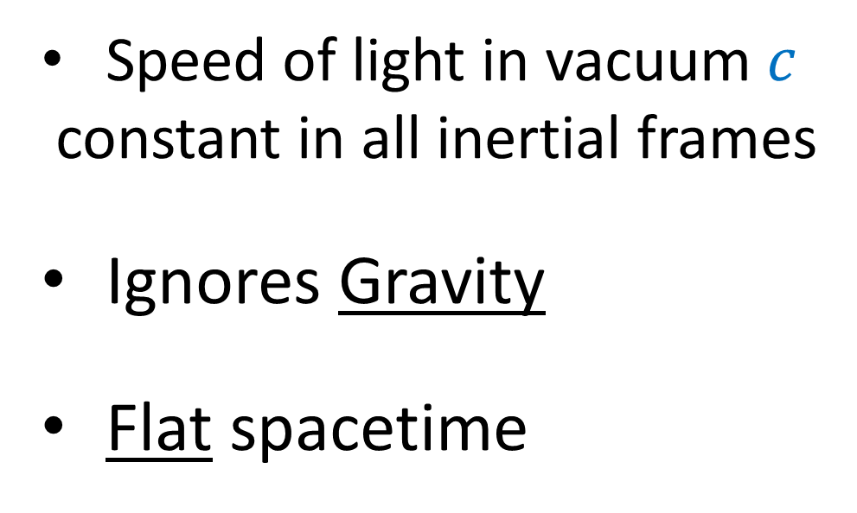
Special Relativity (1905)
General Relativity (1915)
Speed of light in vacuum $c$
constant in all inertial frames
Ignores Gravity
Flat spacetime
A theory of gravity based on “equivalence principle”
local gravitation = acceleration
Takes Gravity into account
Curved spacetime
Notes:
I think now is a good time to explain the differences between special relativity and general relativity, so we can understand where special relativity ends and where general relativity starts.
Special Relativity is a theory of relativity that we get when we take the speed of light in a vacuum C to be constant in all inertial frames
General Relativity is a theory of gravity that we get when we accept the equivalence principle, which says that inertial mass is completely equivalent to gravitational mass.
Special relativity completely ignores gravity. Meanwhile general relativity takes gravity into account
Special relativity is a theory of flat spacetime. Meanwhile, general relativity is a theory of curved spacetime.
Now, I realize a lot of what just said about the equivalence principle and curved spacetime doesn’t make sense right now—we’ll be talking about those in later videos—but the point is that the main difference between special and general relativity is that special relativity ignores gravity, whereas general relativity includes gravity.

Slide 3
General Relativity
Takes Gravity into account
Special Relativity
Ignores Gravity
S.R. (Inertial Frames)
laws of physics are the same
ignoring gravity
speed of light is constant
when viewed from inertial frames:
constant velocity
straight-line coordinates
S.R. (Non-Inertial Frames)
extra ficticious forces exist
speed of light depends on frame
when viewed from inertial frames:
changing velocity (acceleration)
curvilinear coordinates
Notes:
Special relativity can’t deal with gravity, but there’s no rule that says it can’t deal with acceleration or non-inertial reference frames.
That said, special relativity treats inertial frames and non-inertial frames as fundamentally separate situations.
Inertial frames travel at constant velocity, whereas non-inertial frames have changing velocity, or acceleration.
In inertial frames, the laws of physics (ignoring gravity) are all the same, whereas in non-inertial frames, the laws of physics have extra ficticious forces that appear depending on the frame of reference, similar to when you get thrown into the back of a car seat when the driver hits the gas pedal.
The the speed of light is constant in all inertial frames, but in non-inertial frames, the speed of light can change. Later in this video we’ll look at a non-inertial frame where a light beam appears to be frozen in space with zero velocity.
All inertial frames have “straight line” coordinates when viewed from another inertial frme, whereas non-inertial frames have curvilinear coordinates, when viewed from an inertial frame

Slide 4

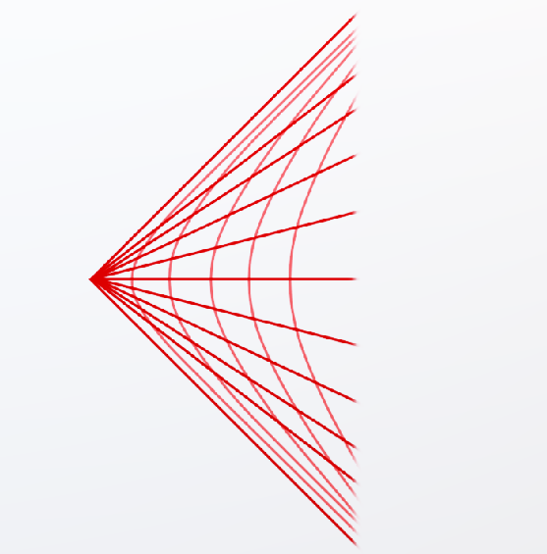
S.R. (Inertial Frames)
laws of physics are the same
ignoring gravity
speed of light is constant
when viewed from inertial frames:
constant velocity
straight-line coordinates
S.R. (Non-Inertial Frames)
extra ficticious forces exist
speed of light depends on frame
when viewed from inertial frames:
changing velocity (acceleration)
curvilinear coordinates
Notes:
It’s important to note that, even though non-inertial frames in special relativity have curved coordinates, the spacetime they describe I still flat like the surface of a table or computer screen.
On the left we have a straight-line coordinate system, and on the right we have a curvilinear coordinate system, but both coordinate systems still describe flat geometry.
We won’t see truly curved geometry until we get to general relativity.

Slide 5
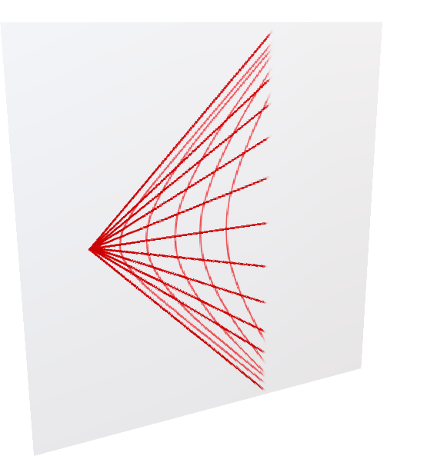
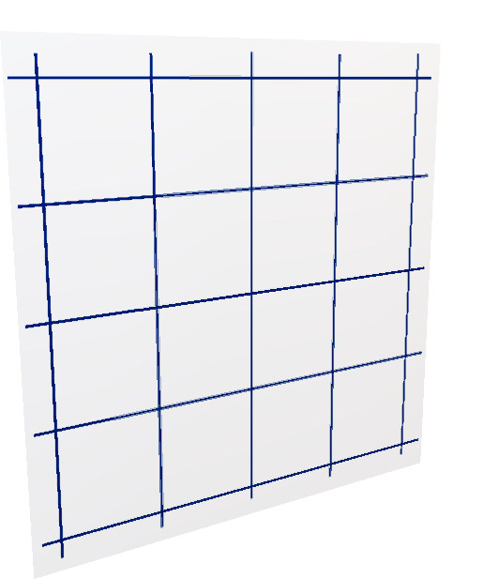
S.R. (Inertial Frames)
laws of physics are the same
ignoring gravity
speed of light is constant
when viewed from inertial frames:
constant velocity
straight-line coordinates
S.R. (Non-Inertial Frames)
extra ficticious forces exist
speed of light depends on frame
when viewed from inertial frames:
changing velocity (acceleration)
curvilinear coordinates

Slide 6
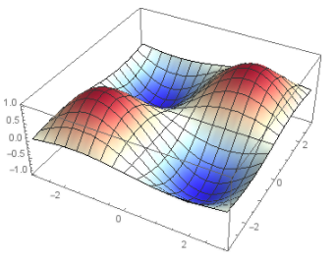
Won’t see truly curved geometry until General Relativity!

Slide 7
Relativity 105: Acceleration In Special Relativity
Hyperbolic Motion (acceleration), Rindler Horizon
Rinder Coordinates and Bell’s Spaceship Paradox
Basis Vectors/Jacobian in Curvilinear Coordinates
The Proper Time Along Curves and Twin Paradox
Covariant Derivative
Geodesic Curves (inertial frames/zero forces)
Notes:
The relativity 105 videos are all about acceleration in special relativity. In this video we’ll talk about hyperbolic motion, which is what constant acceleration looks like in special relativity.
In the next few videos we’ll talk about Rinder coordinates and Bell’s Spaceship paradox, basis vectors in curved coordinates, the jacobian, proper time along curves and the twin paradox, the covariant derivative, and finally, geodesics.

Slide 8

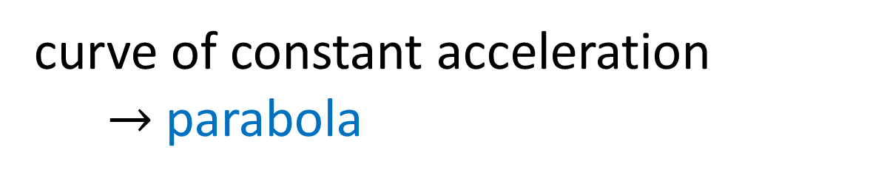
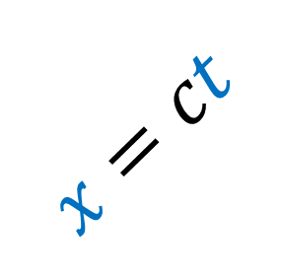



Constant Acceleration in Newtonian Physics
$$ct$$
$$x=ct$$
curve of constant acceleration
$→$ parabola
(light beam)
faster-than-light travel is impossible!! (Relativity 104d)
$$x$$
Notes:
Let’s start by talking about constant acceleration in Newtonian physics. You probably know that the on object travelling at constant acceleration in Newtonian physics traces out the curve of a parabola, as see by falling objects on the earth in everyday life.
If we draw a parabola on a spacetime diagram, with time on the vertical axis, we immediately see a problem. Recall that a beam of light travels at a 45 degree angle on a spacetime diagram. We can see that, beyond this portion of the parabola the object is travelling faster than the speed of light, which we know is impossible from relativity 104d.
So we know that an object undergoing constant acceleration in special relativity can’t trace out a parabola curve because that would mean it eventually would go faster than light.

Slide 9
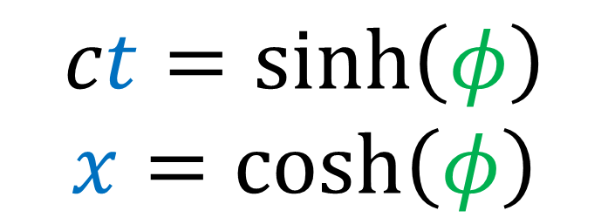
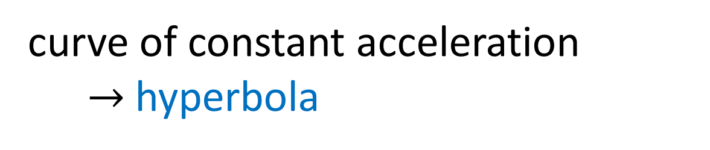




Acceleration in Special Relativity
$$ct$$
(light beam)
$$x=ct$$
never reaches the speed of light!!
curve of constant acceleration
$→$ hyperbola
$$x$$
$$ct=\sinh\left(φ\right)$$
$$x=\cosh\left(φ\right)$$
(see Relativity 104e for review)
Notes:
Instead, we’d expect an accelerating object in special relativity to trace out a curve more like this. Something that goes faster and faster, but never actually reaches the speed of light.
This curve of constant acceleration in special relativity is called a hyperbola, where the time and space coordinates are given by hyperbolic sine and hyperbolic cosine of a hyperbolic angle. See relativity 104e if you want a review of hyperbolic geometry.

Slide 10
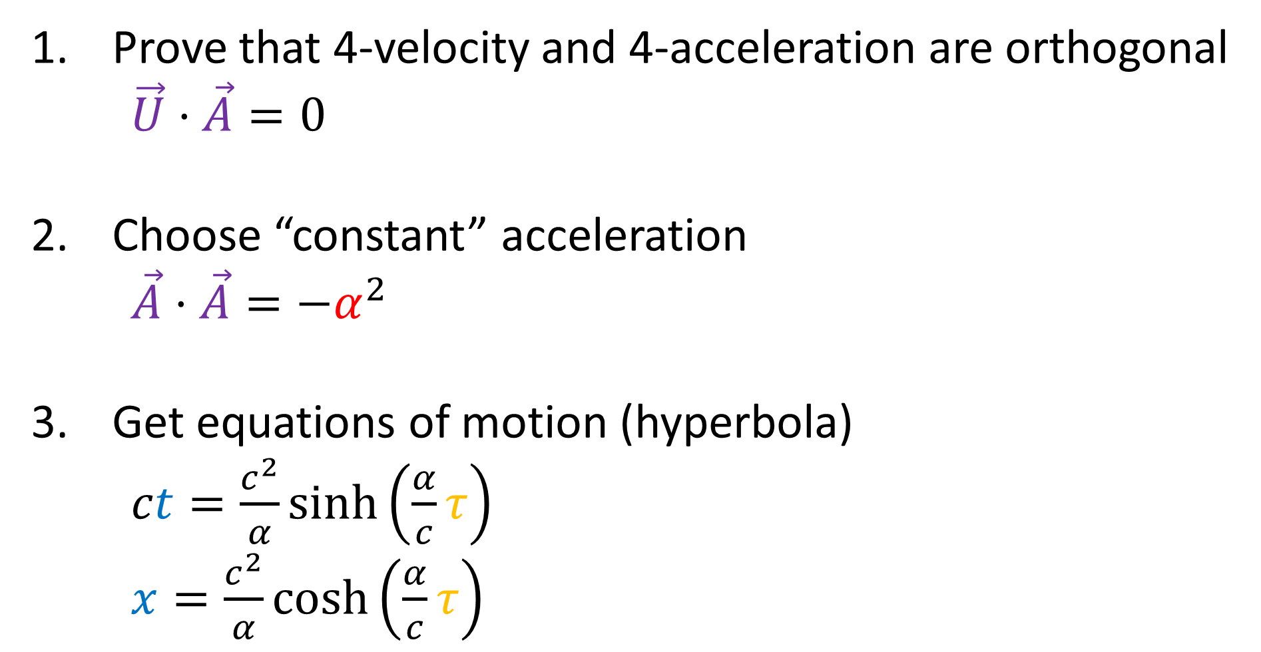
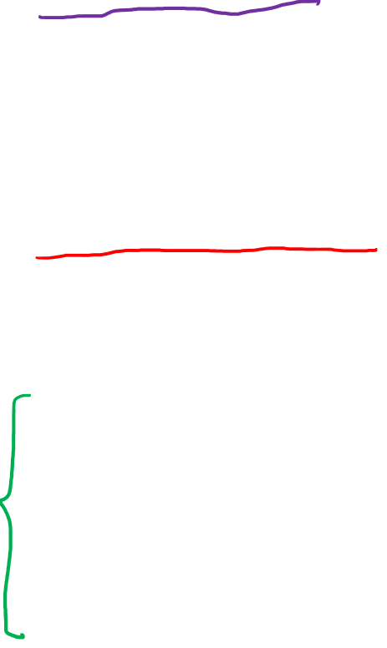
Constant Acceleration in Special Relativity
Prove that 4-velocity and 4-acceleration are orthogonal $\vec{U}⋅\vec{A}=0$
Choose “constant” acceleration $\vec{A}⋅\vec{A}=−α^{2}$
Get equations of motion (hyperbola)
$ct=\frac{c^{2}}{α}\sinh\left(\frac{α}{c}τ\right)$
$x=\frac{c^{2}}{α}\cosh\left(\frac{α}{c}τ\right)$

Slide 11
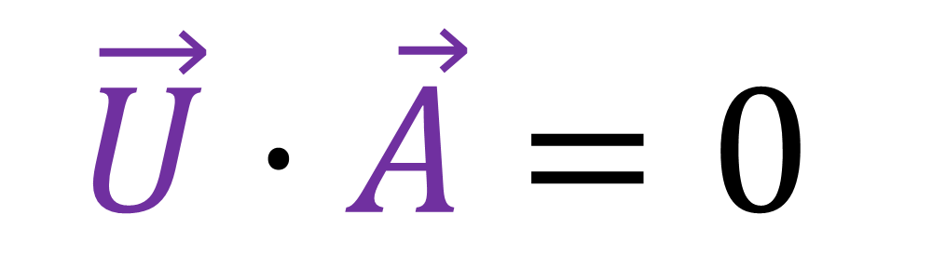
Prove that 4-velocity and 4-acceleration are Minkowski orthogonal
$$\vec{U}⋅\vec{A}=0$$

Slide 12
Euclidean Orthogonal
Minkowski Orthogonal
(equal angles with beam of light)

Slide 13
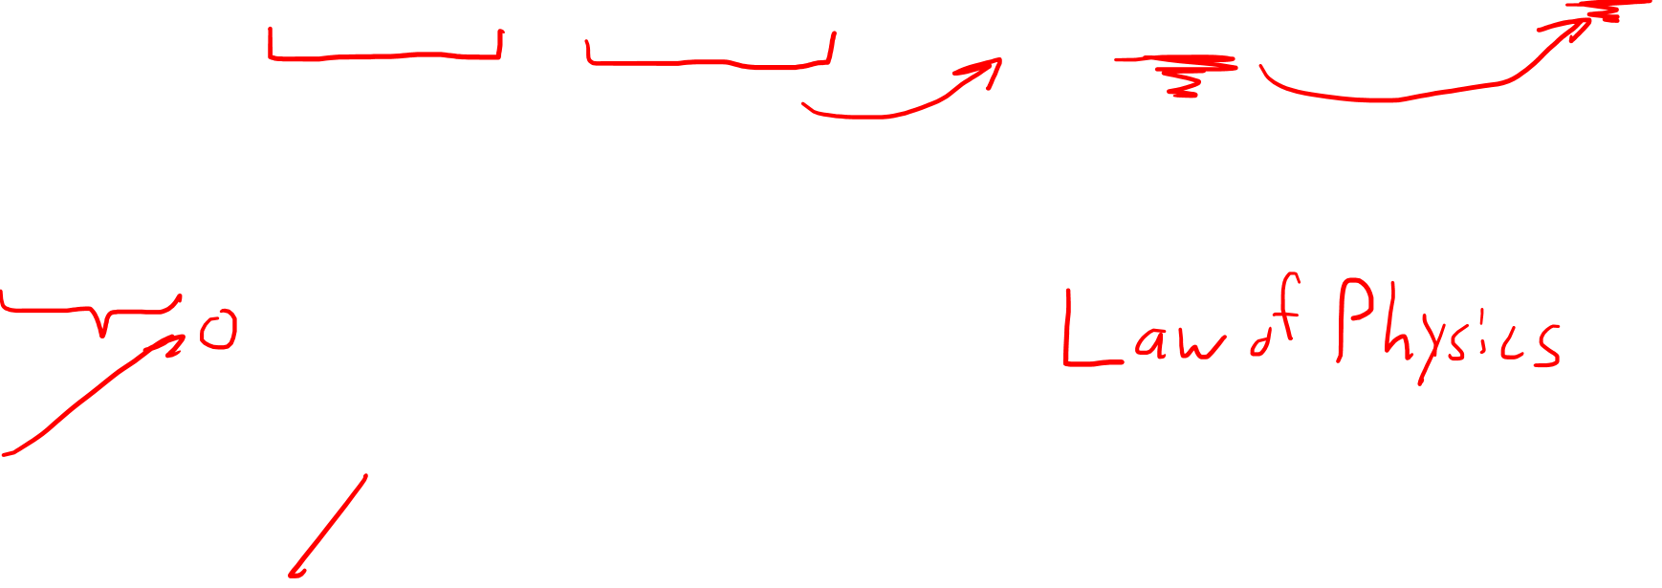
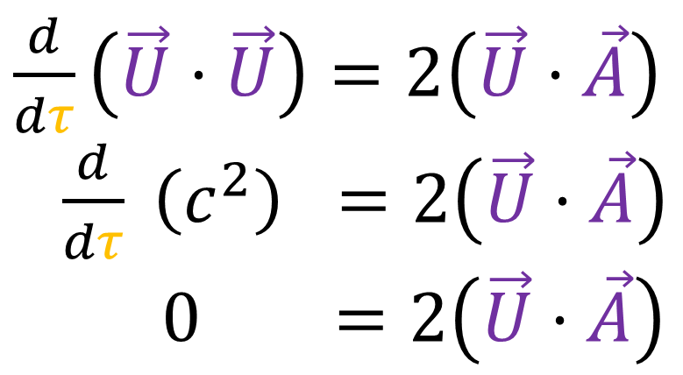
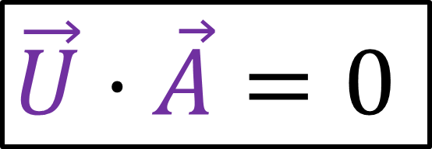
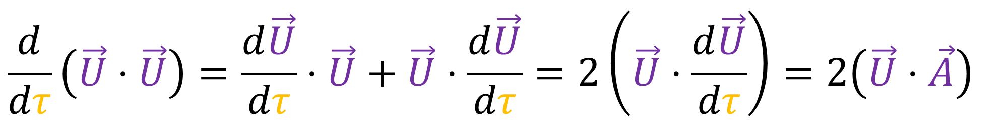
Proof: Product Rule over dot product
$$\frac{d}{dτ}\left(\vec{U}⋅\vec{U}\right)=\frac{d\vec{U}}{dτ}⋅\vec{U}+\vec{U}⋅\frac{d\vec{U}}{dτ}=2\left(\vec{U}⋅\frac{d\vec{U}}{dτ}\right)=2\left(\vec{U}⋅\vec{A}\right)$$
$\frac{d}{dτ}\left(\vec{U}⋅\vec{U}\right)=2\left(\vec{U}⋅\vec{A}\right)$
$\frac{d}{dτ} \left(c^{2}\right) =2\left(\vec{U}⋅\vec{A}\right)$
$0 =2\left(\vec{U}⋅\vec{A}\right)$
$$\vec{U}⋅\vec{A}=0$$
Notes:
ugh

Slide 14
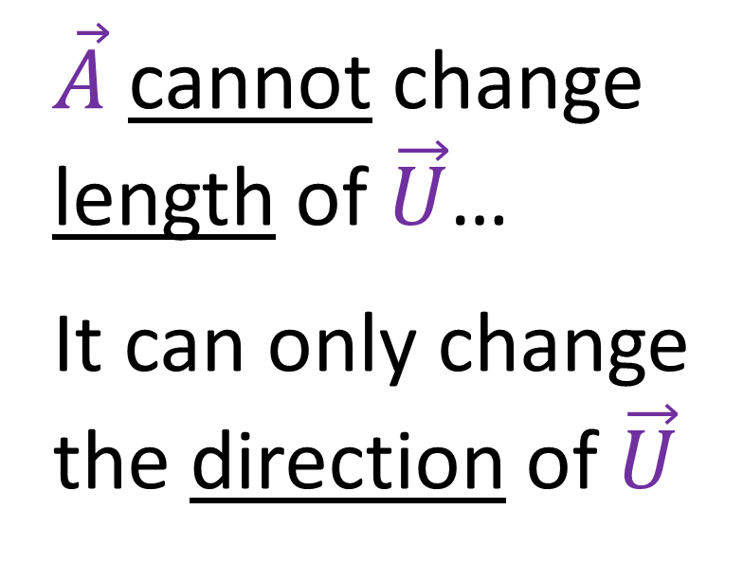


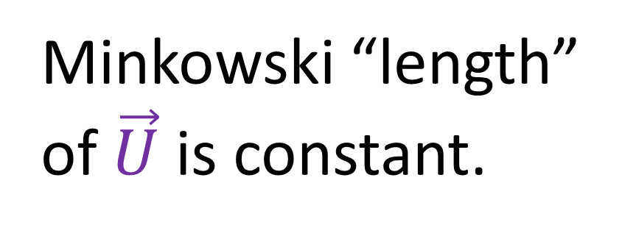
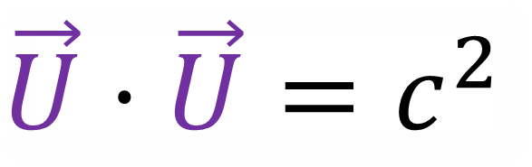

Minkowski “length” of $\vec{U}$ is constant.
$\vec{A}$ cannot change length of $\vec{U}$…
It can only change the direction of $\vec{U}$
$$ct$$
$$\vec{U}⋅\vec{U}=c^{2}$$
$$\vec{U}$$
$$x$$

Slide 15

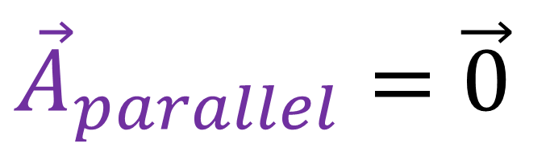
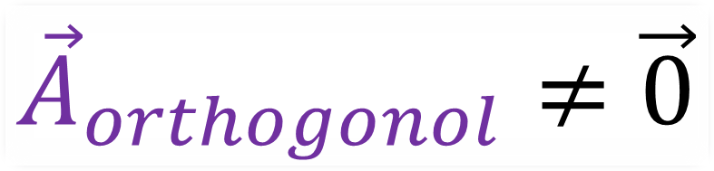


$${\vec{A}}_{parallel}=\vec{0}$$
$$ct$$
$${\vec{A}}_{orthogonol}≠\vec{0}$$
$$\vec{U}$$
$$x$$

Slide 16

Constant Acceleration in Special Relativity
Prove that 4-velocity and 4-acceleration are orthogonal $\vec{U}⋅\vec{A}=0$
Choose “constant” acceleration $\vec{A}⋅\vec{A}=−α^{2}$
Get equations of motion (hyperbola)
$ct=\frac{c^{2}}{α}\sinh\left(\frac{α}{c}τ\right)$
$x=\frac{c^{2}}{α}\cosh\left(\frac{α}{c}τ\right)$

Slide 17
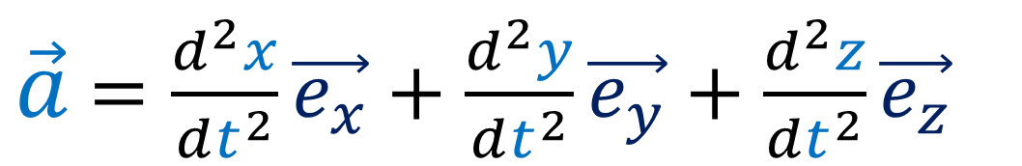
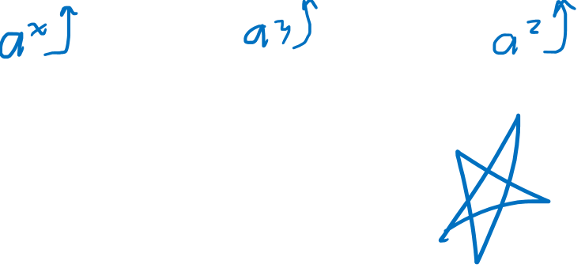

What is “Constant Acceleration”?
Newtonian Acceleration
constant?
relative! (depends on reference frame)
$\vec{a}$ $=\frac{d^{2}x}{dt^{2}}\vec{e_{x}}+\frac{d^{2}y}{dt^{2}}\vec{e_{y}}+\frac{d^{2}z}{dt^{2}}\vec{e_{z}}$
$→$Proper Acceleration

Slide 18
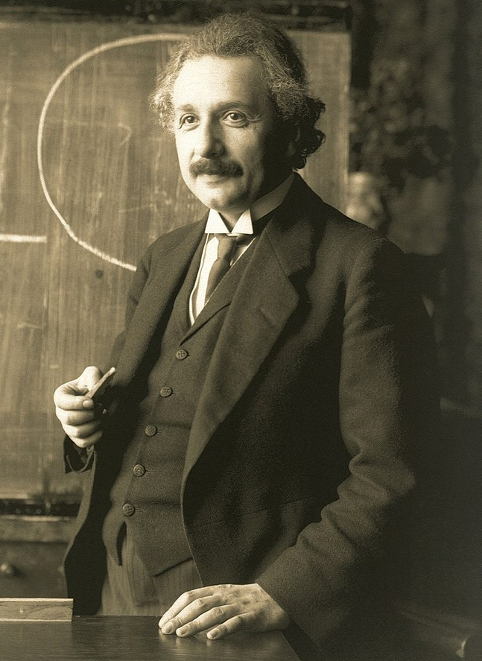

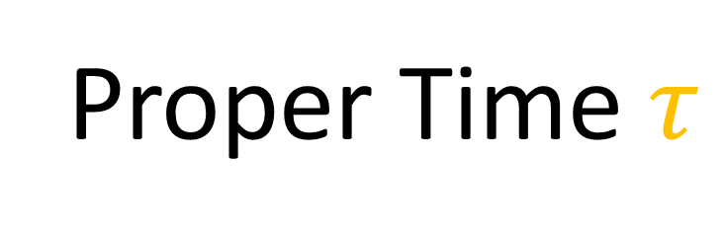
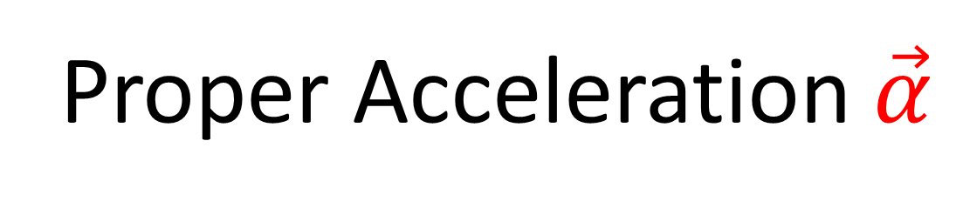
Proper Time $τ$
Proper Acceleration $\vec{α}$
time measured by a clock the observer is carrying with them
acceleration measured by an accelerometer the observer is carrying with them

Slide 19
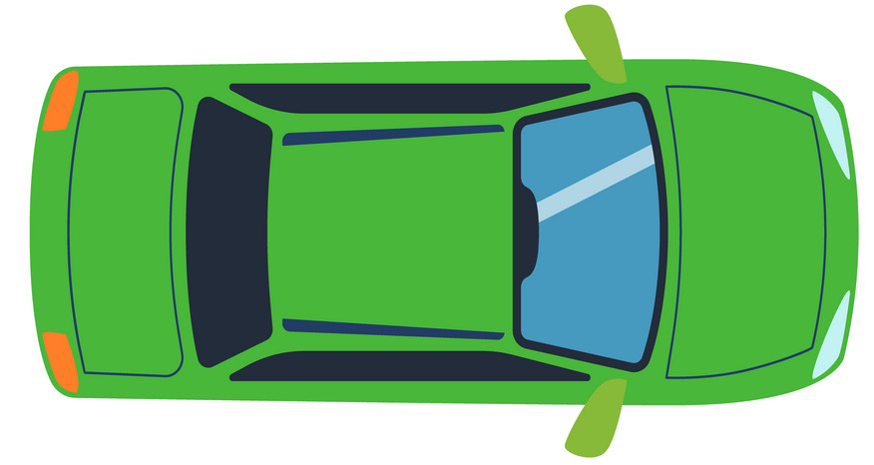

Elevator accelerates
upward…
Car accelerates forward…
… passenger feels pulled backward
Accelerometers can measure accelerations.
(available in most smartphones)
… passenger feels
pulled downward.
Notes:
You might ask what will happen if we’re in an accelerating reference frame, which would be a non-inertial reference frame. We an understand what would happen using our experience in everyday life. If you’ve ever been in an elevator that’s accelerating upward, you might have noticed that you feel heavier, like you’re being pulled downward. If you’ve ever been in an accelerating car, you might have felt like you were fetting pulled into the back of your seat. And if you’ve been in a car that took a sharp turn, the was actually had centripetal accelerating inward , which makes the passenger feel thrown outward toward the side door.

Slide 20
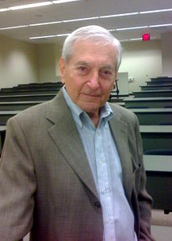
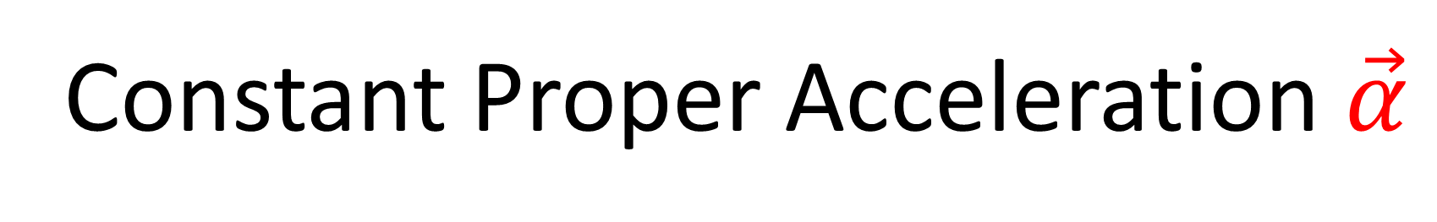
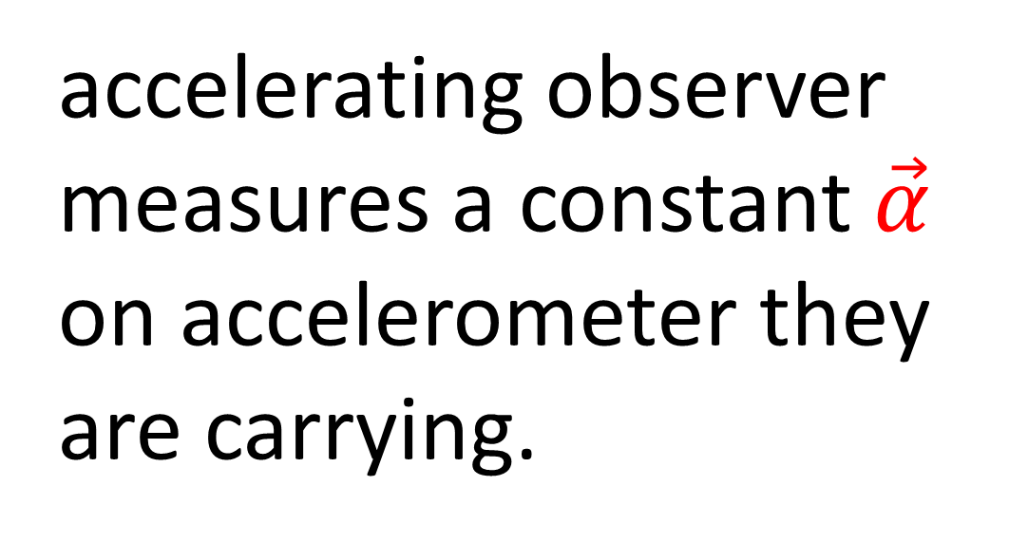
Constant Proper Acceleration $\vec{α}$
accelerating observer measures a constant $\vec{α}$ on accelerometer they are carrying.

Slide 21


$$ct$$
Rindler: constant proper acceleration in x-direction
$$x$$
Einstein: stationary
Notes:
This lead us to a new way to change reference frames in special relativity: The Lorentz transformation. In the Lorentz transformation both the time and position axes of the spacetime coordinate system are slanted. So, visually, the Lorentz transformation involves changing the coordinate systems so that the time axis and the position axis sort of bend toward each other, kind of like the blades in a pair of scissors. Now that we know what the transformation looks like, it’s time to get the actual Lorentz Transformation Equations

Slide 22

Lorentz
Transformation
can change coordinates to any inertial (straight-line) frame.

Slide 23
Lorentz
Transformation
can change coordinates to any inertial (straight-line) frame.
Notes:
This lead us to a new way to change reference frames in special relativity: The Lorentz transformation. In the Lorentz transformation both the time and position axes of the spacetime coordinate system are slanted. So, visually, the Lorentz transformation involves changing the coordinate systems so that the time axis and the position axis sort of bend toward each other, kind of like the blades in a pair of scissors. Now that we know what the transformation looks like, it’s time to get the actual Lorentz Transformation Equations

Slide 24
Lorentz
Transformation
can change coordinates to any inertial (straight-line) frame.

Slide 25
Lorentz
Transformation
cannot change coordinates to a non-inertial (curved) frame.

Slide 26
Lorentz
Transformation
cannot change coordinates to a non-inertial (curved) frame.
Notes:
This lead us to a new way to change reference frames in special relativity: The Lorentz transformation. In the Lorentz transformation both the time and position axes of the spacetime coordinate system are slanted. So, visually, the Lorentz transformation involves changing the coordinate systems so that the time axis and the position axis sort of bend toward each other, kind of like the blades in a pair of scissors. Now that we know what the transformation looks like, it’s time to get the actual Lorentz Transformation Equations

Slide 27


Lorentz
Transformation
can change coordinates to a specific point on a non-inertial worldline
Notes:
This lead us to a new way to change reference frames in special relativity: The Lorentz transformation. In the Lorentz transformation both the time and position axes of the spacetime coordinate system are slanted. So, visually, the Lorentz transformation involves changing the coordinate systems so that the time axis and the position axis sort of bend toward each other, kind of like the blades in a pair of scissors. Now that we know what the transformation looks like, it’s time to get the actual Lorentz Transformation Equations

Slide 28

Lorentz
Transformation
can change coordinates to a specific point on a non-inertial worldline
$$\vec{S}$$
same 4-position
Notes:
This lead us to a new way to change reference frames in special relativity: The Lorentz transformation. In the Lorentz transformation both the time and position axes of the spacetime coordinate system are slanted. So, visually, the Lorentz transformation involves changing the coordinate systems so that the time axis and the position axis sort of bend toward each other, kind of like the blades in a pair of scissors. Now that we know what the transformation looks like, it’s time to get the actual Lorentz Transformation Equations

Slide 29

Lorentz
Transformation
can change coordinates to a specific point on a non-inertial worldline
$$\vec{U}$$
same 4-velocity
Notes:
This lead us to a new way to change reference frames in special relativity: The Lorentz transformation. In the Lorentz transformation both the time and position axes of the spacetime coordinate system are slanted. So, visually, the Lorentz transformation involves changing the coordinate systems so that the time axis and the position axis sort of bend toward each other, kind of like the blades in a pair of scissors. Now that we know what the transformation looks like, it’s time to get the actual Lorentz Transformation Equations

Slide 30


Lorentz
Transformation
can change coordinates to a specific point on a non-inertial worldline
$$\tilde{\vec{e_{t}}}$$
$$\tilde{\vec{e_{x}}}$$
Notes:
This lead us to a new way to change reference frames in special relativity: The Lorentz transformation. In the Lorentz transformation both the time and position axes of the spacetime coordinate system are slanted. So, visually, the Lorentz transformation involves changing the coordinate systems so that the time axis and the position axis sort of bend toward each other, kind of like the blades in a pair of scissors. Now that we know what the transformation looks like, it’s time to get the actual Lorentz Transformation Equations

Slide 31
Lorentz
Transformation
can change coordinates to a specific point on a non-inertial worldline
$$\tilde{\vec{e_{t}}}$$
$$\tilde{\vec{e_{x}}}$$
Notes:
This lead us to a new way to change reference frames in special relativity: The Lorentz transformation. In the Lorentz transformation both the time and position axes of the spacetime coordinate system are slanted. So, visually, the Lorentz transformation involves changing the coordinate systems so that the time axis and the position axis sort of bend toward each other, kind of like the blades in a pair of scissors. Now that we know what the transformation looks like, it’s time to get the actual Lorentz Transformation Equations

Slide 32
Lorentz
Transformation
can change coordinates to a specific point on a non-inertial worldline
$$\tilde{\vec{e_{t}}}$$
$$\tilde{\vec{e_{x}}}$$
Notes:
This lead us to a new way to change reference frames in special relativity: The Lorentz transformation. In the Lorentz transformation both the time and position axes of the spacetime coordinate system are slanted. So, visually, the Lorentz transformation involves changing the coordinate systems so that the time axis and the position axis sort of bend toward each other, kind of like the blades in a pair of scissors. Now that we know what the transformation looks like, it’s time to get the actual Lorentz Transformation Equations

Slide 33



Lorentz
Transformation
$$\tilde{\vec{e_{t}}}$$
can change coordinates to a specific point on a non-inertial worldline
$$\tilde{\vec{e_{x}}}$$
Notes:
This lead us to a new way to change reference frames in special relativity: The Lorentz transformation. In the Lorentz transformation both the time and position axes of the spacetime coordinate system are slanted. So, visually, the Lorentz transformation involves changing the coordinate systems so that the time axis and the position axis sort of bend toward each other, kind of like the blades in a pair of scissors. Now that we know what the transformation looks like, it’s time to get the actual Lorentz Transformation Equations

Slide 34
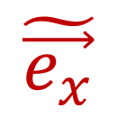


$$\tilde{\vec{e_{t}}}$$
Lorentz
Transformation
$$\tilde{\vec{e_{x}}}$$
can change coordinates to a specific point on a non-inertial worldline
Notes:
This lead us to a new way to change reference frames in special relativity: The Lorentz transformation. In the Lorentz transformation both the time and position axes of the spacetime coordinate system are slanted. So, visually, the Lorentz transformation involves changing the coordinate systems so that the time axis and the position axis sort of bend toward each other, kind of like the blades in a pair of scissors. Now that we know what the transformation looks like, it’s time to get the actual Lorentz Transformation Equations

Slide 35
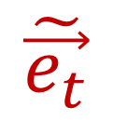
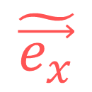


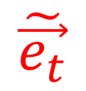
$$\tilde{\vec{e_{t}}}$$
A curved worldline is like a series of instantaneous inertial frames.
$$\tilde{\vec{e_{x}}}$$
$$\tilde{\vec{e_{t}}}$$
$$\tilde{\vec{e_{t}}}$$
$$\tilde{\vec{e_{x}}}$$
$$\tilde{\vec{e_{x}}}$$
Notes:
This lead us to a new way to change reference frames in special relativity: The Lorentz transformation. In the Lorentz transformation both the time and position axes of the spacetime coordinate system are slanted. So, visually, the Lorentz transformation involves changing the coordinate systems so that the time axis and the position axis sort of bend toward each other, kind of like the blades in a pair of scissors. Now that we know what the transformation looks like, it’s time to get the actual Lorentz Transformation Equations

Slide 36
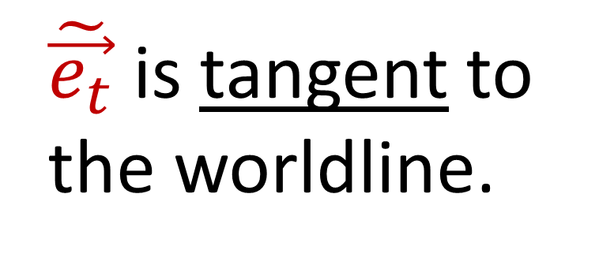
$$\tilde{\vec{e_{t}}}$$
A curved worldline is like a series of instantaneous inertial frames.
$$\tilde{\vec{e_{t}}}$$
$$\tilde{\vec{e_{t}}}$$
$\tilde{\vec{e_{t}}}$ is tangent to the worldline.
Notes:
This lead us to a new way to change reference frames in special relativity: The Lorentz transformation. In the Lorentz transformation both the time and position axes of the spacetime coordinate system are slanted. So, visually, the Lorentz transformation involves changing the coordinate systems so that the time axis and the position axis sort of bend toward each other, kind of like the blades in a pair of scissors. Now that we know what the transformation looks like, it’s time to get the actual Lorentz Transformation Equations

Slide 37
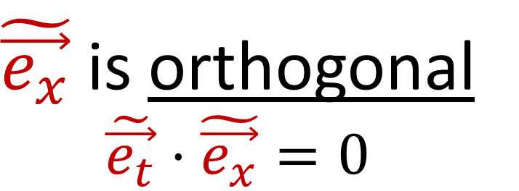
$$\tilde{\vec{e_{t}}}$$
A curved worldline is like a series of instantaneous inertial frames.
$$\tilde{\vec{e_{x}}}$$
$$\tilde{\vec{e_{t}}}$$
$$\tilde{\vec{e_{t}}}$$
$$\tilde{\vec{e_{x}}}$$
$\tilde{\vec{e_{t}}}$ is tangent to the worldline.
$$\tilde{\vec{e_{x}}}$$
$\tilde{\vec{e_{x}}}$ is orthogonal
$$\tilde{\vec{e_{t}}}⋅\tilde{\vec{e_{x}}}=0$$
Notes:
This lead us to a new way to change reference frames in special relativity: The Lorentz transformation. In the Lorentz transformation both the time and position axes of the spacetime coordinate system are slanted. So, visually, the Lorentz transformation involves changing the coordinate systems so that the time axis and the position axis sort of bend toward each other, kind of like the blades in a pair of scissors. Now that we know what the transformation looks like, it’s time to get the actual Lorentz Transformation Equations

Slide 38
“instantaneous inertial frame”
= “local inertial frame”
= “local Lorentz frame”

Slide 39
https://en.wikipedia.org/wiki/Acceleration_(special_relativity)
“instantaneous inertial frame”
= “momentary inertial frame”
= “Momentarily Comoving Reference Frame (MCRF)”

Slide 40

Lorentz
Transformation
can change coordinates to a specific point on a non-inertial worldline
$$\tilde{\vec{e_{t}}}$$
$$\tilde{\vec{e_{x}}}$$
Notes:
This lead us to a new way to change reference frames in special relativity: The Lorentz transformation. In the Lorentz transformation both the time and position axes of the spacetime coordinate system are slanted. So, visually, the Lorentz transformation involves changing the coordinate systems so that the time axis and the position axis sort of bend toward each other, kind of like the blades in a pair of scissors. Now that we know what the transformation looks like, it’s time to get the actual Lorentz Transformation Equations

Slide 41
Lorentz
Transformation
can change coordinates to a specific point on a non-inertial worldline
$$\tilde{\vec{e_{t}}}$$
$$\tilde{\vec{e_{x}}}$$
Notes:
This lead us to a new way to change reference frames in special relativity: The Lorentz transformation. In the Lorentz transformation both the time and position axes of the spacetime coordinate system are slanted. So, visually, the Lorentz transformation involves changing the coordinate systems so that the time axis and the position axis sort of bend toward each other, kind of like the blades in a pair of scissors. Now that we know what the transformation looks like, it’s time to get the actual Lorentz Transformation Equations

Slide 42


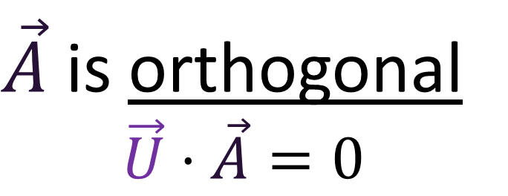





$$\vec{U}$$
A curved worldline is like a series of instantaneous inertial frames.
$$\vec{A}$$
$$\vec{U}$$
$$\vec{U}$$
$$\vec{A}$$
$\vec{U}$ is tangent to the worldline.
$$\vec{A}$$
$\vec{A}$ is orthogonal
$$\vec{U}⋅\vec{A}=0$$
Notes:
This lead us to a new way to change reference frames in special relativity: The Lorentz transformation. In the Lorentz transformation both the time and position axes of the spacetime coordinate system are slanted. So, visually, the Lorentz transformation involves changing the coordinate systems so that the time axis and the position axis sort of bend toward each other, kind of like the blades in a pair of scissors. Now that we know what the transformation looks like, it’s time to get the actual Lorentz Transformation Equations

Slide 43

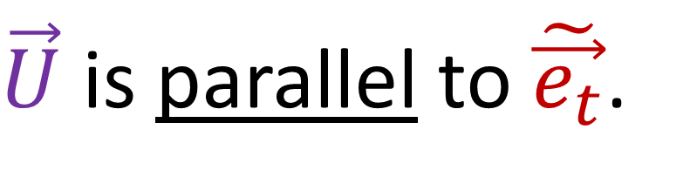
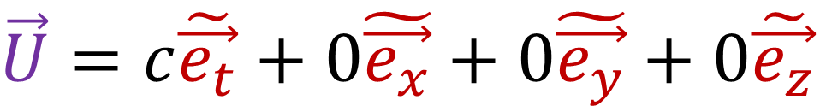

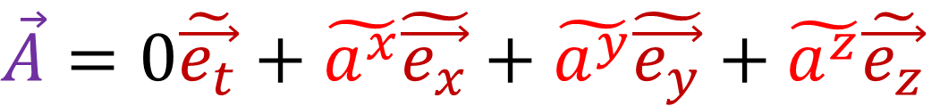

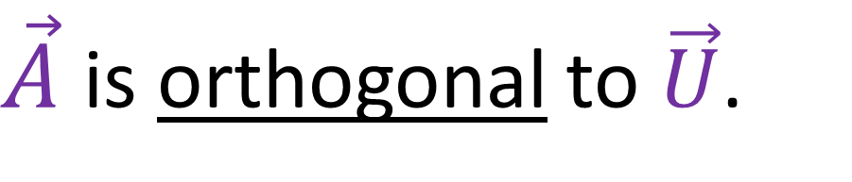
In an instantaneous inertial frame…
$$\tilde{\vec{e_{t}}}$$
$$\tilde{\vec{e_{x}}}$$
$\vec{U}$ is parallel to $\tilde{\vec{e_{t}}}$.
$$\vec{U}=c\tilde{\vec{e_{t}}}+0\tilde{\vec{e_{x}}}+0\tilde{\vec{e_{y}}}+0\tilde{\vec{e_{z}}}$$
(both tangent to worldline)
(The observer in the frame thinks they are stationary in space.)
$\vec{A}$ is orthogonal to $\vec{U}$.
$$\vec{A}=0\tilde{\vec{e_{t}}}+\tilde{a^{x}}\tilde{\vec{e_{x}}}+\tilde{a^{y}}\tilde{\vec{e_{y}}}+\tilde{a^{z}}\tilde{\vec{e_{z}}}$$
(The observer in the frame has purely spatial acceleration.)

Slide 44
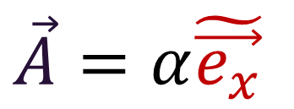


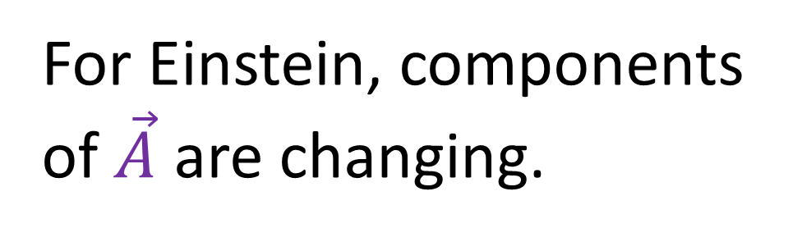

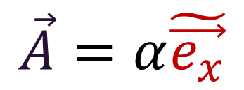














Constant Proper Acceleration:
For Rindler, components of $\vec{A}$ are constant.
For Einstein, components of $\vec{A}$ are changing.
$$\vec{e_{t}}$$
$$\tilde{\vec{e_{t}}}$$
$$\vec{A}=α\tilde{\vec{e_{x}}}$$
$$\vec{A}=a\vec{e_{t}}+b\vec{e_{x}}$$
$$\tilde{\vec{e_{x}}}$$
$$\vec{e_{t}}$$
$$\vec{e_{x}}$$
$$\tilde{\vec{e_{t}}}$$
$$\vec{A}=0\vec{e_{t}}+α\vec{e_{x}}$$
$$\vec{A}=α\tilde{\vec{e_{x}}}$$
$$\vec{e_{x}}$$
$$\tilde{\vec{e_{t}}}$$
$$\tilde{\vec{e_{x}}}$$
$$\vec{e_{t}}$$
$$\vec{A}=−a\vec{e_{t}}+b\vec{e_{x}}$$
$$\vec{e_{x}}$$
$\vec{A}$ $=α\tilde{\vec{e_{x}}}$
$$\tilde{\vec{e_{x}}}$$

Slide 45




(invariant)
$$\tilde{A^{y}}=\tilde{A^{z}}=0$$
$$\vec{A}⋅\vec{A}=−α^{2}$$
$$\vec{A}⋅\vec{A}=−α^{2}$$
$$\vec{e_{t}}$$
$$\tilde{\vec{e_{t}}}$$
$$\vec{A}=α\tilde{\vec{e_{x}}}$$
$$\vec{A}=a\vec{e_{t}}+b\vec{e_{x}}$$
$$\tilde{\vec{e_{x}}}$$
$$\vec{e_{t}}$$
$$\vec{e_{x}}$$
$$\tilde{\vec{e_{t}}}$$
$$\vec{A}=0\vec{e_{t}}+α\vec{e_{x}}$$
$$\vec{A}=α\tilde{\vec{e_{x}}}$$
$$\vec{e_{x}}$$
$$\tilde{\vec{e_{t}}}$$
$$\tilde{\vec{e_{x}}}$$
$$\vec{e_{t}}$$
$$\vec{A}=−a\vec{e_{t}}+b\vec{e_{x}}$$
$$\vec{e_{x}}$$
$\vec{A}$ $=α\tilde{\vec{e_{x}}}$
$$\tilde{\vec{e_{x}}}$$

Slide 46



Constant Acceleration in Special Relativity
Prove that 4-velocity and 4-acceleration are orthogonal $\vec{U}⋅\vec{A}=0$
Choose constant proper acceleration $\vec{A}⋅\vec{A}=−α^{2}$
Get equations of motion (hyperbola)
$ct=\frac{c^{2}}{α}\sinh\left(\frac{α}{c}τ\right)$
$x=\frac{c^{2}}{α}\cosh\left(\frac{α}{c}τ\right)$
$$\tilde{A^{y}}=\tilde{A^{z}}=0$$

Slide 47
















Analyze Rindler’s motion from Einstein’s frame.
$$\vec{e_{t}}$$
$$\vec{e_{t}}$$
$$\vec{e_{t}}$$
$$\vec{e_{x}}$$
$$\vec{e_{x}}$$
$$\vec{e_{t}}$$
$$\vec{e_{t}}$$
$$\vec{e_{x}}$$
$$\vec{e_{x}}$$
$$\vec{e_{t}}$$
$$\vec{e_{x}}$$
$$\vec{e_{t}}$$
$$\vec{e_{x}}$$
$$\vec{e_{x}}$$
(No motion in $y$ or $z$ directions)

Slide 48











$$\vec{e_{t}}$$
$$\vec{U}$$
$$\vec{e_{t}}$$
$$\vec{A}$$
$$\vec{U}$$
$$\vec{e_{x}}$$
$$\vec{e_{x}}$$
$$\vec{e_{t}}$$
$$\vec{U}$$
$$\vec{A}$$
$$\vec{e_{x}}$$
$$\vec{U}=U^{t}\vec{e_{t}}+U^{x}\vec{e_{x}}$$
$$\vec{e_{t}}$$
$$\vec{A}$$
$$\vec{A}=A^{t}\vec{e_{t}}+A^{x}\vec{e_{x}}$$
$$\vec{e_{x}}$$

Slide 49





(Always true.)
$$\left(\vec{U}⋅\vec{U}\right)=+ c^{2}={\left(U^{t}\right)}^{2}−{\left(U^{x}\right)}^{2}$$
(Always true.)
$$\left(\vec{U}⋅\vec{A}\right)= 0=\left(U^{t}\right)\left(A^{t}\right)−\left(U^{x}\right)\left(A^{x}\right)$$
Special Case (“constant” acceleration)
$$\left(\vec{A}⋅\vec{A}\right)=− α^{2}={\left(A^{t}\right)}^{2}−{\left(A^{x}\right)}^{2}$$
$U^{t} A^{t} = U^{x} A^{x}$
$${\left(U^{t}\right)}^{2}{\left(A^{t}\right)}^{2}={\left(U^{x}\right)}^{2}{\left(A^{x}\right)}^{2}$$
$${\left(U^{t}\right)}^{2}{\left(A^{t}\right)}^{2}=\left({\left(U^{t}\right)}^{2}−c^{2}\right)\left({\left(A^{t}\right)}^{2}+α^{2}\right)$$
$${\left(U^{t}\right)}^{2}{\left(A^{t}\right)}^{2}={\left(U^{t}\right)}^{2}{\left(A^{t}\right)}^{2}−c^{2}{\left(A^{t}\right)}^{2}+α^{2}{\left(U^{t}\right)}^{2}−c^{2}α^{2}$$
$$0 =−c^{2}{\left(A^{t}\right)}^{2}+α^{2}\left({\left(U^{t}\right)}^{2}−c^{2}\right)$$
Notes:
So let’s review what we know.
We know that the 4-velocity dotted with itself is c^2. This is basically a law of physics; it’s always true.
We also know that the 4-velocity is orthogonal to 4-acceleration. This follows immediately from the above fact, so it’s also basically a law of physics.
Finally, we’re going to take the specific case of constant acceleration, where 4-acceleration dotted with itself gives a constant –alpha^2.
If we assume there is no motion in the y and z directions, then we only need to worry about the time and x components of these 4-vectors.
This means that bigU-dot-bigU is Ut^2 – Ux^2.
bigU-dot-bigA is UtAt – UxAx.
And bigA-dot-bigA gives At^2 – Ax^2.
If we rearrange formula #2, we get UtAt = UxAx. We can then square both sides. Rearranging formula #1, we can solve for Ux^2 as Ut^2 – c^2. And rearranging formula #3, we can solve for Ax^2 as At^2 + alpha^2.. and we can sub these in.
If we distribute this product, we get 4 terms: Ut^2 At^2 – c^2 At^2 + alpha^2 Ut^2 – c^2 Alpha^2.
The Ut^2 At^2 cancels from both sides, and we can factor alpha^2 from these two terms on the right to get alpha^2 * Ut^2 –c^2. But we know that Ut^2 – c^2 is just Ux^2. Taking the square root of both sides and rearranging, we get that At = alpha/c * Ux. We can repeat this same procedure, but substituting for Ut and At instead of Ux and Ax, and we get another formula Ax = alpha/c * Ux.

Slide 50




(Always true.)
$$\left(\vec{U}⋅\vec{U}\right)=+ c^{2}={\left(U^{t}\right)}^{2}−{\left(U^{x}\right)}^{2}$$
(Always true.)
$$\left(\vec{U}⋅\vec{A}\right)= 0=\left(U^{t}\right)\left(A^{t}\right)−\left(U^{x}\right)\left(A^{x}\right)$$
Special Case (“constant” acceleration)
$$\left(\vec{A}⋅\vec{A}\right)=− α^{2}={\left(A^{t}\right)}^{2}−{\left(A^{x}\right)}^{2}$$
$0 =−c^{2}{\left(A^{t}\right)}^{2}+α^{2}\left({\left(U^{t}\right)}^{2}−c^{2}\right)$
$c^{2}{\left(A^{t}\right)}^{2} = α^{2}\left({\left(U^{t}\right)}^{2}−c^{2}\right)$
$c^{2}{\left(A^{t}\right)}^{2} = α^{2}{\left(U^{x}\right)}^{2}$
$A^{t} = \frac{α}{c}U^{x}$
$$A^{t}=\frac{α}{c}U^{x}$$
$$A^{x}=\frac{α}{c}U^{t}$$
Notes:
So let’s review what we know.
We know that the 4-velocity dotted with itself is c^2. This is basically a law of physics; it’s always true.
We also know that the 4-velocity is orthogonal to 4-acceleration. This follows immediately from the above fact, so it’s also basically a law of physics.
Finally, we’re going to take the specific case of constant acceleration, where 4-acceleration dotted with itself gives a constant –alpha^2.
If we assume there is no motion in the y and z directions, then we only need to worry about the time and x components of these 4-vectors.
This means that bigU-dot-bigU is Ut^2 – Ux^2.
bigU-dot-bigA is UtAt – UxAx.
And bigA-dot-bigA gives At^2 – Ax^2.
If we rearrange formula #2, we get UtAt = UxAx. We can then square both sides. Rearranging formula #1, we can solve for Ux^2 as Ut^2 – c^2. And rearranging formula #3, we can solve for Ax^2 as At^2 + alpha^2.. and we can sub these in.
If we distribute this product, we get 4 terms: Ut^2 At^2 – c^2 At^2 + alpha^2 Ut^2 – c^2 Alpha^2.
The Ut^2 At^2 cancels from both sides, and we can factor alpha^2 from these two terms on the right to get alpha^2 * Ut^2 –c^2. But we know that Ut^2 – c^2 is just Ux^2. Taking the square root of both sides and rearranging, we get that At = alpha/c * Ux. We can repeat this same procedure, but substituting for Ut and At instead of Ux and Ax, and we get another formula Ax = alpha/c * Ux.

Slide 51

(Always true.)
$$\left(\vec{U}⋅\vec{U}\right)=+ c^{2}={\left(U^{t}\right)}^{2}−{\left(U^{x}\right)}^{2}$$
(Always true.)
$$\left(\vec{U}⋅\vec{A}\right)= 0=\left(U^{t}\right)\left(A^{t}\right)−\left(U^{x}\right)\left(A^{x}\right)$$
Special Case (“constant” acceleration)
$$\left(\vec{A}⋅\vec{A}\right)=− α^{2}={\left(A^{t}\right)}^{2}−{\left(A^{x}\right)}^{2}$$
$0 =−c^{2}{\left(A^{t}\right)}^{2}+α^{2}\left({\left(U^{t}\right)}^{2}−c^{2}\right)$
$c^{2}{\left(A^{t}\right)}^{2} = α^{2}\left({\left(U^{t}\right)}^{2}−c^{2}\right)$
$c^{2}{\left(A^{t}\right)}^{2} = α^{2}{\left(U^{x}\right)}^{2}$
$A^{t} = \frac{α}{c}U^{x}$
$$A^{t}=\frac{α}{c}U^{x}$$
$$A^{x}=\frac{α}{c}U^{t}$$
Notes:
So let’s review what we know.
We know that the 4-velocity dotted with itself is c^2. This is basically a law of physics; it’s always true.
We also know that the 4-velocity is orthogonal to 4-acceleration. This follows immediately from the above fact, so it’s also basically a law of physics.
Finally, we’re going to take the specific case of constant acceleration, where 4-acceleration dotted with itself gives a constant –alpha^2.
If we assume there is no motion in the y and z directions, then we only need to worry about the time and x components of these 4-vectors.
This means that bigU-dot-bigU is Ut^2 – Ux^2.
bigU-dot-bigA is UtAt – UxAx.
And bigA-dot-bigA gives At^2 – Ax^2.
If we rearrange formula #2, we get UtAt = UxAx. We can then square both sides. Rearranging formula #1, we can solve for Ux^2 as Ut^2 – c^2. And rearranging formula #3, we can solve for Ax^2 as At^2 + alpha^2.. and we can sub these in.
If we distribute this product, we get 4 terms: Ut^2 At^2 – c^2 At^2 + alpha^2 Ut^2 – c^2 Alpha^2.
The Ut^2 At^2 cancels from both sides, and we can factor alpha^2 from these two terms on the right to get alpha^2 * Ut^2 –c^2. But we know that Ut^2 – c^2 is just Ux^2. Taking the square root of both sides and rearranging, we get that At = alpha/c * Ux. We can repeat this same procedure, but substituting for Ut and At instead of Ux and Ax, and we get another formula Ax = alpha/c * Ux.

Slide 52







Inertial Frame: $\frac{d\vec{e_{t}}}{dτ}=\frac{d\vec{e_{x}}}{dτ}=\frac{d\vec{e_{y}}}{dτ}=\frac{d\vec{e_{z}}}{dτ}=0$
$\vec{A}=\frac{d\vec{U}}{dτ}= \frac{d}{dτ}\left(U^{t}\vec{e_{t}}\right) +\frac{d}{dτ}\left(U^{x}\vec{e_{x}}\right)$ $+0\vec{e_{y}}+0\vec{e_{z}}$
$\vec{A}=\frac{d\vec{U}}{dτ}=\frac{dU^{t}}{dτ}\vec{e_{t}}+U^{t}\frac{d\vec{e_{t}}}{dτ}+\frac{dU^{x}}{dτ}\vec{e_{x}}+U^{x}\frac{d\vec{e_{x}}}{dτ}$
$\vec{A}=\frac{d\vec{U}}{dτ}=\frac{dU^{t}}{dτ}\vec{e_{t}}+ \frac{dU^{x}}{dτ}\vec{e_{x}}$
$A^{t}=\frac{dU^{t}}{dτ}$
$A^{x}=\frac{dU^{x}}{dτ}$
$\vec{A}=\frac{d\vec{U}}{dτ}= A^{t}\vec{e_{t}}+ A^{x}\vec{e_{x}}$

Slide 53



$$A^{t}=\frac{α}{c}U^{x}=\frac{dU^{t}}{dτ}$$
$$A^{x}=\frac{α}{c}U^{t}=\frac{dU^{x}}{dτ}$$

Slide 54








$$\frac{α}{c}U^{x}=\frac{dU^{t}}{dτ}$$
$$U^{t}=\frac{c}{α}\frac{dU^{x}}{dτ}$$
$$\frac{α}{c}U^{x}=\frac{d}{dτ}\left(\frac{c}{α}\frac{dU^{x}}{dτ}\right)$$
$$\frac{α^{2}}{c^{2}}U^{x}=\frac{d^{2}U^{x}}{dτ^{2}}$$
$$U^{x}\left(τ\right)=$$
$$e^{\frac{α}{c}τ}$$
or
$$e^{−\frac{α}{c}τ}$$
$$U^{x}\left(τ\right)= k_{1}e^{\frac{α}{c}τ} + k_{2}e^{−\frac{α}{c}τ}$$

Slide 55









$$U^{x}\left(τ\right)= k_{1}e^{\frac{α}{c}τ}+k_{2}e^{−\frac{α}{c}τ}$$
$$U^{x}\left(τ\right)$$
Multiple solutions….
Need to pick “initial conditions”…
$U^{x}=0$ when $τ=0$.
$$τ$$
$$\vec{U}=U^{t}\vec{e_{t}}+U^{x}\vec{e_{x}}$$
$$τ=0$$
$$\vec{e_{t}}$$
$$\vec{e_{x}}$$

Slide 56






$$\frac{α}{c}U^{x}=\frac{dU^{t}}{dτ}$$
Choose an initial condition:
$→$ start with zero speed.
$$\frac{α}{c}U^{x}=\frac{d}{dτ}\left(\frac{c}{α}\frac{dU^{x}}{dτ}\right)$$
$$\frac{α^{2}}{c^{2}}U^{x}=\frac{d^{2}U^{x}}{dτ^{2}}$$
$U^{x}=0$ when $τ=0$.
$$U^{x}\left(τ\right)=k_{1}e^{\frac{α}{c}τ}+k_{2}e^{−\frac{α}{c}τ}$$
$$U^{x}\left(0\right)=k_{1}e^{\frac{α}{c}\left(0\right)}+k_{2}e^{−\frac{α}{c}\left(0\right)}$$
$$0=k_{1}+k_{2}$$
$$−k_{1}=k_{2}$$
$$U^{x}\left(τ\right)=$$
$$e^{\frac{α}{c}τ}$$
or
$$e^{−\frac{α}{c}τ}$$
$$U^{x}\left(τ\right)= k_{1}e^{\frac{α}{c}τ} + k_{2}e^{−\frac{α}{c}τ}$$

Slide 57



$$\frac{α}{c}U^{x}=\frac{dU^{t}}{dτ}$$
$$U^{t}=\frac{c}{α}\frac{dU^{x}}{dτ}$$
$$\frac{α}{c}U^{x}=\frac{d}{dτ}\left(\frac{c}{α}\frac{dU^{x}}{dτ}\right)$$
$$\frac{α^{2}}{c^{2}}U^{x}=\frac{d^{2}U^{x}}{dτ^{2}}$$
$$U^{t}\left(τ\right)=\frac{c}{α}k_{1}\frac{d}{dτ}\left(e^{\frac{α}{c}τ}−e^{−\frac{α}{c}τ}\right)$$
$$U^{t}\left(τ\right)=\frac{c}{α}k_{1}\frac{α}{c}\left(e^{\frac{α}{c}τ}+e^{−\frac{α}{c}τ}\right)$$
$$U^{t}\left(τ\right)=k_{1}\left(e^{\frac{α}{c}τ}+e^{−\frac{α}{c}τ}\right)$$
$$U^{x}\left(τ\right)=$$
$$e^{\frac{α}{c}τ}$$
or
$$e^{−\frac{α}{c}τ}$$
$$U^{x}\left(τ\right)= k_{1}\left(e^{\frac{α}{c}τ}−e^{−\frac{α}{c}τ}\right)$$

Slide 58








Law of physics: $\vec{U}⋅\vec{U}=c^{2}$
$${\left(U^{t}\left(τ\right)\right)}^{2}−{\left(U^{x}\left(τ\right)\right)}^{2}=c^{2}$$
Choose an initial condition:
$→$ start with zero speed.
enforce this at $τ=0$…
$${\left(U^{t}\left(0\right)\right)}^{2}−{\left(U^{x}\left(0\right)\right)}^{2}=c^{2}$$
$${{\left(k_{1}\right)}^{2}\left(e^{\frac{α}{c}\left(0\right)}+e^{−\frac{α}{c}\left(0\right)}\right)}^{2}=c^{2}$$
$${{\left(k_{1}\right)}^{2}\left(1+1\right)}^{2}=c^{2}$$
$${\left(k_{1}\right)}^{2}{\left(2\right)}^{2}=c^{2}$$
$(k_{1})(2)=c$
$k_{1}=\frac{1}{2}c$
$U^{x}=0$ when $τ=0$.
$$U^{t}\left(τ\right)=k_{1}\left(e^{\frac{α}{c}τ}+e^{−\frac{α}{c}τ}\right)$$
$$U^{x}\left(τ\right)= k_{1}\left(e^{\frac{α}{c}τ}−e^{−\frac{α}{c}τ}\right)$$
Notes:
Now recall that the 4-velocity dotted with itself is always c^2.
This means that Ut^2 – Ux^2 always equals c^2, at all values of tau.
…
We end up getting the constant k1 = +/- c./2 Mathematically speaking, either +c/2 or –c/2 is fine, but in terms of physics, we want a solution where the particle travels from the past to the future, so we’re forced to pic +c/2

Slide 59






$\cosh{φ}=\frac{1}{2}\left(e^{φ}+e^{−φ}\right)$
$\sinh{φ}=\frac{1}{2}\left(e^{φ}−e^{−φ}\right)$
Choose an initial condition:
$→$ start with zero speed.
$U^{x}=0$ when $cτ=0$.
${\left(\cosh{φ}\right)}^{2}$ $−{\left(\sinh{ φ}\right)}^{2}=1$
$U^{t}\left(τ\right)=c\frac{1}{2}\left(e^{\frac{α}{c}τ}+e^{−\frac{α}{c}τ}\right)$
$U^{x}\left(τ\right)=c\frac{1}{2}\left(e^{\frac{α}{c}τ}−e^{−\frac{α}{c}τ}\right)$
$≡c\cosh\left(\frac{α}{c}τ\right)$
$≡c\sinh\left(\frac{α}{c}τ\right)$
Notes:
And this gives us our complete solution for the components of the 4-velocity.
Now, it turns out that cosh of an angle phi = ½ ( e^+phi – e^-phi)… and sinh phi = ½ (e^phi MINUS e^-phi)
I understand that this is a bit of a leap of faith, but both of these representations obey the same trig identities, including cosh^2 – sinh^2 = 1, obey the same derivative rules where the derivative of cosh is sinh, and the derivative of sinh is cosh, and have the same talyor series.
So these functions are really equivalent. So Ut = c * cosh(alpha tau) and Ux = c* sinh(alpha tau).

Slide 60





$\frac{d}{dφ}\cosh{φ}=\frac{d}{dφ} \frac{1}{2}\left(e^{φ}+e^{−φ}\right)$
$\frac{d}{dφ}cosh{φ}= \frac{1}{2}\left(e^{φ}−e^{−φ}\right)$
$=\sinh{φ}$
$\frac{d}{dφ}\sinh{φ}=\frac{d}{dφ} \frac{1}{2}\left(e^{φ}−e^{−φ}\right)$
$\frac{d}{dφ}cosh{φ}= \frac{1}{2}\left(e^{φ}+e^{−φ}\right)$
$=\cosh{φ}$
Notes:
And this gives us our complete solution for the components of the 4-velocity.
Now, it turns out that cosh of an angle phi = ½ ( e^+phi – e^-phi)… and sinh phi = ½ (e^phi MINUS e^-phi)
I understand that this is a bit of a leap of faith, but both of these representations obey the same trig identities, including cosh^2 – sinh^2 = 1, obey the same derivative rules where the derivative of cosh is sinh, and the derivative of sinh is cosh, and have the same talyor series.
So these functions are really equivalent. So Ut = c * cosh(alpha tau) and Ux = c* sinh(alpha tau).

Slide 61







$\left(\vec{S}⋅\vec{S}\right)=−\frac{c^{4}}{α^{2}}$
$ct=∫U^{t}dτ=\frac{c^{2}}{α}\sinh\left(\frac{α}{c}τ\right)+k_{t}$
$x=∫U^{x}dτ=\frac{c^{2}}{α}\cosh\left(\frac{α}{c}τ\right)+k_{x}$
(spacelike)
$$\left(\vec{U}⋅\vec{U}\right)=+c^{2}$$
$U^{t}=\frac{d\left(ct\right)}{dτ}=c\cosh\left(\frac{α}{c}τ\right)$
$U^{x}= \frac{dx}{dτ} =c\sinh\left(\frac{α}{c}τ\right)$
(timelike)
$$\left(\vec{A}⋅\vec{A}\right)=−α^{2}$$
$A^{t}=\frac{dU^{t}}{dτ} =α\sinh\left(\frac{α}{c}τ\right)$
$A^{x}=\frac{dU^{x}}{dτ}=α\cosh\left(\frac{α}{c}τ\right)$
(spacelike)

Slide 62











$ct=\frac{c^{2}}{α}\sinh\left(\frac{α}{c}τ\right)+k_{t}$
$x=\frac{c^{2}}{α}\cosh\left(\frac{α}{c}τ\right)+k_{x}$
$$ct$$
$k_{t}, k_{x}$ are initial conditions…
$$τ=0$$
$$x$$
$$k_{t}=k_{x}=0$$
$$τ=0$$
$$k_{t}=0⇒$$
$ct\left(τ=0\right)=\frac{c^{2}}{α}\sinh\left(\frac{α}{c}\left(0\right) \right)=0$
$$τ=0$$
$$k_{x}=0⇒$$
$x\left(τ=0\right)=\frac{c^{2}}{α}\cosh\left(\frac{α}{c}\left(0\right) \right)=\frac{c^{2}}{α}$

Slide 63



$\left(\vec{S}⋅\vec{S}\right)=−{\left(\frac{c^{2}}{α}\right)}^{2}$
$ct=\frac{c^{2}}{α}\sinh\left(\frac{α}{c}τ\right)$
$x=\frac{c^{2}}{α}\cosh\left(\frac{α}{c}τ\right)$
(spacelike)
$$\left(\vec{U}⋅\vec{U}\right)=+c^{2}$$
$U^{t}=\frac{d\left(ct\right)}{dτ}=c\cosh\left(\frac{α}{c}τ\right)$
$U^{x}= \frac{dx}{dτ} =c\sinh\left(\frac{α}{c}τ\right)$
(timelike)
$$\left(\vec{A}⋅\vec{A}\right)=−α^{2}$$
$A^{t}=\frac{dU^{t}}{dτ} =α\sinh\left(\frac{α}{c}τ\right)$
$A^{x}=\frac{dU^{x}}{dτ}=α\cosh\left(\frac{α}{c}τ\right)$
(spacelike)

Slide 64









Constant Proper Acceleration:
$$ct$$
$$\left(\vec{A}⋅\vec{A}\right)=−α^{2}$$
$$τ>0$$
Initial Conditions:
$τ$ is Rindler’s proper time.
$$k_{t}=k_{x}=0$$
$$U^{x}\left(τ=0\right)=0$$
$$x$$
$$τ=0$$
Equations of motion:
$ct\left(τ\right)=\frac{c^{2}}{α}\sinh\left(\frac{α}{c}τ\right)$
$x\left(τ\right)=\frac{c^{2}}{α}\cosh\left(\frac{α}{c}τ\right)$
$$τ<0$$

Slide 65





Constant Proper Acceleration:
$$ct$$
$$\left(\vec{A}⋅\vec{A}\right)=−α^{2}$$
$$τ>0$$
Initial Conditions:
$\vec{S}\left(τ=0\right)=0\vec{e_{t}}+\frac{c^{2}}{α}\vec{e_{x}}$
$$\vec{U}\left(τ=0\right)=c\vec{e_{t}}+0 \vec{e_{x}}$$
$\vec{U}\left(τ=0\right)=c\vec{e_{t}}$
$$x$$
$$\vec{S}\left(τ=0\right)$$ $=\frac{c^{2}}{α}\vec{e_{x}}$
$$τ=0$$
Equations of motion:
$\vec{S}\left(τ\right)=\frac{c^{2}}{α}\sinh\left(\frac{α}{c}τ\right)\vec{e_{t}}$
$+\frac{c^{2}}{α}\cosh\left(\frac{α}{c}τ\right)\vec{e_{x}}$
$$τ<0$$

Slide 66

Constant Proper Acceleration:
$$ct$$
$$\left(\vec{A}⋅\vec{A}\right)=−α^{2}$$
$$τ>0$$
Initial Conditions:
$\vec{S}\left(τ=0\right)=0\vec{e_{t}}+\frac{c^{2}}{α}\vec{e_{x}}$
$$\vec{U}\left(τ=0\right)=c\vec{e_{t}}+0 \vec{e_{x}}$$
$\vec{U}\left(τ=0\right)=c\vec{e_{t}}$
$$x$$
$$\vec{S}\left(τ=0\right)$$ $=\frac{c^{2}}{α}\vec{e_{x}}$
$$τ=0$$
Equations of motion:
$\vec{S}\left(τ\right)=\frac{c^{2}}{α}\sinh\left(\frac{α}{c}τ\right)\vec{e_{t}}$
$+\frac{c^{2}}{α}\cosh\left(\frac{α}{c}τ\right)\vec{e_{x}}$
$$τ<0$$

Slide 67
Rindler Horizon
Wolfgang Rindler
(1924 – 2019)

Slide 68
Rindler Horizon
$$ct$$
$$x$$
stationary
accelerating

Slide 69

Rindler Horizon
$$ct$$
Rindler is outrunning light!!
$$x$$
(light beam)

Slide 70

Rindler Horizon
$$ct$$
Beams of light sent from inside shaded region will never reach Rindler.
Everything behind the Rindler Horizon is complete darkness to Rindler.
Nothing behind Rindler Horizon can ever get back out.
$$x$$
(Similar to a black hole.)
(light beam)

Slide 71


$$ct$$
Rindler Horizon
The Rindler Horizon is, ultimately, artificial.
As soon as the accelerated observer stops accelerating, it can receive light signals again.
Black hole horizons cannot be removed by changing reference frames.
$$x$$
(light beam)

Slide 72









Rindler Horizon
$$ct$$
Question: How far behind Rindler is the Rindler Horizon?
$$x=ct$$
(Rindler Horizon)
$$\tilde{\vec{e_{t}}}$$
$$\tilde{\vec{e_{x}}}$$
Distance to horizon in Rindler’s frame
$$\tilde{\vec{e_{t}}}$$
$$\tilde{\vec{e_{x}}}$$
$$\tilde{\vec{e_{t}}}$$
$$\tilde{\vec{e_{x}}}$$
$$x$$

Slide 73

Rindler Horizon
$$ct$$
Question: How far behind Rindler is the Rindler Horizon?
$$x=ct$$
(Rindler Horizon)
$$\tilde{\vec{e_{t}}}$$
$$\tilde{\vec{e_{x}}}$$
$$\vec{S}$$
$$\tilde{\vec{e_{t}}}$$
$$\tilde{\vec{e_{x}}}$$
$$\tilde{\vec{e_{t}}}$$
$$\tilde{\vec{e_{x}}}$$
$$x$$

Slide 74



$\left(\vec{S}⋅\vec{S}\right)=−{\left(\frac{c^{2}}{α}\right)}^{2}$
$ct=\frac{c^{2}}{α}\sinh\left(\frac{α}{c}τ\right)$
$x=\frac{c^{2}}{α}\cosh\left(\frac{α}{c}τ\right)$
(spacelike)
$$\left(\vec{U}⋅\vec{U}\right)=+c^{2}$$
$U^{t}=\frac{d\left(ct\right)}{dτ}=c\cosh\left(\frac{α}{c}τ\right)$
$U^{x}= \frac{dx}{dτ} =c\sinh\left(\frac{α}{c}τ\right)$
(timelike)
$$\left(\vec{A}⋅\vec{A}\right)=−α^{2}$$
$A^{t}=\frac{dU^{t}}{dτ} =α\sinh\left(\frac{α}{c}τ\right)$
$A^{x}=\frac{dU^{x}}{dτ}=α\cosh\left(\frac{α}{c}τ\right)$
(spacelike)

Slide 75







Rindler Horizon
$$ct$$
Light pulse is “frozen” in space according to accelerating observer.
$$\tilde{\vec{e_{t}}}$$
Question: How far behind Rindler is the Rindler Horizon?
$$\tilde{\vec{e_{x}}}$$
$\left(\vec{S}⋅\vec{S}\right)=−{\left(\frac{c^{2}}{α}\right)}^{2}$
$$\tilde{\vec{e_{t}}}$$
$$x=ct$$
(Rindler Horizon)
$$\tilde{\vec{e_{x}}}$$
(spacelike)
$$\tilde{\vec{e_{t}}}$$
$$\tilde{\vec{e_{x}}}$$
Proper Length: $L_{0}=$ $\sqrt{−\left(\vec{S}⋅\vec{S}\right)}$
is always $L_{0}=\frac{c^{2}}{α}$ at all times $τ$.
$$\tilde{\vec{e_{t}}}$$
$$\tilde{\vec{e_{x}}}$$
$$x$$
Distance to origin stays the same. (in Rindler’s frame)
$$\vec{S}\left(τ\right)=−L_{0}\tilde{\vec{e_{x}}}$$

Slide 76






















Distance $x$ gets larger and larger.
Distance $\tilde{x}$ stays constant.
$$ct$$
$$ct$$
$$\tilde{\vec{e_{t}}}$$
$$\vec{e_{t}}$$
$$\tilde{\vec{e_{x}}}$$
$$\vec{e_{x}}$$
$$\vec{e_{t}}$$
$$\tilde{\vec{e_{t}}}$$
$$\vec{e_{x}}$$
$$\tilde{\vec{e_{x}}}$$
$$\vec{e_{t}}$$
$$\tilde{\vec{e_{t}}}$$
$$\vec{e_{x}}$$
$$\tilde{\vec{e_{x}}}$$
$$\vec{e_{t}}$$
$$\tilde{\vec{e_{t}}}$$
$$\vec{e_{x}}$$
$$x$$
$$\tilde{\vec{e_{x}}}$$
$$x$$

Slide 77


Special Relativity Postulates
Laws of physics are the same in all inertial reference frames
Speed of light in a vacuum $c=3×{10}^{8}\frac{m}{s}$ is the same in all inertial reference frames
In NON-INERTIAL reference frames, the speed of light can have different values.

Slide 78



Rindler Horizon
$$ct$$
Rindler will never see anything cross the Rindler Horizon.
$$\tilde{\vec{e_{t}}}$$
$$\tilde{\vec{e_{x}}}$$
$$x=ct$$
(Rindler Horizon)
$$\tilde{\vec{e_{t}}}$$
Time Dilation becomes so great that the object “freezes” before it crosses the Rindler Horizon
$$\tilde{\vec{e_{x}}}$$
$$\tilde{\vec{e_{t}}}$$
$$\tilde{\vec{e_{x}}}$$
$$\tilde{\vec{e_{t}}}$$
$$x$$
$$\tilde{\vec{e_{x}}}$$

Slide 79

















$$\tilde{\vec{e_{t}}}$$
$$\tilde{\vec{e_{x}}}$$
$$ct$$
$$\tilde{\vec{e_{t}}}$$
$$γ→∞$$
Time dilation formula:
$$\tilde{t}=γt$$
$$\tilde{\vec{e_{x}}}$$
$$γ=5$$
$γ=\frac{1}{\sqrt{1−{\left(v/c\right)}^{2}}}$
$$\tilde{\vec{e_{t}}}$$
$$\tilde{\vec{e_{x}}}$$
$$γ=2$$
as $v→c$…
then: $γ→∞$
$$\tilde{\vec{e_{t}}}$$
$$\tilde{\vec{e_{x}}}$$
$$x$$
$$γ=1$$

Slide 80
$$\tilde{\vec{e_{t}}}$$
A curved worldline is like a series of instantaneous inertial frames.
$$\tilde{\vec{e_{x}}}$$
$$\tilde{\vec{e_{t}}}$$
$$\tilde{\vec{e_{t}}}$$
$$\tilde{\vec{e_{x}}}$$
$\tilde{\vec{e_{t}}}$ is tangent to the worldline.
$$\tilde{\vec{e_{x}}}$$
$\tilde{\vec{e_{x}}}$ is orthogonal
$$\tilde{\vec{e_{t}}}⋅\tilde{\vec{e_{x}}}=0$$
Notes:
This lead us to a new way to change reference frames in special relativity: The Lorentz transformation. In the Lorentz transformation both the time and position axes of the spacetime coordinate system are slanted. So, visually, the Lorentz transformation involves changing the coordinate systems so that the time axis and the position axis sort of bend toward each other, kind of like the blades in a pair of scissors. Now that we know what the transformation looks like, it’s time to get the actual Lorentz Transformation Equations

Slide 81




Constant Acceleration in Special Relativity
Prove that 4-velocity and 4-acceleration are orthogonal $\vec{U}⋅\vec{A}=0$
Choose constant proper acceleration $\vec{A}⋅\vec{A}=−α^{2}$
Equations of motion (hyperbola)
$$\tilde{A^{y}}=\tilde{A^{z}}=0$$
$\vec{S}\left(τ=0\right)=\frac{c^{2}}{α}\vec{e_{x}}$ $\vec{U}\left(τ=0\right)=c\vec{e_{t}}$
Initial Conditions:
$\vec{S}\left(τ\right)=\frac{c^{2}}{α}\sinh\left(\frac{α}{c}τ\right)\vec{e_{t}}$ $+\frac{c^{2}}{α}\cosh\left(\frac{α}{c}τ\right)\vec{e_{x}}$

Slide 82



Rindler Horizon
$$ct$$
For accelerating observer… Rindler Horizon located at $L_{0}=\frac{c^{2}}{α}$ for all times $τ$.
Light beams sent on the horizon appear frozen in space to the accelerated observer.
$$x$$
No light arrives from behind the Rindler Horizon.
Space beyond it appears completely black.
(light beam)

