Slide 1

Relativity 105: Acceleration In Special Relativity
Hyperbolic Motion (acceleration), Rindler Horizon
Rindler Coordinates and Bell’s Spaceship Paradox
Basis Vectors/Jacobian in Curvilinear Coordinates
The Proper Time Along Curves and Twin Paradox
Covariant Derivative
Geodesic Curves (inertial frames/zero forces)
Notes:
In this video we’re going to talk about basis vectors and the Jacobian for curvilinear coordinates. These tools will help us deal with the mathematics of non-inertial frames in special relativity, and eventually the curved spacetimes of general relativity.
Throughout this video series I’ve been trying to emphasize that we should think of vectors as being made of both basis vectors and vector components.
Also, when basis vectors change in one way, a vector’s components will change in the opposite way.
We saw this first in 2D space, where making the basis vectors twice as big with this matrix of 2s, results in vector components becoming twice as small, with this matrix of 1/2s. Then in Galilean relativity, we saw that when the spacetime basis transformed with a Galilean matrix, vector components transformed with an inverse Galilean matrix. Then in Special Relativity, when the spacetime basis transformed using a Lorentz Matrix, vector components transformed with an inverse Lorentz Matrix.

Slide 2
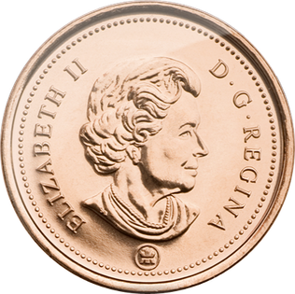




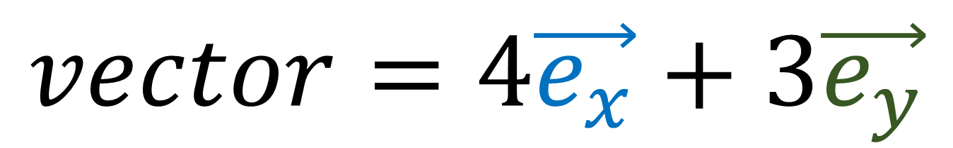
$$vector=4\vec{e_{x}}+3\vec{e_{y}}$$
$$\vec{e_{y}}$$
$$x=4$$
$$\vec{e_{x}}$$
$$y=3$$
Vector Basis (Measuring Sticks)
Vector Components
(Coordinates/Numbers)
Notes:
So I’ve said this several times throughout this series but I’m going to say it again: Basis vectors and vector components are two sides of the same coin.
Any time we’re dealing with vectors, we need to think about both the basis vectors and the components. It doesn’t make sense to talk about one without talking about the other.

Slide 3
Covariant
Contravariant
$$\vec{e_{y}}$$
$$x=4$$
$$\vec{e_{x}}$$
$$y=3$$
Vector Basis (Measuring Sticks)
Vector Components
(Coordinates/Numbers)

Slide 4
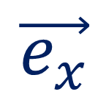
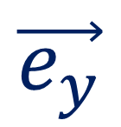
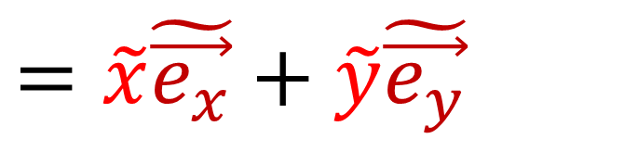
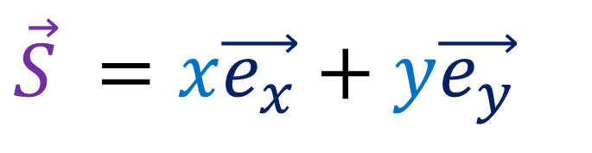
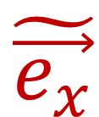
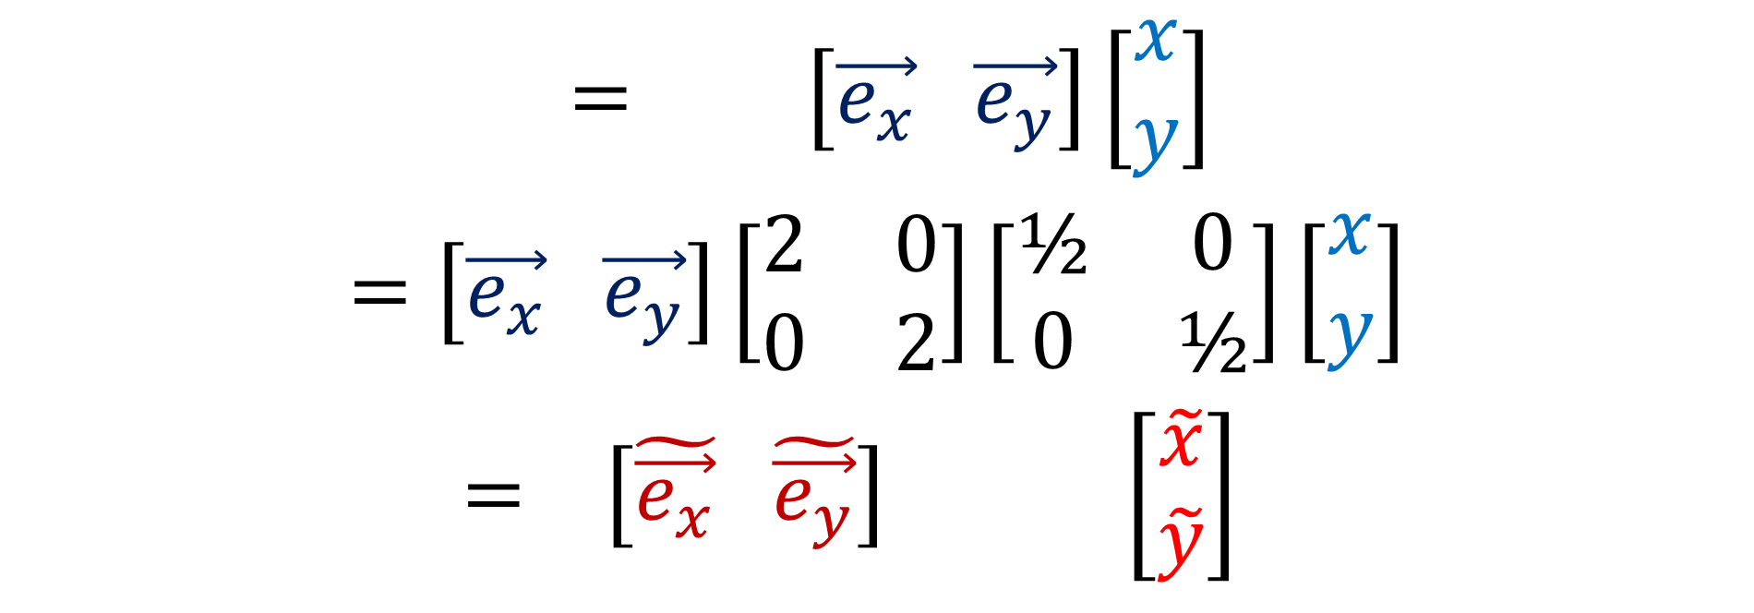
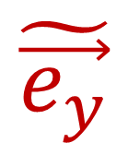
Scaling 2D Space
$$\tilde{\vec{e_{y}}}$$
(Relativity 102b)
$$\vec{e_{y}}$$
$$\vec{e_{x}}$$
$$\tilde{\vec{e_{x}}}$$
$$\vec{S} =t\vec{e_{t}} +x\vec{e_{x}}= \left[\vec{e_{x}} \vec{e_{y}}\right]\left[\begin{aligned}x \\ y\end{aligned}\right]$$
$$=\left[\vec{e_{x}} \vec{e_{y}}\right]\left[\begin{matrix}2 & 0 \\ 0 & 2\end{matrix}\right]\left[\begin{matrix}\text{½} & 0 \\ 0 & \text{½}\end{matrix}\right]\left[\begin{aligned}x \\ y\end{aligned}\right]$$
$$=\tilde{t}\tilde{\vec{e_{t}}}+\tilde{x}\tilde{\vec{e_{x}}}= \left[\tilde{\vec{e_{x}}} \tilde{\vec{e_{y}}}\right] \left[\begin{aligned}\tilde{x} \\ \tilde{y}\end{aligned}\right]$$
$$\vec{S} =x\vec{e_{x}}+y\vec{e_{y}}$$
$$=\tilde{x}\tilde{\vec{e_{x}}}+\tilde{y}\tilde{\vec{e_{y}}}$$

Slide 5

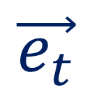
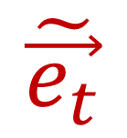
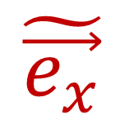
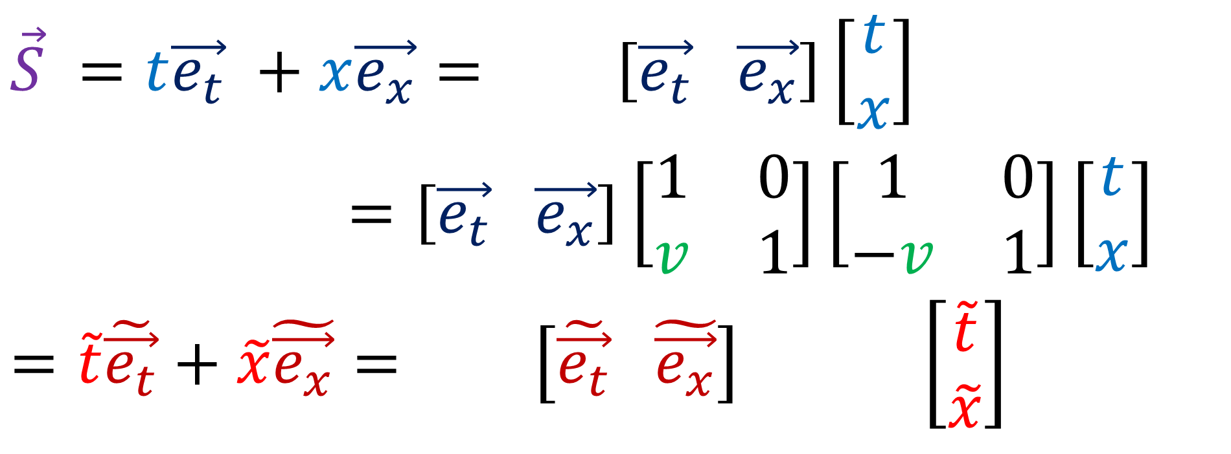
Galilean Transformation
(Relativity 103c)
$$\vec{e_{t}}$$
$$\tilde{\vec{e_{t}}}$$
$$\tilde{\vec{e_{x}}}$$
$$\vec{e_{x}}$$
$$\vec{S} =t\vec{e_{t}} +x\vec{e_{x}}= \left[\vec{e_{t}} \vec{e_{x}}\right]\left[\begin{aligned}t \\ x\end{aligned}\right]$$
$=\left[\vec{e_{t}} \vec{e_{x}}\right]\left[\begin{matrix}1 & 0 \\ v & 1\end{matrix}\right]\left[\begin{matrix}1 & 0 \\ −v & 1\end{matrix}\right]\left[\begin{aligned}t \\ x\end{aligned}\right]$
$$=\tilde{t}\tilde{\vec{e_{t}}}+\tilde{x}\tilde{\vec{e_{x}}}= \left[\tilde{\vec{e_{t}}} \tilde{\vec{e_{x}}}\right] \left[\begin{aligned}\tilde{t} \\ \tilde{x}\end{aligned}\right]$$

Slide 6

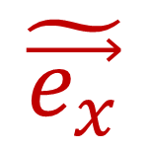
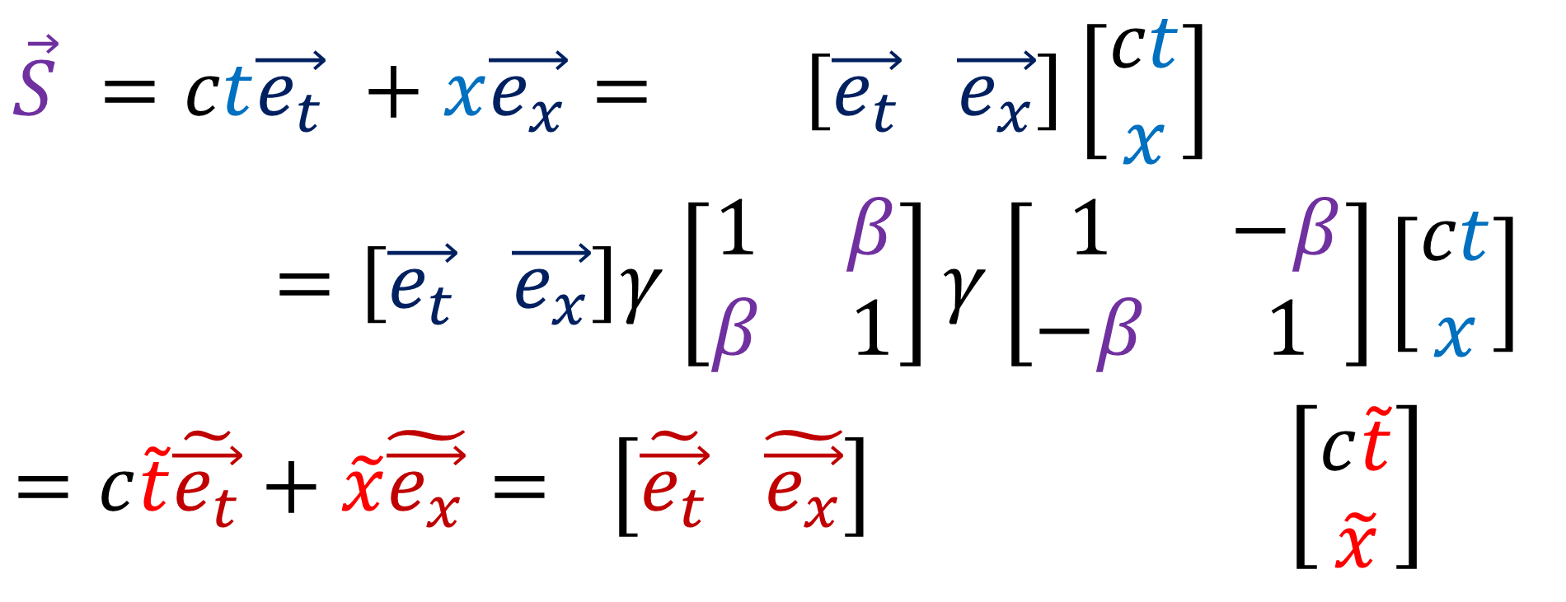
Lorentz Transformation
(Relativity 104a,b)
$$\tilde{\vec{e_{t}}}$$
$$\vec{e_{t}}$$
$$\tilde{\vec{e_{x}}}$$
$$\vec{e_{x}}$$
$$\vec{S} =ct\vec{e_{t}} +x\vec{e_{x}}= \left[\vec{e_{t}} \vec{e_{x}}\right]\left[\begin{aligned}ct \\ x\end{aligned}\right]$$
$=\left[\vec{e_{t}} \vec{e_{x}}\right]γ\left[\begin{matrix}1 & β \\ β & 1\end{matrix}\right]γ\left[\begin{matrix}1 & −β \\ −β & 1\end{matrix}\right]\left[\begin{aligned}ct \\ x\end{aligned}\right]$
$$=c\tilde{t}\tilde{\vec{e_{t}}}+\tilde{x}\tilde{\vec{e_{x}}}= \left[\tilde{\vec{e_{t}}} \tilde{\vec{e_{x}}}\right] \left[\begin{aligned}c\tilde{t} \\ \tilde{x}\end{aligned}\right]$$

Slide 7


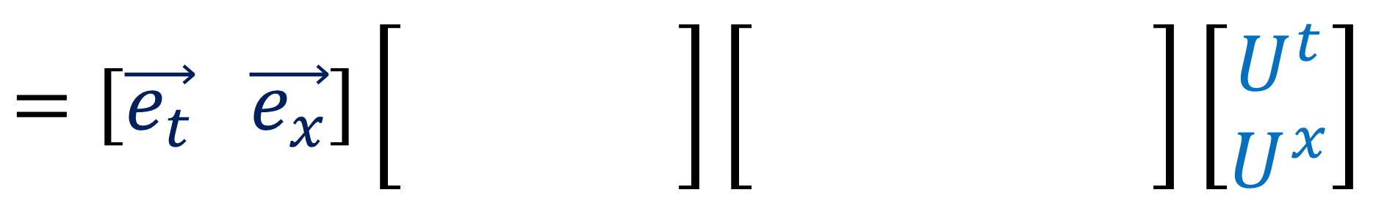

















Curvilinear Change of Basis
D
D
$$\vec{e_{t}}$$
$$\tilde{\vec{e_{t}}}$$
$$\tilde{\vec{e_{x}}}$$
$$\vec{e_{t}}$$
$$\vec{e_{x}}$$
$$\tilde{\vec{e_{t}}}$$
$$\tilde{\vec{e_{x}}}$$
$$\vec{e_{t}}$$
$$\vec{e_{x}}$$
$$\tilde{\vec{e_{t}}}$$
$$\tilde{\vec{e_{x}}}$$
$$\vec{e_{x}}$$
$$\tilde{\vec{e_{t}}}$$
$$\vec{e_{t}}$$
$$\vec{e_{x}}$$
$$\tilde{\vec{e_{x}}}$$
$$=\left[\vec{e_{t}} \vec{e_{x}}\right]\left[\begin{matrix}γ & γβ \\ γβ & γ\end{matrix}\right]\left[\begin{matrix}γ & −γβ \\ −γβ & γ\end{matrix}\right]\left[\begin{aligned}U^{t} \\ U^{x}\end{aligned}\right]$$
Jacobian Matrix
$$?$$
$$?$$
(Inverse) Jacobian Matrix
Notes:
In the last couple videos, we’ve learned that an accelerating object has a different spacetime basis at every point along its worldline.
When basis vectors transform with the Jacobian matrix, a vector’s components will transform using the Inverse Jacobian matrix.

Slide 8
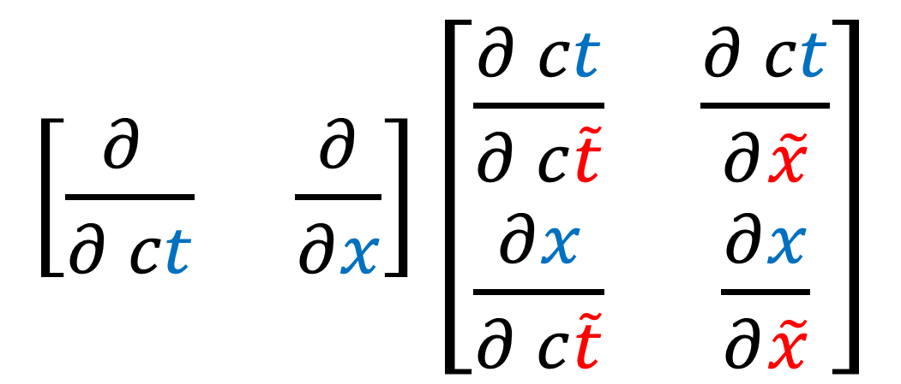

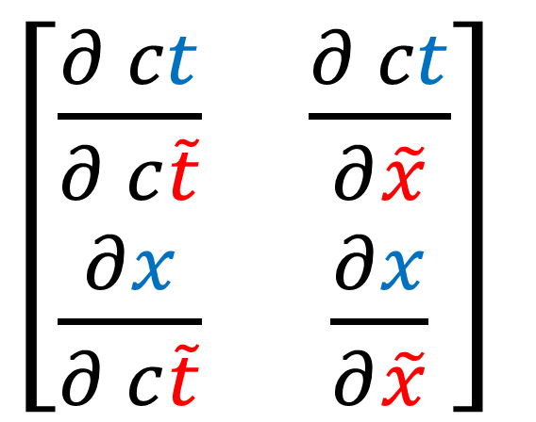
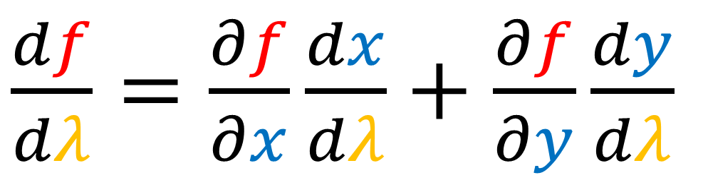
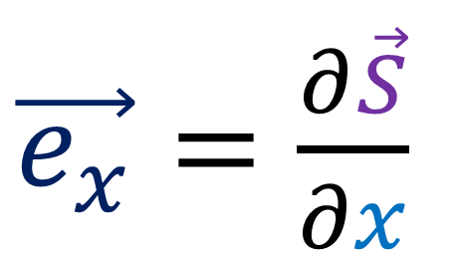
1. Multivariable Chain Rule
$\left[\begin{matrix}\frac{∂ ct}{∂ c\tilde{t}} & \frac{∂ ct}{∂\tilde{x}} \\ \frac{∂x}{∂ c\tilde{t}} & \frac{∂x}{∂\tilde{x}}\end{matrix}\right]$
Jacobian Matrix
$\frac{df}{dλ}=\frac{∂f}{∂x}\frac{dx}{dλ}+\frac{∂f}{∂y}\frac{dy}{dλ}$
2. Basis Vectors as Tangent Vectors
$\left[\begin{matrix}\frac{∂ ct}{∂ c\tilde{t}} & \frac{∂ ct}{∂\tilde{x}} \\ \frac{∂x}{∂ c\tilde{t}} & \frac{∂x}{∂\tilde{x}}\end{matrix}\right]$
$\vec{e_{x}}=\frac{∂\vec{S}}{∂x}$
$\left[\frac{∂ }{∂ ct} \frac{∂}{∂x}\right]\left[\begin{matrix}\frac{∂ ct}{∂ c\tilde{t}} & \frac{∂ ct}{∂\tilde{x}} \\ \frac{∂x}{∂ c\tilde{t}} & \frac{∂x}{∂\tilde{x}}\end{matrix}\right]$
Notes:
To understand the Jacobian matrix, we need to understand 2 ideas:
#1 we need multi-variable chain rule, and #2, we need to think of basis vectors as tangent vectors. If you understand these two ideas, you already know everything you need to know about the Jacobian matrix. Everything afterward is just filling in the details and giving examples.

Slide 9
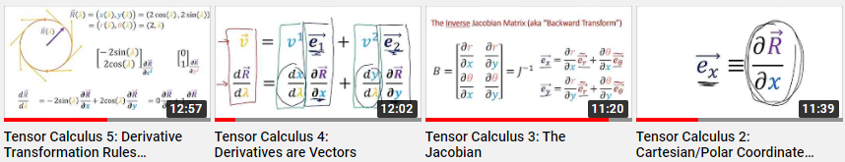
I also cover this in my tensor calculus videos: (link in the description)
Jacobian + Curvilinear Coordinates in 45 minutes
(check these if you want more examples)
Notes:
I’ve covered basis vectors and the Jacobian before in videos 2,3,4 and 5 of my tensor calculus series. The links to those videos are in the description.
The main difference is that the tensor calculus videos cover polar coordinates whereas this video will cover Rindler coordinates.
The tensor calculus videos are more slow-paced than this video, so if you find this video confusing, these videos might help make things clearer.

Slide 10
1. Multivariable Chain Rule
$\frac{df}{dλ}=\frac{∂f}{∂x}\frac{dx}{dλ}+\frac{∂f}{∂y}\frac{dy}{dλ}$
(intuition)
2. Basis Vectors as Tangent Vectors
$\vec{e_{x}}=\frac{∂\vec{S}}{∂x}$
Notes:
The first step to understanding the math of curvilinear coordinate systems is review the multi-variable chain rule. I’m only going to give some quick intuition for why the rule is true. If you want a formal proof, you’ll have too search elsewhere online.

Slide 11
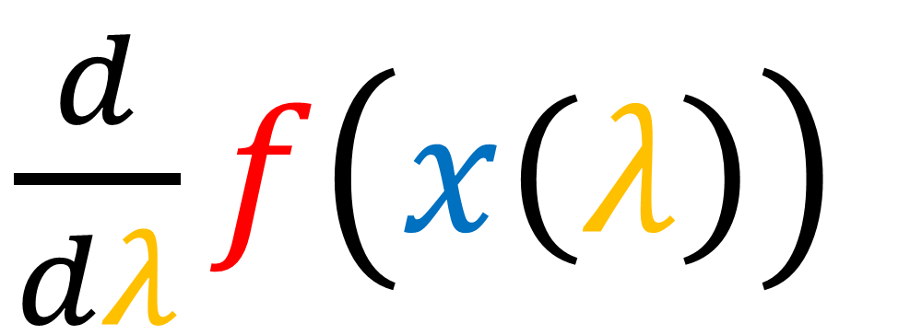
Chain Rule (single-variable)
$\frac{d}{dλ}f\left(x\left(λ\right)\right)$
Notes:
Let’s start with single variable chain-rule, which tells us how to take the derivative of a nested function f(x(lambda))
If we have a some single-variable function f(x), and we zoom in on a small region, the function looks like a straight line.
The height of this small region is df, and it is equal to a small step in the x-direction, dx, times the line’s slope, which is the derivative df/dx. So we have the relationship df = df/dx * dx. If we divide both sides by d-lambda, we end up with single-variable chain rule, which says the relationship between df/dlambda and dx/d-lambda is multiplication by df/dx.
In the example of taking the derivative of f(lambda) = sin(lambda^2), we can set lambda x = lambda^2. Then df/fx is just cos(x) and dx/d-dlambda is 2-lambda. Multipyling them and writing in terms of lambda, we get cos(lambda^2) * 2 lambda.

Slide 12
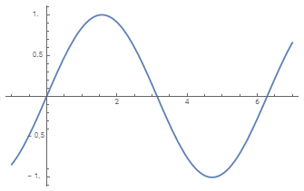
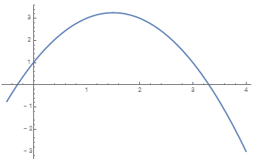
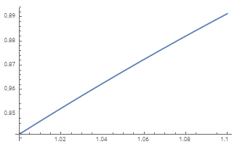

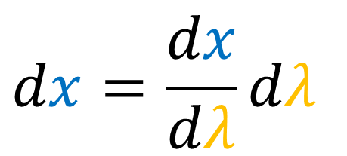
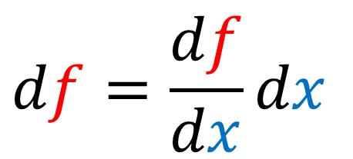






Chain Rule (single-variable)
$$f(x)=\sin\left(x\right)$$
$$x(λ)=− λ^{2} +3λ+1$$
$$x$$
$$λ$$
$$df=\frac{df}{dx}{dx}$$
$$dx=\frac{dx}{dλ}{dλ}$$
$$df=\frac{df}{dx}{\frac{dx}{dλ}{dλ}}$$
$\frac{df}{dλ}=\frac{df}{dx}{ \frac{dx}{dλ}}$
Notes:
Let’s start with single variable chain-rule, which tells us how to take the derivative of a nested function f(x(lambda))
If we have a some single-variable function f(x), and we zoom in on a small region, the function looks like a straight line.
The height of this small region is df, and it is equal to a small step in the x-direction, dx, times the line’s slope, which is the derivative df/dx. So we have the relationship df = df/dx * dx. If we divide both sides by d-lambda, we end up with single-variable chain rule, which says the relationship between df/dlambda and dx/d-lambda is multiplication by df/dx.
In the example of taking the derivative of f(lambda) = sin(lambda^2), we can set lambda x = lambda^2. Then df/fx is just cos(x) and dx/d-dlambda is 2-lambda. Multipyling them and writing in terms of lambda, we get cos(lambda^2) * 2 lambda.

Slide 13
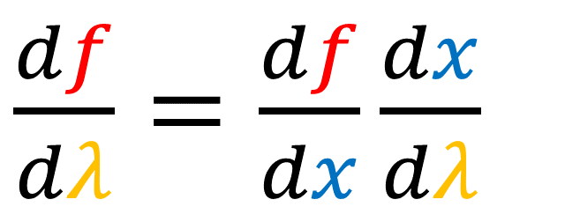
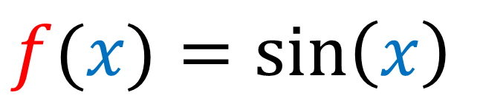







$$f(λ)=\sin\left(λ^{2}\right)$$
$$f(x)=\sin\left(x\right)$$
$$x(λ)= λ^{2}$$
$\frac{df}{dx}=\cos\left(x\right)$
$\frac{dx}{dλ}=2λ$
$\frac{df}{dλ}=\frac{df}{dx}{\frac{dx}{dλ}}$
$=\cos\left(x\right){2λ}$
$=\cos\left(λ^{2}\right){2λ}$

Slide 14










Chain Rule (multi-variable)
$$f\left(x,y\right)=sin\left(x\right)sin\left(y\right)$$
$$df$$
$\frac{∂f}{∂y}$
$\frac{∂f}{∂x}$
$$dy$$
$$dx$$
$df=\frac{∂f}{∂x}{dx}+\frac{∂f}{∂y}{dy}$
Notes:
The multi-variable chain rule is similar.
If we have a function of 2-variables f(x,y), and we zoom in on a small region, the function looks like a flat plane.
The height of this small region is again df, and it is equal to a sum of 2 changes. First, a small step in the x-direction dx, times the slope in the x-direction partial f/partial x.
Then we add to that, a small step in the y-direction dy, times the slope in the y-direction partial f/partial y.
If we divide all terms by d-lambda, we end up with multivariable chain rule.
Let’s do an example f(lambda) = sin(lambda^2) * cos(5 lambda). We can set lambda^2 = x and 5lambda =y.
dx/d-lambda is just 2-lambda and dy/d-lambda is 5.
Now with partial derivatives with respect to x, we treat all other variables in the formula as if they are constants. So we treat y as if it’s a constant. So the partial derivative of sin(x)sin(y) with respect to x is cos(x)sin(y). And partial f by partial y is sin(x)cos(y), since we treat x a a constant.
Subbing in x and y, we get df/dlambda = cos(lambda^2) *2lambda*sin(5lambda) + sin(lambda^2) * cos(5lambda) * 5.

Slide 15






Chain Rule (multi-variable)
$df=\frac{∂f}{∂x}{dx}+\frac{∂f}{∂y}{dy}$
$$f\left(x,y\right)=sin\left(x\right)sin\left(y\right)$$
$dx=\frac{dx}{dλ}{dλ}$
$dy=\frac{dy}{dλ}{dλ}$
$df=\frac{∂f}{∂x}{\frac{dx}{dλ}{dλ}}+\frac{∂f}{∂y}{\frac{dy}{dλ}{dλ}}$
$\frac{df}{dλ}=\frac{∂f}{∂x}{\frac{dx}{dλ}} + \frac{∂f}{∂y}{\frac{dy}{dλ}}$
Notes:
The multi-variable chain rule is similar.
If we have a function of 2-variables f(x,y), and we zoom in on a small region, the function looks like a flat plane.
The height of this small region is again df, and it is equal to a sum of 2 changes. First, a small step in the x-direction dx, times the slope in the x-direction partial f/partial x.
Then we add to that, a small step in the y-direction dy, times the slope in the y-direction partial f/partial y.
If we divide all terms by d-lambda, we end up with multivariable chain rule.
Let’s do an example f(lambda) = sin(lambda^2) * cos(5 lambda). We can set lambda^2 = x and 5lambda =y.
dx/d-lambda is just 2-lambda and dy/d-lambda is 5.
Now with partial derivatives with respect to x, we treat all other variables in the formula as if they are constants. So we treat y as if it’s a constant. So the partial derivative of sin(x)sin(y) with respect to x is cos(x)sin(y). And partial f by partial y is sin(x)cos(y), since we treat x a a constant.
Subbing in x and y, we get df/dlambda = cos(lambda^2) *2lambda*sin(5lambda) + sin(lambda^2) * cos(5lambda) * 5.

Slide 16









$$f(λ)=\sin\left(λ^{2}\right)\sin\left(5λ\right)$$
$$f\left(x,y\right)=sin\left(x\right)sin\left(y\right)$$
$$x(λ)= λ^{2}$$
$$y(λ)=5λ$$
$\frac{∂f}{∂x}=\cos\left(x\right)sin\left(y\right)$
$\frac{dx}{dλ}=2λ$
$\frac{dy}{dλ}=5$
$\frac{∂f}{∂y}=\sin\left(x\right)cos\left(y\right)$

Slide 17








$$f(λ)=\sin\left(λ^{2}\right)\sin\left(5λ\right)$$
$\frac{∂f}{∂x}=\cos\left(x\right)sin\left(y\right)$
$\frac{dx}{dλ}=2λ$
$\frac{dy}{dλ}=5$
$\frac{∂f}{∂y}=\sin\left(x\right)cos\left(y\right)$
$\frac{df}{dλ}=\frac{∂f}{∂x}{\frac{dx}{dλ}}+\frac{∂f}{∂y}{\frac{dy}{dλ}}$
$= \cos\left(x\right) sin\left(y\right) 2λ + \sin\left(x\right) cos\left(y\right) 5$
$=\cos\left(λ^{2}\right)sin\left(5λ\right)2λ+\sin\left(λ^{2}\right)cos\left(5λ\right)5$

Slide 18







Chain Rule (single-variable)
$$df=\frac{df}{dx}{dx}$$
$\frac{df}{dλ}=\frac{df}{dx}{ \frac{dx}{dλ}}$
$$dx=\frac{dx}{dλ}{dλ}$$
Chain Rule (multi-variable)
$df=\frac{∂f}{∂x}{dx}+\frac{∂f}{∂y}{dy}$
$\frac{df}{dλ}=\frac{∂f}{∂x}{\frac{dx}{dλ}}+\frac{∂f}{∂y}{\frac{dy}{dλ}}$
$dx=\frac{dx}{dλ}{dλ}$
$dy=\frac{dy}{dλ}{dλ}$

Slide 19
1. Multivariable Chain Rule
$\frac{df}{dλ}=\frac{∂f}{∂x}\frac{dx}{dλ}+\frac{∂f}{∂y}\frac{dy}{dλ}$
2. Basis Vectors as Tangent Vectors
$\vec{e_{x}}=\frac{∂\vec{S}}{∂x}$
(intuition)
Notes:
Again, these are not proper proofs. I’m mostly trying to appeal to intuition for why the multi-variable chain rule results in a sum of terms for each variable. The idea of “dividing by d-lambda” isn’t a very mathematically rigorous or correct thing to do. If you want proper proofs of these rules you can look them up online.
So that’s multi-variable chain rule. Now let’s look at interpreting basis vectors as tangent derivative vectors. Again I’m going to primarily focus on intuition here instead of being formally correct.

Slide 20
Tangent Vectors = instantaneous velocity vectors along curves

Slide 21



$$ct$$
$$x$$
$$\vec{S}$$

Slide 22
$$ct$$
$$x$$
$$\vec{S}$$

Slide 23
$$ct$$
$$x$$
$$\vec{S}$$

Slide 24
$$ct$$
$$x$$
$$\vec{S}$$

Slide 25
$$ct$$
$$x$$
$$\vec{S}$$

Slide 26
$$ct$$
$$x$$
$$\vec{S}$$

Slide 27
$$ct$$
$$x$$
$$\vec{S}$$

Slide 28
$$ct$$
$$x$$
$$\vec{S}$$

Slide 29






$$ct$$
Path Parameter $λ$
$$\vec{S} \left(λ=2\right)$$
$$\vec{S} \left(λ=0\right)$$
$$x$$
$$\vec{S} \left(λ=1\right)$$
Curve = a function…
from a Path Parameter $λ$
to a position vector $\vec{S}$
$\vec{S}$ $\left(λ=−1\right)$

Slide 30





$$ct$$
$$\frac{d\vec{S}}{dλ}=\lim_{h→0}\frac{\vec{S}\left(λ+h\right) −\vec{S}\left(λ\right)}{h}$$
$$\vec{S}\left(λ+h\right)$$
$$\vec{S}\left(λ+h\right)−\vec{S}\left(λ\right)$$
$$x$$
$$\vec{S}\left(λ\right)$$

Slide 31


$$ct$$
$$x$$

Slide 32
$$ct$$
$$x$$

Slide 33



$$ct$$
$$\frac{d\vec{S}}{dλ}=\lim_{h→0}\frac{\vec{S}\left(λ+h\right) −\vec{S}\left(λ\right)}{h}$$
$$\vec{S}\left(λ+h\right)$$
$$\vec{S}\left(λ+h\right)−\vec{S}\left(λ\right)$$
$$x$$
$$\vec{S}\left(λ\right)$$

Slide 34




$$ct$$
$\frac{d\vec{S}}{dλ}\left(λ=2\right)$
$\frac{d\vec{S}}{dλ} \left(λ=0\right)$
$\frac{d\vec{S}}{dλ} \left(λ=1\right)$
$$x$$
$\frac{d\vec{S}}{dλ} \left(λ=−1\right)$

Slide 35

$$ct$$
$\frac{d\vec{S}}{dλ}\left(λ=2\right)$
$\frac{d\vec{S}}{dλ} \left(λ=0\right)$
$\frac{d\vec{S}}{dλ} \left(λ=1\right)$
$$x$$
$\frac{d\vec{S}}{dλ} \left(λ=−1\right)$
$\frac{d\vec{S}}{dλ}$ is like a velocity vector.
path parameter $λ$ is not necessarily related to time

Slide 36








Tangent vectors along Coordinate Curves
$$ct$$
$\frac{∂\vec{S}}{∂ct}=$ $\vec{e_{t}}$
$\frac{∂\vec{S}}{∂c\tilde{t}}=\tilde{\vec{e_{t}}}$
$\frac{∂\vec{S}}{∂x}=$ $\vec{e_{x}}$
$$c\tilde{t}$$
$$\tilde{x}$$
$$x$$
$\frac{∂\vec{S}}{∂\tilde{x}}=\tilde{\vec{e_{x}}}$
Standard (Inertial) Coordinates
Rindler Coordinates

Slide 37






$$ct$$
$$\vec{S} \left(x=0\right)$$
Curve $\vec{S}\left(x\right)$ …
$\vec{S}$ $\left(x=−1\right)$
$$\vec{S} \left(x=1\right)$$
$$\vec{S} \left(x=2\right)$$
Path Parameter $x$
$$x$$

Slide 38








$$ct$$
$\frac{∂\vec{S}}{∂x}=$ $\vec{e_{x}}$
$$\vec{S}(x+h)−\vec{S}(x)$$
$$\frac{∂\vec{S}}{∂x}=\lim_{h→0}{\frac{\vec{S}(x+h)−\vec{S}(x)}{h}}$$
$$\vec{S}(x)$$
$$\vec{S}(x+h)$$
$$x$$

Slide 39




$$ct$$
$$\frac{\vec{S}(x+2)−\vec{S}(x)}{2}$$
$$\vec{S}(x+2)−\vec{S}(x)$$
$$\vec{S}(x)$$
$$\vec{S}(x+2)$$
$$x$$
Notes:
Let’s say we have a position vector S that depends on the x variable…..
(FILL IN)
If we set h=2, then the difference vector Sh-S is 2 units long. And dividing by h=2, it becomes 1 unit long.
If we set h=1, the different vector is 1 unit long, and dividing by h=1, it stays 1 unit long.
If h=1/2, the vector is ½ units long, and dividing by h=1/2, it becomes 1 unit long.
If we take the limit as h->0, the result of this.
This limit can be thought of as of this as the partial derivative of the vector S with respect to the x variable, and the result is a horizontal vector 1 unit long, which is exactly what the e_x basis vector is.
Repeating this approach for the direction of the ct variable, we get vertical basis vector 1 unit long, so we can think of partial S by partial ct as the e_t basis vector.

Slide 40




$$ct$$
$$\frac{\vec{S}(x+1)−\vec{S}(x)}{1}$$
$$\vec{S}(x+1)−\vec{S}(x)$$
$$\vec{S}(x)$$
$$\vec{S}(x+1)$$
$$x$$

Slide 41




$$ct$$
$$\vec{S}(x+1/2)−\vec{S}(x)$$
$$\frac{\vec{S}(x+1/2)−\vec{S}(x)}{1/2}$$
$$\vec{S}(x)$$
$$\vec{S}(x+1/2)$$
$$x$$

Slide 42




$$ct$$
$$\frac{\vec{S}(x+1/4)−\vec{S}(x)}{1/4}$$
$$\vec{S}(x+1/4)−\vec{S}(x)$$
$$\vec{S}(x)$$
$$\vec{S}(x+1/4)$$
$$x$$

Slide 43





$$ct$$
$\frac{∂\vec{S}}{∂x}$
$\frac{∂\vec{S}}{∂x}=\lim_{h→0}{\frac{\vec{S}(x+h)−\vec{S}(x)}{h}}$
$$\vec{S}(x)$$
$\frac{∂\vec{S}}{∂x}=$ $\vec{e_{x}}$
$$\vec{S}(x+h)$$
$$x$$

Slide 44

$$ct$$
$\frac{∂\vec{S}}{∂x}=\lim_{h→0}{\frac{\vec{S}(x+h)−\vec{S}(x)}{h}}$
$\frac{∂\vec{S}}{∂x}=$ $\vec{e_{x}}$
$\frac{∂\vec{S}}{∂x}=$ $\vec{e_{x}}$
$$x$$

Slide 45






$$ct$$
$$\vec{S}(ct+h)$$
$\frac{∂\vec{S}}{∂ct}$
$\frac{∂\vec{S}}{∂ ct}=\lim_{h→0}{\frac{\vec{S}(ct+h)−\vec{S}(ct)}{h}}$
$\frac{∂\vec{S}}{∂ct}=$ $\vec{e_{t}}$
$$\vec{S}(ct)$$
$$x$$

Slide 46

$$ct$$
$\frac{∂\vec{S}}{∂ct}=$ $\vec{e_{t}}$
$\frac{∂\vec{S}}{∂ ct}=\lim_{h→0}{\frac{\vec{S}(ct+h)−\vec{S}(ct)}{h}}$
$\frac{∂\vec{S}}{∂ct}=$ $\vec{e_{t}}$
$$x$$

Slide 47





$$ct$$
$\frac{∂\vec{S}}{∂\tilde{x}}=\lim_{h→0}{\frac{\vec{S}(\tilde{x}+h)−\vec{S}(\tilde{x})}{h}}$
$$\vec{S}(\tilde{x}+h)$$
$$c\tilde{t}$$
$$\tilde{x}$$
$$\vec{S}(\tilde{x})$$
$$x$$
Notes:
We can also use this approach for the Rindler coordinates.
The curves that measure x-tilde are straight lines that radiate from the original.
This means that the derivative partial by partial x-tilde end up being vectors that point outward from the origin along these lines. These are the ex_tilde basis vectors, which point along the lines of constant time for observers travelling along the hyperbolas in spacetime.
Unlike the ex and et tilde basis vectors, the ex-tilde basis vector is non constant everywhere in spacetime. In change direction depending on where the base of the arrow is located.
And doing the same thing for the ct-tilde coordinate curves, which are hyperbolas, the parital S by partial ct-tilde vectors end up being tangent to these hyperholas. These are the et-tilde basis vectors that point in the direction of constant position for accelerating observers.
Not that the et-tilde basis vectors not only change direction at various places, they also change size. They get longer as we move farther from the origin.
The reason for this is that a constant hyperbolic angle results in longer hyperbolic curves farther from the origin. If we travel a longer curve for the same change in the ct-tilde variable, the tangent vector must be longer.

Slide 48
$$ct$$
$$c\tilde{t}$$
$$\tilde{x}$$
$$x$$
Notes:
We can also use this approach for the Rindler coordinates.
The curves that measure x-tilde are straight lines that radiate from the original.
This means that the derivative partial by partial x-tilde end up being vectors that point outward from the origin along these lines. These are the ex_tilde basis vectors, which point along the lines of constant time for observers travelling along the hyperbolas in spacetime.
Unlike the ex and et tilde basis vectors, the ex-tilde basis vector is non constant everywhere in spacetime. In change direction depending on where the base of the arrow is located.
And doing the same thing for the ct-tilde coordinate curves, which are hyperbolas, the parital S by partial ct-tilde vectors end up being tangent to these hyperholas. These are the et-tilde basis vectors that point in the direction of constant position for accelerating observers.
Not that the et-tilde basis vectors not only change direction at various places, they also change size. They get longer as we move farther from the origin.
The reason for this is that a constant hyperbolic angle results in longer hyperbolic curves farther from the origin. If we travel a longer curve for the same change in the ct-tilde variable, the tangent vector must be longer.

Slide 49
$$ct$$
$$c\tilde{t}$$
$$\tilde{x}$$
$$x$$

Slide 50



$$ct$$
$\frac{∂\vec{S}}{∂\tilde{x}}=\lim_{h→0}{\frac{\vec{S}(\tilde{x}+h)−\vec{S}(\tilde{x})}{h}}$
$$\vec{S}(\tilde{x}+h)$$
$\frac{∂\vec{S}}{∂\tilde{x}}=$ $\tilde{\vec{e_{x}}}$
$$c\tilde{t}$$
$$\tilde{x}$$
$$\vec{S}(\tilde{x})$$
$$x$$

Slide 51

$$ct$$
$\frac{∂\vec{S}}{∂\tilde{x}}=\lim_{h→0}{\frac{\vec{S}(\tilde{x}+h)−\vec{S}(\tilde{x})}{h}}$
$\frac{∂\vec{S}}{∂\tilde{x}}=$ $\tilde{\vec{e_{x}}}$
$\frac{∂\vec{S}}{∂\tilde{x}}=$ $\tilde{\vec{e_{x}}}$
$$c\tilde{t}$$
$$\tilde{x}$$
$$x$$

Slide 52



$$ct$$
$\frac{∂\vec{S}}{∂c\tilde{t}}=\lim_{h→0}{\frac{\vec{S}(c\tilde{t}+h)−\vec{S}(c\tilde{t})}{h}}$
$$\vec{S}(c\tilde{t}+h)$$
$$c\tilde{t}$$
$$\tilde{x}$$
$$\vec{S}(c\tilde{t})$$
$$x$$

Slide 53
$$ct$$
$$c\tilde{t}$$
$$\tilde{x}$$
$$x$$

Slide 54
$$ct$$
$$c\tilde{t}$$
$$\tilde{x}$$
$$x$$

Slide 55



$$ct$$
$\frac{∂\vec{S}}{∂c\tilde{t}}=\lim_{h→0}{\frac{\vec{S}(c\tilde{t}+h)−\vec{S}(c\tilde{t})}{h}}$
$$\vec{S}(c\tilde{t}+h)$$
$\frac{∂\vec{S}}{∂c\tilde{t}}=$ $\tilde{\vec{e_{t}}}$
$$c\tilde{t}$$
$$\tilde{x}$$
$$\vec{S}(c\tilde{t})$$
$$x$$

Slide 56








$$ct$$
$\frac{∂\vec{S}}{∂c\tilde{t}}=$ $\tilde{\vec{e_{t}}}$
$\frac{∂\vec{S}}{∂c\tilde{t}}=\lim_{h→0}{\frac{\vec{S}(c\tilde{t}+h)−\vec{S}(c\tilde{t})}{h}}$
$\frac{∂\vec{S}}{∂c\tilde{t}}=$ $\tilde{\vec{e_{t}}}$
$$c\tilde{t}$$
$$\tilde{x}$$
$$x$$

Slide 57
$$ct$$
$\frac{∂\vec{S}}{∂c\tilde{t}}=$ $\tilde{\vec{e_{t}}}$
$\frac{∂\vec{S}}{∂c\tilde{t}}=\lim_{h→0}{\frac{\vec{S}(c\tilde{t}+h)−\vec{S}(c\tilde{t})}{h}}$
$\frac{∂\vec{S}}{∂c\tilde{t}}=$ $\tilde{\vec{e_{t}}}$
$$c\tilde{t}$$
longer
$$\tilde{x}$$
Constant Hyperbolic Angle
shorter
$$x$$

Slide 58


















Rindler Coordinates
$$\tilde{\vec{e_{t}}}$$
$ct=\tilde{x}\sinh\left(α c\tilde{t}\right)$
$x=\tilde{x}\cosh\left(α c\tilde{t}\right)$
$$ct$$
$$\tilde{\vec{e_{x}}}$$
$$\tilde{\vec{e_{t}}}$$
$$\tilde{\vec{e_{t}}}$$
$$\tilde{\vec{e_{x}}}$$
For curvilinear coordinates, $\tilde{\vec{e_{t}}}$ and $\tilde{\vec{e_{x}}}$ change size and direction.
$$\tilde{\vec{e_{x}}}$$
$$\tilde{\vec{e_{t}}}$$
$$c\tilde{t}$$
$$\tilde{\vec{e_{t}}}$$
$$\tilde{\vec{e_{x}}}$$
$$\tilde{\vec{e_{t}}}$$
$$\tilde{x}$$
$$x$$
$$\tilde{\vec{e_{x}}}$$
$$\tilde{\vec{e_{x}}}$$

Slide 59

1. Multivariable Chain Rule
$\frac{df}{dλ}=\frac{∂f}{∂x}\frac{dx}{dλ}+\frac{∂f}{∂y}\frac{dy}{dλ}$
2. Basis Vectors as Tangent Vectors
$\vec{e_{x}}=\frac{∂\vec{S}}{∂x}$
(intuition)
Notes:
Since we now understand multivariable chain rule and also that basis vectors are tangent vectors along coordinate curves, let’s return to the problem of changing basis in curvilinear coordinate systems.

Slide 60














D
D
$$\vec{e_{t}}$$
$$\tilde{\vec{e_{t}}}$$
$$\tilde{\vec{e_{x}}}$$
$$\vec{e_{t}}$$
$$\vec{e_{x}}$$
$$\tilde{\vec{e_{t}}}$$
$$\tilde{\vec{e_{x}}}$$
$\frac{∂\vec{S}}{∂ct}=$ $\vec{e_{t}}$
$\frac{∂\vec{S}}{∂x}=$ $\vec{e_{x}}$
$$\vec{e_{t}}$$
$$\vec{e_{x}}$$
$\frac{∂\vec{S}}{∂c\tilde{t}}=$ $\tilde{\vec{e_{t}}}$
$\frac{∂\vec{S}}{∂\tilde{x}}=$ $\tilde{\vec{e_{x}}}$
$$\tilde{\vec{e_{t}}}$$
$$\tilde{\vec{e_{x}}}$$
$$\vec{e_{x}}$$
$$\vec{e_{t}}$$
$$\tilde{\vec{e_{t}}}$$
$$\vec{e_{x}}$$
$$\tilde{\vec{e_{x}}}$$
$\tilde{\vec{e_{t}}}=\frac{∂ct}{∂c\tilde{t}}\vec{e_{t}}+\frac{∂x}{∂c\tilde{t}}\vec{e_{x}}$
$\tilde{\vec{e_{x}}}=\frac{∂ct}{∂\tilde{x}}\vec{e_{t}}+\frac{∂x}{∂\tilde{x}}\vec{e_{x}}$
Notes:
We need to figure out how to write the basis vectors et-tilde and ex-tilde in terms of the basis et and ex. We do this by figuring out what the coefficients in front of the basis vectors should be in these formulas.
Remember, basis vectors are really just partial derivatives of the spacetime position vector S with respect to coordinate variables. And now filling in these coefficients is easy. We just get them from multi-variable chain rule.

Slide 61



D
D
$$\vec{e_{t}}$$
$$\tilde{\vec{e_{t}}}$$
$$\tilde{\vec{e_{x}}}$$
$$\vec{e_{t}}$$
$$\vec{e_{x}}$$
$$\tilde{\vec{e_{t}}}$$
$$\tilde{\vec{e_{x}}}$$
$\frac{∂\vec{S}}{∂ct}=$ $\vec{e_{t}}$
$\frac{∂\vec{S}}{∂x}=$ $\vec{e_{x}}$
$$\vec{e_{t}}$$
$$\vec{e_{x}}$$
$\frac{∂\vec{S}}{∂c\tilde{t}}=$ $\tilde{\vec{e_{t}}}$
$\frac{∂\vec{S}}{∂\tilde{x}}=$ $\tilde{\vec{e_{x}}}$
$$\tilde{\vec{e_{t}}}$$
$$\tilde{\vec{e_{x}}}$$
$$\vec{e_{x}}$$
$$\vec{e_{t}}$$
$$\tilde{\vec{e_{t}}}$$
$$\vec{e_{x}}$$
$$\tilde{\vec{e_{x}}}$$
$\frac{∂\vec{S}}{∂c\tilde{t}}=\frac{∂ct}{∂c\tilde{t}}\frac{∂\vec{S}}{∂ct}+\frac{∂x}{∂c\tilde{t}}\frac{∂\vec{S}}{∂x}$
$\frac{∂\vec{S}}{∂\tilde{x}}=\frac{∂ct}{∂\tilde{x}}\frac{∂\vec{S}}{∂ct}+\frac{∂x}{∂\tilde{x}}\frac{∂\vec{S}}{∂x}$
Notes:
These first two cofficients are partial ct/ parital ct-tilde and partial x/parital ct-tilde. And these next two are parital ct/partial x-tilde and partial x/partial x-tilde.

Slide 62







Galilean Matrix
$$\tilde{\vec{e_{t}}}=1\vec{e_{t}}+v\vec{e_{x}}$$
$$\tilde{\vec{e_{x}}}=0\vec{e_{t}}+1\vec{e_{x}}$$
$\left[\tilde{\vec{e_{t}}} \tilde{\vec{e_{x}}}\right]=\left[\vec{e_{t}} \vec{e_{x}}\right]\left[\begin{matrix}1 & 0 \\ v & 1\end{matrix}\right]$
$$\tilde{\vec{e_{t}}}= γ \vec{e_{t}}+γβ\vec{e_{x}}$$
$$\tilde{\vec{e_{x}}}=γβ\vec{e_{t}}+ γ \vec{e_{x}}$$
Lorentz Matrix
$\left[\tilde{\vec{e_{t}}} \tilde{\vec{e_{x}}}\right]=\left[\vec{e_{t}} \vec{e_{x}}\right]\left[\begin{matrix}γ & γβ \\ γβ & γ\end{matrix}\right]$
Jacobian Matrix
$\frac{∂\vec{S}}{∂ c\tilde{t}}=\frac{∂ ct}{∂ c\tilde{t}} \frac{∂\vec{S}}{∂ ct}+\frac{∂x}{∂ c\tilde{t}}\frac{∂\vec{S}}{∂x}$
$\frac{∂\vec{S}}{∂\tilde{x}} =\frac{∂ ct}{∂\tilde{x}} \frac{∂\vec{S}}{∂ ct}+ \frac{∂x}{∂\tilde{x}} \frac{∂\vec{S}}{∂x}$
$\left[\frac{∂\vec{S}}{∂ c\tilde{t}} \frac{∂\vec{S}}{∂\tilde{x}}\right]=\left[\frac{∂\vec{S}}{∂ ct} \frac{∂\vec{S}}{∂x}\right]\left[\begin{matrix}\frac{∂ ct}{∂ c\tilde{t}} & \frac{∂ ct}{∂\tilde{x}} \\ \frac{∂x}{∂ c\tilde{t}} & \frac{∂x}{∂\tilde{x}}\end{matrix}\right]$
Notes:
So we’ve seen we can write the Galilean transformation of spacetime basis vectors in array notation like this, with the basis vectors ass rows, and the coefficients written as a Galilean matrix. We could also write the Lorentz transformation of basis vectors in array notation using a Lorentz matrix.
And now we can write the multi-variable chain-rule method of changing basis vectors in array notation like this, where this matrix of partial derivative coefficients is called the jacobian matrix.
We can also re-write the basis vectors in the standard notation if we want.

Slide 63



Galilean Matrix
$$\tilde{\vec{e_{t}}}=1\vec{e_{t}}+v\vec{e_{x}}$$
$$\tilde{\vec{e_{x}}}=0\vec{e_{t}}+1\vec{e_{x}}$$
$\left[\tilde{\vec{e_{t}}} \tilde{\vec{e_{x}}}\right]=\left[\vec{e_{t}} \vec{e_{x}}\right]\left[\begin{matrix}1 & 0 \\ v & 1\end{matrix}\right]$
$$\tilde{\vec{e_{t}}}= γ \vec{e_{t}}+γβ\vec{e_{x}}$$
$$\tilde{\vec{e_{x}}}=γβ\vec{e_{t}}+ γ \vec{e_{x}}$$
Lorentz Matrix
$\left[\tilde{\vec{e_{t}}} \tilde{\vec{e_{x}}}\right]=\left[\vec{e_{t}} \vec{e_{x}}\right]\left[\begin{matrix}γ & γβ \\ γβ & γ\end{matrix}\right]$
Jacobian Matrix
$\tilde{\vec{e_{t}}}=\frac{∂ ct}{∂ c\tilde{t}}\vec{e_{t}}+\frac{∂x}{∂ c\tilde{t}}\vec{e_{x}}$
$\tilde{\vec{e_{x}}}=\frac{∂ ct}{∂\tilde{x}}\vec{e_{t}}+ \frac{∂x}{∂\tilde{x}}\vec{e_{x}}$
$\left[\tilde{\vec{e_{t}}} \tilde{\vec{e_{x}}}\right]=\left[\vec{e_{t}} \vec{e_{x}}\right]\left[\begin{matrix}\frac{∂ ct}{∂ c\tilde{t}} & \frac{∂ ct}{∂\tilde{x}} \\ \frac{∂x}{∂ c\tilde{t}} & \frac{∂x}{∂\tilde{x}}\end{matrix}\right]$
Notes:
So we’ve seen we can write the Galilean transformation of spacetime basis vectors in array notation like this, with the basis vectors ass rows, and the coefficients written as a Galilean matrix. We could also write the Lorentz transformation of basis vectors in array notation using a Lorentz matrix.
And now we can write the multi-variable chain-rule method of changing basis vectors in array notation like this, where this matrix of partial derivative coefficients is called the jacobian matrix.

Slide 64






$ct=\tilde{x}\sinh\left(\frac{α}{c^{2}} c\tilde{t}\right)$ $x=\tilde{x}\cosh\left(\frac{α}{c^{2}} c\tilde{t}\right)$
$\tilde{\vec{e_{t}}}$
$\frac{∂\vec{S}}{∂ c\tilde{t}}= \frac{∂ ct}{∂ c\tilde{t}} \frac{∂\vec{S}}{∂ ct}+ \frac{∂x}{∂ c\tilde{t}} \frac{∂\vec{S}}{∂x}$
Treat $c\tilde{t}$as a single variable.
This also works:
$\frac{∂}{∂ c\tilde{t}}=\frac{1}{c}\frac{∂}{∂\tilde{t}}$
Notes:
Let’s calculate the coefficients needed to change basis between the standard spacetime coordinates ct and x, and the rindler coordinates ct-tilde and x-tilde.
We already know the equations for ct and x from previous videos.
If we expand the time basis vector in Rindler coordinates, we see we need to calculated these two partial derivatives with respect to ct-tilde.
(HAVE A NOTE ABOUT DERIVATIVES OF SINH AND COSH… HOW it’s DONE, ETC.)
To get partial ct by partial ct-tilde, we just take the sinh in the formula and turn it into a cosh, and multiply the outside by the inner coefficient alpha/c^2. We can do the same thing for partial x by partial ct-tilde, except we turn cosh into sinch.
We can simplify these coefficients further by noticing that x-tilde * cosh is just the formula for x, and x-tilde*sinh is ust the formula for ct.
So the final coefficients to change basis are alpha/c^2 x and alpha/c^2 ct.

Slide 65


$$\frac{d}{dφ}\sinh{φ}=\cosh{φ}$$
$$\frac{d}{dφ}\cosh{φ}=\sinh{φ}$$
$\cosh{φ}=\frac{1}{2}\left(e^{φ}+e^{−φ}\right)$
$\sinh{φ}=\frac{1}{2}\left(e^{φ}−e^{−φ}\right)$

Slide 66



$ct=\tilde{x}\sinh\left(\frac{α}{c^{2}} c\tilde{t}\right)$ $x=\tilde{x}\cosh\left(\frac{α}{c^{2}} c\tilde{t}\right)$
$\frac{∂\vec{S}}{∂ c\tilde{t}}= \frac{∂ ct}{∂ c\tilde{t}} \frac{∂\vec{S}}{∂ ct}+ \frac{∂x}{∂ c\tilde{t}} \frac{∂\vec{S}}{∂x}$
$\frac{∂\vec{S}}{∂ c\tilde{t}}=$ $\left(\frac{α}{c^{2}}\tilde{x}\cosh\left(\frac{α}{c^{2}} c\tilde{t}\right)\right)$ $\frac{∂\vec{S}}{∂ ct}+$ $\left(\frac{α}{c^{2}}\tilde{x}\sinh\left(\frac{α}{c^{2}} c\tilde{t}\right)\right)$ $\frac{∂\vec{S}}{∂x}$
$\frac{∂\vec{S}}{∂ c\tilde{t}}= \frac{α}{c^{2}}x \frac{∂\vec{S}}{∂ ct}+ \frac{α}{c^{2}}ct \frac{∂\vec{S}}{∂x}$
Notes:
Let’s calculate the coefficients needed to change basis between the standard spacetime coordinates ct and x, and the rindler coordinates ct-tilde and x-tilde.
We already know the equations for ct and x from previous videos.
If we expand the time basis vector in Rindler coordinates, we see we need to calculated these two partial derivatives with respect to ct-tilde.
(HAVE A NOTE ABOUT DERIVATIVES OF SINH AND COSH… HOW it’s DONE, ETC.)
To get partial ct by partial ct-tilde, we just take the sinh in the formula and turn it into a cosh, and multiply the outside by the inner coefficient alpha/c^2. We can do the same thing for partial x by partial ct-tilde, except we turn cosh into sinch.
We can simplify these coefficients further by noticing that x-tilde * cosh is just the formula for x, and x-tilde*sinh is ust the formula for ct.
So the final coefficients to change basis are alpha/c^2 x and alpha/c^2 ct.

Slide 67

$ct=\tilde{x}\sinh\left(\frac{α}{c^{2}} c\tilde{t}\right)$ $x=\tilde{x}\cosh\left(\frac{α}{c^{2}} c\tilde{t}\right)$
$\frac{∂\vec{S}}{∂ c\tilde{t}}= \frac{∂ ct}{∂ c\tilde{t}} \frac{∂\vec{S}}{∂ ct}+ \frac{∂x}{∂ c\tilde{t}} \frac{∂\vec{S}}{∂x}$
$\frac{∂\vec{S}}{∂ c\tilde{t}}=$ $\left(\frac{α}{c^{2}}\tilde{x}\cosh\left(\frac{α}{c^{2}} c\tilde{t}\right)\right)$ $\frac{∂\vec{S}}{∂ ct}+$ $\left(\frac{α}{c^{2}}\tilde{x}\sinh\left(\frac{α}{c^{2}} c\tilde{t}\right)\right)$ $\frac{∂\vec{S}}{∂x}$
$\frac{∂\vec{S}}{∂ c\tilde{t}}= \frac{α}{c^{2}}x \frac{∂\vec{S}}{∂ ct}+ \frac{α}{c^{2}}ct \frac{∂\vec{S}}{∂x}$
Notes:
Let’s calculate the coefficients needed to change basis between the standard spacetime coordinates ct and x, and the rindler coordinates ct-tilde and x-tilde.
We already know the equations for ct and x from previous videos.
If we expand the time basis vector in Rindler coordinates, we see we need to calculated these two partial derivatives with respect to ct-tilde.
(HAVE A NOTE ABOUT DERIVATIVES OF SINH AND COSH… HOW it’s DONE, ETC.)
To get partial ct by partial ct-tilde, we just take the sinh in the formula and turn it into a cosh, and multiply the outside by the inner coefficient alpha/c^2. We can do the same thing for partial x by partial ct-tilde, except we turn cosh into sinch.
We can simplify these coefficients further by noticing that x-tilde * cosh is just the formula for x, and x-tilde*sinh is ust the formula for ct.
So the final coefficients to change basis are alpha/c^2 x and alpha/c^2 ct.

Slide 68



$ct=\tilde{x}\sinh\left(\frac{α}{c^{2}} c\tilde{t}\right)$ $x=\tilde{x}\cosh\left(\frac{α}{c^{2}} c\tilde{t}\right)$
$\tilde{\vec{e_{x}}}$
$\frac{∂\vec{S}}{∂\tilde{x}}= \frac{∂ ct}{∂\tilde{x}} \frac{∂\vec{S}}{∂ ct}+ \frac{∂x}{∂\tilde{x}} \frac{∂\vec{S}}{∂x}$
$\frac{∂\vec{S}}{∂\tilde{x}}=$ $\left(\sinh\left(\frac{α}{c^{2}} c\tilde{t}\right)\right)$ $\frac{∂\vec{S}}{∂ ct}+$ $\left(\cosh\left(\frac{α}{c^{2}} c\tilde{t}\right)\right)$ $\frac{∂\vec{S}}{∂x}$
$\frac{∂\vec{S}}{∂\tilde{x}}= \frac{ct}{\tilde{x}} \frac{∂\vec{S}}{∂ ct}+ \frac{x}{\tilde{x}} \frac{∂\vec{S}}{∂x}$
Notes:
We can also expand the rindler x-coordinate using multivariable chain rule. These derivatives with respect to x-tilde are just the original formulas with the x-tilde variable removed.
We can also write these coefficients as ct/x-tilde and x/xtilde.

Slide 69





$ct=\tilde{x}\sinh\left(\frac{α}{c^{2}} c\tilde{t}\right)$ $x=\tilde{x}\cosh\left(\frac{α}{c^{2}} c\tilde{t}\right)$
$\frac{∂\vec{S}}{∂ c\tilde{t}}=\frac{∂ ct}{∂ c\tilde{t}} \frac{∂\vec{S}}{∂ ct}+\frac{∂x}{∂ c\tilde{t}}\frac{∂\vec{S}}{∂x}$
$\frac{∂\vec{S}}{∂\tilde{x}} =\frac{∂ ct}{∂\tilde{x}} \frac{∂\vec{S}}{∂ ct}+ \frac{∂x}{∂\tilde{x}} \frac{∂\vec{S}}{∂x}$
$\left[\frac{∂\vec{S}}{∂ c\tilde{t}} \frac{∂\vec{S}}{∂\tilde{x}}\right]=\left[\frac{∂\vec{S}}{∂ ct} \frac{∂\vec{S}}{∂x}\right]\left[\begin{matrix}\frac{∂ ct}{∂ c\tilde{t}} & \frac{∂ ct}{∂\tilde{x}} \\ \frac{∂x}{∂ c\tilde{t}} & \frac{∂x}{∂\tilde{x}}\end{matrix}\right]$
Jacobian Matrix
$\frac{∂\vec{S}}{∂ c\tilde{t}}=\left(\frac{α}{c^{2}}x\right)\frac{∂\vec{S}}{∂ ct}+\left(\frac{α}{c^{2}}ct\right)\frac{∂\vec{S}}{∂x}$
$\frac{∂\vec{S}}{∂\tilde{x}}=\left( \frac{ct}{\tilde{x}} \right)\frac{∂\vec{S}}{∂ ct}+ \left( \frac{x}{\tilde{x}} \right) \frac{∂\vec{S}}{∂x}$
$\left[\frac{∂\vec{S}}{∂ c\tilde{t}} \frac{∂\vec{S}}{∂\tilde{x}}\right]=\left[\frac{∂\vec{S}}{∂ ct} \frac{∂\vec{S}}{∂x}\right]\left[\begin{matrix}\frac{α}{c^{2}}x & \frac{ct}{\tilde{x}} \\ \frac{α}{c^{2}}ct & \frac{x}{\tilde{x}}\end{matrix}\right]$
Notes:
So we’ve found all the coefficients in these multi-variable chain rule formulas for converting between the standard spacetime basis and the Rindler basis vector. Writing these formulas in array notation, this also means we’ve found the coefficients of the Jacobian Matrix.

Slide 70




$ct=\tilde{x}\sinh\left(\frac{α}{c^{2}} c\tilde{t}\right)$ $x=\tilde{x}\cosh\left(\frac{α}{c^{2}} c\tilde{t}\right)$
$\tilde{\vec{e_{t}}}=\frac{∂ ct}{∂ c\tilde{t}}\vec{e_{t}}+\frac{∂x}{∂ c\tilde{t}}\vec{e_{x}}$
$\tilde{\vec{e_{x}}}=\frac{∂ ct}{∂\tilde{x}}\vec{e_{t}}+ \frac{∂x}{∂\tilde{x}}\vec{e_{x}}$
$\left[\tilde{\vec{e_{t}}} \tilde{\vec{e_{x}}}\right]=\left[\vec{e_{t}} \vec{e_{x}}\right]\left[\begin{matrix}\frac{∂ ct}{∂ c\tilde{t}} & \frac{∂ ct}{∂\tilde{x}} \\ \frac{∂x}{∂ c\tilde{t}} & \frac{∂x}{∂\tilde{x}}\end{matrix}\right]$
Jacobian Matrix
$\tilde{\vec{e_{t}}}=\left(\frac{α}{c^{2}}x\right)\vec{e_{t}}+\left(\frac{α}{c^{2}}ct\right)\vec{e_{x}}$
$\tilde{\vec{e_{x}}}=\left( \frac{ct}{\tilde{x}} \right) \vec{e_{t}}+ \left( \frac{x}{\tilde{x}} \right) \vec{e_{x}}$
$\left[\tilde{\vec{e_{t}}} \tilde{\vec{e_{x}}}\right]=\left[\vec{e_{t}} \vec{e_{x}}\right]\left[\begin{matrix}\frac{α}{c^{2}}x & \frac{ct}{\tilde{x}} \\ \frac{α}{c^{2}}ct & \frac{x}{\tilde{x}}\end{matrix}\right]$

Slide 71



Galilean Matrix
$\left[\tilde{\vec{e_{t}}} \tilde{\vec{e_{x}}}\right]=\left[\vec{e_{t}} \vec{e_{x}}\right]\left[\begin{matrix}1 & 0 \\ v & 1\end{matrix}\right]$
constant
Lorentz Matrix
$\left[\tilde{\vec{e_{t}}} \tilde{\vec{e_{x}}}\right]=\left[\vec{e_{t}} \vec{e_{x}}\right]\left[\begin{matrix}γ & γβ \\ γβ & γ\end{matrix}\right]$
constant
Jacobian Matrix
$\left[\tilde{\vec{e_{t}}} \tilde{\vec{e_{x}}}\right]=\left[\vec{e_{t}} \vec{e_{x}}\right]\left[\begin{matrix}\frac{α}{c^{2}}x & \frac{ct}{\tilde{x}} \\ \frac{α}{c^{2}}ct & \frac{x}{\tilde{x}}\end{matrix}\right]$
depend on location in spacetime

Slide 72

D
$$\vec{e_{t}}$$
$$\tilde{\vec{e_{t}}}$$
$$\tilde{\vec{e_{x}}}$$
$$\vec{e_{t}}$$
$$\vec{e_{x}}$$
$$\tilde{\vec{e_{t}}}$$
$$\tilde{\vec{e_{x}}}$$
$$\vec{e_{t}}$$
$$\vec{e_{x}}$$
$$\tilde{\vec{e_{t}}}$$
$$\tilde{\vec{e_{x}}}$$
$$\vec{e_{x}}$$
$$\vec{e_{t}}$$
$$\tilde{\vec{e_{t}}}$$
Jacobian Matrix
$$\vec{e_{x}}$$
$$\tilde{\vec{e_{x}}}$$
$\left[\tilde{\vec{e_{t}}} \tilde{\vec{e_{x}}}\right]=\left[\vec{e_{t}} \vec{e_{x}}\right]\left[\begin{matrix}\frac{α}{c^{2}}x & \frac{ct}{\tilde{x}} \\ \frac{α}{c^{2}}ct & \frac{x}{\tilde{x}}\end{matrix}\right]$
Notes:
We need to figure out how to write the basis vectors et-tilde and ex-tilde in terms of the basis et and ex. We do this by figuring out what the coefficients in front of the basis vectors should be in these formulas.
Remember, basis vectors are really just partial derivatives of the spacetime position vector S with respect to coordinate variables. And now filling in these coefficients is easy. We just get them from multi-variable chain rule.

Slide 73











Rindler Coordinates
$$\left(ct=2,x=4\right)$$
$\tilde{x}=$ $\sqrt{x^{2}−{\left(ct\right)}^{2}}$ $=\sqrt{12}$
$\tilde{\vec{e_{t}}}= \frac{α}{c^{2}}x \vec{e_{t}}+\frac{ct}{\tilde{x}}\vec{e_{x}}$
$\tilde{\vec{e_{x}}}=\frac{α}{c^{2}}ct\vec{e_{t}}+\frac{x}{\tilde{x}}\vec{e_{x}}$
$$ct$$
$$\tilde{\vec{e_{t}}}$$
$$\vec{e_{t}}$$
for $\frac{α}{c^{2}}=\frac{1}{2}$
$$\tilde{\vec{e_{x}}}$$
$$c\tilde{t}$$
$\tilde{\vec{e_{t}}}=2 \vec{e_{t}}+0.577\vec{e_{x}}$
$\tilde{\vec{e_{x}}}=1\vec{e_{t}}+ 1.155\vec{e_{x}}$
$$\vec{e_{x}}$$
$$\tilde{x}$$
$$x$$
$\tilde{\vec{e_{t}}}= \frac{α}{c^{2}}4 \vec{e_{t}}+\frac{2}{\sqrt{12}}\vec{e_{x}}$
$\tilde{\vec{e_{x}}}=\frac{α}{c^{2}}2\vec{e_{t}}+\frac{4}{\sqrt{12}}\vec{e_{x}}$

Slide 74





$c\tilde{t}=\frac{c^{2}}{α}\operatorname{arctanh}\left(\frac{ct}{x}\right)$
$\tilde{x}=\sqrt{{{\left(x\right)}^{2}−\left(ct\right)}^{2}}$
$\left(ct,x\right)$
$\left(c\tilde{t},\tilde{x}\right)$
$ct=\tilde{x}\sinh\left(\frac{α}{c^{2}}c\tilde{t}\right)$
$x=\tilde{x}\cosh\left(\frac{α}{c^{2}}c\tilde{t}\right)$
Notes:
We can also use this other pair of formulas we derived in the last video, where ct-tilde equals arctanch and x-tilde equals a square root, to do the transformation in the opposite direction.
Remember, taking the square root is the same thing as taking something to the power ½.

Slide 75





$=\frac{d}{dq}\operatorname{arctanh}\left(q\right)$
$=\frac{1}{1−q^{2}}$
$=\frac{d}{dq}\sqrt{q}$
$=\frac{d}{dq}{\left(q\right)}^{1/2}$
$=\frac{1}{2}{\left(q\right)}^{−1/2}$
$=\frac{1}{2}\frac{1}{\sqrt{q}}$
seems legit.
Notes:
To take the derivative of the square root of q with respect to q, we can treat the square root as an exponent to the power ½. We then use power rule to bring the ½ in front and decrease the exponent by 1 to get -1/2, which gives us ½ * 1/sqrt(q).
And the derivative of arctanh of q is 1/(1-q^2) because the internet told me so.

Slide 76

$c\tilde{t}=\frac{c^{2}}{α}\operatorname{arctanh}\left(\frac{ct}{x}\right)$
$\tilde{x}={\left({{\left(x\right)}^{2}−\left(ct\right)}^{2}\right)}^{1/2}$
$\left(ct,x\right)$
$\left(c\tilde{t},\tilde{x}\right)$
$ct=\tilde{x}\sinh\left(\frac{α}{c^{2}}c\tilde{t}\right)$
$x=\tilde{x}\cosh\left(\frac{α}{c^{2}}c\tilde{t}\right)$

Slide 77




$c\tilde{t}=\frac{c^{2}}{α}\operatorname{arctanh}\left(\frac{ct}{x}\right)$ $\tilde{x}=\sqrt{{\left(x\right)}^{2}−{\left(ct\right)}^{2}}$
$$\vec{e_{t}}$$
$\frac{∂\vec{S}}{∂ ct}= \frac{∂ c\tilde{t}}{∂ ct} \frac{∂\vec{S}}{∂ c\tilde{t}}+ \frac{∂\tilde{x}}{∂ ct} \frac{∂\vec{S}}{∂\tilde{x}}$
$\frac{∂\vec{S}}{∂ ct}= \frac{c^{2}}{α}\frac{1}{1−{\left(\frac{ct}{x}\right)}^{2}}\frac{1}{x} \frac{∂\vec{S}}{∂ c\tilde{t}}+\frac{1}{2}\frac{1}{\sqrt{{\left(x\right)}^{2}−{\left(ct\right)}^{2}}}\left(−2ct\right)\frac{∂\vec{S}}{∂\tilde{x}}$
$\frac{∂\vec{S}}{∂ ct}= \frac{c^{2}}{α}\frac{x}{{\left(x\right)}^{2}−{\left(ct\right)}^{2}} \frac{∂\vec{S}}{∂ c\tilde{t}}+ \frac{1}{\sqrt{{\left(x\right)}^{2}−{\left(ct\right)}^{2}}}\left(−ct\right) \frac{∂\vec{S}}{∂\tilde{x}}$
$\frac{∂\vec{S}}{∂ ct}= \left(\frac{c^{2}}{α}\frac{x}{{\tilde{x}}^{2}}\right) \frac{∂\vec{S}}{∂ c\tilde{t}}+ \left(−\frac{ct}{\tilde{x}}\right) \frac{∂\vec{S}}{∂\tilde{x}}$
Notes:
We can expand the standard coordinate time basis vector using chain rule. This derivative with respect to ct involves a derivative of arctanh, which gives us 1/(1- …) the square of the input. We also need to use chain rule to take the derivative of the input with respect to ct, which just gives 1/x.
And for the derivative of x-tilde with respect to ct, we get ½ in front, and then put the square root in the denominator. Again, we need to use chain rule and take the derivative of the term under the square root by ct, which just gives -2ct.
If we change this 1/x to x/x^2, and multiply through, this becomes x/(x^2 –ct^2). And here the ½ and the 2 cancel.
And remember, the square root of x^2 – ct^2 i just x^2 by definition, so this becomes x-tilde x^2 and this becomes x-tilde.
So our coefficients are c^2/alpha x/x-tilde^2 and –ct/x-tilde.

Slide 78


$c\tilde{t}=\frac{c^{2}}{α}\operatorname{arctanh}\left(\frac{ct}{x}\right)$ $\tilde{x}=\sqrt{{\left(x\right)}^{2}−{\left(ct\right)}^{2}}$
$$\vec{e_{t}}$$
$\frac{∂\vec{S}}{∂ ct}= \frac{∂ c\tilde{t}}{∂ ct} \frac{∂\vec{S}}{∂ c\tilde{t}}+ \frac{∂\tilde{x}}{∂ ct} \frac{∂\vec{S}}{∂\tilde{x}}$
$\frac{∂\vec{S}}{∂ ct}= \frac{c^{2}}{α}\frac{1}{1−{\left(\frac{ct}{x}\right)}^{2}}\frac{1}{x} \frac{∂\vec{S}}{∂ c\tilde{t}}+\frac{1}{2}\frac{1}{\sqrt{{\left(x\right)}^{2}−{\left(ct\right)}^{2}}}\left(−2ct\right)\frac{∂\vec{S}}{∂\tilde{x}}$
$\frac{∂\vec{S}}{∂ ct}= \frac{c^{2}}{α}\frac{x}{{\left(x\right)}^{2}−{\left(ct\right)}^{2}} \frac{∂\vec{S}}{∂ c\tilde{t}}+ \frac{1}{\sqrt{{\left(x\right)}^{2}−{\left(ct\right)}^{2}}}\left(−ct\right) \frac{∂\vec{S}}{∂\tilde{x}}$
$\frac{∂\vec{S}}{∂ ct}= \left(\frac{c^{2}}{α}\frac{x}{{\tilde{x}}^{2}}\right) \frac{∂\vec{S}}{∂ c\tilde{t}}+ \left(−\frac{ct}{\tilde{x}}\right) \frac{∂\vec{S}}{∂\tilde{x}}$
Notes:
We can expand the standard coordinate time basis vector using chain rule. This derivative with respect to ct involves a derivative of arctanh, which gives us 1/(1- …) the square of the input. We also need to use chain rule to take the derivative of the input with respect to ct, which just gives 1/x.
And for the derivative of x-tilde with respect to ct, we get ½ in front, and then put the square root in the denominator. Again, we need to use chain rule and take the derivative of the term under the square root by ct, which just gives -2ct.
If we change this 1/x to x/x^2, and multiply through, this becomes x/(x^2 –ct^2). And here the ½ and the 2 cancel.
And remember, the square root of x^2 – ct^2 i just x^2 by definition, so this becomes x-tilde x^2 and this becomes x-tilde.
So our coefficients are c^2/alpha x/x-tilde^2 and –ct/x-tilde.

Slide 79



$c\tilde{t}=\frac{c^{2}}{α}\operatorname{arctanh}\left(\frac{ct}{x}\right)$ $\tilde{x}=\sqrt{{\left(x\right)}^{2}−{\left(ct\right)}^{2}}$
$$\vec{e_{x}}$$
$\frac{∂\vec{S}}{∂x}= \frac{∂ c\tilde{t}}{∂x} \frac{∂\vec{S}}{∂ c\tilde{t}}+ \frac{∂\tilde{x}}{∂x} \frac{∂\vec{S}}{∂\tilde{x}}$
$\frac{∂\vec{S}}{∂x}=\frac{c^{2}}{α}\frac{1}{1−{\left(\frac{ct}{x}\right)}^{2}}\left(−\frac{ct}{x^{2}}\right)\frac{∂\vec{S}}{∂ c\tilde{t}}+\frac{1}{2}\frac{1}{\sqrt{{\left(x\right)}^{2}−{\left(ct\right)}^{2}}}\left(2x\right)\frac{∂\vec{S}}{∂\tilde{x}}$
$\frac{∂\vec{S}}{∂x}= \frac{c^{2}}{α}\frac{−ct}{{\left(x\right)}^{2}−{\left(ct\right)}^{2}} \frac{∂\vec{S}}{∂ c\tilde{t}}+ \frac{1}{\sqrt{{\left(x\right)}^{2}−{\left(ct\right)}^{2}}}\left(x\right) \frac{∂\vec{S}}{∂\tilde{x}}$
$\frac{∂\vec{S}}{∂x}= \left(−\frac{c^{2}}{α}\frac{ct}{{\tilde{x}}^{2}}\right) \frac{∂\vec{S}}{∂ c\tilde{t}}+ \left(\frac{x}{\tilde{x}}\right) \frac{∂\vec{S}}{∂\tilde{x}}$
Notes:
We can following a similar procedure to expand the standard x-basis vector using multi-variable chain rule, and we get the coefficients –c^2/alpha ct/x-tilde^2 and x/x-tilde.

Slide 80





$c\tilde{t}=\frac{c^{2}}{α}\operatorname{arctanh}\left(\frac{ct}{x}\right)$ $\tilde{x}=\sqrt{{\left(x\right)}^{2}−{\left(ct\right)}^{2}}$
$\frac{∂\vec{S}}{∂ ct}=\frac{∂ c\tilde{t}}{∂ ct} \frac{∂\vec{S}}{∂ c\tilde{t}}+\frac{∂\tilde{x}}{∂ ct}\frac{∂\vec{S}}{∂\tilde{x}}$
$\frac{∂\vec{S}}{∂x} =\frac{∂ c\tilde{t}}{∂x} \frac{∂\vec{S}}{∂ c\tilde{t}}+ \frac{∂\tilde{x}}{∂x} \frac{∂\vec{S}}{∂\tilde{x}}$
$\left[\frac{∂\vec{S}}{∂ ct} \frac{∂\vec{S}}{∂x}\right]=\left[\frac{∂\vec{S}}{∂ c\tilde{t}} \frac{∂\vec{S}}{∂\tilde{x}}\right]\left[\begin{matrix}\frac{∂ c\tilde{t}}{∂ ct} & \frac{∂ c\tilde{t}}{∂x} \\ \frac{∂\tilde{x}}{∂ ct} & \frac{∂\tilde{x}}{∂x}\end{matrix}\right]$
(Inverse)
Jacobian Matrix
$\frac{∂\vec{S}}{∂ ct}= \left(\frac{c^{2}}{α}\frac{x}{{\tilde{x}}^{2}}\right) \frac{∂\vec{S}}{∂ c\tilde{t}}+\left(−\frac{ct}{\tilde{x}}\right)\frac{∂\vec{S}}{∂\tilde{x}}$
$\frac{∂\vec{S}}{∂x} =\left(−\frac{c^{2}}{α}\frac{ct}{{\tilde{x}}^{2}}\right)\frac{∂\vec{S}}{∂ c\tilde{t}}+ \left(\frac{x}{\tilde{x}}\right) \frac{∂\vec{S}}{∂\tilde{x}}$
$\left[\frac{∂\vec{S}}{∂ ct} \frac{∂\vec{S}}{∂x}\right]=\left[\frac{∂\vec{S}}{∂ c\tilde{t}} \frac{∂\vec{S}}{∂\tilde{x}}\right]\left[\begin{matrix}\frac{c^{2}}{α}\frac{x}{{\tilde{x}}^{2}} & −\frac{c^{2}}{α}\frac{ct}{{\tilde{x}}^{2}} \\ −\frac{ct}{\tilde{x}} & \frac{x}{\tilde{x}}\end{matrix}\right]$
Notes:
Using these coefficients, we can get the inverse Jacobian matrix.

Slide 81




$c\tilde{t}=\frac{c^{2}}{α}\operatorname{arctanh}\left(\frac{ct}{x}\right)$ $\tilde{x}=\sqrt{{\left(x\right)}^{2}−{\left(ct\right)}^{2}}$
$\vec{e_{t}}=\frac{∂ c\tilde{t}}{∂ ct}\tilde{\vec{e_{t}}}+\frac{∂\tilde{x}}{∂ ct}\tilde{\vec{e_{x}}}$
$\vec{e_{x}}=\frac{∂ c\tilde{t}}{∂x}\tilde{\vec{e_{t}}}+ \frac{∂\tilde{x}}{∂x}\tilde{\vec{e_{x}}}$
$\left[\vec{e_{t}} \vec{e_{x}}\right]=\left[\tilde{\vec{e_{t}}} \tilde{\vec{e_{x}}}\right]\left[\begin{matrix}\frac{∂ c\tilde{t}}{∂ ct} & \frac{∂ c\tilde{t}}{∂x} \\ \frac{∂\tilde{x}}{∂ ct} & \frac{∂\tilde{x}}{∂x}\end{matrix}\right]$
(Inverse)
Jacobian Matrix
$\vec{e_{t}}= \left(\frac{c^{2}}{α}\frac{x}{{\tilde{x}}^{2}}\right)\tilde{\vec{e_{t}}}+\left(−\frac{ct}{\tilde{x}}\right)\tilde{\vec{e_{x}}}$
$\vec{e_{x}}=\left(−\frac{c^{2}}{α}\frac{ct}{{\tilde{x}}^{2}}\right)\tilde{\vec{e_{t}}}+ \left(\frac{x}{\tilde{x}}\right) \tilde{\vec{e_{x}}}$
$\left[\vec{e_{t}} \vec{e_{x}}\right]=\left[\tilde{\vec{e_{t}}} \tilde{\vec{e_{x}}}\right]\left[\begin{matrix}\frac{c^{2}}{α}\frac{x}{{\tilde{x}}^{2}} & −\frac{c^{2}}{α}\frac{ct}{{\tilde{x}}^{2}} \\ −\frac{ct}{\tilde{x}} & \frac{x}{\tilde{x}}\end{matrix}\right]$

Slide 82





(Inverse)
Jacobian Matrix
Jacobian Matrix
$\left[\begin{matrix}\frac{∂ ct}{∂ c\tilde{t}} & \frac{∂ ct}{∂\tilde{x}} \\ \frac{∂x}{∂ c\tilde{t}} & \frac{∂x}{∂\tilde{x}}\end{matrix}\right]$
$\left[\begin{matrix}\frac{∂ c\tilde{t}}{∂ ct} & \frac{∂ c\tilde{t}}{∂x} \\ \frac{∂\tilde{x}}{∂ ct} & \frac{∂\tilde{x}}{∂x}\end{matrix}\right]$
$\left[\begin{matrix}\frac{α}{c^{2}}x & \frac{ct}{\tilde{x}} \\ \frac{α}{c^{2}}ct & \frac{x}{\tilde{x}}\end{matrix}\right]$
$$\left[\begin{matrix}\frac{c^{2}}{α}\frac{x}{{\tilde{x}}^{2}} & −\frac{c^{2}}{α}\frac{ct}{{\tilde{x}}^{2}} \\ −\frac{ct}{\tilde{x}} & \frac{x}{\tilde{x}}\end{matrix}\right]$$

Slide 83


$$\left[\begin{matrix}\frac{c^{2}}{α}\frac{x}{{\tilde{x}}^{2}} & −\frac{c^{2}}{α}\frac{ct}{{\tilde{x}}^{2}} \\ −\frac{ct}{\tilde{x}} & \frac{x}{\tilde{x}}\end{matrix}\right]$$
$\left[\begin{matrix}\frac{α}{c^{2}}x & \frac{ct}{\tilde{x}} \\ \frac{α}{c^{2}}ct & \frac{x}{\tilde{x}}\end{matrix}\right]$

Slide 84







$$\tilde{x}=\sqrt{{\left(x\right)}^{2}−{\left(ct\right)}^{2}}$$
$$\left[\begin{matrix}\frac{c^{2}}{α}\frac{x}{{\tilde{x}}^{2}} & −\frac{c^{2}}{α}\frac{ct}{{\tilde{x}}^{2}} \\ −\frac{ct}{\tilde{x}} & \frac{x}{\tilde{x}}\end{matrix}\right]$$
$\left[\begin{matrix}\frac{α}{c^{2}}x & \frac{ct}{\tilde{x}} \\ \frac{α}{c^{2}}ct & \frac{x}{\tilde{x}}\end{matrix}\right]$
$$\left[\begin{matrix}\left(\frac{α}{c^{2}}x\right)\left(\frac{c^{2}}{α}\frac{x}{{\tilde{x}}^{2}}\right)+\left(\frac{ct}{\tilde{x}}\right)\left(−\frac{ct}{\tilde{x}}\right) & \left(\frac{α}{c^{2}}x\right)\left(−\frac{c^{2}}{α}\frac{ct}{{\tilde{x}}^{2}}\right)+\left(\frac{ct}{\tilde{x}}\right)\left(\frac{x}{\tilde{x}}\right) \\ \left(\frac{α}{c^{2}}ct\right)\left(\frac{c^{2}}{α}\frac{x}{{\tilde{x}}^{2}}\right)+\left(\frac{x}{\tilde{x}}\right)\left(−\frac{ct}{\tilde{x}}\right) & \left(\frac{α}{c^{2}}ct\right)\left(−\frac{c^{2}}{α}\frac{ct}{{\tilde{x}}^{2}}\right)+\left(\frac{x}{\tilde{x}}\right)\left(\frac{x}{\tilde{x}}\right)\end{matrix}\right]$$
$=\left[\begin{matrix}\frac{x^{2}−{\left(ct\right)}^{2}}{{\tilde{x}}^{2}} & \frac{−xct+ctx}{{\tilde{x}}^{2}} \\ \frac{ctx−xct}{{\tilde{x}}^{2}} & \frac{−{\left(ct\right)}^{2}+x^{2}}{{\tilde{x}}^{2}}\end{matrix}\right]$
$$=\left[\begin{matrix}1 & 0 \\ 0 & 1\end{matrix}\right]$$
Notes:
We can multiply the jacobian matrix and inverse jacobian matrix. This row multiplied by this column gives us first entry times first entry + second entry time second entry.
We can fill in all the entries using this method. If we add and multiply things out, and remember that x-tilde is the square root of x^2 –ct^2, we find that the result is the identity matrix. So these two matrices are indeed inverses.
I you want you can prove that the Jacobian and Inverse Jacobian always multiply to give the identity matrix in all cases, not just the case of Rindler coordinates. The proof involves using multivariable chain rule backwards, to collapse terms together. I’ll leave a link to the proof in the description.

Slide 85








$$−1$$
(Inverse)
Jacobian Matrix
Jacobian Matrix
$\left[\begin{matrix}\frac{α}{c^{2}}x & \frac{ct}{\tilde{x}} \\ \frac{α}{c^{2}}ct & \frac{x}{\tilde{x}}\end{matrix}\right]$
$\left[\begin{matrix}\frac{c^{2}}{α}\frac{x}{{\tilde{x}}^{2}} & −\frac{c^{2}}{α}\frac{ct}{{\tilde{x}}^{2}} \\ −\frac{ct}{\tilde{x}} & \frac{x}{\tilde{x}}\end{matrix}\right]$
$$=$$
$\left[\begin{matrix}\frac{∂ ct}{∂ c\tilde{t}} & \frac{∂ ct}{∂\tilde{x}} \\ \frac{∂x}{∂ c\tilde{t}} & \frac{∂x}{∂\tilde{x}}\end{matrix}\right]$
$\left[\begin{matrix}\frac{∂ c\tilde{t}}{∂ ct} & \frac{∂ c\tilde{t}}{∂x} \\ \frac{∂\tilde{x}}{∂ ct} & \frac{∂\tilde{x}}{∂x}\end{matrix}\right]$
Use multi-variable chain rule in reverse! (Proof in link in description)
$$=\left[\begin{matrix}1 & 0 \\ 0 & 1\end{matrix}\right]$$

Slide 86






Jacobian Transformation
$\vec{U}=\frac{d\vec{S}}{dτ}=\frac{d ct}{dτ}\frac{∂\vec{S}}{∂ ct}+\frac{dx}{dτ}\frac{∂\vec{S}}{∂x}$
Change of Basis:
Change of Components:
$\frac{∂\vec{S}}{∂ c\tilde{t}}=\frac{∂ ct}{∂ c\tilde{t}} \frac{∂\vec{S}}{∂ ct}+\frac{∂x}{∂ c\tilde{t}}\frac{∂\vec{S}}{∂x}$
$\frac{∂\vec{S}}{∂\tilde{x}} =\frac{∂ ct}{∂\tilde{x}} \frac{∂\vec{S}}{∂ ct}+ \frac{∂x}{∂\tilde{x}} \frac{∂\vec{S}}{∂x}$
$\frac{∂ c\tilde{t}}{∂ ct}\frac{d ct}{dτ}+\frac{∂ c\tilde{t}}{∂x}\frac{dx}{dτ}=\frac{d c\tilde{t}}{dτ}$
$\frac{∂\tilde{x}}{∂ ct}\frac{d ct}{dτ} + \frac{∂\tilde{x}}{∂x}\frac{dx}{dτ}= \frac{d\tilde{x}}{dτ}$
Jacobian Matrix
(Inverse)
Jacobian Matrix
$\left[\frac{∂\vec{S}}{∂ c\tilde{t}} \frac{∂\vec{S}}{∂\tilde{x}}\right]=\left[\frac{∂\vec{S}}{∂ ct} \frac{∂\vec{S}}{∂x}\right]$ $\left[\begin{matrix}\frac{∂ ct}{∂ c\tilde{t}} & \frac{∂ ct}{∂\tilde{x}} \\ \frac{∂x}{∂ c\tilde{t}} & \frac{∂x}{∂\tilde{x}}\end{matrix}\right]$
$\left[\begin{matrix}\frac{∂ c\tilde{t}}{∂ ct} & \frac{∂ c\tilde{t}}{∂x} \\ \frac{∂\tilde{x}}{∂ ct} & \frac{∂\tilde{x}}{∂x}\end{matrix}\right]\left[\begin{aligned}\frac{d ct}{dτ} \\ \frac{dx}{dτ}\end{aligned}\right]=\left[\begin{aligned}\frac{d c\tilde{t}}{dτ} \\ \frac{d\tilde{x}}{dτ}\end{aligned}\right]$

Slide 87





Jacobian Matrix
Inverse Jacobian Matrix
$\left[\begin{matrix}\frac{∂ ct}{∂ c\tilde{t}} & \frac{∂ ct}{∂\tilde{x}} \\ \frac{∂x}{∂ c\tilde{t}} & \frac{∂x}{∂\tilde{x}}\end{matrix}\right]=\left[\begin{matrix}\frac{α}{c^{2}}x & \frac{ct}{\tilde{x}} \\ \frac{α}{c^{2}}ct & \frac{x}{\tilde{x}}\end{matrix}\right]$
$\left[\begin{matrix}\frac{∂ c\tilde{t}}{∂ ct} & \frac{∂ c\tilde{t}}{∂x} \\ \frac{∂\tilde{x}}{∂ ct} & \frac{∂\tilde{x}}{∂x}\end{matrix}\right]=\left[\begin{matrix}\frac{c^{2}}{α}\frac{x}{{\tilde{x}}^{2}} & −\frac{c^{2}}{α}\frac{ct}{{\tilde{x}}^{2}} \\ −\frac{ct}{\tilde{x}} & \frac{x}{\tilde{x}}\end{matrix}\right]$
$$\vec{U}$$
$$=\tilde{U^{t}}\tilde{\vec{e_{t}}}+\tilde{U^{x}}\tilde{\vec{e_{x}}}$$
$$U^{t}\vec{e_{t}}+U^{x}\vec{e_{x}}=$$

Slide 88






Jacobian Transformation
$\vec{U}=\frac{d\vec{S}}{dτ}=\frac{d ct}{dτ}\frac{∂\vec{S}}{∂ ct}+\frac{dx}{dτ}\frac{∂\vec{S}}{∂x}=\left[\frac{∂\vec{S}}{∂ ct} \frac{∂\vec{S}}{∂x}\right]\left[\begin{aligned}\frac{d ct}{dτ} \\ \frac{dx}{dτ}\end{aligned}\right]$
Jacobian Matrix
Inv. Jacobian Matrix
$\left[\frac{∂\vec{S}}{∂ ct} \frac{∂\vec{S}}{∂x}\right]$ $\left[\begin{matrix}\frac{∂ ct}{∂ c\tilde{t}} & \frac{∂ ct}{∂\tilde{x}} \\ \frac{∂x}{∂ c\tilde{t}} & \frac{∂x}{∂\tilde{x}}\end{matrix}\right]$
$\left[\begin{matrix}\frac{∂ c\tilde{t}}{∂ ct} & \frac{∂ c\tilde{t}}{∂x} \\ \frac{∂\tilde{x}}{∂ ct} & \frac{∂\tilde{x}}{∂x}\end{matrix}\right]\left[\begin{aligned}\frac{d ct}{dτ} \\ \frac{dx}{dτ}\end{aligned}\right]$
$= \left[\frac{∂\vec{S}}{∂ c\tilde{t}} \frac{∂\vec{S}}{∂\tilde{x}}\right] \left[\begin{aligned}\frac{d c\tilde{t}}{dτ} \\ \frac{d\tilde{x}}{dτ}\end{aligned}\right]$
$$=\frac{d c\tilde{t}}{dτ}\frac{∂\vec{S}}{∂ c\tilde{t}}+\frac{d\tilde{x}}{dτ}\frac{∂\vec{S}}{∂\tilde{x}}$$

Slide 89


Jacobian Transformation
$\vec{U}=\frac{d\vec{S}}{dτ}=\frac{d ct}{dτ}\frac{∂\vec{S}}{∂ ct}+\frac{dx}{dτ}\frac{∂\vec{S}}{∂x}=\left[\frac{∂\vec{S}}{∂ ct} \frac{∂\vec{S}}{∂x}\right]\left[\begin{aligned}\frac{d ct}{dτ} \\ \frac{dx}{dτ}\end{aligned}\right]$
$$\vec{U} =U^{t}\vec{e_{t}}+U^{x}\vec{e_{x}}$$

Slide 90
Curvilinear Change of Basis
D
D
$$\vec{e_{t}}$$
$$\tilde{\vec{e_{t}}}$$
$$\tilde{\vec{e_{x}}}$$
$$\vec{e_{t}}$$
$$\vec{e_{x}}$$
$$\tilde{\vec{e_{t}}}$$
$$\tilde{\vec{e_{x}}}$$
$$\vec{e_{t}}$$
$$\vec{e_{x}}$$
$$\tilde{\vec{e_{t}}}$$
$$\tilde{\vec{e_{x}}}$$
$$\vec{e_{x}}$$
$$\tilde{\vec{e_{t}}}$$
$$\vec{e_{t}}$$
$$\vec{e_{x}}$$
$$\tilde{\vec{e_{x}}}$$
$$=\left[\vec{e_{t}} \vec{e_{x}}\right]\left[\begin{matrix}γ & γβ \\ γβ & γ\end{matrix}\right]\left[\begin{matrix}γ & −γβ \\ −γβ & γ\end{matrix}\right]\left[\begin{aligned}U^{t} \\ U^{x}\end{aligned}\right]$$
Jacobian Matrix
$$?$$
$$?$$
(Inverse) Jacobian Matrix
Notes:
In the last couple videos, we’ve learned that an accelerating object has a different spacetime basis at every point along its worldline.
When basis vectors transform with the Jacobian matrix, a vector’s components will transform using the Inverse Jacobian matrix.

Slide 91

Curvilinear Change of Basis
D
D
$$\vec{e_{t}}$$
$$\tilde{\vec{e_{t}}}$$
$$\tilde{\vec{e_{x}}}$$
$$\vec{e_{t}}$$
$$\vec{e_{x}}$$
$$\tilde{\vec{e_{t}}}$$
$$\tilde{\vec{e_{x}}}$$
$$\vec{e_{t}}$$
$$\vec{e_{x}}$$
$$\tilde{\vec{e_{t}}}$$
$$\tilde{\vec{e_{x}}}$$
$$\vec{e_{x}}$$
$$\tilde{\vec{e_{t}}}$$
$$\vec{e_{t}}$$
$$\vec{e_{x}}$$
$$\tilde{\vec{e_{x}}}$$
$=\left[\vec{e_{t}} \vec{e_{x}}\right]$ $\left[\begin{matrix}\frac{α}{c^{2}}x & \frac{ct}{\tilde{x}} \\ \frac{α}{c^{2}}ct & \frac{x}{\tilde{x}}\end{matrix}\right]\left[\begin{matrix}\frac{c^{2}}{α}\frac{x}{{\tilde{x}}^{2}} & −\frac{c^{2}}{α}\frac{ct}{{\tilde{x}}^{2}} \\ −\frac{ct}{\tilde{x}} & \frac{x}{\tilde{x}}\end{matrix}\right]$ $\left[\begin{aligned}U^{t} \\ U^{x}\end{aligned}\right]$
Notes:
In the last couple videos, we’ve learned that an accelerating object has a different spacetime basis at every point along its worldline.
When basis vectors transform with the Jacobian matrix, a vector’s components will transform using the Inverse Jacobian matrix.

Slide 92


























$\vec{U}= U^{t} \vec{e_{t}}+U^{x}\vec{e_{x}}$
$\frac{d\vec{S}}{dτ}=\frac{d ct}{dτ}\frac{∂\vec{S}}{∂ ct}+\frac{dx}{dτ}\frac{∂\vec{S}}{∂x}$
accel.
$=α$
$$ct$$
$$\tilde{\vec{e_{t}}}$$
$$\vec{U}$$
$$c\tilde{t}$$
$$\vec{e_{t}}$$
$$\tilde{\vec{e_{x}}}$$
$$\vec{e_{x}}$$
$$\tilde{x}$$
(Inverse)
Jacobian Matrix
Jacobian Matrix
$$\vec{e_{t}}$$
$\left[\begin{matrix}\frac{∂ ct}{∂ c\tilde{t}} & \frac{∂ ct}{∂\tilde{x}} \\ \frac{∂x}{∂ c\tilde{t}} & \frac{∂x}{∂\tilde{x}}\end{matrix}\right]$
$\left[\begin{matrix}\frac{∂ c\tilde{t}}{∂ ct} & \frac{∂ c\tilde{t}}{∂x} \\ \frac{∂\tilde{x}}{∂ ct} & \frac{∂\tilde{x}}{∂x}\end{matrix}\right]$
$$\vec{U}$$
$$x$$
$$\vec{e_{x}}$$
$$\tilde{\vec{e_{t}}}$$
$$\tilde{\vec{e_{x}}}$$
$$\tilde{\vec{e_{t}}}$$
$$\vec{U}$$
$$\vec{e_{t}}$$
$$\vec{e_{x}}$$
$\frac{d\vec{S}}{dτ}=\frac{d c\tilde{t}}{dτ}\frac{∂\vec{S}}{∂ c\tilde{t}}+\frac{d\tilde{x}}{dτ}\frac{∂\vec{S}}{∂\tilde{x}}$
$$\vec{U}= \tilde{U^{t}} \tilde{\vec{e_{t}}}+\tilde{U^{x}}\tilde{\vec{e_{x}}}$$
$$\tilde{\vec{e_{x}}}$$

Slide 93

$\vec{U}= U^{t} \vec{e_{t}}+U^{x}\vec{e_{x}}$
$\frac{d\vec{S}}{dτ}=\frac{d ct}{dτ}\frac{∂\vec{S}}{∂ ct}+\frac{dx}{dτ}\frac{∂\vec{S}}{∂x}$
accel.
$=α$
$$ct$$
$$\vec{U}$$
$$c\tilde{t}$$
$$\vec{e_{t}}$$
$$\vec{e_{x}}$$
$$\tilde{x}$$
$$\vec{e_{t}}$$
$$\left(ct\left(τ\right),x\left(τ\right)\right)$$
Path parameter $τ$ (Einstein’s proper time)
$$\vec{U}$$
$$x$$
$$\vec{e_{x}}$$
$$\vec{U}$$
$$\vec{e_{t}}$$
$$\vec{e_{x}}$$

Slide 94











accel.
$=α$
$x\left(τ\right)=\frac{c^{2}}{α}$
$$ct$$
$$ct\left(τ\right)=cτ$$
$$\vec{U}$$
$$c\tilde{t}$$
$$\vec{e_{t}}$$
$\frac{d ct}{dτ}=c$
$\frac{dx}{dτ}=0$
$$\vec{e_{x}}$$
$$\tilde{x}$$
$$\vec{e_{t}}$$
$$\vec{U}$$
$$x$$
$$\vec{e_{x}}$$
$\vec{U}= \frac{d\vec{S}}{dτ}=\frac{d ct}{dτ}\frac{∂\vec{S}}{∂ ct}+\frac{dx}{dτ}\frac{∂\vec{S}}{∂x}$
$\vec{U}= \frac{d\vec{S}}{dτ}= c \frac{∂\vec{S}}{∂ ct}+ 0 \frac{∂\vec{S}}{∂x}$
$$\vec{e_{t}}$$
$$\vec{U}$$
$$\vec{e_{x}}$$
$=\frac{d c\tilde{t}}{dτ}\frac{∂\vec{S}}{∂ c\tilde{t}}+\frac{d\tilde{x}}{dτ}\frac{∂\vec{S}}{∂\tilde{x}}$

Slide 95







$\vec{U}= \frac{d\vec{S}}{dτ}=\frac{d ct}{dτ}\frac{∂\vec{S}}{∂ ct}+\frac{dx}{dτ}\frac{∂\vec{S}}{∂x}$
$\vec{U}= \frac{d\vec{S}}{dτ}= c \frac{∂\vec{S}}{∂ ct}+ 0 \frac{∂\vec{S}}{∂x}$
accel.
$=α$
$$ct$$
$$\tilde{\vec{e_{t}}}$$
$$c\tilde{t}$$
$$\vec{U}$$
$$\tilde{\vec{e_{x}}}$$
$$\tilde{x}$$
$=\frac{d c\tilde{t}}{dτ}\frac{∂\vec{S}}{∂ c\tilde{t}}+\frac{d\tilde{x}}{dτ}\frac{∂\vec{S}}{∂\tilde{x}}$
$$\tilde{\vec{e_{t}}}$$
$$\vec{U}$$
$$x$$
$$\tilde{\vec{e_{x}}}$$
$$\tilde{\vec{e_{t}}}$$
$\left[\begin{aligned}\frac{d c\tilde{t}}{dτ} \\ \frac{d\tilde{x}}{dτ}\end{aligned}\right]=\left[\begin{matrix}\frac{∂ c\tilde{t}}{∂ ct} & \frac{∂ c\tilde{t}}{∂x} \\ \frac{∂\tilde{x}}{∂ ct} & \frac{∂\tilde{x}}{∂x}\end{matrix}\right]\left[\begin{aligned}\frac{d ct}{dτ} \\ \frac{dx}{dτ}\end{aligned}\right]$
$\frac{d c\tilde{t}}{dτ}=\frac{∂ c\tilde{t}}{∂ ct}\frac{d ct}{dτ}+\frac{∂\tilde{x}}{∂ ct}\frac{dx}{dτ}$
$\frac{d\tilde{x}}{dτ} =\frac{∂ c\tilde{t}}{∂x}\frac{d ct}{dτ}+\frac{∂\tilde{x}}{∂x}\frac{dx}{dτ}$
$$\vec{U}$$
$$\tilde{\vec{e_{x}}}$$
(Inverse)
Jacobian Matrix

Slide 96




$\left[\begin{aligned}\frac{d c\tilde{t}}{dτ} \\ \frac{d\tilde{x}}{dτ}\end{aligned}\right]=\left[\begin{matrix}\frac{∂ c\tilde{t}}{∂ ct} & \frac{∂\tilde{x}}{∂x} \\ \frac{∂ c\tilde{t}}{∂ ct} & \frac{∂\tilde{x}}{∂x}\end{matrix}\right]\left[\begin{aligned}\frac{d ct}{dτ} \\ \frac{dx}{dτ}\end{aligned}\right]=\left[\begin{matrix}\frac{c^{2}}{α}\frac{x}{{\tilde{x}}^{2}} & −\frac{c^{2}}{α}\frac{ct}{{\tilde{x}}^{2}} \\ −\frac{ct}{\tilde{x}} & \frac{x}{\tilde{x}}\end{matrix}\right]$ $\left[\begin{aligned}c \\ 0\end{aligned}\right]$
$\frac{d c\tilde{t}}{dτ}= \frac{c^{2}}{α}\frac{x}{{\tilde{x}}^{2}}\left(c\right)+\left(−\frac{c^{2}}{α}\frac{ct}{{\tilde{x}}^{2}}\right)\left(0\right)$
$\frac{d\tilde{x}}{dτ} =\left(−\frac{ct}{\tilde{x}}\right)\left(c\right)+ \left(\frac{x}{\tilde{x}}\right)\left(0\right)$
$\vec{U}= \frac{d\vec{S}}{dτ}=\frac{d ct}{dτ}\frac{∂\vec{S}}{∂ ct}+\frac{dx}{dτ}\frac{∂\vec{S}}{∂x}$
$\vec{U}= \frac{d\vec{S}}{dτ}= c \frac{∂\vec{S}}{∂ ct}+ 0 \frac{∂\vec{S}}{∂x}$
$= \frac{d c\tilde{t}}{dτ} \frac{∂\vec{S}}{∂ c\tilde{t}}+ \frac{d\tilde{x}}{dτ} \frac{∂\vec{S}}{∂\tilde{x}}$
$=c\frac{c^{2}}{α}\frac{x}{{\tilde{x}}^{2}}\frac{∂\vec{S}}{∂ c\tilde{t}}−c\frac{ct}{\tilde{x}}\frac{∂\vec{S}}{∂\tilde{x}}$

Slide 97



$\vec{U}= \frac{d\vec{S}}{dτ}= c \frac{∂\vec{S}}{∂ ct}+ 0 \frac{∂\vec{S}}{∂x}$
$=c\frac{c^{2}}{α}\frac{x}{{\tilde{x}}^{2}}\frac{∂\vec{S}}{∂ c\tilde{t}}−c\frac{ct}{\tilde{x}}\frac{∂\vec{S}}{∂\tilde{x}}$
accel.
$=α$
$$ct$$
$$\tilde{\vec{e_{t}}}$$
$$c\tilde{t}$$
$$\vec{U}$$
$$\tilde{\vec{e_{x}}}$$
$$\tilde{x}$$
$ct\left(τ\right)=cτ$ $x\left(τ\right)=\frac{c^{2}}{α}=D$
$$\tilde{\vec{e_{t}}}$$
$$\vec{U}$$
$$x$$
$$\tilde{\vec{e_{x}}}$$
$\vec{U}= \frac{d\vec{S}}{dτ}=c\frac{c^{2}}{α}\frac{c^{2}}{α}\frac{1}{{\tilde{x}}^{2}}\frac{∂\vec{S}}{∂ c\tilde{t}}−c\frac{ct}{\tilde{x}}\frac{∂\vec{S}}{∂\tilde{x}}$
$$\vec{U}= \frac{d\vec{S}}{dτ}= c\frac{D^{2}}{{\tilde{x}}^{2}} \tilde{\vec{e_{t}}} −c\frac{ct}{\tilde{x}}\tilde{\vec{e_{x}}}$$
$$\tilde{\vec{e_{t}}}$$
$$\vec{U}$$
$$\tilde{\vec{e_{x}}}$$

Slide 98














accel.
$=α$
$\tilde{x}\left(τ\right)=\frac{c^{2}}{α}$
$$ct$$
$$c\tilde{t}\left(τ\right)=cτ$$
$$\vec{U}$$
$$\tilde{\vec{e_{t}}}$$
$$c\tilde{t}$$
$$\tilde{\vec{e_{x}}}$$
$\frac{d c\tilde{t}}{dτ}=c$
$\frac{d\tilde{x}}{dτ}=0$
$$\tilde{x}$$
$$\tilde{\vec{e_{t}}}$$
$$\vec{U}$$
$$x$$
$$\tilde{\vec{e_{x}}}$$
$\vec{U}= \frac{d\vec{S}}{dτ}=\frac{d c\tilde{t}}{dτ}\frac{∂\vec{S}}{∂ c\tilde{t}}+\frac{d\tilde{x}}{dτ}\frac{∂\vec{S}}{∂\tilde{x}}$
$\vec{U}= \frac{d\vec{S}}{dτ}= c \frac{∂\vec{S}}{∂ c\tilde{t}}+ 0 \frac{∂\vec{S}}{∂\tilde{x}}$
$$\vec{U}$$
$$\tilde{\vec{e_{t}}}$$
$$\tilde{\vec{e_{x}}}$$

Slide 99




$\vec{U}= \frac{d\vec{S}}{dτ}=\frac{d c\tilde{t}}{dτ}\frac{∂\vec{S}}{∂ c\tilde{t}}+\frac{d\tilde{x}}{dτ}\frac{∂\vec{S}}{∂\tilde{x}}$
$\vec{U}= \frac{d\vec{S}}{dτ}= c \frac{∂\vec{S}}{∂ c\tilde{t}}+ 0 \frac{∂\vec{S}}{∂\tilde{x}}$
accel.
$=α$
$$ct$$
$$\vec{U}$$
$$c\tilde{t}$$
$$\vec{e_{t}}$$
$$\vec{e_{x}}$$
$$\tilde{x}$$
$=\frac{d ct}{dτ}\frac{∂\vec{S}}{∂ ct}+\frac{dx}{dτ}\frac{∂\vec{S}}{∂x}$
$$\vec{e_{t}}$$
$$\vec{U}$$
$$x$$
$$\vec{e_{x}}$$
$\frac{d ct}{dτ}=\frac{∂ ct}{∂ c\tilde{t}}\frac{d c\tilde{t}}{dτ}+\frac{∂ ct}{∂\tilde{x}}\frac{d\tilde{x}}{dτ}$
$\frac{dx}{dτ} =\frac{∂x}{∂ c\tilde{t}}\frac{d c\tilde{t}}{dτ}+ \frac{∂x}{∂\tilde{x}}\frac{d\tilde{x}}{dτ}$
$\left[\begin{aligned}\frac{d ct}{dτ} \\ \frac{dx}{dτ}\end{aligned}\right]=\left[\begin{matrix}\frac{∂ ct}{∂ c\tilde{t}} & \frac{∂ ct}{∂\tilde{x}} \\ \frac{∂x}{∂ c\tilde{t}} & \frac{∂x}{∂\tilde{x}}\end{matrix}\right]$ $\left[\begin{aligned}\frac{d c\tilde{t}}{dτ} \\ \frac{d\tilde{x}}{dτ}\end{aligned}\right]$
$$\vec{e_{t}}$$
$$\vec{U}$$
$$\vec{e_{x}}$$
Jacobian Matrix

Slide 100




$\left[\begin{aligned}\frac{d ct}{dτ} \\ \frac{dx}{dτ}\end{aligned}\right]=\left[\begin{matrix}\frac{∂ ct}{∂ c\tilde{t}} & \frac{∂ ct}{∂\tilde{x}} \\ \frac{∂x}{∂ c\tilde{t}} & \frac{∂x}{∂\tilde{x}}\end{matrix}\right]$ $\left[\begin{aligned}\frac{d c\tilde{t}}{dτ} \\ \frac{d\tilde{x}}{dτ}\end{aligned}\right]=\left[\begin{matrix}\frac{α}{c^{2}}x & \frac{ct}{\tilde{x}} \\ \frac{α}{c^{2}}ct & \frac{x}{\tilde{x}}\end{matrix}\right]$ $\left[\begin{aligned}c \\ 0\end{aligned}\right]$
$\frac{d ct}{dτ}=\frac{α}{c^{2}}x\left(c\right)+\frac{ct}{\tilde{x}}\left(0\right)$
$\frac{dx}{dτ}=\frac{α}{c^{2}}ct\left(c\right)+\frac{x}{\tilde{x}}\left(0\right)$
$\vec{U}= \frac{d\vec{S}}{dτ}=\frac{d c\tilde{t}}{dτ}\frac{∂\vec{S}}{∂ c\tilde{t}}+\frac{d\tilde{x}}{dτ}\frac{∂\vec{S}}{∂\tilde{x}}$
$\vec{U}= \frac{d\vec{S}}{dτ}= c \frac{∂\vec{S}}{∂ c\tilde{t}}+ 0 \frac{∂\vec{S}}{∂\tilde{x}}$
$= \frac{d ct}{dτ} \frac{∂\vec{S}}{∂ ct}+ \frac{dx}{dτ} \frac{∂\vec{S}}{∂x}$
$=c\frac{α}{c^{2}}x\frac{∂\vec{S}}{∂ ct}+c\frac{α}{c^{2}}ct\frac{∂\vec{S}}{∂x}$

Slide 101





$\vec{U}= \frac{d\vec{S}}{dτ}= c \frac{∂\vec{S}}{∂ c\tilde{t}}+ 0 \frac{∂\vec{S}}{∂\tilde{x}}$
$$ct$$
$$\vec{U}$$
$$c\tilde{t}$$
$=c\frac{α}{c^{2}}x\frac{∂\vec{S}}{∂ ct}+c\frac{α}{c^{2}}ct\frac{∂\vec{S}}{∂x}$
$$\vec{e_{t}}$$
$$\vec{e_{x}}$$
$$\tilde{x}$$
$D=\frac{c^{2}}{α }$ Rindler Distance
$$\vec{e_{t}}$$
$$\vec{U}$$
$$x$$
$$\vec{e_{x}}$$
$=c\frac{x}{D} \frac{∂\vec{S}}{∂ ct}+c\frac{ct}{D} \frac{∂\vec{S}}{∂x}$
$=c\frac{x}{D}\vec{e_{t}} +c\frac{ct}{D}\vec{e_{x}}$
$$\vec{e_{t}}$$
$$\vec{U}$$
$$\vec{e_{x}}$$

Slide 102


$\frac{d\vec{S}}{dτ}=\frac{d ct}{dτ}\frac{∂\vec{S}}{∂ ct}+\frac{dx}{dτ}\frac{∂\vec{S}}{∂x}=\frac{d c\tilde{t}}{dτ}\frac{∂\vec{S}}{∂ c\tilde{t}}+\frac{d\tilde{x}}{dτ}\frac{∂\vec{S}}{∂\tilde{x}}$
$$\vec{U}= U^{t} \vec{e_{t}} +U^{x}\vec{e_{x}}= \tilde{U^{t}} \tilde{\vec{e_{t}}} +\tilde{U^{x}}\tilde{\vec{e_{x}}}$$
$c\tilde{t}=\frac{c^{2}}{α}\operatorname{arctanh}\left(\frac{ct}{x}\right)$
$$\tilde{x}=\sqrt{{\left(x\right)}^{2}−{\left(ct\right)}^{2}}$$

Slide 103

Scaling Transform
$$\vec{R} =x\vec{e_{x}}+y\vec{e_{y}}= \left[\vec{e_{x}} \vec{e_{y}}\right]\left[\begin{aligned}x \\ y\end{aligned}\right]$$
$=\left[\vec{e_{x}} \vec{e_{y}}\right]\left[\begin{matrix}1 & 0 \\ 0 & 1\end{matrix}\right]\left[\begin{aligned}x \\ y\end{aligned}\right]$
$=\left[\vec{e_{x}} \vec{e_{y}}\right]\left[\begin{matrix}2 & 0 \\ 0 & 2\end{matrix}\right]\left[\begin{matrix}1/2 & 0 \\ 0 & 1/2\end{matrix}\right]\left[\begin{aligned}x \\ y\end{aligned}\right]$
$=\tilde{x} \tilde{\vec{e_{x}}}+\tilde{y} \tilde{\vec{e_{y}}}$ $=\left[\tilde{\vec{e_{x}}} \tilde{\vec{e_{y}}}\right] \left[\begin{aligned}\tilde{x} \\ \tilde{y}\end{aligned}\right]$

Slide 104

Galilean Transform (Inertial Frames)
$$\vec{S} =t\vec{e_{t}}+x\vec{e_{x}}= \left[\vec{e_{t}} \vec{e_{x}}\right]\left[\begin{aligned}t \\ x\end{aligned}\right]$$
$=\left[\vec{e_{t}} \vec{e_{x}}\right]\left[\begin{matrix}1 & 0 \\ 0 & 1\end{matrix}\right]\left[\begin{aligned}t \\ x\end{aligned}\right]$
$=\left[\vec{e_{t}} \vec{e_{x}}\right]\left[\begin{matrix}1 & 0 \\ v & 1\end{matrix}\right]\left[\begin{matrix}1 & 0 \\ −v & 1\end{matrix}\right]\left[\begin{aligned}t \\ x\end{aligned}\right]$
$=\tilde{t} \tilde{\vec{e_{t}}}+\tilde{x} \tilde{\vec{e_{x}}}$ $=\left[\tilde{\vec{e_{t}}} \tilde{\vec{e_{x}}}\right] \left[\begin{aligned}\tilde{t} \\ \tilde{x}\end{aligned}\right]$

Slide 105

Lorentz Transform (Inertial Frames)
$$\vec{S} =ct\vec{e_{t}}+x\vec{e_{x}}= \left[\vec{e_{t}} \vec{e_{x}}\right]\left[\begin{aligned}ct \\ x\end{aligned}\right]$$
$=\left[\vec{e_{t}} \vec{e_{x}}\right]\left[\begin{matrix}1 & 0 \\ 0 & 1\end{matrix}\right]\left[\begin{aligned}ct \\ x\end{aligned}\right]$
$=\left[\vec{e_{t}} \vec{e_{x}}\right]\left[\begin{matrix}γ & γβ \\ γβ & γ\end{matrix}\right]$ $\left[\begin{matrix}γ & −γβ \\ −γβ & γ\end{matrix}\right]$ $\left[\begin{aligned}ct \\ x\end{aligned}\right]$
$=c\tilde{t} \tilde{\vec{e_{t}}}+\tilde{x} \tilde{\vec{e_{x}}}$ $=\left[\tilde{\vec{e_{t}}} \tilde{\vec{e_{x}}}\right] \left[\begin{aligned}c\tilde{t} \\ \tilde{x}\end{aligned}\right]$

Slide 106

Lorentz Transform (Inertial Frames)
$$\vec{U} =U^{t}\vec{e_{t}}+U^{x}\vec{e_{x}}= \left[\vec{e_{t}} \vec{e_{x}}\right]\left[\begin{aligned}U^{t} \\ U^{x}\end{aligned}\right]$$
$=\left[\vec{e_{t}} \vec{e_{x}}\right]\left[\begin{matrix}1 & 0 \\ 0 & 1\end{matrix}\right]\left[\begin{aligned}U^{t} \\ U^{x}\end{aligned}\right]$
$=\left[\vec{e_{t}} \vec{e_{x}}\right]\left[\begin{matrix}γ & γβ \\ γβ & γ\end{matrix}\right]$ $\left[\begin{matrix}γ & −γβ \\ −γβ & γ\end{matrix}\right]$ $\left[\begin{aligned}U^{t} \\ U^{x}\end{aligned}\right]$
$=\tilde{U^{t}} \tilde{\vec{e_{t}}}+\tilde{U^{x}} \tilde{\vec{e_{x}}}=\left[\tilde{\vec{e_{t}}} \tilde{\vec{e_{x}}}\right] \left[\begin{aligned}\tilde{U^{t}} \\ \tilde{U^{x}}\end{aligned}\right]$

Slide 107



Jacobian Transform
$\vec{U}=\frac{d\vec{S}}{dτ}=\frac{d ct}{dτ}\frac{∂\vec{S}}{∂ ct}+\frac{dx}{dτ}\frac{∂\vec{S}}{∂x}=\left[\frac{∂\vec{S}}{∂ ct} \frac{∂\vec{S}}{∂x}\right]\left[\begin{aligned}\frac{d ct}{dτ} \\ \frac{dx}{dτ}\end{aligned}\right]$
$=\left[\frac{∂\vec{S}}{∂ ct} \frac{∂\vec{S}}{∂x}\right]\left[\begin{matrix}\frac{∂ ct}{∂ c\tilde{t}} & \frac{∂ ct}{∂\tilde{x}} \\ \frac{∂x}{∂ c\tilde{t}} & \frac{∂x}{∂\tilde{x}}\end{matrix}\right]\left[\begin{matrix}\frac{∂ c\tilde{t}}{∂ ct} & \frac{∂ c\tilde{t}}{∂x} \\ \frac{∂\tilde{x}}{∂ ct} & \frac{∂\tilde{x}}{∂x}\end{matrix}\right]\left[\begin{aligned}\frac{d ct}{dτ} \\ \frac{dx}{dτ}\end{aligned}\right]$
$\frac{∂\vec{S}}{∂ c\tilde{t}}=\frac{∂ ct}{∂ c\tilde{t}} \frac{∂\vec{S}}{∂ ct}+\frac{∂x}{∂ c\tilde{t}}\frac{∂\vec{S}}{∂x}$
$\frac{∂\vec{S}}{∂\tilde{x}} =\frac{∂ ct}{∂\tilde{x}} \frac{∂\vec{S}}{∂ ct}+ \frac{∂x}{∂\tilde{x}} \frac{∂\vec{S}}{∂x}$
$\frac{∂ c\tilde{t}}{∂ ct}\frac{d ct}{dτ}+\frac{∂ c\tilde{t}}{∂x}\frac{dx}{dτ}=\frac{d c\tilde{t}}{dτ}$
$\frac{∂\tilde{x}}{∂ ct}\frac{d ct}{dτ} + \frac{∂\tilde{x}}{∂x}\frac{dx}{dτ}= \frac{d\tilde{x}}{dτ}$

Slide 108




Jacobian Transform
$\frac{∂\vec{S}}{∂ c\tilde{t}}=\frac{∂ ct}{∂ c\tilde{t}} \frac{∂\vec{S}}{∂ ct}+\frac{∂x}{∂ c\tilde{t}}\frac{∂\vec{S}}{∂x}$
$\frac{∂\vec{S}}{∂\tilde{x}} =\frac{∂ ct}{∂\tilde{x}} \frac{∂\vec{S}}{∂ ct}+ \frac{∂x}{∂\tilde{x}} \frac{∂\vec{S}}{∂x}$
$\frac{∂ c\tilde{t}}{∂ ct}\frac{d ct}{dτ}+\frac{∂ c\tilde{t}}{∂x}\frac{dx}{dτ}=\frac{d c\tilde{t}}{dτ}$
$\frac{∂\tilde{x}}{∂ ct}\frac{d ct}{dτ} + \frac{∂\tilde{x}}{∂x}\frac{dx}{dτ}= \frac{d\tilde{x}}{dτ}$
$\left[\frac{∂\vec{S}}{∂ c\tilde{t}} \frac{∂\vec{S}}{∂\tilde{x}}\right]=\left[\frac{∂\vec{S}}{∂ ct} \frac{∂\vec{S}}{∂x}\right]$ $\left[\begin{matrix}\frac{∂ ct}{∂ c\tilde{t}} & \frac{∂ ct}{∂\tilde{x}} \\ \frac{∂x}{∂ c\tilde{t}} & \frac{∂x}{∂\tilde{x}}\end{matrix}\right]$
$\left[\begin{matrix}\frac{∂ c\tilde{t}}{∂ ct} & \frac{∂ c\tilde{t}}{∂x} \\ \frac{∂\tilde{x}}{∂ ct} & \frac{∂\tilde{x}}{∂x}\end{matrix}\right]\left[\begin{aligned}\frac{d ct}{dτ} \\ \frac{dx}{dτ}\end{aligned}\right]=\left[\begin{aligned}\frac{d c\tilde{t}}{dτ} \\ \frac{d\tilde{x}}{dτ}\end{aligned}\right]$

Slide 109

Jacobian Transform
$\vec{U}=\frac{d\vec{S}}{dτ}=\frac{d ct}{dτ}\frac{∂\vec{S}}{∂ ct}+\frac{dx}{dτ}\frac{∂\vec{S}}{∂x}=\left[\frac{∂\vec{S}}{∂ ct} \frac{∂\vec{S}}{∂x}\right]\left[\begin{aligned}\frac{d ct}{dτ} \\ \frac{dx}{dτ}\end{aligned}\right]$
$=\left[\frac{∂\vec{S}}{∂ ct} \frac{∂\vec{S}}{∂x}\right]\left[\begin{matrix}\frac{∂ ct}{∂ c\tilde{t}} & \frac{∂ ct}{∂\tilde{x}} \\ \frac{∂x}{∂ c\tilde{t}} & \frac{∂x}{∂\tilde{x}}\end{matrix}\right]\left[\begin{matrix}\frac{∂ c\tilde{t}}{∂ ct} & \frac{∂ c\tilde{t}}{∂x} \\ \frac{∂\tilde{x}}{∂ ct} & \frac{∂\tilde{x}}{∂x}\end{matrix}\right]\left[\begin{aligned}\frac{d ct}{dτ} \\ \frac{dx}{dτ}\end{aligned}\right]$
$= \left[\frac{∂\vec{S}}{∂ c\tilde{t}} \frac{∂\vec{S}}{∂\tilde{x}}\right] \left[\begin{aligned}\frac{d c\tilde{t}}{dτ} \\ \frac{d\tilde{x}}{dτ}\end{aligned}\right]$
$$=\frac{d c\tilde{t}}{dτ}\frac{∂\vec{S}}{∂ c\tilde{t}}+\frac{d\tilde{x}}{dτ}\frac{∂\vec{S}}{∂\tilde{x}}$$

Slide 110






Scaling Transformation
$$\tilde{x}=1/2x$$
$$\tilde{y}=1/2y$$
(Inverse)
Jacobian Matrix
$\left[\begin{matrix}\frac{∂x}{∂\tilde{x}} & \frac{∂x}{∂\tilde{y}} \\ \frac{∂x}{∂\tilde{y}} & \frac{∂y}{∂\tilde{y}}\end{matrix}\right]$
$\left[\begin{matrix}\frac{∂\tilde{x}}{∂x} & \frac{∂\tilde{x}}{∂y} \\ \frac{∂\tilde{y}}{∂x} & \frac{∂\tilde{y}}{∂y}\end{matrix}\right]$
$$\frac{∂\tilde{x}}{∂x}=1/2$$ | $$\frac{∂\tilde{x}}{∂y}=0$$
$$\frac{∂\tilde{y}}{∂x}=0$$ | $$\frac{∂\tilde{y}}{∂y}=1/2$$
$\left[\begin{matrix}2 & 0 \\ 0 & 2\end{matrix}\right]$
$\left[\begin{matrix}1/2 & 0 \\ 0 & 1/2\end{matrix}\right]$
Scaling Matrix
Notes:
We rescale coordinates x,y to be half as big to get x-tilde and y-tilde, then the partial derivatives end up beings ½, 0, 0, and ½. These form the entries of the inverse jacobian matrix, which is just the matrix used to transform vector components. The Jacobian matrix is the inverse of this: a matrix with 2s along the diagonals.
If we take the Galilean transform between coordinates t,x and t-tilde, x-tilde, and look at the partial derivatives, we get 1,0,v, and 1. These entries of the inverse jacobian matrix are just the inverse Galilean matrix, with the jacobian matrix giving a Galilean matrix.
And if we take the Lorentz transform between coordinates ct,x and ct-tilde, x-tilde, the partial derivatives are gamma, -beta*gamma. –beta*gamma, and gamma. These entries of the inverse jacobian are just the inverse Lorentz matrix, with the jacboian matrix giving a Lorentz matrix.
So any coordinate transformation, whether curvilinear or straight-line, has its own Jacobian and inverse Jacobian matrices that can be used to transform basis vectors and vector components.

Slide 111





Galilean Transformation
$$\tilde{t}= t$$
$$\tilde{x}=−vt+x$$
(Inverse)
Jacobian Matrix
$\left[\begin{matrix}\frac{∂\tilde{t}}{∂t} & \frac{∂\tilde{t}}{∂x} \\ \frac{∂\tilde{x}}{∂t} & \frac{∂\tilde{x}}{∂x}\end{matrix}\right]$
$$\frac{∂\tilde{t}}{∂t}=1$$ | $$\frac{∂\tilde{t}}{∂x}=0$$
$$\frac{∂\tilde{x}}{∂t}=−v$$ | $$\frac{∂\tilde{x}}{∂x}=1$$
$\left[\begin{matrix}1 & 0 \\ v & 1\end{matrix}\right]$
$\left[\begin{matrix}1 & 0 \\ −v & 1\end{matrix}\right]$
Galilean Matrix

Slide 112





Lorentz Transformation
$$c\tilde{t}=γ\left( ct−βx\right)$$
$$\tilde{x}=γ\left(−βct+ x\right)$$
(Inverse)
Jacobian Matrix
$\left[\begin{matrix}\frac{∂ ct}{∂ c\tilde{t}} & \frac{∂ ct}{∂\tilde{x}} \\ \frac{∂x}{∂ c\tilde{t}} & \frac{∂x}{∂\tilde{x}}\end{matrix}\right]$
$$\frac{∂ c\tilde{t}}{∂ ct}=γ$$ | $$\frac{∂ c\tilde{t}}{∂x}=−γβ$$
$$\frac{∂\tilde{x}}{∂ ct}=−γβ$$ | $$\frac{∂\tilde{x}}{∂x}=γ$$
$\left[\begin{matrix}γ & −γβ \\ −γβ & γ\end{matrix}\right]$
$\left[\begin{matrix}γ & γβ \\ γβ & γ\end{matrix}\right]$
Lorentz Matrix

