Slide 1


Doppler Effect done
Geometrically
$$2 Hz$$
$$4 Hz$$

Slide 2


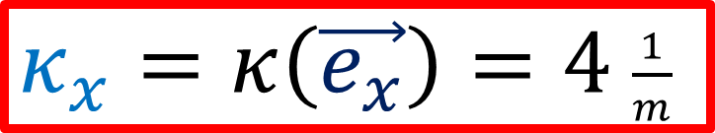


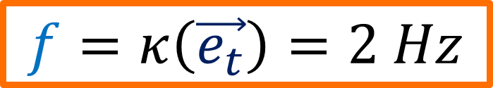

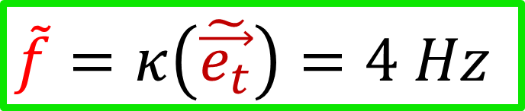
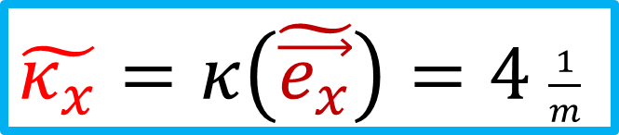
$$\vec{e_{t}}$$
$$\tilde{\vec{e_{t}}}$$
We can also figure this out algebraically.
$$\vec{e_{x}}$$
$$\tilde{\vec{e_{x}}}$$
$$f=κ\left(\vec{e_{t}}\right)=2 Hz$$
$$\tilde{f}=κ\left(\tilde{\vec{e_{t}}}\right)=4 Hz$$
$κ_{x}=κ\left(\vec{e_{x}}\right)=4$ $\frac{1}{m}$
$\tilde{κ_{x}}=κ\left(\tilde{\vec{e_{x}}}\right)=4$ $\frac{1}{m}$

Slide 3
Relativity 106: Tensors
Tensor = mathematical tools
let us write the laws of physics in a way that is the same in all coordinate systems
Frequency-Wavenumber Covector and Doppler Effect
What are Tensors? What are Tensors for?
The Tensor Product

Slide 4
Vector = an arrow
Represents something with direction and size
Covector = a stack
Represents something with direction and density

Slide 5
Vector = an arrow
Represents something with direction and size
Covector = a stack
Represents something with direction and density
Give geometrical representation of:
Position
Velocity
Acceleration
Momentum
Force
(3D and 4D versions)
Give geometrical representation of:
Waves
(Doppler effect)
Density in time = frequency
Density in space = wavenumber

Slide 6
This Video:
Introduction to Covectors (Pure Math)
Application to Doppler Effect
Galilean Doppler Effect
Special Relativistic Doppler Effect (inertial frame)
Special Relativistic Doppler Effect (non-inertial frame)

Slide 7
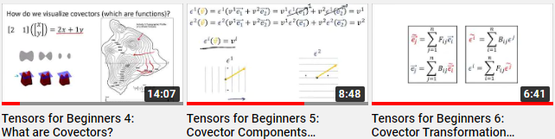
Covered more slowly in “Tensors for Beginners” videos 4, 5, 6.
links in description
If you already know covectors, skip to this part of the video:

Slide 8
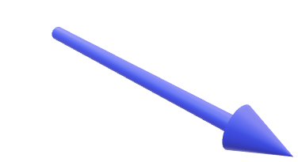


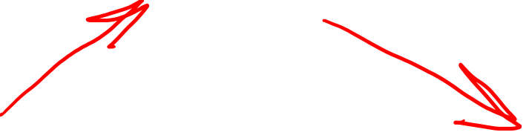
Covector = an oriented stack that eats a vector as input and outputs a number.
2D covector
3D covector

Slide 9

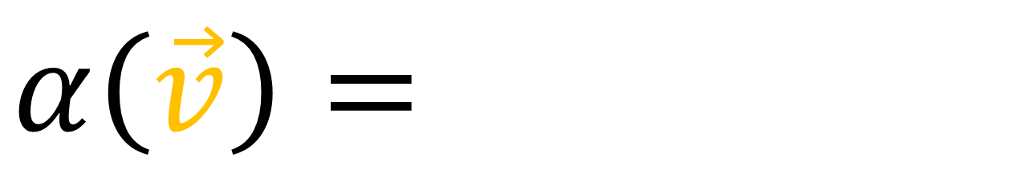
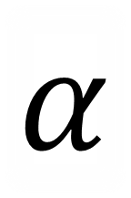

$$\vec{v}$$
$$α\left(\vec{v}\right)=$$
$α\left(\vec{v}\right)=$ # stacks pierced by vector
$$α$$

Slide 10
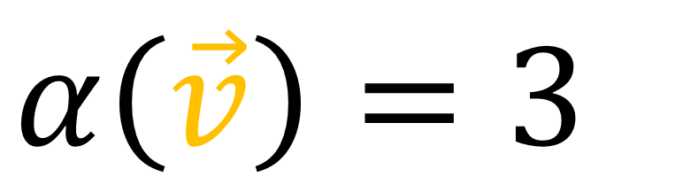

$$α\left(\vec{v}\right)=3$$
$$\vec{v}$$
$$α\left(\vec{v}\right)=$$
$α\left(\vec{v}\right)=$ # stacks pierced by vector
$$α$$

Slide 11
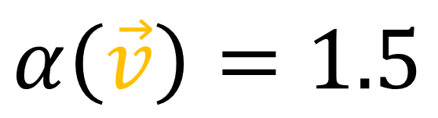
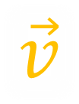

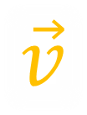

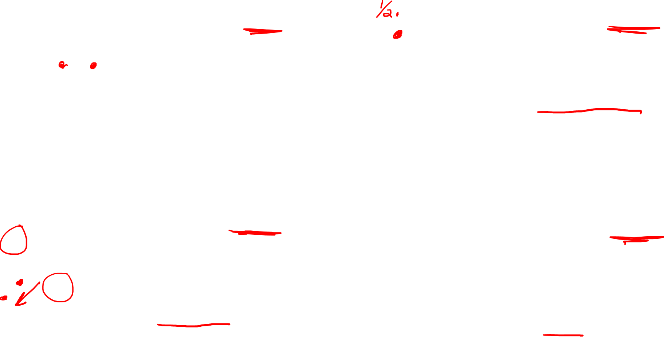

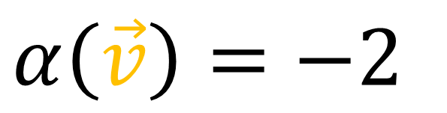
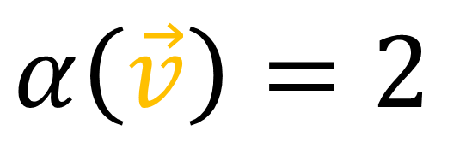
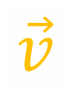
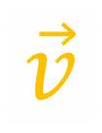

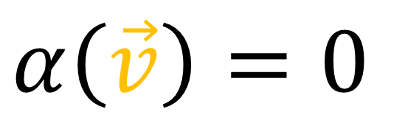
$$α\left(\vec{v}\right)=2$$
$$\vec{v}$$
$$α\left(\vec{v}\right)=1.5$$
$$\vec{v}$$
(result is non-integer if arrow makes it partway between stacks)
$$α$$
$$α$$
$α\left(\vec{v}\right)=−2$
$$\vec{v}$$
$$α\left(\vec{v}\right)=0$$
$$\vec{v}$$
(result is negative is arrow points in opposite direction of stack)
$$α$$
$$α$$
(result is zero if arrow is parallel to stack)

Slide 12
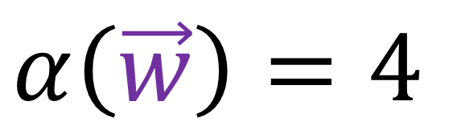
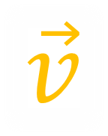
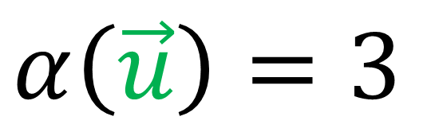

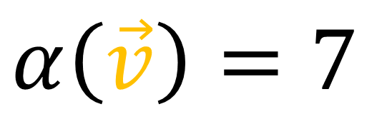

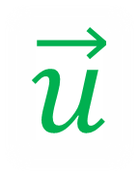
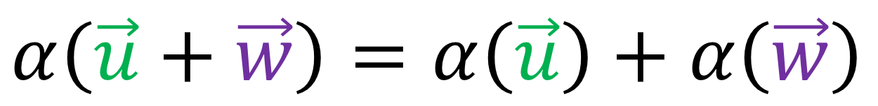

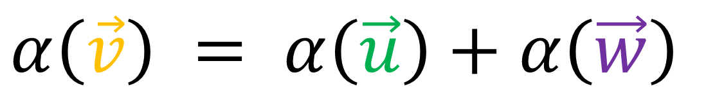
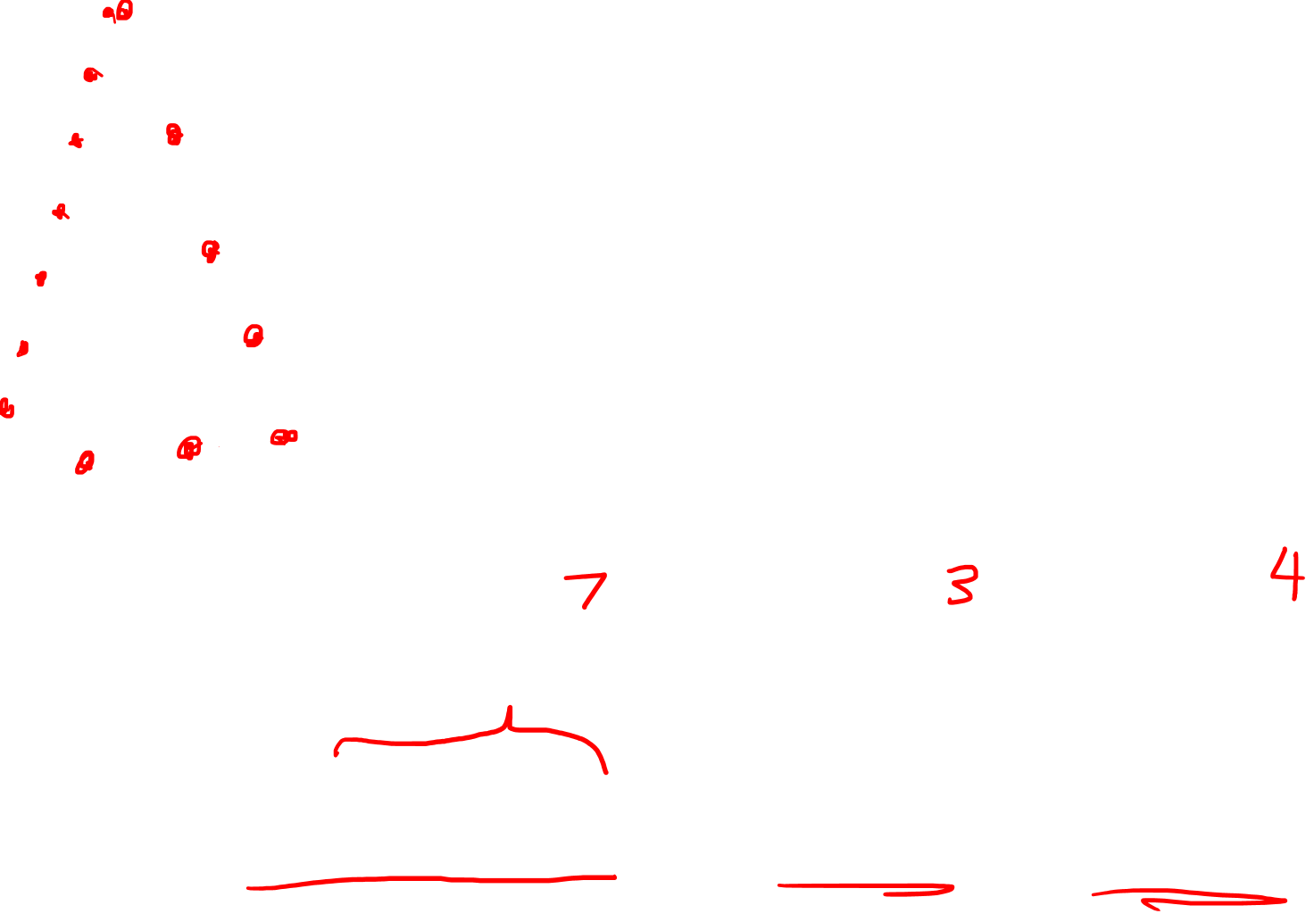
$$α\left(\vec{v}\right)=7$$
$$α\left(\vec{u}\right)=3$$
$$α$$
$$\vec{v}$$
$$\vec{w}$$
$$α\left(\vec{w}\right)=4$$
$\vec{v} = \vec{u} + \vec{w}$
$$\vec{u}$$
$$α\left(\vec{v}\right) = α\left(\vec{u}\right)+α\left(\vec{w}\right)$$
$$α\left(\vec{u}+\vec{w}\right)=α\left(\vec{u}\right)+α\left(\vec{w}\right)$$

Slide 13

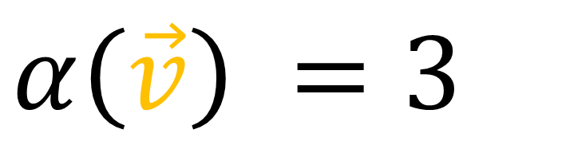
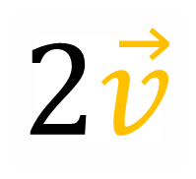
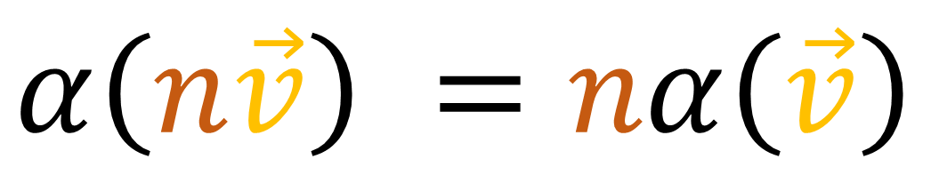
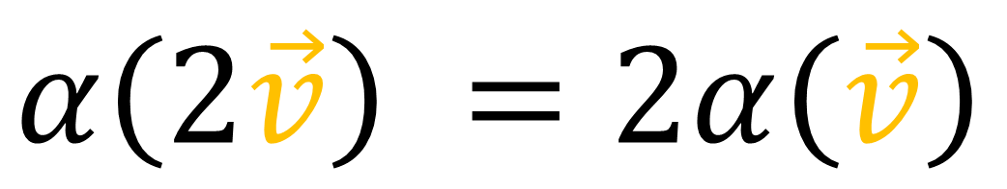
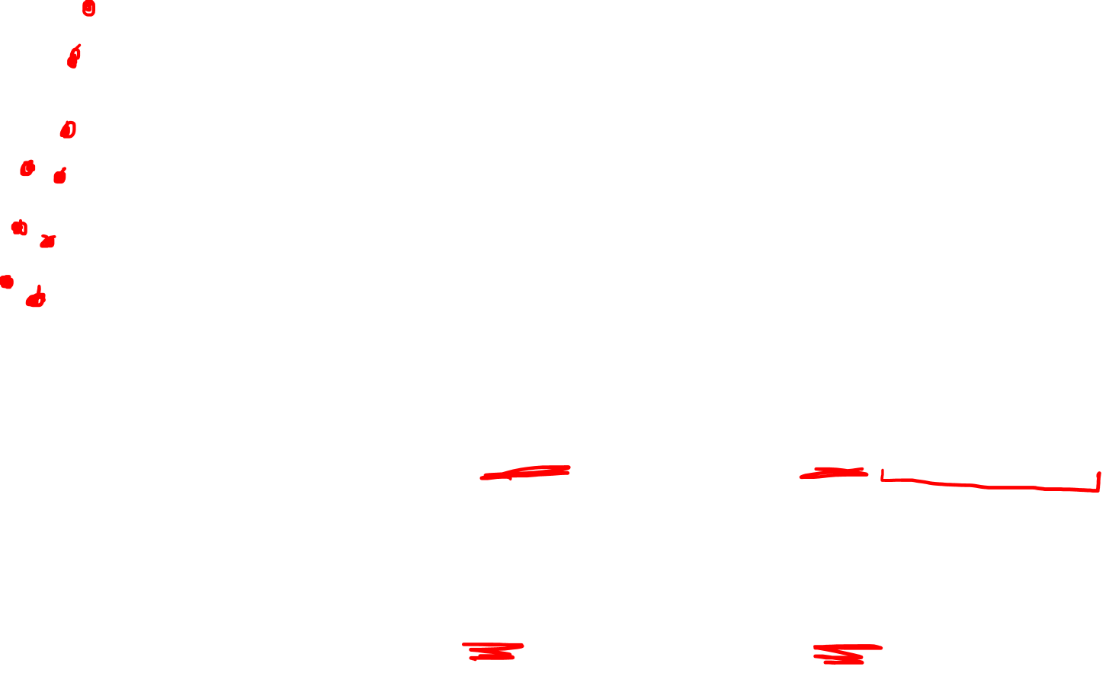
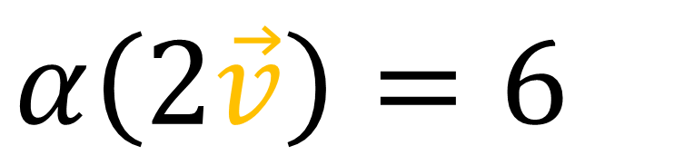
$$α\left(\vec{v}\right) =3$$
$$α$$
$$2\vec{v}$$
$$α\left(2\vec{v}\right)=6$$
$$\vec{v}$$
$$α\left(2\vec{v}\right) =2α\left(\vec{v}\right)$$
$$α\left(n\vec{v}\right) =nα\left(\vec{v}\right)$$

Slide 14

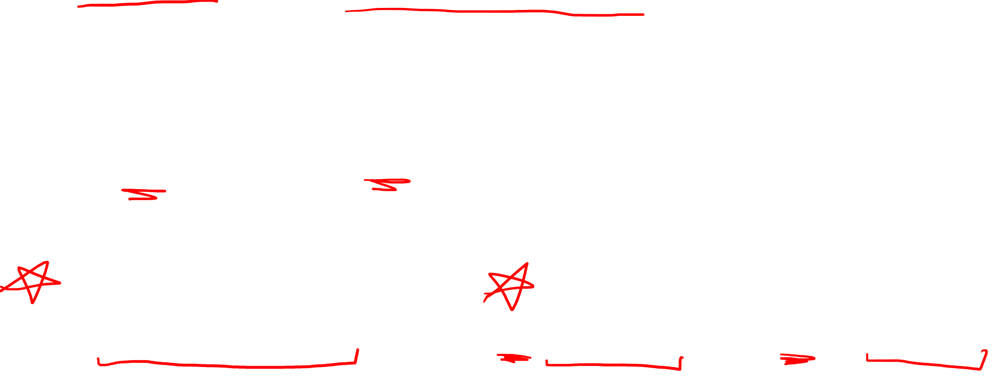

Fundamental Laws of Covectors
Add inputs or add outputs
$$α\left(\vec{u}+\vec{w}\right)=α\left(\vec{u}\right)+α\left(\vec{w}\right)$$
$$α\left(n\vec{v}\right) =nα\left(\vec{v}\right)$$
Scale inputs or scale outputs
$$α\left(a\vec{u}+b\vec{w}\right) =aα\left(\vec{u}\right)+bα\left(\vec{w}\right)$$

Slide 15
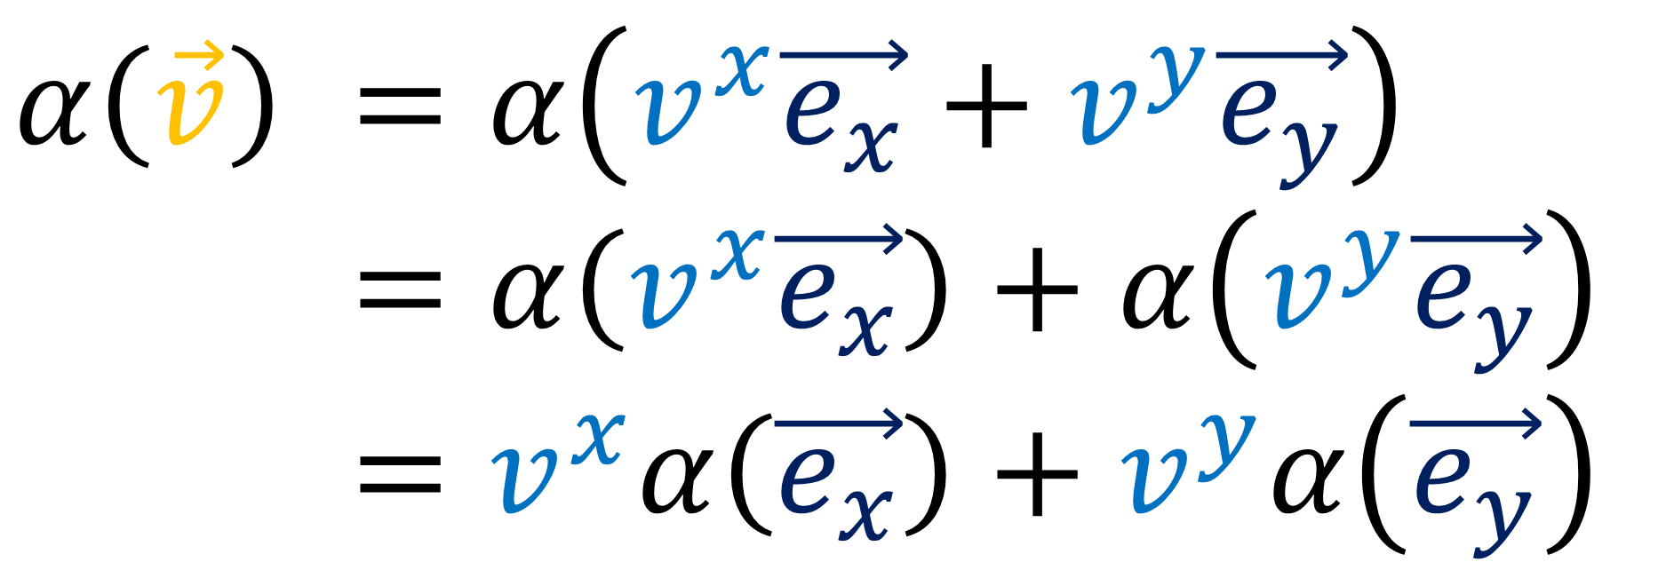

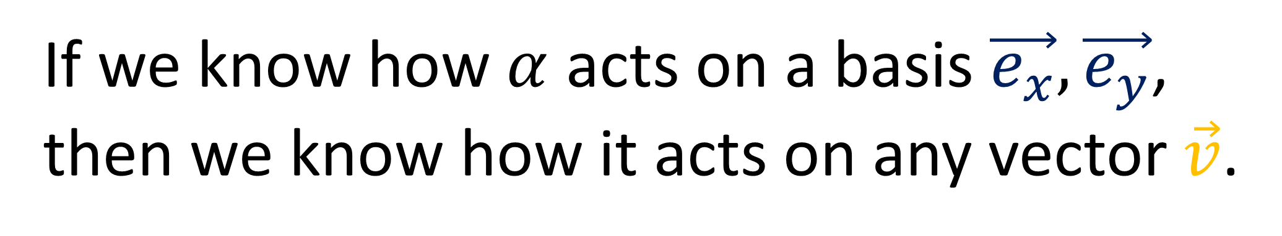
$$α\left(\vec{v}\right) =α\left(v^{x}\vec{e_{x}}+v^{y}\vec{e_{y}}\right)$$
$$α\left(\vec{v}\right) =α\left(v^{x}\vec{e_{x}}\right)+α\left(v^{y}\vec{e_{y}}\right)$$
$$α\left(\vec{v}\right) =v^{x}α\left(\vec{e_{x}}\right)+v^{y}α\left(\vec{e_{y}}\right)$$
If we know how $α$ acts on a basis $\vec{e_{x}},\vec{e_{y}}$, then we know how it acts on any vector $\vec{v}$.

Slide 16
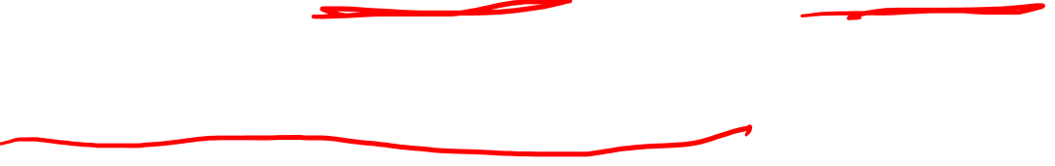
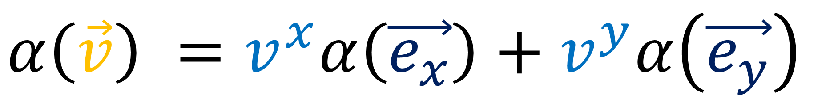
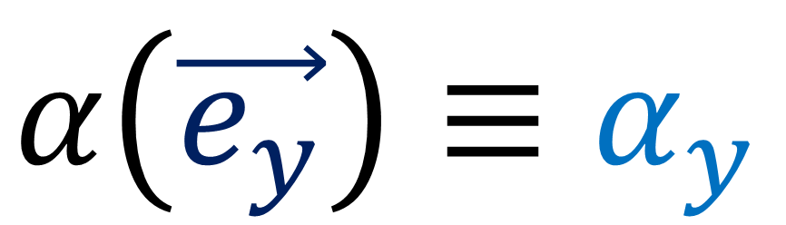
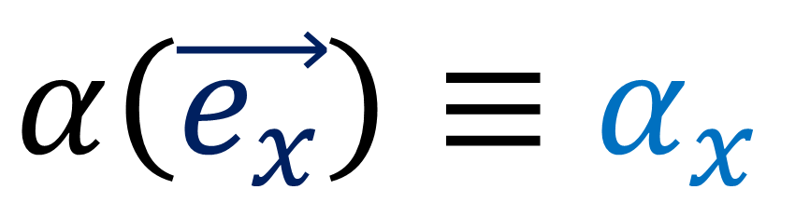
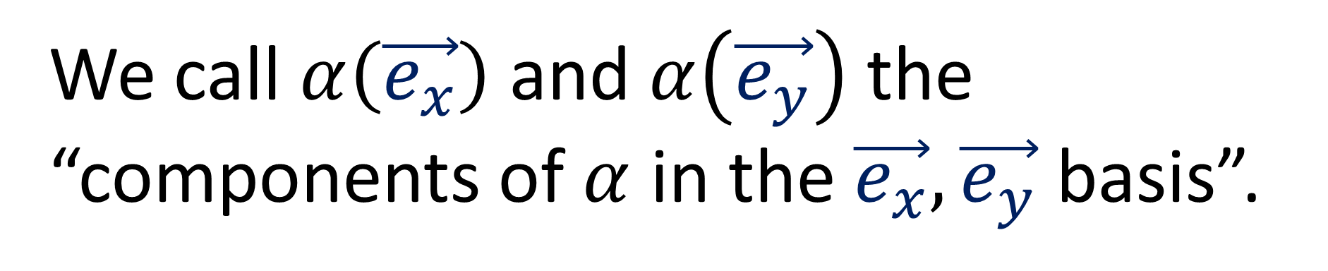
$$α\left(\vec{v}\right) =v^{x}α\left(\vec{e_{x}}\right)+v^{y}α\left(\vec{e_{y}}\right)$$
We call $α\left(\vec{e_{x}}\right)$ and $α\left(\vec{e_{y}}\right)$ the “components of $α$ in the $\vec{e_{x}},\vec{e_{y}}$ basis”.
$α\left(\vec{e_{x}}\right)≡α_{x}$
$α\left(\vec{e_{y}}\right)≡α_{y}$

Slide 17

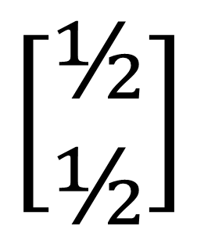
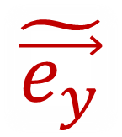
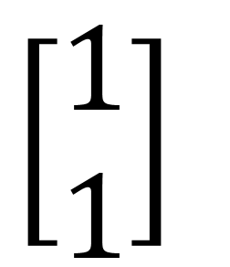








Vector components are contravariant.
$$\tilde{\vec{e_{y}}}$$
$$\left[\begin{aligned}\text{½} \\ \text{½}\end{aligned}\right]$$
$$\left[\begin{aligned}1 \\ 1\end{aligned}\right]$$
$$\vec{e_{y}}$$
$$\vec{v}$$
$$\vec{v}$$
$$\tilde{\vec{e_{x}}}=2\vec{e_{x}}$$
$$\tilde{\vec{e_{y}}}=2\vec{e_{y}}$$
$$\tilde{\vec{e_{x}}}$$
$$\vec{e_{x}}$$
$$\vec{v}=\text{½}\tilde{\vec{e_{x}}}+\text{½}\tilde{\vec{e_{y}}}$$
$$\vec{v}=1\vec{e_{x}}+1\vec{e_{y}}$$
Notes:
½

Slide 18












$$\left[2 2\right]$$
$$\left[4 4\right]$$
Covector components are covariant.
$$\tilde{\vec{e_{y}}}$$
$$\vec{e_{y}}$$
$$α$$
$$α$$
$$\tilde{\vec{e_{x}}}=2\vec{e_{x}}$$
$$\tilde{\vec{e_{y}}}=2\vec{e_{y}}$$
$$\vec{e_{x}}$$
$$\tilde{\vec{e_{x}}}$$
$$α\left(\tilde{\vec{e_{x}}}\right)=\tilde{α_{x}}=4$$
$$α\left(\tilde{\vec{e_{y}}}\right)=\tilde{α_{y}}=4$$
$$α\left(\vec{e_{x}}\right)=α_{x}=2$$
$$α\left(\vec{e_{y}}\right)=α_{y}=2$$

Slide 19


We build vectors using basis vectors:
$$\vec{v}=v^{x}\vec{e_{x}}+v^{y}\vec{e_{y}}$$
Is there a basis for covectors too?
$$α=α_{x}ε^{x}+α_{y}ε^{y}$$
“Dual basis”

Slide 20









$$ε^{x}$$
$$ε^{y}$$
$$\vec{e_{y}}$$
$$\vec{e_{y}}$$
$$\vec{e_{x}}$$
$$\vec{e_{x}}$$
$$ε^{x}\left(\vec{e_{x}}\right)=1$$
$$ε^{x}\left(\vec{e_{y}}\right)=0$$
$$ε^{y}\left(\vec{e_{x}}\right)=0$$
$$ε^{y}\left(\vec{e_{y}}\right)=1$$

Slide 21











$$2ε^{x}+1ε^{y}=α$$
“add the densities”
$$ε^{x}$$
$$ε^{y}$$
$$α$$
$$\vec{e_{y}}$$
$$2$$
$$+ 1$$
$$=$$
$$\vec{e_{x}}$$
$$α\left(\vec{e_{x}}\right)=α_{x}ε^{x}+α_{y}ε^{y}$$

Slide 22



$$2ε^{x}+1ε^{y}=α$$
“add the densities”
$$α$$
$$α\left(\vec{e_{x}}\right)=\left(2ε^{x}+1ε^{y}\right)\left(\vec{e_{x}}\right)$$
$$α\left(\vec{e_{x}}\right)=2ε^{x}\left(\vec{e_{x}}\right)+1ε^{y}\left(\vec{e_{x}}\right)$$
$$α\left(\vec{e_{x}}\right)=2$$
$$\vec{e_{y}}$$
$$\vec{e_{x}}$$
$$α\left(\vec{e_{y}}\right)=\left(2ε^{x}+1ε^{y}\right)\left(\vec{e_{y}}\right)$$
$$α\left(\vec{e_{x}}\right)=2ε^{x}\left(\vec{e_{y}}\right)+1ε^{y}\left(\vec{e_{y}}\right)$$
$$α\left(\vec{e_{x}}\right)=1$$

Slide 23







$$\tilde{\vec{e_{y}}}$$
$$ε^{x}$$
$$\vec{e_{y}}$$
$$\tilde{\vec{e_{x}}}=2\vec{e_{x}}$$
$$\tilde{\vec{e_{y}}}=2\vec{e_{y}}$$
$$\vec{e_{x}}$$
$$\tilde{\vec{e_{x}}}$$
$\tilde{ε^{x}}=\frac{1}{2}ε^{x}$
$$ε^{x}\left(\vec{e_{x}}\right)=1$$
$$ε^{x}\left(\vec{e_{y}}\right)=0$$
$$\tilde{ε^{x}}\left(\tilde{\vec{e_{x}}}\right)=1$$
$$\tilde{ε^{x}}\left(\tilde{\vec{e_{y}}}\right)=0$$

Slide 24






$$ε^{y}$$
$$\vec{e_{y}}$$
$$\tilde{\vec{e_{y}}}$$
$$\vec{e_{x}}$$
$$\tilde{\vec{e_{x}}}$$
$\tilde{ε^{y}}=\frac{1}{2}ε^{y}$
$$ε^{y}\left(\vec{e_{x}}\right)=0$$
$$ε^{y}\left(\vec{e_{y}}\right)=1$$
$$\tilde{ε^{y}}\left(\tilde{\vec{e_{x}}}\right)=0$$
$$\tilde{ε^{y}}\left(\tilde{\vec{e_{y}}}\right)=1$$

Slide 25


$\tilde{ε^{x}}=\frac{1}{2}ε^{x}$
$\tilde{ε^{y}}=\frac{1}{2}ε^{y}$
$$\tilde{\vec{e_{x}}}=2\vec{e_{x}}$$
$$\tilde{\vec{e_{y}}}=2\vec{e_{y}}$$
Basis covectors are Contravariant!

Slide 26


$$α =\left[α_{x} α_{y}\right]\left[\begin{aligned}ε^{x} \\ ε^{y}\end{aligned}\right]$$
$$=\left[α_{x} α_{y}\right]\left[\begin{matrix}1 & 0 \\ 0 & 1\end{matrix}\right]\left[\begin{aligned}ε^{x} \\ ε^{y}\end{aligned}\right]$$
$$=\left[α_{x} α_{y}\right]\left[\begin{matrix}a & b \\ c & d\end{matrix}\right]{\left[\begin{matrix}a & b \\ c & d\end{matrix}\right]}^{−1}\left[\begin{aligned}ε^{x} \\ ε^{y}\end{aligned}\right]$$
$$=\left[\tilde{α_{x}} \tilde{α_{y}}\right] \left[\begin{aligned}\tilde{ε^{x}} \\ \tilde{ε^{y}}\end{aligned}\right]$$

Slide 27


Covectors are stacks
Eat vectors inputs and output numbers
Output of $α\left(\vec{v}\right)$ is # of stacks pierced by vector $\vec{v}$
Fundamental Covector Laws
$α\left(\vec{u}+\vec{w}\right)=α\left(\vec{u}\right)+α\left(\vec{w}\right)$ Add inputs or add outputs
$α\left(n\vec{v}\right) =nα\left(\vec{v}\right)$ Scale inputs or scale outputs

Slide 28





Covectors can have a “dual basis” $α=α_{x}ε^{x}+α_{y}ε^{y}$
Dual basis definition
Covector components
$\vec{e_{x}},\vec{e_{y}}$ and $α_{x},α_{y}$ change in the same way (covariant)
$\vec{e_{x}},\vec{e_{y}}$ and $ε^{x},ε^{x}$ change in opposite ways (contravariant)
$$ε^{x}\left(\vec{e_{x}}\right)=1$$
$$ε^{x}\left(\vec{e_{y}}\right)=0$$
$$ε^{y}\left(\vec{e_{x}}\right)=0$$
$$ε^{y}\left(\vec{e_{y}}\right)=1$$
$$α_{x}=α\left(\vec{e_{x}}\right) α_{y}=α\left(\vec{e_{y}}\right)$$

Slide 29




Vector Space
Dual Space
$$V$$
$$V^{∗}$$
$$\vec{v}∈V$$
$$α∈V^{∗}$$

Slide 30
Practical Application of Covectors:
(Relativistic) Doppler Effect

Slide 31

space $x$

Slide 32





wavelength $λ_{x}$
space $x$
(linear) wavenumber $κ_{x}=\frac{1}{λ_{x}}$
(# peaks in a unit distance)
angular wavenumber $k_{x}=2πκ_{x}=\frac{2π}{λ_{x}}$

Slide 33

space $x$
constant $x$

Slide 34
space $x$
constant $x$

Slide 35





There’s a wavenumber for each direction in 3D:
$$κ_{x}$$
$$κ_{y}$$
$$κ_{z}$$
$${\left(κ_{3D}\right)}^{2}={\left(κ_{x}\right)}^{2}+{\left(κ_{y}\right)}^{2}+{\left(κ_{z}\right)}^{2}$$
For this video, assume $κ_{y}=κ_{z}=0$

Slide 36





period $T$
time $t$
(linear) frequency $f=\frac{1}{T}$
(# peaks in unit time)
angular frequency $ω=2πf=\frac{2π}{T}$

Slide 37


time $t$
space $x$

Slide 38




time $t$
Wave is travelling left.
Wave speed $v_{w}=\frac{f}{κ_{x}}$
Units $\left[Hz⋅\frac{1}{m}\right]=\left[\frac{m}{s}\right]$
space $x$

Slide 39
time $t$
Wave is travelling left.
Wave speed $v_{w}=\frac{f}{κ_{x}}$
Units $\left[Hz⋅\frac{1}{m}\right]=\left[\frac{m}{s}\right]$
Wave covector
(frequency-wavenumber covector)
space $x$

Slide 40
time $t$
Doppler Effect:
When we run towards the source of a wave, its frequency gets higher
When we run away from the source of a wave, its frequency gets lower
Wave covector
(frequency-wavenumber covector)
space $x$

Slide 41


time $t$
space $x$

Slide 42






time $t$
frequency = density in time
$$f=κ\left(\vec{e_{t}}\right)$$
wavenumber = density in space
$$\vec{e_{t}}$$
$$κ_{x}=κ\left(\vec{e_{x}}\right)$$
$$\vec{e_{x}}$$
space $x$

Slide 43




$$\vec{e_{t}}$$
$$f=κ\left(\vec{e_{t}}\right)=2 Hz$$
$$\vec{e_{x}}$$
$κ_{x}=κ\left(\vec{e_{x}}\right)=4$ $\frac{1}{m}$

Slide 44






time $t$
$f =κ\left(\vec{e_{t}}\right)=2$
$$κ_{x}=κ\left(\vec{e_{x}}\right)=4$$
$v_{w}=$ $\frac{density in time}{density in space}$
$v_{w}=\frac{f}{κ_{x}}$
$v_{w}=\frac{2 \frac{1}{s}}{4 \frac{1}{m}}=\frac{1}{2}\frac{m}{s}$
$$\vec{e_{t}}$$
$$\vec{e_{x}}$$
space $x$

Slide 45






time $t$
Speed of car:
$v=\frac{1}{2}\frac{m}{s}$
$$\vec{e_{t}}$$
$$\tilde{\vec{e_{t}}}$$
$$\vec{e_{x}}$$
$$\tilde{\vec{e_{x}}}$$
space $x$

Slide 46




$$\tilde{\vec{e_{t}}}$$
$$\tilde{f}=κ\left(\tilde{\vec{e_{t}}}\right)=4 Hz$$
$$\tilde{\vec{e_{x}}}$$
$\tilde{κ_{x}}=κ\left(\tilde{\vec{e_{x}}}\right)=4$ $\frac{1}{m}$

Slide 47



time $t$
$\tilde{f} =κ\left(\tilde{\vec{e_{t}}}\right)=4$
$$\tilde{κ_{x}}=κ\left(\tilde{\vec{e_{x}}}\right)=4$$
$\tilde{v_{w}}=$ $\frac{density in time}{density in space}$
$\tilde{v_{w}}=\frac{\tilde{f}}{\tilde{κ_{x}}}$
$\tilde{v_{w}}=\frac{4 \frac{1}{s}}{4 \frac{1}{m}}=1\frac{m}{s}$
$$\vec{e_{t}}$$
$$\tilde{\vec{e_{t}}}$$
$$\vec{e_{x}}$$
$$\tilde{\vec{e_{x}}}$$
space $x$

Slide 48




time $t$
Einstein’s frame
$f =κ\left(\vec{e_{t}}\right)=2 Hz$
$κ_{x}=κ\left(\vec{e_{x}}\right)=4$ $\frac{1}{m}$
$v_{w}=−\frac{f}{κ_{x}}$ $=−\frac{1}{2}\frac{m}{s}$
Car’s frame
$$\vec{e_{t}}$$
$$\tilde{\vec{e_{t}}}$$
$\tilde{f} =κ\left(\tilde{\vec{e_{t}}}\right)=4 Hz$
$\tilde{κ_{x}}=κ\left(\tilde{\vec{e_{x}}}\right)=4$ $\frac{1}{m}$
$\tilde{v_{w}}=−\frac{\tilde{f}}{\tilde{κ_{x}}}=−1\frac{m}{s}$
$$\vec{e_{x}}$$
$$\tilde{\vec{e_{x}}}$$
space $x$

Slide 49
$$\vec{e_{t}}$$
$$\tilde{\vec{e_{t}}}$$
We can also figure this out algebraically.
$$\vec{e_{x}}$$
$$\tilde{\vec{e_{x}}}$$
$$f=κ\left(\vec{e_{t}}\right)=2 Hz$$
$$\tilde{f}=κ\left(\tilde{\vec{e_{t}}}\right)=4 Hz$$
$κ_{x}=κ\left(\vec{e_{x}}\right)=4$ $\frac{1}{m}$
$\tilde{κ_{x}}=κ\left(\tilde{\vec{e_{x}}}\right)=4$ $\frac{1}{m}$

Slide 50







Galilean Transform of Basis
(Relativity 103c)
$$\vec{e_{t}}$$
$$\tilde{\vec{e_{t}}}$$
$$\tilde{\vec{e_{t}}}=1\vec{e_{t}}+v\vec{e_{x}}$$
$$\tilde{\vec{e_{x}}}=0\vec{e_{t}}+1\vec{e_{x}}$$
speed of car $v$
$$\vec{e_{x}}$$
$$\tilde{\vec{e_{x}}}$$

Slide 51





Galilean Transform of Basis
$\tilde{f} =1f+vκ_{x}$
$$\tilde{κ_{x}}=0f+1κ_{x}$$
$$\tilde{\vec{e_{t}}}=1\vec{e_{t}}+v\vec{e_{x}}$$
$$\tilde{\vec{e_{x}}}=0\vec{e_{t}}+1\vec{e_{x}}$$
$κ\left(\tilde{\vec{e_{t}}}\right)=κ\left(1\vec{e_{t}}+v\vec{e_{x}}\right)$
$$κ\left(\tilde{\vec{e_{t}}}\right)=κ\left(1\vec{e_{t}}\right)+κ\left(v\vec{e_{x}}\right)$$
$$κ\left(\tilde{\vec{e_{t}}}\right)=1κ\left(\vec{e_{t}}\right)+vκ\left(\vec{e_{x}}\right)$$
$$\tilde{f} = 1 f +v{ κ}_{x}$$
$κ\left(\tilde{\vec{e_{x}}}\right)=κ\left(0\vec{e_{t}}+1\vec{e_{x}}\right)$
$$κ\left(\tilde{\vec{e_{t}}}\right)=κ\left(0\vec{e_{t}}\right)+κ\left(1\vec{e_{x}}\right)$$
$$κ\left(\tilde{\vec{e_{t}}}\right)=0κ\left(\vec{e_{t}}\right)+1κ\left(\vec{e_{x}}\right)$$
$$\tilde{κ_{x}} =0 f +1 κ_{x}$$

Slide 52




Galilean Transform of Basis
$\tilde{f} =1f+vκ_{x}$
$$\tilde{κ_{x}}=0f+1κ_{x}$$
$$\tilde{\vec{e_{t}}}=1\vec{e_{t}}+v\vec{e_{x}}$$
$$\tilde{\vec{e_{x}}}=0\vec{e_{t}}+1\vec{e_{x}}$$
$\tilde{f} =f+vκ_{x}$
$\tilde{f} =f+v\left(\frac{f}{v_{w}}\right)$
$\tilde{f} =f\left(\frac{v_{w}+v}{v_{w}}\right)$
Relative to Einstein:
speed of car $v =\frac{1}{2}\frac{m}{s}$
speed of wave $v_{w}=\frac{1}{2}\frac{m}{s}$

Slide 53



Galilean Transform of Basis
$\tilde{f} =1f+vκ_{x}$
$$\tilde{κ_{x}}=0f+1κ_{x}$$
$$\tilde{\vec{e_{t}}}=1\vec{e_{t}}+v\vec{e_{x}}$$
$$\tilde{\vec{e_{x}}}=0\vec{e_{t}}+1\vec{e_{x}}$$
$\tilde{f} =f+vκ_{x}$
$\tilde{f} =f+v\left(\frac{f}{v_{w}}\right)$
$\tilde{f} =f\left(\frac{v_{w}+v}{v_{w}}\right)$
Relative to Einstein:
speed of wave $v_{w}=\frac{f}{κ_{x}}$
$κ_{x}=\frac{f}{v_{w}}$

Slide 54



Galilean Transform of Basis
$\tilde{f} =1f+vκ_{x}$
$$\tilde{κ_{x}}=0f+1κ_{x}$$
$$\tilde{\vec{e_{t}}}=1\vec{e_{t}}+v\vec{e_{x}}$$
$$\tilde{\vec{e_{x}}}=0\vec{e_{t}}+1\vec{e_{x}}$$
$\tilde{f} =f\left(\frac{v_{w}+v}{v_{w}}\right)$
$\tilde{f} =2\left(\frac{\text{½}+\text{½}}{\text{½}}\right)$
$$\tilde{f} =4 Hz$$
Relative to Einstein:
frequency $f=2 Hz$
speed of wave $v_{w}=\frac{1}{2}\frac{m}{s}$
speed of car $v=\frac{1}{2}\frac{m}{s}$

Slide 55




Galilean Transform of Basis
Doppler Effect (Galilean Relativity)
$$\tilde{\vec{e_{t}}}=1\vec{e_{t}}+v\vec{e_{x}}$$
$$\tilde{\vec{e_{x}}}=0\vec{e_{t}}+1\vec{e_{x}}$$
Lorentz Transform of Basis
Doppler Effect (Special Relativity)
$$\tilde{\vec{e_{t}}}=γ\left( \vec{e_{t}}+β\vec{e_{x}}\right)$$
$$\tilde{\vec{e_{x}}}=γ\left(β\vec{e_{t}}+ \vec{e_{x}}\right)$$
$γ=\frac{1}{\sqrt{1−β^{2}}}$
$β=\frac{v}{c}$

Slide 56







$$ct$$
Time $ct$ is measured in distance units like $m$.
This puts time $ct$ and space $x$ on equal footing.
$$x$$
They are both measured in $m$.

Slide 57







Inertial frames:
Peaks in light waves always travel with speed $c$.
$$ct$$
$c=\frac{f}{κ_{x}}$
$$x$$
$κ_{x}=\frac{f}{c}$
$$≡κ_{t}$$
Time wavenumber
(units are $\frac{1}{m}$, just like $κ_{x}$)

Slide 58







$$ct$$
$\frac{f}{c}=κ_{t}=κ\left(\vec{e_{t}}\right)=2$
$$κ_{x}=κ\left(\vec{e_{x}}\right)=2$$
$β=\frac{v}{c}=\frac{1}{2}$
$γ=\frac{1}{\sqrt{1−β^{2}}}=\frac{2}{\sqrt{3}}$
$$x$$
$$\vec{e_{t}}$$
$$\tilde{\vec{e_{t}}}$$
$$\tilde{\vec{e_{x}}}$$
$$\vec{e_{x}}$$

Slide 59





Lorentz Transform of Basis
$$\tilde{\vec{e_{t}}}= γ \vec{e_{t}}+γβ\vec{e_{x}}$$
$$\tilde{\vec{e_{x}}}=γβ\vec{e_{t}}+ γ \vec{e_{x}}$$
$\tilde{κ_{t}}= γ κ_{t}+γβκ_{x}$
$\tilde{κ_{x}}=γβκ_{t}+ γ κ_{x}$
$κ\left(\tilde{\vec{e_{t}}}\right)=κ\left(γ\vec{e_{t}}+γβ\vec{e_{x}}\right)$
$$κ\left(\tilde{\vec{e_{t}}}\right)=κ\left(γ\vec{e_{t}}\right)+κ\left(γβ\vec{e_{x}}\right)$$
$$κ\left(\tilde{\vec{e_{t}}}\right)=γκ\left(\vec{e_{t}}\right)+γβκ\left(\vec{e_{x}}\right)$$
$$\tilde{κ_{t} }=γ\left(κ_{t} + β κ_{x}\right)$$
$κ\left(\tilde{\vec{e_{x}}}\right)=κ\left(γβ\vec{e_{t}}+γ\vec{e_{x}}\right)$
$$κ\left(\tilde{\vec{e_{t}}}\right)=κ\left(γβ\vec{e_{t}}\right)+κ\left(γ\vec{e_{x}}\right)$$
$$κ\left(\tilde{\vec{e_{t}}}\right)=γβκ\left(\vec{e_{t}}\right)+γκ\left(\vec{e_{x}}\right)$$
$$\tilde{κ_{x}} =γ\left(β κ_{t} + κ_{x} \right)$$

Slide 60




Lorentz Transform of Basis
$$\tilde{\vec{e_{t}}}= γ \vec{e_{t}}+γβ\vec{e_{x}}$$
$$\tilde{\vec{e_{x}}}=γβ\vec{e_{t}}+ γ \vec{e_{x}}$$
$\tilde{κ_{t}}= γ κ_{t}+γβκ_{x}$
$\tilde{κ_{x}}=γβκ_{t}+ γ κ_{x}$
$\tilde{κ_{t}}=κ_{t}\frac{\left(1+β\right)}{\sqrt{1−β^{2}}}$
$\tilde{κ_{t}}=κ_{t}\frac{\sqrt{1+β}\sqrt{1+β}}{\sqrt{1−β}\sqrt{1+β}}$
$\frac{\tilde{f}}{c}=\frac{f}{c}\sqrt{\frac{1+β}{1−β}}$
$$\tilde{κ_{t}}=γκ_{t}+γβκ_{x}$$
$$\tilde{κ_{t}}=γκ_{t}+γβκ_{t}$$
$$\tilde{κ_{t}}=κ_{t}γ\left(1+β\right)$$
$$κ_{t}=κ_{x}$$

Slide 61



Lorentz Transform of Basis
$$\tilde{\vec{e_{t}}}= γ \vec{e_{t}}+γβ\vec{e_{x}}$$
$$\tilde{\vec{e_{x}}}=γβ\vec{e_{t}}+ γ \vec{e_{x}}$$
$\tilde{κ_{t}}= γ κ_{t}+γβκ_{x}$
$\tilde{κ_{x}}=γβκ_{t}+ γ κ_{x}$
$\tilde{κ_{t}}=κ_{t}\sqrt{\frac{1+β}{1−β}}$
$\tilde{κ_{t}}=2\sqrt{\frac{1+\text{½}}{1−\text{½}}}$
$\tilde{κ_{t}}=2\sqrt{3}\frac{1}{m}≈3.46\frac{1}{m}$
Relative to Einstein:
Frequency $κ_{t}=2\frac{1}{m}$
speed fraction $β=\frac{1}{2}$
Notes:
½

Slide 62



Lorentz Transform of Basis
$$\tilde{\vec{e_{t}}}= γ \vec{e_{t}}+γβ\vec{e_{x}}$$
$$\tilde{\vec{e_{x}}}=γβ\vec{e_{t}}+ γ \vec{e_{x}}$$
$\tilde{κ_{t}}= γ κ_{t}+γβκ_{x}$
$\tilde{κ_{x}}=γβκ_{t}+ γ κ_{x}$
$\tilde{κ_{t}}=κ_{t}\sqrt{\frac{1+β}{1−β}}$
$\tilde{κ_{t}}=2\sqrt{\frac{1+\text{½}}{1−\text{½}}}$
$\tilde{κ_{t}}=2\sqrt{3}\frac{1}{m}≈3.46\frac{1}{m}$
$$\vec{e_{t}}$$
$$\tilde{\vec{e_{t}}}$$
$$\tilde{\vec{e_{x}}}$$
$$\vec{e_{x}}$$

Slide 63








$\tilde{f}=f\sqrt{\frac{1+β}{1−β}}>f$
$$\vec{e_{t}}$$
$$β>0$$
$$\tilde{\vec{e_{t}}}$$
$$\tilde{\vec{e_{x}}}$$
$$\vec{e_{x}}$$
Observed Frequency $f$
blueshift

Slide 64




$\breve{f}=f\sqrt{\frac{1+β}{1−β}}<f$
$$\vec{e_{t}}$$
$$β<0$$
$$\breve{\vec{e_{t}}}$$
$$\breve{\vec{e_{x}}}$$
$$\vec{e_{x}}$$
Observed Frequency $f$
redshift

Slide 65






$$ct$$
Doppler effect for Accelerating Frame
Constant proper acceleration $α$
Worldline is a hyperbola (Relativity 105a,b,c)
$D=\frac{c^{2}}{α}$
$$x$$
$ct=\tilde{x}\sinh\left(\frac{c\tilde{t}}{D}\right)$
$x=\tilde{x}\cosh\left(\frac{c\tilde{t}}{D}\right)$
Notes:
This lead us to a new way to change reference frames in special relativity: The Lorentz transformation. In the Lorentz transformation both the time and position axes of the spacetime coordinate system are slanted. So, visually, the Lorentz transformation involves changing the coordinate systems so that the time axis and the position axis sort of bend toward each other, kind of like the blades in a pair of scissors. Now that we know what the transformation looks like, it’s time to get the actual Lorentz Transformation Equations

Slide 66








$$ct$$
$$\tilde{\vec{e_{t}}}$$
Doppler effect for Accelerating Frame
Constant proper acceleration $α$
Worldline is a hyperbola (Relativity 105a,b,c)
$$\tilde{\vec{e_{t}}}$$
$$\tilde{\vec{e_{x}}}$$
$$\tilde{\vec{e_{x}}}$$
$$\tilde{\vec{e_{t}}}$$
$$x$$
$\tilde{\vec{e_{t}}}$ is tangent to the worldline.
$$\tilde{\vec{e_{x}}}$$
$\tilde{\vec{e_{x}}}$ is orthogonal
$$\tilde{\vec{e_{t}}}⋅\tilde{\vec{e_{x}}}=0$$
Notes:
This lead us to a new way to change reference frames in special relativity: The Lorentz transformation. In the Lorentz transformation both the time and position axes of the spacetime coordinate system are slanted. So, visually, the Lorentz transformation involves changing the coordinate systems so that the time axis and the position axis sort of bend toward each other, kind of like the blades in a pair of scissors. Now that we know what the transformation looks like, it’s time to get the actual Lorentz Transformation Equations

Slide 67


From Relativity 105e:
$\vec{e_{t}}=\frac{∂\vec{S}}{∂ct} \vec{e_{x}}=\frac{∂\vec{S}}{∂x}$
$\tilde{\vec{e_{t}}}=\frac{∂\vec{S}}{∂c\tilde{t}}$ $\tilde{\vec{e_{x}}}=\frac{∂\vec{S}}{∂\tilde{x}}$
Basis vectors are partial derivatives.
$\frac{∂\vec{S}}{∂c\tilde{t}}=\frac{∂ct}{∂c\tilde{t}}\frac{∂\vec{S}}{∂ct}+\frac{∂x}{∂c\tilde{t}}\frac{∂\vec{S}}{∂x}$
Multivariable Chain Rule

Slide 68




$ct=\tilde{x}\sinh\left(\frac{c\tilde{t}}{D}\right) x=\tilde{x}\cosh\left(\frac{c\tilde{t}}{D}\right)$
$\frac{∂\vec{S}}{∂c\tilde{t}}= \frac{∂ct}{∂c\tilde{t}} \frac{∂\vec{S}}{∂ct}+ \frac{∂x}{∂c\tilde{t}} \frac{∂\vec{S}}{∂x}$
$\tilde{\vec{e_{t}}}=\frac{\tilde{x}}{D}\cosh\left(\frac{c\tilde{t}}{D}\right)\vec{e_{t}}+\frac{\tilde{x}}{D}\sinh\left(\frac{c\tilde{t}}{D}\right)\vec{e_{x}}$
$κ\left(\tilde{\vec{e_{t}}}\right)=κ\left(\frac{\tilde{x}}{D}\cosh\left(\frac{c\tilde{t}}{D}\right)\vec{e_{t}}+\frac{\tilde{x}}{D}\sinh\left(\frac{c\tilde{t}}{D}\right)\vec{e_{x}}\right)$
$κ\left(\tilde{\vec{e_{t}}}\right)=\frac{\tilde{x}}{D}\cosh\left(\frac{c\tilde{t}}{D}\right)κ\left(\vec{e_{t}}\right)+\frac{\tilde{x}}{D}\sinh\left(\frac{c\tilde{t}}{D}\right)κ\left(\vec{e_{x}}\right)$
$\tilde{κ_{t}} =\frac{\tilde{x}}{D}\cosh\left(\frac{c\tilde{t}}{D}\right) κ_{t} +\frac{\tilde{x}}{D}\sinh\left(\frac{c\tilde{t}}{D}\right) κ_{x}$

Slide 69




$\tilde{κ_{t}}=\frac{\tilde{x}}{D}\cosh\left(\frac{c\tilde{t}}{D}\right)κ_{t}+\frac{\tilde{x}}{D}\sinh\left(\frac{c\tilde{t}}{D}\right)κ_{x}$
$\tilde{κ_{t}}=κ_{t}\frac{\tilde{x}}{D}\left(\cosh\left(\frac{c\tilde{t}}{D}\right)+\sinh\left(\frac{c\tilde{t}}{D}\right)\right)$
$\tilde{κ_{t}}=κ_{t}\frac{\tilde{x}}{D}\left(\frac{1}{2}\left(e^{\frac{c\tilde{t}}{D}}+e^{−\frac{c\tilde{t}}{D}}\right)+\frac{1}{2}\left(e^{\frac{c\tilde{t}}{D}}−e^{−\frac{c\tilde{t}}{D}}\right)\right)$
$\tilde{κ_{t}}=κ_{t}\frac{\tilde{x}}{D}e^{\frac{c\tilde{t}}{D}}$
$\tilde{κ_{t}}=κ_{t}e^{\frac{c\tilde{t}}{D}}$
$$κ_{t}=κ_{x}$$
Hyperbolic Worldline
$$\tilde{x}=D$$

Slide 70












$$ct$$
If $c\tilde{t}→+∞$
then $\tilde{κ_{t}}=κ_{t}e^{\frac{c\tilde{t}}{D}}→+∞$
$$\tilde{\vec{e_{t}}}$$
$$\tilde{\vec{e_{x}}}$$
$$\vec{e_{t}}$$
$$\tilde{\vec{e_{t}}}$$
$$\vec{e_{x}}$$
If $c\tilde{t}=0$
then $\tilde{κ_{t}}=κ_{t}e^{\frac{c\tilde{t}}{D}}=κ_{t}$
$$\tilde{\vec{e_{x}}}$$
$$x$$
$$\tilde{\vec{e_{t}}}$$
$$\tilde{\vec{e_{x}}}$$
If $c\tilde{t}→−∞$
then $\tilde{κ_{t}}=κ_{t}e^{\frac{c\tilde{t}}{D}}→0$
Notes:
This lead us to a new way to change reference frames in special relativity: The Lorentz transformation. In the Lorentz transformation both the time and position axes of the spacetime coordinate system are slanted. So, visually, the Lorentz transformation involves changing the coordinate systems so that the time axis and the position axis sort of bend toward each other, kind of like the blades in a pair of scissors. Now that we know what the transformation looks like, it’s time to get the actual Lorentz Transformation Equations

Slide 71

$$ct$$
If $c\tilde{t}→+∞$
then $\tilde{κ_{t}}=κ_{t}e^{\frac{c\tilde{t}}{D}}→+∞$
blueshift
$$x$$
If $c\tilde{t}→+∞$
then $\tilde{κ_{t}}=κ_{t}e^{−\frac{c\tilde{t}}{D}}→0$
redshift
Notes:
This lead us to a new way to change reference frames in special relativity: The Lorentz transformation. In the Lorentz transformation both the time and position axes of the spacetime coordinate system are slanted. So, visually, the Lorentz transformation involves changing the coordinate systems so that the time axis and the position axis sort of bend toward each other, kind of like the blades in a pair of scissors. Now that we know what the transformation looks like, it’s time to get the actual Lorentz Transformation Equations

Slide 72






Density in time direction
$\frac{f}{c}=κ_{t}=κ\left(\vec{e_{t}}\right)$
$$\vec{e_{t}}$$
Density in x-direction
$$κ_{x}=κ\left(\vec{e_{x}}\right)$$
$$\vec{e_{x}}$$
Wave Covector (frequency-wavenumber covector)
$$κ=κ_{t}ε^{t}+κ_{x}ε^{x}$$
$$κ=κ_{t}ε^{t}+κ_{x}ε^{x}+κ_{y}ε^{y}+κ_{z}ε^{z}$$

Slide 73






$$\vec{e_{t}}$$
$$\tilde{\vec{e_{t}}}$$
$$\tilde{\vec{e_{x}}}$$
$$\vec{e_{x}}$$
$\frac{f}{c}=κ_{t}=κ\left(\vec{e_{t}}\right)$
$$κ_{x}=κ\left(\vec{e_{x}}\right)$$
$\frac{\tilde{f}}{c}=\tilde{κ_{t}}=κ\left(\tilde{\vec{e_{t}}}\right)$
$$\tilde{κ_{x}}=κ\left(\tilde{\vec{e_{x}}}\right)$$

Slide 74




Wave Covector is covariant
$$\tilde{κ_{t}} =Aκ_{t}+Bκ_{x}$$
$$\tilde{κ_{x}}=Cκ_{t}+Dκ_{x}$$
$$\left[\tilde{κ_{t}} \tilde{κ_{x}}\right]=\left[κ_{t} κ_{x}\right]\left[\begin{matrix}A & B \\ C & D\end{matrix}\right]$$
$$\tilde{\vec{e_{t}}}=A\vec{e_{t}}+B\vec{e_{x}}$$
$$\tilde{\vec{e_{x}}}=C\vec{e_{t}}+D\vec{e_{x}}$$
$$\left[\tilde{\vec{e_{t}}} \tilde{\vec{e_{x}}}\right]=\left[\vec{e_{t}} \vec{e_{x}}\right]\left[\begin{matrix}A & B \\ C & D\end{matrix}\right]$$

Slide 75




Doppler Effect
Galilean Relativity (Inertial Frame)
$\tilde{f} =f\left(\frac{v_{w}+v}{v_{w}}\right)$
Special Relativity (Inertial Frame)
$\tilde{κ_{t}}=κ_{t}\sqrt{\frac{1+β}{1−β}}$
Special Relativity (Constant Proper Accel. $α$)
($\tilde{x}=D=\frac{c^{2}}{α}$)
$\tilde{κ_{t}}=κ_{t}e^{\frac{c\tilde{t}}{D}}$

Slide 76
$$\vec{e_{t}}$$
$$f=κ\left(\vec{e_{t}}\right)=2 Hz$$
$$\vec{e_{x}}$$
$κ_{x}=κ\left(\vec{e_{x}}\right)=4$ $\frac{1}{m}$

Slide 77
$$\tilde{\vec{e_{t}}}$$
$$\tilde{f}=κ\left(\tilde{\vec{e_{t}}}\right)=4 Hz$$
$$\tilde{\vec{e_{x}}}$$
$\tilde{κ_{x}}=κ\left(\tilde{\vec{e_{x}}}\right)=4$ $\frac{1}{m}$

