Slide 1
Relativity 107: General Relativity Basics
Equivalence Principle
Manifolds
Curvature of Spacetime
Newton-Cartan Theory (Curved Newtonian Gravity)
Energy–Momentum Tensor
Einstein Field Equations

Slide 2
Special Relativity (Flat Spacetime)
Equivalence Principle
“Gravity is different than the other forces”
Need Curved Spacetime to describe Gravity (Tidal Forces)
General Relativity!

Slide 3

Special Relativity (1905)
Speed of light in vacuum $c$ constant in all inertial frames
Ignores Gravity
Flat spacetime
General Relativity (1915)
A theory of gravity based on “equivalence principle”
local gravitation = acceleration
Takes Gravity into account
Curved spacetime
(relativity 104/105)
Link between S.R. and G.R.:
Equivalence Principle

Slide 4
What is the “Equivalence Principle”?
There are 3 versions:
Weak Equivalence Principle (WEP)
Einstein Equivalence Principle (EEP)
Strong Equivalence Principle (SEP)

Slide 5
What is the “Equivalence Principle”?
Simplified Answer:
“In small regions of spacetime, You cannot tell the difference between upward acceleration and downward gravity.”

Slide 6
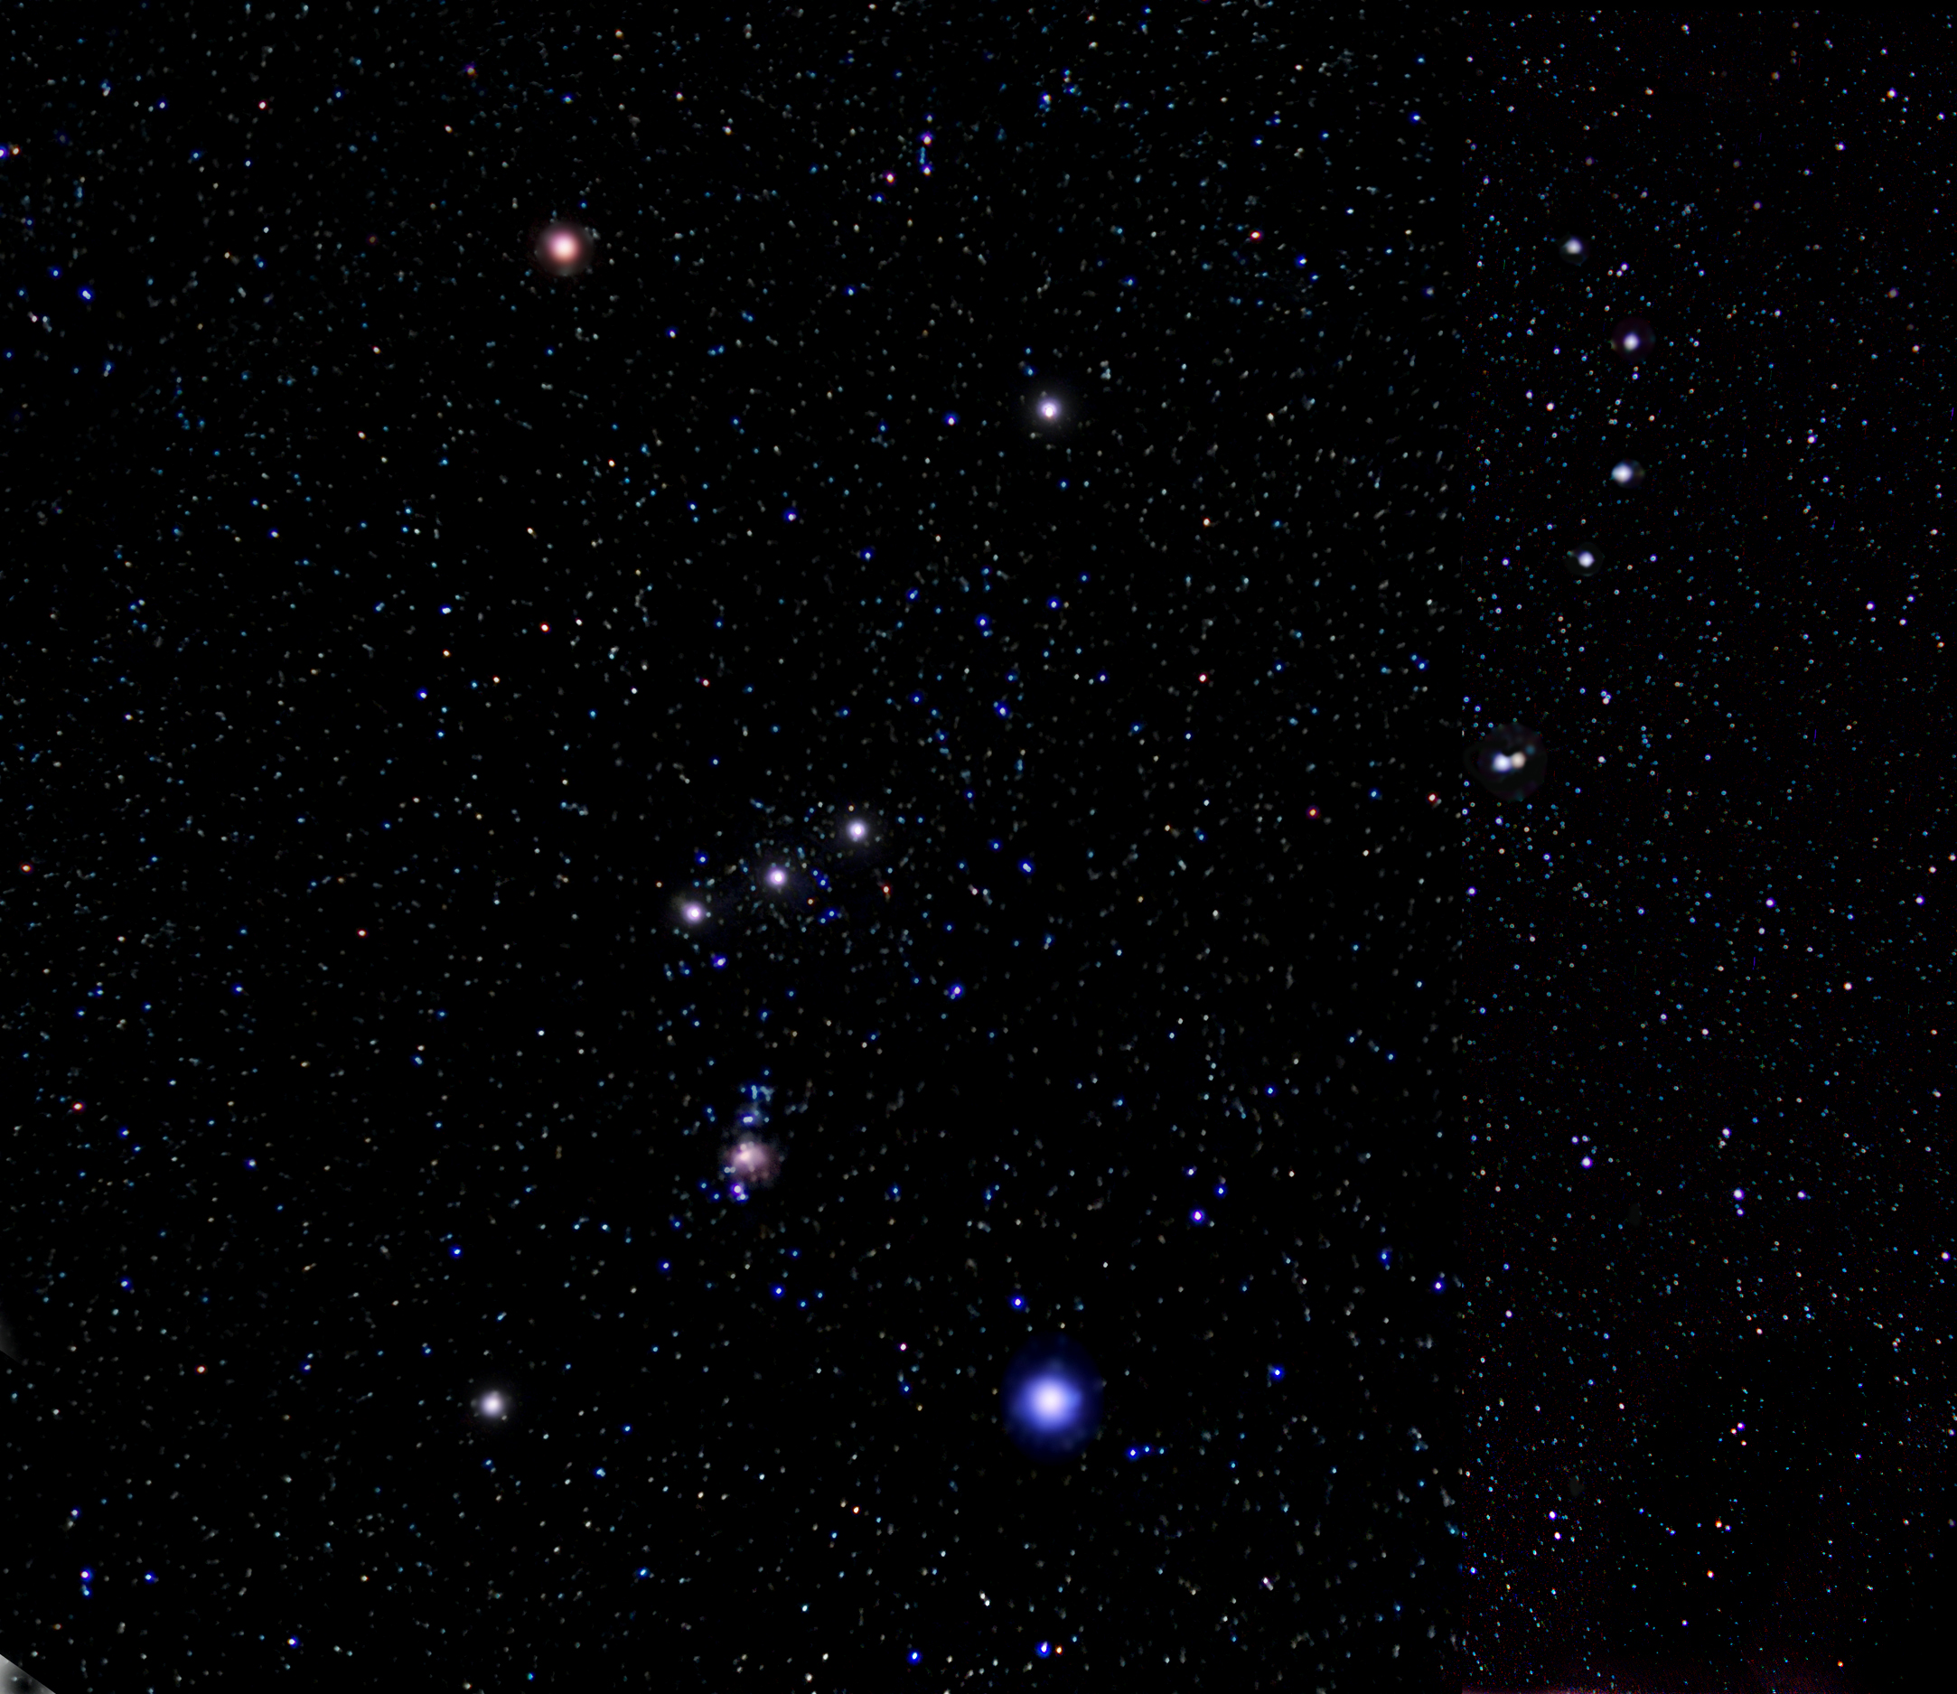
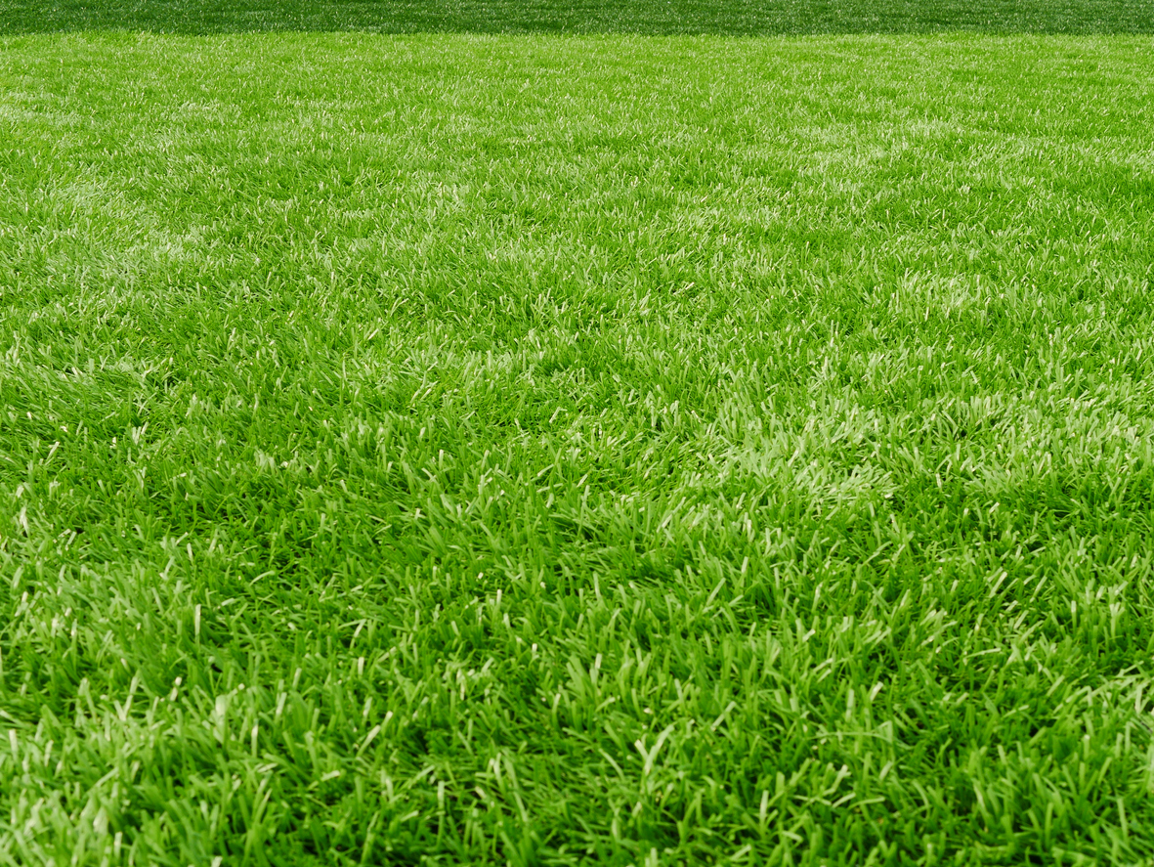
gravity
acceleration
Notes:
This is exactly what would happen to an accelerating box in deep space… passengers would feel a downward pull toward the floor of the spaceship. And according to the equivalence principal, this is indistinguishable from being in a stationary box on earth and feeling the earth’s gravitational pull. There is no way to tell the difference between the two situations.

Slide 7

gravity
acceleration
Notes:
All physical experiments in both situations will behave the exact same. This includes balls dropping to the floor of the box, and any experiments done with light.

Slide 8

Observer floating
outside rocket
time
Notes:
This happens because an observer floating outside the box will simply see the ball floating in the same position overtime. But as time goes by, the floor of the box is accelerate higher and higher, eventually crashing into the ball.

Slide 9
Observer floating
outside rocket
Notes:
This happens because an observer floating outside the box will simply see the ball floating in the same position overtime. But as time goes by, the floor of the box is accelerate higher and higher, eventually crashing into the ball.

Slide 10
Observer floating
outside rocket
Observer inside rocket
Notes:
This happens because an observer floating outside the box will simply see the ball floating in the same position overtime. But as time goes by, the floor of the box is accelerate higher and higher, eventually crashing into the ball.

Slide 11
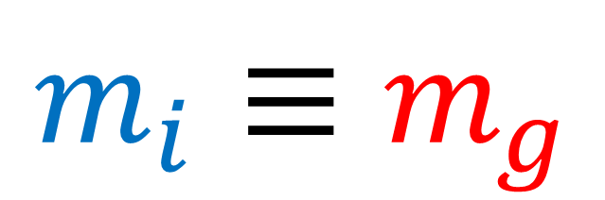
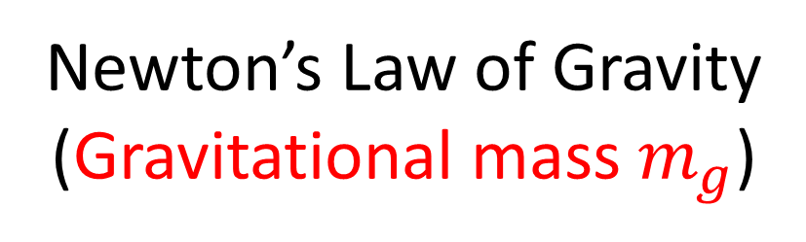
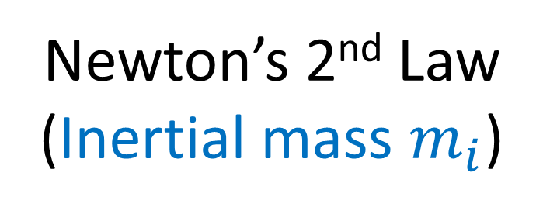
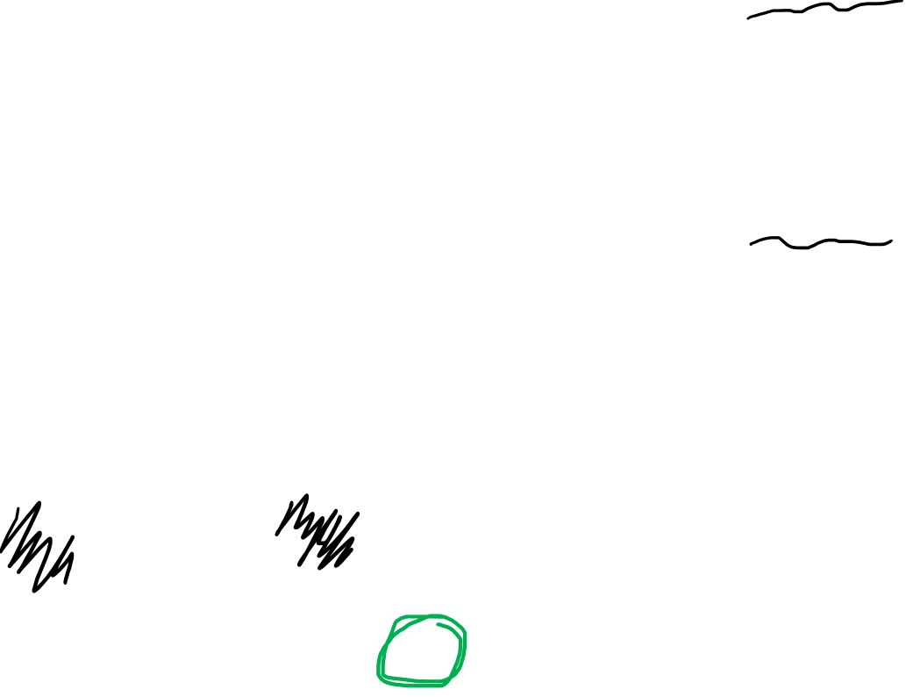
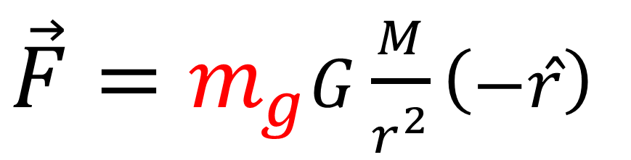
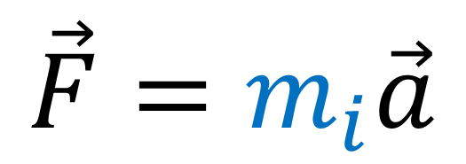
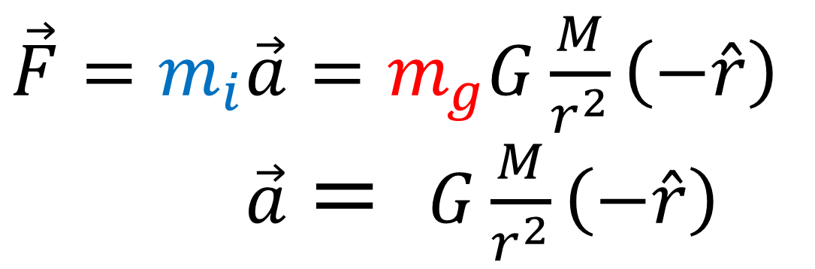
Newton’s 2nd Law
(Inertial mass $m_{i}$)
$$\vec{F}=m_{i}\vec{a}$$
Newton’s Law of Gravity
(Gravitational mass $m_{g}$)
$\vec{F}=m_{g}G\frac{M}{r^{2}}\left(−\hat{r}\right)$
$$m_{i}≡m_{g}$$
All experiments show:
$\vec{F}=m_{i}\vec{a}=m_{g}G\frac{M}{r^{2}}\left(−\hat{r}\right)$
$\vec{F}=m_{i}\vec{a}= G\frac{M}{r^{2}}\left(−\hat{r}\right)$
Object’s acceleration due to gravity is independent of its mass.

Slide 12

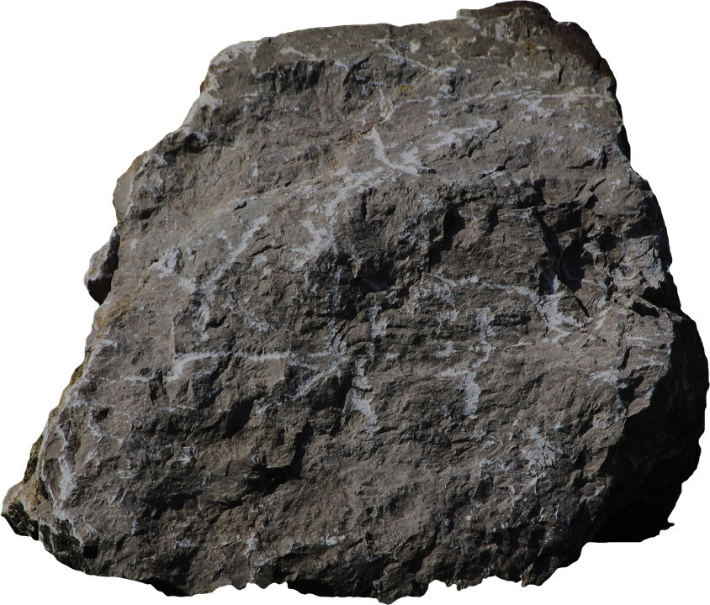
Object’s acceleration is independent of its size/shape/mass.
gravity
(ignoring air resistance)
Notes:
This is exactly what would happen to an accelerating box in deep space… passengers would feel a downward pull toward the floor of the spaceship. And according to the equivalence principal, this is indistinguishable from being in a stationary box on earth and feeling the earth’s gravitational pull. There is no way to tell the difference between the two situations.

Slide 13
Object’s acceleration is independent of its size/shape/mass.
Size/shape/mass do not play a role in collision.
gravity
acceleration
(ignoring air resistance)
Notes:
This is exactly what would happen to an accelerating box in deep space… passengers would feel a downward pull toward the floor of the spaceship. And according to the equivalence principal, this is indistinguishable from being in a stationary box on earth and feeling the earth’s gravitational pull. There is no way to tell the difference between the two situations.

Slide 14


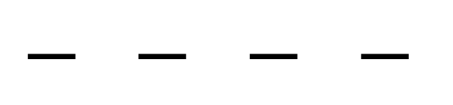
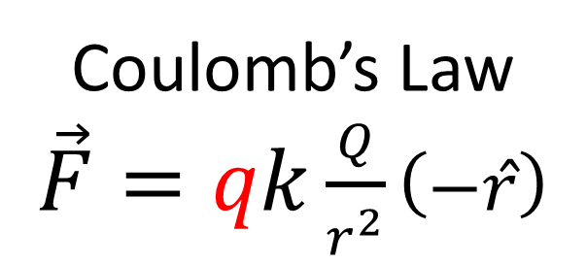

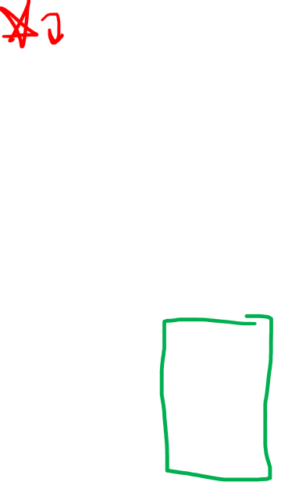


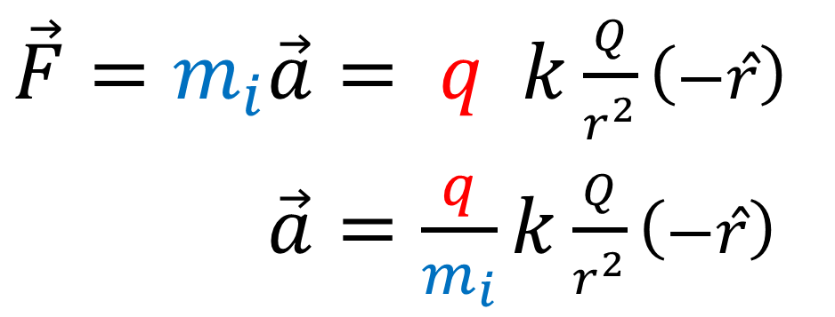

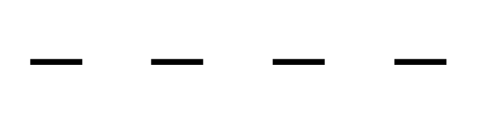


Newton’s 2nd Law
$$\vec{F}=m_{i}\vec{a}$$
$$+$$
Coulomb’s Law
$\vec{F}=qk\frac{Q}{r^{2}}\left(−\hat{r}\right)$
$$+$$
$$+$$
$$+$$
$$+$$
$$+$$
$$+$$
$\vec{F}=m_{i}\vec{a}= q k\frac{Q}{r^{2}}\left(−\hat{r}\right)$
$\vec{F}=m_{i}\vec{a}=\frac{q}{m_{i}}k\frac{Q}{r^{2}}\left(−\hat{r}\right)$
$$− − − −$$
$$− − − −$$

Slide 15

Newton’s 2nd Law
$$\vec{F}=m_{i}\vec{a}$$
$$+$$
Coulomb’s Law
$\vec{F}=qk\frac{Q}{r^{2}}\left(−\hat{r}\right)$
$$+$$
$$+$$
$$+$$
$$+$$
$$+$$
$$+$$
$\vec{F}=m_{i}\vec{a}= q k\frac{Q}{r^{2}}\left(−\hat{r}\right)$
$\vec{F}=m_{i}\vec{a}=\frac{q}{m_{i}}k\frac{Q}{r^{2}}\left(−\hat{r}\right)$
$$− − − −$$
$$− − − −$$

Slide 16
Equivalence Principle:
“Accelerated” (non-inertial) reference frames are indistinguishable from standing on ground a local gravitational field.
gravity
acceleration
Notes:
All physical experiments in both situations will behave the exact same. This includes balls dropping to the floor of the box, and any experiments done with light.

Slide 17
Equivalence Principle:
“Accelerated” (non-inertial) reference frames are indistinguishable from standing on ground a local gravitational field.
gravity
acceleration
Notes:
All physical experiments in both situations will behave the exact same. This includes balls dropping to the floor of the box, and any experiments done with light.

Slide 18
Equivalence Principle:
“Inertial” reference frames are locally indistinguishable from free-fall in a gravitational field.
Box + Ball in Free-fall
Box + Ball inertial in space
Notes:
All physical experiments in both situations will behave the exact same. This includes balls dropping to the floor of the box, and any experiments done with light.

Slide 19
Equivalence Principle:
“Inertial” reference frames are locally indistinguishable from free-fall in a gravitational field.
Box + Ball in Free-fall
Box + Ball inertial in space
Notes:
All physical experiments in both situations will behave the exact same. This includes balls dropping to the floor of the box, and any experiments done with light.

Slide 20
Observer On Ground
time

Slide 21
Observer On Ground

Slide 22
Observer On Ground
Observer In Free-Fall with box/ball

Slide 23
Equivalence Principle:
“Accelerated” (non-inertial) reference frames are indistinguishable from standing on ground a local gravitational field.
gravity
acceleration
Notes:
All physical experiments in both situations will behave the exact same. This includes balls dropping to the floor of the box, and any experiments done with light.

Slide 24
Equivalence Principle:
“Inertial” reference frames are locally indistinguishable from free-fall in a gravitational field.
Box + Ball in Free-fall
Box + Ball inertial in space
Notes:
All physical experiments in both situations will behave the exact same. This includes balls dropping to the floor of the box, and any experiments done with light.

Slide 25
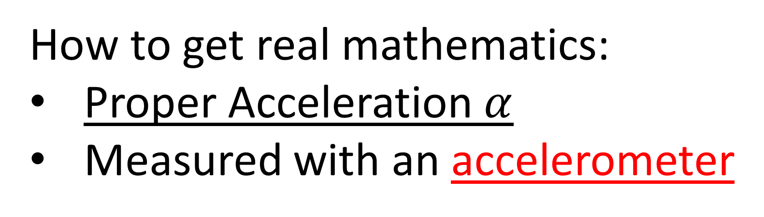
Equivalence Principle:
“Accelerated” (non-inertial) reference frames are indistinguishable from standing on ground a local gravitational field.
“Inertial” reference frames are locally indistinguishable from free-fall in a gravitational field.
How to get real mathematics:
Proper Acceleration $α$
Measured with an accelerometer

Slide 26
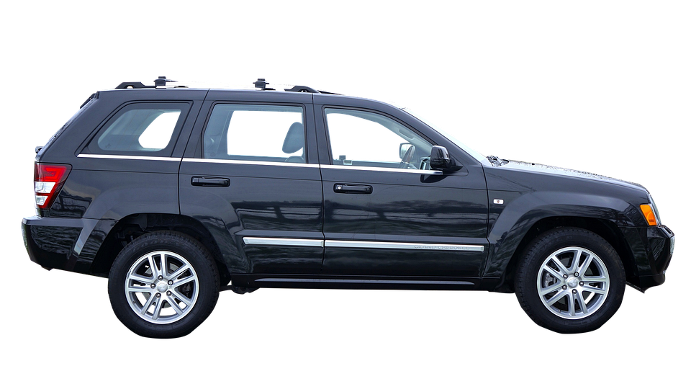
acceleration
Feeling of being pulled back
This is “proper acceleration”

Slide 27
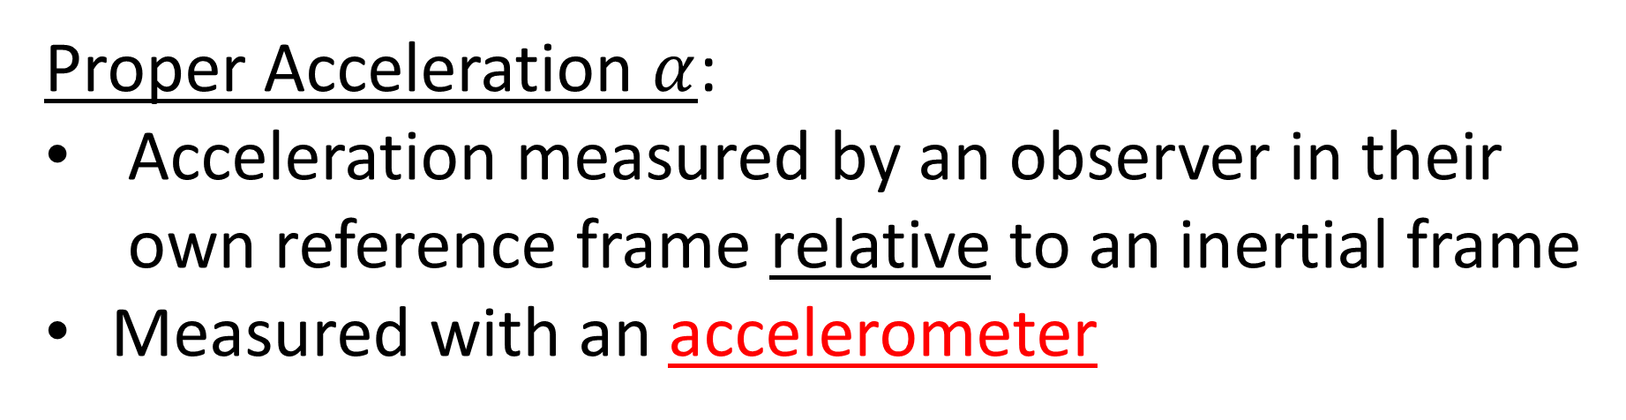
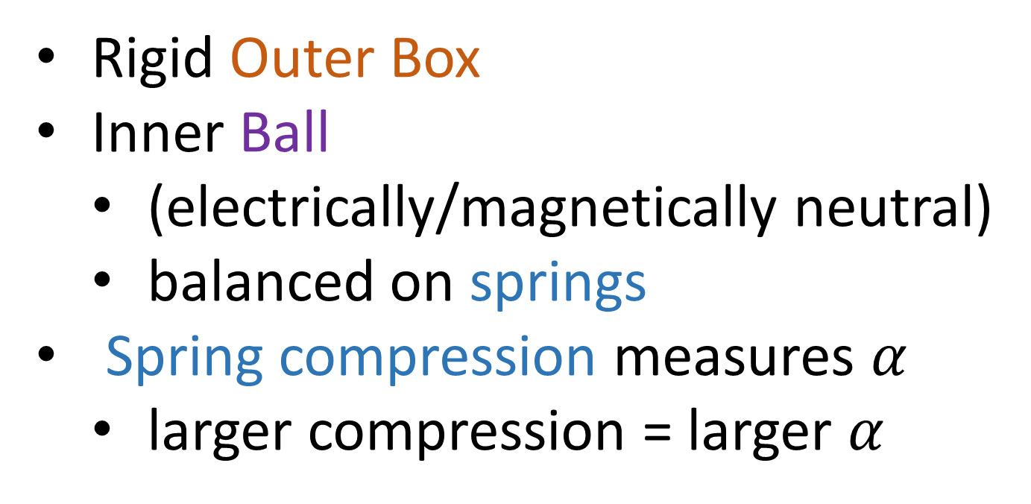
Proper Acceleration $α$:
Acceleration measured by an observer in their own reference frame relative to an inertial frame
Measured with an accelerometer
Rigid Outer Box
Inner Ball
(electrically/magnetically neutral)
balanced on springs
Spring compression measures $α$
larger compression = larger $α$

Slide 28
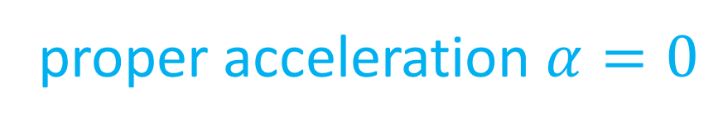
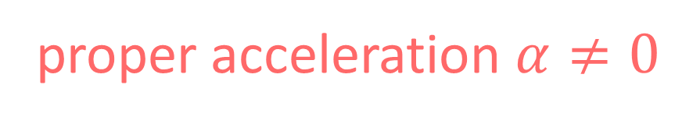
Accelerometers…
“constant velocity”
Relative! (depends on reference frame/ coordinate system)
“acceleration”
“inertial observer”
proper acceleration $α=0$
Objective! (agreed on by all reference frames / coordinate systems)
“non-inertial observer”
proper acceleration $α≠0$

Slide 29

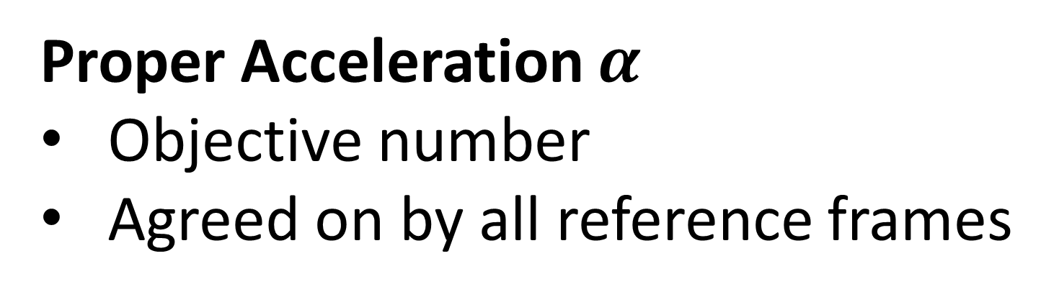

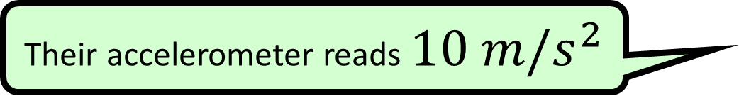

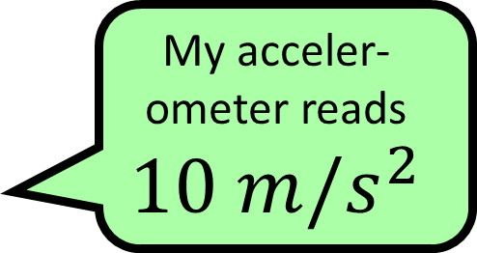
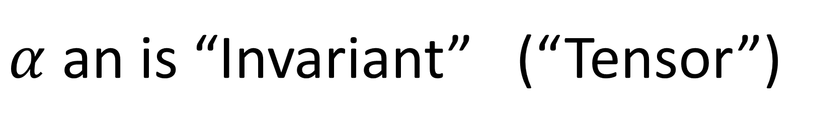
Proper Acceleration $α$
Objective number
Agreed on by all reference frames
$$10 m/s^{2}$$
Their accelerometer reads $10 m/s^{2}$
My acceler-ometer reads $$10 m/s^{2}$$
Their accelerometer reads $10 m/s^{2}$
Their accelerometer reads $10 m/s^{2}$
$α$ an is “Invariant” (“Tensor”)

Slide 30
Rope Force

Slide 31

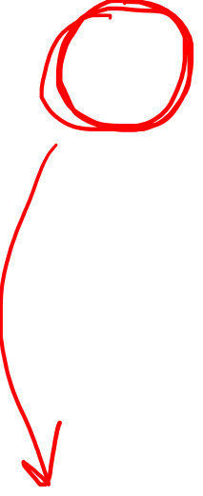
Rope Force
S
Magnet Force
N
$$α>0$$

Slide 32
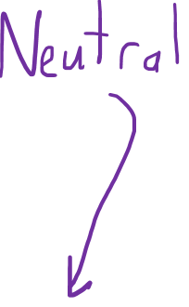
Rope Force
S
Magnet Force
N
$$α>0$$

Slide 33
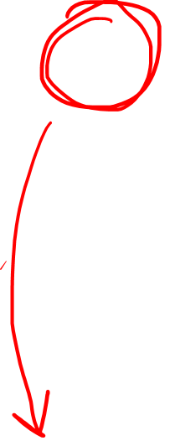
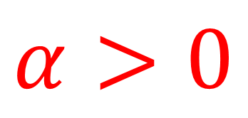
Rope Force
S
Magnet Force
N
$$α>0$$
$$α>0$$

Slide 34
Rope Force
S
Magnet Force
Rocket Force
N
$$α>0$$
$$α>0$$

Slide 35

Rope Force
S
Magnet Force
Rocket Force
N
$$α>0$$
$$α>0$$
$$α>0$$

Slide 36
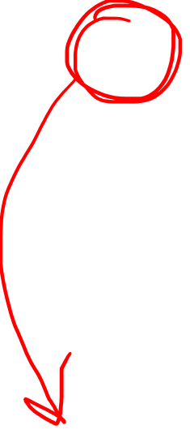
Rope Force
S
Magnet Force
Rocket Force
N
$$α>0$$
$$α>0$$
$$α>0$$

Slide 37
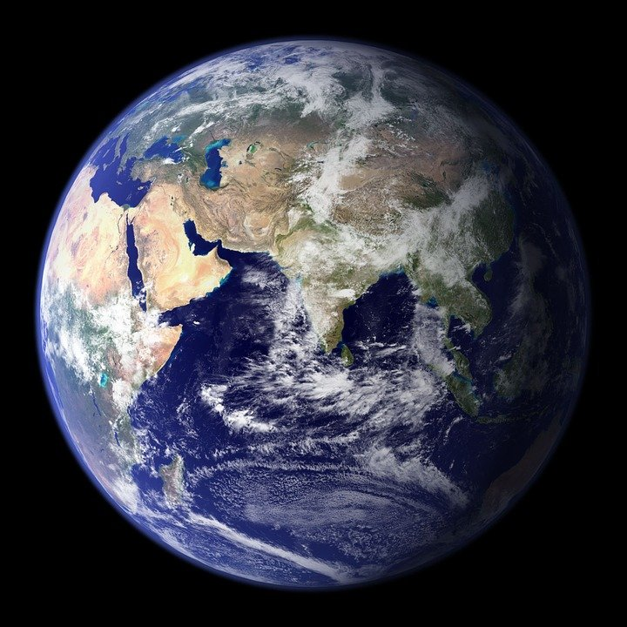
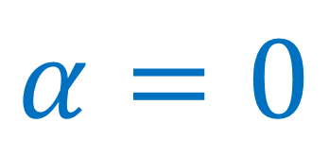
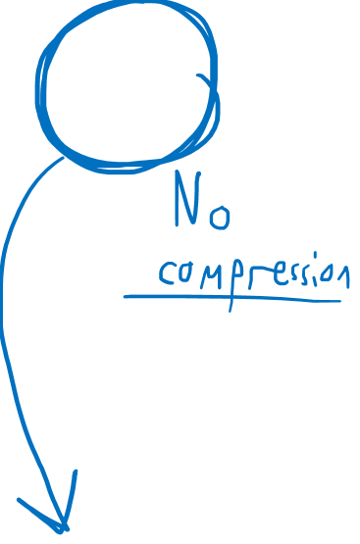
Rope Force
S
Magnet Force
Rocket Force
Gravitational Force
N
$$α>0$$
$$α>0$$
$$α>0$$
$$α=0$$

Slide 38

Rope Force
S
Magnet Force
Rocket Force
Gravitational Force
N
(Gravity is different because it acts on the box and the ball equally)
$$α>0$$
$$α>0$$
$$α>0$$
$$α=0$$

Slide 39
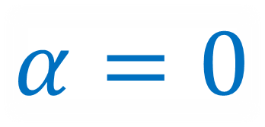
Gravitational Force
(Just like in Inertial Frames)
(Gravity is different because it acts on the box and the ball equally)
$$α=0$$
$$α=0$$

Slide 40
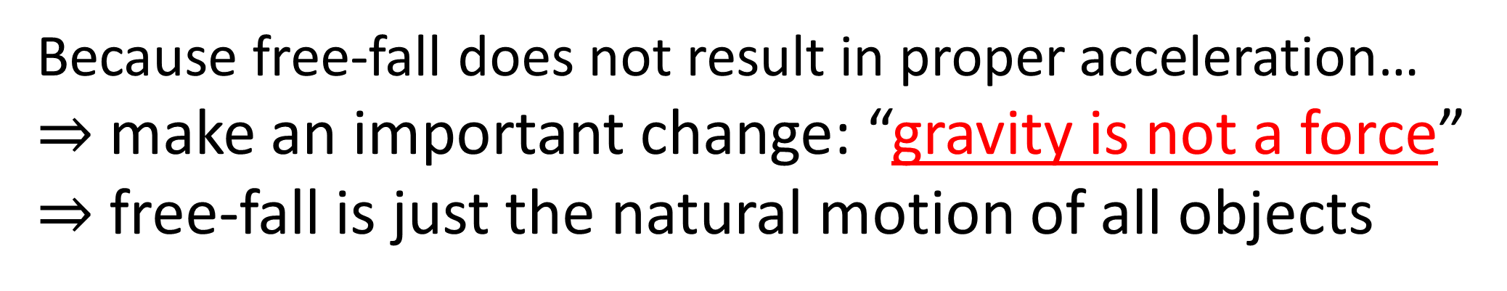
Because free-fall does not result in proper acceleration…
$⇒$ make an important change: “gravity is not a force”
$⇒$ free-fall is just the natural motion of all objects
Newton’s 1st Law:
in an inertial frame, an object with no net external forces acting on it will remain at constant velocity
Newton’s 1st Law for General Relativity:
object with no net forces acting on it will travel along a curve called a time-like geodesic
(see relativity 105f)

Slide 41
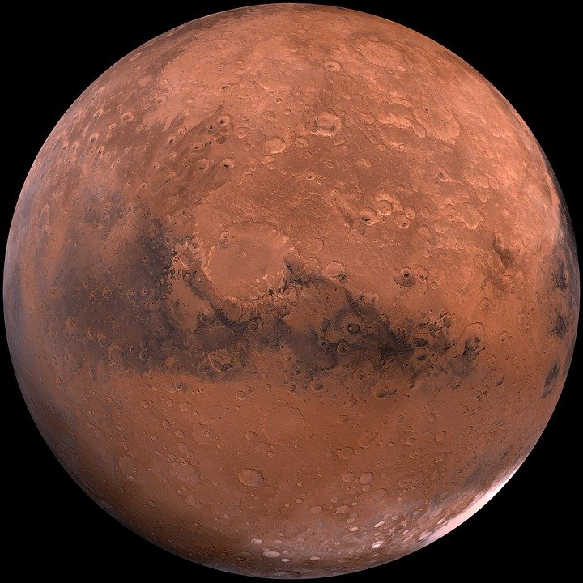
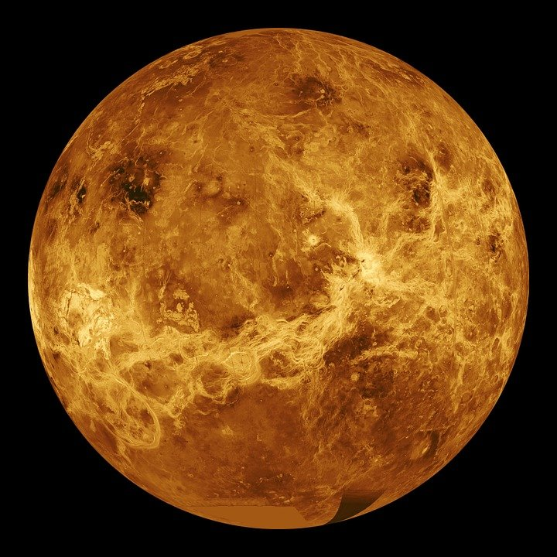
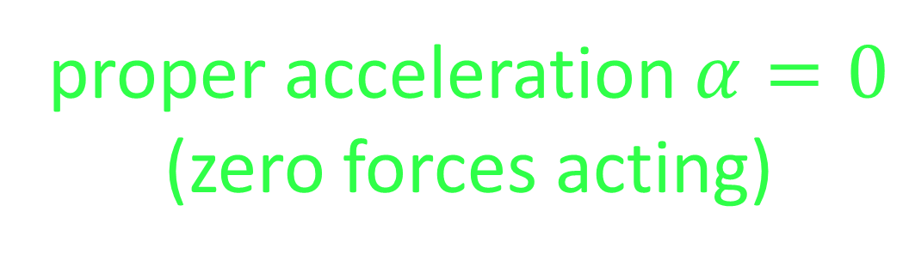
Timelike geodesic = path in spacetime of massive particle in free-fall
(only influenced by gravity)
proper acceleration $α=0$
(zero forces acting)

Slide 42
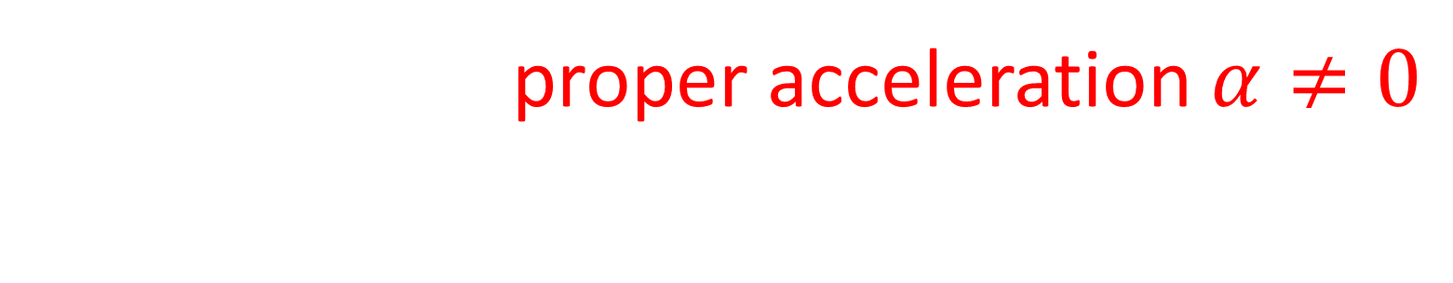

Need net external force to change a particle’s trajectory away from a geodesic
$$\vec{F}$$
Force causes proper acceleration $α≠0$
$⇒$ change path away from a geodesic

Slide 43

4-force $\vec{F}$ required to cause 4-acceleration $\vec{A}$.
4-acceleration $\vec{A}$ changes worldline away from geodesic.
$$\vec{F}$$

Slide 44


An object in free-fall will travel along geodesics.
Free-fall = only influenced by gravity and no other forces.

Slide 45



Newtonian Physics:
General Relativity:
normal force
normal force
$${\vec{F}}_{net}=\vec{0}$$
$${\vec{F}}_{net}≠\vec{0}$$
force of gravity
Geodesic/
Free-fall Path
Molecular forces preventing free-fall

Slide 46

Sitting on Earth

Slide 47

Sitting on Earth
$$α>0$$
Geodesic/
Free-fall Path
Ground forcing the box upward.

Slide 48


Rope Force
S
Magnet Force
Sitting on Earth
N
$$α>0$$
Rocket Force
Sitting on earth has a lot in common with being in a non-inertial frame with a force acting on the box.
In both cases, proper acceleration $α>0$, and the observer feels “pulled” in one direction.
$$α>0$$

Slide 49
Rope Force
S
Magnet Force
Sitting on Earth
N
$$α>0$$
Rocket Force
Sitting on earth has a lot in common with being in a non-inertial frame with a force acting on the box.
In both cases, proper acceleration $α>0$, and the observer feels “pulled” in one direction.
$$α>0$$

Slide 50




Equivalence Principle:
“Inertial” reference frames are locally indistinguishable from free-fall in a gravitational field.
“small/local regions of spacetime”
“uniform gravitational field”
Real gravitational fields are not uniform:
Newtonian Gravity
$$F=G\frac{mM}{r^{2}}$$
big $r→$ weaker
small $r→$ stronger
Notes:
All physical experiments in both situations will behave the exact same. This includes balls dropping to the floor of the box, and any experiments done with light.

Slide 51
Equivalence Principle:
“Inertial” reference frames are locally indistinguishable from free-fall in a gravitational field.
In large enough regions of spacetime, we can tell the difference between global inertial frames far from gravity source, and freely-falling near gravity sources.
We can tell the difference because of tidal forces.
Notes:
All physical experiments in both situations will behave the exact same. This includes balls dropping to the floor of the box, and any experiments done with light.

Slide 52

Equivalence Principle:
“Inertial” reference frames are locally indistinguishable from free-fall in a gravitational field.
Box + Ball inertial in space
Box + Ball in Free-fall
Notes:
All physical experiments in both situations will behave the exact same. This includes balls dropping to the floor of the box, and any experiments done with light.

Slide 53

Equivalence Principle:
“Inertial” reference frames are locally indistinguishable from free-fall in a gravitational field.
Box + Ball inertial in space
Box + Ball in Free-fall
Notes:
All physical experiments in both situations will behave the exact same. This includes balls dropping to the floor of the box, and any experiments done with light.

Slide 54
Not being repelled!! (just not pulled as strongly)
(Think in terms of Newtonian Forces for now…)

Slide 55
Not being repelled!! (just not pulled as strongly)
(Think in terms of Newtonian Forces for now…)

Slide 56
Not being repelled!! (just not pulled as strongly)
(Think in terms of Newtonian Forces for now…)
Tidal forces

Slide 57



Tidal forces from the moon acting on the water on Earth.
Sea water

Slide 58
Not being repelled!! (just not pulled as strongly)
Tidal forces from the moon acting on the water on Earth.
Sea water

Slide 59



In frame of box with constant $α$… It’s possible to make objects look like they have constant acceleration.
In frame of box with constant $α$… It’s possible to make objects look like they have constant acceleration.
Tidal forces can’t be explained by Flat Spacetime/Special Relativity!
constant accel. $α$
fictitious force
free fall
Tidal forces

Slide 60
Tidal forces can’t be explained by Flat Spacetime/Special Relativity!
free fall
We need a new version of relativity that can handle tidal forces
General Relativity!
Describes tidal forces using curved spacetime
Tidal forces

Slide 61

Relativity 107: General Relativity Basics
Equivalence Principle
Manifolds
Curvature of Spacetime
Newton-Cartan Theory (Curved Newtonian Gravity)
Energy–Momentum Tensor
Einstein Field Equations

Slide 62



Summary
An observer’s proper acceleration $α$ is agreed on by all reference frames (objective/invariant/tensor)
$α$ is measured by an accelerometer in observer’s frame
accelerometer = box + ball on springs
$$α=0$$
$$α>0$$

Slide 63





Summary
Equivalence principle:
Inertial motion locally indistinguishable from free-fall under the influence of gravity ($α=0$)
Non-inertial motion (due to force) is locally indistinguishable from standing on a gravitational mass ($α>0$)
$$α=0$$
$$α>0$$
$$α=0$$
$$α>0$$

Slide 64




Summary
Spacetime worldlines with $α=0$ are called time-like geodesics
All “free-fall” motion (falling, orbiting) is along geodesics
Deviation from geodesic requires forces that cause $α>0$
Geodesic $α=0$
$$\vec{F}$$
Force causes $α≠0$

Slide 65

Summary
Real sources of gravity are non-uniform and result in “tidal forces”
Impossible to explain using flat spacetime (special relativity)
We need curved spacetime (general relativity) to explain tidal forces and gravity

