Slide 1
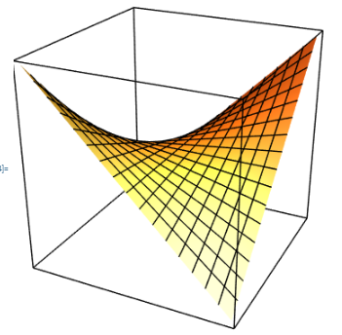
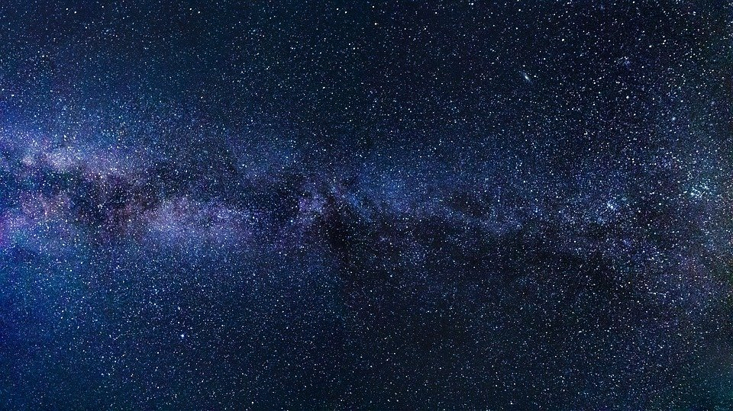
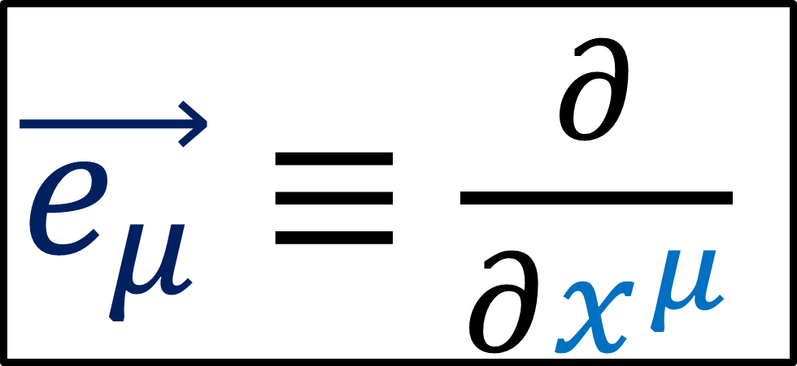




Spacetime is a 4D
Manifold
$$\vec{e_{t}}$$
$$\vec{e_{z}}$$
$\vec{e_{μ}}≡\frac{∂}{∂x^{μ}}$
$$\vec{e_{x}}$$
$$\vec{e_{y}}$$

Slide 2
Relativity 107: General Relativity
Equivalence Principle
Manifolds
Curvature
Newton-Cartan Theory (Curved Newtonian Gravity)
Energy–Momentum Tensor
Einstein Field Equations

Slide 3
!! Warning !!
This video is a brief survey of:
Manifolds
Covariant derivatives
Geodesics
I’m covering a lot of topics in a shallow way in a very small amount of time.
I expect you have only a basic idea of what these terms mean.

Slide 4
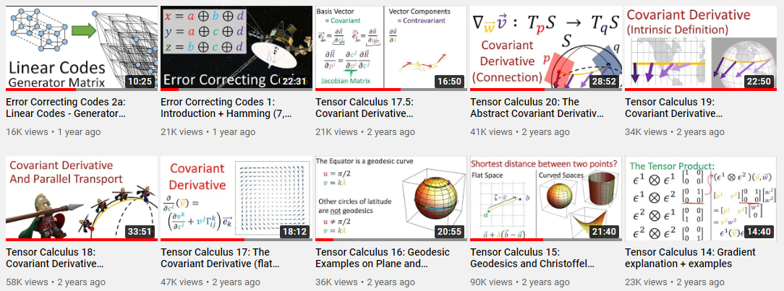
!! Warning !!
If you need more time with these topics… I have several videos in “Tensor Calculus” video series.
(link in description!)

Slide 5
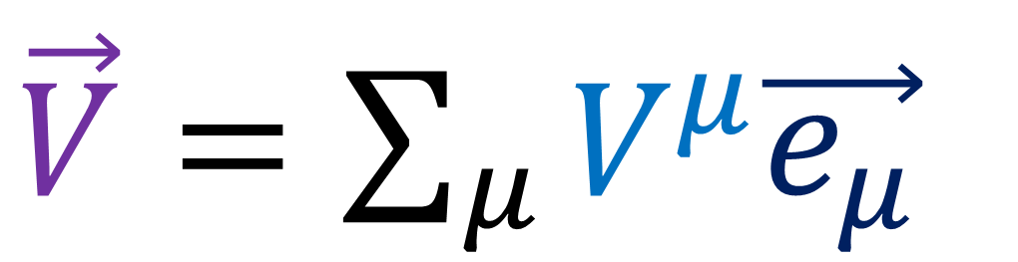
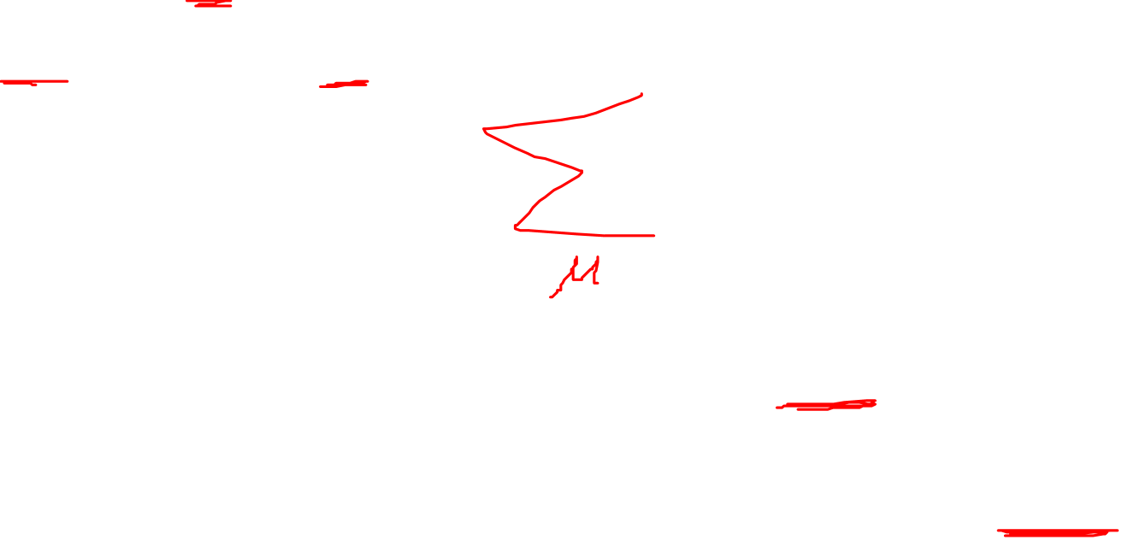
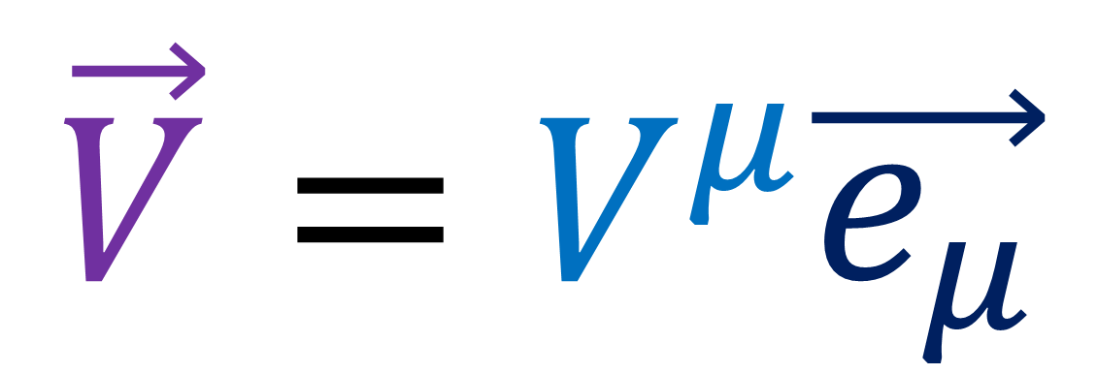
Einstein Summation Notation
$\vec{V}=\sum_{μ}{V^{μ}\vec{e_{μ}}}$
$$\vec{V}=V^{μ}\vec{e_{μ}}$$

Slide 6
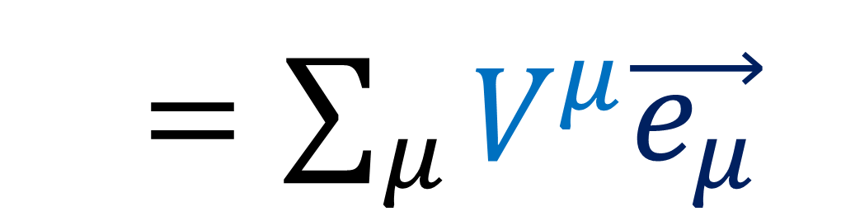
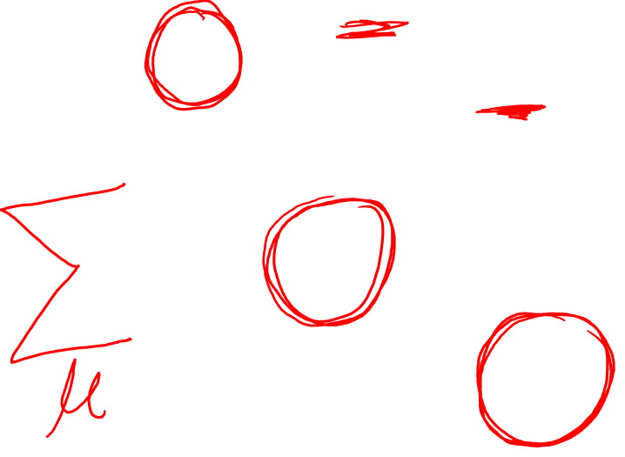
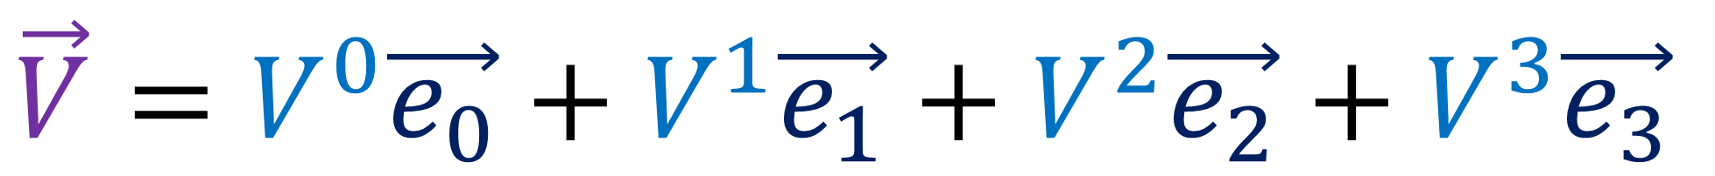
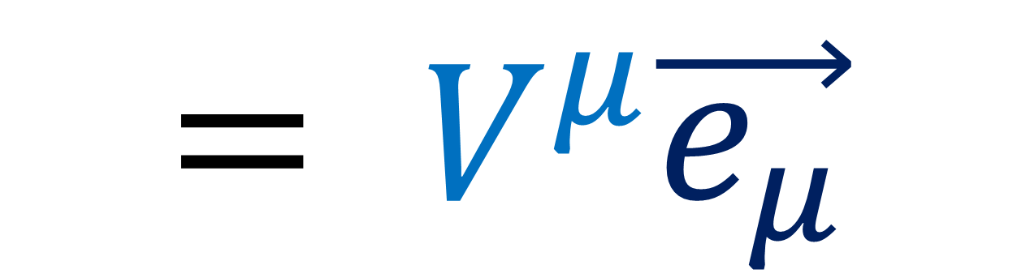
Einstein Summation Notation
$$\vec{V}=V^{0}\vec{e_{0}}+V^{1}\vec{e_{1}}+V^{2}\vec{e_{2}}+V^{3}\vec{e_{3}}$$
$\vec{V}=\sum_{μ}{V^{μ}\vec{e_{μ}}}$
$$= V^{μ}\vec{e_{μ}}$$

Slide 7
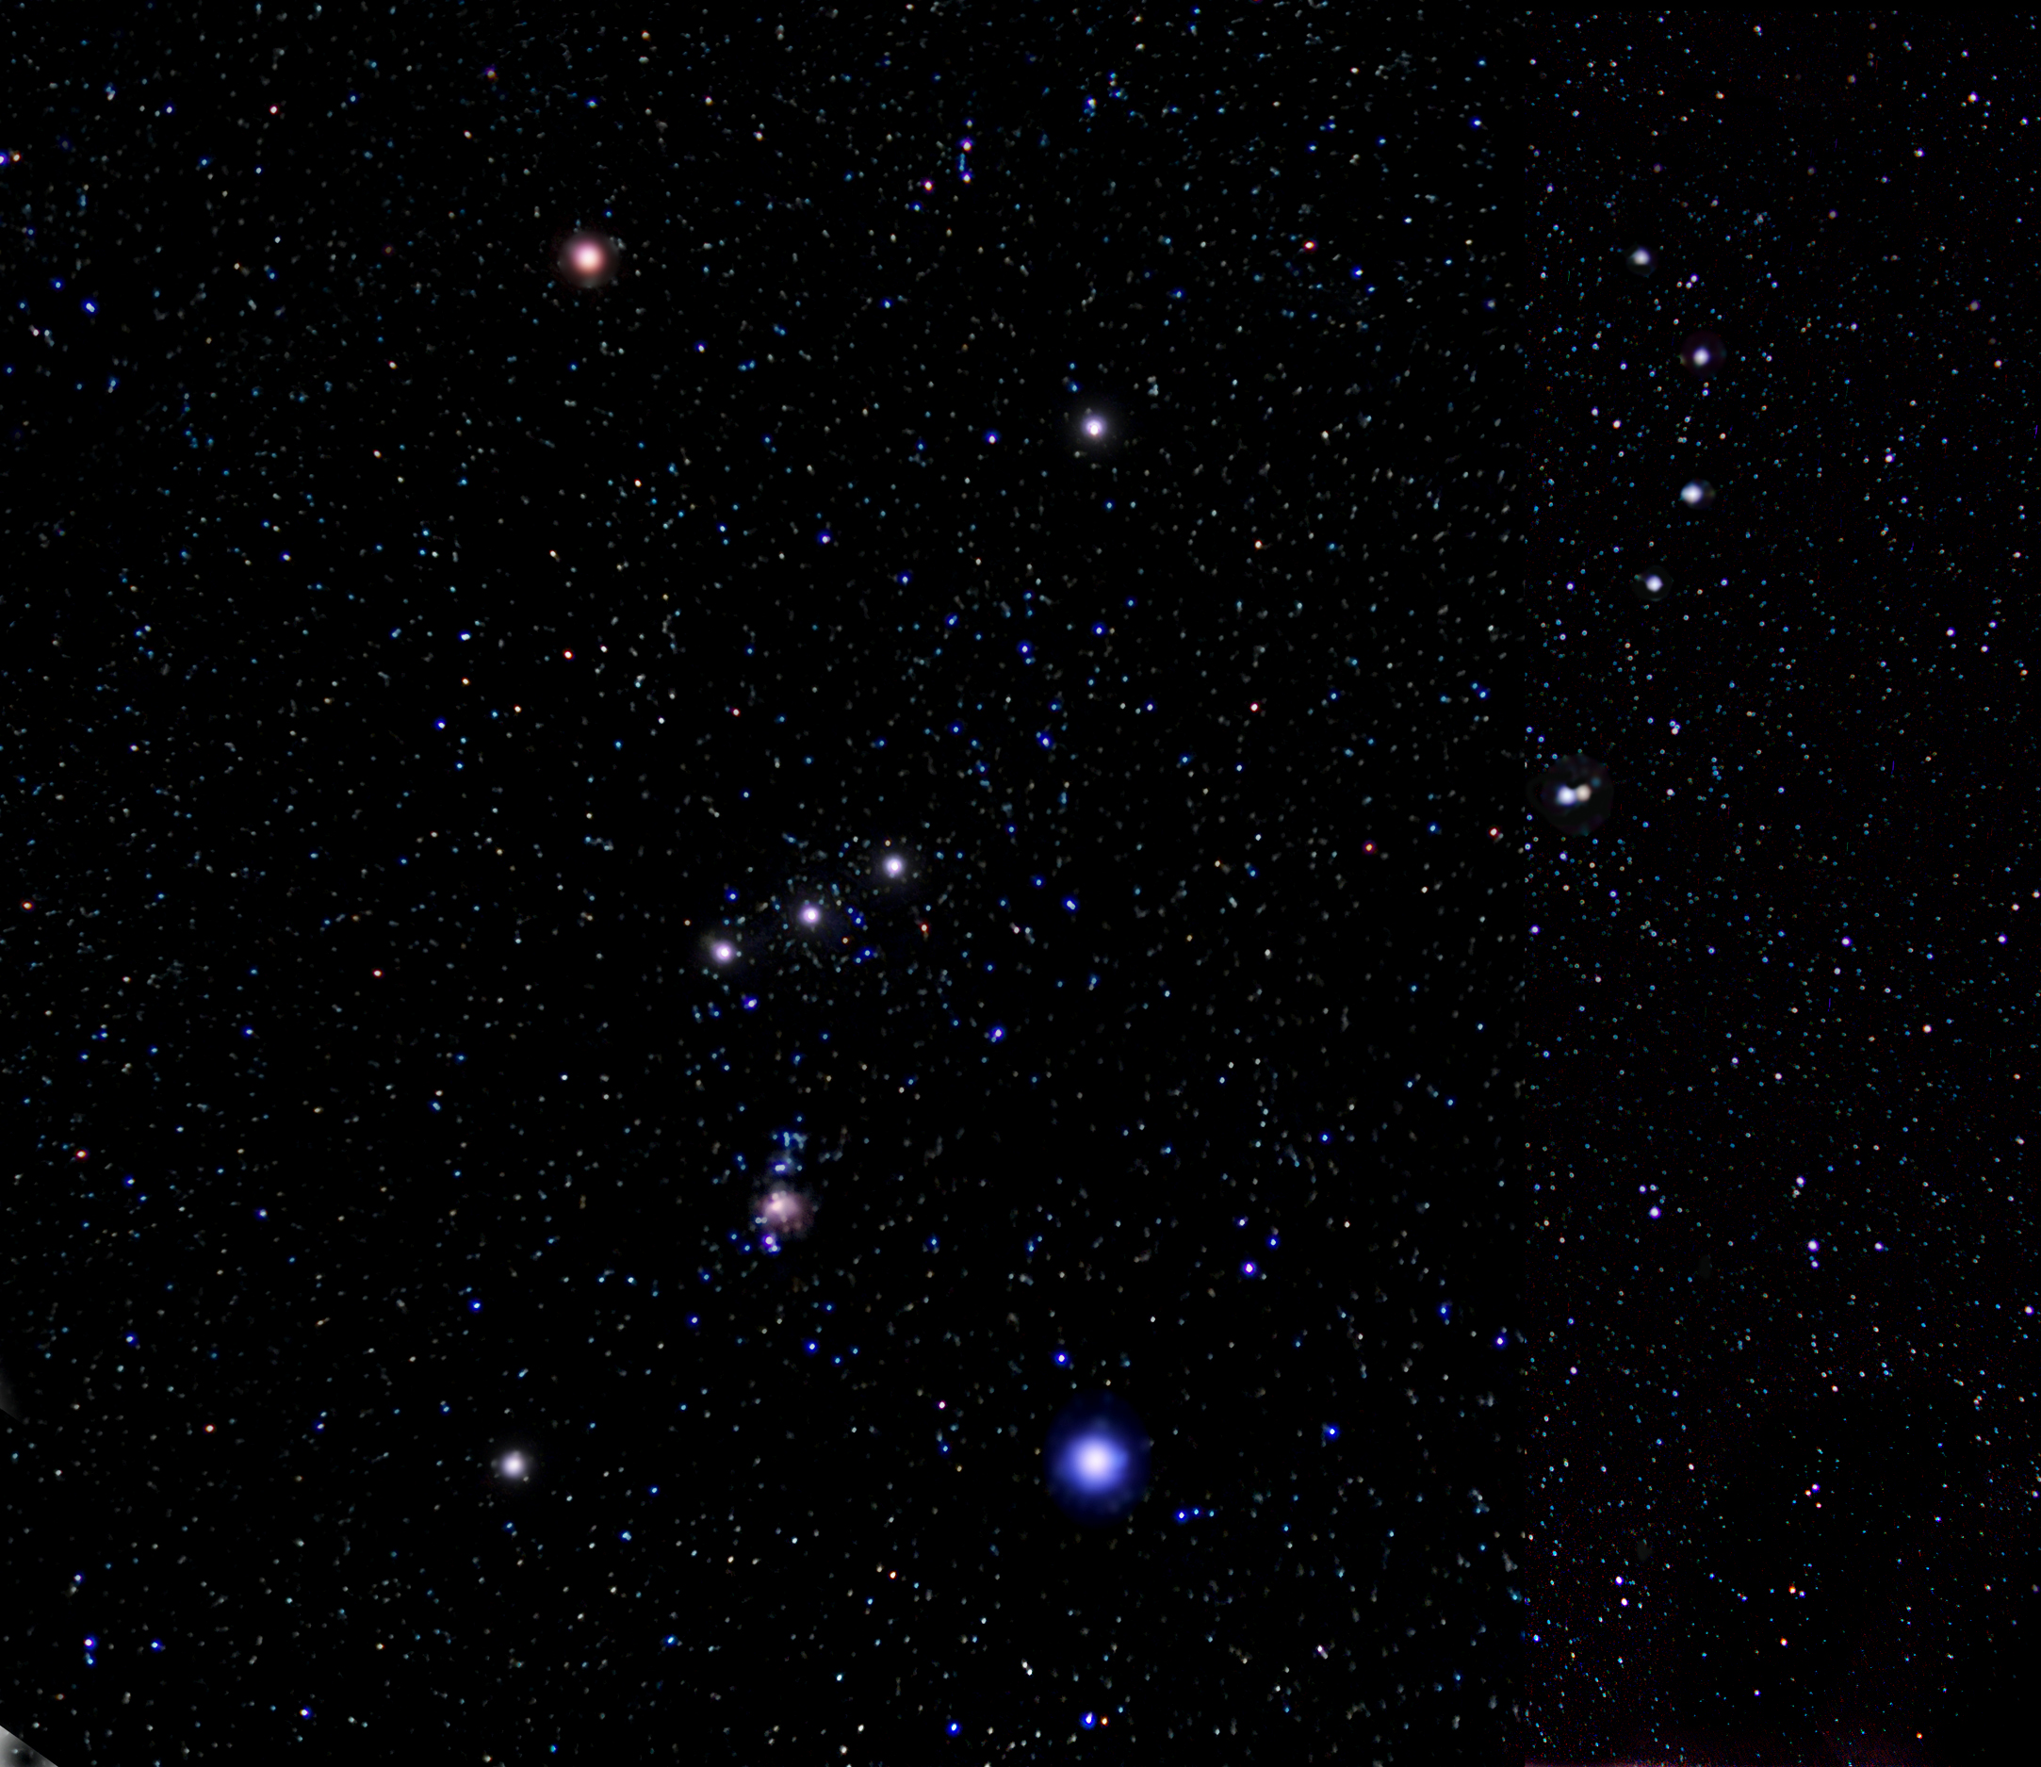

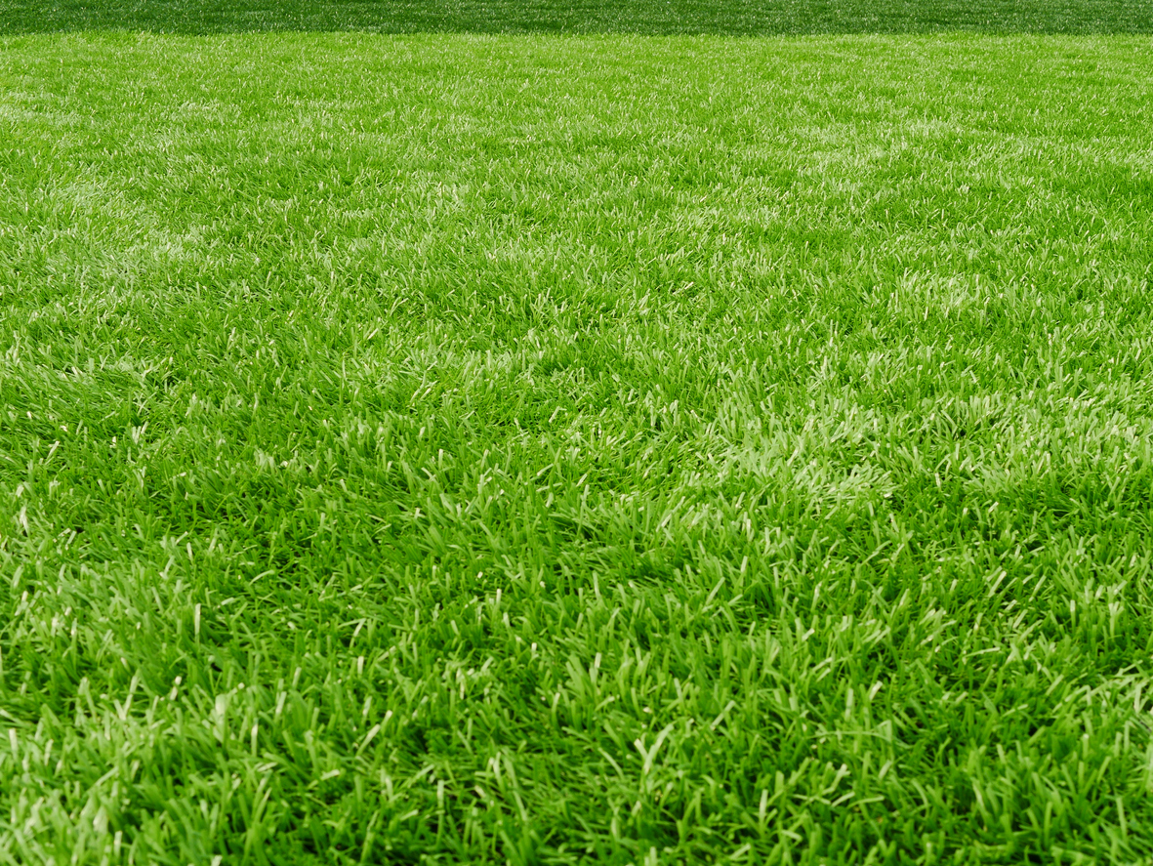
Equivalence Principle:
In small regions of spacetime, falling inside a freely-falling box
feels exactly like floating in deep space in an inertial frame.
Box + Ball in Free-fall
Box + Ball inertial in space
Notes:
All physical experiments in both situations will behave the exact same. This includes balls dropping to the floor of the box, and any experiments done with light.

Slide 8
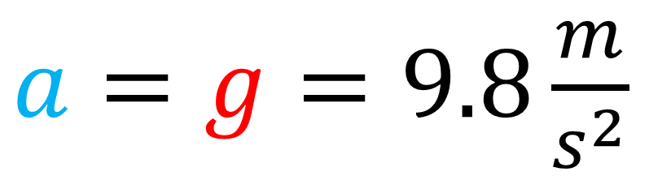
Equivalence Principle:
In small regions of spacetime, sitting on a gravitational mass
feels exactly like being in a rocket that’s accelerating.
gravity
acceleration
$a=g=9.8\frac{m}{s^{2}}$
Notes:
All physical experiments in both situations will behave the exact same. This includes balls dropping to the floor of the box, and any experiments done with light.

Slide 9
Equivalence Principle:
In small regions of spacetime, we can never detect the existence of gravity
Locally, we can always attribute the effects of gravity to being in an inertial or non-inertial frame

Slide 10
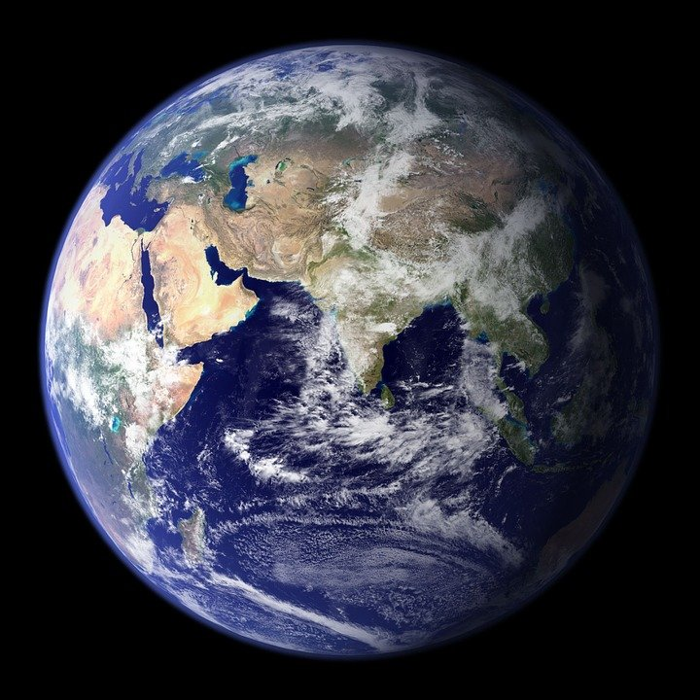
Equivalence Principle:
We can only detect the existence of gravity in large regions of spacetime
Tidal forces (when pull of gravity is non-uniform)
Tidal Forces

Slide 11
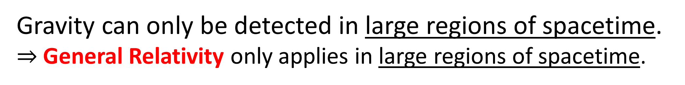
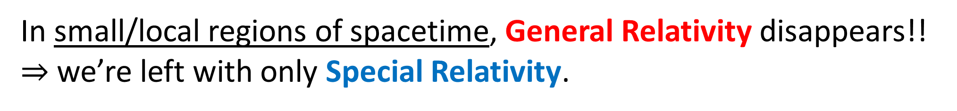
Gravity can only be detected in large regions of spacetime.
$⇒$General Relativity only applies in large regions of spacetime.
In small/local regions of spacetime, General Relativity disappears!!
$⇒$ we’re left with only Special Relativity.
General Relativity is locally indistinguishable from Special Relativity.
Curved Spacetime is locally indistinguishable from Flat Spacetime.

Slide 12
Manifolds
Manifold = curved space that looks flat in a small local region.

Slide 13
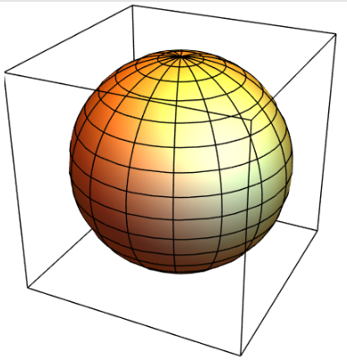
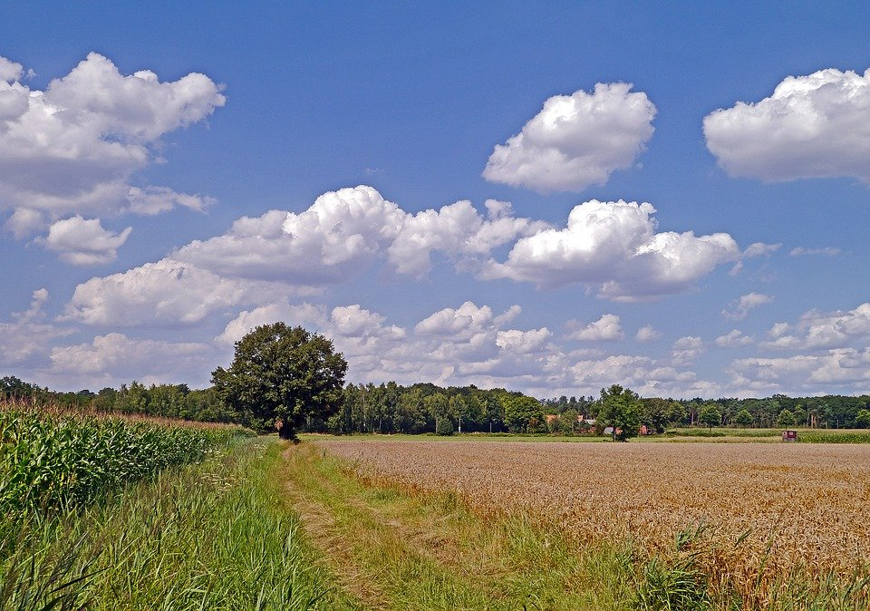
Surface of the Earth is a manifold.
Sphere
Globally, surface is curved.
Up close, the surface looks flat.

Slide 14
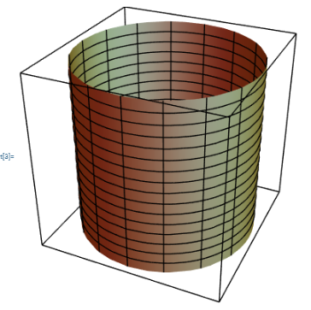
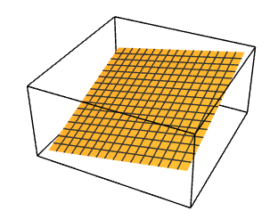
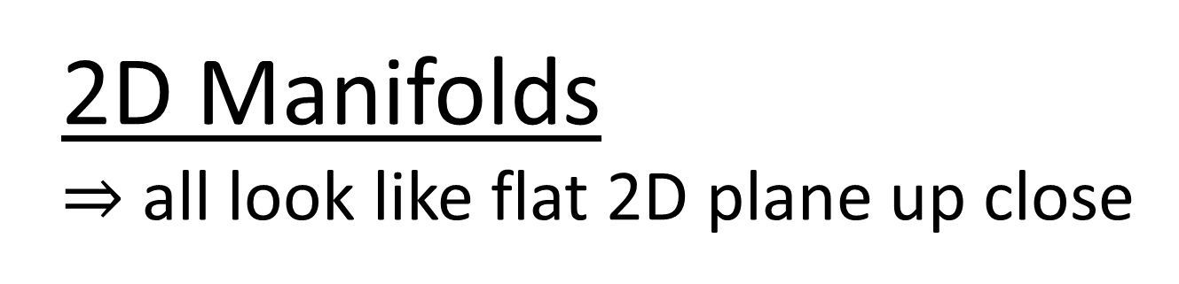
Manifold = curved space that is “locally flat”
Sphere
Saddle (Hyperbolic Paraboloid)
Cylinder
2D Manifolds
$⇒$ all look like flat 2D plane up close

Slide 15

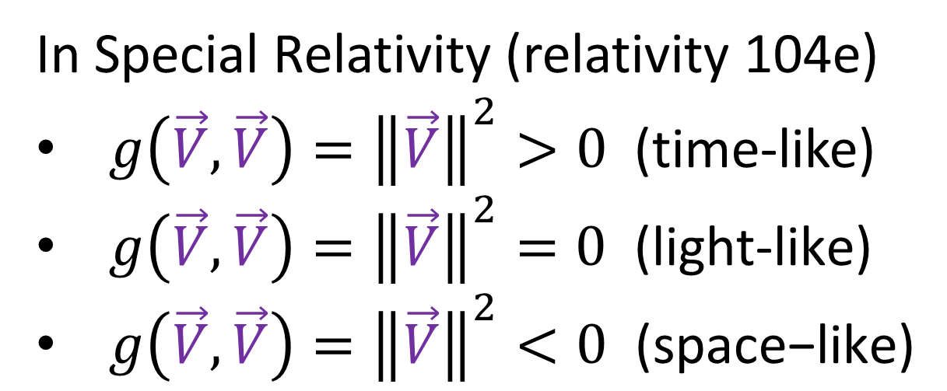
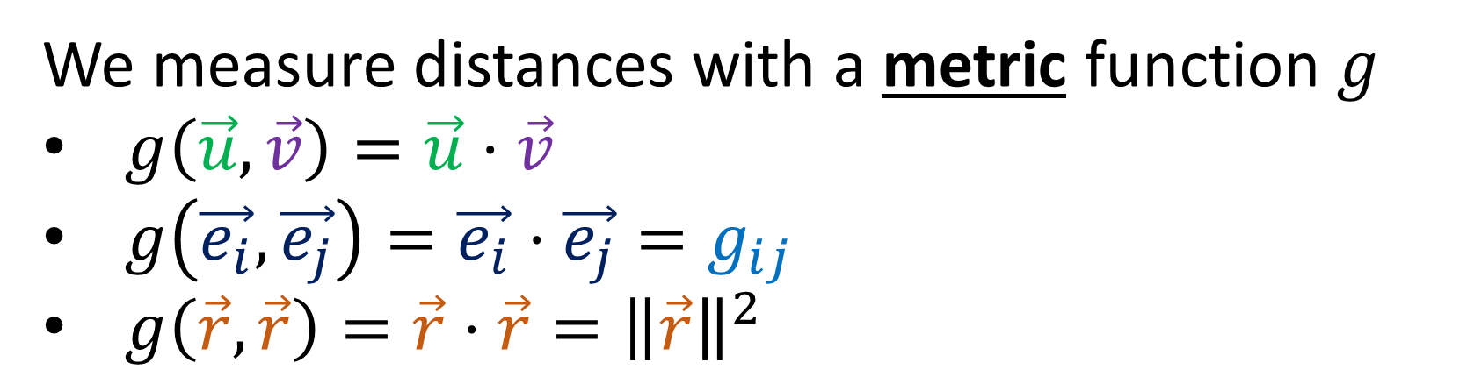
Manifold with concept of distance between two points…
= “Riemannian Manifold”
We measure distances with a metric function $g$
$g\left(\vec{u},\vec{v}\right)=\vec{u}⋅\vec{v}$
$g\left(\vec{e_{i}},\vec{e_{j}}\right)=\vec{e_{i}}⋅\vec{e_{j}}=g_{ij}$
$g\left(\vec{r},\vec{r}\right)=\vec{r}⋅\vec{r}={\left\|\vec{r}\right\|}^{2}$
$$≥0$$
In Special Relativity (relativity 104e)
$g\left(\vec{V},\vec{V}\right)={\left\|\vec{V}\right\|}^{2}>0$ (time-like)
$g\left(\vec{V},\vec{V}\right)={\left\|\vec{V}\right\|}^{2}=0\text{ (}\text{light}\text{−}\text{like}\text{)}$
$g\left(\vec{V},\vec{V}\right)={\left\|\vec{V}\right\|}^{2}<0\text{ (}\text{space}\text{−}\text{like}\text{)}$
Pseudo-metric
+ Manifold
= Pseudo-Riemannian Manifold

Slide 16
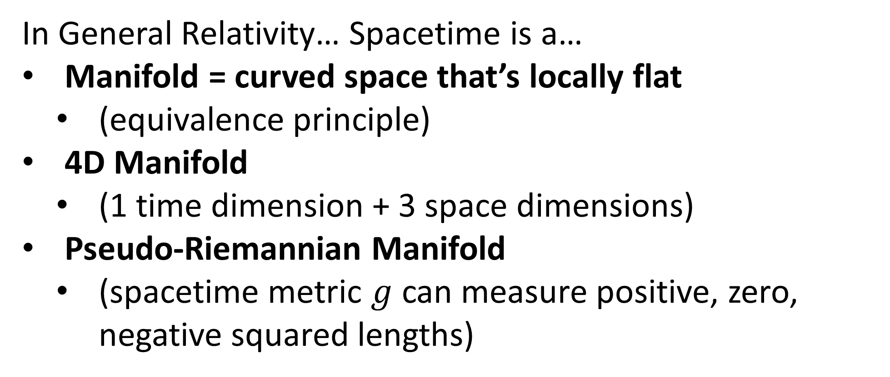
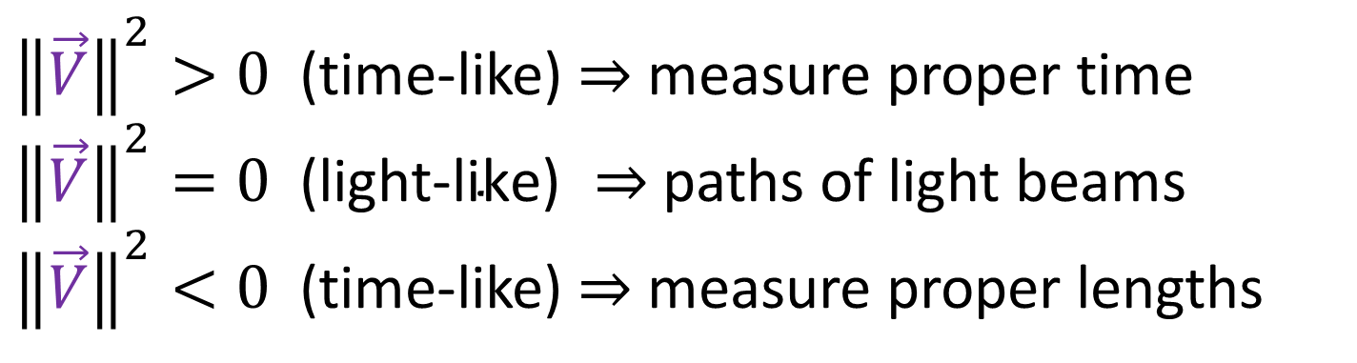
In General Relativity… Spacetime is a…
Manifold = curved space that’s locally flat
(equivalence principle)
4D Manifold
(1 time dimension + 3 space dimensions)
Pseudo-Riemannian Manifold
(spacetime metric $g$ can measure positive, zero, negative squared lengths)
${\left\|\vec{V}\right\|}^{2}>0$ (time-like) $⇒$ measure proper time
${\left\|\vec{V}\right\|}^{2}=0\text{ (}\text{light}\text{−}\text{like}\text{) }⇒$ paths of light beams
${\left\|\vec{V}\right\|}^{2}<0$ (time-like) $⇒$ measure proper lengths

Slide 17
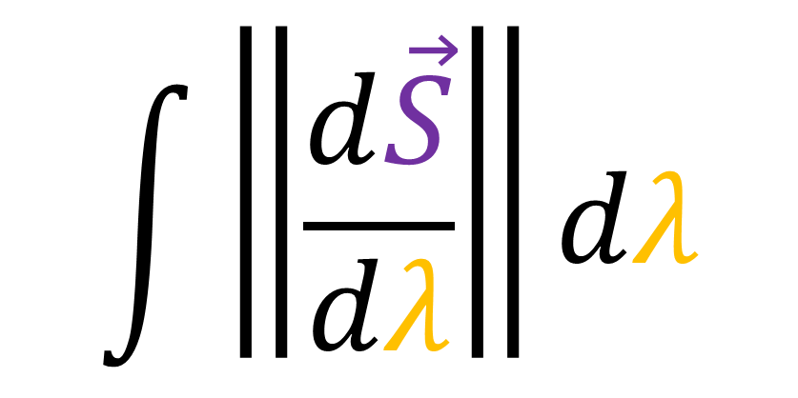
To get the length of a curve:
Integrate over lengths of tangent vectors.
$$\int{\left\|\frac{d\vec{S}}{dλ}\right\|dλ}$$
(see Relativity 105d)

Slide 18

Extrinsic Geometry:
look at surface “from the outside”
Intrinsic Geometry:

Slide 19
Extrinsic Geometry: look at surface “from the outside”

Slide 20
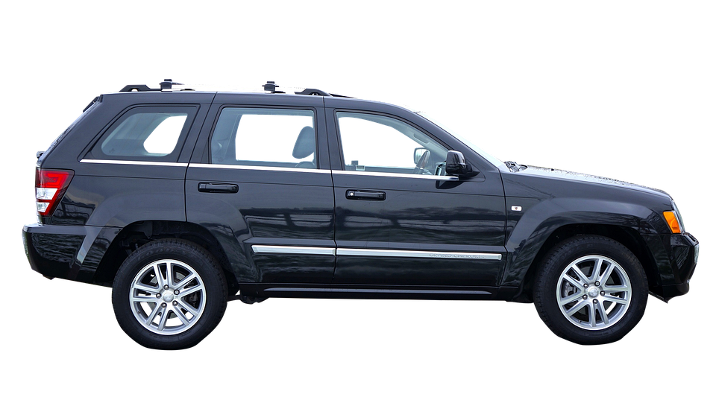


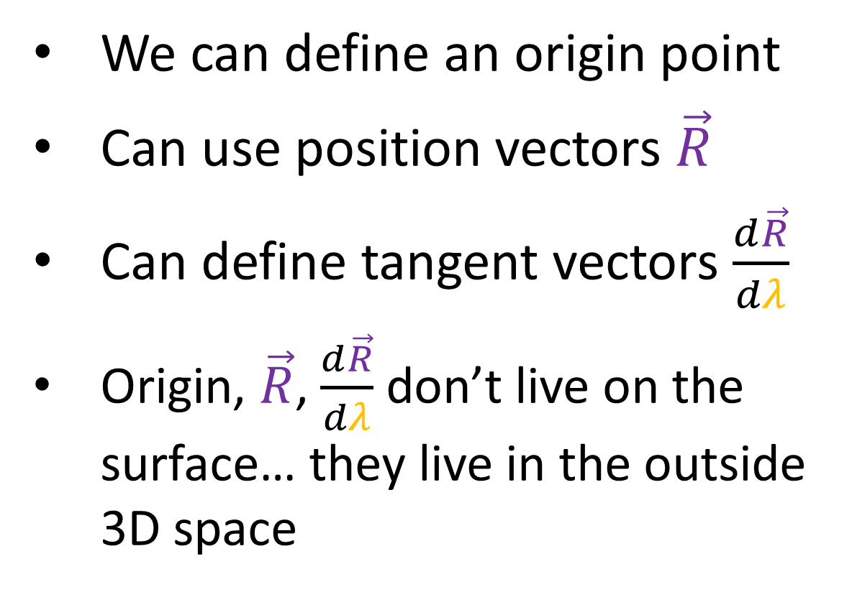
Extrinsic Geometry: look at surface “from the outside”
We can define an origin point
Can use position vectors $\vec{R}$
Can define tangent vectors $\frac{d\vec{R}}{dλ}$
Origin, $\vec{R}$, $\frac{d\vec{R}}{dλ}$ don’t live on the surface… they live in the outside 3D space
$\frac{d\vec{R}}{dλ}$
$$\vec{R}$$
origin

Slide 21
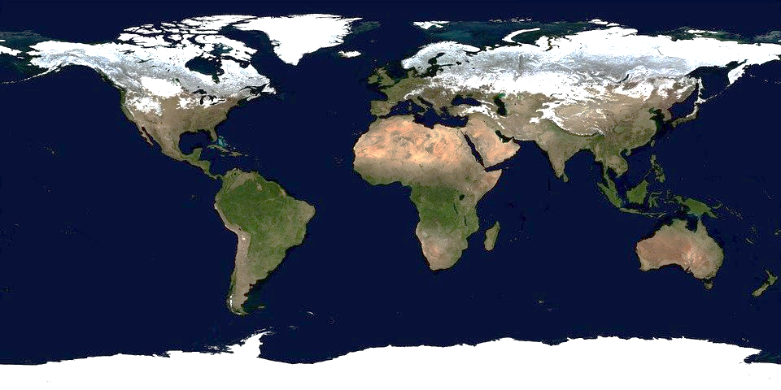
Extrinsic Geometry: look at surface “from the outside”
Intrinsic Geometry:
look at surface “from the inside”

Slide 22
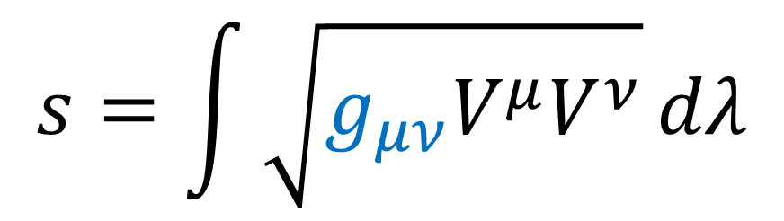
With intrinsic geometry… we can’t measure size using our eyes!
We must calculate distances using a formula that involves the metric.
$$s=\int{\sqrt{g_{μν}V^{μ}V^{ν}}}dλ$$
The metric is the only thing we can rely on to have an accurate description of distances.

Slide 23
Plane
Sphere
Saddle
Cylinder
Extrinsic
Plane
Sphere
Saddle
Cylinder
Intrinsic

Slide 24
Plane
Sphere
Saddle
Cylinder
Extrinsic
Plane
Sphere
Saddle
Cylinder
Intrinsic

Slide 25
Plane
Sphere
Saddle
Cylinder
Extrinsic
Different Lengths
Plane
Sphere
Saddle
Cylinder
Intrinsic

Slide 26
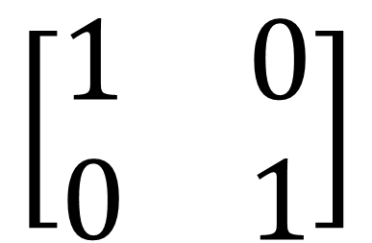
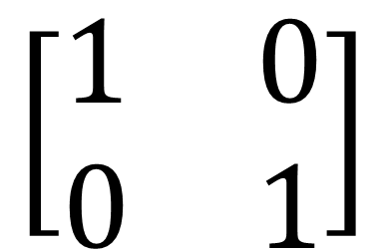
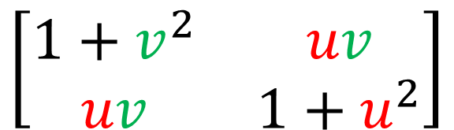
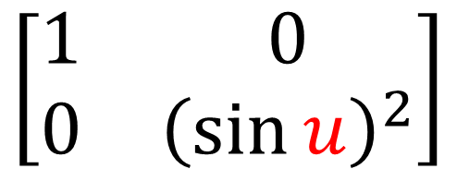
Plane
Sphere
Saddle
Cylinder
$$\left[\begin{matrix}1 & 0 \\ 0 & 1\end{matrix}\right]$$
$$\left[\begin{matrix}1 & 0 \\ 0 & 1\end{matrix}\right]$$
Metrics
$$\left[\begin{matrix}1 & 0 \\ 0 & {\left(\sin{u}\right)}^{2}\end{matrix}\right]$$
$$\left[\begin{matrix}1+v^{2} & uv \\ uv & 1+u^{2}\end{matrix}\right]$$
Different Lengths
Plane
Sphere
Saddle
Cylinder
Intrinsic

Slide 27

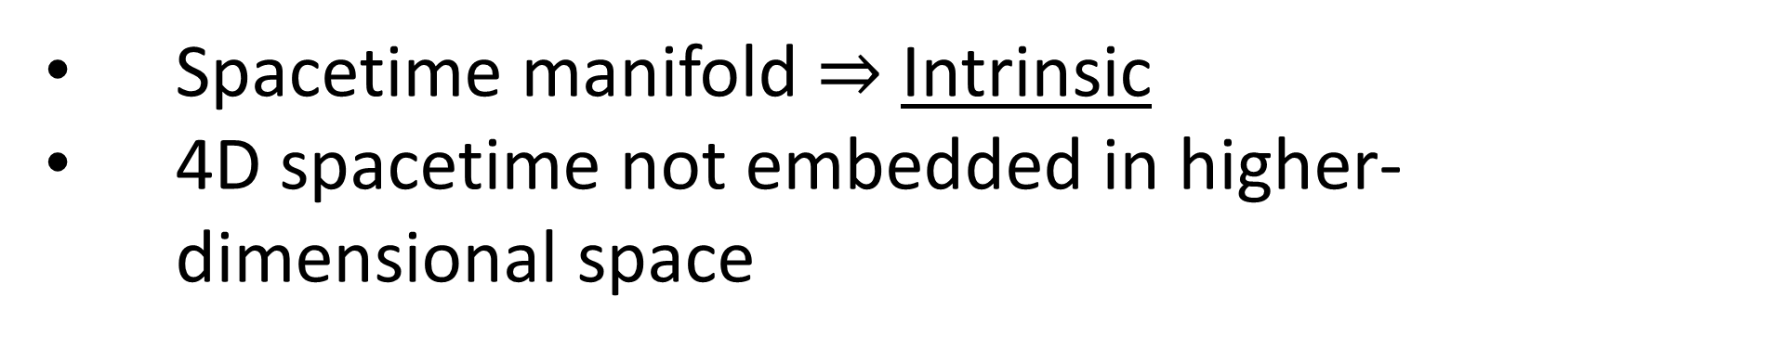

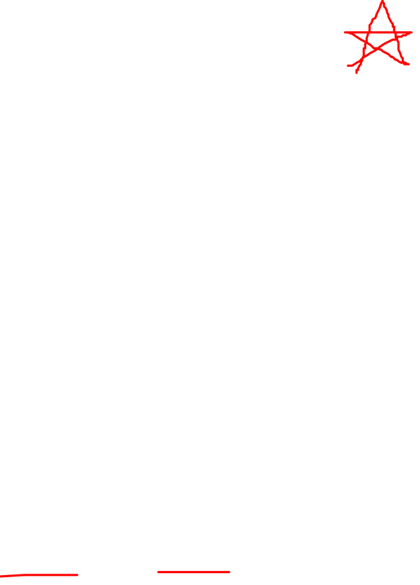



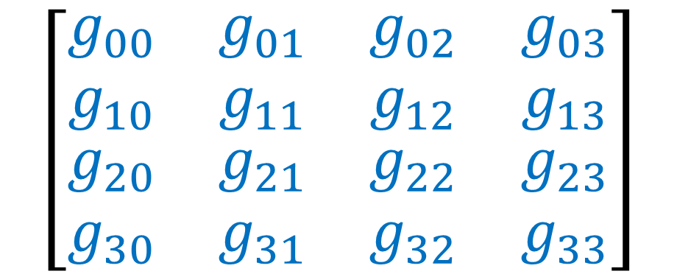
General Relativity (1915)
Spacetime manifold $⇒$ Intrinsic
4D spacetime not embedded in higher-dimensional space
Spacetime metric
$$\left[\begin{matrix}\begin{matrix}\begin{aligned}g_{00} \\ g_{10} \\ \begin{aligned}g_{20} \\ g_{30}\end{aligned}\end{aligned} & \begin{aligned}g_{01} \\ g_{11} \\ \begin{aligned}g_{21} \\ g_{31}\end{aligned}\end{aligned}\end{matrix} & \begin{matrix}\begin{aligned}g_{02} \\ g_{12} \\ \begin{aligned}g_{22} \\ g_{32}\end{aligned}\end{aligned} & \begin{aligned}g_{03} \\ g_{13} \\ \begin{aligned}g_{23} \\ g_{33}\end{aligned}\end{aligned}\end{matrix}\end{matrix}\right]$$
$$x$$
$$ct$$
$$y$$
Einstein Field Equations
$$z$$
$$R_{μν}−\frac{1}{2}Rg_{μν}+Λg_{μν}=\frac{8πG}{c^{4}}T_{μν}$$

Slide 28
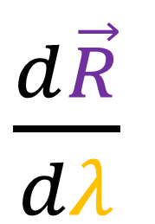
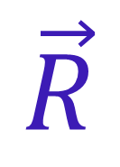

Extrinsic Geometry: look at surface “from the outside”
$\frac{d\vec{R}}{dλ}$
origin
$$\vec{R}$$
$\frac{d\vec{R}}{dλ}$
$$\vec{R}$$
origin
position
vector
tangent
vector

Slide 29
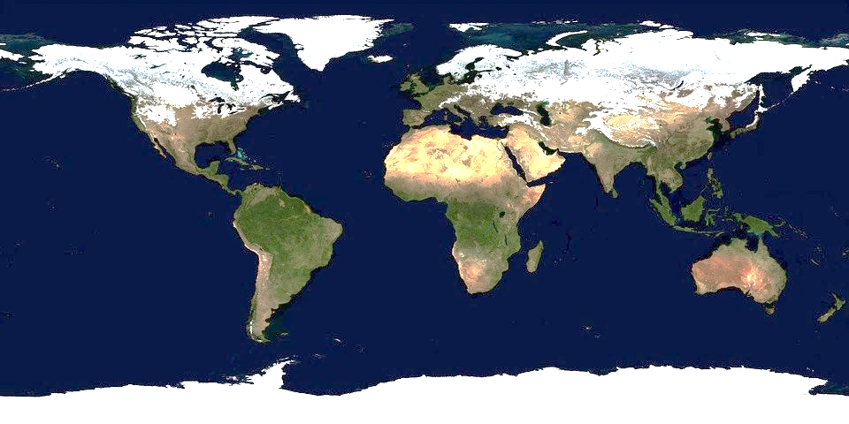
Intrinsic Geometry: look at surface “from the inside”
origin
$\frac{d\vec{R}}{dλ}$
$$\vec{R}$$
origin
position
vector
tangent
vector

Slide 30
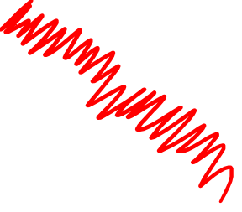
Intrinsic Geometry: look at surface “from the inside”
Vectors (straight arrows) leave the manifold surface

Slide 31

Intrinsic Geometry: look at surface “from the inside”
origin
$$\vec{S}$$
origin
4- position
vector

Slide 32


Extrinsic Geometry: look at surface “from the outside”
$\frac{d\vec{R}}{dλ}$
origin
$$\vec{R}$$
$$λ$$
$\frac{d\vec{R}}{dλ}$
$$\vec{R}$$
origin
position
vector
tangent
vector

Slide 33


Intrinsic Geometry: look at surface “from the inside”
origin
$$λ$$
$\frac{d}{dλ}$
$$\vec{R}$$
origin
4- position
vector
tangent
vector

Slide 34





Linear combination
$2\frac{∂}{∂x}+4\frac{∂}{∂y}$
$\frac{∂}{∂y}$
$\frac{∂}{∂x}$

Slide 35






$$\frac{d}{dλ}=\frac{dx}{dλ}\frac{∂}{∂x}+\frac{dy}{dλ}\frac{∂}{∂y}$$
$$\vec{e_{x}}=\frac{∂}{∂x}$$
$$\vec{e_{y}}=\frac{∂}{∂y}$$
$$λ$$
$\frac{∂}{∂y}$
$\frac{d}{dλ}$
$$\left(x\left(λ\right),y\left(λ\right)\right)$$
$\frac{∂}{∂x}$

Slide 36



Tangent spaces – Extrinsic View
Manifold $M$
point $p$ $∈M$
Tangent space $T_{p}M$
(where tangent vectors at this point live)

Slide 37












Manifold $M$
Tangent spaces – Intrinsic View
$\frac{∂}{∂y}$
$\frac{∂}{∂x}$
$$p$$
$\frac{d}{dλ}$
$$T_{p}M$$
$$q$$
$$T_{q}M$$
$$λ$$
$$a$$
$\frac{d}{dλ}=1\frac{∂}{∂x}+2\frac{∂}{∂y}$
$$T_{a}M$$

Slide 38







$$ct≡x^{0}$$ | $$x≡x^{1}$$ | $$y≡x^{2}$$ | $$z≡x^{3}$$
$$\vec{e_{t}}≡\frac{∂}{∂ ct}$$ | $$\vec{e_{x}}≡\frac{∂}{∂x}$$ | $$\vec{e_{y}}≡\frac{∂}{∂y}$$ | $$\vec{e_{z}}≡\frac{∂}{∂z}$$
$$\frac{∂}{∂x}$$
$$\frac{∂}{∂ ct}$$
$$\frac{∂}{∂y}$$
Tangent Spaces in Spacetime
$$\frac{∂}{∂z}$$
$$q$$
$$T_{q}M$$

Slide 39





$$ct≡x^{0}$$ | $$x≡x^{1}$$ | $$y≡x^{2}$$ | $$z≡x^{3}$$
$$\vec{e_{0}}≡\frac{∂}{∂x^{0}}$$ | $$\vec{e_{1}}≡\frac{∂}{∂x^{1}}$$ | $$\vec{e_{2}}≡\frac{∂}{∂x^{2}}$$ | $$\vec{e_{3}}≡\frac{∂}{∂x^{3}}$$
$$\frac{∂}{∂x^{1}}$$
$$\frac{∂}{∂x^{0}}$$
$$\frac{∂}{∂x^{2}}$$
Tangent Spaces in Spacetime
$$\frac{∂}{∂x^{3}}$$
$$q$$
$$T_{q}M$$

Slide 40




4-Velocity
$\frac{d\vec{S}}{dτ}$
$\frac{d}{dτ}$
$=\frac{dx^{0}}{dτ}\frac{∂}{∂x^{0}}+\frac{dx^{1}}{dτ}\frac{∂}{∂x^{1}}+\frac{dx^{2}}{dτ}\frac{∂}{∂x^{2}}+\frac{dx^{3}}{dτ}\frac{∂}{∂x^{3}}$
proper time
$=\frac{dx^{μ}}{dτ}\frac{∂}{∂x^{μ}}$
$$\frac{∂}{∂x^{1}}$$
$$\frac{∂}{∂x^{0}}$$
$$\frac{∂}{∂x^{2}}$$
Tangent Spaces in Spacetime
$$\frac{∂}{∂x^{3}}$$
$$q$$
$$T_{q}M$$

Slide 41

Derivative Operators = Basis Vectors
$\vec{e_{μ}}≡\frac{∂}{∂x^{μ}}≡∂_{μ}$

Slide 42


How vectors change across a manifold?
$⇒$ How to take derivatives of vectors in a vector field?
$\frac{d\vec{V}}{dλ}$

Slide 43







(relativity 105e)
Covariant derivative in flat space
(ignoring $y,z$)
$\frac{d\vec{V}}{dλ}=\frac{d}{dλ}\left(V^{t}\vec{e_{t}}+V^{x}\vec{e_{x}}\right)$
$\frac{d\vec{V}}{dλ}=\frac{dV^{t}}{dλ}\vec{e_{t}}+V^{t}\frac{d\vec{e_{t}}}{dλ}+\frac{dV^{x}}{dλ}\vec{e_{x}}+V^{x}\frac{d\vec{e_{x}}}{dλ}$
$\frac{d\vec{e_{t}}}{dλ}=\frac{d ct}{dλ}\frac{∂\vec{e_{t}}}{∂ ct}+\frac{dx}{dλ}\frac{∂\vec{e_{t}}}{∂x}$
$\frac{d\vec{e_{x}}}{dλ}=\frac{d ct}{dλ}\frac{∂\vec{e_{x}}}{∂ ct}+\frac{dx}{dλ}\frac{∂\vec{e_{x}}}{∂x}$
$\frac{∂\vec{e_{t}}}{∂ ct}=Γ_{tt}^{t}\vec{e_{t}}+Γ_{tt}^{x}\vec{e_{x}}$
$\frac{∂\vec{e_{t}}}{∂x}=Γ_{tx}^{t}\vec{e_{t}}+Γ_{tx}^{x}\vec{e_{x}}$
$\frac{∂\vec{e_{x}}}{∂ ct}=Γ_{xt}^{t}\vec{e_{t}}+Γ_{xt}^{x}\vec{e_{x}}$
$\frac{∂\vec{e_{x}}}{∂x}=Γ_{xx}^{t}\vec{e_{t}}+Γ_{xx}^{x}\vec{e_{x}}$

Slide 44




(relativity 105e)
Covariant derivative in flat space
(ignoring $y,z$)
$\frac{d\vec{V}}{dλ}=\frac{d}{dλ}\left(V^{t}\vec{e_{t}}+V^{x}\vec{e_{x}}\right)$
$=$ $\frac{dV^{t}}{dλ}\vec{e_{t}}+V^{t}\frac{d ct}{dλ}Γ_{tt}^{t}\vec{e_{t}}+V^{t}\frac{d ct}{dλ}Γ_{tt}^{x}\vec{e_{x}}+V^{t}\frac{dx}{dλ}Γ_{tx}^{t}\vec{e_{t}}+V^{t}\frac{dx}{dλ}Γ_{tx}^{x}\vec{e_{x}}$
$+\frac{dV^{x}}{dλ}\vec{e_{x}}+V^{x}\frac{d ct}{dλ}Γ_{xt}^{t}\vec{e_{t}}+V^{x}\frac{d ct}{dλ}Γ_{xt}^{x}\vec{e_{x}}+V^{x}\frac{dx}{dλ}Γ_{xx}^{t}\vec{e_{t}}+V^{x}\frac{dx}{dλ}Γ_{xx}^{x}\vec{e_{x}}$
$\frac{d\vec{V}}{dλ}=\frac{dx^{μ}}{dλ}\left(\frac{∂V^{σ}}{∂x^{μ}}+V^{ν}Γ_{μν}^{σ}\right)\vec{e_{σ}}$
Einstein sum notation (works in any dimension)
$\frac{d\vec{V}}{dλ}=\left(\frac{dV^{σ}}{dλ}+V^{μ}\frac{dx^{ν}}{dλ}Γ_{μν}^{σ}\right)\vec{e_{σ}}$
$\frac{d\vec{V}}{dλ}=\left(\frac{dx^{μ}}{dλ}\frac{∂V^{σ}}{∂x^{μ}}+V^{μ}\frac{dx^{μ}}{dλ}\frac{∂x^{ν}}{∂x^{μ}}Γ_{μν}^{σ}\right)\vec{e_{σ}}$
$\frac{d\vec{V}}{dλ}=\frac{dx^{μ}}{dλ}\left(\frac{∂V^{σ}}{∂x^{μ}}+V^{ν}Γ_{μν}^{σ}\right)\vec{e_{σ}}$

Slide 45






Covariant derivative notation
$\frac{d}{dλ}\left(\vec{V}\right)=\frac{dx^{μ}}{dλ}\frac{∂}{∂x^{μ}}\left(\vec{V}\right)=\frac{dx^{μ}}{dλ}\left(\frac{∂V^{σ}}{∂x^{μ}}+V^{ν}Γ_{μν}^{σ}\right)\vec{e_{σ}}$
Vector Field
$\frac{d}{dλ}\left(\vec{V}\right)$
$≡∇_{\frac{d}{dλ}}\vec{V}$
$$=∇_{\vec{W}}\vec{V}$$
$\frac{d}{dλ}=\vec{W}$
Rate-of-Change Direction

Slide 46









$∇_{a\vec{W}+b\vec{A}}\vec{V}$
$\left(a\frac{d}{dλ}+b\frac{d}{dα}\right)\left(\vec{V}\right)$
$=a\left(\frac{d}{dλ}\vec{V}\right)+b\left(\frac{d}{dα}\vec{V}\right)$
$$=a∇_{\vec{W}}\vec{V}+b∇_{\vec{A}}\vec{V}$$
$\left(\frac{d}{dλ}\right)\left(\vec{V}+\vec{B}\right)$
$$∇_{\vec{W}}\left(\vec{V}+\vec{B}\right)$$
$=\left(\frac{d}{dλ}\vec{V}\right)+\left(\frac{d}{dλ}\vec{B}\right)$
$$=∇_{\vec{W}}\vec{V}+∇_{\vec{W}}\vec{B}$$

Slide 47






$$∇_{\vec{W}}\left(a\vec{V}\right)$$
$\left(\frac{d}{dλ}\right)\left(a\vec{V}\right)$
$=\left(\frac{d}{dλ}a\right)\vec{V}+a\left(\frac{d}{dλ}\vec{V}\right)$
$=\left(∇_{\vec{W}}a\right)\vec{V}+a\left(∇_{\vec{W}}\vec{V}\right)$
$∇_{\vec{e_{μ}}}a≡\frac{∂}{∂x^{μ}}\left(a\right)$

Slide 48





Covariant derivative notation
$\frac{d}{dλ}\left(\vec{V}\right)=\frac{dx^{μ}}{dλ}\frac{∂}{∂x^{μ}}\left(\vec{V}\right)=\frac{dx^{μ}}{dλ}\left(\frac{∂V^{σ}}{∂x^{μ}}+V^{ν}Γ_{μν}^{σ}\right)\vec{e_{σ}}$
Vector Field
$\frac{∂}{∂x^{μ}}\left(\vec{V}\right)$
$≡∇_{\frac{∂}{∂x^{μ}}}\vec{V}$
$$=∇_{\vec{e_{μ}}}\vec{V}$$
$\frac{∂}{∂x^{μ}}≡\vec{e_{μ}}$
Rate-of-Change Direction

Slide 49




Covariant derivative notation
$\frac{d}{dλ}\left(\vec{V}\right)=\frac{dx^{μ}}{dλ}\frac{∂}{∂x^{μ}}\left(\vec{V}\right)=\frac{dx^{μ}}{dλ}\left(\frac{∂V^{σ}}{∂x^{μ}}+V^{ν}Γ_{μν}^{σ}\right)\vec{e_{σ}}$
$\frac{∂}{∂x^{μ}}\left(\vec{V}\right)≡∇_{\vec{e_{μ}}}\vec{V}$
$=\left(\frac{∂V^{σ}}{∂x^{μ}}+V^{ν}Γ_{μν}^{σ}\right)\vec{e_{σ}}$
$=\left(V_{ ,μ}^{σ}+V^{ν}Γ_{μν}^{σ}\right)\vec{e_{σ}}$
$=\left( V_{ ;μ}^{σ} \right)\vec{e_{σ}}$
$=\left( ∇_{μ}V^{σ} \right)\vec{e_{σ}}$

Slide 50



(Actual vector/arrow)
$\frac{∂}{∂x^{μ}}\left(\vec{V}\right)≡∇_{\vec{e_{μ}}}\vec{V}$
$$\vec{e_{μ}}$$

Slide 51







(Actual vector/arrow)
(Vector components)
$\frac{∂}{∂x^{μ}}\left(\vec{V}\right)≡∇_{\vec{e_{μ}}}\vec{V}$
$∇_{\vec{e_{μ}}}\vec{V}$
$=\left(\frac{∂V^{σ}}{∂x^{μ}}+V^{ν}Γ_{μν}^{σ}\right)\vec{e_{σ}}$
$=\left(V_{ ,μ}^{σ}+V^{ν}Γ_{μν}^{σ}\right)\vec{e_{σ}}$
$=\left( V_{ ;μ}^{σ} \right)\vec{e_{σ}}$
$=\left( ∇_{μ}V^{σ} \right)\vec{e_{σ}}$
$$\vec{e_{2}}$$
$$\vec{e_{1}}$$
$$\vec{e_{3}}$$
$$\vec{e_{0}}$$
$$\vec{e_{μ}}$$

Slide 52

Comparing vectors in Flat Space
basepoint

Slide 53

Comparing vectors in Curved Space

Slide 54

Comparing vectors in Curved Space
Parallel Transport: march along a curve, keeping the vector as straight as possible

Slide 55
Comparing vectors in Curved Space
Parallel Transport: march along a curve, keeping the vector as straight as possible

Slide 56
Comparing vectors in Curved Space
Parallel Transport: march along a curve, keeping the vector as straight as possible

Slide 57
Comparing vectors in Curved Space
1. Parallel transport red vector to blue vector so they are in the same tangent space

Slide 58
Comparing vectors in Curved Space
1. Parallel transport red vector to blue vector so they are in the same tangent space
2. Subtract the vectors to see if they are different.

Slide 59


Comparing vectors in Curved Space
1. Parallel transport red vector to blue vector so they are in the same tangent space
2. Subtract the vectors to see if they are different.
$$V$$
$$λ$$

Slide 60


Comparing vectors in Curved Space
1. Parallel transport red vector to blue vector so they are in the same tangent space
2. Subtract the vectors to see if they are different.
$$V$$
same
$$λ$$
$$∇_{\frac{d}{dλ}}\vec{V}=\vec{0}$$

Slide 61
Comparing vectors in Curved Space
1. Parallel transport red vector to blue vector so they are in the same tangent space
2. Subtract the vectors to see if they are different.
$$V$$
$$λ$$

Slide 62


Comparing vectors in Curved Space
1. Parallel transport red vector to blue vector so they are in the same tangent space
2. Subtract the vectors to see if they are different.
$$V$$
$$λ$$
$$∇_{\frac{d}{dλ}}\vec{V}≠\vec{0}$$

Slide 63
Comparing vectors in Curved Space
$$V$$
Covariant Derivative
= how much a vector deviates away from parallel transport
$$λ$$
$$∇_{\frac{d}{dλ}}\vec{V}≠\vec{0}$$

Slide 64


Perfect parallel transport = zero covariant derivative
Move away from parallel transport = non-zero covariant derivative
$$V$$
$$V$$
$$λ$$
$$λ$$

Slide 65

Perfect parallel transport = zero covariant derivative
$$V$$
$$λ$$

Slide 66
Perfect parallel transport = zero covariant derivative
$$V$$
$$λ$$

Slide 67

Perfect parallel transport = zero covariant derivative
Move away from parallel transport = non-zero covariant derivative
$$V$$
$$V$$
$$λ$$
$$λ$$

Slide 68
Perfect parallel transport = zero covariant derivative
Move away from parallel transport = non-zero covariant derivative
$$V$$
$$V$$
$$λ$$
$$λ$$

Slide 69


Parallel transport is not enough to solve for the Christoffel Symbols in the covariant derivative.
$∇_{\frac{∂}{∂x^{μ}}}\vec{V}=\left(\frac{∂V^{σ}}{∂x^{μ}}+V^{ν}Γ_{μν}^{σ}\right)\vec{e_{σ}}$
Need two additional facts:
Metric Compatibility
Torsion-Free

Slide 70
Fact #1
When we parallel transport a pair of vectors…
Their lengths and the angle between them should stay the same.
$$λ$$
“Metric Compatibility”

Slide 71
Fact #2
Closed 4-sided shape
gap
“Torsion Free”

Slide 72






$$∇_{\vec{W}}\left(\vec{V_{1}}⋅\vec{V_{2}}\right)=\left(∇_{\vec{W}}\vec{V_{1}}\right)⋅\vec{V_{2}}+\vec{V_{1}}⋅\left(∇_{\vec{W}}\vec{V_{2}}\right)$$
Fact #1 – Metric Compatibility
$$∇_{\vec{W}}\left(\vec{V_{1}}⋅\vec{V_{2}}\right)=\left(∇_{\vec{W}}\vec{V_{1}}\right)⋅\vec{V_{2}}+\vec{V_{1}}⋅\left(∇_{\vec{W}}\vec{V_{2}}\right)$$
Parallel transport:
$$∇_{\vec{W}}\vec{V_{1}}=\vec{0}$$
$$∇_{\vec{W}}\vec{V_{2}}=\vec{0}$$
$$\vec{V_{2}}$$
$$\vec{V_{1}}$$
$⇒∇_{\vec{W}}\left(\vec{V_{1}}⋅\vec{V_{1}}\right)=∇_{\vec{W}}\left({\left\|\vec{V_{1}}\right\|}^{2}\right)=0$
$⇒∇_{\vec{W}}\left(\vec{V_{1}}⋅\vec{V_{2}}\right)=0$
$$\vec{W}$$

Slide 73


$$∇_{\vec{W}}\left(\vec{V_{1}}⋅\vec{V_{2}}\right)=\left(∇_{\vec{W}}\vec{V_{1}}\right)⋅\vec{V_{2}}+\vec{V_{1}}⋅\left(∇_{\vec{W}}\vec{V_{2}}\right)$$
Fact #1 – Metric Compatibility
$$∇_{\vec{W}}\left(\vec{V_{1}}⋅\vec{V_{2}}\right)=\left(∇_{\vec{W}}\vec{V_{1}}\right)⋅\vec{V_{2}}+\vec{V_{1}}⋅\left(∇_{\vec{W}}\vec{V_{2}}\right)$$
$$∇_{\vec{e_{σ}}}\left(\vec{e_{μ}}⋅\vec{e_{ν}}\right)=\left(∇_{\vec{e_{σ}}}\vec{e_{μ}}\right)⋅\vec{e_{ν}}+\vec{e_{μ}}⋅\left(∇_{\vec{e_{σ}}}\vec{e_{ν}}\right)$$
$∂_{σ}\left( g_{μν} \right)= Γ_{σμ}^{α}\vec{e_{α}} ⋅\vec{e_{ν}}+\vec{e_{μ}} ⋅ Γ_{σν}^{α}\vec{e_{α}}$
$$∂_{σ}\left( g_{μν} \right)= Γ_{σμ}^{α} g_{αν}+ Γ_{σν}^{α} g_{μα}$$

Slide 74

Fact #2 – Torsion-Free
Closed 4-sided shape
$$Γ_{μν}^{α}=Γ_{νμ}^{α}$$

Slide 75



Metric Compatibility + Torsion-Free $⇒$ Solve for $Γ_{μν}^{α}$
$$∂_{σ}g_{μν}=Γ_{σμ}^{α}g_{αν}+Γ_{σν}^{α}g_{μα}$$
$$∂_{ν}g_{σμ}=Γ_{νσ}^{α}g_{αμ}+Γ_{νμ}^{α}g_{σα}$$
$$∂_{μ}g_{νσ}=Γ_{μν}^{α}g_{ασ}+Γ_{μσ}^{α}g_{να}$$

Slide 76





Metric Compatibility + Torsion-Free $⇒$ Solve for $Γ_{μν}^{α}$
$$∂_{σ}g_{μν}=Γ_{σμ}^{α}g_{αν}+Γ_{σν}^{α}g_{μα}$$
Torsion-Free
$$Γ_{μν}^{α}=Γ_{νμ}^{α}$$
$$∂_{ν}g_{σμ}=Γ_{νσ}^{α}g_{αμ}+Γ_{νμ}^{α}g_{σα}$$
Dot product
is symmetric
$$g_{μν}=g_{νμ}$$
$$∂_{μ}g_{νσ}=Γ_{μν}^{α}g_{ασ}+Γ_{μσ}^{α}g_{να}$$

Slide 77

Metric Compatibility + Torsion-Free $⇒$ Solve for $Γ_{μν}^{α}$
$$∂_{σ}g_{μν}=Γ_{σμ}^{α}g_{αν}+Γ_{σν}^{α}g_{μα}$$
Torsion-Free
$$Γ_{μν}^{α}=Γ_{νμ}^{α}$$
$$∂_{ν}g_{σμ}=Γ_{νσ}^{α}g_{αμ}+Γ_{νμ}^{α}g_{σα}$$
Dot product
is symmetric
$$g_{μν}=g_{νμ}$$
$$∂_{μ}g_{νσ}=Γ_{μν}^{α}g_{ασ}+Γ_{μσ}^{α}g_{να}$$
$$g_{μν}=\vec{e_{μ}}⋅\vec{e_{ν}}=\vec{e_{ν}}⋅\vec{e_{μ}}=g_{νμ}$$

Slide 78




Metric Compatibility + Torsion-Free $⇒$ Solve for $Γ_{μν}^{α}$
$$∂_{σ}g_{μν}=Γ_{σμ}^{α}g_{αν}+Γ_{σν}^{α}g_{μα}$$
Torsion-Free
$$Γ_{μν}^{α}=Γ_{νμ}^{α}$$
$$∂_{ν}g_{σμ}=Γ_{νσ}^{α}g_{αμ}+Γ_{νμ}^{α}g_{σα}$$
Dot product
is symmetric
$$g_{μν}=g_{νμ}$$
$$∂_{μ}g_{νσ}=Γ_{μν}^{α}g_{ασ}+Γ_{μσ}^{α}g_{να}$$
$$∂_{σ}g_{μν}+∂_{ν}g_{σμ}−∂_{μ}g_{νσ}=2Γ_{νσ}^{α}g_{αμ}$$

Slide 79



Metric Compatibility + Torsion-Free $⇒$ Solve for $Γ_{μν}^{α}$
$$2Γ_{νσ}^{α}g_{αμ}=∂_{σ}g_{μν}+∂_{ν}g_{σμ}−∂_{μ}g_{νσ}$$
$Γ_{νσ}^{α}=\frac{1}{2}g^{αμ}\left(∂_{σ}g_{μν}+∂_{ν}g_{σμ}−∂_{μ}g_{νσ}\right)$
Inverse metric: $g_{αμ}g^{βμ}=δ_{α}^{ β}$

Slide 80



$∇_{\frac{∂}{∂x^{ν}}}\vec{V}=\left(\frac{∂V^{α}}{∂x^{ν}}+Γ_{νσ}^{α}V^{σ}\right)\vec{e_{α}}$
$Γ_{νσ}^{α}=\frac{1}{2}g^{αμ}\left(∂_{σ}g_{μν}+∂_{ν}g_{σμ}−∂_{μ}g_{νσ}\right)$
The Covariant Derivative that is:
Metric compatible: $∂_{σ}g_{μν}=Γ_{σμ}^{α}g_{αν}+Γ_{σν}^{α}g_{μα}$
Torsion-Free: $Γ_{νσ}^{α}=Γ_{σν}^{α}$
… is called the “Levi-Civita Connection”
($Γ_{νσ}^{α}$ also called “connection coefficients”)

Slide 81




$∇_{\frac{∂}{∂x^{ν}}}\vec{V}=\left(\frac{∂V^{α}}{∂x^{ν}}+Γ_{νσ}^{α}V^{σ}\right)\vec{e_{α}}$
Covariant derivative “connects” tangent spaces.
$Γ_{νσ}^{α}=\frac{1}{2}g^{αμ}\left(∂_{σ}g_{μν}+∂_{ν}g_{σμ}−∂_{μ}g_{νσ}\right)$
$$p$$
$$a$$
$$T_{a}M$$
$$T_{p}M$$

Slide 82
$∇_{\frac{∂}{∂x^{ν}}}\vec{V}=\left(\frac{∂V^{α}}{∂x^{ν}}+Γ_{νσ}^{α}V^{σ}\right)\vec{e_{α}}$
Covariant derivative “connects” tangent spaces.
$Γ_{νσ}^{α}=\frac{1}{2}g^{αμ}\left(∂_{σ}g_{μν}+∂_{ν}g_{σμ}−∂_{μ}g_{νσ}\right)$
$$p$$
$$a$$
$$T_{a}M$$
$$T_{p}M$$

Slide 83





Geodesic
= path of a particle when no forces acting on it
(relativity 105f)
$$ct$$
$$x$$
4-acceleration
$\frac{d^{2}\vec{S}}{dλ^{2}}=\vec{0}$
$\vec{A}=\frac{d^{2}\vec{S}}{dτ^{2}}=\vec{0}$
(proper time)
(includes paths of light)

Slide 84




Flat space(time)
Manifolds
$\frac{d^{2}\vec{S}}{dλ^{2}}=\vec{0}$
$\frac{d^{2}}{dλ^{2}}=\vec{0}$
$\frac{d}{dλ}\left(\frac{d}{dλ}\right)=\vec{0}$
Geodesic = path of a vector parallel transported parallel to itself
$∇_{\vec{V}} \vec{V} = \vec{0}$

Slide 85
Geodesic: path resulting from parallel transporting a vector parallel to itself.
(result is straightest possible path on a curved surface)

Slide 86




Geodesic Equation (abstract version)
Geodesic Equation (coordinate version)
$\frac{d}{dλ}\left(\frac{d}{dλ}\right)=\vec{0}$
$∇_{\vec{V}} \vec{V} = \vec{0}$
$$\frac{d^{2}x^{σ}}{dλ^{2}}+Γ_{μν}^{σ}\frac{dx^{μ}}{dλ}\frac{dx^{ν}}{dλ}=0$$
$\frac{d}{dλ}=\frac{dx^{μ}}{dλ}\frac{∂}{∂x^{μ}}$
$\vec{V} = V^{μ} \vec{e_{μ}}$
(expand vector in a basis)

Slide 87




$$\vec{0}=∇_{\vec{V}}\vec{V}=∇_{V^{μ}\vec{e_{μ}}}\left(V^{ν}\vec{e_{ν}}\right)$$
$$\vec{0}=∇_{\vec{V}}\vec{V}=V^{μ}∇_{\vec{e_{μ}}}\left(V^{ν}\vec{e_{ν}}\right)$$
$$\vec{0}=∇_{\vec{V}}\vec{V}=V^{μ}\left[∇_{\vec{e_{μ}}}\left(V^{ν}\right)\vec{e_{ν}}+V^{ν}∇_{\vec{e_{μ}}}\left(\vec{e_{ν}}\right)\right]$$
$$\vec{0}=∇_{\vec{V}}\vec{V}=V^{μ}\left[∂_{μ}\left(V^{ν}\right)\vec{e_{ν}}+V^{ν}Γ_{μν}^{σ}\vec{e_{σ}}\right]$$
$$\vec{0}=∇_{\vec{V}}\vec{V}=V^{μ}\left[∂_{μ}\left(V^{σ}\right)\vec{e_{σ}}+V^{ν}Γ_{μν}^{σ}\vec{e_{σ}}\right]$$
$$\vec{0}=∇_{\vec{V}}\vec{V}=V^{μ}\left[∂_{μ}V^{σ}+V^{ν}Γ_{μν}^{σ}\right]\vec{e_{σ}}$$
$$\vec{0}=∇_{\vec{V}}\vec{V}=\left[V^{μ}∂_{μ}V^{σ}+V^{μ}V^{ν}Γ_{μν}^{σ}\right]\vec{e_{σ}}$$
$$∇_{\vec{e_{μ}}}\left(\vec{e_{ν}}\right)=Γ_{μν}^{σ}\vec{e_{σ}}$$
$$0=V^{μ}∂_{μ}V^{σ}+V^{μ}V^{ν}Γ_{μν}^{σ}$$

Slide 88




$$\vec{0}=∇_{\vec{V}}\vec{V}=\left[V^{μ}∂_{μ}V^{σ}+Γ_{μν}^{σ}V^{μ}V^{ν}\right]\vec{e_{σ}}$$
$=\left[\frac{dx^{μ}}{dλ}\frac{∂}{∂x^{μ}}\left(\frac{dx^{σ}}{dλ}\right)+Γ_{μν}^{σ}\frac{dx^{μ}}{dλ}\frac{dx^{ν}}{dλ}\right]\vec{e_{σ}}$
$\vec{V}= V^{μ} \vec{e_{μ}}$
$\frac{d}{dλ}=\frac{dx^{μ}}{dλ}\frac{∂}{∂x^{μ}}$

Slide 89



$$\vec{0}=∇_{\vec{V}}\vec{V}=\left[V^{μ}∂_{μ}V^{σ}+Γ_{μν}^{σ}V^{μ}V^{ν}\right]\vec{e_{σ}}$$
$=\left[\frac{dx^{μ}}{dλ}\frac{∂}{∂x^{μ}}\left(\frac{dx^{σ}}{dλ}\right)+Γ_{μν}^{σ}\frac{dx^{μ}}{dλ}\frac{dx^{ν}}{dλ}\right]\vec{e_{σ}}$
$=\left[ \frac{d}{dλ} \left(\frac{dx^{σ}}{dλ}\right)+Γ_{μν}^{σ}\frac{dx^{μ}}{dλ}\frac{dx^{ν}}{dλ}\right]\vec{e_{σ}}$
$$0= \frac{d^{2}x^{σ}}{dλ^{2}} + Γ_{μν}^{σ}\frac{dx^{μ}}{dλ}\frac{dx^{ν}}{dλ}$$

Slide 90


$$\vec{0}=∇_{\vec{V}}\vec{V}=\left[V^{μ}∂_{μ}V^{σ}+Γ_{μν}^{σ}V^{μ}V^{ν}\right]\vec{e_{σ}}$$
$=\left[\frac{dx^{μ}}{dλ}\frac{∂}{∂x^{μ}}\left(\frac{dx^{σ}}{dλ}\right)+Γ_{μν}^{σ}\frac{dx^{μ}}{dλ}\frac{dx^{ν}}{dλ}\right]\vec{e_{σ}}$
$=\left[ \frac{d}{dλ} \left(\frac{dx^{σ}}{dλ}\right)+Γ_{μν}^{σ}\frac{dx^{μ}}{dλ}\frac{dx^{ν}}{dλ}\right]\vec{e_{σ}}$
$=\left[ \frac{d^{2}x^{σ}}{dλ^{2}} +Γ_{μν}^{σ}\frac{dx^{μ}}{dλ}\frac{dx^{ν}}{dλ}\right]\vec{e_{σ}}$

Slide 91



$$\vec{0}=∇_{\vec{V}}\vec{V}=\left[V^{μ}∂_{μ}V^{σ}+Γ_{μν}^{σ}V^{μ}V^{ν}\right]\vec{e_{σ}}$$
$\vec{0} = \left[\frac{d^{2}x^{σ}}{dλ^{2}}+Γ_{μν}^{σ}\frac{dx^{μ}}{dλ}\frac{dx^{ν}}{dλ}\right]\vec{e_{σ}}$
$$0= \frac{d^{2}x^{σ}}{dλ^{2}} +Γ_{μν}^{σ}\frac{dx^{μ}}{dλ}\frac{dx^{ν}}{dλ}$$
Geodesic Equation (component form)

Slide 92


Geodesic Equation
$∇_{\vec{V}}\vec{V}=\vec{0} ⇒ \frac{d^{2}x^{σ}}{dλ^{2}}+Γ_{μν}^{σ}\frac{dx^{μ}}{dλ}\frac{dx^{ν}}{dλ}=0$
If $\vec{V}$ is “time-like” ($\vec{V}⋅\vec{V}={\left\|\vec{V}\right\|}^{2}>0$)
worldlines of massive particles
particles are in free-fall (no forces, affected by only gravity)
longest possible proper time between two events (twin paradox)

Slide 93





Geodesic Equation
$∇_{\vec{V}}\vec{V}=\vec{0} ⇒ \frac{d^{2}x^{σ}}{dλ^{2}}+Γ_{μν}^{σ}\frac{dx^{μ}}{dλ}\frac{dx^{ν}}{dλ}=0$
If $\vec{V}$ is “time-like” ($\vec{V}⋅\vec{V}={\left\|\vec{V}\right\|}^{2}>0$)
worldlines of massive particles
particles are in free-fall (no forces, affected by only gravity)
longest possible proper time between two events (twin paradox)
Geodesic (longest proper time $τ$)
Non-Geodesic (shorter proper time $τ$)

Slide 94

Geodesic Equation
$∇_{\vec{V}}\vec{V}=\vec{0} ⇒ \frac{d^{2}x^{σ}}{dλ^{2}}+Γ_{μν}^{σ}\frac{dx^{μ}}{dλ}\frac{dx^{ν}}{dλ}=0$
If $\vec{V}$ is “time-like” ($\vec{V}⋅\vec{V}={\left\|\vec{V}\right\|}^{2}>0$)
worldlines of massive particles
particles are in free-fall (no forces, affected by only gravity)
longest possible proper time between two events (twin paradox)
If $\vec{V}$ is “light-like”/“null” ($\vec{V}⋅\vec{V}={\left\|\vec{V}\right\|}^{2}=0$)
worldlines of massless particles (light beams)

Slide 95
Equivalence Principle:
Gravity can only be detected in large regions of spacetime.
$⇒$In small/local regions of spacetime, Gravity is not detectable!
Curved Spacetime of General Relativity
is locally indistinguishable from
the Flat Spacetime of Special Relativity.

Slide 96


Manifold = curved space that is locally flat.
In General Relativity… Spacetime is a…
4D Pseudo-Riemannian Manifold
spacetime metric $g$ can measure positive, zero, negative squared lengths
${\left\|\vec{V}\right\|}^{2}>0$ (time-like) $⇒$ measure proper time
${\left\|\vec{V}\right\|}^{2}=0\text{ (}\text{light}\text{−}\text{like}\text{) }⇒$ paths of light beams
${\left\|\vec{V}\right\|}^{2}<0$ (time-like) $⇒$ measure proper lengths

Slide 97



$\frac{d}{dλ}$
$$\vec{S}$$
Position vectors
Tangent vectors

Slide 98




$\vec{e_{0}}≡\frac{∂}{∂x^{0}}$
$\vec{e_{1}}≡\frac{∂}{∂x^{1}}$
$\vec{e_{2}}≡\frac{∂}{∂x^{2}}$
$\vec{e_{3}}≡\frac{∂}{∂x^{3}}$
Linear Combinations
$$5\vec{e_{0}}+3\vec{e_{1}}$$
$5\frac{∂}{∂x^{0}}+3\frac{∂}{∂x^{1}}$

Slide 99

Parallel Transport = carrying a vector along a path while holding it as straight as possible.
$$λ$$

Slide 100

Parallel Transport = carrying a vector along a path while holding it as straight as possible.
Covariant Derivative (levi-civita connection) = measures how much a vector deviate away from parallel transport
$$λ$$
$$∇_{\frac{d}{dλ}}\vec{V}$$

Slide 101


Geodesic Curve = parallel transporting a vector along itself (“straightest” possible path)
$$λ$$
$$∇_{\frac{d}{dλ}}\frac{d}{dλ}=∇_{\vec{V}}\vec{V}=\vec{0}$$

Slide 102
!! Warning !!
I covered this stuff really quickly:
Manifolds
Covariant derivatives
Geodesics
Requires a few hours of lectures and examples to fully understand.

Slide 103
!! Warning !!
If you need more time with these topics… I have several videos in “Tensor Calculus” video series.
(link in description!)

Slide 104


Next Video:
$$R_{ μβν}^{α}$$
$$R_{μν}$$
Riemann Curvature Tensor
Ricci Curvature Tensor

