Slide 1
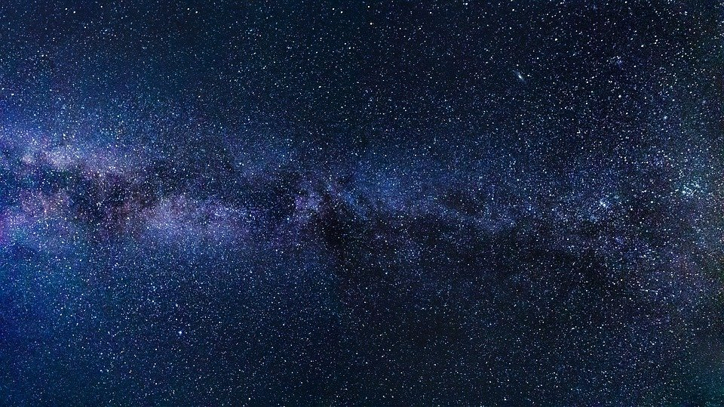



Measuring
Spacetime
Curvature
$$R_{ βγδ}^{α}$$
$$R$$
$$R_{μν}$$

Slide 2
Relativity 107: General Relativity
Equivalence Principle
Manifolds
Curvature
Newton-Cartan Theory (Curved Newtonian Gravity)
Energy-Momentum Tensor
Einstein Field Equations

Slide 3
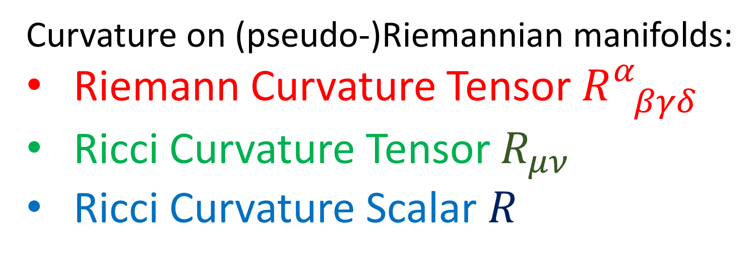

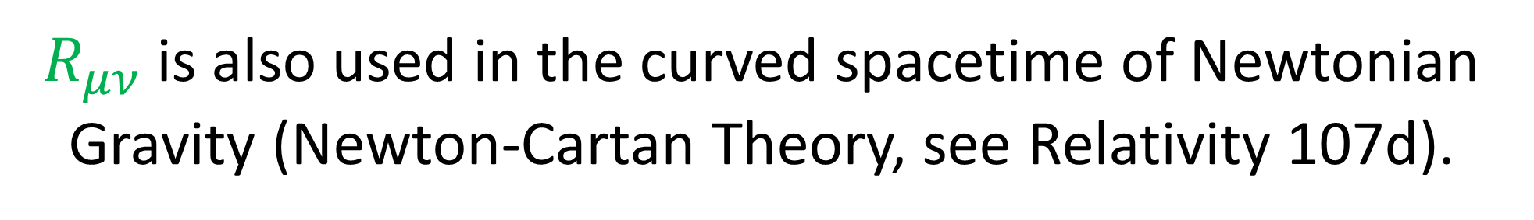
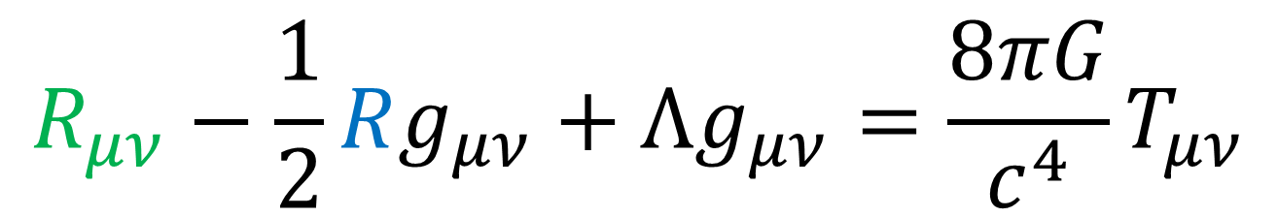
Curvature on (pseudo-)Riemannian manifolds:
Riemann Curvature Tensor $R_{ βγδ}^{α}$
Ricci Curvature Tensor $R_{μν}$
Ricci Curvature Scalar $R$
Einstein Field Equations:
$$R_{μν}−\frac{1}{2}Rg_{μν}+Λg_{μν}=\frac{8πG}{c^{4}}T_{μν}$$
$R_{μν}$is also used in the curved spacetime of Newtonian Gravity (Newton-Cartan Theory, see Relativity 107d).

Slide 4
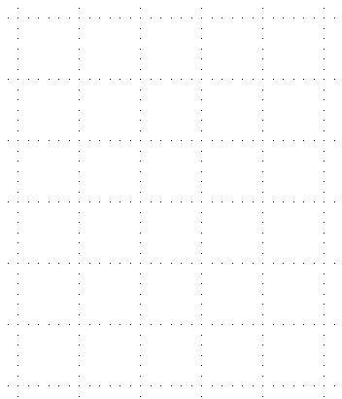

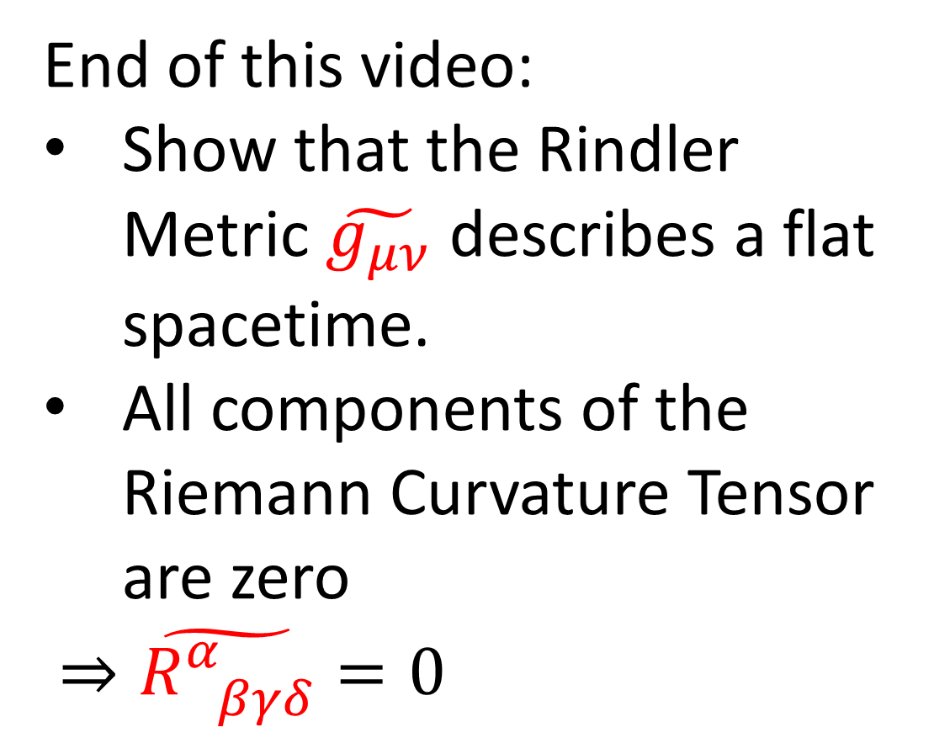





$$ct$$
End of this video:
Show that the Rindler Metric $\tilde{g_{μν}}$ describes a flat spacetime.
All components of the Riemann Curvature Tensor are zero
$⇒\tilde{R_{ βγδ}^{α}}=0$
$$c\tilde{t}$$
$$\tilde{x}$$
$$D$$
$$x$$
(Curved spacetimes will come up in future videos.)

Slide 5
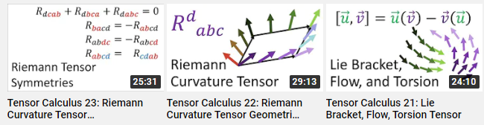
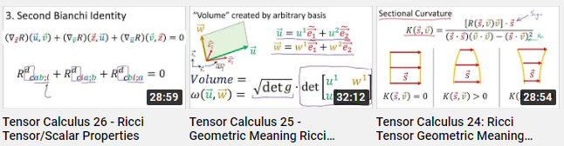
!! Warning !!
If you feel lost after watching this video, look at my videos:
Tensor Calculus 21-26 (3 hours)
Links in description
(Current video will summarize the basic intuition + results.)

Slide 6
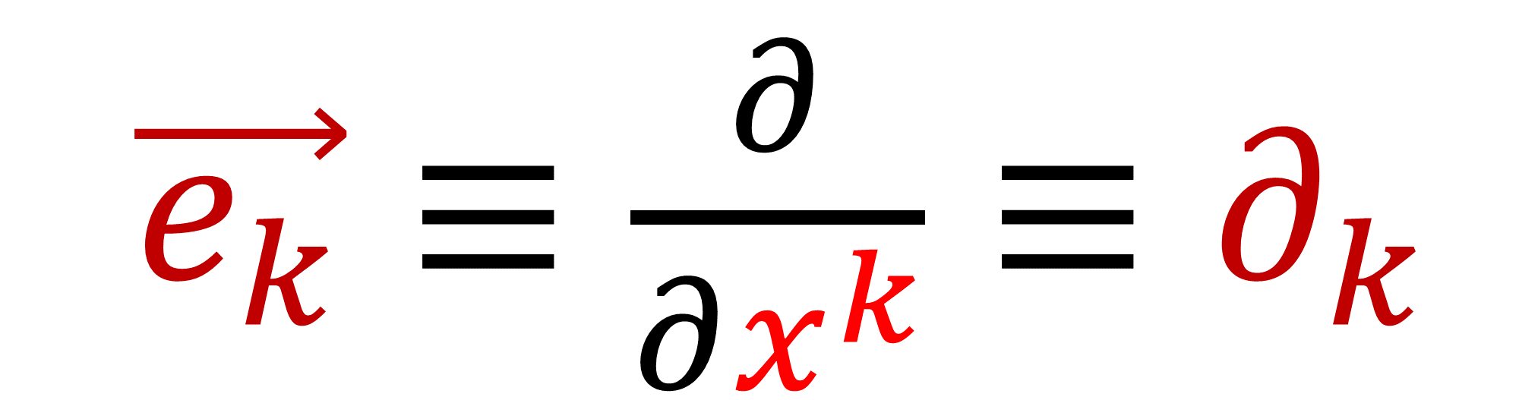
Basis vectors
$\vec{e_{k}}≡\frac{∂}{∂x^{k}}≡∂_{k}$

Slide 7
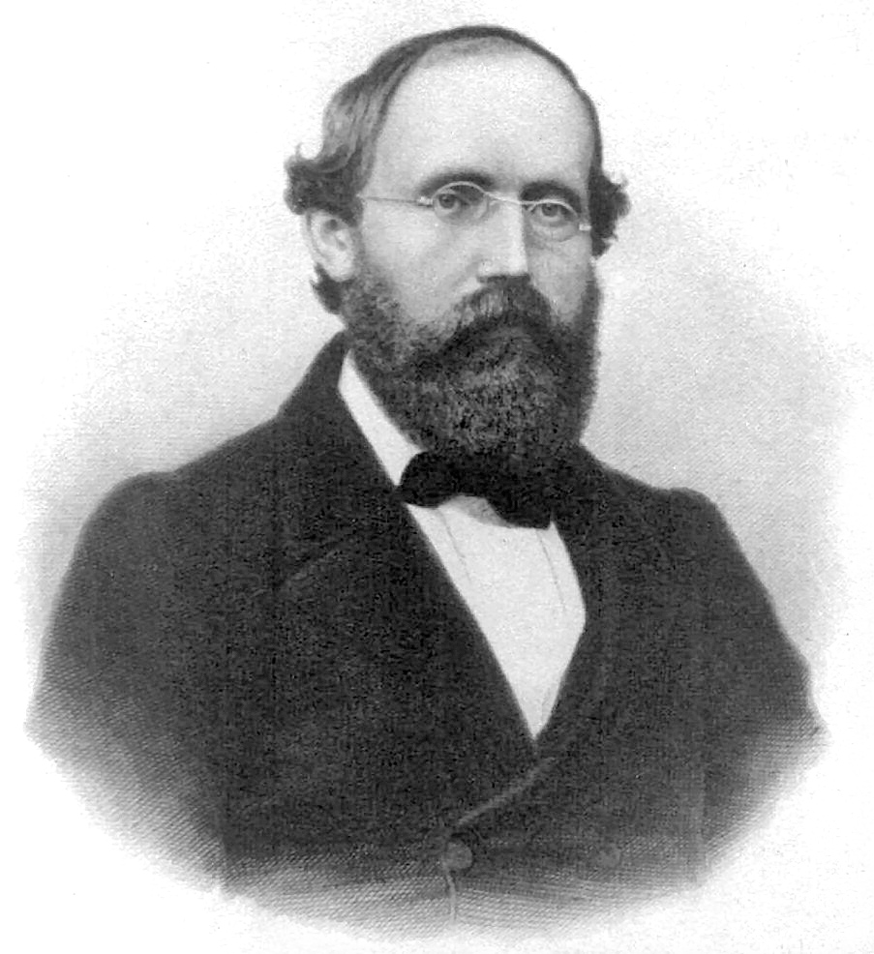
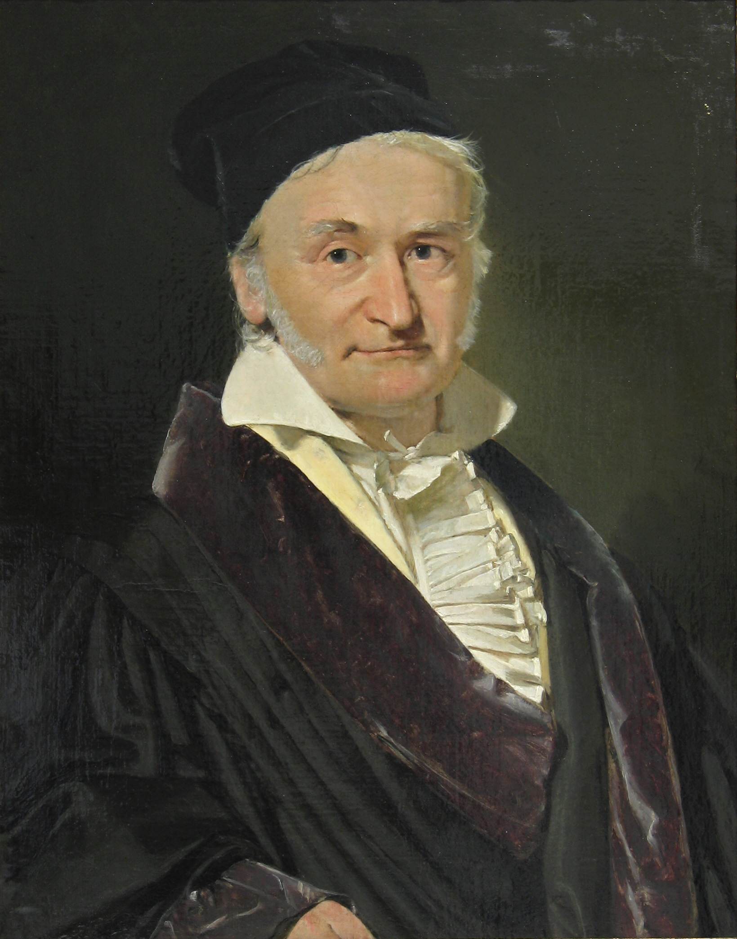
Riemannian Manifolds
Bernhard Riemann (1826-1866)
Differential geometry of 1D curves and 2D surfaces
“Classical Differential Geometry”
Carl Friedrich Gauss (1777-1855)

Slide 8
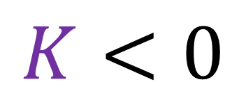
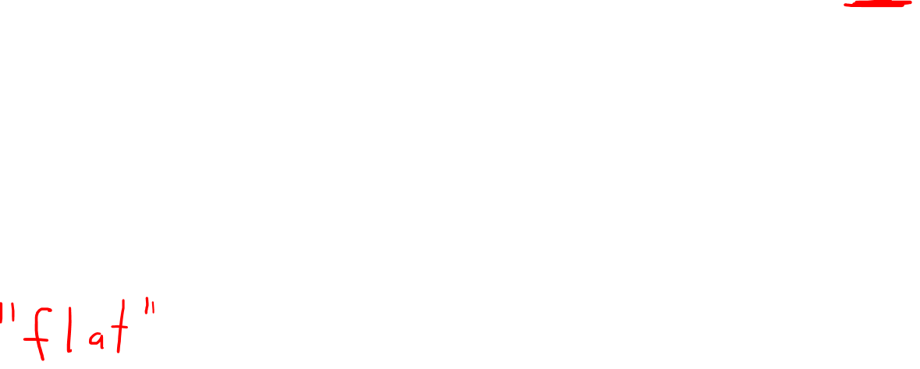
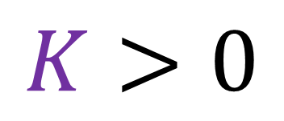
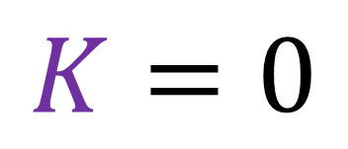
Curvature at a point on 2D surface: Gaussian Curvature $K$
2 smiles
(2 frowns)
at least 1 straight line
1 smile and 1 frown
$$K>0$$
$$K=0$$
$$K<0$$
This only works for 2D surfaces…

Slide 9


Curvature in any dimension: Riemann Curvature Tensor
1. Holonomy (twisting of vector when parallel transported in a loop)
2. Geodesic Deviation (measuring spread of neighbouring geodesics)
$$\vec{T}$$
$$\vec{V}$$

Slide 10

Parallel Transport: march along a curve, keeping the vector as straight as possible

Slide 11
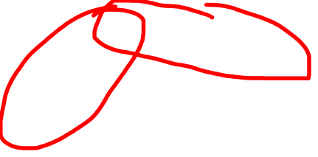

Parallel Transport: march along a curve, keeping the vector as straight as possible
Change in vector after parallel transport around a loop = Holonomy
Holonomy $⇒$ Curvature

Slide 12

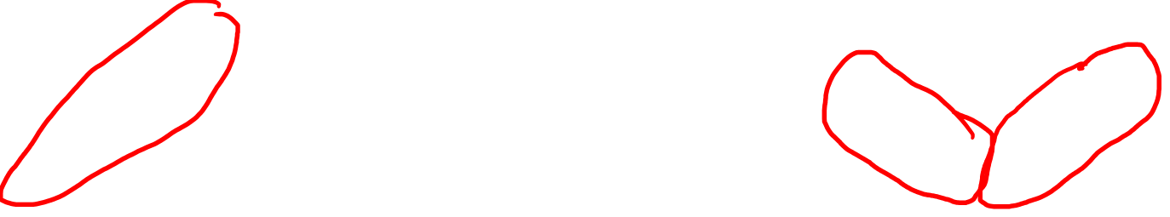

Flat space
Curved space
No Holonomy
$⇒$ No Curvature
Holonomy $⇒$ Curvature

Slide 13
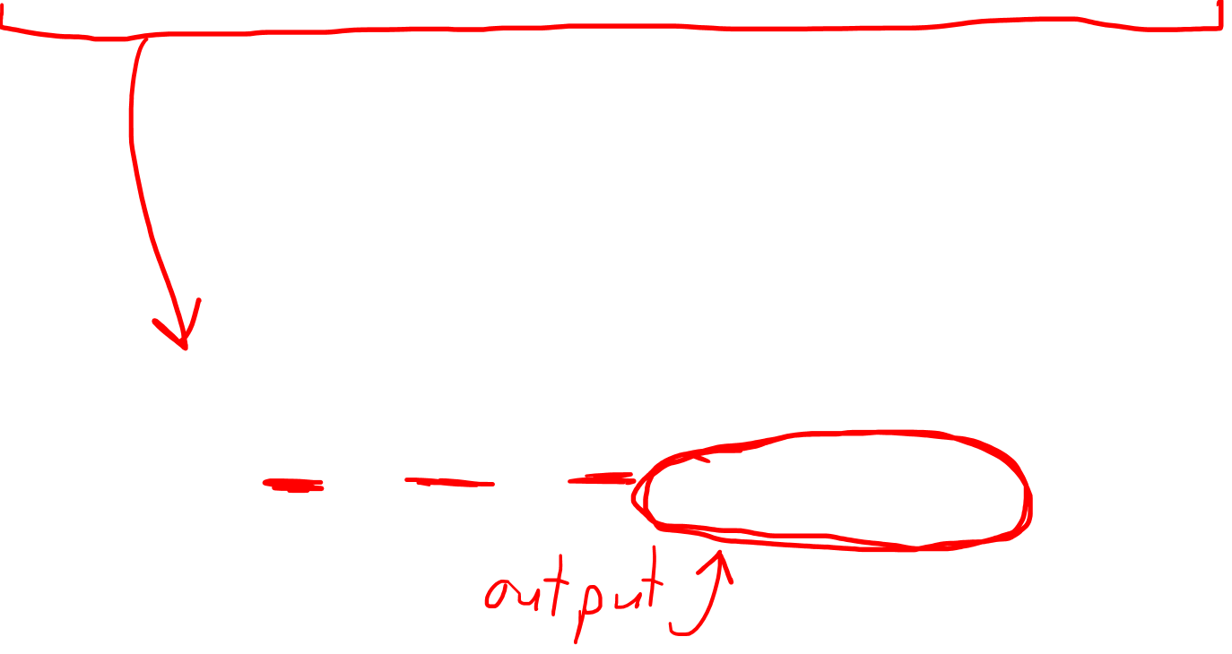
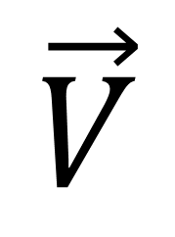
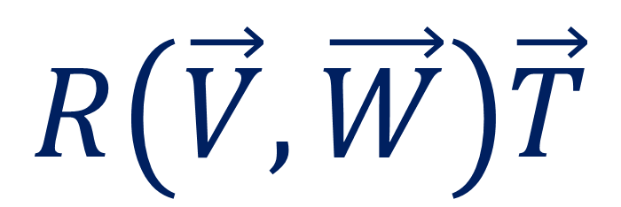

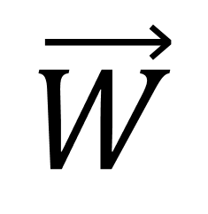
Riemann Curvature Tensor
$$R\left(\vec{V},\vec{W}\right)\vec{T}$$
$$\vec{W}$$
$$\vec{T}$$
$$\vec{V}$$

Slide 14
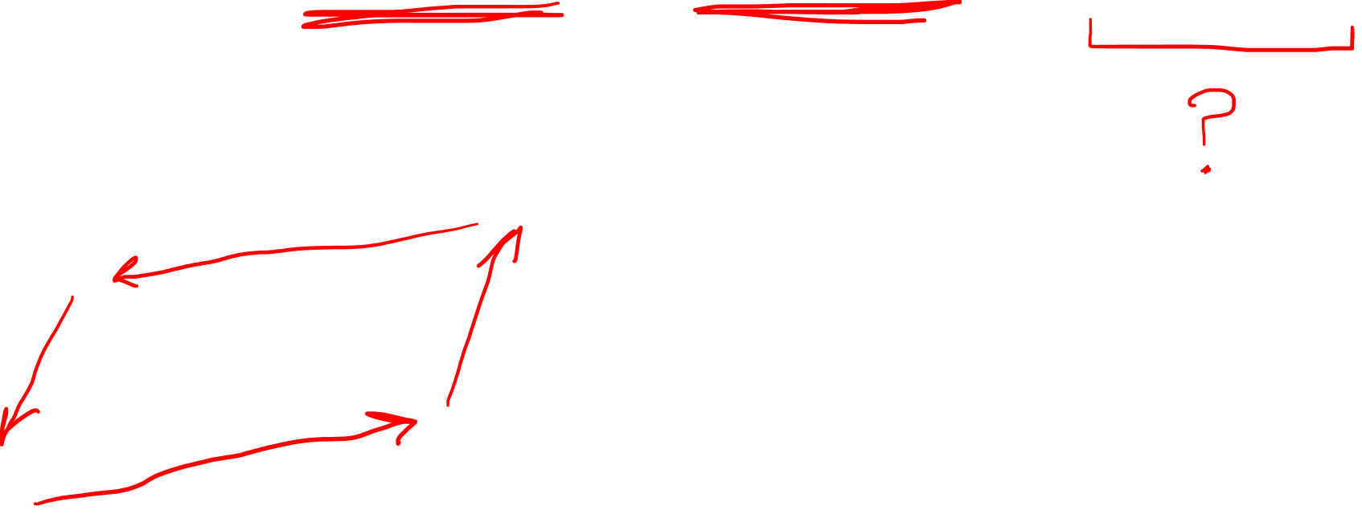
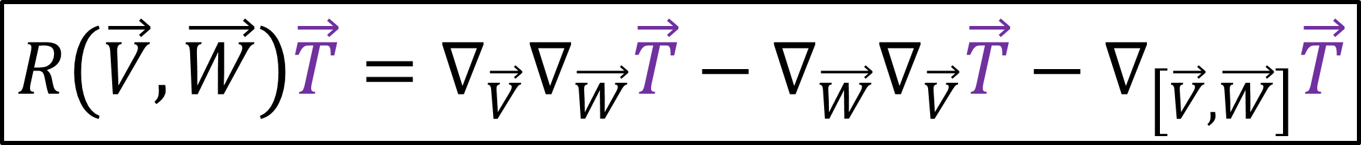

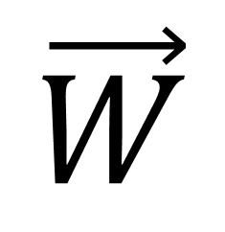
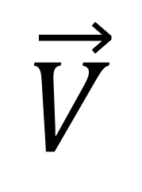
Riemann Curvature Tensor Definition
$$R\left(\vec{V},\vec{W}\right)\vec{T}=∇_{\vec{V}}∇_{\vec{W}}\vec{T}−∇_{\vec{W}}∇_{\vec{V}}\vec{T}−∇_{\left[\vec{V},\vec{W}\right]}\vec{T}$$
$$\vec{W}$$
$$\vec{T}$$
$$\vec{V}$$

Slide 15
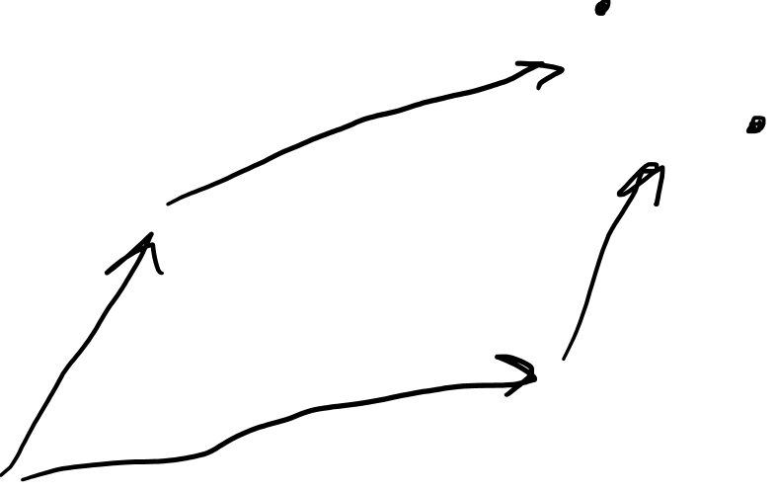
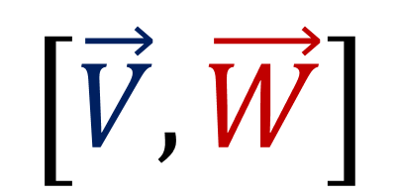


Riemann Curvature Tensor Definition
$$R\left(\vec{V},\vec{W}\right)\vec{T}=∇_{\vec{V}}∇_{\vec{W}}\vec{T}−∇_{\vec{W}}∇_{\vec{V}}\vec{T}−∇_{\left[\vec{V},\vec{W}\right]}\vec{T}$$
$$\left[\vec{V},\vec{W}\right]$$
“Commutator”/ “Lie Bracket”
$$\vec{W}$$
$$\vec{V}$$

Slide 16
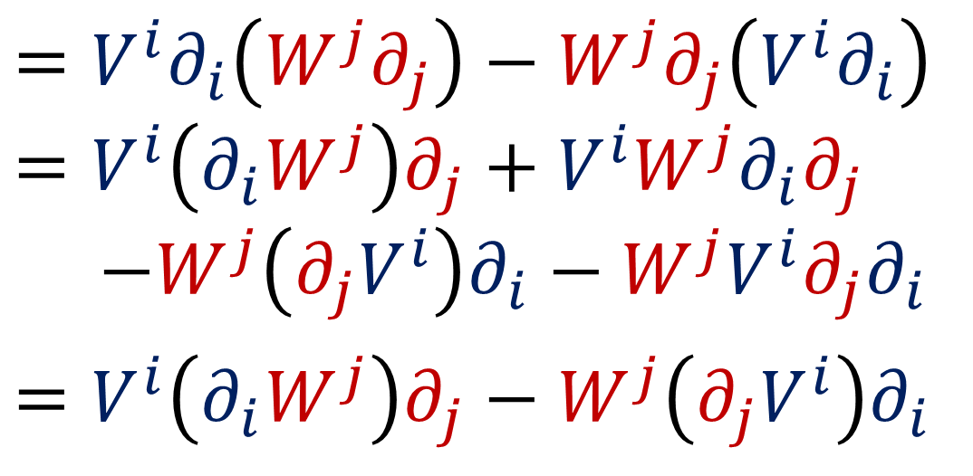
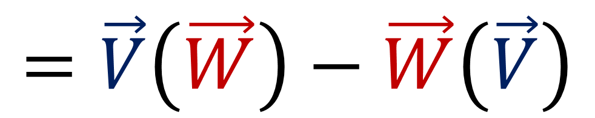
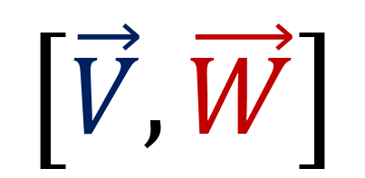
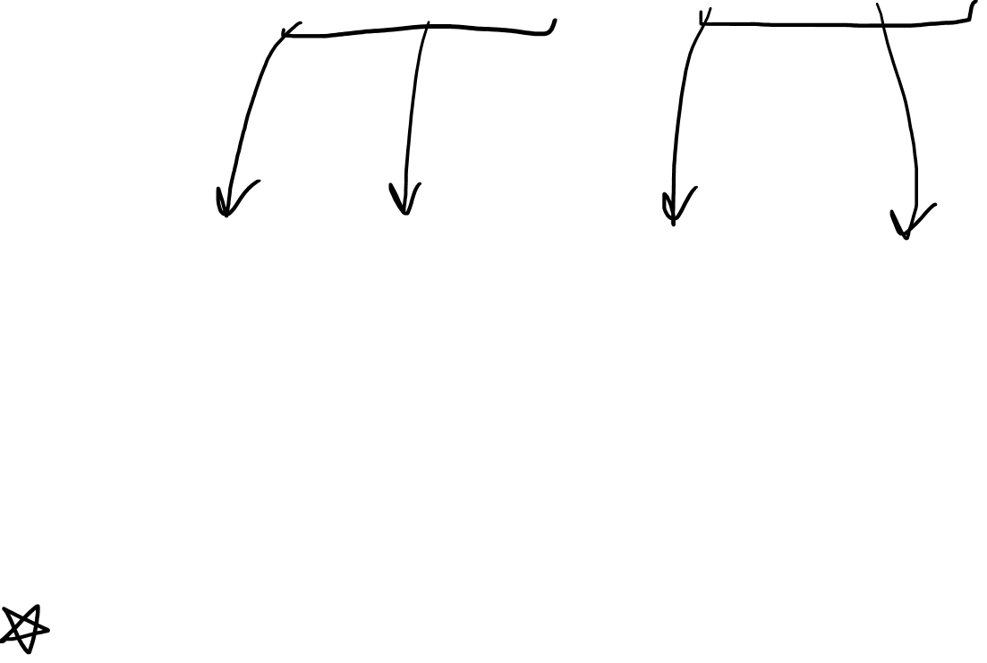
“Commutator”/ “Lie Bracket”
$$\left[\vec{V},\vec{W}\right]$$
$$=\vec{V}\left(\vec{W}\right)−\vec{W}\left(\vec{V}\right)$$
$$=V^{i}∂_{i}\left(W^{j}∂_{j}\right)−W^{j}∂_{j}\left(V^{i}∂_{i}\right)$$
$$=V^{i}\left(∂_{i}W^{j}\right)∂_{j}+V^{i}W^{j}∂_{i}∂_{j}$$
$−W^{j}\left(∂_{j}V^{i}\right)∂_{i}−W^{j}V^{i}∂_{j}∂_{i}$
$$=V^{i}\left(∂_{i}W^{j}\right)∂_{j}−W^{j}\left(∂_{j}V^{i}\right)∂_{i}$$
$$\vec{W}$$
$$\vec{V}$$

Slide 17
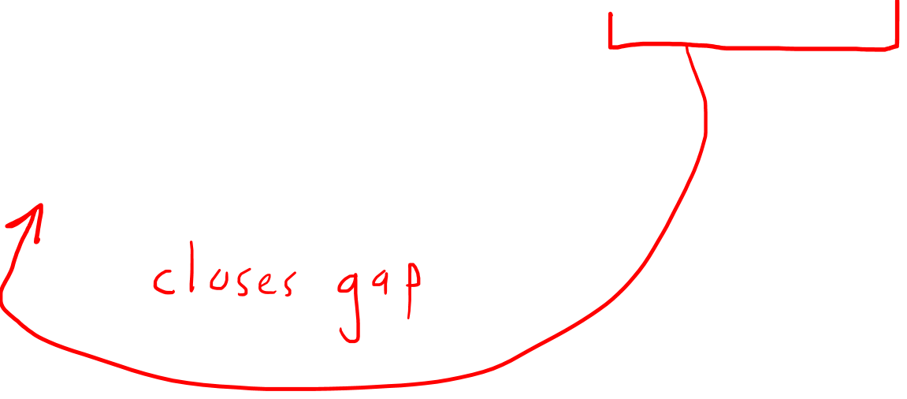
Riemann Curvature Tensor Definition
$$R\left(\vec{V},\vec{W}\right)\vec{T}=∇_{\vec{V}}∇_{\vec{W}}\vec{T}−∇_{\vec{W}}∇_{\vec{V}}\vec{T}−∇_{\left[\vec{V},\vec{W}\right]}\vec{T}$$
$$\left[\vec{V},\vec{W}\right]$$
$$\vec{W}$$
$$\vec{V}$$

Slide 18




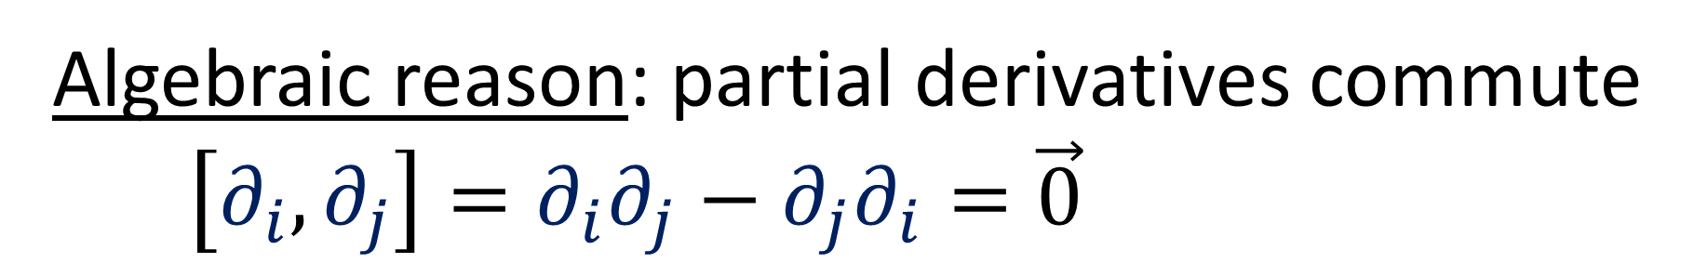


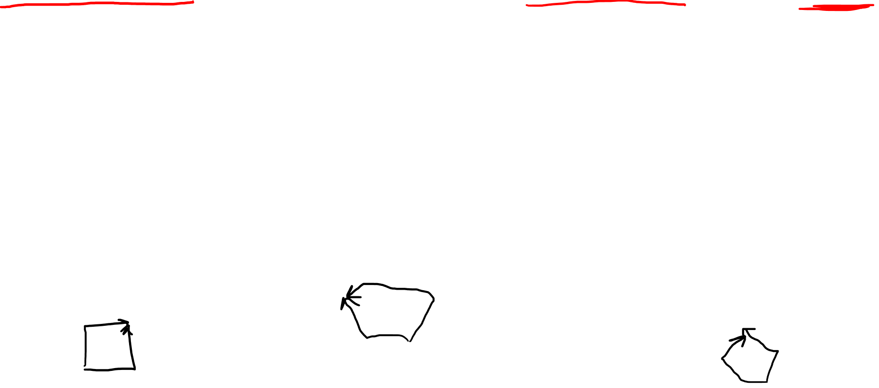
For basis vectors in coordinate system, Lie bracket goes to zero.
Algebraic reason: partial derivatives commute
$\left[∂_{i},∂_{j}\right]=∂_{i}∂_{j}−∂_{j}∂_{i}=\vec{0}$
Geometric reason: coordinate curves form gridboxes
without gaps
$$y$$
$$p$$
$$θ$$
$$q$$
$$x$$
$$r$$

Slide 19
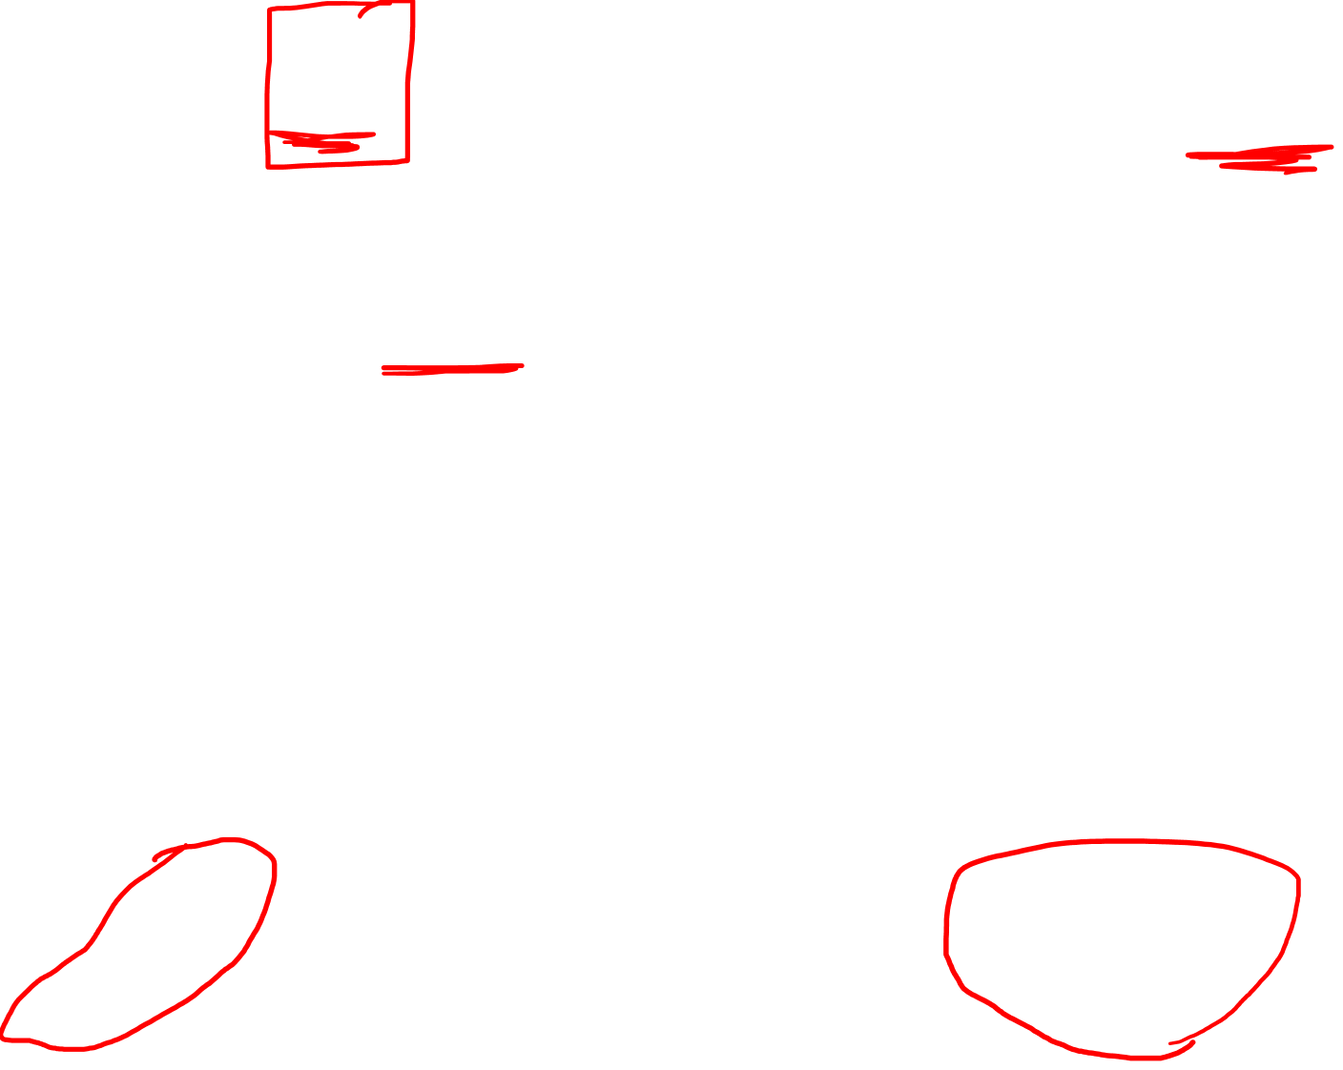

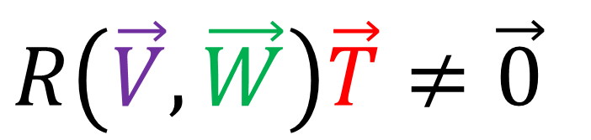
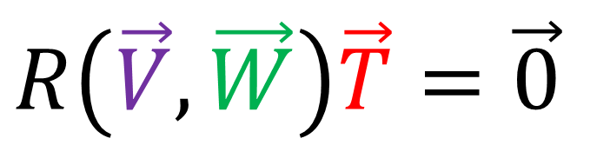
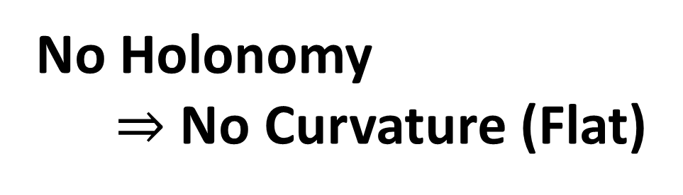
$$R\left(\vec{V},\vec{W}\right)\vec{T}=\vec{0}$$
$$R\left(\vec{V},\vec{W}\right)\vec{T}≠\vec{0}$$
No Holonomy
$⇒$ No Curvature (Flat)
Holonomy $⇒$ Curvature

Slide 20

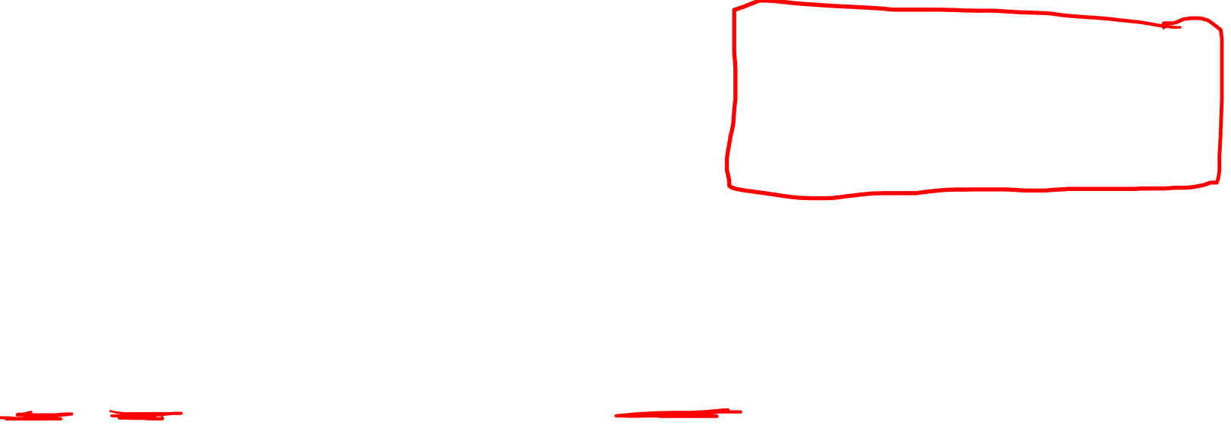
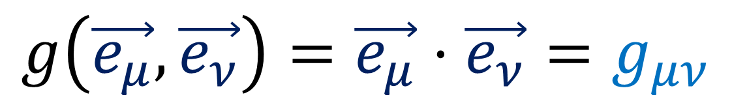
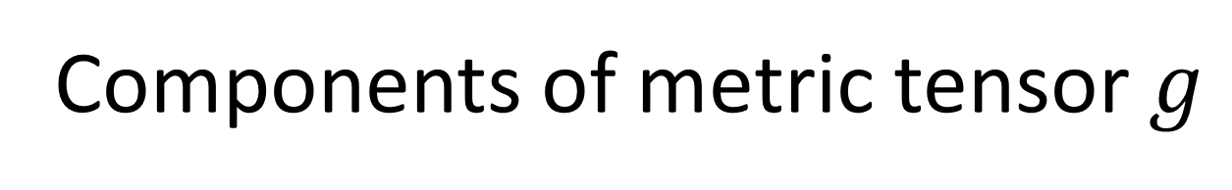
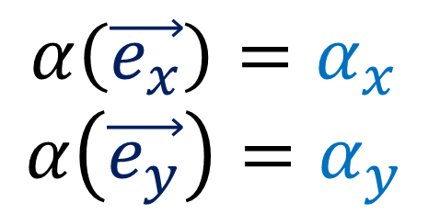
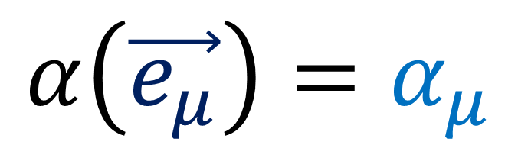
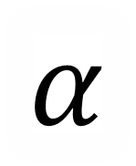


Riemann Tensor Components + Symmetries
Components of a covector $α$ (from Relativity 106a)
$$\vec{e_{y}}$$
$$α$$
$$α\left(\vec{e_{x}}\right)=α_{x}$$
$$α\left(\vec{e_{y}}\right)=α_{y}$$
$$\vec{e_{x}}$$
$$α\left(\vec{e_{μ}}\right)=α_{μ}$$
Components of metric tensor $g$
$$g\left(\vec{e_{μ}},\vec{e_{ν}}\right)=\vec{e_{μ}}⋅\vec{e_{ν}}=g_{μν}$$

Slide 21







Riemann Tensor Components + Symmetries
Components of Riemann Tensor $R$
$$R\left(\vec{e_{μ}},\vec{e_{ν}}\right)\vec{e_{σ}}$$
$$=R_{ σμν}^{ρ}\vec{e_{ρ}}$$
$$\vec{e_{σ}}$$
$$\vec{e_{ν}}$$
$$\vec{e_{μ}}$$

Slide 22

Riemann Tensor Components + Symmetries
Components of Riemann Tensor $R$
$$R\left(\vec{e_{μ}},\vec{e_{ν}}\right)\vec{e_{σ}}$$
$$=R_{ σμν}^{ρ}\vec{e_{ρ}}$$
$$\vec{e_{σ}}$$
$$\vec{e_{ν}}$$
$$\vec{e_{μ}}$$

Slide 23




Covectors are linear (from Relativity 106a)
$$α\left(\vec{e_{x}}+\vec{e_{y}}\right)=α\left(\vec{e_{x}}\right)+α\left(\vec{e_{y}}\right)$$
$α\left(k\vec{e_{x}}\right)$ $= kα\left(\vec{e_{x}}\right)$
$$α\left(V^{x}\vec{e_{x}}+V^{y}\vec{e_{y}}\right)=V^{x}α\left(\vec{e_{x}}\right)+V^{y}α\left(\vec{e_{y}}\right)$$
$$⇒α\left(V^{μ}\vec{e_{μ}}\right) = V^{μ}α\left(\vec{e_{μ}}\right)$$

Slide 24



Covector inputs are linear (from Relativity 106a)
$$α\left(\vec{V}\right)=α\left(V^{μ}\vec{e_{μ}}\right) = V^{μ}α\left(\vec{e_{μ}}\right)$$
Metric Tensor inputs are linear
$$g\left(\vec{V},\vec{W}\right)=g\left(V^{μ}\vec{e_{μ}},W^{μ}\vec{e_{μ}}\right)=V^{μ}W^{μ}g\left(\vec{e_{μ}}, \vec{e_{μ}}\right)$$
Riemann Curvature Tensor inputs are linear
$$R\left(\vec{V},\vec{W}\right)\vec{T}=R\left(V^{μ}\vec{e_{μ}},W^{μ}\vec{e_{ν}}\right)T^{σ}\vec{e_{σ}}$$
$=V^{μ}W^{μ}T^{σ} R\left(\vec{e_{μ}}, \vec{e_{ν}}\right)\vec{e_{σ}}$
$=V^{μ}W^{μ}T^{σ} R_{ σμν}^{ρ}\vec{e_{ρ}}$

Slide 25




Riemann Curvature Tensor Definition
$$R\left(\vec{V},\vec{W}\right)\vec{T}=∇_{\vec{V}}∇_{\vec{W}}\vec{T}−∇_{\vec{W}}∇_{\vec{V}}\vec{T}−∇_{\left[\vec{V},\vec{W}\right]}\vec{T}$$
$$R\left(\vec{e_{μ}}, \vec{e_{ν}}\right)\vec{e_{σ}}=$$
$$∇_{\vec{e_{μ}}}∇_{\vec{e_{ν}}}\vec{e_{σ}}−∇_{\vec{e_{ν}}}∇_{\vec{e_{μ}}}\vec{e_{σ}}−∇_{\left[\vec{e_{μ}}, \vec{e_{ν}}\right]}\vec{e_{σ}}$$
$$R_{ σμν}^{ρ}\vec{e_{ρ}}=$$
$\left(∂_{μ}\left(Γ_{νσ}^{ρ}\right)−∂_{ν}\left(Γ_{μσ}^{ρ}\right)+Γ_{νσ}^{α}Γ_{μα}^{ρ}−Γ_{μσ}^{β}Γ_{νβ}^{ρ}\right)\vec{e_{ρ}}$

Slide 26

Derivation in Tensor Calculus 23 (link in description)
$$R\left(\vec{e_{a}},\vec{e_{b}}\right)\vec{e_{c}}=∇_{\vec{e_{a}}}\left(Γ_{bc}^{i}\vec{e_{i}}\right)−∇_{\vec{e_{b}}}\left(Γ_{ac}^{j}\vec{e_{j}}\right)$$
$$=∇_{\vec{e_{a}}}\left(Γ_{bc}^{i}\right)\vec{e_{i}}+Γ_{bc}^{i}∇_{\vec{e_{a}}}\left(\vec{e_{i}}\right)$$
$−∇_{\vec{e_{b}}}\left(Γ_{ac}^{j}\right)\vec{e_{j}}−Γ_{ac}^{j}∇_{\vec{e_{b}}}\left(\vec{e_{j}}\right)$
$$=∂_{a}\left(Γ_{bc}^{i}\right)\vec{e_{i}}−∂_{b}\left(Γ_{ac}^{j}\right)\vec{e_{j}}+Γ_{bc}^{i}Γ_{ai}^{k}\vec{e_{k}}−Γ_{ac}^{j}Γ_{bj}^{l}\vec{e_{l}}$$
$$=∂_{a}\left(Γ_{bc}^{d}\right)\vec{e_{d}}−∂_{b}\left(Γ_{ac}^{d}\right)\vec{e_{d}}+Γ_{bc}^{i}Γ_{ai}^{d}\vec{e_{d}}−Γ_{ac}^{j}Γ_{bj}^{d}\vec{e_{d}}$$
$$=\left[∂_{a}\left(Γ_{bc}^{d}\right)−∂_{b}\left(Γ_{ac}^{d}\right)+Γ_{bc}^{i}Γ_{ai}^{d}−Γ_{ac}^{j}Γ_{bj}^{d}\right]\vec{e_{d}}$$

Slide 27







All $R\left(\vec{V},\vec{W}\right)\vec{T}=\vec{0}$
Some $R\left(\vec{V},\vec{W}\right)\vec{T}≠\vec{0}$
All $R_{ σμν}^{ρ}=0$
Some $R_{ σμν}^{ρ}≠0$
No Holonomy
$⇒$ No Curvature (Flat)
Holonomy $⇒$ Curvature

Slide 28




$$R_{ σμν}^{ρ}$$
can be any of $t,x,y,z$
$4×4×4×4=256$ components
$⇒$ don’t need to calculate all of them!

Slide 29




$g_{μν}⇒4×4=16$ components
But $g_{μν}=g_{νμ}$!!
6 Repeats
$$\left[\begin{matrix}\begin{matrix}\begin{aligned}g_{00} \\ g_{10} \\ g_{20} \\ g_{30}\end{aligned} & \begin{aligned}g_{01} \\ g_{11} \\ g_{21} \\ g_{31}\end{aligned}\end{matrix} & \begin{matrix}\begin{aligned}g_{02} \\ g_{12} \\ g_{22} \\ g_{32}\end{aligned} & \begin{aligned}g_{03} \\ g_{13} \\ g_{23} \\ g_{33}\end{aligned}\end{matrix}\end{matrix}\right]$$
$⇒10$ independent components

Slide 30



Riemann Curvature Tensor Symmetries (Levi-Civita Connection)
$$R_{ρνσμ}+R_{ρμνσ}+R_{ρσμν}=0$$
$$R_{σρμν}=−R_{ρσμν}$$
$$R_{ρσνμ}=−R_{ρσμν}$$
$$R_{μνρσ}=+R_{ρσμν}$$
4 dimensions
$4×4×4×4=256$ components
$⇒$ 20 independent components

Slide 31


Riemann Curvature Tensor Symmetries (Levi-Civita Connection)
$$R_{ρνσμ}+R_{ρμνσ}+R_{ρσμν}=0$$
$$R_{σρμν}=−R_{ρσμν}$$
$$R_{ρσνμ}=−R_{ρσμν}$$
$$R_{μνρσ}=+R_{ρσμν}$$
2 dimensions
$2×2×2×2=16$ components
$⇒$ 1 independent component

Slide 32









Riemann Curvature Tensor Symmetries (Levi-Civita Connection)
$$R_{ σνμ}^{ρ}=−R_{ σμν}^{ρ}$$
$$\vec{e_{μ}}$$
$$negative$$
$$\vec{e_{ν}}$$
$$\vec{e_{σ}}$$
$$\vec{e_{σ}}$$
$$\vec{e_{ν}}$$
$$\vec{e_{μ}}$$

Slide 33



Riemann Curvature Tensor Symmetries (Levi-Civita Connection)
$$R_{ σνμ}^{ρ}=−R_{ σμν}^{ρ}$$
$$R_{ σμμ}^{ρ}=−R_{ σμμ}^{ρ}$$
$$=0$$
$$R_{ σ00}^{ρ}=R_{ σ11}^{ρ}=R_{ σ22}^{ρ}=R_{ σ33}^{ρ}=0$$

Slide 34

Riemann Curvature Tensor Symmetries (Levi-Civita Connection)
$$R_{ρνσμ}+R_{ρμνσ}+R_{ρσμν}=0$$
$$R_{σρμν}=−R_{ρσμν}$$
$$R_{ρσνμ}=−R_{ρσμν}$$
$$R_{μνρσ}=+R_{ρσμν}$$
See Video 23 for derivations (link in description)

Slide 35



$$R_{ρσμν}=g_{ρα}R_{ σμν}^{α}$$
“Lowering an Index”
$$R_{ σμν}^{α}=g^{αρ}R_{ρσμν}$$
“Raising an Index”
(see “Tensor for Beginners 16” video)

Slide 36








Geodesic Deviation
Lie Bracket
Geodesic Equation
$$\left[\vec{T},\vec{V}\right]=\vec{0}$$
$$∇_{y}∇_{\vec{V}}\vec{V}=\vec{0}$$
$$∇_{\vec{T}}∇_{\vec{V}}\vec{V}=\vec{0}$$
$$\vec{T}$$
$$\vec{V}$$
$$∇_{\vec{T}}∇_{\vec{V}}\vec{V}−∇_{\vec{V}}∇_{\vec{T}}\vec{V}+∇_{\vec{V}}∇_{\vec{T}}\vec{V}=\vec{0}$$
$$R\left(\vec{T},\vec{V}\right)\vec{V}=∇_{\vec{T}}∇_{\vec{V}}\vec{V}−∇_{\vec{V}}∇_{\vec{T}}\vec{V}−∇_{\left[\vec{T},\vec{V}\right]}\vec{V}$$
$$R\left(\vec{T},\vec{V}\right)\vec{V} +∇_{\vec{V}}∇_{\vec{T}}\vec{V}=\vec{0}$$

Slide 37






Geodesic Deviation
Lie Bracket
Geodesic Equation
$$\left[\vec{T},\vec{V}\right]=\vec{0}$$
$$∇_{y}∇_{\vec{V}}\vec{V}=\vec{0}$$
$$\vec{T}$$
$$\left[\vec{T},\vec{V}\right]=\vec{0}$$
+ Torsion-Free
$$Γ_{μν}^{α}=Γ_{νμ}^{α}$$
$$\vec{V}$$
$$R\left(\vec{T},\vec{V}\right)\vec{V}+∇_{\vec{V}}∇_{\vec{T}}\vec{V}=\vec{0}$$
$$⇒∇_{\vec{T}}\vec{V}=∇_{\vec{V}}\vec{T}$$
$$R\left(\vec{T},\vec{V}\right)\vec{V}+∇_{\vec{V}}∇_{\vec{V}}\vec{T}=\vec{0}$$
$$∇_{\vec{V}}∇_{\vec{V}}\vec{T}=−R\left(\vec{T},\vec{V}\right)\vec{V}$$
(Proof in Tensor Calculus 21)

Slide 38


$$∇_{\vec{V}}∇_{\vec{V}}\vec{T}<0$$
On curved manifolds, geodesics can naturally come together or spread apart.
This is how gravity (curved spacetime) can cause objects to naturally come together without forces.

Slide 39


Ricci Tensor
Keeps track of
how “volumes” change along geodesics
Represents Gravity in G.R.
$$R_{μν}−\frac{1}{2}Rg_{μν}+Λg_{μν}=\frac{8πG}{c^{4}}T_{μν}$$

Slide 40


Ricci Curvature Tensor $R_{μν}$
A kind of “summary” of the Riemann Tensor $R_{ σμν}^{ρ}$.

Slide 41



Matrix Trace = sum of diagonal elements
$$Tr\left(M\right)$$
$$=M_{0}^{0}+M_{1}^{1}+M_{2}^{2}+M_{3}^{3}$$
$$= M_{μ}^{μ}$$
$$\left[\begin{matrix}\begin{matrix}\begin{aligned}M_{0}^{0} \\ M_{0}^{1} \\ M_{0}^{2} \\ M_{0}^{3}\end{aligned} & \begin{aligned}M_{1}^{0} \\ M_{1}^{1} \\ M_{1}^{2} \\ M_{1}^{3}\end{aligned}\end{matrix} & \begin{matrix}\begin{aligned}M_{2}^{0} \\ M_{2}^{1} \\ M_{2}^{2} \\ M_{2}^{3}\end{aligned} & \begin{aligned}M_{3}^{0} \\ M_{3}^{1} \\ M_{3}^{2} \\ M_{3}^{3}\end{aligned}\end{matrix}\end{matrix}\right]$$
The trace summarizes a matrix as a single number.

Slide 42




Ricci Tensor = “trace” of Riemann Tensor
$$R_{αβ}= R_{ αρβ}^{ρ}$$
$$R_{αβ}=R_{ α0β}^{0}+R_{ α1β}^{1}+R_{ α2β}^{2}+R_{ α3β}^{3}$$
$$→\left[\begin{matrix}\begin{matrix}\begin{aligned}R_{00} \\ R_{10} \\ R_{20} \\ R_{30}\end{aligned} & \begin{aligned}R_{01} \\ R_{11} \\ R_{21} \\ R_{31}\end{aligned}\end{matrix} & \begin{matrix}\begin{aligned}R_{02} \\ R_{12} \\ R_{22} \\ R_{32}\end{aligned} & \begin{aligned}R_{03} \\ R_{13} \\ R_{23} \\ R_{33}\end{aligned}\end{matrix}\end{matrix}\right]$$
Ricci Tensor is symmetric
$$R_{αβ}=R_{βα}$$

Slide 43




$$R_{αβ}≡R_{ αρβ}^{ρ}$$
$Ricci$ is a “summation” of $Riemann$
Why sum with the middle-lower index?
$R_{ ραβ}^{ρ}$ $=g^{ρσ}R_{σραβ}=−g^{σρ}R_{ρσαβ}=−R_{ σαβ}^{σ}=0$
$R_{ αβρ}^{ρ}$ $=−R_{ αρβ}^{ρ}$
(Full proofs in Tensor Calculus 26, link in description.)

Slide 44







Ricci Tensor $R_{αβ}$ keeps track of volume changes along geodesics.
$$\vec{W}$$
$$\vec{W}$$
$$\vec{V}$$
$$\vec{T}$$
$$\vec{W}$$
$$\vec{V}$$
$$\vec{V}$$

Slide 45




$$Ric\left(\vec{V},\vec{W}\right)→scalar$$
take unit vector $\vec{V}$…
$$Ric\left(\vec{V},\vec{V}\right)=Ric \left(V^{α}\vec{e_{α}},V^{β}\vec{e_{β}}\right)$$
$$Ric\left(\vec{V},\vec{V}\right)=V^{α}V^{β}Ric \left(\vec{e_{α}}, \vec{e_{β}}\right)$$
$$Ric\left(\vec{V},\vec{V}\right)=V^{α}V^{β} R_{αβ}$$
Ricci Curvature
$$∇_{\vec{V}}∇_{\vec{V}}\left(volume\right)≈Ric\left(\vec{V},\vec{V}\right) volume$$
(more details in “Tensor Calculus 25” video)

Slide 46




$$\vec{e_{1}}$$
$$\vec{V}$$
$$\vec{e_{2}}$$
$$\vec{V}$$

Slide 47

Converging Geodesics:
Circle gets smaller
Positive Ricci Curvature $Ric\left(\vec{V},\vec{V}\right)>0$
$$\vec{e_{1}}$$
$$\vec{V}$$
$$\vec{e_{2}}$$
$$\vec{V}$$

Slide 48

$$\vec{e_{1}}$$
$$V$$
$$\vec{e_{2}}$$
$$\vec{V}$$

Slide 49

Diverging Geodesics:
Circle gets bigger
Negative Ricci Curvature $Ric\left(\vec{V},\vec{V}\right)<0$
$$\vec{e_{1}}$$
$$V$$
$$\vec{e_{2}}$$
$$\vec{V}$$

Slide 50
$$\vec{e_{1}}$$
$$\vec{V}$$
$$\vec{e_{2}}$$
$$\vec{V}$$

Slide 51

Geodesics not diverging or converging:
Circle stays the same size
Zero Ricci Curvature $Ric\left(\vec{V},\vec{V}\right)=0$
$$\vec{e_{1}}$$
$$\vec{V}$$
$$\vec{e_{2}}$$
$$\vec{V}$$

Slide 52


$$\vec{e_{1}}$$
$$×2$$
$$×\text{½}$$
$$\vec{V}$$
$$\vec{e_{2}}$$
$$\vec{V}$$

Slide 53


Geodesics converge AND diverge
… such that circle area the same size
Zero Ricci Curvature $Ric\left(\vec{V},\vec{V}\right)=0$
$$\vec{e_{1}}$$
$$×2$$
$$×\text{½}$$
$$\vec{V}$$
$$\vec{e_{2}}$$
$$\vec{V}$$
Notes:
½

Slide 54
Ricci Tensor can detect changes in area/volume.
Ricci Tensor cannot detect changes in shape.
$$\vec{e_{1}}$$
$$×2$$
$$×\text{½}$$
$$\vec{V}$$
$$\vec{e_{2}}$$
$$\vec{V}$$
Notes:
½

Slide 55

$R_{αβ}=0$ does NOT mean space is flat.
It just means that areas/volumes don’t
change along geodesics.
$$\vec{e_{1}}$$
$$×2$$
$$×\text{½}$$
$$\vec{V}$$
$$\vec{e_{2}}$$
$$\vec{V}$$
Notes:
½

Slide 56





Ricci Curvature Scalar $R=g^{αβ}R_{αβ}=R_{ α}^{α}$
$$C=2πr$$
$$A= πr^{2}$$
Flat
Circle
$$r$$

Slide 57


Ricci Curvature Scalar $R=g^{αβ}R_{αβ}=R_{ α}^{α}$
$$C=2πr$$
Circle with same $C$
can have different $A$
$$A= πr^{2}$$
Flat
Circle
“Curved” Circle

Slide 58


$$R>0$$
Flat Space
Curved Space
Same Circumference
less area
MORE AREA
Same Radius
MORE AREA
less area

Slide 59



$$R<0$$
Flat Space
Curved Space
Same Circumference
MORE AREA
less area
Same Radius
less area
MORE AREA

Slide 60

$$R=0$$
Flat Space
Curved Space
Same Circumference
same area
same area
Same Radius
same area
same area

Slide 61


Einstein Field Equations:
Geometry/
Curvature
Mass, energy, momentum
$R_{μν}−\frac{1}{2}Rg_{μν}+Λg_{μν}=\frac{8πG}{c^{4}}T_{μν}$
Metric Tensor $g_{μν}$
Ricci Curvature Tensor $R_{μν}$
Ricci Curvature Scalar $R$

Slide 62



Proof:
Rindler Metric
Flat Spacetime
$\tilde{\vec{e_{t}}}⋅\tilde{\vec{e_{t}}}=+{\left(\frac{\tilde{x}}{D}\right)}^{2}$
$$\tilde{\vec{e_{t}}}⋅\tilde{\vec{e_{x}}}= 0$$
$$\tilde{\vec{e_{x}}}⋅\tilde{\vec{e_{x}}}=−1$$
$$\tilde{R_{ σμν}^{ρ}}=0$$
$$⇒$$

Slide 63

(Relativity 105b)
$$ct$$
$$c\tilde{t}$$
Rindler Coordinates:
coordinates for accelerating observer
proper acceleration $α$
constant Minkowski distance $D=\frac{c^{2}}{α}$ from origin
$$\tilde{x}$$
$$D$$
$$x$$
Notes:
In Relativiy 105b, I introduced Rindler coordinates ct-tilde and x-tilde, which are a non-inertial coordinate system for an accelerating observer. with proper acceleration Alpha. This observer travels on a hyperbola with a constant Mingkoffski distance of D = c^2/alpha from the origin.

Slide 64

















$τ_{5}=5$
Line of Simultaneity
$\tilde{t}=1$ second
$τ_{4}=4$
$τ_{3}=3$
Rindler Horizon
$τ_{2}=2$
$τ_{1}=1$
$=\frac{c^{2}}{α}$
$=\frac{c^{2}}{α}$
$$D$$
$=\frac{c^{2}}{α}$
$=\frac{c^{2}}{α}$
$=\frac{c^{2}}{α}$
$$D$$
$$D$$
$$D$$
$$D$$
$cτ=∫\sqrt{\frac{d\tilde{x^{μ}}}{dλ}\frac{d\tilde{x^{ν}}}{dλ}\tilde{g_{μν}}} dλ$
Rindler Metric

Slide 65




$cτ=∫\sqrt{\frac{d\tilde{x^{μ}}}{dλ}\frac{d\tilde{x^{ν}}}{dλ}\tilde{g_{μν}}} dλ$
Rindler Metric
$\tilde{\vec{e_{t}}}⋅\tilde{\vec{e_{t}}}=+{\left(\frac{\tilde{x}}{D}\right)}^{2}$
$$\tilde{\vec{e_{t}}}⋅\tilde{\vec{e_{x}}}= 0$$
$$\tilde{\vec{e_{x}}}⋅\tilde{\vec{e_{x}}}=−1$$
$$\tilde{g_{μν}}=\tilde{\vec{e_{μ}}}⋅\tilde{\vec{e_{ν}}}$$

Slide 66

Start with the metric $\tilde{g_{μν}}=\tilde{\vec{e_{μ}}}⋅\tilde{\vec{e_{ν}}}$
Calculate the connection coefficients $\tilde{Γ_{νσ}^{α}}$
$\tilde{Γ_{νσ}^{α}}=\frac{1}{2}\tilde{g^{αμ}}\left(\tilde{∂_{σ}}\tilde{g_{μν}}+\tilde{∂_{ν}}\tilde{g_{σμ}}−\tilde{∂_{μ}}\tilde{g_{νσ}}\right)$
Calculate the Riemann Curvature Tensor
$\tilde{R_{ σμν}^{ρ}}=\tilde{∂_{μ}}\left(\tilde{Γ_{νσ}^{ρ}}\right)−\tilde{∂_{ν}}\left(\tilde{Γ_{μσ}^{ρ}}\right)+\tilde{Γ_{νσ}^{α}}\tilde{Γ_{μα}^{ρ}}−\tilde{Γ_{μσ}^{β}}\tilde{Γ_{νβ}^{ρ}}$
Calculate the Ricci Curvature Tensor
$\tilde{R_{ αρβ}^{ρ}}=\tilde{R_{αβ}}$
Calculate the Ricci Scalar
$\tilde{R_{ α}^{α}}=R$

Slide 67



Rindler Metric
$\left[\begin{matrix}\tilde{\vec{e_{t}}}⋅\tilde{\vec{e_{t}}} & \tilde{\vec{e_{t}}}⋅\tilde{\vec{e_{x}}} \\ \tilde{\vec{e_{x}}}⋅\tilde{\vec{e_{t}}} & \tilde{\vec{e_{x}}}⋅\tilde{\vec{e_{x}}}\end{matrix}\right]$ $=\left[\begin{matrix}\tilde{g_{tt}} & \tilde{g_{tx}} \\ \tilde{g_{xt}} & \tilde{g_{xx}}\end{matrix}\right]=\left[\begin{matrix}+{\left({\tilde{x}}/D\right)}^{2} & 0 \\ 0 & −1\end{matrix}\right]$
(Assume no motion in the $\tilde{y}$ or $\tilde{z}$ directions.)

Slide 68





Rindler Metric
$\tilde{g_{μν}} →\left[\begin{matrix}+{\left({\tilde{x}}/D\right)}^{2} & 0 \\ 0 & −1\end{matrix}\right]$
Inverse Metric
$→\left[\begin{matrix}+{\left(D/{\tilde{x}}\right)}^{2} & 0 \\ 0 & −1\end{matrix}\right]$
$\tilde{g^{μν}} →\left[\begin{matrix}+{\left(D/{\tilde{x}}\right)}^{2} & 0 \\ 0 & −1\end{matrix}\right]$
$$\tilde{g^{μα}}\tilde{g_{αν}}=δ_{ ν}^{μ}$$

Slide 69





$\left[\begin{matrix}\tilde{g_{tt}} & \tilde{g_{tx}} \\ \tilde{g_{xt}} & \tilde{g_{xx}}\end{matrix}\right]=\left[\begin{matrix}+{\left({\tilde{x}}/D\right)}^{2} & 0 \\ 0 & −1\end{matrix}\right]$
$\left[\begin{matrix}\tilde{g^{tt}} & \tilde{g^{tx}} \\ \tilde{g^{xt}} & \tilde{g^{xx}}\end{matrix}\right]=\left[\begin{matrix}+{\left(D/{\tilde{x}}\right)}^{2} & 0 \\ 0 & −1\end{matrix}\right]$
$$\sum_{μ=0}^{1}{}$$
$\tilde{Γ_{νσ}^{α}}= \frac{1}{2}\tilde{g^{αμ}}\left(\tilde{∂_{σ}}\tilde{g_{μν}}+\tilde{∂_{ν}}\tilde{g_{σμ}}−\tilde{∂_{μ}}\tilde{g_{νσ}}\right)$
$=\frac{1}{2}\tilde{g^{α0}}\left(\tilde{∂_{σ}}\tilde{g_{0ν}}+\tilde{∂_{ν}}\tilde{g_{σ0}}−\tilde{∂_{0}}\tilde{g_{νσ}}\right)+\frac{1}{2}\tilde{g^{α1}}\left(\tilde{∂_{σ}}\tilde{g_{1ν}}+\tilde{∂_{ν}}\tilde{g_{σ1}}−\tilde{∂_{1}}\tilde{g_{νσ}}\right)$
$0→t$ $1→x$
$=\frac{1}{2}\tilde{g^{αt}}\left(\tilde{∂_{σ}}\tilde{g_{tν}}+\tilde{∂_{ν}}\tilde{g_{σt}}−\tilde{∂_{t}}\tilde{g_{νσ}}\right)+\frac{1}{2}\tilde{g^{αx}}\left(\tilde{∂_{σ}}\tilde{g_{xν}}+\tilde{∂_{ν}}\tilde{g_{σx}}−\tilde{∂_{x}}\tilde{g_{νσ}}\right)$

Slide 70




$\left[\begin{matrix}\tilde{g_{tt}} & \tilde{g_{tx}} \\ \tilde{g_{xt}} & \tilde{g_{xx}}\end{matrix}\right]=\left[\begin{matrix}+{\left({\tilde{x}}/D\right)}^{2} & 0 \\ 0 & −1\end{matrix}\right]$
$\left[\begin{matrix}\tilde{g^{tt}} & \tilde{g^{tx}} \\ \tilde{g^{xt}} & \tilde{g^{xx}}\end{matrix}\right]=\left[\begin{matrix}+{\left(D/{\tilde{x}}\right)}^{2} & 0 \\ 0 & −1\end{matrix}\right]$
$$\sum_{μ∈\{t,x\}}{}$$
$\tilde{Γ_{νσ}^{α}}= \frac{1}{2}\tilde{g^{αμ}}\left(\tilde{∂_{σ}}\tilde{g_{μν}}+\tilde{∂_{ν}}\tilde{g_{σμ}}−\tilde{∂_{μ}}\tilde{g_{νσ}}\right)$
Case 1: $α=t→\tilde{Γ_{νσ}^{t}}$
Case 2: $α=x→\tilde{Γ_{νσ}^{x}}$

Slide 71







$\left[\begin{matrix}\tilde{g_{tt}} & \tilde{g_{tx}} \\ \tilde{g_{xt}} & \tilde{g_{xx}}\end{matrix}\right]=\left[\begin{matrix}+{\left({\tilde{x}}/D\right)}^{2} & 0 \\ 0 & −1\end{matrix}\right]$
$\left[\begin{matrix}\tilde{g^{tt}} & \tilde{g^{tx}} \\ \tilde{g^{xt}} & \tilde{g^{xx}}\end{matrix}\right]=\left[\begin{matrix}+{\left(D/{\tilde{x}}\right)}^{2} & 0 \\ 0 & −1\end{matrix}\right]$
$\tilde{Γ_{νσ}^{x}}=\frac{1}{2}\tilde{g^{xμ}}\left(\tilde{∂_{σ}}\tilde{g_{μν}}+\tilde{∂_{ν}}\tilde{g_{σμ}}−\tilde{∂_{μ}}\tilde{g_{νσ}}\right)$
$\tilde{Γ_{νσ}^{x}}=\frac{1}{2}\tilde{g^{xx}}\left(\tilde{∂_{σ}}\tilde{g_{xν}}+\tilde{∂_{ν}}\tilde{g_{σx}}−\tilde{∂_{x}}\tilde{g_{νσ}}\right)$
$=\frac{1}{2}(−1)\left(−\frac{∂}{∂\tilde{x}}{\left(\frac{\tilde{x}}{D}\right)}^{2}\right)$
$\tilde{Γ_{tt}^{x}}=\frac{1}{2}\tilde{g^{xx}}\left(−\tilde{∂_{x}}\tilde{g_{tt}}\right)$
$=\frac{1}{2}\left(2\tilde{x}{\left(\frac{1}{D}\right)}^{2}\right)$
$$=\frac{\tilde{x}}{D^{2}}$$

Slide 72







$\left[\begin{matrix}\tilde{g_{tt}} & \tilde{g_{tx}} \\ \tilde{g_{xt}} & \tilde{g_{xx}}\end{matrix}\right]=\left[\begin{matrix}+{\left({\tilde{x}}/D\right)}^{2} & 0 \\ 0 & −1\end{matrix}\right]$
$\left[\begin{matrix}\tilde{g^{tt}} & \tilde{g^{tx}} \\ \tilde{g^{xt}} & \tilde{g^{xx}}\end{matrix}\right]=\left[\begin{matrix}+{\left(D/{\tilde{x}}\right)}^{2} & 0 \\ 0 & −1\end{matrix}\right]$
$\tilde{Γ_{νσ}^{t}}=\frac{1}{2}\tilde{g^{tμ}}\left(\tilde{∂_{σ}}\tilde{g_{μν}}+\tilde{∂_{ν}}\tilde{g_{σμ}}−\tilde{∂_{μ}}\tilde{g_{νσ}}\right)$
$\tilde{Γ_{νσ}^{t}}=\frac{1}{2}\tilde{g^{tt}}\left(\tilde{∂_{σ}}\tilde{g_{tν}}+\tilde{∂_{ν}}\tilde{g_{σt}}−\tilde{∂_{t}}\tilde{g_{νσ}}\right)$
$=\frac{1}{2}{\left(\frac{D}{\tilde{x}}\right)}^{2}\left(\frac{∂}{∂\tilde{x}}{\left(\frac{\tilde{x}}{D}\right)}^{2}\right)$
$\tilde{Γ_{tx}^{t}}=\frac{1}{2}\tilde{g^{tt}}\left(\tilde{∂_{x}}\tilde{g_{tt}}\right)$
$=\frac{1}{2}{\left(\frac{D}{\tilde{x}}\right)}^{2}\left(2\tilde{x}{\left(\frac{1}{D}\right)}^{2}\right)$
$$=\frac{1}{\tilde{x}}$$

Slide 73





Connection Coefficients for Rindler Coordinates
$\frac{∂\tilde{\vec{e_{t}}}}{∂ c\tilde{t}}=\tilde{Γ_{tt}^{t}}\tilde{\vec{e_{t}}}+\tilde{Γ_{tt}^{x}}\tilde{\vec{e_{x}}}$
$\frac{∂\tilde{\vec{e_{t}}}}{∂\tilde{x}}=\tilde{Γ_{tx}^{t}}\tilde{\vec{e_{t}}}+\tilde{Γ_{tx}^{x}}\tilde{\vec{e_{x}}}$
$\frac{∂\tilde{\vec{e_{t}}}}{∂ c\tilde{t}}=0\tilde{\vec{e_{t}}}+\frac{\tilde{x}}{D^{2}}\tilde{\vec{e_{x}}}$
$\frac{∂\tilde{\vec{e_{t}}}}{∂\tilde{x}}=\frac{1}{\tilde{x}}\tilde{\vec{e_{t}}}+0\tilde{\vec{e_{x}}}$
$\frac{∂\tilde{\vec{e_{x}}}}{∂ c\tilde{t}}=\tilde{Γ_{xt}^{t}}\tilde{\vec{e_{t}}}+\tilde{Γ_{xt}^{x}}\tilde{\vec{e_{x}}}$
$\frac{∂\tilde{\vec{e_{x}}}}{∂\tilde{x}}=\tilde{Γ_{xx}^{t}}\tilde{\vec{e_{t}}}+\tilde{Γ_{xx}^{x}}\tilde{\vec{e_{x}}}$
$\frac{∂\tilde{\vec{e_{x}}}}{∂ c\tilde{t}}=\frac{1}{\tilde{x}}\tilde{\vec{e_{t}}}+0\tilde{\vec{e_{x}}}$
$\frac{∂\tilde{\vec{e_{x}}}}{∂\tilde{x}}=0\tilde{\vec{e_{t}}}+0\tilde{\vec{e_{x}}}$

Slide 74


Riemann Curvature Tensor:
$$\tilde{R_{ ναβ}^{μ}}=\tilde{∂_{α}}\tilde{Γ_{νβ}^{μ}}−\tilde{∂_{β}}\tilde{Γ_{να}^{μ}}+\tilde{Γ_{νβ}^{σ}}\tilde{Γ_{σα}^{μ}}−\tilde{Γ_{να}^{σ}}\tilde{Γ_{σβ}^{μ}}$$
For 2D, only 1 independent non-zero component:
$$\tilde{R_{ xtx}^{t}}=\tilde{∂_{t}}\tilde{Γ_{xx}^{t}}−\tilde{∂_{x}}\tilde{Γ_{xt}^{t}}+\tilde{Γ_{xx}^{σ}}\tilde{Γ_{σt}^{t}}−\tilde{Γ_{xt}^{σ}}\tilde{Γ_{σx}^{t}}$$

Slide 75





$$\tilde{R_{ ναβ}^{μ}}=\tilde{∂_{α}}\tilde{Γ_{νβ}^{μ}}−\tilde{∂_{β}}\tilde{Γ_{να}^{μ}}+\tilde{Γ_{νβ}^{σ}}\tilde{Γ_{σα}^{μ}}−\tilde{Γ_{να}^{σ}}\tilde{Γ_{σβ}^{μ}}$$
$$R_{ ναβ}^{μ}=∂_{α}Γ_{νβ}^{μ}−∂_{β}Γ_{να}^{μ}+Γ_{νβ}^{σ}Γ_{σα}^{μ}−Γ_{να}^{σ}Γ_{σβ}^{μ}$$
$$\tilde{R_{ xtx}^{t}}=\tilde{∂_{t}}\tilde{Γ_{xx}^{t}}−\tilde{∂_{x}}\tilde{Γ_{xt}^{t}}+\tilde{Γ_{xx}^{σ}}\tilde{Γ_{σt}^{t}}−\tilde{Γ_{xt}^{σ}}\tilde{Γ_{σx}^{t}}$$
$\tilde{Γ_{tt}^{x}}=\frac{\tilde{x}}{D^{2}}$ $\tilde{Γ_{tx}^{t}}=\tilde{Γ_{xt}^{t}}=\frac{1}{\tilde{x}}$
$\tilde{R_{ xtx}^{t}}=\tilde{∂_{t}}\left(\frac{\tilde{x}}{D^{2}}\right)−\tilde{∂_{x}}\left(\frac{1}{\tilde{x}}\right) + 0 −\tilde{Γ_{xt}^{t}}\tilde{Γ_{tx}^{t}}$
$\tilde{R_{ xtx}^{t}}=\tilde{∂_{t}}\left(\frac{\tilde{x}}{D^{2}}\right)−\tilde{∂_{x}}\left(\frac{1}{\tilde{x}}\right)+ 0 −\left(\frac{1}{\tilde{x}}\right)\left(\frac{1}{\tilde{x}}\right)$
$\tilde{R_{ xtx}^{t}}=0−\left(−\frac{1}{{\tilde{x}}^{2}}\right)+0−\left(\frac{1}{{\tilde{x}}^{2}}\right)$
$$=0$$

Slide 76




$$\tilde{R_{ xtx}^{t}}=0$$
For 2D spaces, this means ALL components of the Riemann Curvature Tensor are zero.
$$⇒\tilde{R_{ ναβ}^{μ}}=0$$
The Rindler Metric describes Flat Spacetime.
$$\tilde{R_{ νμβ}^{μ}}≡\tilde{R_{νβ}}=0$$
(This means the Ricci Curvature Tensor and Ricci Scalar are also zero.)
$$R≡\tilde{R_{ ν}^{ν}}=g^{νβ}\tilde{R_{νβ}}=0$$

Slide 77

Curvature on (pseudo-)Riemannian manifolds:
Riemann Curvature Tensor $R_{ βγδ}^{α}$
Ricci Curvature Tensor $R_{μν}$
Ricci Curvature Scalar $R$

Slide 78
Curvature in any dimension: Riemann Curvature Tensor
1. Holonomy (twisting of vector when parallel transported in a loop)
2. Geodesic Deviation (measuring spread of neighbouring geodesics)
$$\vec{T}$$
$$\vec{V}$$

Slide 79


Riemann Curvature Tensor Definition
$$R\left(\vec{V},\vec{W}\right)\vec{T}=∇_{\vec{V}}∇_{\vec{W}}\vec{T}−∇_{\vec{W}}∇_{\vec{V}}\vec{T}−∇_{\left[\vec{V},\vec{W}\right]}\vec{T}$$
$$R_{ σμν}^{ρ}=∂_{μ}\left(Γ_{νσ}^{ρ}\right)−∂_{ν}\left(Γ_{μσ}^{ρ}\right)+Γ_{νσ}^{α}Γ_{μα}^{ρ}−Γ_{μσ}^{β}Γ_{νβ}^{ρ}$$
Flat Spacetime
$$⇔$$
$$R_{ σμν}^{ρ}=0$$

Slide 80

Ricci Tensor
$$R_{ αμβ}^{μ}=R_{αβ}$$
Keeps track of volume changes (due to curvature) along geodesics.

Slide 81


Ricci Tensor
$$R_{ αμβ}^{μ}=R_{αβ}$$
$$=0$$
$⇒$ volumes don’t change due to curvature
(but it’s still possible that space is curved)

Slide 82





Ricci Curvature Scalar $R=g^{αβ}R_{αβ}=R_{ α}^{α}$
For a given Circumference $C$ …
$$R>0$$
$$R=0$$
$$R<0$$
MORE AREA
than flat space
Same area as flat space
less area than flat space

Slide 83

Next video: Newton-Cartan Theory
Use the Ricci Tensor $R_{αβ}$ to describe curved spacetime in Newtonian Gravity.

