Slide 1

Relativity 107: General Relativity
Equivalence Principle
Manifolds
Curvature
Newton-Cartan Theory (Curved Newtonian Gravity)
Energy-Momentum Tensor
Einstein Field Equations

Slide 2
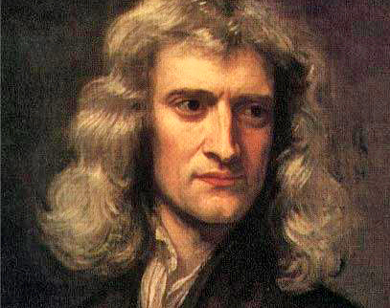
Curved Spacetime
for
Newtonian Gravity

Slide 3
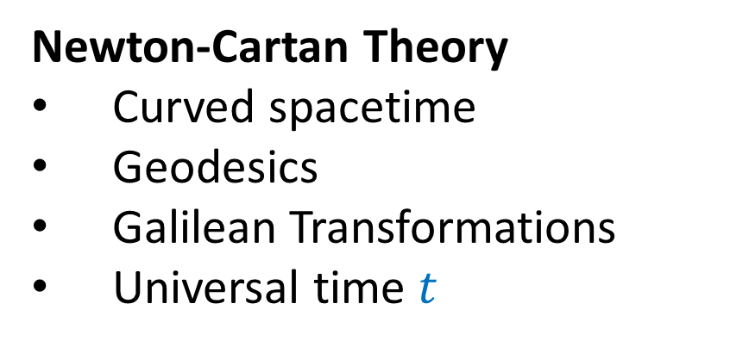
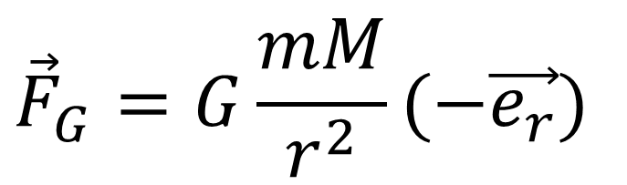
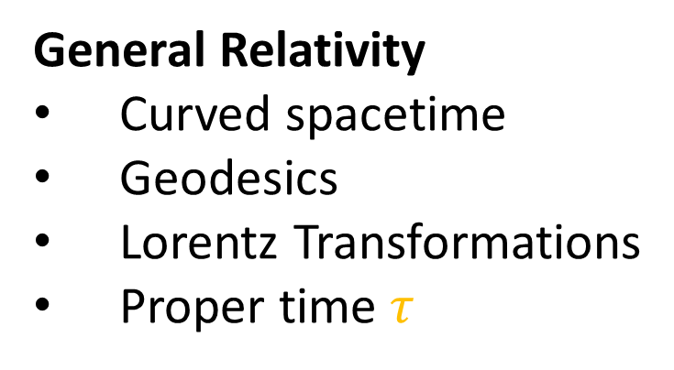
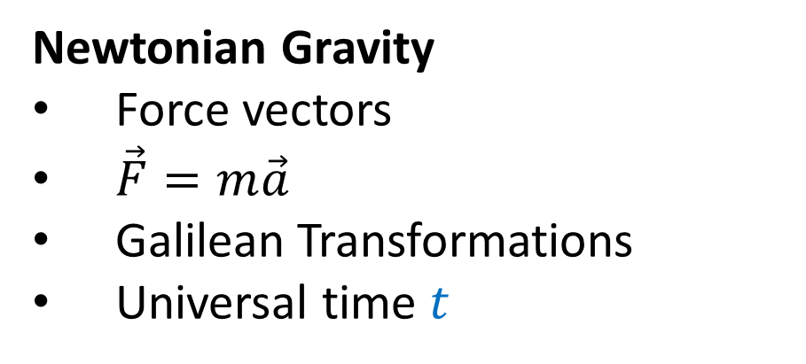

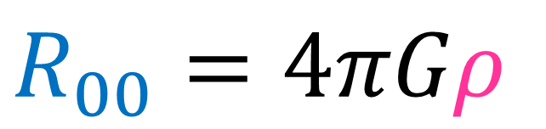
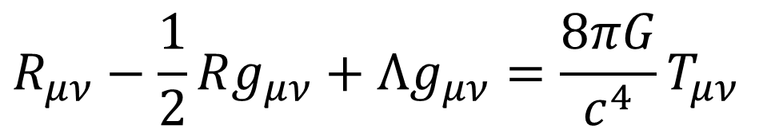
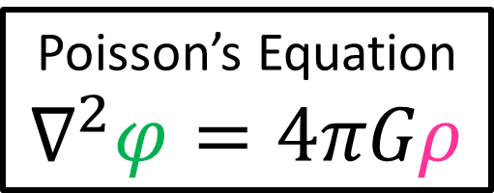
Newtonian Gravity
Force vectors
$\vec{F}=m\vec{a}$
Galilean Transformations
Universal time $t$
$${\vec{F}}_{G}=G\frac{mM}{r^{2}}(−\vec{e_{r}})$$
Poisson’s Equation
$$∇^{2}φ=4πGρ$$
Newton-Cartan Theory
Curved spacetime
Geodesics
Galilean Transformations
Universal time $t$
$$R_{00}=4πGρ$$
General Relativity
Curved spacetime
Geodesics
Lorentz Transformations
Proper time $τ$
$$R_{μν}−\frac{1}{2}Rg_{μν}+Λg_{μν}=\frac{8πG}{c^{4}}T_{μν}$$

Slide 4
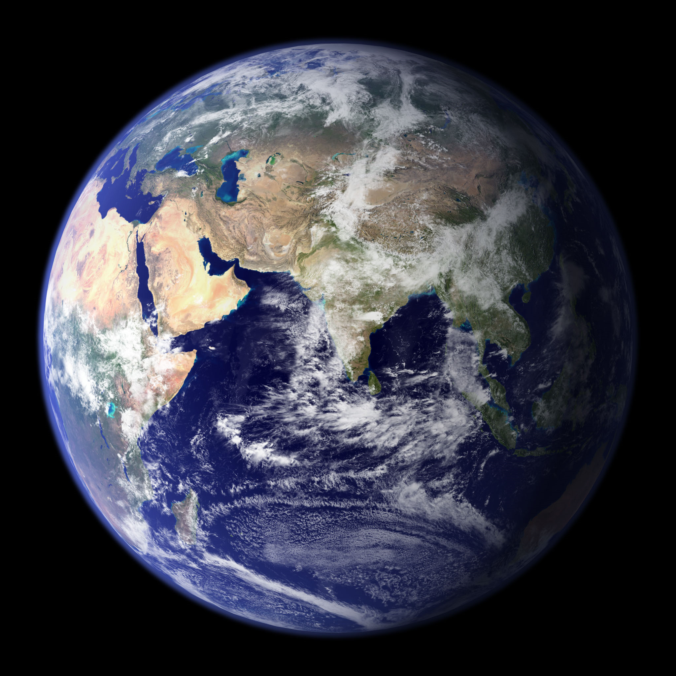
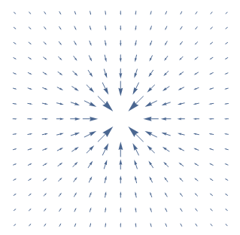

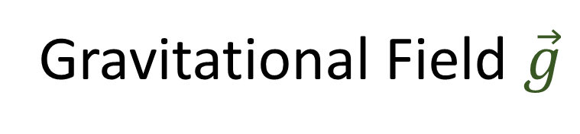
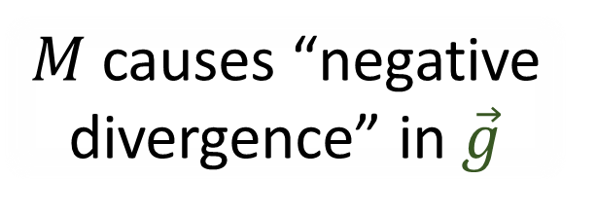
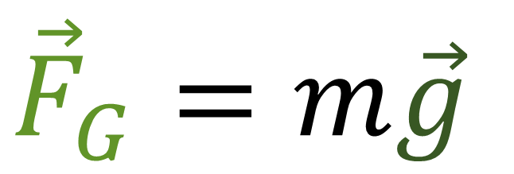



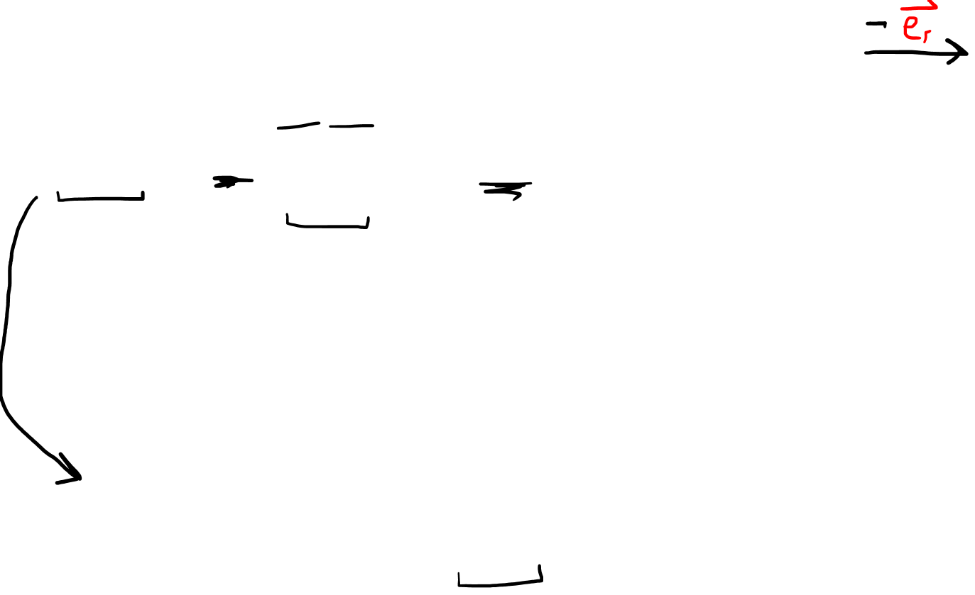
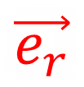
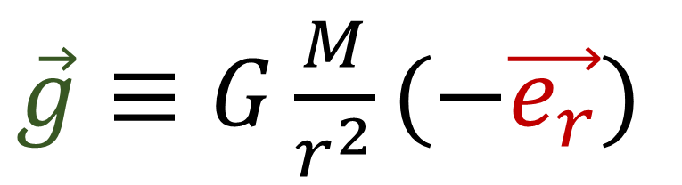
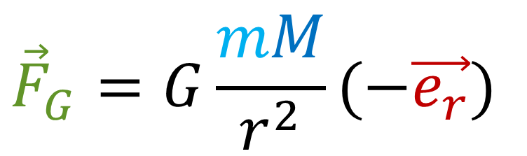
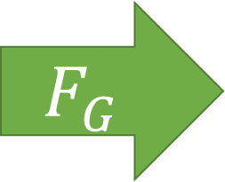
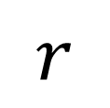
$$M$$
$${\vec{F}}_{G}=G\frac{mM}{r^{2}}(−\vec{e_{r}})$$
$$\vec{e_{r}}$$
$$F_{G}$$
$$m$$
$$r$$
Gravitational Field $\vec{g}$
$$m$$
$${\vec{F}}_{G}=m\vec{g}$$
$$M$$
$\vec{g}≡G\frac{M}{r^{2}}(−\vec{e_{r}})$
$M$ causes “negative divergence” in $\vec{g}$

Slide 5
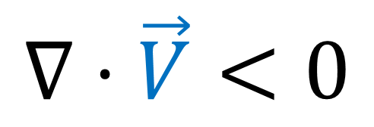


$$∇⋅\vec{V}>0$$
$$∇⋅\vec{V}=0$$
$$∇⋅\vec{V}<0$$
+ve divergence
Zero divergence
-ve divergence
(convergence)
Overall, no vectors “entering”/“leaving” the box.
Overall, vectors are “leaving” the box.
Overall, vectors are “entering” the box.

Slide 6
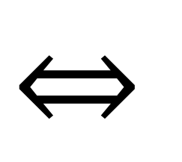
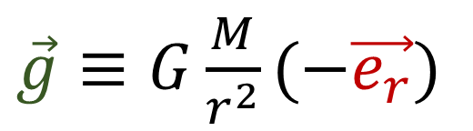
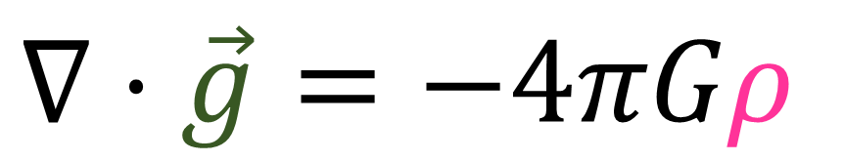

Gravitational (Vector) Field
$$⇔$$
$\vec{g}≡G\frac{M}{r^{2}}(−\vec{e_{r}})$
$∇⋅\vec{g}=−4πGρ$
(equivalent)
Mass density
(mass per volume)

Slide 7
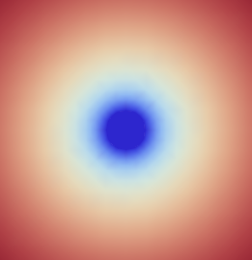
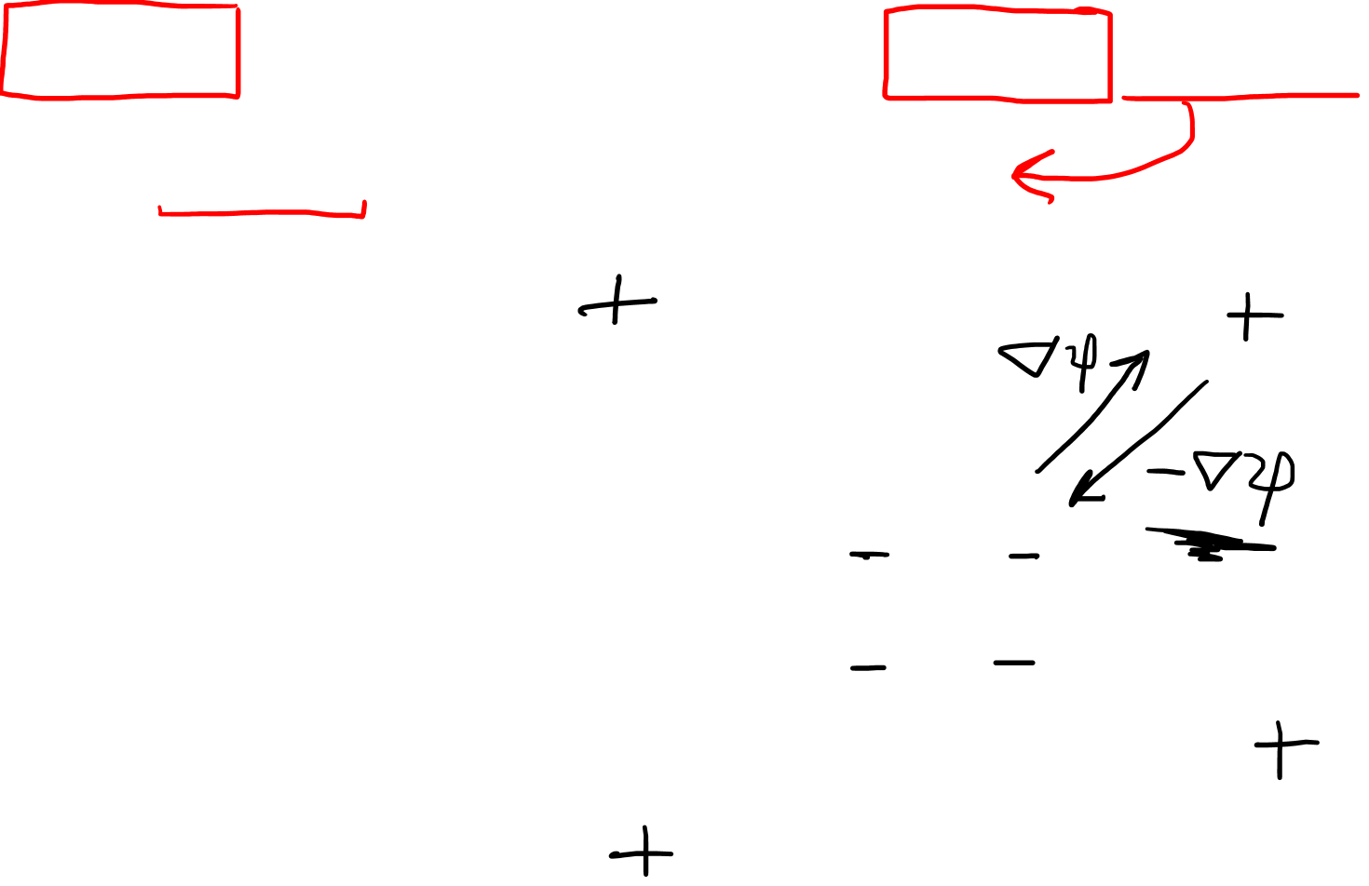

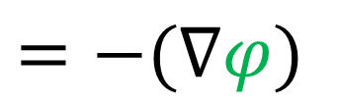
Gravitational (Vector) Field
Gravitational (Scalar) Potential
$$φ$$
$\vec{g}≡G\frac{M}{r^{2}}(−\vec{e_{r}})$
$=−(∇φ)$

Slide 8
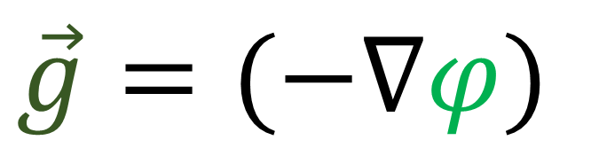
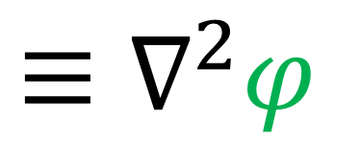
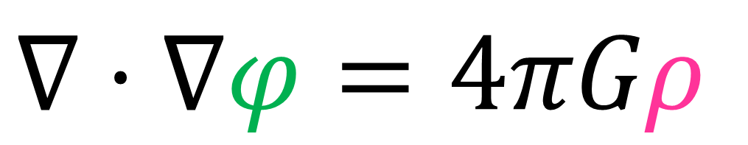
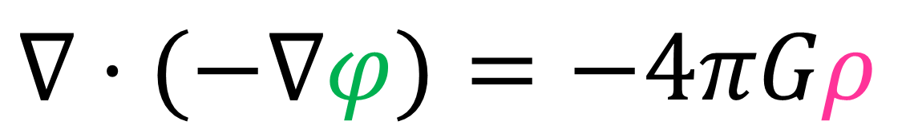

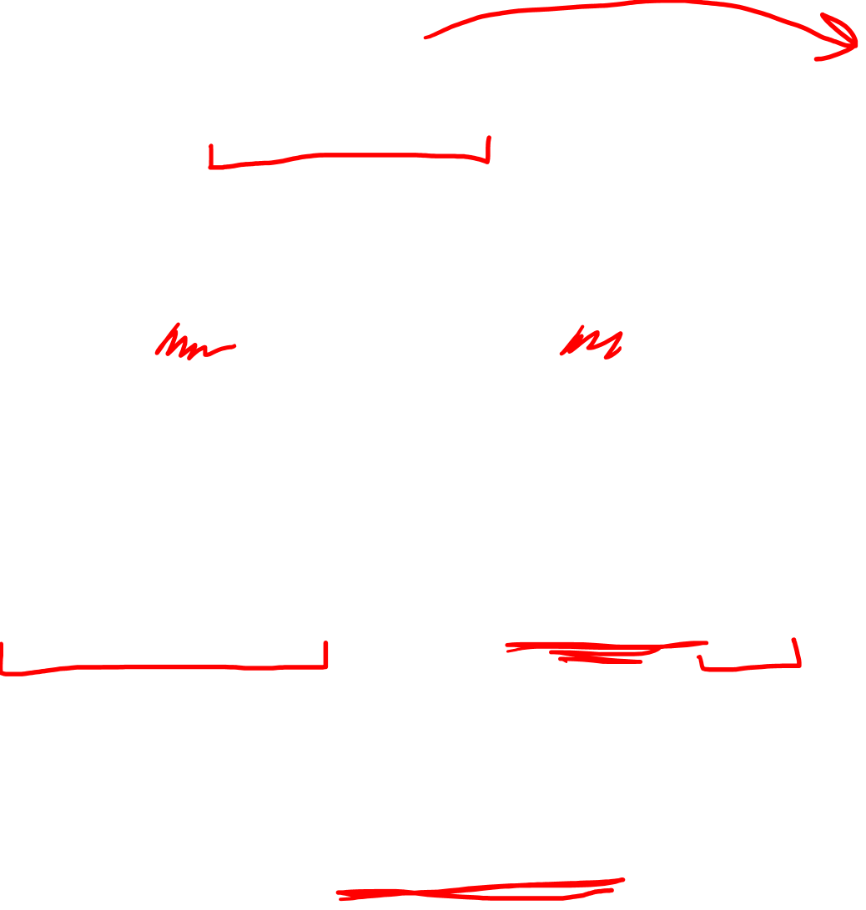
$$\vec{g}=(−∇φ)$$
$∇⋅\vec{g}=−4πGρ$
$∇⋅(−∇φ)=−4πGρ$
Poisson’s Equation
$∇⋅∇φ=4πGρ$
$$≡∇^{2}φ$$
“Laplacian”

Slide 9
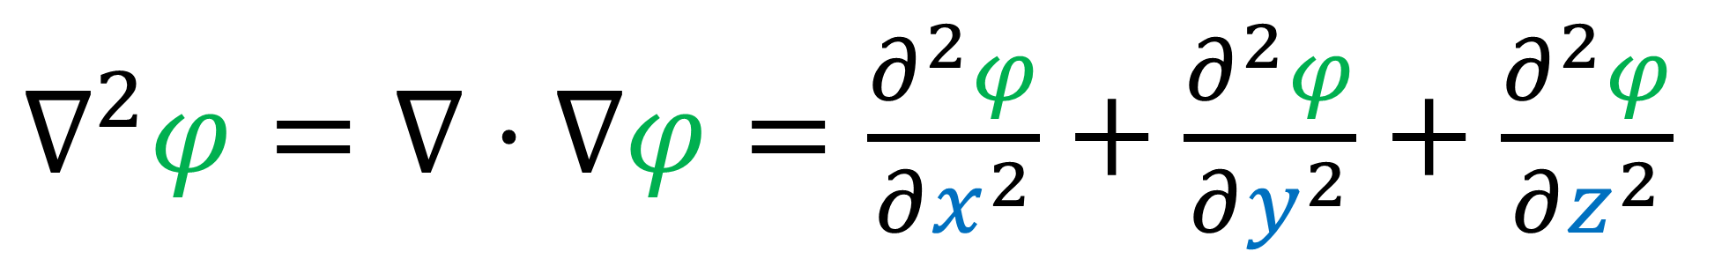

$∇^{2}φ=∇⋅∇φ=\frac{∂^{2}φ}{∂x^{2}}+\frac{∂^{2}φ}{∂y^{2}}+\frac{∂^{2}φ}{∂z^{2}}$
Laplacian = “bump detector” for $φ$

Slide 10
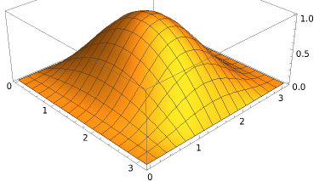
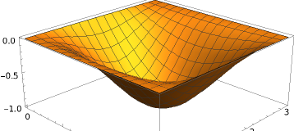
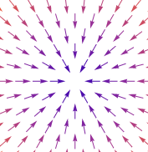
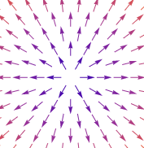
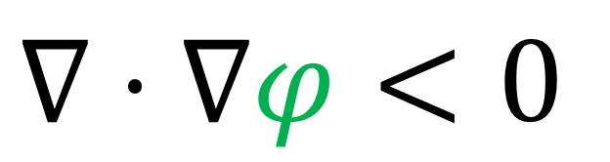
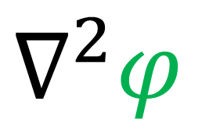
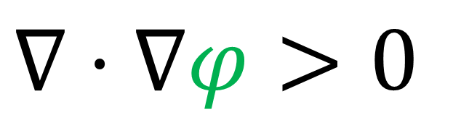
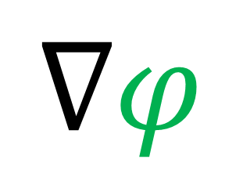

$$φ$$
$$∇φ$$
$$∇^{2}φ$$
$$∇⋅∇φ<0$$
$$∇⋅∇φ>0$$

Slide 11
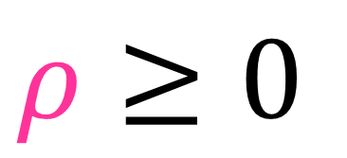
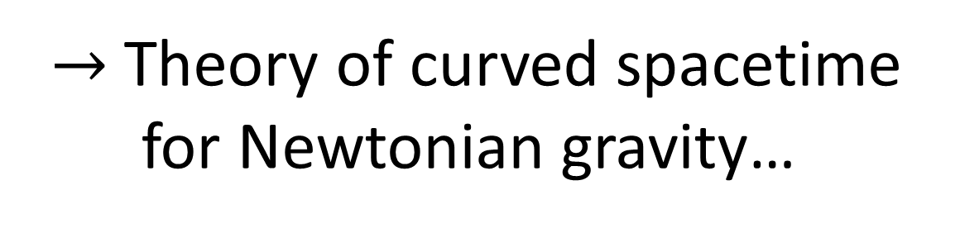
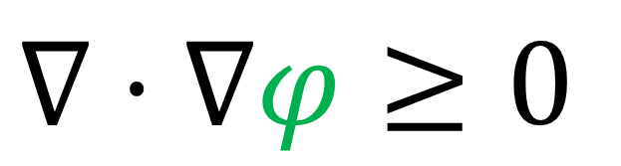




$$ρ≥0$$
Poisson’s Equation
$$∇⋅∇φ≥0$$
$∇⋅∇φ=4πGρ$
$$∇φ$$
$$φ$$
$$ρ$$
$→$ Theory of curved spacetime for Newtonian gravity…

Slide 12
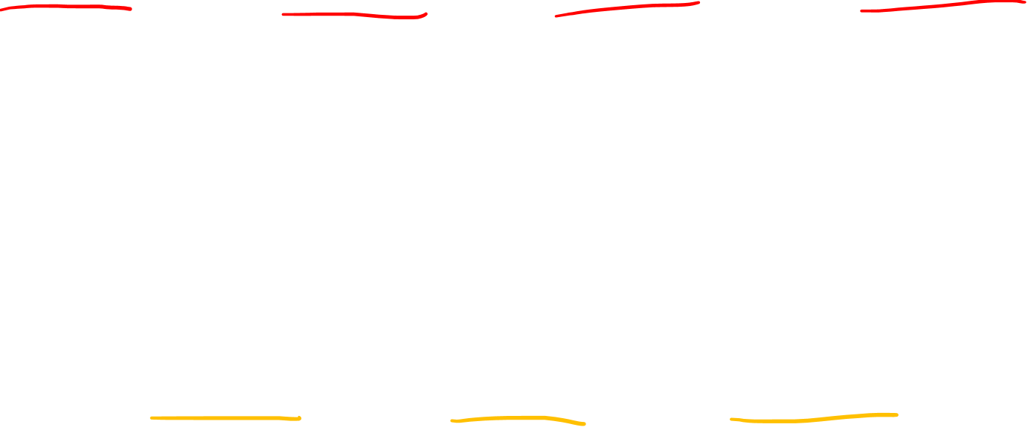
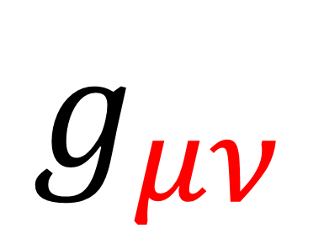


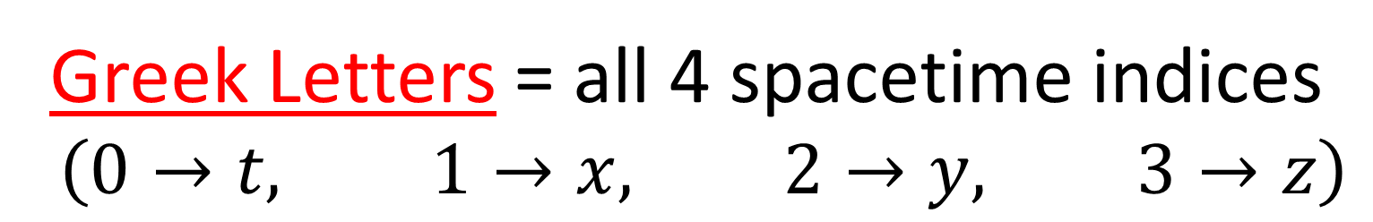
$$g_{μν}$$
Greek Letters = all 4 spacetime indices
$$\left(0→t, 1→x, 2→y, 3→z\right)$$
$$M_{ij}$$
Latin/English Letters = 3 space indices
$$\left(1→x, 2→y, 3→z\right)$$

Slide 13
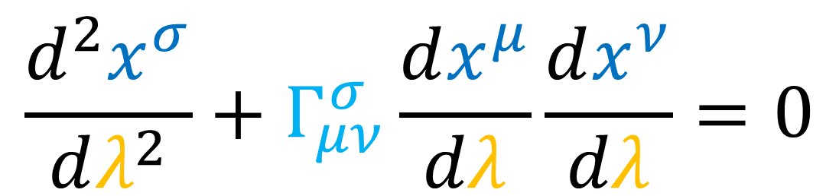
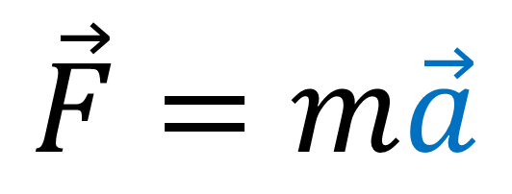
Newton’s 2nd Law
Geodesic Equation
$$\frac{d^{2}x^{σ}}{dλ^{2}}+Γ_{μν}^{σ}\frac{dx^{μ}}{dλ}\frac{dx^{ν}}{dλ}=0$$
$$\vec{F}=m\vec{a}$$

Slide 14




$m\vec{a}={\vec{F}}_{G}$
$m\vec{a}=m\vec{g}$
$\vec{a} = \vec{g}$
$\frac{d^{2}\vec{x}}{dt^{2}}=\left(−∇φ\right)$
$\frac{d^{2}x^{i}}{dt^{2}}=−\frac{∂φ}{∂x^{i}}$
$$\frac{d^{2}x^{i}}{dt^{2}}+\frac{∂φ}{∂x^{i}}=0$$
Looks like the Geodesic Equation…
Find $λ$ and $Γ_{μν}^{σ}$ to make the match!
$$\frac{d^{2}x^{σ}}{dλ^{2}}+Γ_{μν}^{σ}\frac{dx^{μ}}{dλ}\frac{dx^{ν}}{dλ}=0$$

Slide 15









$$\frac{d^{2}x^{i}}{dt^{2}}+\frac{∂φ}{∂x^{i}}=0$$
$\frac{d^{2}x^{σ}}{dλ^{2}}+Γ_{μν}^{σ}\frac{dx^{μ}}{dλ}\frac{dx^{ν}}{dλ}=0$
$$λ→t$$
$\frac{d^{2}x^{σ}}{dt^{2}}+Γ_{μν}^{σ}\frac{dx^{μ}}{dt}\frac{dx^{ν}}{dt}=0$
Find $λ$ and $Γ_{μν}^{σ}$ to make the match!
$$σ→0$$
$\frac{d^{2}x^{0}}{dt^{2}}+Γ_{μν}^{0}\frac{dx^{μ}}{dt}\frac{dx^{ν}}{dt}=0$
$\frac{d^{2}\left(t\right)}{dt^{2}}+Γ_{μν}^{0}\frac{dx^{μ}}{dt}\frac{dx^{ν}}{dt}=0$
$0 +Γ_{μν}^{0}\frac{dx^{μ}}{dt}\frac{dx^{ν}}{dt}=0$
$$⇒Γ_{μν}^{0}=0$$

Slide 16










$$\frac{d^{2}x^{i}}{dt^{2}}+\frac{∂φ}{∂x^{i}}=0$$
$\frac{d^{2}x^{i}}{dt^{2}}+Γ_{μν}^{i}\frac{dx^{μ}}{dt}\frac{dx^{ν}}{dt}=0$
No 1st order $\frac{dx^{i}}{dt}$ terms…
$$Γ_{jk}^{i}=0$$
$Γ_{j0}^{i}=0$
$Γ_{0k}^{i}=0$
$$⇒$$
Find $λ$ and $Γ_{μν}^{σ}$ to make the match!
$\frac{d^{2}x^{i}}{dt^{2}}+Γ_{00}^{i}\frac{dx^{0}}{dt}\frac{dx^{0}}{dt}=0$
$$λ→t$$
$$Γ_{μν}^{0}=0$$
$Γ_{00}^{i}$ must be $\frac{∂φ}{∂x^{i}}$
$\frac{d^{2}x^{i}}{dt^{2}}+\frac{∂φ}{∂x^{i}}\frac{d\left(t\right)}{dt}\frac{d\left(t\right)}{dt}=0$

Slide 17







$$\frac{d^{2}x^{σ}}{dλ^{2}}+Γ_{μν}^{σ}\frac{dx^{μ}}{dλ}\frac{dx^{ν}}{dλ}=0$$
$$λ→t$$
$Γ_{00}^{i}=\frac{∂φ}{∂x^{i}}$
All other $Γ_{μν}^{σ}=0$
$$\frac{d^{2}x^{i}}{dt^{2}}+\frac{∂φ}{∂x^{i}}=0$$
This is a “geodesic equation” for Newtonian Gravity.
$$\vec{a} + ∇φ = 0$$

Slide 18






We have connection coefficients for Newtonian Gravity:
$Γ_{00}^{i}=\frac{∂φ}{∂x^{i}}$
$$Γ_{μν}^{0}=Γ_{jk}^{i}=Γ_{0k}^{i}=Γ_{j0}^{i}=0$$
What’s the “Curvature” of spacetime for this connection?
$$R_{ σμν}^{ρ}=∂_{μ}\left(Γ_{νσ}^{ρ}\right)−∂_{ν}\left(Γ_{μσ}^{ρ}\right)+Γ_{νσ}^{α}Γ_{μα}^{ρ}−Γ_{μσ}^{β}Γ_{νβ}^{ρ}$$
Non-zero terms: lower index $σ$ must be $0$, upper index $ρ$ must be $i$:
$$R_{ 0μν}^{i}=∂_{μ}\left(Γ_{ν0}^{i}\right)−∂_{ν}\left(Γ_{μ0}^{i}\right)+Γ_{ν0}^{α}Γ_{μα}^{i}−Γ_{μ0}^{β}Γ_{νβ}^{i}$$
$$0$$
$$0$$
$$R_{ 0μν}^{i}=∂_{μ}\left(Γ_{ν0}^{i}\right)−∂_{ν}\left(Γ_{μ0}^{i}\right)$$

Slide 19












$$Γ_{μν}^{0}=Γ_{jk}^{i}=0$$
$$Γ_{0k}^{i}=Γ_{j0}^{i}=0$$
$$R_{ 0μν}^{i}=∂_{μ}\left(Γ_{ν0}^{i}\right)−∂_{ν}\left(Γ_{μ0}^{i}\right)$$
$$Γ_{00}^{i}=∂_{i}φ$$
$$μ=0,ν=0$$
$$μ=j,ν=0$$
$$R_{0j0}^{i}=∂_{j}\left(Γ_{00}^{i}\right)−∂_{0}\left(Γ_{j0}^{i}\right)$$
$R_{0j0}^{i}=∂_{j}\left(∂_{i}φ\right)−0$
$$R_{0j0}^{i}=∂_{j}∂_{i}φ$$
$$R_{000}^{i}=∂_{0}\left(Γ_{00}^{i}\right)−∂_{0}\left(Γ_{00}^{i}\right)$$
$$R_{000}^{i}=0$$
$$μ=0,ν=j$$
$$μ=j,ν=k$$
$$R_{00j}^{i}=∂_{0}\left(Γ_{j0}^{i}\right)−∂_{j}\left(Γ_{00}^{i}\right)$$
$R_{00j}^{i}=0−∂_{j}\left(∂_{i}φ\right)$
$$R_{00j}^{i}=−∂_{j}∂_{i}φ$$
$$R_{0jk}^{i}=∂_{j}\left(Γ_{k0}^{i}\right)−∂_{k}\left(Γ_{j0}^{i}\right)$$
$$R_{0jk}^{i}=0−0$$

Slide 20




We have connection coefficients for Newtonian Gravity:
$Γ_{00}^{i}=\frac{∂φ}{∂x^{i}}$
$$Γ_{μν}^{0}=Γ_{jk}^{i}=Γ_{0k}^{i}=Γ_{j0}^{i}=0$$
What’s the “Curvature” of spacetime for this connection?
$R_{0j0}^{i}=−R_{00j}^{i}=∂_{j}∂_{i}φ$
9 components
$$∂_{j}∂_{i}φ=∂_{i}∂_{j}φ$$
$$\left[\begin{matrix}∂_{1}∂_{1}φ & ∂_{2}∂_{1}φ & ∂_{3}∂_{1}φ \\ ∂_{1}∂_{2}φ & ∂_{2}∂_{2}φ & ∂_{3}∂_{2}φ \\ ∂_{1}∂_{3}φ & ∂_{2}∂_{3}φ & ∂_{3}∂_{3}φ\end{matrix}\right]$$
6 independent non-zero components

Slide 21





Explicit formulas (Cartesian Coordinates)
$R_{0j0}^{i}=−R_{00j}^{i}=∂_{j}∂_{i}φ$
Spherical Potential
$φ=−\frac{GM}{r}$
$$r=\sqrt{x^{2}+y^{2}+z^{2}}$$
$∂_{j}∂_{i}φ=\frac{GM}{r^{5}}\left(r^{2}δ^{ij}−3x^{i}x^{j}\right)$
$$→\frac{GM}{r^{5}}\left[\begin{matrix}r^{2}−3x^{2} & −3xy & −3xz \\ −3yx & r^{2}−3y^{2} & −3yz \\ −3zx & −3zy & r^{2}−3z^{2}\end{matrix}\right]$$

Slide 22









Explicit formulas $∂_{j}∂_{i}φ$ (Cartesian Coordinates)
$$+x$$
$$\frac{GM}{r^{5}}\left[\begin{matrix}r^{2}−3x^{2} & −3xy & −3xz \\ −3yx & r^{2}−3y^{2} & −3yz \\ −3zx & −3zy & r^{2}−3z^{2}\end{matrix}\right]$$
Set $x=r, y=z=0$
$$M$$
$→\frac{GM}{r^{3}}\left[\begin{matrix}−2 & 0 & 0 \\ 0 & 1 & 0 \\ 0 & 0 & 1\end{matrix}\right]$
$$+z$$
$$+y$$

Slide 23






Geodesic Deviation (relativity 107c)
$$∇_{\vec{V}}∇_{\vec{V}}\vec{T} =−R\left(\vec{T},\vec{V}\right)\vec{V}$$
Geodesics in time direction $\vec{V}=\vec{e_{0}}$
Separation in space direction $\vec{T}=\vec{e_{j}}$
$$\vec{T}$$
$$\vec{V}$$
$$∇_{\vec{e_{0}}}∇_{\vec{e_{0}}}\vec{e_{j}}=−R\left(\vec{e_{j}},\vec{e_{0}}\right)\vec{e_{0}}$$
$$∇_{\vec{e_{0}}}∇_{\vec{e_{0}}}\vec{e_{j}}=− R_{0j0}^{i} \vec{e_{i}}$$
$$∇_{\vec{e_{0}}}∇_{\vec{e_{0}}}\vec{e_{j}}=−\left(∂_{j}∂_{i}φ\right)\vec{e_{i}}$$

Slide 24





Geodesic Deviation
Special case $x=r, y=z=0$
$∂_{j}∂_{i}φ→$ $\frac{GM}{r^{3}}\left[\begin{matrix}−2 & 0 & 0 \\ 0 & 1 & 0 \\ 0 & 0 & 1\end{matrix}\right]$
$$∇_{\vec{e_{0}}}∇_{\vec{e_{0}}}\vec{e_{j}}=−\left(∂_{j}∂_{i}φ\right)\vec{e_{i}}$$
$j=x$ direction: $∇_{\vec{e_{0}}}∇_{\vec{e_{0}}}\vec{e_{x}}=+2$ $\frac{GM}{r^{3}}$ $\vec{e_{x}}$
geodesics spreading apart
$j=y$ direction: $∇_{\vec{e_{0}}}∇_{\vec{e_{0}}}\vec{e_{y}}=−1$ $\frac{GM}{r^{3}}$ $\vec{e_{y}}$
$j=z$ direction: $∇_{\vec{e_{0}}}∇_{\vec{e_{0}}}\vec{e_{z}}=−1$ $\frac{GM}{r^{3}}$ $\vec{e_{z}}$
geodesics coming together

Slide 25

$$∂_{j}∂_{i}φ→$$
$\frac{GM}{r^{3}}\left[\begin{matrix}−2 & 0 & 0 \\ 0 & 1 & 0 \\ 0 & 0 & 1\end{matrix}\right]$

Slide 26







$$∂_{j}∂_{i}φ→$$
$\frac{GM}{r^{3}}\left[\begin{matrix}−2 & 0 & 0 \\ 0 & 1 & 0 \\ 0 & 0 & 1\end{matrix}\right]$
Riemann Tensor (Newtonian Gravity)
$$x$$
$R_{0j0}^{i}=−R_{00j}^{i}=∂_{j}∂_{i}φ$
$$\left[\begin{matrix}∂_{1}∂_{1}φ & ∂_{2}∂_{1}φ & ∂_{3}∂_{1}φ \\ ∂_{1}∂_{2}φ & ∂_{2}∂_{2}φ & ∂_{3}∂_{2}φ \\ ∂_{1}∂_{3}φ & ∂_{2}∂_{3}φ & ∂_{3}∂_{3}φ\end{matrix}\right]$$
$$y$$
$$z$$
$$Φ_{ij}=∂_{j}∂_{i}φ$$
Tidal Tensor

Slide 27



Geodesic Deviation
$$∇_{\vec{V}}∇_{\vec{V}}\vec{T} =−R\left(\vec{T},\vec{V}\right)\vec{V}$$
Geodesics in space direction $\vec{V}=\vec{e_{k}}$
Separation in space direction $\vec{T}=\vec{e_{j}}$
$$\vec{T}$$
$$\vec{V}$$
$$∇_{\vec{e_{k}}}∇_{\vec{e_{k}}}\vec{e_{j}}=−R\left(\vec{e_{j}},\vec{e_{k}}\right)\vec{e_{k}}$$
$$∇_{\vec{e_{k}}}∇_{\vec{e_{k}}}\vec{e_{j}}=− R_{kjk}^{i} \vec{e_{i}}$$
$$∇_{\vec{e_{k}}}∇_{\vec{e_{k}}}\vec{e_{j}}= \vec{0}$$

Slide 28









$R_{00}=∇^{2}φ=4πGρ$
$R_{00}=0$ does NOT mean spacetime is flat outside Earth
Outside Earth
$$R_{0j0}^{i}=∂_{j}∂_{i}φ>0$$
tidal forces
Outside Earth
$$ρ≈0$$
$R_{00}≈0$
Ricci Tensor $R_{μν}$ cannot detect changes in shape
Ricci Tensor $R_{μν}$ can only detect changes in volume
Tidal forces don’t cause immediate change in volume
$⇒$ $R_{μν}$ cannot see tidal forces
Inside Earth
$ρ>0$
$R_{00}>0$

Slide 29




Recall: Riemann Curvature Tensor:
$$R\left(\vec{V},\vec{W}\right)\vec{T}$$
$$\vec{W}$$
$$\vec{T}$$
$$\vec{V}$$

Slide 30










What’s the “Curvature” of spacetime for this connection?
$R_{0j0}^{i}=−R_{00j}^{i}=∂_{j}∂_{i}φ$
$$\vec{T}$$
$$\vec{e_{k}}$$
$$\vec{e_{0}}$$
$$\vec{e_{0}}$$
$$\vec{e_{j}}$$
$$\vec{e_{j}}$$
$$R\left(\vec{e_{j}},\vec{e_{k}}\right)\vec{T}=\vec{0}$$
$$R\left(\vec{e_{j}},\vec{e_{0}}\right)\vec{e_{0}}≠\vec{0}$$

Slide 31

What’s the “Curvature” of spacetime for this connection?
$R_{0j0}^{i}=−R_{00j}^{i}=∂_{j}∂_{i}φ$
$$R\left(\vec{e_{j}},\vec{e_{k}}\right)\vec{T}=\vec{0}$$
Geodesic Deviation: $∇_{\vec{V}}∇_{\vec{V}}\vec{T}=−R\left(\vec{T},\vec{V}\right)\vec{V}$

Slide 32







Geodesic Deviation
Lie Bracket
Geodesic Equation
$$\left[\vec{T},\vec{V}\right]=\vec{0}$$
$$∇_{y}∇_{\vec{V}}\vec{V}=\vec{0}$$
$$\vec{T}$$
$$\left[\vec{T},\vec{V}\right]=\vec{0}$$
+ Torsion-Free
$$Γ_{μν}^{α}=Γ_{νμ}^{α}$$
$$\vec{V}$$
$$R\left(\vec{T},\vec{V}\right)\vec{V}+∇_{\vec{V}}∇_{\vec{T}}\vec{V}=\vec{0}$$
$$⇒∇_{\vec{T}}\vec{V}=∇_{\vec{V}}\vec{T}$$
$$R\left(\vec{T},\vec{V}\right)\vec{V}+∇_{\vec{V}}∇_{\vec{V}}\vec{T}=\vec{0}$$
$$∇_{\vec{V}}∇_{\vec{V}}\vec{T}=−R\left(\vec{T},\vec{V}\right)\vec{V}$$
(Proof in Tensor Calculus 21)

Slide 33




Riemann Curvature Tensor (non-zero components):
$R_{0j0}^{i}=−R_{00j}^{i}=∂_{j}∂_{i}φ$
$$R_{αβ}= R_{αμβ}^{μ}$$
Ricci Curvature Tensor:
$$R_{00}=R_{0μ0}^{μ}$$
$$R_{00}=R_{000}^{0}+R_{010}^{1}+R_{020}^{2}+R_{030}^{3}$$
$R_{00}=\left(0+∂_{1}∂_{1}φ+∂_{2}∂_{2}φ+∂_{3}∂_{3}φ\right)$
$R_{00}=\left(\frac{∂^{2}φ}{∂x^{2}}+\frac{∂^{2}φ}{∂y^{2}}+\frac{∂^{2}φ}{∂z^{2}}\right)=∇^{2}φ$

Slide 34







Poisson’s Equation
$$∇^{2}φ=4πGρ$$
$R_{00}≡R_{tt}=∇^{2}φ=4πGρ$
Poisson’s Equation
$$\vec{e_{x}}$$
$$ρ>0$$
$$\vec{e_{t}}$$
$$\vec{e_{y}}$$
$$\vec{e_{t}}$$

Slide 35


Converging Geodesics:
Mass density $ρ$ creates a potential “well” $∇^{2}φ$
potential “well” $∇^{2}φ$ causes time-pointing geodesics to converge $R_{tt}$
“Mass attracts other mass”
$R_{00}≡R_{tt}=∇^{2}φ=4πGρ$
$$\vec{e_{x}}$$
$$ρ>0$$
$$\vec{e_{t}}$$
$$\vec{e_{y}}$$
$$\vec{e_{t}}$$

Slide 36


Poisson’s Equation
$$∇^{2}φ=4πGρ$$
$R_{00}≡R_{tt}=∇^{2}φ=4πGρ$
Poisson’s Equation
time
$$ρ$$
$$ρ$$

Slide 37
Poisson’s Equation
$$∇^{2}φ=4πGρ$$
$R_{00}≡R_{tt}=∇^{2}φ=4πGρ$
Poisson’s Equation
time
$$ρ$$
$$ρ$$

Slide 38


Converging Geodesics:
Mass density $ρ$ creates a potential “well” $∇^{2}φ$
potential “well” $∇^{2}φ$ causes time-pointing geodesics to converge $R_{tt}$ (shrinking volume)
“Mass attracts other mass”
$R_{00}=R_{tt}≡∇^{2}φ=4πGρ$
time
$$ρ$$
$$ρ$$

Slide 39






$$m\vec{a}={\vec{F}}_{G}=m\left(−∇φ\right)$$
Newtonian Gravity Force Law
$\frac{d^{2}x^{i}}{dt^{2}}+\frac{∂φ}{∂x^{i}}=0$
“Geodesic Equation”
$$λ=t$$
$$\frac{d^{2}x^{σ}}{dλ^{2}}+Γ_{μν}^{σ}\frac{dx^{μ}}{dλ}\frac{dx^{ν}}{dλ}=0$$
$Γ_{00}^{i}=\frac{∂φ}{∂x^{i}}$

Slide 40



We have connection coefficients for Newtonian Gravity:
$Γ_{00}^{i}=\frac{∂φ}{∂x^{i}}$
$$Γ_{μν}^{0}=Γ_{jk}^{i}=Γ_{0k}^{i}=Γ_{j0}^{i}=0$$
Curvature of spacetime in Newtonian Gravity:
$$R_{0j0}^{i}=−R_{00j}^{i}=∂_{j}∂_{i}φ$$
Ricci Curvature related to Poisson’s Equation:
$R_{00}=R_{tt}≡∇^{2}φ=4πGρ$

Slide 41





$ρ$ is not Lorentz invariant (not a tensor)
$$Δx$$
$$\text{½} Δx$$
Length contraction
$\frac{m}{V}=ρ$
$\frac{m}{\text{½}V}=2ρ$

Slide 42


$$R_{00}=4πGρ$$
$$\left[\begin{matrix}\begin{matrix}\begin{aligned}R_{00} \\ 0 \\ 0 \\ 0\end{aligned} & \begin{aligned}0 \\ 0 \\ 0 \\ 0\end{aligned}\end{matrix} & \begin{matrix}\begin{aligned}0 \\ 0 \\ 0 \\ 0\end{aligned} & \begin{aligned}0 \\ 0 \\ 0 \\ 0\end{aligned}\end{matrix}\end{matrix}\right]=4πG\left[\begin{matrix}\begin{matrix}\begin{aligned}ρc^{2} \\ 0 \\ 0 \\ 0\end{aligned} & \begin{aligned}0 \\ 0 \\ 0 \\ 0\end{aligned}\end{matrix} & \begin{matrix}\begin{aligned}0 \\ 0 \\ 0 \\ 0\end{aligned} & \begin{aligned}0 \\ 0 \\ 0 \\ 0\end{aligned}\end{matrix}\end{matrix}\right]$$
There are 16 equations in this tensor formula (only 10 are unique).
Poisson’s Equation is actually 1 of 10 equations. At low mass density, and low speeds, the other 9 equations are just 0 = 0.

Slide 43


$$R_{00} = 4πGρ$$
$$\left[\begin{matrix}\begin{matrix}\begin{aligned}R_{00} \\ 0 \\ 0 \\ 0\end{aligned} & \begin{aligned}0 \\ 0 \\ 0 \\ 0\end{aligned}\end{matrix} & \begin{matrix}\begin{aligned}0 \\ 0 \\ 0 \\ 0\end{aligned} & \begin{aligned}0 \\ 0 \\ 0 \\ 0\end{aligned}\end{matrix}\end{matrix}\right]=4πG\left[\begin{matrix}\begin{matrix}\begin{aligned}ρ \\ 0 \\ 0 \\ 0\end{aligned} & \begin{aligned}0 \\ 0 \\ 0 \\ 0\end{aligned}\end{matrix} & \begin{matrix}\begin{aligned}0 \\ 0 \\ 0 \\ 0\end{aligned} & \begin{aligned}0 \\ 0 \\ 0 \\ 0\end{aligned}\end{matrix}\end{matrix}\right]$$
Energy-Momentum Tensor (next video)

Slide 44



$$∇^{2}φ=4πGρ=R_{00}$$
$ρ$ is not Lorentz invariant (not a tensor)
Its value is different in different reference frames due to length contraction… (same mass, half volume) $ρ$ must be one component of a larger 4x4 tensor, just like $R_{00}$ in the 4x4 Ricci Tensor.
$⇒$ Energy-Momentum Tensor! (next video)

