Slide 1
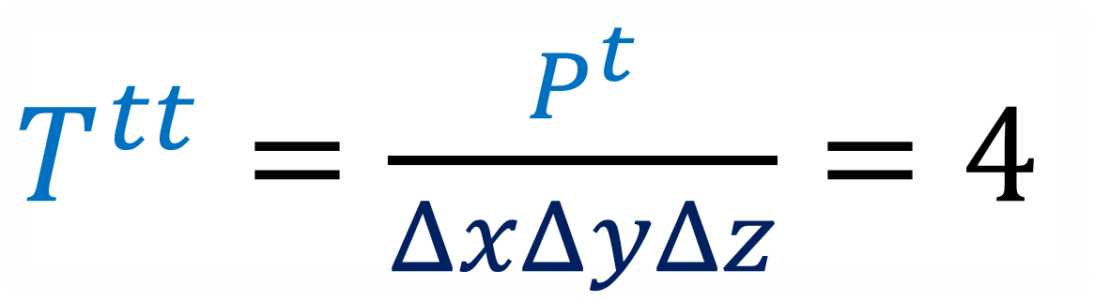
Energy-Momentum Tensor
$T^{tt}=\frac{P^{t}}{ΔxΔyΔz}=4$

Slide 2
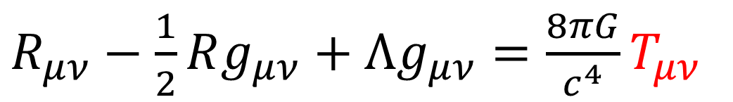

Relativity 107: General Relativity
Equivalence Principle
Tangent Spaces
Curvature
Newton-Cartan Theory (Curved Newtonian Gravity)
Energy-Momentum Tensor
Einstein Field Equations
$R_{μν}−\frac{1}{2}Rg_{μν}+Λg_{μν}=\frac{8πG}{c^{4}}T_{μν}$

Slide 3
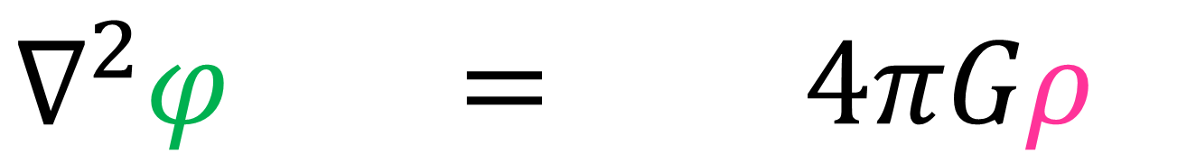
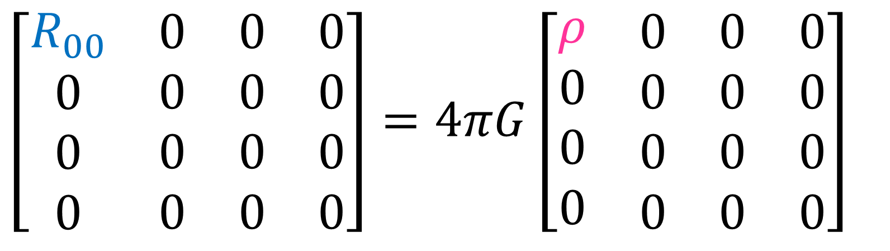

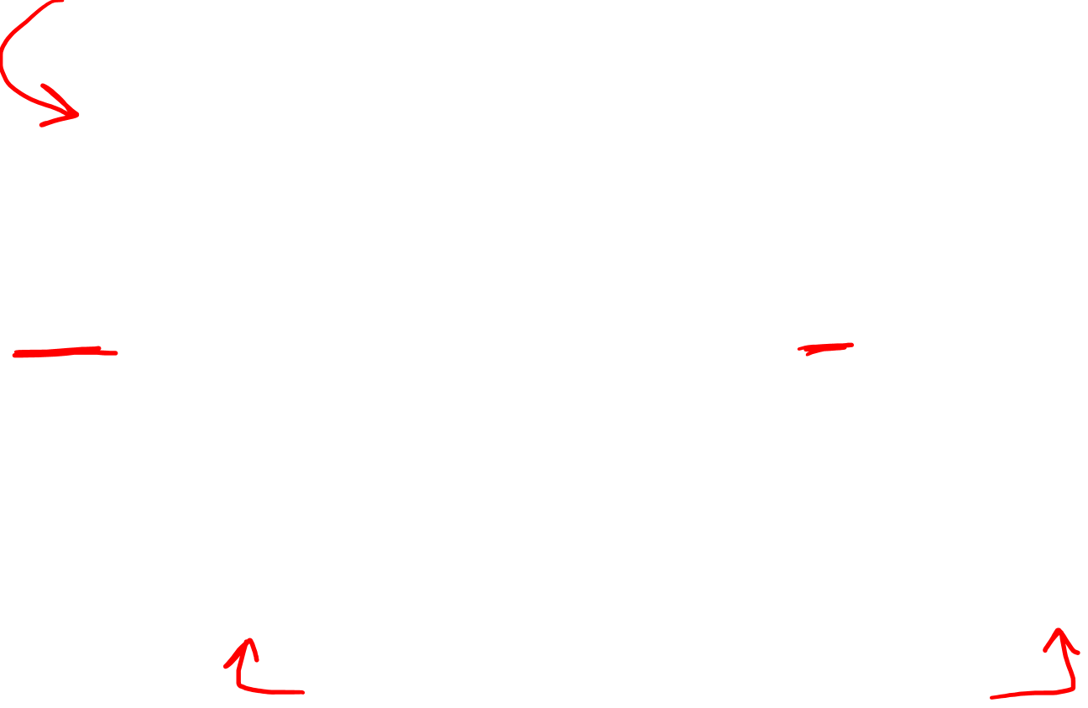
Poisson’s Equation:
$$∇^{2}φ = 4πGρ$$
$$R_{00} = 4πGρ$$
$$\left[\begin{matrix}\begin{matrix}\begin{aligned}R_{00} \\ 0 \\ 0 \\ 0\end{aligned} & \begin{aligned}0 \\ 0 \\ 0 \\ 0\end{aligned}\end{matrix} & \begin{matrix}\begin{aligned}0 \\ 0 \\ 0 \\ 0\end{aligned} & \begin{aligned}0 \\ 0 \\ 0 \\ 0\end{aligned}\end{matrix}\end{matrix}\right]=4πG\left[\begin{matrix}\begin{matrix}\begin{aligned}ρ \\ 0 \\ 0 \\ 0\end{aligned} & \begin{aligned}0 \\ 0 \\ 0 \\ 0\end{aligned}\end{matrix} & \begin{matrix}\begin{aligned}0 \\ 0 \\ 0 \\ 0\end{aligned} & \begin{aligned}0 \\ 0 \\ 0 \\ 0\end{aligned}\end{matrix}\end{matrix}\right]$$
(not Lorentz-invariant)

Slide 4
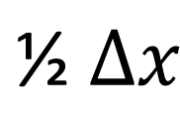

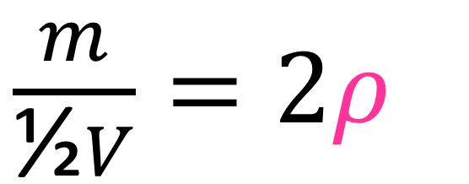
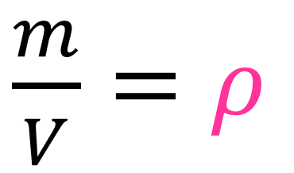
Mass density is not Lorentz invariant (not a tensor)
Rest frame
$$\text{½} Δx$$
$$Δx$$
Moving Frame
Length contraction
$\frac{m}{V}=ρ$
$\frac{m}{\text{½}V}=2ρ$

Slide 5
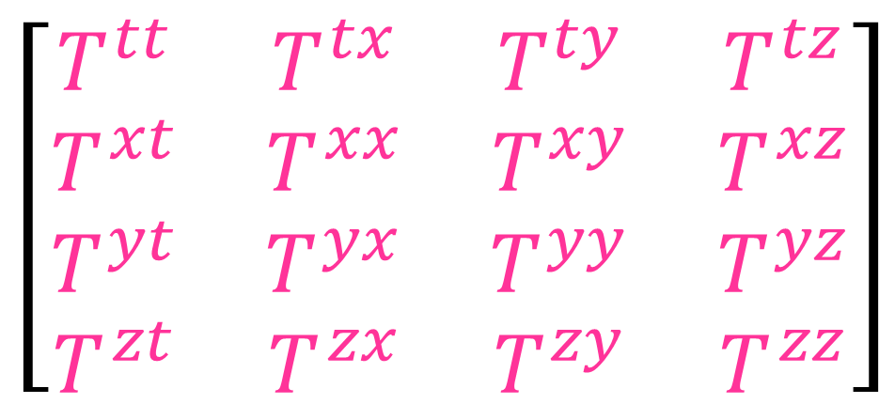
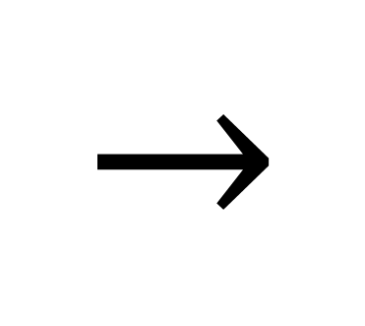

Energy-Momentum Tensor (Lorentz-invariant!)
Mass Density (not Lorentz-invariant)
$$ρ$$
$\left[\begin{matrix}\begin{matrix}\begin{aligned}T^{tt} \\ T^{xt} \\ T^{yt} \\ T^{zt}\end{aligned} & \begin{aligned}T^{tx} \\ T^{xx} \\ T^{yx} \\ T^{zx}\end{aligned}\end{matrix} & \begin{matrix}\begin{aligned}T^{ty} \\ T^{xy} \\ T^{yy} \\ T^{zy}\end{aligned} & \begin{aligned}T^{tz} \\ T^{xz} \\ T^{yz} \\ T^{zz}\end{aligned}\end{matrix}\end{matrix}\right]$
$$→$$

Slide 6
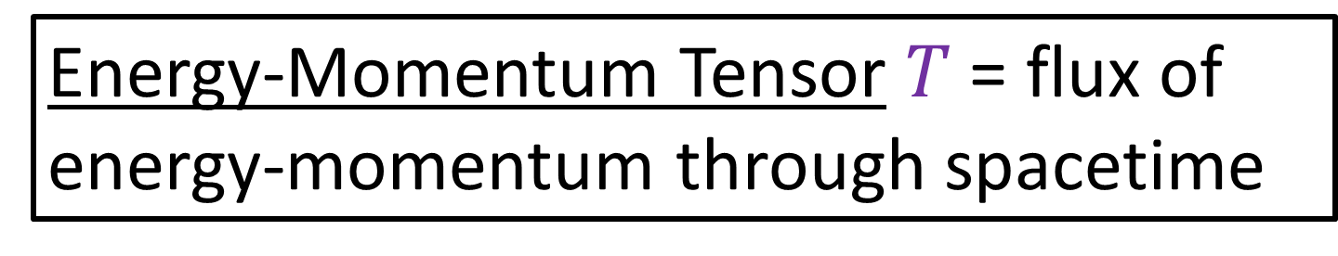
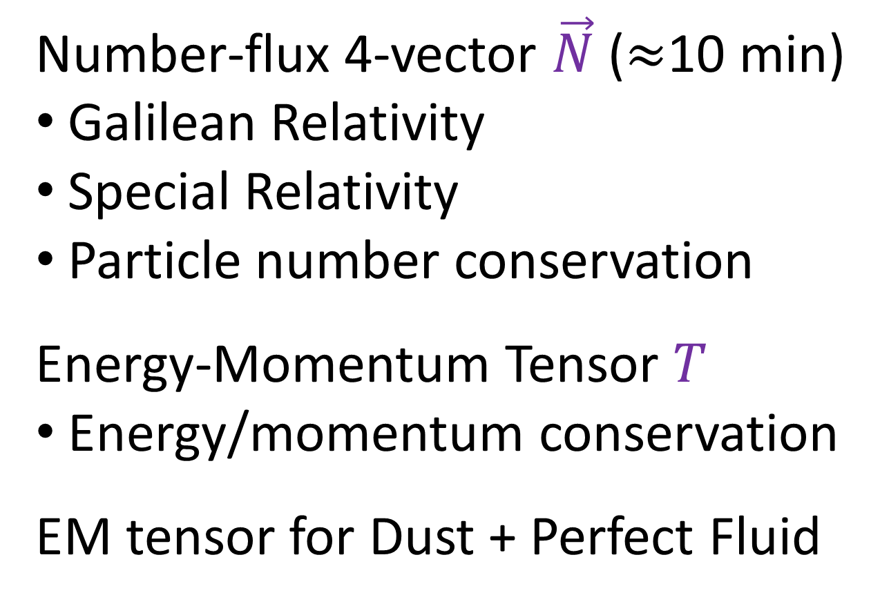
Energy-Momentum Tensor $T$ = flux of energy-momentum through spacetime
Number-flux 4-vector $\vec{N}$ ($≈$10 min)
Galilean Relativity
Special Relativity
Particle number conservation
Energy-Momentum Tensor $T$
Energy/momentum conservation
EM tensor for Dust + Perfect Fluid

Slide 7
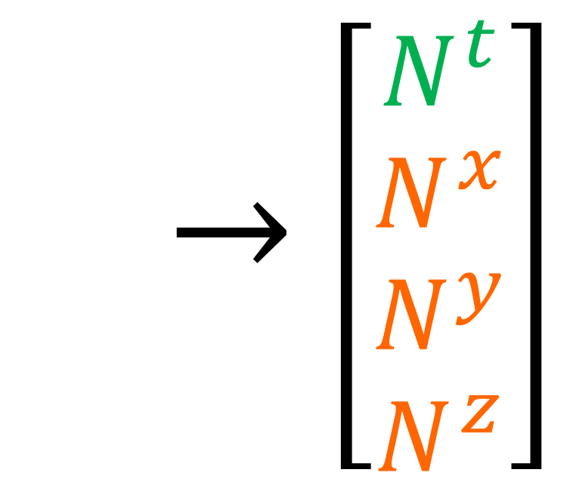


Number-flux 4-vector (Galilean Relativity)
Number density (time-flux)
$\vec{N}→$ $\left[\begin{aligned}N^{t} \\ N^{x} \\ N^{y} \\ N^{z}\end{aligned}\right]$
$$\vec{N}$$
Number current density (space-flux)

Slide 8














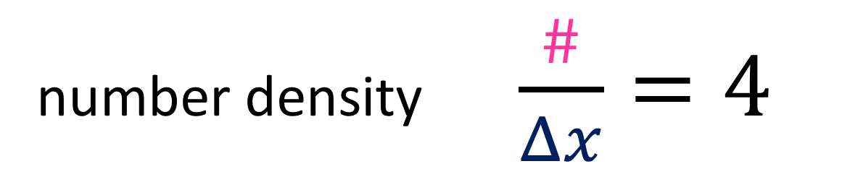






density (1D) = quantity per unit length
$$e^{−}$$
$$e^{−}$$
$$e^{−}$$
$$e^{−}$$
$$e^{−}$$
$$e^{−}$$
$$e^{−}$$
$$e^{−}$$
$$e^{−}$$
$$e^{−}$$
$$kg$$
$$kg$$
$$kg$$
$$kg$$
$$kg$$
$$kg$$
$$kg$$
$$kg$$
$$kg$$
$$kg$$
charge density
= charge/length
mass density
= kg/length
number density
= #/length
number density $\frac{\#}{Δx}=4$

Slide 9














density (1D) = quantity per unit length
$$e^{−}$$
$$e^{−}$$
$$e^{−}$$
$$e^{−}$$
$$e^{−}$$
$$e^{−}$$
$$e^{−}$$
$$e^{−}$$
$$e^{−}$$
$$e^{−}$$
$$kg$$
$$kg$$
$$kg$$
$$kg$$
$$kg$$
$$kg$$
$$kg$$
$$kg$$
$$kg$$
$$kg$$
charge density
= charge/length
mass density
= kg/length
number density
= #/length
current (1D) = quantity passing point in unit time
$$e^{−}$$
$$e^{−}$$
$$e^{−}$$
$$e^{−}$$
$$e^{−}$$
$$e^{−}$$
$$e^{−}$$
$$kg$$
$$kg$$
$$kg$$
$$kg$$
$$kg$$
$$kg$$
$$kg$$
electric current
= charge/second
mass current
= kg/second
number current
= #/second

Slide 10



$$\vec{e_{t}}$$
$$\vec{e_{x}}$$

Slide 11



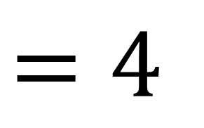
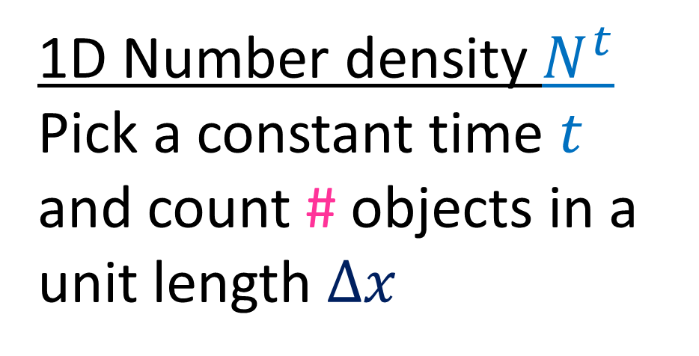
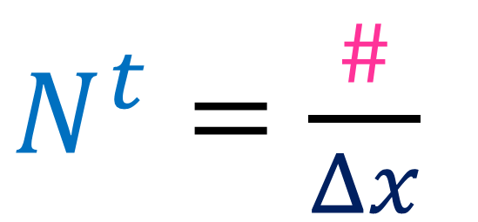
1D Number density $N^{t}$
Pick a constant time $t$ and count # objects in a unit length $Δx$
$$Δx$$
$$t$$
$$\vec{e_{t}}$$
$N^{t}=\frac{\#}{Δx}$
$=4$
$$\vec{e_{x}}$$

Slide 12
$$\vec{e_{t}}$$
$$\vec{e_{x}}$$

Slide 13


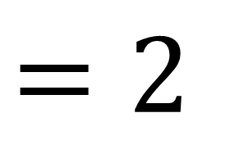

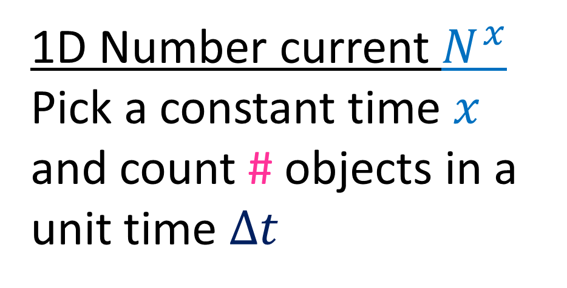
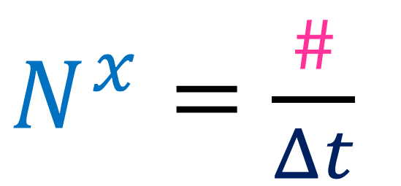
$$x$$
1D Number current $N^{x}$
Pick a constant time $x$ and count # objects in a unit time $Δt$
$$Δt$$
$$\vec{e_{t}}$$
$N^{x}=\frac{\#}{Δt}$
$=2$
$$\vec{e_{x}}$$

Slide 14
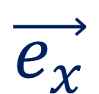

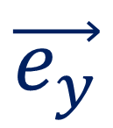
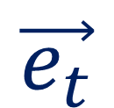
2D number density
$$\vec{e_{t}}$$
$$\vec{e_{x}}$$
$$\vec{e_{y}}$$

Slide 15


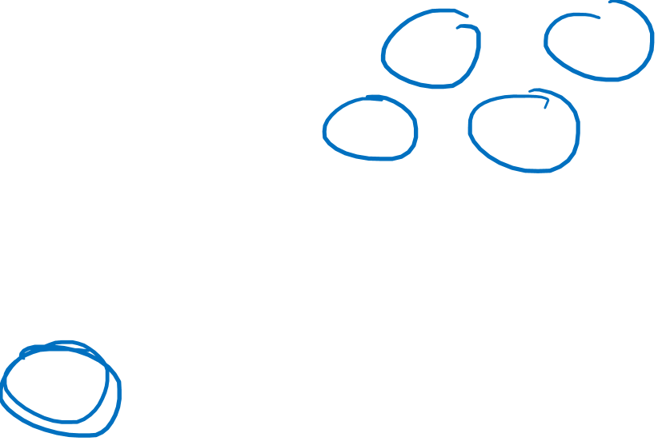

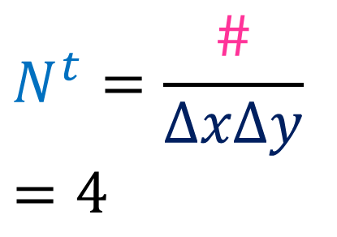
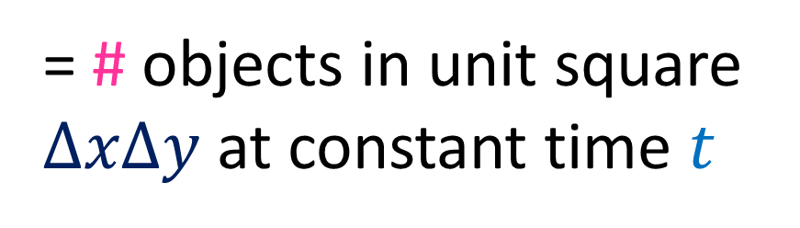
2D number density
$$\vec{e_{t}}$$
= # objects in unit square $ΔxΔy$ at constant time $t$
$$\vec{e_{x}}$$
$$\vec{e_{y}}$$
$$\vec{e_{t}}$$
$$\vec{e_{x}}$$
$$N^{t}=\frac{\#}{ΔxΔy}$$
$=4$
$$\vec{e_{y}}$$

Slide 16
2D x-current density
$$\vec{e_{t}}$$
$$\vec{e_{x}}$$
$$\vec{e_{y}}$$

Slide 17


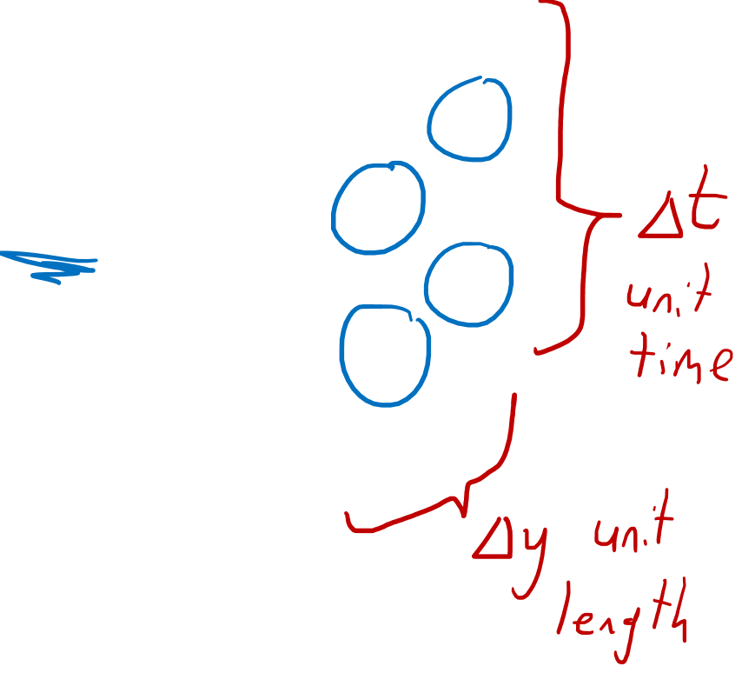

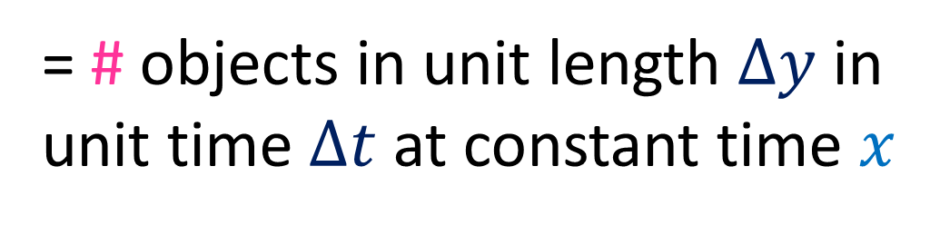

2D x-current density
$$\vec{e_{t}}$$
= # objects in unit length $Δy$ in unit time $Δt$at constant time $x$
$$\vec{e_{x}}$$
$$\vec{e_{y}}$$
$$N^{x}=\frac{\#}{ΔtΔy}$$
$=4$
$$\vec{e_{t}}$$
$$\vec{e_{x}}$$
$$\vec{e_{y}}$$

Slide 18
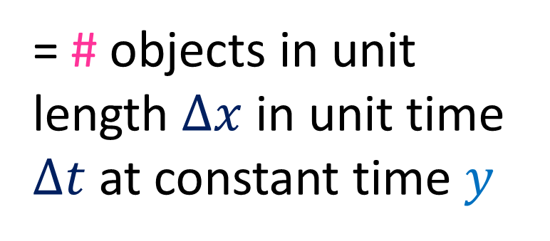
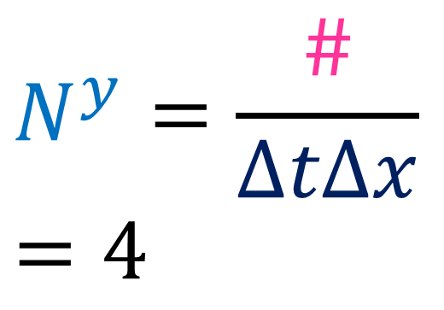

2D y-current density
$$\vec{e_{t}}$$
$$\vec{e_{x}}$$
= # objects in unit length $Δx$ in unit time $Δt$at constant time $y$
$$\vec{e_{y}}$$
$$N^{y}=\frac{\#}{ΔtΔx}$$
$=4$

Slide 19

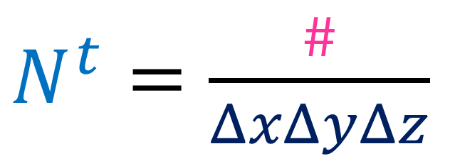
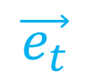
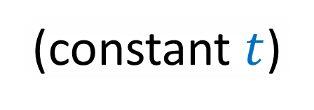

3D density
$$\vec{e_{z}}$$
$$\vec{e_{t}}$$
(Visualization doesn’t make sense on paper.)
$$\vec{e_{z}}$$
$$\vec{e_{t}}$$
$$\vec{e_{x}}$$
$$\vec{e_{x}}$$
$$\vec{e_{y}}$$
$$\vec{e_{y}}$$
$N^{t}=\frac{\#}{ΔxΔyΔz}$
(constant $t$)

Slide 20
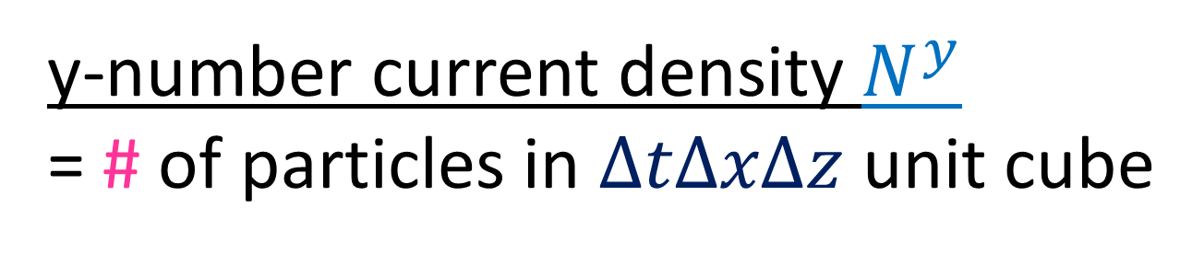
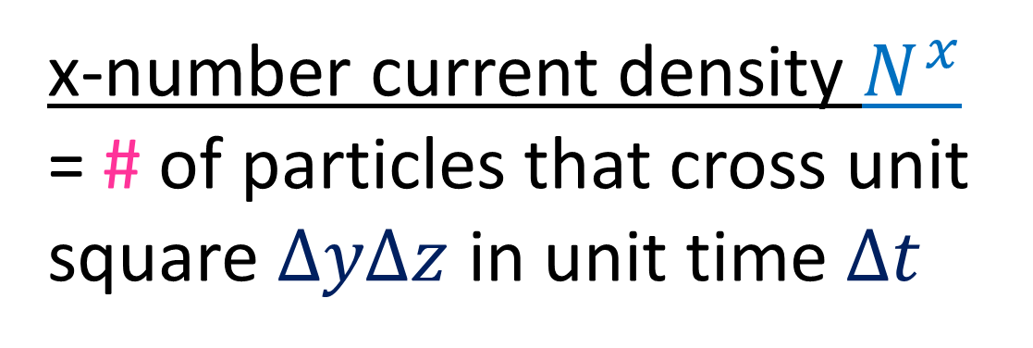




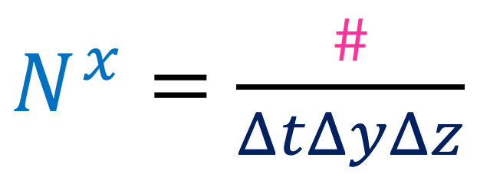
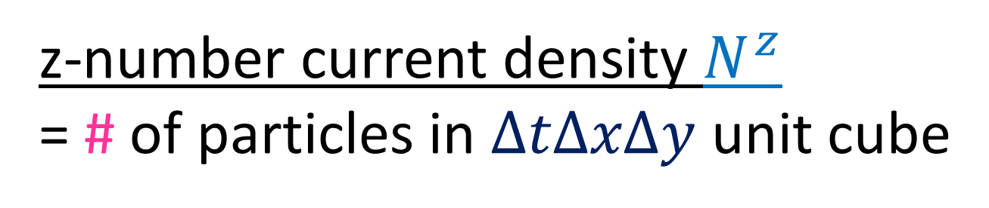
x-number current density $N^{x}$
= # of particles that cross unit square $ΔyΔz$ in unit time $Δt$
$N^{x}=\frac{\#}{ΔtΔyΔz}$
$$Δy$$
$$Δt$$
$$Δz$$
y-number current density $N^{y}$
= # of particles in $ΔtΔxΔz$ unit cube
z-number current density $N^{z}$
= # of particles in $ΔtΔxΔy$ unit cube

Slide 21

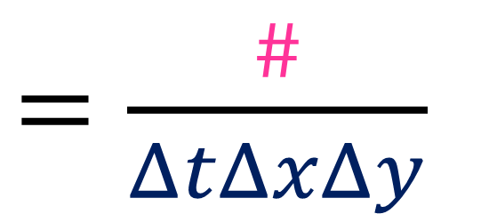
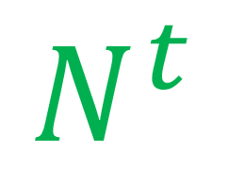
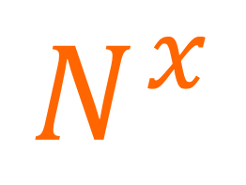
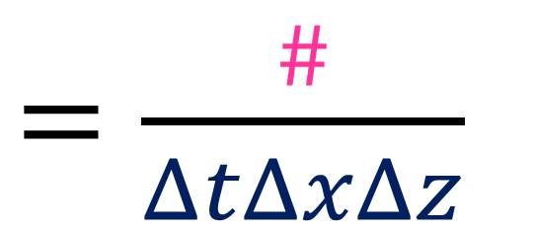
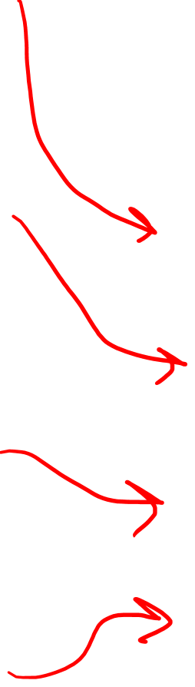
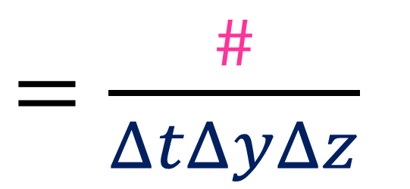
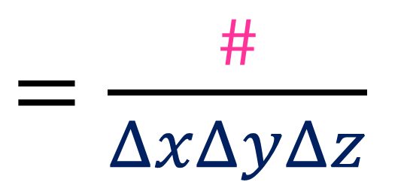

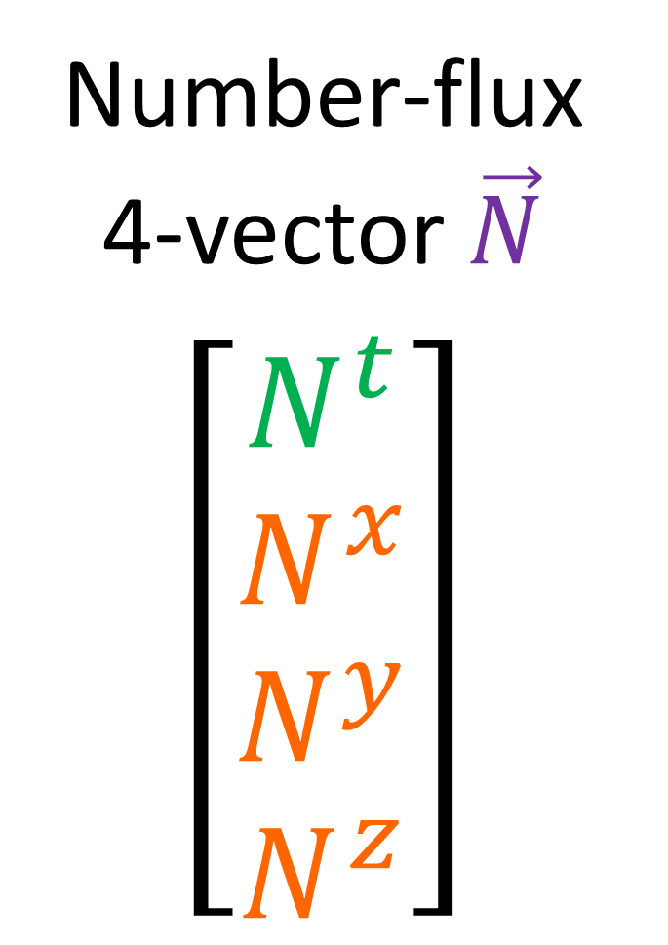
$=\frac{\#}{ΔxΔyΔz}$
Number density
$$N^{t}$$
Number-flux 4-vector $\vec{N}$
$$\left[\begin{aligned}N^{t} \\ N^{x} \\ N^{y} \\ N^{z}\end{aligned}\right]$$
$$N^{x}$$
$=\frac{\#}{ΔtΔyΔz}$
Number current density
$$N^{y}$$
$=\frac{\#}{ΔtΔxΔz}$
$=\frac{\#}{ΔtΔxΔy}$
$$N^{z}$$

Slide 22

For my videos:
Flux $≡$ “current density”
(2D flux)
# of worldlines that cross a unit box in a spacetime diagram
# of particles in a unit box when one spacetime coordinate is held constant

Slide 23



If 5 worldlines enter a spacetime box…
… then 5 worldlines must leave.
(particles don’t get created or destroyed)
$$\vec{e_{t}}$$
$⇒$ 4D “divergence” of flux vector $\vec{N}$ is zero
$\frac{∂N^{t} }{∂t}+\frac{∂N^{x}}{∂x}+\frac{∂N^{y}}{∂y}+\frac{∂N^{z}}{∂z}=0$
$$\vec{e_{x}}$$

Slide 24










$\frac{∂N^{t} }{∂t}+\frac{∂N^{x}}{∂x}+\frac{∂N^{y}}{∂y}+\frac{∂N^{z}}{∂z}=0$
$∂_{μ}N^{μ}=0$
“Continuity Equation”
$\frac{∂N^{t}}{∂t} + ∇⋅\vec{N^{i}} =0$
$∇⋅\vec{N^{i}}>0$
$∇⋅\vec{N^{i}}<0$
$\frac{∂N^{t}}{∂t}<0$
$\frac{∂N^{t}}{∂t}>0$
$$ΔxΔyΔz$$
$$ΔxΔyΔz$$

Slide 25
















$=\frac{\#}{ΔxΔyΔz}$
$$N^{t}$$
$≡n$
$$N^{x}$$
$=\frac{\#}{ΔtΔyΔz}$
$=\frac{Δx}{Δt}\frac{\#}{ΔxΔyΔz}$
$=u^{x}n$
$=\frac{\#}{ΔtΔxΔz}$
$=\frac{Δy}{Δt}\frac{\#}{ΔxΔyΔz}$
$$N^{y}$$
$=u^{y}n$
$=\frac{\#}{ΔtΔxΔy}$
$=\frac{Δz}{Δt}\frac{\#}{ΔxΔyΔz}$
$$N^{z}$$
$=u^{z}n$

Slide 26



$$\vec{N}→\left[\begin{aligned}N^{t} \\ N^{x} \\ N^{y} \\ N^{z}\end{aligned}\right]=\left[\begin{aligned}n1 \\ nu^{x} \\ nu^{y} \\ nu^{z}\end{aligned}\right]=n\left[\begin{aligned}1 \\ u^{x} \\ u^{y} \\ u^{z}\end{aligned}\right]$$
3-velocity is relative:
$$\vec{u}=u^{x}\vec{e_{x}}+u^{y}\vec{e_{y}}+u^{z}\vec{e_{z}}$$
$$\tilde{\vec{u}}=\tilde{u^{x}}\tilde{\vec{e_{x}}}+\tilde{u^{y}}\tilde{\vec{e_{y}}}+\tilde{u^{z}}\tilde{\vec{e_{z}}}$$

Slide 27










1D Number density $\tilde{N^{t}}$
Pick a constant time $\tilde{t}$ and count # objects in a unit length $Δ\tilde{x}$
$$Δ\tilde{x}$$
$$\tilde{t}$$
$$\vec{e_{t}}$$
$$\tilde{\vec{e_{t}}}$$
$N^{t}=\frac{\#}{Δx}$
$=4$
$\tilde{N^{t}}=\frac{\#}{Δ\tilde{x} }$
$=4$
$$\vec{e_{x}}$$
$$\tilde{\vec{e_{x}}}$$

Slide 28







1D Number current $\tilde{N^{x}}$
Pick a constant position $\tilde{x}$ and count # objects in a unit time $Δ\tilde{t}$
$$\tilde{x}$$
$$\vec{e_{t}}$$
$$\tilde{\vec{e_{t}}}$$
$$Δ\tilde{t}$$
$N^{x}=\frac{\#}{Δt}$
$=0$
$\tilde{N^{x}}=\frac{\#}{Δ\tilde{t}}$
$=−2$
$$\vec{e_{x}}$$
$$\tilde{\vec{e_{x}}}$$

Slide 29



Upgrade to Special Relativity:
Rest frame
$$\text{½} Δx$$
$$Δx$$
Moving Frame
Length contraction
$\frac{\#}{ΔxΔyΔz }=n$
$\frac{\#}{\text{½}ΔxΔyΔz }=2n$

Slide 30












$$\vec{e_{t}}$$
$$\tilde{\vec{e_{t}}}$$
$$\tilde{\vec{e_{x}}}$$
$$\vec{e_{x}}$$
Number density $\tilde{N^{t}}$
Pick a constant time $c\tilde{t}$ and count # objects in a unit length $Δ\tilde{x}$
$$c\tilde{t}$$
$$\tilde{\vec{e_{t}}}$$
$$\vec{e_{t}}$$
$N^{t}=\frac{\#}{Δx}$
$$Δ\tilde{x}$$
$=4$
$$\tilde{\vec{e_{x}}}$$
$\tilde{N^{t}}=\frac{\#}{Δ\tilde{x}}$
$≈5$
$$\vec{e_{x}}$$

Slide 31






$$\vec{e_{t}}$$
$$\tilde{\vec{e_{t}}}$$
$$\tilde{\vec{e_{x}}}$$
$$\vec{e_{x}}$$
Number density $\tilde{N^{t}}$
Pick a constant time $c\tilde{t}$ and count # objects in a unit length $Δ\tilde{x}$
$$c\tilde{t}$$
$$\tilde{N^{t}}=nγ=4γ$$
$$\tilde{\vec{e_{t}}}$$
$$\vec{e_{t}}$$
$N^{t}=\frac{\#}{Δx}$
$$Δ\tilde{x}$$
$=4$
$$\tilde{\vec{e_{x}}}$$
$\tilde{N^{t}}=\frac{\#}{Δ\tilde{x}}$
$≈5$
$$\vec{e_{x}}$$

Slide 32






$x$-number current $\tilde{N^{x}}$
Pick a constant position $\tilde{x}$ and count # objects in a unit time $Δc\tilde{t}$
$$\tilde{x}$$
$$\tilde{\vec{e_{t}}}$$
$$Δc\tilde{t}$$
$$\vec{e_{t}}$$
$N^{x}=\frac{\#}{Δct}$
$=0$
$$\tilde{\vec{e_{x}}}$$
$\tilde{N^{x}}=\frac{\#}{Δc\tilde{t}}$
$≈−3$
$$\vec{e_{x}}$$

Slide 33


$x$-number current $\tilde{N^{x}}$
Pick a constant position $\tilde{x}$ and count # objects in a unit time $Δc\tilde{t}$
$$\tilde{x}$$
$$\tilde{\vec{e_{t}}}$$
$${\tilde{N^{x}}}_{Lorentz}={\tilde{N^{x}}}_{Galilean}γ=(−2)γ$$
$$Δc\tilde{t}$$
$$\vec{e_{t}}$$
$N^{x}=\frac{\#}{Δct}$
$=0$
$$\tilde{\vec{e_{x}}}$$
$\tilde{N^{x}}=\frac{\#}{Δc\tilde{t}}$
$≈−3$
$$\vec{e_{x}}$$

Slide 34











$$\vec{N}→\left[\begin{aligned}N^{t} \\ N^{x} \\ N^{y} \\ N^{z}\end{aligned}\right]=\left[\begin{aligned}n1 \\ nu^{x} \\ nu^{y} \\ nu^{z}\end{aligned}\right]=n\left[\begin{aligned}1 \\ u^{x} \\ u^{y} \\ u^{z}\end{aligned}\right]$$
Galilean Relativity
Special Relativity
$$\vec{S}→\left[\begin{aligned}t \\ x \\ y \\ z\end{aligned}\right]$$
$$\vec{S}→\left[\begin{aligned}ct \\ x \\ y \\ z\end{aligned}\right]$$
Looks like 4-velocity $\vec{U}$
Rest number density (same in all frames)
$γ$
$$\vec{N}→n\left[\begin{aligned}1 \\ u^{x} \\ u^{y} \\ u^{z}\end{aligned}\right]$$
$$\vec{N}→n\left[\begin{aligned}γ c \\ {γ u}^{x} \\ γ u^{y} \\ γ u^{z}\end{aligned}\right]$$
$γ$
$γ$
$γ$

Slide 35


Rest number density (same in all frames)
Number-flux
4-vector
4-velocity
$$\vec{N}=n \vec{U}$$
$$=nγ\left(c\vec{e_{t}}+u^{x}\vec{e_{x}}+u^{y}\vec{e_{y}}+u^{z}\vec{e_{z}}\right)$$

Slide 36







$$\vec{N}=n \vec{U}$$
Particle “rest number density” $n$
is the same in all frames.
Transform $\vec{U}$
Transform $\vec{N}$
$\left[\begin{aligned}\tilde{U^{t}} \\ \tilde{U^{x}} \\ \tilde{U^{y}} \\ \tilde{U^{z}}\end{aligned}\right]=$ $\left[\begin{matrix}\begin{matrix}\begin{aligned}γ \\ −γβ \\ 0 \\ 0\end{aligned} & \begin{aligned}−γβ \\ γ \\ 0 \\ 0\end{aligned}\end{matrix} & \begin{matrix}\begin{aligned}0 \\ 0 \\ 1 \\ 0\end{aligned} & \begin{aligned}0 \\ 0 \\ 0 \\ 1\end{aligned}\end{matrix}\end{matrix}\right]$ $\left[\begin{aligned}U^{t} \\ U^{x} \\ U^{y} \\ U^{z}\end{aligned}\right]$
$n\left[\begin{aligned}\tilde{U^{t}} \\ \tilde{U^{x}} \\ \tilde{U^{y}} \\ \tilde{U^{z}}\end{aligned}\right]=$ $\left[\begin{matrix}\begin{matrix}\begin{aligned}γ \\ −γβ \\ 0 \\ 0\end{aligned} & \begin{aligned}−γβ \\ γ \\ 0 \\ 0\end{aligned}\end{matrix} & \begin{matrix}\begin{aligned}0 \\ 0 \\ 1 \\ 0\end{aligned} & \begin{aligned}0 \\ 0 \\ 0 \\ 1\end{aligned}\end{matrix}\end{matrix}\right]$ $n\left[\begin{aligned}U^{t} \\ U^{x} \\ U^{y} \\ U^{z}\end{aligned}\right]$
Lorentz Transformation
$\left[\begin{aligned}\tilde{N^{t}} \\ \tilde{N^{x}} \\ \tilde{N^{y}} \\ \tilde{N^{z}}\end{aligned}\right] =$ $\left[\begin{matrix}\begin{matrix}\begin{aligned}γ \\ −γβ \\ 0 \\ 0\end{aligned} & \begin{aligned}−γβ \\ γ \\ 0 \\ 0\end{aligned}\end{matrix} & \begin{matrix}\begin{aligned}0 \\ 0 \\ 1 \\ 0\end{aligned} & \begin{aligned}0 \\ 0 \\ 0 \\ 1\end{aligned}\end{matrix}\end{matrix}\right]$ $\left[\begin{aligned}N^{t} \\ N^{x} \\ N^{y} \\ N^{z}\end{aligned}\right]$

Slide 37







$x$-number current density $n^{x}$
is the number of particles # that pass through a point in a test time $Δt$
$$\tilde{\vec{e_{t}}}$$
$$\vec{e_{t}}$$
$n^{x} =\frac{\#}{Δt}$
$=2$
$$\tilde{\vec{e_{x}}}$$
$$\vec{e_{x}}$$

Slide 38
$x$-number current density $n^{x}$
is the number of particles # that pass through a point in a test time $Δt$
$$\tilde{\vec{e_{t}}}$$
$$\vec{e_{t}}$$
$n^{x} =\frac{\#}{Δt}$
$=2$
$$\tilde{\vec{e_{x}}}$$
$$\vec{e_{x}}$$

Slide 39




$$Δx$$
Number density $n$
is the number of particles # in a test length $Δx$, measured in a reference frame at rest.
$$\tilde{\vec{e_{t}}}$$
$$\vec{e_{t}}$$
$n =\frac{\#}{Δ\tilde{x}}$
$≈6$
$$\tilde{\vec{e_{x}}}$$
$$\vec{e_{x}}$$

Slide 40

Components of Energy-Momentum Tensor
$T^{αβ}=$
flux of $α$-momentum going through a unit box of constant $β$.

Slide 41




Number flux = total # particles in a spacetime box of size 1
Total 4-momentum in a spacetime box of size 1?
$\left[\begin{aligned}□ \\ □ \\ □ \\ □\end{aligned}\right]$
$\left[\begin{aligned}N^{t} \\ N^{x} \\ N^{y} \\ N^{z}\end{aligned}\right]$
Energy- momentum Tensor
Number-flux 4-vector
$\left[\begin{matrix}\begin{matrix}\begin{aligned}T^{tt} \\ T^{xt} \\ T^{yt} \\ T^{zt}\end{aligned} & \begin{aligned}T^{tx} \\ T^{xx} \\ T^{yx} \\ T^{zx}\end{aligned}\end{matrix} & \begin{matrix}\begin{aligned}T^{ty} \\ T^{xy} \\ T^{yy} \\ T^{zy}\end{aligned} & \begin{aligned}T^{tz} \\ T^{xz} \\ T^{yz} \\ T^{zz}\end{aligned}\end{matrix}\end{matrix}\right]$

Slide 42
$$\vec{e_{t}}$$
$$\vec{e_{x}}$$

Slide 43
$$\vec{e_{t}}$$
$$\vec{e_{x}}$$

Slide 44
$$\vec{e_{t}}$$
$$\vec{e_{x}}$$

Slide 45




1D $\vec{P}$ density (per unit length)
Box $Δx$ of size 1 at constant time $ct$:
$$ct$$
$$\vec{e_{t}}$$
$$Δx$$
$$\vec{e_{x}}$$

Slide 46



1D $\vec{P}$ density (per unit length)
Box $Δx$ of size 1 at constant time $ct$:
Total time momentum:
$$ct$$
$$T^{tt}$$
$$\vec{e_{t}}$$
Total x-momentum:
$$Δx$$
$$T^{xt}$$
$$\vec{e_{x}}$$

Slide 47



1D $\vec{P}$ flux (per unit time)
$$x$$
Box $Δct$ of size 1 at constant time $x$:
$$Δct$$
$$\vec{e_{t}}$$
$$\vec{e_{x}}$$

Slide 48



1D $\vec{P}$ flux (per unit time)
$$x$$
Box $Δct$ of size 1 at constant time $x$:
Total time momentum:
$$T^{tx}$$
$$Δct$$
$$\vec{e_{t}}$$
Total x-momentum:
$$T^{xx}$$
$$\vec{e_{x}}$$

Slide 49

Energy-momentum Tensor is Symmetric
$$T^{αβ}=T^{βα}$$

Slide 50

$$ct$$
$$\vec{e_{t}}$$
$$\vec{e_{x}}$$

Slide 51
$$ct$$
$$\vec{e_{t}}$$
$$\vec{e_{x}}$$

Slide 52


$$x$$
$$ct$$
$$T^{xt}$$
$$\vec{e_{t}}$$
$$\vec{e_{x}}$$

Slide 53
$$x$$
$$ct$$
$$T^{xt}$$
$$\vec{e_{t}}$$
$$\vec{e_{x}}$$

Slide 54
$$x$$
$$ct$$
$$T^{xt}$$
$$\vec{e_{t}}$$
$$\vec{e_{x}}$$

Slide 55



$$x$$
$$ct$$
$$T^{xt}$$
$$T^{tx}$$
$$\vec{e_{t}}$$
$$T^{xt}=T^{tx}$$
$$T^{αβ}=T^{βα}$$
$$\vec{e_{x}}$$

Slide 56

Generalize to 4D spacetime:
$T^{αβ}=$
amount of $α$-momentum going through a 3D unit volume of constant $β$.

Slide 57
















$$⇒T^{αt}$$
constant $ct$
$$\vec{e_{z}}$$
$$\vec{e_{t}}$$
$\frac{P^{t}}{ΔxΔyΔz}$
$$\vec{e_{x}}$$
$$=T^{tt}$$
$$\vec{e_{y}}$$
$\frac{P^{x}}{ΔxΔyΔz}$
$$=T^{xt}$$
$$Δz$$
$\frac{P^{y}}{ΔxΔyΔz}$
$$=T^{yt}$$
$$Δy$$
$\frac{P^{z}}{ΔxΔyΔz}$
$$=T^{zt}$$
$$Δx$$

Slide 58
















$$⇒T^{αx}$$
constant $x$
$$\vec{e_{t}}$$
$$\vec{e_{x}}$$
$\frac{P^{t}}{ΔctΔyΔz}$
$$\vec{e_{z}}$$
$$=T^{tx}$$
$$\vec{e_{y}}$$
$\frac{P^{x}}{ΔctΔyΔz}$
$$=T^{xx}$$
$$Δct$$
$\frac{P^{y}}{ΔctΔyΔz}$
$$=T^{yx}$$
$$Δy$$
$\frac{P^{z}}{ΔctΔyΔz}$
$$=T^{zx}$$
$$Δz$$

Slide 59








$$⇒T^{αy}$$
$$⇒T^{αz}$$
$\frac{P^{t}}{ΔctΔxΔz}=T^{ty}$
$\frac{P^{x}}{ΔctΔxΔz}=T^{xy}$
$\frac{P^{y}}{ΔctΔxΔz}$ $=T^{yy}$
$\frac{P^{z}}{ΔctΔxΔz}$ $=T^{zy}$
$\frac{P^{t}}{ΔctΔxΔy}=T^{tz}$
$\frac{P^{x}}{ΔctΔxΔy}=T^{xz}$
$\frac{P^{y}}{ΔctΔxΔy}$ $=T^{yz}$
$\frac{P^{z}}{ΔctΔxΔy}$ $=T^{zz}$
$$ΔctΔxΔz$$
$$ΔctΔxΔy$$
constant $y$
constant $z$

Slide 60




Energy-momentum Tensor
River/spaghetti of 4-momentum in spacetime
$\left[\begin{matrix}\begin{matrix}\begin{aligned}T^{tt} \\ T^{xt} \\ T^{yt} \\ T^{zt}\end{aligned} & \begin{aligned}T^{tx} \\ T^{xx} \\ T^{yx} \\ T^{zx}\end{aligned}\end{matrix} & \begin{matrix}\begin{aligned}T^{ty} \\ T^{xy} \\ T^{yy} \\ T^{zy}\end{aligned} & \begin{aligned}T^{tz} \\ T^{xz} \\ T^{yz} \\ T^{zz}\end{aligned}\end{matrix}\end{matrix}\right]$
$α$-momentum
$T^{αβ}=$
flux of $α$-momentum going through a 3D unit volume of constant $β$.
constant $β$

Slide 61





Energy Momentum Tensor $T$
= machine that takes 2 unit vector inputs and outputs a momentum density
$T\left(\vec{V},\vec{W}\right)=$ momentum in $\vec{V}$-direction inside unit 3D spacetime box perpendicular to $\vec{W}$-vector
$$\vec{V}$$
$$\vec{W}$$
$T^{αβ}=T\left(\vec{e_{α}},\vec{e_{β}}\right)$

Slide 62





$T^{αβ}=$ amount of $α$-momentum going through a 3D unit volume of constant $β$.
$t$-momentum $≡$ energy
$t$-flux $≡$ spatial density
$\left[\begin{matrix}\begin{matrix}\begin{aligned}T^{tt} \\ T^{xt} \\ T^{yt} \\ T^{zt}\end{aligned} & \begin{aligned}T^{tx} \\ T^{xx} \\ T^{yx} \\ T^{zx}\end{aligned}\end{matrix} & \begin{matrix}\begin{aligned}T^{ty} \\ T^{xy} \\ T^{yy} \\ T^{zy}\end{aligned} & \begin{aligned}T^{tz} \\ T^{xz} \\ T^{yz} \\ T^{zz}\end{aligned}\end{matrix}\end{matrix}\right]$

Slide 63


Energy Density
Energy Flux
$\left[\begin{matrix}\begin{matrix}\begin{aligned}T^{tt} \\ T^{xt} \\ T^{yt} \\ T^{zt}\end{aligned} & \begin{aligned}T^{tx} \\ T^{xx} \\ T^{yx} \\ T^{zx}\end{aligned}\end{matrix} & \begin{matrix}\begin{aligned}T^{ty} \\ T^{xy} \\ T^{yy} \\ T^{zy}\end{aligned} & \begin{aligned}T^{tz} \\ T^{xz} \\ T^{yz} \\ T^{zz}\end{aligned}\end{matrix}\end{matrix}\right]$
Momentum Density
Momentum Flux
Shear Stress
Pressure

Slide 64

Energy-momentum Tensor is Symmetric
$$T^{αβ}=T^{βα}$$

Slide 65


Conservation of Energy-Momentum
For now: assume special relativity
with cartesian coordinates
$\frac{∂\vec{e_{μ}}}{∂x^{ν}}=\vec{0}$
$⇒Γ_{μν}^{σ}=0$

Slide 66







$\frac{∂T^{tt}}{∂ct}+\frac{∂T^{tx}}{∂x}+\frac{∂T^{ty}}{∂y}+\frac{∂T^{tz}}{∂z}=0$
Energy-flux
$\left[\begin{matrix}\begin{matrix}\begin{aligned}T^{tt} \\ T^{xt} \\ T^{yt} \\ T^{zt}\end{aligned} & \begin{aligned}T^{tx} \\ T^{xx} \\ T^{yx} \\ T^{zx}\end{aligned}\end{matrix} & \begin{matrix}\begin{aligned}T^{ty} \\ T^{xy} \\ T^{yy} \\ T^{zy}\end{aligned} & \begin{aligned}T^{tz} \\ T^{xz} \\ T^{yz} \\ T^{zz}\end{aligned}\end{matrix}\end{matrix}\right]$
Divergence:
$\frac{∂T^{tt}}{∂ct}+\frac{∂T^{tx}}{∂x}+\frac{∂T^{ty}}{∂y}+\frac{∂T^{tz}}{∂z}$
$$T^{tt}$$
$$T^{tx}$$
$$T^{ty}$$
$$T^{tz}$$

Slide 67






$\frac{∂T^{tt}}{∂ct}+\frac{∂T^{tx}}{∂x}+\frac{∂T^{ty}}{∂y}+\frac{∂T^{tz}}{∂z}=0$
$\frac{∂ρ_{energy}}{∂ct} + ∇⋅\vec{T^{ti}} =0$
$∇⋅\vec{T^{ti}}>0$
$∇⋅\vec{T^{ti}}<0$
$\frac{∂ρ_{e}}{∂ct}<0$
$\frac{∂ρ_{e}}{∂ct}>0$

Slide 68
$\frac{∂T^{tt}}{∂ct}+\frac{∂T^{tx}}{∂x}+\frac{∂T^{ty}}{∂y}+\frac{∂T^{tz}}{∂z}=0$
$\frac{∂ρ_{energy}}{∂ct} + ∇⋅\vec{T^{ti}} =0$
$∇⋅\vec{T^{ti}}>0$
$∇⋅\vec{T^{ti}}<0$
$\frac{∂ρ_{e}}{∂ct}<0$
$\frac{∂ρ_{e}}{∂ct}>0$

Slide 69

Energy-flux
$\left[\begin{matrix}\begin{matrix}\begin{aligned}T^{tt} \\ T^{xt} \\ T^{yt} \\ T^{zt}\end{aligned} & \begin{aligned}T^{tx} \\ T^{xx} \\ T^{yx} \\ T^{zx}\end{aligned}\end{matrix} & \begin{matrix}\begin{aligned}T^{ty} \\ T^{xy} \\ T^{yy} \\ T^{zy}\end{aligned} & \begin{aligned}T^{tz} \\ T^{xz} \\ T^{yz} \\ T^{zz}\end{aligned}\end{matrix}\end{matrix}\right]$
“Energy is conserved”
Divergence:
$\frac{∂T^{tt}}{∂ct}+\frac{∂T^{tx}}{∂x}+\frac{∂T^{ty}}{∂y}+\frac{∂T^{tz}}{∂z}=0$

Slide 70


x-momentum-flux
$\left[\begin{matrix}\begin{matrix}\begin{aligned}T^{tt} \\ T^{xt} \\ T^{yt} \\ T^{zt}\end{aligned} & \begin{aligned}T^{tx} \\ T^{xx} \\ T^{yx} \\ T^{zx}\end{aligned}\end{matrix} & \begin{matrix}\begin{aligned}T^{ty} \\ T^{xy} \\ T^{yy} \\ T^{zy}\end{aligned} & \begin{aligned}T^{tz} \\ T^{xz} \\ T^{yz} \\ T^{zz}\end{aligned}\end{matrix}\end{matrix}\right]$
“x-momentum is conserved”
Divergence:
$\frac{∂T^{xt}}{∂ct}+\frac{∂T^{xx}}{∂x}+\frac{∂T^{xy}}{∂y}+\frac{∂T^{xz}}{∂z}=0$

Slide 71







$\frac{∂T^{xt}}{∂ct}+\frac{∂T^{xx}}{∂x}+\frac{∂T^{xy}}{∂y}+\frac{∂T^{xz}}{∂z}=0$
$∇⋅\vec{T^{xi}}>0$
$∇⋅\vec{T^{xi}}<0$
$\frac{∂T^{xt}}{∂ct}<0$
$\frac{∂T^{xt}}{∂ct}>0$
$$ΔctΔyΔz$$
$$ΔctΔyΔz$$

Slide 72


y-momentum-flux
z-momentum-flux
$\left[\begin{matrix}\begin{matrix}\begin{aligned}T^{tt} \\ T^{xt} \\ T^{yt} \\ T^{zt}\end{aligned} & \begin{aligned}T^{tx} \\ T^{xx} \\ T^{yx} \\ T^{zx}\end{aligned}\end{matrix} & \begin{matrix}\begin{aligned}T^{ty} \\ T^{xy} \\ T^{yy} \\ T^{zy}\end{aligned} & \begin{aligned}T^{tz} \\ T^{xz} \\ T^{yz} \\ T^{zz}\end{aligned}\end{matrix}\end{matrix}\right]$
“y/z-momentum are conserved”
$\frac{∂T^{yt}}{∂ct}+\frac{∂T^{yx}}{∂x}+\frac{∂T^{yy}}{∂y}+\frac{∂T^{yz}}{∂z}=0$
$\frac{∂T^{zt}}{∂ct}+\frac{∂T^{zx}}{∂x}+\frac{∂T^{zy}}{∂y}+\frac{∂T^{zz}}{∂z}=0$

Slide 73









$\frac{∂T^{tt}}{∂ct}+\frac{∂T^{tx}}{∂x}+\frac{∂T^{ty}}{∂y}+\frac{∂T^{tz}}{∂z}=0$
$⇒∂_{ν}T^{tν}=0$
$\frac{∂T^{xt}}{∂ct}+\frac{∂T^{xx}}{∂x}+\frac{∂T^{xy}}{∂y}+\frac{∂T^{xz}}{∂z}=0$
$⇒∂_{ν}T^{xν}=0$
$\frac{∂T^{yt}}{∂ct}+\frac{∂T^{yx}}{∂x}+\frac{∂T^{yy}}{∂y}+\frac{∂T^{yz}}{∂z}=0$
$⇒∂_{ν}T^{yν}=0$
$\frac{∂T^{zt}}{∂ct}+\frac{∂T^{zx}}{∂x}+\frac{∂T^{zy}}{∂y}+\frac{∂T^{zz}}{∂z}=0$
$⇒∂_{ν}T^{zν}=0$
$∂_{ν}T^{μν}=0$

Slide 74



Divergence of a Tensor
$∂_{ν}T^{μν}=0$
$⇒ ∇⋅T=0$
$\left[\begin{matrix}\begin{matrix}\begin{aligned}T^{tt} \\ T^{xt} \\ T^{yt} \\ T^{zt}\end{aligned} & \begin{aligned}T^{tx} \\ T^{xx} \\ T^{yx} \\ T^{zx}\end{aligned}\end{matrix} & \begin{matrix}\begin{aligned}T^{ty} \\ T^{xy} \\ T^{yy} \\ T^{zy}\end{aligned} & \begin{aligned}T^{tz} \\ T^{xz} \\ T^{yz} \\ T^{zz}\end{aligned}\end{matrix}\end{matrix}\right]$
Divergence of each row = 0

Slide 75





For now: assume special relativity
with cartesian coordinates
$∂_{ν}T^{μν}=0$
$\frac{∂\vec{e_{μ}}}{∂x^{ν}}=\vec{0}⇒Γ_{μν}^{σ}=0$
All coordinate systems:
$∇_{ν}T^{μν}=T_{ ;ν}^{μν}=0$
$∇_{\vec{e_{σ}}}T=∇_{\vec{e_{σ}}}\left(T^{μν} \vec{e_{μ}}⊗\vec{e_{ν}}\right)$
$$=∇_{\vec{e_{σ}}}\left(T^{μν}\right)\vec{e_{μ}}⊗\vec{e_{ν}}+T^{μν}∇_{\vec{e_{σ}}}\left(\vec{e_{μ}}\right)⊗\vec{e_{ν}}+T^{μν}\vec{e_{μ}}⊗∇_{\vec{e_{σ}}}\left(\vec{e_{ν}}\right)$$
$$=\left(∂_{σ}T^{μν}+T^{αν}Γ_{ασ}^{μ}+T^{μα}Γ_{ασ}^{ν}\right)\vec{e_{μ}}⊗\vec{e_{ν}}$$
$$=\left( ∇_{σ}T^{μν} \right)\vec{e_{μ}}⊗\vec{e_{ν}}$$

Slide 76

General Relativity
(differential) conservation of energy-momentum only applies locally
(at an infinitesimal point)
In large regions of curved spacetime, there is NO law of conservation of energy-momentum.

Slide 77


General Relativity
Blue Light (higher energy)

Slide 78
General Relativity
Blue Light (higher energy)
Red Light (lower energy)

Slide 79
Parallel transport of vectors depends on the path

Slide 80
Parallel transport of vectors depends on the path

Slide 81
Parallel transport of vectors depends on the path

Slide 82
Energy-Momentum Tensor Examples
Dust
Perfect Fluid
Dust = collection of particles not exerting pressure on each other

Slide 83








Each particle has 4-momentum $\vec{P}$
Densities described by number-flux 4-vector $\vec{N}$
constant $ct$
Total 4-momentum in unit $ΔxΔyΔz$ box:
$$Δz$$
$$→\left[\begin{aligned}P^{t}N^{t} \\ P^{x}N^{t} \\ P^{y}N^{t} \\ P^{z}N^{t}\end{aligned}\right]$$
$$T^{αt}=\vec{P}N^{t}$$
$$Δy$$
$$Δx$$

Slide 84







Each particle has 4-momentum $\vec{P}$
Densities described by number-flux 4-vector $\vec{N}$
constant $x$
Total 4-momentum in unit $ΔctΔyΔz$ box:
$$Δct$$
$$→\left[\begin{aligned}P^{t}N^{x} \\ P^{x}N^{x} \\ P^{y}N^{x} \\ P^{z}N^{x}\end{aligned}\right]$$
$$T^{αx}=\vec{P}N^{x}$$
$$Δz$$
$$Δy$$

Slide 85





Flux of 4-momentum in $β$-direction:
$$T^{αβ}=\vec{P}N^{β}$$
$\left[\begin{matrix}\begin{matrix}⋯ & \begin{aligned}T^{tβ} \\ T^{xβ} \\ T^{yβ } \\ T^{zβ }\end{aligned}\end{matrix} & \begin{matrix}⋯ & ⋯\end{matrix}\end{matrix}\right]$
$$→\left[\begin{aligned}P^{t}N^{β} \\ P^{x}N^{β} \\ P^{y}N^{β} \\ P^{z}N^{β}\end{aligned}\right]$$
($β$-column of EM tensor)

Slide 86





$T_{dust}=$ outer product of $\vec{P}$ and $\vec{N}$
$$\left[\begin{matrix}\begin{matrix}N^{t} & N^{x}\end{matrix} & \begin{matrix}N^{y} & N^{z}\end{matrix}\end{matrix}\right]$$
$$\left[\begin{aligned}P^{t} \\ P^{x} \\ P^{y} \\ P^{z}\end{aligned}\right]$$
$\left[\begin{matrix}\begin{matrix}\begin{aligned}P^{t}N^{t} \\ P^{x}N^{t} \\ P^{y}N^{t} \\ P^{z}N^{t}\end{aligned} & \begin{aligned}P^{t}N^{x} \\ P^{x}N^{x} \\ P^{y}N^{x} \\ P^{z}N^{x}\end{aligned}\end{matrix} & \begin{matrix}\begin{aligned}P^{t}N^{y} \\ P^{x}N^{y} \\ P^{y}N^{y} \\ P^{z}N^{y}\end{aligned} & \begin{aligned}P^{t}N^{z} \\ P^{x}N^{z} \\ P^{y}N^{z} \\ P^{z}N^{z}\end{aligned}\end{matrix}\end{matrix}\right]$
$$T_{dust}=\vec{P}⊗\vec{N}$$
(tensor product)

Slide 87













$$T_{dust}=\vec{P}⊗\vec{N}$$
$$T_{dust}^{μν}=P^{μ}N^{ν}$$
Transformation Matrices
Rank-2 Tensor $→T^{μν}$
$$Λ_{μ}^{ρ}Λ_{ν}^{σ}=\tilde{T^{ρσ}}$$
$$P^{μ}Λ_{μ}^{ρ}=\tilde{P^{ρ}}$$
$$N^{ν}Λ_{ν}^{σ}=\tilde{N^{σ}}$$
$$\tilde{\vec{e_{t}}}$$
$$\vec{P}$$
$$\vec{e_{t}}$$
$$\tilde{\vec{e_{t}}}$$
$$\tilde{\vec{e_{x}}}$$
$$\vec{e_{t}}$$
$$\tilde{\vec{e_{x}}}$$
$$\vec{e_{x}}$$
$$\vec{e_{x}}$$

Slide 88



Invariant (agreed on by all coordinate systems)
$$T$$
$$=T^{μν}\left(\vec{e_{μ}}⊗\vec{e_{ν}}\right)=\tilde{T^{ρσ}}\left(\tilde{\vec{e_{ρ}}}⊗\tilde{\vec{e_{σ}}}\right)$$
$$T^{μν}Λ_{μ}^{ρ}Λ_{ν}^{σ}=\tilde{T^{ρσ}}$$

Slide 89
$T_{dust}=$ outer product of $\vec{P}$ and $\vec{N}$
$$\left[\begin{matrix}\begin{matrix}N^{t} & N^{x}\end{matrix} & \begin{matrix}N^{y} & N^{z}\end{matrix}\end{matrix}\right]$$
$$\left[\begin{aligned}P^{t} \\ P^{x} \\ P^{y} \\ P^{z}\end{aligned}\right]$$
$\left[\begin{matrix}\begin{matrix}\begin{aligned}P^{t}N^{t} \\ P^{x}N^{t} \\ P^{y}N^{t} \\ P^{z}N^{t}\end{aligned} & \begin{aligned}P^{t}N^{x} \\ P^{x}N^{x} \\ P^{y}N^{x} \\ P^{z}N^{x}\end{aligned}\end{matrix} & \begin{matrix}\begin{aligned}P^{t}N^{y} \\ P^{x}N^{y} \\ P^{y}N^{y} \\ P^{z}N^{y}\end{aligned} & \begin{aligned}P^{t}N^{z} \\ P^{x}N^{z} \\ P^{y}N^{z} \\ P^{z}N^{z}\end{aligned}\end{matrix}\end{matrix}\right]$

Slide 90



$T_{dust}=$ outer product of $\vec{P}$ and $\vec{N}$
$$n\left[\begin{matrix}\begin{matrix}U^{t} & U^{x}\end{matrix} & \begin{matrix}U^{y} & U^{z}\end{matrix}\end{matrix}\right]$$
$$m\left[\begin{aligned}U^{t} \\ U^{x} \\ U^{y} \\ U^{z}\end{aligned}\right]$$
$\left[\begin{matrix}\begin{matrix}\begin{aligned}U^{t}U^{t} \\ U^{x}U^{t} \\ U^{y}U^{t} \\ U^{z}U^{t}\end{aligned} & \begin{aligned}U^{t}U^{x} \\ U^{x}U^{x} \\ U^{y}U^{x} \\ U^{z}U^{x}\end{aligned}\end{matrix} & \begin{matrix}\begin{aligned}U^{t}U^{y} \\ U^{x}U^{y} \\ U^{y}U^{y} \\ U^{z}U^{y}\end{aligned} & \begin{aligned}U^{t}U^{z} \\ U^{x}U^{z} \\ U^{y}U^{z} \\ U^{z}U^{z}\end{aligned}\end{matrix}\end{matrix}\right]$

Slide 91






$T_{dust}=$ outer product of $\vec{P}$ and $\vec{N}$
$$n\left[\begin{matrix}\begin{matrix}U^{t} & U^{x}\end{matrix} & \begin{matrix}U^{y} & U^{z}\end{matrix}\end{matrix}\right]$$
$$m\left[\begin{aligned}U^{t} \\ U^{x} \\ U^{y} \\ U^{z}\end{aligned}\right]$$
$$ρ\left[\begin{matrix}\begin{matrix}\begin{aligned}U^{t}U^{t} \\ U^{x}U^{t} \\ U^{y}U^{t} \\ U^{z}U^{t}\end{aligned} & \begin{aligned}U^{t}U^{x} \\ U^{x}U^{x} \\ U^{y}U^{x} \\ U^{z}U^{x}\end{aligned}\end{matrix} & \begin{matrix}\begin{aligned}U^{t}U^{y} \\ U^{x}U^{y} \\ U^{y}U^{y} \\ U^{z}U^{y}\end{aligned} & \begin{aligned}U^{t}U^{z} \\ U^{x}U^{z} \\ U^{y}U^{z} \\ U^{z}U^{z}\end{aligned}\end{matrix}\end{matrix}\right]$$
Rest mass density $ρ=m n$
$$T_{dust}=\vec{P}⊗\vec{N}$$

Slide 92




$T_{dust}=$ outer product of $\vec{P}$ and $\vec{N}$
$$nγ\left[\begin{matrix}\begin{matrix}c & u^{x}\end{matrix} & \begin{matrix}u^{y} & u^{z}\end{matrix}\end{matrix}\right]$$
$$mγ\left[\begin{aligned}c \\ u^{x} \\ u^{y} \\ u^{z}\end{aligned}\right]$$
$ργ^{2}\left[\begin{matrix}\begin{matrix}\begin{aligned}cc \\ u^{x}c \\ u^{y}c \\ u^{z}c\end{aligned} & \begin{aligned}cu^{x} \\ u^{x}u^{x} \\ u^{y}u^{x} \\ u^{z}u^{x}\end{aligned}\end{matrix} & \begin{matrix}\begin{aligned}cu^{y} \\ u^{x}u^{y} \\ u^{y}u^{y} \\ u^{z}u^{y}\end{aligned} & \begin{aligned}cu^{z} \\ u^{x}u^{z} \\ u^{y}u^{z} \\ u^{z}u^{z}\end{aligned}\end{matrix}\end{matrix}\right]$
Rest mass density $ρ=m n$
$$T_{dust}=\vec{P}⊗\vec{N}$$

Slide 93





$T_{dust}=$ outer product of $\vec{P}$ and $\vec{N}$
$$\left[\begin{matrix}n\begin{matrix}c & 0\end{matrix} & \begin{matrix}0 & 0\end{matrix}\end{matrix}\right]$$
(rest frame)
$$\left[\begin{aligned}mc \\ 0 \\ 0 \\ 0\end{aligned}\right]$$
$\left[\begin{matrix}\begin{matrix}\begin{aligned}ρc^{2} \\ 0 \\ 0 \\ 0\end{aligned} & \begin{aligned} 0 \\ 0 \\ 0 \\ 0\end{aligned}\end{matrix} & \begin{matrix}\begin{aligned} 0 \\ 0 \\ 0 \\ 0\end{aligned} & \begin{aligned} 0 \\ 0 \\ 0 \\ 0\end{aligned}\end{matrix}\end{matrix}\right]$
Rest energy density
$$"E=mc^{2}"$$
density
Rest mass density $ρ=m n$

Slide 94





Perfect Fluid = particles exert pressure $p$
equally in all directions
$\left[\begin{matrix}\begin{matrix}\begin{aligned}ρc^{2} \\ 0 \\ 0 \\ 0\end{aligned} & \begin{aligned}0 \\ p \\ 0 \\ 0\end{aligned}\end{matrix} & \begin{matrix}\begin{aligned}0 \\ 0 \\ p \\ 0\end{aligned} & \begin{aligned}0 \\ 0 \\ 0 \\ p\end{aligned}\end{matrix}\end{matrix}\right]$
Perfect Fluid EM Tensor
(rest frame) $→$
$$\left(+−−−\right)$$
metric
$$T_{perfect fluid}=\left(ρ+\frac{p}{c^{2}}\right)\vec{U}⊗\vec{U}−pg$$

Slide 95





$$ρ$$
Mass Density
Number density (time-flux)
$$\left[\begin{aligned}N^{t} \\ N^{x} \\ N^{y} \\ N^{z}\end{aligned}\right]$$
Number-flex 4-vector
$$\vec{N}$$
Number current density (space-flux)
Energy-Momentum Tensor
$\left[\begin{matrix}\begin{matrix}\begin{aligned}T^{tt} \\ T^{xt} \\ T^{yt} \\ T^{zt}\end{aligned} & \begin{aligned}T^{tx} \\ T^{xx} \\ T^{yx} \\ T^{zx}\end{aligned}\end{matrix} & \begin{matrix}\begin{aligned}T^{ty} \\ T^{xy} \\ T^{yy} \\ T^{zy}\end{aligned} & \begin{aligned}T^{tz} \\ T^{xz} \\ T^{yz} \\ T^{zz}\end{aligned}\end{matrix}\end{matrix}\right]$
$$T$$

Slide 96


$$ρ$$
Mass Density
Number density (time-flux)
$$\left[\begin{aligned}N^{t} \\ N^{x} \\ N^{y} \\ N^{z}\end{aligned}\right]$$
Number-flex 4-vector
$$\vec{N}$$
Number current density (space-flux)
$$N^{t}=\frac{\#}{ΔxΔyΔz}$$
$$N^{x}=\frac{\#}{ΔctΔyΔz}$$
$$N^{y}=\frac{\#}{ΔctΔxΔz}$$
$$N^{z}=\frac{\#}{ΔctΔxΔy}$$

Slide 97







Energy-Momentum Tensor $T$
$$T^{tt}=\frac{P^{t}}{ΔxΔyΔz}$$
$$T^{xt}=\frac{P^{x}}{ΔxΔyΔz}$$
$$T^{yt}=\frac{P^{y}}{ΔxΔyΔz}$$
$$T^{zt}=\frac{P^{z}}{ΔxΔyΔz}$$
$$T^{tx}=\frac{P^{t}}{ΔctΔyΔz}$$
$$T^{xx}=\frac{P^{x}}{ΔctΔyΔz}$$
$$T^{yx}=\frac{P^{y}}{ΔctΔyΔz}$$
$$T^{zx}=\frac{P^{z}}{ΔctΔyΔz}$$
$$T^{ty}=\frac{P^{t}}{ΔctΔxΔz}$$
$$T^{xy}=\frac{P^{x}}{ΔctΔxΔz}$$
$$T^{yy}=\frac{P^{y}}{ΔctΔxΔz}$$
$$T^{zy}=\frac{P^{z}}{ΔctΔxΔz}$$
$$T^{tz}=\frac{P^{t}}{ΔctΔxΔy}$$
$$T^{xz}=\frac{P^{x}}{ΔctΔxΔy}$$
$$T^{yz}=\frac{P^{y}}{ΔctΔxΔy}$$
$$T^{zz}=\frac{P^{z}}{ΔctΔxΔy}$$
$$P^{t}→$$
$$P^{x}→$$
$$P^{y}→$$
$$P^{z}→$$
$T→$ $\left[\begin{matrix}\begin{matrix}\begin{aligned}T^{tt} \\ T^{xt} \\ T^{yt} \\ T^{zt}\end{aligned} & \begin{aligned}T^{tx} \\ T^{xx} \\ T^{yx} \\ T^{zx}\end{aligned}\end{matrix} & \begin{matrix}\begin{aligned}T^{ty} \\ T^{xy} \\ T^{yy} \\ T^{zy}\end{aligned} & \begin{aligned}T^{tz} \\ T^{xz} \\ T^{yz} \\ T^{zz}\end{aligned}\end{matrix}\end{matrix}\right]$

Slide 98



Conservation of Energy-momentum:
$∇⋅T=0$
$∇_{ν}T^{μν}=0$
$$∇_{σ}T^{μν}=∂_{σ}T^{μν}+T^{αν}Γ_{ασ}^{μ}+T^{μα}Γ_{ασ}^{ν}$$

Slide 99



$$ρ→T_{μν}$$
Next video: Generalize Poisson’s Equation to Einstein Field Equations
$$∇^{2}φ = 4πGρ$$
$R_{μν}−\frac{1}{2}Rg_{μν}+Λg_{μν}=\frac{8πG}{c^{4}}T_{μν}$

