Slide 1

Einstein Field Equations
$G_{μν}−Λg_{μν}=\frac{8πG}{c^{4}}T_{μν}$
Detailed Derivation (with sign conventions)

Slide 2
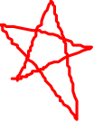
Relativity 107: General Relativity
Equivalence Principle
Tangent Spaces
Curvature
Newton-Cartan Theory (Curved Newtonian Gravity)
Energy-Momentum Tensor
Einstein Field Equations

Slide 3
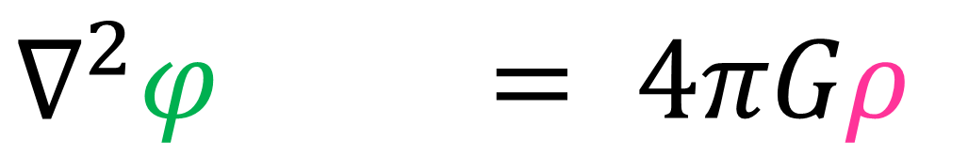
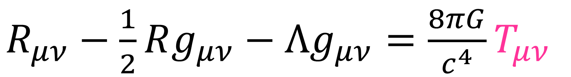
Generalize Poisson’s Equation
$$∇^{2}φ = 4πGρ$$
to Einstein Field Equations
$R_{μν}−\frac{1}{2}Rg_{μν}−Λg_{μν}=\frac{8πG}{c^{4}}T_{μν}$

Slide 4
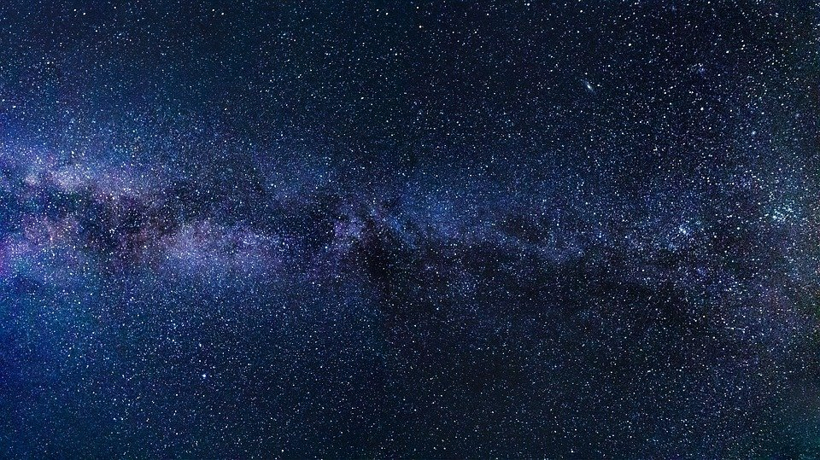
Relativity 107a/b: Equivalence Principle
Gravity = curvature of spacetime manifold
Special Relativity
Equivalence Principle:
Local gravitation
=
acceleration
General Relativity

Slide 5
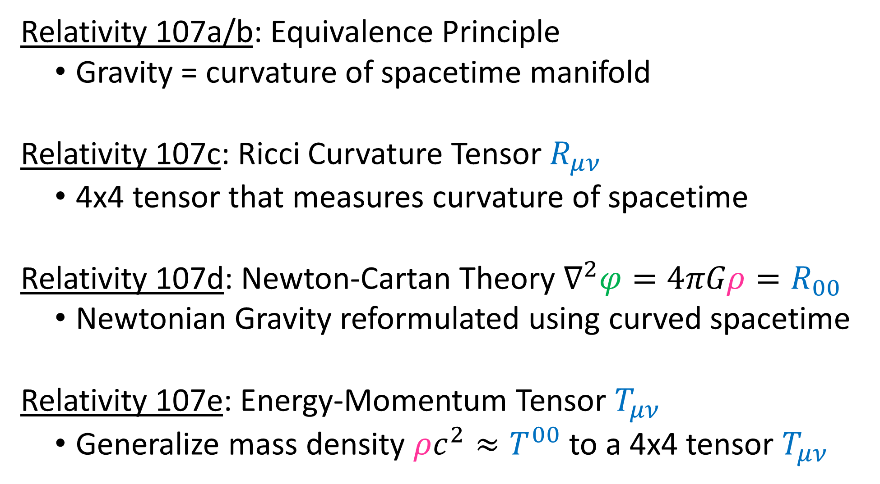

Relativity 107a/b: Equivalence Principle
Gravity = curvature of spacetime manifold
Relativity 107c: Ricci Curvature Tensor $R_{μν}$
4x4 tensor that measures curvature of spacetime
Relativity 107d: Newton-Cartan Theory $∇^{2}φ=4πGρ=R_{00}$
Newtonian Gravity reformulated using curved spacetime
Relativity 107e: Energy-Momentum Tensor $T_{μν}$
Generalize mass density $ρc^{2}≈T^{00}$ to a 4x4 tensor $T_{μν}$

Slide 6
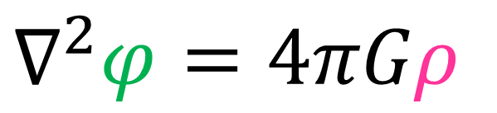
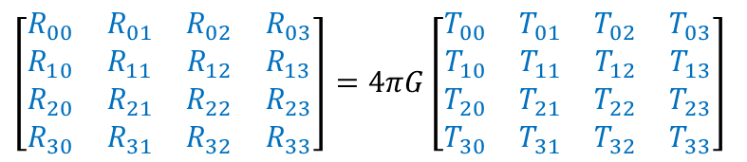
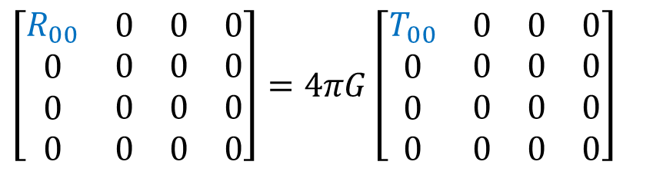


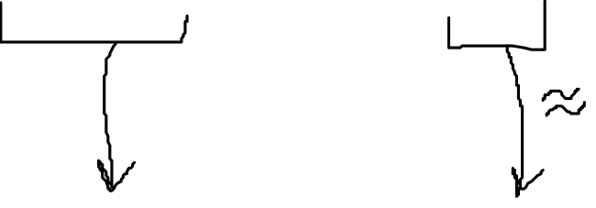
$$∇^{2}φ=4πGρ$$
Poisson’s Equation
$$R_{00}≈4πGT_{00}$$
Newton-Cartan Reformulation
Not relativistic
(not Lorentz-invariant)
$$\left[\begin{matrix}\begin{matrix}\begin{aligned}R_{00} \\ 0 \\ 0 \\ 0\end{aligned} & \begin{aligned}0 \\ 0 \\ 0 \\ 0\end{aligned}\end{matrix} & \begin{matrix}\begin{aligned}0 \\ 0 \\ 0 \\ 0\end{aligned} & \begin{aligned}0 \\ 0 \\ 0 \\ 0\end{aligned}\end{matrix}\end{matrix}\right]=4πG\left[\begin{matrix}\begin{matrix}\begin{aligned}T_{00} \\ 0 \\ 0 \\ 0\end{aligned} & \begin{aligned}0 \\ 0 \\ 0 \\ 0\end{aligned}\end{matrix} & \begin{matrix}\begin{aligned}0 \\ 0 \\ 0 \\ 0\end{aligned} & \begin{aligned}0 \\ 0 \\ 0 \\ 0\end{aligned}\end{matrix}\end{matrix}\right]$$
$R_{μν}≈4πGT_{μν}$ ???
Close! But not quite…
There are some problems…
$$\left[\begin{matrix}\begin{matrix}\begin{aligned}R_{00} \\ R_{10} \\ R_{20} \\ R_{30}\end{aligned} & \begin{aligned}R_{01} \\ R_{11} \\ R_{21} \\ R_{31}\end{aligned}\end{matrix} & \begin{matrix}\begin{aligned}R_{02} \\ R_{12} \\ R_{22} \\ R_{32}\end{aligned} & \begin{aligned}R_{03} \\ R_{13} \\ R_{23} \\ R_{33}\end{aligned}\end{matrix}\end{matrix}\right]=4πG\left[\begin{matrix}\begin{matrix}\begin{aligned}T_{00} \\ T_{10} \\ T_{20} \\ T_{30}\end{aligned} & \begin{aligned}T_{01} \\ T_{11} \\ T_{21} \\ T_{31}\end{aligned}\end{matrix} & \begin{matrix}\begin{aligned}T_{02} \\ T_{12} \\ T_{22} \\ T_{32}\end{aligned} & \begin{aligned}T_{03} \\ T_{13} \\ T_{23} \\ T_{33}\end{aligned}\end{matrix}\end{matrix}\right]$$

Slide 7
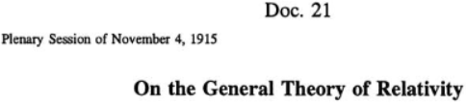
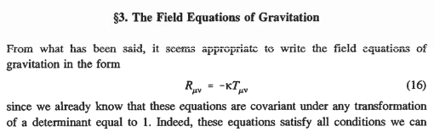
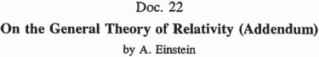


https://einsteinpapers.press.princeton.edu/vol6-trans/85
(See links in description)
https://einsteinpapers.press.princeton.edu/vol6-trans/115
https://einsteinpapers.press.princeton.edu/vol6-trans/121

Slide 8

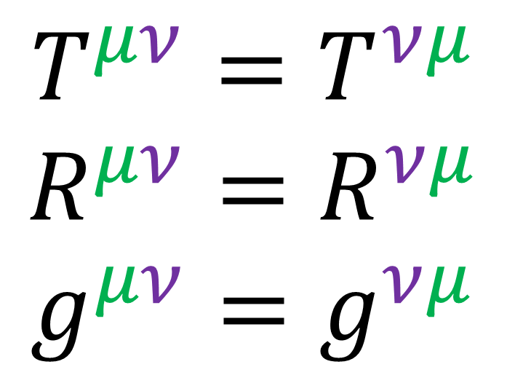
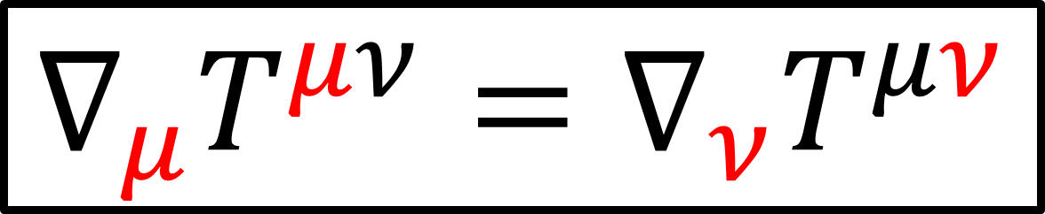
Divergence: $∇_{μ}T^{μν}$
$$T^{μν}=T^{νμ}$$
$$R^{μν}=R^{νμ}$$
$$g^{μν}=g^{νμ}$$
Symmetric Tensors:
$$∇_{μ}T^{μν}=∇_{ν}T^{μν}$$

Slide 9
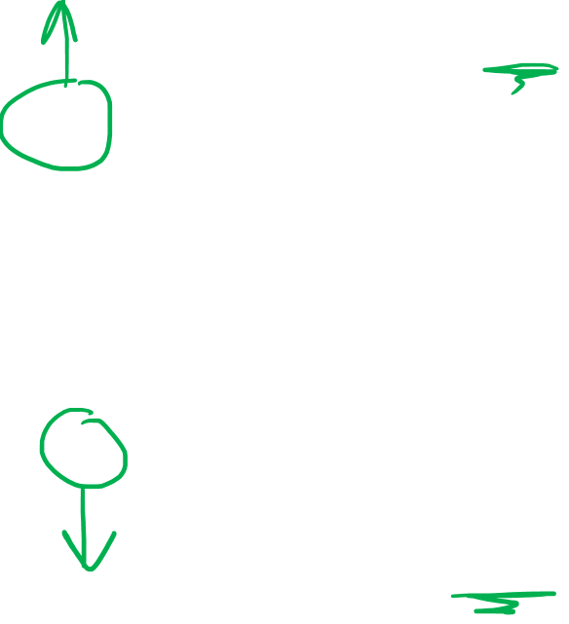
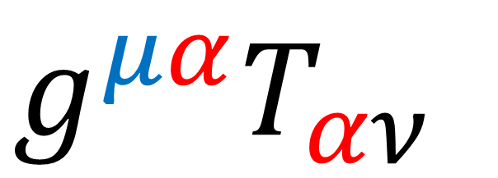
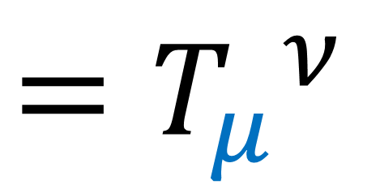
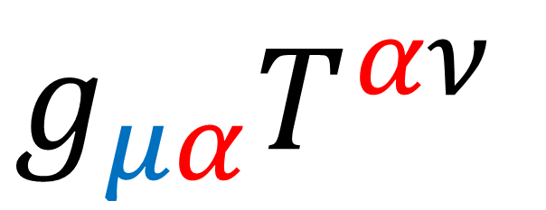
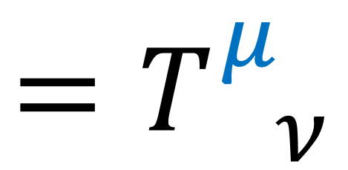
$$g^{μα}T_{αν}$$
$$=T_{ ν}^{μ}$$
Raising Index:
$$g_{μα}T^{αν}$$
$$=T_{μ}^{ ν}$$
Lowering Index:

Slide 10

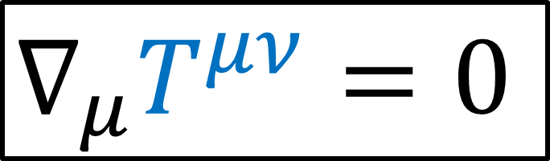
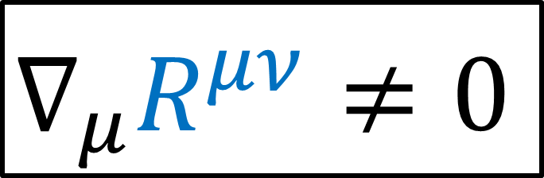
$$R^{μν}=κT^{μν}$$
$∇_{μ}R^{μν}≠0$
$$∇_{μ}T^{μν}=0$$
Conservation of energy-momentum
(Relativity 107e)

Slide 11
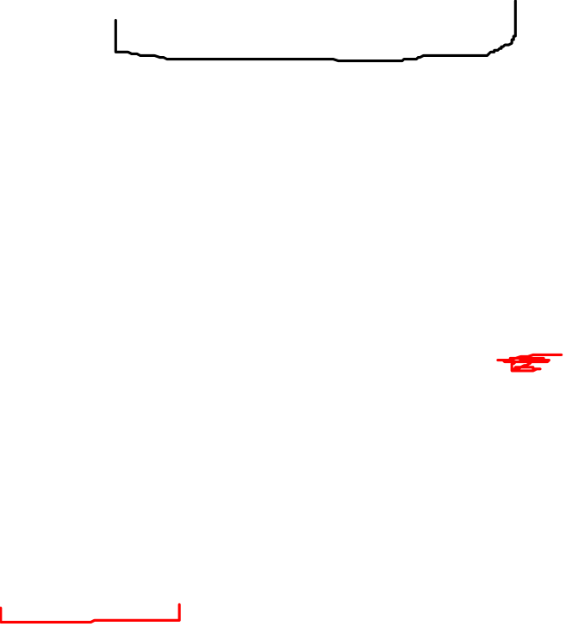


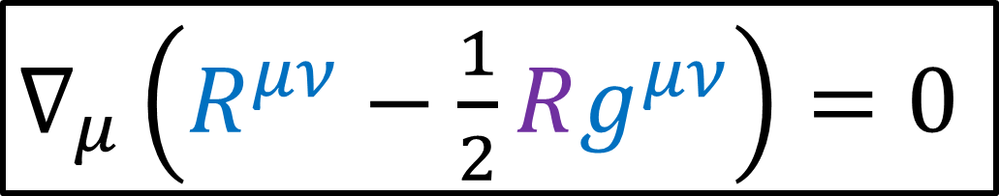
$R^{μν}−\frac{1}{2}Rg^{μν}=κT^{μν}$
$∇_{μ}\left(R^{μν}−\frac{1}{2}Rg^{μν}\right)=0$
$$∇_{μ}T^{μν}=0$$
Conservation of energy-momentum
(Relativity 107e)
$G^{μν}$ Einstein Tensor

Slide 12
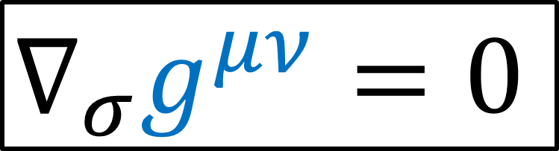
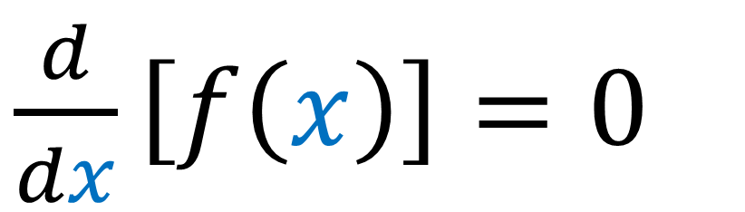

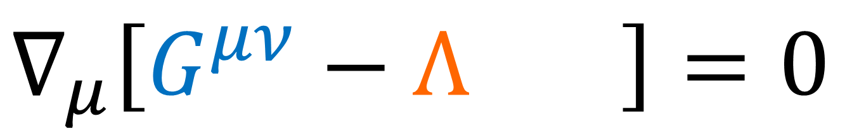
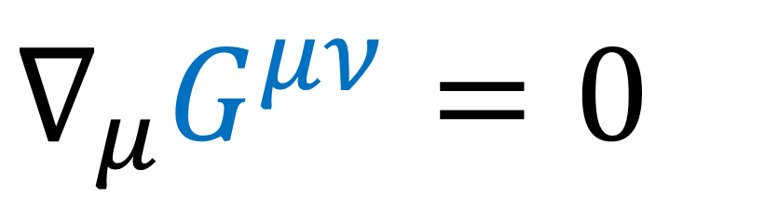
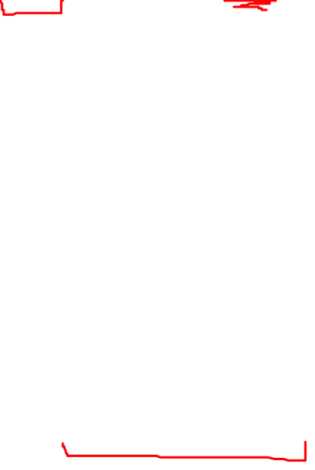
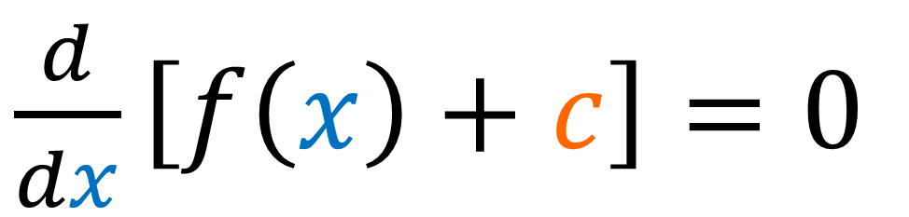
$\frac{d}{dx}\left[f\left(x\right)\right]=0$
Metric Compatibility
$∇_{σ}g^{μν}=0$
$\frac{d}{dx}\left[f\left(x\right)+c\right]=0$
$∇_{μ}G^{μν}=0$
Cosmological Constant
$$g^{μν}$$
$∇_{μ}\left[G^{μν}−Λg^{μν}\right]=0$

Slide 13

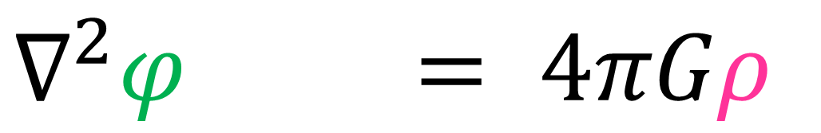
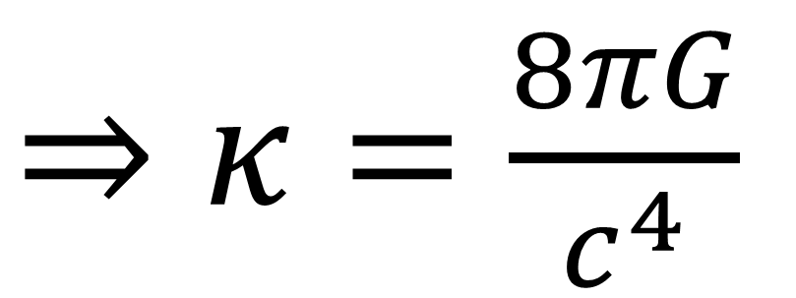
$G^{μν}−Λg^{μν}=κT^{μν}$
Take weak gravity limit
$$∇^{2}φ = 4πGρ$$
$⇒κ=\frac{8πG}{c^{4}}$

Slide 14
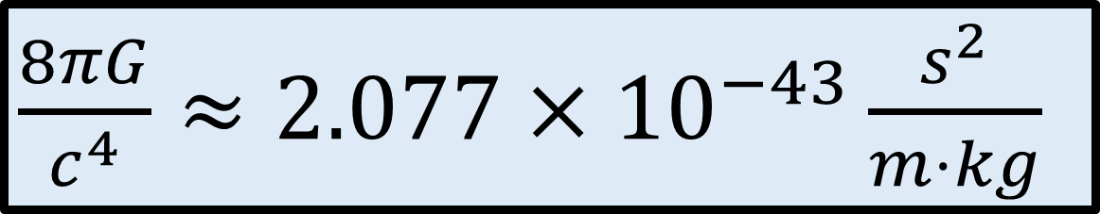
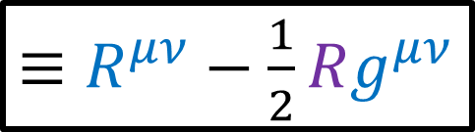

Einstein Field Equations
$G^{μν}−Λg^{μν}=\frac{8πG}{c^{4}}T^{μν}$
$≡R^{μν}−\frac{1}{2}Rg^{μν}$
Spacetime “stiffness”
mass/ energy/ momentum
Spacetime Curvature
$\frac{8πG}{c^{4}}≈2.077×{10}^{−43}\frac{s^{2}}{m⋅kg}$

Slide 15
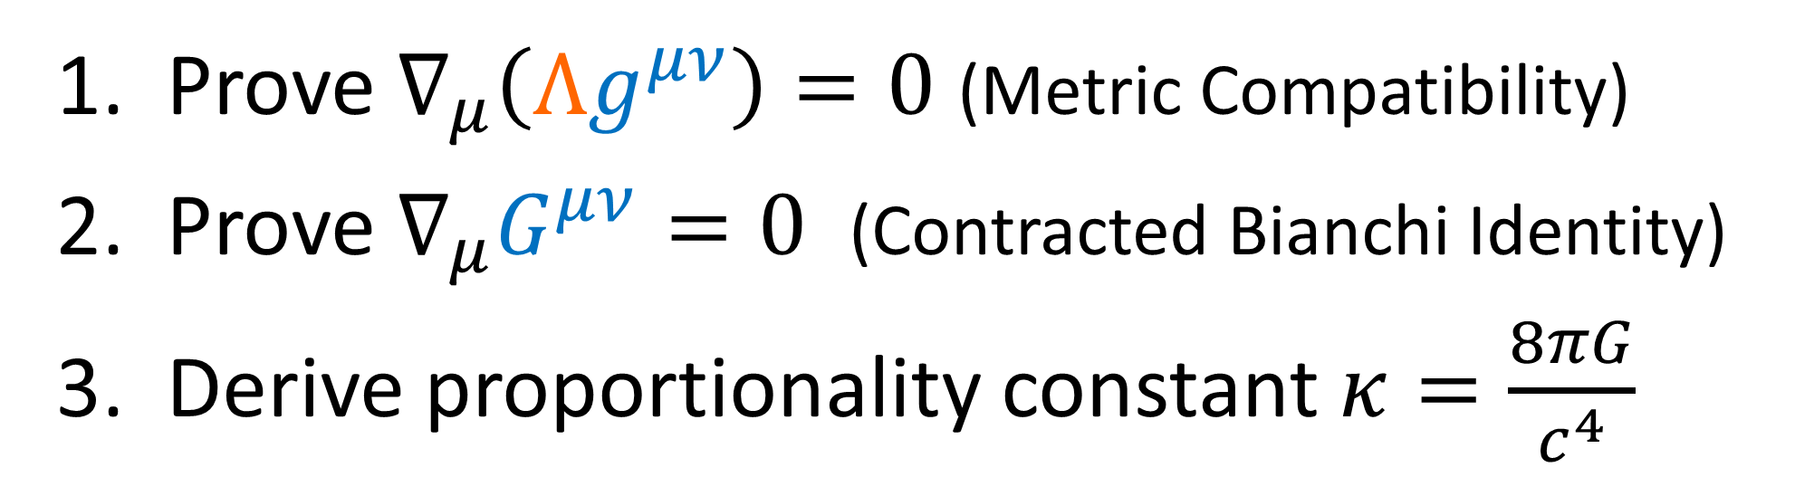
Einstein Field Equations
$G^{μν}−Λg^{μν}=\frac{8πG}{c^{4}}T^{μν}$
Prove $∇_{μ}\left(Λg^{μν}\right)=0$ (Metric Compatibility)
Prove $∇_{μ}G^{μν}=0$ (Contracted Bianchi Identity)
Derive proportionality constant $κ=\frac{8πG}{c^{4}}$

Slide 16
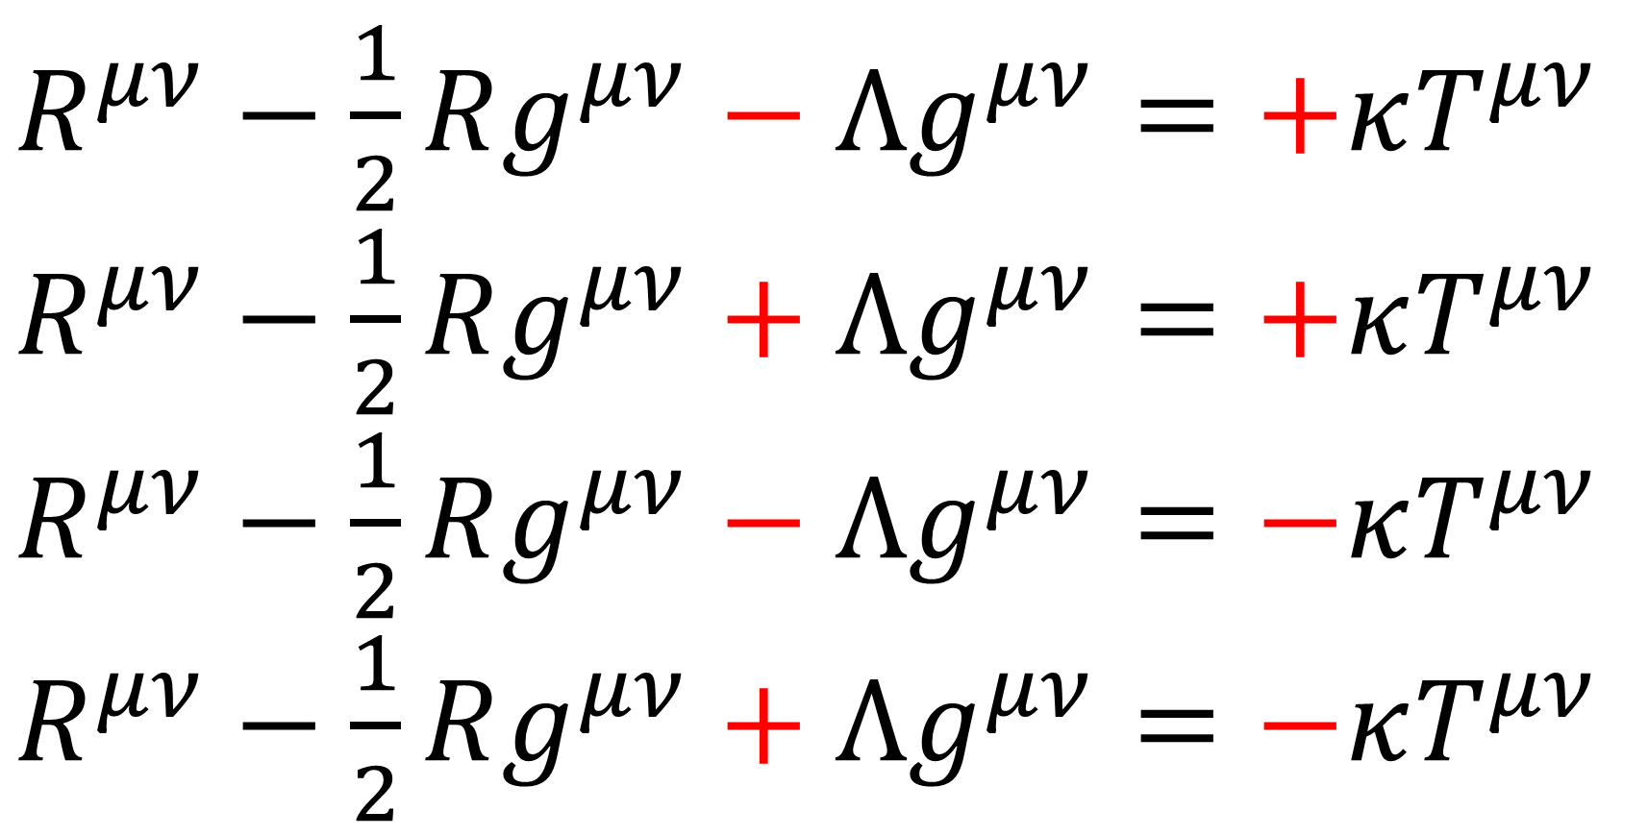
E.F.E. Sign Conventions:
$R^{μν}−\frac{1}{2}Rg^{μν}−Λg^{μν}=+κT^{μν}$
$R^{μν}−\frac{1}{2}Rg^{μν}+Λg^{μν}=+κT^{μν}$
$R^{μν}−\frac{1}{2}Rg^{μν}−Λg^{μν}=−κT^{μν}$
$R^{μν}−\frac{1}{2}Rg^{μν}+Λg^{μν}=−κT^{μν}$

Slide 17
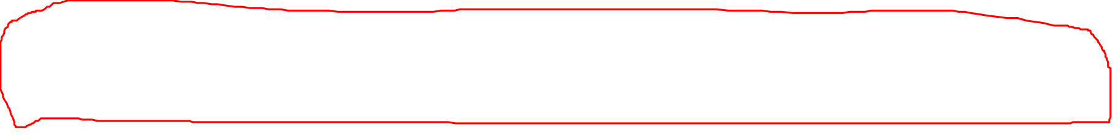
Einstein Field Equations
$G^{μν}−Λg^{μν}=\frac{8πG}{c^{4}}T^{μν}$
Prove $∇_{μ}\left(Λg^{μν}\right)=0$ (Metric Compatibility)
Prove $∇_{μ}G^{μν}=0$ (Contracted Bianchi Identity)
Derive proportionality constant $κ=\frac{8πG}{c^{4}}$

Slide 18
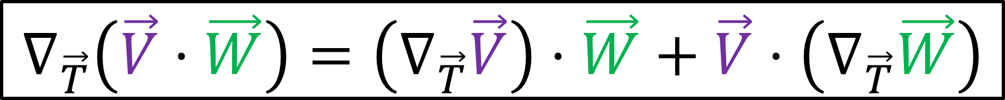


Metric Compatibility (Relativity 107c)
$$∇_{\vec{T}}\left(\vec{V}⋅\vec{W}\right)=\left(∇_{\vec{T}}\vec{V}\right)⋅\vec{W}+\vec{V}⋅\left(∇_{\vec{T}}\vec{W}\right)$$
$$\vec{W}$$
(keeps angles + lengths constant during parallel transport)
$$\vec{V}$$

Slide 19
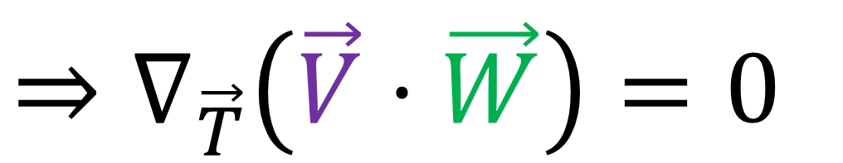
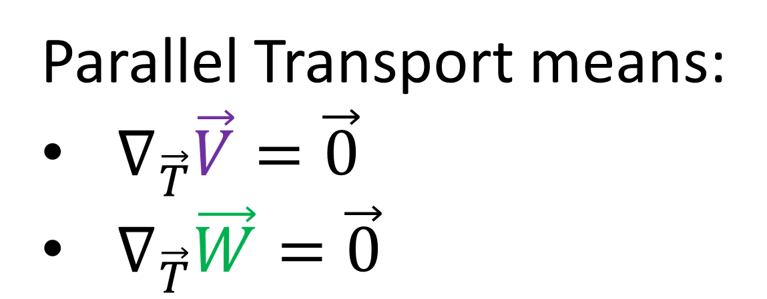
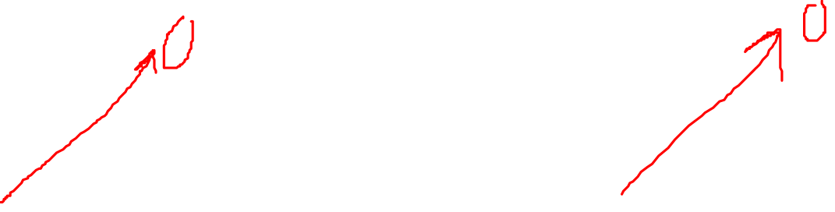
Metric Compatibility (Relativity 107c)
$$∇_{\vec{T}}\left(\vec{V}⋅\vec{W}\right)=\left(∇_{\vec{T}}\vec{V}\right)⋅\vec{W}+\vec{V}⋅\left(∇_{\vec{T}}\vec{W}\right)$$
Parallel Transport means:
$∇_{\vec{T}}\vec{V}=\vec{0}$
$∇_{\vec{T}}\vec{W}=\vec{0}$
$$\vec{W}$$
$$\vec{V}$$
$$⇒∇_{\vec{T}}\left(\vec{V}⋅\vec{W}\right)=0$$

Slide 20
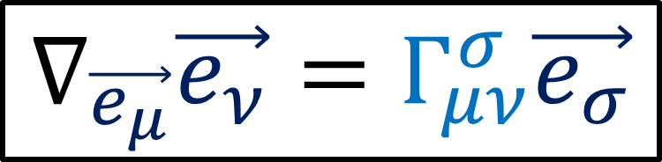
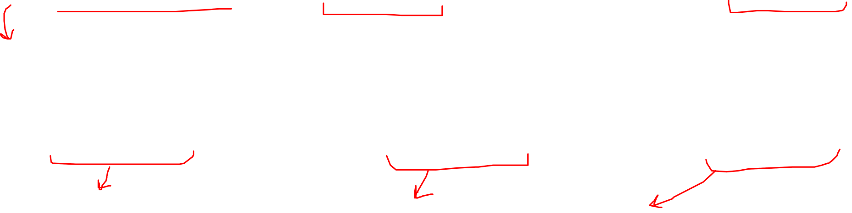
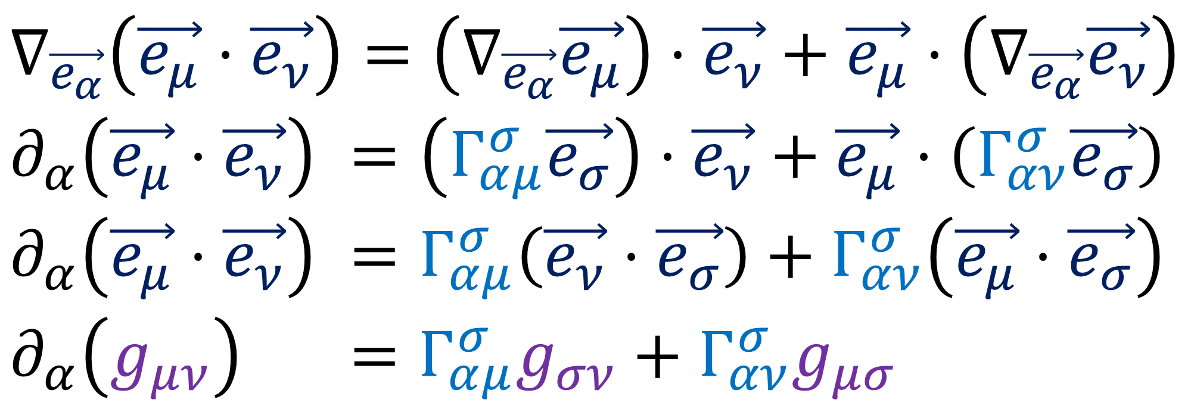
Metric Compatibility
$$∇_{\vec{e_{μ}}}\vec{e_{ν}}=Γ_{μν}^{σ}\vec{e_{σ}}$$
$$∇_{\vec{T}}\left(\vec{V}⋅\vec{W}\right)=\left(∇_{\vec{T}}\vec{V}\right)⋅\vec{W}+\vec{V}⋅\left(∇_{\vec{T}}\vec{W}\right)$$
$$∇_{\vec{e_{α}}}\left(\vec{e_{μ}}⋅\vec{e_{ν}}\right)=\left(∇_{\vec{e_{α}}}\vec{e_{μ}}\right)⋅\vec{e_{ν}}+\vec{e_{μ}}⋅\left(∇_{\vec{e_{α}}}\vec{e_{ν}}\right)$$
$$∂_{α}\left(\vec{e_{μ}}⋅\vec{e_{ν}}\right) =\left(Γ_{αμ}^{σ}\vec{e_{σ}}\right)⋅\vec{e_{ν}}+\vec{e_{μ}}⋅\left(Γ_{αν}^{σ}\vec{e_{σ}}\right)$$
$$∂_{α}\left(\vec{e_{μ}}⋅\vec{e_{ν}}\right) =Γ_{αμ}^{σ}\left(\vec{e_{ν}}⋅\vec{e_{σ}}\right)+Γ_{αν}^{σ}\left(\vec{e_{μ}}⋅\vec{e_{σ}}\right)$$
$$∂_{α}\left(g_{μν}\right) =Γ_{αμ}^{σ}g_{σν}+Γ_{αν}^{σ}g_{μσ}$$

Slide 21
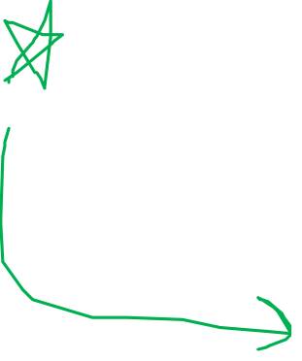
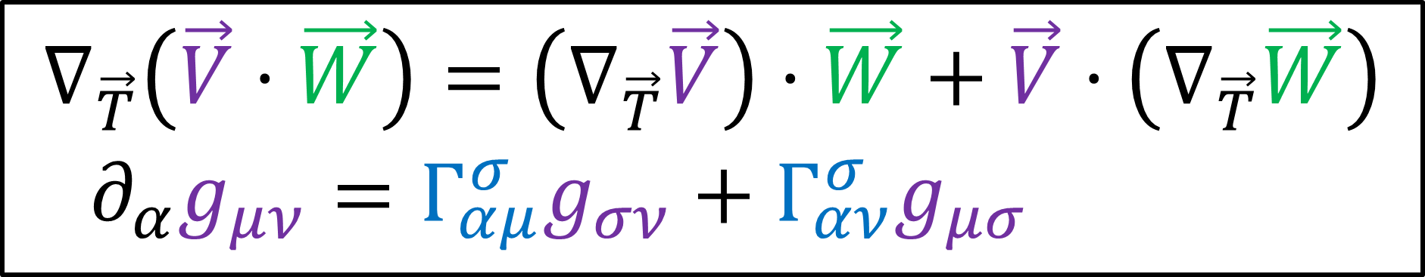
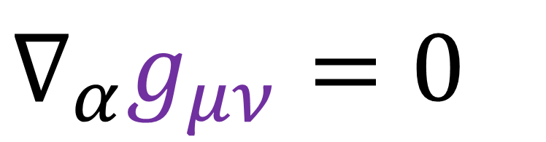
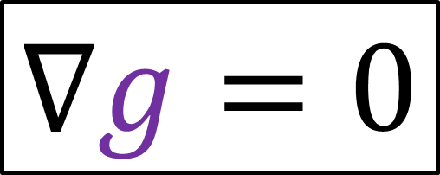
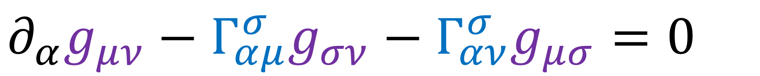
Metric Compatibility
$$∇_{\vec{T}}\left(\vec{V}⋅\vec{W}\right)=\left(∇_{\vec{T}}\vec{V}\right)⋅\vec{W}+\vec{V}⋅\left(∇_{\vec{T}}\vec{W}\right)$$
$$∂_{α}g_{μν}=Γ_{αμ}^{σ}g_{σν}+Γ_{αν}^{σ}g_{μσ}$$
$$∂_{α}g_{μν}−Γ_{αμ}^{σ}g_{σν}−Γ_{αν}^{σ}g_{μσ}=0$$
$$∇_{α}g_{μν}=0$$
$$∇g=0$$

Slide 22
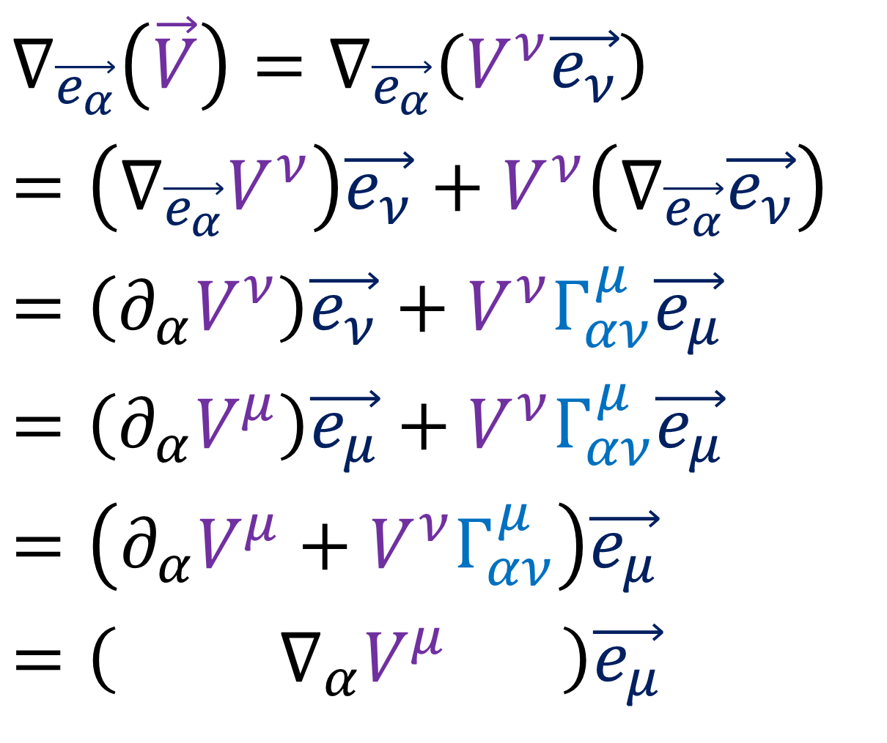
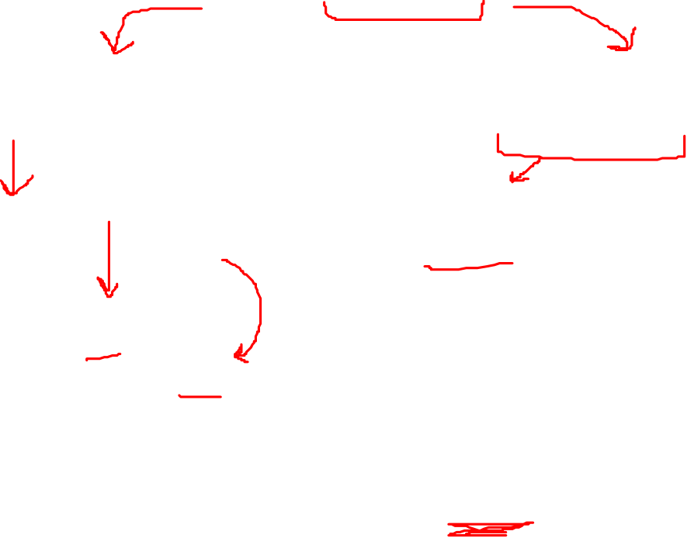
Covariant Derivative (Vector)
$$∇_{\vec{e_{α}}}\left(\vec{V}\right)=∇_{\vec{e_{α}}}\left(V^{ν}\vec{e_{ν}}\right)$$
$$=\left(∇_{\vec{e_{α}}}V^{ν}\right)\vec{e_{ν}}+V^{ν}\left(∇_{\vec{e_{α}}}\vec{e_{ν}}\right)$$
$$=\left(∂_{α}V^{ν}\right)\vec{e_{ν}}+V^{ν}Γ_{αν}^{μ}\vec{e_{μ}}$$
$$=\left(∂_{α}V^{μ}\right)\vec{e_{μ}}+V^{ν}Γ_{αν}^{μ}\vec{e_{μ}}$$
$$=\left(∂_{α}V^{μ}+V^{ν}Γ_{αν}^{μ}\right)\vec{e_{μ}}$$
$$=\left( ∇_{α}V^{μ} \right)\vec{e_{μ}}$$

Slide 23


Covariant Derivative (Metric Tensor)
$$∇_{\vec{e_{α}}}\left(g\right)=∇_{\vec{e_{α}}}\left(g_{μν}ε^{μ}⊗ε^{ν}\right)$$
$$=\left(∇_{\vec{e_{α}}}g_{μν}\right)\left(ε^{μ}⊗ε^{ν}\right)+g_{μν}∇_{\vec{e_{α}}}\left(ε^{μ}⊗ε^{ν}\right)$$
$$=\left(∂_{α}g_{μν}\right)\left(ε^{μ}⊗ε^{ν}\right)+g_{μν}\left(\left(∇_{\vec{e_{α}}}ε^{μ}\right)⊗ε^{ν}\right)+g_{μν}\left(ε^{μ}⊗\left(∇_{\vec{e_{α}}}ε^{ν}\right)\right)$$
$$=\left(∂_{α}g_{μν}\right)\left(ε^{μ}⊗ε^{ν}\right)+g_{μν}\left(\left(Ω_{ασ}^{μ}ε^{σ}\right)⊗ε^{ν}\right)+g_{μν}\left(ε^{μ}⊗\left(Ω_{ασ}^{ν}ε^{σ}\right)\right)$$
$$=\left(∂_{α}g_{μν}\right)\left(ε^{μ}⊗ε^{ν}\right)+g_{μν}Ω_{ασ}^{μ}\left(ε^{σ}⊗ε^{ν}\right)+g_{μν}Ω_{ασ}^{ν}\left(ε^{μ}⊗ε^{σ}\right)$$
$$=\left(∂_{α}g_{μν}\right)\left(ε^{μ}⊗ε^{ν}\right)+g_{σν}Ω_{αμ}^{σ}\left(ε^{μ}⊗ε^{ν}\right)+g_{μσ}Ω_{αν}^{σ}\left(ε^{μ}⊗ε^{ν}\right)$$
$$=\left(∂_{α}g_{μν}+g_{σν}Ω_{αμ}^{σ}+g_{μσ}Ω_{αν}^{σ}\right)\left(ε^{μ}⊗ε^{ν}\right)$$
$$=\left( ∇_{α}g_{μν} \right)\left(ε^{μ}⊗ε^{ν}\right)$$

Slide 24




Covariant Derivative of a Covector
$$α=\vec{a}⋅__$$
$$∇_{\vec{e_{α}}}\left(α\left(\vec{v}\right)\right)=∇_{\vec{e_{α}}}\left(\vec{a}⋅\vec{v}\right)$$
$$∇_{\vec{w}}\left(\vec{v}⋅\vec{u}\right)=\left(∇_{\vec{w}}\vec{v}\right)⋅\vec{u}+\vec{v}⋅\left(∇_{\vec{w}}\vec{u}\right)$$
Metric Compatibility
$$∇_{\vec{e_{α}}}\left(\vec{a}⋅\vec{v}\right)=\left(∇_{\vec{e_{α}}}\vec{a}\right)⋅\vec{v}+\vec{a}⋅\left(∇_{\vec{e_{α}}}\vec{v}\right)$$
$$∂_{α}\left(\vec{a}⋅\vec{v}\right)=\left(∇_{\vec{e_{α}}}α\right)\left(\vec{v}\right)+α\left(∇_{\vec{e_{α}}}\vec{v}\right)$$
$∂_{α}\left(α_{ν}ε^{ν}\left(v^{σ}\vec{e_{σ}}\right)\right)=$
$+\left(∂_{α}α_{ν}+α_{ν}Ω_{μσ}^{ν}\right)ε^{σ}\left(\vec{v}\right)+\left(∂_{α}v^{σ}+v^{ν}Γ_{μν}^{σ}\right)α\left(\vec{e_{σ}}\right)$

Slide 25



Covariant Derivative of a Covector
$$∂_{α}\left(α_{ν}v^{σ}ε^{ν}\left(\vec{e_{σ}}\right)\right)=$$
$\left(∂_{α}α_{ν}+α_{ν}Ω_{ασ}^{ν}\right)ε^{σ}\left(\vec{v}\right)+\left(∂_{α}v^{σ}+v^{ν}Γ_{αν}^{σ}\right)α\left(\vec{e_{σ}}\right)$
$∂_{α}\left(α_{σ}v^{σ}\right)=\left(∂_{α}α_{σ}+α_{ν}Ω_{μσ}^{ν}\right)v^{σ}+\left(∂_{α}v^{σ}+v^{ν}Γ_{μν}^{σ}\right)α_{σ}$
$∂_{α}\left(α_{σ}v^{σ}\right)=\left(∂_{α}α_{σ}\right)v^{σ}+α_{σ}\left(∂_{α}v^{σ}\right)+α_{ν}v^{σ}Ω_{μσ}^{ν}+α_{σ}v^{ν}Γ_{μν}^{σ}$
$0=α_{ν}v^{σ}Ω_{μσ}^{ν}+α_{σ}v^{ν}Γ_{μν}^{σ}$
$0=α_{σ}v^{ν}Ω_{μν}^{σ}+α_{σ}v^{ν}Γ_{μν}^{σ}$
$$Ω_{μν}^{σ}=−Γ_{μν}^{σ}$$

Slide 26



Covariant Derivative of a Covector
$$α=\vec{a}⋅__$$
$$∇_{\vec{e_{μ}}}\left(α\left(\vec{v}\right)\right)=∇_{\vec{e_{μ}}}\left(\vec{a}⋅\vec{v}\right)$$
$$∇_{\vec{w}}\left(\vec{v}⋅\vec{u}\right)=\left(∇_{\vec{w}}\vec{v}\right)⋅\vec{u}+\vec{v}⋅\left(∇_{\vec{w}}\vec{u}\right)$$
Metric Compatibility
$$∇_{\vec{e_{μ}}}\left(\vec{a}⋅\vec{v}\right)=\left(∇_{\vec{e_{μ}}}\vec{a}\right)⋅\vec{v}+\vec{a}⋅\left(∇_{\vec{e_{μ}}}\vec{v}\right)$$
$$∂_{μ}\left(α\left(\vec{v}\right)\right)=\left(∇_{\vec{e_{μ}}}α\right)\left(\vec{v}\right)+α\left(∇_{\vec{e_{μ}}}\vec{v}\right)$$
$∂_{μ}\left(α_{ν}ε^{ν}\left(v^{σ}\vec{e_{σ}}\right)\right)$
$=∂_{μ}\left(α_{ν}v^{σ}ε^{ν}\left(\vec{e_{σ}}\right)\right)=∂_{μ}\left(α_{ν}v^{σ}δ_{σ}^{ν}\right)=∂_{μ}\left(α_{σ}v^{σ}\right)$

Slide 27




Covariant Derivative of a Covector
$$α=\vec{a}⋅__$$
$$∇_{\vec{e_{μ}}}\left(α\left(\vec{v}\right)\right)=∇_{\vec{e_{μ}}}\left(\vec{a}⋅\vec{v}\right)$$
$$∇_{\vec{w}}\left(\vec{v}⋅\vec{u}\right)=\left(∇_{\vec{w}}\vec{v}\right)⋅\vec{u}+\vec{v}⋅\left(∇_{\vec{w}}\vec{u}\right)$$
Metric Compatibility
$$∇_{\vec{e_{μ}}}\left(\vec{a}⋅\vec{v}\right)=\left(∇_{\vec{e_{μ}}}\vec{a}\right)⋅\vec{v}+\vec{a}⋅\left(∇_{\vec{e_{μ}}}\vec{v}\right)$$
$$∂_{μ}\left(α\left(\vec{v}\right)\right)=\left(∇_{\vec{e_{μ}}}α\right)\left(\vec{v}\right)+α\left(∇_{\vec{e_{μ}}}\vec{v}\right)$$
$∂_{μ}\left(α_{σ}v^{σ}\right)=$
$$+\left(∂_{μ}α_{σ}+α_{ν}Ω_{μσ}^{ν}\right)ε^{σ}\left(\vec{v}\right)+α\left(\left(∂_{μ}v^{σ}+v^{ν}Γ_{μν}^{σ}\right)\vec{e_{σ}}\right)$$

Slide 28


Covariant Derivative of a Covector
$$∂_{μ}\left(α_{σ}v^{σ}\right)=$$
$\left(∂_{μ}α_{σ}+α_{ν}Ω_{μσ}^{ν}\right)ε^{σ}\left(\vec{v}\right)+\left(∂_{μ}v^{σ}+v^{ν}Γ_{μν}^{σ}\right)α\left(\vec{e_{σ}}\right)$
$∂_{μ}\left(α_{σ}v^{σ}\right)=\left(∂_{μ}α_{σ}+α_{ν}Ω_{μσ}^{ν}\right)v^{σ}+\left(∂_{μ}v^{σ}+v^{ν}Γ_{μν}^{σ}\right)α_{σ}$
$$∂_{μ}\left(α_{σ}v^{σ}\right)=\left(∂_{μ}α_{σ}\right)v^{σ}+α_{σ}\left(∂_{μ}v^{σ}\right)+α_{ν}v^{σ}Ω_{μσ}^{ν}+α_{σ}v^{ν}Γ_{μν}^{σ}$$
$0=α_{ν}v^{σ}Ω_{μσ}^{ν}+α_{σ}v^{ν}Γ_{μν}^{σ}$
$0=α_{σ}v^{ν}Ω_{μν}^{σ}+α_{σ}v^{ν}Γ_{μν}^{σ}$
$0=α_{σ}v^{ν}\left(Ω_{μν}^{σ}+Γ_{μν}^{σ}\right)$
$$Ω_{μν}^{σ}=−Γ_{μν}^{σ}$$

Slide 29






$$∇_{\vec{e_{α}}}\left(g\right)=∇_{\vec{e_{α}}}\left(g_{μν}ε^{μ}⊗ε^{ν}\right)$$
$$=\left(∂_{α}g_{μν}+Ω_{αμ}^{σ}g_{σν}+Ω_{αν}^{σ}g_{μσ}\right)\left(ε^{μ}⊗ε^{ν}\right)$$
$$=\left(∂_{α}g_{μν}−Γ_{αμ}^{σ}g_{σν}−Γ_{αν}^{σ}g_{μσ}\right)\left(ε^{μ}⊗ε^{ν}\right)$$
$$Ω_{αν}^{σ}=−Γ_{αν}^{σ}$$
Metric Compatibility
$$∇_{\vec{T}}\left(\vec{V}⋅\vec{W}\right)=\left(∇_{\vec{T}}\vec{V}\right)⋅\vec{W}+\vec{V}⋅\left(∇_{\vec{T}}\vec{W}\right)$$
$∂_{α}g_{μν}−Γ_{αμ}^{σ}g_{σν}−Γ_{αν}^{σ}g_{μσ}=0$
$$∇g=0$$
$$∇_{α}g_{μν}=0$$

Slide 30


Einstein Field Equations
$G^{μν}−Λg^{μν}=\frac{8πG}{c^{4}}T^{μν}$
$∇_{σ}g^{μν}=0$
$$∇_{μ}T^{μν}=0$$
Conservation of energy-momentum
(Relativity 107e)
Metric Compatibility

Slide 31

Einstein Field Equations
$G^{μν}−Λg^{μν}=\frac{8πG}{c^{4}}T^{μν}$
Prove $∇_{μ}\left(Λg^{μν}\right)=0$ (Metric Compatibility)
Prove $∇_{μ}G^{μν}=0$ (Contracted Bianchi Identity)
Derive proportionality constant $κ=\frac{8πG}{c^{4}}$

Slide 32





$G^{μν}≡R^{μν}−\frac{1}{2}Rg^{μν}$
$∇_{μ}G^{μν}≡∇_{μ}\left(R^{μν}−\frac{1}{2}Rg^{μν}\right)=0$
$$∇_{α}R_{μν}≡R_{μν;α}$$
Covariant derivative notation:
$G_{ ;μ}^{μν}≡{\left(R^{μν}−\frac{1}{2}Rg^{μν}\right)}_{;μ}=0$

Slide 33






Riemann Tensor Symmetries:
$$R_{ρσνμ}=−R_{ρσμν}$$
Ricci Tensor
$$R_{σμ}=R_{ σμν}^{μ }$$
$$R_{σρμν}=−R_{ρσμν}$$
$$R_{μνρσ}=+R_{ρσμν}$$
(Bianchi identity)
$$R_{ σμν}^{ρ}+R_{ νσμ}^{ρ}+R_{ μνσ}^{ρ}=0$$

Slide 34




Ricci Tensor
$$R_{μν}=R_{ μαν}^{α}$$
Ricci Scalar
$$R=R_{ μ}^{μ}$$
$$R_{μν}=R_{νμ}$$

Slide 35




First Bianchi Identity
$$R_{ σμν}^{ρ}+R_{ νσμ}^{ρ}+R_{ μνσ}^{ρ}=0$$
Second Bianchi Identity
$$R_{ σμν;α}^{ρ}+R_{ σαμ;ν}^{ρ}+R_{ σνα;μ}^{ρ}=0$$
Contracted Bianchi Identity
${\left(R^{μν}−\frac{1}{2}Rg^{μν}\right)}_{;μ}=0$
3. Second Bianchi Identity
$$\left(∇_{\vec{z}}R\right)\left(\vec{u},\vec{v}\right)\vec{w}+\left(∇_{\vec{v}}R\right)\left(\vec{z},\vec{u}\right)+\left(∇_{\vec{u}}R\right)\left(\vec{v}, \vec{z}\right)=0$$

Slide 36


Second Bianchi Identity
$$R_{ σμν;α}^{ρ}+R_{ σαμ;ν}^{ρ}+R_{ σνα;μ}^{ρ}=0$$
Prove in “local inertial coordinates” where $Γ_{μν}^{α}=0$ (at a specific point $p$)
Abstract Version:
$$∇_{\vec{T}}R\left(\vec{V},\vec{W}\right)+∇_{\vec{W}}R\left(\vec{T},\vec{V}\right)+∇_{\vec{V}}R\left(\vec{W},\vec{T}\right)=0$$

Slide 37

Second Bianchi Identity
$$R_{ σμν;α}^{ρ}+R_{ σαμ;ν}^{ρ}+R_{ σνα;μ}^{ρ}=0$$
Prove in “local inertial coordinates” where $Γ_{μν}^{α}=0$ (at a specific point $p$)
Since result is 0 in one coordinate system, it is zero in all coordinate systems
Full general-coordinate proof in video “Tensor Calculus 26” (link in description)

Slide 38




Review Definition of Covariant Derivative
$∇_{\vec{e_{α}}}Riemann=∇_{\vec{e_{α}}}\left(R_{ σμν}^{ρ} \vec{e_{ρ}}⊗ε^{σ}⊗ε^{μ}⊗ε^{ν}\right)$
$$=\left(∂_{α}R_{ σμν}^{ρ}+R_{ σμν}^{β}Γ_{αβ}^{ρ}−R_{ βμν}^{ρ}Γ_{ασ}^{β}−R_{ σβν}^{ρ}Γ_{αμ}^{β}−R_{ σμβ}^{ρ}Γ_{αν}^{β}\right)$$
$$\vec{e_{ρ}}⊗ε^{σ}⊗ε^{μ}⊗ε^{ν}$$
$$R_{ σμν;α}^{ρ}$$
$$R_{ σμν}^{ρ}=∂_{μ}\left(Γ_{νσ}^{ρ}\right)−∂_{ν}\left(Γ_{μσ}^{ρ}\right)+Γ_{νσ}^{γ}Γ_{μγ}^{ρ}−Γ_{μσ}^{δ}Γ_{νδ}^{ρ}$$

Slide 39



2nd Bianchi Identity (Normal Coords)
$$R_{ σμν;α}^{ρ}+R_{ σαμ;ν}^{ρ}+R_{ σνα;μ}^{ρ}=0$$
$$R_{ σμν;α}^{ρ}=∂_{α}R_{ σμν}^{ρ}+R_{ σμν}^{β}Γ_{αβ}^{ρ}−R_{ βμν}^{ρ}Γ_{ασ}^{β}−R_{ σβν}^{ρ}Γ_{αμ}^{β}−R_{ σμβ}^{ρ}Γ_{αν}^{β}$$
$$R_{ σμν}^{ρ}=∂_{μ}\left(Γ_{νσ}^{ρ}\right)−∂_{ν}\left(Γ_{μσ}^{ρ}\right)+Γ_{νσ}^{γ}Γ_{μγ}^{ρ}−Γ_{μσ}^{δ}Γ_{νδ}^{ρ}$$
Riemann Normal Coordinates at point $p$
(a.k.a. “Local Inertial Frame”)
$g_{μν}=η_{μν}$ at point $p$
$Γ_{μν}^{α}=0$ at point $p$

Slide 40





2nd Bianchi Identity (Normal Coords)
$$R_{ σμν;α}^{ρ}+R_{ σαμ;ν}^{ρ}+R_{ σνα;μ}^{ρ}=0$$
$$R_{ σμν;α}^{ρ}=∂_{α}R_{ σμν}^{ρ}$$
(at point $p$)
$$R_{ σμν}^{ρ}=∂_{μ}\left(Γ_{νσ}^{ρ}\right)−∂_{ν}\left(Γ_{μσ}^{ρ}\right)+Γ_{νσ}^{γ}Γ_{μγ}^{ρ}−Γ_{μσ}^{δ}Γ_{νδ}^{ρ}$$
$$R_{ σμν;α}^{ρ}=∂_{α}\left(∂_{μ}\left(Γ_{νσ}^{ρ}\right)−∂_{ν}\left(Γ_{μσ}^{ρ}\right)+Γ_{νσ}^{γ}Γ_{μγ}^{ρ}−Γ_{μσ}^{δ}Γ_{νδ}^{ρ}\right)$$
$$R_{ cab;i}^{d}=∂_{α}∂_{μ}\left(Γ_{νσ}^{ρ}\right)−∂_{α}∂_{ν}\left(Γ_{μσ}^{ρ}\right)+∂_{α}\left(Γ_{νσ}^{γ}Γ_{μγ}^{ρ}\right)−∂_{α}\left(Γ_{μσ}^{δ}Γ_{νδ}^{ρ}\right)$$
$=∂_{α}∂_{μ}\left(Γ_{νσ}^{ρ}\right)−∂_{α}∂_{ν}\left(Γ_{μσ}^{ρ}\right)$ $+∂_{α}\left(Γ_{νσ}^{γ}\right)Γ_{μγ}^{ρ}+Γ_{νσ}^{γ}∂_{α}\left(Γ_{μγ}^{ρ}\right)−∂_{α}\left(Γ_{μσ}^{δ}\right)Γ_{νδ}^{ρ}−Γ_{μσ}^{δ}∂_{α}\left(Γ_{νδ}^{ρ}\right)$
$$R_{ cab;i}^{d}=∂_{α}∂_{μ}\left(Γ_{νσ}^{ρ}\right)−∂_{α}∂_{ν}\left(Γ_{μσ}^{ρ}\right)$$
(at point $p$)

Slide 41

2nd Bianchi Identity (Normal Coords)
$$R_{ σμν;α}^{ρ}+R_{ σαμ;ν}^{ρ}+R_{ σνα;μ}^{ρ}=0$$
$$R_{ σμν;α}^{ρ}=∂_{α}∂_{μ}\left(Γ_{νσ}^{ρ}\right)−∂_{α}∂_{ν}\left(Γ_{μσ}^{ρ}\right)$$
$$R_{ σαμ;ν}^{ρ}=∂_{ν}∂_{α}\left(Γ_{μσ}^{ρ}\right)−∂_{ν}∂_{μ}\left(Γ_{ασ}^{ρ}\right)$$
$$R_{ σνα;μ}^{ρ}=∂_{μ}∂_{ν}\left(Γ_{ασ}^{ρ}\right)−∂_{μ}∂_{α}\left(Γ_{νσ}^{ρ}\right)$$

Slide 42


http://astro.dur.ac.uk/~done/gr/l11.pdf
2nd Bianchi Identity (Normal Coords)
$$R_{ σμν;α}^{ρ}+R_{ σαμ;ν}^{ρ}+R_{ σνα;μ}^{ρ}=0$$
$$R_{ σμν;α}^{ρ}=∂_{α}∂_{μ}\left(Γ_{νσ}^{ρ}\right)−∂_{α}∂_{ν}\left(Γ_{μσ}^{ρ}\right)$$
$$R_{ σαμ;ν}^{ρ}=∂_{ν}∂_{α}\left(Γ_{μσ}^{ρ}\right)−∂_{ν}∂_{μ}\left(Γ_{ασ}^{ρ}\right)$$
$$R_{ σνα;μ}^{ρ}=∂_{μ}∂_{ν}\left(Γ_{ασ}^{ρ}\right)−∂_{μ}∂_{α}\left(Γ_{νσ}^{ρ}\right)$$

Slide 43

http://astro.dur.ac.uk/~done/gr/l11.pdf
2nd Bianchi Identity (Normal Coords)
$$R_{ σμν;α}^{ρ}+R_{ σαμ;ν}^{ρ}+R_{ σνα;μ}^{ρ}=0$$
$$R_{ σμν;α}^{ρ}=∂_{α}∂_{μ}\left(Γ_{νσ}^{ρ}\right)−∂_{α}∂_{ν}\left(Γ_{μσ}^{ρ}\right)$$
$$R_{ σαμ;ν}^{ρ}=∂_{ν}∂_{α}\left(Γ_{μσ}^{ρ}\right)−∂_{ν}∂_{μ}\left(Γ_{ασ}^{ρ}\right)$$
$$R_{ σνα;μ}^{ρ}=∂_{μ}∂_{ν}\left(Γ_{ασ}^{ρ}\right)−∂_{μ}∂_{α}\left(Γ_{νσ}^{ρ}\right)$$

Slide 44

First Bianchi Identity
$$R_{ σμν}^{ρ}+R_{ νσμ}^{ρ}+R_{ μνσ}^{ρ}=0$$
Second Bianchi Identity
$$R_{ σμν;α}^{ρ}+R_{ σαμ;ν}^{ρ}+R_{ σνα;μ}^{ρ}=0$$
Contracted Bianchi Identity
${\left(R^{μν}−\frac{1}{2}Rg^{μν}\right)}_{;μ}=0$

Slide 45




Contracted Bianchi Identity
$R_{ρσμν;α}+R_{ρσαμ;ν}+R_{ρσνα;μ} =0$
$$g^{σν}g^{ρμ}\left(R_{ρσμν;α}+R_{ρσαμ;ν}+R_{ρσνα;μ}\right)=0$$
$$g^{σν} \left(R_{ σμν;α}^{μ}+R_{ σαμ;ν}^{μ}+g^{ρμ}R_{ρσνα;μ}\right)=0$$
$$∇_{\vec{e_{i}}}\left(g\left(Riem\right)\right)=\left(∇_{\vec{e_{i}}}g\right)\left(Riem\right)+g(∇_{\vec{e_{i}}}Riem)$$
$${\left(g^{αμ}R_{αβγδ}\right)}_{;ν}=g^{αμ}\left(R_{αβγδ;ν}\right)$$
$${ \left(R_{ βγδ}^{μ}\right)}_{;ν} =g^{αμ}(R_{αβγδ;ν})$$
$$∇g=0$$
Metric
Compatibility

Slide 46

Contracted Bianchi Identity
$R_{ρσμν;α}+R_{ρσαμ;ν}+R_{ρσνα;μ} =0$
$$g^{σν}g^{ρμ}\left(R_{ρσμν;α}+R_{ρσαμ;ν}+R_{ρσνα;μ}\right)=0$$
$$g^{σν} \left(R_{ σμν;α}^{μ}+R_{ σαμ;ν}^{μ}+g^{ρμ}R_{ρσνα;μ}\right)=0$$
$$∇_{\vec{e_{i}}}\left(g\left(Riem\right)\right)=\left(∇_{\vec{e_{i}}}g\right)\left(Riem\right)+g(∇_{\vec{e_{i}}}Riem)$$
$${\left(g^{αμ}R_{αβγδ}\right)}_{;ν}=g^{αμ}\left(R_{αβγδ;ν}\right)$$
$${ \left(R_{ βγδ}^{μ}\right)}_{;ν} =g^{αμ}(R_{αβγδ;ν})$$
$$∇g=0$$
Metric
Compatibility

Slide 47


Contracted Bianchi Identity
$R_{ρσμν;α}+R_{ρσαμ;ν}+R_{ρσνα;μ} =0$
$$g^{σν}g^{ρμ}\left(R_{ρσμν;α}+R_{ρσαμ;ν}+R_{ρσνα;μ}\right)=0$$
$$g^{σν} \left(R_{ σμν;α}^{μ}+R_{ σαμ;ν}^{μ}+g^{ρμ}R_{ρσνα;μ}\right)=0$$
$g^{σν} \left(R_{ σμν;α}^{μ}−R_{ σμα;ν}^{μ}−g^{ρμ}R_{σρνα;μ}\right)=0$
$g^{σν} \left( R_{σν;α} − R_{σα;ν} −g^{ρμ}R_{σρνα;μ}\right)=0$
$$\left( R_{ ν;α}^{ν} − R_{ α;ν}^{ν} −g^{ρμ}R_{ ρνα;μ}^{ν}\right)=0$$
$\left( R_{ ν;α}^{ν} − R_{ α;ν}^{ν}−g^{ρμ}R_{ρα;μ}\right)=0$
$$\left( R_{ ν;α}^{ν} − R_{ α;ν}^{ν}− R_{ α;μ}^{μ} \right)=0$$

Slide 48


Contracted Bianchi Identity
$$R_{ ν;α}^{ν}−R_{ α;ν}^{ν}−R_{ α;μ}^{μ}=0$$
$$R_{;α} −R_{ α;μ}^{μ}−R_{ α;μ}^{μ}=0$$
$R_{;α} − 2R_{ α;μ}^{μ}=0$
$\frac{1}{2}R_{;α} − R_{ α;μ}^{μ}=0$
$\frac{1}{2}δ_{ α}^{μ}R_{;μ} − R_{ α;μ}^{μ}=0$
$\frac{1}{2}g^{να}δ_{ α}^{μ}R_{;μ}−g^{να}R_{ α;μ}^{μ}=0$
$\frac{1}{2}g^{νμ}R_{;μ} − R_{ ;μ}^{μν}=0$

Slide 49



Contracted Bianchi Identity
$$R_{ ν;α}^{ν}−R_{ α;ν}^{ν}−R_{ α;μ}^{μ}=0$$
$$R_{;α} −R_{ α;μ}^{μ}−R_{ α;μ}^{μ}=0$$
$R_{;α} − 2R_{ α;μ}^{μ}=0$
$\frac{1}{2}R_{;α} − R_{ α;μ}^{μ}=0$
$\frac{1}{2}δ_{ α}^{μ}R_{;μ} − R_{ α;μ}^{μ}=0$
$\frac{1}{2}g^{να}δ_{ α}^{μ}R_{;μ}−g^{να}R_{ α;μ}^{μ}=0$
$\frac{1}{2}g^{μν}R_{;μ} − R_{ ;μ}^{μν}=0$
Metric
Compatibility
$$∇g=0$$

Slide 50







$R_{ ;μ}^{μν}−\frac{1}{2}g^{μν}R_{;μ}=0$
$R_{ ;μ}^{μν}−\frac{1}{2}g^{μν}R_{;μ}=0$
Contracted Bianchi Identity
$∇_{μ}\left(R^{μν}−\frac{1}{2}g^{μν}R\right)=0$
$∇_{μ}R^{μν}−∇_{μ}\left(\frac{1}{2}g^{μν}R\right) =0$
$∇_{μ}R^{μν}−\frac{1}{2}g^{μν}∇_{μ}R=0$
Metric
Compatibility
$$∇_{σ}g^{μν}=0$$
$R_{ ;μ}^{μν}−\frac{1}{2}g^{μν}R_{;μ}=0$

Slide 51




$∇_{μ}\left(R^{μν}−\frac{1}{2}Rg^{μν}\right)=0$
$R^{μν}−\frac{1}{2}Rg^{μν}−Λg^{μν}=κT^{μν}$
$∇_{μ}\left(Λg^{μν}\right)=0$
$$∇_{μ}T^{μν}=0$$

Slide 52

Einstein Field Equations
$G^{μν}−Λg^{μν}=\frac{8πG}{c^{4}}T^{μν}$
Prove $∇_{μ}\left(Λg^{μν}\right)=0$ (Metric Compatibility)
Prove $∇_{μ}G^{μν}=0$ (Contracted Bianchi Identity)
Derive proportionality constant $κ=\frac{8πG}{c^{4}}$

Slide 53



$G^{μν}−Λg^{μν}=κT^{μν}$
Low velocity limit
Weak gravity limit
Time-independent metric
$⇒κ=\frac{8πG}{c^{4}}$
$$∇^{2}φ = 4πGρ$$

Slide 54






Low-velocity limit $⇒u≪c$
$β=\frac{u}{c}≈0$
$γ=\frac{1}{\sqrt{1−β^{2}}}≈1$
$t=γτ⇒t≈τ$
Weak gravity limit $⇒g_{μν}≈η_{μν}+h_{μν}$
$η_{μν}=diag\left(+1,−1,−1,−1\right)$
$\left\|h_{μν}\right\|≪1$
$$\vec{U}→\left[\begin{aligned}U^{t} \\ U^{x} \\ U^{y} \\ U^{z}\end{aligned}\right]=\left[\begin{aligned}γc \\ γu^{x} \\ γu^{y} \\ γu^{z}\end{aligned}\right]≈\left[\begin{aligned}c \\ 0 \\ 0 \\ 0\end{aligned}\right]$$
$$Λ≈0$$
Time-independence $⇒∂_{t}g_{μν}=∂_{0}g_{μν}=0$
$$⇒∂_{0}Γ_{μν}^{σ}=0$$

Slide 55





Weak gravity limit $⇒g_{μν}≈η_{μν}+h_{μν}$
$$\left\|h_{μν}\right\|≪1$$
When doing
summations
When taking derivatives
$T^{μα}g_{αν}$
$$=T^{μα}\left(η_{αν}+h_{αν}\right)$$
$=$ $T^{μα}η_{αν}+T^{μα}h_{αν}$
$$≈T^{μα}η_{αν}+0$$
$∂_{σ}g_{μν}$
$$=∂_{σ}\left(η_{μν}+h_{μν}\right)$$
$$=∂_{σ}η_{μν}+∂_{σ}h_{μν}$$
$$≈0+∂_{σ}h_{μν}$$

Slide 56




$R^{μν}−\frac{1}{2}Rg^{μν}=κT^{μν}$
$$T_{dust}=ρ\vec{U}⊗\vec{U}$$
$T^{μν}→ρ$ $\left[\begin{matrix}\begin{matrix}c & 0\end{matrix} & \begin{matrix}0 & 0\end{matrix}\end{matrix}\right]\left[\begin{aligned}c \\ 0 \\ 0 \\ 0\end{aligned}\right]=\left[\begin{matrix}\begin{matrix}\begin{aligned}ρc^{2} \\ 0 \\ 0 \\ 0\end{aligned} & \begin{aligned}0 \\ 0 \\ 0 \\ 0\end{aligned}\end{matrix} & \begin{matrix}\begin{aligned}0 \\ 0 \\ 0 \\ 0\end{aligned} & \begin{aligned}0 \\ 0 \\ 0 \\ 0\end{aligned}\end{matrix}\end{matrix}\right]$
$T^{00}=ρc^{2}$; all other $T^{μν}=0$

Slide 57





$T^{00}=ρc^{2}$
$$T_{μν}=T^{αβ}g_{αμ}g_{βν}$$
$T_{μν}≈T^{αβ}η_{αμ}η_{βν}$
all other $T^{μν}=0$
$T_{00}≈T^{00}η_{00}η_{00}$
$T_{00}=T^{00}\left(+1\right)\left(+1\right)$
$$T_{00}=T^{00}$$
$$T_{00}=ρc^{2}$$
$T_{00}=ρc^{2}$

Slide 58





$T_{00}=ρc^{2}$; all other $T_{μν}=0$
$R_{μν}−\frac{1}{2}Rg_{μν}=κT_{μν}$
$$R=R_{μ}^{μ}=g^{μν}R_{μν}≈η^{μν}R_{μν}$$
$$R=R_{00}−R_{11}−R_{22}−R_{33}$$
$R=R_{00}−3\left(−\frac{1}{2}R\right)$
$R=R_{00}+\frac{3}{2}R$
$R_{00}=−\frac{1}{2}R$
Spatial components (x,y,z):
$R_{ij}−\frac{1}{2}Rη_{ij}=κT_{ij}$
$R_{ij}−\frac{1}{2}R\left(−δ_{ij}\right)=0$
$R_{ij}=−\frac{1}{2}Rδ_{ij}$

Slide 59








$R_{μν}=−\frac{1}{2}R$ $δ_{μν}$;
$T_{00}=ρc^{2}$; all other $T_{μν}=0$
$R_{μν}−\frac{1}{2}Rg_{μν}=κT_{μν}$
$−\frac{1}{2}R\left[\begin{matrix}\begin{matrix}\begin{aligned}1 \\ 0 \\ 0 \\ 0\end{aligned} & \begin{aligned}0 \\ 1 \\ 0 \\ 0\end{aligned}\end{matrix} & \begin{matrix}\begin{aligned}0 \\ 0 \\ 1 \\ 0\end{aligned} & \begin{aligned}0 \\ 0 \\ 0 \\ 1\end{aligned}\end{matrix}\end{matrix}\right]−\frac{1}{2}R\left[\begin{matrix}\begin{matrix}\begin{aligned}1 \\ 0 \\ 0 \\ 0\end{aligned} & \begin{aligned}0 \\ −1 \\ 0 \\ 0\end{aligned}\end{matrix} & \begin{matrix}\begin{aligned}0 \\ 0 \\ −1 \\ 0\end{aligned} & \begin{aligned}0 \\ 0 \\ 0 \\ −1\end{aligned}\end{matrix}\end{matrix}\right]=κ\left[\begin{matrix}\begin{matrix}\begin{aligned}ρc^{2} \\ 0 \\ 0 \\ 0\end{aligned} & \begin{aligned}0 \\ 0 \\ 0 \\ 0\end{aligned}\end{matrix} & \begin{matrix}\begin{aligned}0 \\ 0 \\ 0 \\ 0\end{aligned} & \begin{aligned}0 \\ 0 \\ 0 \\ 0\end{aligned}\end{matrix}\end{matrix}\right]$
$\left[\begin{matrix}\begin{matrix}\begin{aligned}−R \\ 0 \\ 0 \\ 0\end{aligned} & \begin{aligned}0 \\ 0 \\ 0 \\ 0\end{aligned}\end{matrix} & \begin{matrix}\begin{aligned}0 \\ 0 \\ 0 \\ 0\end{aligned} & \begin{aligned}0 \\ 0 \\ 0 \\ 0\end{aligned}\end{matrix}\end{matrix}\right]=κ\left[\begin{matrix}\begin{matrix}\begin{aligned}ρc^{2} \\ 0 \\ 0 \\ 0\end{aligned} & \begin{aligned}0 \\ 0 \\ 0 \\ 0\end{aligned}\end{matrix} & \begin{matrix}\begin{aligned}0 \\ 0 \\ 0 \\ 0\end{aligned} & \begin{aligned}0 \\ 0 \\ 0 \\ 0\end{aligned}\end{matrix}\end{matrix}\right]$
$−R=κρc^{2}$
$2R_{00}=κρc^{2}$

Slide 60





From Relativity 107d:
Use low-velocity limit to solve for $Γ_{μν}^{σ}$ and $R_{00}$!
$m\vec{a}={\vec{F}}_{G}$
$m\vec{a}=m\vec{g}$
$\vec{a} = \vec{g}$
$\frac{d^{2}\vec{x}}{dt^{2}}=\left(−∇φ\right)$
$\frac{d^{2}x^{i}}{dt^{2}}=−\frac{∂φ}{∂x^{i}}$
$$\frac{d^{2}x^{i}}{dt^{2}}+\frac{∂φ}{∂x^{i}}=0$$
Looks like the Geodesic Equation…
Find $λ$ and $Γ_{μν}^{σ}$ to make the match!
$$\frac{d^{2}x^{σ}}{dλ^{2}}+Γ_{μν}^{σ}\frac{dx^{μ}}{dλ}\frac{dx^{ν}}{dλ}=0$$

Slide 61






https://physics.stackexchange.com/questions/474234/how-does-one-derive-the-einstein-field-equations
$\frac{d^{2}x^{σ}}{dτ^{2}}+Γ_{μν}^{σ}\frac{dx^{μ}}{dτ}\frac{dx^{ν}}{dτ}=0$
$\frac{d^{2}x^{σ}}{dτ^{2}}+Γ_{μν}^{σ}U^{μ}U^{ν}=0$
$\frac{d^{2}x^{σ}}{dt^{2}}+Γ_{00}^{σ}U^{0}U^{0}=0$
$\frac{d^{2}x^{σ}}{dt^{2}}+Γ_{00}^{σ}c^{2}=0$
$\frac{d^{2}x^{0}}{dt^{2}}+Γ_{00}^{0}c^{2}=0$
$\frac{d^{2}ct}{dt^{2}}+Γ_{00}^{0}c^{2}=0$
Low-velocity limit
$t≈τ$
$U^{0}≈c$
$U^{i}≈0$
$$\vec{U}→\left[\begin{aligned}c \\ 0 \\ 0 \\ 0\end{aligned}\right]$$
$$x^{0}=ct$$
$$Γ_{00}^{0}=0$$

Slide 62





https://physics.stackexchange.com/questions/474234/how-does-one-derive-the-einstein-field-equations
$\frac{d^{2}x^{σ}}{dτ^{2}}+Γ_{μν}^{σ}\frac{dx^{μ}}{dτ}\frac{dx^{ν}}{dτ}=0$
$\frac{d^{2}x^{σ}}{dτ^{2}}+Γ_{μν}^{σ}U^{μ}U^{ν}=0$
$\frac{d^{2}x^{σ}}{dt^{2}}+Γ_{00}^{σ}U^{0}U^{0}=0$
$\frac{d^{2}x^{σ}}{dt^{2}}+Γ_{00}^{σ}c^{2}=0$
$\frac{d^{2}x^{k}}{dt^{2}}+Γ_{00}^{k}c^{2}=0$
Low-velocity limit
$t≈τ$
$U^{0}≈c$
$U^{i}≈0$
$$\vec{U}→\left[\begin{aligned}c \\ 0 \\ 0 \\ 0\end{aligned}\right]$$
$$x^{0}=ct$$
$$Γ_{00}^{0}=0$$
$⇒Γ_{00}^{k}=\frac{∂φ}{∂x^{k}}\frac{1}{c^{2}}$
$\frac{d^{2}x^{k}}{dt^{2}} +\frac{∂φ}{∂x^{k}}=0$
(Other $Γ_{μν}^{σ}$ can be non-zero!!)

Slide 63




https://physics.stackexchange.com/questions/474234/how-does-one-derive-the-einstein-field-equations
Low-velocity limit
$t≈τ$
$U^{0}≈c$
$U^{i}≈0$
$$\vec{U}→\left[\begin{aligned}c \\ 0 \\ 0 \\ 0\end{aligned}\right]$$
$\frac{d^{2}x^{σ}}{dτ^{2}}+Γ_{μν}^{σ}U^{μ}U^{ν}=0$
$$Γ_{00}^{σ}U^{0}U^{0}+Γ_{01}^{σ}U^{0}U^{1}+Γ_{02}^{σ}U^{0}U^{2}+Γ_{12}^{σ}U^{1}U^{2}+⋯$$
$$Γ_{00}^{σ} c^{2} +Γ_{01}^{σ}\left(0\right)\left(0\right)+Γ_{02}^{σ}\left(0\right)\left(0\right)+Γ_{12}^{σ}\left(0\right)\left(0\right)+⋯$$
$Γ_{00}^{k}=\frac{∂φ}{∂x^{k}}\frac{1}{c^{2}}$
(Other $Γ_{μν}^{σ}$ can be non-zero!!)

Slide 64







$Γ_{00}^{i}=\frac{1}{c^{2}}∂_{i}φ$
Determine the spacetime curvature $R_{00}$.
$$R_{00}=R_{ 0μ0}^{μ}=R_{ 0i0}^{i}$$
$$R_{ 000}^{0}=−R_{ 000}^{0}=0$$
$$R_{ σμν}^{ρ}=∂_{μ}\left(Γ_{νσ}^{ρ}\right)−∂_{ν}\left(Γ_{μσ}^{ρ}\right)+Γ_{νσ}^{α}Γ_{μα}^{ρ}−Γ_{μσ}^{β}Γ_{νβ}^{ρ}$$
$$R_{ 0i0}^{i}=∂_{i}\left(Γ_{00}^{i}\right)−∂_{0}\left(Γ_{i0}^{i}\right)+Γ_{00}^{α}Γ_{iα}^{i}−Γ_{i0}^{β}Γ_{0β}^{i}$$
$R_{ 0i0}^{i}=∂_{i}\left(Γ_{00}^{i}\right)=\sum_{i}{∂_{i}\left(\frac{1}{c^{2}}∂_{i}φ\right)}$
$R_{00}=\frac{1}{c^{2}}∇^{2}φ$

Slide 65








$Γ_{00}^{i}=\frac{1}{c^{2}}∂_{i}φ$
Determine the spacetime curvature $R_{00}$.
$$R_{00}=R_{ 0μ0}^{μ}=R_{ 0i0}^{i}$$
$$R_{ 000}^{0}=−R_{ 000}^{0}=0$$
$$R_{ σμν}^{ρ}=∂_{μ}\left(Γ_{νσ}^{ρ}\right)−∂_{ν}\left(Γ_{μσ}^{ρ}\right)+Γ_{νσ}^{α}Γ_{μα}^{ρ}−Γ_{μσ}^{β}Γ_{νβ}^{ρ}$$
$$R_{ 0i0}^{i}=∂_{i}\left(Γ_{00}^{i}\right)−∂_{0}\left(Γ_{i0}^{i}\right)+Γ_{00}^{α}Γ_{iα}^{i}−Γ_{i0}^{β}Γ_{0β}^{i}$$
$$Γ_{00}^{α}Γ_{iα}^{i}−Γ_{i0}^{β}Γ_{0β}^{i}$$
${\left(Γ\right)}^{2}→$
very small
$Γ_{00}^{i}=\frac{∂_{i}φ}{c^{2}}$
$$⇒$$
$Γ$small
$←$huge

Slide 66







$2R_{00}=κρc^{2}$
$2\frac{1}{c^{2}}∇^{2}φ=κρc^{2}$
$R_{00}=\frac{1}{c^{2}}∇^{2}φ$
$2\frac{1}{c^{2}}4πGρ=κρc^{2}$
$$∇^{2}φ=4πGρ$$
Poisson’s Equation
$\frac{8πG}{c^{4}}=κ$

Slide 67
Einstein Field Equations
$G^{μν}−Λg^{μν}=\frac{8πG}{c^{4}}T^{μν}$
Prove $∇_{μ}\left(Λg^{μν}\right)=0$ (Metric Compatibility)
Prove $∇_{μ}G^{μν}=0$ (Contracted Bianchi Identity)
Derive proportionality constant $κ=\frac{8πG}{c^{4}}$

Slide 68


$R_{μν}−\frac{1}{2}Rg_{μν}−Λg_{μν}=κT_{μν}$
$R_{μν}g^{μν}−\frac{1}{2}Rg_{μν}g^{μν}−Λg_{μν}g^{μν}=κT_{μν}g^{μν}$
$R_{μ}^{μ}−\frac{1}{2}Rδ_{μ}^{μ} −Λδ_{μ}^{μ}=κT_{μ}^{μ}$
$R −\frac{1}{2}R4 −Λ4 =κT$
$R−2R−4Λ=κT$
$R=−4Λ−κT$
$R_{μν}−\frac{1}{2}\left(−4Λ−κT\right)g_{μν}−Λg_{μν}=κT_{μν}$
$R_{μν}+2Λg_{μν}+\frac{1}{2}κTg_{μν}−Λg_{μν}=κT_{μν}$
$R_{μν}=κ\left(T_{μν}−\frac{1}{2}Tg_{μν}\right)−Λg_{μν}$
Trace-Reversed Form

Slide 69


$R_{μν}=κ\left(T_{μν}−\frac{1}{2}Tg_{μν}\right)−Λg_{μν}$
$R_{00}=κ\left(T_{00}−\frac{1}{2}T_{0}^{0}g_{00}\right)−0$
$R_{00}=κ\left(T_{00}−\frac{1}{2}T_{00}\left(+1\right)\right)$
$R_{00}=\frac{1}{2}κT_{00}$
$\frac{1}{c^{2}}∇^{2}φ=\frac{1}{2}κ\left(ρc^{2}\right)+0$
$\frac{1}{c^{2}}4πGρ=\frac{1}{2}κ\left(ρc^{2}\right)$
$\frac{8πG}{c^{4}}=κ$

Slide 70
This derivation doesn’t work. (see next slide)
$R_{μν}=κ\left(T_{μν}−\frac{1}{2}Tg_{μν}\right)−Λg_{μν}$
$R_{00}=κ\left(T_{00}−\frac{1}{2}T_{0}^{0}g_{00}\right)−0$
$R_{00}=κ\left(T_{00}−\frac{1}{2}T_{00}\left(+1\right)\right)$
$R_{00}=\frac{1}{2}κT_{00}$
$\frac{1}{c^{2}}∇^{2}φ=\frac{1}{2}κ\left(ρc^{2}\right)+0$
$\frac{1}{c^{2}}4πGρ=\frac{1}{2}κ\left(ρc^{2}\right)$
$\frac{8πG}{c^{4}}=κ$

Slide 71

E.F.E. Sign Conventions:
$R_{μν}−\frac{1}{2}Rg_{μν}−Λg_{μν}=+κT_{μν}$
$R_{μν}−\frac{1}{2}Rg_{μν}+Λg_{μν}=+κT_{μν}$
$R_{μν}−\frac{1}{2}Rg_{μν}−Λg_{μν}=−κT_{μν}$
$R_{μν}−\frac{1}{2}Rg_{μν}+Λg_{μν}=−κT_{μν}$

Slide 72


https://en.wikipedia.org/wiki/Einstein_field_equations#Sign_convention

Slide 73




Mostly-minus
Mostly-plus
$$\left[\begin{matrix}\begin{matrix}\begin{aligned}+1 \\ 0 \\ 0 \\ 0\end{aligned} & \begin{aligned}0 \\ −1 \\ 0 \\ 0\end{aligned}\end{matrix} & \begin{matrix}\begin{aligned}0 \\ 0 \\ −1 \\ 0\end{aligned} & \begin{aligned}0 \\ 0 \\ 0 \\ −1\end{aligned}\end{matrix}\end{matrix}\right]$$
$$\left[\begin{matrix}\begin{matrix}\begin{aligned}−1 \\ 0 \\ 0 \\ 0\end{aligned} & \begin{aligned}0 \\ +1 \\ 0 \\ 0\end{aligned}\end{matrix} & \begin{matrix}\begin{aligned}0 \\ 0 \\ +1 \\ 0\end{aligned} & \begin{aligned}0 \\ 0 \\ 0 \\ +1\end{aligned}\end{matrix}\end{matrix}\right]$$
$$×\left(−1\right)$$

Slide 74




$$g_{μν}↦(−g_{μν})$$
$$g^{μν}↦(−g^{μν})$$
$$(−g_{μα})\left(−g^{αν}\right)=g_{μα}g^{αν}=δ_{ ν}^{μ}$$

Slide 75




$$g_{μν}↦(−g_{μν})$$
$$g^{μν}↦(−g^{μν})$$
$Γ_{μν}^{σ}=\frac{1}{2}g^{σα}\left(∂_{ν}g_{μα}+∂_{μ}g_{αν}−∂_{α}g_{μν}\right)$
$Γ_{μν}^{σ}=\frac{1}{2}\left(−g^{σα}\right)\left(∂_{ν}\left(−g_{μα}\right)+∂_{μ}\left(−g_{αν}\right)−∂_{α}\left(−g_{μν}\right)\right)$
$Γ_{μν}^{σ}=\frac{1}{2}g^{σα}\left(∂_{ν}g_{μα}+∂_{μ}g_{αν}−∂_{α}g_{μν}\right)$
$$Γ_{μν}^{σ}↦Γ_{μν}^{σ}$$
$$R_{ σμν}^{ρ}=∂_{μ}\left(Γ_{νσ}^{ρ}\right)−∂_{ν}\left(Γ_{μσ}^{ρ}\right)+Γ_{νσ}^{γ}Γ_{μγ}^{ρ}−Γ_{μσ}^{δ}Γ_{νδ}^{ρ}$$

Slide 76




$$g_{μν}↦(−g_{μν})$$
$$g^{μν}↦(−g^{μν})$$
$$Γ_{μν}^{σ}↦Γ_{μν}^{σ}$$
$$R_{ σμν}^{ρ}=∂_{μ}\left(Γ_{νσ}^{ρ}\right)−∂_{ν}\left(Γ_{μσ}^{ρ}\right)+Γ_{νσ}^{γ}Γ_{μγ}^{ρ}−Γ_{μσ}^{δ}Γ_{νδ}^{ρ}$$
$$R_{αβ}=R_{ αμβ}^{μ}$$
$$R_{ σμν}^{ρ}↦R_{ σμν}^{ρ}$$
$$R_{αβ}↦R_{ αμβ}^{μ}$$

Slide 77



$$g_{μν}↦(−g_{μν})$$
$$g^{μν}↦(−g^{μν})$$
$$Γ_{μν}^{σ}↦Γ_{μν}^{σ}$$
$$R_{ σμν}^{ρ}↦R_{ σμν}^{ρ}$$
$$R_{αβ}↦R_{αβ}$$
$$R=R_{αβ}g^{αβ}↦R_{αβ}\left(−g^{αβ}\right)=−R$$

Slide 78



$$g_{μν}↦(−g_{μν})$$
$$g^{μν}↦(−g^{μν})$$
$$Γ_{μν}^{σ}↦Γ_{μν}^{σ}$$
$$R_{ σμν}^{ρ}↦R_{ σμν}^{ρ}$$
$$R↦−R$$
$$R_{αβ}↦R_{αβ}$$
$\frac{1}{2}Rg_{μν}↦\frac{1}{2}\left(−R\right)\left(−g_{μν}\right)=\frac{1}{2}Rg_{μν}$

Slide 79


$$g_{μν}↦(−g_{μν})$$
$$g^{μν}↦(−g^{μν})$$
$$Γ_{μν}^{σ}↦Γ_{μν}^{σ}$$
$$R_{ σμν}^{ρ}↦R_{ σμν}^{ρ}$$
$$R↦−R$$
$$R_{αβ}↦R_{αβ}$$
$$T↦−T$$
$\frac{1}{2}Tg_{μν}↦\frac{1}{2}\left(−T\right)\left(−g_{μν}\right)=\frac{1}{2}Tg_{μν}$

Slide 80

$$g_{μν}↦(−g_{μν})$$
$$g^{μν}↦(−g^{μν})$$
$$Γ_{μν}^{σ}↦Γ_{μν}^{σ}$$
$$R_{ σμν}^{ρ}↦R_{ σμν}^{ρ}$$
$$R↦−R$$
$$R_{αβ}↦R_{αβ}$$
$$T↦−T$$
$$Λg_{μν}↦Λ\left(−g_{μν}\right)=−Λg_{μν}$$

Slide 81








$$g_{μν}↦(−g_{μν})$$
$$R_{αβ}↦R_{αβ}$$
$$R↦−R$$
$$\left(+−−−\right)$$
$R_{μν}−\frac{1}{2}Rg_{μν}−Λg_{μν}=\frac{8πG}{c^{4}}$ $T_{μν}$
$$\left(−+++\right)$$
$R_{μν}−\frac{1}{2}Rg_{μν}+Λg_{μν}=\frac{8πG}{c^{4}} T_{μν}$

Slide 82

https://en.wikipedia.org/wiki/Einstein_field_equations#Sign_convention

Slide 83




My definition:
$$R_{ σμν}^{ρ}≡∂_{μ}\left(Γ_{νσ}^{ρ}\right)−∂_{ν}\left(Γ_{μσ}^{ρ}\right)+Γ_{νσ}^{γ}Γ_{μγ}^{ρ}−Γ_{μσ}^{δ}Γ_{νδ}^{ρ}$$
Other definition:
$$ℛ_{ σμν}^{ρ}≡∂_{ν}\left(Γ_{μσ}^{ρ}\right)−∂_{μ}\left(Γ_{νσ}^{ρ}\right)+Γ_{μσ}^{δ}Γ_{νδ}^{ρ}−Γ_{νσ}^{γ}Γ_{μγ}^{ρ}$$
$$ℛ_{ σμν}^{ρ}≡−R_{ σμν}^{ρ}$$
My definition:
Other definition:
$$R_{ αμβ}^{μ}≡R_{αβ}$$
$R_{ αβμ}^{μ}≡ℛ_{αβ}=−$ $R_{αβ}$

Slide 84






$$g_{μν}≡\left[S1\right]diag\left(−1,+1,+1,+1\right)$$
$R_{μν}−\frac{1}{2}Rg_{μν}+\left[S1\right]Λg_{μν}=\frac{8πG}{c^{4}} T_{μν}$
This video:
$$\left[S1\right]=−$$
$$\left(+−−−\right)$$
$R_{μν}−\frac{1}{2}Rg_{μν}−Λg_{μν}=\frac{8πG}{c^{4}}$ $T_{μν}$

Slide 85




$$R_{ σμν}^{ρ}≡\left[S2\right]\left(∂_{μ}\left(Γ_{νσ}^{ρ}\right)−∂_{ν}\left(Γ_{μσ}^{ρ}\right)+Γ_{νσ}^{γ}Γ_{μγ}^{ρ}−Γ_{μσ}^{δ}Γ_{νδ}^{ρ}\right)$$
$$R_{αβ}≡\left[S_{a}\right]R_{ αμβ}^{μ}$$
$R_{μν}−\frac{1}{2}Rg_{μν}+\left[S1\right]Λg_{μν}=\frac{8πG}{c^{4}}$ $T_{μν}$
$\left(\left[S2\right]×\left[S_{a}\right]\right)R_{μν}−\left(\left[S2\right]×\left[S_{a}\right]\right)\frac{1}{2}Rg_{μν}$
$+\left[S1\right]Λg_{μν}=\frac{8πG}{c^{4}}$ $T_{μν}$

Slide 86



$$R_{ σμν}^{ρ}≡\left[S2\right]\left(∂_{μ}\left(Γ_{νσ}^{ρ}\right)−∂_{ν}\left(Γ_{μσ}^{ρ}\right)+Γ_{νσ}^{γ}Γ_{μγ}^{ρ}−Γ_{μσ}^{δ}Γ_{νδ}^{ρ}\right)$$
$$R_{αβ}≡\left[S_{a}\right]R_{ αμβ}^{μ}$$
$G_{μν}≡R_{μν}−\frac{1}{2}Rg_{μν}$
$\left(\left[S2\right]×\left[S_{a}\right]\right)G_{μν}+\left[S1\right]Λg_{μν}=\frac{8πG}{c^{4}}T_{μν}$

Slide 87






$$g_{μν}≡\left[S1\right]diag\left(−1,+1,+1,+1\right)$$
$$R_{ σμν}^{ρ}≡\left[S2\right]\left(∂_{μ}\left(Γ_{νσ}^{ρ}\right)−∂_{ν}\left(Γ_{μσ}^{ρ}\right)+Γ_{νσ}^{γ}Γ_{μγ}^{ρ}−Γ_{μσ}^{δ}Γ_{νδ}^{ρ}\right)$$
$$R_{αβ}≡\left[S_{a}\right]R_{ αμβ}^{μ}$$
$\left(\left[S2\right]×\left[S_{a}\right]\right)G_{μν}+\left[S1\right]Λg_{μν}=\frac{8πG}{c^{4}}T_{μν}$
This video:
$$\left[S1\right]=−$$
$$\left[S2\right]=+$$
$$\left[S_{a}\right]=+$$
$+G_{μν}−Λg_{μν}=\frac{8πG}{c^{4}}T_{μν}$

Slide 88

$$g_{μν}≡\left[S1\right]diag\left(−1,+1,+1,+1\right)$$
$$R_{ σμν}^{ρ}≡\left[S2\right]\left(∂_{μ}\left(Γ_{νσ}^{ρ}\right)−∂_{ν}\left(Γ_{μσ}^{ρ}\right)+Γ_{νσ}^{γ}Γ_{μγ}^{ρ}−Γ_{μσ}^{δ}Γ_{νδ}^{ρ}\right)$$
$$R_{αβ}≡\left[S_{a}\right]R_{ αμβ}^{μ}$$
$\left(\left[S2\right]×\left[S_{a}\right]\right)G_{μν}+\left[S1\right]Λg_{μν}=\frac{8πG}{c^{4}}T_{μν}$

Slide 89




$$g_{μν}≡\left[S1\right]diag\left(−1,+1,+1,+1\right)$$
$$R_{ σμν}^{ρ}≡\left[S2\right]\left(∂_{μ}\left(Γ_{νσ}^{ρ}\right)−∂_{ν}\left(Γ_{μσ}^{ρ}\right)+Γ_{νσ}^{γ}Γ_{μγ}^{ρ}−Γ_{μσ}^{δ}Γ_{νδ}^{ρ}\right)$$
$$R_{αβ}≡\left[S_{a}\right]R_{ αμβ}^{μ}$$
Wikipedia article on Einstein Field Equations:
$\left(\left[S1\right]×\left[S3\right]\right)Λg_{μν}+$
Missing $Λg_{μν}$ ☹

Slide 90






Poisson’s Equation
$$∇^{2}φ=4πGρ$$
Mass density is not Lorentz invariant (not a tensor)
Rest frame
$$Δx$$
Moving Frame
Length contraction
$$\text{½} Δx$$
$\frac{m}{V}=ρ$
$\frac{m}{\text{½}V}=2ρ$

Slide 91






$$\left[\begin{matrix}\begin{matrix}\begin{aligned}R_{00} \\ R_{10} \\ R_{20} \\ R_{30}\end{aligned} & \begin{aligned}R_{01} \\ R_{11} \\ R_{21} \\ R_{31}\end{aligned}\end{matrix} & \begin{matrix}\begin{aligned}R_{02} \\ R_{12} \\ R_{22} \\ R_{32}\end{aligned} & \begin{aligned}R_{03} \\ R_{13} \\ R_{23} \\ R_{33}\end{aligned}\end{matrix}\end{matrix}\right]=4πG\left[\begin{matrix}\begin{matrix}\begin{aligned}T_{00} \\ T_{10} \\ T_{20} \\ T_{30}\end{aligned} & \begin{aligned}T_{01} \\ T_{11} \\ T_{21} \\ T_{31}\end{aligned}\end{matrix} & \begin{matrix}\begin{aligned}T_{02} \\ T_{12} \\ T_{22} \\ T_{32}\end{aligned} & \begin{aligned}T_{03} \\ T_{13} \\ T_{23} \\ T_{33}\end{aligned}\end{matrix}\end{matrix}\right]$$
$$∇^{2}φ=4πGρ$$
Poisson’s Equation
$R_{μν}=4πGT_{μν}$ ???
Close! But not quite…
There are some problems…
$$∇_{μ}R^{μν}≠0$$
$$∇_{μ}T^{μν}=0$$

Slide 92


Contracted Bianchi Identity
$∇_{μ}\left(R^{μν}−\frac{1}{2}Rg^{μν}\right)=0$
Einstein Tensor
$$G^{μν}$$

Slide 93


Metric Compatibility
Cosmological Constant
$∇_{σ}g^{μν}=0$
$$−Λg_{μν}$$

Slide 94



$G^{μν}−Λg^{μν}=κT^{μν}$
$⇒κ=\frac{8πG}{c^{4}}$
Take weak gravity limit
$$∇^{2}φ = 4πGρ$$

Slide 95

Einstein Field Equations
$R_{μν}−\frac{1}{2}Rg_{μν}−Λg_{μν}=\frac{8πG}{c^{4}}T_{μν}$
Gravitational Waves
Black Holes
Gravitational Time Dilation
Expansion of the Universe
more…

